Slide 1
Week at a Glance Learning Focus: Patterns
Parents: Here is some background information on the topic in mathematics we will be exploring this week.
Essential Learning for Patterns:
Patterns show order in the world.
Patterns can be found in many different forms.
Essential Questions to ask your child:
Where are patterns found?
What is a pattern?
What is the repeating unit (core) in the pattern?

Slide 2
Monday: Patterns
Look at the 3 pictures.
Do you see any patterns?
What part repeats in each picture?
What comes next?

Slide 3
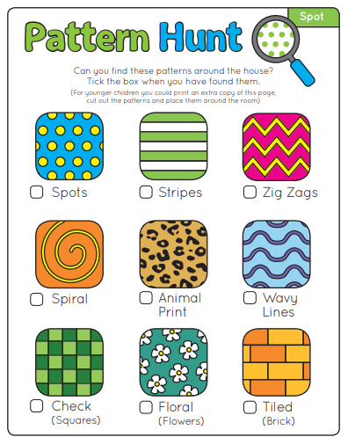
Monday Math Game: Pattern Hunt #1 www.viewsfromastepstool.com
Notes:
https://viewsfromastepstool.com/pattern-scavenger-hunt/
www.viewsfromastepstool.com

Slide 4
Tuesday: Patterns
Find some cubes or objects in two or three different colours. Make a pattern that repeats three times.
Can you put actions to your pattern? For example, clap, snap, pat, clap, snap, pat

Slide 5
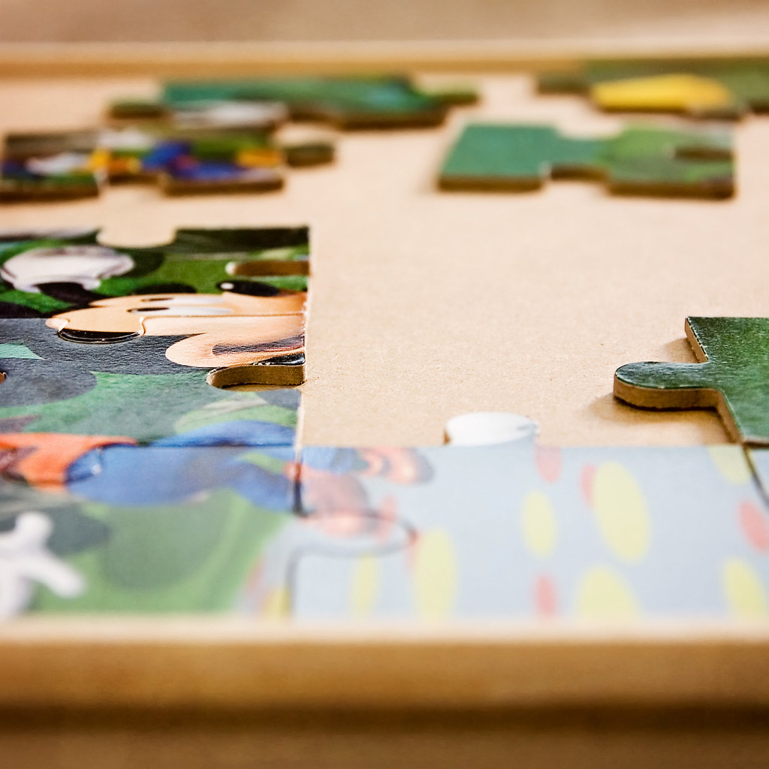
Tuesday: Do a Puzzle!
Choose a puzzle and complete it.
If you don't have a puzzle, cut up a cereal box to make your own.
Notes:
"06-09-11 - Unfinished Puzzle Square Crop" by Lynda Giddens is licensed under CC BY-NC-SA 2.0

Slide 6
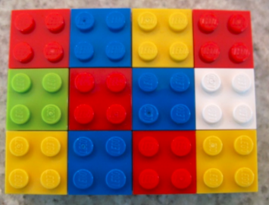
Wednesday: Number Talk
What do you notice?
What do you wonder?
What else can you count?

Slide 7
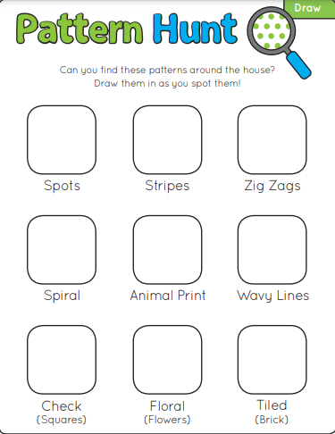
Wednesday Math Game: Pattern Hunt #2 Challenge: can you find these patterns in different places in your house than you found on Monday? www.viewsfromastepstool.com
Notes:
https://viewsfromastepstool.com/pattern-scavenger-hunt/

Slide 8
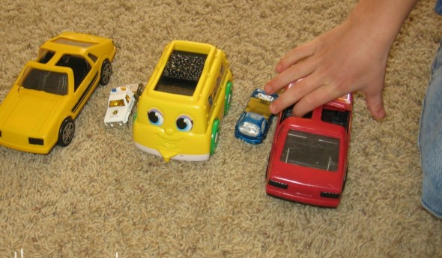
Thursday: Patterns
What pattern do you see in the photograph?
Find some objects in your house. Make a similar pattern.
Can you make a different pattern?

Slide 9
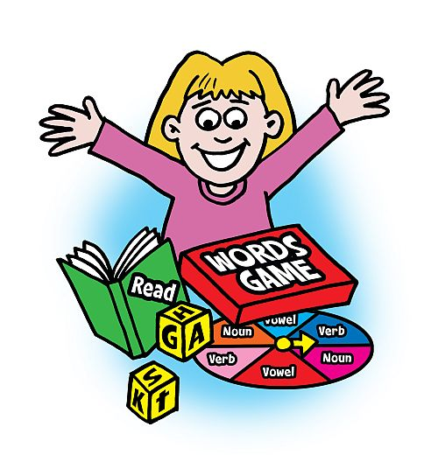
Thursday: Play a Board Game!
Choose any board game you have in your house and play it. Have fun!
https://pixy.org/src/52/529628.jpg
Notes:
https://pixy.org/src/52/529628.jpg

Slide 10
Friday: Patterns
A pattern includes these 3 colours.
What might the pattern look like?
Show a few different patterns using drawings or objects.

Slide 11
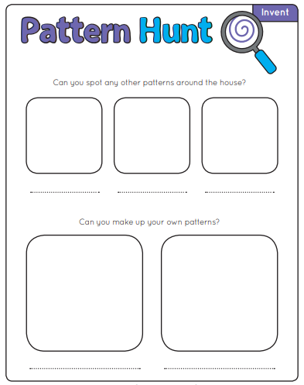
Friday Math Game: Pattern Hunt #3 www.viewsfromastepstool.com
Notes:
https://viewsfromastepstool.com/pattern-scavenger-hunt/

Slide 12
Week at a Glance Learning Focus: Quantity
Parents: Here is some background information on the topic in mathematics we will be exploring this week.
Essential Learning for Quantity:
The quantity of a small collection can often be determined through instant recognition or by thinking of it in its parts. This is also known as subitizing.
Essential Questions to ask your child:
How many dots/objects do you see?
How do you see them?

Slide 13
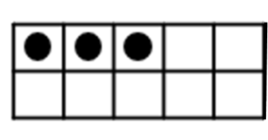
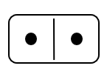
Monday – Quantity (Subitizing)
What numbers do you see in each picture?
Did you see them quickly or did you count?

Slide 14
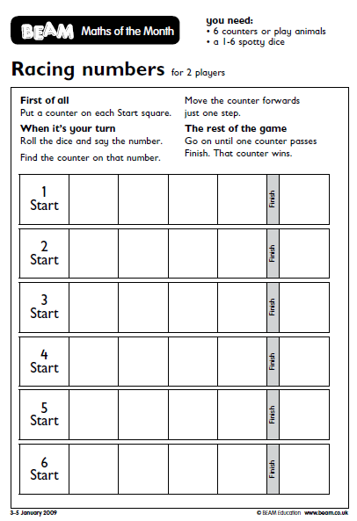
Monday Math Game: Race to the Finish!
TO PLAY:
Gather 6 counters and put one counter on each Start square.
Roll the dice and say the number. Move the counter on that number forward one space.
Continue until one of the counters makes it past the finish line. That counter wins!
Notes:
www.beam.co.uk
https://www.stem.org.uk/resources/elibrary/resource/28133/counting-games-students-aged-3-5
https://www.stem.org.uk/rxvh7

Slide 15
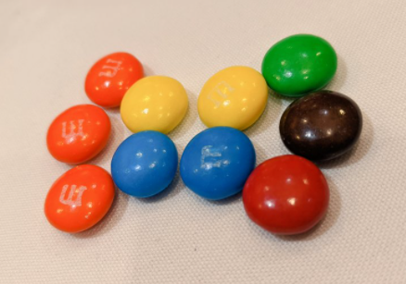
Tuesday – Quantity (Subitizing)
What do you notice?
What do you wonder?
How did you count them?

Slide 16
Tuesday: Do a Puzzle!
Choose a puzzle and complete it.
If you don't have a puzzle, cut up a cereal box to make your own.
Notes:
"06-09-11 - Unfinished Puzzle Square Crop" by Lynda Giddens is licensed under CC BY-NC-SA 2.0

Slide 17
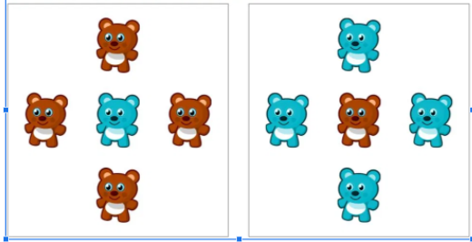
Wednesday – Number Talk
What is the same about the two pictures?
What is different about the two pictures?

Slide 18
Wednesday Math Game: Race to the Finish!
TO PLAY:
Gather 6 counters and put one counter on each Start square.
Roll the dice and say the number. Move the counter on that number forward one space.
Continue until one of the counters makes it past the finish line. That counter wins!
Notes:
www.beam.co.uk
https://www.stem.org.uk/resources/elibrary/resource/28133/counting-games-students-aged-3-5
https://www.stem.org.uk/rxvh7

Slide 19
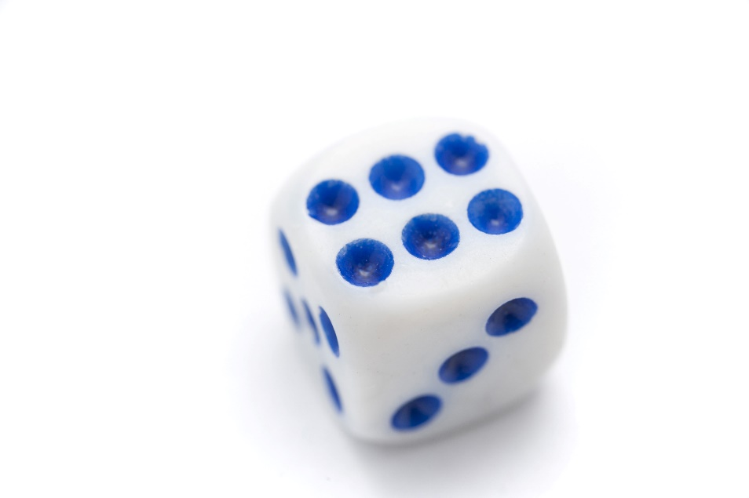
Thursday – Quantity (Subitizing)
Roll a die - say the number and hold up the same amount of fingers
Can you say the number rolled without counting the dots?
Can you hold up your fingers all at once,
or one at a time?
REPEAT! Roll your die at least 10 times!
This Photo by Unknown Author is licensed under CC BY

Slide 20
Thursday: Play a Board Game!
Choose any board game you have in your house and play it. Have fun!
https://pixy.org/src/52/529628.jpg
Notes:
https://pixy.org/src/52/529628.jpg

Slide 21
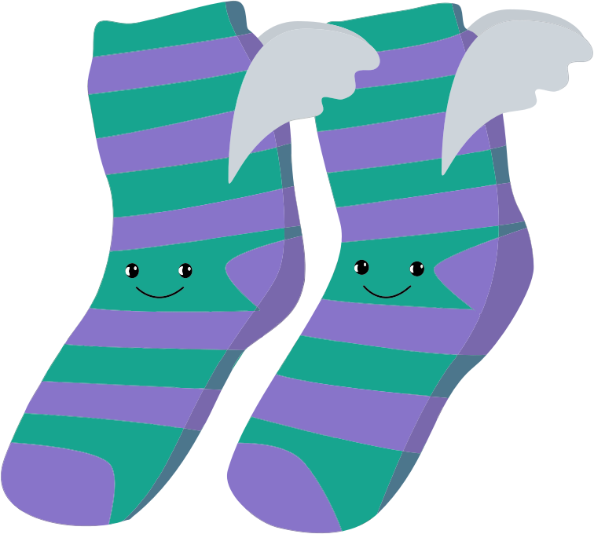
Friday – Quantity (Subitizing)
Look at the picture.
How many socks are there?
How are they grouped?
Are there things in your house that also come in groups? Find at least 3 things.
Notes:
Image Source - https://openclipart.org/detail/23449/rainbow-socks, https://openclipart.org/detail/264101/sockslineart, https://openclipart.org/detail/245229/anthropomorphic-winged-socks, https://openclipart.org/detail/607/athletic-crew-socks, https://openclipart.org/detail/25294/architetto-calzettoni
NEED SOURCE or … possible suggestion: https://pixy.org/1748305/ and https://pixy.org/1739543/

Slide 22
Friday Math Game: Racing Numbers
TO PLAY:
Gather 6 counters and put one counter on each Start square.
Roll the dice and say the number. Move the counter on that number forward one space.
Continue until one of the counters makes it past the finish line. That counter wins!
Notes:
www.beam.co.uk
https://www.stem.org.uk/resources/elibrary/resource/28133/counting-games-students-aged-3-5
https://www.stem.org.uk/rxvh7

Slide 23
Week at a Glance Learning Focus: Counting
Parents: Here is some background information on the topic in mathematics we will be exploring this week.
Essential Learning for Counting:
Quantities can be counted and compared using numbers, words, and numerals.
Essential Questions to ask your child:
What math words can be used to count?
How can objects be counted?

Slide 24
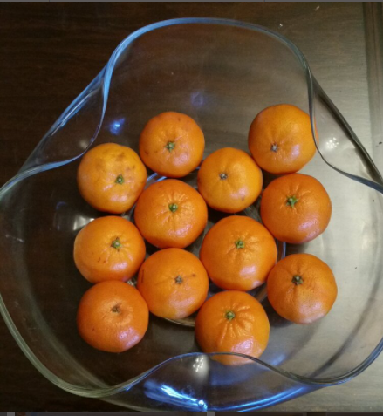
Monday - Counting
Look at the picture.
How many oranges do you see?
How did you count them?
Do you see any smaller numbers or groups in the picture?

Slide 25
Monday Math Game: First to 10 in a Row! (2 players)
GOAL: BE THE FIRST TO PUT THE NUMBERS 1 TO 10 IN THE CORRECT ORDER.
Set up:
• Take out all face cards. Aces count as 1.
• Shuffle the cards and give ten cards to each player, face down in a line/row.
• The rest of the deck is put in a pile in the center.
• Turn over 1 card and put it in a discard pile next to the center pile
Players can pick a card either from the centre pile OR from the discard pile. The player puts this card, number-side-up in its correct spot. The player flips over the card that is already in that spot. That card goes to the discard pile. Then it is the next players turn. Play continues until one player has all ten cards in a row.
Example of winning row:

Slide 26
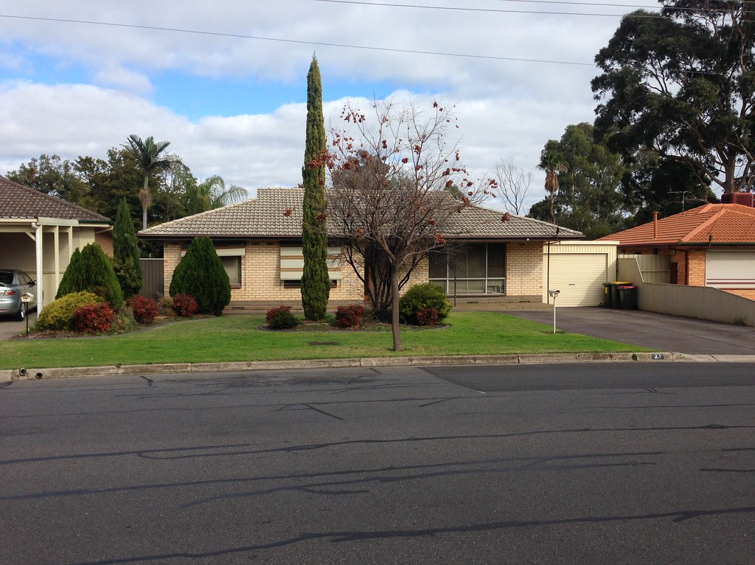
Tuesday – Counting
Go outside and choose a section of your street for this activity. Count the following:
How many trees are there?
How many houses have a garage?
What numbers can you see on the houses?
How many fire hydrants are there?
What else can you count?
Notes:
"Suburban house 2 in Salisbury East, Adelaide" by philip.mallis is licensed under CC BY-SA 2.0

Slide 27
Tuesday: Do a Puzzle!
Choose a puzzle and complete it.
If you don't have a puzzle, cut up a cereal box to make your own.
Notes:
"06-09-11 - Unfinished Puzzle Square Crop" by Lynda Giddens is licensed under CC BY-NC-SA 2.0

Slide 28
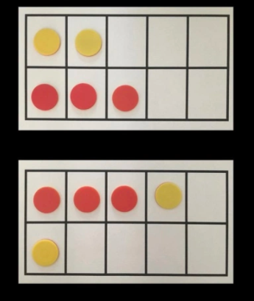
Wednesday – Number Talk
What is the same in the two pictures?
What is different in the two pictures?

Slide 29
Wednesday Math Game: First to 10 in a Row! (2 players)
GOAL: BE THE FIRST TO PUT THE NUMBERS 1 TO 10 IN THE CORRECT ORDER.
Set up:
• Take out all face cards. Aces count as 1.
• Shuffle the cards and give ten cards to each player, face down in a line/row.
• The rest of the deck is put in a pile in the center.
• Turn over 1 card and put it in a discard pile next to the center pile
Players can pick a card either from the centre pile OR from the discard pile. The player puts this card, number-side-up in its correct spot. The player flips over the card that is already in that spot. That card goes to the discard pile. Then it is the next players turn. Play continues until one player has all ten cards in a row.
Example of winning row:

Slide 30
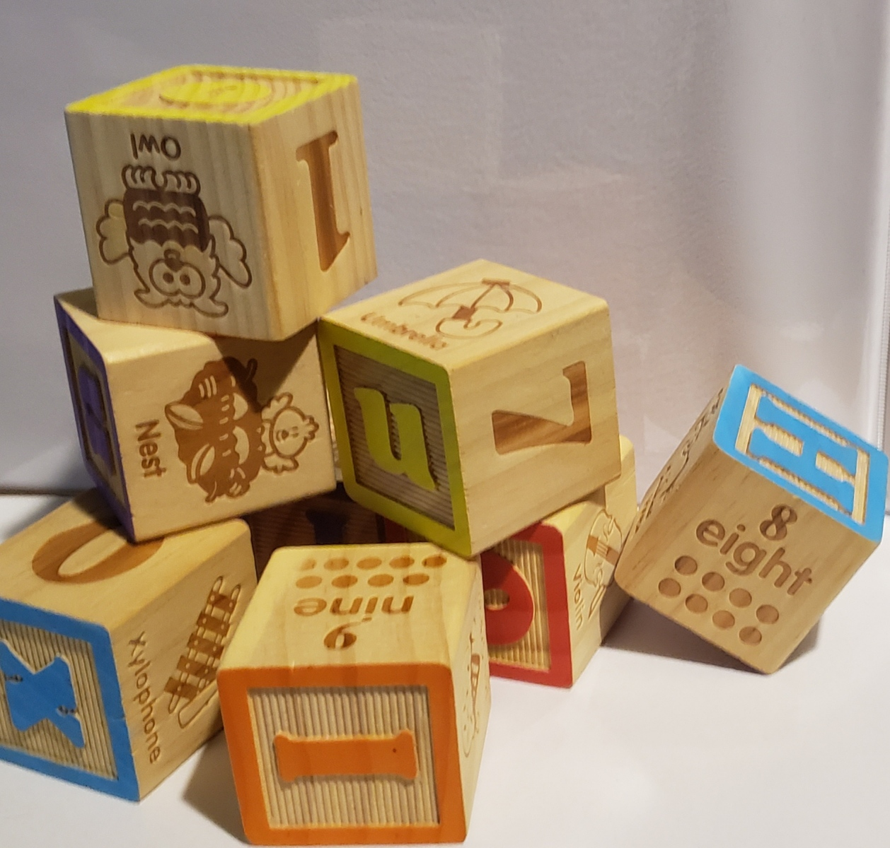
Thursday - Counting
Look at all the blocks.
Do you think it is easy or hard to count them all?
How could you arrange them to make them easier to count?
Find some blocks or small objects and try it!
Notes:
Photo credit – Kari Bergmuller

Slide 31
Thursday: Play a Board Game!
Choose any board game you have in your house and play it. Have fun!
https://pixy.org/src/52/529628.jpg
Notes:
https://pixy.org/src/52/529628.jpg

Slide 32
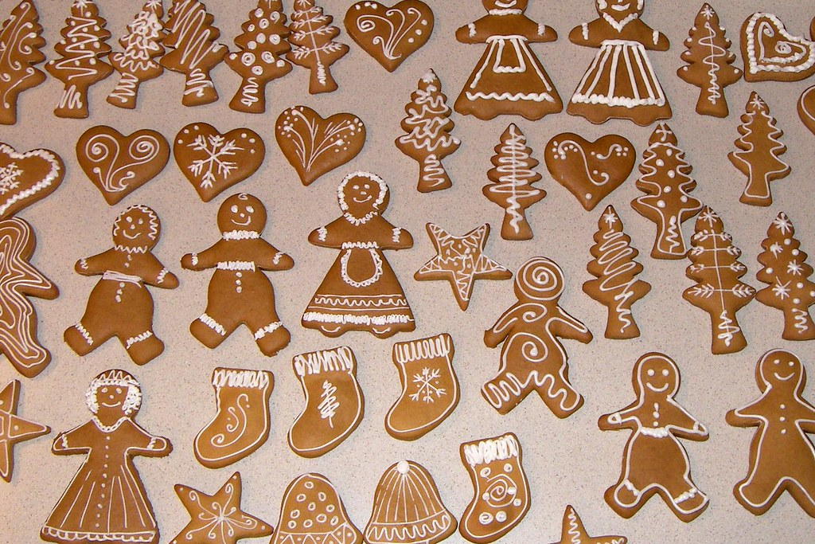
Friday – Counting
Look at the picture.
Find 5 different things that you can count and count them!
Are some things easier to count than others? Why?
Notes:
"Gingerbread cookies" by deborah.soltesz is marked with CC0 1.0

Slide 33
Friday Math Game: First to 10 in a Row! (2 players)
GOAL: BE THE FIRST TO PUT THE NUMBERS 1 TO 10 IN THE CORRECT ORDER.
Set up:
• Take out all face cards. Aces count as 1.
• Shuffle the cards and give ten cards to each player, face down in a line/row.
• The rest of the deck is put in a pile in the center.
• Turn over 1 card and put it in a discard pile next to the center pile
Players can pick a card either from the centre pile OR from the discard pile. The player puts this card, number-side-up in its correct spot. The player flips over the card that is already in that spot. That card goes to the discard pile. Then it is the next players turn. Play continues until one player has all ten cards in a row.
Example of winning row:

Slide 34
Week at a Glance Learning Focus: Comparing
Parents: Here is some background information on the topic in mathematics we will be exploring this week.
Essential Learnings for Comparing:
Objects can be compared using the same attribute.
Essential Questions to ask your child:
How can objects be compared?
Which is bigger/smaller?
Which is taller/shorter?

Slide 35
Monday – Comparing
Look outside your window.
Find something that is tall. What did you find?
What word could you use to describe the opposite of tall?
Find something outside your window that fits this description.
What other opposites can you see outside your window?
Challenge: How many opposites can you find inside your house?

Slide 36
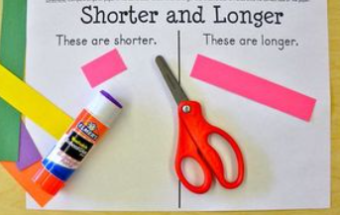
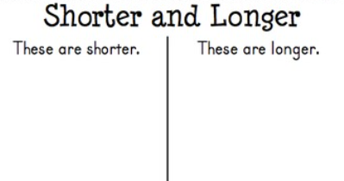
Monday Math Game
Get out strips of paper, scissors and glue (see below picture).
Have your child cut the strips of paper into various lengths.
Decide which strips are shorter and which are longer.
Glue strips onto the empty template.

Slide 37
Tuesday – Comparing
Find two different cups in your house.
Which one will hold more water?
Fill them both. Measure the water. Were you right?
Repeat with two other cups.
Does a larger cup always hold more? Why or why not?

Slide 38
Tuesday: Do a Puzzle!
Choose a puzzle and complete it.
If you don't have a puzzle, cut up a cereal box to make your own.
Notes:
"06-09-11 - Unfinished Puzzle Square Crop" by Lynda Giddens is licensed under CC BY-NC-SA 2.0

Slide 39
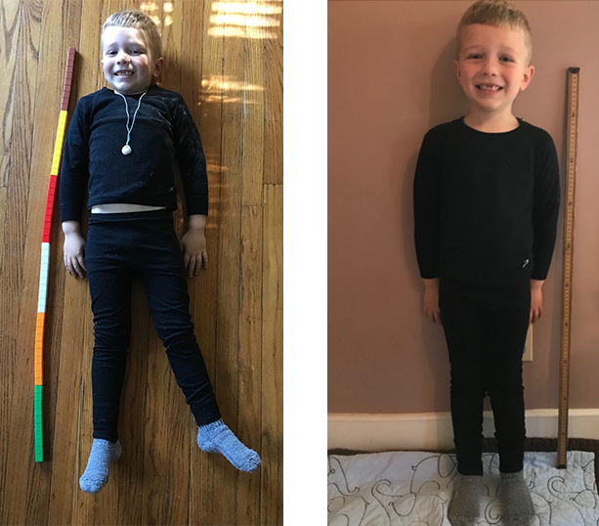
Wednesday – Number Talk
What is the same about the two pictures?
What is different about the two pictures?

Slide 40
Wednesday Math Game
Find a collection of the same item that you have at home and use it to measure yourself.
You could use blocks, plastic cups, Barbies, containers of the same size, or anything that you can find in your home that is the same size.
How many _______ tall were you?

Slide 41
Thursday – Comparing
What is a sorting rule you could use to sort these two objects together?
What other objects could you sort with them?
If you sorted these objects into two different groups, what could the sorting rules be?
What other objects could you sort with each object?

Slide 42
Thursday: Play a Board Game!
Choose any board game you have in your house and play it. Have fun!
https://pixy.org/src/52/529628.jpg
Notes:
https://pixy.org/src/52/529628.jpg

Slide 43
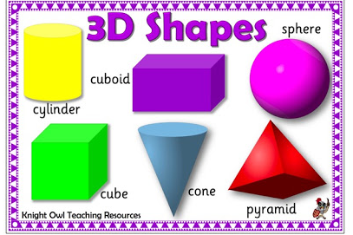
Friday – Comparing
Choose one of the 3-D objects in the picture.
Choose one of the attributes of that object. (colour/size/shape)
Find three or more household objects that have that attribute.
Draw them or write their names.
Notes:
http://knightowl.education/wp-content/uploads/2017/12/3D.jpg

Slide 44
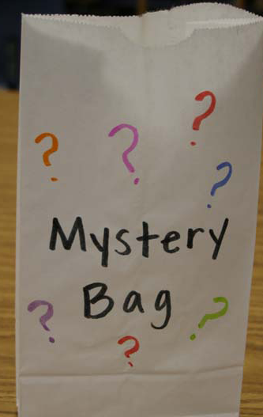
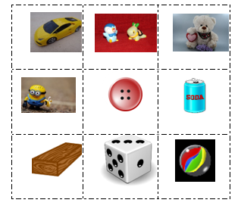
Friday Math Game: Mystery Bag
Find a bag that can be used as a Mystery Bag or make your own out of a paper bag. Collect a variety of objects to be used in the game. Some examples are in the picture below.
To Play:
Have your child close their eyes while you chose an object to put inside the mystery bag.
Child puts their hand in the bag and tries to identify the object by feeling it.
Once they correctly guess the object, have them put an object in the bag for you to guess.
Take turns until you have gone through all of the objects.
Encourage each player to say how it feels before guessing using the following descriptive language; smooth, rough, big, small, round, square, hard, squishy, soft, bumpy, sphere, cube, cylinder, cone, etc.
Notes:
https://commons.wikimedia.org/wiki/File:Plastic_car_toys.jpg, https://pixnio.com/media/flower-heart-lilac-love-romance, https://pxhere.com/en/photo/987198, https://www.peakpx.com/433816/minion-plastic-toy, https://, https://openclipart.org/detail/245273/coloured-wooden-plank, https://openclipart.org/detail/125227/canica-ball, https://openclipart.org/detail/303332/soda-can, https://openclipart.org/detail/213457/dice-3, https://openclipart.org/search/?query=button

Slide 45
Week at a Glance Learning Focus: Positional Language
Parents: Here is some background information on the topic in mathematics we will be exploring this week.
Essential Learnings for Positional Language:
Spatial awareness and relationships allow children to locate objects and navigate the environment
Objects remain the same even when their orientation changes
Mathematical problem solving depends on good spatial awareness
Essential Questions to ask your child:
How can objects be described?
Where are objects/people located in relation to other objects/people?

Slide 46
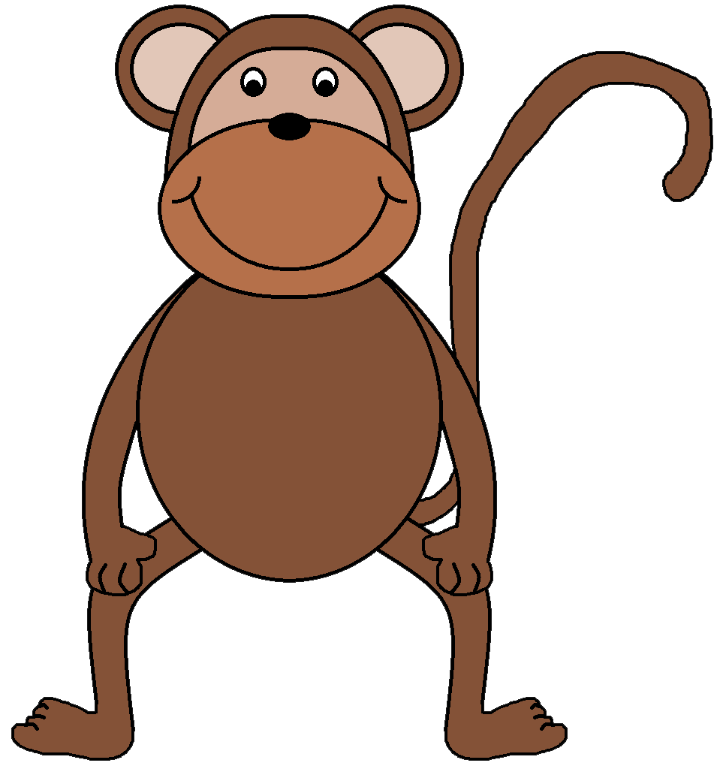
Monday – Positional Language
Can you find the monkey?
Look carefully...he is very good at hiding!
Where’s the monkey?
https://pixy.org/src/147/1472997.png
Notes:
Positional language is not a math outcome however, positional language is important to know and understand. The following learning experiences support students language development which will help students with their math learning.

Slide 47
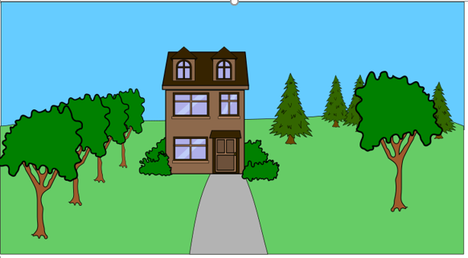
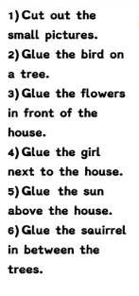
Monday Game / Activity
Notes:
https://openclipart.org/detail/300356/townhouse-with-2-views, https://openclipart.org/detail/316128/red-bird, https://openclipart.org/detail/218210/small-flowers, https://openclipart.org/search/?query=girl, https://openclipart.org/detail/147721/cool-happy-sun, https://openclipart.org/detail/301664/lovely-squirrel

Slide 48
Tuesday – Positional Language
Go get your favourite stuffie! With a partner, take turns hiding it around the room.
Give your partner clues to help them find it!
It is ON something...............
It is UNDER something...............
It is BESIDE, BEHIND, BETWEEN, OVER, etc.

Slide 49
Tuesday: Do a Puzzle!
Choose a puzzle and complete it.
If you don't have a puzzle, cut up a cereal box to make your own.
Notes:
"06-09-11 - Unfinished Puzzle Square Crop" by Lynda Giddens is licensed under CC BY-NC-SA 2.0

Slide 50
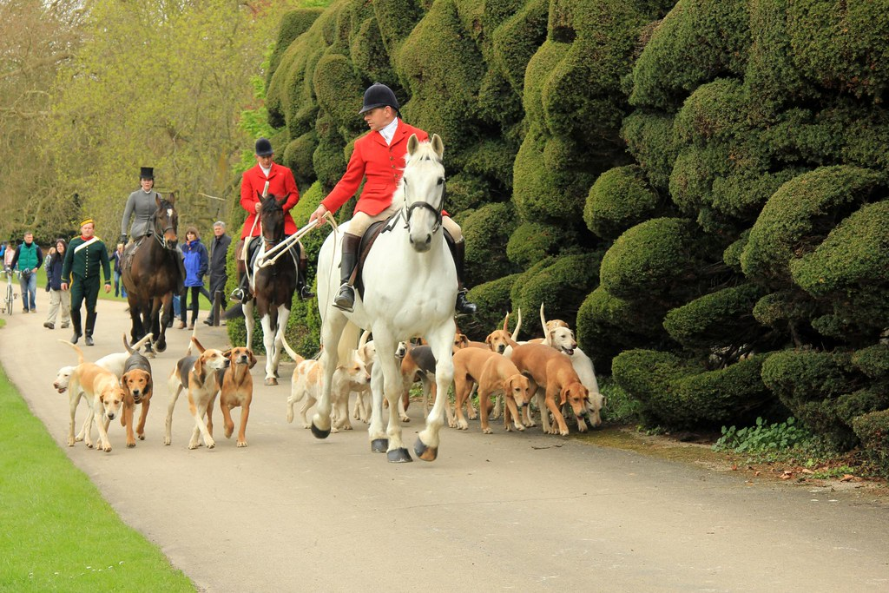
Wednesday – Number Talk Can you describe where the people and animals are in the picture?
Notes:
Use instead: "Audley End House & Gardens (EH) 06-05-2012" by Karen Roe is licensed under CC BY 2.0

Slide 51
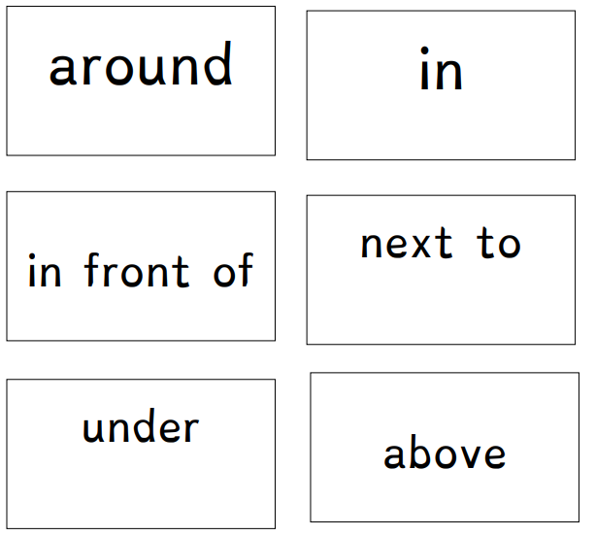
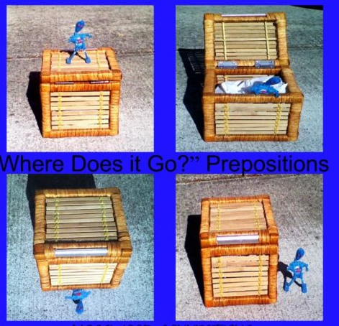
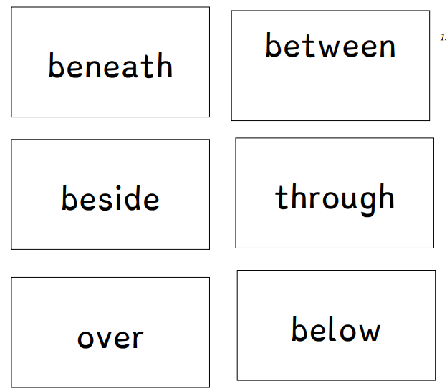
Wednesday Game
WHERE DOES IT GO?
Materials Needed:
A Toy and a Container for each player
How to play:
Choose a word from the list and put your toy/object in that position. The other player tries to guess the word you chose. Take turns until you have gone through all the words.

Slide 52
Thursday – Positional Language
Let's go on a bear hunt!

Slide 53
Thursday: Play a Board Game!
Choose any board game you have in your house and play it. Have fun!
https://pixy.org/src/52/529628.jpg
Notes:
https://pixy.org/src/52/529628.jpg

Slide 54
Friday – Positional Language
Parents/caregivers: print the following phrases on small pieces of paper and place in a bag
Take turns removing a piece of paper, reading the phrase and finding something in your house or outside to match.
I see _______ UNDER ______ I see _______ BETWEEN ______
I see a ______ ON ______ I see _______ BEHIND _______
I see a ______ BESIDE ______ I see _______ IN FRONT OF ______

Slide 55
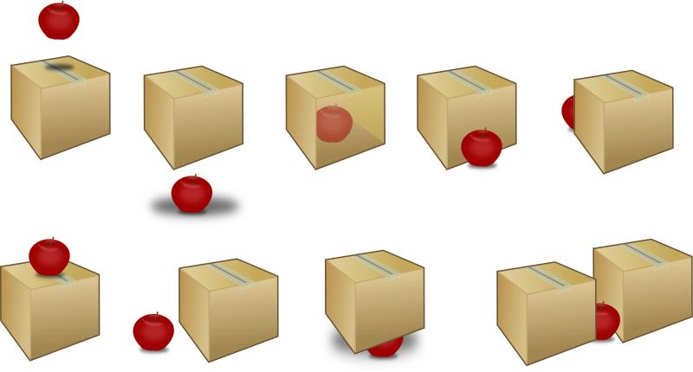
Friday Game
above
In front of
under
in
behind
Stuffie Challenge:
Can you put your stuffed animal in each of the positions shown on the game board? Cover the space when you complete it.
Then, have your partner put your stuffie in one of the positions on the board. Can you guess the word?
On top of
beside
under
In between
Notes:
https://openclipart.org/detail/271243/prepositions-of-place

Slide 56
Week at a Glance Learning Focus: Representing Number
Parents: Here is some background information on the topic in mathematics we will be exploring this week.
Essential Learning for Representing Number:
Quantities can be represented in a variety of ways with objects pictures and numerals
Essential Questions to ask your child:
How can quantities be shown?
How many ways can you represent a number?

Slide 57
Monday – Representing Number
Hold up your fingers to show the following amounts:
4 (can you show 4 using both hands?)
3 (can you show 3 using both hands?)
6 (can you show it another way?)
8 (can you show it another way?)
7 (can you show it another way?)

Slide 58
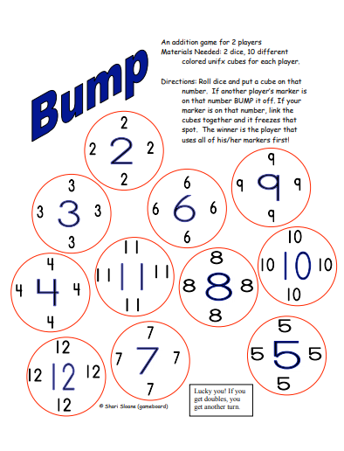
Monday Game
Bump!
Printable Gameboard
Notes:
https://www.scribd.com/doc/59677075/Bump

Slide 59
Tuesday – Representing Number
How Many Candies?
Sara and Sam each have a box of candies. They each have the SAME number of candies.
Sara's candies are ALL red.
Sam's has some red candies and some green candies.
How many candies could they each have?
Sara
Sam
Continued on next slide…

Slide 60
Tuesday – Representing Number
How Many Candies?
Draw a picture or use some objects to show your thinking.
Can you find another answer?
Sara
Sam

Slide 61
Tuesday: Do a Puzzle!
Choose a puzzle and complete it.
If you don't have a puzzle, cut up a cereal box to make your own.
Notes:
"06-09-11 - Unfinished Puzzle Square Crop" by Lynda Giddens is licensed under CC BY-NC-SA 2.0

Slide 62
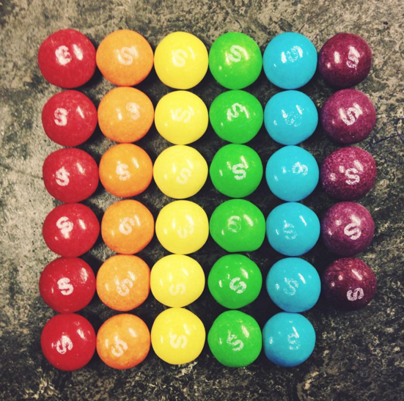
Wednesday Number Talk
What math words and numbers can you use to describe this picture?

Slide 63
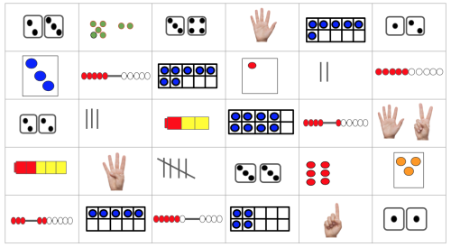
Wednesday Game
Count the X’s!
Material Needed: a die (1 to 6), 2 different coloured markers
Take turns rolling a die. Match the corresponding number on the die to one of the representations shown with the same number. Put an X in the box you matched using your selected marker colour.
The next player rolls the die and matches the number on the die to a corresponding square and uses their coloured marker to put an X in the box.
Continue playing until all the squares that can be matched have an X through them.
The player with the most X’s in their colour wins!
Notes:
https://docs.google.com/presentation/d/1FTP6TV6-M4Zl5mjdi5nG3nKmE45Gjy4qHz-zZiOsGnw/edit#slide=id.p

Slide 64
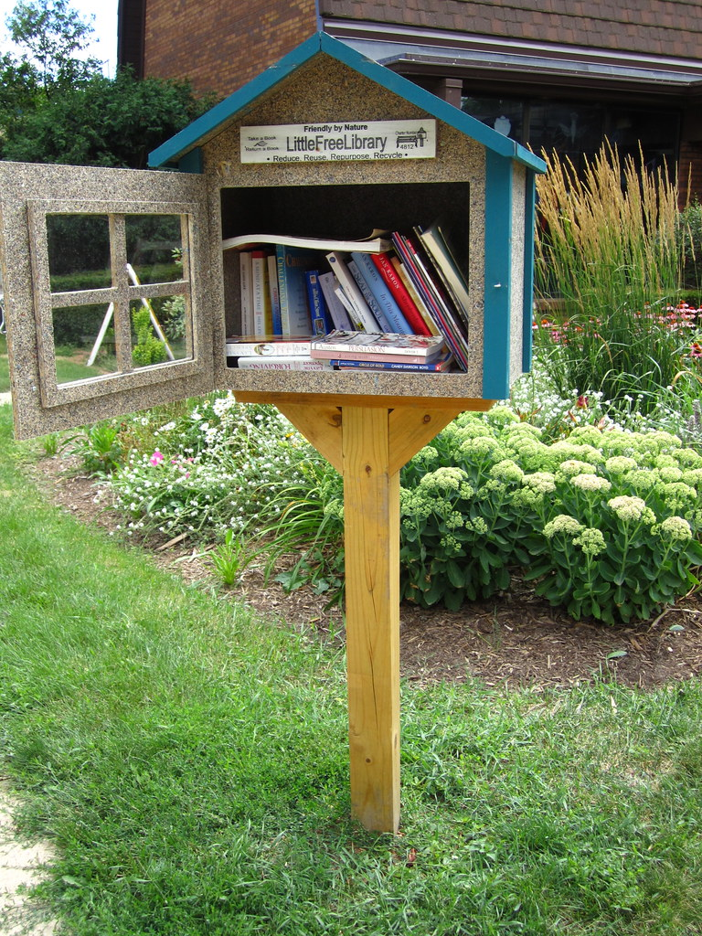
Thursday – Representing Number
There are three free little libraries in my neighborhood! Some people donate books to the libraries. Some people borrow books, too. I’m excited to donate these books to the little libraries today. Look at my books and tell how many I might put in each library.
Challenge:
Can you do it another way?
Notes:
"Little Free Library, Madison" by ali eminov is licensed under CC BY-NC 2.0
https://pixy.org/503501/
https://pixy.org/src/131/1318753.png

Slide 65
Thursday: Play a Board Game!
Choose any board game you have in your house and play it. Have fun!
https://pixy.org/src/52/529628.jpg
Notes:
https://pixy.org/src/52/529628.jpg

Slide 66
Friday – Representing Number
Rolling Dice
You roll two dice and count all the dots. The total number of dots is LESS than 8.
What could you have rolled? Find all the ways you can.
Is it possible that the numbers on the two dice are the same?
Notes:
https://openclipart.org/detail/181461/dice-a%C2%BEaidima%C2%B3-kauliukas-loaima%C2%B3-games

Slide 67
Friday Game
Bump!
Printable Gameboard
Notes:
https://www.scribd.com/doc/59677075/Bump

Slide 68
Week at a Glance Learning Focus: Comparing Quantity
Parents: Here is some background information on the topic in mathematics we will be exploring this week.
Essential Learning for Comparing:
Quantities can be compared using numbers, words and numerals
Essential Questions to ask your child:
Which has more?
Which has less/fewer?
How do you know?

Slide 69
Monday – Comparing
Let's listen to a story!
Just Enough Carrots
***Pause the recording on pages with amounts (ours, more, same, fewer). Ask students to compare the amounts using number words.
e.g. "We have 5, the basket with more has 7" etc. "7 is more than 5"
Notes:
https://www.mathstart.net/uploads/2/1/8/1/21819274/3514678_orig.jpg
Pause on the pages with the amounts (ours, more, same, fewer)….ask students to compare the amounts using number words.
e.g. "We have 5, the basket with more has 7" etc. "7 is more than 5"

Slide 70
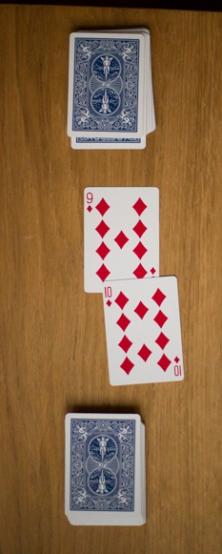
Monday: Comparing Number Game
Number Battle!
A game for 2 players
The goal is to be the first player to win all 52 cards
THE DEAL (remove face cards, aces = 1)
The deck is divided evenly, with each player receiving 20 cards, dealt one at a time, face down. Anyone may deal first. Each player places their stack of cards face down, in front of them.
THE PLAY
Each player turns up a card at the same time and the player with the higher card takes both cards and puts them, face down, on the bottom of his stack.
If the cards are the same rank, it is a BATTLE! Each player turns up one card face down and one card face up. The player with the higher cards takes both piles (six cards). If the turned-up cards are again the same rank, each player places another card face down and turns another card face up. The player with the higher card takes all 10 cards, and so on.
The game ends when one player has all the cards.

Slide 71
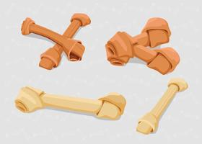
Tuesday – Comparing
1) Count the dogs
How many?
2) Count the bones
How many?
3) Are there enough bones
so each dog can have one?
4) How do you know?
Continued on next slide…
Notes:
https://pixy.org/4653896/
https://www.cesarsway.com/wp-content/uploads/2019/07/AdobeStock_75954460-1024x731.jpeg

Slide 72
Tuesday – Comparing
1) Count the children.
How many?
2) Count the juice boxes.
How many?
3) Are there enough milk cartons so each child can have one?
4) How do you know?
5) How many more will you need?
Continued on next slide…
Notes:
https://pixy.org/src/458/4589125.jpeg
https://pixy.org/3271658/

Slide 73
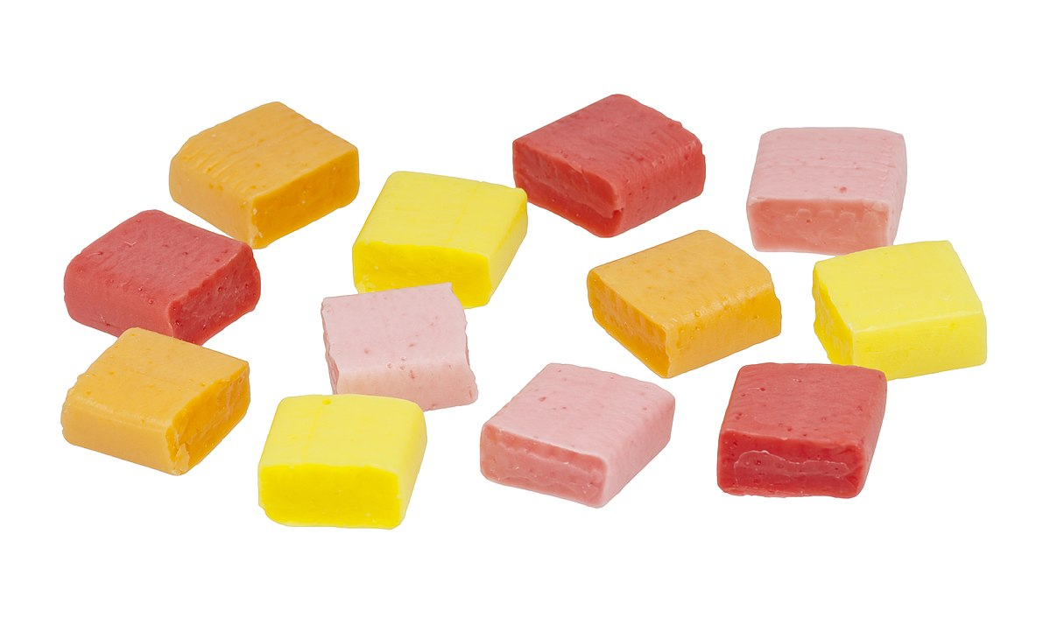
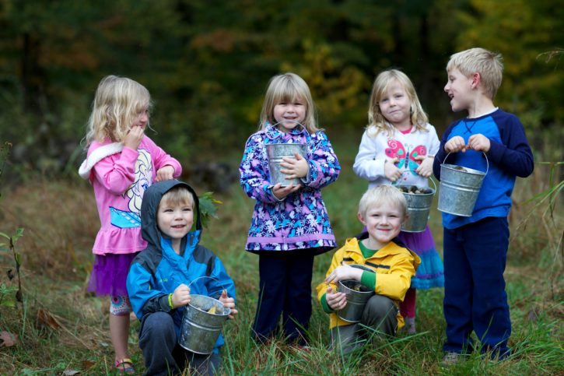
Tuesday Challenge - Comparing
Are there more candies or children?
How do you know?
Describe how you can give out all the candies to the children?
Notes:
https://commons.wikimedia.org/wiki/File:Starburst-Candies.jpg

Slide 74
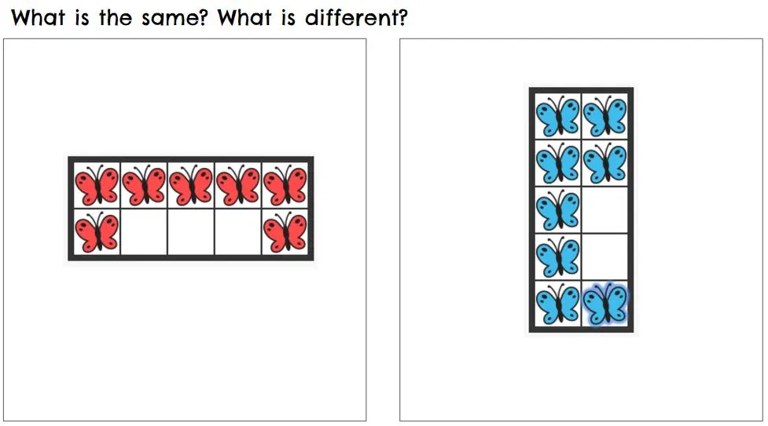
Wednesday – Number Talk
What is the same?
What is different?

Slide 75
Wednesday: Comparing Number Game
Number Battle!
A game for 2 players
The goal is to be the first player to win all 52 cards
THE DEAL (remove face cards, aces = 1)
The deck is divided evenly, with each player receiving 20 cards, dealt one at a time, face down. Anyone may deal first. Each player places their stack of cards face down, in front of them.
THE PLAY
Each player turns up a card at the same time and the player with the higher card takes both cards and puts them, face down, on the bottom of his stack.
If the cards are the same rank, it is a BATTLE! Each player turns up one card face down and one card face up. The player with the higher cards takes both piles (six cards). If the turned-up cards are again the same rank, each player places another card face down and turns another card face up. The player with the higher card takes all 10 cards, and so on.
The game ends when one player has all the cards.

Slide 76
Thursday – Comparing
Imagine that you put some blocks each side of a teeter-totter.
How many blocks might you put on each side so the teeter-totter is unbalanced and looks like this?
Is there a different amount you could out on each side?
Explain how you chose the amounts?
Drag the blocks to place them on the teeter-totter

Slide 77
Thursday: Play a Board Game!
Choose any board game you have in your house and play it. Have fun!
https://pixy.org/src/52/529628.jpg
Notes:
https://pixy.org/src/52/529628.jpg

Slide 78
Friday – Comparing
Which arrangements make it easy for you to tell whether there are more blue or more orange counters?
Explain your choice.

Slide 79
Friday: Comparing Number Game
Number Battle!
A game for 2 players
The goal is to be the first player to win all 52 cards
THE DEAL (remove face cards, aces = 1)
The deck is divided evenly, with each player receiving 20 cards, dealt one at a time, face down. Anyone may deal first. Each player places their stack of cards face down, in front of them.
THE PLAY
Each player turns up a card at the same time and the player with the higher card takes both cards and puts them, face down, on the bottom of his stack.
If the cards are the same rank, it is a BATTLE! Each player turns up one card face down and one card face up. The player with the higher cards takes both piles (six cards). If the turned-up cards are again the same rank, each player places another card face down and turns another card face up. The player with the higher card takes all 10 cards, and so on.
The game ends when one player has all the cards.

Slide 80
Week at a Glance Learning Focus: Subitizing
Parents: Here is some background information on the topic in mathematics we will be exploring this week.
Essential Learning for Comparing:
The quantity of a small collection can often be determined through instant recognition or by thinking of it in its parts.
Essential Questions to ask your child:
How many dots/objects do you see?
How do you see them?
** There are two types of subitizing:
Perceptual subitizing is instantly recognizing how many are in a small set, usually up to 4 or 5.
Conceptual subitizing is recognizing smaller groups within a larger set and adding those small groups together, such as two dots and two dots equals four dots.

Slide 81
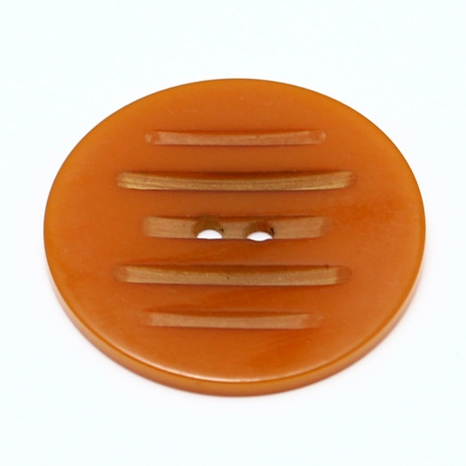
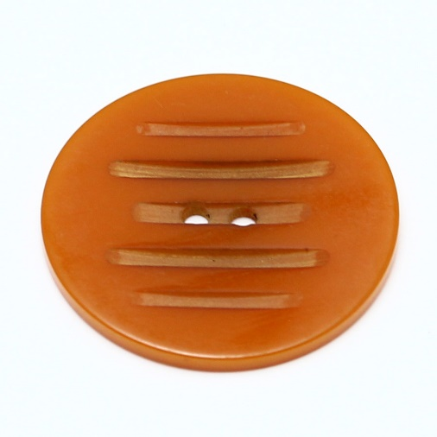
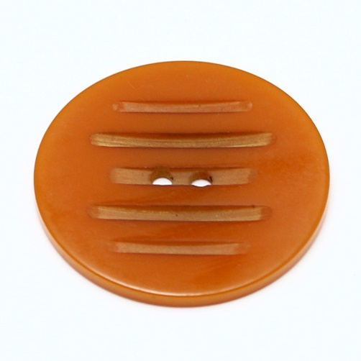
Monday – Subitizing
Look at this picture......do you know how many there are without counting?
Is there another way you could arrange them so it is still easy to know how many?
Find some small objects.....buttons, cubes, etc.
Roll a die and arrange your objects so that someone can easily recognize how many.
Notes:
https://pixy.org/src/79/790195.jpg

Slide 82
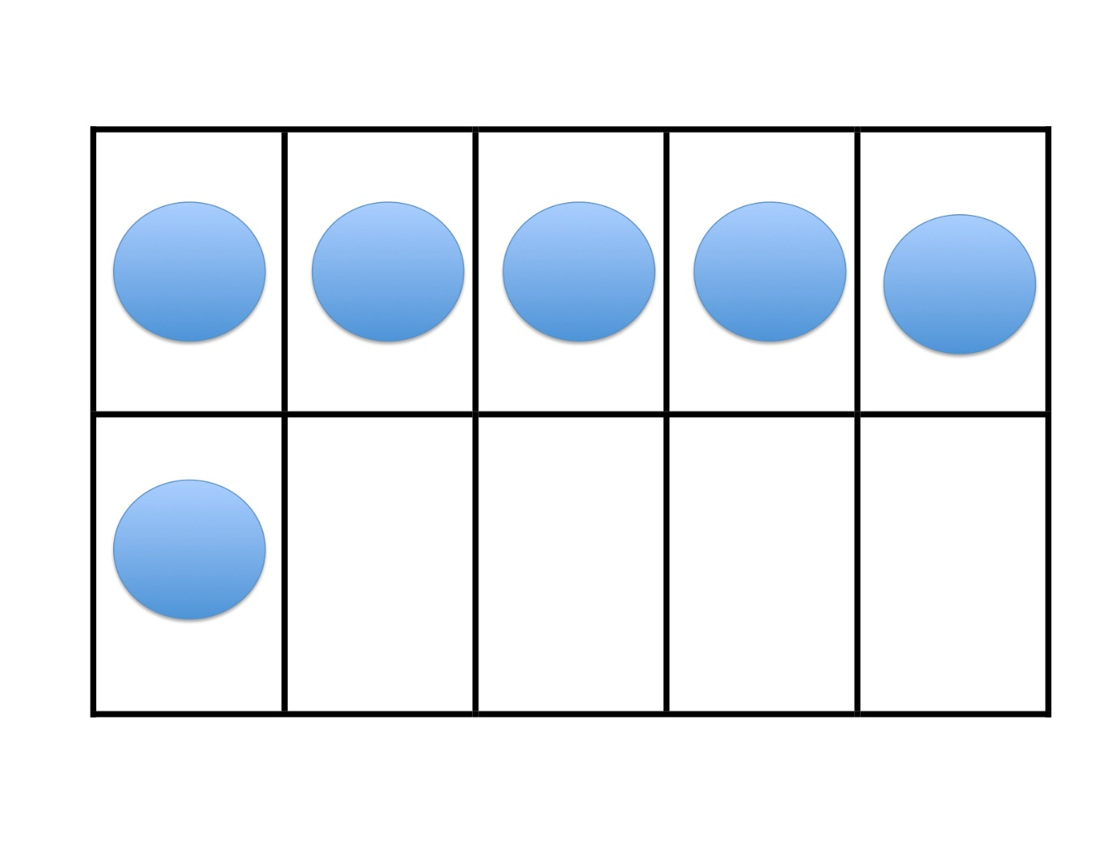
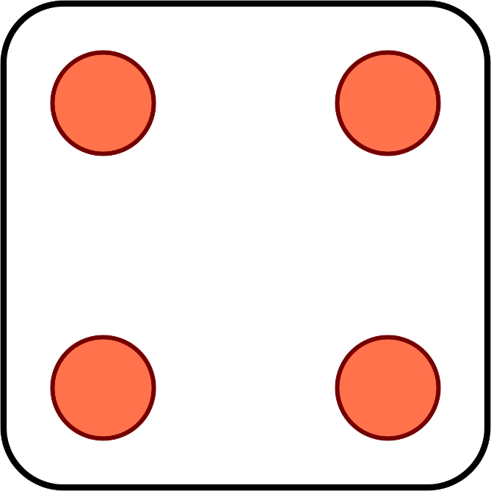
Tuesday – Subitizing
Ways to represent numbers:
1) Choose a number between 1-10.
2) Represent that number in at least three different ways.
Beside this box are some examples of different ways to represent number.
six
Continued on next slide…

Slide 83
Tuesday – Subitizing
Ways to represent numbers:
Part 2:
Look at your picture showing the three ways you represented your number.
Which way best shows:
Your number is less than 10?
Your number is made up of smaller parts?
Your number is in between two other numbers?
Your number has a group of 5 and some more?
six

Slide 84
Tuesday: Do a Puzzle!
Choose a puzzle and complete it.
If you don't have a puzzle, cut up a cereal box to make your own.
Notes:
"06-09-11 - Unfinished Puzzle Square Crop" by Lynda Giddens is licensed under CC BY-NC-SA 2.0

Slide 85
Wednesday – Number Talk
Look at each picture and say the number that you see that tells how many dots there are....
Ready?
Notes:
"Dots" by XoMEoX is licensed under CC BY 2.0

Slide 86
Wednesday – Number Talk

Slide 87
Wednesday – Number Talk

Slide 88
Wednesday – Number Talk

Slide 89
Wednesday – Number Talk

Slide 90
Wednesday – Number Talk

Slide 91
Wednesday – Number Talk

Slide 92
Wednesday – Number Talk

Slide 93
Wednesday – Number Talk Challenge!
How many different ways can you show the total number of dots?
Look at one example on the next slide

Slide 94
Wednesday – Number Talk Challenge!
I see a group of 6, and three more. That is 9!

Slide 95
Thursday – Subitizing
The Hoop Game
Goal: To toss a small set of bean bags and subitize and label the quantity of bean bags landing inside/outside a hula hoop or other defined space
Materials: Hula hoop (or other defined space on the floor); bean bags; tape to mark where to stand
Number of Players: 2 or 3 children
Directions: Children take turns standing at the tape line and tossing a small set of bean bags, one by one, into a hula hoop lying on the ground. You may want to start with 3 bean bags per turn, then try 4, and then 5. Each child throws the whole set and then subitizes and labels how many landed inside the hoop and how many landed outside the hoop
This game provides practice with decomposing small quantities. With practice, children will come to internalize the combinations that make 3, 4, and 5.
Notes:
Adapted from Effective Math Instruction in the Pre-K Classroom © 2009 by Juanita Copley.
Source: https://1woqu41bs5kerai2f3lyxkm7-wpengine.netdna-ssl.com/wp-content/uploads/2018/09/Hoop_Game_Instructions.pdf

Slide 96
Thursday: Play a Board Game!
Choose any board game you have in your house and play it. Have fun!
https://pixy.org/src/52/529628.jpg
Notes:
https://pixy.org/src/52/529628.jpg

Slide 97
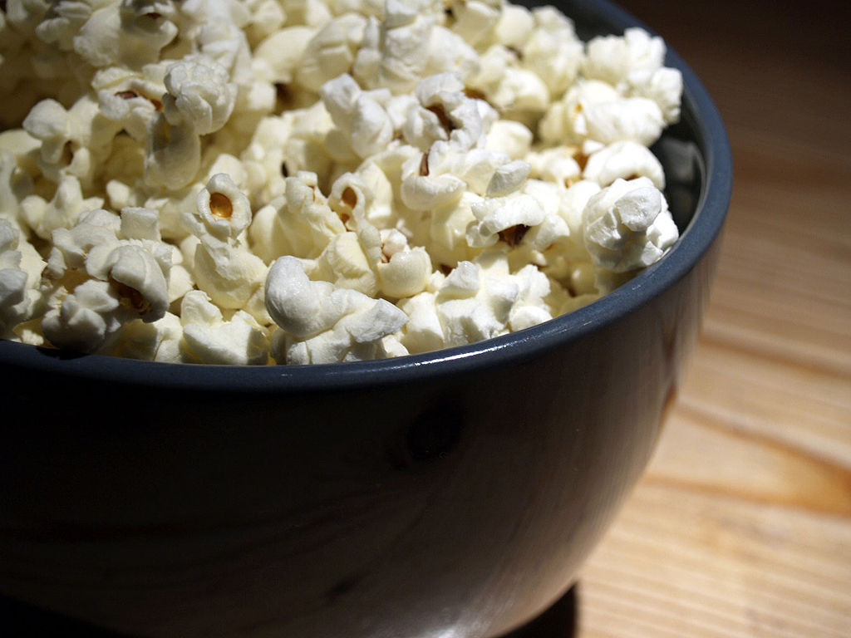
Friday – Subitizing Challenge
Imagine you have a bowl of popcorn. Mom told you that you could eat 20 pieces of popcorn.
How can you arrange the popcorn so that it is easy for someone to count or to see that there are twenty pieces?
On the following slides are some tools you may want to use.
Notes:
"Popcorn bowl" by theglobalpanorama is licensed under CC BY-SA 2.0

Slide 98
Explain how the ten frames can help you count the pieces of popcorn.

Slide 99
Explain how the number path can help you count the pieces of popcorn.
1 2 3 4 5 6 7 8 9 10 11 12 13 14 15 16 17 18 19 20

Slide 100
Explain how the circles can help you count the pieces of popcorn.
Could you use more or fewer circles to help you count?

Slide 101
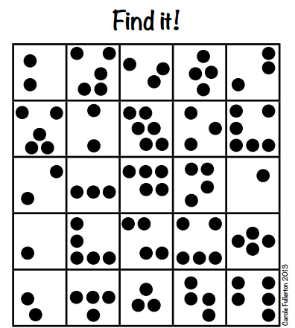
Friday – Subitizing Game
Materials Needed:
Print off the Find It! Gameboard
2 different colours of counters
Dice
To Play:
1) Roll the dice.
2) Find the same number of dots. Cover it in in your colour of counter.
3) Give your partner a turn.
4) 3 in a line in your colour wins!
Printable game board
Notes:
Source: https://mindfull.files.wordpress.com/2015/01/find-it-add-and-count-for-k1.pdf

