Slide 1
Moving to a New Planet
Grade 6 Science - Solar Systems

Slide 2
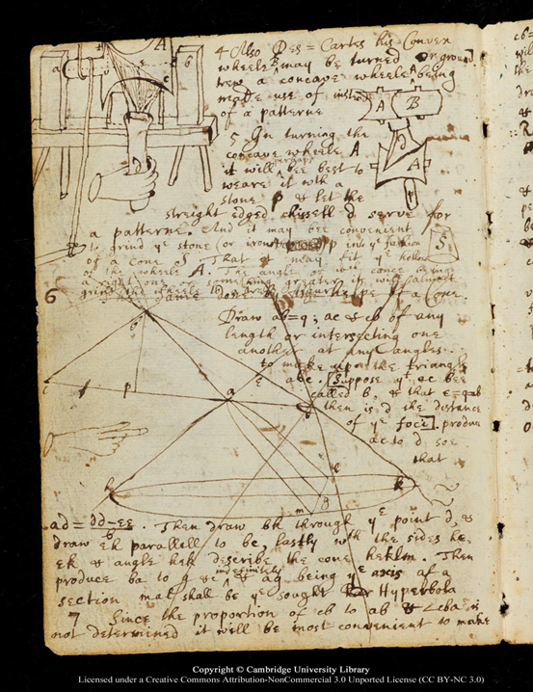
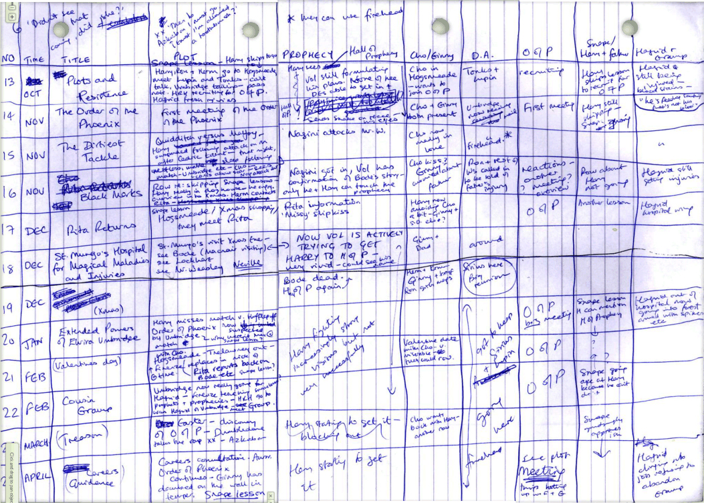
Thoughtbooks:
Newton's
early draft for
"The Division of a Monochord"
What is a thoughtbook:
A safe place where I can jot down my thoughts and ideas.
A safe place where I can review my thoughts and change my thinking by applying new things I learn.
A safe place I can draw or create ideas.
A safe place I can keep my work and review it often. Making changes as I learn and grow.
A safe place for my teacher and myself to know where I am in my learning and what I need to do to hit my learning target.
JK Rowling Harry Potter and the Order of the Phoenix Plot Spreadsheet.
Notes:
Teacher Notes:
Provide students with a duotang or 2 pocket folder as a thoughtbook.
There are pages in the learning experience that indicate a thoughtbook page.
Project pages can also be included as we want students to know that it is okay to get messy when they are planning and designing.
Discuss the importance of thoughtbooks and even that famous authors and scientists use a thoughbooks to jot down their ideas and thinking as they go through the creative process.

Slide 3
How important is it to consider the following ideas when choosing the most habitable planet?
Thoughtbook Entry #1:
Travel Time & Distance from the Sun
Moon & Gravity
Technology & Developments
Size & Composition
Not Important At All
A Little Important
Somewhat Important
Very Important
Click on the rocketship and push the right arrow to place it where you think its level of importance should be.
Photo Credit: Rocket

Slide 4
Student Learning Board
THE CHALLENGE:
Throughout this learning experience you will be designing a plan to leave Earth to live on the next most habitable planet.
After each lesson you will get the opportunity to add, revise or extend on your final project using new information that you have gathered.
Enjoy your Space Adventure!
The Planets: Size & Composition
The Moon & Gravity
Travel Time & Distance from the Sun
Space Technology & Developments
Discover each of the planets, their size, composition and the qualities that make them unique.
Study the purpose of the moon and compare the gravity differences on other planets.
Determine how long it would take to travel to the moon and different planets from Earth. And how proximity to the sun can affect the lives of living things.
Identify famous astronauts and what they contributed to science as well as the new technological developments for space.
Notes:
Teacher Notes:
Ask students to take a look at the Moon & Gravity section first. Students are asked to complete a lunar log that takes 4 weeks to complete. This may be a good place for them to start and they can work on other areas as they work on their lunar logs.

Slide 5
The Planets
01
Learning Objectives:
Identify the planets in the solar system and describe their size relative to the Earth and their position relative to the Sun.
Classify planets as inner or outer planets, based on their position relative to the asteroid belt, and describe characteristics of each type.

Slide 6
Order of the Planets
Click the boxes & label the planets in order from closest to the sun to furthest away.
Use the first letter of each planet, in order, and create an acronym phrase to help you remember the names and the order of the planets.
For example, an acronym phrase for remembering the strings on a guitar ( E, A, D, G, B, E ) is
→ Excited Animals Do Get Big Eyes!
M___________ V___________ E___________ M___________ J___________ S___________ U___________ N___________ P___________

Slide 7
Planet Scavenger Hunt
Use the sites provided and fill in the chart on the next slide about each planet.
Include the title of the site you found the answer.
Go to the search Engine KIDDLE: Research “Solar System” or “Planets”. The following sites are also great resources:
THE EARTH IN SPACE-Bodnar.PPT - https://scdolinski.weebly.com/uploads/4/4/6/0/4460107/1_planets_info.pdf
Astronomy for Kids | Astronomy.com - https://astronomy.com/observing/astro-for-kids
The Planets Overview - http://www.solarspace.co.uk/Planets.php
Astronomy for kids - http://www.astronomy-for-kids-online.com/definitionofastronomy.html

Slide 8
Planet: Image credit: <a href='https://www.freepik.com/vectors/abstract'>Abstract vector created by macrovector - www.freepik.com</a> | Scavenger Hunt Question: | Answer: | Size & Distance from the sun | Identify if it is an Inner or Outer Planet | Composition: What is the atmosphere and surface made of? | Source: (website title(s))
Mercury | What is the hottest or coldest it gets? |  | Size: Distance: | Inner / Outer | Atmosphere: Surface:
Venus | What is the yellow cloud? |  | Size: Distance: | Inner / Outer | Atmosphere: Surface:
Mars | Why is it red? |  | Size: Distance: | Inner / Outer | Atmosphere: Surface:
Jupiter | What is the big red spot? |  | Size: Distance: | Inner / Outer | Atmosphere: Surface:
Saturn | What are the rings made of? |  | Size: Distance: | Inner / Outer | Atmosphere: Surface:
Uranus | What is the surface made of? |  | Size: Distance: | Inner / Outer | Atmosphere: Surface:
Neptune | What is the big dark spot? |  | Size: Distance: | Inner / Outer | Atmosphere: Surface:
Pluto | When did Pluto change to a dwarf planet? Why? |  | Size: Distance: | Inner / Outer | Atmosphere: Surface:

Slide 9
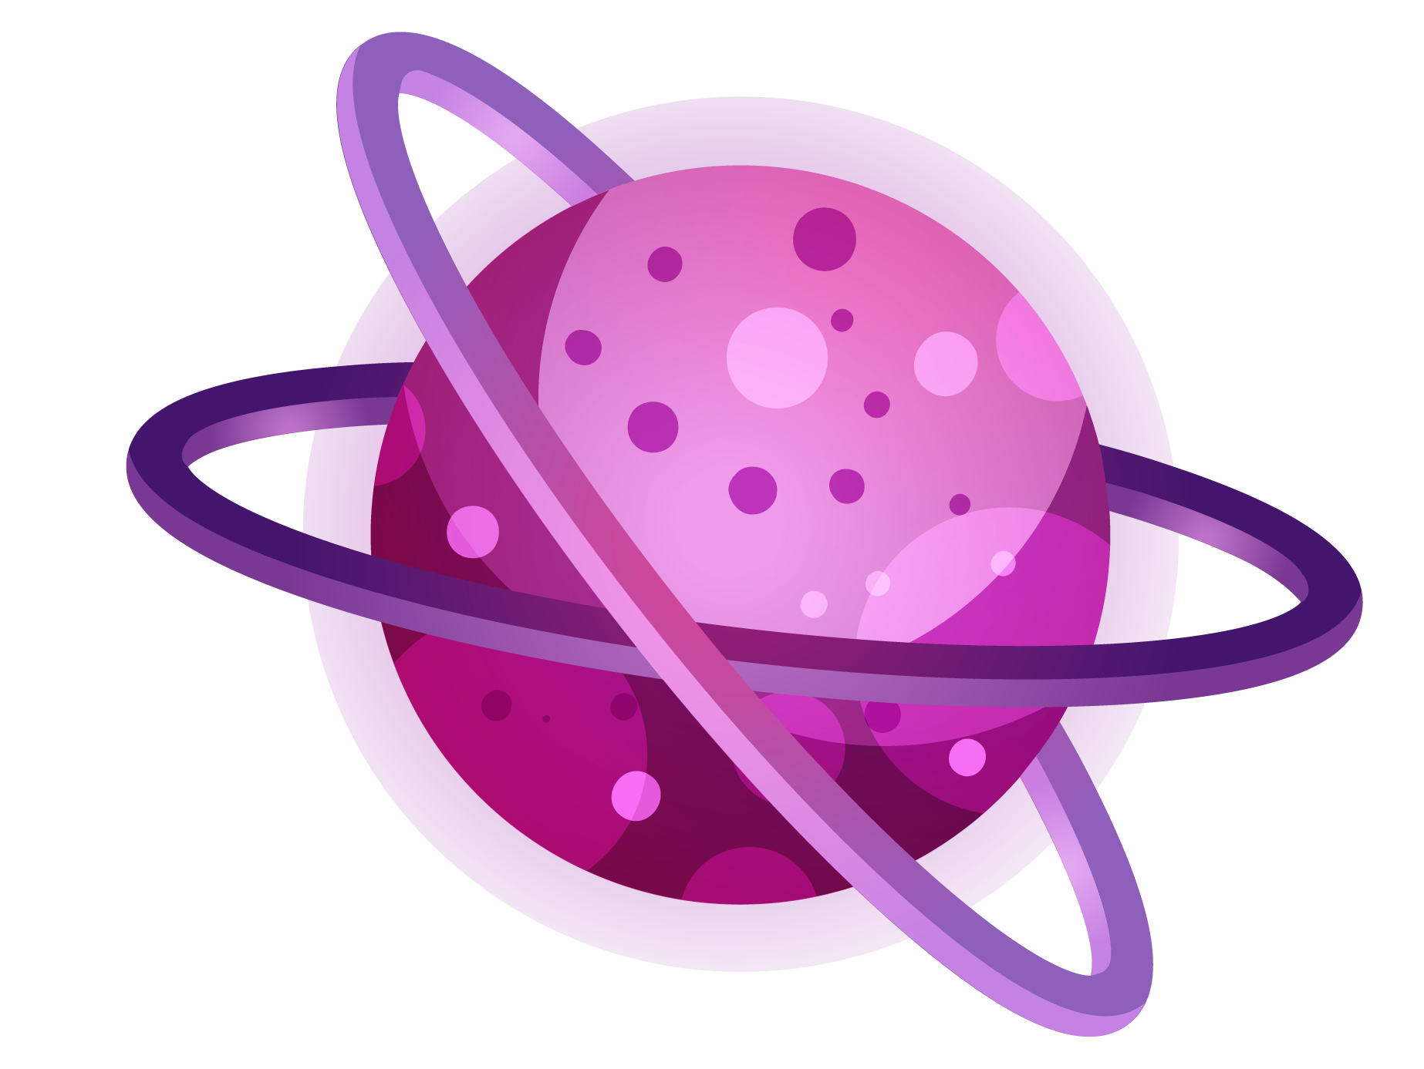
THE CHALLENGE - PART 1
Narrowing down the planets.
Brainstorm all the things that make a planet habitable (liveable) for all living things?

Slide 10
THE CHALLENGE - PART 1
Narrowing down the planets.
Thoughtbook Entry #2:
Review your list and choose the 5 basic needs that all living things need to survive.
List the top 5 planets in order of most habitable (1) to least habitable (5). Justify your decision.
Use what you know about the needs of living things.
Pay attention to the size of each planet.
Pay attention to what the surface of each planet is made of (surface composition).
Pay attention to what the air is made of (atmosphere composition).
I think the planets:
Mercury
Venus
Mars
Jupiter
Saturn
Uranus
Neptune
Pluto (dwarf planet)
1.
2.
3.
4.
are most habitable because…
5.

Slide 11
THE CHALLENGE - PART 1
What would you need to survive?
Thoughtbook Entry #2:
If you were to live on 1 of the 5 planets you chose… what would you need to survive on each?
THINK:
What would you need on a space shuttle?
Do you need a space suit? Why? What would it need?
How do you obtain your basic living needs? Food? Water? Shelter? Air? Sunlight/Warmth?
Planet 1
Planet 2
Planet 3
Planet 4
Planet 5
Remember this is your thoughtbook - This is a safe place to write down all your ideas even if you are not sure about them. You can come back and change your thinking later.

Slide 12
Size & Composition
Thoughtbook Entry #3:
“How important is it to consider size and composition when inhabiting a new planet?”
Not Important At All
A Little Important
Somewhat Important
Very Important
Review Slide 2 - Did your thinking change?
“I think size and composition are ______________, my thinking (did / did not) change because…”

Slide 13
The Moon & Gravity
02
Learning Objectives:
Explain how the relative positions of the Earth, moon, and Sun are responsible for moon phases and eclipses.
Recognize that mass is the amount of matter in an object, that weight is the force of gravity on the mass of an object, and that the force of gravity varies from planet to planet
Demonstrate an understanding of multiplication and division including decimals.

Slide 14
How does the Moon change Shape?
Lunar Log: Use the chart below and document the changing of the moon for 4 weeks. What do you notice? What do you wonder?
Date/Time: Choose one day out of the week. Observe the moon on that same night for 4 weeks. (Eg. Every Wednesday night) | Drawing: Draw what the moon looks like (if it is cloudy and you cannot see the moon, try the next night) | I Notice: Write down any things you notice about the moon while you were observing. | I Wonder? What has changed from last time? What do you wonder about when you look at the moon?
Date: Time:
Date: Time:
Date: Time:
Date: Time:

Slide 15
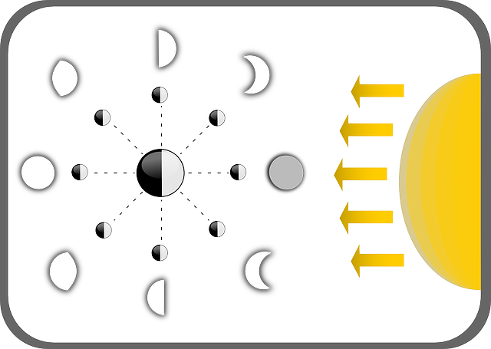
Explain Your Lunar Log:
Write a short summary:
Explain how the moon was changing from week to week.
Use the websites below to explain what you were seeing and why it was happening.
What phases of the moon did you see and what days did you see them?
Moon Phases / Lunar Phases Explained - https://www.moonconnection.com/moon_phases.phtml
The Universe: The Phases of the Moon | History - https://www.youtube.com/watch?v=nXseTWTZlks&feature=related
Photo Credit: Phases Of The Moon
Type in here:

Slide 16
Label the Moon Phases:
Insert lines and connect the labels with their appropriate Moon phase.
Full Moon
Waning Crescent
Waxing Crescent
Waning Gibbous
Waxing Gibbous
First Quarter
New Moon
Third Quarter
Answer the question:
Why do the moon names use “quarter” when the moon looks like half? Why is there no name “Half Moon”?
Photo Credit Lunar Phase Moon

Slide 17
What Does The Moon Do?
Read over the questions below and choose True or False BEFORE Learning. (Delete the response you do not want, for example if the answer you chose is TRUE then select and delete the X)
Check out the sites: Overview/Earth's Moon & The Nine Planets and the videos What Would Happen If There Were No Moon? and What Would Happen If The Moon Disappeared
Choose True or False AFTER Learning. If the answer is false, insert a textbox to put the true fact below the false fact.
Before Learning:
Statement:
After Learning:
The moon stabilizes the climate on Earth.
The seasons are caused by the moon.
Without the moon our days would be longer.
Without the moon the oceans would spread all over the earth.
Earth would have no wind without the moon.
The Earth would spin faster without the moon.
The moon keeps the animals in ocean alive.
Notes:
Teacher Notes:
Site links:
Overview/Earth’s Moon - https://solarsystem.nasa.gov/moons/earths-moon/overview/#:~:text=The%20brightest%20and%20largest%20object,humans%20for%20thousands%20of%20years.
The Nine Planets - https://nineplanets.org/questions/what-would-happen-if-there-was-no-moon/#:~:text=The%20moon%20affects%20the%20angle%20of%20the%20Earth's%20tilt.&text=The%20moon%20influences%20life%20as,of%20our%20days%20would%20alter
Video Links
What Would Happen if there was no moon? - https://www.youtube.com/watch?v=Vwuge1U4y8Q&feature=emb_logo
What would happen if the moon disappeared? - https://www.youtube.com/watch?v=6MP920xMC0Q

Slide 18
Planetary Moons
0 Moons
0 Moons
2 Moons
79 Moons
62 Moons
27 Moons
14 Moons
Mercury
Venus
Mars
Jupiter
Saturn
Uranus
Neptune
Based on what you know about moons which planets would be okay to live on? Justify your response.
Information Source: In Depth | Moons – NASA Solar System Exploration

Slide 19
Find and Define!
Gravity
Mass
Weight
Look up and define the words below in your own words.

Slide 20
Where do I weigh the least? most? same as Earth?
I weigh the most on…
I weigh the least on…
I would weigh almost the same, as I do on Earth, on…
If you can float away on the moon because there is not a lot of gravity (0.17g) but you do not float on Earth (1g):
Which planets would be safest? Why?
2. Which planets would be most dangerous? Why?
Gravity on Earth is 1g. But the force of gravity changes on different planets.
So, you would weigh different amounts on the other planets.
You may also float up into space on some planets or be too heavy to move on others.
Student’s Weight on Earth: | Moon: (x 0.17) | Mercury (x 0.38) | Venus (x 0.9) | Mars (x 0.38) | Jupiter (x 2.53) | Saturn (x 1.07) | Uranus (x 0.89) | Neptune (x 1.14)
Information Source: Gravitational Factors of Our Eight Planets

Slide 21
THE CHALLENGE PART 2:
Choose the TOP 3 Planets!
Thoughtbook Entry #4:
Remember your TOP 5 most habitable planets?
Go back and review them:
Do you still agree with the choices you made? Why or why not?
Narrow down the list to the top 3:
Consider new information:
Planetary moons
Gravity
What planets are your top 3. Justify your decision.
I think the 3 planets:
Mercury
Venus
Mars
Jupiter
Saturn
Uranus
Neptune
Pluto (dwarf planet)
1.
2.
3.
are most habitable because…

Slide 22
THE CHALLENGE PART 2:
Planetary Moons and Gravity
Thoughtbook Entry #4:
If you were to live on 1 of the 3 planets you chose… what would life be like on each?
THINK:
How many moons does each planet have?
How do you think having that many moons will affect life on earth? Tides? Seasons? Day/Night?
What would a space shuttle or your shelter need to help you cope with these living conditions?
What would gravity be like on these planets? Could you walk without too much trouble?
Would you need to space suits with more weight?
Planet 1
Planet 2
Planet 3
Remember this is your thoughtbook - This is a safe place to write down all your ideas even if you are not sure about them. You can come back and change your thinking later.

Slide 23
The Moon & Gravity
Thoughtbook Entry #5:
“How important is it to consider the moon and gravity when inhabiting a new planet?”
Not Important At All
A Little Important
Somewhat Important
Very Important
Review Slide 2 - Did your thinking change?
“I think the moon and gravity are ______________, my thinking (did / did not) change because…”

Slide 24
Travel Time & Distance from the Sun
03
Learning Objectives:
Introduction to rates
Solving problems with large numbers using technology
Demonstrate an understanding of multiplication and division including decimals.
Recognize that the Sun is the centre of the solar system and it is the source of energy for all life on Earth.

Slide 25
Travelling Through Space.
The distances in space are so large it is hard to comprehend. Think about the time it takes to travel to another town, or city within our province by car? For example from Winnipeg to Portage takes about an hour travelling at 100 kilometers per hour (km/h). How long would it take to walk from Winnipeg to Portage or Winnipeg to Brandon, or even Winnipeg to Calgary? The distance is so large that it would take days, weeks or even months. But space travel would be even longer.
Let’s look at the Math: Travel Time from Winnipeg… Use the example to help you fill in Brandon & Calgary.
Destination: | Distance from Winnipeg: | Walking: 3 km/h | Driving: 100 km/h | Flying: 900 km/h
Portage la Prairie, MB | 85 km | 85km ÷ 3km/h = 28.3hrs = 28 hours 18 minutes | 85km ÷ 100km/h = 0.85hrs x 60min/h = 51 min | 85km ÷ 900km/hr = 0.09hrs x 60min/h = 5.7min
Brandon, MB | 214 km
Calgary, AB | 1 335 km

Slide 26
Travelling in Space
Let’s see how long it would take to travel from Earth to the moon and other planets.
Use the link: https://theplanets.org/distances-between-planets/ to find the distances from Earth to each planet.
Destination: | Distance from Earth: | Walking: 3 km/h | Driving: 100 km/h | Flying: 900 km/h | Space Shuttle: 28 000 km/h | Arrival Age: If you left now, how old would you be when you arrived? *Hint you need the travel time in Years/Months*
Earth's Moon
Mercury
Venus
Mars
Jupiter
Saturn
Uranus
Neptune
Pluto

Slide 27
Match the distances with the planets.
Insert a line and attach the correct distance from the sun to the planet.
* * hint ** pay close attention to details and use what you already know to be true about the planets.

Slide 28
Read the Article → The Power of the Sun. Write 8 reasons why the sun’s distance helps life on Earth thrive.
Notes:
Teacher Notes:
Article Link: https://www.nationalgeographic.org/article/power-sun/#:~:text=The%20sun%20is%20the%20closest%20star%20to%20Earth.&text=It%20radiates%20light%20and%20heat,and%20the%20oxygen%20they%20produce.

Slide 29
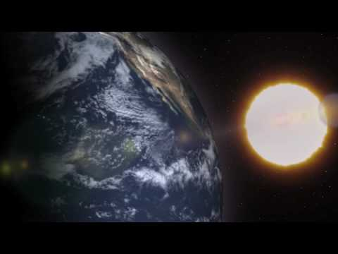
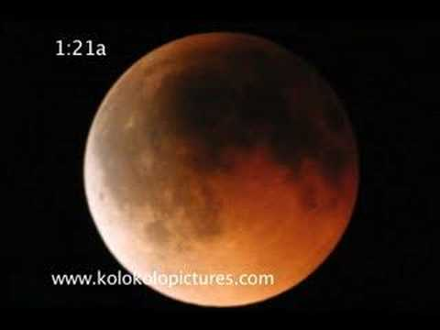
What else does the Sun do?
Fill in the Blanks on the next Page
A Day on Earth
Solar Eclipse
Lunar Eclipse
https://www.youtube.com/watch?v=r-dtBfkzyl0&feature=related
https://www.youtube.com/watch?v=XMyqPxFh5Zw
https://www.youtube.com/watch?v=2dk--lPAi04

Slide 30
FIll in the Blank
Use the word bank and complete the sentences below:

Slide 31
THE CHALLENGE PART 3:
Choose your New Planet!
Thoughtbook Entry #6:
Remember your TOP 3 most habitable planets?
Go back and review them:
Do you still agree with the choices you made? Why or why not?
Narrow down the list to just 1 PLANET:
Consider new information:
Travel Time from Earth
Distance from the sun
What planet are you going to live on? WHY
The planet I choose to live on is ______________ this planet is the most habitable because…

Slide 32
THE CHALLENGE PART 3:
Choose your New Planet!
Thoughtbook Entry #6:
If you were to live on that 1 planet you chose… what would life be like?
THINK:
How long would it take to travel there? How old you would be?
Would you need anything special on the space shuttle to help you travel there?
What would the weather be like? Would you be far from the sun or closer to it? Would you need any special equipment to help you survive?
How would you get your basic needs? Food? Water? Shelter? Air? Tempuratiure?
Planet 1
Remember this is your thoughtbook - This is a safe place to write down all your ideas even if you are not sure about them. You can come back and change your thinking later.

Slide 33
Travel Time and Distance from the Sun
Thoughtbook Entry #7:
“How important is it to consider travel time from Earth and the planet’s distance from the sun when inhabiting a new planet?”
Not Important At All
A Little Important
Somewhat Important
Very Important
Review Slide 2 - Did your thinking change?
“I think travel time and distance from the sun are ______________, my thinking (did / did not) change because…”

Slide 34
Technology & Developments
04
Learning Objectives:
Identify technological developments that enable astronauts to meet their basic needs in space.
Identify Canadians who have contributed to space science or space technology, and describe their achievements.
Investigate past and present space research programs involving astronauts, and explain the contributions to scientific knowledge.
Identify technological devices placed in space that help humans learn more about the Earth and communicate more efficiently.

Slide 35
Technology & Developments Part 1:
Who made the most useful contributions to space science or technology?
Research:
Assignment:
Astronauts - Canada.ca - https://www.asc-csa.gc.ca/eng/astronauts/default.asp
Article Canadian Astronauts - https://www.thecanadianencyclopedia.ca/en/article/astronaut
Official Chris Hadfield | First Canadian astronaut to walk in space - https://chrishadfield.ca/
Chris Reads his Children's Book 'The Darkest Dark' - https://www.youtube.com/watch?v=sxoG6Eug7jI
Define what “Most Useful” means by developing a list of criteria.
Find the names of 2 famous Canadians who made the most useful contributions to space science or space technology.
1 Active
1 Former
Write a short summary paragraph on the 5 W’s for each person.
Who were they?
What did they contribute?
Where did this occur?
When did this occur?
Why is it most useful to space exploration?

Slide 36
Criteria for “Most Useful”
Brainstorm list of ideas that could make an invention important for space science or technology. For example, provides clean water for drinking and bathing.
Choose the top 3-5 most important ideas from your list (Use the fill colour to indicate which ideas are your top 5)
* hint use what you already know to be true about the needs of living things*
Use this criteria to help you choose which astronauts you will research.

Slide 37
2 Famous Astronauts
Find the names of 2 famous Canadians who made the most useful contributions to space science or space technology.
❒ 1 Active ❒ 1 Former
Write a summary paragraph on each astronaut.

Slide 38
Technology & Developments Part 2:
What mission made the most useful contributions to space science or technology?
Research
Assignment
Space missions - Canada.ca - https://www.asc-csa.gc.ca/eng/missions/default.asp
The Apollo 11 Mission | - https://science.howstuffworks.com/lunar-landing2.htm
Race to the Moon | NASA: Challenging the Space Frontier - http://teacher.scholastic.com/space/apollo11/index.htm
Apollo 13 NASA Mission Page - https://www.nasa.gov/mission_pages/apollo/missions/apollo13.html
Use your criteria for most useful.
Review the missions and choose 1 that made the most useful contributions to space science or technology.
Use the Report Organizer on the next slide to organize your information
Present an oral or written report about the mission.

Slide 39
Report Information Gathering Organizer
Name of the Mission: | Date of the Mission
Name of the Launch Vehicle: | Countries Involved:
Drawing of the Launch Vehicle:
Crew Member Names: | Crew Member Roles:
Purpose of the Mission: | Contributions of the mission to space science or technology (including why it is most useful).

Slide 40
Technology & Developments
Thoughtbook Entry #8:
“How important is it to consider technology & developments when inhabiting a new planet?”
Not Important At All
A Little Important
Somewhat Important
Very Important
Review Slide 2 - Did your thinking change?
“I think technology and developments are ______________, my thinking (did / did not) change because…”

Slide 41
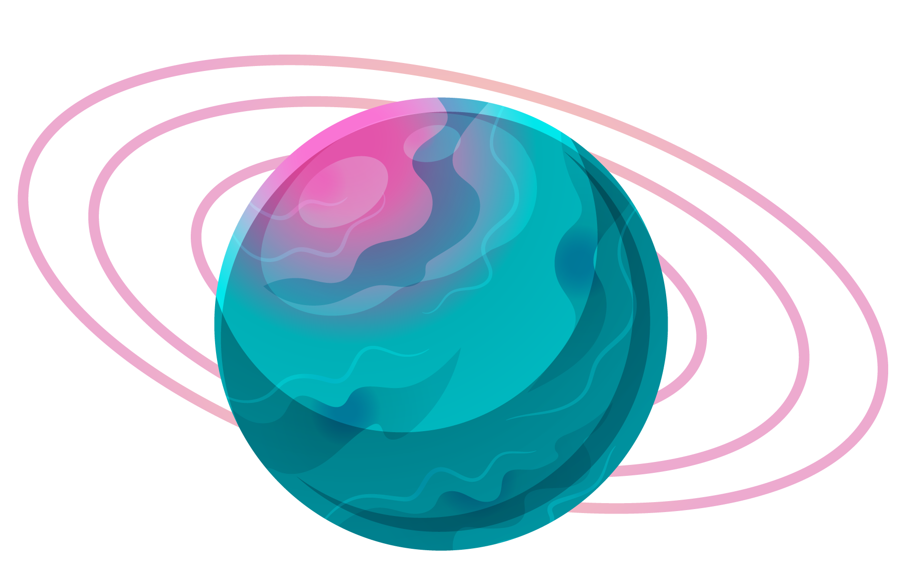
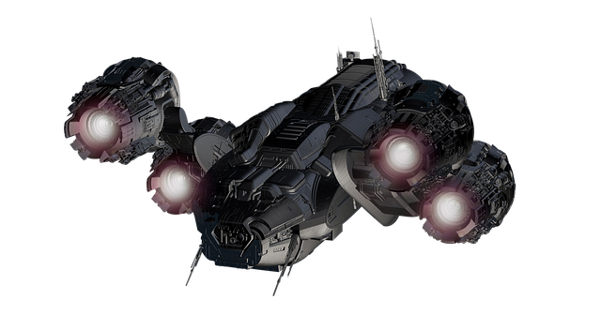
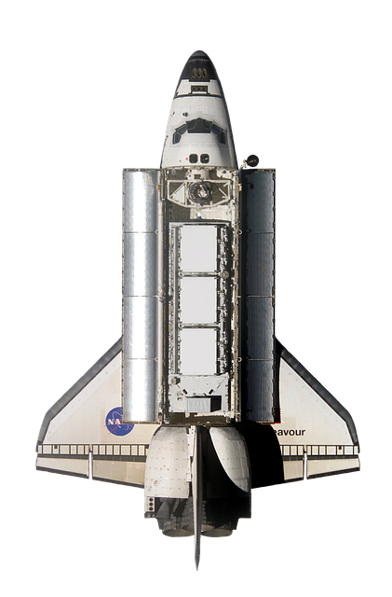
THE CHALLENGE PART 4:
Design a New Space Shuttle
Using what you learned about most useful science and technology tools for space exploration and what you already know about the needs of living things; design a space shuttle that will not only provide your transportation to the planet but will also provide you with a home when you land on the planet.

Slide 42
Design Process Page 1
Designing a New Space Shuttle
Thoughtbook Entry #9:
Define the Task: What do you need to do? | What do you already know about space shuttles?
Do background research on space shuttles: | Source: (Title and Link of websites used)
Initiating
Researching

Slide 43
Design Process Page 2
Thoughtbook Entry #10:
Describe your plan: What features will your space shuttle have? (See Part 2 → HERE & Part 3 → HERE) | List Materials needed on the space shuttle to ensure your survival: (see part 1→ HERE)
Draw and Label your space shuttle: Use a seperate sheet of paper to do this.
Include 2 views: Outside view (label all important parts) Inside view (label rooms and features)
Planning
Implementing Plan

Slide 44
Design Process Page 3
Thoughtbook Entry #11:
Observing, Measuring, Recording
Name and describe the different feature your space shuttle has and why you decided to include them in your space shuttle?

Slide 45
Design Process Page 4
Thoughtbook Entry #12:
Analyzing and Interpreting
Review the criteria for “Most Useful” (See Part 4 → HERE) | Check if you have included everything:
Review criteria for “habitable/livable” (See Part 1 → HERE) | Check if you have included everything to survive while you develop the planet.

Slide 46
Design Process Page 5
Thoughtbook Entry #13:
Concluding and Applying
Write a informative paragraph on the details of your new space shuttle. Convince me that this new space shuttle is the most useful and you will be able to survive your trip and your stay on this planet.
Present your final Project: record (voice or video) include video or images of your final project! | Reflect on what you learned through research as well as while you were completing the project. What did you find easy? Difficult? What would you do differently? Why?
Slide show & Audio Presentation & Video recording Flip Grid Other - if you would like to present in a different way, please review with the teacher first.
Reflecting

Slide 47
How important is it to consider the following ideas when choosing the most habitable planet?
Thoughtbook Entry #14:
Travel Time & Distance from the Sun
Moon & Gravity
Technology & Developments
Size & Composition
Not Important At All
A Little Important
Somewhat Important
Very Important
Click on the rocketship and push the right arrow to place it where you think its level of importance should be based on your new learning.
Photo Credit: Rocket

Slide 48
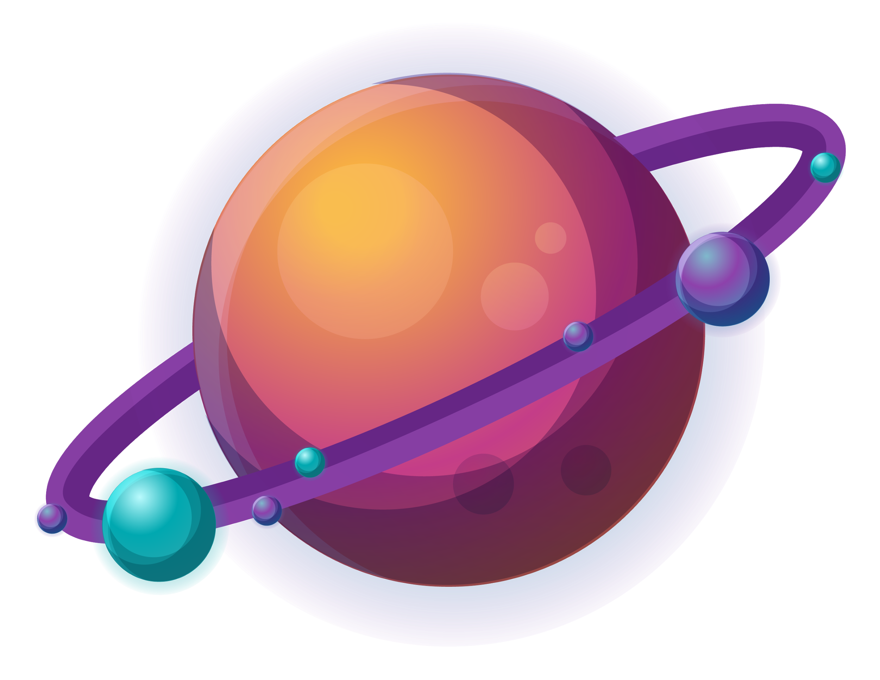
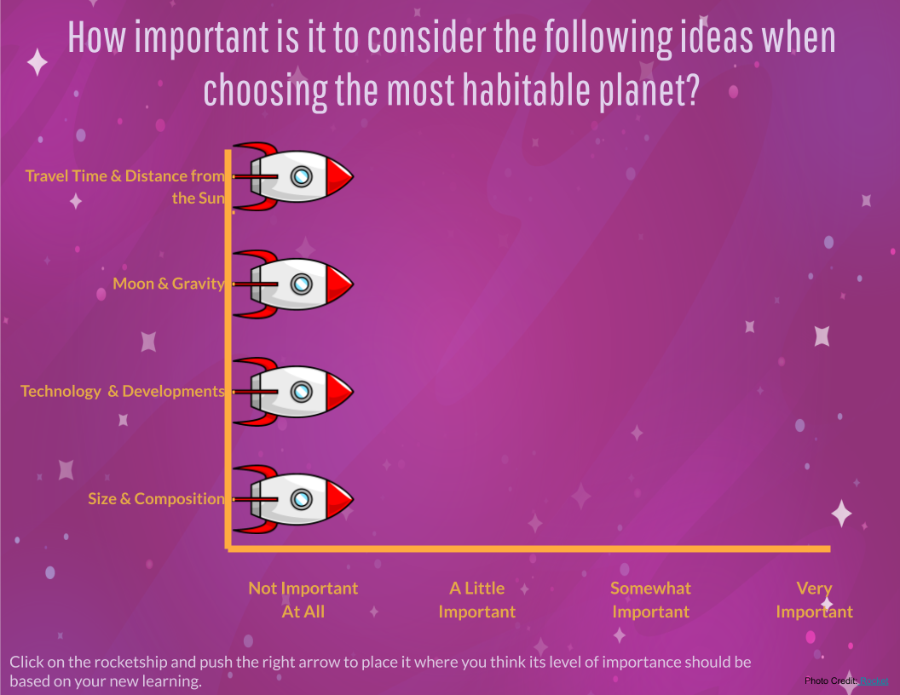
THE CHALLENGE PART 5:
Reflect on your Thinking
Thoughtbook Entry #15:
Compare slides 3 and 47→
Review Thoughtbook Entries - Did your thinking change?
What was the same?
What was different?
What idea(s) did you find were the most important to consider when choosing the most habitable planet? Why is it the most important?
What idea was the least important to consider when choosing the most habitable planet? Why is it the least important?
Answer Here:

Slide 49
Grade 6 Mathematics Achievement indicators:
Outcome & Achievement indicators: | Limited Requires considerable, ongoing teacher support and/or direction to choose strategies or to explain concepts and procedures. May not recognize that results are not reasonable. | Basic Requires occasional teacher or peer support to choose and explain appropriate strategies and procedures. Recognizes when results are extremely unlikely. | Good Represents and explains concepts accurately and clearly; chooses and explains appropriate strategies and procedures. Recognizes when results are not reasonable. | Excellent Represents and explains concepts accurately and clearly; chooses and explains appropriate strategies and procedures. Recognizes when results are not reasonable.
6.N.2 - Solve problems involving large numbers, using technology [ME, PS, T]
6.N.8. Demonstrate an understanding of multiplication and division of decimals [C, CN, ME, PS, R, V]

Slide 50
Grade 6 Science Assessment Tool: Evidence of Student Learning
View Achievement Profiles: Manitoba Report Card Grade Scale—Science Achievement Profiles (Grades 1 to 8) Subject Category: Knowledge and Understanding Science Outcomes: | In the boxes below indicate the students responses and evidence of learning through their work in the project as well as the report and diorama
 | Limited (1): Requires considerable ongoing teacher support to explain concepts related to a topic of study. make connections between science concepts and real world contexts describe thinking and reasoning using science vocabulary | Basic (2): Requires occasional teacher or peer support to: explain concepts related to a topic of study. make connections between science concepts and real world contexts describe thinking and reasoning using science vocabulary | Good (3): Explains concepts related to a topic of study Makes connections between science concepts and real-world applications. Requires occasional prompting to describe thinking and reasoning using science vocabulary | Very Good to Excellent (4): Explains concepts related to a topic of study accurately, clearly, and flexibly. Logically and creatively makes connections between science concepts and real-world applications. Explains thinking and reasoning clearly using appropriate science vocabulary.
6-4-14 Explain how the relative positions of the Earth, moon, and Sun are responsible for moon phases and eclipses.
6-4-11 Recognize that mass is the amount of matter in an object, that weight is the force of gravity on the mass of an object, and that the force of gravity varies from planet to planet
6-4-8 Recognize that the Sun is the centre of the solar system and it is the source of energy for all life on Earth.
6-4-9 Identify the planets in the solar system and describe their size relative to the Earth and their position relative to the Sun.
6-4-10 Classify planets as inner or outer planets, based on their position relative to the asteroid belt, and describe characteristics of each type.

Slide 51
Grade 6 Science Assessment Tool: Evidence of Student Learning
View Achievement Profiles: Manitoba Report Card Grade Scale—Science Achievement Profiles (Grades 1 to 8) Subject Category: Design Process and Problem Solving Science Outcomes: | In the boxes below indicate the students responses and evidence of learning through their work in the project as well as the report and diorama
 | Limited (1): Requires considerable, ongoing teacher support to make connections between science concepts and design. Shows limited application of science concepts to help solve a problem. | Basic (2): Requires occasional teacher or peer support to make connections between science concepts and design. Occasionally provides incomplete explanations of science concepts needed to solve a problem. | Good (3): Applies science concepts to solve problems using criteria and/or constraints. Explanations of science concepts needed to solve the problem are organized and complete. | Very Good to Excellent (4): Applies appropriate science concepts efficiently and accurately to analyze problems and choose the best solution with regard to criteria and/or constraints. Explanations of science concepts needed to solve the problem are clear, comprehensive, and logical.
6-4-6 Identify technological devices placed in space that help humans learn more about the Earth and communicate more efficiently.
6-4-4 Investigate past and present space research programs involving astronauts, and explain the contributions to scientific knowledge.
6-4-3 Identify Canadians who have contributed to space science or space technology, and describe their achievements
6-4-2 Identify technological developments that enable astronauts to meet their basic needs in space.

Slide 52
Grade 6 ELA Assessment Tool: Evidence of Student Learning:
The following chart is one way to record your body of evidence of student learning. It is important to consider the identified grade band descriptors in relation to the practices and elements as you look through the body of evidence. You are describing the extent to which students enacted the descriptors. Transfer this information into the appropriate reporting categories.
Evidence of Learning in English Language Arts: https://app.mapleforem.ca/en/groups/229/wiki/pages/1622#3to5overview |  | Interrelated Dimensions of Learning Growth (IDOL-G) - https://app.mapleforem.ca/en/groups/229/wiki/pages/2205
 |  | Independence: Emerging Expanding Extending | Depth: Emerging Expanding Extending | Breadth: Emerging Expanding Extending | Transformation: Emerging Expanding Extending
4 ELA Practices & Elements | Grade Band Descriptors Identified
Power Agency · Contemplate the actions that can be taken, consider alternative viewpoints, and contribute other perspectives | Learners are exploring multiple perspectives, points of view, and interpretations.
Exploration and Design · Research and study topics and ideas · Interpret and integrate information and ideas from multiple texts and sources · Manage information and ideas · Invent, take risks, and reflect to create possibilities | Learners are participating in, extending, and discussing creative processes for designing. Learners are selecting, assessing, and organizing a variety of sources and information for different purposes.
Sense Making ​ Access, use, build, and refine schema. Select from and use a variety of strategies. Be aware of and articulate the ways that one engages with text. | Learners are using and integrating background knowledge and sources of information purposefully to make sense of increasingly varied and complex text.
System​ Recognize, apply, and adapt rules and conventions. | Learners are using their understanding of a range of text structures and features to understand and communicate clearly and effectively.

Slide 53
Congratulations You are Done!
Hope you Enjoyed Your Space Adventure

Slide 54
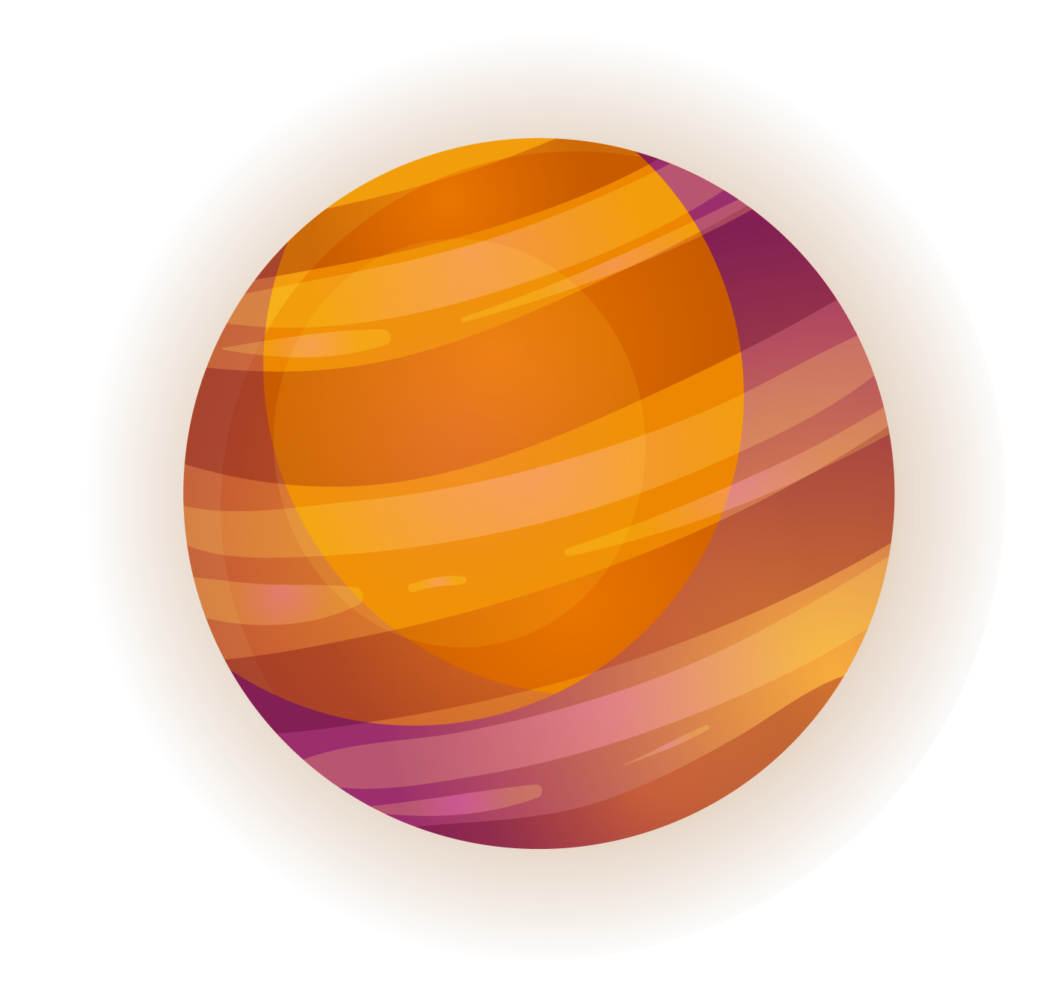
CREDITS
Did you like the resources on this template? Get them for free at our other websites.
VECTORS
Galaxy background with colorful planets
Galaxy background with colorful planets II
Infographic about the layers of the earth
Colorful galaxy background with flat design
Outer space cover collection
Colorful gradient space with a rocket background
Gradient outer space cover collection
This is where you give credit to the ones who are part of this project.
Presentation template by Slidesgo
Icons by Flaticon
Infographics by Freepik
Images created by Freepik
Author introduction slide photo created by Freepik
Text & Image slide photo created by Freepik.com

