Slide 1
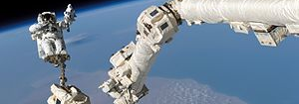
Impact of Technology and Innovation on Life in Canada
This Photo by Unknown Author is licensed under CC BY-SA
Inquiry Question: How have technology and innovation impacted life in Canada?
This Photo by Unknown Author is licensed under CC BY-SA
Let’s kickstart our thinking!
What kinds of things do you think we will learn about?
This Photo by Unknown Author is licensed under CC BY-SA-NC

Slide 2
Before we start, there are some important
words/vocabulary that we need to understand:
What is technology?
“…the use of knowledge to invent new devices or tools. Throughout history, technology has made people’s lives easier.”
Source: Britannica Kids Technology and Invention - Kids | Britannica Kids | Homework Help
What is innovation?
“a new idea, method, or device; the introduction of something new”
Source: Merriam-Webster Innovation | Definition of Innovation by Merriam-Webster (merriam-webster.com)
And you also may be wondering…..
what is an invention?
“something invented: such as a useful new device or process”
Source: Merriam-Webster Learner’s Dictionary Invention - Definition for English-Language Learners from Merriam-Webster's Learner's Dictionary
Notes:
-Alternative: Have students look up the definitions on their own or in a small group and report back.
-Discussion of examples can happen here or wait until after the next 2 slides.

Slide 3
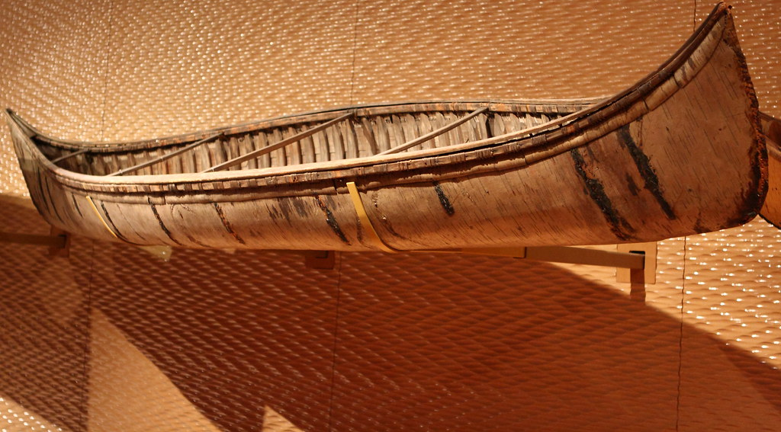
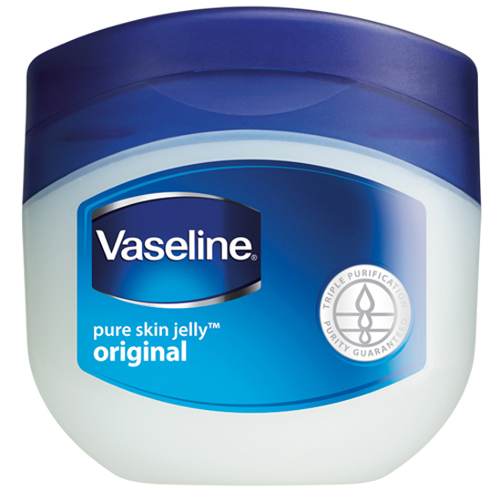
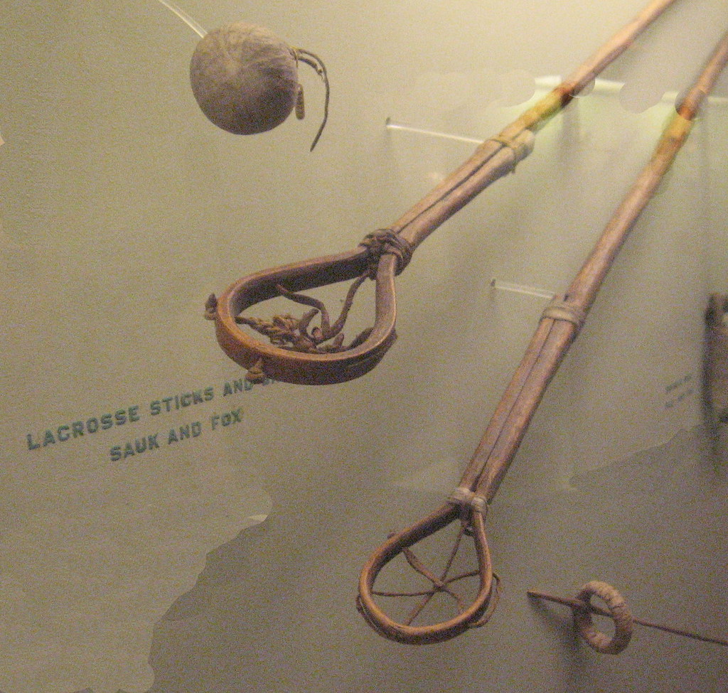
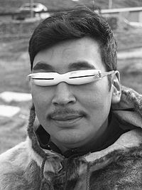
What do you notice?
To help us better understand technology, innovation, and invention, look at the pictures.
What do you wonder?
This Photo by Unknown Author is licensed under CC BY
This Photo by Unknown Author is licensed under CC BY-SA
This Photo by Unknown Author is licensed under CC BY-SA
This Photo by Unknown Author is licensed under CC BY-NC
This Photo by Unknown Author is licensed under CC BY-SA

Slide 4
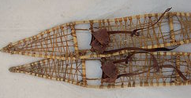
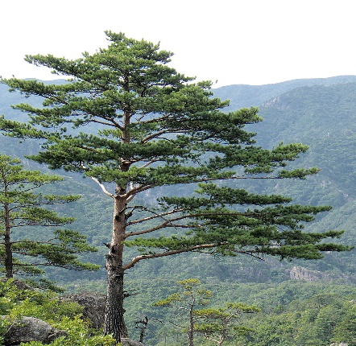
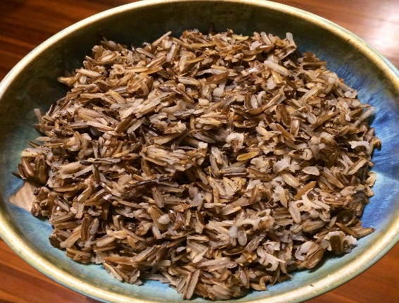
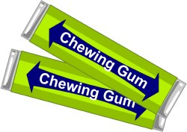
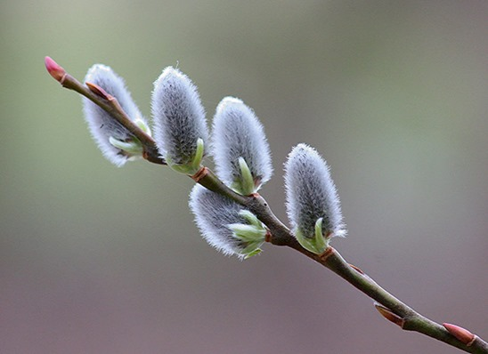
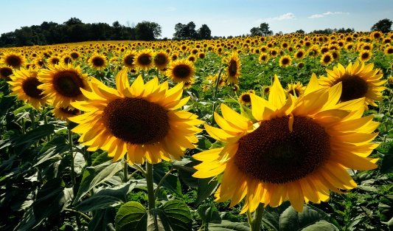
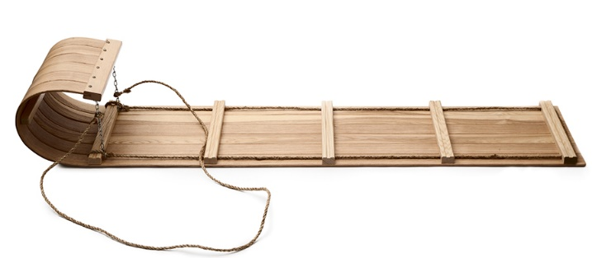
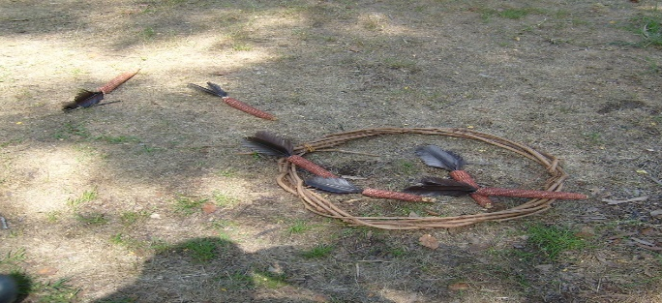
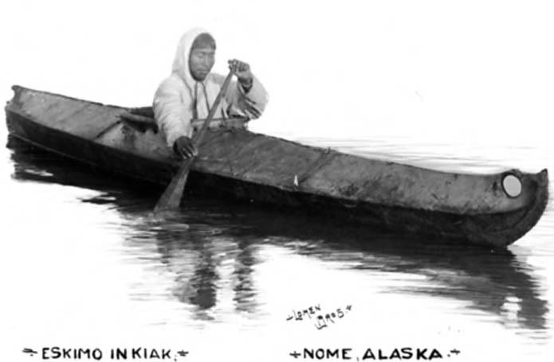
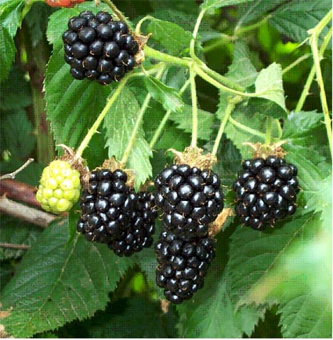
All the items are Indigenous technology, innovations, and inventions!
Let’s look at more Indigenous technology, innovations, and inventions!
Source: Did you know? (rcaanc-cirnac.gc.ca)
This Photo by Unknown Author is licensed under CC BY-SA
This Photo by Unknown Author is licensed under CC BY-NC
This Photo by Unknown Author is licensed under CC BY-ND
This Photo by Unknown Author is licensed under CC BY-SA
This Photo by Unknown Author is licensed under CC BY-SA
This Photo by Unknown Author is licensed under CC BY-SA-NC
This Photo by Unknown Author is licensed under CC BY
This Photo by Unknown Author is licensed under CC BY-SA
This Photo by Unknown Author is licensed under CC BY-NC-ND
This Photo by Unknown Author is licensed under CC BY-SA
This Photo by Unknown Author is licensed under CC BY-SA
This Photo by Unknown Author is licensed under CC BY-SA
This Photo by Unknown Author is licensed under CC BY-SA
This Photo by Unknown Author is licensed under CC BY-NC-ND
This Photo by Unknown Author is licensed under CC BY-NC
Notes:
-See Diverse Peoples – Aboriginal Contributions and Inventions BLM cut and paste for at-home activity or to guide discussion and sort. Some students may remember doing the cut and paste in grade 2.
-Discuss what each picture represents and what it was used for using the BLM or the website information.

Slide 5
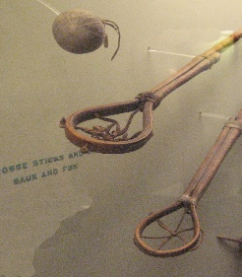
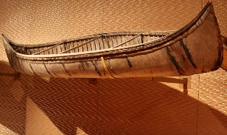
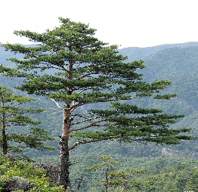
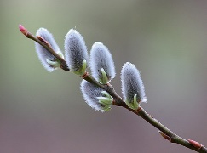
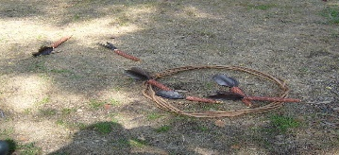
Human health & well-being, the environment, and the economy contribute to quality of life. Sort the items into the area they impact the most.
Health & Well-Being
Environment
Economy
This Photo by Unknown Author is licensed under CC BY-SA
This Photo by Unknown Author is licensed under CC BY-NC
This Photo by Unknown Author is licensed under CC BY-ND
This Photo by Unknown Author is licensed under CC BY-SA
This Photo by Unknown Author is licensed under CC BY-SA
This Photo by Unknown Author is licensed under CC BY-SA-NC
This Photo by Unknown Author is licensed under CC BY
This Photo by Unknown Author is licensed under CC BY-SA
This Photo by Unknown Author is licensed under CC BY-NC-ND
This Photo by Unknown Author is licensed under CC BY-SA
This Photo by Unknown Author is licensed under CC BY-SA
This Photo by Unknown Author is licensed under CC BY-SA
This Photo by Unknown Author is licensed under CC BY-SA
This Photo by Unknown Author is licensed under CC BY-NC-ND
This Photo by Unknown Author is licensed under CC BY-NC
Notes:
-Discuss what human health and well-being, environment, and economy means with examples before students discuss and sort the items. (See MB ED Sustainable Development info for gr 5-12 Guide to Grades 5 to 12 Sustainability Poster:Layout 1.qxd (gov.mb.ca)). Here is a video for kids explaining economy https://youtu.be/6XZ_iAt3UTc. It may also be helpful for students to think about those 3 areas by thinking about these areas: transportation, communication, medicine and health, recreation and leisure, education, and business and industry.
-Students, individually or in a small group, can prepare a short argument to present to the class about which item had/has the most impact on health & well-being, the environment, or the economy, which has the least impact.

Slide 6
Math BREAK!!
Ratios and Percent!!
Health & Well-Being
Environment
Economy
There are 15 examples of Indigenous innovations/inventions that we sorted.
What ratio demonstrates how many of the 15 Indigenous examples positively impact:
human health & well-being
the environment
the economy
and any other ratios that you can see
What percent demonstrates how many of the 15 Indigenous examples positively impact:
human health & well-being
the environment
the economy
and any other percent that you can see
This Photo by Unknown Author is licensed under CC BY-SA
This Photo by Unknown Author is licensed under CC BY-NC
This Photo by Unknown Author is licensed under CC BY-ND
This Photo by Unknown Author is licensed under CC BY-SA
This Photo by Unknown Author is licensed under CC BY-SA
This Photo by Unknown Author is licensed under CC BY-SA-NC
This Photo by Unknown Author is licensed under CC BY
This Photo by Unknown Author is licensed under CC BY-SA
This Photo by Unknown Author is licensed under CC BY-NC-ND
This Photo by Unknown Author is licensed under CC BY-SA
This Photo by Unknown Author is licensed under CC BY-SA
This Photo by Unknown Author is licensed under CC BY-SA
This Photo by Unknown Author is licensed under CC BY-SA
This Photo by Unknown Author is licensed under CC BY-NC-ND
This Photo by Unknown Author is licensed under CC BY-NC
Notes:
-Ratios and percent may be demonstrated pictorially (using pictures of the items or colour the Centimetre Grid BLM) and/or symbolically (eg. 15:15, 100%), depending on student understanding.
-You may wish to give students the opportunity to express ratios and percent in all of their symbolic forms as they will see them in many forms in the real world. For example, ratios can be expressed as 7:15, 7/15, and 7 to 15, and percent as 47/100, .47, and 47%.

Slide 7
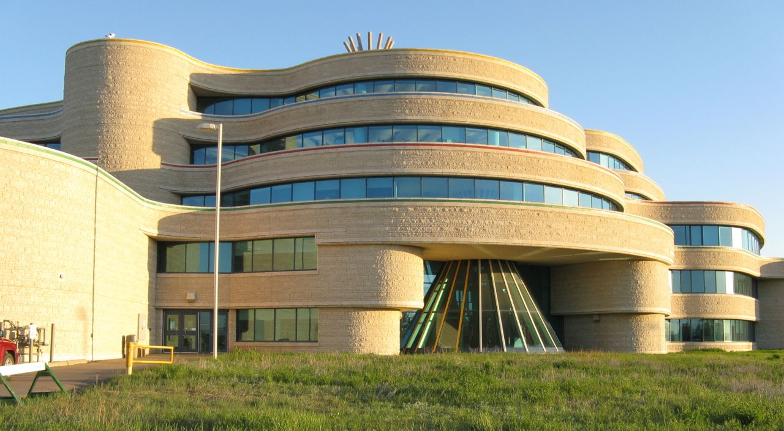
Click here 1491 to explore more Indigenous technology, innovation, and inventions in this online activity.
As you “play the game”, think about how the technology, innovation or invention impacted human health and well-being, the environment and/or the economy.
What did you notice?
What did you wonder?
This Photo by Unknown Author is licensed under CC BY-SA
Notes:
-Students can journal about the impact of the different innovations and inventions that they explore on the website.
-Debrief with students about their thinking about the different innovations and inventions and the impact of each.

Slide 8
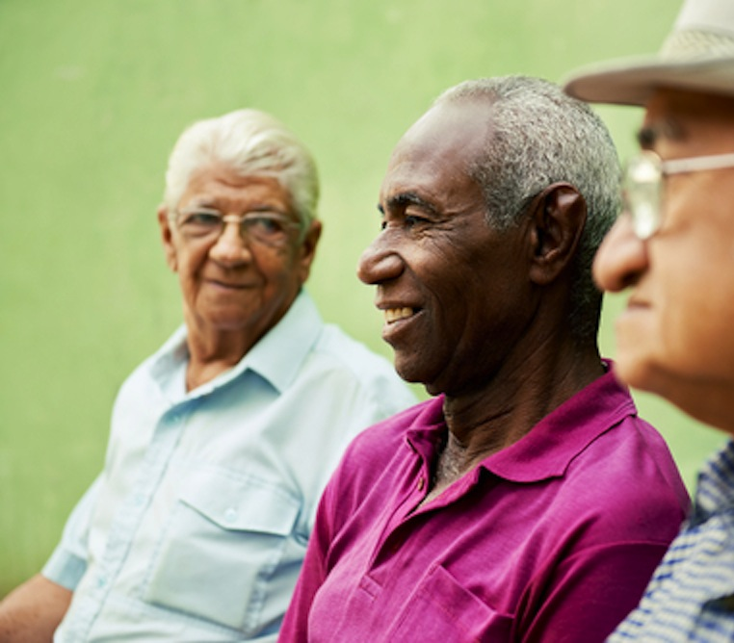
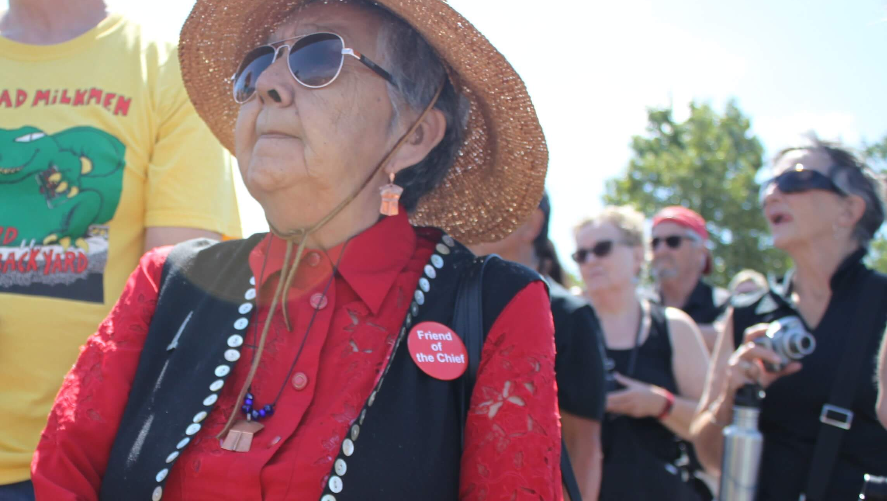
Now that you have looked at Indigenous technology, innovation, and inventions, it’s interview time!
Watch this video on how to do an interview - Tell Me Your Story - Interviewing Tips for Kids - YouTube
Interview the oldest family or community member that you know.
Ask them what one technology, innovation or invention that they think has had the greatest impact on their life in Canada and why.
This Photo by Unknown Author is licensed under CC BY
This Photo by Unknown Author is licensed under CC BY-SA
This Photo by Unknown Author is licensed under CC BY-ND
Notes:
-The video, with tips for kids about how to conduct an interview, uses a flood as the topic for types of questioning. Have students make up their own questions or use the It’s Interview Time BLM.
-Students could video record the interview to share IF the interviewee agrees.
-Alternate assignment: also have students interview youngest family or community member to compare answers with oldest interviewees.
-Debrief by discussing similarities and/or differences in interviewee responses and the major changes that have taken place in the use of technology and innovation in Canada in the last two generations and reflect on how this has changed daily life for many people.

Slide 9
Now it’s time to research a Canadian invention or innovation!
Thinking about the 3 areas of life, health & well-being, environment, and economy, do you know any Canadian inventions or innovations? Please share. ☺
Watch the first 2 minutes of the following video to stimulate your thinking: Canadian inventions and trivia – YouTube
Watch this video as well to get ideas about innovation ☺: The Métis artist inspiring Canadians from coast-to-coast | #GGInnovation - YouTube
Research a Canadian technology, innovation, or invention. Be sure to use credible resources. Some are listed on the next slide.
Prepare and share a report on the invention including its impact on health & well-being, the environment and/or the economy.
You may choose to present your information using a song, poem, dance, video, puppet show, PowerPoint, poster, or other teacher-approved option. ☺
This Photo by Unknown Author is licensed under CC BY-SA-NC
Notes:
-May do the Why do We Invent BLM activity before starting the research.
-May use Researching Canadian Inventors and Innovators BLM
-May choose to review Primary and Secondary Sources using Teacher Background Notes BLM
-May choose to use the Citing Sources Teacher Background Notes BLM

Slide 10
Resources to help with your technology, innovation or invention (STEAM) research:
heritage minutes Canadian inventions – YouTube
20 Canadian entrepreneurs to watch in 2020 - MaRS Discovery District (marsdd.com)
smoke architecture
HOME | TWO ROW 2020
MEMBERS | Canadian Black Scientists
Alain Fournier | EVOQ (evoqarchitecture.com)
Chemistry (Episode 13) - YouTube
6 cool things invented by Canadians | Explore | Awesome Activities & Fun Facts | CBC Kids
Douglas Cardinal Architect (djcarchitect.com)
Top 100 Inventions Made in Canada (thoughtco.com)
NSERC – Women in Science and Engineering (nserc-crsng.gc.ca)
16 amazing things invented by Canadians | CBC Television
More than 30 inventions you wouldn’t expect to be Canadian – RCI | English (rcinet.ca)
11 Inventions to Celebrate - Canada's History
NSERC - Prizes (nserc-crsng.gc.ca) Click any of the 5 NSERC prizes, then click a year and a winner
30 made-in-Manitoba inventions to be thankful for | Winnipeg Sun
Notable Black Canadians (blackmontreal.com)
AbInv.jpg (675×450) (smartstartlearning.com)
Canadian Inventions | The Canada Guide
The 15 Greatest Canadian Inventions | Indie88
Inventors & Innovators — Canadian Multicultural Inventors Museum (multiculturalmuseums.org)
Contemporary: Faye HeavyShield – YouTube
ᐄᓃᐤ (ÎNÎW) River Lot 11∞ (Edmonton's Indigenous Art Park) – YouTube
Indigenous ecological knowledge - Science and conservation (pc.gc.ca)
Architect with career in Nunavut gets honorary degree from OCAD university | CBC News
Innovators — Indigenous Innovators
Further resources about jobs/roles/training/education important for technology and innovation:
I'm a Chemical Engineer by Queen's Faculty of Engineering and Applied Science – issuu
Who We Are | IndigiSTEAM (indigesteam.ca)
Read — Canadian Multicultural Inventors Museum (multiculturalmuseums.org)
Notes:
-Resources for research: Examples of Canadian Inventions and Technologies BLM, Heritage Minute relevant videos: Marconi, Avro Arrow, Marshall McLuhan, Sir Sanford Fleming, Joseph-Armand Bombardier, James Naismith.
-May discuss how Canada changed from rural, land-based (reflected in early Indigenous innovations & inventions) to a technological, industrialized society (reflected through evolution of inventions since time in memoriam).
-May discuss the types of education, training, and jobs that the inventors had that enabled them to meet needs, solve problems, create and innovate.

Slide 11
Now it’s time to become an innovator or inventor!

Slide 12
Think of needs/concerns & collect data
Think of 5 or 6 needs/concerns Canadians have today in the areas of health & well-being, environment, or economy. (transportation, communication, medicine and health, recreation and leisure, education, and business and industry).
Develop a question about those 5 or 6 needs/concerns and survey several family and friends about which need/concern they think is most important. You may use hard copy or technology to collect your data. This video explains data and data collection: Describe ways on how to collect and organize data – YouTube
This Photo by Unknown Author is licensed under CC BY
Notes:
-May use the You are the Pollster BLM, Microsoft Forms survey/other technology option, or pen and paper for data collection.

Slide 13
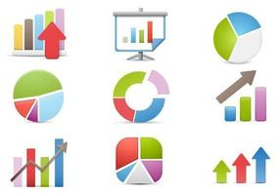
Graph your results
Create a graph displaying the data results of your survey. This video explains bar, pie, and line graphs: Bar graph, circle graph, line graph and Tally marks – YouTube
This video explains how to create a graph in Word: How to create a Graph in Microsoft Word 2019 (2020 Tutorial) - YouTube
This Photo by Unknown Author is licensed under CC BY
Notes:
-May use the Centimetre Grid BLM, plain paper, or technology for the graph.

Slide 14
Think of a solution
Think of a technology, innovation or invention that could fill or solve the most important need or concern identified in your survey (be as creative as possible ☺).
Plan, design, and/or maybe build the technology, innovation, or invention.
For example, you may decide to solve a concern related to a more affordable electric car that still benefits the environment. Or you may decide to meet a need for more creative outdoor spaces that people can enjoy when managing Covid-19 restrictions. Or you may decide to think of a way to provide fresh fruits & vegetables to all those that need it in your community.
This Photo by Unknown Author is licensed under CC BY
Notes:
-May use Technology, Innovation or Invention Planning & Design BLM for design.
-Suggestion: tailor the examples to students’ community context.

Slide 15
Present your findings
Present your findings and idea. Be sure to include how it supports human health & well-being, the environment, and/or the economy.
You may choose to present your information using a song, poem, dance, video, puppet show, PowerPoint, poster, or other teacher-approved option. ☺
This Photo by Unknown Author is licensed under CC BY-NC

Slide 16
Advocate
Write a persuasive letter or email to someone of influence that you think is most likely to help you advocate for or address the need/concern and your solution.
Here is a link to information about writing a persuasive letter or email: How to Write Persuasive Letter or Email (with Sample & Template) (docformats.com),
This Photo by Unknown Author is licensed under CC BY-SA
Notes:
-Students may think someone of influence could be a social media influencer, celebrity, editor of a newspaper or online journal, or politician. Here is a link to contact information for Manitoba politicians at all levels: AMM - Association of Manitoba Municipalities | Municipal Directory

Slide 17
Impact of Technology and Innovation on Life in Canada
This Photo by Unknown Author is licensed under CC BY-SA
So………what was the most exciting/ surprising/concerning/important thing that you learned about how technology and innovation impact life in Canada?
This Photo by Unknown Author is licensed under CC BY-SA
This Photo by Unknown Author is licensed under CC BY-SA-NC
Notes:
You may wish to also now have a conversation about how Canadian technology, innovation, and inventions have impacted Canada’s influence and relationships with the rest of the world, if it has not come up before in the project.

