Slide 1
The Crust
Grade 7

Slide 2
How is our understanding of the Earth’s crust impacted by evidence from technology and research?

Slide 3
How has the Earth’s crust changed overtime?
How does technology and research contribute to our ideas about the Earth’s geology?
How can creativity and joy be used to create texts that share ideas about the world around us?
Guiding Questions

Slide 4
Before | Statements | After
T F | Only men are given credit for scientific discoveries. | T F
T F | All of the ocean floor has been mapped. | T F
T F | The scientific community embraces every new idea that comes along. | T F
T F | Evidence alone is enough to convince someone of a new idea or theory. | T F
Anticipation Guide

Slide 5
Alfred Wegener is the scientist who first proposed the idea that the continents drift. View this video and record your thinking about the following questions:
How did Wegener contribute to the theory of plate tectonics? What evidence did he offer?
What barriers existed to the validity of his ideas?
How do the creators of this animation express creativity and joy?
Continental Drift
Notes:
https://www.biointeractive.org/classroom-resources/animated-life-pangea

Slide 6
Print out a copy of the next slide. Cut out the continents.
Arrange the continents as they appear in the world today.
Write the name of each continent on each piece.
Try to fit the continents together into what Pangaea might have looked like.
Find and label where these mountain ranges are: Rocky Mountains, Andes Mountains, Himalayas, Alps, Atlas Mountains, Great Dividing Range
In the space to the right, insert a photo of your pieces and write your thoughts on how scientists believe the world may have cracked and drifted apart.
Continents Adrift
Notes:
https://www.researchgate.net/figure/From-Pangaea-to-the-present-day-continents_fig2_225366117

Slide 7
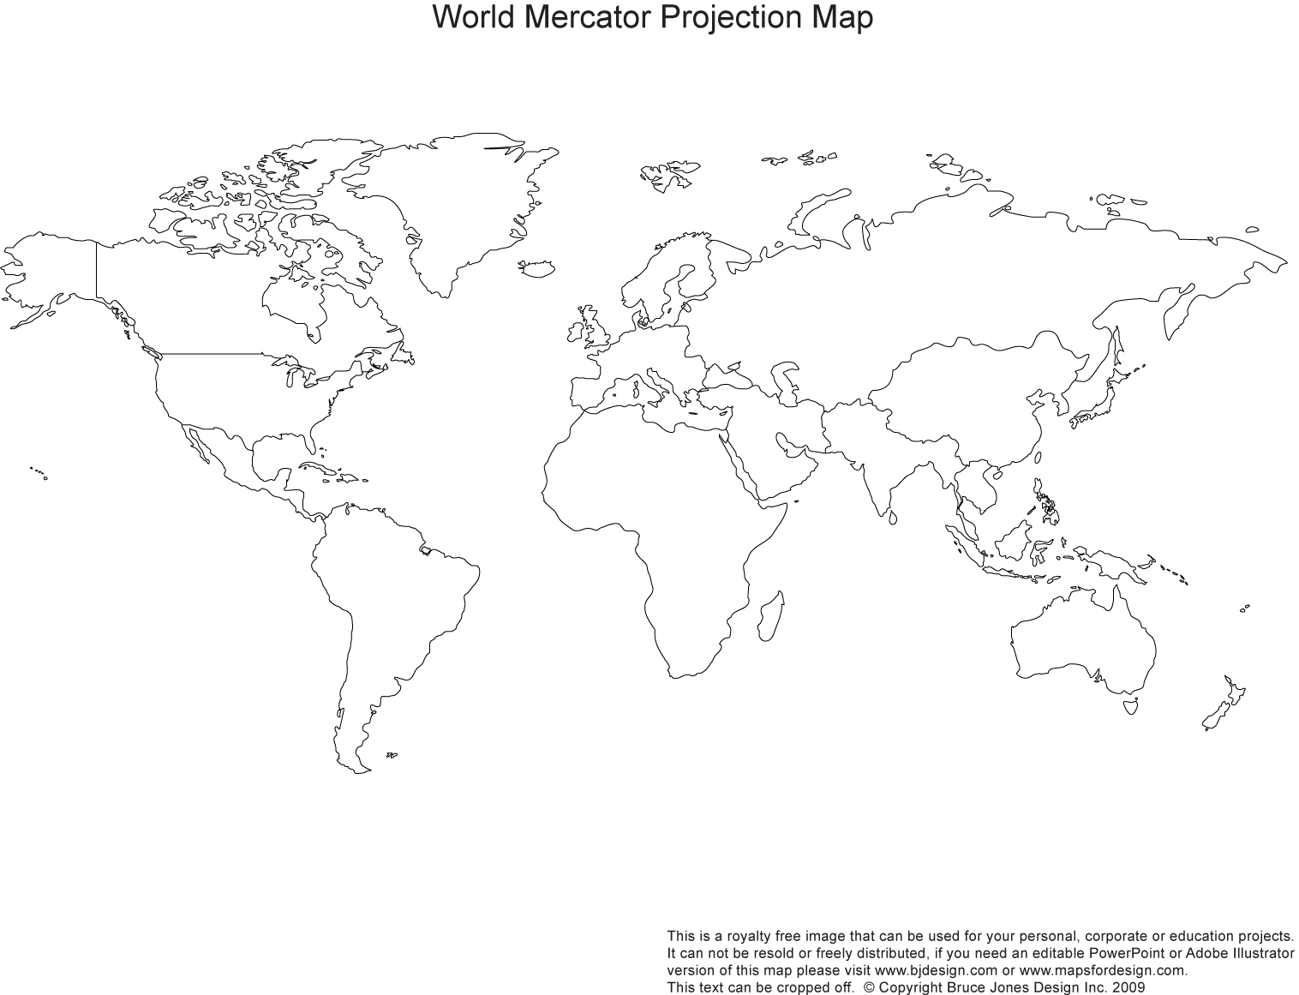

Slide 8
In the Text What’s this text about? Who’s telling the story? What does the author want me to know/think?
In your Head What did I notice? What surprised me? What challenged, changed, or confirmed my thinking?
In your Heart How did this make me feel? What did I learn about me? How will this influence my decision making and actions?
View the video How One Brilliant Woman Mapped the Secrets of the Ocean Floor. Complete the chart above.
Notes:
https://www.youtube-nocookie.com/embed/vE2FK0B7gPo?autoplay=1&iv_load_policy=3&loop=1&modestbranding=1&playlist=vE2FK0B7gPo

Slide 9
What evidence did Marie Tharp share with the scientific community?
What technology was used to collect that evidence?
What barriers did Marie Tharp have to overcome?
Why did those barriers exit?
Revisit the video How One Brilliant Woman Mapped the Secrets of the Ocean Floor. Be prepared to discuss the above questions with your class.
Notes:
https://www.youtube-nocookie.com/embed/vE2FK0B7gPo?autoplay=1&iv_load_policy=3&loop=1&modestbranding=1&playlist=vE2FK0B7gPo

Slide 10
Watch the videoThe Pangaea Pop-up. What evidence is there to support the theory of plate tectonics? Record your thoughts below.
Evidence of Pangaea
Notes:
https://www.youtube.com/watch?v=p-vNSqUy0l4

Slide 11
Watch the video about the making of the pop-up book.
Why did the author/creator choose the pop-up medium?
Was the medium effective? Why or why not?
Record your ideas below:
Medium choice
Notes:
https://www.youtube.com/watch?v=RZR_b753ZJ0

Slide 12
Watch Tectonic Plates Demonstration
Either recreate the three types of boundaries using materials from home or draw sketches from the demonstration for each type of boundary.
Record pictures of your models or drawings in the chart.
Divergent
Transform
Convergent
Plate Boundaries
Notes:
https://www.youtube-nocookie.com/embed/GX7nai2aEtw?autoplay=1&iv_load_policy=3&loop=1&modestbranding=1&playlist=GX7nai2aEtw

Slide 13
A seismograph is an instrument used to record the motion of the ground during an earthquake. It is one technology that contributes to our understanding of the Earth’s crust. View the video.
What do you learn about seismographs in this video?
How do the Amoeba People express creativity and joy about seismographs?
Record your thinking below:
Seismograph
Notes:
https://www.youtube.com/watch?v=otTDBBkNpHE

Slide 14
Pause & Reflect
What do you know about how the Earth’s crust changes? | What do you still wonder about how the Earth’s crust changes?

Slide 15
Self-Directed
Inquiry
Choose a question that you are still wondering about the Earth’s crust.
Pursue answers to your question.
Share your learning using a medium that allows you to utilize creativity and joy.

Slide 16
My Project Proposal
Topic:
What supporting questions will support your inquiry?
Why are you passionate about or interested in this topic?
What essential or main question is driving this project?

Slide 17
What I learned:
New Questions:
Where I learned it:
How good the info is:
Notes:
Instructions:
This template can be used by students if needed to keep track of their learning while researching their inquiry questions. They can make as many copies as needed.

Slide 18
Guide to Success:
Assessment tool for students and teachers
Task Checklist (What do I need to do?) | Excellence Criteria (What do I need to do to do it well?) | Self-Reflection (What did I do well? What could I improve on?) | Teacher Guidance (What is going well? What might need to be changed?)
 |  | Affirm - What did I do really well? Revise - What could I have done better at? What changes could I make? Aspire - Where would I like to go next? What would I like to learn more about? | Affirm - What is going well? Revise - What changes could be considered?
Notes:
Instructions:
This slide can be used to co-create success criteria with your students as well as provide a template for student self-reflection and teacher feedback while students are working on their inquiry.

Slide 19
Return to slide 4 and complete the ‘After’ column.
Then complete the reflection below:
Did your thinking change?
My thinking (did/did not) change because ________________________
____________________________________________________________________________________________________________________________________________________________________________________________________________________________________________________
Learning Reflection

Slide 20
This Template is free to use under https://creativecommons.org/licenses/by/4.0/
Download More Templates
MyFreePPT.com
Graphics/Icons by : U.S. Government Works, NASA, Undraw.co, Microsoft & Google Inc.
To Give us Credit Keep this slide or mention us somewhere in your presentation. Would be very appreciated!

