Slide 1
Playing with PATTERNS
Notes:
Image Source: PowerPoint Design Ideas

Slide 2
Guiding Concepts
Anchored in inquiry
Open ended questions, student centered, student choice
Low floor, high ceiling
Multiple ways to show understanding

Slide 3
Big Ideas
Patterns can be represented in a variety of ways
Algebra, with the use of symbols or variables, expressions, and equations, is a tool for generalizing and representing mathematical situations and patterns in our world
Relationships between quantities can be described using rules involving variables
Curricular Outcomes
8.PR.1 – Graph and analyze two-variable linear relations.
8.PR.2 – Model and solve problems using linear equations, concretely, pictorially, and symbolically.

Slide 4
Instructions
This collection of tasks is designed around the concept of patterns and relations as well as using patterns to solve problems. The sections (colored blocks on slide 6 of the PowerPoint) represent independent sets of learning experiences that could function effectively as 45min-1hour session with a combination of synchronous and asynchronous parts, some of which are easily adaptable either way depending on your situation and access to technology and connectivity.
*FOR SYNCHRONOUS LEARNING, THE SLIDEDECK MUST BE IN EDIT MODE (not present mode)*
Each section provides a different way of engaging with the concept and is divided into 3 main parts:
Get Ready: begins the experience with an activity meant to activate student thinking and promote rich student discourse. This activity can be delivered prior to the lesson as an asynchronous task so students have time to prepare their thinking. It can also be delivered at the beginning of the synchronous session to help the teacher pre-assess prior knowledge and prime thinking for the upcoming learning experience.
Work it out: comprises the main learning experience for the day. This is where new content is presented and individual or small group responses are required. These activities are best completed with students working in pairs or small groups. If your platform allows for breakout rooms, this feature is a good tool that will facilitate student collaboration and discourse.
Look Back: is a final culminating task that provides opportunities to check for student understanding of the concepts, consolidate different solutions and solve problems. It allows for students to reflect on their learning and make connections.
Notes:
More detailed instructions for each learning experience are included in the NOTES section under each slide.

Slide 5
Materials
It is highly recommended that if this is the first-time students are experiencing virtual manipulatives, allow them time to "play". This allows for the opportunity to explore and have fun with the tools BEFORE they will be required to use them purposefully.
Websites for virtual manipulatives are suggested. Hands-on materials are ideal. Significant learning occurs when students can build and visualize different representations of mathematics.
If School Divisions have another platform for delivering online instruction (ie See Saw, Google Classrooms), asynchronous tasks can be copied and uploaded there.
For virtual manipulatives visit https://toytheater.com/category/teacher-tools/virtual-manipulatives/

Slide 6
PLAYING WITH PATTERNS
Multiple Representations
(x3)
Real World Connections
(x2)
Problem Solving
(x2)
Pattern Play
(x1)

Slide 7
Visual Connections
1
Get Ready
2
Work it out!
3
Looking Back
Which One Doesn’t Belong
Seeing
Write About It
Representing
or,
Record It
Displaying
Notes:
Activator – number talk, choral count…
Work it out - Challenges make up the focus of the day(s) lesson (you may only have one and all students are assigned the same task, you may have a choice of two or three, or you may have all students begin at challenge 1 and move on as greater challenge is needed / Consolidate & Reflect on what you’ve learned during this part of the project.
Looking Back – a place for extension/reflection/self-assessment
Images Sources: https://openclipart.org/detail/172707/edit-icon-icono-editar, https://openclipart.org/detail/212116/screencast

Slide 8
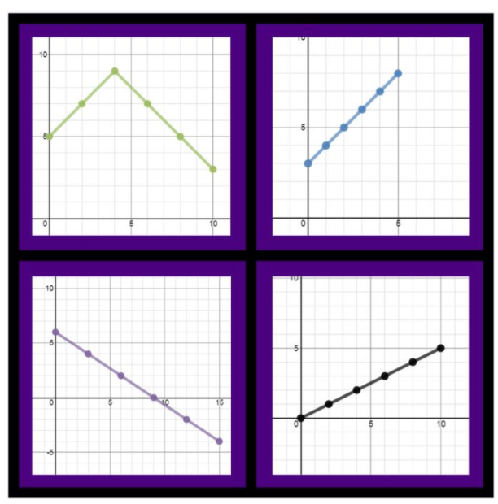
1
Get Ready
Which One Doesn’t Belong?
Notes:
Source: wodb.ca (Graph 18 – Annie Forest)

Slide 9
1
Which One Doesn’t Belong?
Get Ready
This one doesn’t belong because…
This one doesn’t belong because…
This one doesn’t belong because…
This one doesn’t belong because…
Notes:
Teacher Notes
Teacher can collect student responses here – synchronous
Students could complete, finding at least one reason for each quadrant – asynchronous
Source: wodb.ca (Graph 18 – Annie Forest)

Slide 10
1
Get Ready
End of this section

Slide 11
2
Part 1 – Seeing Patterns
Work it out
Examine the pattern below and describe in words everything you know about it:
Everything I know:
Notes:
Teacher Notes
“Seeing Patterns”
This set of slides (11-19) would be best “pushed out” to all students so they can do their own thinking and manipulating of the pattern.
Small groups would also be helpful in having students articulate their thinking and see the differences in how people view the pattern’s growth.
Alternately, select pages could be assigned to students as needed – each student to copy and paste the slide (within your PowerPoint) and put their name at the top, or pushed out as a handout in the Smart Learning Suite for example)
Students analyze the pattern and decern how they see it growing. Push for more than “it goes up by 3”.
Encourage students to use the most descriptive language they can!

Slide 12
2
Work it out
Using the blocks to the right, can you build the next two terms in the pattern?
term 4
term 5
Notes:
Teacher Notes
Students are to build the 4th and 5th terms. This can be done individually or in small groups depending on the goals for the lesson.

Slide 13
2
Add colour to the terms help illustrate how you see the pattern growing.
Work it out
term 4
term 5
The colours should help us understand HOW you see it increasing.
Notes:
Students complete individually, if possible share with another student or small group and discuss.
Teacher Notes
Have students find structure (same type of shape) within the pattern. When this structure identically repeats itself, we can justify that is part of the pattern. Colour these groups one colour and, if possible, circle each group for the three terms. We would say these groups, or the number of squares in each group are the coefficients to the variables.
Next, see what is always staying the same from one term to the next. This represents the constant.
Extension: Have students write a number sentence [ 3(1) + 1, 3(2) + 1, 3(3) + 1 ] to represent each term they coloured in. The constant always stays the same, and the coefficient only changes based on the term number.

Slide 14
2
Work it out
How many squares will the 10th term have? How do you know?
The stack of tiles is here in case you need them to help you justify your thinking.
*Note: You have NOT been asked to BUILD the 10th term.
Notes:
Teacher Notes
The strategy students use to complete this slide will provide insight into their understanding of how the pattern increases.

Slide 15
2
Part 2 – Representing Patterns
Work it out
Create a table of values to represent the first 7 terms in the pattern:
Term number | Number of Squares
1
2
3
4
5
6
7
In words, tell how the number of squares in any single term relates to its term number.
Call the term number "x".
Can you write an expression to represent the relationship?
Notes:
Teacher Notes
“Representing Patterns”
Students will represent the visual pattern in a few different form. This should be familiar from grade 6/7.
A good discussion to have would be how the table of values is represented in the expression.

Slide 16
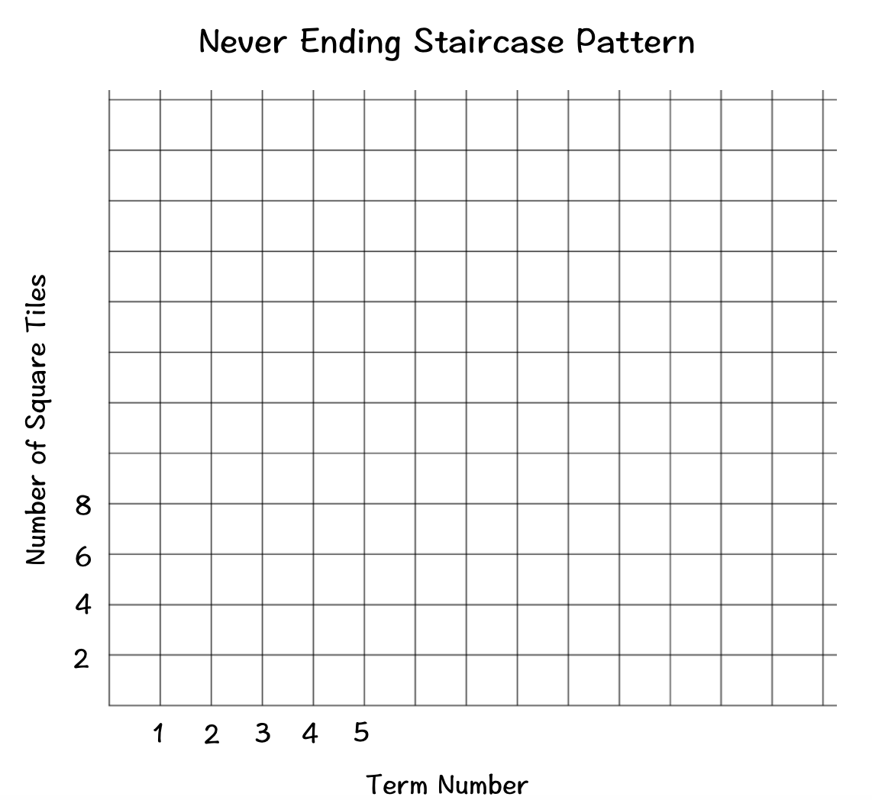
2
Part 3 – Displaying Patterns
Work it out
Complete the graph to show the relationship in a different visual format.
Drag the dots and line below to plot the pattern on the graph.
Notes:
Teacher Notes
“Displaying Patterns”
Graphing patterns was introduced in grade 7 outcomes and carries over into Grade 8.

Slide 17
2
Work it out
Describe what the 53rd term would look like.
How many squares would it have?
Show how you figured it out:
*Note: You have NOT been asked to BUILD the 53rd term.
Notes:
Teacher Notes
This slide indicate which students have a good understanding of finding patterns and relating them to expressions/rules. Students unable to complete this slide likely have difficulty expressing a pattern rule in the form of y=mx + b.
With a selection of different representations, students can choose HOW they would like to figure it out.

Slide 18
2
Work it out
EXTENSION - Optional
If each side of a square is 1cm, what would the perimeter of the 20th term be?
Show how you figured it out:
The stack of tiles is here in case you need them to help you justify your thinking.
Notes:
Teacher Notes
Extension option for students who need a further challenge.

Slide 19
2
Work it out
End of this section

Slide 20
3
Looking Back
Consolidation Task
I always buy paper plates in packages of 25. I only have 3 loose plates left in an open package.
25x + 3 is the expression that represents the total number of plates I would have if I were to buy more packages, where x represents the number of packages I buy.
Find at least 2 examples around your home of things that come in groups.
Write an expression for each one that could be used to calculate the total number of items you would have if you purchased more packages, where the unknown, x, represents the number of packages.
Take a picture of each example and type its expression on or beside the image.
Extension (optional) - Is there more than one expression that could work?
Explain.
Notes:
Teacher Notes
This consolidation and extension task could be assigned to students as asynchronous work and submitted for teacher feedback.
25x + 3 where x is the number of FULL packages, and add on the 3 ”extras”.
25x – 22 where x is the number of packages I have (regardless if they are open or not), minus the 22 plates that have already been used.
Images Sources: https://openclipart.org/detail/172707/edit-icon-icono-editar, https://openclipart.org/detail/212116/screencast

Slide 21
3
Looking Back
End of this section

Slide 22
Problem Solving
1
Get Ready
2
Work it out!
3
Looking Back
Cha-Ching $
Write About It
Would You Rather
Cha-Ching $$
or,
Record It
Cha-Ching $$$
Notes:
Images Sources: https://openclipart.org/detail/172707/edit-icon-icono-editar, https://openclipart.org/detail/212116/screencast

Slide 23
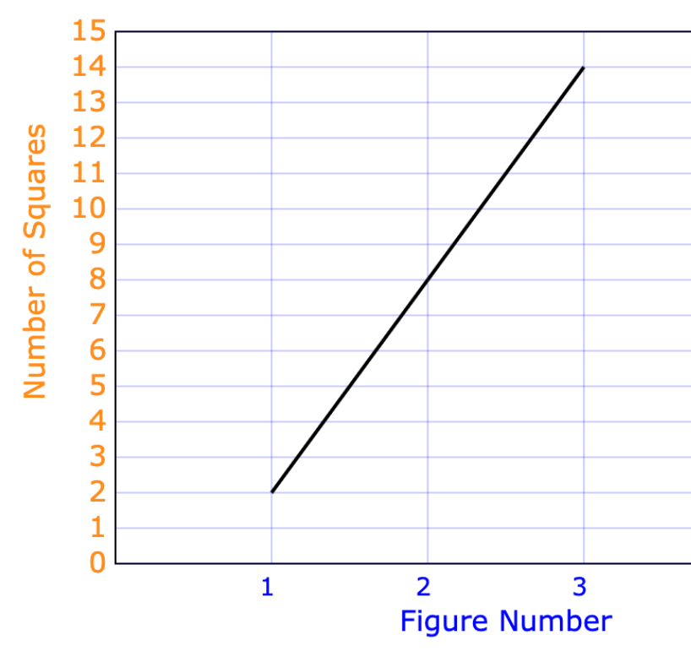
1
Get Ready
Each representation below represents a different increasing pattern.
x | Number of Squares
1 | 7
2 | 13
3 | 19
4 | 25
5 | 31
y = 12x
Where y represents the
of squares
For which pattern would you rather find the number of squares in the 18th figure?
Why did you pick that one, and how many squares do you think it would have?
Notes:
Teacher Notes
Students may have a good reason for selecting each representation.
Equation: y = 12x , y = 12(18) , y = 12(10)+12(8) = 180+36 , y = 216
Table of values: y = 6x + 1, if x=18…y = 6(18) + 1 , y = 108 + 1 , y = 109
Graph: y = 6x -4, if x=18 … y = 6(18) – 4 , y = 108 – 4 , y = 104 (students will need to first analyze the graph, possibly create a table of values and/or the equation in order to determine the generalization and calculate for the 18th figure).

Slide 24
1
Get Ready
End of this section

Slide 25
2
Work it out
Cha-Ching $
Max is a website designer. He charges a flat fee of $65 and an additional $15 per hour for his time.
How much more would someone pay to have Max spend a total of 24 hours on their website creation instead of only 17 hours?
Can you write an equation that Max could use to calculate a customer’s total bill for any number of hours that he spends?
Notes:
Teacher Notes
Part one is a calculation question: 65 + 24(15) compared to 65 + 17(15), and subtract. Or a student might realize the difference is only in the number of hours (7 hours), so simply calculate 7(15) directly.
Part two asks students to algebra-tize the situation: Cost = 65 + 15x

Slide 26
2
Work it out
Cha-Ching $$
Max is a website designer. He charges a flat fee of $65 and an additional $15 per hour for his time.
If a customer received a bill for $335, how many hours did Max need to spend on their website creation? Justify your thinking.
Notes:
Teacher Notes
Students will likely work backwards, extend a table of values, or use the equation. If working synchronously, this is a good opportunity to spotlight one solution of each type and discuss its ease of use. Be sure to reinforce that there is no one right way to solve it, but some ways are easier and more efficient. When students are comfortable with their understanding of the more efficient strategies they are more likely to use them. They need to “see” them in use (preferably from their peers).

Slide 27
2
Work it out
Cha-Ching $$ - Extension (optional)
Max is a website designer. He charges a flat fee of $65 and an additional $15 per hour for his time.
Maric got his bill for $207.50 for 10 hours of work and thought something was wrong. Can you figure out what might have happened?
Notes:
Teacher Notes
65 + 10(15) = 65 + 150 = $215
215 – 207.50 = $7.50 which represent a half hour of work. Max must have only spent 9.5 hours on his website and charges him accordingly.

Slide 28
3
Work it out
Cha-Ching $$$
Max’s biggest competitor Asha charges her customers using a different system. She charges an hourly rate of $23 and requires a minimum on each job of at least 5 hours.
Jayla wants a website designed for her “Home Cooked Cooking” business that is likely to take about 12 hours of time to create. Which person would charge less for that job?
Do you think Jayla would ALWAYS get a better deal from the person you determined above?
Notes:
Teacher Notes
Part one is a calculation question:
Part two asks students to algebra-tize the situation: Cost = 5(23) + 23(x-5)

Slide 29
2
Work it out
Cha-Ching $$$ - Extension (optional)
Max charges a flat fee of $65 and an additional $15 per hour for his time.
Asha charges an hourly rate of $23 and requires a minimum of at least 5 hours of work.
Which one provides the better deal? Prove it.
Notes:
Teacher Notes
This is an open question for students to engage with to the degree they are able. Some students may use some examples to show which is the better deal for particular number of hours. Other students may use the equations or tables of values to help them. Yet other students might choose to graph both patterns and illustrate precisely at the number of hours that Max and Asha would be charging the same fee.
8 hours is the closest intersection point (Max $185, Asha $184).
Asha is the better deal up to 8 hours of work, however she doesn’t take jobs of less than 5 hours so Max is the ONLY guy in town for jobs less than 5 hours. With more than 8 hours of work Max will be the better deal.

Slide 30
2
Work it out
End of this section

Slide 31
3
Looking Back
Make a list of all the information you know by looking at this graph:
Notes:
Teacher Notes
Examine a graph for information (best viewed in presentation mode for clarity)
This consolidation task could be assigned to students as asynchronous work and submitted for teacher feedback or used for a class discussion if synchronous time is available.
Alternately, students could record their observations by inserting an audio recording or on another platform such as SeeSaw if available.
Images Sources: https://openclipart.org/detail/172707/edit-icon-icono-editar, https://openclipart.org/detail/212116/screencast

Slide 32
3
Looking Back
End of this section

Slide 33
Visual Connections
1
Get Ready
2
Work it out!
3
Looking Back
Seeing
Would You Rather
Write About It
Representing
or,
Record It
Displaying
Notes:
Activator – number talk
Work it out - Challenges make up the focus of the day(s) lesson (you may only have one and all students are assigned the same task, you may have a choice of two or three, or you may have all students begin at challenge 1 and move on as greater challenge is needed / Consolidate & Reflect on what you’ve learned during this part of the project.
Looking Back – a place for extension/reflection/self-assessment
Images Sources: https://openclipart.org/detail/172707/edit-icon-icono-editar, https://openclipart.org/detail/212116/screencast

Slide 34
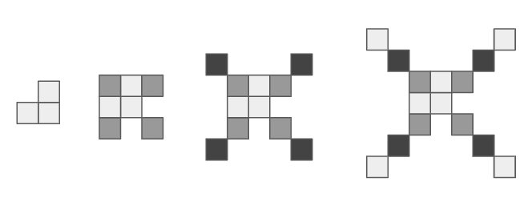
1
Get Ready
Each representation below represents a different increasing pattern.
x | Number of Squares
1 | -1
2 | 1
3 | 3
4 | 5
5 | 7
y = x² - 2
Where y represents the
of squares
For which pattern would you rather find the number of squares in the 100th figure?
Why did you pick that one, and how many squares do you think it would have?
Notes:
Teacher Notes
Equation: Not linear, however students should be familiar with “squares” (focus of another grade 8 outcome) and be able to calculate 100 x 100 - 2
Table of values: y = 2x-3, Figure 100 has 197 squares (students not able to create the rule from the table will struggle with this one as it will be tedious to continue the chart up to 100.
Visual Image: y = 4x -1, for figure 100, y = 399 (students will need to first analyze the pattern, possibly create a table of values and/or the equation in order to determine the generalization and calculate for the 100th figure.

Slide 35
1
Get Ready
End of this section

Slide 36
2
Part 1 – Seeing Patterns
Work it out
Examine the pattern below and describe in words everything you know about it:
Everything I know:
Notes:
Teacher Notes
“Seeing Patterns”
This set of slides (37-43) would be best “pushed out” to all students so they can do their own thinking and manipulating of the pattern.
Small groups would also be helpful in having students articulate their thinking and see the differences in how people view the pattern’s growth.
Alternately, select pages could be assigned to students as needed – each student to copy and paste the slide (within your PowerPoint) and put their name at the top, or pushed out as a handout in the Smart Learning Suite for example)
Students analyze the pattern and decern how they see it growing. Push for more than “it goes up by 3”.
Encourage students to use the most descriptive language they can!

Slide 37
2
Work it out
Using the blocks to the right, build the next two figures.
Figure 1
Figure 2
Figure 3
Figure 4
Figure 5
Notes:
Teacher Notes
Students are to build the 4th and 5th terms. This can be done individually or in small groups depending on the goals for the lesson.

Slide 38
2
Work it out
Add colour to the terms help illustrate how you see the pattern growing.
The colours should help us understand HOW you see it increasing.
Notes:
Students complete individually, if possible share with another student or small group and discuss.
Teacher Notes
Have students find structure (same type of shape) within the pattern. When this structure identically repeats itself, we can justify that is part of the pattern. Colour these groups one colour and, if possible, circle each group for the three terms. We would say these groups, or the number of squares in each group are the coefficients to the variables.
Next, see what is always staying the same from one term to the next. This represents the constant.
Extension: Have students write a number sentence [ 4(1) + 1, 4(2) + 1, 4(3) + 1 ] to represent each term they coloured in. The constant always stays the same, and the coefficient only changes based on the term number.

Slide 39
2
Work it out
How many rectangles will the 12th term have? How do you know?
The stacks of tiles are here in case you need them to help you justify your thinking.
*Note: You have NOT been asked to BUILD the 12th term.
Notes:
Teacher Notes
The strategy students use to complete this slide will provide insight into their understanding of how the pattern increases.

Slide 40
2
Part 2 – Representing Patterns
Work it out
Complete the table of values to represent the first 7 figures of the pattern:
Figure number | Number of rectangles
1
2
3
4
5
6
7
In words, tell how the number of rectangles in any single term relates to its figure number.
Call the figure number "x".
Can you write an expression to represent the relationship?
Notes:
Teacher Notes
“Representing Patterns”
Students will represent the visual pattern in a few different form. This should be familiar from grade 6/7.
A good discussion to have would be how the table of values is represented in the expression.

Slide 41
2
Part 3- Displaying Patterns
Work it out
Growing Catepillar
Complete the graph to show the relationship in a different visual format.
Drag the dots and line below to plot the pattern on the graph.
Number of rectangles
Notes:
Teacher Notes
“Displaying Patterns”
Graphing patterns was introduced in grade 7 outcomes and carries over into Grade 8.

Slide 42
2
Work it out
Describe what the 100th term would look like.
How many rectangles would it have?
Show how you figured it out:
*Note: You have NOT been asked to BUILD the 100th term.
Notes:
Teacher Notes
This slide indicate which students have a good understanding of finding patterns and relating them to expressions/rules. Students unable to complete this slide likely have difficulty expressing a pattern rule in the form of y=mx + b.
With a selection of different representations, students can choose HOW they would like to figure it out.

Slide 43
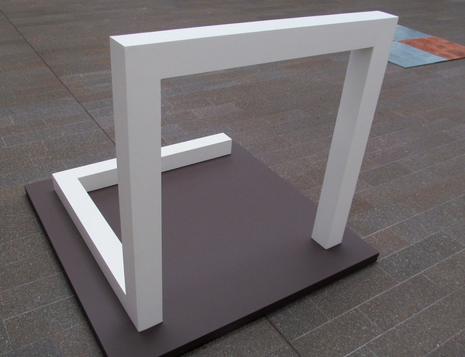
2
Work it out
EXTENSION - Optional
Could you extend the 3-D version of this pattern based on the picture below?
Take a picture of your creation to share your thinking.
Notes:
Teacher Notes
Extension option for students who need a further challenge.
Image Source: "Sol LeWitt" by rocor is licensed with CC BY-NC 2.0. To view a copy of this license, visit https://creativecommons.org/licenses/by-nc/2.0/

Slide 44
2
Work it out
End of this section

Slide 45
3
Looking Back
So far, we have worked with patterns that start with the visual representation, a set of pictures to analyze.
If instead, you were given the equation y = 2x + 1, could you create a visual representation to go with it?
Create the first 4 terms of a visual pattern that follows the rule above.
Notes:
Teacher Notes
This “reflection” is more of a “pre-flection” in that students are being asked to do something they’ve not done before. However, it is important that they realize that patterns can “start” with any one of the representations, so this is just their first thinking around that.
Images Sources: https://openclipart.org/detail/172707/edit-icon-icono-editar, https://openclipart.org/detail/212116/screencast

Slide 46
3
Looking Back
End of this section

Slide 47
Problem Solving
1
Get Ready
2
Work it out!
3
Looking Back
Notice
&
Wonder
Billiard Ball Wizard Problem
The Vampire Hunter Riddle
Notes:
Activator – number talk, choral count…
Work it out - Challenges make up the focus of the day(s) lesson (you may only have one and all students are assigned the same task, you may have a choice of two or three, or you may have all students begin at challenge 1 and move on as greater challenge is needed / Consolidate & Reflect on what you’ve learned during this part of the project.
Looking Back – a place for reflection/self-assessment

Slide 48
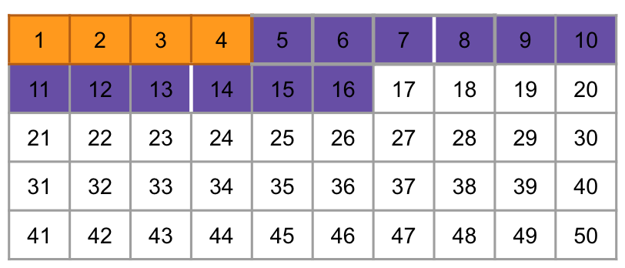
1
Get Ready
WHAT DO YOU NOTICE?
y = 3x + 4
x | y
1 | 7
2 | 10
3 | 13
4 | 16
5 | 19
WHAT DO YOU WONDER?
Notes:
Teacher Notes
Activator – Notice & Wonder: See what connections students make between the representations. They all represent the exact same relationship, just in a different way.

Slide 49
1
Get Ready
End of this section

Slide 50
2
Work it out
Billiard Ball Wizard
There are a couple of rules for this odd game of billiards that must be followed:
The billiard table has only 4 ”pockets”, one in each corner (top left, top right, bottom left, bottom right).
The ball is ALWAYS launched at a 45º angle from the bottom left corner of the grid.
If the ball bounces off a side, it will do so at the same 45º angle and continue on its path. (Since the ball is always traveling at 45º angles, its path will always follow the diagonal of the grid squares).
start
start
To earn the title Billiard Ball Wizard, you will need to be able to predict with 100% accuracy, which pocket the ball will end up in for ANY SIZED RECTANGULAR TABLE.
end
Notes:
Teacher Notes
Finding patterns is about looking for structure. Sometimes relationships exist and are linear (nice and neat), other times they exist but are more complex (non-linear), and other times the relationships exist where we didn’t expect to find them!
This is a problem solving tasks that asks students to investigate, conjecture, and look for patterns. There are no definitive correct answers, but many conjectures to be made and investigated.
Source (Adapted from): https://mathforlove.com/lesson/billiard-ball-problem/
Image source: https://openclipart.org/detail/169442/simple-queue-with-ball
Image source: https://openclipart.org/detail/286395/motor-racing-flag-1-chequered-flag

Slide 51
2
Work it out
Billiard Ball Wizard
Investigate the path of the billiard ball on different sized tables below.
Remember to start in the bottom left corner each time.
What do you notice? What do you wonder?
Notes:
Teacher Notes
Finding patterns is about looking for structure. Sometimes relationships exist and are linear (nice and neat), other times they exist but are more complex (non-linear), and other times the relationships exist where we didn’t expect to find them!
This is a problem solving tasks that asks students to investigate, conjecture, and look for patterns.
Source: https://mathforlove.com/lesson/billiard-ball-problem/

Slide 52
2
Work it out
Create a table with your own dimensions to see where the billiard ball will end up.
Remember to start in the bottom left corner each time.
Notes:
Teacher Notes
Finding patterns is about looking for structure. Sometimes relationships exist and are linear (nice and neat), other times they exist but are more complex (non-linear), and other times the relationships exist where we didn’t expect to find them!
This is a problem solving tasks that asks students to investigate, conjecture, and look for patterns.
Source: https://mathforlove.com/lesson/billiard-ball-problem/

Slide 53
2
Work it out
What information would be helpful to track?
Create a table of values to track your findings:
Notes:
Teacher Notes
This is wide open to allow students to allow student the opportunity to make decisions about how to organize their results, what will they track? Length, width, area of the table? Bounces before sunk?
So many interesting things to look at!
Source: https://mathforlove.com/lesson/billiard-ball-problem/

Slide 54
2
Work it out
Based on your findings, what do you know for sure about making predictions on these billiard tables?
Could you predict which pocket the ball will land in on a table of size:
10 x 12?
7 x 9?
8 x 11?
Notes:
Teacher Notes
Analyze your data (easier if it’s organized, not just in picture form)
Source: https://mathforlove.com/lesson/billiard-ball-problem/

Slide 55
2
Work it out
End of this section

Slide 56
3
Looking Back
Notes:
Teacher Notes
This video will show from start to finish, how to solve the riddle. It would be best to play the video for students during a synchronous session, after students have had time experimenting with the Billiard Ball Wizard problem. You will want to STOP the video at the first “Pause” point and let students do the thinking (as a hint, you could provide them with the coordinate grid on the following slide to ignite their thinking about how they might use coordinate pairs to help them). If available, send student to breakout rooms to discuss with a few of their peers, come back and share, then playout the rest of the video.
Source: https://www.youtube.com/watch?v=P4-n0IMQSrQ

Slide 57
3
Looking Back
(0,0)
Notes:
Teacher Notes
Working pace for the Vampire Hunter Riddle

Slide 58
3
Looking Back
End of this section

Slide 59
Visual Connections
1
Get Ready
2
Work it out!
3
Looking Back
Which One Doesn’t Belong
Seeing
Write About It
Representing
or,
Record It
Displaying
Notes:
Activator – number talk, choral count…
Work it out - Challenges make up the focus of the day(s) lesson (you may only have one and all students are assigned the same task, you may have a choice of two or three, or you may have all students begin at challenge 1 and move on as greater challenge is needed / Consolidate & Reflect on what you’ve learned during this part of the project.
Looking Back – a place for reflection/self-assessment
Images Sources: https://openclipart.org/detail/172707/edit-icon-icono-editar, https://openclipart.org/detail/212116/screencast

Slide 60
1
Get Ready
3x – 2 = -14
20 – 8x = -52
Which One Doesn’t Belong?
4x – 18 = -30
6x + 8 = -16
Notes:
Teacher Notes
This slide is intended to be on screen when students are signing into your class to prime their thinking for the day.

Slide 61
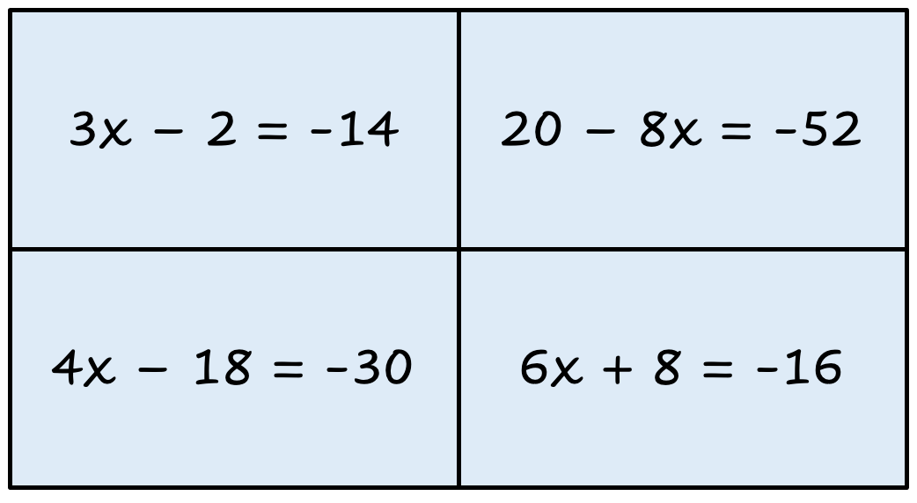
1
Which One Doesn’t Belong?
Get Ready
This one doesn’t belong because…
This one doesn’t belong because…
This one doesn’t belong because…
This one doesn’t belong because…
Notes:
Teacher Notes
Teacher can collect student responses here – synchronous
Students could complete, finding at least one reason for each quadrant - asynchronous

Slide 62
1
Get Ready
End of this section

Slide 63
2
Part 1 – Seeing Patterns
Work it out
Examine the pattern below and describe in words everything you know about it:
Everything I know:
Notes:
Teacher Notes
“Seeing Patterns”
This set of slides (63-68) would be best “pushed out” to all students so they can do their own thinking and manipulating of the pattern.
Small groups would also be helpful in having students articulate their thinking and see the differences in how people view the pattern’s growth.
Alternately, select pages could be assigned to students as needed – each student to copy and paste the slide (within your PowerPoint) and put their name at the top, or pushed out as a handout in the Smart Learning Suite for example)
Students analyze the pattern and decern how they see it growing. Push for more than “it goes up by 3”.
Encourage students to use the most descriptive language they can!

Slide 64
2
Using the blocks to the right, can you build the next two terms in the pattern?
Work it out
term 4
term 5
Notes:
Teacher Notes
Students are to build the 4th and 5th terms. This can be done individually or in small groups depending on the goals for the lesson.

Slide 65
2
Add colour to the terms help illustrate how you see the pattern growing.
Work it out
term 4
term 5
The colours should help us understand HOW you see it increasing.
Notes:
Students complete individually, if possible share with another student or small group and discuss.
Teacher Notes
Have students find structure (same type of shape) within the pattern. When this structure identically repeats itself, we can justify that is part of the pattern. Colour these groups one colour and, if possible, circle each group for the three terms. We would say these groups, or the number of squares in each group are the coefficients to the variables.
Next, see what is always staying the same from one term to the next. This represents the constant.
Extension: Have students write a number sentence [ 7 – 2(1), 7 – 2(2), 7 – 2(3) ] to represent each term they coloured in. The constant always stays the same, and the coefficient only changes based on the term number.
It is more difficult to see the constant in decreasing patterns. To help with this, finding the zero term shows students how many squares are in the constant. They can then use this knowledge to continue to look at the pattern.

Slide 66
2
Part 2 – Representing Patterns
Work it out
Create a table of values to represent the first 7 terms in the pattern:
Term number | Number of Squares
1
2
3
4
5
6
7
In words, tell how the number of squares in any single term relates to its term number.
Call the term number "x".
Can you write an expression to represent the relationship?
Notes:
Teacher Notes
“Representing Patterns”
Students will represent the visual pattern in a few different form. This should be familiar from grade 6/7.
A good discussion to have would be how the table of values is represented in the expression.

Slide 67
2
Part 3 – Displaying Patterns
Work it out
Disappearing Tower
Complete the graph to show the relationship in a different visual format.
Drag the dots and line below to plot the pattern on the graph.
Notes:
Teacher Notes
“Displaying Patterns”
Graphing patterns was introduced in grade 7 outcomes and carries over into Grade 8.

Slide 68
2
Work it out
Describe what the 53rd term would look like.
How many squares would it have?
Show how you figured it out:
*Note: You have NOT been asked to BUILD the 53rd term.
Notes:
Teacher Notes
This slide indicate which students have a good understanding of finding patterns and relating them to expressions/rules. Students unable to complete this slide likely have difficulty expressing a pattern rule in the form of y=mx + b.
With a selection of different representations, students can choose HOW they would like to figure it out.

Slide 69
2
Work it out
End of this section

Slide 70
3
Looking Back
How many squares will the “zero” term have?
How do you know?
What could the zero term represent in an expression/pattern rule?
The stack of tiles is here in case you need them to help you justify your thinking.
Notes:
Teacher Notes
We look for the zero term to find the constant for the expression. The zero term also gives us the y-intercept, providing an extension opportunity for students ready for the challenge.
It is also important for students to see that not all functions begin at the origin, providing further opportunities for discussion into why this happens.
Images Sources: https://openclipart.org/detail/172707/edit-icon-icono-editar, https://openclipart.org/detail/212116/screencast

Slide 71
3
Look Back
End of this section

Slide 72
Problem Solving
1
Get Ready
2
Work it out!
3
Looking Back
What do you notice?
What do you wonder?
Write About It
Interesting Relationships
or,
Record It
Notes:
Activator – number talk, choral count…
Work it out - Challenges make up the focus of the day(s) lesson (you may only have one and all students are assigned the same task, you may have a choice of two or three, or you may have all students begin at challenge 1 and move on as greater challenge is needed / Consolidate & Reflect on what you’ve learned during this part of the project.
Looking Back – a place for reflection/self-assessment
Images Sources: https://openclipart.org/detail/172707/edit-icon-icono-editar, https://openclipart.org/detail/212116/screencast

Slide 73
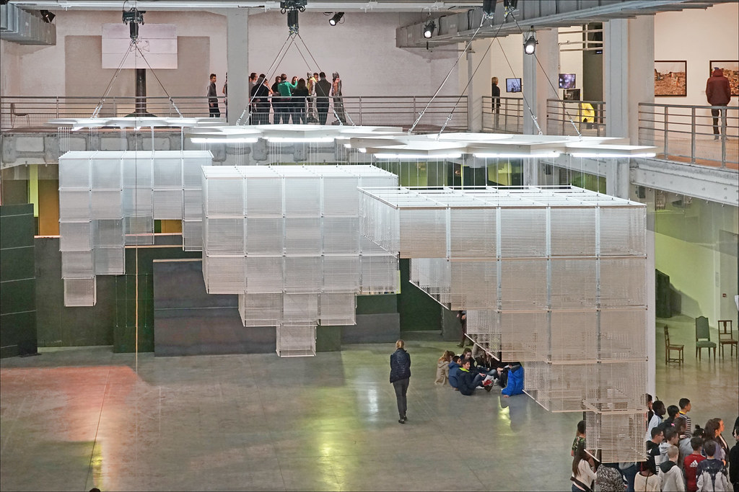
1
Get Ready
What do you notice?
What do you wonder?
Notes:
Source: https://search.creativecommons.org/photos/1d95a0e6-6e27-4980-af09-375ba08da1b6
'Sol LeWitt Upside Down' d'Haegue Yang (Biennale de Lyon 2015)

Slide 74
1
Get Ready
What do you notice?
What do you wonder?
Notes:
Source: https://search.creativecommons.org/photos/1d95a0e6-6e27-4980-af09-375ba08da1b6
'Sol LeWitt Upside Down' d'Haegue Yang (Biennale de Lyon 2015)

Slide 75
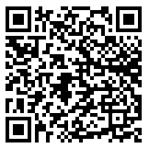
1
Get Ready
Want to learn more about Sol LeWitt?
Try out the app here
Google Play Store
Apple App Store
Notes:
Optional
'Sol LeWitt Upside Down' d'Haegue Yang (Biennale de Lyon 2015)

Slide 76
1
Get Ready
End of this section

Slide 77
2
Work it out
Interesting Relationships
1. Watch the video
(you may want to watch it more than once)!
2. Describe in words what is happening in the video.
Include as many of the following terms as you can: pattern, area, volume, square, cube
Write it here or, insert an audio clip of your observations.
Notes:
Link to video and Adapted from: https://nrich.maths.org/325
Solution: https://nrich.maths.org/325/solution

Slide 78
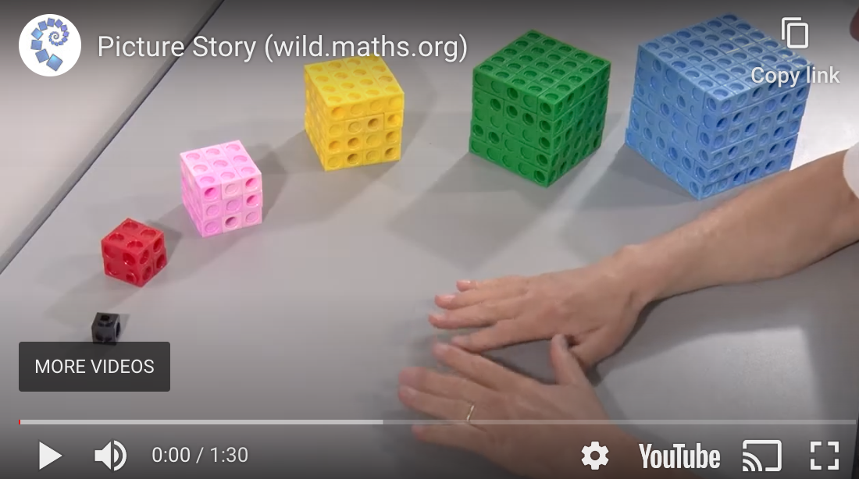
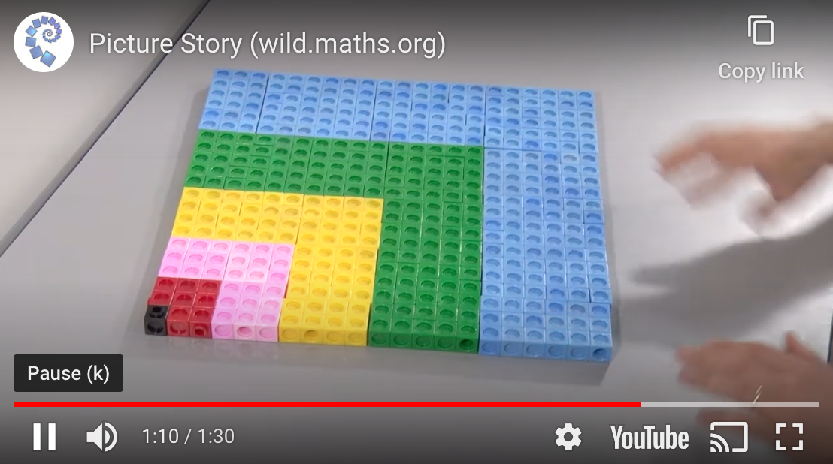
2
Work it out
Interesting Relationships
Responses can be typed here or,
insert an audio recording if you prefer.
3. Explain/show how the video might continue if more little cubes were available:
4. Can you be sure the pattern will continue? Explain your thinking.
Notes:
Source Adapted from: https://nrich.maths.org/325
Solution: https://nrich.maths.org/325/solution

Slide 79
2
Work it out
Interesting Relationships
5. Can you organize the patterns you see in a table of values?
6. Can you use algebra to represent any of the patterns you saw?
Notes:
Teacher Notes
This problem is about finding patterns, seeing relationships and finding ways to represent what we see visually using symbols. It is not the intention for students to gain full understanding of the algebraic notation to record the relationships, but an exploration of how they might apply what they know to a new, challenging situation. The focus is not on an “answer” but rather gaining understanding of the patterns and relationships and use words, tables and possibly algebra to represent them.
Source Adapted from: https://nrich.maths.org/325
Solution: https://nrich.maths.org/325/solution

Slide 80
2
Work it out
End of this section

Slide 81
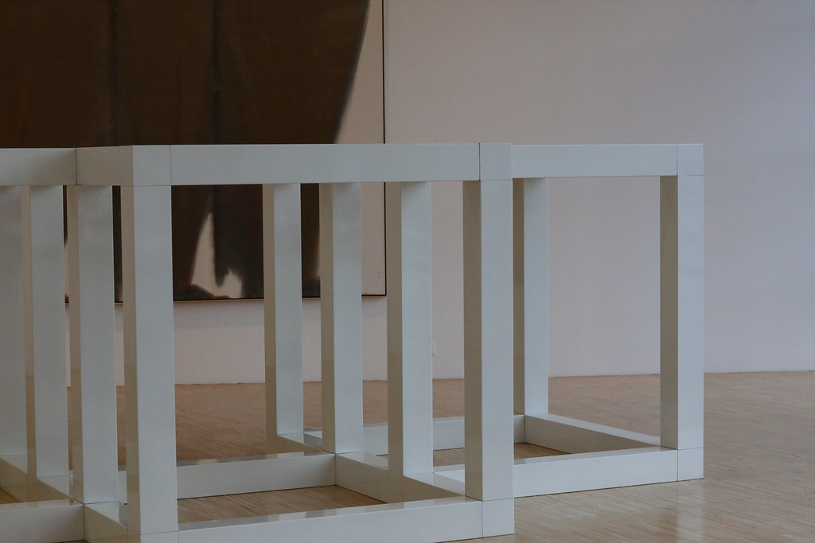
3
Looking Back
Find an artist who uses pattern in their artwork.
Select one piece of art and explain where you see the pattern(s) and why you think humans are so interested in patterns in art.
Make sure to include the art piece and the name of the artist when submitting your thinking.
Notes:
Teacher Notes
Slide for Part III, this is where instructions for reflection, journal prompts, a consolidation question…go. Again, copy and paste as needed for your purpose.
Image Source: "IMG_5802E Sol Lewitt. 1928-2007. New York. White five part modular pièce. Blanc cinq parties pièce modulaire. 1971. Grenoble. Musée des Beaux Arts. L'art minimal.The minimal art." by jean louis mazieres is licensed with CC BY-NC-SA 2.0. To view a copy of this license, visit https://creativecommons.org/licenses/by-nc-sa/2.0/
Images Sources: https://openclipart.org/detail/172707/edit-icon-icono-editar, https://openclipart.org/detail/212116/screencast

Slide 82
3
Look Back
End of this section

Slide 83
Pattern Play
1
Get Ready
2
Work it out!
3
Looking Back
Round 1
Before & After
Notice
&
Wonder
Write About It
Round 2
What comes next
or,
Record It
Round 3
In Between
Notes:
Activator – number talk, choral count…
Work it out - Challenges make up the focus of the day(s) lesson (you may only have one and all students are assigned the same task, you may have a choice of two or three, or you may have all students begin at challenge 1 and move on as greater challenge is needed / Consolidate & Reflect on what you’ve learned during this part of the project.
Looking Back – a place for reflection/self-assessment
Images Sources: https://openclipart.org/detail/172707/edit-icon-icono-editar, https://openclipart.org/detail/212116/screencast

Slide 84
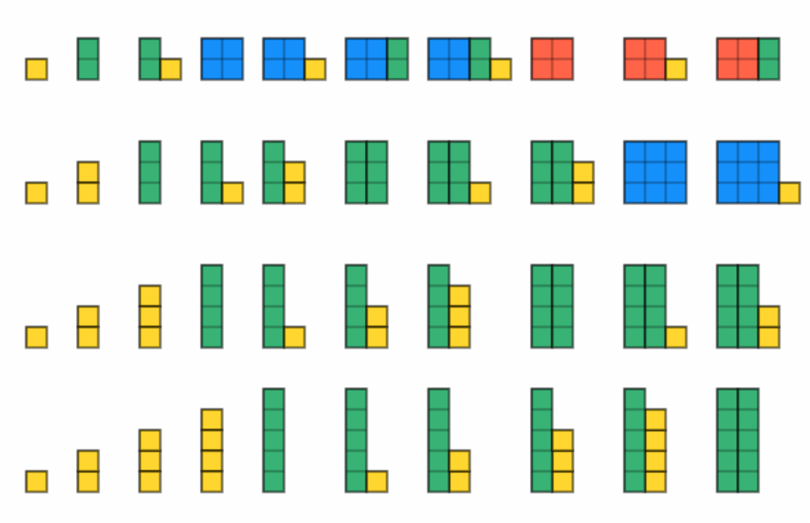
1
Get Ready!
What do you NOTICE?
What do you WONDER?
Notes:
Teacher Notes
Students will be pattern detectives! This is a representation of the first numbers in 4 different bases. Can students determine what’s going on?
Image Source: unknown

Slide 85
1
Get Ready
End of this section

Slide 86
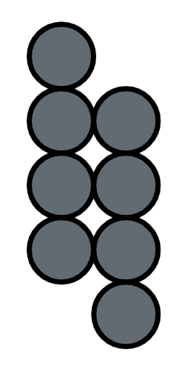
2
Round 1- Before & After
Work it out
Below you will see a term from an increasing pattern.
Draw the terms that might have come before and after it in the sequence.
before
after
Describe how you see this pattern growing:
Notes:
Teacher Notes
Students will be asked to stretch their thinking about visual patterns by looking at a random term in the pattern and designing surrounding terms based on some rule they create. This should be open and creative. It is okay if students patterns are not increasing/decreasing at consistent intervals (linear), this is more about playing with patterns and students ideas about patterns. The “pattern rule” could be discussed and linear vs non-linear could be an interesting point of discussion (what that means and how we can tell).
Do not engage in student sharing until AFTER they have completed the next slide!!
Source - Adapted from: NCTM Session - The Creative Power of Visual Patterns, Michael Fenton, 2018

Slide 87
2
Round 1- Before & After
Work it out
Here is the same starting place…create new before and after terms that would be part of a completely different pattern.
before
after
Describe how you see this pattern growing:
Notes:
Teacher Notes
Can students stretch their thinking to see growth in a different way. Maybe they choose a different number to increase/decrease by, or maybe they focus on the arrangement (if non-linear).
If you are working synchronously, this would be a good time to send students to breakout rooms (3-4 students) and have them share and discuss.

Slide 88
2
Round 2 – What Comes Next
Work it out
Below you will see the first term of an increasing pattern.
Draw the terms that might have come after it in the sequence.
Term 1
Term 2
Term 3
Describe how your pattern is growing:
Notes:
Teacher Notes
Students will be asked to stretch their thinking about visual patterns by looking at a random term in the pattern and designing surrounding terms based on some rule they create. This should be open and creative. It is okay if students patterns are not increasing/decreasing at consistent intervals (linear), this is more about playing with patterns and students ideas about patterns. The “pattern rule” could be discussed and linear vs non-linear could be an interesting point of discussion (what that means and how we can tell).

Slide 89
2
Round 2 – What Comes Next
Work it out
Here is the same starting place…create new before and after terms that would be part of a completely different pattern.
Term 1
Term 2
Term 3
Describe how your new pattern is growing:
Notes:
Can students stretch their thinking to see growth in a different way. Maybe they choose a different number to increase/decrease by, or maybe they focus on the arrangement (if non-linear).
Again, if you are working synchronously, this would be a good time to send students to breakout rooms (3-4 students) and have them share and discuss.

Slide 90
2
Round 3 – In Between
Work it out
Below you see two terms of a pattern but there is one missing in between them.
Draw the missing term so the sequence displays an increasing pattern.
between
Describe how your pattern is growing:
Notes:
Teacher Notes
Students will be asked to stretch their thinking about visual patterns by looking at a random term in the pattern and designing surrounding terms based on some rule they create. This should be open and creative. It is okay if students patterns are not increasing/decreasing at consistent intervals (linear), this is more about playing with patterns and students ideas about patterns. The “pattern rule” could be discussed and linear vs non-linear could be an interesting point of discussion (what that means and how we can tell).

Slide 91
2
Round 3 – In Between
Work it out
Here is the same starting place…create new before and after terms that would be part of a completely different pattern.
between
Describe how your new pattern is growing:
Notes:
Start with the same known term and create

Slide 92
3
Back It Up!
Look Back
Finally, let's consider terms that might come before what is seen…
First
Questions to consider. Respond thoughtfully to as many as you can!
What could have come first?
What definitely could not have come first?
Notes:
This task could be assigned to students to complete individually/asynchronously, and submitted to the teacher for feedback.

Slide 93
3
Back It Up!
Look Back
What came before the first?
And before that?
And how far back can we go?
Could we enter negative space?
First
Notes:
Teacher Notes
Leave room for discussion!! DON’T move to the table of values too quickly! Play with the visual!!

Slide 94
2
Work it out
End of this section

Slide 95
3
Look Back
On the next slide there are representations of four different patterns. Find the representations that match and group them together.
Each pattern is represented in four different ways (a visual image, a graph, a table of values and an expression)

Slide 96
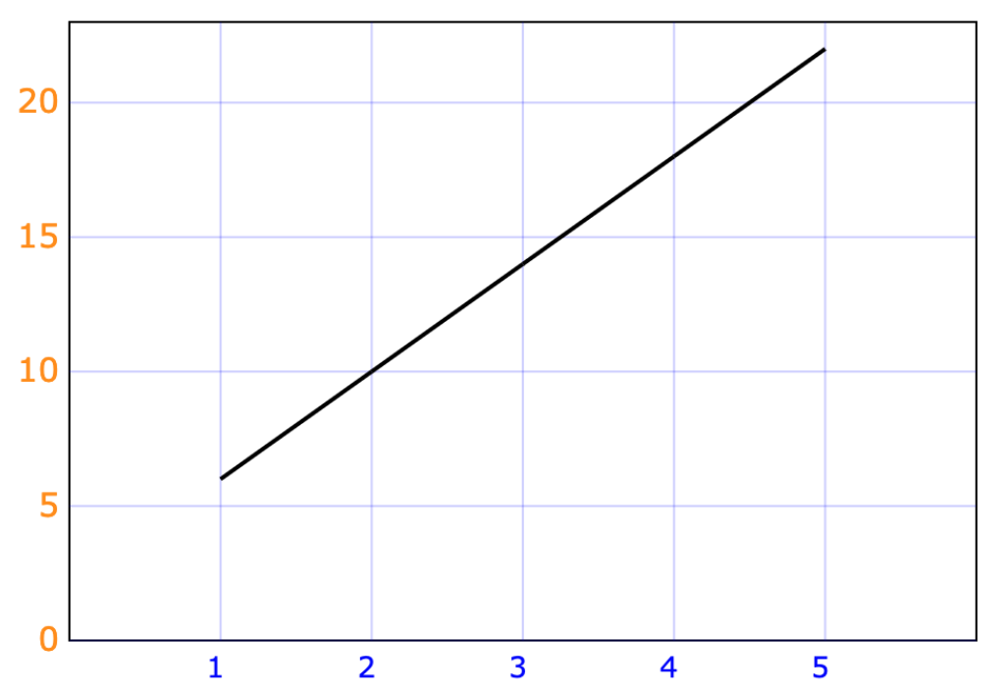
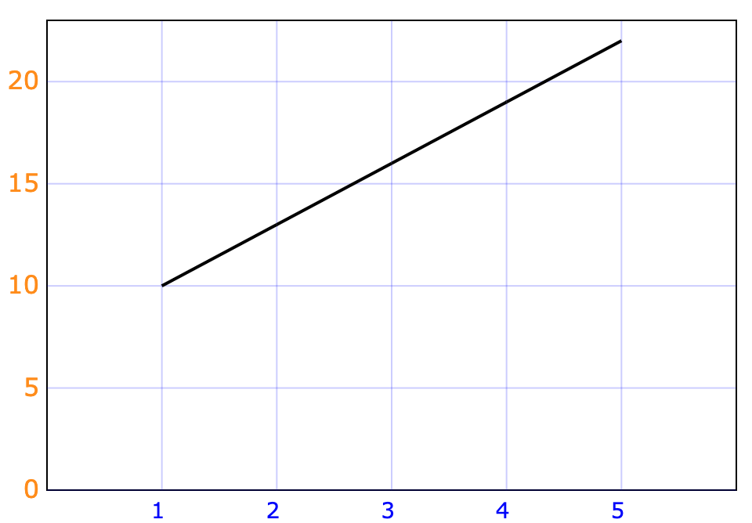
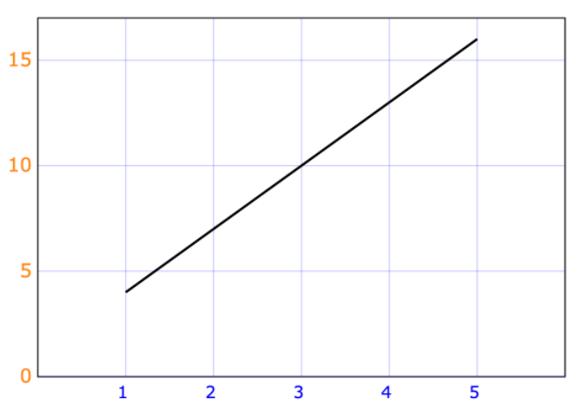
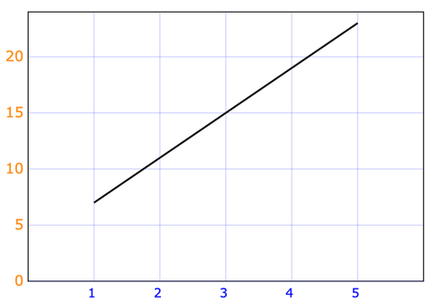
3
Look Back
x | y
1 | 4
2 | 7
3 | 10
4 | 13
5 | 16
x | y
1 | 6
2 | 10
3 | 14
4 | 18
5 | 22
x | y
1 | 10
2 | 13
3 | 16
4 | 19
5 | 22
x | y
1 | 7
2 | 11
3 | 15
4 | 19
5 | 23
y = 3x + 1
y = 4x + 3
y = 4x + 2
y = 3x + 7
Notes:
Teacher Notes
This is a revisit to the visual connections lessons from earlier in the unit.

Slide 97
3
Look Back
x | y
1 | 6
2 | 10
3 | 14
4 | 18
5 | 22
x | y
1 | 4
2 | 7
3 | 10
4 | 13
5 | 16
y = 4x + 2
y = 3x + 1
x | y
1 | 7
2 | 11
3 | 15
4 | 19
5 | 23
x | y
1 | 10
2 | 13
3 | 16
4 | 19
5 | 22
y = 3x + 7
y = 4x + 3
Notes:
Teacher Notes
Answer key to consolidate thinking with students. This should only be shown once students have had a chance to share and discuss their thinking of the sorting activity.

Slide 98
3
Look Back
End of this section

Slide 99
Real World Connections
1
Get Ready
2
Work it out!
3
Looking Back
A Shiny New Company
Would You Rather…
Write About It
Get Your Dollars in Order
or,
Record It
Making Projections
Notes:
Activator – number talk, choral count…
Work it out – For this learning experience all students will begin at challenge 1 – A Shiny New Company, and move on as they complete each part of the project.
Looking Back – a place for reflection/self-assessment
Images Sources: https://openclipart.org/detail/172707/edit-icon-icono-editar, https://openclipart.org/detail/212116/screencast

Slide 100
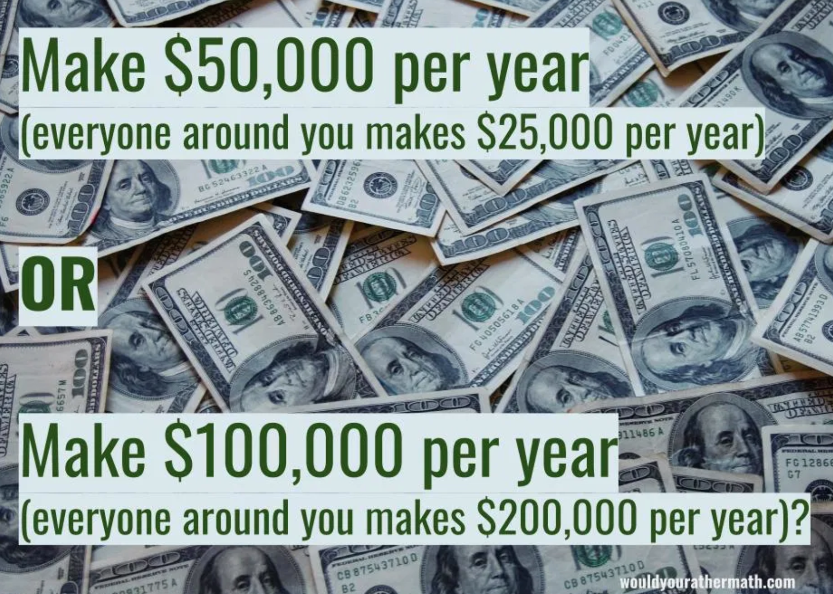
1
Get Ready
Would you rather…
Notes:
Teacher Notes
Part I, the activating activity…would you rather.
Allow students some time for individual thinking first, then share thinking with a small group or some students share out to the class. These tend to go quicker than other number talks so a few have been included. It is entirely possible that you would only want to use one or two as your activating activity. This “Real World” design challenge could/will likely take more than one day to complete. You could assign a different one each day if that works with your synchronous class time.
Source: https://www.wouldyourathermath.com/category/6to8/

Slide 101
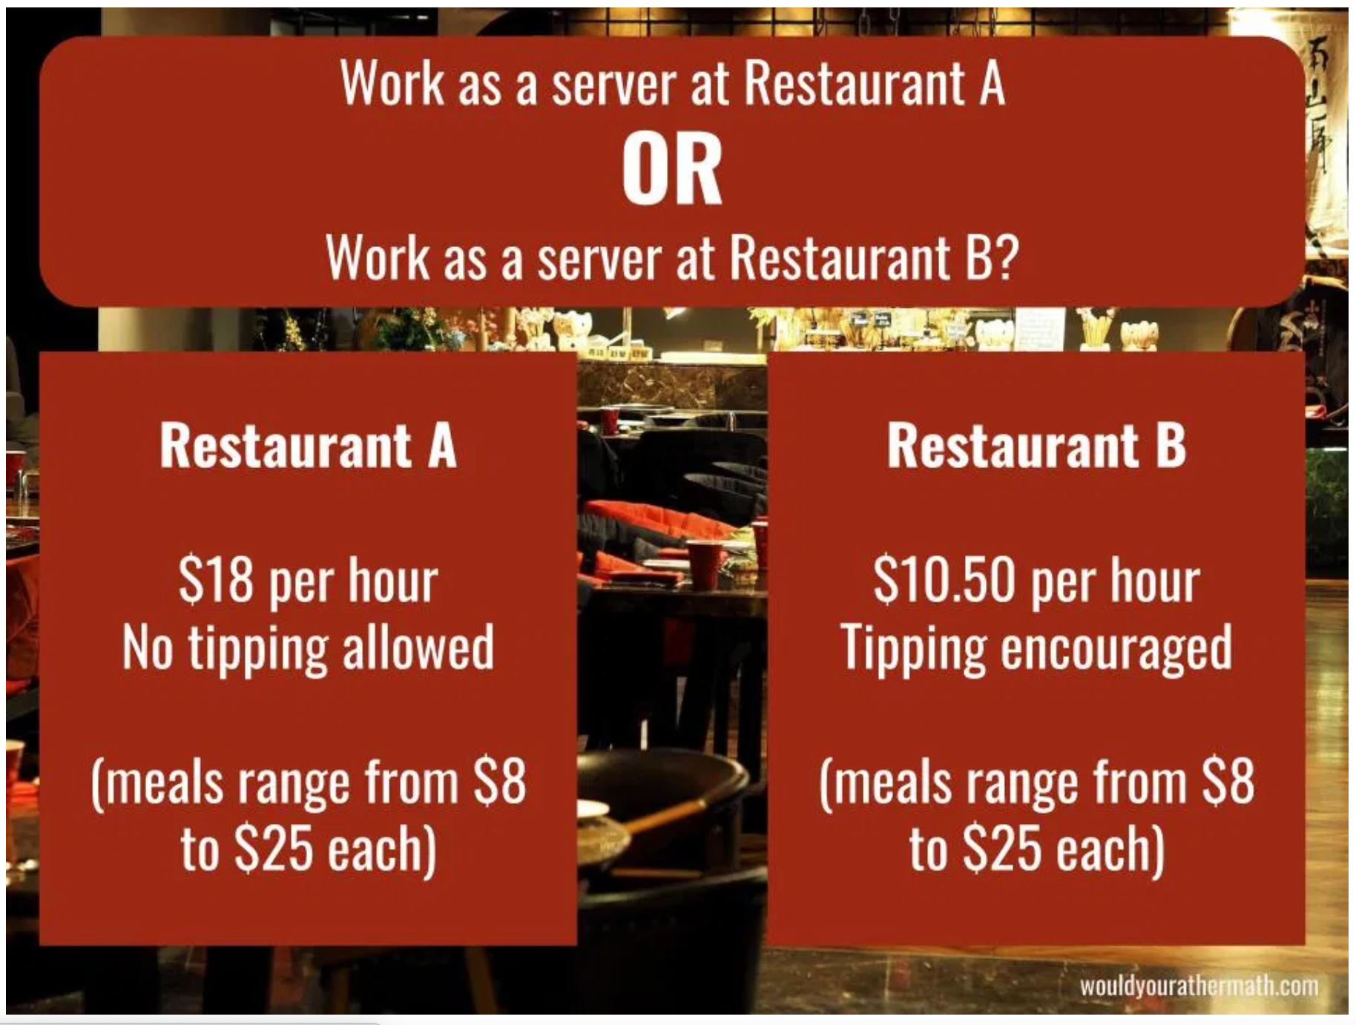
1
Get Ready
Would you rather…
Notes:
Teacher Notes
This “Real World” design challenge could/will likely take more than one day to complete. A different “Would You Rather” could be used each day if that works with your synchronous class time. These examples will serve to support students in their thinking around the creation of their own cost structures in the follow-up activity.
Source: https://www.wouldyourathermath.com/category/6to8/

Slide 102
1
Get Ready
Notes:
Teacher Notes
Not enough info here to know for sure…let them debate it out, can they figure a situation where it wouldn’t matter because the cost would be the same? So if the cost is greater than that…
Source: https://www.wouldyourathermath.com/category/6to8/

Slide 103
1
Get Ready
End of this section

Slide 104
2
Design Challenge – A Shiny New Company
Work it out
Many business rely on patterns and trends to make a profit.
Among other factors, how a company structures its customer admission fees or ticket prices plays an important role in generating as much profit as possible.
You are the CEO (head of a company) in charge of setting up the structure for charging your customers (a few example ideas are provided on the next page for inspiration). Your company must provide a minimum of TWO options for customers to select from depending on their needs or personal preference.
Name of your company:
First brainstorming and description of the things your company charges customers for:
Notes:
Teacher Notes
This culminating activity encourages students to consider the things in their world that are structured in such a way that equations and patterns can be used to represent them. They will select a type of company to consider and develop a cost structure to help a company make money.

Slide 105
2
Design Challenge – A Shiny New Company
Work it out
Ideas you may develop if you need inspiration for your business. These are NOT complete. You will need to take the idea and design the pricing structure!
Wanda’s Waterpark has three admission fee options for customer to select from depending on how much time they want to spend in the park…
Troy’s Tacos sells three different combinations of their World’s Best, award winning Taco of All Tacos…individual, house party packs, and super party packs…
Felix’s Flix movie streaming service charges a monthly fee for…or individual movies can be purchased at a per movie rate but a minimum number of movies must be purchased each month…
Luna’s Limo service provides two options for customers wanting to rent a limousine and driver. One option focuses on the number of hours the limo is required and the other is based on the distance traveled.
The Red River Ex charges admission fees to get into the fairgrounds, as well as wristbands for all access rides, or a few different ride ticket packages…
Other things you may want/need to consider:
hours of operation (in the case of admission fees)
Age of customer (Adult vs child vs family admission)
Notes:
Teacher Notes
This slide may or may not be shared with students, depending on the needs of your students.

Slide 106
2
Design Challenge – Get Your Dollar$ in Order
Work it out
Display the cost options for your customers here:
Share what your company does/sells and your payment options with a family member or friend. What payment option would they select? Why?
Notes:
Teacher Notes
Students should be encouraged to create at least one (if not all) LINEAR relationship(s) in their cost structure (there is a constant interval, or pattern rule).
After displaying their payment options it is valuable to have students talk/share their thinking (small groups synchronously), and get ideas/feedback. They may want to go back and do some revising after these discussions and that should be encouraged, companies are always looking for ways they might make more money!

Slide 107
2
Design Challenge – Making Projections
Work it out
Display the data for your various payment options in a table of values.
The tables will help the company see the effects as increasing numbers of customers opt for each of the different payment options.
Notes:
Teacher Notes
Students will need to make decisions about what factors they will track in their table of values…number of option #1 sold in a day vs dollars collected, number of option #2 sold in a day vs number of items needed (tickets, tacos…).
Students should be encouraged to look for a LINEAR relationship in their cost structure (there is a constant interval, or pattern rule)

Slide 108
2
Design Challenge – Making Projections
Work it out
Can you create any equations you could use to help calculate the money collected?
Use your equation(s) to calculate the amount of money collected for each payment option if, on one rather strange day, ALL customers selected that payment option. You can select an appropriate number of customers that might visit your company in a single day.
Notes:
Teacher Notes
This is left open to see what students make sense of in terms of their payment structure and connecting it to algebra. They also get the freedom to choose the number of customers they will calculate for, so students should be able to find an entry point.

Slide 109
2
Work it out
End of this section

Slide 110
3
Looking Back
Your company’s Board of Directors has decided to dedicate $10 000 to advertising.
Your job is to create a “pitch” to the board to explain how much of the $10 000 should be used to promote each of your company’s pricing options.
(All price points need to be advertised)
Notes:
Teacher Notes
This consolidation task was intended to be assigned to students as asynchronous work and submitted for teacher feedback.
The task is intended to stay open to promote student choice, but you may want to guide students as they work through the activity toward using the knowledge they have gained over the past 2 weeks.
Images Sources: https://openclipart.org/detail/172707/edit-icon-icono-editar, https://openclipart.org/detail/212116/screencast

Slide 111
3
Looking Back
End of this section

Slide 112
Playing with Patterns – Grade 8
Student: | Basic descriptors to help guide your formative assessments.
Full details of the student achievement profiles can be found here: Knowledge & Understanding Mental Math & Estimation Problem Solving | Requires considerable, on-going teacher support. | Requires occasional, teacher or peer support. | Accurate, clear, uses appropriate strategies & procedures. Requires occasional prompting for clarification. | Accurate, clear, flexible, consistent & efficient. Justifies & explains reasoning clearly and completely using accurate math vocabulary.
 | Limited | Basic | Good | V. Good/Excellent
Tracking student data throughout these learning experiences will allow the teacher to make an informed assessment about the students’ level of achievement of these outcomes.
Understands that patterns can be represented in a variety of ways.
Represent and describe patterns and relationships using a table of values and a linear relation.
Demonstrates understanding of the connections that exist between visual patterns, tables of values and equations.
Given any representation of a pattern, can produce the other representations (including a graph).
Describes the relationship between the variables of a graph of a linear relation.
Gathers information from the graph of a linear relation and can represent the pattern in an alternate form.
Determine future terms of a pattern to solve problems.
Applies understanding of patterns to design an appropriate cost structure for the “Shiny New Company” mini-project.
Assessment Rubrics
Suggested Codes for daily record keeping purposes:
I - Knowledge has been demonstrated individually
H - is used when knowledge has been demonstrated individually, but with help from the teacher or a peer
G - is used when knowledge has been demonstrated within a group
X - is used when a question has been attempted but answered incorrectly
N - is used when a question has not been attempted.
Notes:
Teacher Notes
There is a separate Microsoft Word document with a ready to print rubric. You can also copy and paste the table above into Microsoft Word or similar program.
Tracking student data throughout these learning experiences will allow the teacher to make an informed assessment about the students’ level of achievement on these outcomes.
Adapted from: Liljedahl, P. (2021). Building thinking classrooms in mathematics, grades K-12: 14 teaching practices for enhancing learning. Thousand Oaks, CA: Corwin Press Inc.

Slide 113
Credits
T. Scott Dempster - St. James-Assiniboia School Division
Heather Jones - St. James-Assiniboia School Division
Reviewers
Charmaine Mackid - Hanover School Division
Lisa Page - St. James - Assiniboia School Division
Dayna Quinn-LaFleche - St. James-Assiniboia School Division

