Slide 1
First Nations Communities in Manitoba
Social Studies Unit for Grade 2

Slide 2
Think about your own community:
What is the name of your community?
Is it rural or urban, city, town, farm, mining, remote, fly-in?
Is it southern or northern, eastern or western?
What languages do people speak in your community?
What are some buildings or places in your community?
Is your community close to any landmarks?
Are there any major streets/roads close to or in your community?
Who makes decisions for your community?
What is your favourite part of your community?
Locate/show your community on a map of Manitoba.

Slide 3
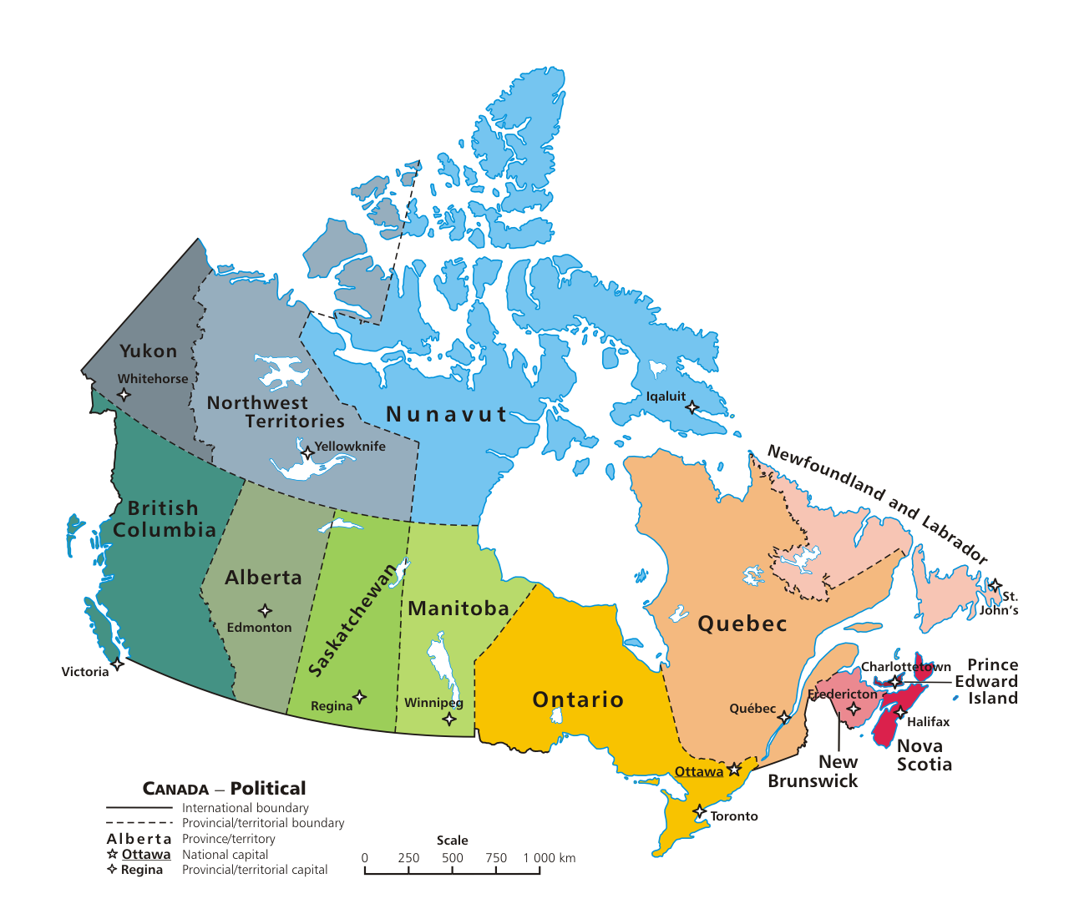
How do communities in Canada meet the needs of the people that live in them?
Now that communities are on your mind, we may want to ask...
Insert a picture of your community and/or have students draw a picture of their community and share with the class.
This Photo by Unknown author is licensed under CC BY-SA.

Slide 4
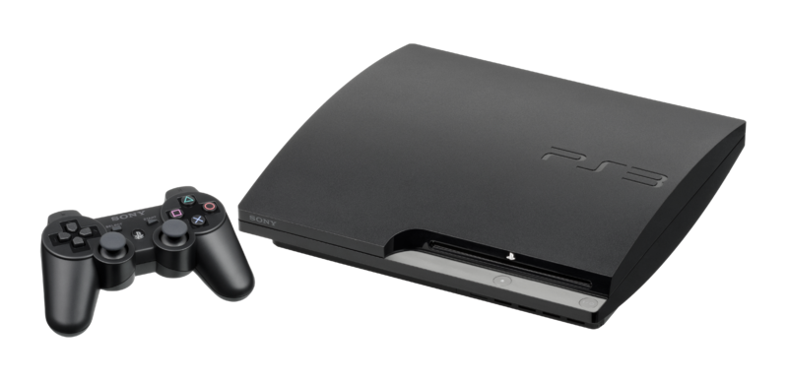
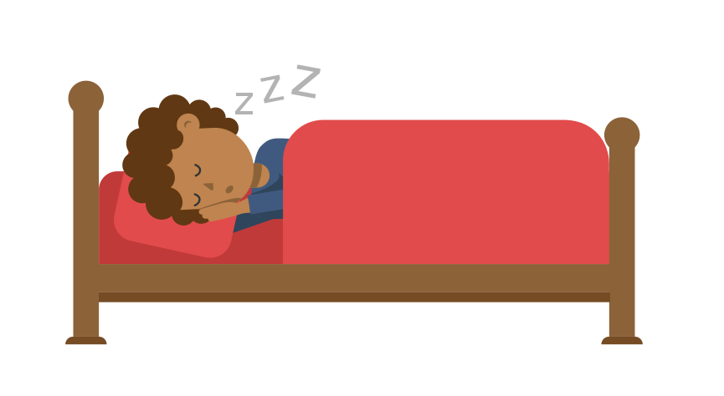
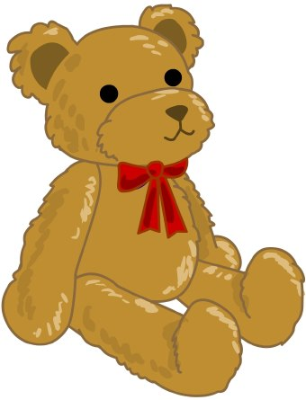
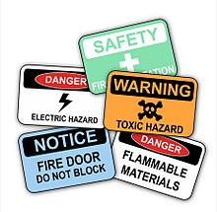
What is a need? What is a want?
Decide which of the things is a need or a want and sort it into the correct column.
Needs | Wants
This Photo by Unknown author is licensed under CC BY-ND.
This Photo by Unknown author is licensed under CC BY-SA.
This Photo by Unknown author is licensed under CC BY-SA.
This Photo by Unknown author is licensed under CC BY-SA.
This Photo by Unknown author is licensed under CC BY-NC.
This Photo by Unknown author is licensed under CC BY-SA.
This Photo by Unknown author is licensed under CC BY-ND.

Slide 5
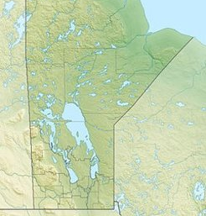
Before we can answer our big question about how communities in Canada meet the needs of the people that live in them, let's look at First Nations communities in Manitoba.

Slide 6
Who are First Nations Peoples?
Who is Indigenous?
The word Indigenous and First Nation explained by CBC Kids News
https://www.youtube.com/watch?v=CISeEFTsgDA
What is a First Nation community?
A place where First Nations people live. To learn more check out this website.
https://www.rcaanc-cirnac.gc.ca/eng/1316530294102/1535458624988#un4

Slide 7
First Nations Communities in Manitoba
Do you or anyone you know live in a First Nation community?
Have you ever visited a First Nation community?
Look at the following map "Traditional First Nation Community Names" from the Manitoba First Nations Education Resource Centre.
https://mfnerc.org/community-map/
How many First Nation communities are in Manitoba?
How many First Nations communities are Cree? Dene? Oji-Cree? Ojibway? Dakota?
Write an addition and subtraction sentence that represents the different First Nations communities in Manitoba.
Which First Nation community are you closest to?

Slide 8
Choose a First Nation Community to learn more about
This can be done as a class, or individually, or both.
Which cultural/linguistic group does the First Nation identify as? For example: Cree, Dene, Oji-Cree, Ojibway, Dakota, etc.
What is the population of the First Nation community?
https://geo.aadnc-aandc.gc.ca/cippn-fnpim/index-eng.html
Show where the First Nation community is located on the same map of Manitoba that you used to label your community.
Is the First Nation part of a treaty? If so which treaty? http://www.trcm.ca/treaties/treaties-in-manitoba/view-pdf-interactive-map-of-numbered-treaties-trcm-july-20-entry/
Does the First Nation community have its own website? Search online to find out. For example, here are websites for Long Plain and Norway House: https://www.lpband.ca http://nhcn.ca

Slide 9
Community Roles
Can you think of roles/jobs in your community?
Did you know, there are similarities and differences between Indigenous and non-Indigenous communities?
For example, most town/cities have a Mayor, and First Nations communities have a Chief. It’s similar and different at the same time. The Mayor works at city hall and the Chief works at the band office. They are both leaders in their communities.
Let's learn about roles/jobs in a First Nation Community...

Slide 10
Community Roles
Role | Place | What they do
Chief | Band Office | Leader of the community, help run things.
Councilors | Band Office | Help run things (jobs, money, services, etc.)
Office Clerk | Band Office | Work on a computer and file papers.
Police | Police Detachment | Make sure people are safe.
Fire Fighter | Fire Department | Help put out fires.
Health Director | Health Centre | In charge of health.
Doctor | Health Centre | See people when they are sick.
Nurse | Health Centre | Help people get better.

Slide 11
Community Roles (continued)
Role | Place | What they do
Elder | Cultural Centre | Share teachings about culture.
Principal | School | Look after the school.
Teacher | School | Teach kids.
Day Care Worker | Day Care | Look after toddlers.
Entrepreneur | Business | Run a business.
Store Clerk | Grocery Store | Work at the grocery store.
Gas Attendant | Gas Station | Work at the gas station.
Recreation Director | Recreation Centre | Plan sports and games.

Slide 12
Imagine a Day in the Life of...
Pick one of the community roles.
Your name:
Your community role:
Where you work:
What you do/how do you help people:
What you like/dislike about your job:
Write and/or draw
(BLM)

Slide 13
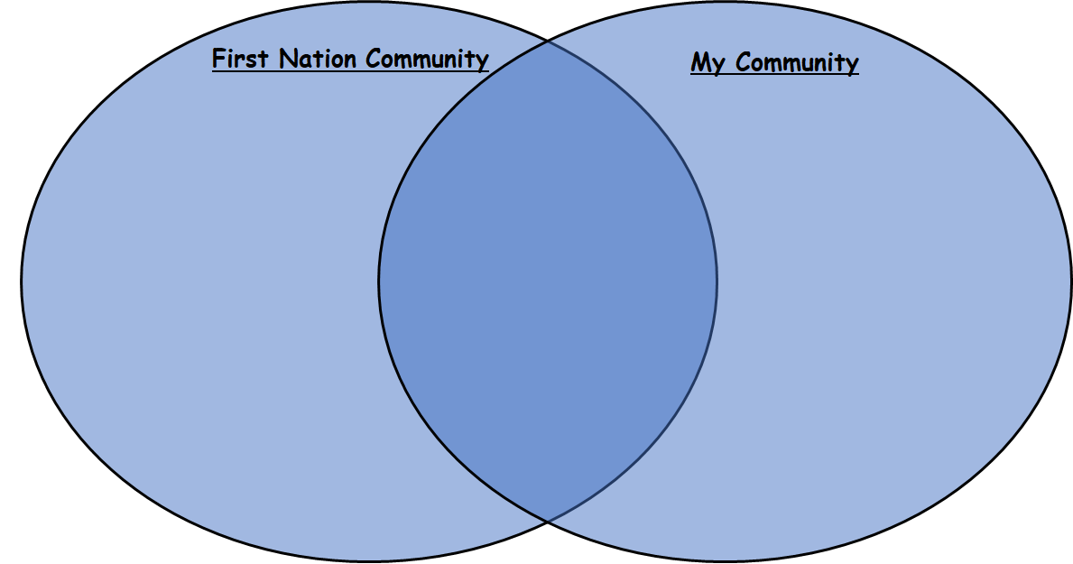
Reflection: Compare the First Nation Community and Your Community
Similarities

Slide 14
Reflection: Think about community roles. How do communities in Canada meet the needs of the people that live in them?
Needs of the People | Way Community Meets the Need
Example: food | Grocery Story – Store Clerk

Slide 15
Additional Links for Learning
First Nations in Manitoba
https://www.aadnc-aandc.gc.ca/eng/1100100020558/1100100020563
Treaty Relations Commission of Manitoba
http://www.trcm.ca/
Manitoba First Nations Police
http://www.dops.org/
Career Journeys First Nations Career Role Model Program (FNESC)
http://www.fnesc.ca/careerjourneys-2/

Slide 16
Books
Turtle Island Voices – Grade 1 Series – Pearson Education
“Our Reserve” by Robert Cutting
https://www.rubiconpublishing.com/product/our-reserve/
Take Action for Reconciliation – Scholastic Series
“Community Ties” by Scholastic
https://education.scholastic.ca/product/9781443045094

