Slide 1
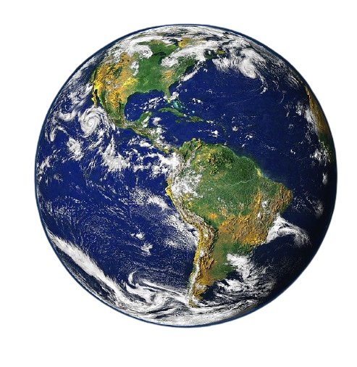
How Impacted Are Animals By Changes In Their Environment?
Grade 4
Habitats & Communities
Inspired by:
Lakeshore School Division
Adapted by:
Jocelynn Foxon
Photo Credit: www.pixabay.com

Slide 2
Lesson Objectives
In this lesson you will learn:
That each plant and animal depends on a specific habitat to meet its needs.
Physical and behavioural adaptations of animals and plants, and infer how these adaptations help them to survive in a specific habitat.
About a variety of local and regional habitats and their associated populations of plants and animals.
About food chains and how changes to the food chain can affect all animals in a habitat.
Final Project Learning Outcomes:
(4-1-12) - Use the design process to construct a model of a local or regional habitat and its associated populations of plants and animals
(4-1-13) - Predict, based on their investigations, how the removal of a plant or animal population may affect the rest of the community
(4-1-14) - Investigate natural and human-caused changes to habitats, and identify resulting effects on plant and animal populations.
Contemplate the actions that can be taken, consider alternative viewpoints, and contribute other perspectives.
reflecting on and using what they know about texts and themselves to make purposeful and personal decisions.

Slide 3
Initial Thinking
How affected are animals by changes to their habitats?
Drag and drop the happy face to indicate your initial thoughts to the question above.

Slide 4
Final
Project
Write a report discussing 2-4 environmental changes and how they would impact the different animals in your diorama.
Create a diorama representing a habitat and the animals that co-live in that environment

Slide 5
Step 1:
Select and complete the KWL
Step 2:
Watch the videos and complete the I Notice, I Wonder section.
Step 3:
Choose an area from the middle. All 5 areas must be completed before the final project. But can be completed in any order.
Step 4:
Complete both Final Projects.
KWL
Notice & Wonder
Animal
Needs
Adaptations
Food Chains
Habitats
Changes
Final Project:
Research Report
Final Project:
Diorama

Slide 6
RETURN to Choice Board

Slide 7
Videos
(click below and follow the links)
RETURN to Choice Board
What is a Habitat?
Animal Habitats
Exploring Animal Habitats
Notes:
Video Links:
https://www.generationgenius.com/videolessons/habitats-video-for-kids/
https://kids.sandiegozoo.org/videos/kids-corner-episode-2-animal-habitats
https://www.dailymotion.com/video/x6gi9hp

Slide 8
I notice
RETURN to Choice Board
I Wonder
While viewing and/or reading what are somethings that you notice about habitats?
While viewing and/or reading what are somethings you still wonder about habitats?
Viewing and reading resources found on next slide.

Slide 9
Books & Websites
(click below and follow the links)
RETURN to Choice Board
Animals
Habitats
Habitat Books
Notice Wonder
Notes:
Website Links:
https://kids.nationalgeographic.com/animals/
https://kids.nationalgeographic.com/explore/nature/habitats/
https://www.getepic.com/collection/946964/habitats

Slide 10
Animal Needs:
Think back to the videos you watched for Notice & Wonder, or rewatch them by following the arrow below. Choose 2 animals to focus on. Name the habitat they live in and describe how each of the basic needs are met in each habitat. Fill in the next 2 Animal Needs Slides with the information you find.
* Animals must be from different habitats. *
RETURN to Choice Board
North America
Asia
Europe
South America
Africa
Australia
Habitat Videos

Slide 11
Animal Needs:
RETURN to Choice Board
Animal: ___________________________________
Habitat:__________________________________
FOOD:
WATER:
SHELTER:
TEMPERATURE:

Slide 12
Animal Needs:
RETURN to Choice Board
Animal: ___________________________________
Habitat:__________________________________
FOOD:
WATER:
SHELTER:
TEMPERATURE:

Slide 13
RETURN to Choice Board
List of Habitats:
Deserts
Forests
Grasslands
Islands
Jungles
Mountains
Oceans
Wetlands
Lakes or Rivers
Describing
Habitats
Choose from the 2 Habitats from the list and use the next 2 slides to describe the habitat and list the various plant and animal populations living in that habitat. You may need to do a little research here.

Slide 14
RETURN to Choice Board

Slide 15
RETURN to Choice Board

Slide 16
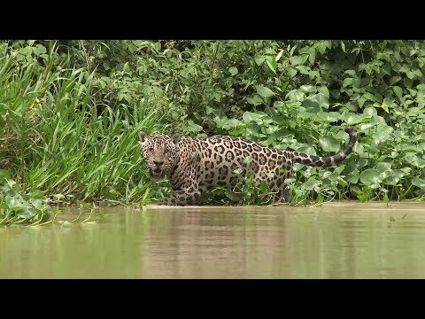
Adaptations
The ability to change and evolve to the environment in order to meet basic needs.
RETURN to Choice Board
What this video →
Fill in the next 2 slides!
https://www.youtube.com/watch?app=desktop&v=ZrSWYE37MJs
Notes:
Video Link:
https://www.youtube.com/watch?app=desktop&v=ZrSWYE37MJs

Slide 17
Adaptations:
RETURN to Choice Board
Animal: ___________________________________
Habitat:__________________________________
Use the table below and describe 4 adaptations the animal has and why they need it for survival from the video.
Behavioural Adaptations::
Physical Adaptations:

Slide 18
Adaptations:
RETURN to Choice Board
Animal: ___________________________________
Habitat:__________________________________
Use the table below and describe 4 adaptations the animal has and why they need it for survival from the video.
Behavioural Adaptations::
Physical Adaptations:

Slide 19
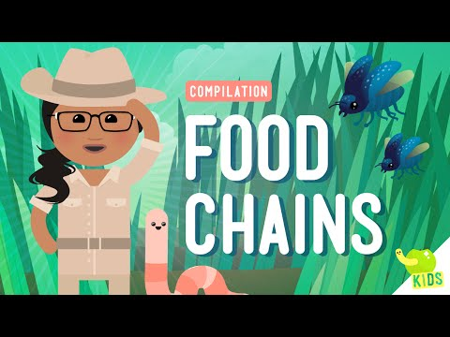
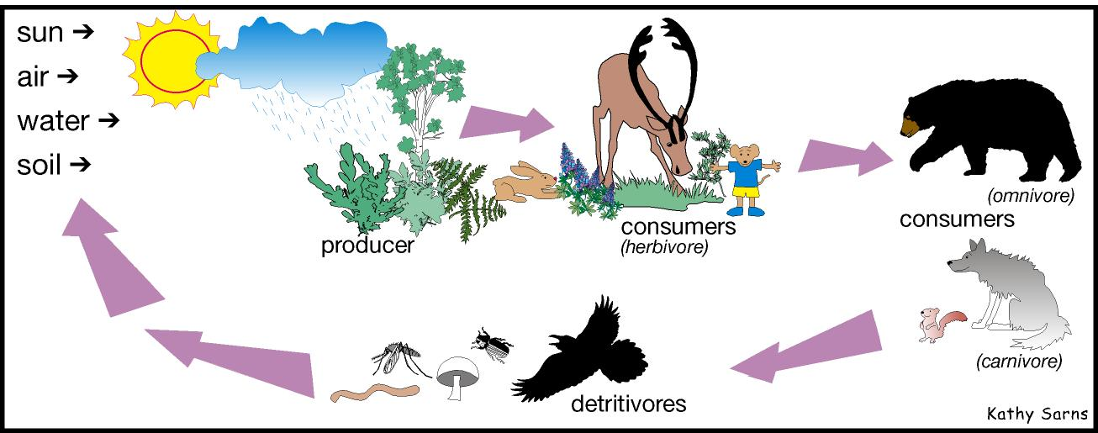
Food Chains:
Food Chain: describes the order that living things depend on each other for food. Every habitat has one or more food chains within it.
Producers: plants are called producers because they produce their own food.
Consumers: any living thing that needs to eat other living things in order to get energy to live.
Herbivores: living things that eat only plants and plant materials.
Omnivores: living things that eat both plants and other animals and/or insects.
Carnivores: living things that eat only other animals and/or insects.
Detritivores: living things that eat dead things and decompose them back into smaller molecules that return to the soil.
RETURN to Choice Board
https://www.youtube.com/watch?v=CZhE2p46vJk
Complete the next 4 slides before heading back to the choice board!
Photo Credit: https://pixy.org/491472/
Notes:
Video Link:
https://www.youtube.com/watch?v=CZhE2p46vJk

Slide 20
Drag the animals into their appropriate category: Using text boxes add 3 more plants, animals or insects to each category.
RETURN to Choice Board

Slide 21
Use the animals and create a food chain. Use arrows to show the chain and include text boxes to indicate which group each animal belongs to.
RETURN to Choice Board

Slide 22
Use the animals and create a different food chain. Use arrows to show the chain and include text boxes to indicate which group each animal belongs to.
RETURN to Choice Board

Slide 23
Look at the food chain below: what would happen to this habitat if all the water dried up?
If the water was removed… because...
RETURN to Choice Board
Sun, Air & Water
Grasses
(Producer)
Zebra
(Herbivore)
Lion
(Carnivore)

Slide 24
Habitat Changes:
RETURN to Choice Board
Books and Websites on habitat changes: (click below and follow the links)
Habitat Destruction Article!
How do living things change their environments?
Habitat destruction Facts for Kids
Habitat Changes Unit Children's Book Collection | Discover Epic Children's Books, Audiobooks, Videos & More
Videos on Habitat changes: (click below and follow the links)
Factors That Cause Changes in a Habitat
Changing Climate, Changing Habitat
Habitat Destruction and its Effects
BEFORE VIEWING:
Read through the next slide and fill it in while you are viewing the resources on this page.
Notes:
Book & Website Links:
https://kids.nationalgeographic.com/explore/science/habitat-destruction/
https://thekidshouldseethis.com/post/how-do-living-things-change-their-environments
https://kids.kiddle.co/Habitat_destruction
https://www.getepic.com/collection/64389/habitat-changes-unit
Video Links:
https://www.youtube.com/watch?v=WzX9_G6nnO0
https://www.youtube.com/watch?v=lC1_iZrPYWE
https://www.youtube.com/watch?v=1pp3_tCMwaM

Slide 25
Brainstorm 2 lists of the different habitat changes.
RETURN to Choice Board
Human Impact Changes:
Natural Environmental Changes:
Cutting down Trees
Floods

Slide 26
Final Project
Animal Research Report
RETURN to Choice Board
Use this search engine → KIDDLE
Choose one animal you would like to learn more about.
Use the graphic organizer provided to gather information.
Use the information gathered to fill in the report writing template.
Edit and revise the information on the template. (You could share with a partner)
Write/Type your report in word/docs.
Check the rubric to ensure you submit the best report you can!
Submit to the teacher at: _____________________
Notes:
Link:
www.kiddle.co

Slide 27
Graphic Organizer
Notes for Page #1 - Introduce your animal!
Notes: List the information you find. | Source: List the title and author of the book or website you found your information.
Animal Name:
Habitat Name:
Age: (How long can it live on average?)
Baby Name: Number of Babies: Live or Eggs:
Enemies:
Two interesting facts about your animal:

Slide 28
Graphic Organizer
Notes for Page #2 - Habitat and Animal Needs Met
Notes: List the information you find. How are the basic needs met in your animal’s habitat? | Source: List the title and author of the book or website you found your information.
Habitat description:
Food:
Temperature:
Space:
Shelter:
Adaptations:

Slide 29
Graphic Organizer
Notes for Page #3 - Food Chains within the Habitat
Notes: List the information you find. What other plants and animals live in the same habitat and how do they interact with one another? | Source: List the title and author of the book or website you found your information.
Habitats List of Plant and Animals populations
Where is your animal on the food chain?
Describe the food web in your animal’s habitat:

Slide 30
Graphic Organizer
Notes for Page #4 - The Effect of Habitat Change
Notes: List the information you find. How do changes in the environment affect your animal? | Source: List the title and author of the book or website you found your information.
Natural Habitat Changes that can occur:
Human habitat changes that can occur:
Predict what would happen to your animal if there was a drought (the water ran out) in its habitat? Indicate if this is a natural or human change on the environment?

Slide 31
Report Writing Template
Write in full sentences and provide information in your own words.
Page #1 - Introduce your animal!
Sentence 1: I am researching and learning about ____________________________________________
Sentence 2: (Write a catchy introductory sentence about your animal)
Sentence 3+: (Introduce your animal using the information from page 1 of your notes)
Closing sentence: (Write a sentence that ends the paragraph)

Slide 32
Report Writing Template
Write in full sentences and provide information in your own words.
Page #2 - Habitat and Animal Needs Met
Sentence 1: The ________ lives in the habitat ____________________________________________.
Sentence 2+: (Describe the habitat that your animal lives in include how each of the basic needs are met. Also describe the adaptations that your animal has in order to survive in their habitat.)
Closing sentence: (Write a sentence that ends the paragraph)

Slide 33
Report Writing Template
Write in full sentences and provide information in your own words.
Page #3 - Food Chains within the Habitat
Sentence 1: (Provide an introductory sentence)
Sentence 2+: (Describe how your animal interacts with the plants and animals in their habitat. Describe the food chains or food webs that exist in your animals habitat.)
Closing sentence: (Write a sentence that ends the paragraph)

Slide 34
Report Writing Template
Write in full sentences and provide information in your own words.
Page #4 - The Effects of Habitat Change
Sentence 1: (Provide an introductory sentence)
Sentence 2+: (Describe how natural and human changes affect your animal and their habitat.)
Closing sentence: (Write a sentence that ends the paragraph)

Slide 35
Edit, Revise, Rewrite & Submit
Editing Checklist
Revising Checklist::
Did I re-read my work to make sure it makes sense? | Yes | No
Did I re-read my work slowly and look for any mistakes. | Yes | No
Did I use lowercase and uppercase letters correctly? | Yes | No
Did I end each sentence with a period, exclamation point or question mark? | Yes | No
Did I check and fix misspelled words? | Yes | No
Did I check to make sure I have spaces in between all my words? | Yes | No
Did I have someone else read through my work and identify mistakes? | Yes | No
I clearly stated all my thoughts. | Yes | No
I used descriptive detail. | Yes | No
I have an introductory sentence and closing sentence on each page. | Yes | No
I used the correct grammar and my sentences and paragraphs all make sense and flow well. | Yes | No
I made sure the paragraphs were interesting and exciting to read. | Yes | No
I included all important information. | Yes | No
I answered all the questions in my notes section in my report. | Yes | No
After editing and revising your initial report, rewrite in Microsoft Word or Google Docs and submit to your teacher at: ___________________________.

Slide 36
Final Project
Diorama
RETURN to Choice Board
Collect Materials: (See the list on the next page ).
Choose a habitat (The habitat from your report).
Draw out a rough plan of your diorama.
Make a list of plants and animals that live in this habitat (choose 5-10 to include).
Create your diorama.
Take pictures of different steps throughout your process. (Include the rough draft in these pictures)
Create a slideshow or video of the process of building the diorama and your final project.
Check the rubric to ensure you will submit the best project you can!
Submit to your teacher at: ____________________

Slide 37
Diorama List of Materials
Check with a caregiver before collecting these materials. Always be safe when using scissors!
Small box (shoe box)
Construction paper
Glue
Clay or playdough
(Easy Play Dough Recipe)
Paint
Markers
Recyclables (toilet paper rolls, plastic containers etc.)
Scissors
Toy animals (optional) → ask a caregiver for permission first!
Notes:
Link:
https://funlearningforkids.com/easy-play-dough-recipe-without-cream-tartar/

Slide 38
Creating a Diorama
Cover the inside of the box to look like the habitat you chose (paint or paper)
Add plants and animals into your habitat
Label all areas of your habitat
On the back of your box include information that answers the following questions:
Why did you choose this habitat?
What types of plants and animals live in this habitat
What are the food chains in this habitat?

Slide 39
New Thinking
How affected are animals by changes to their habitats?
Drag and drop the happy face to indicate your initial thoughts to the question above.

Slide 40
Final Thoughts - A Reflection on Learning:
Look back at your initial thinking and answer the following questions:
How has your opinion changed?
What caused your thinking to change?
What are your new thoughts on how animals lives are impacted and changed?
If your thinking/opinion has not changed justify why you agree with your initial thoughts.
Return to your KWL and complete the “I Learned” section
Congratulations you are Finished!

Slide 41
Grade 4 Science Assessment Tool: Evidence of Student Learning
View Achievement Profiles: Manitoba Report Card Grade Scale—Science Achievement Profiles (Grades 1 to 8) Subject Category: Knowledge and Understanding Science Outcomes: | In the boxes below indicate the students responses and evidence of learning through their work in the project as well as the report and diorama
 | Limited (1): Requires considerable ongoing teacher support to explain concepts related to a topic of study. make connections between science concepts and real world contexts describe thinking and reasoning using science vocabulary | Basic (2): Requires occasional teacher or peer support to: explain concepts related to a topic of study. make connections between science concepts and real world contexts describe thinking and reasoning using science vocabulary | Good (3): Explains concepts related to a topic of study Makes connections between science concepts and real-world applications. Requires occasional prompting to describe thinking and reasoning using science vocabulary | Very Good to Excellent (4): Explains concepts related to a topic of study accurately, clearly, and flexibly. Logically and creatively makes connections between science concepts and real-world applications. Explains thinking and reasoning clearly using appropriate science vocabulary.
(4-1-12) - Use the design process to construct a model of a local or regional habitat and its associated populations of plants and animals (See notes on report as well as process for creating diorama)
(4-1-13) - Predict, based on their investigations, how the removal of a plant or animal population may affect the rest of the community. (See, initial and final thinking, food chains,page 4 of their report (research and written) and final diorama project)
(4-1-14) - Investigate natural and human-caused changes to habitats, and identify resulting effects on plant and animal populations. (See, initial and final thinking, food chains,page 4 of their report (research and written) and final diorama project)

Slide 42
Grade 4 ELA Assessment Tool: Evidence of Student Learning:
The following chart is one way to record your body of evidence of student learning. It is important to consider the identified grade band descriptors in relation to the practices and elements as you look through the body of evidence. You are describing the extent to which students enacted the descriptors. Transfer this information into the appropriate reporting categories.
Evidence of Learning in English Language Arts: https://app.mapleforem.ca/en/groups/229/wiki/pages/1622#3to5overview |  | Interrelated Dimensions of Learning Growth (IDOL-G) - https://app.mapleforem.ca/en/groups/229/wiki/pages/2205
 |  | Independence: Emerging Expanding Extending | Depth: Emerging Expanding Extending | Breadth: Emerging Expanding Extending | Transformation: Emerging Expanding Extending
4 ELA Practices & Elements | Grade Band Descriptors Identified
Power Agency · Recognize and analyze inequities, viewpoints, and bias in texts and ideas · Investigate complex moral and ethical issues · Contemplate the actions that can be taken, consider alternative viewpoints, and contribute other perspectives | Learners are recognizing the need for validity and reliability. | Example: Expanding: Students describes the impacts of natural and human changes on living things and suggest reasonable changes that can be made.
Exploration and Design · Research and study topics and ideas · Interpret and integrate information and ideas from multiple texts and sources · Manage information and ideas · Invent, take risks, and reflect to create possibilities | Learners are using strategies, resources, and sources to explore ideas and deepen and extend thinking.
Sense Making ​ · Access, use, build, and refine schema · Select from and use a variety of strategies · Be aware of and articulate the ways that one engages with text. | Learners are reflecting on and using what they know about texts and themselves to make purposeful and personal decisions.
System​ · Recognize, apply, and adapt rules and conventions · Identify, analyze, and apply understandings of whole-part-whole relationships | Learners are using classroom resources and what they know about spelling, grammar, capitalization, and punctuation to understand and compose texts.

Slide 43
All DOne
Every small action counts. Let’s protect the environment together!
CREDITS: This presentation template was created by Slidesgo, including icons by Flaticon and infographics & images by Freepik.

