Slide 1
Water Systems: Ocean currents
Convection, Coriolis effect, and prevailing winds

Slide 2
Learning Objectives:
Students will demonstrate through experimentation and interpretation:
How water density impacts ocean currents.
How convection impacts ocean currents.
What role does the Coriolis Effect play in global ocean currents.
How do land masses and continents impact ocean currents.
GLO’s D3, D5, E1,E2,C2,C6,A1,A2

Slide 3
The big question!
How important are convection, the coriolis effect, density, and prevailing winds to the global ocean currents?
1
Coriolis effect
Rank the concept to its importance to global ocean currents using a line. 1 being most important, 4 least important.
2
density
3
Prevailing winds
4
convection

Slide 4
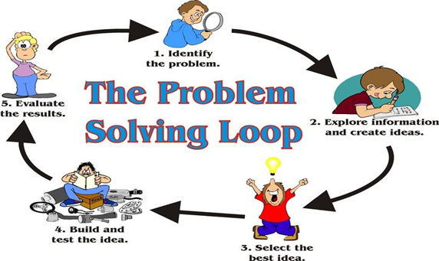
Scientific Inquiry
Initiating
Researching
C
Planning
Demonstrating Scientific and Technological Attitudes
Implementing Plan
Reflecting
Observing, Measuring, Recording
Concluding and Applying
Analyzing and Interpreting
Image: https://pixy.org/4592163/
Image: David Gamble 2020

Slide 5
KWL on Ocean currents
What I Know
I wonder?
I Learned
In the Know box list all the things you already know about Ocean currents.In the Wonder box write down any questions you have about Ocean currents. What is something you want to learn about? Leave the L box for the end of the lesson!
I know about Ocean currents…
I wonder about Ocean currents…
I learned about Ocean Currents…
Initiating

Slide 6
Create a definition in your own words
Convection:
Prevailing winds:
Instructions
Using your text, notes, and or the internet to research the terms on the left.
After you have completed your research create a definition for each term in your own words.
Coriolis Effect:
Continent:
Researching

Slide 7
Convection and density
In the following experiments you will have the chance to observe how convection and density impact ocean currents behavior. Think about how convection works when warm and cold bodies of water come in contact.
Questions to consider:
When warm and cold water come in contact do they mix?
If warm water has a higher density will it float on cold less dense water?
If cold water has a higher density than warm water what happens?
Observing, Measuring, Recording
Planning
Researching

Slide 8
Convection and density Experiment materials for #1 & #2
What you need:
Clear Bottles or 4 clear glasses(all the same)
1 cup of salt
A spoon
A thin piece of rigid plastic or playing card
A pan or catch basin
Something to colour the water with tea bag, coffee, food colouring
Planning

Slide 9
Experiment #1 - Convection & density:
Implementing Plan
Planning
Procedure
Part 1:
Fill two of the bottles or glasses with hot water from the tap and the other two bottles with cold water. Use masking tape and a pen to label the bottles “HOT” and “COLD.”
Use yellow food coloring in the warm water and blue food coloring in the cold water. Each bottle must be filled to the brim with water.
Place the card or piece of thin plastic over the mouth of a hot water bottle (the yellow water). This can be a little tricky, but with practice you’ll get it. Hold the card or plastic in place as you turn the bottle upside down and place it on top of a cold water bottle (the blue water). The two bottles should be positioned so that they are mouth-to-mouth with the card/plastic separating the two liquids. (Have paper towels close by in case everything doesn’t go exactly as planned.)
Carefully slide the card out from between the two bottles. Make sure you are holding the top bottle as you remove the card. Watch and record what happens to the colored liquids in the two bottles when the card is removed.
Part 2:
The second part of the experiment is similar to the first. This time, you need to place the cold water (blue) on top of the hot water (yellow). Repeat Steps 3 and 4 and carefully remove the card. Watch and record what happens this time.
Tips
You can use coffee or tea to color water instead of food colouring
If you do not have a playing card or the mouth of the container is to big look through the recycling bin for thin plastic that can be repurposed.
See next slide for an example of this experiment.
Perform experiment in the sink to reduce clean up!

Slide 10
Example of what your experiments should look like:
Hot water
Cold water
Playing Card/ Thin plastic
Playing card/Thin plastic
Cold water
Hot water
Image: David Gamble 2020
Implementing Plan
Record your results on the next page

Slide 11
Experiment #1 - Convection & density questions: what Happened
Analyzing and Interpreting
Reflecting
Draw a picture of your experiment setup and label the parts

Slide 12
Experiment #1 - Convection & density results:what happened?
Part 1 - Hot above Cold:
Part 2 - Cold above Hot:
When warm and cold water come in contact do they mix?
If warm water has a higher density will it float on cold less dense water?
If cold water has a higher density than warm water what happens?
Does the water behavior change as temperature changes?
Observing, Measuring, Recording
Reflecting

Slide 13
Convection and density Experiment two procedure
Implementing Plan
Planning
Fill one of the bottles or glasses with hot water from the tap and the other with hot salt water. Fill the remaining bottles with cold tap water and cold salt water.
Use masking tape and a pen to label the bottles “HOT” , “hot salt water”, “COLD”, and cold salt water.
Use yellow food coloring in the warm water and blue food coloring in the cold water. Each bottle must be filled to the brim with water.
Place a card or rigid plastic on the hot salt water and the cold salt water. This can be a little tricky, but with practice you’ll get it. Hold the card or plastic in place as you turn the bottle upside down and place the hot salt water on top of the cold fresh water. The two bottles should be positioned so that they are mouth-to-mouth with the card/plastic separating the two liquids. (Have paper towels close by in case everything doesn’t go exactly as planned.)
Carefully slide the card out from between the two bottles. Make sure you are holding the top bottle as you remove the card. Watch and record what happens to the colored liquids in the two bottles when the card is removed.
Part 2:
The second part of the experiment is similar to the first. This time, you need to place the cold salt water (blue) on top of the hot freshwater (yellow). Repeat Steps 3 and 4 and carefully remove the card. Watch and record what happens this time.
Tips
You can use coffee or tea to color water instead of food colouring
If you do not have a playing card or the mouth of the container is to big look through the recycling bin for thin plastic that can be repurposed.
To make the salt water:add salt to water 1 tablespoon at a time while stirring. Keep adding salt to water until until the water will not hold any more salt and salt particles gather at the bottom after stirring for 30 seconds
Perform experiment in the sink to reduce clean up!

Slide 14
Example of what your experiments should look like:
Hot water
Cold water
Playing Card/ Thin plastic
Playing card/Thin plastic
Cold salt water
Hot salt water
Image: David Gamble 2020
Implementing Plan
Record your results on the next page

Slide 15
Experiment #2 - Convection & density
Analyzing and Interpreting
Reflecting
Draw a picture of your experiment setup and label the parts.

Slide 16
Experiment #2 - Convection & density results:what happened?
Part 1 - Hot saltwater above Cold:
Part 2 - Cold fresh water above Hot salt water:
When warm and cold water come in contact do they mix?
If warm water has a higher density will it float on cold less dense water?
If cold water has a higher density than warm water what happens?
Does the water behavior change as temperature changes?
Observing, Measuring, Recording

Slide 17
Design your own experiment
Design your own experiment to illustrate the role of density and convection in Ocean currents. Include:
List of needed materials.
A written procedure/instructions for the experiment.
Detailed drawings of experiment setup with label the components of the experiment (ie water, bottle, bucket, ect).
Explanation of how the experiment illustrates the role of density and convection in ocean currents.
Students can make a video (flip grid), audio recordings with pictures (movie maker),provide a written answer that includes sketches and explanations, or create an infographic
Concluding and Applying
Analyzing and Interpreting
Concluding and Applying
Reflecting
Implementing Plan
Planning

Slide 18
Investigation: which way does the water drain?
Observing, Measuring, Recording
Instructions
Tub or shower
Bathroom sink
Go around your home and fill the vessels listed to the right with water.
Drain the water from each vessel one at a time and observe how the water behaves closely as it drains.
In each box provide a diagram and description of what you observed.
Toilet (already full)
Kitchen sink

Slide 19
Investigation: which way does the water drain? questions
Reflecting
Analyzing and Interpreting
Answer the following questions using the data you collected during your investigation.
What direction did the water drain in?
Bathtub:
Bathroom sink:
Toilet:
Kitchen sink:
What did you notice?
What forces are acting on the water that cause it to behave this way?
Does it drain the same way everywhere in the world? If it is different how is it different where and why? Remember what you already learned and apply it.

Slide 20
Investigation:Ocean currents
Analyzing and Interpreting
Researching
Instructions
Notes and questions
Watch the following three videos:
https://youtu.be/p4pWafuvdrY
https://www.nationalgeographic.org/media/ocean-currents-and-climate/
https://youtu.be/N8mCn8f3za0?t=196
Make notes as you watch in the box to the right. Note important facts and questions you have.

Slide 21
Based on your research and experimentation answer the following questions:
Density differences in ocean water drive the global conveyor belt. This global circulation system is also called thermohaline circulation. When broken down into its root words, what does “thermohaline” mean?
The global conveyor belt carries water and heat energy across the globe. What is the difference in how the conveyor belt moves water in the tropics compared to the Arctic?
What forces are responsible for tidal currents and are they predictable?
Analyzing and Interpreting
Concluding and Applying
Reflecting

Slide 22
Using the illustration on the next slide predict how continents impact ocean currents, why do you think that?
Concluding and Applying
Analyzing and Interpreting
Observing, Measuring, Recording
Reflecting

Slide 23
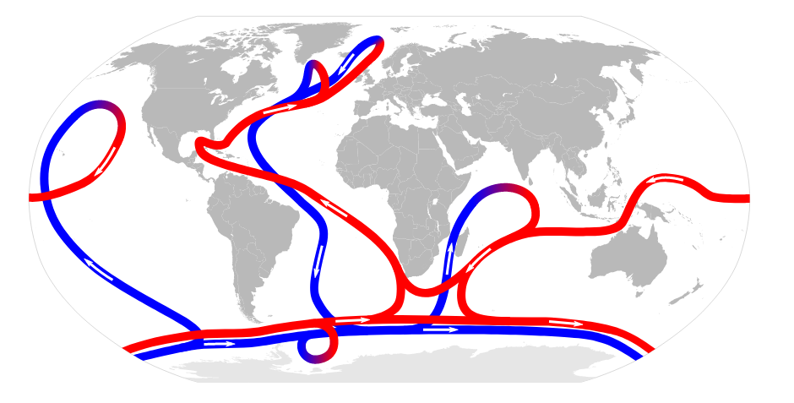
Researching
Image:https://commons.wikimedia.org/wiki/File:Thermohaline_Circulation.svg

Slide 24
The big question!
The big question!
tHE BIG QUESTION...
How important are convection, the coriolis effect, density, and prevailing winds to the global ocean currents?
Rank the concept to its importance to global ocean currents using a line. 1 being most important, 4 least important.
1
Coriolis effect
2
density
3
Prevailing winds
4
convection
Explain your choices. Your answer can include diagrams, pictures, written explanation, a self produced video, or you can give a presentation. Remember what you already learned and apply it.
Concluding and Applying
Reflecting

Slide 25
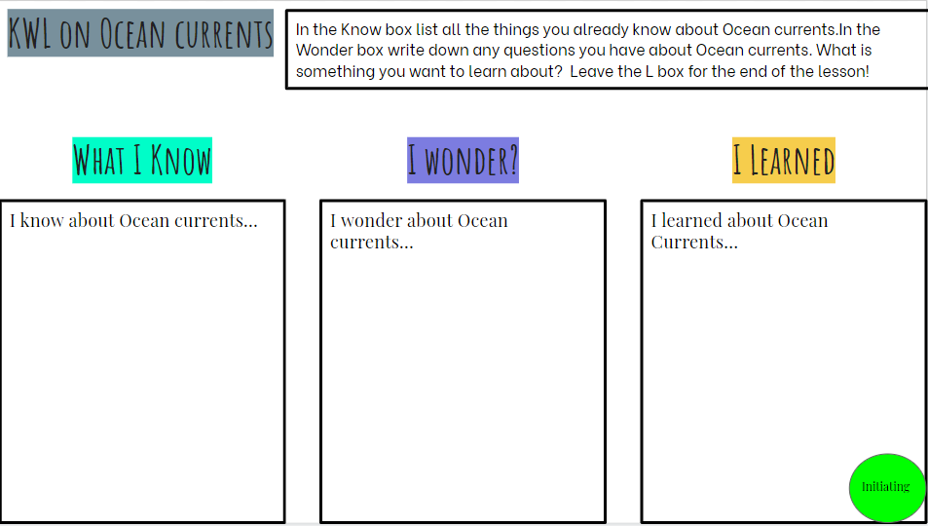
KWL:WHAT I LEARNED
Please now return to the KWL on slide 4 and fill in the “What I learned” section. Explain what you learned and how your learning changed.
Concluding and Applying
Reflecting

Slide 26
Outcomes Addressed | Achievement Grade Profiles https://www.edu.gov.mb.ca/k12/assess/report_cards/grading/profiles.html
 | Limited | Basic | Good | Very Good to Excellent:
Science—Design Process and Problem Solving | Requires considerable, ongoing teacher support to ▪ apply strategies to solve practical problems and to explain reasoning ▪ use scientific vocabulary ▪ use criteria or constraints to define a problem and evaluate the chosen solution ▪ recognize when changes need to be made to a plan ▪ work collaboratively with peers | Requires occasional teacher or peer support to ▪ apply strategies to solve practical problems and to explain reasoning ▪ use scientific vocabulary ▪ use criteria or constraints to define a problem and evaluate the chosen solution ▪ recognize when changes need to be made to a plan ▪ work collaboratively with peers | Applies appropriate strategies to solve practical problems; requires occasional prompting to recognize when changes need to be made to a plan. Explains and justifies reasoning using appropriate science vocabulary, and generalizes to similar contexts; requires occasional prompting for clarification. Collaborates effectively with peers. | Demonstrates flexibility, resilience, and creativity when solving practical problems; critically analyzes results and makes any necessary changes to a plan. Explains and justifies reasoning clearly using appropriate science vocabulary and generalizes to other contexts. Collaborates effectively with peers, often taking a key role in group work.
8-0-3a Formulate a prediction/hypothesis that identifies a cause and effect relationship between the dependent and independent variables. GLO: A2, C2
8-0-3b Identify the independent and dependent variables in an experiment. GLO: A2, C2
8-4-01 Use appropriate vocabulary related to their investigations of water systems.

Slide 27
8-4-04 Identify factors that can work individually or in combination to affect ocean currents. Include: convection, Coriolis effect, prevailing winds, position of continents. GLO: D5, E2
8-4-05 Describe how the heat capacity of large bodies of water and the movement of ocean currents influence regional climates. Examples: Gulf Stream effects, El Niño, lake effect... GLO: D3, D5, E2
8-4-06 Describe the components of the global water cycle and explain how it works. GLO: D3, D5, E2
8-4-03 Compare and contrast characteristics and properties of fresh water and salt water

Slide 28
8-0-4a Carry out procedures that comprise a fair test. Include: controlling variables, repeating experiments to increase accuracy and reliability. GLO: C2
8-0-7a Draw a conclusion that explains investigation results. Include: explaining the cause and effect relationship between the dependent and independent variables; identifying alternative explanations for observations; supporting or rejecting a prediction/hypothesis. GLO: A1, A2, C2
8-0-7b Critically evaluate conclusions, basing arguments on fact rather than opinion. GLO: C2, C4
8-0-7g Communicate methods, results, conclusions, and new knowledge in a variety of ways. Examples: oral, written, multimedia presentations... GLO: C6

Slide 29
Links to videos and research information available:
How do Ocean Currents Work: https://youtu.be/p4pWafuvdrY
Ocean Current and Climate information: https://www.nationalgeographic.org/media/ocean-currents-and-climate/
Colourful Convection Currents: https://youtu.be/RCO90hvEL1I
Density/convection experiment:https://www.stevespanglerscience.com/lab/experiments/colorful-convection-currents/

