Slide 1
Boy, Were We Wrong
Grade 5 Weather

Slide 2
Boy, Were We Wrong
In this book, author Kathleen Kudlinski shared many ideas about how our knowledge and thinking about weather has changed.
In this learning experience we are going to examine different ways that we can forecast the weather and examine their accuracy. You will be keeping track of your ideas in a Thoughtbook to help you answer this final question:
Which is a more accurate method of weather prediction – weather related sayings; traditional or local knowledge; short-term (1-day) forecasts; or long-term (5+day) forecasts?

Slide 3
Questions:
How do meteorologists make predictions about future weather conditions?
How do meteorologists measure current weather conditions?
How has weather predicting changed over time?
How do we gather and organize data to answer questions?

Slide 4
Assessment Rubric
Report Card | Big Idea | Limited | Basic | Good | Very Good to Excellent
Science – Knowledge & Understanding | Observations & Measurements of air are used to make predictions about future weather conditions. | Names components of weather that can be observed and measured. | Identifies instruments that are used to observe and measure weather. | Explains how local weather conditions are observed and measured. | Designs an instrument to observe and measure local weather conditions.
Science, Knowledge and Understanding | Knowledge about weather has changed over time and has impacted our accuracy in forecasting. | Names technology that helps us understand weather. | Describes how advances in technology have impacted our scientific understanding of weather. | Compares various methods of forecasting. | Evaluates the accuracy of short- and long-term forecasts.
Science – Design Process and Problem Solving | Scientific and technological developments result from evaluating information and ideas encountered during investigations and daily life. | Follows a template or instructions to build a weather instrument. | Observes and collects data to represent findings from the construction of a design. | Manipulates the design of a weather instrument to improve its accuracy. | Appraises the design of technology to observe and measure weather.
Math – Knowledge & Understanding | Data is gathered and organized in order to answer questions. | States sources of data. | Differentiates between first-hand and second-hand data. | Selects data to answer questions about weather. | Compares data about weather from a variety of resources.

Slide 5
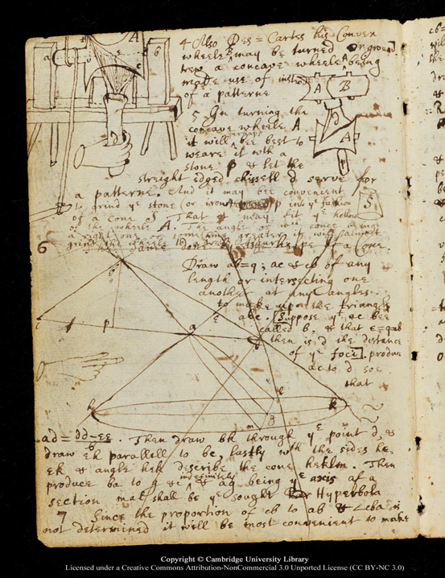
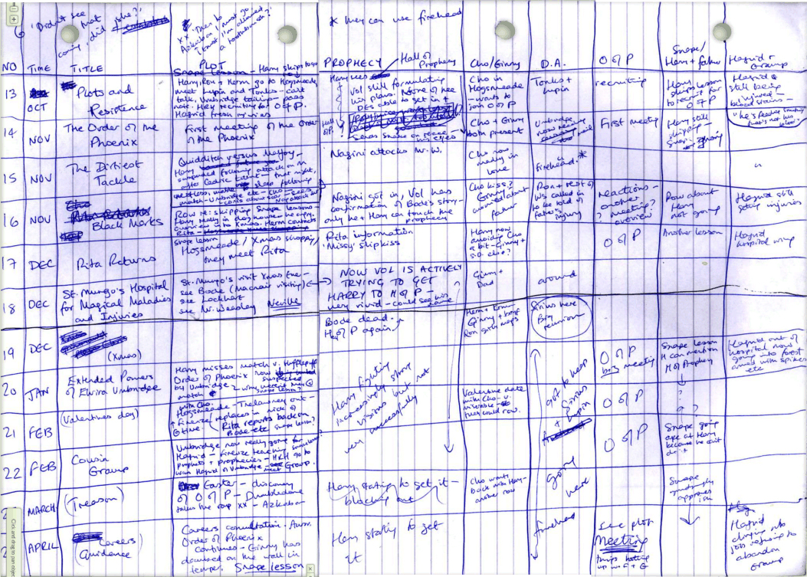
Thoughtbooks:
Newton's
early draft for
"The Division of a Monochord"
What is a thoughtbook:
A safe place where I can jot down my thoughts and ideas.
A safe place where I can review my thoughts and change my thinking by applying new things I learn.
A safe place I can draw or create ideas.
A safe place I can keep my work and review it often. Making changes as I learn and grow.
A safe place for my teacher and myself to know where I am in my learning and what I need to do to hit my learning target.
JK Rowling Harry Potter and the Order of the Phoenix Plot Spreadsheet.
Notes:
Teacher Notes:
Provide students with a duotang or 2 pocket folder as a thoughtbook.
There are pages in the learning experience that indicate a thoughtbook page.
Pages for their data collection can also be included as we want students to know that it is okay to get messy when they are thinking and considering their organization.
Discuss the importance of thoughtbooks and even that famous authors and scientists use a thoughbooks to jot down their ideas and thinking as they go through the creative process.

Slide 6
Rate the accuracy of the following types of weather forecasting:
Thoughtbook
For each thermometer, move the red blocks over to indicate the accuracy of each type of forecasting.
Always accurate
Always accurate
Always accurate
Always accurate
Always wrong
Always wrong
Always wrong
Always wrong
Weather-related sayings (e.g. red sky at night, sailor’s delight)
Traditional or local knowledge (e.g. how ruffled an animal’s neck is indicates how cold a winter will be)
Short-term (1 day) forecasts
Long-term (5+ day) forecasts

Slide 7
Weather Forecast Components
What are common components of a weather forecast?
View or listen to 2-3 weather forecasts for our location and answer the questions on the next slide to prepare for our class conversation tomorrow.
Government of Canada
The Weather Network
Notes:
https://weather.gc.ca/forecast/canada/index_e.html?id=MB
www.theweathernetwork.com

Slide 8
Weather Forecast Components
What components do these forecasts have in common?
What information do these components tell us about the weather?

Slide 9
Meteorologist Predictions
First watch the video: How Do We Know When It Will Rain?
How do meteorologists’ predictions compare with the actual weather?
Choose a weather report that will give you a short-term (1 day) forecast as well as a long-term (5 day forecast). Record this forecast as well as the short-term forecast each day for the next 4 days.
Each day record the actual weather as well.
You will need to organize the data you are going to collect so that you will be able to compare the accuracy of the short- and long-term predictions. A chart may be useful for this purpose. You can do this on the next slide or on paper and then insert a photo of your work on the next slide.
Notes:
https://www.youtube.com/watch?v=dLQ0lHpyZd8

Slide 10
Meteorologist Predictions

Slide 11
Reflecting on Meteorologists Predictions
Thoughtbook
How did the short-term (1-day) forecasts compare or contrast with the actual weather?
Were there discrepancies with the short-term (1-day) forecasts?
What are some possible reasons for these discrepancies?
How did the long-term (5+day) forecasts compare or contrast with the actual weather?
Were there discrepancies with the long-term (5+day) forecasts?
What are some possible reasons for these discrepancies?

Slide 12
Weather Instrument DIY
How do meteorologists collect data about the weather?
Choose 2 or 3 weather instruments
Make the instrument using materials and recyclables found around your home. You may need to adapt the ideas based on the materials you have available at home for creating.
Use the next slide to record your design process.
Duplicate the slide for each instrument. (select slide>file>duplicate)
Notes:
https://inventorsoftomorrow.com/2018/01/22/diy-weather-station-for-kids/

Slide 13
Weather Instrument: ______________
Materials:
Draw a sketch of your plan:
How is your instrument working?
How can you improve the design of your instrument?
Insert a photo of your actual instrument:

Slide 14
Collecting Weather Data
How do meteorologists collect data about the weather?
Use your weather instruments to collect data about the weather for 5 days.
Also collect the same data from a local weather report. Consider how you will organize this data so you can compare your data from home with the local weather reports. Consider how you will organize this data so you can compare the results. Use the Data Collection slide to record this data.
Notes:
https://inventorsoftomorrow.com/2018/01/22/diy-weather-station-for-kids/

Slide 15
Data Collection

Slide 16
Reflecting on my DIY Weather Instruments
Thoughtbook
How did my weather instruments compare or contrast with the actual weather readings from a local weather resource?
Were there discrepancies with my instruments and those of local weather forecasters?
What are some possible reasons for these discrepancies?

Slide 17
Other Forecasters
How useful are other methods of predicting weather?
View the video Folklore Weather Sayings – Which Ones are Reliable?
Choose a weather-related saying or traditional/local knowledge about weather.
Design a method to collect data for a period of 5 days to check it’s accuracy.
Consider how you will organize your data so you can compare the saying/knowledge with the actual weather. Use the next slide to record your data.
Notes:
https://www.youtube.com/watch?v=Pc4qy9FZJOE

Slide 18
Other Forecasters

Slide 19
Reflecting on my DIY Weather Instruments
Thoughtbook
How did the weather related saying or traditional/local knowledge compare or contrast with the actual weather?
Were there discrepancies with weather related saying or traditional/local knowledge with the actual weather?
What are some possible reasons for these discrepancies?

Slide 20
Weather History
How has technology contributed to our understanding of weather?
Your teacher will assign each of you a weather technology
Research the technology:
When was it invented ?
How it contributes to weather knowledge and/or forecasting?
What type of data it collects? (Include units if appropriate)
Picture of the instrument
Add your image and date to a class or group timeline as assigned by your teacher.
Link your picture to a new slide where you will share your information from your research.

Slide 21
Weather Technology Timeline
500 BC
Today

Slide 22
Reflecting on Weather Technology Timeline
Thoughtbook
What do you notice?
What do you wonder?
What was the most important weather technology invented? Why?
What do you think should be invented next? Why?

Slide 23
Re-rate the accuracy of the following types of weather forecasting:
Thoughtbook
For each thermometer, move the red blocks over to indicate the accuracy of each type of forecasting.
Always accurate
Always accurate
Always accurate
Always accurate
Always wrong
Always wrong
Always wrong
Always wrong
Weather-related sayings (e.g. red sky at night, sailor’s delight)
Traditional or local knowledge (e.g. how ruffled an animals neck is indicates how cold a winter will be)
Short-term (1 day) forecasts
Long-term (5+ day) forecasts

Slide 24
Reflecting on the Accuracy of Forecasting
Thoughtbook
Look back through your Thougtbook pages. Consider how your thinking may have changed or stayed the same through this learning experience. What evidence do you have to support your thinking? Compare your initial thinking on slide 6 with your current thinking on slide 23.
My thinking has (changed/stayed the same) because….

Slide 25
The end!
Please keep this slide for attribution

