Slide 1
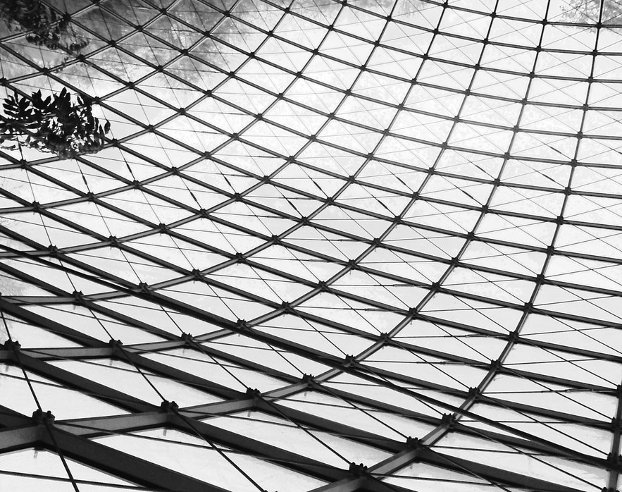
Exploring AREA
Notes:
https://search.creativecommons.org/photos/5cd63668-07e9-4b9c-b46e-e16126a19f87

Slide 2
Guiding Concepts
Anchored in inquiry
Open ended questions, student centered, student choice
Low floor, high ceiling tasks
Multiple ways to show understanding

Slide 3
Enduring Understandings
Many geometric properties and attributes of shapes are related to measurement.
The area of a rectangle can be used to develop the formula for the area of other shapes.
Curricular Outcomes
7.SS.1. Demonstrate an understanding of circles by
describing the relationships among radius, diameter, and circumference of circles;
relating circumference to pi (p);
determining the sum of the central angles (*This concept is not explicitly taught within the learning experiences.)
constructing circles with a given radius or diameter;
solving problems involving the radii, diameters, and circumferences of circle
7.SS.2. Develop and apply a formula for determining the area of
Triangles
Parallelograms
circles
Note: These learning experiences compliment the curricular outcomes outlined above. Teachers should look to enhance each experience with their own lessons/activities to allow students to internalize their learning.

Slide 4
Instructions
This collection of tasks is designed around the concept of Space and Shape, specifically using direct or indirect measurement to solve problems. The sections (colored blocks on slide 6 of the PowerPoint) represent independent sets of learning experiences that could function effectively as 45min-1hour session with a combination of synchronous and asynchronous parts, some of which are easily adaptable either way depending on your situation and access to technology and connectivity. FOR SYNCHRONOUS LEARNING, THE SLIDEDECK MUST BE IN EDIT MODE.
Each section provides a different way of engaging with the concept and is divided into 3 main parts:
Get Ready: begins the experience with an activity meant to activate student thinking and promote rich student discourse. This activity can be delivered prior to the lesson as an asynchronous task so students have time to prepare their thinking. It can also be delivered at the beginning of the synchronous session to help the teacher pre-assess prior knowledge and prime thinking for the upcoming learning experience.
Work it out: comprises the main learning experience for the day. This is where new content is presented and individual or small group responses are required. These activities are best completed with students working in pairs or small groups. If your platform allows for breakout rooms, this feature is a good tool that will facilitate student collaboration and discourse.
Look Back: is a final culminating task that provides opportunities to check for student understanding of the concepts, consolidate different solutions and solve problems. It allows for students to reflect on their learning and make connections.
Notes:
More detailed instructions for each learning experience are included in the NOTES section under each slide.

Slide 5
Materials
If this is the first-time students are experiencing virtual manipulatives, it is highly recommended to allow them time to "play". This gives the opportunity to explore and have fun with the tools BEFORE student are required to use them purposefully.
Hands-on manipulatives are ideal as significant learning occurs when students can build and visualize different representations of mathematics. Websites containing virtual manipulatives are suggested.
If a specific platform is used for delivering online instruction (i.e., Seesaw, Google Classroom), asynchronous tasks can be uploaded there.
For virtual manipulatives visit:
https://toytheater.com/category/teacher-tools/virtual-manipulatives/
https://mathigon.org/tangram
https://www.mathlearningcenter.org/apps/geoboard

Slide 6
Additional Lessons
Each shape’s learning experience concludes with links for additional lessons/activities to further assist teachers in guiding their students in their learning. Many of these resources are interactive through web apps, thus require an internet connection with a connected device to fully benefit.
GeoGebra applets (animations)
These applets can be used as demonstrations to support a lesson or you could have students explore the animation and respond to what they see.
Lessons and Practice activities
Lessons and Practice activities from Illustrative Mathematics designed through GeoGebra and include exploration and require student responses.

Slide 7
THEME / BIG IDEA / FOCUS of INQUIRY
Rectangles
Parallelograms
Triangles
Problem Solving
Circles
Number Play / Playing with Animations
Notes:
This is the “launch screen”.
Each piece represents an activity or a task that supports the theme and may take anywhere from a single day to multiple days to complete.

Slide 8
Problem Solving
1
Get Ready
2
Work it out!
3
Looking Back
Tangram Exploration
a closer look
build it – squares
build it - triangles
Write About It
Notice
&
Wonder
and
Record It
Notes:
Activator – number talk, choral count…
Work it out - Challenges make up the focus of the day(s) lesson (you may only have one and all students are assigned the same task, you may have a choice of two or three, or you may have all students begin at challenge 1 and move on as greater challenge is needed / Consolidate & Reflect on what you’ve learned during this part of the project.
Looking Back – a place for reflection/self-assessment

Slide 9
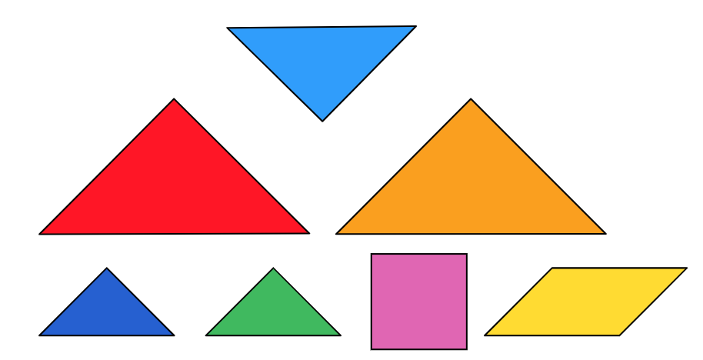
1
Get Ready
What do you notice?
What do you wonder?
Notes:
Teacher Notes
Hopefully students take note of the different shapes (vocabulary), and comparisons of the areas (speculation).
Tangram puzzles were popular during World War 1 and have become the most popular dissection puzzle in the world. Many different shapes can be constructed using this precise set of 7 pieces. Your first challenge will be to arrange them into a square. You must use ALL 7 pieces and you mustn’t overlap any.
Image Source: Screen shot of random arrangement of tangrams found at https://toytheater.com/tangram/

Slide 10
1
Get Ready
What do you notice?
What do you wonder?
Notes:
Teacher recording sheet. Could be copied for each student to record their own thinking.
Image Source: Screen shot of random arrangement of tangrams found at https://toytheater.com/tangram/

Slide 11
1
Get Ready
End of this section

Slide 12
2
Work it out
Tangram Exploration – A Closer Look
Follow the link to explore the set of Tangram pieces: https://toytheater.com/tangram/
Take some time to move them around, turn them, compare them to each other.
Look for relationships between the pieces.
After you have spent some time exploring the pieces, collect your findings on the following slide.
Notes:
Image Source: Screen shot of random arrangement of tangrams found at https://toytheater.com/tangram/

Slide 13
2
Work it out
Tangram Exploration – A Closer Look
List all the relationships you have found between the pieces.
Draw sketches or paste in screen shots to help show what you have discovered.
Notes:
Student work slide – students can make themselves an additional copy if they need more space. This could also be a good exercise to have students sketch with paper and pencil and then submit a photo. They could also explain their thinking in words and use the web application to create their sketches (taking screen shots to include with their thinking).
Image Source: Screen shot of random arrangement of tangrams found at https://toytheater.com/tangram/

Slide 14
2
Work it out
Tangram Exploration – Build it #1 - Rectangles
Can you build it? If so, tell which pieces you used and make a sketch to show it.
a rectangle using only 1 tangram piece?
How many rectangles can you make using any 2 tangram pieces?
Notes:
Student work slide – students can make themselves an additional copy if they need more space. This could also be a good exercise to have students sketch with paper and pencil and then submit a photo. They could also explain their thinking in words and use the web application to create their sketches (taking screen shots to include with their thinking).
Source: Activities adapted from “Enhanced Points of Departure with Tangrams”, SI Manufacturing.
Image Source: Screen shot of random arrangement of tangrams found at https://toytheater.com/tangram/

Slide 15
2
Work it out
Build it #1 – Rectangles - Continued
Can you build it? If so, tell which pieces you used and make a sketch to show it.
How many rectangles can you make using any 3 tangram pieces?
How many rectangles can you make using any 4 tangram pieces?
Notes:
Student work slide – students can make themselves an additional copy if they need more space. This could also be a good exercise to have students sketch with paper and pencil and then submit a photo. They could also explain their thinking in words and use the web application to create their sketches (taking screen shots to include with their thinking).
Source: Activities adapted from “Enhanced Points of Departure with Tangrams”, SI Manufacturing.
Image Source: Screen shot of random arrangement of tangrams found at https://toytheater.com/tangram/

Slide 16
2
Work it out
Build it #1 – Rectangles - Continued
Can you build a rectangle using ALL 7 tangram pieces?
Use the online manipulatives and paste a screen shot of your final solution below.
Do you think you have found ALL possible rectangles (made of any number of tangram pieces)? Why or why not?
Notes:
Student work slide – students can make themselves an additional copy if they need more space. This could also be a good exercise to have students sketch with paper and pencil and then submit a photo. They could also explain their thinking in words and use the web application to create their sketches (taking screen shots to include with their thinking).
Image Source: Screen shot of random arrangement of tangrams found at https://toytheater.com/tangram/

Slide 17
2
Work it out
Tangram Exploration – Build it #2 - Triangles
If you can build it, tell which pieces you used and make a sketch to show it.
How many triangles can you make using any 3 tangram pieces?
How many triangles can you make using any 4 tangram pieces?
Notes:
Student work slide – students can make themselves an additional copy if they need more space. This could also be a good exercise to have students sketch with paper and pencil and then submit a photo. They could also explain their thinking in words and use the web application to create their sketches (taking screen shots to include with their thinking).
Image Source: Screen shot of random arrangement of tangrams found at https://toytheater.com/tangram/

Slide 18
2
Work it out
Tangram Exploration – Build it #2 - Triangles
Can you build a right triangle using ALL 7 tangram pieces?
Use the online manipulatives and paste a screen shot of your final solution below.
Do you think there are other ways the pieces could be arranged into a right triangle? Can you prove it?
Notes:
Student work slide – students can make themselves an additional copy if they need more space. This could also be a good exercise to have students sketch with paper and pencil and then submit a photo. They could also explain their thinking in words and use the web application to create their sketches (taking screen shots to include with their thinking).
Image Source: Screen shot of random arrangement of tangrams found at https://toytheater.com/tangram/

Slide 19
2
Work it out
Tangram Exploration – Extension: Shape Shifter
Looking for an extra challenge?
Start by constructing an isosceles triangle using all 7 pieces.
Now shift only ONE piece to create a parallelogram.
Notes:
Image Source: Screen shot of random arrangement of tangrams found at https://toytheater.com/tangram/

Slide 20
2
Work it out
End of this section

Slide 21
3
Looking Back
Write about it and record it!
Using any, or all, of the 7 tangram pieces that make up a single set, construct one or more of each of the following shapes. Sketch them here (or drop an image of your work from the app or that you completed on paper).
Use the insert audio tool to describe your thinking about how you constructed each one.
Square
Right Triangle
Parallelogram
Rectangle
Notes:
Students could complete this activity asynchronously. They should continue to use the web application to ”play” with the tangrams and then record their work in a way that works for them. Look for evidence of student understanding regarding the composition of the shapes, which can be used to construct others, how the parts relate to the whole…

Slide 22
3
Looking Back
End of this section

Slide 23
Rectangles
1
Get Ready
2
Work it out!
3
Looking Back
The Basics
Which One Doesn’t Belong?
Write About It
Make Connections
or,
Record It
Extend Your Thinking
Notes:
Activator – number talk
Work it out – 3 stages of progression through the depth of knowledge related to the concept (can be used for differentiation)
Looking Back – a place for reflection/self-assessment
Photo Sources: https://openclipart.org/detail/172707/edit-icon-icono-editar, https://openclipart.org/detail/212116/screencast

Slide 24
1
Get Ready
Which one doesn’t belong?
Notes:
Number Talk – The goal of this provocation is to delve into student thinking and knowledge of terms and definitions of these 2D shapes. This could be used to pre-assess student understanding of the appropriate vocabulary (the following is a list of possible terms that may come up): rectangle, triangle, right triangle, parallelogram, circle, parallel lines, perpendicular lines, 90degree angle, acute angle, obtuse angle, sides, vertices, area, perimeter, circumference

Slide 25
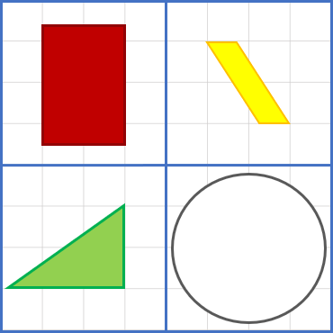
1
Get Ready
This is the only one that…
This is the only one that…
This is the only one that…
This is the only one that…
Notes:
Teacher Notes
Student page (duplicate for the number of students you have if working synchronously with students)
This is a slide where the teacher can scribe/record student notice and wonderings. (If students have viewed this ahead of time, they may have some responses ready. The teacher can then collect the responses ahead of time.

Slide 26
1
Get Ready
End of this section

Slide 27
2
The Basics
Work it out
On the grid, draw 3 rectangles that look different, but all have the same area.
What characteristics are THE SAME about all your rectangles? List as many as you can!
How do you know all your rectangles have the same area?
Notes:
Student work slide – students can make themselves an additional copy if they need more space.
Goal of this section is to get students recognizing that rectangles have properties that are the same for all rectangles…two sets of parallel lines, four 90 degree angles, usually a long side and a shorter side (length vs width), and that also a square is just a special case of a rectangle where both sets of parallel lines happen to be the same length.

Slide 28
Notes:
Goal of this section is establish what we might call the different dimensions of a rectangle (length & width), and that to calculate area we don’t need to count one-by-one, but rather multiply the length by the width. A=l x w (Students should have experiences with the area and perimeter of a rectangle/square from prior grades. Depending on students’ experiences, this may need to reviewed.)

Slide 29
Notes:
Student work slide – students can make themselves an additional copy if they need more space.
Here students need to make some decisions about how the shape can be divided up into rectangles. (9x3) + (6x6) or (9x6) + (3x3) or (9x9) – (6x3)
These tasks show students how to use perimeter dimensions to calculate area.

Slide 30
2
Extend Your Thinking
Work it out
width
length
What formula can we use to find the area of any rectangle?
A = l x w
length
width
Notes:
TEMPLATE SLIDE – All objects are editable.

Slide 31
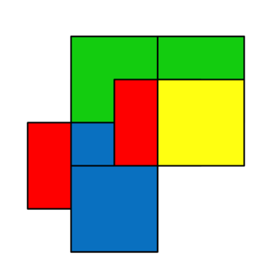
Make Connections
2
Work it out
IF the LARGE blue square has a value of 1, what is the value of each of the colours?
Draw on the image to show your thinking
Blue:
Red:
Yellow:
Green:
What is the value of the entire shape?
Notes:
Student work slide – students can make themselves an additional copy if they need more space.
These tasks ask students to focus on areas and how they are related to each other, without focussing on perimeter.
Source: https://stevewyborney.com/2017/02/3-powerful-tile-strategies-and-40-new-downloadable-pages/

Slide 32
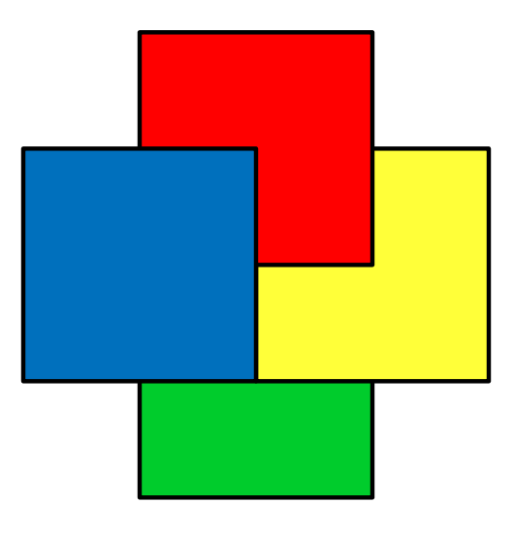
Find the area of each color if the blue square is worth ½ .
Verify your areas using a different method:
Blue:
Red:
Yellow:
Green:
Total area of this shape:
Blue:
Red:
Yellow:
Green:
Total area of this shape:
Notes:
Student work slide – students can make themselves an additional copy if they need more space. This could also be a good exercise to have students sketch with paper and pencil and then submit a photo. They could also explain their thinking in words and use the web application to create their sketches (taking screen shots to include with their thinking).
Source: https://stevewyborney.com/2017/02/3-powerful-tile-strategies-and-40-new-downloadable-pages/

Slide 33
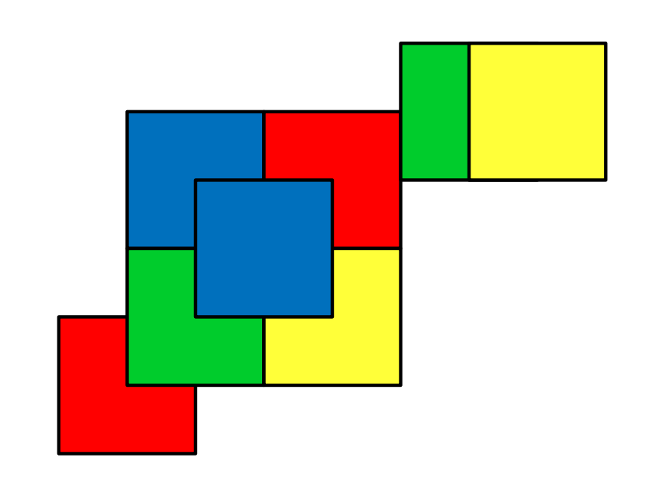
Find the area of each color if the blue square is worth 1.
Verify your areas using a different method:
Blue:
Red:
Yellow:
Green:
Total area of this shape:
Blue:
Red:
Yellow:
Green:
Total area of this shape:
Notes:
Student work slide – students can make themselves an additional copy if they need more space.
Source: https://stevewyborney.com/2017/02/3-powerful-tile-strategies-and-40-new-downloadable-pages/

Slide 34
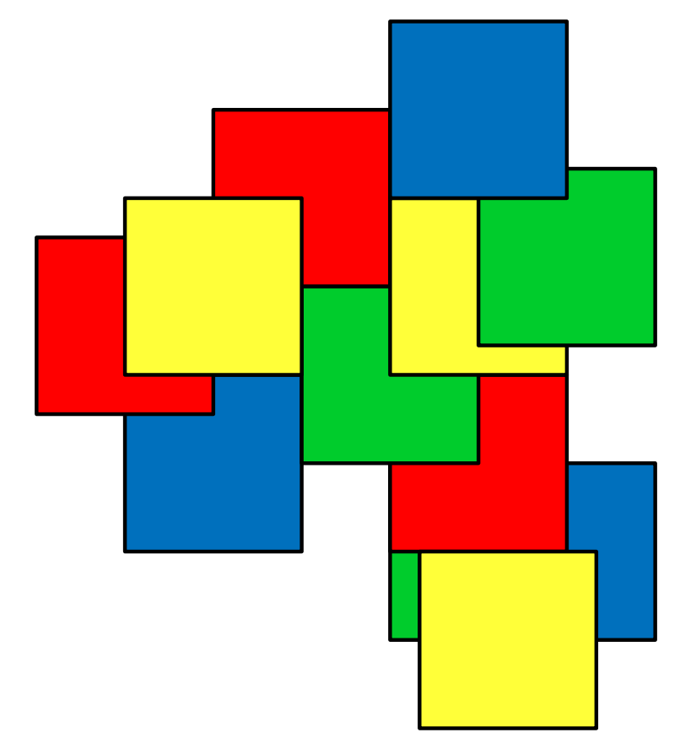
Find the area of each color if the blue square is worth 1.
Verify your areas using a different method:
Blue:
Red:
Yellow:
Green:
Total area of this shape:
Blue:
Red:
Yellow:
Green:
Total area of this shape:
Notes:
Student work slide – students can make themselves an additional copy if they need more space.
Source: https://stevewyborney.com/2017/02/3-powerful-tile-strategies-and-40-new-downloadable-pages/

Slide 35
2
Work it out
End of this section

Slide 36
3
Looking Back
Look around your home and notice all the things that are rather rectangular in shape. Name some of those objects here:
Select one of the objects you listed above. Draw a basic sketch of it:
Make an ESTIMATE of the area of one of its rectangular faces:
Next, find a ruler, meter stick or measuring tape (metric).
Measure the dimensions (length and width) of the rectangular face. Record them on your sketch.
Calculate the actual area of the rectangle using the formula A = l x w.
Notes:
Rectangles in the environment. Asynchronous activity.
Image source: PowerPoint Stock 3D model

Slide 37
3
Looking Back
Select a different object from your list that is quite different in size than your first object. Draw a basic sketch of it:
Make an ESTIMATE of the area of one of its rectangular faces:
Next, find a ruler, meter stick or measuring tape (metric). Measure the dimensions (length and width) of the rectangular face and record them on your sketch.
Calculate the actual area of the rectangle using the formula A = l x w.
Notes:
Rectangles in the environment. Asynchronous activity.
Possible extension activity: Have students explore area using Google Earth. Could ask them to select a particular area (ex, 100m² ) that appears to contain the greatest or fewest number of buildings…have students investigate the differences in density of the populations of different countries…potential here for connections to social studies (geography) and science (forces & structures).
Image source: PowerPoint Stock 3D model

Slide 38
3
Looking Back
End of this section

Slide 39
Problem Solving
1
Get Ready
2
Work it out!
3
Looking Back
Tangram Challenges
Basic Constructions
Animals / Geometry
Advanced
Write About It
Which One Doesn’t Belong?
and
Record It
Notes:
This day will work best if each student has their own copy of the slides. It is recommended that the teacher copy and paste the slides for this lesson into a new PowerPoint that can be shared out to students so they have their own copy of it (do not share the link to give everyone access to the same file, they each need their own).
Activator – number talk, choral count…
Work it out - Challenges make up the focus of the day(s) lesson (you may only have one and all students are assigned the same task, you may have a choice of two or three, or you may have all students begin at challenge 1 and move on as greater challenge is needed / Consolidate & Reflect on what you’ve learned during this part of the project.
Looking Back – a place for reflection/self-assessment

Slide 40
1
Get Ready
Which One Doesn’t Belong?
Notes:
These shapes should look familiar to students from the Tangram exploration activity. Hopefully students will make reference to the shapes themselves and the shapes contained within them, as well as relating the areas to each other.
Image Source: Screen shot of random arrangement of tangrams found at https://toytheater.com/tangram/

Slide 41
1
Get Ready
This is the only one that…
This is the only one that…
This is the only one that…
This is the only one that…
Notes:
Teacher recording sheet. Could be copied for each student to record their own thinking.

Slide 42
1
Get Ready
End of this section

Slide 43
2
Work it out
Tangram Challenges – Basic Constructions
Today we are going to use a set of Tangram pieces from: https://mathigon.org/tangram
When you arrive at Mathigon’s Tangram on-line web tool you will notice that the challenge set selected is Basic. Spend about 10 minutes on this set of challenges.
Snap images of your completed shapes and paste them here (friend, house, tree, boat…):
Notes:
This day is intended to have students work to develop their spatial sense. While not talking about area explicitly in this set of tasks students are developing their thinking and understanding of the shapes and how they “fit together” while exploring the puzzles.
Link to Tangram Manipulative: https://mathigon.org/tangram

Slide 44
2
Work it out
Tangram Challenges – Basic Constructions
Snap images of your completed figure(s) and paste them here:
Notes:
Student work slide – students can make themselves an additional copy if they need more space. This could also be a good exercise to have students sketch with paper and pencil and then submit a photo. They could also explain their thinking in words and use the web application to create their sketches (taking screen shots to include with their thinking).
This day is intended to have students work to develop their spatial sense. While not talking about area explicitly in this set of tasks students are developing their thinking and understanding of the shapes and how they “fit together” while exploring the puzzles.
Link to Tangram Manipulative: https://mathigon.org/tangram

Slide 45
2
Work it out
Tangram Challenges – Animals / Geometry
For your next level of challenges today, select a figure from the Animals or Geometry sets to construct. Complete as many of these as you can. Snap images of your completed figure(s) and paste them on the following slide.
Animals:
Geometry:
Notes:
This day is intended to have students work to develop their spatial sense. While not talking about area explicitly in this set of tasks students are developing their thinking and understanding of the shapes and how they “fit together” while exploring the puzzles.
Link to Tangram Manipulative: https://mathigon.org/tangram

Slide 46
2
Work it out
Tangram Challenges – Animals / Geometry
Snap images of your completed figure(s) and paste them here:
Notes:
Student work slide – students can make themselves an additional copy if they need more space. This could also be a good exercise to have students sketch with paper and pencil and then submit a photo. They could also explain their thinking in words and use the web application to create their sketches (taking screen shots to include with their thinking).
This day is intended to have students work to develop their spatial sense. While not talking about area explicitly in this set of tasks students are developing their thinking and understanding of the shapes and how they “fit together” while exploring the puzzles.
Link to Tangram Manipulative: https://mathigon.org/tangram

Slide 47
2
Work it out
Tangram Challenges – Advanced
Select a figure from the Advanced set of challenges. Complete more than one if you can!
Snap images of your completed shape(s) and paste them here:
Notes:
This day is intended to have students work to develop their spatial sense. While not talking about area explicitly in this set of tasks students are developing their thinking and understanding of the shapes and how they “fit together” while exploring the puzzles.
Link to Tangram Manipulative: https://mathigon.org/tangram

Slide 48
2
Work it out
Tangram Challenges – Advanced
Snap images of your completed figure(s) and paste them here:
Notes:
Student work slide – students can make themselves an additional copy if they need more space. This could also be a good exercise to have students sketch with paper and pencil and then submit a photo. They could also explain their thinking in words and use the web application to create their sketches (taking screen shots to include with their thinking).
This day is intended to have students work to develop their spatial sense. While not talking about area explicitly in this set of tasks students are developing their thinking and understanding of the shapes and how they “fit together” while exploring the puzzles.
Link to Tangram Manipulative: https://mathigon.org/tangram

Slide 49
2
Work it out
End of this section

Slide 50
3
Looking Back
Write about it and record it!
Using all 7 of the tangram pieces that make up a single set, construct a “figure” of your own. It could be a figure that is easily recognizable, a letter or number, a symmetrical shape…the possibilities are endless!
Insert an image of your figure here:
Use the insert audio tool to describe your image.
Notes:
Students could complete this activity asynchronously. They should continue to use the web application to ”play” with the tangrams and then record their work in a way that works for them. Look for evidence of student understanding regarding the composition of the shapes, which can be used to construct others, how the parts relate to the whole…

Slide 51
3
Looking Back
End of this section

Slide 52
Parallelograms
1
Get Ready
2
Work it out!
3
Looking Back
The Basics
Write About It
or,
Activator
Make Connections
Record It
Extend Your Thinking
Notes:
Activator – number talk, choral count…
Work it out - Challenges make up the focus of the day(s) lesson (you may only have one and all students are assigned the same task, you may have a choice of two or three, or you may have all students begin at challenge 1 and move on as greater challenge is needed / Consolidate & Reflect on what you’ve learned during this part of the project.
Looking Back – a place for reflection/self-assessment

Slide 53
1
Get Ready
Get Ready
Which one doesn’t belong?
Notes:
Number Talk – Today we want students to focus in on the composition of shapes, the isosceles triangle can be made of 2 right triangles, the two blue triangles would fit together to make a square, the right triangle can be halved into two smaller right triangles…are there triangles in parallelograms? What about the area? Students will hopefully notice that the green shape is the only one that does NOT fill half of it’s 4x4 square.

Slide 54
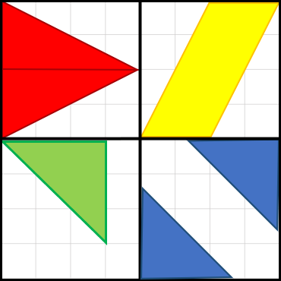
1
Get Ready
This is the only one that…
This is the only one that…
This is the only one that…
This is the only one that…
Notes:
Teacher recording sheet. Could be copied for each student to record their own thinking.

Slide 55
1
Get Ready
End of this section

Slide 56
2
The Basics
Work it out
Examine the parallelograms above. Look carefully at their sides and angles. What properties do we see in all parallelograms?
Do the terms ”length” and “width” work effectively for this shape? Why or why not?
Notes:
Aiming for the defining factors that make a quadrilateral a parallelogram…4 sides, 4 angles, NO right angles, 2 pairs of congruent parallel lines.

Slide 57
2
The Basics
Get Ready
Using the “Insert” – “Shapes” tool, create a parallelogram using any combination of shapes you like; but you may NOT use the parallelogram tool itself!
How do you know that you have created a parallelogram?
What is the area of your parallelogram?
Notes:
TEMPLATE SLIDE – All objects are editable.
Student work slide – students can make themselves an additional copy if they need more space.

Slide 58
2
The Basics
Get Ready
Using the shapes you made on the previous slide (copy & paste them here), can you rearrange them to make a different regular polygon?
What is the area of your new shape?
How do you know?
Notes:
TEMPLATE SLIDE – All objects are editable.
Student work slide – students can make themselves an additional copy if they need more space.

Slide 59
2
Make Connections
Get Ready
Examine the diagrams.
Use words to explain what do you notice?
How does that help us?
Cut here!
Notes:
Teacher Notes
Students should notice that a parallelogram can be rearranged into a rectangle of equal area. We know they are the same area as no area was lost or gained in the shift, the triangle simply moved to the other side. This is where it will be necessary to solidify with students the fact that we use the terms BASE and HEIGHT to describe a parallelogram but they are similar and related to the LENGTH and WIDTH of a rectangle. Ensure students find their way to the formula A=bh. Students can try the shift themselves on the original parallelogram.

Slide 60
Rearrange the parts of the parallelograms to transform each one into an equivalently sized rectangle.
Then, use the formula A= l x w to calculate the area of each rectangle.
Notes:
Teacher Notes
Students should notice that a parallelogram can be rearranged into a rectangle of equal area. We know they are the same area as no area was lost or gained in the shift, the triangle simply moved to the other side. This is where it will be necessary to solidify with students the fact that we use the terms BASE and HEIGHT to describe a parallelogram but they are similar and related to the LENGTH and WIDTH of a rectangle. Ensure students find their way to the formula A=bh. Students can try the shift themselves on the original parallelogram.

Slide 61
2
Make Connections
Get Ready
Are these shapes the same size?
Do they have equal areas?
How do you know?
How did we find the area of the rectangles on the previous slide?
Notes:
Students should notice that a parallelogram can be rearranged into a rectangle of equal area. We know they are the same area as no area was lost or gained in the shift, the triangle simply moved to the other side. This is where it will be necessary to solidify with students the fact that we use the terms BASE and HEIGHT to describe a parallelogram but they are similar and related to the LENGTH and WIDTH of a rectangle. Ensure students find their way to the formula A=bh. Students can try the shift themselves on the original parallelogram.

Slide 62
2
Make Connections
Get Ready
Width?
Width?
Width?
Width?
Which coloured line represents the width of the parallelogram?
Width?
Notes:
Students should notice that a parallelogram can be rearranged into a rectangle of equal area. We know they are the same area as no area was lost or gained in the shift, the triangle simply moved to the other side. This is where it will be necessary to solidify with students the fact that we use the terms BASE and HEIGHT to describe a parallelogram but they are similar and related to the LENGTH and WIDTH of a rectangle. Ensure students find their way to the formula A=bh. Students can try the shift themselves on the original parallelogram.

Slide 63
2
Make Connections
Get Ready
Length?
Length?
Length?
Which coloured line represents the length of the parallelogram?
Length?
Notes:
Students should notice that a parallelogram can be rearranged into a rectangle of equal area. We know they are the same area as no area was lost or gained in the shift, the triangle simply moved to the other side. This is where it will be necessary to solidify with students the fact that we use the terms BASE and HEIGHT to describe a parallelogram but they are similar and related to the LENGTH and WIDTH of a rectangle. Ensure students find their way to the formula A=bh. Students can try the shoft themselves on the original parallelogram.

Slide 64
2
Make Connections
Get Ready
height
We need to use the height of the parallelogram for the two measurements to be equal.
Height/width
Notes:
Students should notice that a parallelogram can be rearranged into a rectangle of equal area. We know they are the same area as no area was lost or gained in the shift, the triangle simply moved to the other side. This is where it will be necessary to solidify with students the fact that we use the terms BASE and HEIGHT to describe a parallelogram but they are similar and related to the LENGTH and WIDTH of a rectangle. Ensure students find their way to the formula A=bh. Students can try the shoft themselves on the original parallelogram.

Slide 65
2
Make Connections
Get Ready
base
base
Notes:
Students should notice that a parallelogram can be rearranged into a rectangle of equal area. We know they are the same area as no area was lost or gained in the shift, the triangle simply moved to the other side. This is where it will be necessary to solidify with students the fact that we use the terms BASE and HEIGHT to describe a parallelogram but they are similar and related to the LENGTH and WIDTH of a rectangle. Ensure students find their way to the formula A=bh. Students can try the shoft themselves on the original parallelogram.

Slide 66
2
Make Connections
Get Ready
height
What formula can we use to find the area of any parallelogram?
A = b x h
base
height
base
Notes:
Teacher Notes
At this point, students should be able to generalize the formula for finding the area of any parallelogram. This slide can be used as a consolidation/discussion for how we can find the area of any parallelogram and how this generalization connects to rectangles. As a class, you can find the area of the parallelogram using the formula.
The text in the dashed box can be slid upwards to reveal the formula during class instruction/discussion once students have defined it.
This also presents an opportunity to using proper organization for using a formula to find areas.

Slide 67
2
Work it out
End of this section

Slide 68
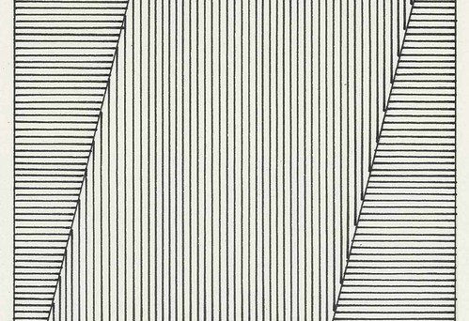
3
Looking Back
Often, we find parallelograms in art. To the right is a piece by artist Sol LeWitt (1979) and the Dockland Building in Hamburg, Germany (2006).
Create your own parallelogram art or structure and then find out the area of the piece by measuring the base and height of each parallelogram.
Notes:
Slide for Part III, this is where instructions for reflection, journal prompts, a consolidation question…go. Again, copy and paste as needed for your purpose.
Image Source: "[ L ] Sol LeWitt - Parallelogram (1979) - Detail" by Cea. is licensed under CC BY 2.0
"Views of Hamburg City - The DockLand Building" by ANBerlin [Ondré] is licensed under CC BY-NC-SA 2.0

Slide 69
3
Looking Back
End of this section
*Additional resources for area of a rectangle on next slide.

Slide 70
Additional Teacher Resources:
PARALLELOGRAM – Playing With Animations - GEOGEBRA
GeoGebra applets (animations) - area of a parallelogram
Parallelogram Area
Area of Parallelograms
Area of a parallelogram
These applets can be used as demonstrations to support a lesson or you could have students explore the animation and respond to what they see.
Lessons and Practice activities from Illustrative Mathematics designed through GeoGebra and include exploration and require student responses.
Create a parallelogram with a given area
Parallelogram: Area
Notes:
TEACHER SLIDE (move or delete before using slideshow with students).
These resources can be integrated in your synchronous lessons (use an animation as a number talk for example), or they can be assigned to students to investigate asynchronously.
The lessons practice activities should be reviewed first by the teacher to ensure content is covered in a way that is appropriate to your students. These could be used effectively as asynchronous work or to help students solidify or check their understanding.

Slide 71
Problem Solving
1
Get Ready
2
Work it out!
3
Looking Back
Area Challenges
Partitioning Parallelograms
Build it to Spec!
Write About It
Notice
&
Wonder
and
Record It
Notes:
This day will work best if each student has their own copy of the slides. It is recommended that the teacher copy and paste the slides for this lesson into a new PowerPoint that can be shared out to students so they have their own copy of it (do not share the link to give everyone access to the same file, they each need their own).
Activator – number talk, choral count…
Work it out - Challenges make up the focus of the day(s) lesson (you may only have one and all students are assigned the same task, you may have a choice of two or three, or you may have all students begin at challenge 1 and move on as greater challenge is needed / Consolidate & Reflect on what you’ve learned during this part of the project.
Looking Back – a place for reflection/self-assessment

Slide 72
1
Get Ready
What do you notice?
What do you wonder?
Notes:
For teacher reference: Please watch if you are unfamiliar with this “proof”, so you can facilitate appropriate group discussion.
Please do NOT share video with students at this point as it will be used in an upcoming lesson: https://youtu.be/YokKp3pwVFc
Image Source: by creator

Slide 73
1
Get Ready
What do you notice?
What do you wonder?
Notes:
Teacher recording sheet. Could be copied for each student to record their own thinking.
Image Source: by creator

Slide 74
1
Get Ready
End of this section

Slide 75
2
Work it out
Partitioning Parallelograms
Timmy says a parallelogram can always be divided up into a rectangle and two matching triangles.
Tommy says all parallelograms can be divided into exactly 2 matching triangles.
Who do you agree with? Use drawings to help you explain your thinking.
Notes:
Student work slide – students can make themselves an additional copy if they need more space.
This day is intended to have students work to develop their spatial sense and make connections to both the idea of area itself and how the areas of the shapes relate to each other.
Image source: https://webstockreview.net/explore/boys-clipart-student/

Slide 76
2
Work it out
Build it to Spec!
Construct a rectangle and a parallelogram such that the area of the rectangle is exactly half the area of the parallelogram.
Explain how you know your shapes fit the specs!
Notes:
Student work slide – students can make themselves an additional copy if they need more space.
Students should recognize that the length and width of the rectangle exactly match the base and height of the parallelogram.

Slide 77
2
Work it out
Build it to Spec!
Sketch and show the dimensions of a square, a parallelogram and a rectangle that is not a square such that…
the area of the square is exactly half the area of the parallelogram, and…
the area of the rectangle is exactly double the area of the parallelogram.
Explain how you know your shapes fit the specs!
Notes:
Student work slide – students can make themselves an additional copy if they need more space.
In this problem students need to recognize that a specific area can take multiple forms (shapes). Halving and doubling the areas to create other shapes will illustrate that the area changes…which is where we are headed next with the exploration of triangles.

Slide 78
2
Work it out
Build it to Spec!
Sketch and show the dimensions of a square, a parallelogram and a rectangle such that…
the area of the square is three times the area of the parallelogram and,
the area of the rectangle is exactly half the area of the parallelogram.
Explain how you know your shapes fit the specs!
Notes:
Student work slide – students can make themselves an additional copy if they need more space.
This time students are asked to deal with thirds as well for an added challenge.

Slide 79
2
Work it out
End of this section

Slide 80
3
Looking Back
Write about it and record it!
Write your own creative problem comparing a rectangle, a square, and a parallelogram.
Make sure your problem is solvable! (on the next slide show the solution to your problem).
Notes:
Students could complete this activity asynchronously. They can use the shape tools to play with relationships and then record their work in a way that works for them. Look for evidence of student understanding regarding the composition of the shapes, which can be used to construct others, how the parts relate to the whole…

Slide 81
3
Looking Back
End of this section

Slide 82
Problem Solving
1
Get Ready
2
Work it out!
3
Looking Back
Growing Shapes
Parallelograms
Triangles
Write About It
Notice
&
Wonder
and
Record It
This From That
Rectangles
Parallelograms
Notes:
This day will work best if each student has their own copy of the slides. It is recommended that the teacher copy and paste the slides for this lesson into a new PowerPoint that can be shared out to students so they have their own copy of it (do not share the link to give everyone access to the same file, they each need their own).
Activator – number talk, choral count…
Work it out - Challenges make up the focus of the day(s) lesson (you may only have one and all students are assigned the same task, you may have a choice of two or three, or you may have all students begin at challenge 1 and move on as greater challenge is needed / Consolidate & Reflect on what you’ve learned during this part of the project.
Looking Back – a place for reflection/self-assessment

Slide 83
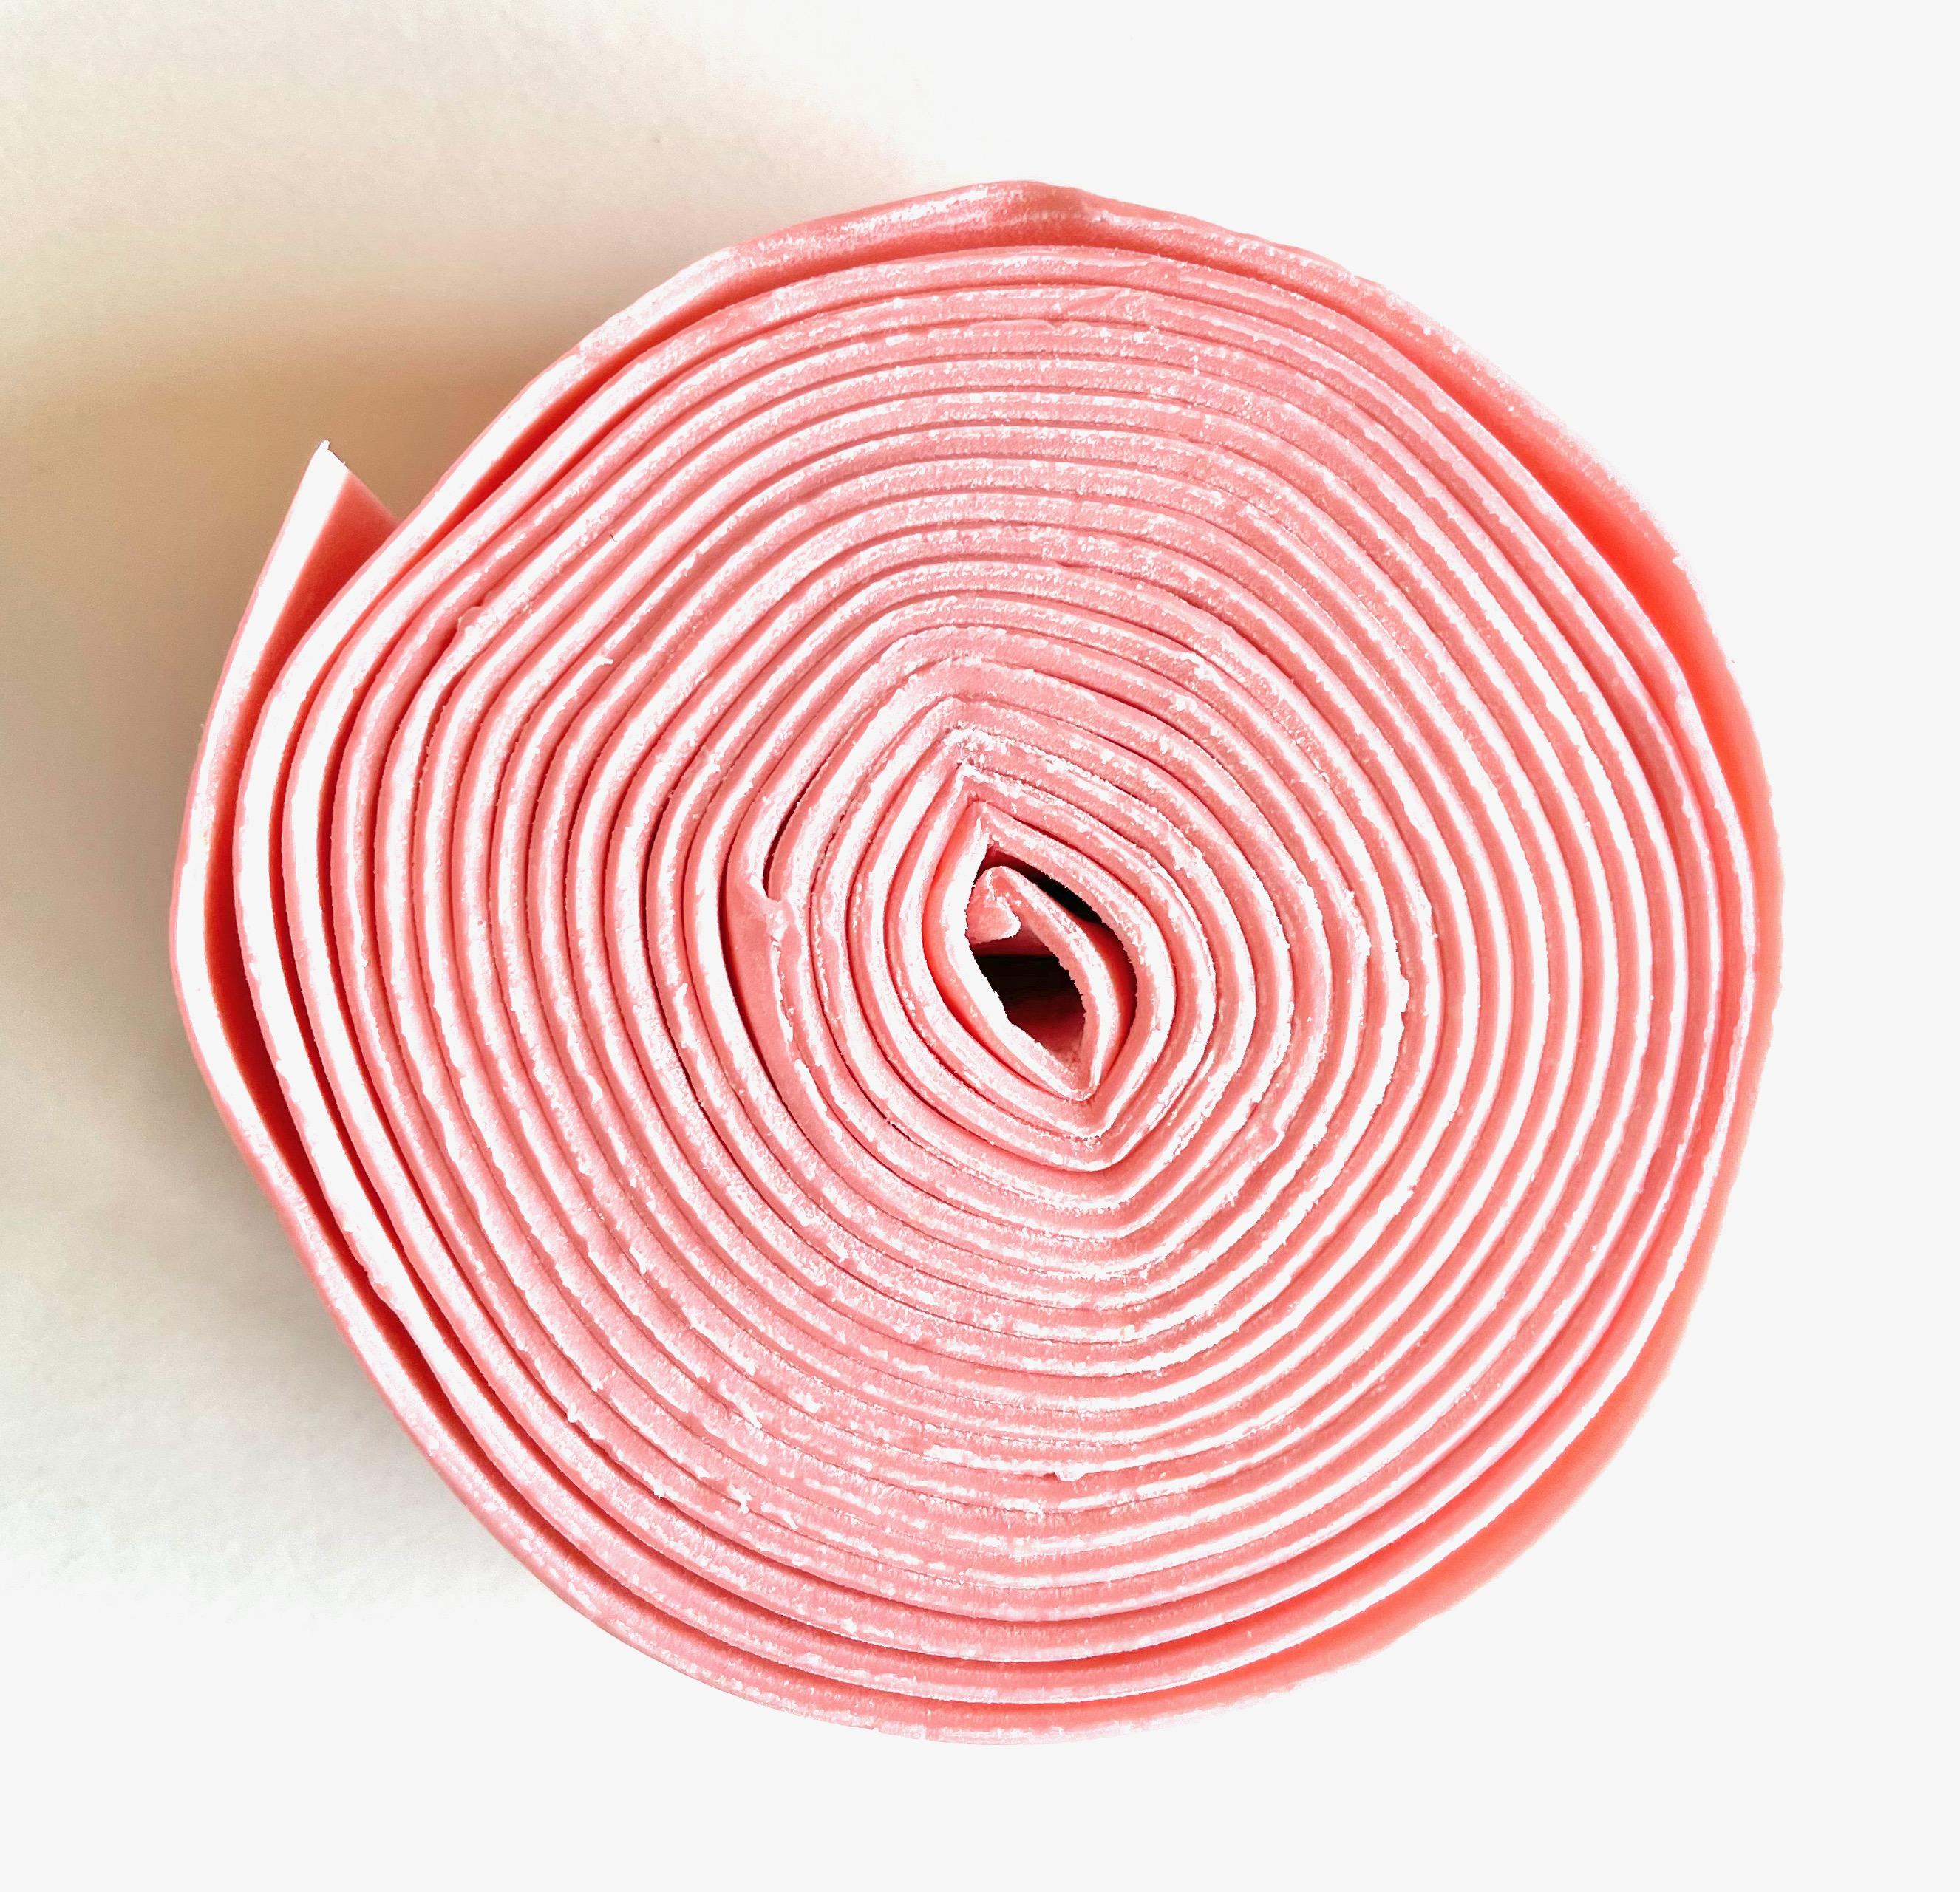
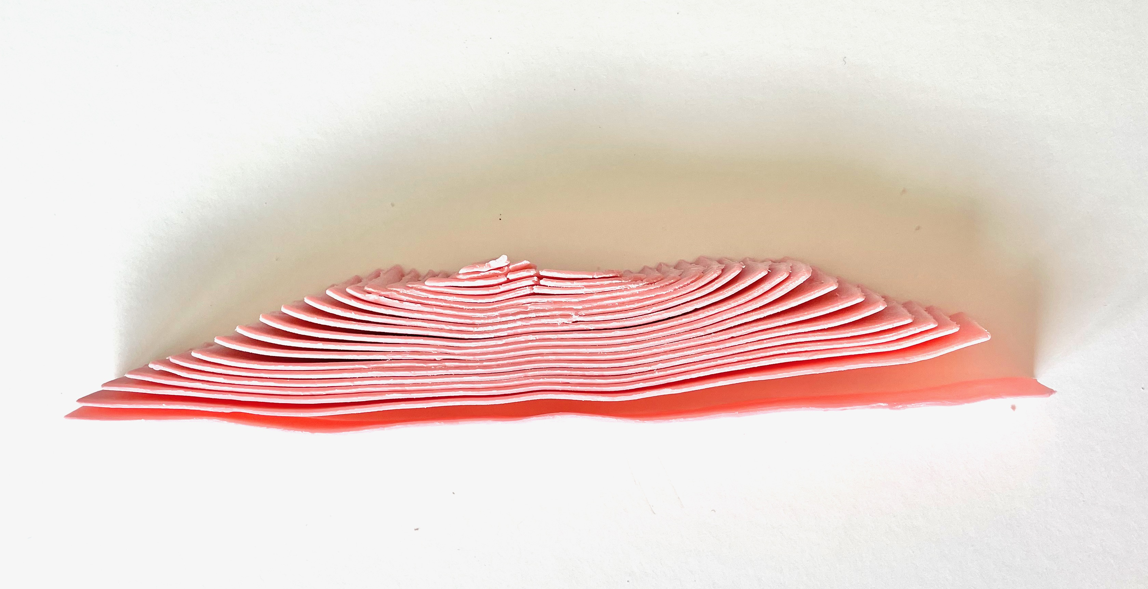
1
Get Ready
What do you notice?
What do you wonder?
Notes:
For teacher reference: Please watch if you are unfamiliar with this “proof”, so you can facilitate appropriate group discussion: https://youtu.be/Sx-5YJbszuI
Image Source: by creator

Slide 84
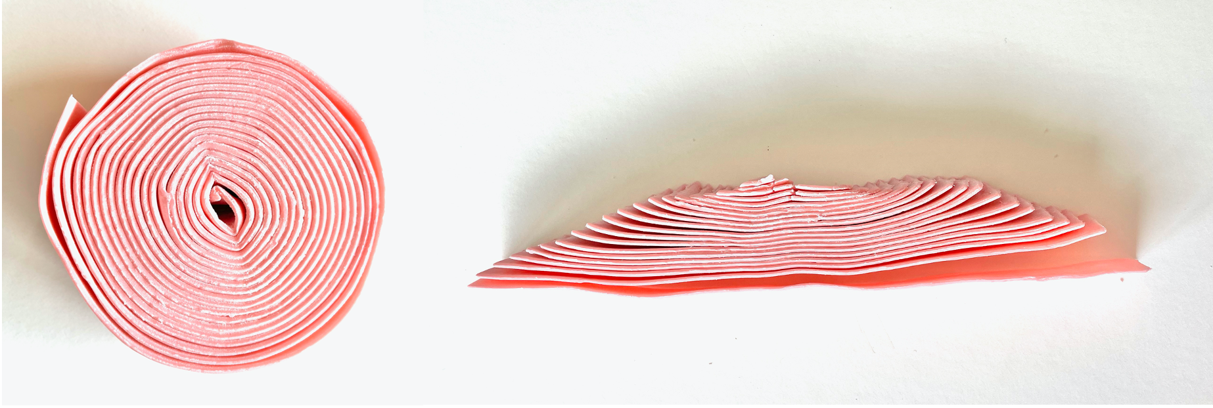
1
Get Ready
What do you notice?
What do you wonder?
Notes:
Teacher recording sheet. Could be copied for each student to record their own thinking.
Image Source: by creator

Slide 85
1
Get Ready
End of this section

Slide 86
Work it out
1
Growing Shapes

Slide 87
2
Work it out
Growing Parallelograms
Can matching parallelogram tiles be used to create larger parallelograms?
Would any amount of parallelograms work?
Show some examples to defend your answer:
Notes:
Student work slide – students can make themselves an additional copy if they need more space.
This problem is intended to get students thinking about building shapes out of parallelograms. Do they notice that some amounts are more “flexible” than others?

Slide 88
2
Work it out
Growing Parallelograms
Have a closer look at how different amounts of parallelogram tiles can be arranged to create larger parallelograms.
Do you notice a difference in the arrangement of the tiles when using an odd vs an even number of parallelograms?
Explain your findings.
Notes:
Student work slide – students can make themselves an additional copy if they need more space.
Even amounts can be arranged in any shape “array” for the factors of the number.
Odd amounts can be arranged in this manner as long as they are not prime.
Prime numbers are the only numbers that can’t be arranged as an array with side length greater than 1. This could present an interesting conversation for discovering prime numbers (connect with divisibility - 7.N.1)

Slide 89
2
Work it out
Growing Triangles
Is it possible to construct a large triangle using only matching triangles?
If so, how many matching triangles could be used to create a larger version of the same type of triangle?
Show some examples to illustrate your answer:
Notes:
Student work slide – students can make themselves an additional copy if they need more space.
This problem is intended to get students thinking about building shapes out of triangles and what the number of triangles tells us about the rectangles compared to the triangles within it.

Slide 90
2
Work it out
Growing Triangles
Do all types of triangles work the same?
Show/explain your thinking.
Notes:
Student work slide – students can make themselves an additional copy if they need more space.
This problem is intended to get students thinking about building shapes out of triangles and what the number of triangles tells us about the rectangles compared to the triangles within it.

Slide 91
Work it out
2
Make This From That

Slide 92
2
Work it out
Make This From That - rectangles
Is it possible to construct a rectangle using only matching triangle tiles?
If so, how many matching triangles could be used to create a rectangle?
Show some examples to illustrate your answer:
Notes:
This problem is intended to get students thinking about building shapes out of triangles and what the number of triangles tells us about the rectangles compared to the triangles within it.

Slide 93
2
Work it out
Make This From That - rectangles
Are there some amounts of matching triangles that WILL work to create rectangles and some amounts that WON’T work? Justify your thinking.
Does the type of triangle matter (right/equilateral…acute/obtuse)?
Notes:
Student work slide – students can make themselves an additional copy if they need more space.
This day is intended to have students work to develop their spatial sense. While not talking about area explicitly in this set of tasks students are developing their thinking and understanding of the shapes and how they “fit together” while exploring the puzzles.
Link to Tangram Manipulative: https://mathigon.org/tangram

Slide 94
2
Work it out
Make This From That - parallelograms
Is it possible to construct a parallelogram using only matching triangles?
If so, how many matching triangles can be used to create a parallelogram?
Show some examples to illustrate your answer:
Notes:
Student work slide – students can make themselves an additional copy if they need more space.
This day is intended to have students work to develop their spatial sense. While not talking about area explicitly in this set of tasks students are developing their thinking and understanding of the shapes and how they “fit together” while exploring the puzzles.
Link to Tangram Manipulative: https://mathigon.org/tangram

Slide 95
2
Work it out
End of this section

Slide 96
3
Looking Back
Write about it and record it!
In this set of tasks you explored how rectangles, parallelograms and triangles relate to each other. The number talk (roll of gum) had you thinking about the area of a circle.
Could triangles be used to find the area of a circle?
How could triangles and circles be related?
Notes:
Students could complete this activity asynchronously. This should provide some insight into student thinking about how ALL these shapes are related.

Slide 97
3
Looking Back
End of this section

Slide 98
Triangles
1
Get Ready
2
Work it out!
3
Looking Back
The Basics
Write About It
Which One Doesn’t Belong?
or,
Make Connections
Record It
Extend Your Thinking
Notes:
Activator – number talk, choral count…
Work it out - Challenges make up the focus of the day(s) lesson (you may only have one and all students are assigned the same task, you may have a choice of two or three, or you may have all students begin at challenge 1 and move on as greater challenge is needed / Consolidate & Reflect on what you’ve learned during this part of the project.
Looking Back – a place for reflection/self-assessment

Slide 99
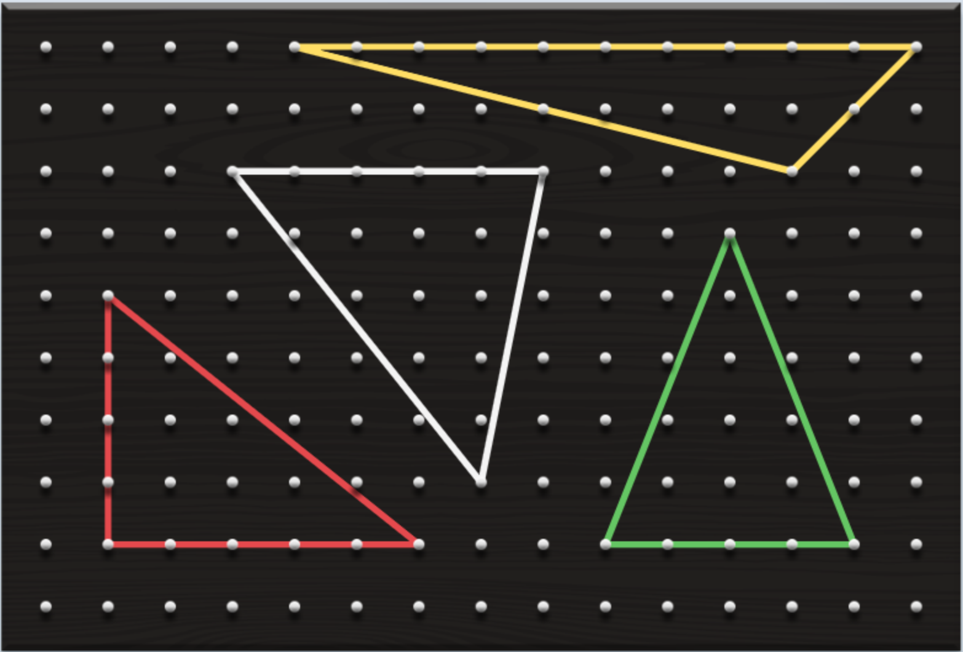
1
Get Ready
Which one doesn’t belong?
Notes:
Image Source: by creator using geoboard manipulative at: https://apps.mathlearningcenter.org/geoboard/

Slide 100
1
Get Ready
Which one doesn’t belong?
The WHITE triangle is the only one that…
The YELLOW triangle is the only one that…
The RED triangle is the only one that…
The GREEN triangle is the only one that…
Notes:
Image Source: by creator using geoboard manipulative at: https://apps.mathlearningcenter.org/geoboard/

Slide 101
1
Get Ready
End of this section

Slide 102
2
The Basics
Work it out
Using the geoboard web app (click here), create a rectangle anywhere on the grid. Use the LARGER (9X14) GRID.
What is the area of your rectangle?
How do you know?
Insert a picture of your rectangle to the right.
Notes:
Student work slide – students can make themselves an additional copy if they need more space. This could also be a good exercise to have students sketch with paper and pencil and then submit a photo. They could also explain their thinking in words and use the web application to create their sketches (taking screen shots to include with their thinking).
Teacher Notes
Students should remember from previous learning experiences and grades the formula for finding the area of any rectangle. We plan to use this understanding to explore area of triangles and the connection between the two shapes’ areas.

Slide 103
2
The Basics
Work it out
Using the geoboard web app (click here), create a rectangle anywhere on the grid. Use the LARGER (9X14) GRID.
Now, draw a line from one of the upper corners of the rectangle to the diagonally opposite lower corner.
What is the area of each of the two triangles your line created?
How do you know?
Insert a picture of your rectangle to the right.
Notes:
Student work slide – students can make themselves an additional copy if they need more space. This could also be a good exercise to have students sketch with paper and pencil and then submit a photo. They could also explain their thinking in words and use the web application to create their sketches (taking screen shots to include with their thinking).
Teacher Notes
Connecting area of rectangles to area of triangles. Students should notice that the areas have not changed with nothing being deleted by cutting the rectangle on the diagonal. Using the terms base and height over length and width will further help students connect the formulas for the two shapes. We can guide students to notice that the height of the rectangle and triangles are equivalent as well as the base of the shapes are equivalent. Next, students should see that the triangles are half the size of the rectangle, hence giving us a way of determining the area of the triangles.

Slide 104
2
The Basics
Work it out
Using the geoboard web app (click here), create a rectangle anywhere on the grid. Use the LARGER (9X14) GRID.
Now draw two lines, one from each of the lower corners and connecting anywhere on the upper length of the rectangle. Make sure that your lines meet!
What is the area of each of the three triangles that your lines created?
How do you know?
Insert a picture of your rectangle to the right.
Notes:
Student work slide – students can make themselves an additional copy if they need more space. This could also be a good exercise to have students sketch with paper and pencil and then submit a photo. They could also explain their thinking in words and use the web application to create their sketches (taking screen shots to include with their thinking).
Teacher Notes
Students should be able to explain that the sum of the three triangles is exactly half of the large rectangle.
Students should use their knowledge of the triangle being half of the rectangle to find the areas of the three triangles created. If students are not yet using the standard area formula, teachers can guide them to finding the triangles by creating smaller rectangles that would be double the size of their corresponding triangles. Students would then find the area of the three rectangles created, and then half them to determine the area of each triangle.

Slide 105
2
The Basics
Work it out
Using the geoboard web app (click here), create two identical triangles anywhere on the grid. Use the LARGER (9X14) GRID.
What is the total area of the two triangles that you created?
How did you figure it out?
Do you notice a pattern yet?
Insert a picture of your geoboard to the right.
Notes:
Student work slide – students can make themselves an additional copy if they need more space. This could also be a good exercise to have students sketch with paper and pencil and then submit a photo. They could also explain their thinking in words and use the web application to create their sketches (taking screen shots to include with their thinking).
Teacher Notes
Students should use their knowledge of the triangle being half of the rectangle to find the areas of the two triangles created. If students are not yet using the standard area formula, teachers can guide them to finding the triangles by creating smaller rectangles that would be double the size of their corresponding triangles. Students would then find the area of the rectangles and half them to determine the area of each triangle.

Slide 106
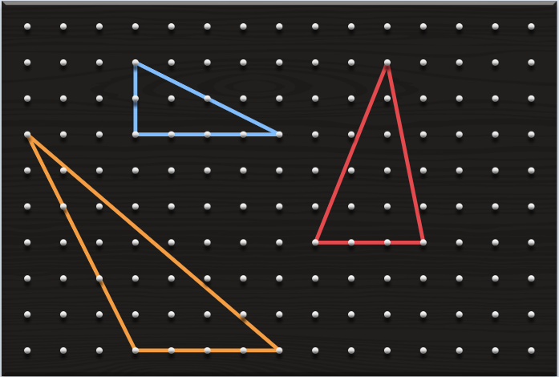
The Basics
2
Work it out
What formula can we use to find the area of any triangle?
A = $\frac{b x h}{2}$
Notes:
Teacher Notes
At this point, students should be able to generalize the formula for finding the area of any triangle. This slide can be used as a consolidation/discussion for how we can find the area of any triangle and how this generalization connects to rectangles. As a class, you can find the area of the triangles using the formula.
The text in the dashed box can be slid upwards to reveal the formula during class instruction/discussion once students have defined it.
This also presents an opportunity to using proper organization for using a formula to find areas.

Slide 107
2
Work it out
End of this section

Slide 108
3
Looking Back
Create 3 triangles that all have the same area but look quite different from each other (not just in colour)! Use the Geoboard app found at the Math Learning Center.
Paste an image of your geoboard here & show how you know they all have the same area.
Notes:
Slide for Part III, this is where instructions for reflection, journal prompts, a consolidation question…go. Again, copy and paste as needed for your purpose.

Slide 109
3
Looking Back
End of this section
*Additional resources for area of a rectangle on next slide.

Slide 110
Additional Teacher Resources:
TRIANGLES – Playing With Animations - GEOGEBRA
GeoGebra applets (animations) - area of a triangle
Area of a right triangle demo
Area of a triangle compared to area of a rectangle (shows formulas)
Area of a triangle demo (using perpendicular)
Create a triangle with a given area
These applets can be used as demonstrations to support a lesson or you could have students explore the animation and respond to what they see.
Lessons and Practice activities from Illustrative Mathematics designed through GeoGebra and include exploration and require student responses.
Finding Area by Decomposing and Rearranging
Create a Triangle with Given Area: Quick Formative Assessment
Notes:
TEACHER SLIDE (move or delete before using slideshow with students).
These resources can be integrated in your synchronous lessons (use an animation as a number talk for example), or they can be assigned to students to investigate asynchronously.
The lessons practice activities should be reviewed first by the teacher to ensure content is covered in a way that is appropriate to your students. These could be used effectively as asynchronous work or to help students solidify or check their understanding.

Slide 111
Problem Solving
1
Get Ready
2
Work it out!
3
Looking Back
Write About It
Notice
&
Wonder
36 Fences
or,
Record It
Notes:
Activator – number talk, choral count…
Work it out - Challenges make up the focus of the day(s) lesson (you may only have one and all students are assigned the same task, you may have a choice of two or three, or you may have all students begin at challenge 1 and move on as greater challenge is needed / Consolidate & Reflect on what you’ve learned during this part of the project.
Looking Back – a place for reflection/self-assessment

Slide 112
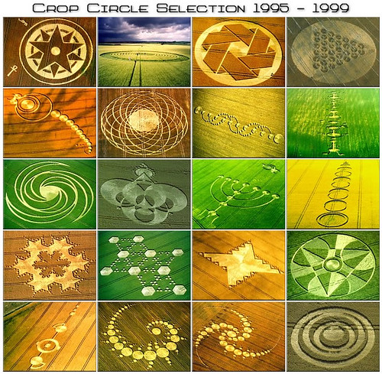
1
Get Ready
What do you notice?
What do you wonder?
Notes:
Image Source: "Crop Circles 1995-1999" by crystaleagle is licensed under CC BY-NC-ND 2.0

Slide 113
1
Get Ready
What do you notice?
What do you wonder?
Notes:
Teacher recording sheet. Could be copied for each student to record their own thinking.
Image Source: "Crop Circles 1995-1999" by crystaleagle is licensed under CC BY-NC-ND 2.0

Slide 114
1
Get Ready
End of this section

Slide 115
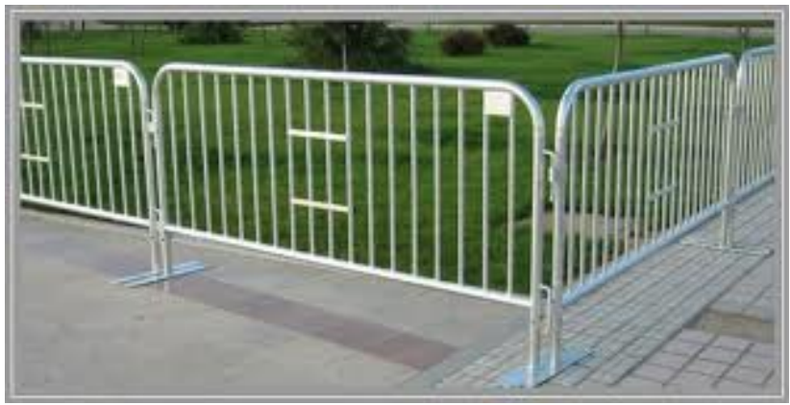
2
Work it out
A farmer has 36 individual lengths of fence. Each is 1 meter long.
What is the smallest area that can be enclosed using all 36 fences?
What is the largest area that can be enclosed using all 36 fences?
Notes:
Teacher Notes
This has been set up to introduce the problem using the 3-Read Protocol (http://www.sfusdmath.org/3-read-protocol.html). Once complete, students can work individually or in breakout rooms if available.
Slide for Part II, the main focus of the work for this part of the activity. Copy and paste as many as you need for your purpose.
Source: Boaler, J., The Elephant in the Classroom: Hearing Children Learn and Love Maths. UK: Souvenir Press, 2009.

Slide 116
36 Fences
GROUP SCORE BOARD:
Largest Area found so far… ##
Smallest Area found so far… ##
BREAKOUT ROOM #
Instructions: What is the largest/smallest possible area with 36 – 1m fences?
These are your
36 fences.
Notes:
This is a template slide for breakout rooms. It is suggested that students work in small groups (4-5) to talk through and experiment with the problem. You would copy and paste a slide for each of the groups you will have. If using TEAMS, you would push them out into breakout rooms so they can discuss, however their work would take place on their slide here in the PowerPoint. You may have another method of delivery depending on the platform you are using.
Copy this slide for the number of Breakout Rooms you intend to have (4-5 students per room is best). Conversely, you can modify this slide so that each individual student has a slide.

Slide 117
2
Work it out
End of this section

Slide 118
3
Looking Back
In the real world, there are times where we want or need larger or smaller areas or perimeters. Describe a situation where either a large area with a small perimeter or a small area with a large perimeter is important.
Pick two of the 2 dimensional shapes form the following list and explain how they are related to each other. Repeat, at least one of your shapes must change.
Rectangle
Triangle
Parallelogram
Circle
Notes:
Consolidation / Reflection – Could be assigned as an Asynchronous follow-up activity. Watch for students making connections between the first 3 shapes and the circle.

Slide 119
3
Looking Back
End of this section

Slide 120
Circles - Circumference
1
Get Ready
2
Work it out!
3
Looking Back
The Basics
Write About It
Which One Doesn’t Belong?
or,
Make Connections
Record It
Extend Your Thinking
Notes:
Activator – number talk, choral count…
Work it out - Challenges make up the focus of the day(s) lesson (you may only have one and all students are assigned the same task, you may have a choice of two or three, or you may have all students begin at challenge 1 and move on as greater challenge is needed / Consolidate & Reflect on what you’ve learned during this part of the project.
Looking Back – a place for reflection/self-assessment

Slide 121
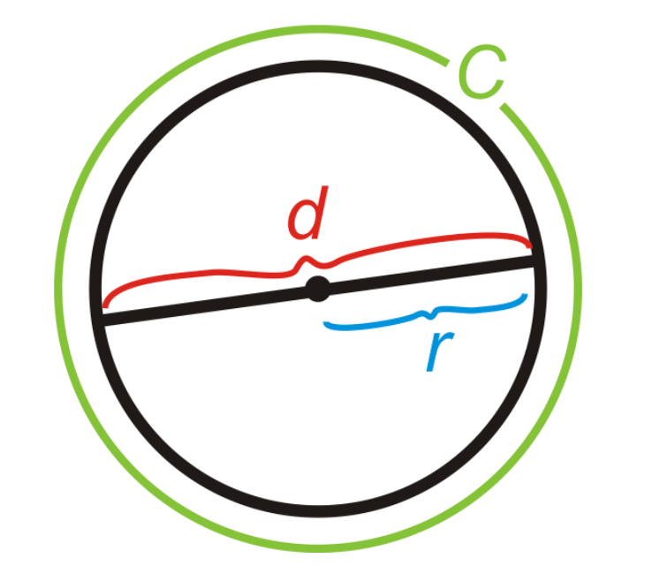
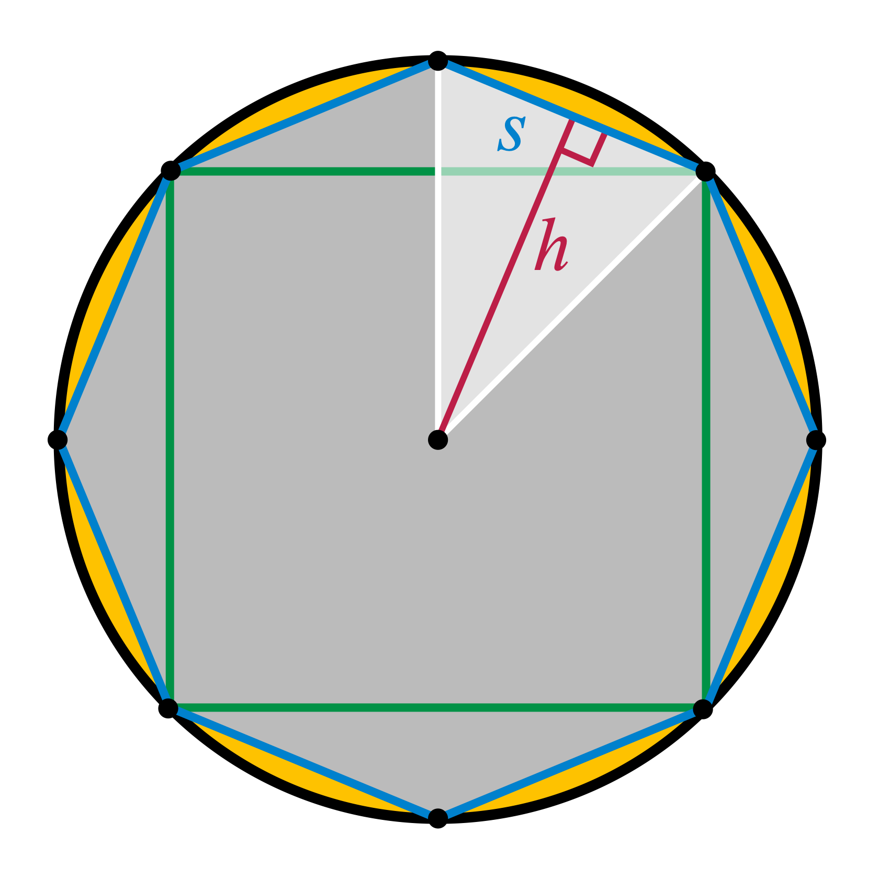
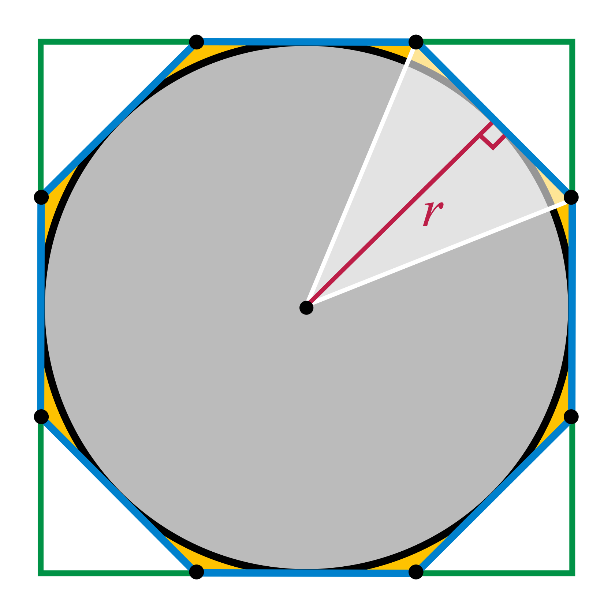
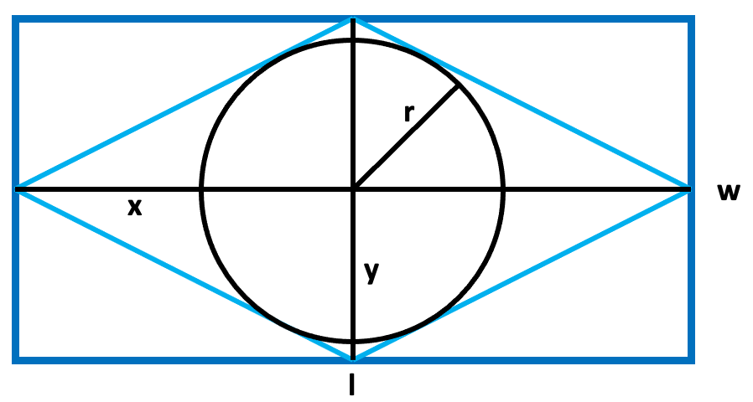
1
Get Ready
Which one doesn’t belong?
Notes:
Vocabulary – the intention if this slide is to pre-assess student knowledge of the terms we use to measure a circle. Hopefully students will make observations and comparisons between the different measurements that are labelled for various different shapes. On the following slide you will construct the definitions for circumference, diameter and radius.
Image Sources:
https://www.ck12.org/geometry/circumference/lesson/Circumference-BSC-GEOM/
https://commons.wikimedia.org/wiki/File:Archimedes_circle_area_proof_-_inscribed_polygons.svg
https://commons.wikimedia.org/wiki/File:Archimedes_circle_area_proof_-_inscribed_polygons.svg

Slide 122
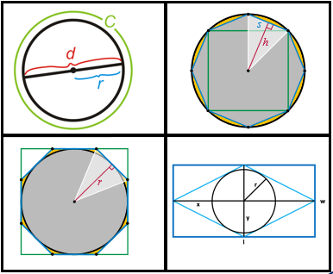
1
Get Ready
This is the only one that…
This is the only one that…
This is the only one that…
This is the only one that…
Notes:
Teacher recording sheet. Could be copied for each student to record their own thinking.

Slide 123
1
Get Ready
End of this section

Slide 124
2
The Basics
Work it out
Circumference:
The distance around a circle.
Diameter:
The distance across a circle, from one point on the circumference to another that passes through the middle.
Radius:
The distance from the center of a circle to any point on its circumference.
Notes:
Have students describe the properties of each measurement. Uncover definition by deleting the dotted grey box.

Slide 125
2
Make Connections
Work it out
Resize the circle to the right to have a radius of 2.
Tip: Hold “SHIFT” while resizing the circle.
Use the image to estimate the missing measurements:
Radius = 2 units
Diameter =
Area =
Circumference =
Notes:
Student work slide – students can make themselves an additional copy if they need more space.
Teacher Notes
Students will use basic counting to look for connections between the 4 measurements of the circle. The goal is for them to notice that the radius is exactly half of the diameter or that the diameter is double the radius. Also, they should notice a relationship between the diameter and circumference (that the circumference is about three times the diameter). Students will be at different points in their understanding of $π$. At this point, it does not need to be discussed which will allow students to internalize the relationship as a multiplier of the diameter to find the circumference.

Slide 126
2
Make Connections
Work it out
Resize the circle to the right to have a radius of 5.
Tip: Hold “SHIFT” while resizing the circle.
Use the image to estimate the missing measurements:
Radius = 2 units
Diameter =
Area =
Circumference =
Notes:
Student work slide – students can make themselves an additional copy if they need more space.
Teacher Notes
Students will use basic counting to look for connections between the 4 measurements of the circle. The goal is for them to notice that the radius is exactly half of the diameter or that the diameter is double the radius. Also, they should notice a relationship between the diameter and circumference (that the circumference is about three times the diameter). Students will be at different points in their understanding of $π$. At this point, it does not need to be discussed which will allow students to internalize the relationship as a multiplier of the diameter to find the circumference.

Slide 127
2
Make Connections
Work it out
Resize the circle to the right to have a radius of your choosing.
Tip: Hold “SHIFT” while resizing the circle.
Use the image to estimate the missing measurements:
Radius = 2 units
Diameter =
Area =
Circumference =
Notes:
Student work slide – students can make themselves an additional copy if they need more space.
Teacher Notes
Students will use basic counting to look for connections between the 4 measurements of the circle. The goal is for them to notice that the radius is exactly half of the diameter or that the diameter is double the radius. Also, they should notice a relationship between the diameter and circumference (that the circumference is about three times the diameter). Students may begin to discuss $π$ and that it can be multiplied by the diameter to find the circumference. Generalizations should begin to surface by this point.

Slide 128
2
Extend Your Thinking
Work it out
On the circle, draw a green line to indicate the radius.
Next, draw a red line to indicate the diameter.
What do you notice?
What do you wonder?
Notes:
Student work slide – students can make themselves an additional copy if they need more space.
Teacher Notes
Students should be able to explain the relationship between the radius and diameter without a standard formula.

Slide 129
2
Extend Your Thinking
Work it out
What is the relationship between the radius and the diameter?
The radius is half the diameter, or the diameter is twice the radius.
$d=2$r
or
r = ½(d)
Notes:
Teacher Notes
At this point, students should be able to generalize the formula for understanding the relationship between the radius and diameter. This slide can be used as a consolidation/discussion for how we can find the radius/diameter of any circle given that we know the other measurement.
The text in the dashed box can be slid upwards to reveal the formula during class instruction/discussion once students have defined it.
This also presents an opportunity to using proper organization for using a formula to find these measurements.

Slide 130
2
Extend Your Thinking
Work it out
On the circle, draw a blue line to indicate the circumference.
Next, draw a red line to indicate the diameter.
What do you notice?
What do you wonder?
Tip: Look back to slides 114 – 116
Notes:
Student work slide – students can make themselves an additional copy if they need more space.
Teacher Notes
Students should be able to explain the relationship between the diameter and circumference without a standard formula.

Slide 131
2
Extend Your Thinking
Work it out
Get Ready
What is the relationship between the circumference and the diameter?
The circumference is a little more than 3 times the diameter.
C $=πd$
or
C/d = $π$
Notes:
Teacher Notes
At this point, students should be able to generalize the formula for understanding the relationship between diameter, circumference and $π$. This slide can be used as a consolidation/discussion for how we can find the circumference of any circle given that we know the diameter/radius.
The text in the dashed box can be slid upwards to reveal the formula during class instruction/discussion once students have defined it.
This also presents an opportunity to using proper organization for using a formula to find circumference.

Slide 132
2
Work it out
End of this section

Slide 133
3
Looking Back
Watch the video (more than once if you like)!
In your own words, explain what $π$ is.
Give more than just its numerical value, explain what it is.
Notes:
Consolidation / Reflection – Could be assigned as an Asynchronous follow-up activity. Watch for students making connections.

Slide 134
3
Looking Back
End of this section
*Additional resources for area of a rectangle on next slide.

Slide 135
Additional Teacher Resources:
CIRCLES – Playing With Animations - GEOGEBRA
GeoGebra applets (animations) – Circumference
Rolling a Circle to Find Pi
Circumference = ? (Animation I)
Circumference = ? (Animation II)
Circumference of Circles
These applets can be used as demonstrations to support a lesson or you could have students explore the animation and respond to what they see.
Notes:
TEACHER SLIDE (move or delete before using slideshow with students).
These resources can be integrated in your synchronous lessons (use an animation as a number talk for example), or they can be assigned to students to investigate asynchronously.

Slide 136
Circles - Area
1
Get Ready
2
Work it out!
3
Looking Back
The Basics
Write About It
Notice
&
Wonder
or,
Make Connections
Record It
Extend Your Thinking
Notes:
Activator – number talk, choral count…
Work it out - Challenges make up the focus of the day(s) lesson (you may only have one and all students are assigned the same task, you may have a choice of two or three, or you may have all students begin at challenge 1 and move on as greater challenge is needed / Consolidate & Reflect on what you’ve learned during this part of the project.
Looking Back – a place for reflection/self-assessment

Slide 137
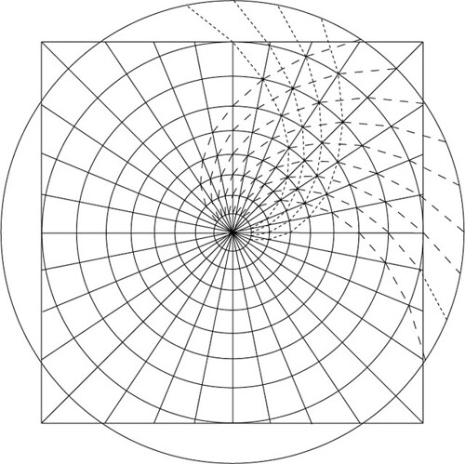
1
Get Ready
What do you notice?
What do you wonder?
Notes:
Image Sources:
"spiral circle" by EricGjerde is licensed under CC BY-NC 2.0

Slide 138
1
Get Ready
What do you notice?
What do you wonder?
Notes:
Image Source: https://pbs.twimg.com/media/ErqMRInVoAAq2ht?format=jpg&name=4096x4096

Slide 139
1
Get Ready
End of this section

Slide 140
2
The Basics
Work it out
Find 3 different sized circular objects in your house that can be traced onto a piece of paper (ex: coffee cup, canned food)
Trace each object and measure the diameter of each circle.
Next, estimate the area of the circle.
Notes:
Teacher Notes
This is intended to be a physical activity to allows students to manipulate the objects/circles they find/create. Students will also work on their estimating skills as well as their understanding of metric system of measurement and square area.

Slide 141
2
The Basics
Work it out
Cut up each circle into equal-sized “triangles”.
Use the “triangles” to find the area of each circle.
What do you notice?
What do you wonder?
Note: The “triangles” may not have straight edges along their base.
Notes:
Teacher Notes
This is intended to be a physical activity to allows students to manipulate the circles. Students will need to have a good understanding for finding the area of triangles to find the area of their circles. Since the base of the triangles area curved, finding a range for their areas will help them see their area of the larger cirlce as a more exact estimate rather than the exact area.

Slide 142
Make Connections
2
Work it out
After watching this video, go back to your circles and see if you can be more exact in determining their areas.
Notes:
Teacher Notes
Watching the video will allow students to notice the connection between the area of the triangles (rearranged to a rectangle) and the area of a circle. It is important that after students watch the video, they try the activity with their physical circles to internalize the generalization.

Slide 143
Make Connections
2
Work it out
What formula can we use to find the area of any circle?
$$A=πr^{2}$$
Notes:
Teacher Notes
At this point, students should be able to generalize the formula for finding the area of any circle. This slide can be used as a consolidation/discussion for how we can find the area of any circle given that we know the radius.
The text in the dashed box can be slid upwards to reveal the formula during class instruction/discussion once students have defined it.
This also presents an opportunity to using proper organization for using a formula to find area.

Slide 144
Extend Your Thinking
2
Work it out
Notes:
Teacher Notes
Watching the video will allow students further see connections.
This slide can be used as a whole class consolidation/reflection where the teacher plays the video and stops it before getting student input into which option they prefer.

Slide 145
2
Work it out
End of this section

Slide 146
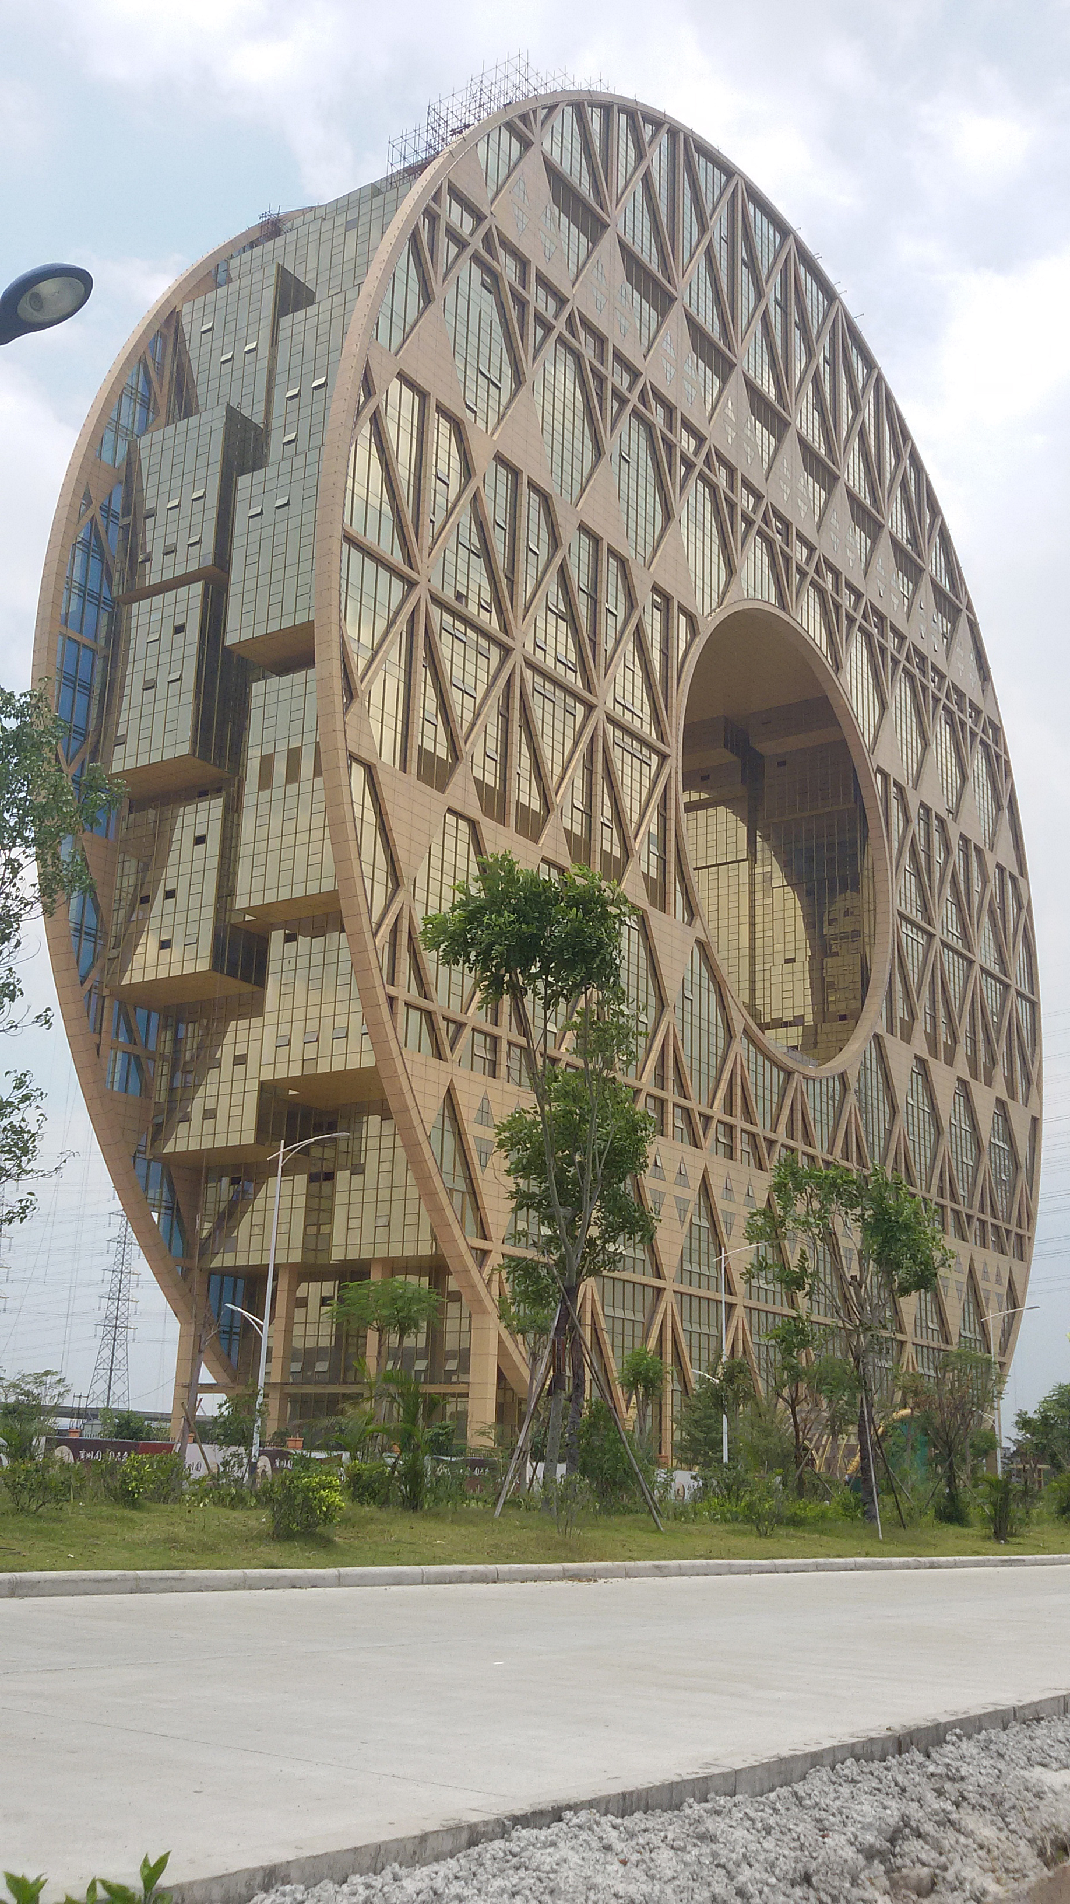
3
Looking Back
How much glass do you think was needed to cover the face of this building if the building is 138 meters tall?
Can you defend your estimate?
Notes:
Consolidation / Reflection – Could be assigned as an Asynchronous follow-up activity.
Image Source: "File:Guangzhou Circle Building 1.jpg" by CRCHF is licensed under CC BY-SA 3.0

Slide 147
3
Looking Back
End of this section

Slide 148
Additional Teacher Resources:
CIRCLES – Playing With Animations - GEOGEBRA
GeoGebra applets to demonstrate circle relationships.
Area of a circle by dissecting into parts (connected to area of a rectangle)
Area of a circle by dissecting into parts (connected to area of a triangle)
Roll the circumference to make connection to diameter
These applets can be used as demonstrations to support a lesson or you could have students explore the animation and respond to what they see.
Dan Meyer 3-Act Task: Carcaravan
Notes:
TEACHER SLIDE (move or delete before using slideshow with students).
These resources can be integrated in your synchronous lessons (use an animation as a number talk for example), or they can be assigned to students to investigate asynchronously.
Dan Meyer’s Carcaravan lesson has a full lesson plan at the link provided.

Slide 149
Number Play
1
Get Ready
2
Work it out!
3
Looking Back
Open Middle
Write About It
Number Talk - Equation
or,
Open Middle Visual
Record It
Notes:
Activator – number talk, choral count…
Work it out - Challenges make up the focus of the day(s) lesson (you may only have one and all students are assigned the same task, you may have a choice of two or three, or you may have all students begin at challenge 1 and move on as greater challenge is needed / Consolidate & Reflect on what you’ve learned during this part of the project.
Looking Back – a place for reflection/self-assessment

Slide 150
1
Get Ready
How would you solve this?
2.4 x 31
Can you solve it another way?
Notes:
Teacher Notes
Multiplying Decimals
NOTE: You will be looking to see whether students see the relationship from the previous slide and this slide, allowing them to use the same strategies discussed, adjusting now for the decimal.
Students understanding of rounding to the nearest whole number will be critical for them to be successful in solving these types of expressions.
Source: Adapted from: Humphreys, C., & Parker, R. (2015). Making Number Talks Matter: Developing Mathematical Practices and Deepening Understanding, Grades 3-10 (Illustrated ed.). Stenhouse Publishers.
You may wish to skip the next slide depending on timing and your goals for the lesson. ​

Slide 151
1
Get Ready
2.4 x 31
How would you solve this?
Can you solve it another way?
Notes:
Student slide (copy and paste as needed if working synchronously with students)
Source: Adapted from: Humphreys, C., & Parker, R. (2015). Making Number Talks Matter: Developing Mathematical Practices and Deepening Understanding, Grades 3-10 (Illustrated ed.). Stenhouse Publishers.

Slide 152
1
2.4 x 31
Get Ready
How can we visualize our solutions?
Notes:
Student slide (copy and paste as needed if working synchronously with students)
Source: Adapted from: Humphreys, C., & Parker, R. (2015). Making Number Talks Matter: Developing Mathematical Practices and Deepening Understanding, Grades 3-10 (Illustrated ed.). Stenhouse Publishers.

Slide 153
1
Get Ready
Pick ONE of these:
0.3 x 3.8
7.2 x 0.8
7.1 x 1.2
Show how you visualize the solution?
How does this help you understand the question?
Notes:
Student slide (copy and paste as needed if working synchronously with students)
Source: Adapted from: Humphreys, C., & Parker, R. (2015). Making Number Talks Matter: Developing Mathematical Practices and Deepening Understanding, Grades 3-10 (Illustrated ed.). Stenhouse Publishers.

Slide 154
1
Get Ready
End of this section

Slide 155
2
Using the digits 1-9, create two numbers that have a product as close as possible to 99.99 You may use each digit only once.
Work it out
. x
0.
Use Me!
Notes:
Adapted from: https://www.openmiddle.com/
Student page (copy and paste as needed if working synchronously with students)

Slide 156
2
Work it out
. x
0.
Copy over the digits from problem you created on the previous slide.
Show your visual representation in the space to the right.
Notes:
Adapted from: https://www.openmiddle.com/
Student page (copy and paste as needed if working synchronously with students)

Slide 157
2
Work it out
End of this section

Slide 158
3
Looking Back
Given what you have learned about visually creating expressions, what do you think this expression visual solution would look like?
. x
x
0.
Create the expression with the smallest possible product and then use the draw tool to show what the product would look like visually.
Use Me!
Notes:
Adapted from: https://www.openmiddle.com/
Student page (copy and paste as needed if working synchronously with students)
Could be assigned as an Asynchronous follow-up activity.

Slide 159
3
Looking Back
End of this section

Slide 160
Problem Solving – Culminating Activity
1
Get Ready
2
Work it out!
3
Looking Back
Which One Doesn’t Belong?
Open Middle Area Challenges
Write About It
or,
Record It
Notes:
Activator – number talk, choral count…
Work it out - Challenges make up the focus of the day(s) lesson (you may only have one and all students are assigned the same task, you may have a choice of two or three, or you may have all students begin at challenge 1 and move on as greater challenge is needed / Consolidate & Reflect on what you’ve learned during this part of the project.
Looking Back – a place for reflection/self-assessment

Slide 161
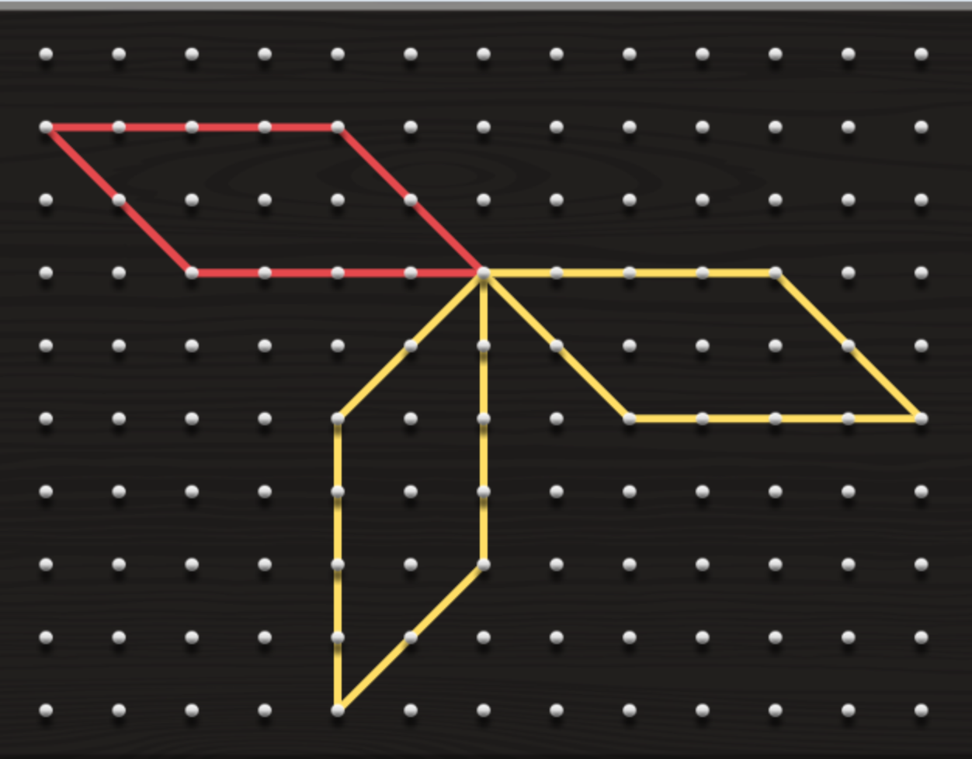
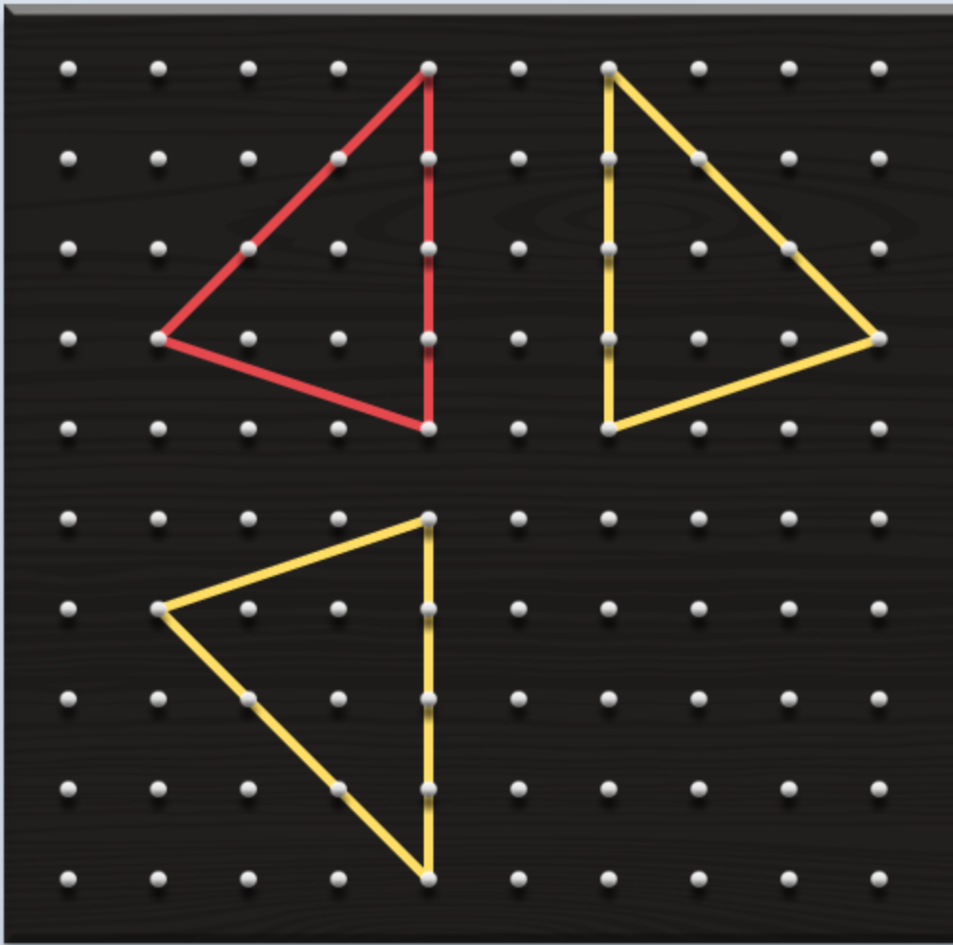
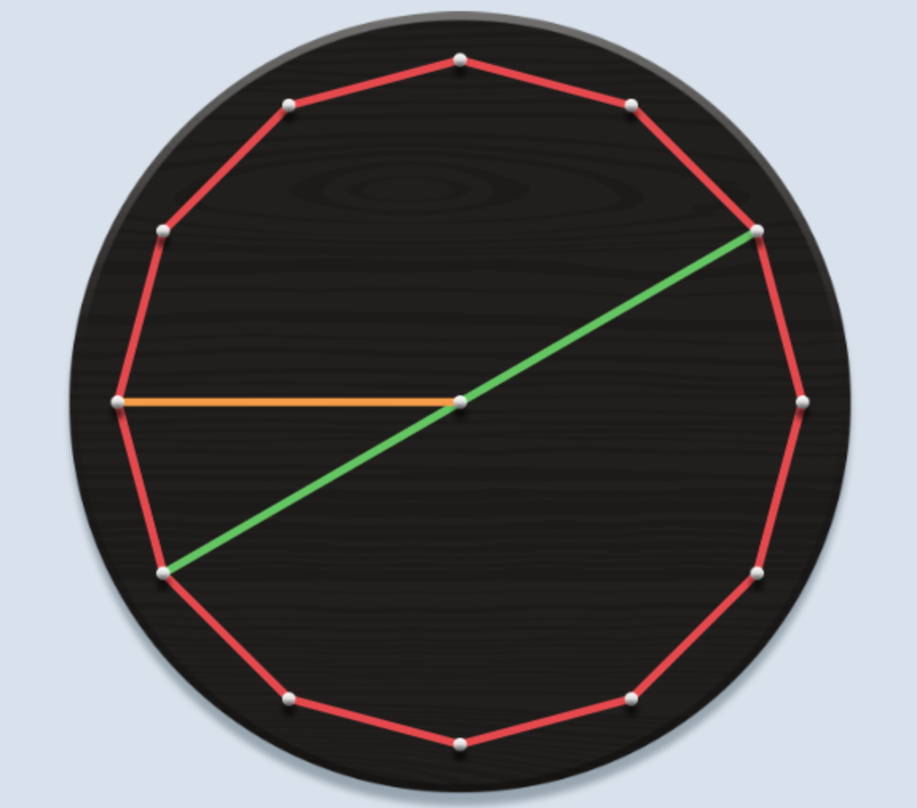
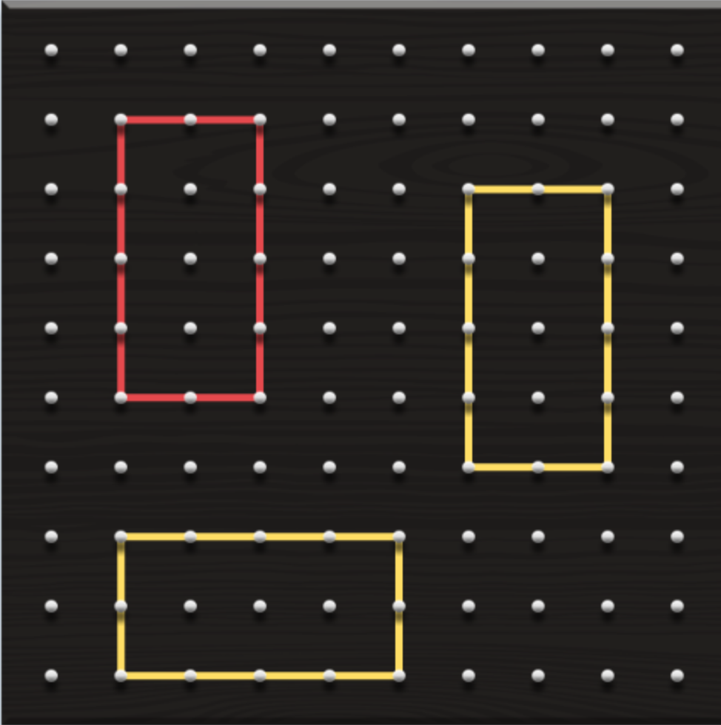
1
Get Ready
Which One Doesn’t Belong?
2.76units
Notes:
This number talk is intended to recap what was learned throughout this set of learning experiences (vocabulary, area) and push student thinking into another area of grade 7 math, transformations.

Slide 162
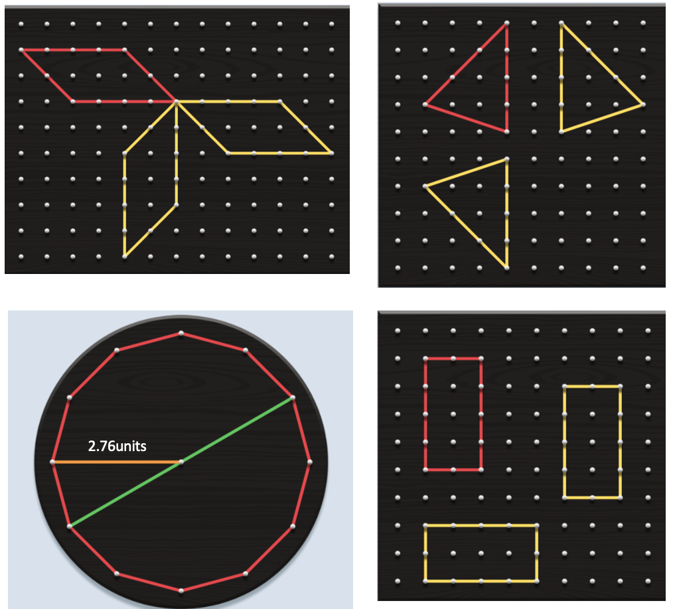
1
Get Ready
Which One Doesn’t Belong?
This one doesn’t belong because it’s the only one that…
This one doesn’t belong because it’s the only one that…
This one doesn’t belong because it’s the only one that…
This one doesn’t belong because it’s the only one that…
2.76units
Notes:
Student slide – to collect their thinking. You could make a slide for each student to use prior to your class discussion.

Slide 163
2
Work it out
Using the digits 1-9 at most one time each, fill in the dimensions for the shapes to create…
The largest possible area of all 3 shapes combined.
The smallest possible area of all 3 shapes combined.
Areas for the shapes in ascending order…with the smallest possible area for the circle.
Use Me!

Slide 164
1
Get Ready
End of this section

Slide 165
Open Middle Task – Challenge #1
GROUP SCORE BOARD:
Largest combined area found so far… ##
BREAKOUT ROOM #
Instructions: Use the digits 1 to 9, at most one time each, to find the largest possible area of 3 shapes combined.
Notes:
TEACHER SLIDE FOR GIVING INSTRUCTIONS - Share this screen with students to explain the task.
Students may only use a digit ONCE in the template (a repeat digit may occur in the product, that’s okay!
Groups will update their “Group Score Board” as they go (only showing their ANSWER (not their entire equation).
Groups will keep track of their work in the NOTES section of their slide (record the equations used to get their solutions so they can be verified).
The teacher will be moving from group to group, groups should be on task when I arrive. I may chat with your group when I’m there or I may just listen in (if it’s clear you don’t need me I won’t interrupt).
Level 1 – Multiply & add single digits
Teacher Info:
Basic Facts: Multiplication & Addition
*Note: Digits in the product may be repeats of digits that were used in the multiplier/multiplicand (so there are no boxes for the solution).
The largest possible positive product (225)
The smallest possible positive product (20)
A product equal to a decade number (other then 20), is there more than one? Which decade numbers can you make? Are there any you can’t make?
A product as close as possible to 250

Slide 166
2
Work it out
End of this section

Slide 167
3
Looking Back
Construct the following shapes, each with an area of about 80 units².
Rearrange the tiles below to show what you think will be the easiest to the most difficult to create.
Triangle
Parallelogram
Rectangle
Circle
Square
Use either a text box or the Insert–Audio feature to explain why you selected this order.
On the following slides you will create a sketch of each shape and label their dimensions. You will also use the formula to show how you calculated the area of each.
Notes:
Consolidation / Reflection – Could be assigned as an Asynchronous follow-up activity. Look for student understanding of the complexity (or lack thereof) for the various shapes.

Slide 168
3
Triangle
Looking Back
Sketch (include dimensions):
Show how to use the formula to calculate the area of this shape:
A = $\frac{b x h}{2}$
Notes:
Consolidation / Reflection – Could be assigned as an Asynchronous follow-up activity. Watch for students making connections between the first 3 shapes and the circle.

Slide 169
3
Parallelogram
Looking Back
Sketch (include dimensions):
Show how to use the formula to calculate the area of this shape:
A = b x h
Notes:
Consolidation / Reflection – Could be assigned as an Asynchronous follow-up activity. Watch for students making connections between the first 3 shapes and the circle.

Slide 170
3
Rectangle
Looking Back
Sketch (include dimensions):
Show how to use the formula to calculate the area of this shape:
A = l x w
Notes:
Consolidation / Reflection – Could be assigned as an Asynchronous follow-up activity. Watch for students making connections between the first 3 shapes and the circle.

Slide 171
3
Circle
Looking Back
Sketch (include dimensions):
Show how to use the formula to calculate the area of this shape:
$$A=πr^{2}$$
Notes:
Consolidation / Reflection – Could be assigned as an Asynchronous follow-up activity. Watch for students making connections between the first 3 shapes and the circle.

Slide 172
3
Square
Looking Back
Sketch (include dimensions):
Show how to use the formula to calculate the area of this shape:
A = l x w
Notes:
Consolidation / Reflection – Could be assigned as an Asynchronous follow-up activity. Watch for students making connections between the first 3 shapes and the circle.

Slide 173
3
Looking Back
End of this section

Slide 174
Basic descriptors to help guide your formative assessments. Full details of the student achievement profiles can be found here: Mental Math & Estimation Knowledge and Understanding Problem Solving | Requires considerable, on-going teacher support. | Requires occasional, teacher or peer support. | Accurate, clear, uses appropriate strategies & procedures. Requires occasional prompting for clarification. | Accurate, clear, flexible, consistent & efficient. Justifies and explains reasoning clearly and completely using accurate mathematical vocabulary.
Area of 2D Shapes | Limited | Basic | Good | Very Good/ Excellent
Demonstrate an understanding of how shapes can be rearranged to construct other shapes (rectangles, parallelograms, triangles, circles).
Demonstrate understanding of the formula for the area of a triangle and why it works (including appropriate terminology such as base & height).
Demonstrate understanding of the formula for the area of a parallelogram and why it works (including appropriate terminology such as base & height).
Demonstrate an understanding of circles by describing the relationships among radius, diameter and circumference.
Demonstrate understanding of the formula for the circumference of a circle and the relationship between circumference and diameter (π).
Constructs circles with a given radius or diameter.
Demonstrate understanding of the formula for the area of a circle and why it works (including appropriate terminology such as radius, pi).
Solves problems involving the radius, diameter and circumference of a circle.
Solve problems involving areas of parallelograms and triangles.
Assessment Rubrics
Suggested Codes for daily record keeping purposes:
I - Knowledge has been demonstrated individually
H - is used when knowledge has been demonstrated individually, but with help from the teacher or a peer
G - is used when knowledge has been demonstrated within a group
X - is used when a question has been attempted but answered incorrectly
N - is used when a question has not been attempted.
Notes:
You can also copy and paste the table above into Microsoft Word or similar program.
Tracking student data throughout these learning experiences will allow the teacher to make an informed assessment about the students’ level of achievement on these outcomes.
Adapted from: Liljedahl, P. (2021). Building thinking classrooms in mathematics, grades K-12: 14 teaching practices for enhancing learning. Thousand Oaks, CA: Corwin Press Inc.

Slide 175
Credits
Scott Dempster - St. James-Assiniboia School Division
Heather Jones - St. James-Assiniboia School Division
Reviewers
Charmaine Mackid - Hanover School Division
Lisa Page - St. James - Assiniboia School Division
Dayna Quinn-LaFleche - St. James-Assiniboia School Division

