Slide 1
Lesson resources
Part 1

Slide 2
Breakfast Around the World
Grade 3
FPPT.com

Slide 3
Sliced Up! Act 1
Notes:
Video: https://vimeo.com/209250578

Slide 4
Sliced Up! Act 1
What did you notice?
What do you wonder?

Slide 5
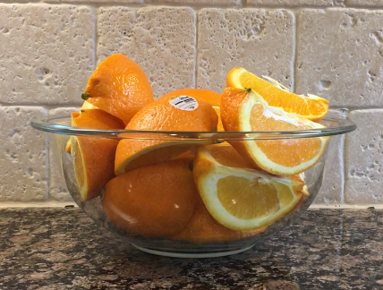
How many whole oranges are in the bowl?
Estimate:
Place your best estimate on the number line below and label.
Low Estimate
High Estimate
Notes:
Image: https://gfletchy.com/sliced-up/

Slide 6
How many whole oranges are in the bowl?
What information would you like to know?
Notes:
Image: https://gfletchy.com/sliced-up/

Slide 7
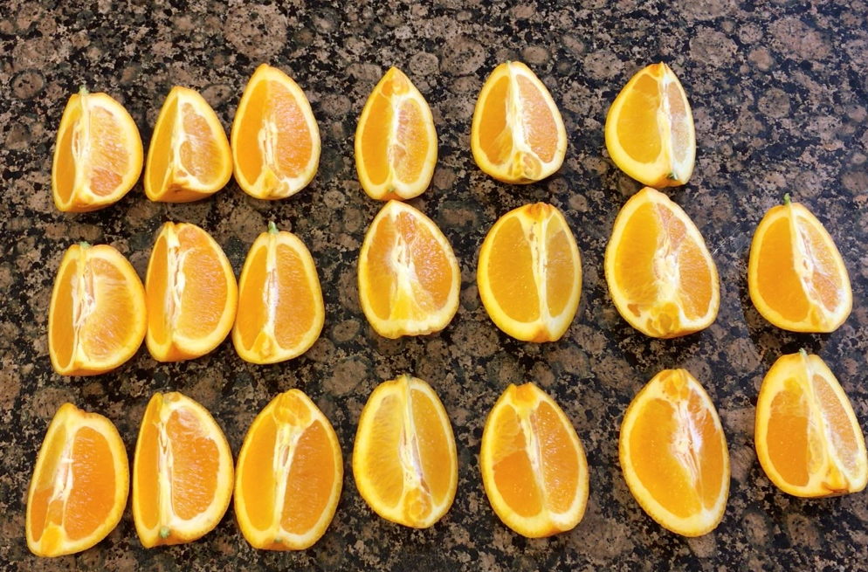
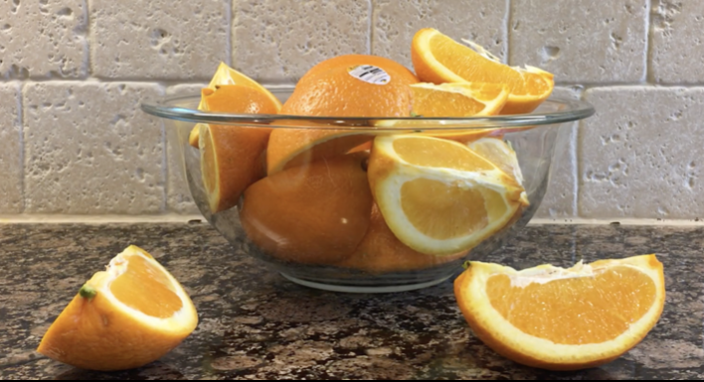
Sliced Up! Act 2
Each wedge is a fourth (or quarter).
Notes:
Images:
https://e2t2dwn1mz-flywheel.netdna-ssl.com/wp-content/uploads/2018/12/Number-of-Orange-Wedges.jpg
https://e2t2dwn1mz-flywheel.netdna-ssl.com/wp-content/uploads/2018/12/Size-of-Wedge-Act-2.png

Slide 8
How many whole oranges are in the bowl?
Show your work:
Answer:

Slide 9
Sliced Up! Act 3
Notes:
Video: https://vimeo.com/210815156

Slide 10
Essential Questions
How do we use fractions to represent quantities?
How do we show diversity through breakfast and food?

Slide 11
Breakfast Around the World
Notes:
Video: https://youtu.be/F2th3RagZEE

Slide 12
Breakfast Around the World
What do you and your family share for breakfast or for another meal? What fraction of this item do you each get? Draw and label a picture to show how much you each get.

Slide 13
Fractions in the Kitchen
Materials: measuring cups, measuring spoons, water, sink
Directions:
In a sink with some water, use the measuring cups and spoons to investigate the questions below and some of your own questions.
Record your thinking with words and pictures/photos on the next slide.
Questions:
How many $\frac{1}{2}$ cups are in a whole (1) cup? How many $\frac{1}{3}$ cups? How many $\frac{1}{4}$ cups?
How many $\frac{1}{2}$ teaspoons are in a whole (1) teaspoon? How many $\frac{1}{4}$ teaspoons? How many $\frac{1}{8}$ teaspoons?

Slide 14
Fractions in the Kitchen
Observations:

Slide 15
Mama Panya’s Pancakes
Listen to the story: Mama Panya’s Pancakes
If Mama Panya’s 1 cup and ½ tsp measuring tools are missing, how could she measure out the ingredients for her pancakes? Show your thinking below:
Ingredients for Mama Panya’s Pancakes:
1 ¼ cups plain flour
2 cups cold water
⅓ cup vegetable oil
½ tsp salt
½ tsp cardamom
½ tsp red chili pepper flakes, crushed
Notes:
Video: https://www.youtube-nocookie.com/embed/-7zCNCw5qKo?autoplay=1&iv_load_policy=3&loop=1&modestbranding=1&playlist=-7zCNCw5qKo

Slide 16
Fractions in the Kitchen 2
Materials: uncooked spaghetti OR licorice
Directions:
Take a piece of spaghetti. Where do you think you should break it to make $\frac{1}{2}$ ?
Break your spaghetti to make $\frac{1}{2}$. Do your new pieces represent $\frac{1}{2}$ ? How do you know?
Record your thinking with words and pictures/photos on the next slide.
Try making other fractions such as $\frac{1}{3}$ and $\frac{1}{4}.$

Slide 17
Fractions in the Kitchen 2
Observations:

Slide 18
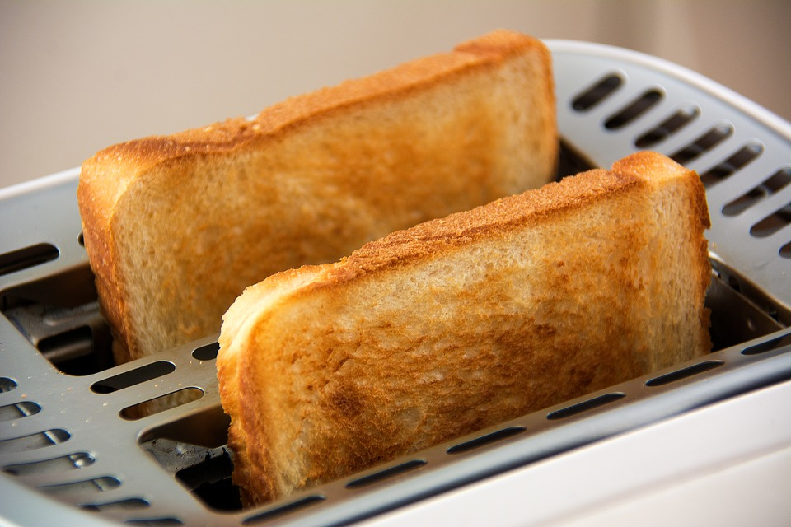
Lili’s Toast
Lili has toast for breakfast every morning. She likes her toast cut into fourths. What are some different ways that she can cut her toast into fourths? Use the squares below to show your thinking.
Read the story Lili’s Breakfast
Notes:
Image: https://cdn.pixabay.com/photo/2015/12/05/11/04/bread-1077984_960_720.jpg
Story: https://www.slideshare.net/lsammut/lilis-breakfast

Slide 19
The Cookie Fiasco
Listen to the story: The Cookie Fiasco
At the end of the story, the 4 friends are going to share 3 glasses of milk. How much milk will each friend get if they share the milk equally? What if they shared 3 pancakes?
Notes:
Video: https://www.youtube.com/watch?v=ZnhjuhVsjgA

Slide 20
Groceries Around the World
View the article Hungry Planet: What the World Eats.
What did you notice?
What do you wonder?
Notes:
Article: https://www.theguardian.com/lifeandstyle/gallery/2013/may/06/hungry-planet-what-world-eats

Slide 21
Breakfast of My Family
Interview an older family member or caregiver. Write down their responses on this slide and the following slide.
Name: _______________________________________________
In what year were you my age?____________
When you were my age, describe what you ate for breakfast.
____________________________________________________________________________________________________________________________________________________________

Slide 22
Breakfast of My Family
How has your breakfast changed since you were my age?
________________________________________________________________________________________________________
Why do you think it changed?____________________________
____________________________________________________
How has your breakfast stayed the same? __________________
____________________________________________________

Slide 23
Canada’s Food Guide Comparison
View the Canada’s Food Guide Snapshot. Using the circle as your plate, label the food groups and the fractional amount of your plate that each food group should get below.
On the plate below, draw what you had for breakfast today. Group your food items by food group. Label the fractional amount of your plate that is taken up by each food group.
What do you notice? How are they the same? How are they different?
Notes:
Reference material: https://food-guide.canada.ca/en/

Slide 24
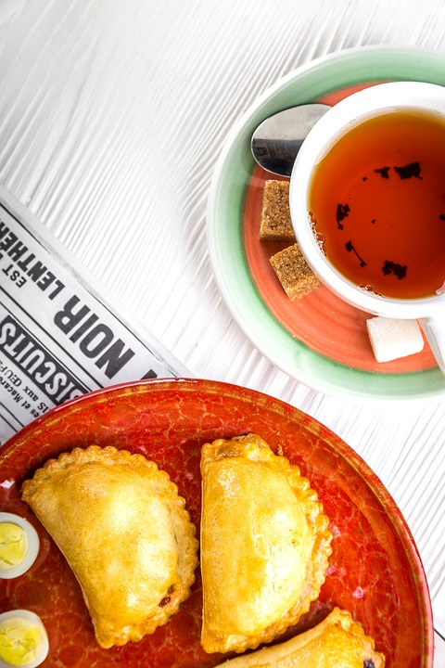
Comparing Breakfast Around the World
Your final challenge is to create a visual display of two or more breakfasts from different cultures/countries or time periods. Express the components of the meal as fractions and share how the breakfasts are the same and different.
Notes:
Image: https://pixabay.com/photos/tea-breakfast-cup-drink-food-1894045/

Slide 25
Guide to Success:
Assessment tool for students and teachers
Task Checklist (What do I need to do?) | Excellence Criteria (What do I need to do to do it well?) | Self-Reflection (What did I do well? What could I improve on?) | Teacher Guidance (What is going well? What might need to be changed?)
 |  | Affirm - What did I do really well? Revise - What could I have done better at? What changes could I make? Aspire - Where would I like to go next? What would I like to learn more about? | Affirm - What is going well? Revise - What changes could be considered?

Slide 26
Is it fair? resources
Part 2

Slide 27
Is it Fair?
In each set of pictures, two people are sharing breakfast.
For each image, indicate if it is fair or not fair by dragging an apple to the appropriate box.
Notes:
All images in this section are the property of the resource creator.

Slide 28
Set 1

Slide 29
Fair
Hayden’s Breakfast
Kivory’s Breakfast
Not Fair

Slide 31
Fair
Hayden’s Breakfast
Kivory’s Breakfast
Not Fair

Slide 33
Fair
Hayden’s Breakfast
Kivory’s Breakfast
Not Fair

Slide 35
Fair
Hayden’s Breakfast
Kivory’s Breakfast
Not Fair

Slide 37
Fair
Hayden’s Breakfast
Kivory’s Breakfast
Not Fair

Slide 38
Set 2

Slide 39
Fair
Hayden’s Breakfast
Kivory’s Breakfast
Not Fair

Slide 41
Fair
Hayden’s Breakfast
Kivory’s Breakfast
Not Fair

Slide 43
Fair
Hayden’s Breakfast
Kivory’s Breakfast
Not Fair

Slide 45
Fair
Hayden’s Breakfast
Kivory’s Breakfast
Not Fair

Slide 47
Fair
Hayden’s Breakfast
Kivory’s Breakfast
Not Fair

Slide 48
Set 3

Slide 49
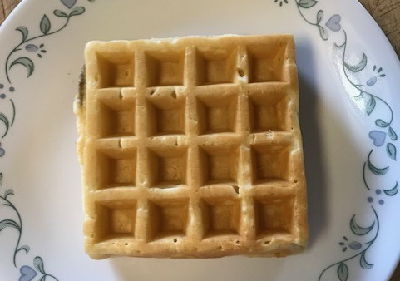
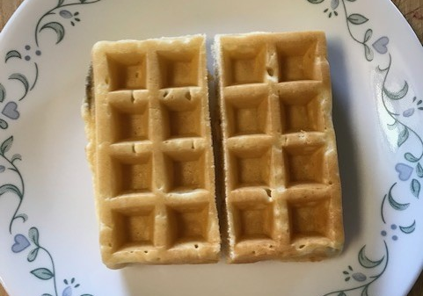
Fair
Meredith’s Breakfast
Tega’s Breakfast
Not Fair

Slide 51
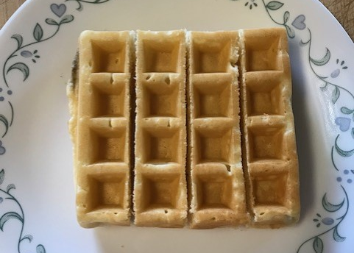
Fair
Meredith’s Breakfast
Tega’s Breakfast
Not Fair

Slide 53
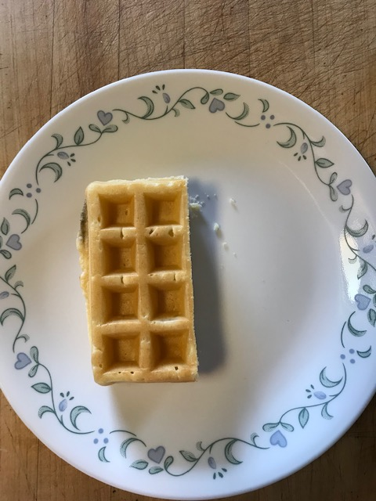
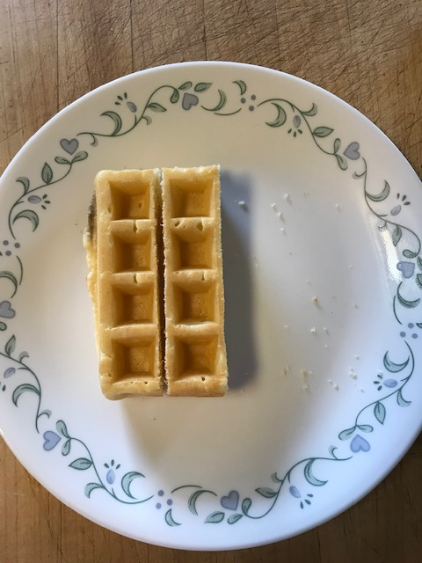
Fair
Meredith’s Breakfast
Tega’s Breakfast
Not Fair

Slide 55
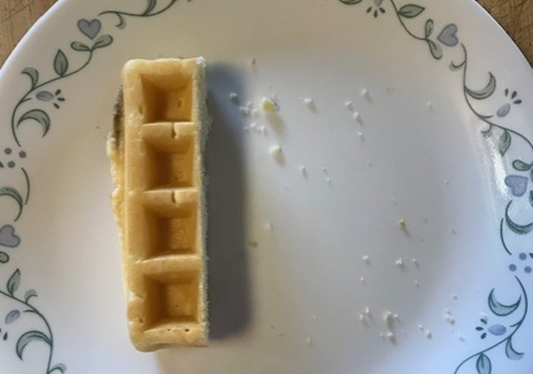
Fair
Meredith’s Breakfast
Tega’s Breakfast
Not Fair

Slide 57
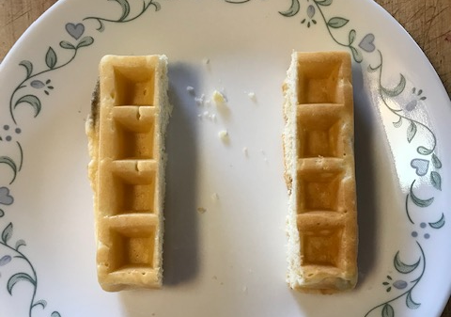
Fair
Meredith’s Breakfast
Tega’s Breakfast
Not Fair

Slide 58
Set 4

Slide 59
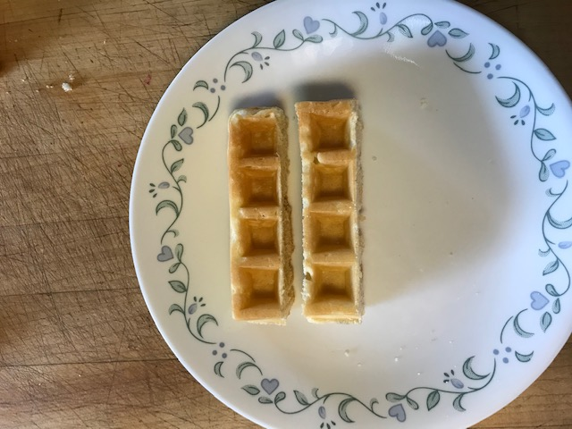
Fair
Meredith’s Breakfast
Tega’s Breakfast
Not Fair

Slide 61
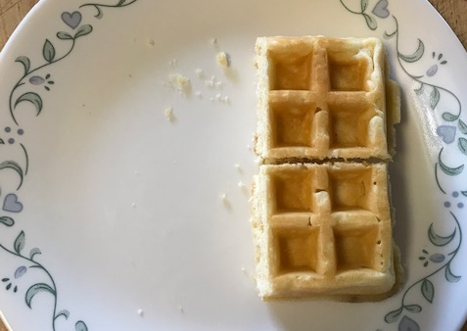
Fair
Meredith’s Breakfast
Tega’s Breakfast
Not Fair

Slide 63
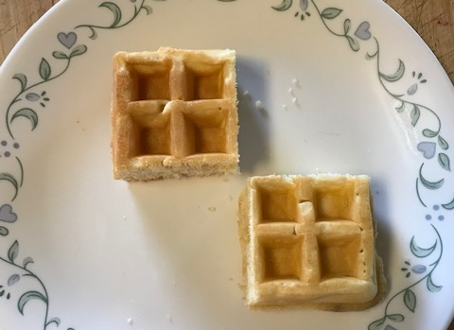
Fair
Meredith’s Breakfast
Tega’s Breakfast
Not Fair

Slide 65
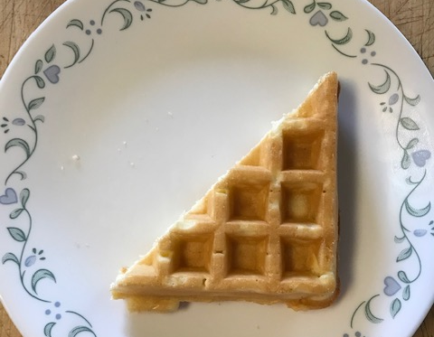
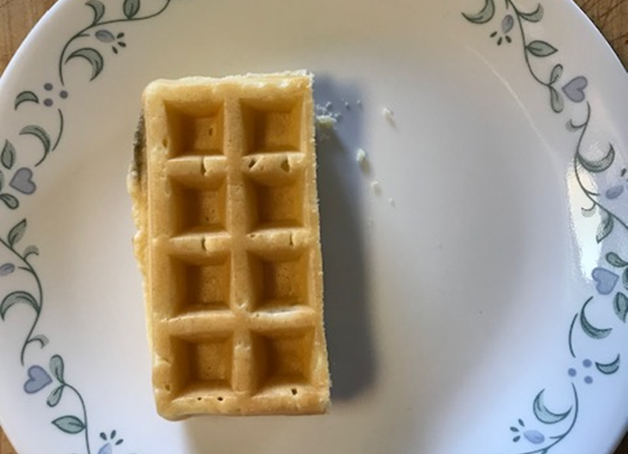
Fair
Meredith’s Breakfast
Tega’s Breakfast
Not Fair

Slide 67
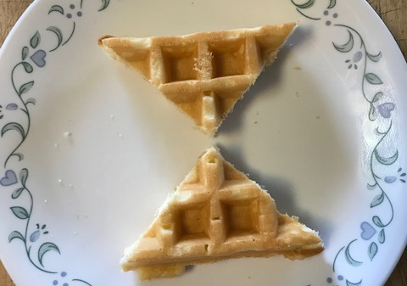
Fair
Meredith’s Breakfast
Tega’s Breakfast
Not Fair

Slide 68
Set 5

Slide 69
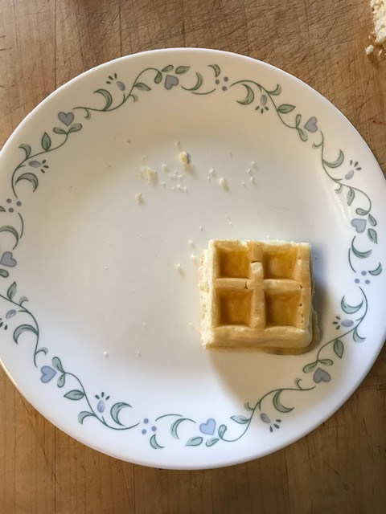
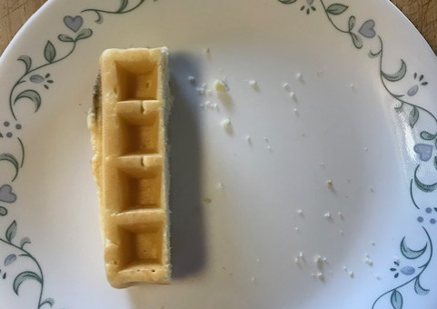
Fair
Meredith’s Breakfast
Tega’s Breakfast
Not Fair

Slide 71
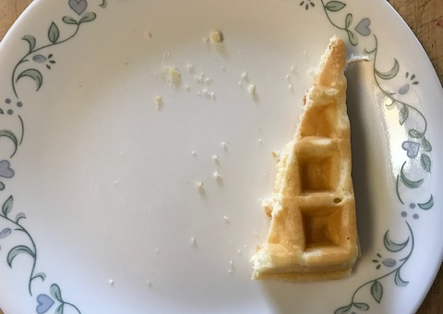
Fair
Meredith’s Breakfast
Tega’s Breakfast
Not Fair

Slide 73
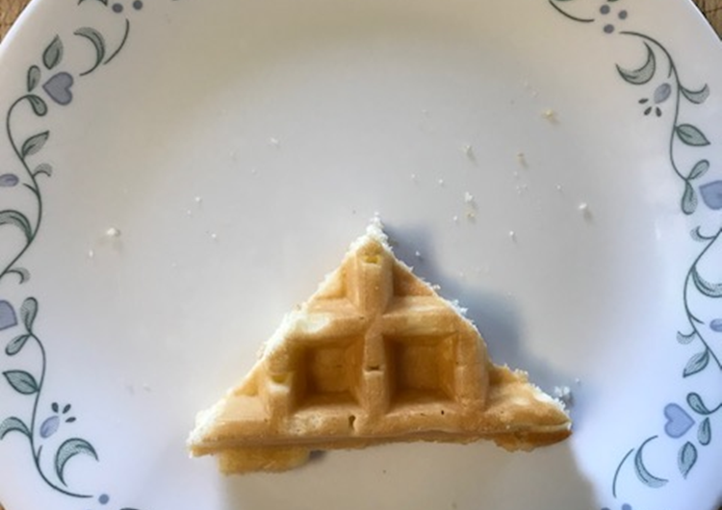
Fair
Meredith’s Breakfast
Tega’s Breakfast
Not Fair

Slide 75
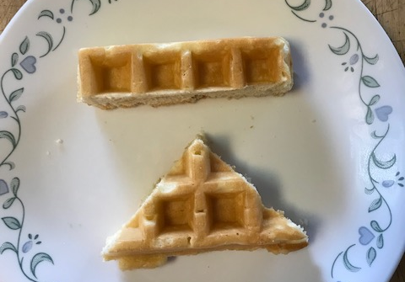
Fair
Meredith’s Breakfast
Tega’s Breakfast
Not Fair

