Slide 1
Electricity
Grade 6

Slide 2
Student Choice Board
Be Safe Around Electricity
Create a Narrative of your choice.
Electric Cars Vs. Gas Powered
What Is The Best Way To Represent Electricity Data Graphically?
Energy Efficient Homes
BONUS
Tinkercad Circuits

Slide 3
What can you do to make your home more energy-efficient?
Challenge: Propose action to improve the energy efficiency of your house.
Student Name: _______________
Teacher Name: _______________
Grade: _______________
Back to Choice Board
Adapted from The Critical Thinking Consortium https://tc2.ca/online/

Slide 4
What will I learn?
In this lesson, I will be deciding what actions my family can take to help improve the energy efficiency of our home.
Outcomes: Grade 6 Electricity Cluster:
6-3-18 Describe factors that affect the consumption of electrical energy, and outline an action plan to reduce electrical energy consumption at home, at school, or in the community. GLO: B5, C4, E4
6-3-19 Describe the ways in which electricity has had an impact on daily life. GLO: B1, B2, B5
Source: The Thinking Consortium https://tc2.ca/online/

Slide 5
Source: The Thinking Consortium https://tc2.ca/online/
Make an Initial Decision
Instructions
Take a walk around your home and observe any features or characteristics that help reduce energy usage, and any features or characteristics that increase energy usage.
Using your current understanding of “energy efficiency,” mark an X on the scale found on Activity Sheet: Make an initial decision.
Not energy efficient Somewhat energy efficient Very energy efficient

Slide 6
Considering Criteria…
An energy efficient home is …
Using Less Fuel | Homes that are energy efficient are well insulated and airtight, with high-efficiency heating and cooling equipment. The home has simple devices designed to decrease consumption of energy and water.
Kind to Environment | An energy-efficient home has efficient features and elements that work together to reduce the amount of energy that is consumed. This reduces greenhouse gas emissions and shrinks the home’s carbon footprint.
Comfortable and Healthy | An energy-efficient home is warm in winter and cool in summer. The home has effective ventilation and excellent air quality.
Source: The Thinking Consortium https://tc2.ca/online/

Slide 7
What Factors Limit Energy Efficiency?
Instructions:
Read through Briefing Sheet B: What is an Energy-Efficient Home?
Using ideas from the briefing sheet to guide your thinking, identify the 4 features or characteristics within your home that most greatly limit its energy efficiency. List these in the 1st column in the chart found on Activity Sheet: Improving home energy efficiency.
Source of energy inefficiency in my home | Action to improve energy efficiency | Why the action should improve efficiency | Rating of the effectiveness of the actions
 |  |  | 4 highly effective 3 considerably effective 2 somewhat effective 1 limit effectiveness
 |  |  | 4 highly effective 3 considerably effective 2 somewhat effective 1 limit effectiveness
 |  |  | 4 highly effective 3 considerably effective 2 somewhat effective 1 limit effectiveness
 |  |  | 4 highly effective 3 considerably effective 2 somewhat effective 1 limit effectiveness
Source: The Thinking Consortium https://tc2.ca/online/

Slide 8
Identify Effective Solutions
Instructions
Read the interview provided in Briefing Sheet A: Advice From a Home.
Use ideas presented in this briefing sheet to guide your thinking, as well as the criteria provided for ”a highly effective solution.” Identify actions that would fix the energy inefficiencies that you described in the previous slide. List these actions in the 1st column of the chart found on Activity Sheet: Identifying effective solutions.
In the 2nd column, explain the impact each action would have on the energy efficiency of your home.
In the last column, rank each solution from 1-4 based on how effective you think it is (use the criteria provided for “a highly effective solution”).
Action to improve energy efficiency | Why the action should improve efficiency | Rating of the effectiveness of the actions
 |  | 4 highly effective 3 considerably effective 2 somewhat effective 1 limit effectiveness
 |  | 4 highly effective 3 considerably effective 2 somewhat effective 1 limit effectiveness
 |  | 4 highly effective 3 considerably effective 2 somewhat effective 1 limit effectiveness
 |  | 4 highly effective 3 considerably effective 2 somewhat effective 1 limit effectiveness
Criteria for a highly effective solution:
Reduces fuel consumption
Kind to the environment
Contributes to a comfortable and healthy home
Source: The Thinking Consortium https://tc2.ca/online/

Slide 9
Propose a Course of Action
Instructions
Based on the 4 inefficiencies and possible solutions you identified in the previous slides, develop a plan (or course of action) that your family can follow to improve your home’s energy efficiency.
In the chart found on Activity Sheet: Propose a course of action, list the 4 actions you would suggest to your parents to improve the energy efficiency of your home in order, from most effective to least effective.
Provide reasons (evidence) to explain why each suggestion will improve the energy efficiency of your home.
Action |  | Reason
1
2
3
4
Criteria for an energy efficient home… Uses less fuel: Homes that are energy efficient are well insulated and airtight, with high-efficiency heating and cooling equipment. The home has simple devices designed to decrease consumption of energy and water. Kind to the environment: An energy-efficient home has efficient features and elements that work together to reduce the amount of energy that is consumed. This reduces greenhouse gas emissions and shrinks the home’s carbon footprint. ✓Comfortable and healthy: An energy-efficient home is warm in winter and cool in summer. The home has effective ventilation and excellent air quality.
Source: The Thinking Consortium https://tc2.ca/online/

Slide 10
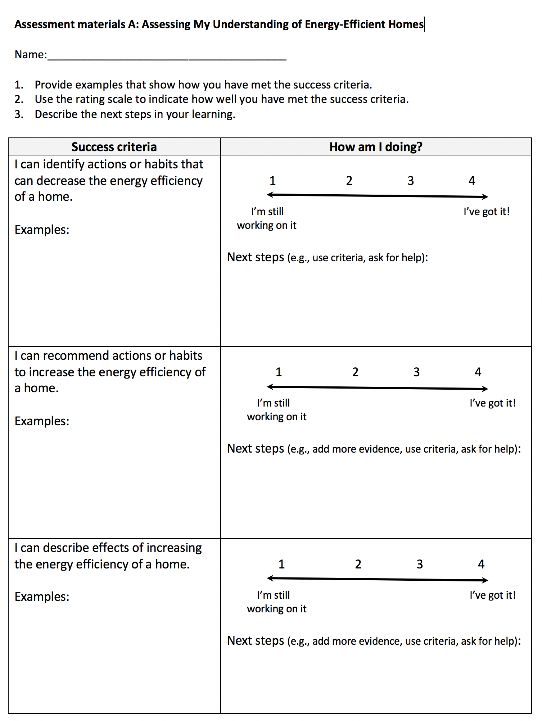
Reflect on What You’ve Learned
Instructions
Refer to Assessment Materials: Assessing my Understanding of Energy-Efficient Homes to reflect on what you have learned by completing this lesson.
Source: The Thinking Consortium https://tc2.ca/online/

Slide 11
CONGRATULATIONS!
Challenge Completed
Share with your teacher
Return to Student Choice Board.

Slide 12
How Effectively do Electric Vehicles Solve the Problem of Gas-Powered Vehicles?
Challenge: Use a “dashboard” to rate the effectiveness of electric vehicles as a solution to the problems created by vehicles with internal combustion engines.
Student Name: _______________
Teacher Name: _______________
Grade: _______________
Back to Choice Board
Adapted from The Critical Thinking Consortium https://tc2.ca/online/

Slide 13
What will I learn?
In this lesson, you will learn to assess the effectiveness of electric vehicles (EVs) as a solution to problems created by gas-powered vehicles.
You will also consider how this solution compares to using solar power-generated electricity to offset emissions produced, and energy consumed, by gas-powered vehicles.
Source: The Thinking Consortium https://tc2.ca/online/

Slide 14
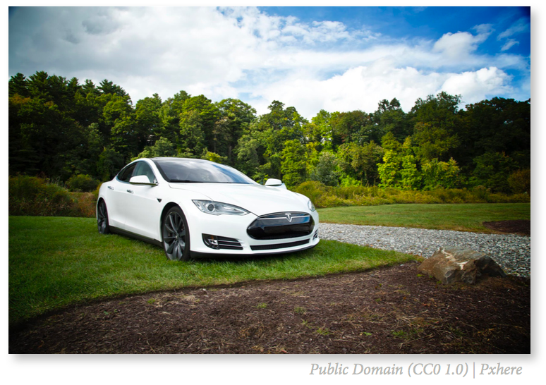
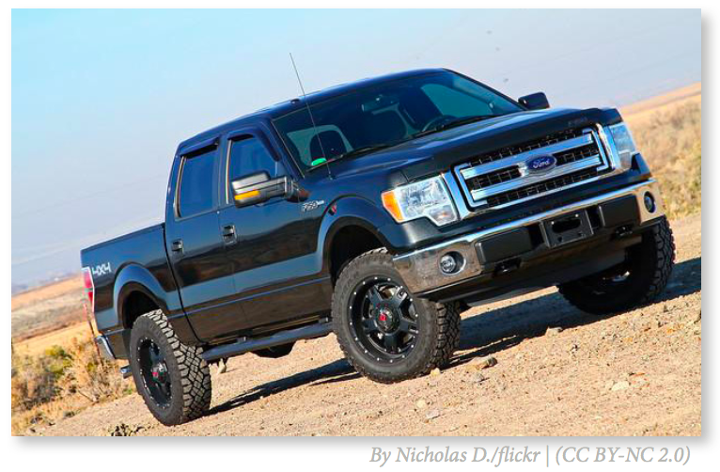
Make an Initial Decision
Gasoline-powered Truck
Electric Car
How effectively will the electric car address the problems created by the gas-powered truck?
Instructions:
Based on your current understanding of electric vehicles, answer the above question by circling the level of effectiveness on the dashboard found on Activity Sheet: Make an initial decision.
Provide reasons to support your initial decision.
Source: The Thinking Consortium https://tc2.ca/online/

Slide 15
Considering Criteria…
An effective solution is one that…
Significantly Reduces Consumption of Fossil Fuels | Vehicles with internal combustion engines (ICE) burn fossil fuels, gasoline or diesel.
Significantly Reduces Energy Consumption | Vehicles that use more fuel and more energy have greater impacts on the environment.
Significantly Reduces Carbon Emissions Over the Vehicle’s Entire Lifecycle | The vehicle’s lifecycle includes its production, operation, and disposal. ICE produce emissions including nitrous oxides (NOx) and carbon dioxide (CO2 ). CO2 emissions contribute to climate change. While electric vehicles (EV) produce no emissions while driving, there may be emissions produced by generating electricity.
Maintains the Vehicle’s Utility | A vehicle’s utility refers to how easy it is to refuel, how capable it is of carrying heavy loads, whether it can travel long distances, and if its design is functional and practical.
Source: The Thinking Consortium https://tc2.ca/online/

Slide 16
Reassess Initial Decision
Gasoline-powered Truck
Electric Car
How effectively will the electric car address the problems created by the gas-powered truck?
Instructions:
Revisit your initial decision on effectiveness and consider whether your reasoning fits with the criteria presented on the previous slide.
Would you adjust your initial decision and/or reasoning? Indicate any changes on Activity Sheet: Reassess my initial decision.
Source: The Thinking Consortium https://tc2.ca/online/

Slide 17
Locate Evidence
Definitions:
• Fact: a piece information that can observed and proven to be true • Evidence: a fact or piece of information that helps determine whether a conclusion is believable • Conclusion: a final decision or judgment reached by examining evidence
Instructions
Read each statement below.
Determine if it is fact, evidence or a conclusion by placing an ‘X’ in the appropriate box on Activity Sheet: Locate Evidence.
Use online resources to research information about cars.
Add two new pieces of information to the list and complete the chart
Statement | Fact | Evidence | Conclusion
In 2017, 81 per cent of new vehicles purchased in Alberta were trucks.
Driving an electric vehicle (EV) is better for the environment than a gasoline- powered vehicle.
The combined (highway and city) mileage of Ford F-series trucks is 10.9L/100km.
89 per cent of Alberta’s electricity is produced using fossil fuels.
Driving a Ford F-series truck produces the equivalent of 7,900 kg of CO2 in a year.
Using coal-fired generated electricity to charge a Tesla Model S produces the equivalent of 4,120 kg of CO2 in a year.
CO2 emissions are a cause of global climate change.
Solar-generated electricity creates no emissions.
Add:
Add:
Source: The Thinking Consortium https://tc2.ca/online/

Slide 18
Record Initial Thinking
Instructions:
Read Briefing Sheet: Addressing the Environmental Impacts of Vehicle Use.
Using the information in the briefing sheet to guide your thinking, mark on the dashboards found on Activity Sheet: Record initial thinking a ranking for each criteria for an effective solution.
Identify facts or evidence in the briefing sheet to support and justify your ranking for each criteria.
Remember: you might change your mind as you learn more!
How Effectively do Electric Vehicles Solve the Problem of Gas-Powered Vehicles?
Criterion 1: Significantly Reduces Consumption of Fossil Fuels | Criterion 2: Significantly Reduces Energy Consumption | Criterion 3: Significantly Reduces Carbon Emissions Over the Vehicle’s Entire Lifecycle | Criterion 4: Maintains the Vehicle’s Utility
Facts/Evidence:
Facts/Evidence:
Facts/Evidence:
Facts/Evidence:
Source: The Thinking Consortium https://tc2.ca/online/

Slide 19
Explore Other Solutions: Part 1
Instructions:
Read “Part 1” below to learn about an alternative solution that addresses the problem of carbon emissions created by vehicles.
Use this information, and the information on the next 3 slides, to determine if it is possible to offset the emissions produced by vehicles using solar energy.
On the next two slides, read through Steps 1-3 and the formulae detailed in the left-hand column of the charts. This is what is required to determine the number of solar panels required to offset a vehicle’s emissions for one year of driving.
Following the sample calculation provided for the Ford F-250 in the middle column, calculate the number of solar panels required to offset the emissions produced by a Tesla Model S electric vehicle in one year of driving. Write these calculations in the space provided in the far right column of the table found on Activity sheet: Calculating Solar PV requirements for energy and emissions offsets.
Source: The Thinking Consortium https://tc2.ca/online/

Slide 20
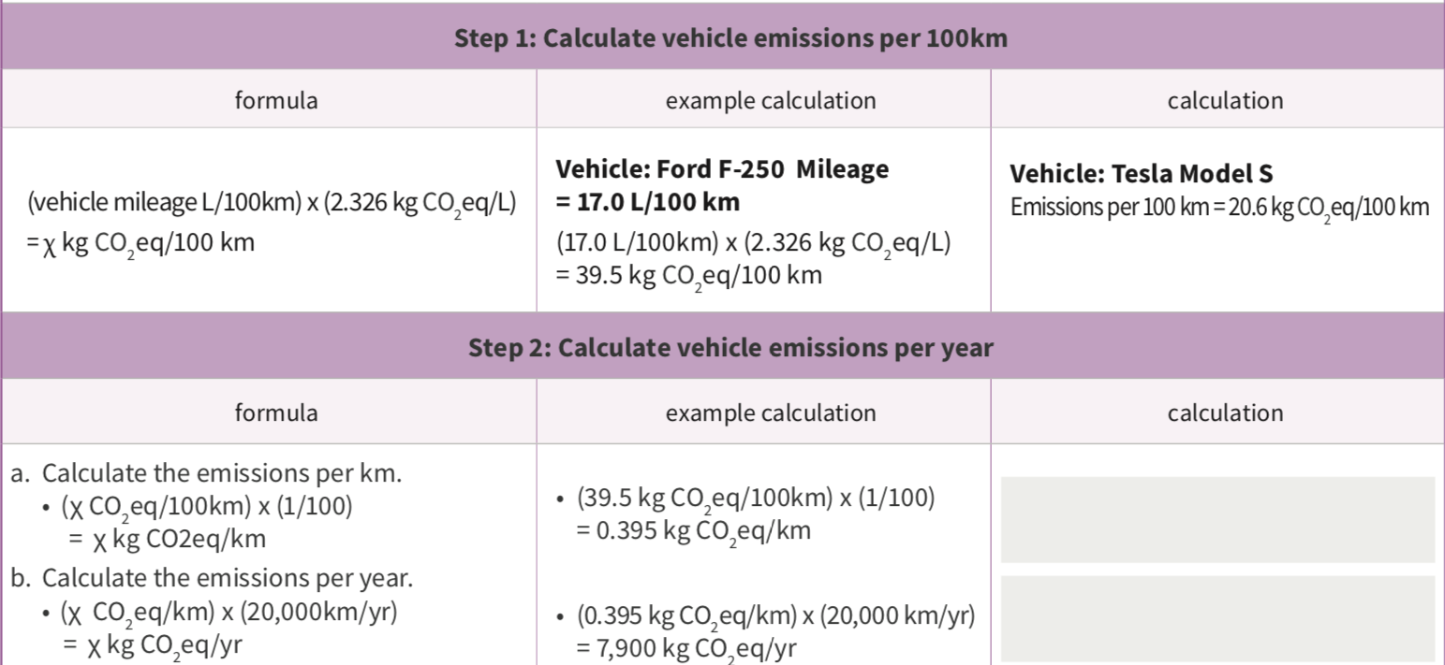
Explore Other Solutions (continued)
Source: The Thinking Consortium https://tc2.ca/online/

Slide 21
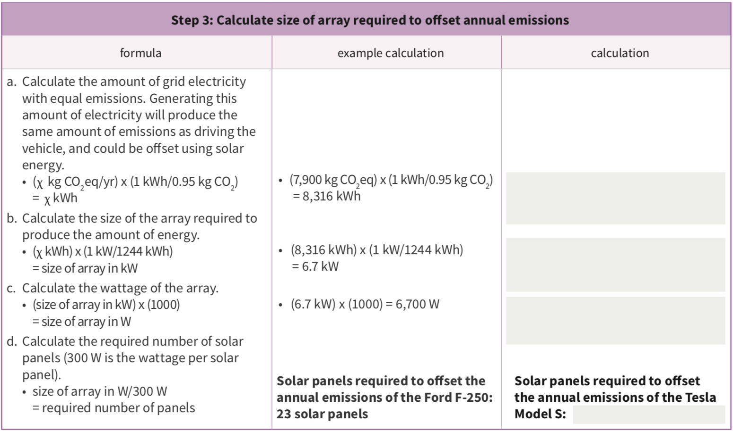
Explore Other Solutions (continued)
Source: The Thinking Consortium https://tc2.ca/online/

Slide 22
Explore Other Solutions: Part 2
Instructions:
Read “Part 2” below to learn about an alternative solution that addresses the problem of energy consumption created by electric vehicles. You can also find this information on Activity Sheet D.
Use this information, and the information on the next slide, to determine if it is possible to offset the annual energy consumption by electric vehicles using solar energy.
On the next slide, read through Steps 1 and 2 and the formulae detailed in the left-hand column of the charts. This is what is required to determine the number of solar panels required to offset the energy consumed by an electric vehicle for one year of driving.
Following the sample calculation provided for the Nissan LEAF in the middle column, calculate the number of solar panels required to offset the energy consumed by a Tesla Model S electric vehicle in one year of driving. Write these calculations in the space provided in the far right column of Activity Sheet D.
Source: The Thinking Consortium https://tc2.ca/online/

Slide 23
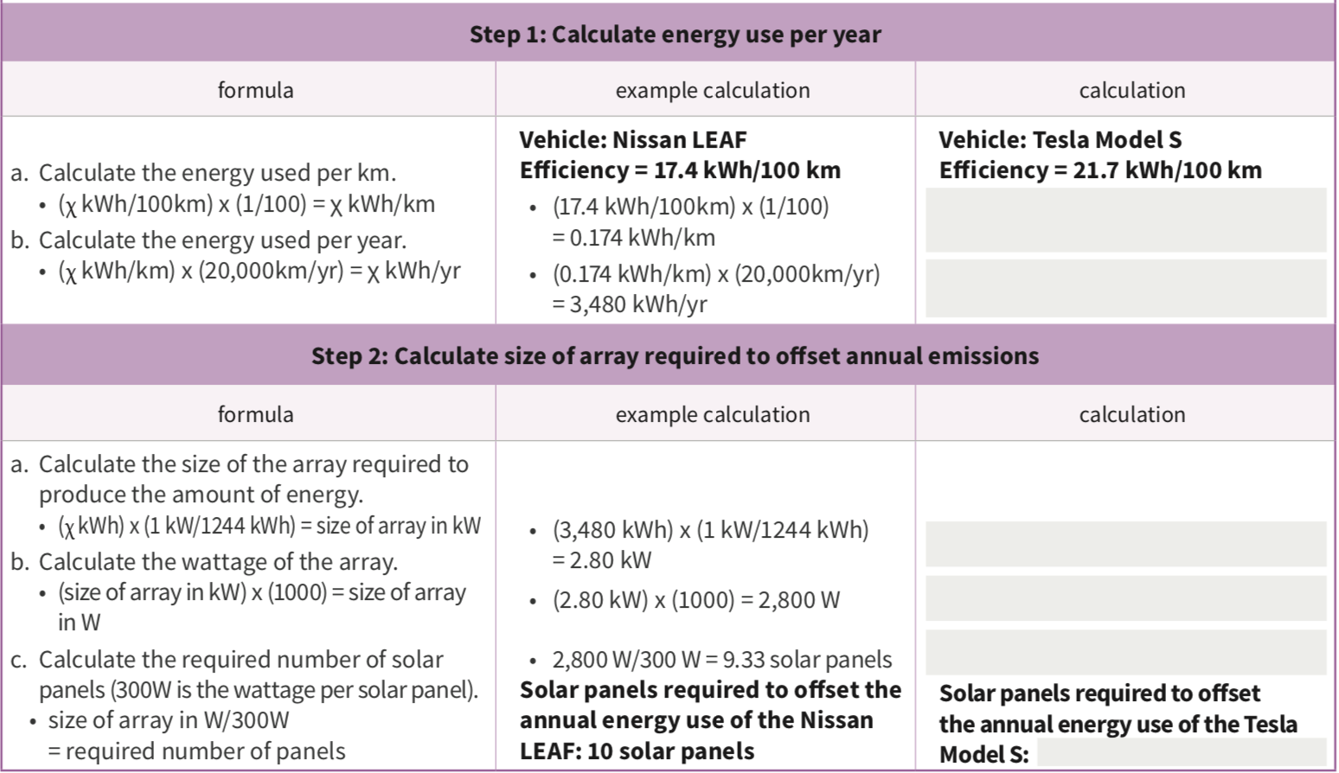
Explore Other Solutions (continued)
Source: The Thinking Consortium https://tc2.ca/online/

Slide 24
Reassess Initial Thinking
Instructions:
Now that we have considered alternative solutions to the problems created by gas-powered vehicles, think again about the question below.
Using all the information that has been presented in this lesson—briefing sheets and sample calculations—re-consider how electric vehicles satisfy the four criteria for “an effective solution.”
Mark on the dashboards below a ranking for each criteria for an effective solution.
Add or change the facts/evidence provided to support and justify your ranking for each criteria.
How Effectively do Electric Vehicles Solve the Problem of Gas-Powered Vehicles?
Criterion 1: Significantly Reduces Consumption of Fossil Fuels | Criterion 2: Significantly Reduces Energy Consumption | Criterion 3: Significantly Reduces Carbon Emissions Over the Vehicle’s Entire Lifecycle | Criterion 4: Maintains the Vehicle’s Utility
Facts/Evidence:
Facts/Evidence:
Facts/Evidence:
Facts/Evidence:
Source: The Thinking Consortium https://tc2.ca/online/

Slide 25
Source: The Thinking Consortium https://tc2.ca/online/
Make an Final Decision
How effectively does the electric car address the problems created by the gas-powered truck?
Instructions:
Based on what you have learned throughout this lesson, answer the above question by circling the level of effectiveness on the dashboard.
Detail below your justification for adjusting your initial decision.
Provide the four most compelling reasons that support your final decision:
1.
2.
3.
4.

Slide 26
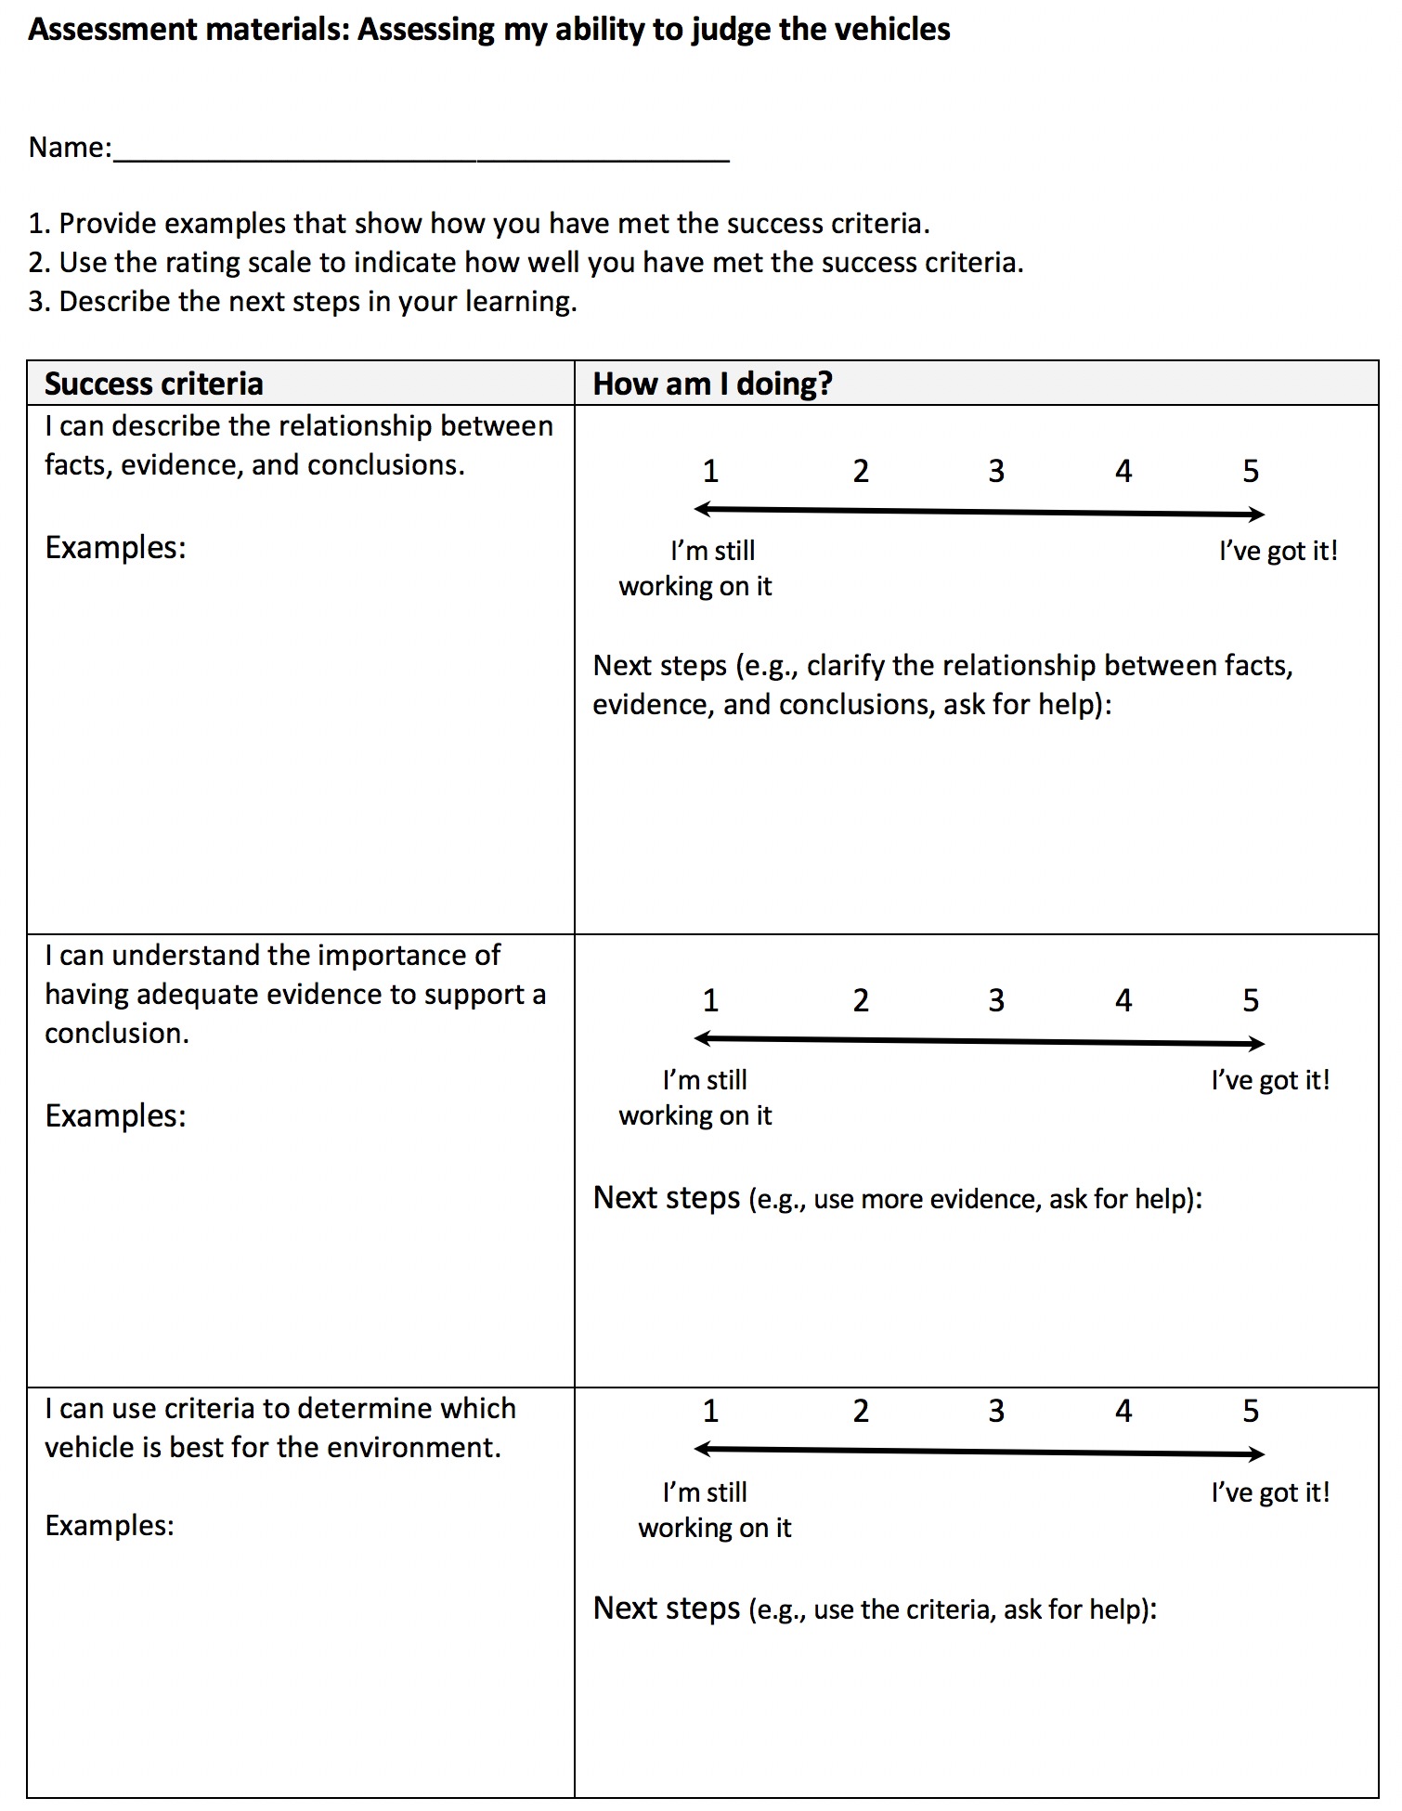
Reflect on What You’ve Learned
Instructions
Refer to Assessment Material Assessing my ability to judge the vehicles to reflect on what you have learned by completing this lesson.
Source: The Thinking Consortium https://tc2.ca/online/

Slide 27
CONGRATULATIONS!
Challenge Completed
Share with your Teacher
Return to Student Choice Board.

Slide 28
How Can You Stay Safe Around Electricity?
Challenge: Create a narrative to demonstrate the electrical safety precautions you can take at home or out in the community.
Student Name: _______________
Teacher Name: _______________
Grade: _______________
Back to Choice Board

Slide 29
What will I learn?
In this learning experience, I will look at electrical safety in my home and community
I will be deciding what actions my family can take to stay safe around current and static electricity.
You will analyze different text
You will create a narrative of your choice and develop skills on planning, writing and presenting a narrative.

Slide 30
Get Inspired
with
These Great Books
The Magic School Bus: The Electrical Field Trip
By Joanna Cole
Video
When Charlie McButton Lost Power
By Suzanne Collins
Video
Oscar and the Bird: A Book About Electricity
By Geoff Waring
Video
Electrical Wizard: How Nikola Tesla Lit Up the World
By Elizabeth Rusch
Video

Slide 31
Brainstorm Safety Considerations Regarding Both Static And Current Electricity
Static Electricity (Lightening)
Current Electricity
HINT: Feel free to look up videos or research different ways to stay safe around electricity to help you compile this list.

Slide 32
Your Challenge: You will create an info-fiction text:
Poem
Screenplay
Children’s story

Slide 33
Pre-writing-Think about:
Who will you be writing for? (Audience)
What age group will your text be for?
What message do you want to give them?
What scientific vocabulary can you use?
How long will your text be?
Where will your text take place? (Setting)
Who are the characters going to be?
What will their purpose in the text be?
Protagonist (main character and/or hero)
Antagonist (villain)
Secondary character (Sidekick to the main character)
Mentor (Teaches the characters something important)

Slide 34
Plot Planner Part 1:
Fill in the Graphic Organizer with your initial thoughts.
Mood: keywords to set the tone of your text:
Protagonist:: Draw & describe your main character:
Audience: Who will enjoy this text the most?
Antagonist:: Draw & describe the villain

Slide 35
Plot Planner Part 2:
Fill in the Graphic Organizer with your initial thoughts.
Scientific Vocabulary:
Conflict: What will be the problem in your info-fiction? (Choose 3 or more electrical safety concerns from your list)
Setting: Describe or Draw where your text will take place
Lesson Learned: What will the Characters and Audience learn from your info-fiction:

Slide 36
Plot Planner Part 3:
Fill in the Graphic Organizer with your initial thoughts.
Title: ________________________________________________________________
Exposition: What happens in the beginning?
Rising Action: What happens in the middle?
Climax: What happens at the climax?
Resolution: What happens at the end?

Slide 37
Info-Fiction Title: _______________
Written by: ____________________
Write your info-fiction text here:

Slide 38
Info-Fiction Title: ___________Continued
Continue your info-fiction text here:

Slide 39
Choose your Medium:
How do you want to present your story? Be sure to choose the best option for the audience.
Slideshow (with images)
Video (oral reading or acting out the story)
Written (with or without images)
Other: ______________

Slide 40
Grade 6 ELA Assessment Tool:
The following chart is one way to record your body of evidence of student learning. It is important to consider the identified grade band descriptors in relation to the practices and elements as you look through the body of evidence. You are describing the extent to which students enacted the descriptors. Transfer this information into the appropriate reporting categories.
Evidence of Learning in English Language Arts https://app.mapleforem.ca/en/groups/229/wiki/pages/1622#3to5overview |  | Interrelated Dimensions of Learning Growth (IDOL-G) https://app.mapleforem.ca/en/groups/229/wiki/pages/2205 ​
 |  | Independence Emerging Expanding Extending | Breadth Emerging Expanding Extending | Depth Emerging Expanding Extending | Transformation Emerging Expanding Extending
4 ELA Practices & Elements | Grade Band Descriptors Identified
Power Agency · Recognize and analyze inequities, viewpoints, and bias in texts and ideas · Investigate complex moral and ethical issues · Contemplate the actions that can be taken, consider alternative viewpoints, and contribute other perspectives | Learners are understanding that texts represent and promote particular beliefs, values, and ideas.
Exploration and Design · Research and study topics and ideas · Interpret and integrate information and ideas from multiple texts and sources · Manage information and ideas · Invent, take risks, and reflect to create possibilities | Learners are reconstructing, manipulating, and remixing existing texts or sets of texts to create new ideas, forms, purposes, and messages.
Sense Making ​ · Access, use, build, and refine schema · Select from and use a variety of strategies · Be aware of and articulate the ways that one engages with text. | Learners are strategically selecting and applying strategies and processes for making sense of and creating different types of text for different purposes and audiences.
System​ · Recognize, apply, and adapt rules and conventions · Identify, analyze, and apply understandings of whole-part-whole relationships | Learners are using their understanding of a range of text structures and features to understand and communicate clearly and effectively.

Slide 41
CONGRATULATIONS!
Challenge Completed
Share with your Teacher
Return to Student Choice Board.

Slide 42
What Is The Best Way To Represent Electricity Data Graphically?
Challenge: Create 3 different graphs from a set of data and choose which graph represents the data in the best way.
Student Name: _______________
Teacher Name: _______________
Grade: _______________
Back to Choice Board

Slide 43
What will I learn?
In this lesson, you will learn how to represent data in a variety of forms
Also, you will decide which form of data will be the best for the data being represented.

Slide 44
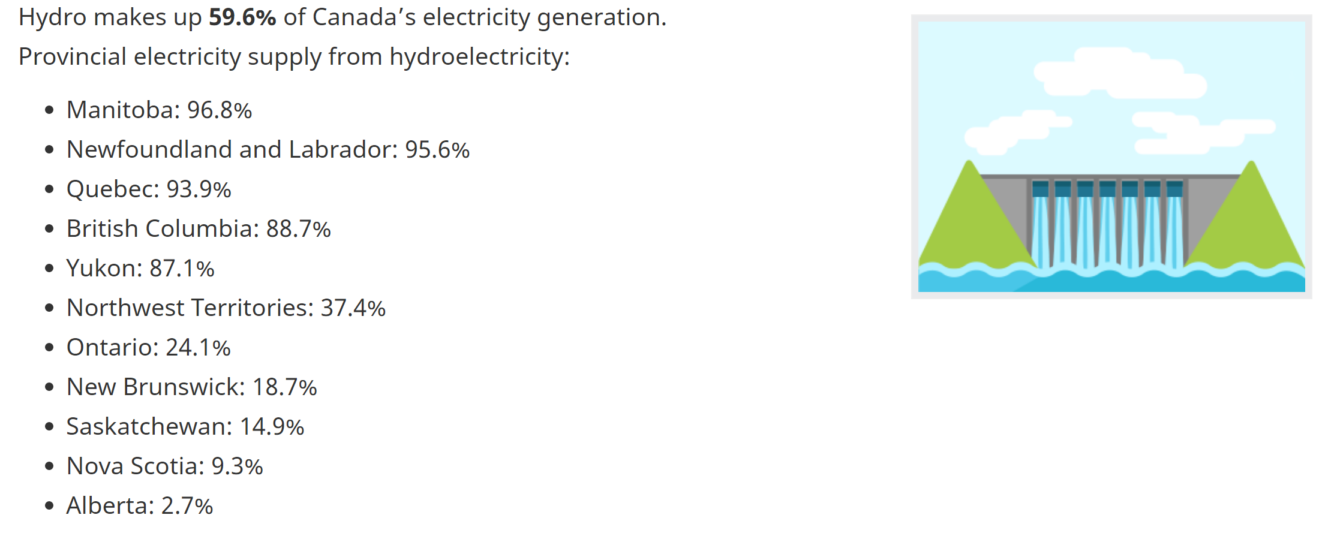
Hydro Usage in Canada:
Instructions:
Read over the data below: Write down any noticings and wonderings you have about the data below.
Source of information: Electricity facts
I NOTICE:
I WONDER?:

Slide 45
Make an Initial Decision
What is the most best way to represent electricity data graphically?
Instructions:
Based on your current understanding of graphs make an initial decision about how to best represent the data below.
Provide reasons to support your initial decision.
Source of information: Electricity facts
I think representing the data with a
Pictograph
Line graph
Bar Graph
Would be the best because…

Slide 46
Considering Criteria…
The best graph for representing is one that…
Easy to Read | For data to be easy to read it needs to be neatly presented, organized, labeled correctly, includes a key or legend and has no distractions from the data being represented.
Allows the reader to answer specific questions | When you look at your chart can you answer the following questions quickly: What is the graph about? What data is being represented? Which province has the most hydro usage? Which province has the least hydro usage? What is the hydro usage for _________ province?
Data is not misleading | Data can be displayed in many different ways, but the data needs to be represented in the clearest way possible so everyone can answer the questions in the same way: Does the data make one province look higher than the other one even if they are close? Does the data show the true hydro usage for each province? Can some of the data be questioned as being wrong? Could some of the data be read by different people in different ways?
Type of Data is appropriate for Graph | Continuous Data Data points are connected such as length over time. 2 or more categories being compared but they are connected in some way Discrete Data Data points are not connected 2 or more categories being compared

Slide 47
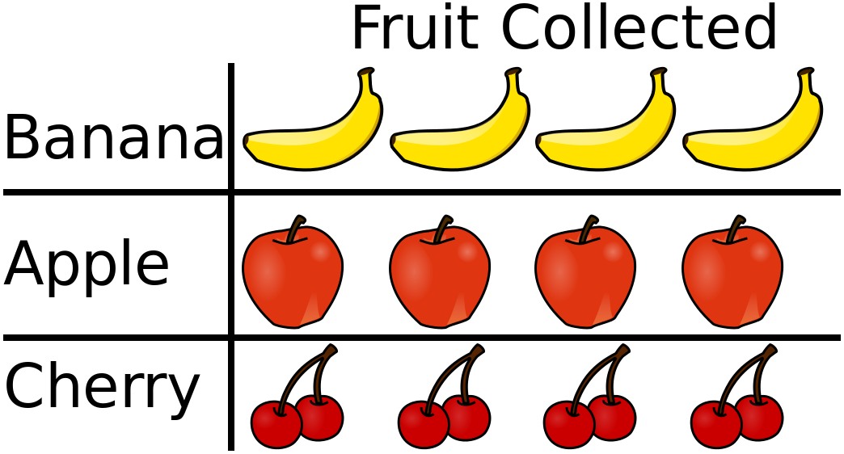
Creating a pictograph?
Pictographs use pictures as symbols to represent data. Each picture represents a certain number of things.
Learn more here: Pictographs
Pictograph Example:
Image Source - https://commons.wikimedia.org/wiki/File:Pictograph_aligned_and_similar_size.svg

Slide 48
Make a Pictograph
Instructions:
Create a pictograph using the data by filling in the chart below:
Choose one image to represent a certain percentage of data. For example 1 Hydro Pole = 10% of hydro usage.
Be sure to label your pictograph with a title and a legend/key.
Source of information: Electricity facts
Title: _____________________________________________
Provinces/Territories | % Hydro Usage:
Manitoba
Newfoundland and Labrador
Quebec
British Columbia
Yukon
Northwest Territories
Ontario
New Brunswick
Saskatchewan
Nova Scotia
Alberta

Slide 49
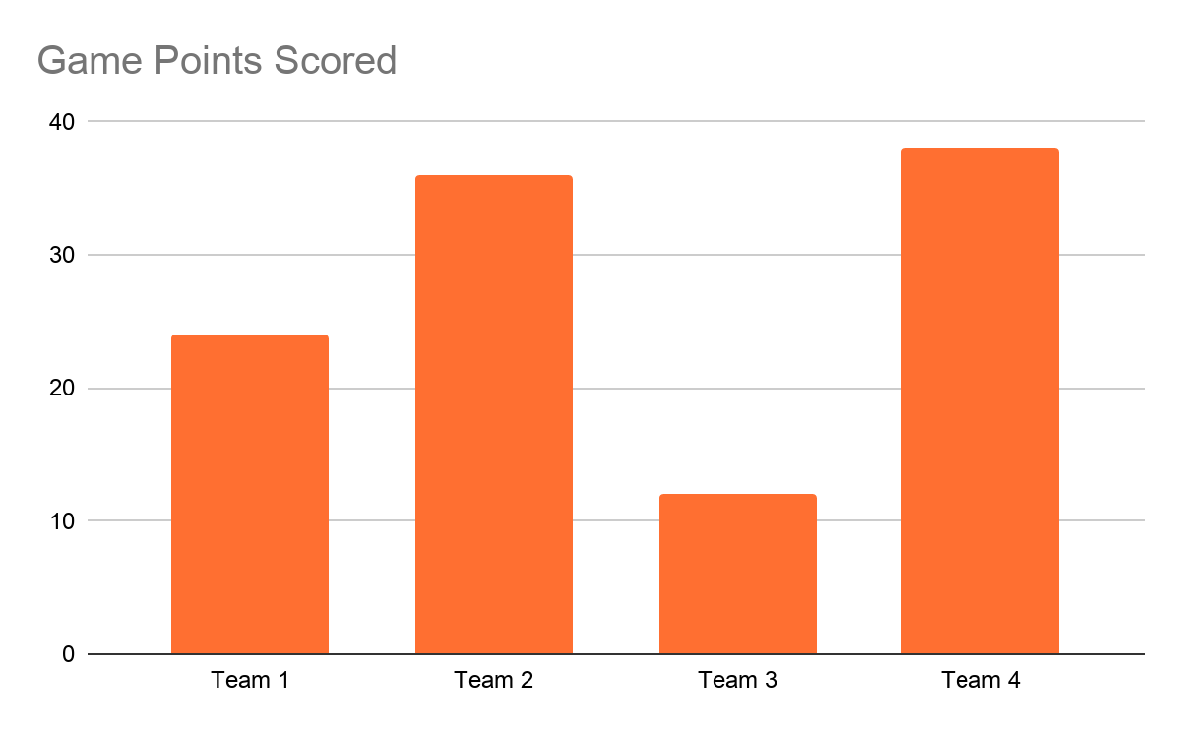
Creating a Bar Graph:
Bar Graphs compare data. It is best used when data is discrete (it is in categories) rather than continuous data. For example the types of pizza a group of people like would be categorical, but a person's height over time would be continuous.
Learn more here:
Bar Graphs
Bar Graph Example:

Slide 50
Make a Bar Graph
Instructions:
Create a Bar Graph using the data by filling in the chart below:
Be sure to label your bar graph with a title, categories and a legend/key if needed.
Title: _____________________________________________
Source of information: Electricity facts

Slide 51
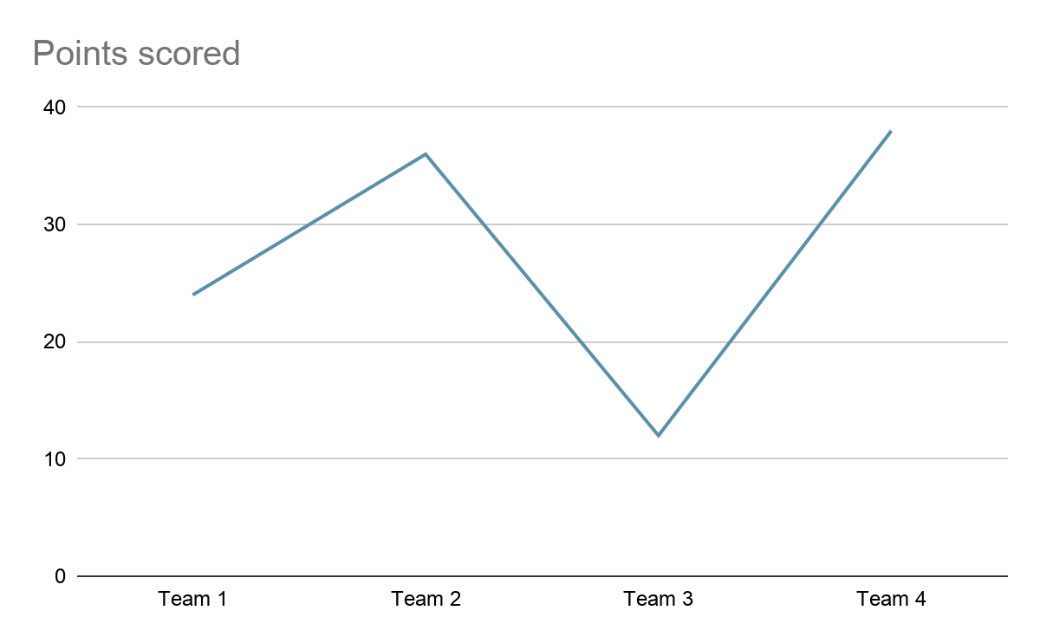
Creating a LINE Graph:
Line Graphs use points on a graph that are connected to compare data that is continuous. For example a person’s height over time. Line graphs can also show non-continuous (discrete) data such as the example below.
Learn more here:
Line Graphs
Line Graph Example:

Slide 52
Make a Line Graph
Instructions:
Create a Line Graph using the data by filling in the chart below:
Be sure to label your bar graph with a title, categories and a legend/key if needed.
Title: _____________________________________________
Source of information: Electricity facts

Slide 53
Considering Criteria…
Instructions:
Look back on the 3 graphs you created.
Use the Criteria chart below to compare each graphical representation.
The best graph for representing is one that…
Criteria The graph... | Pictograph | Bar Graph | Line Graph
as easy to read, it is… | neatly presented Organized, labeled correctly includes a key or legend no distractions | neatly presented Organized, labeled correctly includes a key or legend no distractions | neatly presented Organized, labeled correctly includes a key or legend no distractions
allows me to easily answer questions such as… | What is the graph about? What data is being represented? Which province has the most hydro usage? Which province has the least hydro usage? What is the hydro usage for _________? (province) | What is the graph about? What data is being represented? Which province has the most hydro usage? Which province has the least hydro usage? What is the hydro usage for _________? (province) | What is the graph about? What data is being represented? Which province has the most hydro usage? Which province has the least hydro usage? What is the hydro usage for _________? (province)
is not misleading | The graph shows the true hydro usage for each province? All the data on the graph matches the data given in the information Anyone who reads the graph would get the same answers to amount of hydro being used by each province. | The graph shows the true hydro usage for each province? All the data on the graph matches the data given in the information Anyone who reads the graph would get the same answers to amount of hydro being used by each province. | The graph shows the true hydro usage for each province? All the data on the graph matches the data given in the information Anyone who reads the graph would get the same answers to amount of hydro being used by each province.
Type of Data is Appropriate for the Graph | Data used is numerical Data has categories Data is discrete (not continuous) | Data is comparing 2 or more categories Data is discrete (not continuous) | Data is comparing 2 or more categories Data is connected with a line because it is continuous Data is not connected with a line, points on a graph, because it is discrete.

Slide 54
Make an Final Decision
What is the most best way to represent electricity data graphically?
Instructions:
Based on what you have learned throughout this lesson, answer the above question by checking off which graph you think represents the hydro usage data the best.
Reflect back on your initial decision: did you adjust your thinking.
Detail below your justification for adjusting your initial decision or if you did not change your thinking what did you learn that can help you proof your intial statement.
I think representing the data with a
Pictograph
Line graph
Bar Graph
Would be the best because…
Provide the three most compelling reasons that support your final decision:
1.
2.
3.

Slide 55
Grade 6 Mathematics Achievement indicators:
Outcome & Achievement indicators: 6.SP.1 - Create, label, and interpret line graphs to draw conclusions. [C, CN, PS, R, V] | Limited Requires considerable, ongoing teacher support and/or direction to choose strategies or to explain concepts and procedures. May not recognize that results are not reasonable. | Basic Requires occasional teacher or peer support to choose and explain appropriate strategies and procedures. Recognizes when results are extremely unlikely. | Good Represents and explains concepts accurately and clearly; chooses and explains appropriate strategies and procedures. Recognizes when results are not reasonable. | Excellent Represents and explains concepts accurately and clearly; chooses and explains appropriate strategies and procedures. Recognizes when results are not reasonable.
Determine whether a set of data can be represented using a line graph (continuous data) or a series of points (discrete data), and explain why.
Create a line graph from a table of values or a set of data
Interpret a line graph to draw conclusion
6.SP.3 Graph collected data and analyze the graph to solve problems. [C, CN, PS] Select a type of graph for displaying a set of collected data and justify the choice of the graph.
Solve a problem by graphing data and interpreting the resulting graph

Slide 56
CONGRATULATIONS!
Challenge Completed
Share with your Teacher
Return to Student Choice Board.

