Slide 1
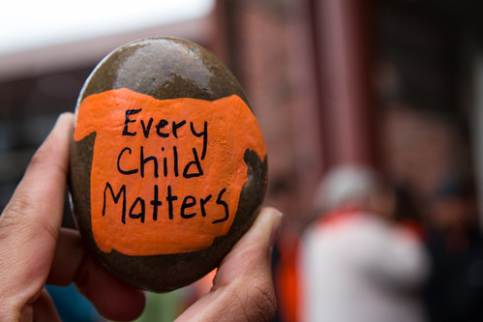
Residential Schools
This Photo by Unknown author is licensed under CC BY-NC-ND.
Grades K-4

Slide 2
Inquiry Question
Why is it important to learn about residential schools?

Slide 3
How much do you know about residential schools?
I know very little about residential schools. | I know a little bit about residential schools. | I know some things about residential schools. | I know a lot about residential schools.
Extend the arrow to the spot on the continuum that reflects
how much you know about residential schools.

Slide 4
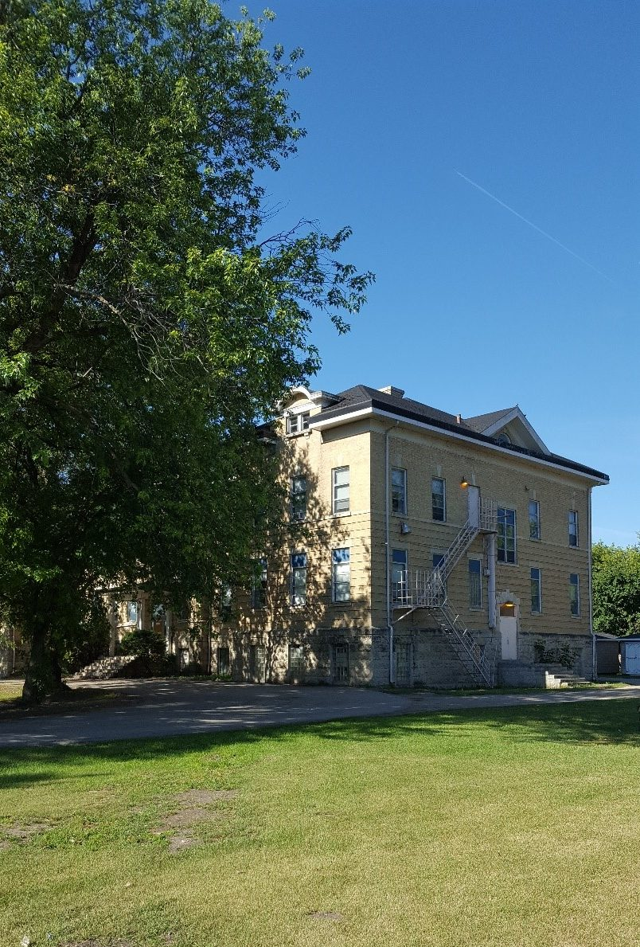
Residential Schools
Residential schools are schools that Indigenous children had to go to.
Residential schools are not around anymore; the last one closed in 1996.
Residential schools existed for over 150 years in Canada.
For the most part, children were not treated very well at these schools.
This Photo by Unknown author is licensed under CC BY-ND.

Slide 5
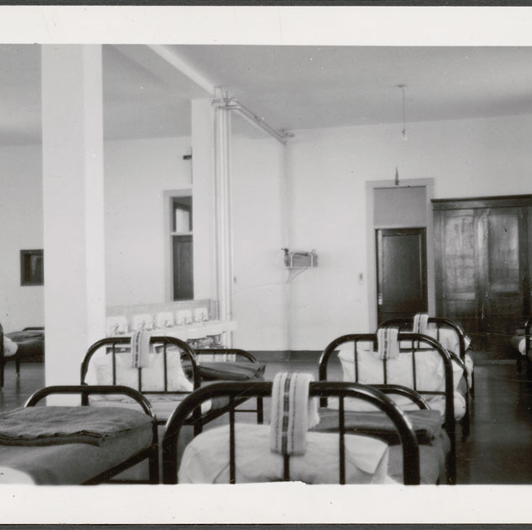
Far Away
Some of the schools were really far away and the kids had to live there.
They had rooms with rows of beds for the kids to sleep in.
They went to school in September, and they did not go home until June.
Cross Lake, MB, 1940
Library and Archives Canada
Notes:
Cross Lake, MB, 1940 – Library and Archives Canada https://data2.archives.ca/e/e444/e011080269-v8.jpg
You may choose to follow up this slide with the Courage BLM#5 activity.

Slide 6
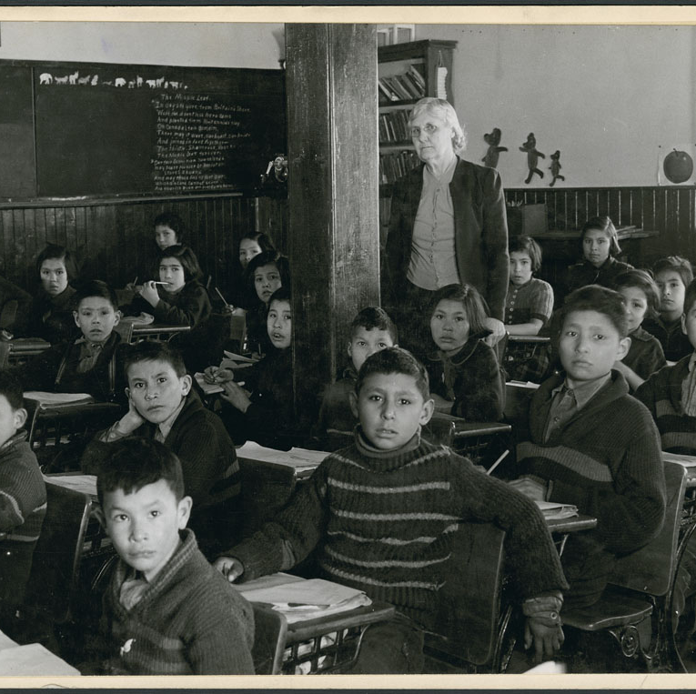
Hard Work
The kids had to work very hard at these schools.
They were given adult chores like cleaning the school, washing dishes, doing laundry, sewing clothes, milking cows, and weeding the garden.
There was little free time for kids to make friends and play.
Lac La Ronge, SK, 1945
Library and Archives Canada
Notes:
Lac La Ronge, SK, 1945 – Library and Archives Canada https://data2.archives.ca/e/e439/e010962313-v8.jpg

Slide 7
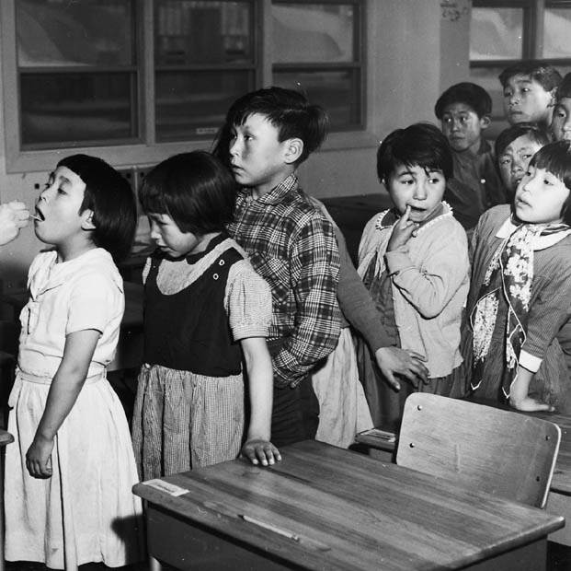
No Choices
The kids were not allowed to make any choices.
There was no sleeping in. Kids had to wake up early every morning, even on weekends.
They had to make their beds every day.
Kids were not allowed to celebrate their traditions.
Frobisher Bay, Iqaluit, 1959
Library and Archives Canada
Notes:
Frobisher Bay, Iqaluit, 1959 – Library and Archives Canada https://data2.archives.ca/e/e101/e002504641.jpg
You may choose to follow up this slide with the Traditions and Celebrations BLM#4 activity.

Slide 8
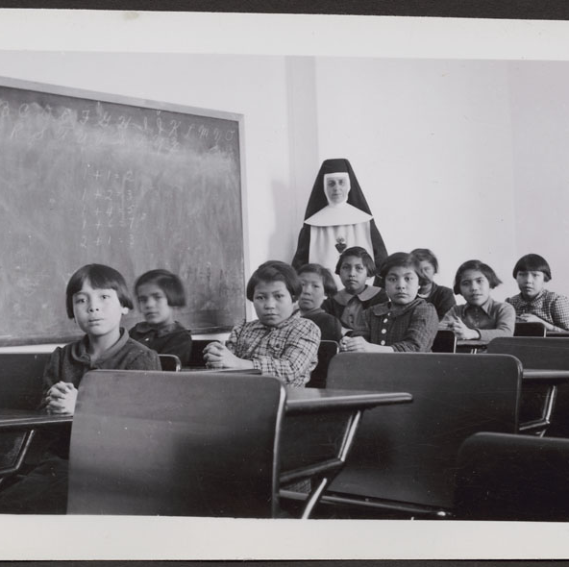
Hard Times
The food was plain and bland. It was mostly just porridge, soup, stew, and bread.
Children were not allowed to speak their language. They had to learn a new language without being allowed to ask questions.
Some of the children were given a different name, many were only called upon by number.
Cross Lake, MB, 1940
Library and Archives Canada
Notes:
Cross Lake, MB, 1940 – Library and Archives Canada https://data2.archives.ca/e/e444/e011080274-v8.jpg
You may choose to follow up this slide with the Stolen Words BLM#3a & #3b activities.

Slide 9
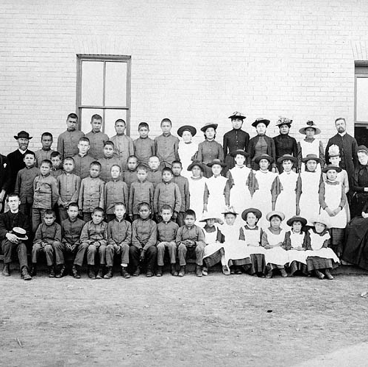
Everyone the Same
They wanted all the kids to be the same.
They all had to have the same haircut and they all had to wear the same clothes.
The clothes they gave them were dull colours, like white, black and grey.
None of the kids felt like they mattered.
St. Paul's, MB, 1901
Library and Archives Canada
Notes:
St. Paul's, MB, 1901 – Library and Archives Canada https://data2.archives.ca/ap/a/a182251.jpg
You may choose to follow up this slide with the You are Special BLM#2 activity.

Slide 10
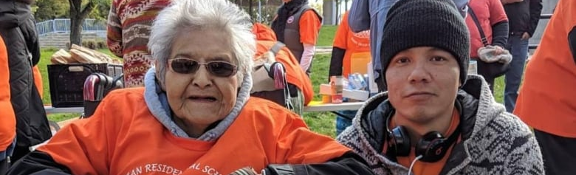
There are still people alive today that went to these schools.
They were little kids then and now they are older.
Many of them are grandmas and grandpas now.
Sometimes they get sad when they think about their time at residential school.
This Photo by Unknown author is licensed under CC BY-NC.

Slide 11
Phyllis Webstad
When Phyllis was 6 years old, her granny bought her a shiny orange shirt. Phyllis was excited about her new shirt, and she wore it on her first day at residential school. But when she got there, they took her orange shirt and she never saw it again and it made her feel sad.
We wear orange on September 30th to show Phyllis that we care about her and all the children that went to residential schools.
"Members of the Legislative Assembly and the Orange Shirt Society say ‘Every Child Matters’" by BC Gov Photos is licensed under CC BY-NC-ND 2.0
Notes:
Phyllis (Jack) Webstad's story in her own words... https://www.orangeshirtday.org/phyllis-story.html
Phyllis Webstad Orange Shirt Day Presentation (1:55 min) https://www.youtube.com/watch?v=E3vUqr01kAk&t=1s
You may choose to follow up this slide with the Design an Orange Shirt BLM#6 activity.

Slide 12
What can you do?
The good news is there are things you can do to help survivors of residential schools feel better.
The best way is to show that you care.
There are lots of ways to show that you care.
Can you think of any?
This Photo by Unknown author is licensed under CC BY-NC-ND.

Slide 13
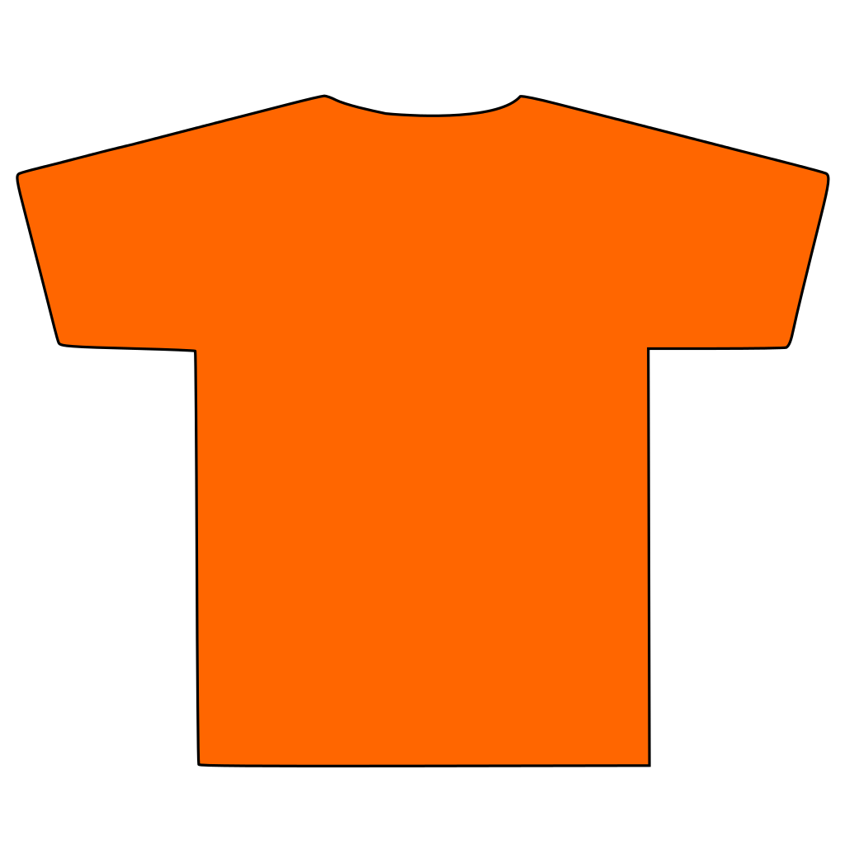
Every Child Matters
You can colour an orange heart.
You can paint a rock with orange paint.
You can write "Every Child Matters" on an orange piece of paper.
You can wear orange on Orange Shirt Day, which is September 30th of every year.
You can continue to learn about residential schools.
This Photo by Unknown author is licensed under CC BY-NC-ND.
This Photo by Unknown author is licensed under CC BY-SA.

Slide 14
How much do you know about residential schools now?
I know very little about residential schools. | I know a little bit about residential schools. | I know some things about residential schools. | I know a lot about residential schools.
Extend the arrow to the spot on the continuum that reflects how much you know about residential schools.
Notes:
You and/or the students may notice that the first column has been greyed-out and the arrow moved to the second column. It is expected that by this point in the learning experience that students know more about residential schools than they did at the beginning.

Slide 15
Reflection
Why is it important to learn about residential schools?
This Photo by Unknown author is licensed under CC BY-NC-ND.
Notes:
You may choose to use the Residential School Reflection BLM#7 to support students’ reflection.

