Slide 1
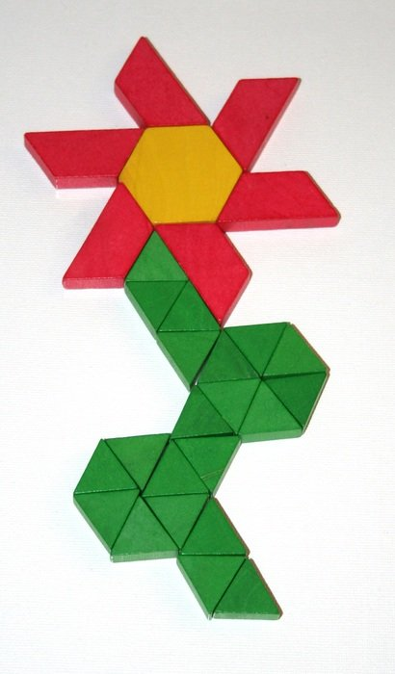
Investigating 2-D Shapes and 3-D Objects
Notes:
Photo Source: https://pxhere.com/en/photo/611056

Slide 2
Guiding Concepts
Anchored in inquiry
Open ended questions, student centered, student choice
Low floor, high ceiling tasks
Multiple ways to show understanding

Slide 3
Big Ideas
Two- and three-dimensional objects can be described, classified, and analyzed by their attributes
Curricular Outcomes
2.SS.6 Sort 2-D shapes and 3-D objects using two attributes and explain the sorting rule.
2.SS.7. Describe, compare, and construct 3-D objects, including: cubes, spheres, cones, cylinders, prisms, and pyramids.
2.SS.8. Describe, compare, and construct 2-D shapes, including: triangles, squares, rectangles, and circles.
2.SS.9. Identify 2-D shapes as parts of 3-D objects in the environment.

Slide 4
Enduring Understandings:
Geometric shapes and objects can be classified by attributes.
A 3-D object can be analyzed in terms of its 2-D parts.
Essential Questions:
What are the attributes of a shape or object?
What are ways shapes or objects can be sorted?
How can 3-D objects and 2-D shapes be described?
What are the attributes of 3-D objects and 2-D shapes?

Slide 5
Materials
It is highly recommended that if this is the first-time students are experiencing virtual manipulatives, allow them time to "play". This allows for the opportunity to explore and have fun with the tools BEFORE they will be required to use them purposefully.
Websites for virtual manipulatives are suggested. Hands-on materials are ideal. Significant learning occurs when students can build and visualize different representations of mathematics.
If School Divisions have another platform for delivering online instruction (Seesaw, Google Classrooms), asynchronous tasks can be uploaded there.
For virtual manipulatives visit https://toytheater.com/category/teacher-tools/virtual-manipulatives/
To enhance their learning experiences students will need:
Some premade manipulatives have been provided on specific slides

Slide 6
Instructions
This collection of tasks is designed around the concept of space and shape, more specifically identifying, sorting, comparing, and constructing 3-D objects and 2-D shapes. Each day represents independent sets of 3-part learning experiences that could function effectively as 45min-1hour session with a combination of synchronous and asynchronous parts, some of which are easily adaptable either way depending on your situation and access to technology and connectivity.
FOR SYNCHRONOUS LEARNING, THE SLIDEDECK SHOULD BE IN EDIT MODE.
Each day has been divided into 3 main parts. Each part provides various ways of engaging with the concept and is correlated with the coloured blocks found on slide 7:
Get Ready: begins the experience with an activity meant to activate student thinking and promote rich student discourse. This activity can be delivered prior to the lesson as an asynchronous task so students have time to prepare their thinking. It can also be delivered at the beginning of the synchronous session to help the teacher pre-assess prior knowledge and prime thinking for the upcoming learning experience.
Work it out: comprises the main learning experience for the day. This is where new content is presented and individual or small group responses are required. These activities are best completed with students working in pairs or small groups. If your platform allows for breakout rooms, this feature is a good tool that will facilitate student collaboration and discourse.
Look Back: is a final culminating task that provides opportunities to check for student understanding of the concepts, consolidate different solutions and solve problems. It allows for students to reflect on their learning and make connections.

Slide 7
Investigating Addition and Subtraction
Visual Connections
Real World Connections
Mental Math & Estimation
Problem Solving
Interdisciplinary Connections
Number Play
Notes:
This is the “launch screen”. Each tile above represents different learning experiences.
The outer border of each slide is colour-coded and corresponds to the tiles above.

Slide 8
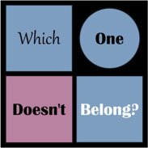
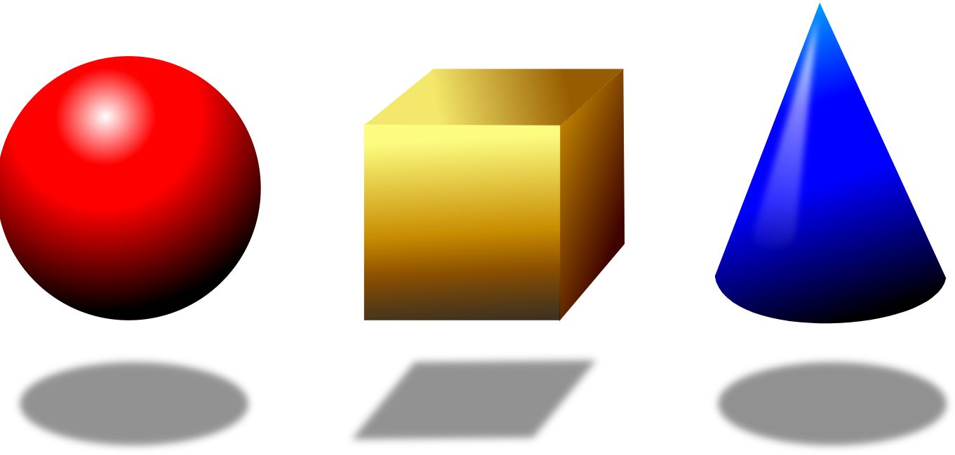
Day 1
1
Get Ready
2
Work it out!
3
Looking Back
Draw It,
then,
Write About It
or,
Record it
Sort It Out!
Notes:
Images source:
https://openclipart.org/download/117355/Geometry-1-by-Merlin2525.svg (3D Objects)
https://openclipart.org/detail/172707/edit-icon-icono-editar, (pencil)
https://openclipart.org/detail/212116/screencast (record)
https://www.pikist.com/free-photo-swbtb (coloured pencils)

Slide 9
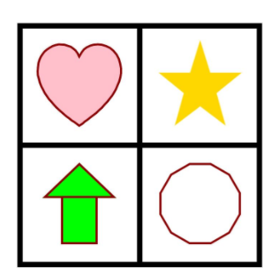
1
Print me to limit screen time
Get Ready!
Which One Doesn't Belong?
Why?
Notes:
Instructions to note:
Present this phrase on the screen. **Note** To allow all students think time, teachers can push this slide out to students prior to the synchronous lesson. That allows for all students to collect their ideas ahead of time and have something to share.
Image Source: https://wodb.ca/shapes.html (Shape 5)

Slide 10
1
Print me to limit screen time
Get Ready!
The doesn't belong because...
The doesn't belong because...
The doesn't belong because...
The doesn't belong because...
Notes:
Instructions to note:
Present this phrase on the screen. **Note** To allow all students think time, teachers can push this slide out to students prior to the synchronous lesson. That allows for all students to collect their ideas ahead of time and have something to share.
Image Source: https://wodb.ca/shapes.html (Shape 5)

Slide 11
1
Get Ready!
End of this section​

Slide 12
2
Work it out
A Mousy Mess,
by Laura Driscoll
Listen to the story.
How do the little mice fix the big problem they encounter?
Do you have a place to keep things you play with?
What can you sort?
How would you sort them?
Notes:
Image Source: https://www.youtube.com/watch?v=fgYBfCT8IKI
Another excellent read is Sam Sorts, by Marthe Jocelyn. There is no youtube version of this story as a read aloud.

Slide 13
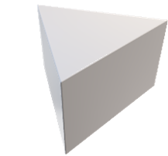
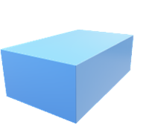
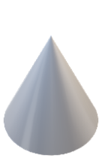
2
Work it out
Sort It Out
Find objects around your home or click and drag me
Sorting Rule:
Sorting Rule:
Notes:
Source: Manitoba Support Document for Teachers Grade 2
Assessing Prior Knowledge:
Give students a small group of 3-D objects. Use the objects on the page as a sample. Have students collect objects around their home to sort.
Have them sort them and then state their sorting rule.
Can the student:
sort a collection of 3-D objects using self-selected attribute
state the sorting rule 3-D

Slide 14
2
Work it out
Sort It Out: Sort the objects a different way.
Sort the shapes you found or sort the shapes a different way.
Sorting Rule:
Sorting Rule:
Click and drag me!
Notes:
Source: Manitoba Support Document for Teachers Grade 2
Assessing Prior Knowledge:
Give students a small group of 3-D objects.
Ask them to re-sort the set and then state their new sorting rule.
Can the students:
sort a collection of 3-D objects using self-selected attribute
state the sorting rule 3-D
re-sort a set in another way 3-D

Slide 15
2
Work it out
Sort It Out: Sort the objects a different way.
Sort the shapes you found or sort the shapes a different way.
Sorting Rule:
Sorting Rule:
Click and drag me!
Notes:
Source: Manitoba Support Document for Teachers Grade 2

Slide 16
2
Work it out
Sort It Out: What are the sorting rules?
Where would this shape go?
Why do you think that?
The Sorting Rule is:
The Sorting Rule is:
Notes:
Source: Manitoba Support Document for Teachers Grade 2
Sort a set of objects into two groups. Have students identify the sorting rule. Hold up another one of the sorted objects and ask them to identify where it should go.
Can the student:
sort a collection of 3-D objects using self-selected attribute
state the sorting rule 3-D
re-sort a set in another way 3-D
identify the sorting rule of a pre-sorted set 3-D
identify the placement of an additional object 3-D

Slide 17
2
Work it out
Sort It Out
Click and drag me!
Sorting Rule:
Sorting Rule:
Notes:
Source: Manitoba Support Document for Teachers Grade 2
Assessing Prior Knowledge:
Give students a small group of 2-D shapes.
Have them sort them and then state their sorting rule.
Can the student:
sort a collection of 2-D shapes using self-selected attribute
state the sorting rule 2-D

Slide 18
2
Work it out
Sort It Out: Sort the shapes a different way.
Click and drag me!
Sorting Rule:
Sorting Rule:
Notes:
Source: Manitoba Support Document for Teachers Grade 2
Assessing Prior Knowledge:
Give students a small group of 2-D shapes.
Have them sort them and then state their sorting rule.
Ask them to re-sort the set and then state their new sorting rule.
sort a collection of 2-D shapes using self-selected attribute
state the sorting rule 2-D
re-sort a set in another way 2-D
identify the sorting rule of a pre-sorted set 2-D
identify the placement of an additional object 2-D

Slide 19
2
Sort It Out: What is the Sorting Rule?
Work it out
Where would this shape go?
Why do you think that?
Sorting Rule:
Sorting Rule:
Notes:
Source: Manitoba Support Document for Teachers Grade 2
Assessing Prior Knowledge
Sort a set of objects into two groups. Have students identify the sorting rule. Hold up another one of the sorted objects and ask them to identify where it should go.
Can the student:
identify the sorting rule of a pre-sorted set 2-D
identify the placement of an additional object 2-D

Slide 20
2
Work it out
We sorted today using different attributes.
Attributes are how we describe what we know about characteristics of an object (for example, how it looks, how it feels, and how it moves).
What were some ways we sorted the 3-D objects and 2-D shapes today? (Think about ways to sort and then move the blue blocks and see some ways of sorting.)
colour size shape number of sides
Notes:
Source: https://www.edu.gov.mb.ca/k12/cur/math/glossary_k-8/document.pdf
The characteristic(s) of a set of items that allow(s) them to be sorted, classified, and interpreted.
Mathematical attributes include size and shape, number of sides, and size of angles.
Non-mathematical attributes include colour and purpose.
Graphical attributes include title, axes, intervals, and legend.

Slide 21
2
Work it out
End of this section

Slide 22
3
Print me to limit screen time
Looking Back
Create Your Own: Sort It Out
Find some things in your house that you can sort into two different sets.
Write your sorting rules below each set.
Take a picture of your sets and explain why you sorted your collection in this way.
Sorting Rule:
Sorting Rule:
Notes:
This could be an asynchronous activity. If Seesaw or Google Classroom are digital platforms, copy this slide into that platform.

Slide 23
3
Looking Back
End of this day.

Slide 24
Day 2
1
Get Ready
2
Work it out!
3
Looking Back
Think About It
then...
The Button Box
Write About It
or,
Record It
Notes:
Source: wodb.ca
Image Source: https://pixy.org/906437/
https://openclipart.org/detail/172707/edit-icon-icono-editar
https://openclipart.org/detail/212116/screencast

Slide 25
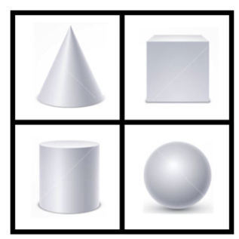
1
Get Ready!
Which One Doesn't Belong?
Why?
Notes:
https://wodb.ca/shapes.html

Slide 26
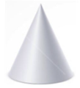
1
Print me to limit screen time
Get Ready!
The doesn't belong because...
The doesn't belong because...
The doesn't belong because...
The doesn't belong because...
Notes:
Instructions to note:
Present this phrase on the screen. **Note** To allow all students think time, teachers can push this slide out to students prior to the synchronous lesson. That allows for all students to collect their ideas ahead of time and have something to share.
Image Source: https://wodb.ca/shapes.html (Shape 5)

Slide 27
1
Get Ready!
End of this section​

Slide 28
2
The Button Box
by Margarette S. Reid
Work it out
Listen to the story.
Can you find objects in your house with buttons?
Where did you find the buttons?
How many kinds of buttons can you find?
Notes:
Book Source: https://www.youtube.com/watch?v=96WFbOHUhFg
Listen to the story The Button Box by Margarette S Reid. Ask students if they or someone they know also have a button box. The questions on this slide are meant to build engagement and start a conversation about where we can find buttons (clothing, boots, shoes, some kitchen towels, etc.).

Slide 29
2
Print me to limit screen time
Work it out
Button Sort
What might the sorting rule be?
(Think about ways to sort and then move the blue blocks and see some ways of sorting.)
Sorting Rule:
Yellow Buttons
Sorting Rule:
Two colours
Notes:
Source: Support Document for Teachers: Grade Two
Button Sort:
Sort a set of buttons using two attributes. Have students guess the sorting rule.
This example uses yellow buttons for the purple set and two colours for the orange set.
The rules are under the blue rectangles.
Image Sources:
https://thenounproject.com/term/clothes-button/730376/
https://hobbii.com/plastikknap-18-mm-sort?store_id=10&gclid=Cj0KCQiAw_H-BRD-ARIsALQE_2PVYjhVCx77Ae3X8jjsCD93w1t_067rbBmylQ7Cq2qCHdGXHK4m5pcaAvvOEALw_wcB
https://www.onlinewebfonts.com/icon/62337
https://pixabay.com/vectors/search/record%20button/
https://pixy.org/2782713/
https://www.dewyvenerius.com/en/product/shaman-stone-button-hollow-knight/
https://www.dewyvenerius.com/en/product/gathering-swarm-button-hollow-knight/
https://www.indiamart.com/proddetail/shirt-button-11877492897.html
https://www.123rf.com/photo_29287257_blue-shirt-button.html
https://shop.buttons.com/770012836100141-p/770012836100141.htm
https://shop.buttons.com/770012836100361-p/770012836100361.htm
https://dolejsi.si/en/products/buttons_and_accessories_made_of_plastic/women/shirt_buttons/1379/button_g_5128/
https://shop.buttons.com/770012836100331-p/770012836100331.htm
https://www.pinterest.ca/pin/482307441315092730/
https://www.myfabrics.co.uk/24-453037-040_mother-of-pearl-button-roots-sunshine-yellow.html
https://buttontopia.com.au/reddish-brown-plain-wood-large-button-4-holes-40mm-1-5-8/
https://www.aliexpress.com/item/32849332625.html
https://www.indiamart.com/proddetail/garment-plain-button-12193290548.html
https://www.indiamart.com/proddetail/plastic-button-10119889348.html
https://www.pixelscrapper.com/melo-vrijhof/designs/hello-hot-pink-button-asset-embellishment-4-hole-sewing
https://webiconspng.com/icon/53760
https://webiconspng.com/icon/53736

Slide 30
2
Work it out
Button Sort
Let's try another way.
Sorting Rule:
Sorting Rule:
Click and drag me!
Notes:
Source: Support Document for Teachers: Grade Two
Button Sort:
Sort a set of buttons using two attributes. Have students guess the sorting rule. Do this synchronously.
Image Sources:
https://thenounproject.com/term/clothes-button/730376/
https://hobbii.com/plastikknap-18-mm-sort?store_id=10&gclid=Cj0KCQiAw_H-BRD-ARIsALQE_2PVYjhVCx77Ae3X8jjsCD93w1t_067rbBmylQ7Cq2qCHdGXHK4m5pcaAvvOEALw_wcB
https://www.onlinewebfonts.com/icon/62337
https://pixabay.com/vectors/search/record%20button/
https://pixy.org/2782713/
https://www.dewyvenerius.com/en/product/shaman-stone-button-hollow-knight/
https://www.dewyvenerius.com/en/product/gathering-swarm-button-hollow-knight/
https://www.indiamart.com/proddetail/shirt-button-11877492897.html
https://www.123rf.com/photo_29287257_blue-shirt-button.html
https://shop.buttons.com/770012836100141-p/770012836100141.htm
https://shop.buttons.com/770012836100361-p/770012836100361.htm
https://dolejsi.si/en/products/buttons_and_accessories_made_of_plastic/women/shirt_buttons/1379/button_g_5128/
https://shop.buttons.com/770012836100331-p/770012836100331.htm
https://www.pinterest.ca/pin/482307441315092730/
https://www.myfabrics.co.uk/24-453037-040_mother-of-pearl-button-roots-sunshine-yellow.html
https://buttontopia.com.au/reddish-brown-plain-wood-large-button-4-holes-40mm-1-5-8/
https://www.aliexpress.com/item/32849332625.html
https://www.indiamart.com/proddetail/garment-plain-button-12193290548.html
https://www.indiamart.com/proddetail/plastic-button-10119889348.html
https://www.pixelscrapper.com/melo-vrijhof/designs/hello-hot-pink-button-asset-embellishment-4-hole-sewing
https://webiconspng.com/icon/53760
https://webiconspng.com/icon/53736

Slide 31
2
Work it out
Button Sort
Can these be sorted a different way?
Sorting Rule:
Sorting Rule:
Click and drag me!
Notes:
Source: Support Document for Teachers: Grade Two
Button Sort:
Sort a set of buttons using two attributes. Have students guess the sorting rule. Do this synchronously.
Have small groups of students in breakout rooms sort sets of buttons using two (or more) attributes, write the sorting rule on a slide. Then share the group slides with the class and see if they can guess the sorting rules.
Image Sources:
https://thenounproject.com/term/clothes-button/730376/
https://hobbii.com/plastikknap-18-mm-sort?store_id=10&gclid=Cj0KCQiAw_H-BRD-ARIsALQE_2PVYjhVCx77Ae3X8jjsCD93w1t_067rbBmylQ7Cq2qCHdGXHK4m5pcaAvvOEALw_wcB
https://www.onlinewebfonts.com/icon/62337
https://pixabay.com/vectors/search/record%20button/
https://pixy.org/2782713/
https://www.dewyvenerius.com/en/product/shaman-stone-button-hollow-knight/
https://www.dewyvenerius.com/en/product/gathering-swarm-button-hollow-knight/
https://www.indiamart.com/proddetail/shirt-button-11877492897.html
https://www.123rf.com/photo_29287257_blue-shirt-button.html
https://shop.buttons.com/770012836100141-p/770012836100141.htm
https://shop.buttons.com/770012836100361-p/770012836100361.htm
https://dolejsi.si/en/products/buttons_and_accessories_made_of_plastic/women/shirt_buttons/1379/button_g_5128/
https://shop.buttons.com/770012836100331-p/770012836100331.htm
https://www.pinterest.ca/pin/482307441315092730/
https://www.myfabrics.co.uk/24-453037-040_mother-of-pearl-button-roots-sunshine-yellow.html
https://buttontopia.com.au/reddish-brown-plain-wood-large-button-4-holes-40mm-1-5-8/
https://www.aliexpress.com/item/32849332625.html
https://www.indiamart.com/proddetail/garment-plain-button-12193290548.html
https://www.indiamart.com/proddetail/plastic-button-10119889348.html
https://www.pixelscrapper.com/melo-vrijhof/designs/hello-hot-pink-button-asset-embellishment-4-hole-sewing
https://webiconspng.com/icon/53760
https://webiconspng.com/icon/53736

Slide 32
2
Work It Out!
End of this section​

Slide 33
3
Looking Back
Check for Understanding
Attributes are how we describe what we know about characteristics of an object.
What are some examples of attributes that we have used in sorting collections?

Slide 34
3
Looking Back
End of this day.
Notes:
.

Slide 35
Day 3
1
Get Ready
2
Work it out!
3
Looking Back
What is the rule?
Guess my Shape
Sorting Logic Blocks
Notes:
Images source:
https://openclipart.org/detail/172707/edit-icon-icono-editar, (pencil)
https://openclipart.org/detail/212116/screencast (record)

Slide 36
1
Get Ready!
Omari has a sorting hoop that looks like this:
Click and drag me!
What sorting rule might he be using?
Sort the other shapes using this rule.
Notes:
Source: Marian Small, Open Questions for Rich Math Lessons

Slide 37
1
Get Ready!
Anna has a sorting hoop that looks like this:
Move the shapes
What sorting rule might she be using?
Sort the other shapes using this rule.
Notes:
Source: Marian Small, Open Questions for Rich Math Lessons

Slide 38
1
Get Ready!
End of this section​

Slide 39
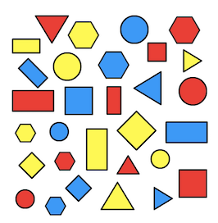
2
Work it out
Sorting Logic Blocks
You will need some blocks of different shapes and colours, or you could print off and cut out the shapes on this sheet.
Choose a rule, like “four-sided shapes” or “red shapes”.
Challenge someone else to work out your rule. They can do this by choosing a shape for you to say either "Yes, that follows my rule and is in my set" (you then put it over on the left) or "No, this does not follow my rule and so is not in my set" (you then put it over on the right). How did they decide which shapes to choose? Did they get quicker at finding out the rule? What was the smallest number of shapes they needed to try? Could you make some more shapes to add to the set? What would you make and why?
Notes:
Source: https://nrich.maths.org/7192
Printable sheet with shapes: https://nrich.maths.org/content/id/7192/LogicBlocks.pdf

Slide 40
2
Work it out
End of this section

Slide 41
3
Looking Back
Thinking about Shape Attributes
Choose 4 shapes from the previous activity. Write 3 clues for each shape following the format below. Have someone try and name and draw the different shapes.
Clues:
The shape is ___________________________________
The shape has __________________________________
The shape does not have _________________________
Notes:
Can students describe different attributes for various shapes?

Slide 42
3
Looking Back
Thinking about shape attributes
Here is an example:
Clues:
The shape is red
The shape has 3 sides
The shape does not have a point at the top.
Answer: A red triangle
Notes:
Can students describe different attributes for various shapes?

Slide 43
3
Looking Back
End of this day.

Slide 44
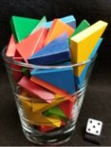
Day 4
1
Get Ready
2
Work it out!
3
Looking Back
Shapes Around My House
Esti-Mystery
Sort with a Venn Diagram
Write About It
or,
Record It
Notes:
Image source:
https://stevewyborney.com/2019/09/51-esti-mysteries/
https://openclipart.org/download/117355/Geometry-1-by-Merlin2525.svg (3D objects)
https://openclipart.org/detail/172707/edit-icon-icono-editar
https://openclipart.org/detail/212116/screencast

Slide 45
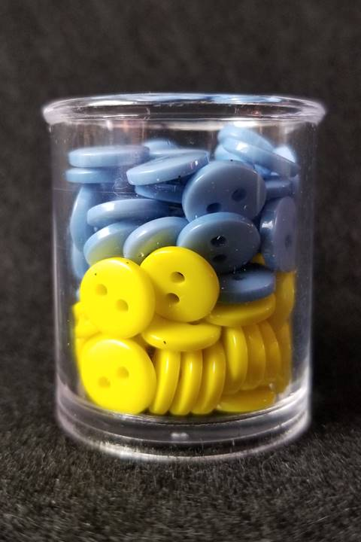
1
Get ready!
Buttons Blue and Yellow, Too!
Notes:
Source: https://stevewyborney.com/2019/09/51-esti-mysteries/ (210)
Instructions to note:
TO USE THE FOLLOWING SLIDES YOU MUST BE IN SLIDE SHOW / PRESENT MODE.
Go to SLIDE SHOW FROM CURRENT SLIDE

Slide 46
1
Print me to limit screen time
Get ready!
Buttons Blue and Yellow, Too!
First Estimate:
Second Estimate:
Third Estimate:
Fourth Estimate:
Final Estimate:
Notes:
Source: https://stevewyborney.com/2019/09/51-esti-mysteries/ (210)
Instructions to note:
TO USE THE FOLLOWING SLIDES YOU MUST BE IN SLIDE SHOW / PRESENT MODE.
Go to SLIDE SHOW FROM CURRENT SLIDE

Slide 47
How many buttons are in the glass?
As the clues appear, use the information to narrow the possibilities to a smaller set. After each clue, use estimation again to determine which of the remaining answers is the most reasonable.
Write down your first estimate. After each clue, you’ll see if your estimate is still a possibility. After each clue, if it is no longer possible write down a new estimate – and be prepared to explain why you chose it.
Steve Wyborney
www.stevewyborney.com

Slide 48
Clue #1
Clue #1
The answer is between 40 and 100.
Clue #2
Clue #2
The answer is an odd number.
Clue #3
The answer does not include the digits 5 or 6.
Clue #3
Clue #4
Clue #4
The answer does not include the digits 7 or 8.
Clue #5
The digit in the ones place is a 9.
Clue #5
Steve Wyborney
www.stevewyborney.com

Slide 49
After seeing the clues, you have narrowed the possibilities to a small set of numbers. Before you see the answer, select your final estimate. Write it down, and explain to someone why you chose that number.
Steve Wyborney
www.stevewyborney.com

Slide 50
99 buttons
The Reveal
Click to see the answer.
Important Note:
If you can see this box, then the slide show is not playing and the reveal won’t work.
Here is the solution:
If you are using PowerPoint, click on Slide Show, then click on From Current Slide.
If you are using Google Slides, click on View then Present.
Steve Wyborney
www.stevewyborney.com

Slide 51
1
Get ready!
End of this section​

Slide 52
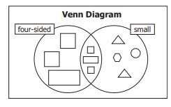
2
Work it out
Using a Venn Diagram for Sorting
This Venn diagram shows a sort by two attributes—four-sided and small. The intersection of the two circles contains figures that share both attributes.
Notes:
Source: Grade Two Mathematics Support Document for Teachers

Slide 53
2
Work it out
Using a Venn Diagram for Sorting
The section between the two circles is called an intersection.
The intersection contains objects that belong to both sets.
Notes:
Source: Grade Two Mathematics Support Document for Teachers

Slide 54
2
Work it out
Using a Venn Diagram for Sorting
Sorting Rule:
Sorting Rule:
Click and drag me!
Notes:
Source: Grade Two Mathematics Support Document for Teachers
Give students a small group of regular and irregular 2-D shapes.
1. Have them sort them according to two attributes and then state their sorting rule.
2. Sort a set of objects into two groups. Have students identify the sorting rule.
Can students:
sort a collection of 2-D shapes according to two attributes
state the sorting rule 2-D
identify the sorting rule of a pre-sorted set 2-D

Slide 55
2
Work it out
Using a Venn Diagram for Sorting
(Think about ways to sort and then move the blue blocks and see some ways of sorting.)
Sorting Rule: Big
Sorting Rule: Red
Notes:
Source: Grade Two Mathematics Support Document for Teachers
Give students a small group of regular and irregular 2-D shapes.
Sort a set of objects into two groups. Have students identify the sorting rule. Delete the blue shades over the sorting rule to expose what the rules are.

Slide 56
2
Work it out
Using a Venn Diagram for Sorting
Sorting Rule:
Sorting Rule:
Click and drag me!
Notes:
Source: Grade Two Mathematics Support Document for Teachers
Here is an opportunity for students to sort within a small group. You can dupicate this slide for each breakout room. Students can work together to decide how to sort the shapes provided.
1. Have them sort them according to two attributes and then state their sorting rule.
2. Sort a set of objects into two groups. Have students identify the sorting rule.

Slide 57
2
Work it out
Using a Venn Diagram for Sorting
Notes:
Source: Grade Two Mathematics Support Document for Teachers
Another option is for the students to select their own shapes and sort them.
To do this students will have to understand how to use either the drawing tool, or insert shapes.

Slide 58
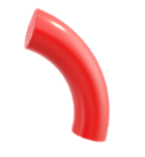
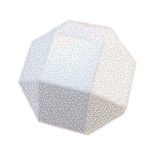
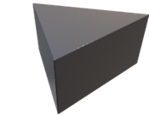
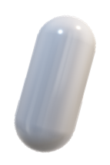
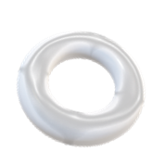
2
Work it out
Using a Venn Diagram for Sorting
Sorting Rule:
Sorting Rule:
Click and drag me!
Notes:
Source: Grade Two Mathematics Support Document for Teachers
Give students a small group of regular and irregular 3-D objects.
1. Have them sort them according to two attributes and then state their sorting rule.
2. Sort a set of objects into two groups. Have students identify the sorting rule.
Can students:
sort a collection of 3-D objects according to two attributes
state the sorting rule 3-D

Slide 59
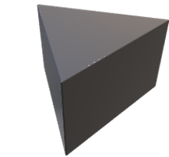
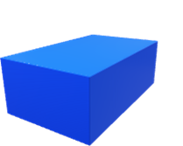
2
Work it out
Using a Venn Diagram for Sorting
(Think about ways to sort and then move the blue blocks and see some ways of sorting.)
Sorting Rule:
Regular 3-D Object
Sorting Rule:
Red
Notes:
Source: Grade Two Mathematics Support Document for Teachers
Give students a small group of regular and irregular 3-D objects.
Sort a set of objects into two groups. Have students identify the sorting rule.
Can Students:
identify the sorting rule of a pre-sorted set 3-D

Slide 60
2
Work it out
Using a Venn Diagram for Sorting
Sorting Rule:
Sorting Rule:
Click and drag me!
Notes:
Source: Grade Two Mathematics Support Document for Teachers
Again, here is another opportunity for students to sort within a small group. You can dupicate this slide for each breakout room. Students can work together to decide how to sort the shapes provided.
Give students a small group of regular and irregular 3-D objects.
1. Have them sort them according to two attributes and then state their sorting rule.
2. Sort a set of objects into two groups. Have students identify the sorting rule.
Can students:
sort a collection of 3-D objects according to two attributes
state the sorting rule 3-D
identify the sorting rule of a pre-sorted set 3-D

Slide 61
2
Work it out
Using a Venn Diagram for Sorting
Notes:
Source: Grade Two Mathematics Support Document for Teachers
Another option is for the students to select their own shapes and sort them.
To do this students will have to understand how to use either the drawing tool, or insert shapes.

Slide 62
2
Get ready!
End of this section​

Slide 63
2
Print me to limit screen time
Looking Back
Using a Venn Diagram for Sorting
Notes:
Source: Grade Two Mathematics Support Document for Teachers
Find either 3-D objects or 2-D shapes in or around your house. Sort them in a Venn Diagram using two different attributes. Use pictures and words to describe your thinking.

Slide 64
3
Looking Back
End of this day​

Slide 65
Day 5
1
Get Ready
2
Work it out!
3
Looking Back
Esti-Mystery
Looking at Attributes
Write About It
Record It
3-D and 2-D Shape Sort
Notes:
Images sourced from
https://openclipart.org/detail/172707/edit-icon-icono-editar
https://openclipart.org/detail/212116/screencast

Slide 66
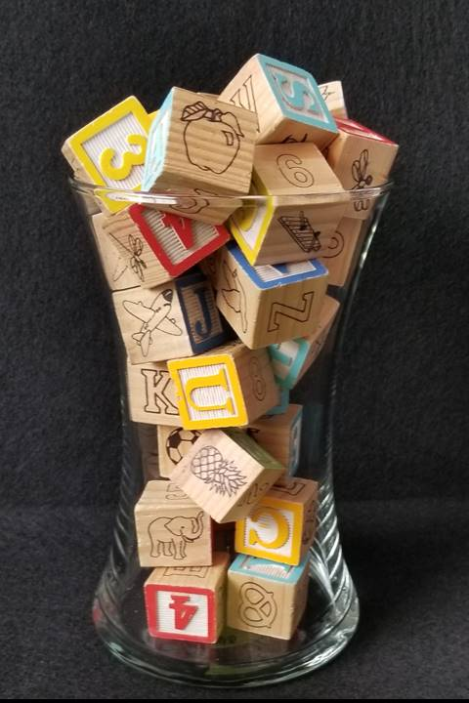
1
Get ready!
Block Talk, Level 2
Notes:
Source: https://stevewyborney.com/2019/09/51-esti-mysteries/ (207)
Instructions to note:
TO USE THE FOLLOWING SLIDES YOU MUST BE IN SLIDE SHOW / PRESENT MODE.
Go to SLIDE SHOW FROM CURRENT SLIDE

Slide 67
1
Print me to limit screen time
Get ready!
Block Talk, Level 2
First Estimate:
Second Estimate:
Third Estimate:
Fourth Estimate:
Final Estimate:
Notes:
Source: https://stevewyborney.com/2019/09/51-esti-mysteries/ (207)
Instructions to note:
TO USE THE FOLLOWING SLIDES YOU MUST BE IN SLIDE SHOW / PRESENT MODE.
Go to SLIDE SHOW FROM CURRENT SLIDE

Slide 68
How many blocks are in the vase?
As the clues appear, use the information to narrow the possibilities to a smaller set. After each clue, use estimation again to determine which of the remaining answers is the most reasonable.
Write down your first estimate. After each clue, you’ll see if your estimate is still a possibility. After each clue, if it is no longer possible write down a new estimate – and be prepared to explain why you chose it.
Steve Wyborney
www.stevewyborney.com

Slide 69
Clue #1
Clue #1
The answer is an odd number that is less than 60.
You can cross off 2, 4, 6, 8, …
Clue #2
Clue #2
If you look carefully you can see a yellow block with the number 3. The answer includes the digit 3.
Clue #3
The answer does NOT have the same digit in the ones and the tens place.
Clue #3
Clue #4
Clue #4
Look carefully for the red block. You might even see 2 of them. The answer does not include the digit 4.
Clue #5
The answer is not 35, 37, or 39.
Clue #5
Steve Wyborney
www.stevewyborney.com

Slide 70
After seeing the clues, you have narrowed the possibilities to a small set of numbers. Before you see the answer, select your final estimate. Write it down, and explain to someone why you chose that number.
Steve Wyborney
www.stevewyborney.com

Slide 71
31 blocks
The Reveal
Click to see the answer.
Important Note:
If you can see this box, then the slide show is not playing and the reveal won’t work.
Here is the solution:
If you are using PowerPoint, click on Slide Show, then click on From Current Slide.
If you are using Google Slides, click on View then Present.
Steve Wyborney
www.stevewyborney.com

Slide 72
1
Get Ready
End of this section

Slide 73
2
Work it out
Looking at Attributes of 3-D Objects
Let’s look at the Cylinder.
What do you notice?
What 2-D shapes can be found on a cylinder?
Notes:
Manitoba Education Grade Two Mathematics BLM
The shapes above are 3-D objects that can be manipulated to help students further understand the attributes.

Slide 74
2
Work it out
Looking at Attributes of 3-D Objects
Let’s look at the Cube.
What do you notice?
What 2-D shapes can be found on a cube?
Notes:
Manitoba Education Grade Two Mathematics BLM
The shapes above are 3-D objects that can be manipulated to help students further understand the attributes.

Slide 75
2
Work it out
Looking at Attributes of 3-D Objects
Let’s look at the Rectangular Prism.
What do you notice?
What 2-D shapes can be found on a rectangular prism?
Notes:
Manitoba Education Grade Two Mathematics BLM
The shapes above are 3-D objects that can be manipulated to help students further understand the attributes.

Slide 76
2
Work it out
Looking at Attributes of 3-D Objects
Let’s look at the Triangular Prism.
What do you notice?
What 2-D shapes can be found on a triangular prism?
Notes:
Manitoba Education Grade Two Mathematics BLM
Image Source: https://openclipart.org/download/279990/1495284147.svg
The shapes above are 3-D objects that can be manipulated to help students further understand the attributes.

Slide 77
2
Work it out
Looking at Attributes of 3-D Objects
Let’s look at the pyramid.
What do you notice?
What 2-D shapes can be found on a pyramid?
Notes:
Manitoba Education Grade Two Mathematics BLM
The shapes above are 3-D objects that can be manipulated to help students further understand the attributes.

Slide 78
2
Work it out
Looking at Attributes of 3-D Objects
Let’s look at the cone.
What do you notice?
What 2-D shapes can be found on a cone?
Notes:
Manitoba Education Grade Two Mathematics BLM
The shapes above are 3-D objects that can be manipulated to help students further understand the attributes.

Slide 79
2
Print me to limit screen time
Work it out
Sorting 3-D Objects
Place the 3D objects in the correct column.
Click and drag me!
Cylinders | Cones | Pyramids
Notes:
Manitoba Education Grade Two Mathematics BLM

Slide 80
2
Print me to limit screen time
Work it out
Attributes of 2-D Shapes
Name of 2-D Shape | Number of Sides
Circle
Square
Rectangle
Triangle
Notes:
Manitoba Education Grade Two Mathematics BLM
Work through this chart with the class as you discover attributes of 2-D shapes on the following slides. Teachers may want to duplicate this slide for each student to ensure they have their own copy. (Students in grade 2 do not have to know the number of edges and corners of a shape. However, students are curious and would benefit knowing these attributes of the objects.)

Slide 81
2
Looking at Attributes of 2-D Shapes
Work it out
Let’s look at circles.
What do you notice?
Notes:
Manitoba Education Grade Two Mathematics BLM

Slide 82
2
Looking at Attributes of 2-D Shapes
Work it out
Let’s look at squares.
What do you notice?
Notes:
Manitoba Education Grade Two Mathematics BLM

Slide 83
2
Looking at Attributes of 2-D Shapes
Work it out
Let’s look at rectangles.
What do you notice?
Notes:
Manitoba Education Grade Two Mathematics BLM

Slide 84
2
Looking at Attributes of 2-D Shapes
Work it out
Let’s look at triangles.
What do you notice?
Notes:
Manitoba Education Grade Two Mathematics BLM

Slide 85
2
Print me to limit screen time
Work it out
Sorting 2-D Shapes
Place the 2D shapes in the correct column.
Click and drag me!
Triangles | Squares | Rectangles | Circles
Notes:
Manitoba Education Grade Two Mathematics BLM

Slide 86
2
Work it out
End of this section

Slide 87
2
Print me to limit screen time
Looking Back
Same and Different
How is a pyramid like a cone?
How is it different?
Notes:
Image Source: Manitoba Education Grade Two Mathematics BLM

Slide 88
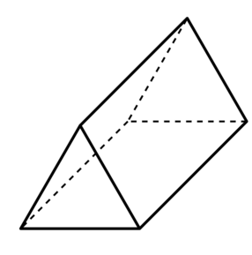
2
Looking Back
Sorting Solids
Click and drag me!
Rectangular Faces
Odd Number of Faces
Notes:
Image Source: Manitoba Education Grade Two Mathematics BLM
https://www.abcteach.com/documents/clip-art-3d-solids-triangular-prism-bw-i-abcteachcom-19419
https://www.vectorstock.com/royalty-free-vector/geometric-solids-set-vector-22515925

Slide 89
3
Looking Back
End of this day.

Slide 90
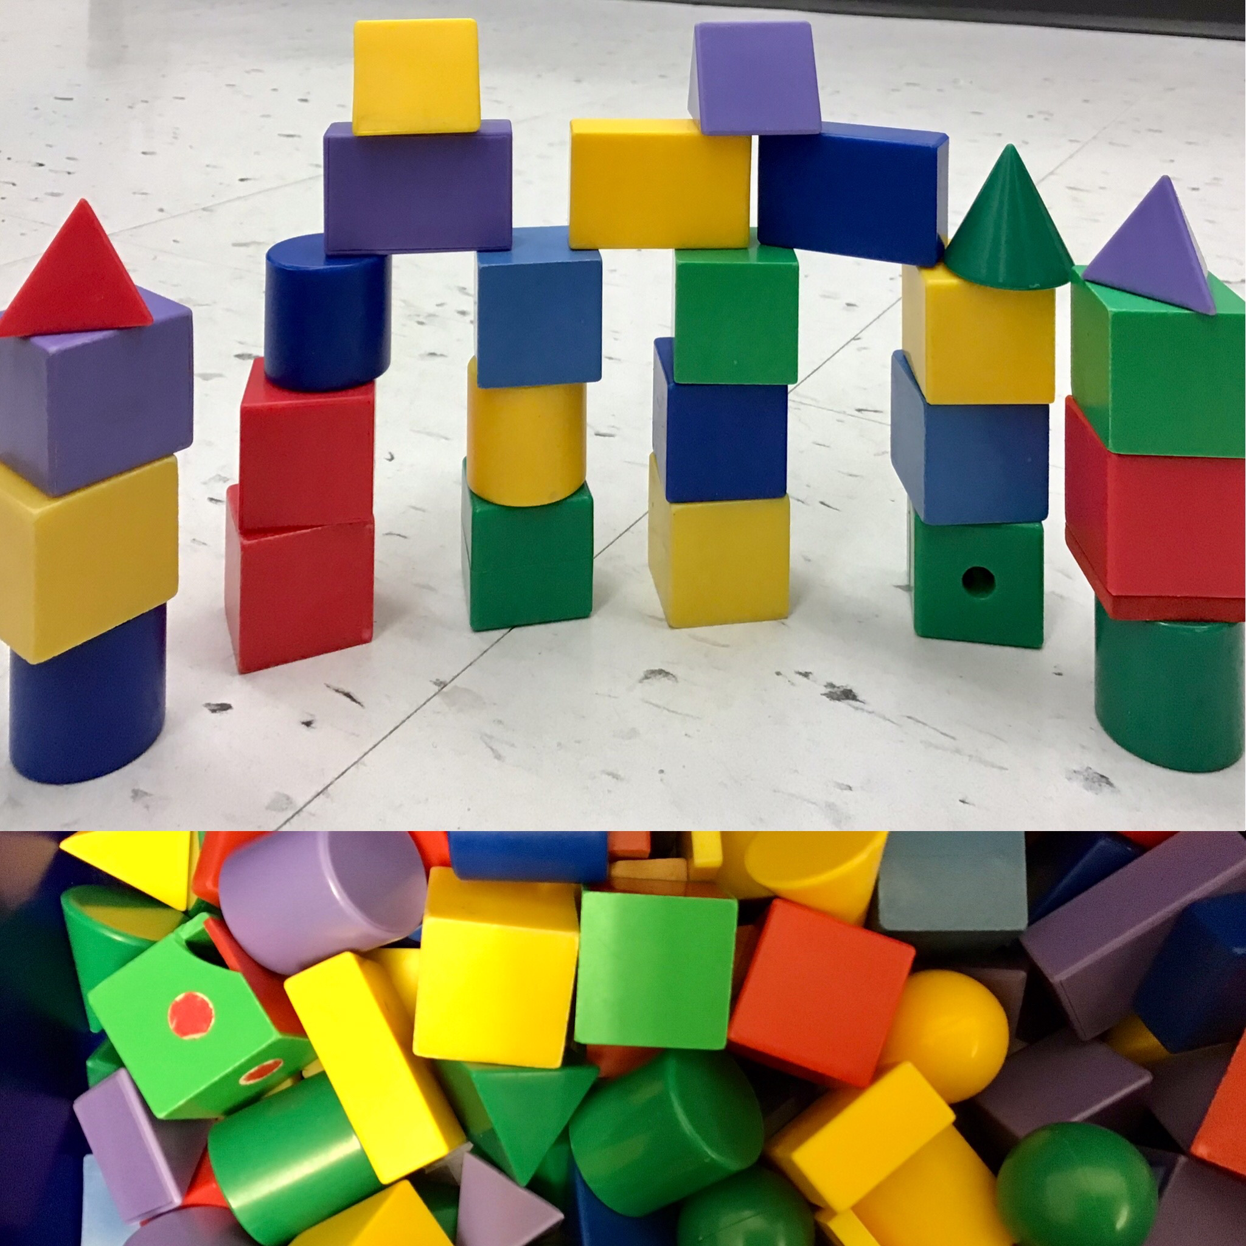
Day 6
1
Get Ready
2
Work it out!
3
Looking Back
Create It,
Write It
or
Record It
I Spy
Three Block Towers
Notes:
Image sourced:
http://clipart-library.com/clipart/arts-and-crafts-clipart_9.htm (create)
https://openclipart.org/detail/172707/edit-icon-icono-editar
https://openclipart.org/detail/212116/screencast

Slide 91
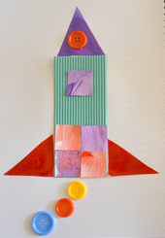
1
Print me to limit screen time
Get Ready
What are some 2-D shapes that you see in this picture?
Show your thinking here:
Notes:
Picture Source: https://childhood101.com/hands-on-activities-for-learning-about-2d-3d-shapes/

Slide 92
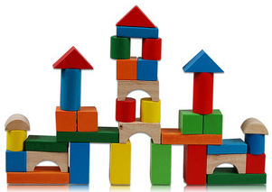
1
Print me to limit screen time
Get Ready
What are some 3-D objects and 2-D shapes that you see in this picture?
Show your thinking here:
Notes:
Picture Source: https://compdecomp.weebly.com/3d-shapes.html

Slide 93
1
Get Ready
End of this section

Slide 94
2
Work it out
Three Block Towers
How many different towers can you make using one red, one green, and one yellow block? Show your thinking for all combinations you can find.
Use me!
Notes:
Adapted from: https://nrich.maths.org/137
How do you know if you have found all of the ways?

Slide 95
2
Work it out
Four Block Towers
How many can you make if you have a blue block as well?​
Use me!
Notes:
Adapted from: https://nrich.maths.org/137
Extension questions:
How do you know when you have found all the ways?
What about a five block tower?
What patterns are you noticing?

Slide 96
2
Work it out
End of this section​

Slide 97
3
Create a 2-D Picture
Looking Back
Use craft materials to create an image that uses many different 2-D shapes. Take a photo of your picture and name the 2-D shapes in your image. Explain what part each shape plays in the whole creation.
odd
add
subtract
multiple
count
Notes:
Grade Two Support Document for Teachers
This could be an asynchronous activity

Slide 98
3
Looking Back
End of this day.

Slide 99
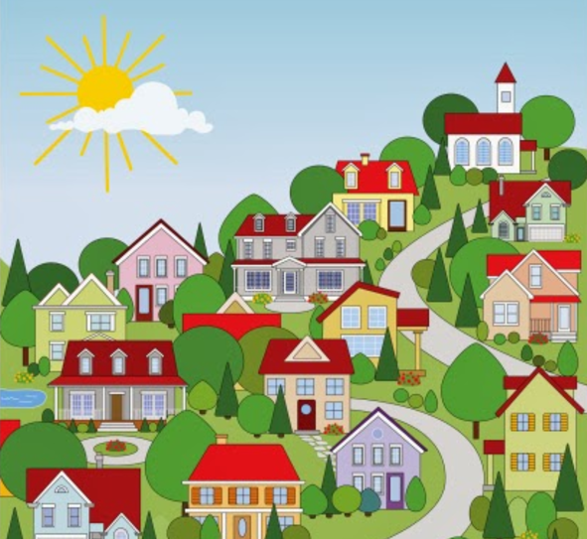
Day 7
https://www.clker.com/cliparts/a/7/5/8/1498573684994052349community-neighborhood.hi.png
1
Get Ready
2
Work it out!
3
Looking Back
3-D Object Search
Scavenger Hunt
Building with
3-D Objects
Notes:
Images sourced https://www.clker.com/cliparts/a/7/5/8/1498573684994052349community-neighborhood.hi.png
"File:Kawaii magnifying glass black and white clipart.svg" by Mvolz is marked with CC0 1.0

Slide 100
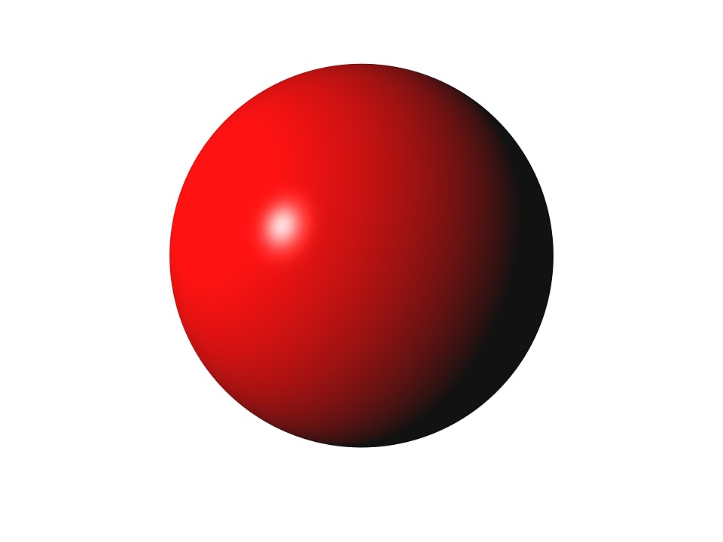
1
Get Ready!
Choose one of the following 3-D objects:
cube sphere cylinder
Find three or more household objects that are similar to the 3-D object you chose. How are the objects similar to the 3-D object? How are they different?
Notes:
Source: Marian Small, Open Questions for Rich Math Lessons

Slide 101
1
Get Ready!
End of this section​

Slide 102
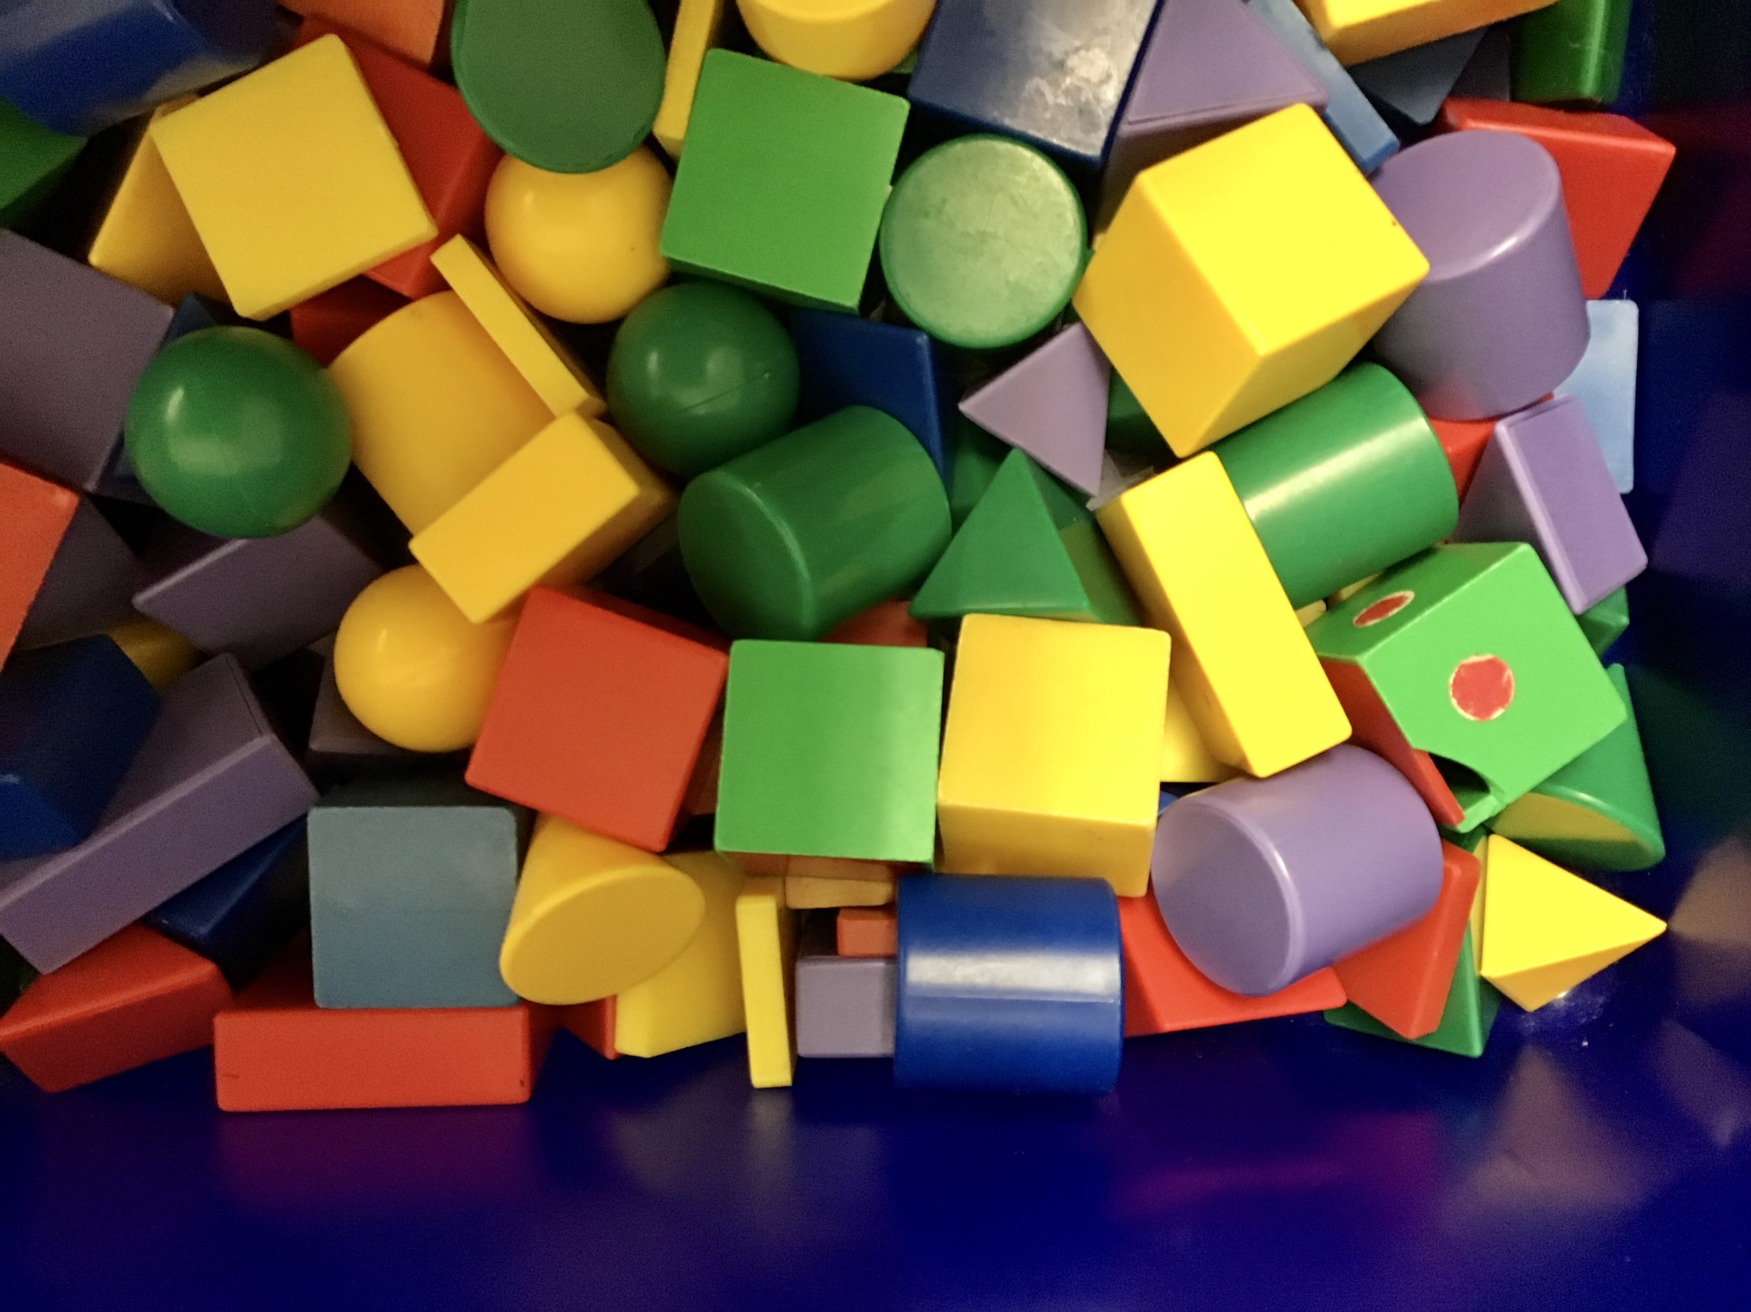
2
Work it out
Building with 3-D Objects
Build a structure using five or more 3-D objects found around your house.
Take a photo or make a drawing of your design.
Describe your structure to a classmate but mention only 2-D shapes in your description.
Challenge your classmate to recreate your structure (either by building or drawing). Compare the two structures and tell how they are similar and different.
Notes:
Adapted from: Marian Small Open Questions for Rich Math Lessons

Slide 103
2
Work it out
End of this section

Slide 104
3
Looking Back
Scavenger Hunt
Take a big person with you and go on a scavenger hunt around your community to find examples of 3-D objects in the environment.
Take photos to record your findings.
Write or record about the characteristics of the shape and how they are used in real-life situations.
Notes:
Source: Grade Two Mathematics Support Document for Teachers
Image Source: https://www.clker.com/cliparts/a/7/5/8/1498573684994052349community-neighborhood.hi.png

Slide 105
3
Looking Back
End of this section.
Notes:
This could be an asynchronous activity. If your school uses Seesaw, you can copy this slide into that platform.

Slide 106
Day 8
1
2
3
Get Ready
Work it out!
Looking Back
3-D Object Search
Think About It
then,
Structure
Stability
Write About It
or,
Record It
Notes:
Images sourced from openclipart.org
Image Source:
"File:Kawaii magnifying glass black and white clipart.svg" by Mvolz is marked with CC0 1.0
https://pixy.org/906437/
https://openclipart.org/detail/172707/edit-icon-icono-editar
https://openclipart.org/detail/212116/screencast

Slide 107
1
Get Ready!
Choose a different 3-D object than you did last time:
cube sphere cylinder
Find three or more household objects that are similar to the 3-D object you chose. How are the objects similar to the 3-D object? How are they different?
Notes:
Source: Marian Small, Open Questions for Rich Math Lessons

Slide 108
1
Get Ready!
End of this section​

Slide 109
2
Work it out
Structure Stability
In a box of solid shapes there are cubes, triangular prisms, cones, rectangular prisms, cylinders, and pyramids.
Notes:
Image created

Slide 110
2
Work it out
Structure Stability
A
B
C
D
E
F
G
H
I
J
Which of the buildings below would fall if we tried to make them? Why?
Notes:
Images created.
Duplicate a slide for each student.
Students can use the DRAW feature and circle the structures that would fall if we tried to make them. The explanation on why certain structures will fall will be what you are looking for. For example, can they reason or justfy why a curved surface cannot be stacked?

Slide 111
2
Work it out
Structure Stability
Build a structure using 3-D objects that will fall.
Build a structure using 3-D objects that will not fall.
Why does the structure fall?
Why does the structure not fall?
Notes:
Images created.
Use the shapes on the side of the slide to create and build a structure that will fall and another one that will not. Why does the structure fall/ not fall? Write or record your findings.

Slide 112
2
Work It Out!
End of this section​
Notes:
…

Slide 113
3
Print me to limit screen time
Looking Back
Build A Tower
Imagine that you have just built a tower out of 3-D objects. What 3-D objects and 2-D shapes would you expect to see at the bottom of your tower? What objects and shapes would you expect to see at the top?
Build a tower out of eight or more objects to help support your response. Take a photo of it. Describe the objects and shapes that you used in your tower.
Notes:
This could be an asynchronous activity. If Seesaw or Google Classroom are digital platforms, copy this slide into that platform.
These could be assigned to students as asynchronous work, to be submitted for teacher feedback. Students may need to use objects found in their home. You might want them to keep track and make note of objects they will need for this task throughout the two week learning experience.

Slide 114
3
Looking Back
End of this section.

Slide 115
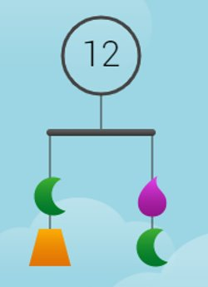
Day 9
1
Get Ready
2
Work it out!
3
Looking Back
Solve Me Mobile
The Greedy Triangle
The Important Book
Write a story,
edit and,
Record it
Notes:
Images source:
https://solveme.edc.org/mobiles/
https://openclipart.org/detail/172707/edit-icon-icono-editar, (pencil)
https://openclipart.org/detail/212116/screencast (record)

Slide 116
1
Print me to limit screen time
Get Ready!
Notes:
Image Source: https://solveme.edc.org/mobiles/
Instructions to note:
Present this on the screen. **Note** To allow all students think time, teachers can push this slide out to students prior to the synchronous lesson. That allows for all students to collect their ideas ahead of time and have something to share.
The activator for today is a SolveMe Mobile. This is a closed mobile. Begin with asking does anyone know what a mobile is? (Sometimes over a baby's crib, or maybe they have one at home, or they built one at school).
Next, ask What do You notice in this image? (shapes, 2 on one side and 2 on the other, there is a 12, there is a black line) There is a black line! Wow! What is that black line showing?
If instruction is occurring online, model what that straight line would look like for students using body actions (arms straight out). Hopefully they will say balanced, or equal, or the same. Then tilt. Ask "What does this show?" Hopefully they will answer not balanced, not equal, not the same. Go back to balanced, not balanced. Then relate it to the image. This black line is straight across, what is it showing balanced or not balanced? What does being balanced mean?
This is balanced so both sides need to be the same value. The hope is for students to connect that the 12 at the top is the total value for the mobile. (if they do not notice that, then show point that out).
12 is the total value of the mobile. Each side has to have the same value of 6. What might the value of each shapes be?
Think and explore!

Slide 117
1
Get Ready!
End of this section​

Slide 118
2
The Important Book
By Margaret Wise Brown
Work it out
Listen to the story.
After, think about
3-D objects and why they are important to us.
Notes:
Video Source: https://www.youtube.com/watch?v=CjPtA4jcDy0

Slide 119
2
Print me to limit screen time
Work it out
The Important Book About 3-D Objects
The important thing about a __________ is that it____________.
It ___________________________________, and it ____________.
But the important thing about a __________ is that it ____________
Notes:
Model a page or two with the class. Let them select a shape.
For example:
The important thing about a cube is that it has six square faces.
It can roll when it is a die, and it can stack when it is a box.
But the important thing about a cube is that is has six square faces.
The important thing about a cone is that it is both flat and round.
It can hold ice cream, and it can be a party hat.
But the important thing about a cone is that is both flat and round.

Slide 120
2
Print me to limit screen time
Work it out
The Important Book About 3-D Objects
The important thing about a __________ is that it____________.
It ___________________________________, and it _____________.
But the important thing about a __________ is that it ___________.
Notes:
Have students create their own page for a class book. They can do this in a small group as breakout room challenge or work on this independently.
They can also illustrate their page, or search a real life example of their 3-D object.

Slide 121
2
Work it out
End of this section

Slide 122
3
The Greedy Triangle
By Marilyn Burns
Looking Back
Listen to the story.
Notes:
Video Source: https://www.youtube.com/watch?v=ak5q-DY-uyQ

Slide 123
3
Create A Story
Looking Back
Create a story about the important attributes of 2-D shapes.
Your story must include the following 2-D shapes:
Square, triangle, rectangle, and circle.
Draw illustrations for each shape.
Notes:
Students can write a story and design illustrations. Once it has been edited for publication, they can record themselves reading the story, just like the other two stories they have heard. Teachers can share these stories for the class to hear during story time.

Slide 124
3
Looking Back
End of this section​

Slide 125
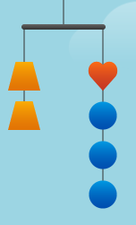
DAY 10
1
Get Ready
2
Work it out!
3
Looking Back
Solve Me Mobile
Build It,
Take a Photo.
Riddle Me This!
Write About It
or…
Record It
Notes:
Image source:
https://solveme.edc.org/Mobiles.html?toosmall=no
https://pixabay.com/illustrations/constructor-detail-part-brick-game-761618/
https://openclipart.org/download/300963/kamera.svg
https://openclipart.org/detail/172707/edit-icon-icono-editar
https://openclipart.org/detail/212116/screencast

Slide 126
1
Get Ready!
If
What might the values of the other shapes be?
What might the total number of the mobile be?
Notes:
Source: https://solveme.edc.org/Mobiles.html?toosmall=no
The activator for today is a SolveMe Mobile. This is a closed mobile. Next, ask What do You notice in this image? (shapes, 2 on one side and four on the other, the orange =4, there is a black line)
If instruction is occurring online, model what that straight line would look like for students using body actions (arms straight out). Hopefully they will say balanced, or equal, or the same. Then then tilt. Ask "What does this show?" Hopefully they will answer not balanced, not equal, not the same. Go back to balanced, not balanced. Then relate it to the image. This black line is straight across, what is it showing balanced or not balanced? What does being balanced mean?
This is balanced so both sides need to be the same value.

Slide 127
1
Get Ready!
What if we do not know the value of the orange trapezoid?
How might the values of the shapes change?
What might the total number of the mobile be?
Notes:
Source: https://solveme.edc.org/Mobiles.html?toosmall=no
This is the same mobile, but now we are taking all of the values away. Students can make the shapes any value they want.
For this SolveMe Mobile tell the students the following criteria: same shape, same colour must be the same value. A different shape, different colour, must have a different value.
For example if the orange trapezoid = 50 the total value for that side is 100. It makes sense that the blue circles could be 25, but then the red heart would also have to be 25 for it to be balanced. This cannot work given the criteria.
But if the blue circles are 30 each, and the red heart is 10, then that side of the mobile is also equal to 100 (answers may vary).
* The criteria for the SolveMe mobile could vary. For example, same shape, same colour must be the same value. A different shape, different colour, may have the same value.
For example if the orange trapezoid = 50 the total value for that side is 100. The blue circles and the heart could be worth 25 each.

Slide 128
1
Get Ready!
End of this section​

Slide 129
I am a 2-D shape. The white/chalk board has my shape. I am found on the covers of most books. I am a face on a cereal
2
Work it out
Riddle Me This!
I am a 2-D shape.
The white board has my shape.
I am found on the covers of most books.
I am a face on a cereal box.
I have four sides, two long and two short.
What am I?
I am a rectangle!
(Think what it could be then move the blue block to see the answer.)
Notes:
Source: Grade Two Mathematics, Support Document For Teacher
Tell students that they are going to make a class riddle book for 3-D objects and 2-D shapes. Show students an example.
Co-construct a criteria with the class on what their riddle will need to include. What are some important information the class has learned

Slide 130
2
Work it out
Riddle Me This! Success Criteria
Let's Build Our Criteria.
Every riddle must have the following:
Notes:
Use this slide to co-construct criteria with your students:
Refer back to the example and what are the important clues that you need to be able to have success in building a riddle.
What to look for and include in the criteria:
select and correctly name a 3-D object or 2-D shape
identify examples in the environment
identify attributes of the object/shape
put the information together in the form of a riddle

Slide 131
2
Work it out
End of this section

Slide 132
3
Looking Back
Choose two of the following 3-D Objects:
Describe each of them in as many ways possible.
Tell where you can find these objects at home, at school, or in your community.
Notes:
Source: Grade Two Support Document for Teachers, Manitoba Education
This could be an asynchronous activity. If your school uses Seesaw, you can copy this slide into that platform.
The student is able to:
identify the object
identify the attributes of the object
identify examples of the objects in the environment

Slide 133
3
Looking Back!
End of this section​

Slide 134
3
Looking Back
In thinking about this learning experience on space and shape. Tell what you know about 3-D objects and 2-D shapes.
Think about:
What are the attributes of a shape or object?
What are ways shapes or objects can be sorted?
How can 3-D objects and 2-D shapes be described?
What are the attributes of 3-D objects and 2-D shapes?
Notes:
This would be an opportunity to compare student solutions to look at similarities, differences, and make connections between them.

Slide 135
What are the attributes of a shape or object?
What are ways shapes or objects can be sorted?
How can 3-D objects and 2-D shapes be described?
What are the attributes of a 2-D shapes or 3-D objects?
Notes:
Duplicate for each student to reflect upon their learning experience.

Slide 136
Looking Back!
End of this investigative learning experience

Slide 137
Basic descriptors to help guide your formative assessments. Full details of the student achievement profiles can be found here: Mental Math & Estimation Knowledge and Understanding Problem Solving | Requires considerable, on-going teacher support | Requires occasional, teacher or peer support | Accurate, clear, uses appropriate strategies & procedures. Requires occasional prompting for clarification. | Accurate, clear, flexible, consistent & efficient. Justifies and explains reasoning clearly and completely using accurate mathematical vocabulary.
Gr. 2 – SHAPE AND SPACE RUBRIC | Limited | Basic | Good | Very Good/ Excellent
Describe and apply Mental Math strategies: Estimation of numbers to 100 based on place value
Describe and apply Mental Math strategies: Find sums to create a balanced equation
Sort 2-D shapes and 3-D objects using two attributes and explain the sorting rule.
Describe, compare, and construct 3-D objects, including: cubes, spheres, cones, cylinders, prisms, and pyramids.
Describe, compare, and construct 2-D shapes, including: triangles, squares, rectangles, and circles.
Identify 2-D shapes as parts of 3-D objects in the environment.
Use knowledge of 2-D shapes and 3-D solids to create and solve problems.
Assessment Rubrics
Suggested Codes for daily record keeping purposes:
I - Knowledge has been demonstrated individually
H - is used when knowledge has been demonstrated individually, but with help from the teacher or a peer
G - is used when knowledge has been demonstrated within a group
X - is used when a question has been attempted but answered incorrectly
N - is used when a question has not been attempted.
See the rubric for detailed information.
Notes:
Create Assessment rubrics to go here

Slide 138
Credits
Lisa Page St. James-Assiniboia School Division
Dayna Quinn-LaFleche St. James-Assiniboia School Division
Reviewers
T. Scott Dempster St. James-Assiniboia School Division
Heather Jones St. James-Assiniboia School Division
Charmaine Mackid Hanover School Division

