Slide 1
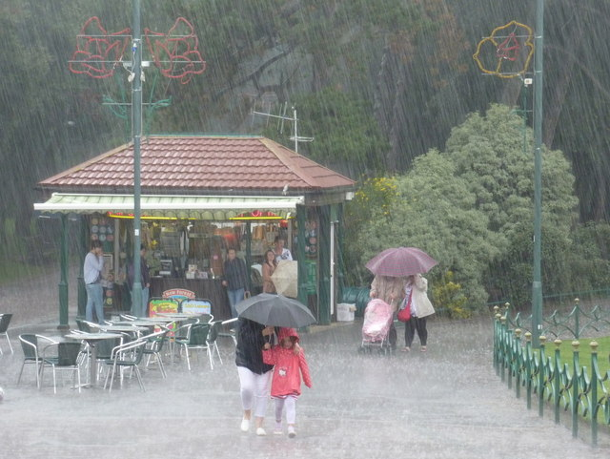
Probability
Notes:
Source of Image: 2572297_969450d4.jpg (640×481) (geograph.org.uk)

Slide 2
This is what you will learn:
what probability is
why it’s important
thinking of events on a probability line
using the language of probability
why probability activities are like a science experiment
thinking about probability when you do experiments
using fractions to record your results
Notes:
Source of Image: 15593-illustration-of-a-dancing-cartoon-blue-man-pv.png (958×958) (freestockphotos.biz)

Slide 3
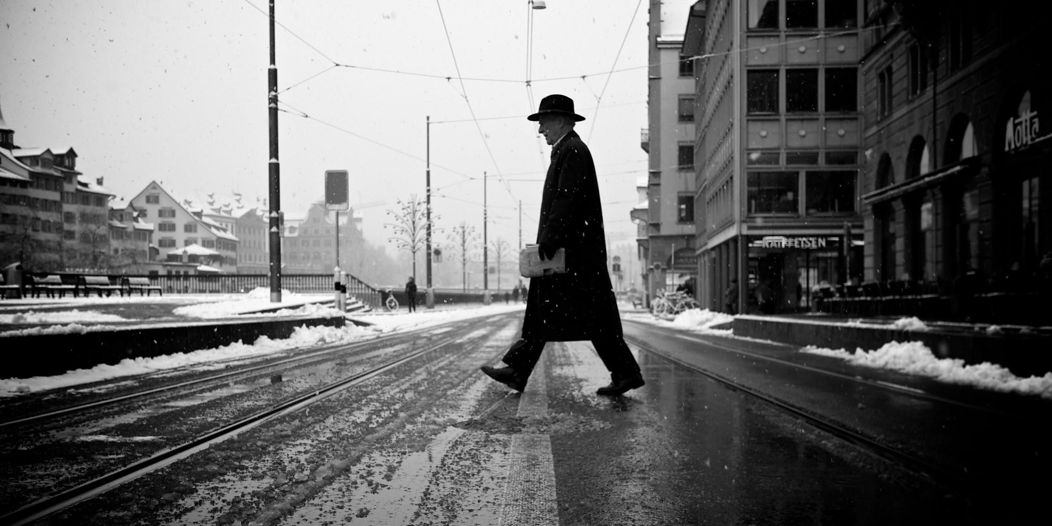
What is probability?
Probability is about how likely it is for something to happen.
We use it all the time in real life.
This man is crossing in the middle of the street because he did not think he was likely to get hit.
Notes:
Source of image: https://upload.wikimedia.org/wikipedia/commons/1/12/Guy_crossing_a_street.jpg

Slide 4
Why is it important?
We use probability all the time in real life.
It is used to make decisions for things like:
forecasting the weather
politics
sports
games of chance
Who will likely win the next election?
What is the probability of the Winnipeg Jets winning the Stanley Cup?
What are the chances of rain today?
Am I more likely to win if I buy more lottery tickets?
Notes:
Source of Image: https://www.freepik.com/premium-vector/man-is-leaning-against-big-question-mark-symbol-think-question_13267423.htm

Slide 5
A Probability Line
We can think of probability as being on a continuum (like a number line).
The likelihood of something happening ranges from impossible to certain.
Impossible
Certain

Slide 6
More on the Probability Line
Most things are neither impossible nor certain so we use other words to describe probability.
Words such as “unlikely”, “equally likely”, and “likely” can be used to describe probabilities between impossible and certain.
Unlikely
Likely
Impossible
Equally Likely
Certain

Slide 7
Activity 1
Draw your own probability line. Place these events where you think they’d go. Write only the underlined word on the continuum.
1) You will watch TV at least once today.
2) It will snow in January.
3) You will wash the dishes tonight.
4) If you drop a piece of bread on the floor, it will land butter-side up.
5) Your principal is younger than 20 years old.
6) You will find a loonie outside today.
7) Someone in Manitoba will win the lottery twice in one year.
Choose 3 events and explain why you placed them where you did on the Probability Line.

Slide 8
How is Doing Probability Activities Like
a Science Experiment?
Well, you really are doing an experiment. You have a problem or situation you’d like to test out because are not sure how it will turn out.
Here are the steps you go through:
1. There is a problem or question you’d like to answer.
2. You predict the outcome.
3. You perform the experiment.
4. You compare your results to your prediction.
Notes:
Source of Image: cartoon-chemist-scientist-vector-clipart.png (1623×2389) (goodfreephotos.com)

Slide 9
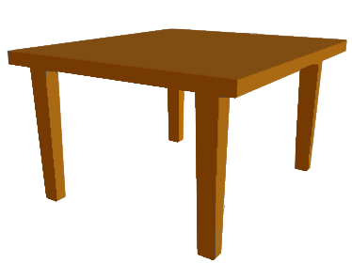
Activity 2a: Cup Drop
Materials needed: paper or plastic cup
PROBLEM: Which way do you think a paper cup will land will land when you drop it?
PREDICTION::
1) Record your prediction. I think the most likely way the cup will land will be: bottom down top down sideways I think the least likely way the cup will land will be: bottom down top down sideways
EXPERIMENT:
2) Now drop your cup from the height of a table. Do this 20 times and record on a chart using tally marks.
3) One of the ways probability results can be written is as a fraction. Write your results as a fraction below each of the ways on the chart. (HINT: You tossed it 20 times so 20 will be your denominator.)
COMPARE RESULTS TO THE PREDICTION:
4) Questions:
How do your results compare with your prediction? (Were your results close? Surprising?)
Based on your observations, what would you predict to be the most likely way for the cup to land if you dropped the cup one more time?
Notes:
Source of Image: https://upload.wikimedia.org/wikipedia/commons/b/bb/TableDiagram.png

Slide 10
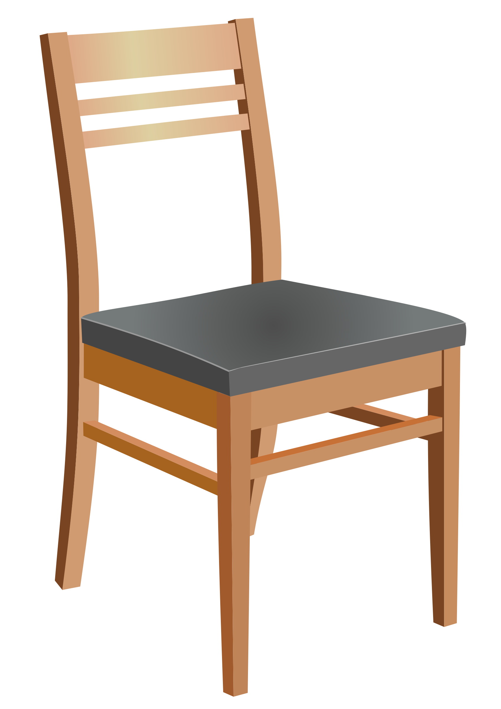
Activity 2b: Cup Drop from a Different Height
Materials needed: paper or plastic cup
PROBLEM: Will you get the same results if you now drop the cup from the height of the seat of a chair?
PREDICTION:
Record your prediction. I think the most likely way the cup will land will be: bottom down top down sideways I think the least likely way the cup will land will be: bottom down top down sideways
EXPERIMENT:
Now drop your cup from the height of a seat of a chair. Do this 20 times and record on a chart using tally marks.
Write your results as a fraction below each of the ways on the chart. (HINT: You tossed it 20 times so 20 will be your denominator.)
COMPARE RESULTS TO THE PREDICTION:
Questions:
How do your results compare with your prediction? (Were your results close? Surprising?)
Based on your observations, what would you predict to be the most likely way for the cup to land if you dropped the cup one more time?
Notes:
Source of Image: https://www.goodfreephotos.com/albums/vector-images/wooden-chair-vector-art.png

Slide 11
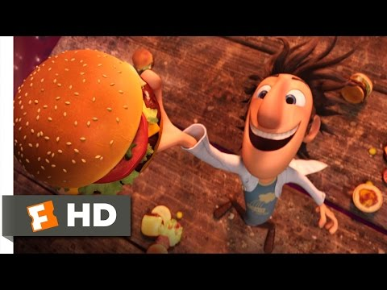
Activity 3: Predicting Weather
This activity is based on the book Cloudy with a Chance of Meatballs.
In the land of Chewandswallow, it never rained rain. It never snowed snow. It rained things like soup and juice. It snowed mashed potatoes and green peas. And sometimes the wind blew in storms of hamburgers.
Watch this clip from the movie based on this book.
Then do the activity on the following slide.
Cloudy with a Chance of Meatballs - It's Raining Burgers Scene (1/10) | Movieclips - YouTube

Slide 12
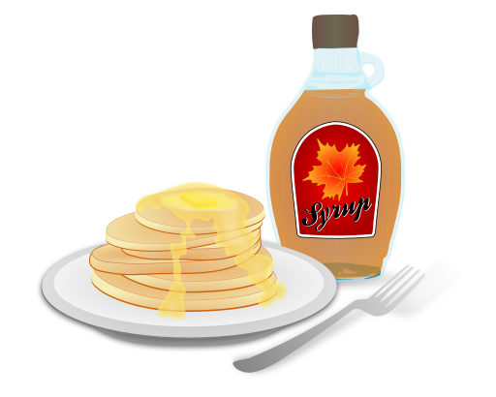
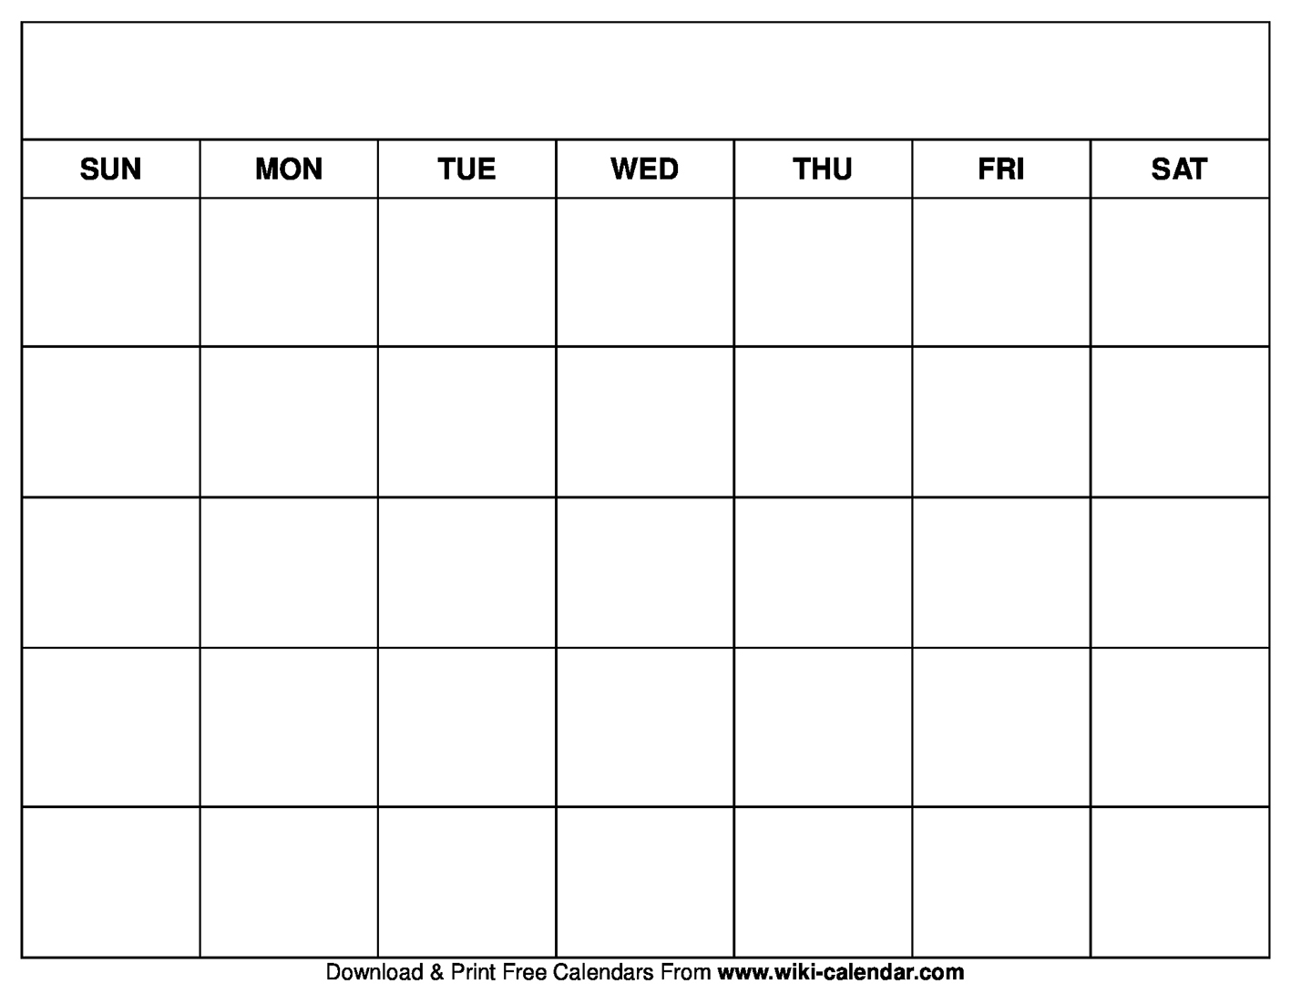
Activity 3: Simulate the Weather
Materials needed: a coin or use digital format (https://toytheater.com/coin-flip/)
PROBLEM: What will the weather be like in Chewandswallow in June?
PREDICTION: We can simulate the weather by tossing a coin. (Simulate means to imitate.) Toss a coin. If it lands: - “heads”, it will be snowing pancakes. - “tails”, it will be raining syrup. Will it snow pancakes or rain syrup more often? My prediction is: ____________________________________________________
EXPERIMENT:
Toss a coin 30 times. Each time you toss a coin, it represents the weather for that day in Chewandswallow.
Mark “P” for pancakes and “S” for syrup.
Write your results for each outcome (pancakes or syrup) as a fraction. (Hint: 30 will be your denominator.)
COMPARE RESULTS TO THE PREDICTION:
Questions:
How do your results compare to your prediction?
Based on your results, what do you think you will most likely be eating on July 1? Explain your thinking.
June
Notes:
Source of Image: https://upload.wikimedia.org/wikipedia/commons/thumb/c/c1/Pancakes_with_syrup.svg/512px-Pancakes_with_syrup.svg.png

Slide 13
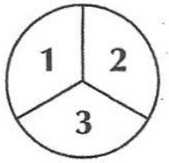
Activity 4a: Spinner A
Materials needed: paper clip, paper to make spinner, recording sheet
PROBLEM: When you spin this spinner, are some numbers more likely to come up?
PREDICTION:
Predict which number will occur the most often. ____________
EXPERIMENT:
Now spin the spinner and record the number that comes up. Repeat until one column on the recording sheet is filled in.
COMPARE RESULTS TO THE PREDICTION:
Questions:
How do your results compare to your prediction?
With this spinner, would you say that any given number is more likely, less likely, or equally likely to come up? Explain why.

Slide 14
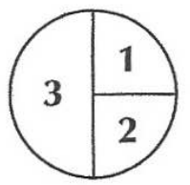
Activity 4b: Spinner B
Materials needed: paper clip, paper to make spinner, recording sheet
PROBLEM: When you spin this spinner, are some numbers more likely to come up?
PREDICTION:
Predict which number will occur the most often. ____________
EXPERIMENT:
Now spin the spinner and record the number that comes up. Repeat until one column on the recording sheet is filled in.
COMPARE RESULTS TO THE PREDICTION:
Questions:
How do your results compare to your prediction?
Are the results the same or different as Activity 4a?
With this spinner, would you say that any given number is more likely, less likely, or equally likely to come up? Explain why.

Slide 15
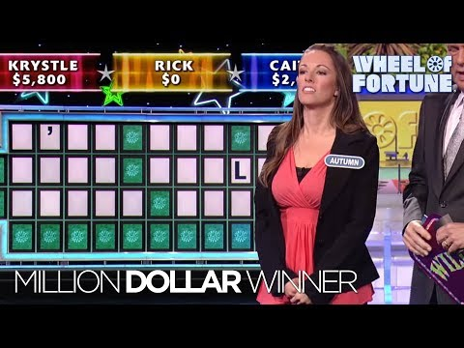
Activity 5: Wheel of Fortune – What are the Chances?
Notes:
Source of Video: Second Million Dollar Winner! | Wheel of Fortune - YouTube

Slide 16
Activity 5a: Wheel of Fortune
Materials needed: cartoon strip (on next slide), piece of paper with all the letters of the alphabet written on it
PROBLEM: You have been selected to be a contestant on the Wheel of Fortune game show on TV. To win the game, it helps to know which letters of the alphabet are the most frequently used.
PREDICTION:
Predict the 5 letters that are the most commonly used in the English language. Start with the one you think is the most common. ___ ___ ___ ___ ___
EXPERIMENT:
Write down all the letters of the alphabet in a list so you can keep a tally.
Choose one of the boxes in the cartoon strip on the next page. Tally how many times each letter appears in those sentences.
COMPARE RESULTS TO THE PREDICTION:
Questions:
Which 5 letters occurred the most frequently in your sample? ___ ___ ___ ___ ___
Compare your results with your predictions. How many were the same?
Your teacher has the actual order of the frequency of letters in the English language. Check with him or her about the answer. (Note to Teacher: Answer is on Slide 22.)
Notes:
Source of Image: http://1.bp.blogspot.com/_h6-aCoXJbLQ/R6SIfq5opeI/AAAAAAAAAjg/W_UT5bsJKls/s400/abecedario.gif

Slide 17
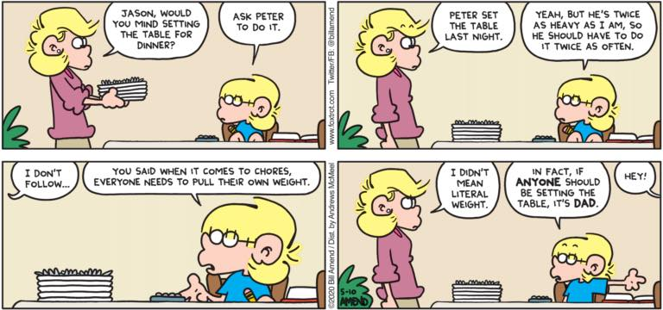
Comic for Activity 5a: Wheel of Fortune
Choose only one frame from the comic strip below.
On a piece of paper write each letter of the alphabet.
Tally the number of times each letter occurs.
Notes:
Source of Image:
FoxTrot by Bill Amend, May 10, 2020
https://foxtrot.com/2020/05/10/weighty-matters/

Slide 18
Activity 5b: Wheel of Fortune in Italy
Materials needed: cartoon strip (on next slide), piece of paper with all the letters of the alphabet written on it
PROBLEM: You have been selected to be a contestant on the Wheel of Fortune game show in Italy. To win the game, it helps to know which letters of the alphabet are the most frequently used.
PREDICTION:
Predict the 5 letters that are the most commonly used in the Italian language. Start with the one you think is the most common. ___ ___ ___ ___ ___
EXPERIMENT:
Write down all the letters of the alphabet in a list so you can keep a tally.
Look at the sentence from an Italian book on the next slide. Tally how many times each letter appears in those sentences.
COMPARE RESULTS TO THE PREDICTION:
Questions:
Which 5 letters occurred the most frequently in your sample? ___ ___ ___ ___ ___
Compare your results with your predictions. Describe how your results were different.
Your teacher has the actual order of the frequency of letters in the Italian language. Check with him or her about the answer. (Note to teacher: Answer is on Slide 23.)
Notes:
Source of Image: 1533676498.png (600×600) (freesvg.org)

Slide 19
Test for Activity 5b: Wheel of Fortune in Italy
Tally the number of times each letter occurs.

Slide 20
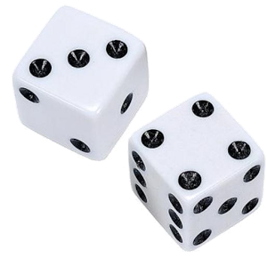
Activity 6: The Game of PIG
Materials needed: 2 dice (or 2 spinners with 1-6) or use digital dice (https://toytheater.com/dice/)
No. of players: 2
GOAL: To be the first person to get a score of 100 or more.
INSTRUCTIONS:
Draw 2 columns on a sheet of paper. Label one column with your name and one with your partner’s name.
Players take turns. When it is your turn, roll the dice as many times as you like. Keep a running total of what you roll. Don’t write down the sums, but add them mentally and say them aloud so your partner can check.
When you decide to stop rolling, record the total for that round in that column. Then add it to your total sum from the previous round.
IMPORTANT: • If a 1 comes up on one of the dice -->your turn ends and you score 0 for that round. • If both dice show 1s -->your turn ends and your total score so far goes to zero.
TASK: After playing this game several times, write what you think is a strategy to win the game. About how many times should you roll the dice before you should stop?
Notes:
Source of dice image: dice_PNG47.png (300×300) (pngimg.com)

Slide 21
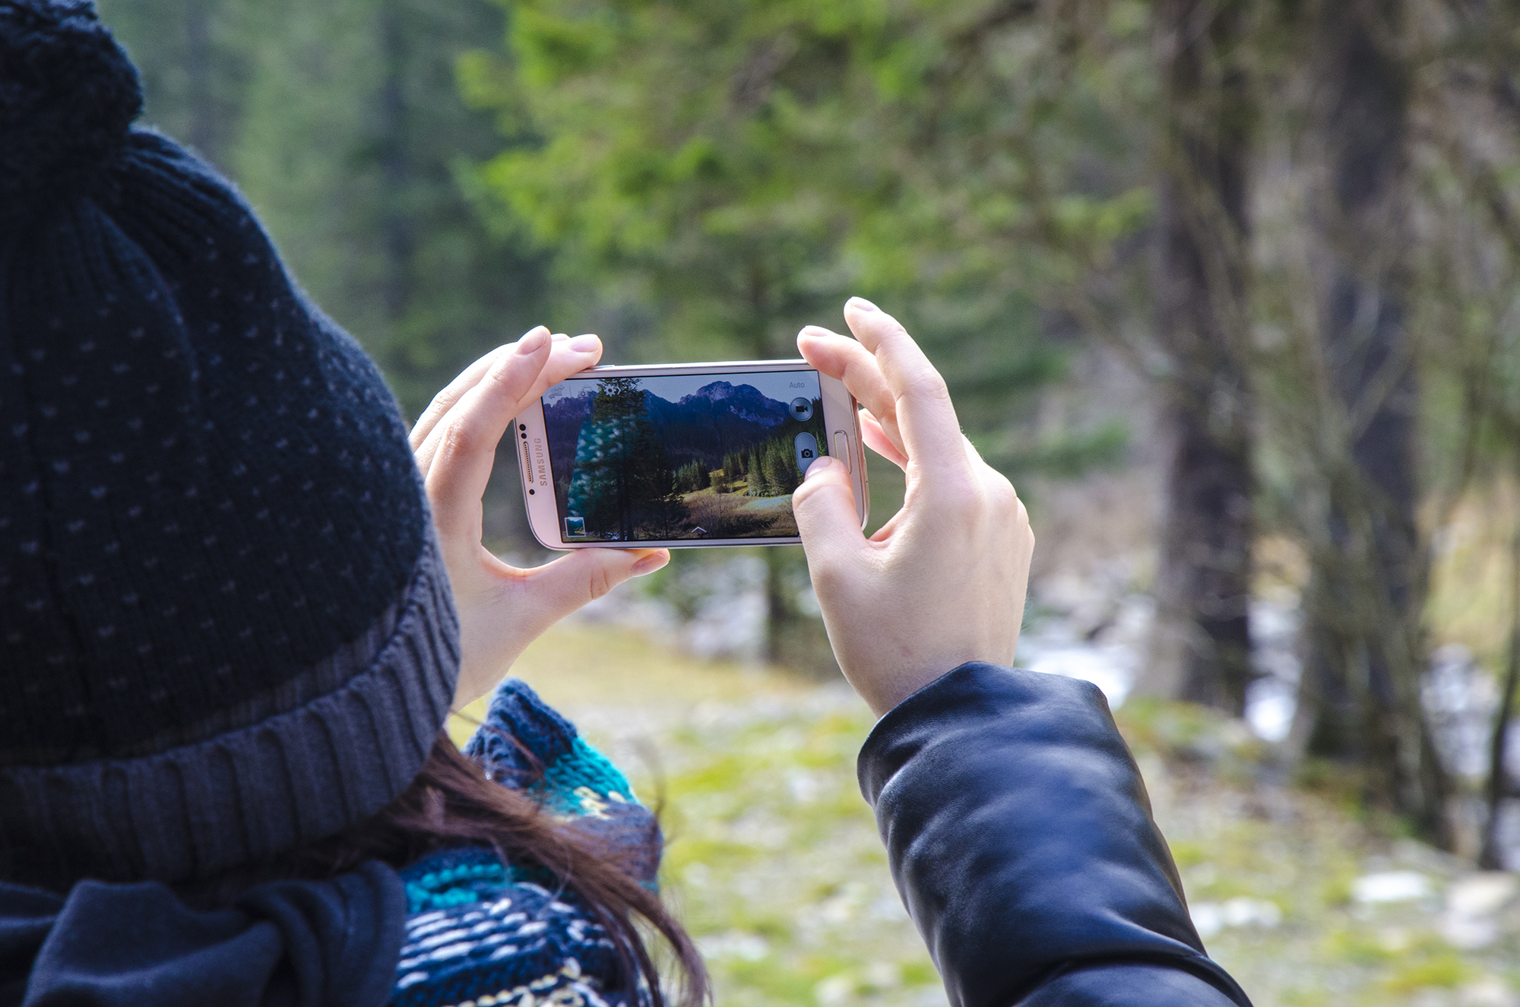
Activity 7: Probability Photo Story
Materials needed: smart phone, computer
INSTRUCTIONS:
Use a camera to take 6 pictures. Each picture should illustrate an event whose likelihood of occurring can be described as:
Impossible
Possible
Certain
Equally likely
More likely
Less likely
Use one picture for each word or phrase. The events can be ones you create or ones you actually see occurring.
Make a Google Slides or Powerpoint show with your images. On each slide:
state which word or phrase it illustrates and
describe why the event illustrated in each picture is included.
Notes:
Source of Image: smartphone-man-person-people-camera-photographer-child-mobile-phone-taking-photo-samsung-interaction-1077817.jpg (2000×1325) (pxhere.com)

Slide 22
Wheel of Fortune Answers (Activity 5a - Slide 16)
The actual order of frequency of letters in the English language:
E T A O (N I) S R H L D C U (P F) M W Y (B G) V K (Q X) (J Z)
NOTE: Those letters in brackets have the same frequency of occurrence.

Slide 23
Wheel of Fortune Answers (Activity 5b - Slide 19)
In Italian, these are the 5 most frequently occurring letters.
Starting with the most frequent, they are:
A E I O N

