Slide 1
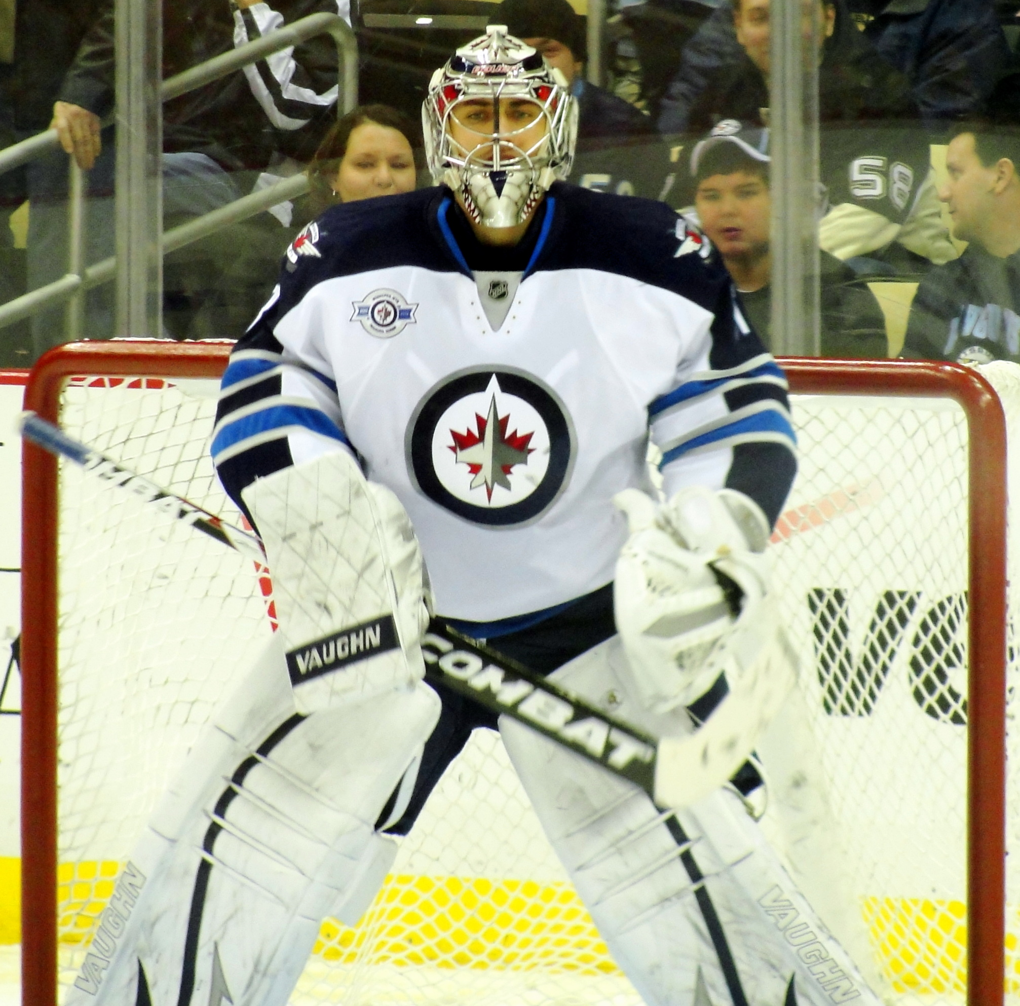
Probability
Grade 6
Notes:
Source of Image: https://upload.wikimedia.org/wikipedia/commons/a/ac/Ondrej_Pavelec_Jets_2012-02-11.JPG

Slide 2
This is what you will learn:
what probability is
why it’s important
thinking of events on a probability line
using the language of probability
why probability activities are like a science experiment
using fractions, decimals and percent to describe probability
comparing experimental and theoretical results
Notes:
Source of Image: 15593-illustration-of-a-dancing-cartoon-blue-man-pv.png (958×958) (freestockphotos.biz)

Slide 3
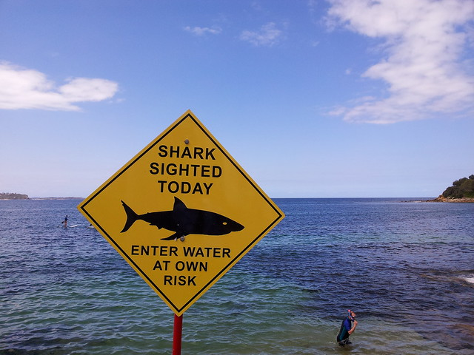
What is probability?
Probability is about how likely something will happen.
We use it all the time in real life.
This man is going into the water because he thinks he is unlikely, or has little chance, of being attacked by a shark.
Notes:
Source of Image: https://farm9.staticflickr.com/8098/8382109029_45238844f0_z.jpg

Slide 4
Why is it important?
Who will likely win the next election?
We use probability all the time in real life.
It is used to make decisions for things like:
forecasting the weather
politics
sports
games of chance
deciding the best location for a business
creating consumer products
What is the probability of the Winnipeg Jets winning the Stanley Cup?
What are the chances of rain today?
Am I more likely to win if I buy more lottery tickets?
Notes:
Source of Image: https://www.freepik.com/premium-vector/man-is-leaning-against-big-question-mark-symbol-think-question_13267423.htm

Slide 5
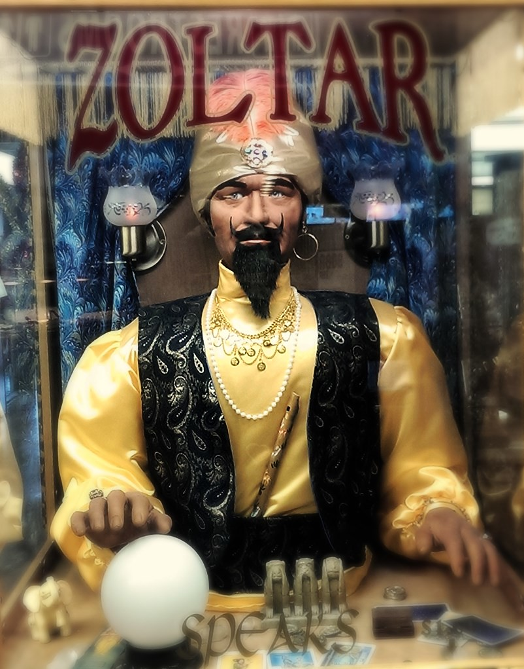
How is Probability Different from Other Math Topics?
In math we are used to dealing with things that are completely certain.
If you add 5 + 5, you’ll always get 10.
If you multiply 2 x 3, you’ll always get 6.
There is no uncertainty at all.
In the real world, things aren’t always so predictable.
Notes:
Source of Image: 15635754159_d3c4d254ba_b.jpg (802×1022) (staticflickr.com)

Slide 6
Using a Probability Line
Most things in real life are neither impossible nor certain to happen. So a probability line can help visualize the likelihood of events happening.
Video Source: Math Antics - Basic Probability - YouTube

Slide 7
Some Vocabulary
An outcome is a possible result of an experiment The outcomes for: - rolling a dice are 1, 2, 3, 4, 5, 6. - tossing a coin are heads or tails. - the spinner shown is red, yellow, and green.
A favourable outcome is the outcome that the experimenter is looking for. It is also called an event.
Examples of favourable outcomes or events are: - getting an even number when you roll a die - getting a tail when tossing a coin - landing on a red section when you spin a spinner

Slide 8
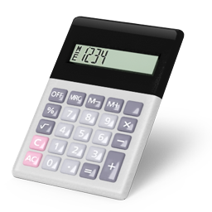
But How Do You Measure Chance?
Probability looks at the chance of something happening.
There are two ways to determine the probability of something happening:
Mathematically with calculations (theoretical probability)
Experimentally with trials (experimental probability)
Notes:
Source of Image (calculator): http://www.pngall.com/wp-content/uploads/2016/05/Calculator-Transparent.png
Source of Image (flipping coin): https://www.clipartmax.com/download/m2i8N4i8b1K9G6G6_flip-a-coin-flip-a-coin-cartoon/

Slide 9
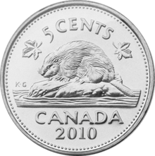
Experimental Probability
Experimental probability is the probability of an event calculated from experimental results.
Problem: What is the probability of getting a “tail” when you toss a coin? You toss a coin 10 times. You get a tail 6 times.
Experimental probability = number of observed favorable outcomes* total number of trials
*A favorable outcome is the outcome the experimenter is looking for.
Your experimental probability is . The way we can write our results is P(tail) = . The outcome you are looking for is inside the brackets. We read it as: “The probability of getting a tail is “.
Notes:
Source of Image: https://upload.wikimedia.org/wikipedia/en/thumb/b/bb/Canadian_Nickel_-_reverse.png/220px-Canadian_Nickel_-_reverse.png

Slide 10
Experimental Probability with Spoons
Let’s do another example.
Problem: What is the probability of dropping a spoon and it landing upside down?
Drop a spoon (metal or plastic) from waist height 20 times.
The way we can write our results is: P(spoon landing upside down) = __ . 20 We read it as: “The probability of a spoon landing upside down is ____” .
What was your experimental probability? ___________
.
.
Notes:
Source of Image: http://pngimg.com/uploads/spoon/spoon_PNG3050.png

Slide 11
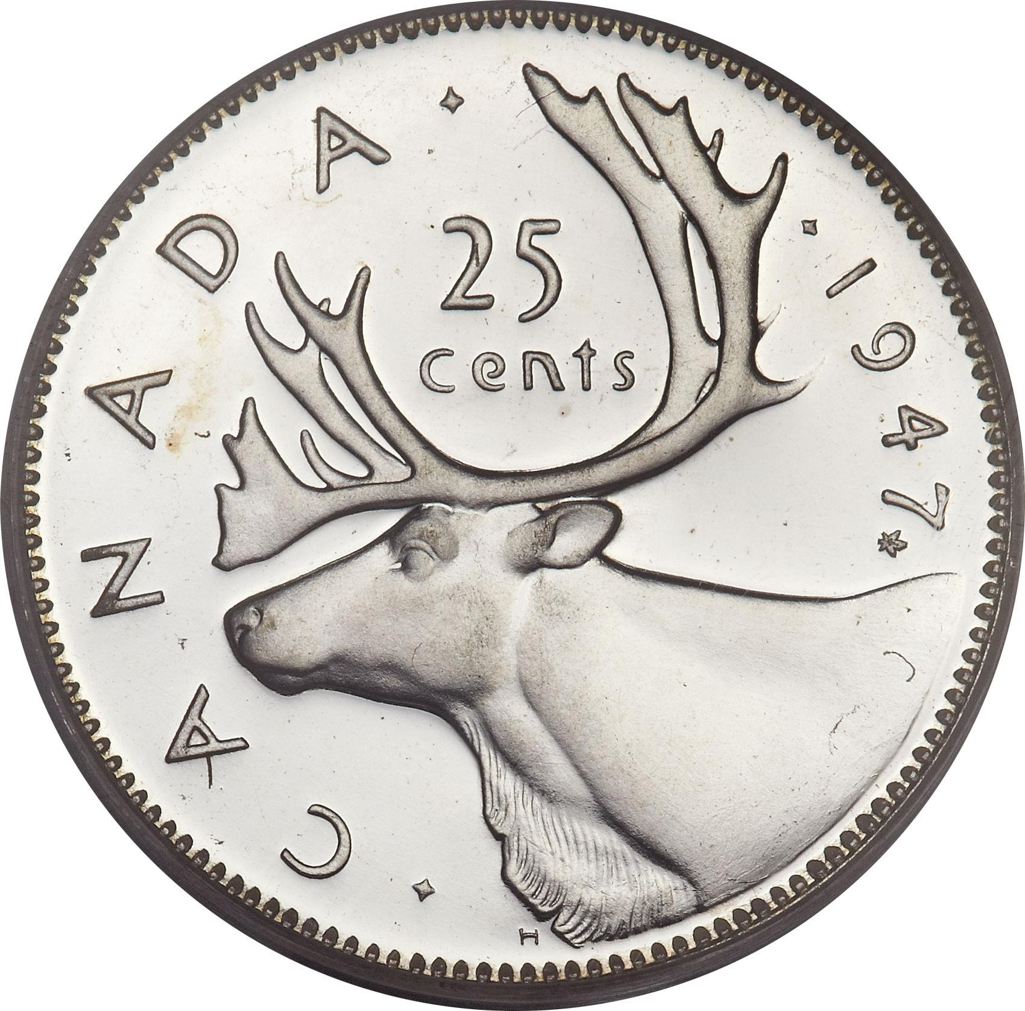
Theoretical Probability
2) Theoretical probability: Another way of finding the probability of a specific outcome, or event, is a logical analysis of the situation.
Problem: What’s the probability of getting a “tail” when you toss a coin?
What are the possible outcomes for a coin to land? 2 (heads or tails) What are the number of ways that event (getting a tail) can occur? 1
Theoretical probability = number of favorable outcomes number of possible outcomes
So, P(tail) is or 0.5 or 50%.

Slide 12
Some More Examples of Theoretical Probability
Video Source: Probability: Determining Chance - YouTube

Slide 13
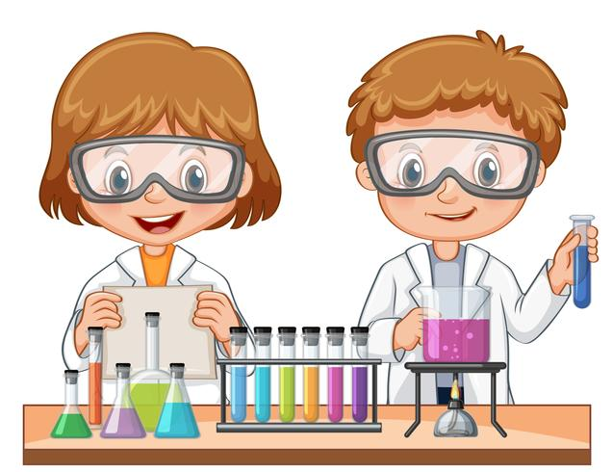
How is Doing Probability Activities Like
a Science Experiment?
Well, you really are doing an experiment. You have a problem or situation you’d like to test out because you are not sure how it will turn out.
Here are the steps you go through:
There is a problem or question you’d like to answer.
You predict the outcome.
You perform the experiment.
You compare your results to your prediction.
Notes:
Source of Image: https://static.vecteezy.com/system/resources/previews/000/445/768/non_2x/vector-girl-and-boy-doing-science-experiment.jpg

Slide 14
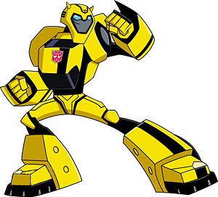
Toy Companies Testing Products
Toy companies often use kids to test out their games and inventions to see how probable it is for children to want to play with them.
In the movie Big, Josh is a 13-year-old boy who is transformed into a 35-year-old man by a fortune telling machine at a carnival. He still thinks like he’s 13 years old and ends up getting a job at a toy company testing out the design of toys. In this movie clip, he is giving his opinion about the company’s new toy and how likely kids are to like it.
Video Source: https://www.youtube.com/watch?v=3ERuhks3GNk
Notes:
Source of Image: https://tfwiki.net/mediawiki/images2/thumb/6/6a/Bumblebeeanimated.jpg/300px-Bumblebeeanimated.jpg

Slide 15
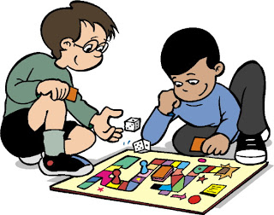
Fair/Unfair Games
A fair game is one where ALL the players are likely to win.
Try out the games that follow to see if they are fair or not.
You’ll be able to find both the experimental and theoretical probability of winning.
Notes:
Source of Video: https://www.fairviewhs.org/system/photos/2965/original/board_games_clipart39.jpg?1374490092

Slide 16
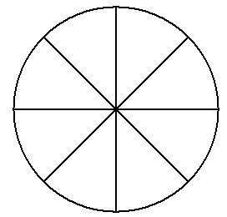
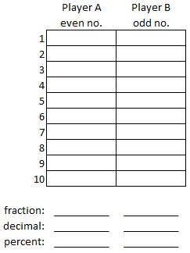
Is This a Fair Game? Spinner Game 1
Materials needed: a spinner divided into 8 sections, a paper clip
PROBLEM: Is this game fair? Spin the spinner. If the pointer lands on an even number, Player A gets a point. If the pointer lands on an odd number Player B gets a point. PREDICTION: Is this a fair game?
EXPERIMENT: 1) Make a spinner with 8 sections. Put each of these numbers in a section: 1, 2, 3, 4, 4, 5, 6, 7 2) Make a chart and label it: Player A (even no.) and Player B (odd no.). 3) Spin the spinner. Put a check in the box by each trial number as to which player got an even or odd number. 4) Do 10 trials. 5) What is your experimental probability for getting an odd number? P(odd number) = _____(fraction) _____ (percent) 6) What is the theoretical probability of getting an odd number? P(odd number) = _____(fraction) ______ (percent) (*Use a calculator if needed.)
COMPARE RESULTS TO THE PREDICTION: 7) Is this a fair game? How do you know? 8) If you do another 10 trials will your experimental results be the same? Try it.
3
4
2
4
1
5
7
6

Slide 17
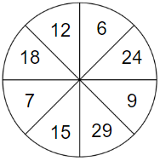
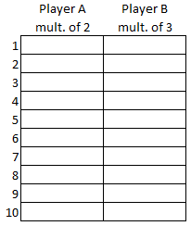
Is This a Fair Game? Spinner Game 2
Materials needed: a spinner divided into 8 sections, a paper clip
PROBLEM: Is this game fair? Spin the spinner. If the pointer lands on a multiple of 2, Player A gets a point. If it lands on a multiple of 3, Player B gets a point. PREDICTION: Is this a fair game? How do you know?
EXPERIMENT: 1) Make a spinner with 8 sections. Put each of these numbers in a section: 6, 7, 9, 12, 15, 18, 24, 29 2) Make a chart and label it: Player A (multiple of 2) and Player B (multiple 3). 3) Spin the spinner. Put a check in the box by each trial number as to which player got a point. 4) Do 10 trials. 5) What is your experimental probability for getting a multiple of 2? multiple of 3? Write it as a fraction and percent. 6) What is the theoretical probability of getting a multiple of 2? multiple of 3? Write it as a fraction and percent. (*Use a calculator if needed.)
COMPARE RESULTS TO THE PREDICTION: 7) Questions: a) Is this a fair game? How do you know? b) Would you have the same experimental results if you played this game again?

Slide 18
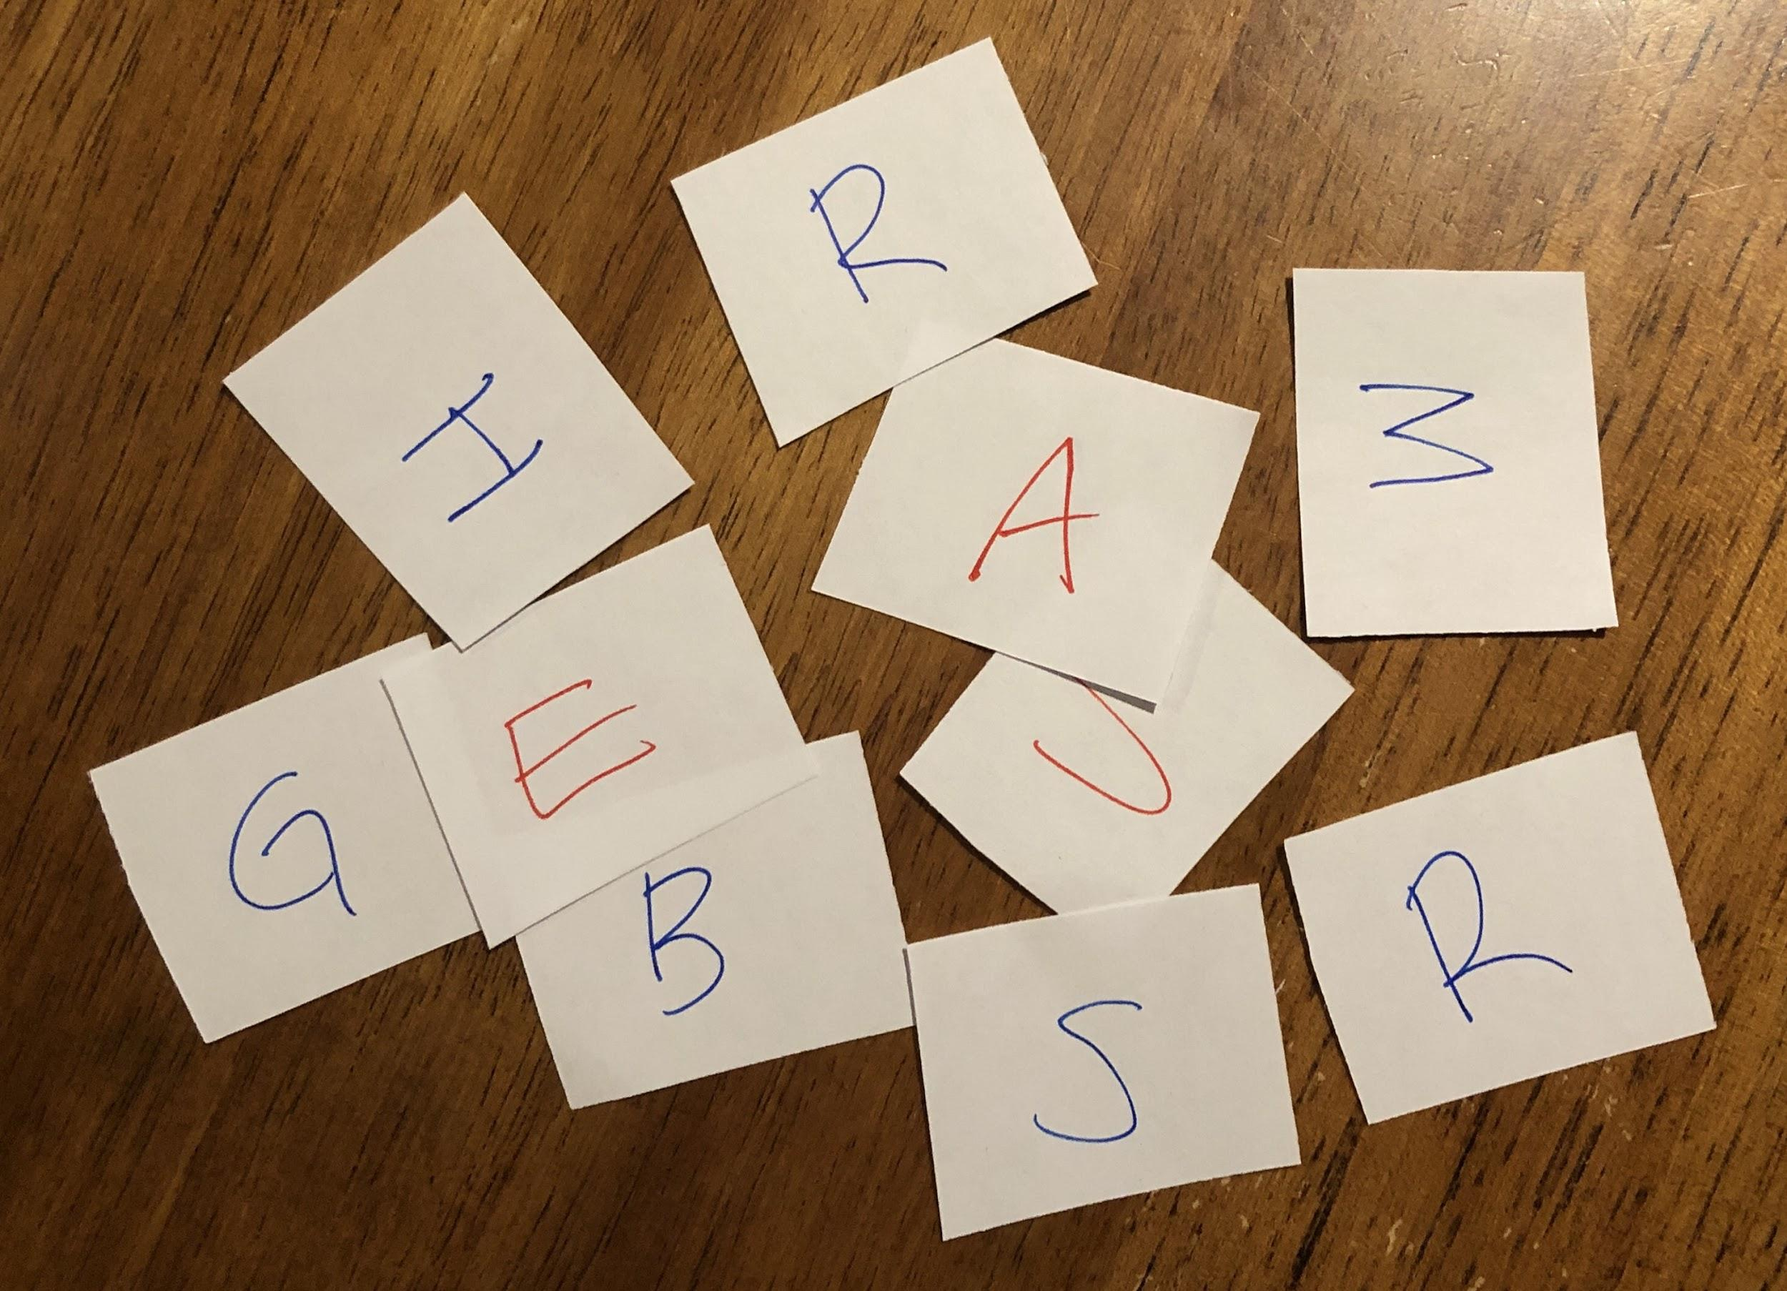
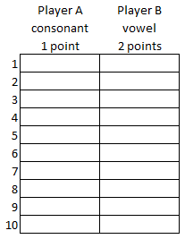
Is This a Fair Game? Hamburgers!
Materials needed: 10 small pieces of paper, small plastic or paper bag
PROBLEM: Is this game fair? Write each of the letters from the word HAMBURGERS on a small piece of paper. Put the letters in a bag. Take turns drawing letters from the bag. If a player draws a card with a consonant, Player A gets 1 point. Because there are less vowels, if a player draws a vowel Player B gets 2 points. Record the score and return the letter to the bag before the next player draws. PREDICTION: Which player do you think will win?
EXPERIMENT: 1) Each of the pieces of paper has a letter from the word HAMBURGERS on it. Put them in a small bag. 2) Make a chart and label it: Player A (consonant - 1 point) and Player B (vowel - 2 points). 3) Draw a card. Put a check in the box by each trial number as to which player got a point. Put the paper back in the bag. 4) Do 20 trials. (Make another chart.) 5) What is your experimental probability for getting a vowel? consonant? Write it as a fraction and percent. 6) What is the theoretical probability of getting a a vowel? consonant? Write it as a fraction and percent. COMPARE RESULTS TO THE PREDICTION: 7) Is this a fair game? How do you know? 8) If you do another 20 trials will your experimental results be the same? Try it.

Slide 19
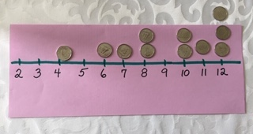
Sum of 2 Dice Game
Materials needed: 2 dice or use digital dice (https://toytheater.com/dice/), line with numbers 2-12 spaced out, counters (bingo chips, beans, coins)
PROBLEM: Toss 2 dice and add the numbers. There are 11 possible outcomes: 2, 3, 4, 5, 6, 7, 8, 9, 10, 11, 12 Will any one sum come up more often than any other?
PREDICTION: I think _________ is the most likely sum.
EXPERIMENT: 1) Each player makes a number line with the numbers 2-12 spaced out so you have room to put your counters above each sum. Numbers can have more than 1 counter and some numbers may have none. 2) Player A rolls the dice and adds both numbers. 3) She removes one of the counters above that sum. If there is more than one counter for that sum, only one can be removed. 4) Now it’s Player B’s turn and he rolls the dice, adds the numbers and removes a counter (if possible). 5) The player who removes all his/her counters first wins. Play the game several times to develop a strategy.
COMPARE RESULTS TO THE PREDICTION: 6) I found these numbers _____________ came up the most often. 7) What advice would you give someone for a strategy to use when they play this game?

Slide 20
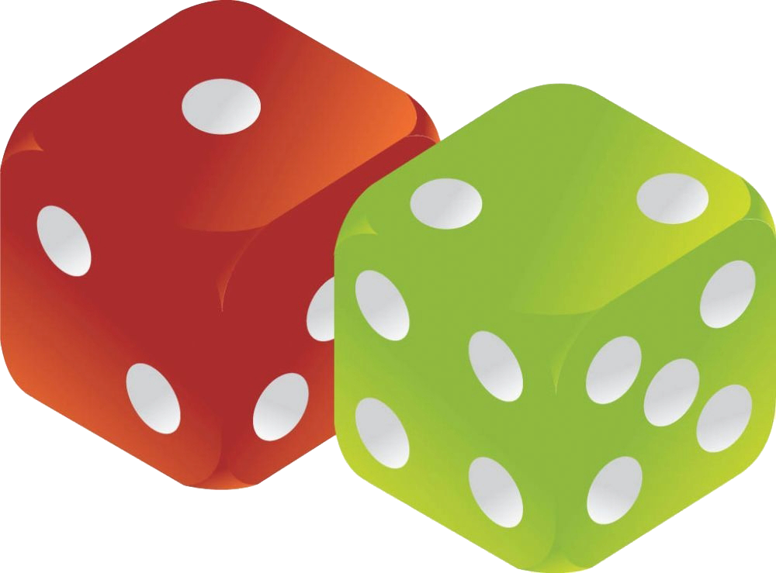
Sum of 2 Dice Game (Theoretical Probability)
Let’s analyze how this game works.
Even though 1+2 and 2+1 are the same numbers and have the same sum, they can happen differently. So that’s counted as two ways.
Notes:
Source of Image (dice): https://www.kindpng.com/imgv/ibohhxx_background-dice-transparent-dice-vector-free-hd-png/
Source of Image (boy): 3dcartoonmodels.com.toonKid1_01pointing.png (600×600) (bp.blogspot.com)

Slide 21
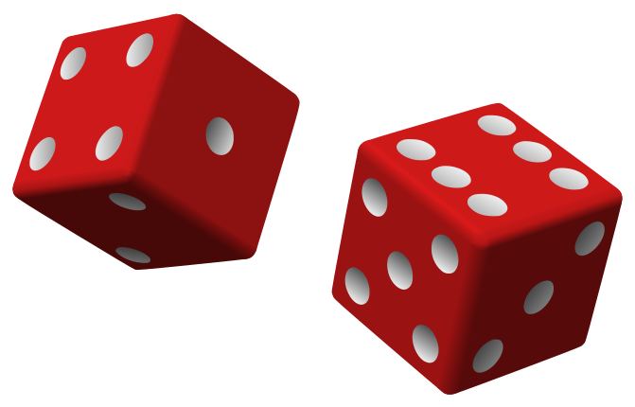
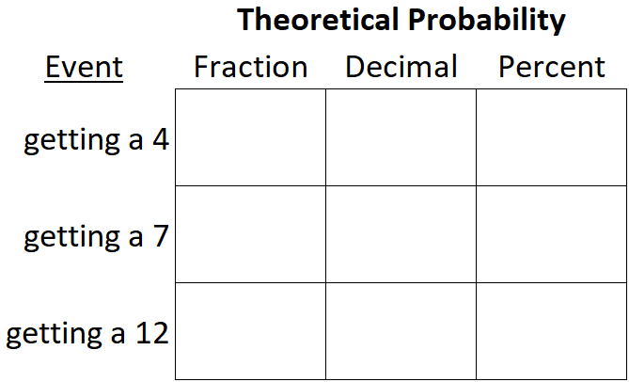
Sum of 2 Dice Game: Questions
Questions:
How many sums are possible with the 2 Dice Game? _____
Fill in the chart. Use a calculator.
Kim’s prediction is that 12 would be the sum to come up the most often. Explain why this is very unlikely to happen.
Mark saw the chart with all the possible combinations. He decided to place all his counters on 6, 7, and 8. Do you agree with this strategy? Why or why not?
Notes:
Source of Image: https://upload.wikimedia.org/wikipedia/commons/thumb/3/36/Two_red_dice_01.svg/671px-Two_red_dice_01.svg.png

Slide 22
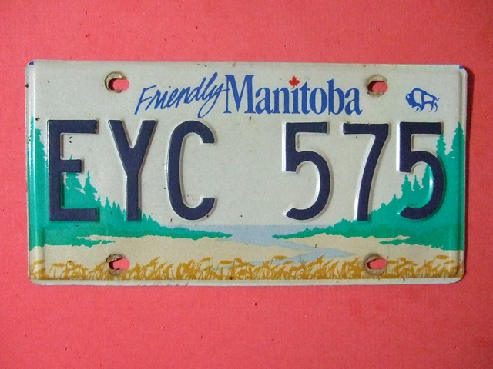
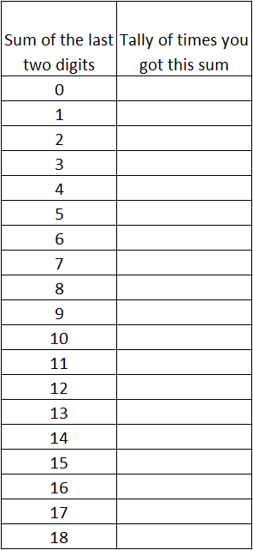
License Plates
Materials needed: paper and pencil
PROBLEM: If you add the last 2 numbers on a license plate, will any sum come up more often than any other? PREDICTION: I think _________ is the most likely sum.
EXPERIMENT: 1) Write down the license plate numbers of 10 cars. 2) Add the last 2 numbers. 3) Make a chart like the one on the right. 4) Put a tally mark on the chart each time you get that sum. COMPARE RESULTS TO THE PREDICTION: 5) I found this sum came up the most often. ________ 6) Was this result different or the same as your prediction? 7) Which sum do you think would come up the most often if you looked at thousands of license plates?
Notes:
Source of Image: https://farm9.staticflickr.com/8078/8329703471_6be97ebba8_z.jpg

Slide 23
License Plates (Theoretical Probability)
To find the theoretical probability, let’s make a chart like the one for the Sum of 2 Dice Game.
Questions:
Fill in the rest of the chart.
What is the total number of sums? ________
Which three sums come up the most frequently? ________
Twelve was an unlikely event in the Sum of 2 Dice game. Why is 12 more likely in the License Plates activity?
Express the probability of the most likely event as a fraction, decimal, and a percent. (Use a calculator.)

Slide 24
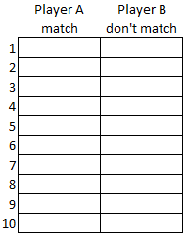
Is This a Fair Game? Drawing Objects from a Bag
Materials needed: small paper or plastic bag, 2 red and 2 blue small pieces of paper
You could also use 4 small objects - 2 are one colour and 2 are another colour. An example of objects could be 2 green and 2 gold buttons, or paperclips or bingo chips.
(They should be about the same size.)
PROBLEM: Is this a fair game? Draw 2 objects from the bag. If they are both the same colour, Player A gets a point. If they are different colours, player B gets a point. PREDICTION: I think this (is/isn’t) _______ a fair game.
EXPERIMENT: 1) Draw an object from the bag. Record on the chart (shade in that square) which player got the point. 2) Put the object back in the bag. 3) Do 10 trials. COMPARE RESULTS TO THE PREDICTION: 4) Write the experimental probability as a percent for: a) P(objects that match) ________ b) P(objects that don’t match) ________ 5) How did your results compare with your prediction? Any surprises? 6) Would you have the same results if you did this experiment again?
Notes:
Source of image (hand): https://www.wisc-online.com/assetrepository/getthumbnailfile?id=1539
Source of image (bag): https://cdn.pixabay.com/photo/2014/04/02/16/16/bag-306740_960_720.png

Slide 25
Drawing Objects from a Bag (Theoretical Probability)
Let’s make a list of what could happen when we draw the objects from the bag:
red-red
blue-blue
red-blue
blue-red
1. Total possible outcomes = _______
2. Total number of outcomes for: - objects that match ______ - objects that don’t match ______
3. P(match) = _______ (fraction) _______ (decimal) _______ (percent)
5. Is this a fair game? Explain your thinking.
4. P(don’t match) = _______ (fraction) _______ (decimal) _______ (percent)
Notes:
Source of image (bag): https://cdn.pixabay.com/photo/2014/04/02/16/16/bag-306740_960_720.png

Slide 26
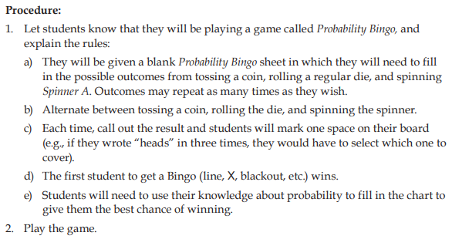
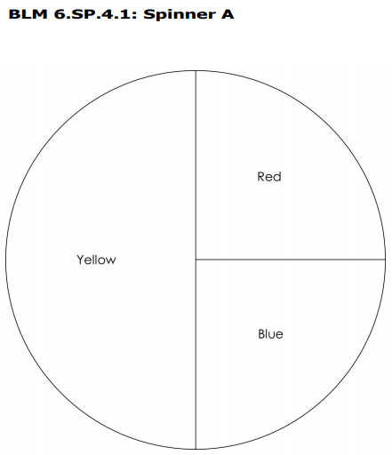
Note to Teachers:
Look in the document below for a great game. *Students need to have had probability experience tossing a coin, rolling a die and spinning different kinds of spinners. (There is a separate file for BLM that go along with the activities.)
Gr. 6 Math Curriculum Support document p. 35 for directions on playing probability bingo.
Notes:
Source of Image: https://www.edu.gov.mb.ca/k12/cur/math/support_gr6/blms/gr6_math_blms.pdf - BLM 6.SP.4.1: Spinner A

