Slide 1
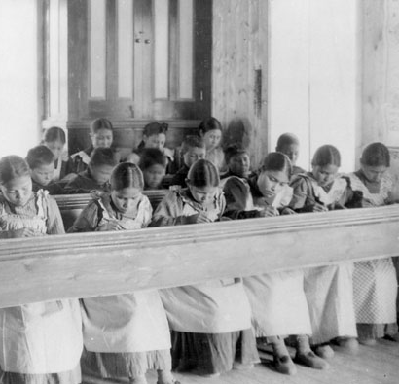
Residential Schools
Grades 5-8
Library and Archives Canada
Fort Resolution, NWT
Notes:
Fort Resolution, NWT – Library and Archives Canada https://data2.archives.ca/ap/a/a042133-v6.jpg
To activate and assess prior knowledge, you may choose to ask student what they know about residential schools already and/or what they notice about the photograph.
The residential school experience can be a very sensitive subject for both adults and children. It is very important that this topic be approached with respect. The following general guidelines are intended to assist teachers in dealing with controversial issues in the classroom. (Source: From Apology to Reconciliation, p. 4, PDF p. 12)

Slide 2
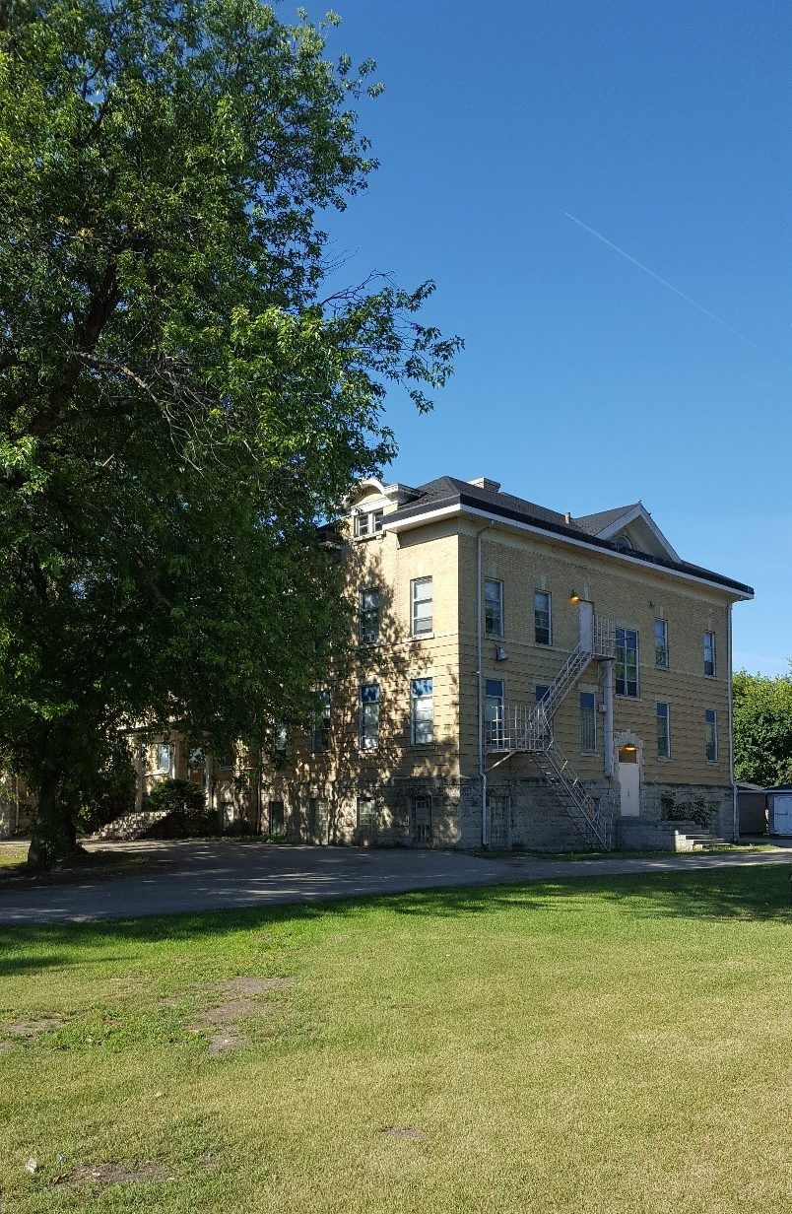
How have residential schools impacted the lives of Indigenous Peoples?
Inquiry Question
This Photo by Unknown author is licensed under CC BY-ND.
Notes:
To activate and assess prior knowledge, you may choose to ask student what they know already about how residential schools impacted the lives of Indigenous Peoples in Canada.
The residential school experience can be a very sensitive subject for both adults and children. It is very important that this topic be approached with respect. The following general guidelines are intended to assist teachers in dealing with controversial issues in the classroom. (Source: From Apology to Reconciliation, p. 4, PDF p. 12)

Slide 3
How much do you know about the impact of residential schools?
I know very little about the impact of residential schools. | I know a little bit about the impact of residential schools. | I know some things about the impact of residential schools. | I know a lot about the impact of residential schools.
Extend the arrow to the spot on the continuum that reflects how much you know about the impact of residential schools.
Notes:
You may wish to print this slide and have students draw the arrow, or duplicate the slide for as many students as you have in the class so that they each can mark their knowledge on the continuum.

Slide 4
Indigenous Worldview and Education
Consider, reflect, and discuss Indigenous Worldview and Education with a classmate or family member.
This Photo by Unknown Author is licensed under CC BY
Children are taught by many different members of their family and community
Learning is hands-on, experiential, and takes place out on the land
Learning is lifelong
Children are the students and also the teachers; adults and Elders can also learn from the children
Children learn by watching and doing
Knowledge is passed down through stories, songs, dances, and artistic representations
Education is holistic and children learn how everything is interconnected
At the core, is the value of respect
Source: AFN Tool Kit Plain Talk Pre-Contact.pdf, p. 27&28
Notes:
AFN Tool Kit https://education.afn.ca/afntoolkit/wp-content/uploads/2018/05/Plaintalk-2-Pre-Contact.pdf, p. 27&28
You may choose to have students revisit this slide at the end of the learning experience to complete the Indigenous Worldview and Education BLM#12.

Slide 5
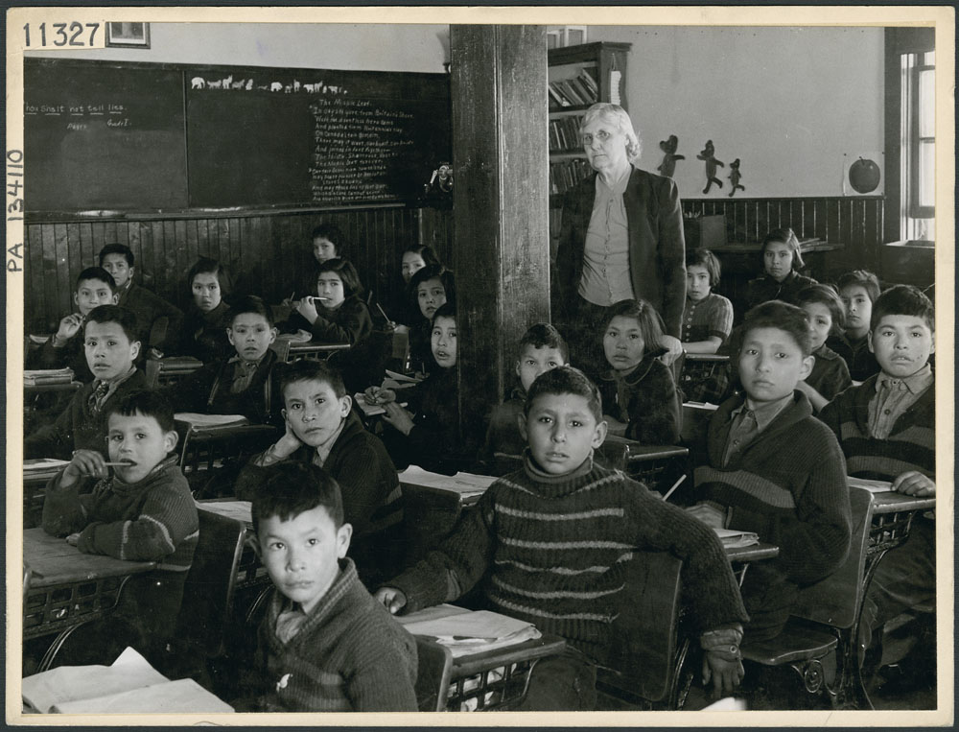
Residential Schools
Residential schools are schools that First Nations, Inuit, and some Metis children had to go to.
They were around for over 150 years in Canada, from 1831 to 1996.
Lac La Ronge, SK, 1945
Library and Archives Canada
Notes:
Lac La Ronge, SK, 1945 – Library and Archives Canada https://data2.archives.ca/e/e439/e010962313-v8.jpg

Slide 6
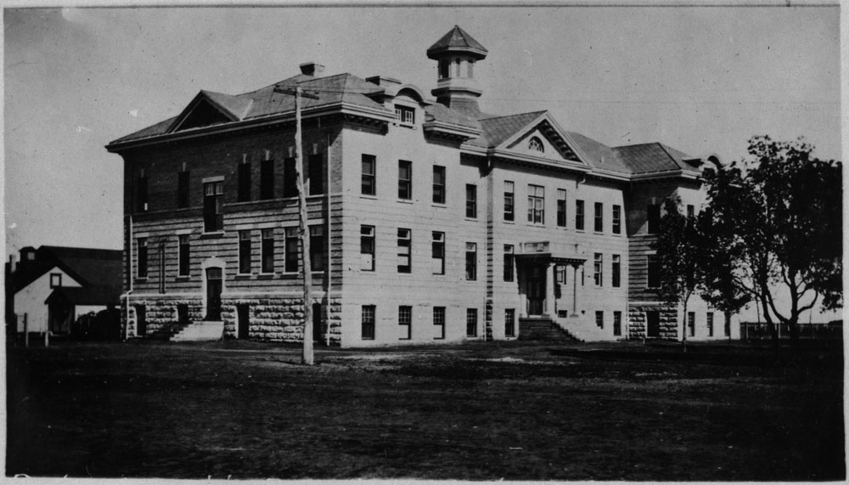
Residential Schools
There were over 130 residential schools in Canada, and over 150,000 children attended.
It is important to learn about residential schools because the impacts are still being felt today.
Portage la Prairie, MB, 1914-15
Library and Archives Canada
Notes:
Portage la Prairie, MB, 1914-15 – Library and Archives Canada https://data2.archives.ca/ap/a/a047850-v8.jpg

Slide 7
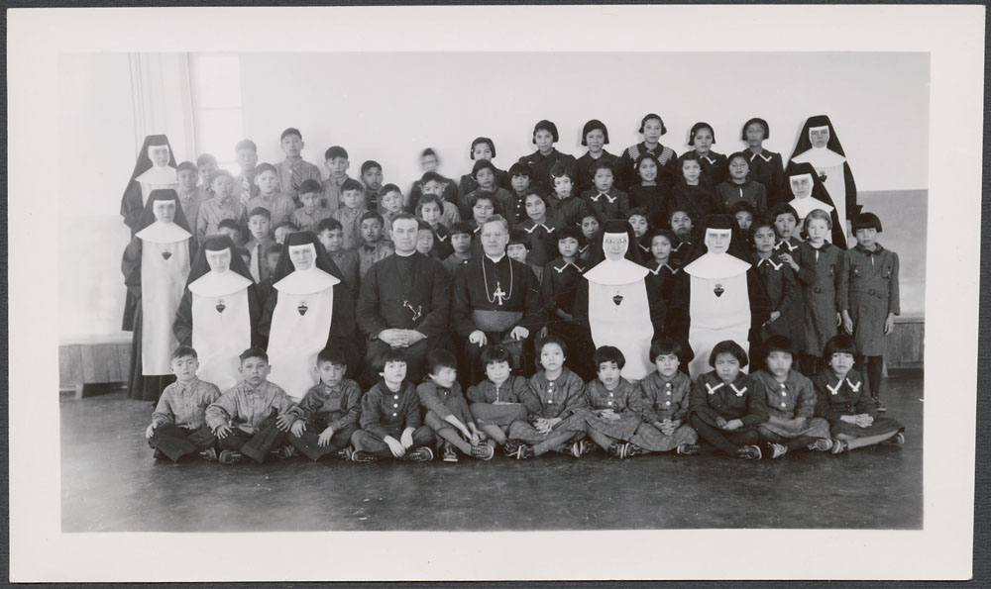
Away From Home
Many children were only 6 years old when they first went to residential school.
Many of the schools were far away and the children had to travel far distances to get there.
Cross Lake, MB, 1940
Library and Archives Canada
Notes:
Cross Lake, MB, 1940 – Library and Archives Canada https://data2.archives.ca/e/e444/e011078116-v8.jpg

Slide 8
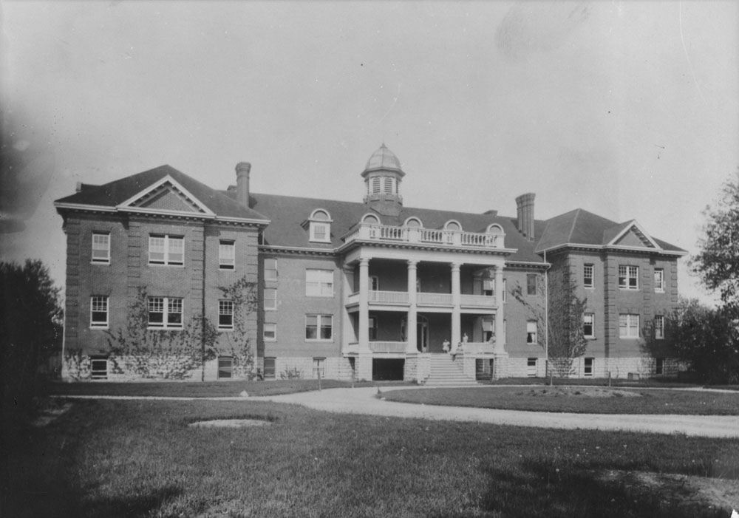
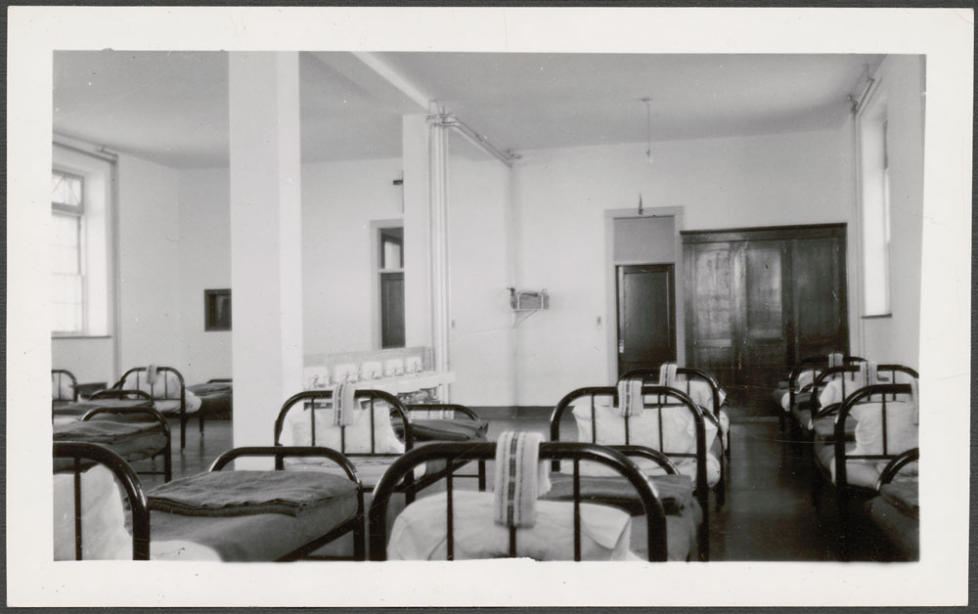
About the Schools
Mohawk, Brantford, ON
Most of the schools were tall 3 story buildings and the children had to live there. They had dorm rooms with rows of beds.
Most of the children had to stay there for 10 months of the year, from September until June.
Some got to go home for Christmas, some did not. Some got to go home for the summer, some did not.
Library and Archives Canada
Cross Lake, MB, 1940
Library and Archives Canada
Notes:
Mohawk, Brantford, ON – Library and Archives Canada https://data2.archives.ca/ap/a/a043613-v8.jpg
Cross Lake, MB, 1940 – Library and Archives Canada https://data2.archives.ca/e/e444/e011080269-v8.jpg

Slide 9
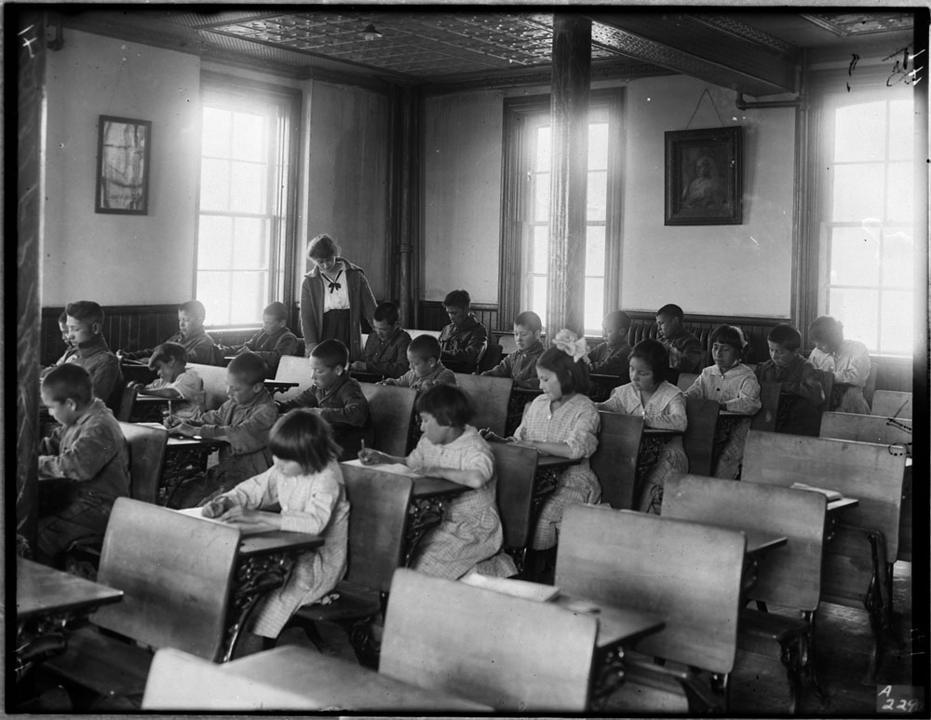
Regimented Routine
All the kids had to look the same. They all had the same haircut and they all had to wear the same uniforms.
The children also had to follow a very strict routine.
There was no sleeping in, they were told when to wake up, when to sleep, when to eat.
Brandon, MB, 1946
Library and Archives Canada
Notes:
Brandon, MB, 1946 – Library and Archives Canada https://data2.archives.ca/ap/a/a048571-v8.jpg

Slide 10
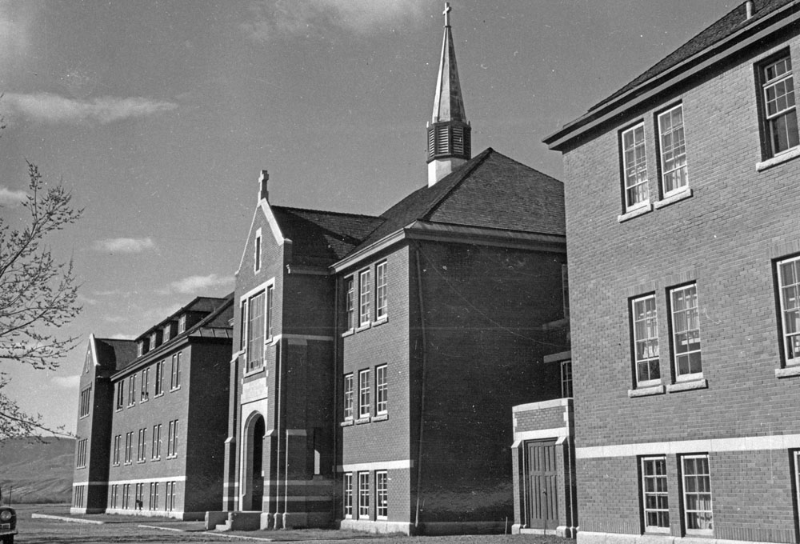
Structure
They had to stand at attention, come when called upon, speak when spoken to, and do as they were told without hesitation.
There was play time, but even that was structured.
They had to do as they were told 24 hours a day, seven days a week.
Kamloops, BC, 1970
Library and Archives Canada
Notes:
Kamloops, BC, 1970 – Library and Archives Canada https://data2.archives.ca/ap/a/a185532-v8.jpg

Slide 11
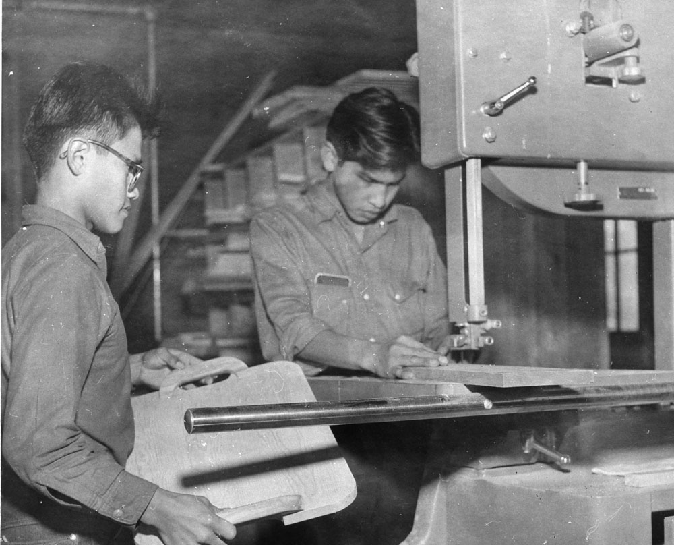
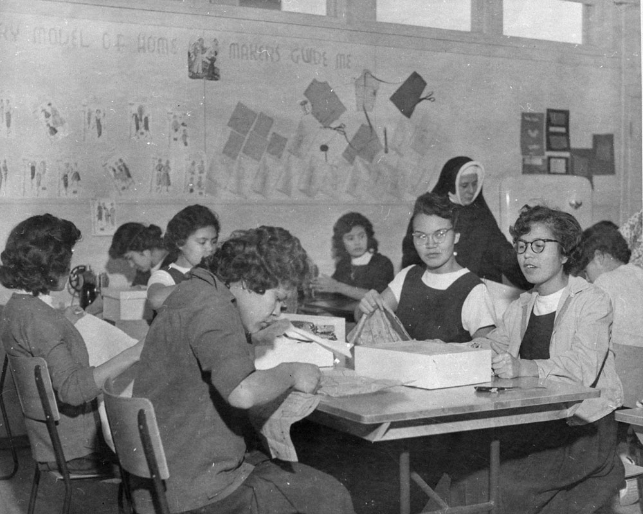
Living Conditions
Kamloops, BC, 1958-59
The living conditions at residential schools made it hard too.
Most kids were underfed and the food they were given was bland and lacked nutrients. Porridge, soup, and stew were common.
The students had to work very hard; they worked beyond appropriate expectations for their age. They were given jobs like cleaning the school, doing laundry, washing dishes, sewing clothes, making their beds, and farm work.
Library and Archives Canada
Kamloops, BC, 1958-59
Library and Archives Canada
Notes:
Kamloops, BC, 1958-59 – Library and Archives Canada https://data2.archives.ca/ap/a/a185652-v8.jpg
Kamloops, BC, 1958-59 – Library and Archives Canada https://data2.archives.ca/ap/a/a185655-v8.jpg

Slide 12
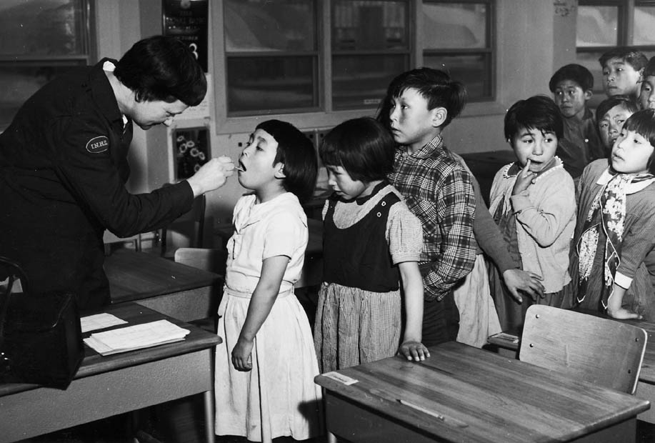
Living Conditions
The buildings were often cold and poorly ventilated.
They lived close together and as a result were more likely to get sick from tuberculosis and influenza.
Frobisher Bay, Iqaluit, 1959
Library and Archives Canada
Notes:
Frobisher Bay, Iqaluit, 1959 – Library and Archives Canada https://data2.archives.ca/e/e101/e002504641.jpg

Slide 13
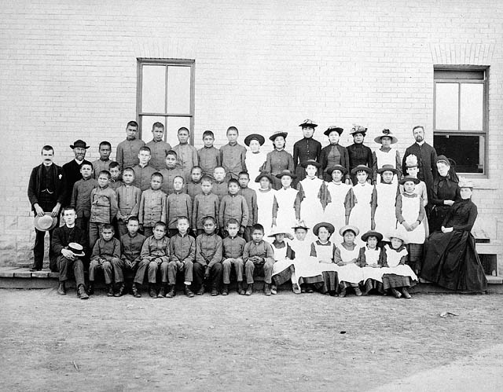
Treatment of Children
The children were not treated very well, and the staff were very strict.
Children were usually punished if they disobeyed or broke a rule.
Usually they would get a strap, sometimes they would even lock kids up.
They were not allowed to speak their language, or they would be punished.
St. Paul's, MB, 1901
Library and Archives Canada
Notes:
St. Paul's, MB, 1901 – Library and Archives Canada https://data2.archives.ca/ap/a/a182251.jpg

Slide 14
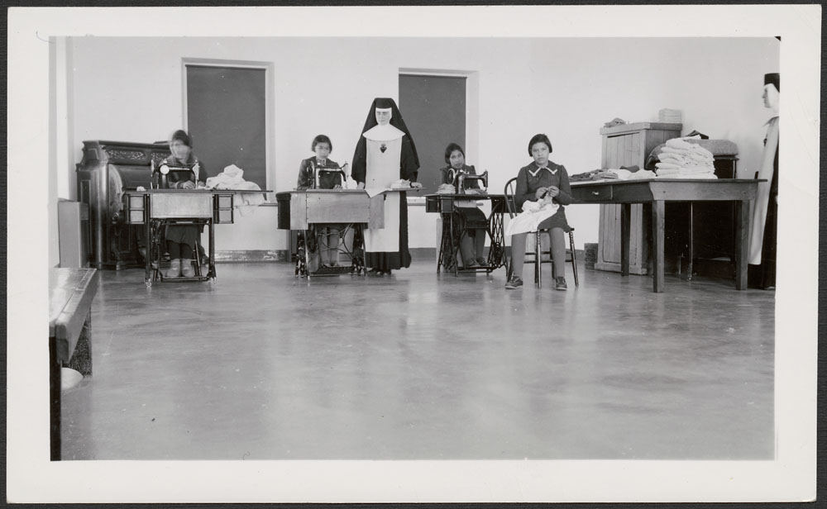
Treatment of Children
Some of the children were given a different name, some were only called upon by number.
They were also made to feel bad about their culture.
Many children did as they were told out of fear, but some resisted and stood up for themselves. Unfortunately, that would often result in more punishment.
Cross Lake, MB, 1940
Library and Archives Canada
Notes:
Cross Lake, MB, 1940 – Library and Archives Canada https://data2.archives.ca/e/e444/e011080273-v8.jpg
You may wish to use the Who I Am BLMs#1a &1b to support this learning experience.

Slide 15
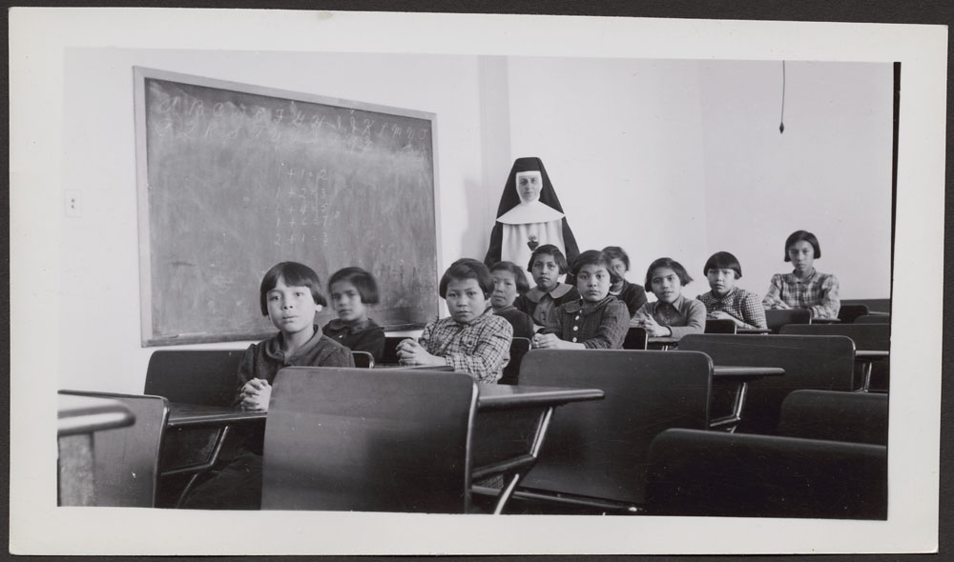
Imagine
You can imagine how the children must have felt - stressed, lonely, afraid, angry, and sad.
You can imagine how hard it must have been for them to live their childhood that way.
Cross Lake, MB, 1940
Library and Archives Canada
Notes:
Cross Lake, MB, 1940 – Library and Archives Canada https://data2.archives.ca/e/e444/e011080274-v8.jpg

Slide 16
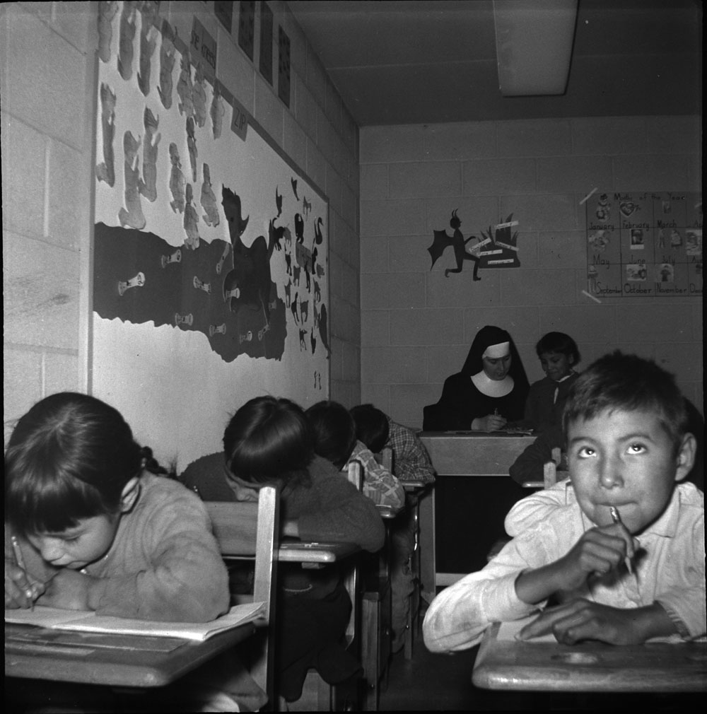
Run Away
Some children tried to run away.
Some made it home, but others were caught and punished when they were brought back.
Pukatawagan, MB, 1960
Library and Archives Canada
Notes:
Pukatawagan, MB, 1960 – Library and Archives Canada https://data2.archives.ca/ap/a/a213331-v8.jpg

Slide 17
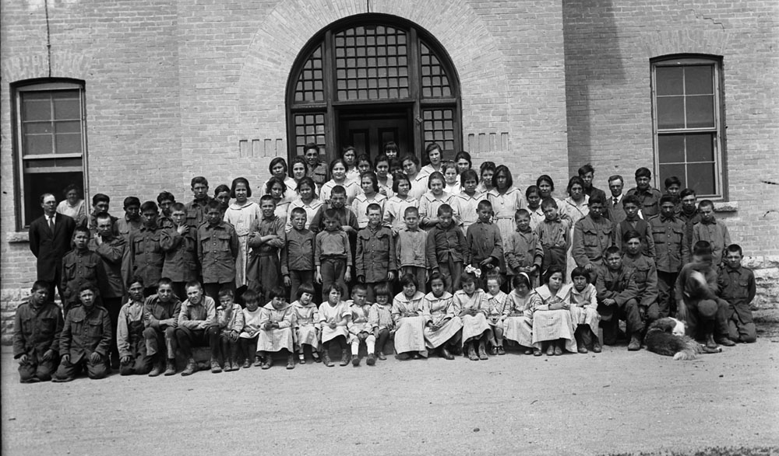
Why were Residential Schools Created?
Residential schools were designed to assimilate Indigenous children to adopt European culture.
The Canadian Government provided the funding and various churches oversaw the day-to-day operations of the schools.
Brandon, MB, 1946
Library and Archives Canada
Notes:
Brandon, MB, 1946 – Library and Archives Canada https://data2.archives.ca/ap/a/a048574-v8.jpg
At this point in the learning experience, you may wish to use the Impactful Images BLM#2 and/or the Residential School Word Splash BLM#3 to support student learning.

Slide 18
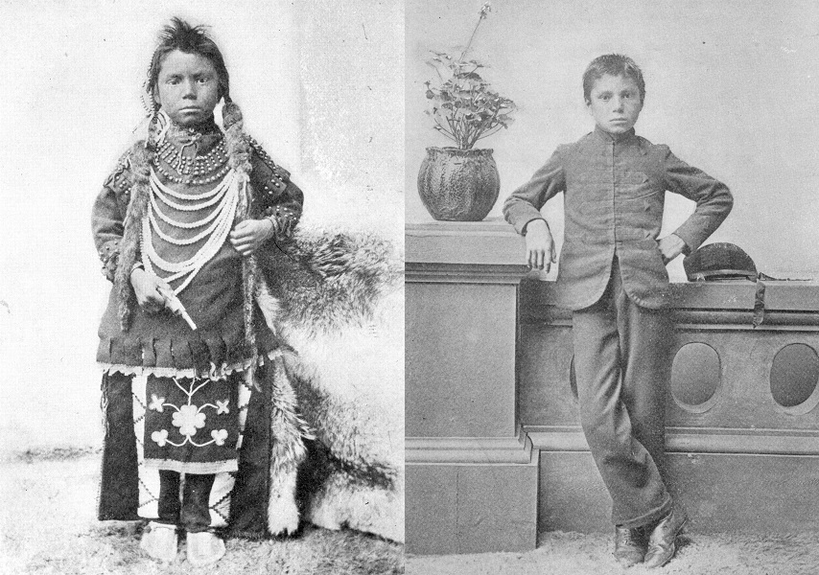
Thomas Moore
Compare the two photographs.
What do you notice?
What do you wonder?
Photo Source
Notes:
Saskatchewan Archives Board, Item R-A8223 (1)-(2) - Thomas Moore before and after admission to Regina Indian Industrial School
Photo Source https://www.facinghistory.org/resource-library/image/thomas-moore?backlink=https://www.facinghistory.org/stolen-lives-indigenous-peoples-canada-and-indian-residential-schools/chapter-4/punishment-and-abuse
(Photographs are considered primary source evidence. For more information, see the link: https://historicalthinking.ca/primary-source-evidence)
You may choose to use the Thomas Moore Photograph BLM#4 to support this learning experience.
The following notes may help you truthfully and sensitively guide conversation with students.
“These are staged “before and after” photos taken by government officials." FacingHistory.org
Photographs like these helped to convince Canadians that Indian Residential Schools were a "good thing." Thomas Moore, the boy in the picture, entered the Regina Residential School in 1874. In the first picture, he is wearing traditional clothing, he has long hair and he is holding a pistol. In the second picture, he looks slightly older. He is now wearing a military style uniform and has short hair and his left hand hangs relaxed and empty. The first picture represents an uncivilized and potentially dangerous person. The second represents a civilized, unarmed, and therefore unthreatening person.
http://wherearethechildren.ca
“Thomas Moore – Threat? Official opinions about Aboriginal education, the Davin Report, and the Carlisle boarding school model, all helped to convince many Canadians about the kind of Industrial School System they were willing to support. In this environment, the Reginal Industrial School first made its appearance, and Thomas Moore was promoted as its model student. In the first of the two photographs, Moore wears tribal style clothing: cloth leggings, a shirt decorated with metal tacks, a long necklace, a breechcloth with a beaded floral design, and moccasins. His long hair is wrapped in fur and hangs down over his chest, and he holds a pistol in his right hand. Moore looks directly into the camera with a blank expression on his face, and the diffused lighting in the background provides no hint of time or place.” Legacy of Hope – Where are the Children – A History of the Residential School System in Canada – Timeline (part 33 of the timeline) https://legacyofhope.ca/wherearethechildren/
“Thomas Moore – Threat Neutralized. In the second photograph, Moore looks slightly older. He now wears a military style uniform, and has short hair. To the right of him is a potted plant, and to his left we can see his cap resting on an arnate railing. Once again, he looks directly into the camera, although this time he appears much more confident. A side-by-side comparison of the two photographs reveals a similar pose: in each portrait, Moore’s left arm and hand forms the same shape. However, in the first photo, one hand touches his braid, while the other hand touches the pistol; in the second, Moore leans agains a railing, which allows him to place his right arm on his hip while his left hand hangs relaxed, and empty. The two photographs offer two different readings of the Aboriginal body: the first represents an uncivilized and potentially dangerous Indian. The second represents a civilized, unarmed, and therefore unthreatening Indain. In fact, “Scott admitted frankly that the provision of education to Indian Communities was indispensable, for without it and “with neglect” they “would produce an undesirable and often dangerous element in society.” (Dominion of Canada Annual Report of the Department of Indian Affairs for the year ended March 31, 1910. p. 273) Legacy of Hope – Where are the Children – A History of the Residential School System in Canada – Timeline (part 34 of the timeline) https://legacyofhope.ca/wherearethechildren/
“These are staged “before and after” photos taken by government officials. Thomas Moore, a young Indigenous boy who attended Regina Industrial School, is portrayed with short hair and Western-style clothing. Otticials and missionaries created such propaganda so that they could adopt it as evidence of the racial, “beneficial” changes the schools brought about in their students.”
https://www.facinghistory.org/resource-library/image/thomas-moore?backlink=https://www.facinghistory.org/stolen-lives-indigenous-peoples-canada-and-indian-residential-schools/chapter-4/punishment-and-abuse
Saskatchewan Archives Board, Item R-A8223 (1)-(2) - Thomas Moore before and after admission to Regina Indian Industrial School
https://search.saskarchives.com/thomas-moore-before-and-after-admission-to-regina-indian-industrial-school

Slide 19
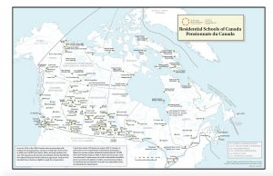
Where were Residential Schools located?
TRC Residential Schools of Canada Map
Where were Manitoba's residential schools CBC
CBC – Did you live near a residential school?
Interactive Map: Manitoba's former residential schools
Google Earth – Canada's Residential Schools
This Photo by Unknown author is licensed under CC BY-NC-ND.
Notes:
Truth and Reconciliation Commission of Canada – Residential Schools of Canada Map
http://www.trc.ca/assets/pdf/2039_T&R_map_nov2011_final.pdf
CBC – Did you live near a residential school? https://www.cbc.ca/news2/interactives/beyond-94-residential-school-map/
Interactive Map: Manitoba's former residential schools https://winnipeg.ctvnews.ca/interactive-map-manitoba-s-former-residential-schools-1.5451637
Google Earth – Canada's Residential Schools https://earth.google.com/web/@43.127456,-80.240846,200.99398697a,4500000d,35y,0h,44.99993929t,0r/data=CkYSRBIgYTBlNWFkNDVhMjBiMTFlN2IzZmQzZjBhY2YwNDZiOWEiIGVmZWVkX3JjZ3NfcmVzaWRlbnRpYWxfc2Nob29sc18w
You may choose to use the Mapping Former Residential Schools in Manitoba BLM#5 to support this learning experience.

Slide 20
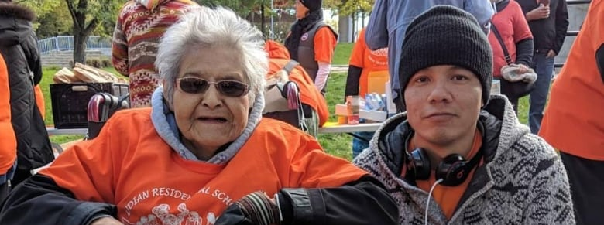
Impact Today
This Photo by Unknown author is licensed under CC BY-NC.
Many survivors have a lot of painful memories.
Intergenerational trauma is passed down through generations.
Everyone is on their own healing journey, at their own pace. It takes time.
Notes:
You may wish to use the Write a Letter BLM#6 and/or the Reconciliation Word Splash BLM#7 at this point in the whole residential school learning experience.
Note: Once students have completed both the Residential School Word Splash BLM #3 and Reconciliation Word Splash BLM #7, you may want students to compare and contrast both word splashes. For more information about Historical Thinking Concepts: Continuity and Change and Cause and Consequence, see https://historicalthinking.ca/continuity-and-change & https://historicalthinking.ca/cause-and-consequence
You may also choose to have students revisit slide 4 now and complete the Indigenous Worldview and Education BLM#12.

Slide 21
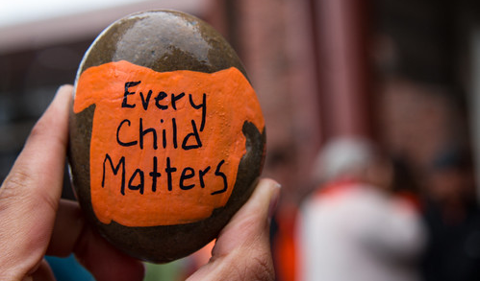
What can you do?
Continue to learn and raise awareness about residential schools
Show compassion and empathy
Create an art piece
Write a poem or song
Participate in Orange Shirt Day (September 30th)
This Photo by Unknown author is licensed under CC BY-NC-ND.
Notes:
You may wish to use the Continue to Learn BLM#11 and/or the Create an Art Piece BLM#13 to support student learning.

Slide 22
Orange Shirt Day
When Phyllis was 6 years old, her granny bought her a shiny orange shirt. Phyllis was excited about her new shirt, and she wore it on her first day at residential school. But when she got there, they took her orange shirt and she never saw it again and it made her feel sad.
We wear orange on September 30th to show Phyllis that we care about her and all the children that went to residential schools.
"Members of the Legislative Assembly and the Orange Shirt Society say ‘Every Child Matters’" by BC Gov Photos is licensed under CC BY-NC-ND 2.0
Notes:
Phyllis (Jack) Webstad's story in her own words... https://www.orangeshirtday.org/phyllis-story.html
Phyllis Webstad Orange Shirt Day Presentation (1:55 min) https://www.youtube.com/watch?v=E3vUqr01kAk&t=1s
You may wish to use Design an Orange Shirt BLM#8 to support this learning experience.

Slide 23
How much do you know about the impact of residential schools now?
I know very little about the impact of residential schools. | I know a little bit about the impact of residential schools. | I know some things about the impact of residential schools. | I know a lot about the impact of residential schools.
Extend the arrow to the spot on the continuum that reflects how much you know about the impact of residential schools.
Notes:
You and/or the students may notice that the first column has been greyed-out and the arrow moved to the second column. It is expected that by this point in the learning experience that students know more about the impact of residential schools than they did at the beginning. Ask students to reflect on their learning and go back to slide 3 to see if they would change their answer.

