Slide 1
Are you drinking the same water as the first people on Earth?
Grade 2 Science

Slide 2
Which glass would you NOT drink from?
A
B
I would NOT drink from ______ because…
Image adapted from: https://www.flickr.com/photos/aquamech-utah/25045792466

Slide 3
How would you clean the water in glass B so that you could drink it?
B
My ideas:
Image adapted from: https://www.flickr.com/photos/aquamech-utah/25045792466

Slide 4
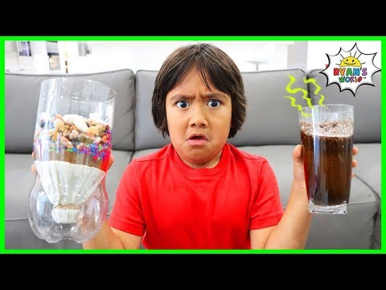
The Final Challenge
At the end of this lesson you will be asked to:
Create a water filtration system to provide clean drinking water for plants, animals, and humans.
Stop Video at 1:53
Notes:
Teacher Notes:
Links to experiments:
This video could be a great way to introduce the challenge. The video should be formatted to stop the video at 1:53 but if not, be sure to stop it so students cannot see the solution. “How are we going to make a filter?” https://www.youtube.com/watch?v=6Z3JBH-Hg8w
Answer for the teacher: https://www.youtube.com/watch?v=yEZPrdEMZSQ

Slide 5
TABLE OF CONTENTS:
01
02
03
04
Water in the Environment
The Water Cycle
Water Pollution
Drinking Water
Notes:
Teacher Notes:
Each section is linked to the Title slide for that learning section.
Google Slides > click on the section and follow the link
PPT > right click on the section and select open link.

Slide 6
01
Water in the Environment
What is the most useful form of water in the environment?
Notes:
Teacher Notes:
Ask the students this question to begin the conversation. Students might have many ideas about the most useful form of water. Take 5 minutes to discuss their ideas.

Slide 7
Sound Reasoning
When making a decision you need two (2) things to help you with your thinking:
Pay attention to all details.
Use and apply what you already know to be true.
This is called Sound Reasoning. It is how we think!
Notes:
Teacher Notes:
Students need to think about their thinking. It is important to remind them that when they are making sound decisions they need to use sound reasoning.
Post this slide up in the class for student to reference and be reminded of continually throughout this unit of study.

Slide 8
What is the most useful form of water in the environment?
In order to answer the question, we need to think about what we already know about the topic…
What forms of water are in the environment?
In order to answer the question, we also need to pay attention to the details of the question so we can know what it is asking…
What is the criteria for most useful?
Notes:
Teacher Notes:
Post the question for the students on the board.
Inform students that before they can answer one question they need to think about what they already know to be true.
Ask the students if they can name different forms of water in the environment already.
Make a class list.
Inform students that before answering a question they need to know exactly what the question is asking, so they have to pay attention to the details of the question.
Ask the students if they know what most useful means?
Make a list of students ideas of most useful.

Slide 9
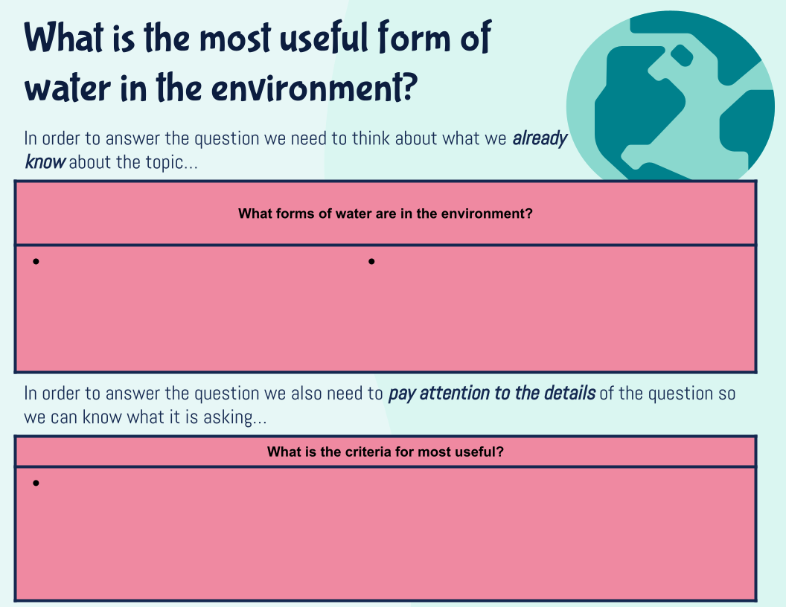
Water Forms:
Read/View the story Hey, Water by Antoinette Portis
After the story, go back to this slide.
Are there water forms, from the story, that you missed that could be added to the list?
Notes:
Teacher Notes:
Remember to always ask the students to review/revise their thinking when they have read/viewed something new.
Book Link: https://www.youtube.com/watch?v=u7XN3k6kcEg

Slide 10
More resources for Water Forms and Uses
With a teacher or another grown-up, read the article below and watch the video.
Water Facts
Water Bodies
Water Facts for Kids - Kids Encyclopedia
The Water Bodies | The Dr. Binocs Show | Educational Videos For Kids
Each time you learn something new, head back to this slide and add to your thinking.
What are other forms of water?
What are some useful forms and what makes them useful?
Notes:
Teacher Notes:
Remember to always ask the students to review/revise their thinking when they have read/viewed something new.

Slide 11
Pencil Paper Task:
Draw and label a picture to show where water is found in the environment. Include at least six different forms of water.
Students can take a picture of their drawing and insert it into the slide below:
For Teachers: Use the following checklist to assess the drawing:
includes detail
is labelled
shows an understanding of the location of water in the environment
includes six or more different forms
Notes:
Teacher Notes:
This is a great time for students to practice their independent learning. They can take everything they have learned and draw different water forms on a sheet and send in the information.
You can ask students to present their drawings to the class.
This can be a drawing of 6 different forms in 6 different sections of a paper or students could draw it out like a map.
Task Source: https://www.edu.gov.mb.ca/k12/cur/science/found/kto4/2c4.pdf Page 7/16

Slide 12
Apply Your Learning:
What are the most useful forms of water in the environment?
Choose 5 forms of water from the class list that are the most useful. Make sure to use the criteria you created. Then rank the 5 forms from most useful (1) to least useful (5) on the ladder. Justify your choice.
What is the criteria for most useful?
Practical (used for drinking, washing, growing etc) Safe for plants, animals and humans Clean
The top 5 most useful forms of water are…
because…
Notes:
Teacher Notes:
Inform students that when they are making a judgement such as “most useful” they need to understand what it means to be useful.
Discuss the concept of criteria with students and say that it can help us make the best decision because it gives us guidelines to follow.
Ask students which water forms meet the criteria in the pink box (if students can think of other criteria for “useful” even better
Then ask students to rank the 5 most useful forms in order of best/most useful (1) to worst/least useful (5) on the ranking ladder.

Slide 13
02
The Water Cycle
How is the water cycle important?
Notes:
Teacher Notes:
Ask the students this question to begin the conversation. Students might have many ideas about the water cycle. Take 5 minutes to discuss their ideas.
Remind students to use sound reasoning and refer to the Sound Reasoning Penguin Poster. (You may duplicate it (Select > ctrl D) and move here to remind students.
Some articles that may have been or could be used in this section:
https://online.kidsdiscover.com/unit/water/topic/why-water-is-important
https://www.youtube.com/watch?v=R0K7VKkksyc
https://www.youtube.com/watch?v=ncORPosDrjI

Slide 14
Mirror Magic
My Observations & Explanation:
All experiments should be done with a teacher or another grown-up.
Place a mirror in the freezer section of the refrigerator for five to ten minutes. Carefully remove the mirror from the freezer and breathe on it.
What forms on the mirror?
Do your best to explain why this is happening.
Write down any questions you have after.
My Questions:
Notes:
Teacher Notes:
Have the students do this experiment.
Ask them to record their observations.
Ask them to try their best to explain why they saw what they saw.
Ask students to write down any questions they have about the experiment
Inform students that you will return to this later but to keep this experiment in mind.
Experiment source: https://www.edu.gov.mb.ca/k12/cur/science/found/kto4/2c4.pdf Page 6/16

Slide 15
Different Demonstrations:
ALL DEMONSTRATIONS NEED TO BE DONE WITH A GROWN-UP OR DONE BY THE TEACHER!!!
Cloud in a Bottle
Making it Rain
Pour hot water into a large jar (4 litres) and swirl it around to warm up the glass. Pour the hot water out of the jar, keeping the jar
upside down to prevent any heat from escaping. Light a match or a couple of matches at once and let the smoke rise inside the jar.
Quickly place the lid on the jar to trap the smoke inside.
Once the lid is on, turn the jar upright and place ice cubes on the lid. Shine a flashlight through the jar to help students observe what
happens. Fog or cloud begins to form when the air near the lid starts to cool.
Have students draw what they see.
Ask students to explain where the cloud came from. Record possible explanations.
Place ice cubes on a cookie sheet for a long enough duration to make the metal cold. Hold the cookie sheet over a steaming kettle. Ask students to notice what happens when the steam from the kettle hits the cold cookie sheet. (Droplets of water form on
the bottom of the cookie sheet. When the droplets of water become too heavy they fall like rain.)
Have students draw what
they see.
Ask students to explain what happened to the water.
Notes:
Teacher Notes:
Other demonstrations can be done here as well.
These demonstrations can be found on the MB Support Document for Grade 2 Science: https://www.edu.gov.mb.ca/k12/cur/science/found/kto4/2c4.pdf
Cloud in a Bottle - Page 6/16
Making it Rain - Page 8/16

Slide 16
Observation and Reflection Journal
Cloud in a Jar
While observing Cloud in a Jar what did you see? Notice? Wonder? (Explain in words or draw a picture)
Where do you think the cloud came from? How did it form?

Slide 17
Observation and Reflection Journal
Making It Rain
While observing Making it Rain what did you see? Notice? Wonder? (Explain in words or draw a picture)
What do you think happened to the water?

Slide 18
Learning Entry Log
While you look at the following articles and videos, on the next slide, fill in the following questions:
What do you know about water?
2. What did you learn about water today?
What questions would you like to ask?
Notes:
Teacher Notes:
This can be done individually or as class together

Slide 19
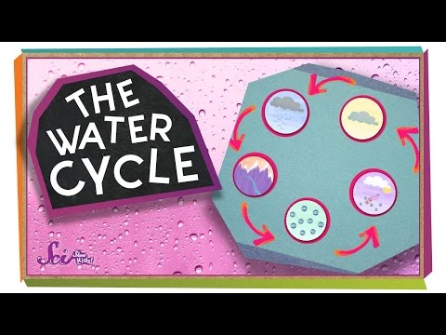
More resources About the Water Cycle With a teacher or another grown-up read the article below and watch the videos.
Why is Water Important
Where Does Water Come From?
The Water Cycle
Article → Why Water Is Important
Where Does Water Come From? | Ecology for Kids
The Water Cycle | The Dr. Binocs Show | Learn Videos For Kids
Notes:
Teacher Notes:
For each video and/or article ask the student to review/revise their thinking on their Learning Entry Log on the slide before.
https://online.kidsdiscover.com/unit/water/topic/why-water-is-important
https://www.youtube.com/watch?v=R0K7VKkksyc
https://www.youtube.com/watch?v=ncORPosDrjI

Slide 20
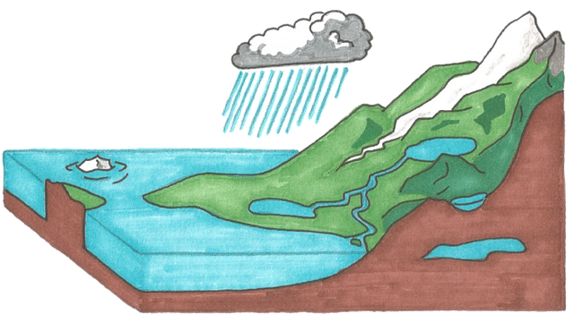
Performance Task - Water Cycle in a Bag & Journal
Water Cycle in a Bag & Journal
Materials needed:
A XL ziplock plastic bag
Permanent Markers
water
blue food coloring (optional)
packing tape
Steps:
Draw the water cycle diagram on the bag. Include words learned during the lesson:
Precipitation
Water vapour
Evaporation
condensation
Warm up the water until steam starts to rise but do not let it boil.
Add blue food coloring into the water.
Pour the water into a ziplock bag and zip it up.
Hang the bag upright on the window using packing tape.
Observe what happens inside the bag throughout the day and make observation notes & draw images of what you see.
Notes:
Teacher Notes:
Ask students to complete 1 of the 2 performance tasks above.
Water Cycle in a bag comes from the site - https://www.rookieparenting.com/what-is-water-cycle/#:~:text=Pour%20the%20water%20into%20a,I%20did
If students are not able to access the Water cycle in a bag option then this is also available
Water Cycle Model is in the Grade 2 Science Curriculum https://www.edu.gov.mb.ca/k12/cur/science/found/kto4/2c4.pdf Page 9 of this document.
Materials needed:
a paper plate
markers
construction paper
Cotton balls
String
Glue
Steps:
Make a model of the water cycle
Label all parts
Write a description of how the water cycle works
Include words learned during the lesson:
Precipitation
Water vapour
Evaporation
Condensation

Slide 21
Observation and Reflection Journal: Part 1
While observing your water cycle model, what did you see? Notice? Wonder?
How is the water cycle in your model the same as the water cycle in the world?

Slide 22
Observation and Reflection Journal: Part 2
Why do you think the Water Cycle is so important?
Why do we need to protect the water we have on Earth?

Slide 23
Apply Your Learning
Return to Mirror Magic.
Read over your observations and explanation. Try to expand your explanation now that you know more about the water cycle.
Read over your questions.
Respond to your own questions or ask a partner if they can answer them for you.
Write down your responses.
Notes:
Teacher Notes:
Image is linked to the original slide.
Google Slides > click on the image and follow the link
PPT > right click on the image and select open link.

Slide 24
03
Water Pollution
What are the worst pollutants in the water today?
Notes:
Teacher Notes:
Ask the students this question to begin the conversation. Students might have many ideas about water pollution. Take 5 minutes to discuss their ideas.
Remind students to use sound reasoning and refer to the Sound Reasoning Penguin Poster. (You may duplicate it (Select > ctrl D) and move here to remind students.

Slide 25
KWL Pollution
K
L
W
What do you think you know about pollution?
What do you want to know about pollution?
What did you today learn about pollution?
Notes:
Teacher Notes:
This can be done individually or as class together

Slide 26
What types of pollution are there?
With a teacher or another grown-up, read the article
“Pollution Facts for Kids”
Fill in the headings with types of pollution and add in examples under each heading?
Notes:
Teacher Notes:
Article Link: https://kids.kiddle.co/Pollution
Types of pollution in the article include:
Air
Water
Soil/Land
Noise
Plastic
Thermal

Slide 27
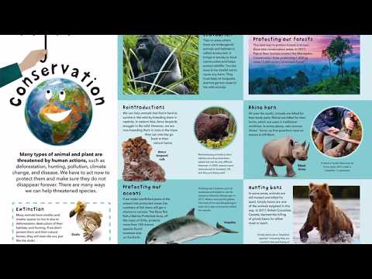
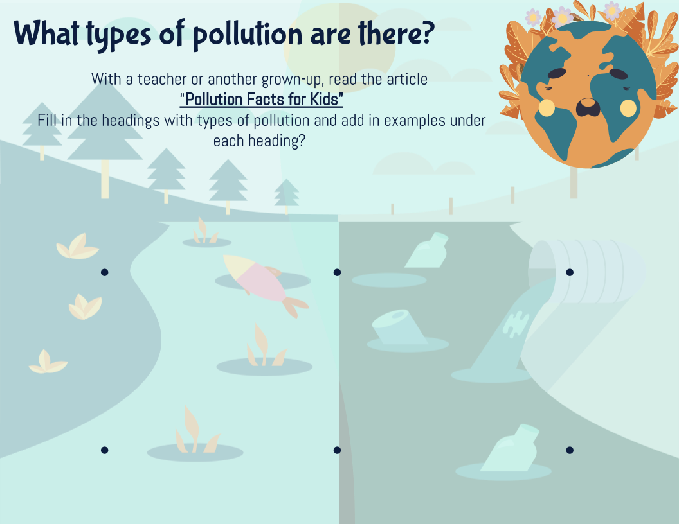
Resources About Pollution:
With a teacher or another grown-up, read the article below and watch the videos.
What a Waste by Jess French
Harry Saves the Sea by N.G.K
EPIC books on Pollution
Story → Ms. Alex reads What A Waste
Story → Harry Saves the Ocean! [Children's story | Read Aloud]
Collection of books → Pollution Children's Book Collection
Air Pollution with Dr. Binocs
Water Pollution with Dr. Binocs
Video → What Causes Air Pollution? | The Dr Binocs Show
Video → What Causes Water Pollution? | The Dr Binocs Show
Notes:
Teacher Notes:
For each video and/or article ask the student to review/revise their thinking on their Pollution Charts on previous slide.
Links:
What a Waste by Jess French: https://www.youtube.com/watch?v=Y18sB-oBsbU
Collection of books on Pollution found in Epic App: https://www.getepic.com/collection/171765/pollution
Harry Saves the Sea by N.G.K: https://www.youtube.com/watch?v=RU7AP4JUX-o
Dr. Binocs Air Pollution: https://www.youtube.com/watch?v=fephtrPt6wk&t=32s
Dr. Binocs Water Pollution: https://www.youtube.com/watch?v=MEb7nnMLcaA&t=44s

Slide 28
Create an Oil Spill:
Materials Needed:
Large Pan Water Vegetable Oil Small fan Big rock(s) Sand/clay/dirt Sticks/Acorns/Leaves/branches | Fake fur/feathers Stuffed animal(s)/Plastic Animals Toy Boat Dawn Dish Soap Paper Towels Cotton Balls
Instructions: (ask a teacher or caregiver for help)
Step 1: Place the rocks, dirt, animals etc into the pan
Step 2: Add water
Step 3: discuss the habitat and what animals could be living in the sea and around the sea.
Step 4: Add the boat and discuss how a boat can carry cargo such as oil/gas/petroleum across the sea.
Step 4: Add the vegetable oil and discuss how this could represent the oil spilling into the sea.
Step 5: Create wind (use a fan)
Step 6: Observe and record what is happening to the oil as the wind blows.
Step 7: Ask students how they could clean up the oil spill.
Step 8: use the dawn dish soap and paper towels or cotton balls to clean off the animals, rocks, leaves etc.

Slide 29
How are living things affected by pollution?
Think about the experiments and videos you observed as well as the articles and books you read.
Give examples of how pollution can affect these living things?
Plants
Animals
Humans
Notes:
Teacher Notes:
Students could look back at this article Link: https://kids.kiddle.co/Pollution

Slide 30
Criteria for Worst Pollutant
Notes:
Teacher Notes:
Students should have a good idea about what pollutants are at this point.
Ask students to discuss the meaning of WORST.
Add their ideas to the boxes
Ask the students to choose the top 3 criteria for worst
Use the criteria on the next page to answer the section questions.

Slide 31
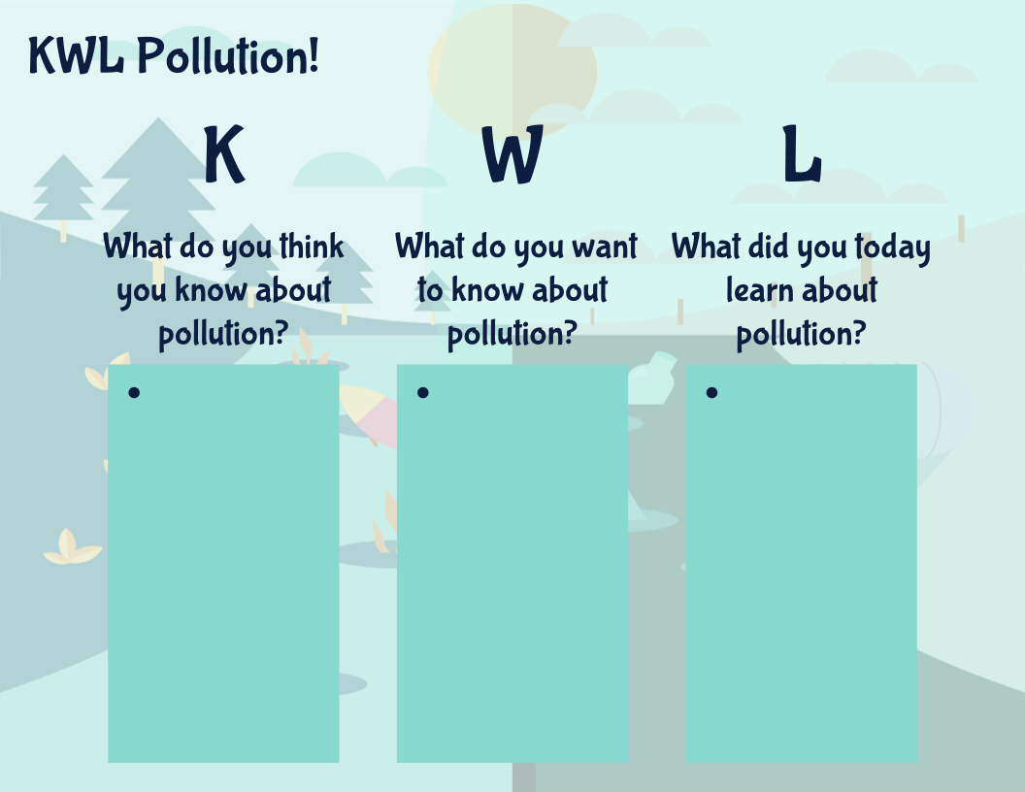
Apply your learning:
What is the worst pollutant? Use your top 3 criteria
Why is it bad if all the air/water is polluted?
How can you help?
Go Back in fill in the L section. What have you learned about pollution

Slide 32
04
Drinking Water
Is clean drinking water fair for everyone in the world?
Notes:
Teacher Notes:
Ask the students this question to begin the conversation. Students might have many ideas about the drinking water. Take 5 minutes to discuss their ideas.
Additional Resources for this section:
Why do we need water video: https://www.youtube.com/watch?v=31F0laJjyy8
Article Drinking Water: https://kids.niehs.nih.gov/topics/pollution/water/tips/index.htm
Article Water Treatment: https://kids.niehs.nih.gov/topics/pollution/water/treatment/index.htm
Website Right to Water: https://www.humanium.org/en/world/right-to-water/
Water Problem Video Links: https://www.koshland-science-museum.org/water/new/en/Overview/index.html
https://www.youtube.com/watch?v=dpO764iAFlI&feature=emb_logo
Manitoba Islands Reserve clean water: https://www.winnipegfreepress.com/no-running-water/?section=how#printedition

Slide 33
Clean drinking water, around the world, is fair for everyone!
NOT FAIR
FAIR
I think clean drinking water for everyone around the whole world is fair/not fair because…
Notes:
Teacher Notes:
Have each student answer this question on their own.
Remind students to use sound reasoning and refer to the Sound Reasoning Penguin Poster. (You may duplicate it (Select > ctrl D) and move here to remind students.
Inform students that they will return to this question and review/revise after they learn more about it.

Slide 34
Remember those glass of water from the beginning?
Do you think everyone in the world gets to drink from the clean water glass?
What would happen if some of us had to drink from this glass everyday?
Image adapted from: https://www.flickr.com/photos/aquamech-utah/25045792466
Notes:
Teacher Notes:
Have a class discussion around these two questions.
Make a note of the students answers and replies.

Slide 35
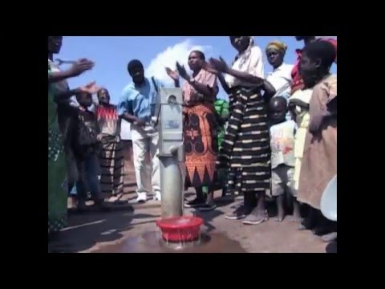
Water Around the World:
Watch this video:
Answer the questions on the next slide:

Slide 36
Notes:
Teacher Notes:
Text boxes have been added to this slide so students can type in their answers.
To edit the slide or see the answer key see last slide here

Slide 37
1 in 6 children in the world do NOT get clean safe drinking water.
Image adapted from: https://www.flickr.com/photos/aquamech-utah/25045792466
Notes:
Teacher Notes:
Put students names in the boxes and demonstrate that for every 6 students in the class 1 would not get to drink the nice clean glass.

Slide 38
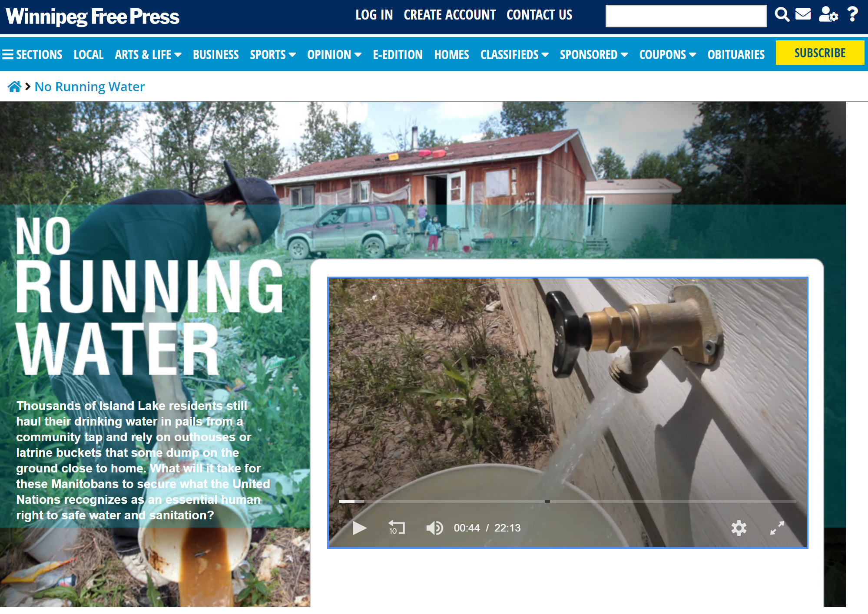
Is clean water fair for everyone in Manitoba?
Winnipeg Free Press Article:
https://www.winnipegfreepress.com/no-running-water/?section=how#printedition
Check out the map in this article.
How close are these communities to your community?
Do you think this could happen to you?
Notes:
Teacher Notes:
There is some great mapping opportunity here - see/enlarge the map on the article and pinpoint your location with students to see how close this community is.
Discuss with students how even in Manitoba, Canada where clean water and water filtration is taken for granted there are still communities without fresh, safe, clean drinking water.
Ask the students if this could happen to them, and how would they feel?
Ask the students why this is a concern?

Slide 39
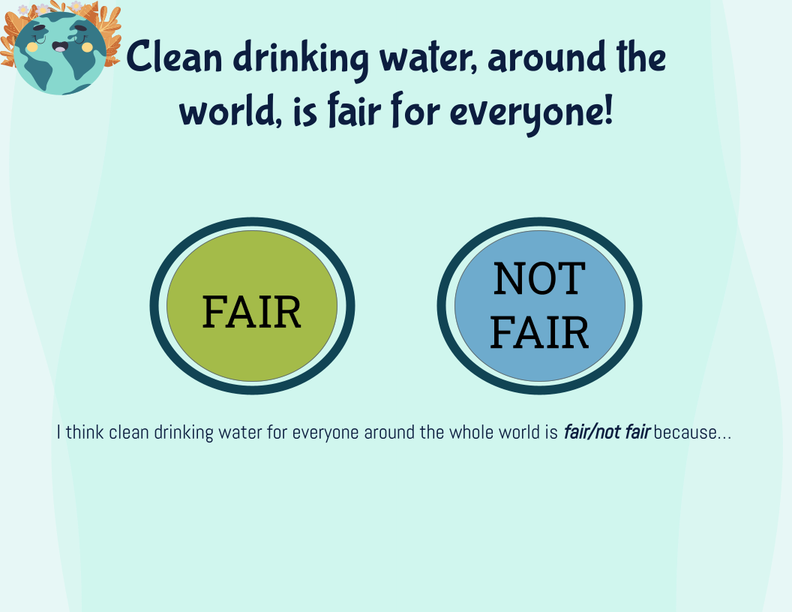
Apply your learning:
Review your Thinking:
Go back to this slide →
Has your thinking changed?
Complete the prompts below:
I think drinking water is fair /not fair for everyone in the world because…
My thinking has changed / not changed because now I know…
The consequences of unsafe drinking water are:
Notes:
Teacher Notes:
Ask students to review the information they just learned and ask them, to review and/or revise their initial thinking.
Ask the students why they chose to revise their thinking (reason) and ask other students why they chose to stick with their original thinking (justify)

Slide 40
05
Final Challenge

Slide 41
FINAL CHALLENGE: Planning
How would you clean the water in glass B so that you could drink it?
Add to your ideas:
B
My ideas:
Image adapted from: https://www.flickr.com/photos/aquamech-utah/25045792466
Notes:
Teacher Notes:
Ask students to return to this slide/sheet number 3 (HERE) and add any ideas they can think of from the different things they have learned in the lesson
Remind students of the water cycle and the different treatments people in other countries need to get fresh water.
Ask the students what could they do to help everyone get clean water?

Slide 42
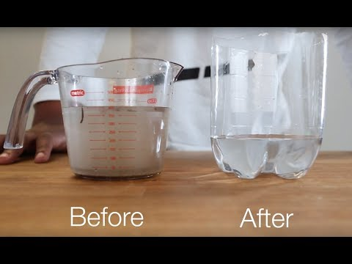
Final Challenge: Research
Watch these videos and add their ideas to your ideas on the previous slide.
Create your own filtration system. You can use your own ideas or you can use the ideas from the videos.
Be sure to follow the steps on the next few slides:

Slide 43
List the materials you will need:
Describe your plan (step-by-step)
Step 1:
Step 2:
Step 3:
Step 4:
Notes:
Teacher Notes:
Ask students to make a plan for their filtration system
List materials they think they will need
Describe the steps to create the filtration system in steps.

Slide 44
Create & draw your filtration design
Observe (video record your filtration working) and record what’s happening:
Hour 1:
Hour 2:
Hour 3:
Notes:
Teacher Notes:
Ask students to build their filtration system by following their steps and then draw their design on a separate sheet of paper and take a picture of it to include in this slide
Perform the task of filtering a dirty glass or water and ask students to record their findings. They can video record their filtration system working and then describe what they are seeing using sentences.

Slide 45
Conclusion: Would you drink your water? Why or why not?
Could your idea work to help others around the world get clean, safe drinking water?
Why is it important to keep water clean?
(Are you drinking the same water as the first people on Earth?)
Notes:
Teacher Notes:
Ask students to answer these questions once they have completed their task.

Slide 46
Guide to Success: Drinking Water
Reflection tool for students
Learning Challenge Checklist (What do I need to do?) | Self Reflection (What did I do well? What could I improve on?) | Excellence Criteria (What do I need to do to do it well?)
Ideas List of materials Step-by-step plan Drawing Observation video & notes Conclusion questions answered. | Affirm - What went well? What did I learn about? What did I do well? Revise - What was hard about this project? What changes could I make? Aspire - Where would I like to go next? What would I like to learn more about? | I used my own ideas and ideas from the video to make a filtration system I created a clear plan and followed it to make a filtration system. My drawing is clear, labeled neatly and easy to understand. My observations are described fully and make sense for what I could see in the video. Conclusion is appropriate and demonstrates a clear understanding of the importance of taking care of water.
Teacher Guidance (What is went well? What might need to be changed?)
Affirm - What did the student do well? (excellence criteria) Revise - What changes could be considered?
Notes:
Teacher Notes:
Ask the students to review the work they are about to submit.
Ask them to check to make sure they have included everything in their checklist.
Review criteria for excellence with the students and ask them to fill out the self reflection section on the work they have completed.
Ask the students what did they feel went well during this section, what did they learn and what did they do well?
Ask the students what they feel was the most challenging in this section and what changes they feel they could make?
Ask the students where they would like to go next in their learning, what next steps would help them reach their learning goal and complete the challenge?
Once you have received their work for this section affirm and revise the work and conference with the students to compare their self reflection with the teacher's guidance/feedback.

Slide 47
Success!!
Please make sure your teacher has all your work!
Well Done!
Notes:
Teacher Notes:
This slide must be kept in as it gives credit to the creators of the template

Slide 48
Science Outcomes:
2-4-06 Observe and identify examples of water in the
environment.
Examples: dew, frost, snow, rain, lakes, puddles,
clouds, fog, perspiration… Section 01 - Slides 11 & 12
2-4-07 Describe evidence of water changing state, and
recognize that these changes are part of the
water cycle.
Examples: puddles evaporating after a
rainstorm, snow melting… Section 02 - Slides 21-23
2-4-11 Explain and appreciate the importance of clean
air and water for humans, plants, and animals. Section 03 & 04 - Slide 45 Conclusion
2-4-12 Identify substances that pollute air and water,
and describe ways of reducing such pollution.
Examples: car exhaust, smoke, carbon monoxide,
oil, house paints, and sewage… Section 03 - Slides 29 & 31
2-4-13 Recognize that clean water is an increasingly
scarce resource in many parts of the world, and
describe consequences of a shortage of clean
Water. Section 04 - Slide 39
Review Documents for Reporting Purposes:
Manitoba Report Card Grade Scale—Science Achievement Profiles (Grades 1 to 8) Subject Category: Knowledge and Understanding
Manitoba Report Card Grade Scale—Science Achievement Profiles (Grades 1 to 8) Subject Category: Design Process and Problem Sol
Notes:
Teacher Notes:
The slides mentioned for each outcome are great places to formatively or summatively assess these outcomes.
The apply your learning sections of the learning experience should demonstrate the students ability to achieve the above outcomes.
Slide 46 is an important assessment piece as the student can see where they are in their own learning and reflect on the the learning experience before receiving feedback for the teacher.
Slide 46 (student reflection) could serve as a great conference template for each section of the learning experience as well. To use at the end of each section duplicate the slide and modify the questions and the excellence criteria to match the sections learning targets.

Slide 49
EDITABLE / ANSWER KEY
Fill in the blanks
Use the wordbox to help you
Word Box
Questions:
1.1 BILLION people live without access to safe drinking water.
Most of the Earth’s water is too SALTY to drink.
Some parts of the world get plenty of water while other parts receive LITTLE or NONE.
Water has some natural contaminants that make it unsafe. But other things that make it unsafe is waste caused by HUMANS, ANIMALS, AGRICULTURE, and INDUSTRY.
MILLIONS of women and girls spend hours each day collecting water.
Contaminated water can be PURIFIED using treatments.
1.1 billion
Agriculture
Animals
Humans
Industry
Little
Millions
None
Purified
Salty
Notes:
Teacher Notes:
The slide with these questions has the questions as a background image.
To edit the questions you need to use this slide and insert the blanks on your own. Then replace your slide with the one above.

