Slide 1
Come Back, New York, All is Forgiven: Using Images In The Creation of Detailed Descriptions

Slide 2
Activate Prior Learning: What is New York City like?
What do you know about New York City?
What do you think it would be like to live there?
Do you know any famous landmarks or features of the city?
Notes:
After you’ve gathered some ideas from the class - perhaps on a collaborative whiteboard or jamboard, show the next slides to generate even more ideas.

Slide 3
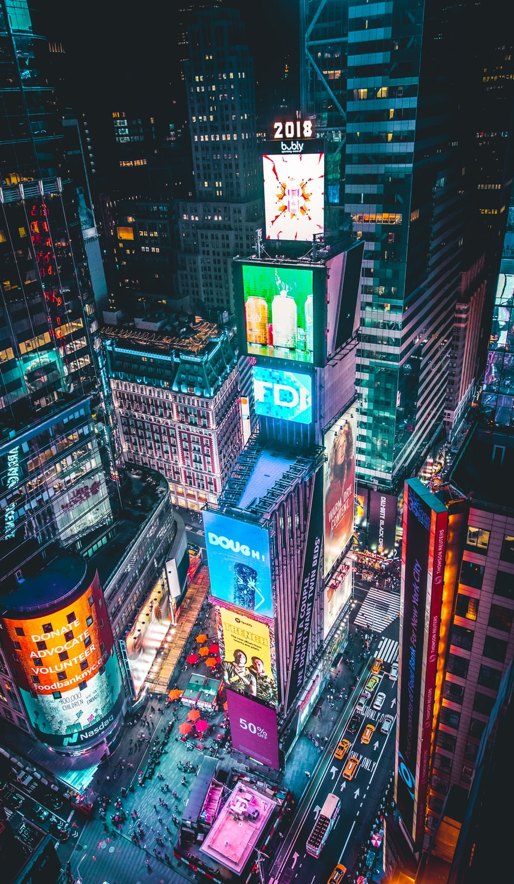
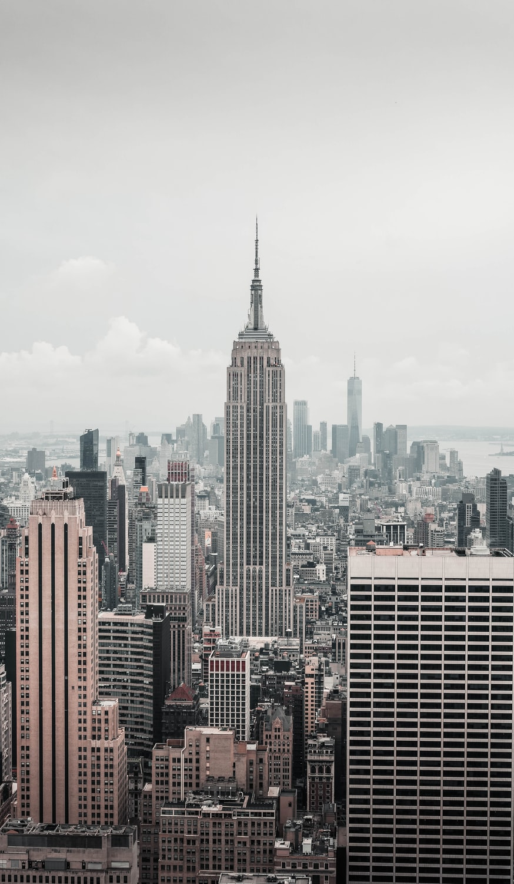
Photo by Andre Benz on Unsplash
Photo by Luca Bravo on Unsplash
Photo by Luca Bravo on Unsplash

Slide 4
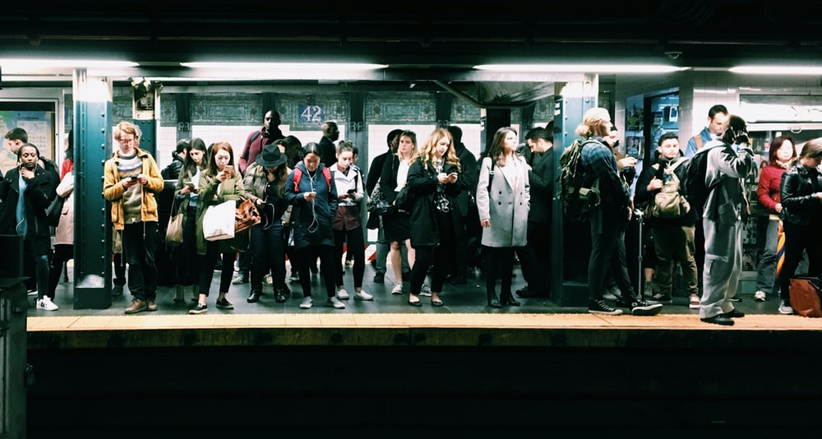
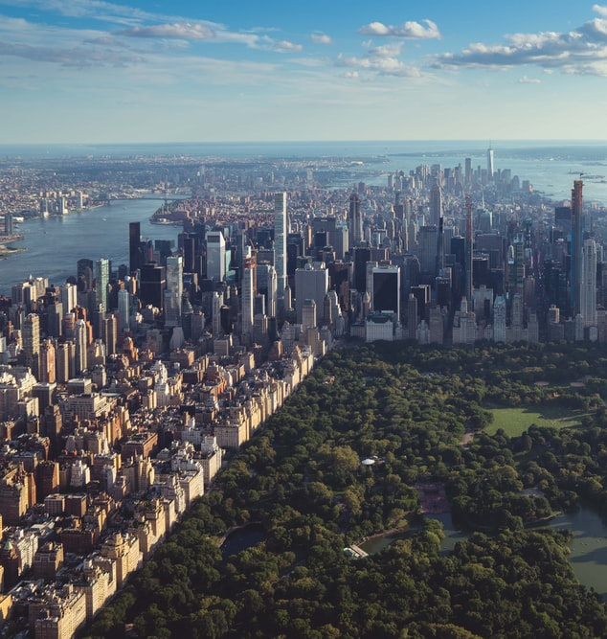
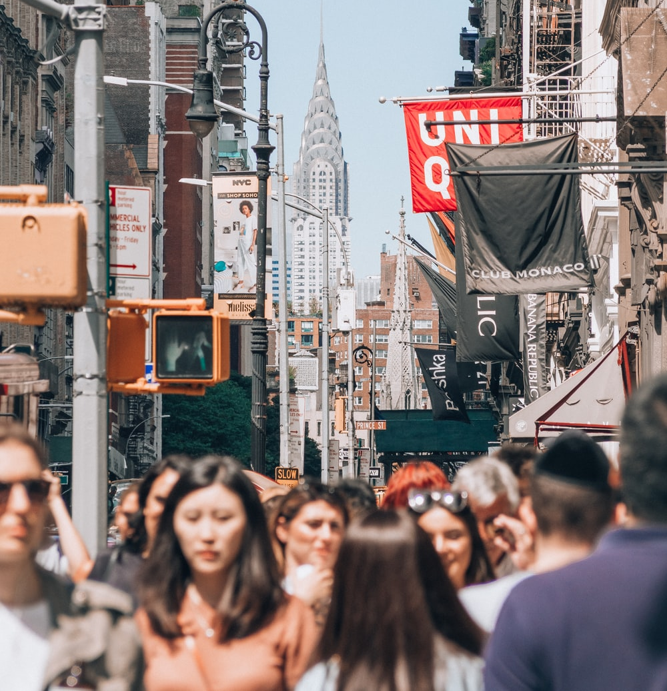
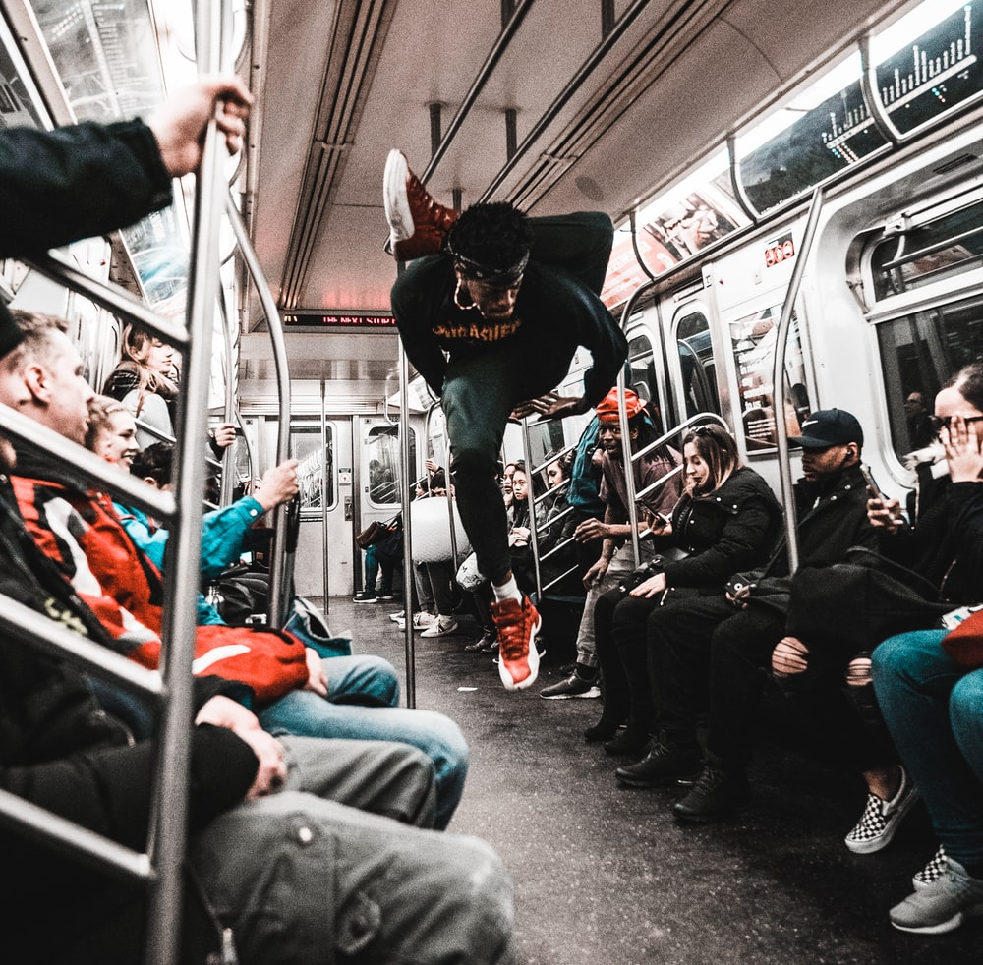
Photo by Eddi Aguirre on Unsplash
Photo by Yoav Aziz on Unsplash
Photo by Josh Gordon on Unsplash
Photo by Jermaine Ee on Unsplash
Notes:
Some ideas:
Over 18 million people
Crowded, a lot of apartment buildings and huge skyscrapers, subway trains, taxis, stereotypes of rude people, rats, pigeons,

Slide 5
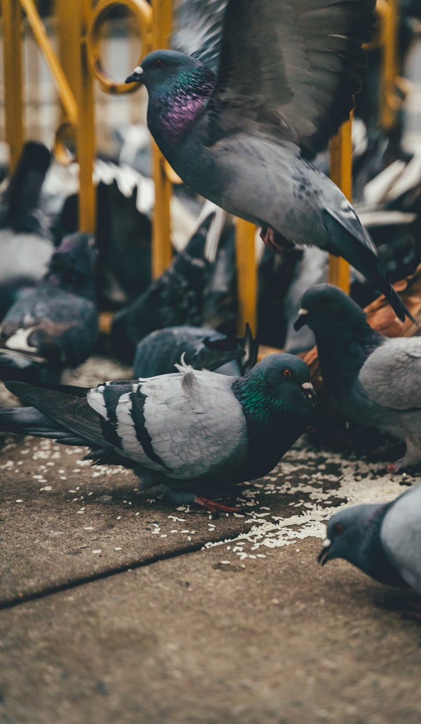
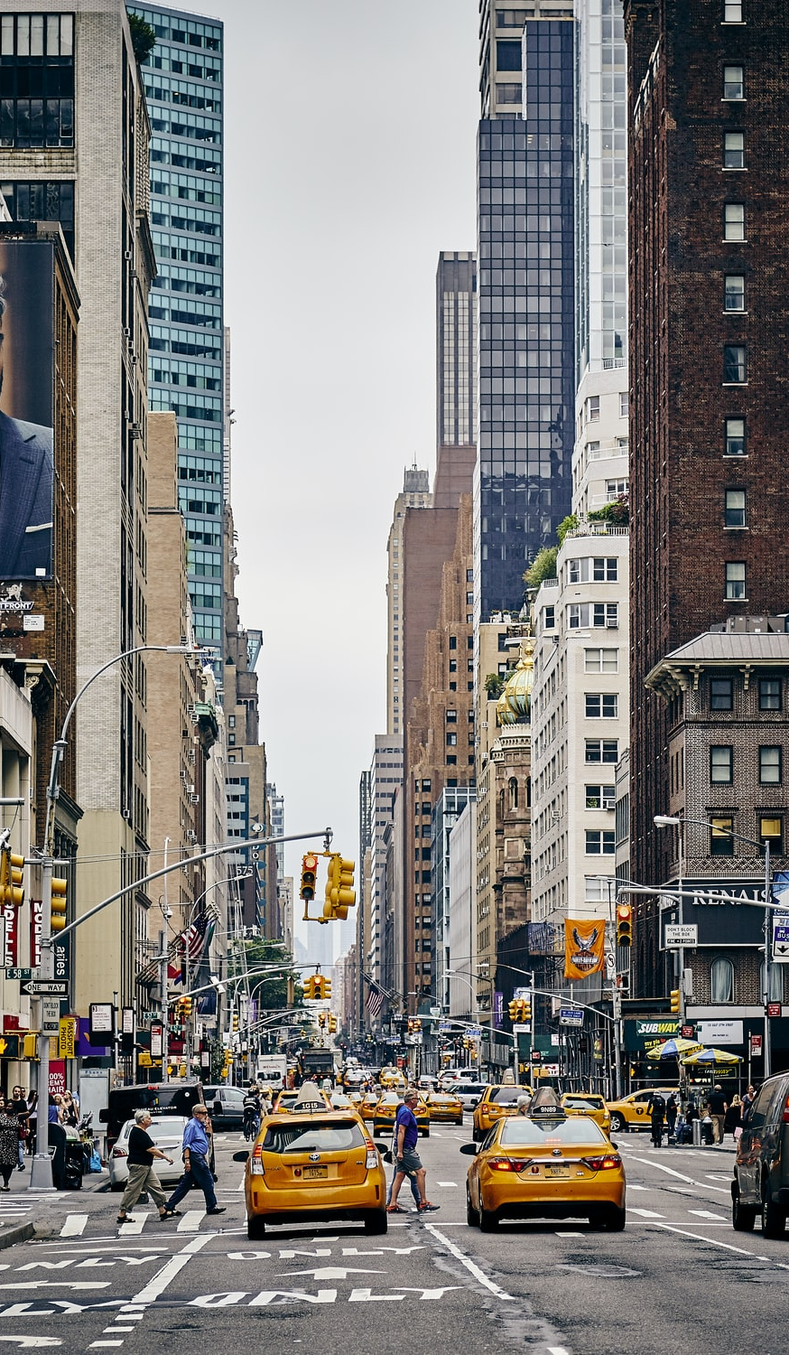
Photo by Nic Y-C on Unsplash
Photo by Alina Grubnyak on Unsplash
Photo by Fabien Bazanegue on Unsplash

Slide 6
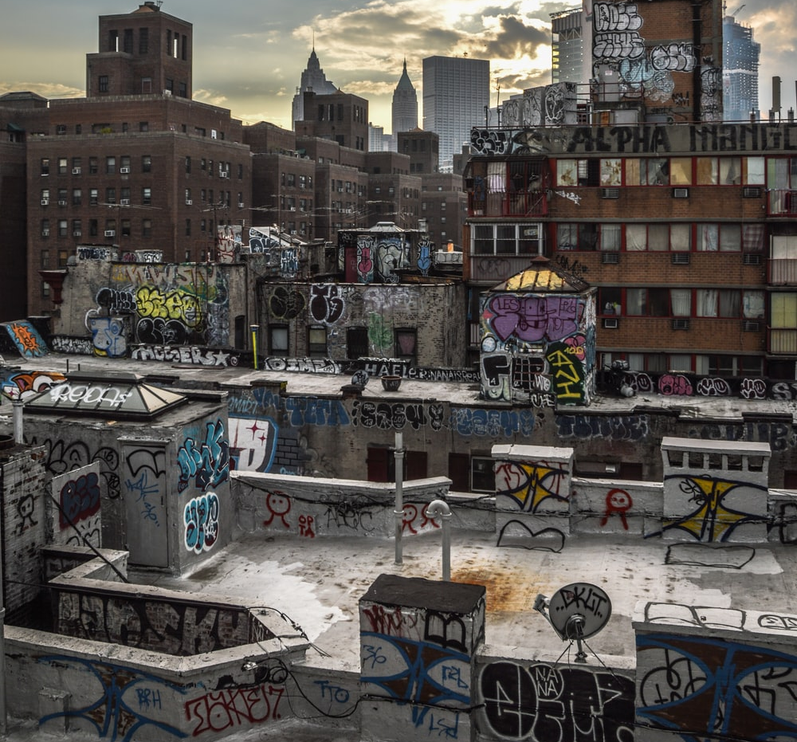
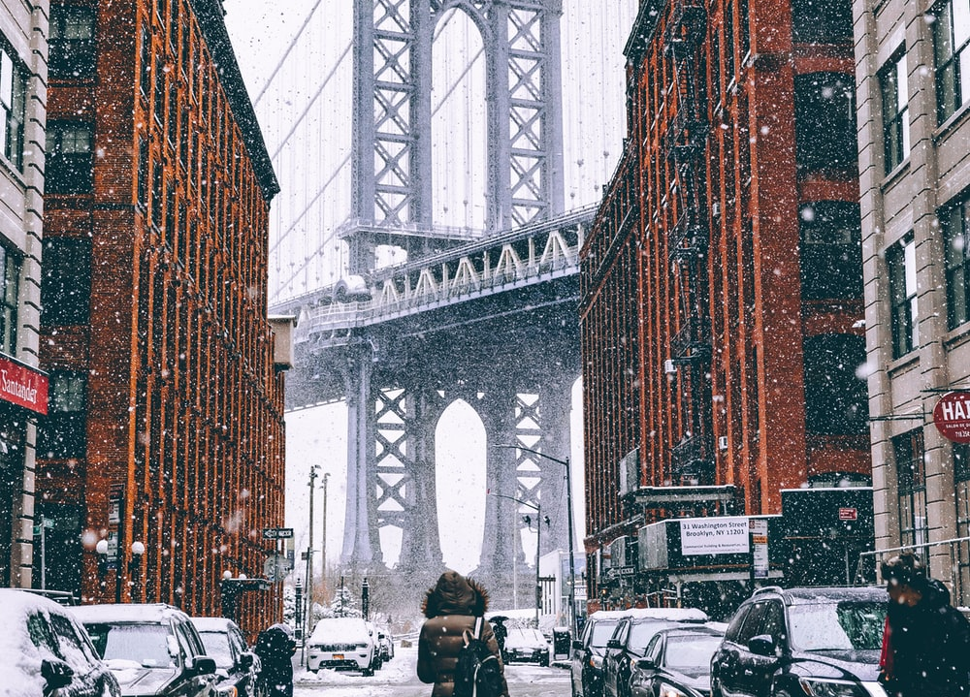
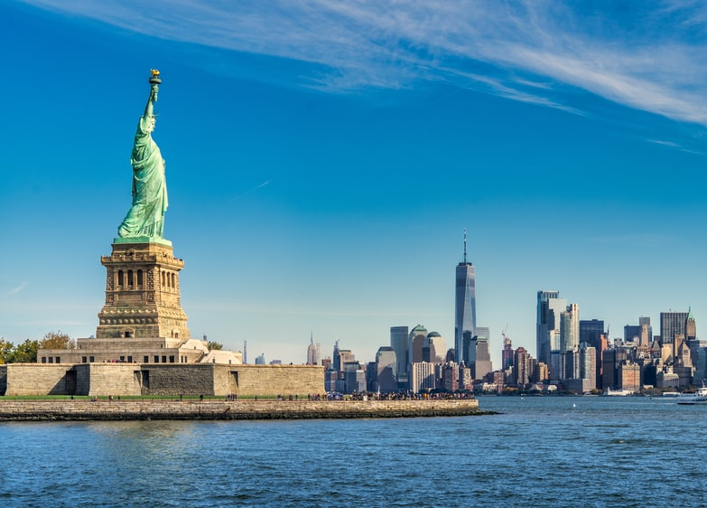
Photo by Andre Benz on Unsplash
Photo by Olivier de Sadeleer on Unsplash
Photo by Priyanka Puvvada on Unsplash

Slide 7
Activate Prior Learning: What is New York City like?
Now that we’ve looked at these images, should we add anything to our list?
Notes:
Allow time for students to add to the list.

Slide 8
“Come Back, New York, All is Forgiven” By Roger Cohen Opinion Columnist New York Times ­­April 10, 2020
Notes:
1. Introduce model text “Come Back, New York, All is Forgiven” and begin to analyze as a class.
When was this written?
Why is this significant? (direct links to how the lockdown is affecting the author’s experience in the city)
What does this tell us about the author? (he is not originally from NYC)
2. Send a copy to students to mark up on their own during asynchronous time.

Slide 9
Come Back, New York, All Is Forgiven By Roger Cohen March 2020
I forgive you, New York. I forgive you your snarl, your aggression, your hustle and hassle. I forgive you LaGuardia and your summer stench of uncollected garbage. I forgive you no cabs in the rain. I forgive you the crusty, deceptive puddles of slush at curbside. I even forgive you the Mets and no place to park and delivery trucks in the bike lane.
All is forgiven if you will only return: the subway soliloquies of the homeless, the trains that never come, the trains that stop in the middle of the tunnel, the traffic, the garbage trucks blocking cross streets, the jackhammering of construction, the hiss of smoke from a manhole cover, the idling stretch-limo S.U.V.s, the drone of a million air-conditioning units, the drivers leaning on horns, the city hum that never ceases, until it did…
I forgive you the rats — yes, even the rats — and I’ll throw in the roaches. The swelter of August, forgiven. The icy winter winds off the Hudson and the East River, forgiven. The impossibility of getting across town, forgiven. I forgive you the crowds, the craziness, the cruelty, the cursing, the complaining customers...
I forgive you for driving me crazy at times, for making me want to scream, “Get me out of here!” I forgive you everything without exception if you will only promise to reappear.

Slide 10
Come Back, New York, All Is Forgiven, cont.
Please, do not be proud. I know, we cursed you with irresponsible abandon. Forgive us, as I forgive you. We did not imagine the silence that could fall, the sirens that would fill the night, the sick and the dying, the doctors laboring on the 10th circle of the inferno, the ghostliness of shuttered stores, the empty skies, the canceled events, the post-apocalypse latex gloves scattered here and there. We took you too much for granted. Yes, forgive us for not giving daily praise for the miracle of New York.
I know I did not thank you enough for those clear winter mornings, for that dive I love on West 26th, for your tolerance, for your open arms, for the sun glinting on the Empire State Building, for your ampleness, for New York Noodletown, for your secrets slowly revealed, for your endlessness, for your boldness... for your wit, for Coney Island, for the water towers, for the Staten Island Ferry being free... and seeing you and thinking this is home, for taking me in as no other city ever could.
Being a New Yorker, I was in a hurry. I was forgetful. You get that. Please forgive me. Please forgive us all. I’ll throw in the pigeons. Forgive you for every one of those awful birds. Just come back, just return, please. I know we can make a deal.

Slide 11
Analysis: Come Back, New York, All is Forgiven
What are some examples of imagery Cohen uses?
What else did you notice about this piece?
How does Cohen feel about New York City? How do you know?
Is it possible to be confused?
Have you ever felt this way about a place?
Notes:
1. Begin by discussing student analysis of the poem that they worked on during asynchronous time.
2. Use the questions above to guide a discussion.
Discuss: How does the author really feel about New York? Is it possible to be confused when reading this poem?
3. Be sure that the students see the major shift in tone beginning with the paragraph “I know I did not thank you enough” – where he suddenly starts listing things he loves about New York instead of the things he hates about New York.

Slide 12
“ONE Great city!” The WeakerThans, Reconstruction site, 2003
Notes:
Introduce another model text – “One Great City!” by the Weakerthans, a band from Winnipeg, Manitoba.
You can read the lyrics as a class or have the students analyze them individually.

Slide 13
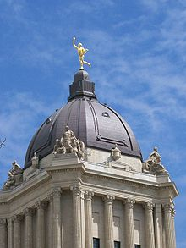
One Great City!
Late afternoon another day is nearly done A darker grey is breaking through a lighter one A thousand sharpened elbows in the underground That hollow hurried sound of feet on polished floor And in the dollar store the clerk is closing up And counting loonies trying not to say I hate Winnipeg
The driver checks the mirror seven minutes late The crowded riders' restlessness enunciates The Guess Who suck, the Jets were lousy anyway The same mood every day And in the turning lane Someone's stalled again He's talking to himself And hears the price of gas repeat his phrase I hate Winnipeg
Up above us all, Leaning into sky Our golden business boy Will watch the north end die And sing 'I love this town' Then let his arching wrecking ball proclaim: "I...hate...Winnipeg"
This Photo by Unknown Author is licensed under CC BY-SA
Notes:
Optional: Show another example of an author presenting contradictory ideas about a city by reading the lyrics to “One Great City!” by the Weakerthans. Begin to analyze as a class.
https://www.anti.com/releases/reconstruction-site/tracks/one-great-city/
How does the mood and voice change between the first and third stanzas?
How does the lyricist really feel about Winnipeg?
How does the speaker feel about “the North End” being destroyed? Who/What does “the North End” symbolize?
Can the students recognize any other Winnipeg-specific references? (The “golden business boy” is referring to the Golden Boy on top of Manitoba’s Parliament: https://www.gov.mb.ca/finance/legtour/golden.html) / “The North End” / “The Guess Who”
When was this written? (2003 – Jets weren’t back yet, important to know).

Slide 14
Notes:
Listen to a performance of “One Great City!” https://www.youtube.com/watch?v=xLlsjEP7L-k
Discuss: Does it change your understanding of the meaning of the song? How?
What does this song have in common with “Come Back, New York, All is Forgiven?” (repetition, complex feelings about a city etc.)
How would the singer feel performing it in Winnipeg? Another city?
This article below has a lot of background information that may be helpful to the teacher:
https://canlitguides.ca/bronwyn-malloy/listening-to-canada-the-weakerthans-one-great-city/

Slide 15
Analysis: One Great City!
What are some examples of imagery in this song?
How does the speaker feel about Winnipeg? How do you know?
Is it possible to be confused?
How does this relate to Come Back, New York, All is Forgiven?
Notes:
Also point out the title – ‘One Great City!” and official motto of Winnipeg but also ironic considering how many of the characters feel and how “the North End” is being treated.
Both show the complex relationships people can have with a place.

Slide 16
Now it’s your turn!

Slide 17
Poetry Activity: Creating an Imagery-Rich Poem about a Place
Brainstorm what place you will write about. It could be your school, your neighbourhood, your city, or even an imagined place – perhaps a place from a novel you have read. Just be sure it is place you know well so you can use your knowledge of it to create imagery to make your writing come to life.
Now, imagine that you are separated from this place for whatever reason. The model text was about the Coronavirus, but yours does not have to be.
Then, think of all the specific things that bother you about that place and list them. Remember to use adjectives to describe the features of your city.
Next, think of all the specific things that you love about that place. Are there specific times that this place is better? What specifically makes it better?

Slide 18
Poetry Activity: Creating an Imagery-Rich Poem about a Place
Finally, use the model text to create the structure of your poem. Consider these sentence starters:
I forgive you the ___,____, ____and ___ (all negative things)
I did not imagine the ____, ____, and ____ (things that were even worse)
I know I did not thank you enough for the ___, ___, ___ (all positive things).
I forgive you for every one of those ______ (negative thing), just please come back.

Slide 19
Sources
The model text has been altered from a New York Times Opinion Piece by Roger Cohen: https://www.nytimes.com/2020/04/10/opinion/coronavirus-new-york.html
All images of New York City are from Unsplash.com (under a “freely-useable image license”) and individual photographers are listed in the AltText of each image.
The image of “Roof of Manitoba Legislative Building” was taken by Zef and released to the Public Domand: https://commons.wikimedia.org/wiki/File:GoldenBoyWinnipeg.JPG
Slide 13: Lyrics to “One Great City!” by The Weakerthans https://www.anti.com/releases/reconstruction-site/tracks/one-great-city/
Slide 14: “One Great City!” by The Weakerthans https://www.youtube.com/watch?v=xLlsjEP7L-k
The Assessment Rubric was adapted from The Write Genre by Lori Jamison Rog and Paul Kropp and from the PSDC Literacy Coach Team JUNE 2020 by way of Jennifer Stark

