Slide 1

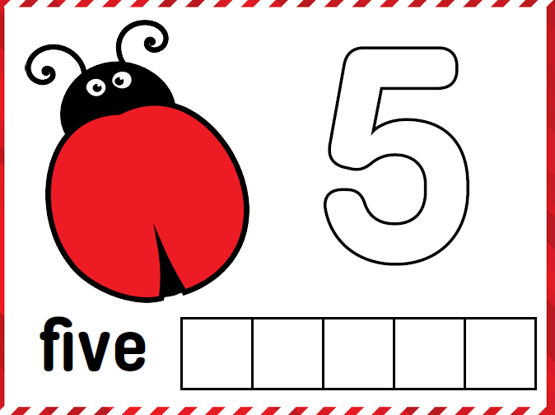



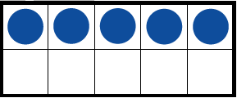
Exploring the Number 5

Slide 2

Teacher Instructions
This collection of learning experiences is designed around the concept of number and the development of number ideas for numbers up to 10, specifically the number five. Students come to schools with many ideas about number but it takes many learning experiences and time to develop a full understanding of a sense of number. The learning experiences represented in the PowerPoint consist of daily sessions that can take place over two weeks. The 30 to 45 minutes sessions are a combination of synchronous and asynchronous parts that can be adapted depending on your situation and access to technology and connectivity.
*FOR SYNCHRONOUS LEARNING, THE SLIDEDECK MUST BE IN EDIT MODE (not present mode)*
Slides with green borders are teacher instructions, slides with red borders are student presentation slides. Slides with both green and red borders are slides that usually show an example. The decision to show or not to show the slide is the decision of the teacher.
Turn the PowerPoint to present mode to show the story books.
For each day, the lesson is presented in three parts:
Opening Routine - Number talk to get students thinking and sharing ideas
Work it out – These are learning experiences for each lesson. Lessons can be done with the whole class, small groups or individuals.
Debrief and Consolidation - Learning experiences that involve reflections, assessments, further consolidation or extensions.
Notes:
1. Opening Routine – number talk to get students thinking and sharing ideas
2. Work it out - These are learning experiences for each lesson. Lessons can be done with the whole class, small groups or individuals Depending on the set up available, you can put students into breakout rooms to work on the lessons together.
3. Debrief and Consolidation– Learning experiences that involve reflections, assessments, further consolidation or extensions.

Slide 3
Teacher Background Information
Having good number sense involves an understanding of the many relationships that exist among numbers. It is important to emphasize number relationships in order to use numbers in meaningful ways. When students learn to represent numbers in various ways and investigate how numbers are interconnected, they build their knowledge of how numbers relate to each other. In the book, Teaching Student Centered Mathematics PreK-2 (2018), John Van de Walle’s outlines four important number relationships that help students develop number sense and working with operations.
One and Two More/Less – Knowing which numbers are one and two less or more than any given number. The one/two more or less than relationship involves more than just the ability to count. Students must also associate quantity with the count. For example, being able to communicate to say 6 is one more than 5 and 2 less than 8.
Anchors and Benchmarks of Five and Ten – The ability to relate numbers to both 5 and 10 is useful for comparing and relating numbers. A benchmark number serves as a reference to which something else (e.g., another number) may be compared (e.g., In the question, “Is the number 4 closer to the number 1 or to the number 5?“ the numbers 1 and 5 are benchmarks.).
Part-Part-Whole Relationships – Part-part-whole is being able to recognize numbers can be broken apart and then put together. Understanding numbers can be represented in many ways supports students understanding of part-part-whole relationships. Addition and subtraction are built on composition (putting numbers together) and decomposition (breaking up numbers).
Spatial Relationships (Subitizing) – Subitizing is being able to recognize sets of objects in patterned arrangements and tell how many without counting. There are two types of subitizing.
    Perceptual subitizing is the ability to recognize the quantity of a set without counting. It is the basis for counting and cardinality.
    Conceptual subitizing is seeing number patterns within a set (part—whole) and then determining the quantity by putting the number patterns together.
These four relationships will be used to understand the importance of the number five. Highlighting these number relationships is crucial to supporting students’ development of number sense. The following lessons focus on developing and strengthening these number relationships.

Slide 4
Curricular Outcomes
K.N.1. Say the number sequence by 1s, starting anywhere from 1 to 30 and from 10 to 1.
Subitize and name familiar arrangements of 1 to 6 dots (or objects).
K.N.3. Relate a numeral, 1 to 10, to its respective quantity.
K.N.4. Represent and describe numbers 2 to 10 in two parts, concretely and pictorially.
K.N.5. Demonstrate an understanding of counting to 10 by indicating that the last number said identifies “how many” showing that any set has only one count.
K.N.6. Compare quantities, 1 to 10, using one-to-one correspondence by ordering numbers representing different quantities

Slide 5
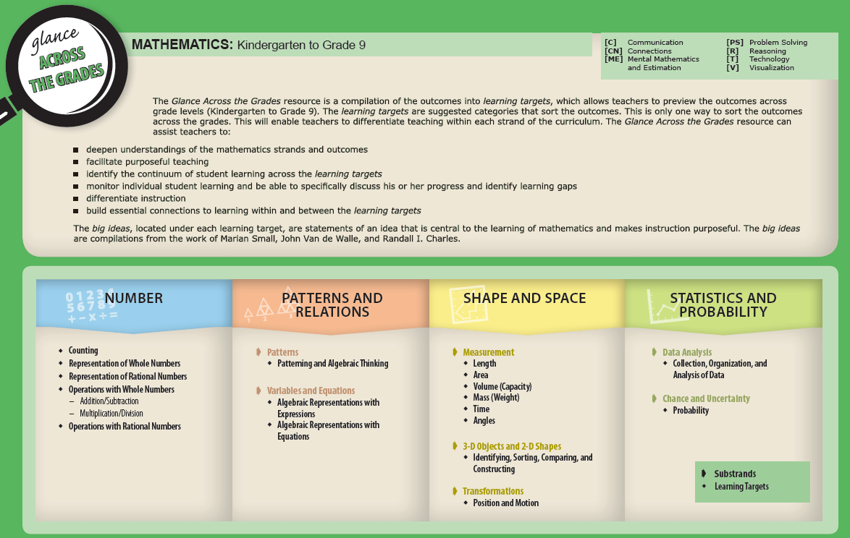
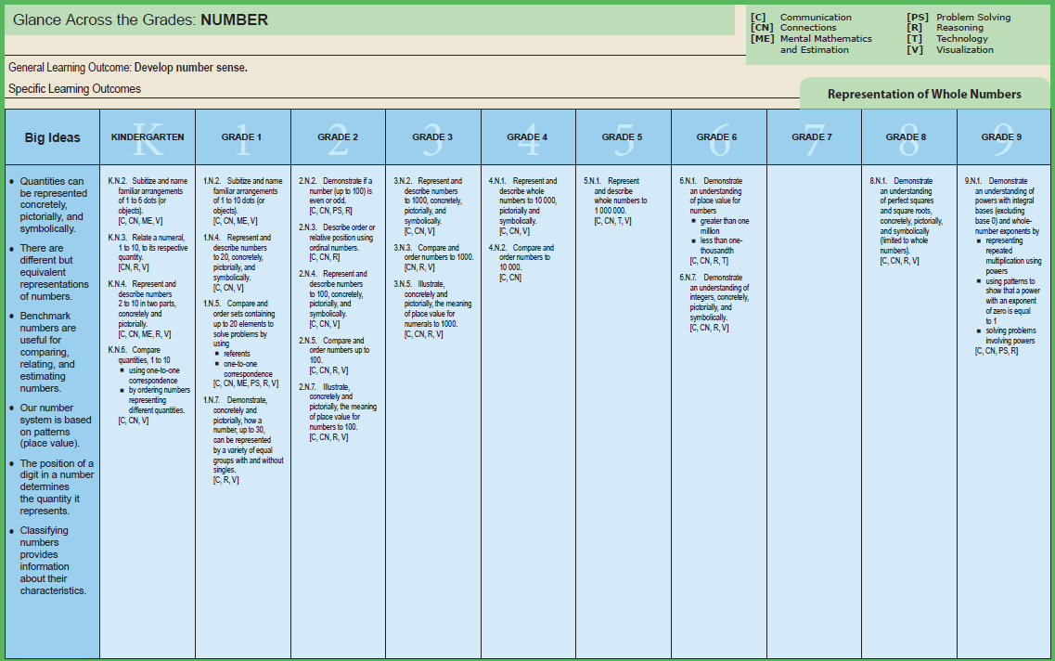
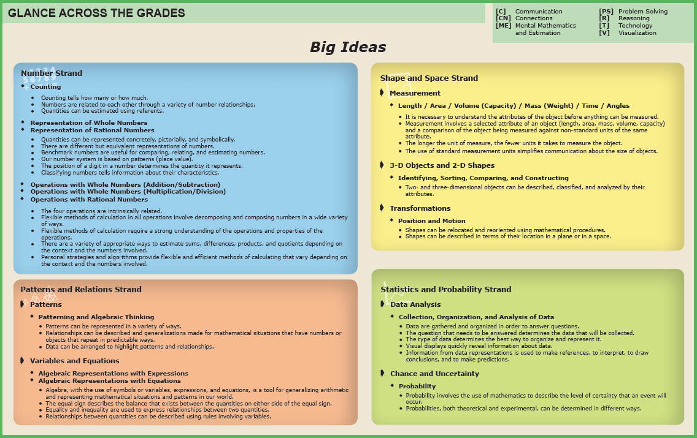
Big Ideas
The Glance Across the Grades document is a learning progression based on the Manitoba math curriculum. Teachers can gain information about their students’ progress in math using the document, which in turn, can support differentiating instruction and support learning.
Viewing learning outcomes as connections of big ideas allows students to think about the big picture of mathematics and its applications. Big ideas make connections between specific learning outcomes and mathematical concepts and provide purpose, focus, and meaning for teaching and learning the curriculum. Glance Across the Grades provides descriptions of big ideas within strands that can lead to making mathematics instruction more purposeful. Framing big ideas within mathematical content and learning experiences allows students to make essential connections between mathematical concepts and procedures.
Glance Across the Grades

Slide 6
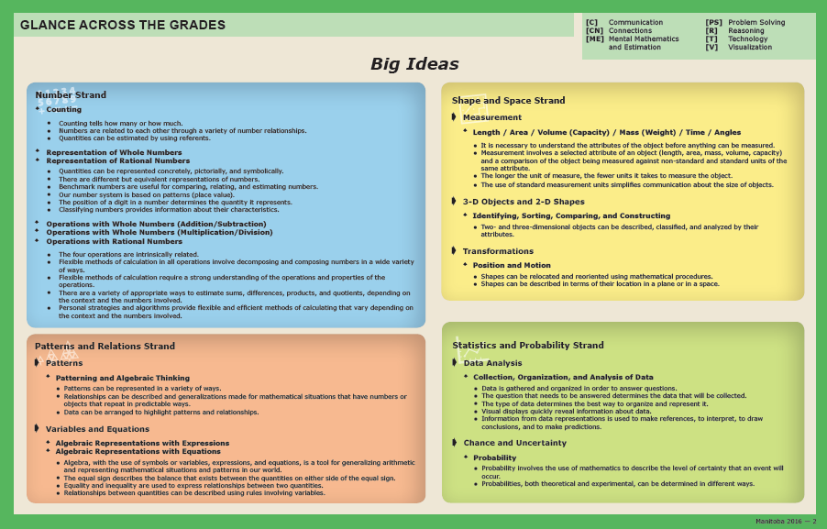
Big Ideas Within the Learning Experiences
Counting tells how many and how much.
Numbers are related to each other through a variety of number relationships.
Quantities can be represented concretely, pictorially, and symbolically.
There are different but equivalent representations of numbers.
Benchmark numbers are useful for comparing, relating, and estimating numbers.

Slide 7
Background Information
As students develop explore number and represent numbers in multiple ways, they develop flexible thinking about numbers. Focusing on number relationships with students will help them learn how numbers are interconnected and how numbers can be used in meaningful ways. As students work with numbers 1 to 10, they build on three number relationships that help the make meaning of numbers and operations.
One and two more, one and two less
Benchmarks of 5 and 10
Part-part-whole relationships
Students need many experiences using and constructing the number five because it is a pivotal number in our base-ten system. Students who are able to compose and decompose the number five will be able to have more flexibility in mental mathematics and estimation.

Slide 8
Materials
The PowerPoint, project instructions and rubric.
It is highly recommended that if this is the first-time students are experiencing virtual learning, allow them time to "play". This allows for the opportunity to explore and have fun with the tools BEFORE they will be required to use them purposefully.
Students will be virtually using tool on the PowerPoint. Hands-on materials are ideal. Significant learning occurs when students can build and visualize different representations of mathematics.
If School Divisions have another platform for delivering online instruction (ie See Saw, Google Classrooms), asynchronous tasks can be uploaded there.
Collection of counting items.
Deck of playing cards

Slide 9
Day 1
1
Opening Routine
2
Work it out!
3
Debrief and Consolidation
Sharing and Recording Thinking About Counting
Counting Collections
Five Frame Flash

Slide 10

1
Opening Routine
How Many?
Notes:
Five Frame Flash: Use a set of five frame cards. Briefly flash a five frame. Have students identify the number shown.
Ask students:
How many dots did you see?
How did you see them?
Subitizing is the ability to rapidly determine the quantity of a small group of objects without counting. Subitizing is a fundamental skill in a student’s development of number understanding.
There are two types of subitizing; perceptual and conceptual. Perceptual subitizing is the ability to recognize the quantity of a set without counting. It is the basis for counting and cardinality and the focus of the Kindergarten outcomes. Conceptual subitizing is seeing number patterns within a set (part—whole) and then determining the quantity by putting the number patterns together.

Slide 12

1
Opening Routine
How Many?
Notes:
Five Frame Flash: Use a set of five frame cards. Briefly flash a five frame. Have students identify the number shown.
Ask students:
How many dots did you see?
How did you see them?
Subitizing is the ability to rapidly determine the quantity of a small group of objects without counting. Subitizing is a fundamental skill in a student’s development of number understanding.
There are two types of subitizing; perceptual and conceptual. Perceptual subitizing is the ability to recognize the quantity of a set without counting. It is the basis for counting and cardinality and the focus of the Kindergarten outcomes. Conceptual subitizing is seeing number patterns within a set (part—whole) and then determining the quantity by putting the number patterns together.

Slide 14

1
Opening Routine
How Many?
Notes:
Five Frame Flash: Use a set of five frame cards. Briefly flash a five frame. Have students identify the number shown.
Ask students:
How many dots did you see?
How did you see them?
Subitizing is the ability to rapidly determine the quantity of a small group of objects without counting. Subitizing is a fundamental skill in a student’s development of number understanding.
There are two types of subitizing; perceptual and conceptual. Perceptual subitizing is the ability to recognize the quantity of a set without counting. It is the basis for counting and cardinality and the focus of the Kindergarten outcomes. Conceptual subitizing is seeing number patterns within a set (part—whole) and then determining the quantity by putting the number patterns together.

Slide 16

1
Opening Routine
How Many?
Notes:
Five Frame Flash: Use a set of five frame cards. Briefly flash a five frame. Have students identify the number shown.
Ask students:
How many dots did you see?
How did you see them?
Subitizing is the ability to rapidly determine the quantity of a small group of objects without counting. Subitizing is a fundamental skill in a student’s development of number understanding.
There are two types of subitizing; perceptual and conceptual. Perceptual subitizing is the ability to recognize the quantity of a set without counting. It is the basis for counting and cardinality and the focus of the Kindergarten outcomes. Conceptual subitizing is seeing number patterns within a set (part—whole) and then determining the quantity by putting the number patterns together.

Slide 18

1
Opening Routine
How Many?
Notes:
Five Frame Flash: Use a set of five frame cards. Briefly flash a five frame. Have students identify the number shown.
Ask students:
How many dots did you see?
How did you see them?
Subitizing is the ability to rapidly determine the quantity of a small group of objects without counting. Subitizing is a fundamental skill in a student’s development of number understanding.
There are two types of subitizing; perceptual and conceptual. Perceptual subitizing is the ability to recognize the quantity of a set without counting. It is the basis for counting and cardinality and the focus of the Kindergarten outcomes. Conceptual subitizing is seeing number patterns within a set (part—whole) and then determining the quantity by putting the number patterns together.

Slide 20
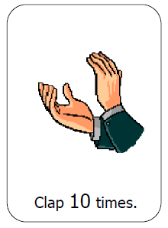
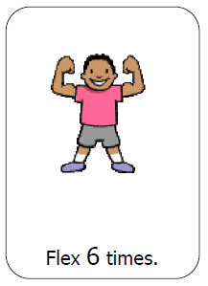
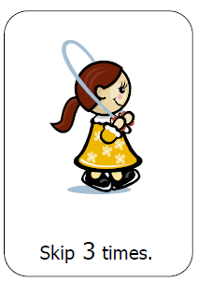
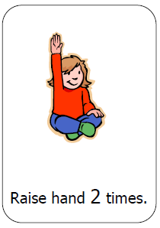
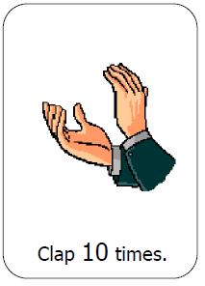
1
Opening Routine
Action Cards
Get ready to count and move!
Remember to count out loud and the correct times.
Notes:
Show the action cards one at time. The students perform the activity on the card that number of times. Have students count aloud as the actions are performed. This activating strategy can review counting principles such as:
Stable Order
One-to-one correspondence
Cardinality
For more information regarding the counting principles see the Grade 1 Math Support document (https://www.edu.gov.mb.ca/k12/cur/math/support_gr1/index.html). Also check out Kyle Pearce’s document, Principles of Counting and Quantity (https://tapintoteenminds.com/counting-principles/).
Action cards can be found in the Kindergarten Support Document BLMs (https://www.edu.gov.mb.ca/k12/cur/math/k_support/blms/index.html)

Slide 21





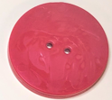


2
Work it out – Counting Collections
Today we will be learning to count collections in different ways.
Notes:
In Counting Collections, children are given a collection of objects to count. Children often begin by using early strategies like counting each item one-by-one and moving toward increasingly sophisticated and efficient strategies, like counting by tens. After they count, children are then asked to record how they counted. In an online environment, the learning experience can start with an online counting collecting.
Read through the problem and invite students to share their strategies. This could be done as a whole class done synchronously or in small groups.
Math concepts to review with students with this slide:
Practice counting the buttons starting at different buttons (order irrelevance).
Practice counting sequence (stable order).
Model one-to-one correspondence.

Slide 22
2
Work it out – Counting Collections
My grandma gave me some buttons to add to my collection. I would like to find out how many buttons there are.
Think about a way we can count this collection of buttons?
Notes:
In Counting Collections, children are given a collection of objects to count. Children often begin by using early strategies like counting each item one-by-one and moving toward increasingly sophisticated and efficient strategies, like counting by tens. After they count, children are then asked to record how they counted. In an online environment, the learning experience can start with an online counting collecting.
Read through the problem and invite students to share their strategies. This could be done as a whole class done synchronously or in small groups.
Math concepts to review with students with this slide:
Practice counting the buttons starting at different buttons (order irrelevance).
Practice counting sequence (stable order).
Model one-to-one correspondence.

Slide 23
2
Work it out – Counting Collections
How could we count the buttons?
What strategy could we use?
How can we record the way we counted?
Can we count the buttons in another way?
Notes:
The main focus of counting collections is to have the students take the lead and decide on a way to count them. They will come up with their own strategies, approaches and processes to count. Asking the open questions on the slide can find out what students are thinking. Students will suggest many ways.
Additional questions to ask:
How could we count the buttons?
What strategy could we use?
How can we record in the way we counted?
Can we count the buttons in another way?

Slide 24
2
Work it out – Counting Collections
Let’s record how we counted.
Notes:
Discuss in groups or whole class: How do I communicate my ideas in words, numbers, and drawings?
Discuss how the students recorded the collections in a way that is quick and easy to see the amount.
Within the editing mode of PowerPoint, you can move the buttons around in the different ways students suggest. Four slides have been created to show the different ways students counted the collections. Duplicate the slide if more slides are needed.

Slide 25
2
Work it out – Counting Collections
Let’s record how we counted.
Notes:
Within the editing mode of PowerPoint, you can move the buttons around in the different ways students suggest. Four slides have been created to show the different ways students counted the collections. Duplicate the slide if more slides are needed.

Slide 26
2
Work it out – Counting Collections
Let’s record how we counted.
Notes:
Within the editing mode of PowerPoint, you can move the buttons around in the different ways students suggest. Four slides have been created to show the different ways students counted the collections. Duplicate the slide if more slides are needed.

Slide 27
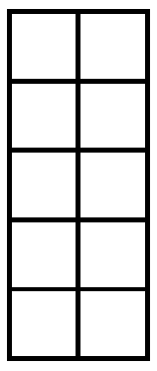
2
Work it out – Counting Collections
Notes:
You may suggest tools to help students keep track of their count. Empty five frames and ten frames can be used from the Math Tool Kits: Tools to Support Thinking and Learning in the Early Years' Mathematics Classroom (https://www.edu.gov.mb.ca/k12/cur/math/math_toolkit/). The five and ten frame from this slide could be cut and pasted onto other slides.

Slide 28


3
Looking Back
What did you discover?
What was a common way of counting the collections?
What strategy helped us count quickly and easily?
Why do we count?
Notes:
Observations:
What mathematical thinking did students show?
How did the group organize the collection? Let them show you their thinking. Was it efficient for the count?
Discuss the questions and let students share their thinking. You can listen to reflections or have students write about and send you their reflections. Choose two questions for students to share in breakout rooms if that is available.

Slide 29
Day 2
1
Opening Routine
2
Work it out!
3
Debrief and Consolidation
Sharing and Recording Thinking About Counting
Counting Collections
In Our Home
Count-On
Which one doesn’t belong?

Slide 30


1
Opening Routine
Look at the number shown and start counting the next number.
Mr. Happy’s finger will show you whether you count forwards or backwards.
Forwards
Backwards
Notes:
One of the counting principles is stable order. Stable order is the words used in counting must be the same sequence of words used from
one count to the next. Helping students acquire the flexibility to count on and count backwards will take time but will help build an understanding of counting and quantity.
If you observed students miscounting try intentionally miscounting an asking the student to tell what number you missed.
Change the Count – Start counting together from a given starting point. After a short time clap your hands and change the counting sequence. Change the sequence several times.
Different numbers have been placed on the slide to help with the count. Students can use number charts found in the Math Tool Kits: Tools to Support Thinking and Learning in the Early Years' Mathematics Classroom (https://www.edu.gov.mb.ca/k12/cur/math/math_toolkit/).
For example: The number 8 is shown in the slide, students will starting counting the next number until you clap or give a signal. Switch slides and start at another number. The emoji tells students to count forwards or backwards.
In counting on, the students count forwards beginning at any number. Counting back is challenging for many young students, and students need many opportunities to gain skill and confidence in counting backwards from different numbers.

Slide 31

1
Opening Routine
Notes:
Change the Count – Start counting together from a given starting point. After a short time clap your hands and change the counting sequence. Change the sequence several times.
Different numbers have been placed on the slide to help with the count. Students can use number charts found in the Math Tool Kits: Tools to Support Thinking and Learning in the Early Years' Mathematics Classroom (https://www.edu.gov.mb.ca/k12/cur/math/math_toolkit/).
For example: The number 8 is shown in the slide, students will starting counting the next number until you clap or give a signal. Switch slides and start at another number. The emoji tells students to count forwards or backwards.
Use this slide to practice with students.

Slide 32

1
Opening Routine
Notes:
Change the Count – Start counting together from a given starting point. After a short time clap your hands and change the counting sequence. Change the sequence several times.
Different numbers have been placed on the slide to help with the count. Students can use number charts found in the Math Tool Kits: Tools to Support Thinking and Learning in the Early Years' Mathematics Classroom (https://www.edu.gov.mb.ca/k12/cur/math/math_toolkit/).
For example: The number 8 is shown in the slide, students will starting counting the next number until you clap or give a signal. Switch slides and start at another number. The emoji tells students to count forwards or backwards.
Use this slide to practice with students.

Slide 33

1
Opening Routine
Notes:
Change the Count – Start counting together from a given starting point. After a short time clap your hands and change the counting sequence. Change the sequence several times.
Different numbers have been placed on the slide to help with the count. Students can use number charts found in the Math Tool Kits: Tools to Support Thinking and Learning in the Early Years' Mathematics Classroom (https://www.edu.gov.mb.ca/k12/cur/math/math_toolkit/).
For example: The number 8 is shown in the slide, students will starting counting the next number until you clap or give a signal. Switch slides and start at another number. The emoji tells students to count forwards or backwards.
Use this slide to practice with students.

Slide 34

1
Opening Routine
Notes:
Change the Count – Start counting together from a given starting point. After a short time clap your hands and change the counting sequence. Change the sequence several times.
Different numbers have been placed on the slide to help with the count. Students can use number charts found in the Math Tool Kits: Tools to Support Thinking and Learning in the Early Years' Mathematics Classroom (https://www.edu.gov.mb.ca/k12/cur/math/math_toolkit/).
For example: The number 8 is shown in the slide, students will starting counting the next number until you clap or give a signal. Switch slides and start at another number. The emoji tells students to count forwards or backwards.
Use this slide to practice with students.

Slide 35

1
Opening Routine
Notes:
Change the Count – Start counting together from a given starting point. After a short time clap your hands and change the counting sequence. Change the sequence several times.
Different numbers have been placed on the slide to help with the count. Students can use number charts found in the Math Tool Kits: Tools to Support Thinking and Learning in the Early Years' Mathematics Classroom (https://www.edu.gov.mb.ca/k12/cur/math/math_toolkit/).
For example: The number 8 is shown in the slide, students will starting counting the next number until you clap or give a signal. Switch slides and start at another number. The emoji tells students to count forwards or backwards.
Use this slide to practice with students.

Slide 36

1
Opening Routine
Notes:
Change the Count – Start counting together from a given starting point. After a short time clap your hands and change the counting sequence. Change the sequence several times.
Different numbers have been placed on the slide to help with the count. Students can use number charts found in the Math Tool Kits: Tools to Support Thinking and Learning in the Early Years' Mathematics Classroom (https://www.edu.gov.mb.ca/k12/cur/math/math_toolkit/).
For example: The number 8 is shown in the slide, students will starting counting the next number until you clap or give a signal. Switch slides and start at another number. The emoji tells students to count forwards or backwards.
Use this slide to practice with students.

Slide 37
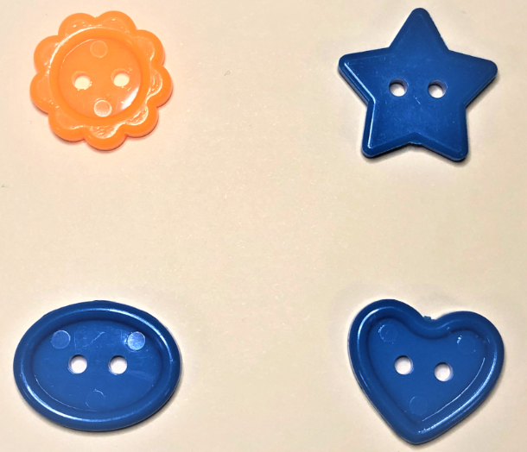
1
Opening Routine
Which one doesn’t belong?
Notes:
Which one doesn’t belong routine: This is a visual number talk that builds the skills of noticing similarities and differences. The routine supports reasoning and communication goals. Images for this routine can be used to support a variety of concepts from numbers, graphs, shapes, patterns, and so on.
Classifying and sorting is important for developing numerical concepts and the ability to group numbers.
By classifying and sorting, logical thinking is applied to everyday objects, which is important for later mathematics as well as all decision making. It helps develop problem solving skills.
As children begin to sort and classify items, they start with two simple questions:
What's the same?
What's different?
They communicate and justify their reasoning by describing how the items in a group are alike or different.
Seeing common characteristics, making conjectures, and explaining their thinking are all important elements of reasoning in young children.

Slide 38
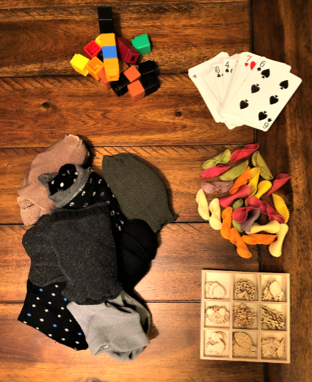
2
Work it out – Counting Collections
Find a counting collection in your home!
Ask an adult to help you find a collection of items to count. Some items to count are toys, books, blocks, socks in a drawer, a cup of macaroni, rock collections, cards, craft material, buttons or paperclips.
Notes:
Students will be working asynchronously to find counting collections around their home.

Slide 39
2
Work it out – Counting Collections
Find a collection of items to count.
Count your collection.
Record how you counted on a piece of paper.
On another piece of paper, record another way to count those items.
Notes:
Go over directions.
To help students organize suggest to them to use cups, ten frames, bowls, egg cartons, muffin cups, etc. Various numbers charts should be accessible to students as well.
Have students send you their recordings. Set up individual sessions with students to observe and assess their work.
How did you count?
How many do you have in all?
What strategy did you use to count?
How did you record your counting?
Counting collections can become a regular instructional routine. As students become familiar and more confident with counting collections, short classroom lessons can be introduced to go over strategies and to guide students’ in their thinking and understanding about counting.

Slide 40
3
Looking Back
How did you count?
How many do you have in all?
What strategy did you use to count?
How did you record your counting?
How is the picture telling how you are counted?
Why do we count?
Notes:
Observations:
What mathematical thinking did students show?
How did the group organize the collection? Let them show you their thinking. Was it efficient for the count?
Discuss the questions and let students share their thinking. You can listen to reflections or have students write about and send you their reflections. Choose two questions for students to share in breakout rooms if that is available.

Slide 41
Day 3
1
Opening Routine
2
Work it out!
3
Debrief and Consolidation
What do you notice?
What do you wonder?
Ways to Show 5
Show 5 in Different Ways

Slide 42
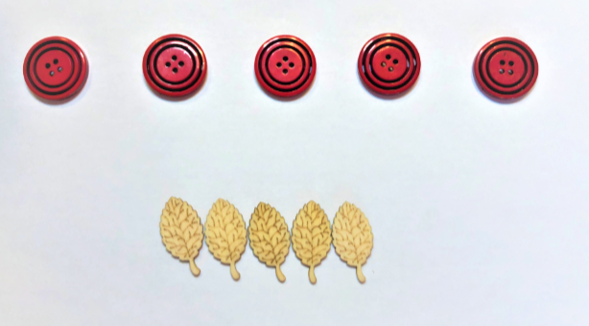
1
Opening Routine
What do you notice? What do you wonder?
Notes:
The research related to how children learn to count identifies principles which children need to acquire to become proficient at counting. They include:
Stable Order: Words used in counting must be the same sequence of words used from one count to the next.
Order Irrelevance: The order in which objects are counted does not matter. Counting things in a different order still gives the same count.
Conservation: The count for a set of objects stays the same whether the objects are spread out or close together. The only way the count can change is when objects are added to the set or removed from the set.
Abstraction: Different things can be counted and still give the same count. Things that are the same, different, or imaginary (ideas) can be counted.
One-to-one Correspondence: Each object being counted is given one count in the counting sequence.
Cardinality: After a set of objects has been counted, the last number counted represents the number of objects in that set. If students need to recount they don’t understand the principle.
Information and other ideas can be found in the Kindergarten Mathematics: Support Document for Teachers (https://www.edu.gov.mb.ca/k12/cur/math/k_support/index.html)
This particular noticing highlights the principle of conservation. If students see that the amounts are different some follow-up questions can be:
Which row has more?
Which row has less?
How are the row the same?

Slide 43

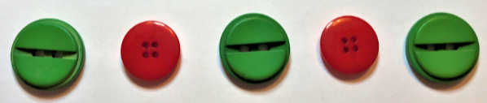


2
Work it out
What do you notice about 5 in each of these pictures?
Notes:
It is necessary to have students create representations in various ways but it is also important to ask students to show what they see in the representations. By asking students to show what they see in the representations, it enriches characteristics of numbers and builds number sense.
Guiding questions:
Which picture shows different parts of the number 5?
Which picture shows that 5 is more than a number?
Which picture shows that 5 is less than a number?
Which picture shows the number is easy to identify quickly?
Which picture shows number is made up of equal parts?
To develop a good sense of number, students have to develop an intuition about numbers and their relationships. Their ability to think flexibly about numbers develops gradually as a result of exploring numbers and visualizing them in a variety of contexts.
When students are representing numbers in a variety of ways, they demonstrate their understanding of the use of a number (e.g., my house number is 34), how a number compares to another number (e.g., 34 is 1 less than 35), how a number can be broken into parts (e.g., 34 is 32 + 2), and place value (e.g., 34 is 30 + 4 or 20 + 14 or 10 + 24).
The ability to represent numbers in a variety of ways will benefit students when doing operations and mental mathematics problems. Present number sentences horizontally as well as vertically to encourage students to use different representations of numbers and part-part-whole thinking.
Ask students, “What do you notice about 5 in each of these pictures?” It’s important to have students make different representations of numbers but it is important to have students to see what they see in each representation. This question helps students see different relationships in numbers and elicits the big ideas such as:
showing the number is made up of parts
showing the number is greater or less than another number
showing the number is made up of equal parts
making the number easy to identify quickly
showing the number is close to a familiar benchmark number
showing how the number relates to another number

Slide 44
3
Debrief and Consolidation
Show 5 in lots of different ways.
Tell what each way shows about 5.
Notes:
Students can work synchronously in breakout groups or asynchronously at home.
Assessment:
This template may be uploaded to SeeSaw or a similar platform for students to use.
These questions could also be used with individually students for assessment.

Slide 45
Day 4
1
Opening Routine
2
Work it out!
3
Debrief and Consolidation
Action Cards:
Show Number Relationships
2. What do you notice?
Guess the Number on the Number Path
Using the Number Path

Slide 46
1
Opening Routine
Action Cards
Listen to instructions!
Notes:
Instead of just performing the activity on the card that number of times, adapt the number by telling students to take the action and the number and do the following:
Act out the number one less than the number shown on the card,
Act out the number one more than the number shown on the card.
Action cards can be found in the Kindergarten Support Document BLMs (https://www.edu.gov.mb.ca/k12/cur/math/k_support/blms/index.html)

Slide 47
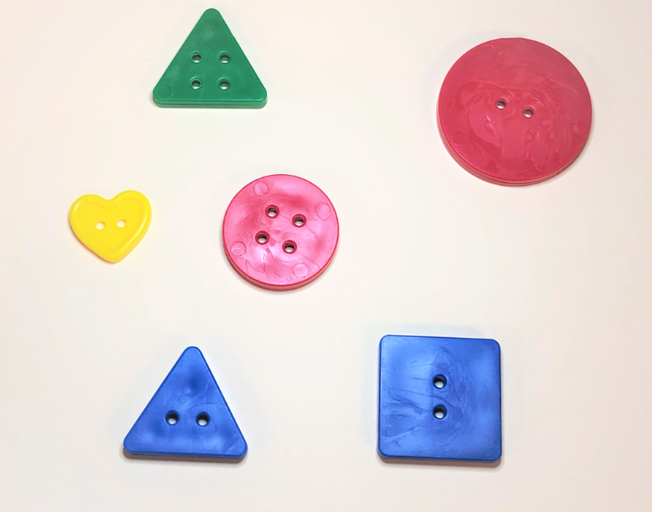
2
Opening Routine
What do you notice? How can we count this collection of buttons?
Notes:
This slide is good to discuss attributes of buttons and review the principles of counting. Guiding questions;
What do you notice?
Can you describe the buttons?
If I start counting at a different button will we still get 6?
Can we count the buttons in different ways?
Can we count the buttons starting with this button.
Would the buttons fit on a five frame?
t
We want students to “trust the count’. “Trusting the count” allows students to know that if they count a set of objects more than once, they will get the same amount. “Trusting the count” is knowing that:
when you’re counting a set of objects, the last number you say represents the total number in the set.
if you count a set of objects and then count it again, you’ll get the same answer…every time.
if you move around a set of objects but nothing is added or removed from the set, you’ll get the same answer, every time.

Slide 48


2
Work it out
Which pictures make it easy to see five without counting? Why?
Notes:
Discuss the questions.
The range of answers may vary. Some students will say the five frame because the frame is full. A student may say the dice because they play games and use it all the time. The reflections from students will help you understand their thinking. An additional question to ask students is, “Does how each picture is shown, help you see the number more quickly and easily ?” OR “Which picture did you just know there was 5?”
We want to have students not relying on counting from one. The tools we use helps us relate number to objects, conservation of number, representation of number and with part-part-whole understanding.

Slide 49


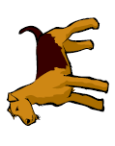
1
Opening Routine
Are there enough dog bones, too many, or too few?
Notes:
Students need to learn what we mean when we say something is more, less or the same (comparison). We need to attach meaning to counting with experiences that show quantity. Building piles of buttons, shoes, mitts, toys, blocks or anything around the class or house and asking the question repeatedly will help students learn the concept.
With the PowerPoint in edit mode, you can count the items to reinforce the one-to-one principle. Match bones to the dogs to make comparisons.
Question adapted from Math for Young Children: Building A Strong Foundation in PreK-Grade 2 by Marian Small, Teachers College, 2018.

Slide 50

2
Work it out
What do you notice about this number path?
Notes:
The number path is a good tool to use before students use the number line. The number path is a counting model. Each rectangle space can be counted. The units on a number path are easier to recognize. The number path accentuates the units (the spaces). Students can also build a number path with linking cubes. The cubes show that each block is “one unit”, and that same unit is repeated over and over (iterated) to form the number path. This is a big idea for measurement.
Students will give various answers. There are four text boxes available to write in. You can have students share their responses orally or in the chat box and you can write them in the boxes. If students do not notice how the numbers are shaded in groups of five, ask them about it. The shading helps students recognize benchmark numbers.
How the number pathway is structured (shaded) brings out the importance of the benchmark numbers such as 5 and 10.

Slide 51
2
Work it out
Show 5!
Use Me:
Move and stretch
Notes:
Have students describe or copy slide to give to students.
*Remember if they are showing you five, the first five rectangles need to be circled. If you show 7, the first seven rectangles must be circled. This supports the counting principle of cardinality. Emphasize how the structure of this number path helps them recognize numbers quickly. The structure can support students to get past counting one-to-one. The shading on the number paths in groups of 5 makes it easier to relate numbers to the benchmarks of 5 and 10.

Slide 52
2
Work it out
Show 2!
Use Me:
Move and stretch
Notes:
Have students show different numbers. Remember if they are showing you five, the first five rectangles need to be shaded or circled.

Slide 53
2
Work it out
Show 1!
Use Me:
Move and stretch
Notes:
Have students describe or copy slide to give to students.

Slide 54
2
Work it out
Show 3!
Use Me:
Move and stretch
Notes:
Have students describe or copy slide to give to students.

Slide 55
2
Work it out
Show 7!
Use Me:
Move and stretch
Notes:
Have students describe or copy slide to give to students.

Slide 56
2
Work it out
Show 9!
Use Me:
Move and stretch
Notes:
Have students describe or copy slide to give to students.

Slide 57
2
Work it out
Show 4!
Use Me:
Move and stretch
Notes:
Have students describe or copy slide to give to students.

Slide 58
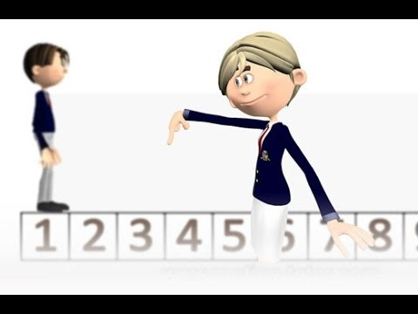
2
Let’s learn about starting at a number and counting on from a number.
Work it out
Number Path - Count from a number - YouTube
Notes:
The following video from Motion-Tutor describes how to add on more jumps. The video link can be shown or sent to students. You can show the video or discuss the concept with students.
https://youtu.be/wf32qr0eXWg

Slide 59
2
Work it out
Gather objects around the house.
Place each collection in order from the fewest to the most.
Take pictures of what you did.
Notes:
Student instructions: Gather objects around the house and show what each number looks like? Place each collection in order from the fewest to the most. Make collections from 1 to 10. Make at least 2 collections for each number.
Take pictures of what you did. Send them to me. We will have a math talk about your collections.

Slide 60
3
Debrief and Consolidation
Gather objects around the house.
Place each collection in order from the fewest to the most.
Take pictures of what you did.
Notes:
Student instructions: Gather objects around the house and show what each number looks like? Place each collection in order from the fewest to the most. Make collections from 1 to 10. Make at least 2 collections for each number.
Assessment:
This template may be uploaded to SeeSaw or a similar platform for students to use.
These questions could also be used with individually students for assessment.
With the pictures students send you can further assess students understanding. Questions to ask:
Can you tell me about your collections.
Name the number before.
Name the number after.
Show me collections that are the same.
Count your collections.
How many in this collection. How do you know?
“How many are there?” (without having to recount)
Take advantage of your one-on-one time to ask questions of the student.

Slide 61
Day 5
1
Opening Routine
2
Work it out!
3
Looking Back
1. Counting Strategies
2. Using the Number Path: What number might the ? represent?
Placing Numbers on the Number Path
Game: Four Kings

Slide 62
1
Opening Routine
What strategy did you use to count them?
Notes:
We want to nudge students to be strategic about counting. We do not want students overly reliant on immature counting-based strategies (one-to-one counting). Ask students to find how many in the picture by asking them to find how many starts but do not count them one at a time.
Have students share strategies.

Slide 63
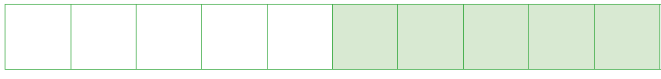
1
Opening Routine
What number might the ? represent? How sure are you?
?
5
?
Notes:
The opening routine is using the number path and having students reason out what the missing number is. Focus on the explanation of students. Listen to see if student are using the structure of the number path.
Listen to the math language:
It must be more than 5
I counted on from 5
I counted back from 10.

Slide 64
2
Work it out
6
7
9
4
1
3
Place The Number
2
8
5
Notes:
Place The Number: Place a number somewhere on the path. Have students place another number on the grid using the language of before and after to explain the number placement. *When students are confident with numbers to 10 you can add another more onto the path. Note: You do not need to assess beyond 10.
Examples of language to be used:
The number before
The number after
Is less than
Is more than
Assessment:
This template may be uploaded to SeeSaw or a similar platform for students to use.
These questions could also be used with individual students as an assessment.

Slide 65
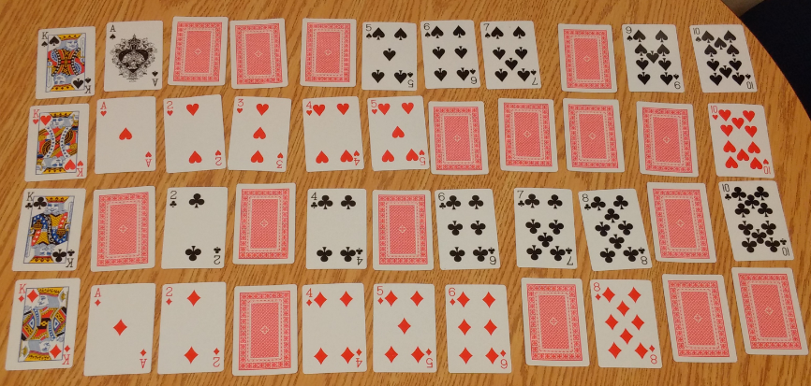
2
Debrief and Consolidation
Game: Four Kings
://www.edu.gov.mb.ca/k12/cur/math/games/index.html
://www.edu.gov.mb.ca/k12/cur/math/games/index.html
Notes:
Send students the instructions for Four Kings. The game can be found on the Manitoba Education website (://www.edu.gov.mb.ca/k12/cur/math/games/index.html) The game is found with the teachers instruction hand out.
Four Kings Instruction:
Materials – deck of cards with all the face cards removed
The object of a game of kings is to form 4 rows of cards from Ace (1) to 10 in ascending order without turning up the 4 kings. The game ends when the fourth king is uncovered. Place the 4 Jacks face up at the side to indicate which suit will be in which row. Shuffle the cards and lay them face down on the table in rows of ten. Place the 4 cards left over on the side, face down. The player turns over one of the four cards and puts it in the correct spot in the correct suit row after first removing the card that was in that position. This card is then put in its proper position. If a King turns up it is put to the side and a replacement taken from the remaining cards at the side.

Slide 66
Exploring the Number Ten End of Week 1

Slide 67
Day 1
1
Opening Routine
2
Work it out!
3
Debrief and Consolidation
Frame Flash: One more, One less
Comparing Quantities
Use Different Representations of Numbers to Make a Number Path
Making a Number Path

Slide 68
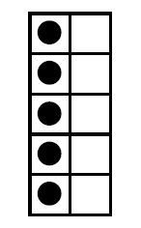
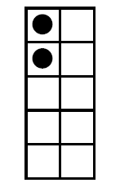
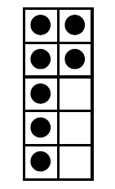
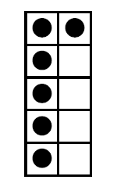
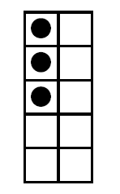
2
Ten Fames
Opening Routine
Frame Flash
Say the number that is 1 less
Five Fames
Notes:
The following slides are a quick routine by showing a ten frame and having students say the number that is 2 more. The frames are under the blue cards. There are ten frames and five frames. Use the cards needed for your students.

Slide 69
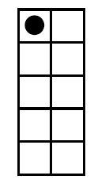
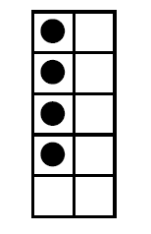
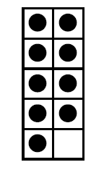
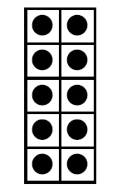
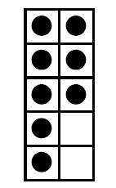
2
Frame Flash
Say the number that is 1 more
Opening Routine
Five Frames
Ten Frames
Notes:
The following slides are a quick routine by showing a ten frame and having students say the number that is 2 more. There are four ten frames per slide. There are five ten frames per slide. The frames are under the blue card.

Slide 70
1
Opening Routine
Are there enough dog bones, too many, or too few?
Notes:
Students need to learn what we mean when we say something is more, less or the same (comparison). We need to attach meaning to counting with experiences that show quantity. Building piles of buttons, shoes, mitts, toys, blocks or anything around the class or house and ask the question repeatedly will help students learn the concept.
With the PowerPoint in edit mode, you can count the items to reinforce the one-to-one principle. Match bones to the dogs to make comparisons.
Question adapted from Math for Young Children: Building A Strong Foundation in PreK-Grade 2 by Marian Small, Teachers College, 2018.

Slide 71

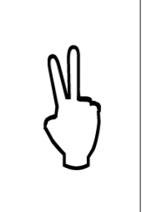


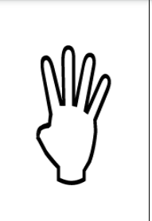

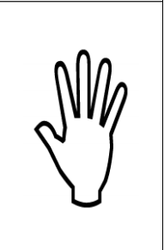
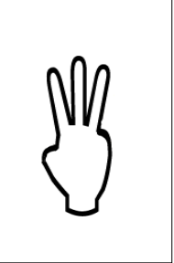


2
Work it out
Let’s make a number path!
Move the cards to make a number path.
Move the cards to make a number path.
Notes:
Students will practice building a number path (1 to 10) using a different representations of numbers. This activity allows students to use the learning within the last week and connect it to prior learning. The opening activity involves placing numerals and ten frames in the correct order. Model the following language in order for students to hear and use it in context.
You can leave the number path on the bottom or remove it depending on the needs of your students.
Have students guide you to make the number path with the different representations. To get started, ask some of the guiding questions:
How should we start?
Do we have to start with 1 or could we start with another number?
What comes after …?
What comes before …?
Could we use the numbers 5 and 10 to help us? The introduction of the word “benchmark” can be used.

Slide 72
2
Place the circle around the direction.
Debrief and Consolidation
On the number path,
Circle the number that is 1 more than 5.
Circle the number is 1 more than 3.
Circle the number that is 1 less than 4.
Circle the number that is 1 less than 8.
Notes:
Assessment: Do the assessment one-on-one.

Slide 73
Day 2
1
Opening Routine
2
Work it out!
3
Debrief and Consolidation
What do you notice?
What do you wonder?
Stories about 5
Number Stories about 5

Slide 74
2
Opening Routine
Use a 5-frame to show 2 numbers that are different. How are they different?

Slide 75
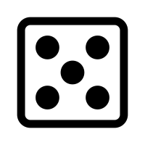
2
Work it out
What do you notice?
Which pictures make it easy to see five without counting? Why?
Notes:
Discuss the questions.
The range of answers may vary. Some students will say the five frame because the frame is full. A student may say the dice because they play games and use it all the time. The reflections from students will help you understand their thinking. An additional question to ask students is, “Does how each picture is shown, help you see the number more quickly and easily?” OR “Which picture did you just know there was 5?”
We want to have students not relying on counting from one. The tools we use helps us relate number to objects, conservation of number, representation of number and with part-part-whole understanding.
Question adapted from Open Questions for Rich Math Lessons by Marian Small. Rubicon Publishing, 2016.

Slide 76
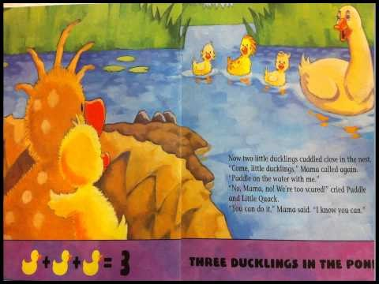
2
Listen to the story,
“Little Quack"
By Lauren Thompson
Work it out
Little Quack by Lauren Thompson, Little Simon; Illustrated edition (Feb. 1 2005) ISBN: 0689876459
Notes:
Click the link to the read aloud, “Little Quack" by Lauren Thompson on YouTube. Have students listen. The story includes equations but this should not be the focus of the book.

Slide 77
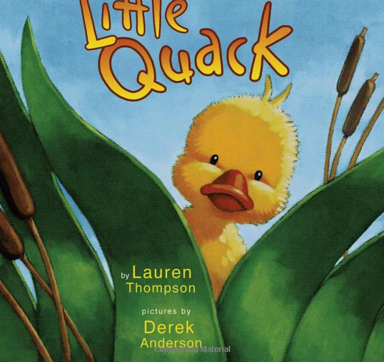
2
Listen to the story,
“Little Quack"
By Lauren Thompson”
Work it out
While you listen to the story, use pictures or counters to represent the actions you hear.
Little Quack by Lauren Thompson, Little Simon; Illustrated edition (Feb. 1 2005) ISBN: 0689876459
Notes:
Click the link to the story “Little Quack" on YouTube. In the second re-read, students will be model the story using counters.
Have students get counters from their math tool kit or something around the house such as coins, buttons or little pieces of paper. The students will model the actions as they hear the story. You can stop the story and ask students what their representation looks like. Students can draw their own pond or use the next slide and represent the story digitally.

Slide 78
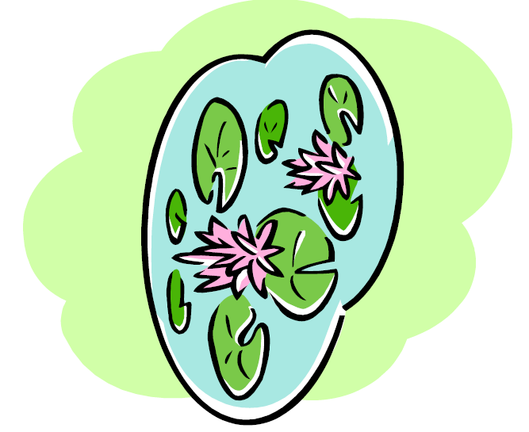

2
Work it out
Move the little ducks to the pond.
Notes:
As you listen to the story, Little Quack, move the little ducks to represent the actions you hear.

Slide 79
2
Debrief and Consolidation
Retell the story to a family member.
How many ducks were there all together?
Tell the different ways the 5 ducks were arranged?
Move the little ducks to the pond.
Notes:
Student Instructions: Retell the story to a family member. Use counters this page as way to show the different ways the little ducks were in the water and in the nest.

Slide 80
Day 3
1
Opening Routine
2
Work it out!
3
Debrief and Consolidation
What do You Notice, What do You Wonder
Compatible Number Pairs for 5
Make 5 Game

Slide 81
What Number Am I
1
Opening Routine
I am less than 6.
I am more than 3.
If you have 3 buttons and you find 2 more, you would have this number.
What number am I?

Slide 82

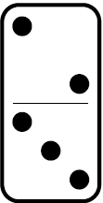
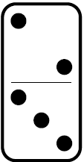

Which One Doesn’t Belong
2
Work it Out
Notes:
Which one doesn’t belong routine: This is a visual number talk that builds the skills of noticing similarities and differences. The routine supports reasoning and communication goals. Images for this routine can be used to support a variety of concepts from numbers, graphs, shapes, patterns, and so on.
This particular, “Which one doesn’t belong” connects to the lesson of making five.

Slide 83
Making 5!
2
Work it Out
What are the different ways we can put 5 blocks into two groups.
Find 5 objects in your home, and show how to
Move the blocks to make 5.
AND
Notes:
Students will be decomposing the number 5.
Tell students we are going to take the 5 and break into parts. We are doing to find how many different combinations of 5.
Discuss with the students how to break up the numbers and say, 4 and 1 make 5. Repeat this with other combinations.
Assessment:
The following templates may be uploaded to SeeSaw or a similar platform for students to use.
This question can also be used with individually students for assessment.

Slide 84
Find all the ways to make 5!
2
Debrief and Consolidation
Move the blocks to make 5.
AND
AND
Notes:
Student Instructions: Find all the ways to make 5. Move the blocks so show the ways to make 5.

Slide 85
Find all the ways to make 5!
2
Debrief and Consolidation
Move the blocks to make 5.
AND
AND
Notes:
Student Instructions: Find all the ways to make 5. Move the blocks so show the ways to make 5.

Slide 86
Find all the ways to make 5!
2
Debrief and Consolidation
Move the blocks to make 5.
AND
AND
Notes:
Student Instructions: Find all the ways to make 5. Move the blocks so show the ways to make 5.

Slide 87
Find all the ways to make 5!
2
Debrief and Consolidation
Move the blocks to make 5.
AND
AND
Notes:
Student Instructions: Find all the ways to make 5. Move the blocks so show the ways to make 5.

Slide 88
Day 4
1
Opening Routine
2
Work it out!
3
Debrief and Consolidation
How Many to 5?
Representing 5!
Story Problem
Make Up A Story

Slide 89
1
Opening Routine
How many do you see?
How do you know?
How many more to 5?
Notes:
This activity can be adapted easily depending on the needs of students. The various arrangements of counters on the five frames will prompt different mental images of numbers, all in connection with the numbers' relationship to five. The arrangement of the dots are in a five-wise pattern. Using the five-wise pattern helps students use the number 5 as an anchor.
Go over the three questions you will ask students. If you are using an online platform such as Teams or Zoom, have students place their answers to one of the questions in the chat box or call upon students to answer one of the questions. Flash each frame for about 3 seconds and move onto the next slide with the questions.
Possible guiding questions:
What do you see? How did you see it?
How many dots do you see? (Observe if the students are counting or can recognize the number at a glance.)
How do you know? How did you see __?
How many more to ten?

Slide 90
1
Opening Routine
How Many to 5?
Notes:
Dot Card Flash: Use a set of dot cards with regular dot formations for the numbers 1 to 6. Give each student a work mat and counters. Explain to the students that you are going to flash a card and then ask them to make the arrangement they saw using the counters. Hold up the card for about three seconds.
After they have built the dot arrangement, ask:
How many dots did you see?
How did you see them?
How many counters did you use on your mat?

Slide 91
1
Opening Routine
How Many to 5?
Notes:
Dot Card Flash: Use a set of dot cards with regular dot formations for the numbers 1 to 6. Give each student a work mat and counters. Explain to the students that you are going to flash a card and then ask them to make the arrangement they saw using the counters. Hold up the card for about three seconds.
After they have built the dot arrangement, ask:
How many dots did you see?
How did you see them?
How many counters did you use on your mat?

Slide 92
1
Opening Routine
How Many to 5?
Notes:
Dot Card Flash: Use a set of dot cards with regular dot formations for the numbers 1 to 6. Give each student a work mat and counters. Explain to the students that you are going to flash a card and then ask them to make the arrangement they saw using the counters. Hold up the card for about three seconds.
After they have built the dot arrangement, ask:
How many dots did you see?
How did you see them?
How many counters did you use on your mat?

Slide 93
1
Opening Routine
How Many to 5?
Notes:
Dot Card Flash: Use a set of dot cards with regular dot formations for the numbers 1 to 6. Give each student a work mat and counters. Explain to the students that you are going to flash a card and then ask them to make the arrangement they saw using the counters. Hold up the card for about three seconds.
After they have built the dot arrangement, ask:
How many dots did you see?
How did you see them?
How many counters did you use on your mat?

Slide 94
1
Opening Routine
How Many to 5?
Notes:
Dot Card Flash: Use a set of dot cards with regular dot formations for the numbers 1 to 6. Give each student a work mat and counters. Explain to the students that you are going to flash a card and then ask them to make the arrangement they saw using the counters. Hold up the card for about three seconds.
After they have built the dot arrangement, ask:
How many dots did you see?
How did you see them?
How many counters did you use on your mat?

Slide 95
1
Opening Routine
You have 5 counters that are in 2 groups. How many counters could be in each pile. What do the groups show you about the number 5?
The counters can move.
Notes:
This question can be changed to different number. The problem allows teachers to assess if students can decompose the number 5.

Slide 96
1
Work It OUt
There are 2 counters under the piece of paper. How many are there altogether?
Move the paper to check your answer.
Notes:
This question can be changed to different number. The problem allows teachers to assess if students can decompose the number 5. You can move the square paper to check answers with students.

Slide 97


2
Listen to the story,
“Five Little Monkeys”
By Eileen Christelow”
Work it Out
While you listen to the story, use pictures or counters to represent the actions you hear.
Five Little Monkeys Jumping on the bed by Eileen Christelow, Clarion Books; Illustrated edition (March 15 1989) ISBN: 0395557011
Notes:
Have students close their eyes and imagine the 5 objects. Ask, “How do you see 5?” Students should reply giving the part-part-
whole representation (e.g., “I see 3 and 2.” or “I see 1 and 4.”).

Slide 98
2
Number Stories
Work it Out
Notes:
Questions to discuss with students:
What do you see?
Can you tell me a counting story about what you see in the tank?

Slide 99
2
Debrief and Consolidation
Number Stories
Make a story about the number 5. Use pictures, words and numbers to show your story.
Notes:
Student Instructions: Make up your own number story using the number 5. Use pictures, words and numbers to show your story.
The following templates may be uploaded to SeeSaw or a similar platform for students to use.
Students can share this with other students and with the teacher.

Slide 100
Day 5
1
Opening Routine
2
Work it out!
3
Debrief and Consolidation
What do you notice? What do you wonder?
Missing Part Cards: Part-Part-Whole (5)
Tell me about 5.

Slide 101
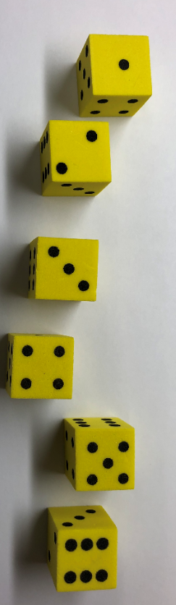
1
Opening Routine
What do you notice? What do you wonder?

Slide 102
1
Opening Routine
There are five cookies on a pan. There are more chocolate chip than peanut butter on the pan. How many of each might there be?
Move the counters.
Notes:
This question can be changed to different number. The problem allows teachers to assess if students can decompose the number 5.

Slide 103

1
Opening Routine
Missing Part Cards -
Move the screen.
Notes:
Each card has a numeral for the whole and two dot pattern sets with one set covered by a screen. Student say what is the missing part to make the total five. This may be a challenge for students so they can use counters or a five frame to support their thinking. Ask students what their strategies for finding the missing number.
You can find the missing part cards online: Math Tool Kits: Tools to Support Thinking and Learning in the Early Years' Mathematics Classroom (https://www.edu.gov.mb.ca/k12/cur/math/math_toolkit/).

Slide 104

1
Opening Routine
Missing Part Cards -
Move the screen.
Notes:
Each card has a numeral for the whole and two dot pattern sets with one set covered by a screen. Student say what is the missing part to make the total five. This may be a challenge for students so they can use counters or a five frame to support their thinking. Ask students what their strategies for finding the missing number.
You can find the missing part cards online: Math Tool Kits: Tools to Support Thinking and Learning in the Early Years' Mathematics Classroom (https://www.edu.gov.mb.ca/k12/cur/math/math_toolkit/).

Slide 105

1
Opening Routine
Missing Part Cards -
Move the screen.
Notes:
Each card has a numeral for the whole and two dot pattern sets with one set covered by a screen. Student say what is the missing part to make the total five. This may be a challenge for students so they can use counters or a five frame to support their thinking. Ask students what their strategies for finding the missing number.
You can find the missing part cards online: Math Tool Kits: Tools to Support Thinking and Learning in the Early Years' Mathematics Classroom (https://www.edu.gov.mb.ca/k12/cur/math/math_toolkit/).

Slide 106

1
Opening Routine
Missing Part Cards -
Move the screen.
Notes:
Each card has a numeral for the whole and two dot pattern sets with one set covered by a screen. Student say what is the missing part to make the total five. This may be a challenge for students so they can use counters or a five frame to support their thinking. Ask students what their strategies for finding the missing number.
You can find the missing part cards online: Math Tool Kits: Tools to Support Thinking and Learning in the Early Years' Mathematics Classroom (https://www.edu.gov.mb.ca/k12/cur/math/math_toolkit/).

Slide 107

1
Opening Routine
Missing Part Cards -
Move the screen.
Notes:
Each card has a numeral for the whole and two dot pattern sets with one set covered by a screen. Student say what is the missing part to make the total five. This may be a challenge for students so they can use counters or a five frame to support their thinking. Ask students what their strategies for finding the missing number.
You can find the missing part cards online: Math Tool Kits: Tools to Support Thinking and Learning in the Early Years' Mathematics Classroom (https://www.edu.gov.mb.ca/k12/cur/math/math_toolkit/).

Slide 108
2
Debrief and Consolidation
The Number 5
Show everything you know about the number 5!
Use pictures, words and numbers.
Notes:
Student Instructions: Show everything you know about the number 5. Use pictures, words and numbers.
The following templates may be uploaded to SeeSaw or a similar platform for students to use.
Students can share this with other students and with the teacher.

