Slide 1
Structures

Slide 2
Objectives:
Use appropriate vocabulary related to their investigations of materials and structures. Include: strength, balance, stability, structure, frame structure, natural structure, human-built structure, force.
Conduct experiments to compare the strength of common materials. Examples: wooden toothpicks, plastic straws, paper, cardboard, polystyrene foam…
Explore to determine ways to strengthen a material used for building. Include: changing shape, bulk, and number of layers.
Explore to determine an appropriate method for joining two materials for a specific use.
Recognize that balance affects the stability of a structure.
Explore to determine ways to improve the strength and stability of a frame structure.
Use the design process to build a structure that meets given criteria related to strength, stability, and function.

Slide 3
KWL on Structures:
In the Know box list all the things you already know about Structures.
In the Wonder box write down any questions you have about Structures. What is something you want to learn about? Leave the L box for the end of the lesson!
K
W
L
I know about Structures…
What I know
I wonder…
I wonder?
I learned…
I learned

Slide 4
The strongest structure is made of:
I can build a tower 30 cm tall using marshmallows and toothpicks and it will not fall over.
My answer…..
wood
plastic
paper
cardboard
polystyrene foam…
I think this because…
Place an arrow anywhere on the number line to indicate your initial thinking.
Initiating
Impossible
Possible
Certain
Image:David Gamble 2020

Slide 5
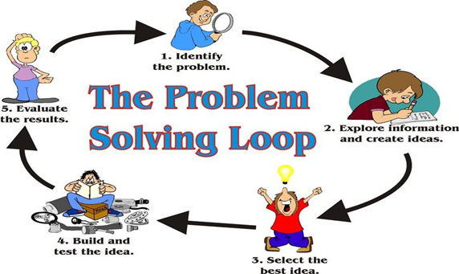
Scientific Inquiry
These bubbles are placed on the following slides to indicate where you are in the Scientific Inquiry Cycle. Match the bubble to the steps in the graphic organizer on the next slide.
Initiating
Researching
C
Planning
Demonstrating Scientific and Technological Attitudes
Implementing Plan
Reflecting
Observing, Measuring, Recording
Concluding and Applying
Analyzing and Interpreting
Image: https://pixy.org/4592163/
Image: David Gamble 2020

Slide 7
So what is a structure?
A structure is...
Initiating
Notes:
Have students fill out what a structure is in their own words after watching the video.

Slide 8
Structure scavenger hunt
Look around your house, yard or community for structures and write them down in the correct column.
NATURAL STRUCTURES | HUMAN-MADE STRUCTURES
Initiating

Slide 9
The strongest structure is made of:
I can build a tower 30 cm tall using marshmallows and toothpicks and it will not fall over.
My answer…..
wood
plastic
paper
cardboard
polystyrene foam…
I think this because…
Place an arrow anywhere on the number line to indicate your initial thinking.
Initiating
Impossible
Possible
Certain
Image:David Gamble 2020

Slide 10
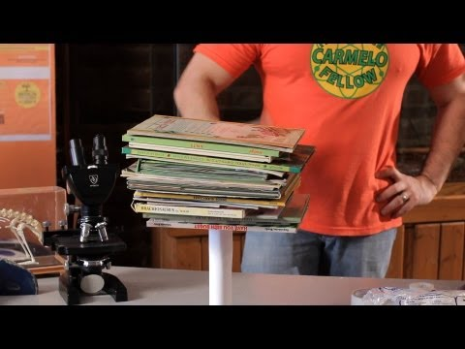
The strength of a structure is its ability to hold a load against gravity
Researching

Slide 11
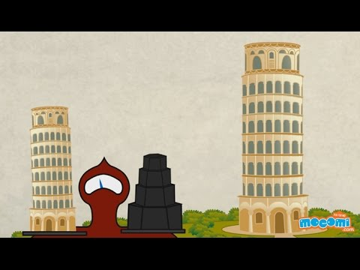
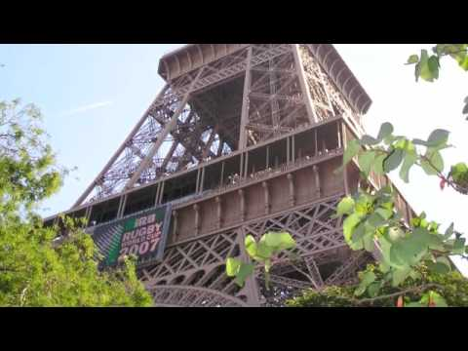
Watch the research videos
Researching

Slide 12
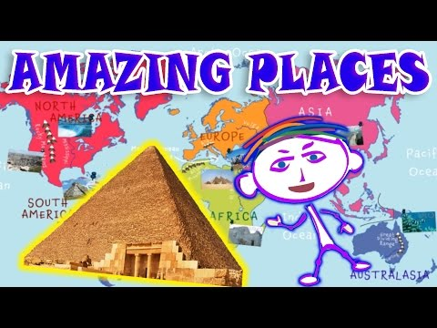
Watch the research videos
Researching

Slide 13
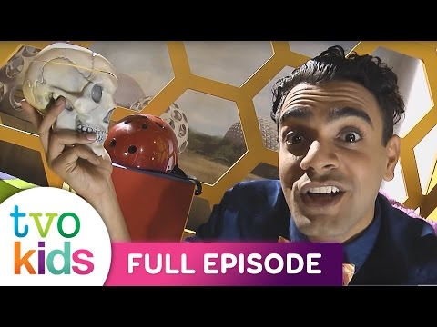
Watch the research videos
Researching

Slide 14
Question & Challenge STEP ONE
Draw or sketch out your building plan
Build the tallest tower you can out of the supplied toothpicks and mini marshmallows.
Use lines to show toothpicks
Use squares to show marshmallows
At the bottom of the picture include how many marshmallows and toothpicks you used.
Planning

Slide 15
Observational Journal
Take photos or draw a photo of each version of your tower. Make notes about how you built the tower and changes you made during building.
Photo or Drawing: | Notes: (indicate if and why a structure did not stand without falling over)
Model 1:
Model 2:
Model 3:
Observing, Measuring, Recording
Analyzing and Interpreting

Slide 16
I can build a tower 30 cm tall using marshmallows and toothpicks and it will not fall over.
Place an arrow anywhere on the number line to indicate your initial thinking.
Impossible
Possible
Certain
Image:David Gamble 2020
Concluding and Applying

Slide 17
Explain why your tower was successful or not?
My tower was (successful / not successful) because…
Reflecting

Slide 18
Glossary
Strength-the capacity of an object or substance to withstand great force or pressure.
Balance-The equalization of forces.
Stability- is the quality of being unchanging.
Structure-is something of many parts that is put together. A structure can be a skyscraper, an outhouse, your or body.
frame structure-is a structure having the combination of beam, column and slab to resist the side to side and gravity loads.
natural structure-are structures that occur naturally. Such as plants, animal bodies, mountains, caves, rock formations, and icebergs, the materials from which they are made, and their colors, shapes, and textures.
human-built structure-are structures that no not occur naturally. Buildings, cars, and roads are examples of human-built structures
force-the effort applied
Researching

Slide 19
Outcomes Addressed | Achievement Grade Profiles https://www.edu.gov.mb.ca/k12/assess/report_cards/grading/profiles.html
 | Limited | Basic | Good | Very Good to Excellent:
Science - Design Process and Problem Solving | Requires considerable, ongoing teacher support to ▪ apply strategies to solve practical problems and to explain reasoning ▪ use scientific vocabulary ▪ use criteria or constraints to define a problem and evaluate the chosen solution ▪ recognize when changes need to be made to a plan ▪ work collaboratively with peers | Requires occasional teacher or peer support to ▪ apply strategies to solve practical problems and to explain reasoning ▪ use scientific vocabulary ▪ use criteria or constraints to define a problem and evaluate the chosen solution ▪ recognize when changes need to be made to a plan ▪ work collaboratively with peers | Applies appropriate strategies to solve practical problems; requires occasional prompting to recognize when changes need to be made to a plan. Explains and justifies reasoning using appropriate science vocabulary, and generalizes to similar contexts; requires occasional prompting for clarification. Collaborates effectively with peers. | Demonstrates flexibility, resilience, and creativity when solving practical problems; critically analyzes results and makes any necessary changes to a plan. Explains and justifies reasoning clearly using appropriate science vocabulary and generalizes to other contexts. Collaborates effectively with peers, often taking a key role in group work.
3-2-01 Use appropriate vocabulary related to their investigations of materials and structures.
3-2-02 Conduct experiments to compare the strength of common materials.
3-2-03 Explore to determine ways to strengthen a material used for building.
3-2-04 Explore to determine an appropriate method for joining two materials for a specific use.
3-2-05 Recognize that balance affects the stability of a structure.
3-2-06 Explore to determine ways to improve the strength and stability of a frame structure.
3-2-07 Identify shapes that are part of natural and human-built structures from various cultures and describe how these shapes help to provide strength and stability.
3-2-09 Use the design process to build a structure that meets given criteria related to strength, stability, and function.
3-2-10 Describe the effects of various forces on different structures.
3-2-11 Evaluate simple structures to determine if they are safe and appropriate to the user.
Aaaaa i was disconnected!

Slide 20
How tall of a tower can I build using only toothpicks and marshmallows ?
Using the Scientific inquiry loop and the graphic organizer below answer the question, fill out as you go :
What was the initiating question, wondering, problem?
What is your plan for solving/answering the problem, wondering, question?
What did you learn about this problem, wondering, question?
Implementing Plan
Concluding and Applying
Initiating
What did your research reveal?
Note what you have done, what you have noticed, and measured .
Were your first impressions correct? What did you learn? How can you use what you learned?
Research
Observing, Measuring, Recording
Reflecting
How will you solve/answer this problem, wondering, question?
What does your notes about what you did, noticed, and measured tell you?
What steps did you take to solve your problem, wondering, question? What worked? What didn't?
Analyzing and Interpreting
Demonstrating Scientific and Technological Attitudes
Planning
Image: David Gamble 2020
Teacher resource

