Slide 1
St. Laurent: A Living Culture
Grade 4 Social Studies Inquiry Project
This project was made possible through the important contributions of the following St. Laurent community members:
Roland Bruce – Community Member and Volunteer
Raymond Millar – Community Member, Local Musician, and Volunteer
Crystal Millar-Courchene – Local School Principal & Former Community Member

Slide 2
Think about St. Laurent: A Living culture….
Have you ever heard of St. Laurent? Have you ever been to St. Laurent?
Have you heard of the Metis? Who are the Metis?
What do you think the phrase, “A living culture” means?
Look for examples of “living culture” in St. Laurent throughout the learning experience.
BLM#1
Notes:
-There is a KWL BLM#1 to support the activation of this unit. You may have students complete the “L” portion at the end of the unit.
As discussion flows with the above questions, you may wish to ask the students the following question to help them make a connection: HOW DO YOU LIVE YOUR CULTURE?

Slide 3
What does it mean to be Metis?
Watch this video segment (17:27-21:13):
Every Child Matters: Reconciliation - Act Two – Rosie Darling – YouTube
Think about these words/phrases as you watch the video:
-First Nations peoples
-voyageurs
-prairies
-fur trade
-First Nations people helped the voyageurs
-marriage
-babies grew up with both mom & dad’s cultures
-first generation Metis
More videos to explore who the Metis are:
The word Indigenous - explained l CBC Kids – YouTube (2:26min)
Indigenous 101: Metis Culture – YouTube(7:05 min)
Parks Canada Metis Stories – YouTube (3-6 min videos)
This Photo by Unknown Author is licensed under CC BY
Notes:
Rosie Darling explaining what it means to be Metis – https://www.youtube.com/watch?v=CISeEFTsgDA
The word Indigenous explained CBC kids - https://www.youtube.com/watch?v=8ATDgdeK5qU
Parks Canada Metis Stories - https://www.youtube.com/playlist?list=PLbqoPJvXJygVdseuUZd0uBEZ46LXpqNHa
-You may also wish to read the key points from N is for New Nation to the students while they colour the map. http://www.Metismuseum.ca/browse/index.php?id=13161
-Extension activity: Read alouds with Metis subject matter: https://www.strongnations.com/store/item_list.php?it=3&cat=1050 OR https://gdins.org/me/uploads/2014/04/Teacher-Guide-GDI-Resources-Cover-Page-Feb-2015-1200px.jpg

Slide 4
First Nations have been living in North America for thousands and thousands of years. Think about the land and the people that have walked here before. Many, many nations and peoples have lived here.
What is a nation?
A nation is a group of people that share a common language, culture, history, and territory.
First Nations living in North America had, and still have, their own forms of government, laws, economy, trade, education, health care, scientists, astronomers, engineers, artists, scholars, etc.
First Nations and the European Newcomers
It is important to recognize that the First Nations were here first. And it was the First Nations that showed the European newcomers how to live here.
Metis: During the Fur Trade, marriages between First Nations and Europeans began to take place. The children from those marriages were then brought up with both cultures. From there, a distinct language and culture emerged and thus the Metis nation was born.
Click to learn more!
•First Nations in Manitoba
•Native-land.ca
•First Nations Seeker
•Giant Floor Map
Notes:
First Nations in Manitoba -https://mfnerc.org/community-map/
Native land.ca - https://native-land.ca/
First Nations Seeker - https://www.firstnationsseeker.ca/
Giant Floor Map - http://www.canadiangeographic.com/educational_products/tiled_map_ipac.asp
For more information about First Nations pre-contact, see Assembly of First Nations (AFN) - It’s our Time Tool Kit: https://education.afn.ca/afntoolkit/learning-module/pre-contact-2/ https://education.afn.ca/afntoolkit/wp-content/uploads/2018/05/Plaintalk-2-Pre-Contact.pdf

Slide 5
Metis Flag
You will see this Metis symbol throughout the learning experience.
Watch all or part of this video Metis Pride - Flags of the Metis - YouTube (4:40).
Think about the flags/symbols you saw in the video.
Create your own flag . The flag can represent your culture, identity, interests, likes/dislikes, and/or family heritage. Think about symbols that would represent you.
BLM#2
This Photo by Unknown Author is licensed under CC BY
Notes:
Flags of the Metis – https://www.youtube.com/watch?v=sdeyWhSJVPI
Other resources you may wish to explore:
Manitoba Metis Federation – History of the Metis Flag - http://www.mmf.mb.ca/history_of_the_Metis_flag.php#:~:text=The%20Metis%20Nation%20has%20many%20symbolic%20flags%20which,force%20of%20the%20Metis%20as%20early%20as%201816.
Gabriel Dumont Institute – Flags of the Metis - http://www.Metismuseum.ca/browse/index.php?id=349
Louis Riel Institute – The Metis Flag - http://louisrielinstitute.ca/the-Metis-flag.php#:~:text=The%20variation%20on%20the%20M%C3%A9tis,background%20represents%20the%20Northwest%20Company.

Slide 6
Key vocabulary/words you will hear throughout the learning experiences. See if you can match the word to its definition.
Indigenous
Opposition to a plan
Metis
A person/object/event that represents something general
resistance
Customs, beliefs, way of life
Michif-French
Belonging to a particular place
bombardier
A community’s cultural & historical traditions passed down by word of mouth
infinity
A person whose family comes from both Indigenous and European backgrounds
culture
symbol
Vehicle with tracks for ice fishing
oral tradition
Metis language
Having no end or limit
BLM#3
Definitions adapted from Oxford Advanced Learner's Dictionary at Oxford Learner's Dictionaries & The Canadian Encyclopedia & Dictionary.com | Meanings and Definitions of Words at Dictionary.com
Notes:
-This activity invites the students to guess which definition matches the word. The animations are designed to move the words from the top to the bottom (from Indigenous to oral tradition) beside its definition.
-You may want students to create a personal dictionary using Vocabulary Builder BLM#3.

Slide 7
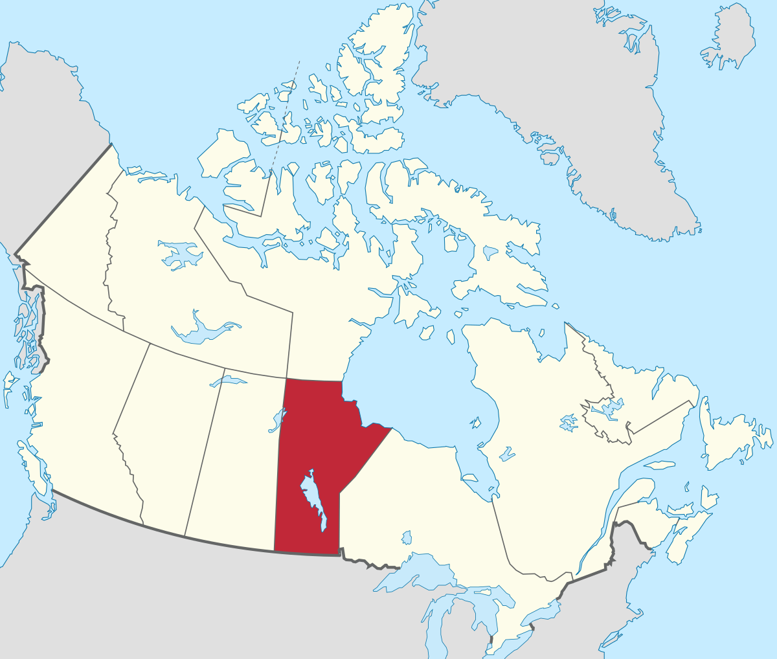
inquiry question:
Think about it throughout the learning experience.
How are the land and culture important to the people of St. Laurent, Manitoba?
This Photo by Unknown Author is licensed under CC BY-SA

Slide 8
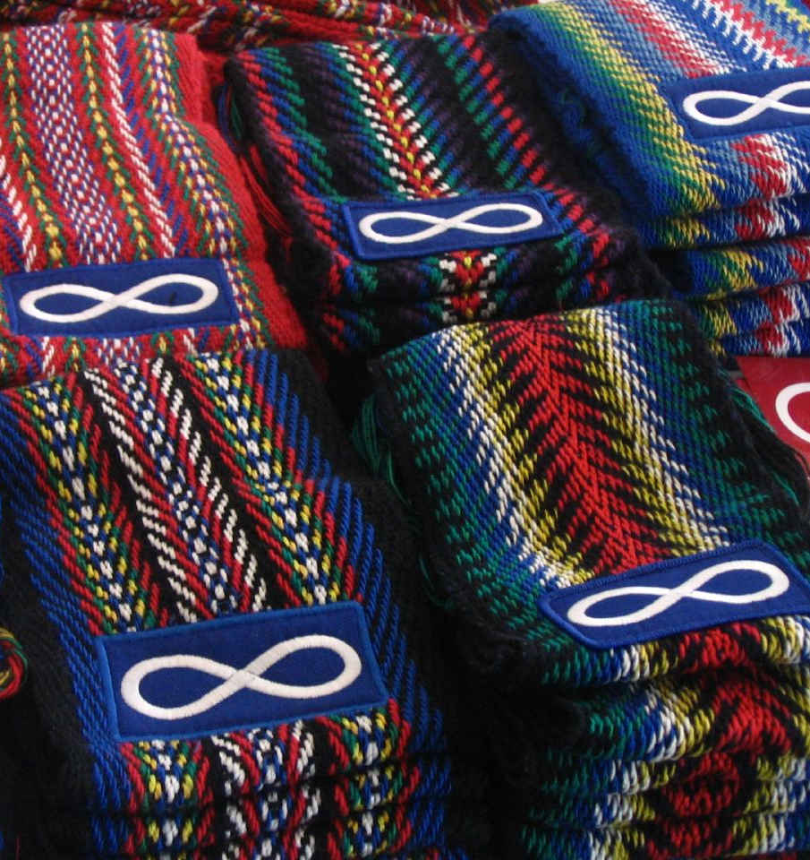
A true and false activity on the Metis in Manitoba….
Metis people in St. Laurent take part in ice fishing.
The Metis flag is green and white.
English, French, and Michif are languages spoken in St. Laurent.
A bombardier is used for trapping.
There is a museum display about Metis people of Manitoba at a museum in the United States.
Louis Riel died of old age in Manitoba.
The fiddle is an important part of Metis music.
Manipogo is a legendary monster found in Lake Winnipeg.
Traditional and modern ways of life are evident in St. Laurent.
There are Metis cultural festivals in Manitoba communities.
BLM#4
This Photo by Unknown Author is licensed under CC BY-SA-NC
Notes:
-You may choose to do this activity as a whole class, small group, partner or individual.
-You may choose to use the Metis Communities in Manitoba: True or False BLM#4 to support this activity.
-You may want to come back to this activity at the end of the unit to see if the students want to change some of the guesses they made here.
(This activity was adapted from the Manitoba Education St. Laurent Teacher's Guide Booklet page 9).

Slide 9
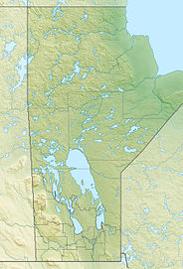
Do you live in or near a Metis community? Which one?
Indicate the following locations on a map of Manitoba:
St. Laurent
your home community
Winnipeg/Red River Settlement
Lake Manitoba
Lake Winnipeg
Red River
Assiniboine River
and 4 other Metis communities
This Photo by Unknown Author is licensed under CC BY-SA
Notes:
-You may wish to have students use the map of Manitoba from Manitoba Education Grade 4 Blackline Master 4.3.1 https://www.edu.gov.mb.ca/k12/cur/socstud/foundation_gr4/blms/index.html
-Metis people live all over Manitoba, however, here are some Manitoba Metis communities: St. Ambroise, St. Leon, St. Malo, St. Vital (part of Winnipeg), St. Boniface (part of Winnipeg), St. Norbert (part of Winnipeg), Ste. Elizabeth, Ste. Anne, Marchand, St-Lazare, Ste. Agathe, San Clara, St. Francois Xavier, St. Adolphe, Norway House, Lorette, Camperville, Cross Lake, Duck Bay, Ile des Chenes, St. Eustache, and Ste-Genevieve.
(Source: Manitoba Metis Federation Governance Structure map: http://www.mmf.mb.ca/docs/MMF_Locals_Map_Dec_2015.pdf)

Slide 10
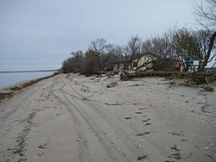
St. Laurent, MB
St. Laurent was originally called Fond du Lac.
St. Laurent is the oldest living Metis community in the world.
The Metis of St. Laurent speak Michif-French.
St. Laurent has a population of 1400 people. In summer, the population increases three times that number because of local cottages.
There are 5 beaches around St. Laurent.
The Smithsonian Museum in Washington, DC had a St. Laurent exhibit for 10 years featuring an antique bombardier used for ice fishing, fishing equipment, and videos about daily life in the community.
RM of St. Laurent | Manitoba
This Photo by Unknown Author is licensed under CC BY-SA
Notes:
RM of St. Laurent – https://www.rmstlaurent.com/
The picture is of Twin Lakes Beach in the RM of St. Laurent.
You may wish to have a class discussion about the facts above. Ask the students if they can make any connections to self, text, or the world about the above St. Laurent facts.
Smithsonian National Museum of the American Indian - https://www.si.edu/museums/american-indian-museum?destination=/museums&searchResults=1&id=p1b-1474716020541-1475755580110-0

Slide 11
St. Laurent Metis people’s
CONNECTION TO THE LAND
Winter
-ice fishing
-feeding hay to cows and horses
-feeding pigs and chickens
Spring
-trapping muskrat
-harvesting morel (mushrooms)
-readying the garden
Although times have changes, the people of St. Laurent are still very connected to the land and continue many of these land-based practices today.
Families lived off the land year-round feeding themselves and selling anything extra. Living and working on the land connected whole families and communities. Indigenous worldview, “The land takes care of us and we take care of the land.”
Fall
-hunting geese and ducks
-hunting deer, elk, rabbit, prairie chicken & partridge
-canning vegetables, fruits, wild berries, fish & wild meat
Summer
-gardening
-cutting hay
-harvesting berries (saskatoons, cranberries)
-harvesting medicine (Seneca root for tea)
-frog picking
-fishing in small boats
Do you know anyone who…..
Have you ever or would you ever……
BLM#5
Notes:
-You may wish to use Connection to the Land: Seasons in St. Laurent BLM#5 to support this learning experience.
-Metis families are still very connected to the land in St. Laurent. However, over time due to inflation, unfortunately it is no longer feasible or sustainable for families to solely live off the land. They will ice fish in the winter and find work, like construction, in the summer.
-Frog picking is done to catch frogs for their leg meat that could be cooked over a fire or breaded. Frogs were sold to Winnipeg or US customers. Commercial frog picking was done until the 1980s. The frog population has declined substantially since the 2011 flood.
-Do you know anyone that traps, hunts, harvests (morels, berries, plant food and medicine), goes fishing/ice fishing, farming (cattle, dairy, hay), and/or gardens.
-Or have you ever, or would you ever want to trap, hunt, harvest (morels, berries, plant food and medicine), go fishing/ice fishing, farm (cattle, dairy, hay), and/or garden.
Au pays des Mitchifs/Michif Country YouTube Video Playlist. The videos are in French, but parts of them can be used without the sound, or with subtitles. Videos 9-24 are on hunting and fishing. They are an up-to-date example of how St. Laurent's local fishermen/harvesters do what they do. WARNING!!!! Some of the content in the videos can be quite graphic I.e. filleting fish, skinning animals, etc. Watch the videos beforehand and only show the parts that you're comfortable with.
https://www.youtube.com/playlist?list=PLu0WeHVQ6midPNOBEObZJVN4HA0uYkpth

Slide 12
History of St. Laurent
Timeline of St. Laurent
1824 – St. Laurent was born
1870 – Manitoba joins Canada
1882 – St. Laurent incorporated as a town
Listen as the teacher reads this history of St. Laurent and complete the picture timeline. History | RM of St. Laurent
Watch the video(s): The Red River Heritage Park depicts life in Manitoba during the 1820s – YouTube (1:00 min) and/or Riel House National Historic Site – YouTube (3:27)
Compare life in St. Laurent today to life in the 1820s.
BLM#6&7
Sources: History | RM of St. Laurent (rmstlaurent.com), The Virtual Museum of Metis History and Culture (Metismuseum.ca), Standing Senate Committee on Aboriginal Peoples - “The People Who Own Themselves”: Recognition of Metis Identity in Canada (sencanada.ca), St. Laurent MB | RM of St. Laurent | Manitoba (rmstlaurent.com)
Notes:
History of St. Laurent - https://www.rmstlaurent.com/history
Red River Heritage Park – Life in Manitoba during the 1820s - https://www.youtube.com/watch?v=m6E1VBe1FXQ
Riel House National Historic Site - https://www.youtube.com/watch?v=4e8Ym6_H130
Virtual Museum of Metis History - http://www.metismuseum.ca/resource.php/14630
Standing Senate Committee on Recognition of Metis Identity - https://sencanada.ca/content/sen/committee/411/appa/dpk/01jun13/gallery-e.htm
RM of St. Laurent - https://www.rmstlaurent.com/
You may choose to use the St. Laurent Timeline BLM#6 & the Comparing Life in St. Laurent Today to Life in the 1820s BLM#7 to support learning about the History of St. Laurent.
Canadian Indigenous Historical Timeline Poster for purchase: http://whitespottedhorse.com/index.php/products/

Slide 13
Michif-French Language – Allo
Michif-French language is at the core of the identity, of the Metis of St. Laurent.
“The Metis are well known as speakers of many languages. In the past many Metis spoke up to five or six languages, including Michif, French, English, Cree, Ojibway and Bungee."
The Metis' ability to communicate in so many languages was incredibly useful for their many roles as voyageurs, buffalo hunters, boatmen, fisherman, traders, small business owners, lumbermen, farmers, cattlemen and interpreters.
"Michif is historically an oral language and as a result there is no standardized spelling...
Michif-French is a dialect of French but has different pronunciation, many shortened words and uses some vocabulary not common in today’s French language.”
Source: Speaking Michif-French, Teacher’s Manual, Louis Riel Institute Publication, Choosing a Spelling System for the Michif-French language, p. 3, http://www.louisrielinstitute.com/docs/Speaking%20Michif%20-%20French%20Manual.pdf
Notes:
Source: Speaking Michif-French, Teacher’s Manual, Louis Riel Institute Publication, Choosing a Spelling System for the Michif-French language, p. 3, http://www.louisrielinstitute.com/docs/Speaking%20Michif%20-%20French%20Manual.pdf
You may wish to have students make comments or ask questions as each paragraph appears. The next slide provides an opportunity for students to see and hear a Michif-French teacher teaching a lesson with students.

Slide 14
Michif-French Language – Boon zhoor
Watch the beginning of this video - Louis Riel Institute - Speaking Michif-French "Intro" Part 1/7 (3 min) Youtube –
Watch one of the other videos in the playlist Louis Riel Institute - Speaking Michif-French Playlist - YouTube:
“Frog Picking”
“Ice Fishing”
“Deer Hunting”
“Bannock”
“Duck Hunting”
“Trapping”
Choose 3 of the words from the video and complete the Michif-French Vocabulary Builder sheet
Additional Michif-French resources:
Speaking Michif-French – Teacher’s Manual Final (louisrielinstitute.ca)
Michif-French Samples – Welcome to Louis Riel Institute
Videos – Our Michif Stories...St. Laurent, Manitoba
Michif | The Canadian Encyclopedia
BLM#8
Notes:
LRI Speaking Michif-French with Madam Patsy (3 minutes) - https://www.youtube.com/playlist?list=PLQh2MwNjojI_RNNMe7k4dTHLHi0nRyZBp
Speaking Michif-French, Teacher’s Manual - http://www.louisrielinstitute.com/docs/Speaking%20Michif%20-%20French%20Manual.pdf
Michif-French Samples – https://www.louisrielinstitute.com/michif-french/
Michif Language Videos – scroll down to Our Michif Stories and listen to one or more videos of St. Laurent past or present community members - https://language.metisportals.ca/videos/
Canadian Encyclopedia – Information and history about Michif and Michif-French (French Michif)- https://www.thecanadianencyclopedia.ca/en/article/michif
Indigenous Peoples Atlas of Canada – Languages - https://indigenouspeoplesatlasofcanada.ca/article/languages/

Slide 15
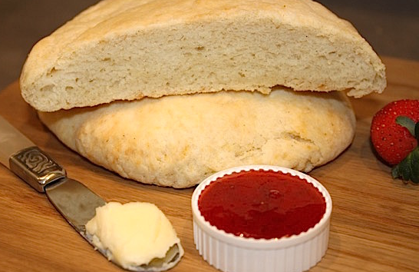
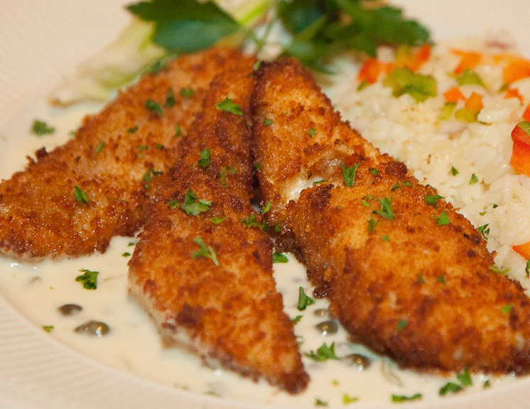
Food of the Metis in St. Laurent
Metis foods have been adapted from their First Nations, Euro-Canadian, and European ancestors.
Other traditional and current Metis foods: fish, boulettes (meatballs), bannock, bangs (fried bread), galette, pemmican, wild rice, soups, stews, tarts, pies, and tourtière (meat pie).
Which ones have you had, or would you like to try?
Create an acrostic poem about your favourite food.
Source: Virtual Museum – Traditional Metis Food and Diet
This Photo by Unknown Author is licensed under CC BY-NC-ND
This Photo by Unknown Author is licensed under CC BY-NC
This Photo by Unknown Author is licensed under CC BY
Notes:
Sources:
Virtual Museum – Traditional Metis Food and Diet - https://www.mnbc.ca/wp-content/uploads/2020/06/Metis_Cookbook_SecondEdition.pdf
https://open.library.ubc.ca/cIRcle/collections/ubctheses/831/items/1.0097651
https://www.mnbc.ca/wp-content/uploads/2020/06/Metis_Cookbook_SecondEdition.pdf
Some families called stews that were not thickened, boiled dinner. The family said it would have been bland but fed the family.
Au pays des Mitchifs/Michif Country YouTube Video Playlist. The videos are in French, but parts of them can be used without the sound, or with subtitles. Videos 1-8 are on Metis cooking. https://www.youtube.com/playlist?list=PLu0WeHVQ6midPNOBEObZJVN4HA0uYkpth

Slide 16
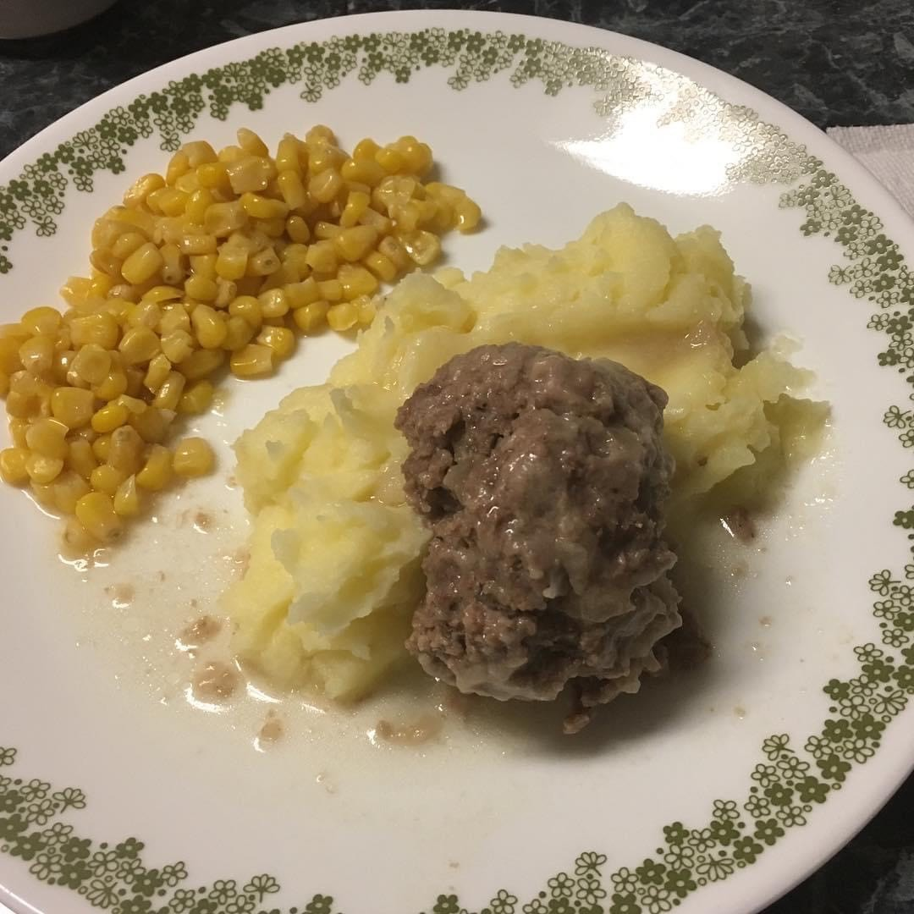
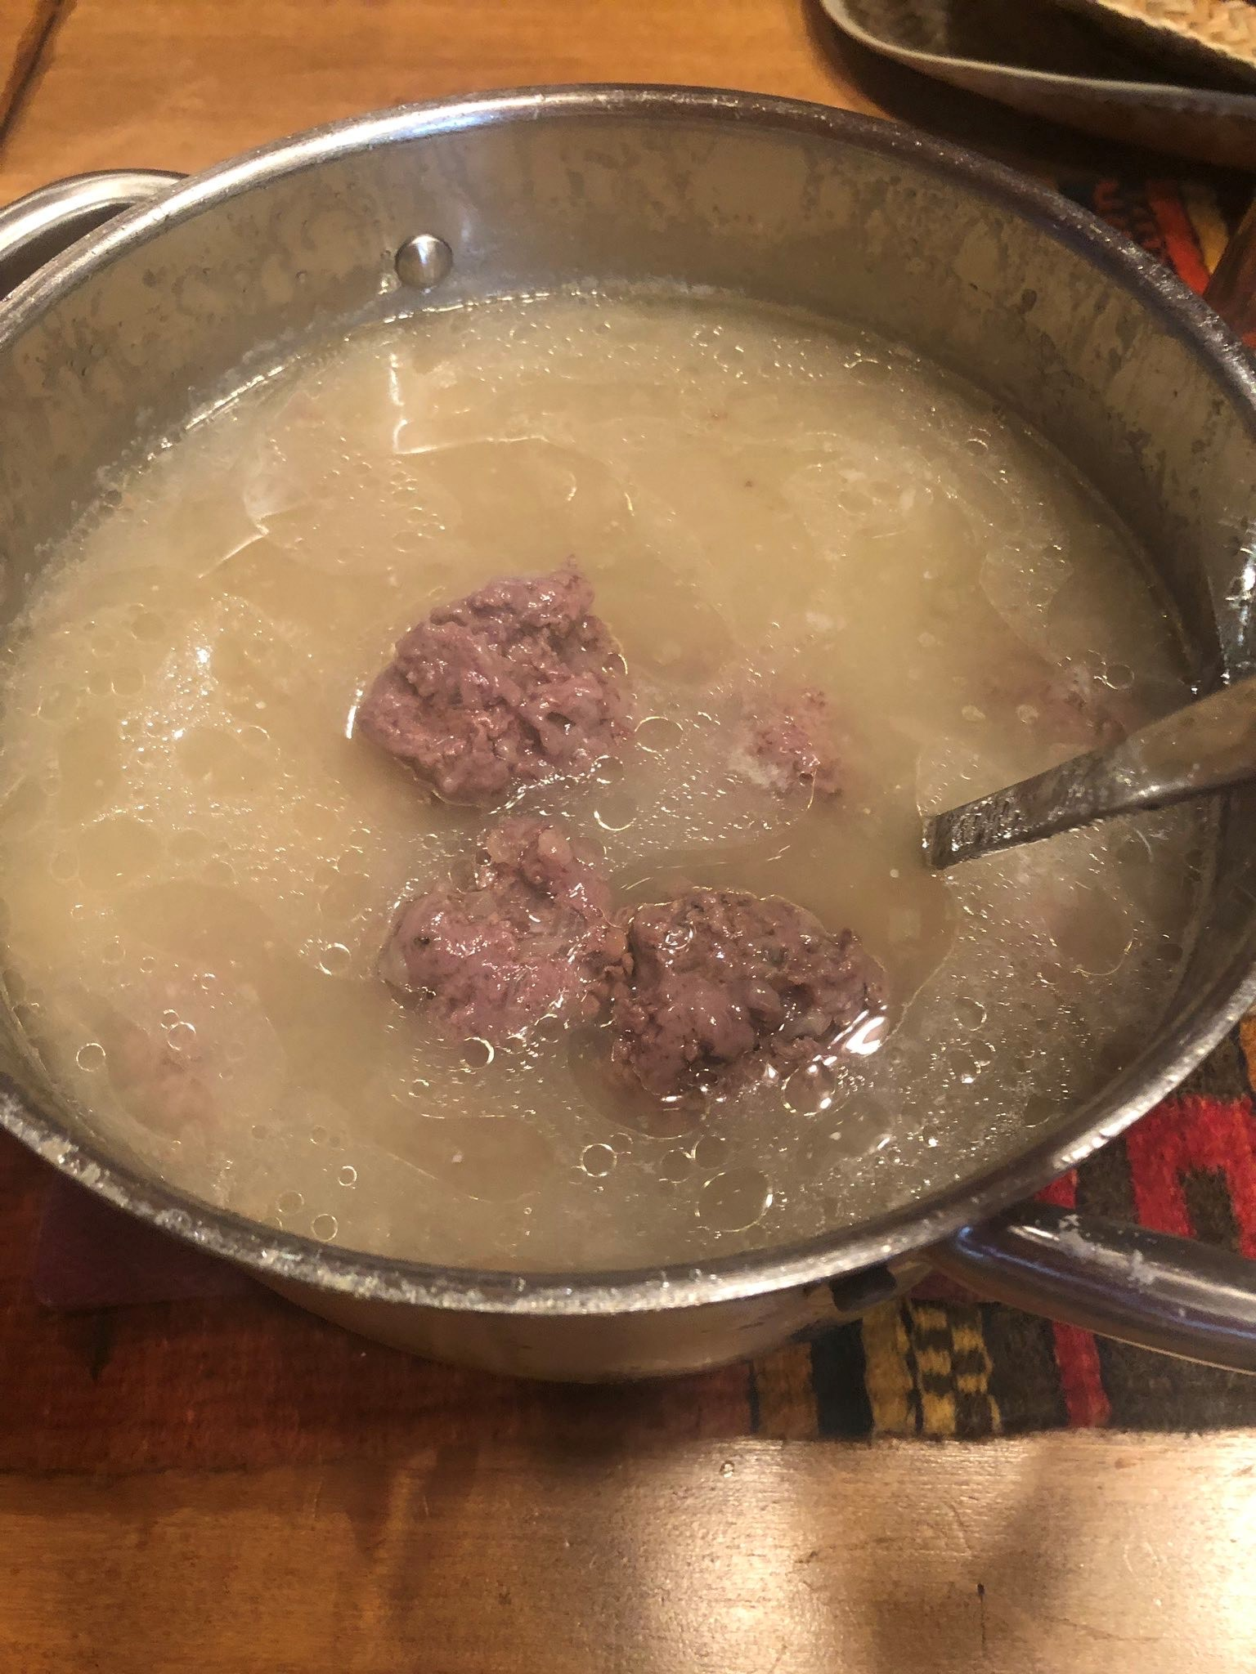
Food of the Metis in St. Laurent
Li Boulette
This meal was prepared by Patricia Millar
Photos used with permission from Crystal Millar Courchene

Slide 17
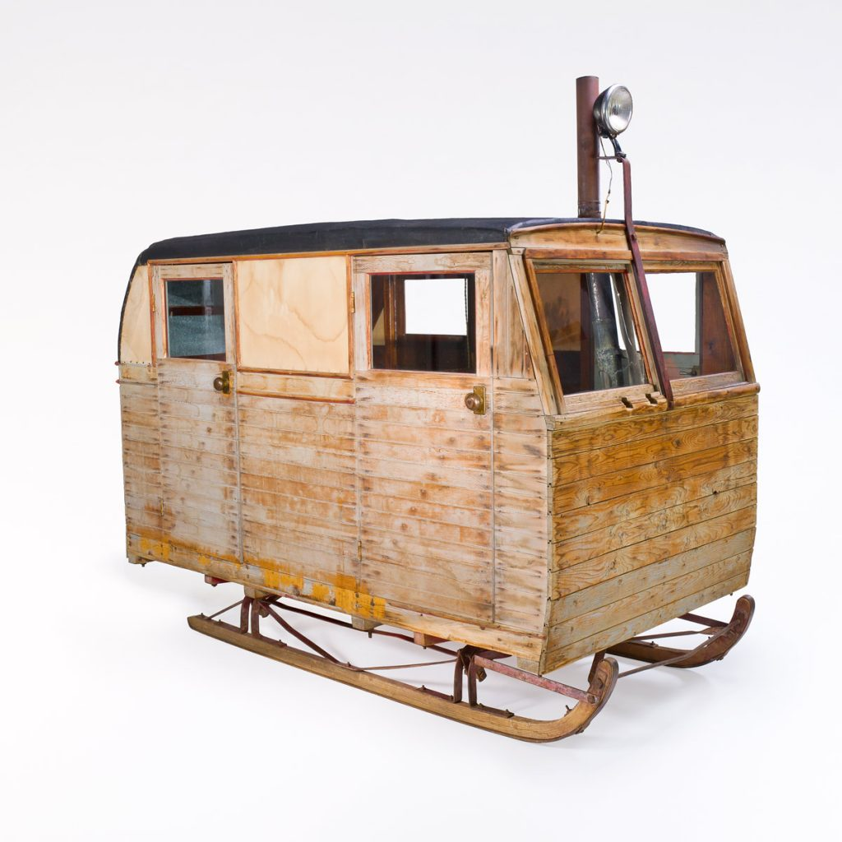
History of Fishing in St. Laurent:
Fishing knowledge and skills have been passed down throughout the generations in St. Laurent.
Commercial ice fishing began in the late 1800s, early 1900s in St. Laurent. Fishermen would take a team of horses and a sleigh with a caboose (sometimes dogsled) out on the ice for 1-2 weeks at a time.
There was a bunkhouse (beds), grub box (food), and a woodstove in the caboose.
The grub box was prepared by the women with enough food to last the entire trip.
While the men were away fishing, the women looked after the farm and family for the entire 1-2 weeks.
They would take extra hay for the horses.
Look at pictures of Ice Fishing in the St. Laurent history book: St. Laurent History Book (pages 98-103)
Horse-drawn caboose | Canadian Museum of History (historymuseum.ca)
Notes:
Commercial fishing is where you are not just fishing to feed yourself – you want to catch extra fish to sell.
-If you click the link to the St. Laurent History Book - https://digitalcollections.lib.umanitoba.ca/islandora/object/uofm:3114857#page/98/mode/1up , click one-page view, then zoom in to show the students a larger version of the pictures. The students will find the pictures interesting and entertaining.

Slide 18
Fishing in St. Laurent:
Today, there are over 30 commercial outfitters in St. Laurent.
Pickerel, jackfish, mullet/suckers, tullibees, perch, mariahs, bass, and rainbow trout are caught on the lake.
Commercial outfitters are part of the Lake Manitoba Co-op Fisheries (the Co-op began in 1969).
Many outfitters have rebuilt Bombardiers to travel onto the lake. They have highway crossing signs and share trails and a winter road down to the lake. Some also use skidoos.
It’s normal for anyone in the community to have an ice fishing shack.
The 2011 flood affected fishing on Lake Manitoba. It changed the environment and where the fish are located (fishing spots). St. Laurent fishermen are adapting to the changes just as they have for hundreds of years.
Watch the following video Lake Manitoba Commercial Ice Fishing – YouTube (5:53 min)
Commercial Ice Fishing in a Bombardier B12 – YouTube (11:53min)
As you watch……What do you notice? What do you wonder?
This Photo by Unknown Author is licensed under CC BY-SA
BLM#9
Notes:
Lake Manitoba Commercial Ice Fishing - https://www.youtube.com/watch?v=uMfzsNGcrYM&feature=share
Commercial Ice Fishing in a Bombardier - https://www.youtube.com/watch?v=e8voZRFY-lE
Fishermen group together in a Co-op so that it is easier to sell their fish, working together like a team.
-The RM of St. Laurent has more pictures of ice fishing https://www.rmstlaurent.com/
-You may wish to use the Commercial Fishing Video Reflection BLM#9 to support this learning experience.
-You may wish to ask the students if there is a skill or tradition that they have learned from an older family or community member?

Slide 19
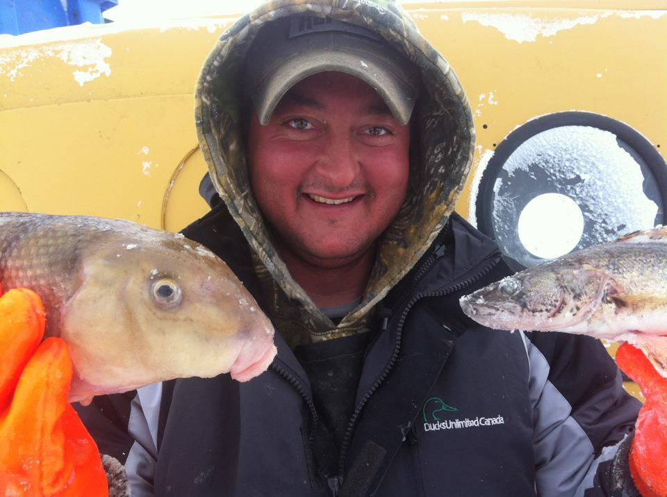
Meet Leon!
Leon is a local, modern-day Metis fisherman, hunter, and trapper.
The next 5 slides show pictures of Leon and his family.
What do you notice?
What do you wonder?
Photo used with permission

Slide 20
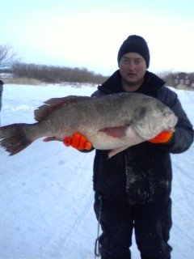
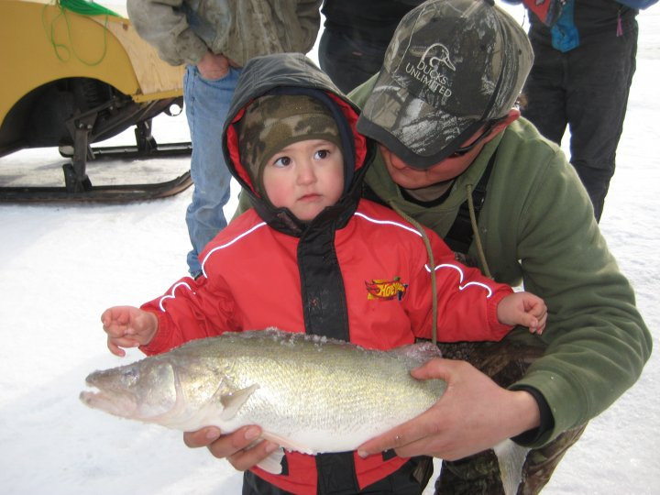
Ice Fishing
Leon says, “the hard work is worth it if you are doing what you love!”
70lb Inconnu
Great Slave Lake, NWT
Buffalo Fish
Pickerel (Walleye)
Photos used with permission

Slide 21
A beautiful catch!
Video of Ice Fishing
Press Play!
Have you ever been Ice Fishing?
Would you ever want to go?
Video used with permission

Slide 22
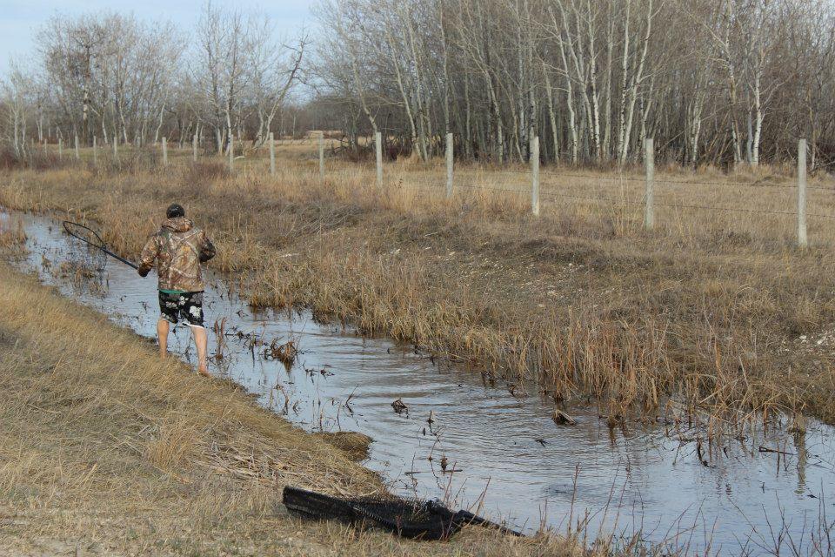
Fishing for Carp in the ditches and channels
Photos used with permission

Slide 23
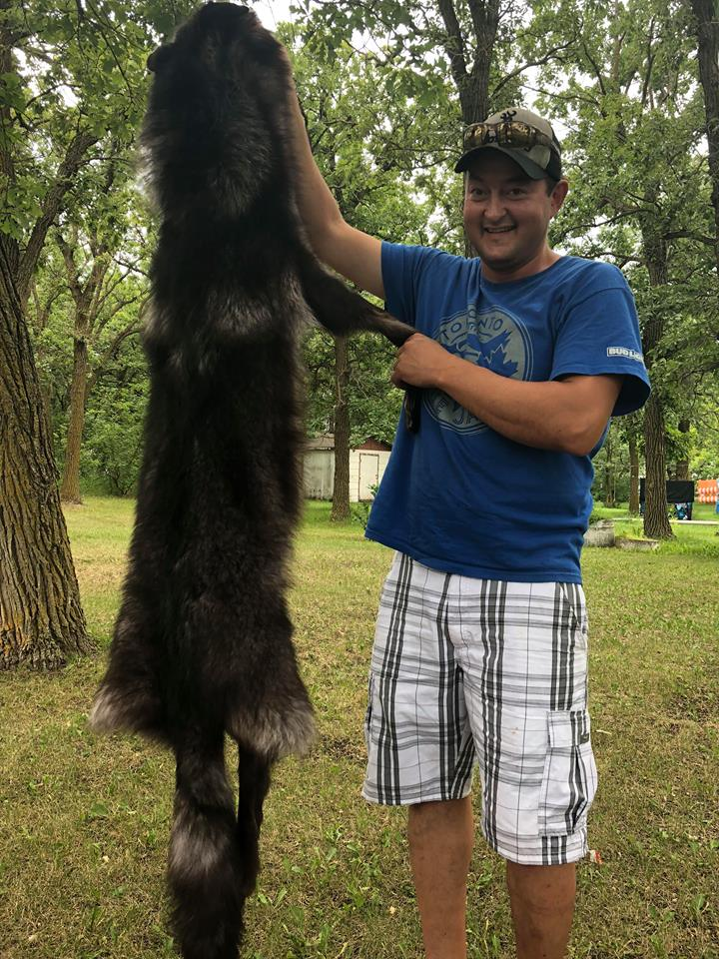
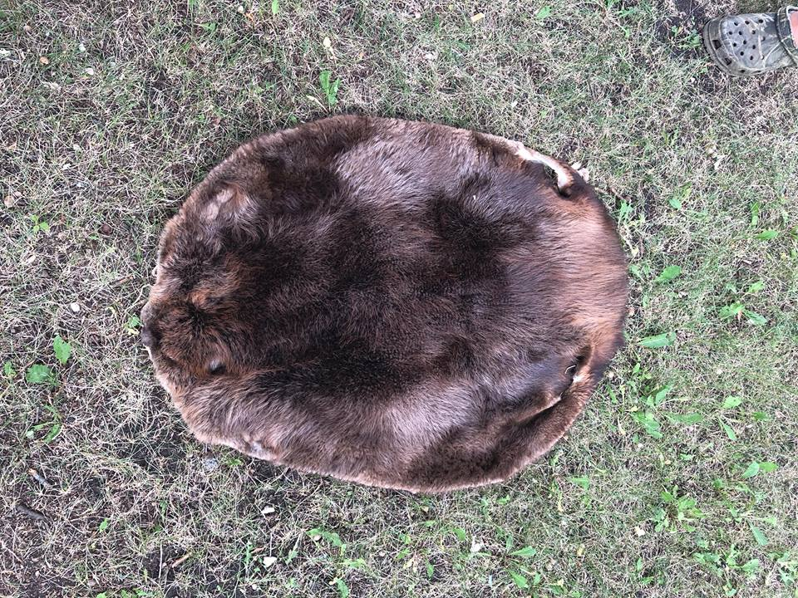
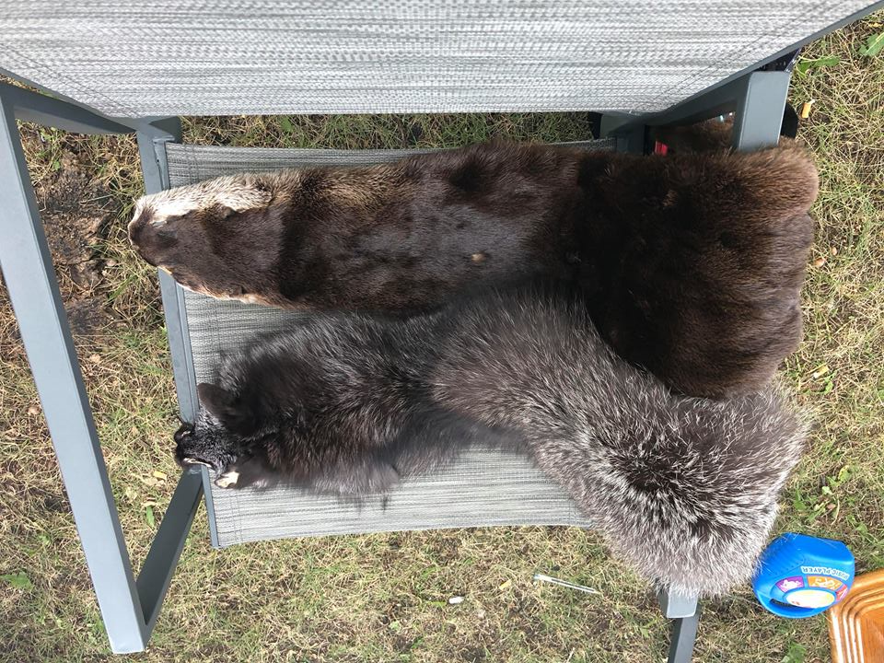
Leon is also a Trapper
Photos used with permission

Slide 24
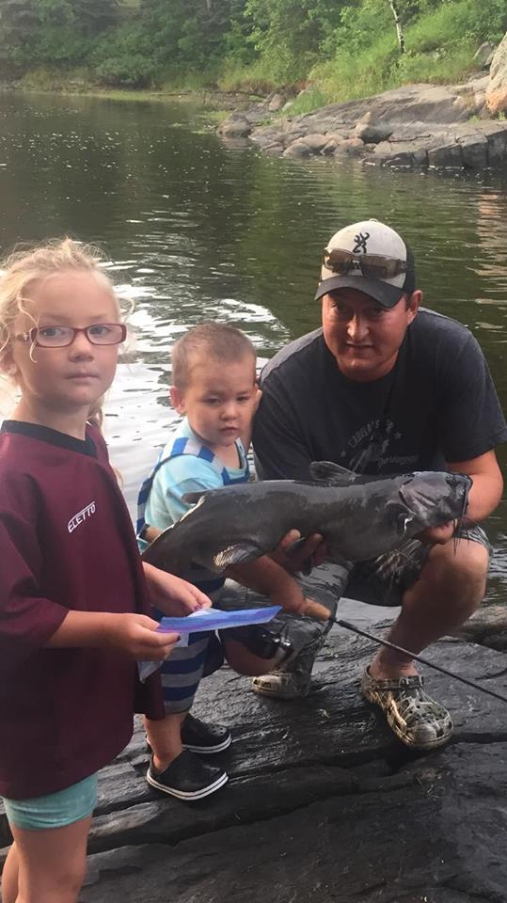
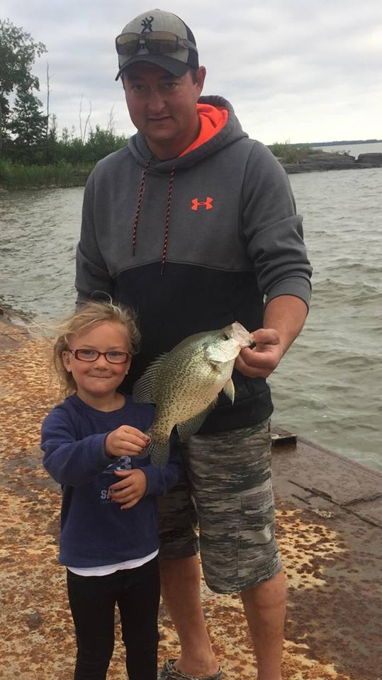
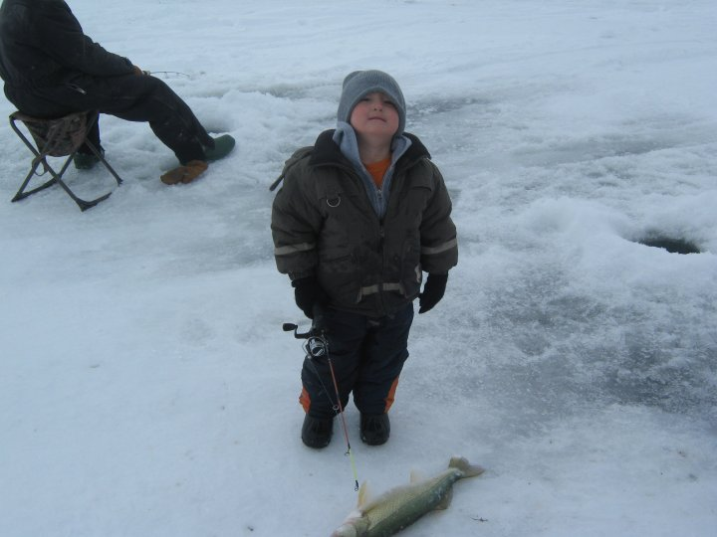
Leon believes in the importance of
passing down knowledge and traditions to future generations.
Photos used with permission

Slide 25
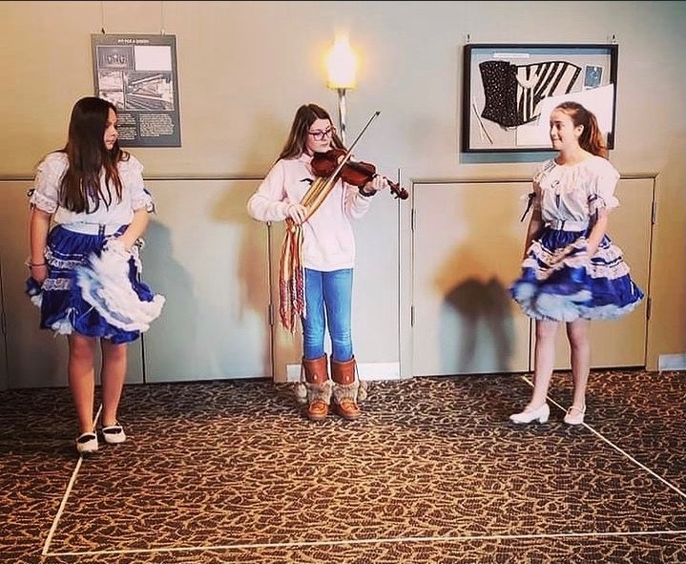
Music and Dance in St. Laurent
Music is central to the culture/identity of St. Laurent.
There are several bands, musicians, fiddle players, and square dancers in or from St. Laurent.
St. Laurent School has a fiddle program.
Many people in St. Laurent sing, dance, and/or can play an instrument. Travelling Truth Tour The Myth is Canada Metis Days St Laurent Manitoba – YouTube (4:56 min)
APM Performance musicale de Coulée: Red River Jig (1:12 min) - YouTube
Do you like fiddle music? Would you ever want to learn how to play the fiddle?
Do you jig or square dance? Would you ever want to learn how to jig or square dance?
Photo used with permission from Crystal Millar Courchene
Notes:
Travelling Truth Tour Metis Days St. Laurent - https://www.youtube.com/watch?v=ybHL2Vb-ViI
APM Red River Jig - https://www.youtube.com/watch?v=_BjzhjQ55zQ&list=PLu0WeHVQ6midOQCOKMmYum-DtIjH6FEG9&index=8
Au pays des Mitchifs/Michif Country YouTube Video Playlist The videos are in French, but parts of them can be used with subtitles. Videos 1-8 (1:12 – 4:09 min) are on Metis music. https://www.youtube.com/watch?v=Z6vVbxHhS8I&list=PLu0WeHVQ6midOQCOKMmYum-DtIjH6FEG9
Sagkeeng's Finest tops Canada's Got Talent (not Metis, but some very talented First Nations Jiggers!)
https://www.aptnnews.ca/national-news/sagkeengs-finest-tops-canadas-got-talent/

Slide 26
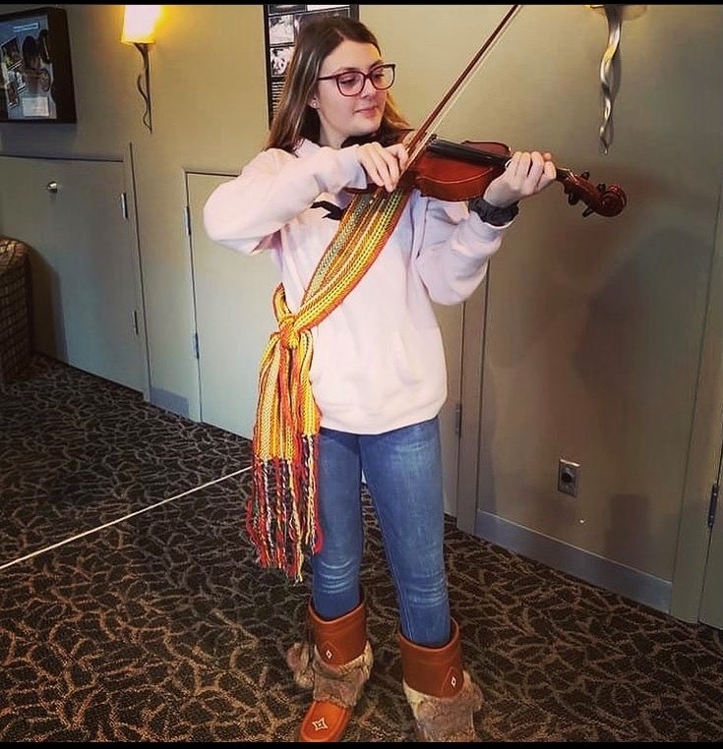
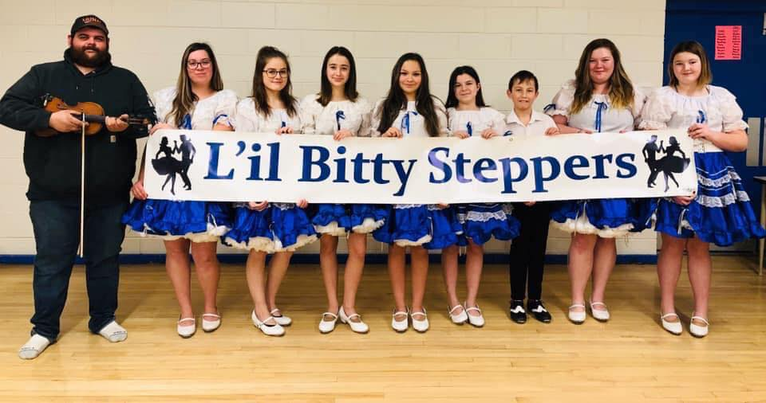
There are some very talented square dancers and fiddle players in St. Laurent! It takes a lot of practice to get good.
The L’il Bitty Steppers are a Metis Square Dancing group in St. Laurent. They dance to the beat of the fiddle music.
Photo used with permission from Crystal Millar Courchene
Photo used with permission from the L’il Bitty Steppers Instructor/Leader Brittany Ducharme

Slide 27
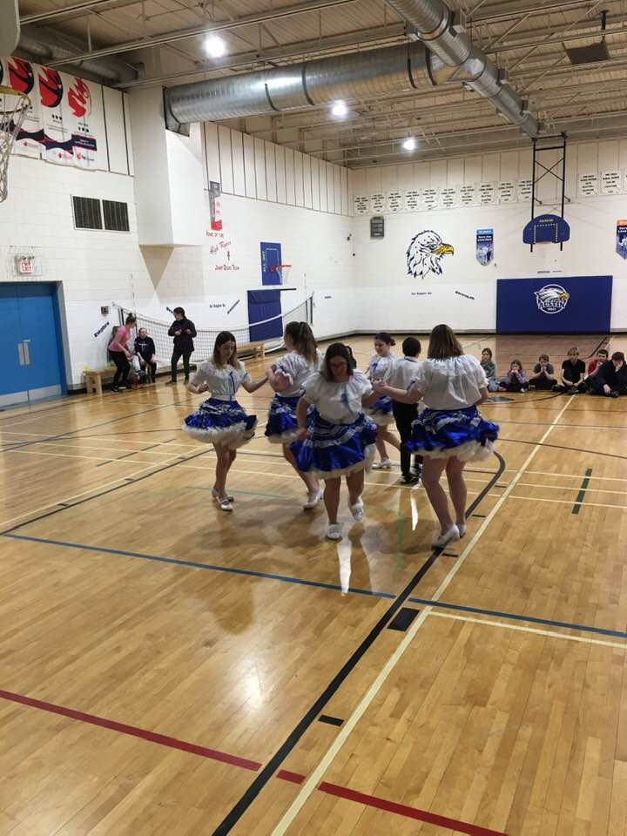
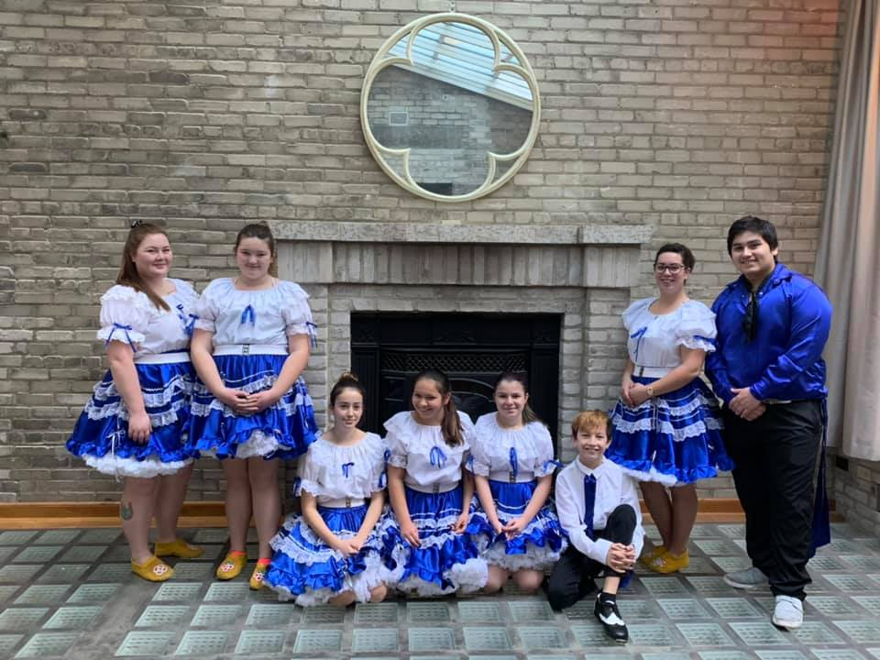
If you can’t dance, you fiddle. If you can’t fiddle you dance. Some do both!
Square Dancing in action!
Photo used with permission from the L’il Bitty Steppers Instructor/Leader Brittany Ducharme

Slide 28
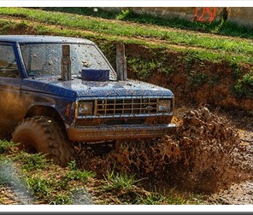
St. Laurent Celebrations
This Photo by Unknown Author is licensed under CC BY-SA
St. Laurent high-lights Metis culture each year at the:
Manipogo – Winter Festival in March celebrates the end of the ice fishing season. Manipogo is the name of the serpent-like monster that lives in Lake Manitoba.
Oak Point Music Festival in June features musical performances and mud bogging.
Metis Days Celebration on August long weekend includes music, dancing, mud-bogging, and a slow pitch tournament.
Former Lt. Gov. Yvon Dumont often attends the celebrations as a participant and/or Master of Ceremonies.
Watch the following videos to see some of the festival fun:
St. Laurent Metis Days!!! – YouTube (0:58 min)
The Gaudry Boys – YouTube (3:29 min)
Mud Bogging! St. Laurent, Manitoba - Metis Days –YouTube (5:28 min)
Create a brochure or pamphlet advertising one of the St. Laurent celebrations.
Photo used with permission from Crystal Millar Courchene
Photos used with permission from the L’il Bitty Steppers Instructor/Leader Brittany Ducharme
Notes:
Manipogo takes place on the “drudge”, formerly a ship harbour, with a tent set up inland. Metis Days is held at the local Metis grounds which has a structure that includes an open stage with a tent attached, a kitchen, and baseball diamonds.
St. Laurent Metis Days - https://www.youtube.com/watch?v=C28vFyu4Zl8
The Gaudry Boys - https://www.youtube.com/watch?v=PLnZLbriSGo
Mud Bogging – St. Laurent - https://www.youtube.com/watch?v=lxEdy69-EDE
Sources:
St. Laurent RM - http://www.stlaurentmb.ca/recreation/
Interlake Tourism - https://interlaketourism.com/roots_connections/Metis-days-celebrations/
Interlake Tourism - https://interlaketourism.com/roots_connections/Metis-days-music/
The Manipogo Festival takes place at the Drudge: History of “The Drudge” (local nickname for the man made harbor): It was dug in July of 1902. My great grandfather Angus Millar was the foreman. They used a steam engine to dig it. Some say it was sunk in the drudge and is still there to this day. They used it to haul freight from the north, and salt from Lake Winnipegosis. Then it was then loaded on wagons and hauled to Raeburn, MB, which was the closest railway point at that time. The fish was hauled to the freezer, a building at the south end of Twin Lakes Beach. Then it was shipped across Lake Francis, on sailing boats, to Raeburn, to be shipped by train to Winnipeg. It was only used like this, commercially, for 2 years. In 1904 the CN Line was built through the community, and The Drudge was no longer needed. The railway, and then eventually trucks took over hauling products out of the area. In 1903 they also shut down commercial summer fishing, which was another use for the harbor called “The Drudge”.

Slide 29
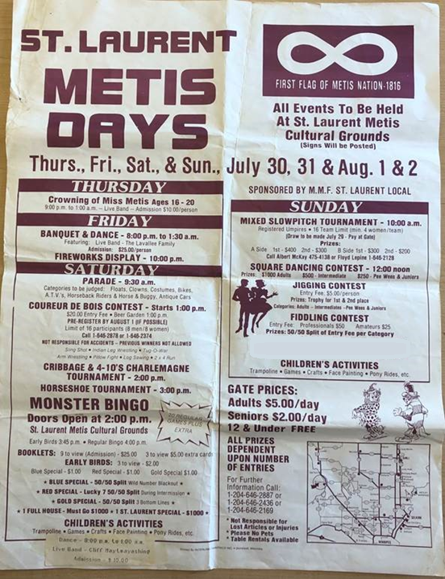
Metis Days
Here is a program of the St. Laurent Metis Days from the late 1980s.
What do you see on this program?
Which events would you want to attend?
How is this event similar and different to events that you’ve attended?
Photo used with permission from Roland Bruce

Slide 30
Metis Games
Can you guess what some Metis games might be?
Tug of war
Arm or leg wresting
Strong man games (carrying sacks of flour, tire-flipping)
Baseball, horseshoes
String games
Which one of the games will you try playing?
This Photo by Unknown Author is licensed under CC BY-NC
Notes:
-You may wish to choose one or two of the games on the list to have the students play “out on the land”. Did you know the 2010 Olympic Torch went through St. Laurent and they had elders blessed the torch? The torch went through St. Laurent because it is the oldest living Metis community in the world.
Sources:
-Learn Michif: Games http://www.learnmichif.com/games
-Gabriel Dumont Institute: Metis socialization and entertainment http://www.Metismuseum.ca/resource.php/00724
http://www.Metismuseum.ca/media/document.php/14630.St.%20Laurent%20MB.pdf
-Virtual Museum: Metis Games http://www.virtualmuseum.ca/edu/ViewLoitLo.do?method=preview&lang=EN&id=11582
-Exploring Numeracy through Traditional Games - https://www.youtube.com/watch?v=xjXH2E2__eA

Slide 31
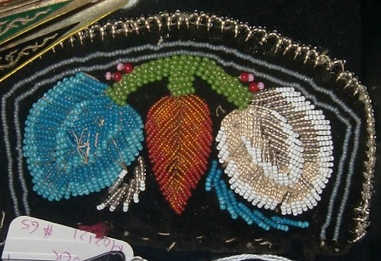
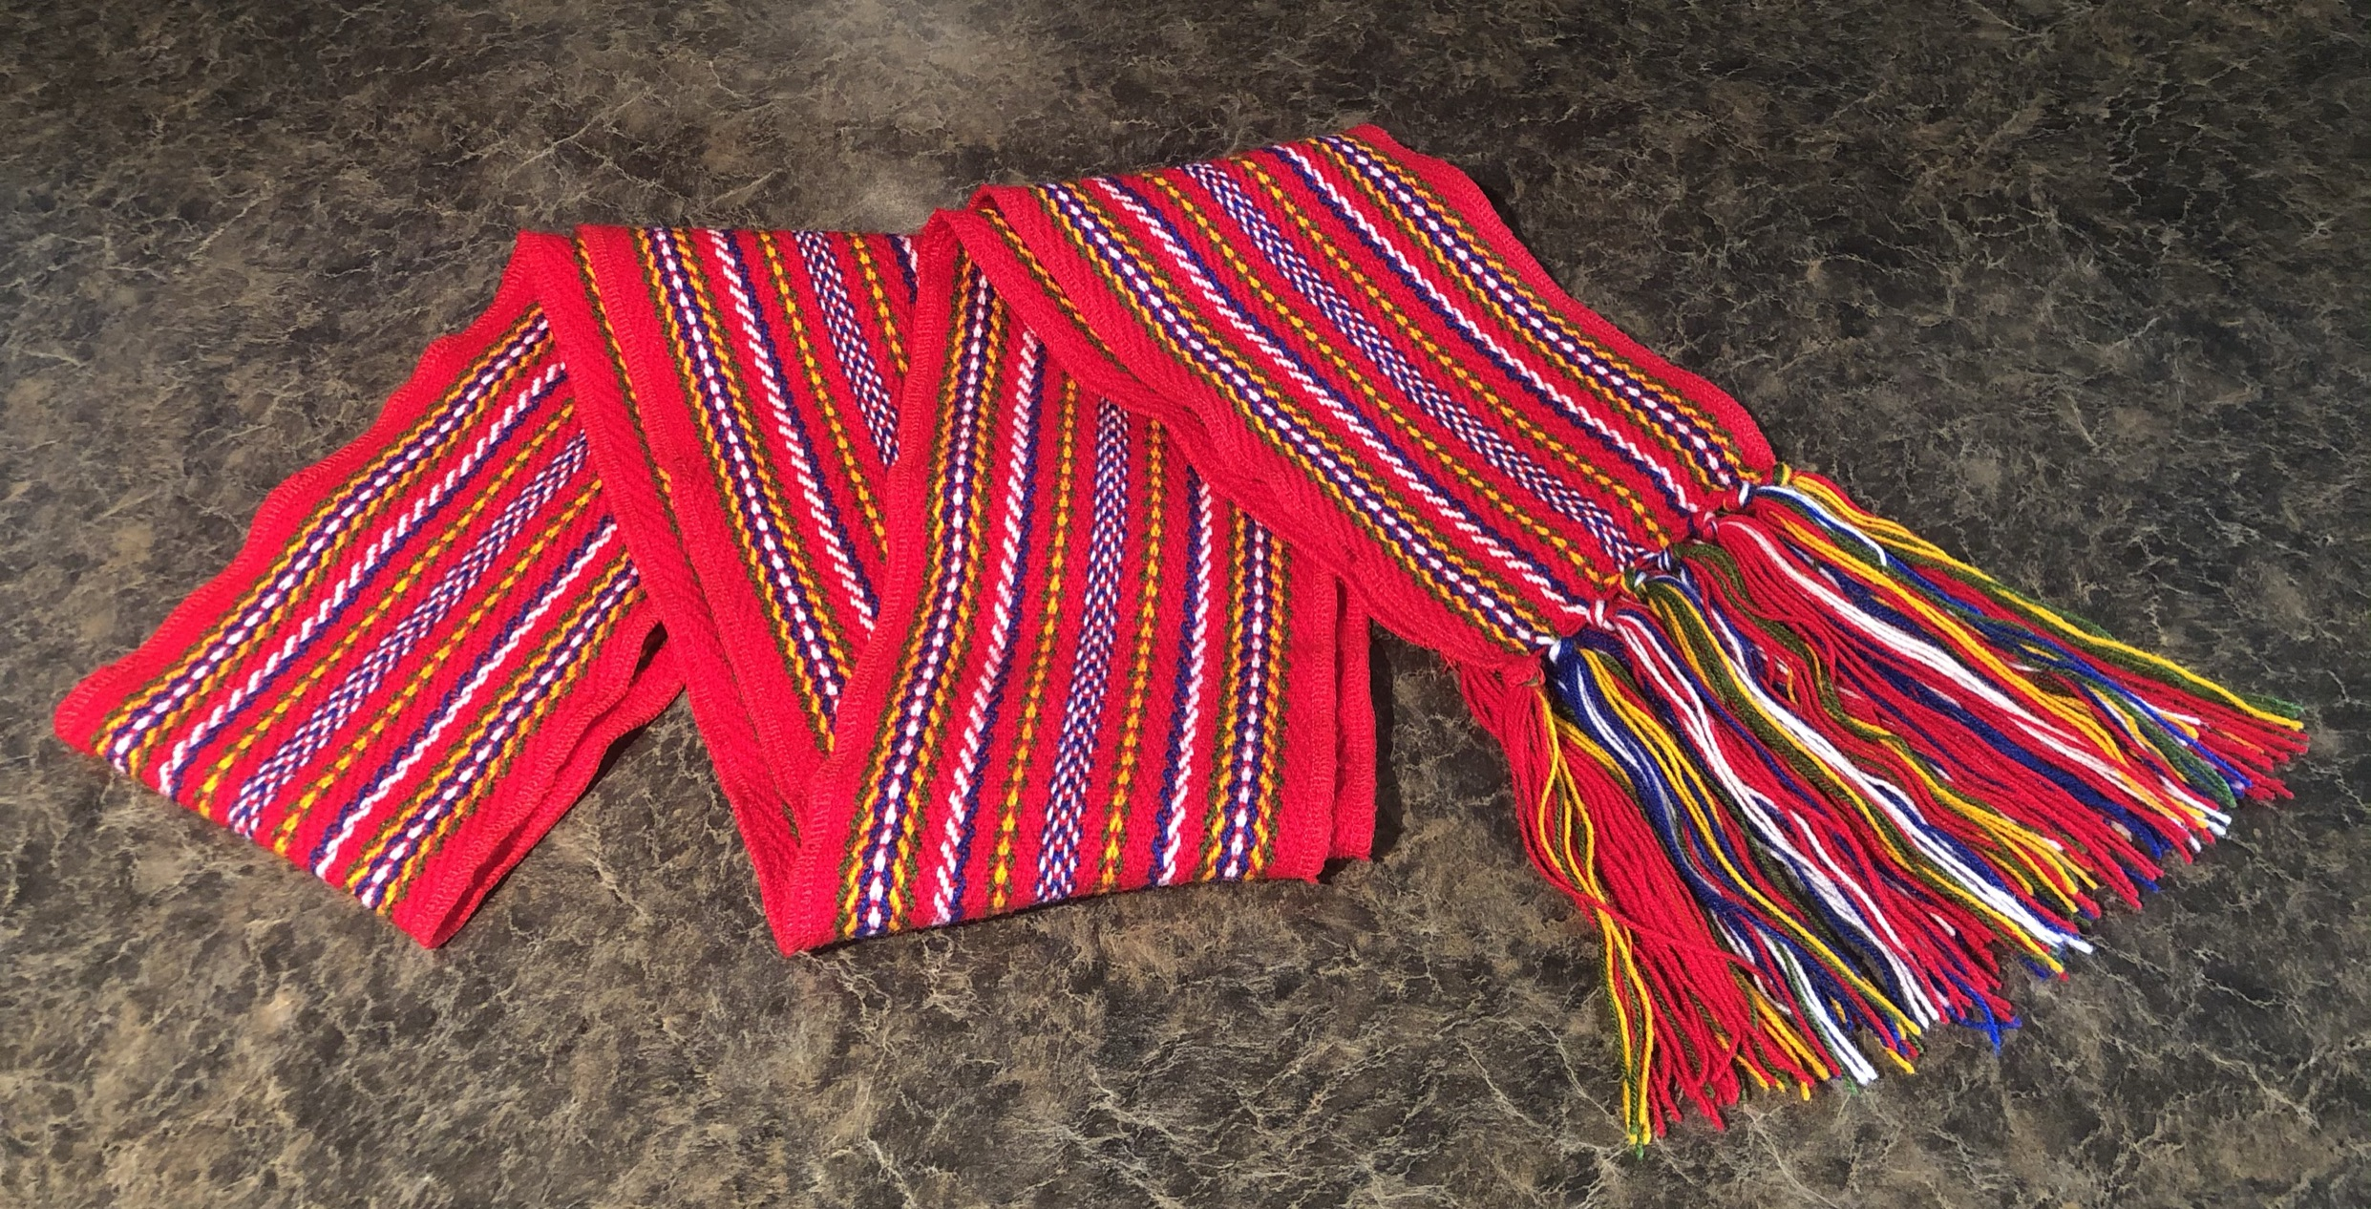
Sash & Beading
Photo used with permission from Jill Fast
This Photo by Unknown Author is licensed under CC BY-NC-ND
Brainstorm ideas about how the sash was used by the first generations of Metis.
Colour the B is for Beadwork page while you watch all or part of the following videos: The Metis Sash – YouTube (5:09 min) The Flower Beadwork People – YouTube (4:41 min)
Notes:
The Metis Sash - https://www.youtube.com/watch?v=L7TeEt5qa0Q
The Flower Beadwork People - https://www.youtube.com/watch?v=54ipBLZJ6L4
-You may use the Gabriel Dumont Institute – B is for Beadwork colouring page PDF – http://www.Metismuseum.ca/resource.php/149609
More ideas about uses for the sash:
More than a fashion statement, the Metis sash was like 'Batman's utility belt’ Lenard Monkman ·
https://www.cbc.ca/news/indigenous/Metis-sash-louis-riel-day-1.5465090?fbclid=IwAR17QUptToEdPtPBJ8PyTc1AkrWfxlldwQOvNlcyxCgB7GhCNCld52BDFcQ

Slide 32
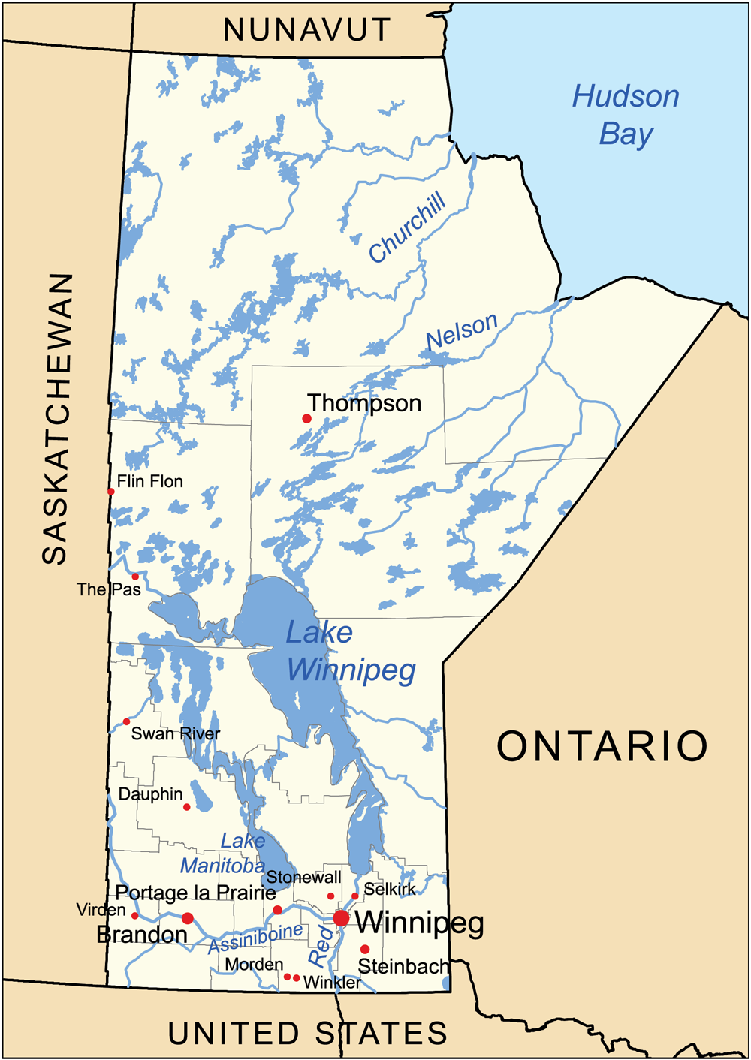
Plan a trip to St. Laurent
Use Google Maps or another map to determine how far it is from your community to St. Laurent.
Research and share the following information with the class:
why you have chosen to go to St. Laurent
the total kilometers there and back
how long it would take to get there
what time you would leave
what time you would arrive home.
BLM#10
This Photo by Unknown Author is licensed under CC BY-SA
Notes:
You may wish to use Trip Planner to St. Laurent BLM#10
Check out a map of St. Laurent from their history book page 23
https://digitalcollections.lib.umanitoba.ca/islandora/object/uofm%3A3114857#page/23/mode/1up

Slide 33
St. Laurent Reflection:
Complete the “L” section of the KWL.
Discuss & correct the True and False activity.
Think about the inquiry question.
How would you answer the inquiry question?
What are some examples of “living culture” that you found in the learning experience?
How are the land and culture important to the people of St. Laurent, Manitoba?

Slide 34
Thank you again to the following St. Laurent community members for their important contributions to the St. Laurent: A Living Culture project:
Roland Bruce – Community Member and Volunteer
Raymond Millar – Community Member, Local Musician, and Volunteer
Crystal Millar-Courchene – Local School Principal & Former Community Member
All photos and video in PowerPoint have been used with permission

