Slide 1
How to Code A …
Grade 2 Learning Experience

Slide 2
Essential Question
How precise does our language need to be to describe objects and to communicate instructions on how to move them?
Draw an arrow on the dashboard to show your decision. Why did you choose to put your arrow where you did?
a little bit specific
mostly specific
My language can be _____ to describe objects and to communicate instructions on how to move them because…
unclear or general
very precise

Slide 3
Some Guiding Questions:
How do we describe the position of objects?
How can 2D objects be described and classified?
How do we use language to communicate instructions?
How can we use the process of problem solving to persevere through challenges?

Slide 4
Instructions
You are going to do a number of tasks to help you be able to answer the questions on the previous slides and to complete the final challenge.
Final Challenge:
Create code to build a device for a teddy bear or doll.
Trade code with a classmate and use their code to build their device.

Slide 5
Rosie’s Walk
1
How do we describe an object’s movement?

Slide 6
Rosie’s Walk
Watch the animated version of Rosie’s Walk by Pat Hutchins.
What words did the author use to describe the path Rosie took? Record the words in the chart below:
What other words could the author have used to describe Rosie’s path? Record these words in the chart below:
Notes:
https://www.youtube.com/watch?v=UAdviuJ4H20

Slide 7
Rosie’s New walk:
What path could Rosie or your pet take around your home and/or yard? Draw a picture and write a description of the path they could take. Insert/record your work below.

Slide 8
Reflect
Ask a family member to follow the path in your new walk for Rosie.
Reflect on how well your description worked below:
Did your family member follow the path the way that you imagined it? | What worked well? | Do you need to make any changes? What changes would you make?

Slide 9
A stone Sat Still
2
How do we describe objects?
How might others describe objects?

Slide 10
A stone sat still
Listen to the story A Stone Sat Still by Brendan Wenzel and then listen to Brendan talk about the story behind A Stone Sat Still.
Notes:
https://www.youtube.com/watch?v=fA-pfoV7ays
https://www.youtube.com/watch?v=P11LB4A-pjI

Slide 11
Outside Observation
Find a safe place outside to quietly observe objects in nature. Draw and/or write to share your thinking about the following questions:
What animals, birds, and insects may visit the area?
How might they observe objects around you?
How would their observations be different from yours?
How would their observations change if they move to a different location?

Slide 12
Ruby’s Dance
3
What is code?
How can we use code to create a dance?

Slide 13
In computer technology, code is a set of instructions that tells the computer what to do.
Watch the video Banana Banana Meatball. What code or instructions are given in the video? Record your thoughts below:
https://cdn.pixabay.com/photo/2016/11/19/14/00/code-1839406_960_720.jpg
Notes:
https://www.youtube.com/watch?v=BQ9q4U2P3ig

Slide 14
Hello Ruby: Adventures in Coding
With a family member, read to the end of chapter 5 in Hello Ruby: Adventures in Coding.
While reading, look for examples of where Ruby provides code (or instructions) during her adventure.
Record you findings below:
Notes:
https://drive.google.com/file/d/0B03ZlEOjN-UIVEFBajF1dDB4Tmc/view

Slide 15
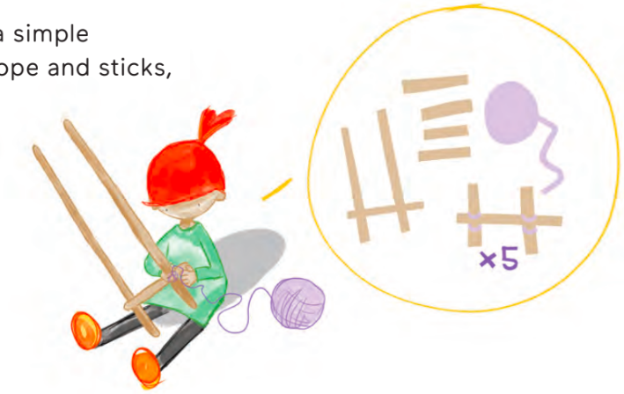
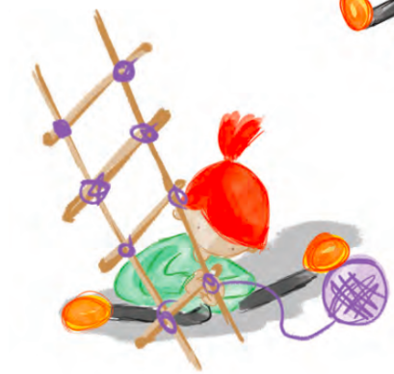
Ruby uses a loop to create a ladder:
A loop repeats a sequence of steps.
Notes:
Attribution:
Created by San Francisco Unified School District (SFUSD) Computer Science team: CSinSF.org
Shared under a Creative Commons license (CC BY-NC-SA 4.0)
Link to materials: https://docs.google.com/presentation/d/1OBoaEBJ6z7JdLDwKj_YfYoehUNJ_iCPBWkuAhk7npaU/edit#slide=id.p

Slide 16
Ruby’s dance:
Use a loop to repeat this dance 3 times.
Notes:
Attribution:
Created by San Francisco Unified School District (SFUSD) Computer Science team: CSinSF.org
Shared under a Creative Commons license (CC BY-NC-SA 4.0)
Link to materials: https://docs.google.com/presentation/d/1OBoaEBJ6z7JdLDwKj_YfYoehUNJ_iCPBWkuAhk7npaU/edit#slide=id.p

Slide 17
YOUR dance:
Choose and drag dance moves into the grey boxes.
How many times should it repeat? Insert a number at the top.
Notes:
Attribution:
Adapted from materials created by San Francisco Unified School District (SFUSD) Computer Science team: CSinSF.org
Shared under a Creative Commons license (CC BY-NC-SA 4.0)
Link to materials: https://docs.google.com/presentation/d/1OBoaEBJ6z7JdLDwKj_YfYoehUNJ_iCPBWkuAhk7npaU/edit#slide=id.p

Slide 18
Reflect
Ask a family member to follow the loop code for your dance.
Reflect on how well your loop code worked below:
Did your family member follow the loop code the way that you imagined it? | What worked well? | Do you need to make any changes? What changes would you make?

Slide 19
Moving in a Shape
4
How can we write code to walk in a shape?

Slide 20
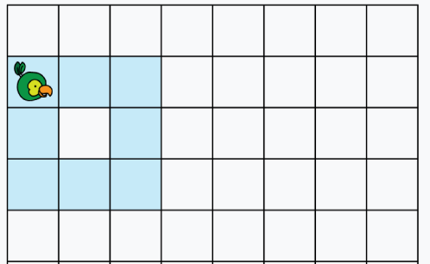
Program:
Forward
Drag code on the right to create a set of instructions or a program so our parrot bot can move in the shape of a square. Your program should read from top to bottom.
Turn Right
Turn Left
Notes:
Adapted from Creative Commons licensed resources developed by San Francisco Unified School District (SFUSD) Computer Science team (CSinSF.org) and the CS Unplugged project by the Computer Science Education Research Group at the University of Canterbury, New Zealand (csunplugged.org)
Shared under a Creative Commons license (CC BY-NC-SA 4.0)

Slide 21
Reflect
Ask a family member to move the parrot bot following your program.
Reflect on how well your program worked below:
Did the parrot bot follow the program the way that you imagined it? | What worked well? | Do you need to make any changes? What changes would you make?

Slide 22
Program:
Forward
Now create a program for a family member to walk the shape of a square in your house.
DO NOT TELL YOUR FAMILY MEMBER WHAT SHAPE THEY ARE GOING TO WALK.
Ask your family member to follow the code and tell you what shape they walked in.
Turn Right
Turn Left
Notes:
Adapted from Creative Commons licensed resources developed by San Francisco Unified School District (SFUSD) Computer Science team (CSinSF.org)
Shared under a Creative Commons license (CC BY-NC-SA 4.0)

Slide 23
Reflect
Ask a family member to follow the program for a square.
Reflect on how well your program worked below:
Did your family member follow the program the way that you imagined it? | What worked well? | Do you need to make any changes? What changes would you make?

Slide 24
Program:
Forward
Now create a program for a family member to walk the shape of a rectangle in your house. How is a square different from a rectangle? How will you need to change your program?
DO NOT TELL YOUR FAMILY MEMBER WHAT SHAPE THEY ARE GOING TO WALK.
Ask your family member to follow the code and tell you what shape they walked in.
Turn Right
Turn Left
Notes:
Adapted from Creative Commons licensed resources developed by San Francisco Unified School District (SFUSD) Computer Science team (CSinSF.org)
Shared under a Creative Commons license (CC BY-NC-SA 4.0)

Slide 25
Reflect
Ask a family member to follow the program for a rectangle.
Reflect on how well your program worked below:
Did your family member follow the program the way that you imagined it? | What worked well? | Do you need to make any changes? What changes would you make?

Slide 26
CHALLENGE:
Program:
Forward
What other shapes can you make a program for? Write a program for another shape. How is it different from the squares and rectangles?
DO NOT TELL YOUR FAMILY MEMBER WHAT SHAPE THEY ARE GOING TO WALK.
Ask your family member to follow the code and tell you what shape they walked in.
Turn Right
Turn Left
Notes:
Adapted from Creative Commons licensed resources developed by San Francisco Unified School District (SFUSD) Computer Science team (CSinSF.org)
Shared under a Creative Commons license (CC BY-NC-SA 4.0)

Slide 27
How to Code A…
5
How do we use language to communicate instructions?

Slide 28
How to Code a Sandcastle
View the book How to Code a Sandcastle by Josh Funk.
What did Pearl learn about coding as she programmed Pascal to build a sandcastle? Record your ideas below:

Slide 29
Final Challenge
Create code to build a device such as a sled, wagon, or car for a teddy bear or a doll.
If you would like an extra challenge, consider making a device that has wheels that turn and/or is able to carry a load!

Slide 30
Brainstorm all of the possible solutions and available materials for your task. What kind of device do you want to build? What ideas could you use for your design?
IMAGINE!

Slide 31
Choose ideas from your brainstorm to plan your design. Draw and label your design. List the materials you will need. Draft your instructions using coding language.
PLAN!

Slide 32
Create your device. Insert a picture below. Finalize your code to make the device.
Create!

Slide 33
Reflect
After building your device, reflect on how well your draft code worked below:
Did your code work the way that you imagined it? | What worked well? | Did you need to make any changes? What changes did you make to your code?

Slide 34
You will now share code with a classmate. Use their code to build their device. Record your results below:
Share!

Slide 35
Reflect
After building your classmate’s device, reflect on how well their code worked below and share with your classmate:
Did the code work the way that you imagined it? | What worked well? | Does the code need any changes? What changes to the code would you suggest?

Slide 36
Essential Question
How precise does our language need to be to describe objects and to communicate instructions on how to move them?
Draw an arrow on the dashboard to show your decision. Explain your thinking.
Now I think my language can be _____ to describe objects and to communicate instructions on how to move them because …
a little bit specific
mostly specific
My thinking changed/stayed the same because …
unclear or general
very precise

Slide 37
Credits
Special thanks to all the people who made and released these awesome resources for free:
Presentation template by SlidesCarnival
Some coding activities and graphics from San Francisco Unified School District (SFUSD) CSinSF.org and the Computer Science Education Research Group csunplugged.org

