Slide 1
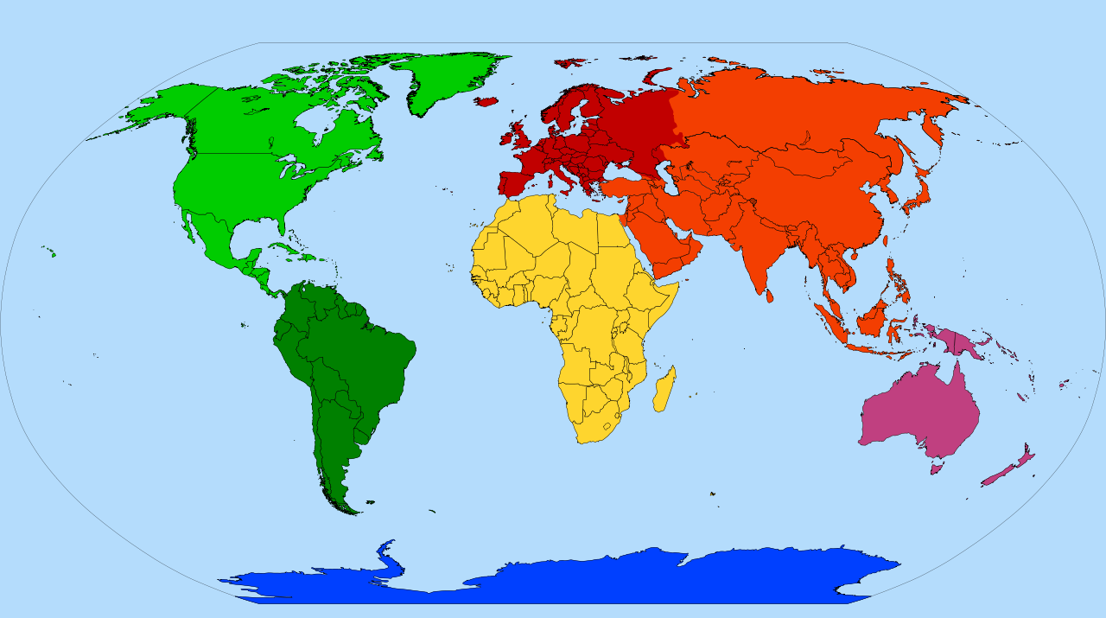
Indigenous Peoples of the World
Grade 3 Social Studies
BLM#1
This Photo by Unknown author is licensed under CC BY-SA.
Notes:
-Ask students if they think they know what they will be studying or if they know anything about Indigenous peoples of the world.
-You may wish to have students complete the ‘K’ and ‘W’ portions of the Indigenous Peoples of the World KWL BLM#1a.
-After some of the learning experiences in this project, you may wish to have students complete a section or two of the Mind Map BLM#1b.
Essential Understandings for this Learning Experience
It is important for educators to be mindful of and have class discussions where appropriate with regards to the following:
Peoples of the World
We are all individuals. We are part of a collective community (We are all unique, just like everyone else!)
Happiness and wanting to do well resides in all of us.
Recognize there are different ways to live and that’s okay. Life is about being happy and healthy with family and friends.
Diversity and Balance
There is diversity within Indigenous groups, just as there are between groups.
All cultures adapt and change overtime. Some Indigenous peoples continue to live a more traditional life-style, and some live a more modern life-style. Often times, Indigenous peoples combine both life-styles.
It is important to portray Indigenous peoples in the present, and not only in the past. Use the present tense as much as possible and where appropriate.
Hearing peoples’ stories can give us new perspectives on the way people live. Empathy is thinking about how it would feel to be in someone else's shoes. Empathy is encouraged because it helps develop understanding.

Slide 2
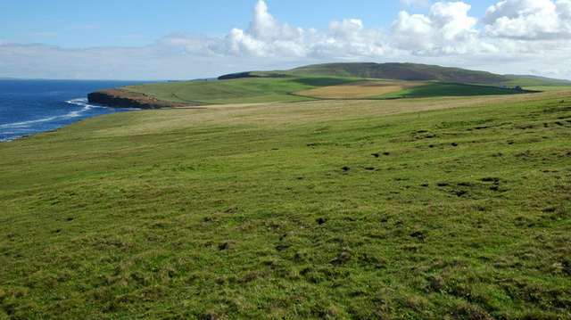
Inquiry Question
Think about this question throughout the learning experiences.
How is the connection to the land and culture important to the Indigenous Peoples of the World?
This Photo by Unknown author is licensed under CC BY-SA.
Notes:
After each learning experience in the project/unit, we recommend that the teacher discusses the following with the class. You could also model how to complete a reflective journal entry about these questions using jot notes, mind maps, etc.
What can we learn from Indigenous peoples’ connections to land and culture?
What is the interrelationship between the land and Indigenous peoples?
How is the connection to land and culture important to Indigenous peoples?

Slide 3
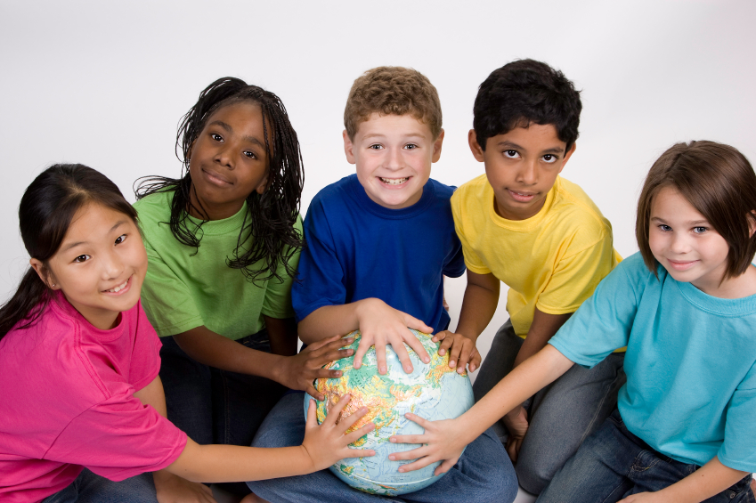
Who are Indigenous Peoples?
Indigenous Peoples:
are people who self-identify as being Indigenous,
are the descendants of the first people to be living in a place,
have a strong connection to the land,
have distinctive traditions, language, culture, laws, and beliefs.
The following video explains the word Indigenous from a Canadian perspective - CBC Kids-2:26 min YouTube
This Photo by Unknown author is licensed under CC BY-NC.
That is about the same number of people that live in Canada AND the US in 2021.
Did you know there are more than 370 million Indigenous peoples in the world?
Are you Indigenous?
Do you know anyone who is Indigenous?
Notes:
The UN does not have an official definition of Indigenous Peoples but there is a common understanding about Indigenous peoples by the UN as described in the bullets above.
Additional resources:
Who are Indigenous Peoples Fact Sheet: https://www.un.org/esa/socdev/unpfii/documents/5session_factsheet1.pdf
Indigenous Peoples of the World Info graph Poster http://www.fao.org/resources/infographics/infographics-details/en/c/454472/

Slide 4
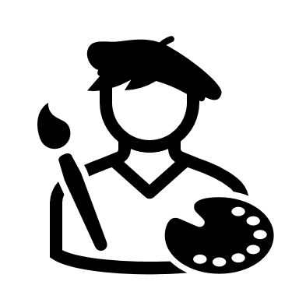
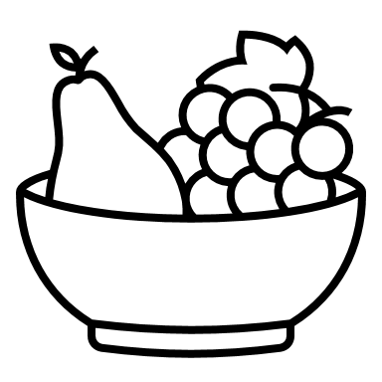
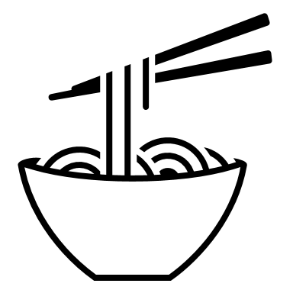
What is Culture?
Think about …
Which cultures you know about?
What culture you practice?
Culture has to do with the way you live. People from all over the world have different ways of doing things. We often live or experience culture through:
Art
Food
Clothing
Language
Beliefs
Celebrations
BLM#2
Explore different cultures through the following videos and read alouds:
YouTube Videos
Scenes from schools around the world 5:12 min)- YouTube
Show and Tell Foreign Languages | Show and Tell | 5:54 min - YouTube
Read Aloud Children's Books
Whoever You Are by Mem Fox (3:01 min)
The Day You Begin by Jacqueline Woodso (7:11 min)
Notes:
-You may wish to use the Cultures Around the World BLM#2 to support this learning experience.
Additional resources:
Creating Racism Free Schools MB ED - https://www.edu.gov.mb.ca/k12/docs/support/racism_free/index.html
Diversity Education MB ED - https://www.edu.gov.mb.ca/k12/diversity/index.html

Slide 5
Get to Know the World!
Listen to the following song:
7 Continents Song - (2:07min) YouTube
Label all the continents on a world map. Also label the equator and the northern and southern hemisphere.
Indigenous Peoples of the World
More than 370 million people
5/100 of the world's population
More than 5,000 different groups
Live in more than 90 countries
Where they live makes up 8/10 of the world's biodiversity - "The variety of animal and plant life in any environment is known as biodiversity." Britannica Kids Biodiversity - Britannica Kids
Did you know, there are Indigenous Peoples on nearly every continent?
Indigenous Peoples live on the following continents:
North America
South America
Africa
Asia
Australia
Europe
The only continent that doesn't have Indigenous Peoples is Antarctica. No humans have ever permanently lived there. But we like to visit!
BLM#3
This Photo by Unknown author is licensed under CC BY-SA.
Notes:
-You may wish to use Continents of the World BLM#3a and Indigenous Peoples of the World: Math Activity BLM#3b to support this learning experience.
Additional resources:
BLM Grade 9 World Village https://www.edu.gov.mb.ca/k12/cur/socstud/foundation_gr9/blms/9-3-1e.pdf
Indigenous Peoples of the World Info graph Poster http://www.fao.org/resources/infographics/infographics-details/en/c/454472/

Slide 6
Connections to the Land
BLM#4
Indigenous peoples have deep connections with the land and have been living on, and with, the land for thousands and thousands of years.
Watch the following video: Learning how to care for Mother Earth with Elder Dave Courchene (3:32 min) CBC Manitoba
Draw a picture of the land where you live. What is your favourite part about nature?
Do a land-based activity. Go outside and spend time with nature.
To Indigenous peoples, land is more than soil and rocks. The land is everything, all of nature, interconnected, in balance and harmony.
Indigenous peoples are considered land experts and have valuable knowledge about the plants, rocks, animals, water, seasons, weather, sky, and stars.
Indigenous peoples remind us, we are part of the land instead of apart from the land.
Notes:
-You may wish to use Connections to the Land BLM#4 to support this learning experience and the next slide as well.

Slide 7
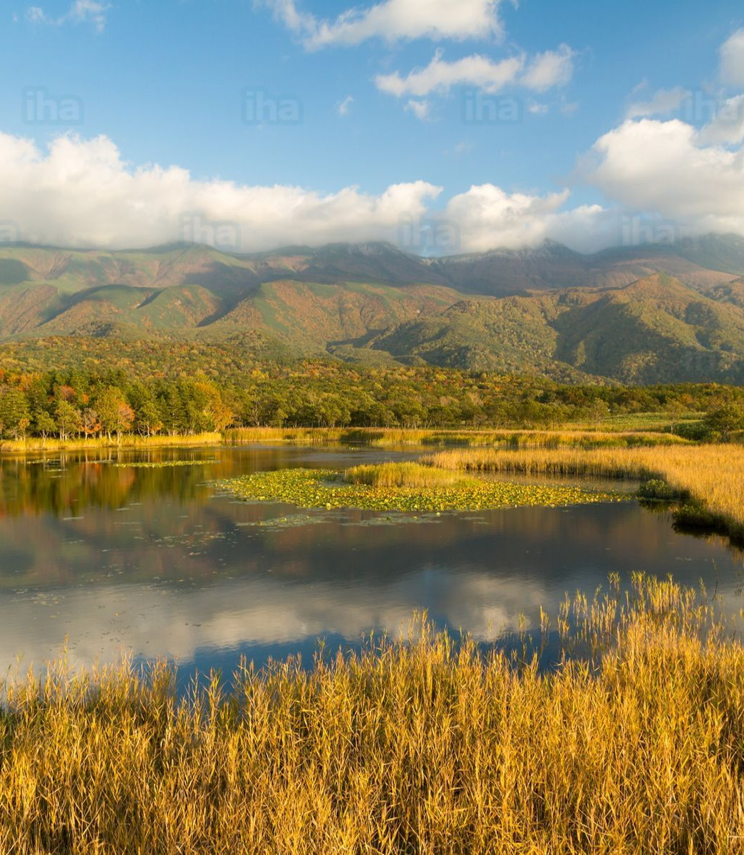
Land Protectors
BLM#4
Although, Indigenous peoples only make up 5/100 of the world's population, their territories make up 80/100 of the World's Biodiversity!
What can you do to help protect the environment?
Listen and learn from Indigenous peoples. Raise awareness about things that are hurting the environment (deforestation, mining, oil, pollution, etc.) Take action (recycle, compost, pick up litter, etc.)
This Photo by Unknown Author is licensed under CC BY-SA-NC
Notes:
-You may wish to use Connections to the Land BLM#4 to support this learning experience.
Additional resources:
Education for Sustainable Development (ESD) – Manitoba Ed
https://www.edu.gov.mb.ca/k12/esd/

Slide 8
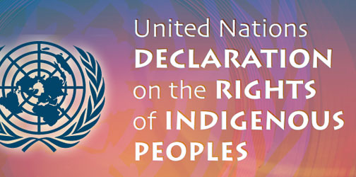
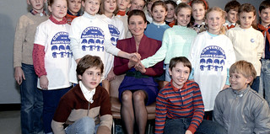
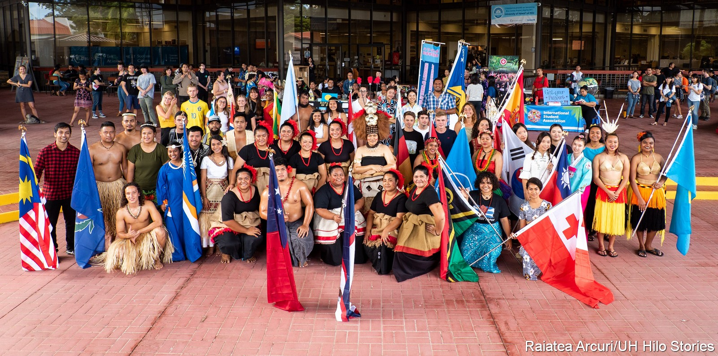
UNDRIP
The United Nations is a group of countries that work together to make the world a better place.
United Nations - explained l CBC Kids News (2:30 min)- YouTube
This Photo by Unknown Author is licensed under CC BY-SA-NC
The United Nations Declaration on the Rights of Indigenous Peoples was adopted in 2007 to protect Indigenous Rights.
Indigenous Peoples have the Right to:
Decide what's best for themselves
Live freely and be safe
Practice their culture and language
Not be discriminated against
Keep their relationship with the land
Not be forced from their lands
BLM#5
This Photo by Unknown Author is licensed under CC BY-NC-ND
FAO, Indigenous Peoples and the Free, Prior & Informed Consent (FPIC) 2:50 min- YouTube
Assembly of First Nations UNDRIP YouTube Video 0:57 min
This Photo by Unknown Author is licensed under CC BY
Notes:
-You may wish to use United Nations and the Rights of Indigenous Peoples BLM#5 to support this learning experience.
Additional resources:
Youth Version UNDRIP: http://files.unicef.org/policyanalysis/rights/files/HRBAP_UN_Rights_Indig_Peoples.pdf

Slide 9
Indigenous Peoples of the World
Sami
First Nations, Métis, and Inuit
Hmong
Maya
Aboriginal and Torres Strait Islanders
Maasai
BLM#6
This Photo by Unknown author is licensed under CC BY-SA.
Notes:
-You may wish to use Indigenous Peoples of the World BLM#6a and/or Indigenous Peoples of the World BLM#6b to support the learning experiences on slides 10-15.
Note: There are over 5,000 different Indigenous groups in the world. https://en.wikipedia.org/wiki/List_of_indigenous_peoples
Cautionary note regarding the videos: It is difficult to find videos that portray Indigenous peoples accurately. The videos in this PowerPoint were selected because they do a relatively good job of portraying Indigenous peoples, but they are not perfect. There is diversity within Indigenous groups, just as there are between groups. Therefore, it's important to have discussions with students about the videos and these topics. Teachers are encouraged to preview the videos. Keep in mind, some of the videos were produced with a promotional agenda.

Slide 10
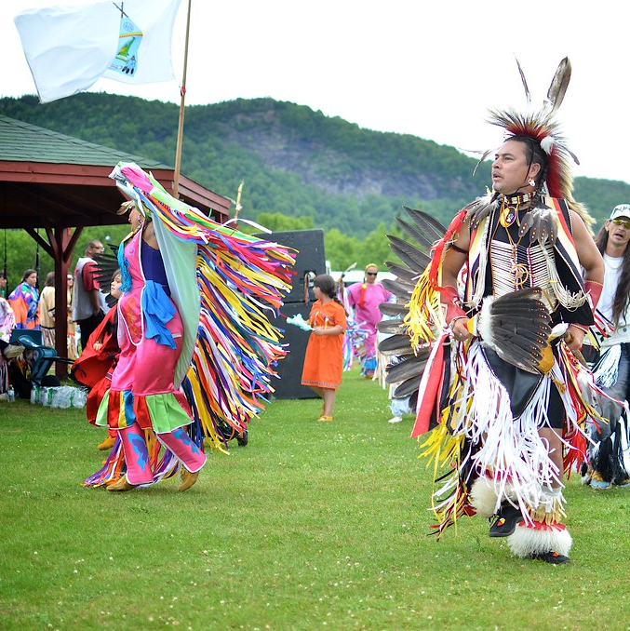
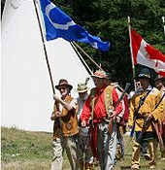
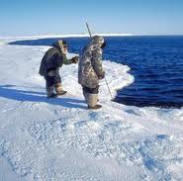
First Nations, Métis, and Inuit
Go Back to the Map
Meet Indigenous kids from all across Canada TVO Raven's Quest
First Nations, Metis, and Inuit are Indigenous Peoples whose traditional territories are in Canada.
Indigenous Hunter Keeps Traditions Alive in Boreal Forest (6:17 min) - YouTube
The Pimachiowin Aki Profile (1:54 min)- YouTube
The Métis of Wood Buffalo National Park (4:34 min) – YouTube
The Métis Homesteads 2:49 min
Living in the Arctic - Silaqqi, Teacher in Nunavut, Canada (3:25 min) - YouTube
BLM#6
This Photo by Unknown author is licensed under CC BY-SA.
This Photo by Unknown author is licensed under CC BY-SA.
This Photo by Unknown author is licensed under CC BY-NC.
Notes:
-You may wish to use Indigenous Peoples of the World BLM#6a and/or Indigenous Peoples of the World BLM#6b to support this learning experience.
There are 1.6 million Indigenous peoples living in Canada (2016). https://www12.statcan.gc.ca/census-recensement/2016/as-sa/fogs-spg/Facts-CAN-eng.cfm?Lang=Eng&GK=CAN&GC=01&TOPIC=9

Slide 11
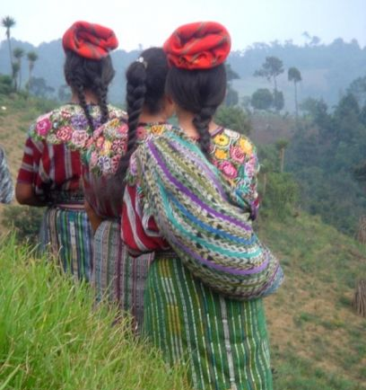
Maya
BLM#6
Go Back to the Map
The Maya are Indigenous Peoples whose traditional territories are in Mexico, Guatemala, Belize, El Salvador, and Honduras.
The Maya People (2:54 min)
A Day in the Life Mayan Mother with 12 Kids (9:55 min)
Notes:
-You may wish to use Indigenous Peoples of the World BLM#6a and/or Indigenous Peoples of the World BLM#6b to support this learning experience.
There are 7 million Maya living in the world today. https://maya.nmai.si.edu/maya#:~:text=Today%2C%20more%20than%20seven%20million,advanced%20civilizations%20in%20the%20Americas.
About the Maya: https://www.ancient.eu/Maya_Civilization/#:~:text=The%20Maya%20are%20an%20indigenous,Belize%2C%20El%20Salvador%20and%20Honduras.

Slide 12
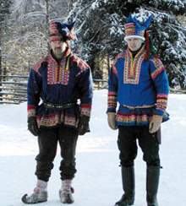
Sami
Go Back to the Map
The Sami are Indigenous Peoples whose traditional territories are in Norway, Sweden, Finland, and Russia.
Expediton Norway - The South Sami People (14:23 min) – (parts of reindeer carcus)YouTube
People under the northern lights: Story of a Sami reindeer herder (0:45 min)
Will this be the last generation of Sami reindeer herders? 4:49 min- YouTube
This Photo by Unknown author is licensed under CC BY-SA.
Notes:
-You may wish to use Indigenous Peoples of the World BLM#6a and/or Indigenous Peoples of the World BLM#6b to support this learning experience.
There are between 50,000-100,000 Sami living in the world today. https://www.iwgia.org/en/sapmi.html#:~:text=The%20Sami%20are%20the%20indigenous,represent%20between%2050%2C000%20and%20100%2C000.
About the Sami: https://www.iwgia.org/en/sapmi.html

Slide 13
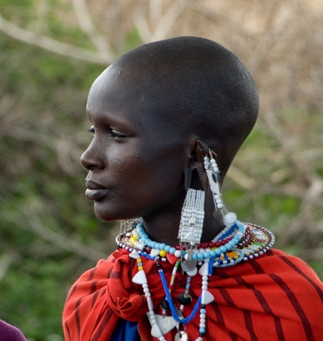
Maasai
BLM#6
Go Back to the Map
The Maasai are Indigenous Peoples whose traditional territories are in Kenya and Tanzania.
Maasai Life Through A Child's Eyes YouTube (3:33 min) Amboseli Masai Village Visit (3:13 min) Beads tell stories of Maasai culture (3:15 min)
Maasai in 360 VR (2:04 min)
Maasai Wilderness Conservation Trust (3:31 min)
This Photo by Unknown author is licensed under CC BY-SA-NC.
Notes:
-You may wish to use Indigenous Peoples of the World BLM#6a and/or Indigenous Peoples of the World BLM#6b to support this learning experience.
There are 2 million Maasai living in the world today. https://en.wikipedia.org/wiki/Maasai_people
About the Maasai: https://minorityrights.org/minorities/maasai/ Maasai Wilderness Conservation Trust - Kenya Wildlife Conservation
The Maasai Culture and Traditions - Maasai Wilderness Conservation

Slide 14
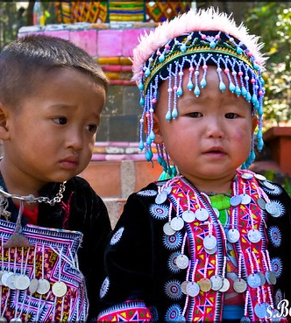
Hmong
BLM#6
Go Back to the Map
The Hmong are Indigenous Peoples whose traditional territories are in China, Viet Nam, Laos, Myanmar, and Thailand.
Hmong Culture in the US "Sound of Colors" (5:35 min)- YouTube
Rice Planting Season in Sapa (1:41 min)
Ker's House (1:39 min)
Adventures in the mountains (2:26 min)
Foraging in the mountains (1:50 min)
This Photo by Unknown Author is licensed under CC BY-NC-ND
Notes:
-You may wish to use Indigenous Peoples of the World BLM#6a and/or Indigenous Peoples of the World BLM#6b to support this learning experience.
There are 14-15 million Hmong living in the world today. https://simple.wikipedia.org/wiki/Hmong_people
About the Hmong Peoples: https://unpo.org/members/7891#:~:text=The%20Hmong%20are%20an%20indigenous,spoken%20language%2C%20culture%20and%20religion.

Slide 15
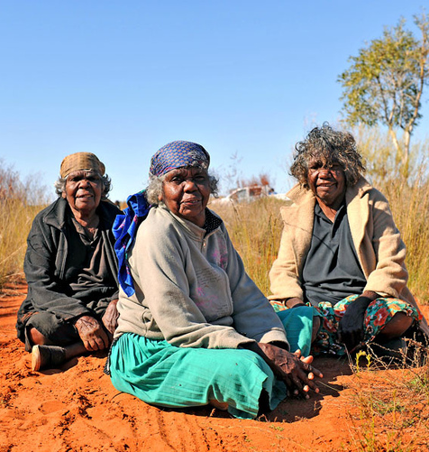
Aboriginal and Torres Strait Islanders
BLM#6
Go Back to the Map
Aboriginal and Torres Strait Islanders are Indigenous Peoples whose traditional territories are in Australia.
Australian kids explain aspects of Aboriginal culture (1:43 min)
National Aboriginal and Torres Strait Islander Children's Day Launch Video Clip (1:12 min) (shows kids are kids all over the world) animation
Connection to Country (Land) (3:13 min)
Map of Indigenous Australia | AIATSIS
Music Videos 'Identity Matters' Series
This Photo by Unknown author is licensed under CC BY-ND.
Notes:
-You may wish to use Indigenous Peoples of the World BLM#6a and/or Indigenous Peoples of the World BLM#6b to support this learning experience.
There are about 800,000 Aboriginal and Torres Strait Islander peoples living in Australia (2016). https://www.aihw.gov.au/reports/australias-welfare/profile-of-indigenous-australians
Music Videos 'Identity Matters' Series
Feel The Fire (3:27) https://www.youtube.com/watch?v=4e54HKlBDx0
Two Worlds (3:27) https://www.youtube.com/watch?v=Slvd0OYD2_o
The Spirits are Calling (3:01) https://www.youtube.com/watch?v=7krhV36LEOw
Our Connection to the Land (3:29) https://www.youtube.com/watch?v=av3SeQpn37o

Slide 16
The Land
Look at the chart to compare the different places Indigenous peoples live.
Look at a map the World (landforms, vegetation, etc.)
Find or draw images of the places and/or choose one and make a diorama.
Indigenous Group | First Nations, Métis and Inuit | Maya | Sami | Maasai | Hmong | Aboriginal and Torres Strait Islanders
Location | North America | Central America | Northern Europe | East Africa | Southeast Asia | Australia
Weather | Hot and cold | Warm/hot | Cold/warm | Hot/dry | Warm/rain | Warm/hot
Landforms/ Vegetation | Mountains, prairie, tundra, forests | Jungle, lush forests | Mountains, forests, snow, ice | Deserts, some trees | Mountains, lush forests | Deserts, forests, beaches
Animals | Deer, rabbits, bears | Monkeys, birds | Reindeer, salmon, moose | Lions, zebras, giraffes | Tigers, monkeys, birds | Kangaroos, koala bears
Notes:
You may also instruct the students to do a jigsaw activity for the picture search/drawings/diorama.

Slide 17
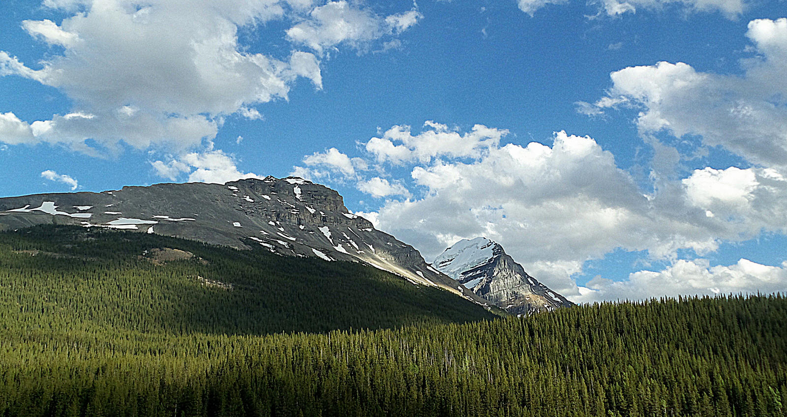
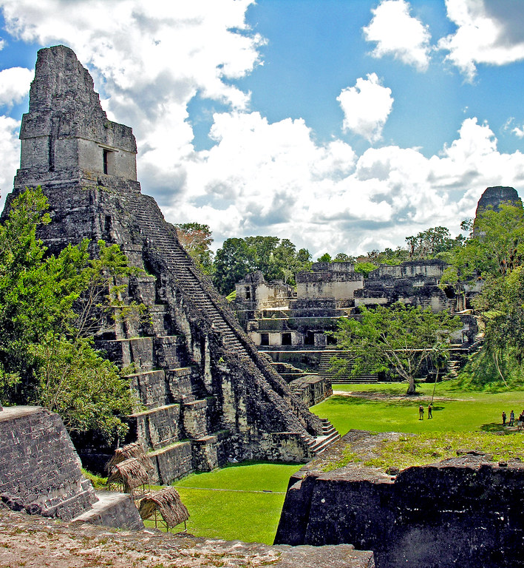
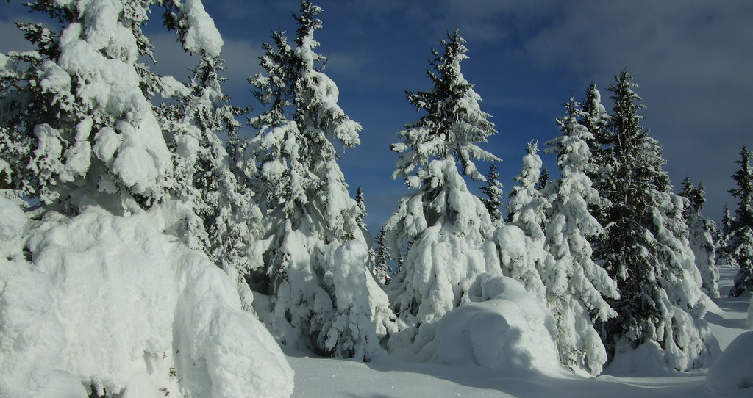
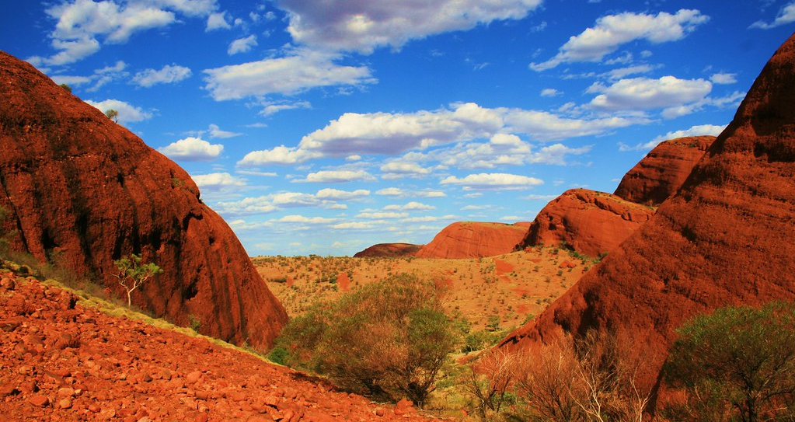
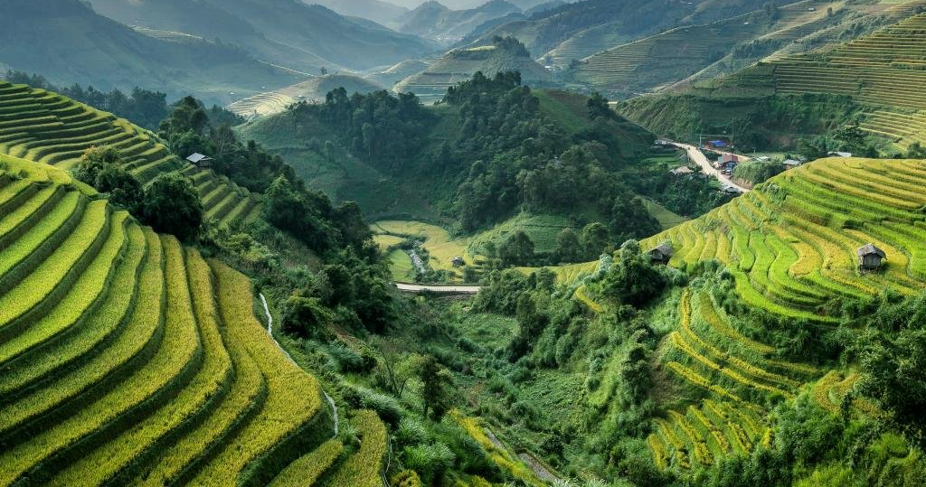
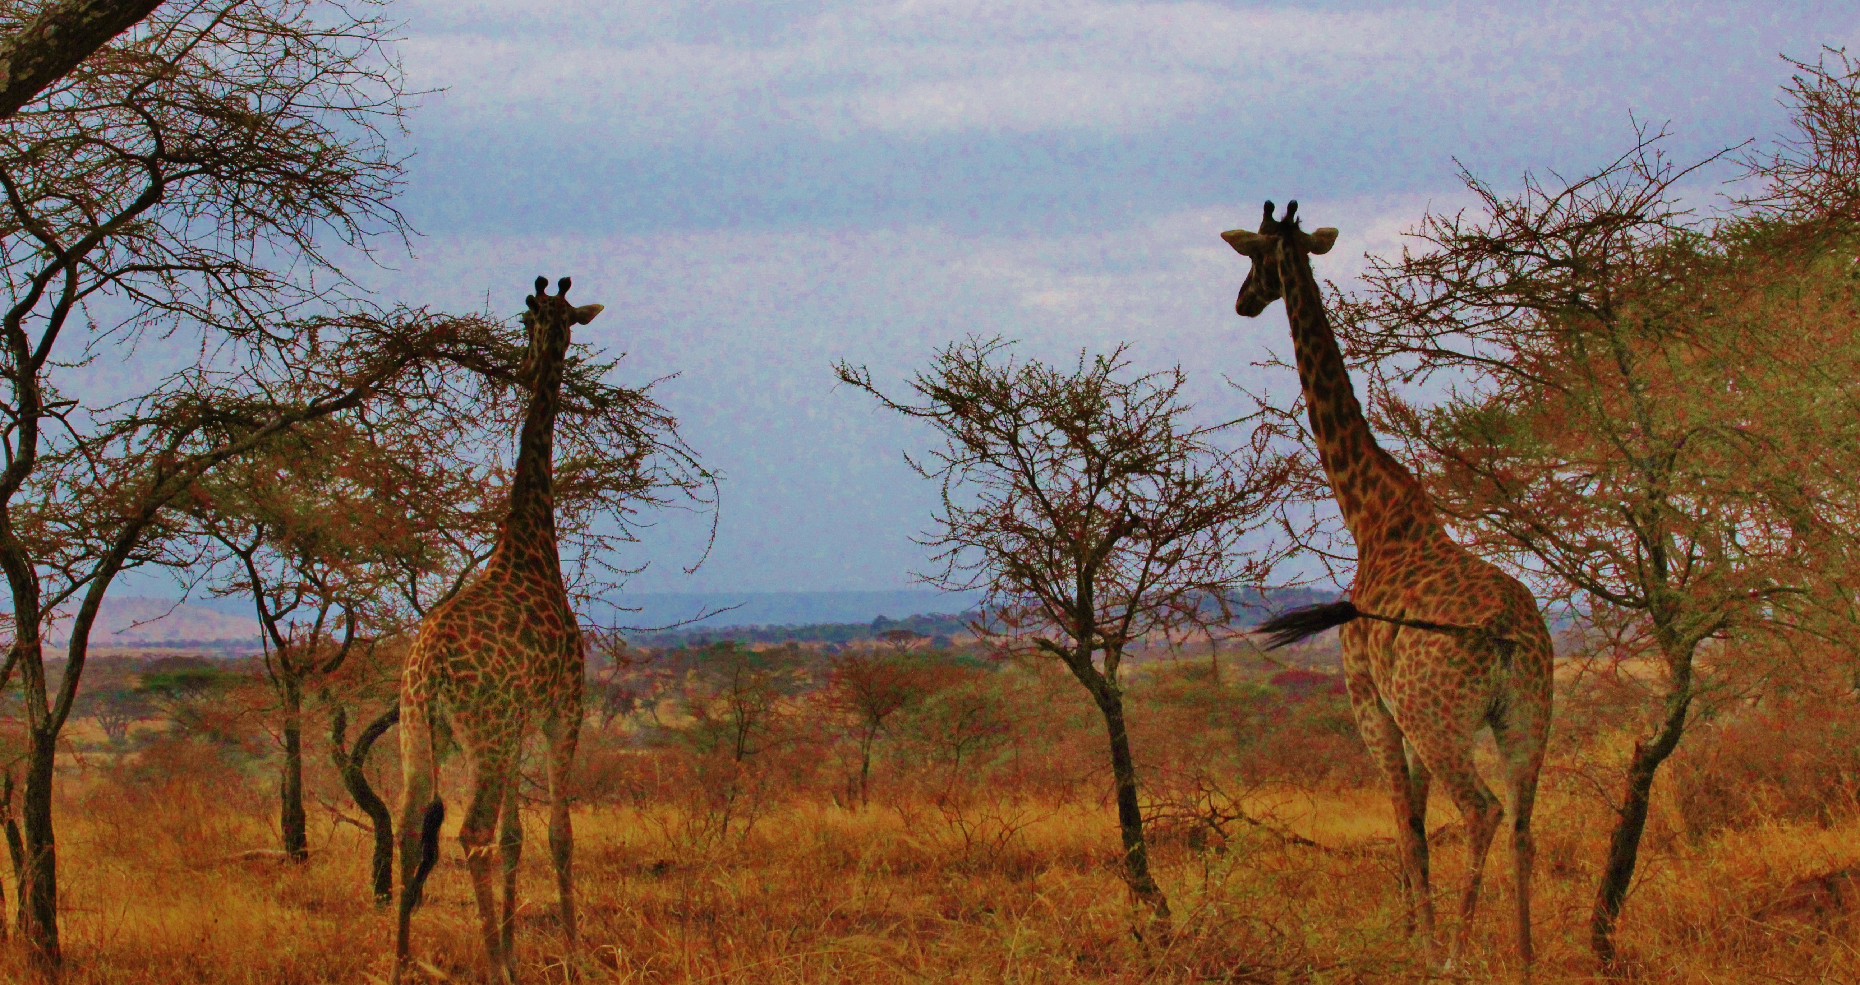
BLM#7
1
4
5
This Photo by Unknown author is licensed under CC BY-NC.
This Photo by Unknown author is licensed under CC BY-SA-NC.
2
6
This Photo by Unknown author is licensed under CC BY.
This Photo by Unknown author is licensed under CC BY-SA.
This Photo by Unknown author is licensed under CC BY-NC.
3
Match the pictures of the places with the Indigenous groups that live there​.
First Nations, Métis and Inuit​ | Maya​ | Sami​ | Maasai​ | Hmong​ | Aboriginal and Torres Strait Islanders​
North America​ | Central America​ | Northern Europe​ | East Africa​ | Southeast Asia​ | Australia​
This Photo by Unknown author is licensed under CC BY-SA.
Notes:
-You may wish to use Where in the World? BLM#7 to support the learning experience on this slide and the next slide.

Slide 18
Exploring the World
If you could live anywhere in the world, where would you live and why?
BLM#7
This Photo by Unknown Author is licensed under CC BY-SA
Notes:
-You may wish to use Where in the World? BLM#7 to support the learning experience on this slide and the previous slide.

Slide 19
International Day of the World's Indigenous Peoples
BLM#8
This Photo by Unknown author is licensed under CC BY-SA.
August 9th of every year
What will you do to celebrate and raise awareness? Make a poster, brochure, video, poem, etc.
#IndigenousDay
This Photo by Unknown author is licensed under CC BY-SA-NC.
Click the following to learn more!
YouTube Video 1:19 min
United Nations International Day of the World's Indigenous Peoples
Notes:
-You may wish to use International Day of the World's Indigenous Peoples BLM#8 to support this learning experience.
-You could also celebrate June 21st National Indigenous Peoples Day in Canada
https://www.rcaanc-cirnac.gc.ca/eng/1100100013248/1534872397533
https://www.rcaanc-cirnac.gc.ca/eng/1100100013251/1534874002459?wbdisable=true

Slide 20
Celebrate Culture in your Classroom
As a class, decide how you want to celebrate. Be sure to include Indigenous cultures in your celebration.
Have each student pick one of the following:
Teach your classmates about your own culture
Choose a culture to learn about and share with your classmates
As a class, you can celebrate with food, music, games, song, dance, posters, displays, signs and banners, etc.
Notes:
Cautionary Note: Cultural Celebrations are a good idea, but you must be mindful of stereotypes and cultural appropriation. It is preferred that each student chooses their own culture to celebrate and involves their family to decide which aspects of their culture they want to share. It's also important to recognize that some children may not know about their culture, so they may choose another culture to learn about and share with their classmates.

Slide 21
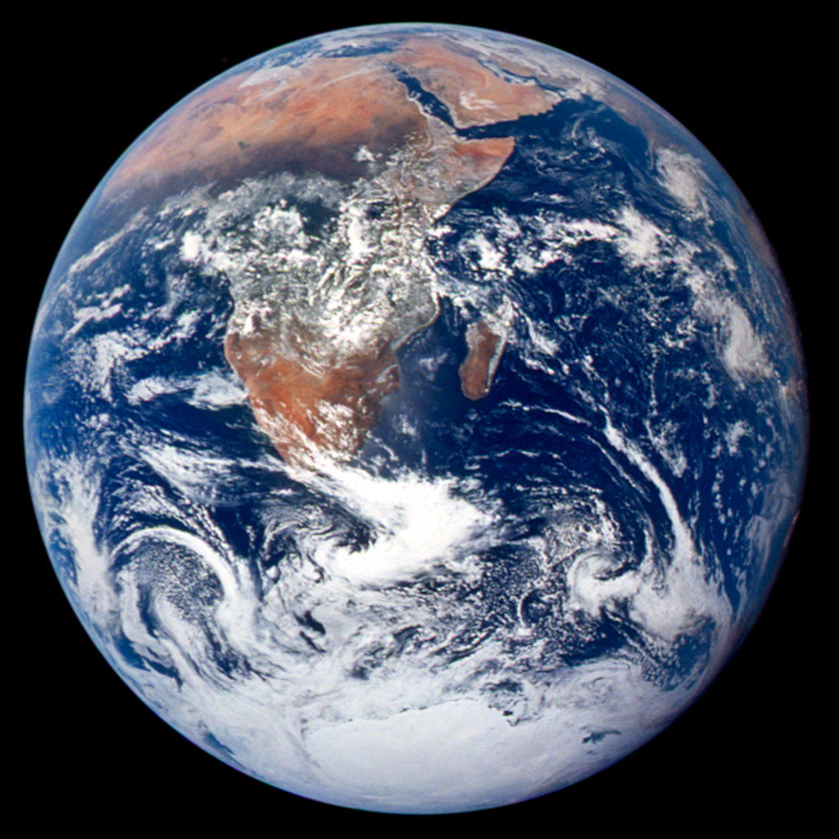
Indigenous Peoples of the World Reflection
Complete the "L" section of the KWL.
Think about the inquiry question.
How would you answer the inquiry question?
BLM#1
How is the connection to the land and culture important to the Indigenous Peoples of the World ?
This Photo by Unknown author is licensed under CC BY.
Notes:
-You may wish to have students complete the ‘L’ portions of the Indigenous Peoples of the World KWL BLM#1a.

