Slide 1


Mapping Electoral Districts

Slide 2
Minds On
Imagine:
You are at a family party to celebrate a
grand-parent’s birthday.

Slide 3
Minds On
There are seven people at the party:
two grand-parents
two adults
one three-year-old
two teenagers
How would you divide the cake so that everyone gets their fair share?
Notes:
[Teacher’s note: You can prompt students with additional questions, e.g. “Should everyone get the same-sized piece? Should the cake be divided based on age, size or other factors?”]

Slide 4
Inquiry Question
What makes an electoral district fair?

Slide 5
Activity
Did you know?
Canada is divided into 338 electoral districts.
In each district, voters elect one member of Parliament to represent everyone who lives there.
To reflect changes in the Canadian population,
the number of electoral districts is adjusted every 10 years.

Slide 6
Activity
When deciding on new boundaries, we consider:
the size of the population
geographic features
social factors such as culture and language

Slide 7
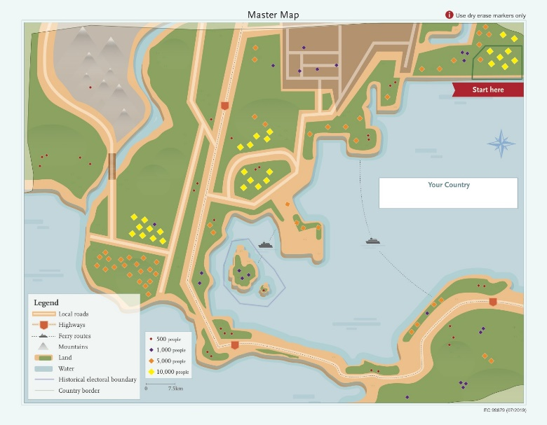
Activity
Getting Ready
Your group will need:
the master map
three reference maps
  language communities
  shared history
  population distribution
info sheet for reference maps
dry-erase markers
Notes:
[Teacher’s notes: The population distribution map is the same as the master map, only smaller. Students can use this map as a rough draft or to collaborate more effectively. You can prompt the students to make comparisons with their own community.]

Slide 8
Activity
Your task:
Draw the electoral boundaries for an
imaginary country.

Slide 9

Activity
Start by naming your country.

Slide 10
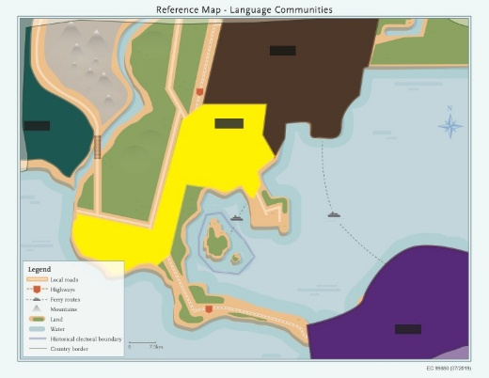
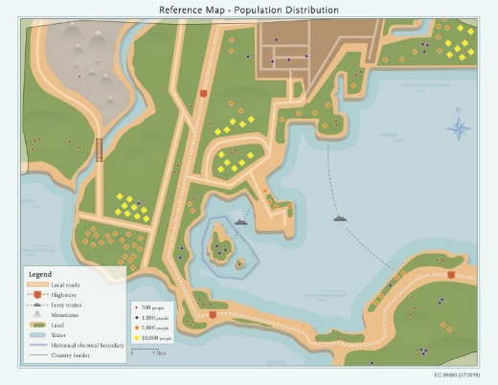
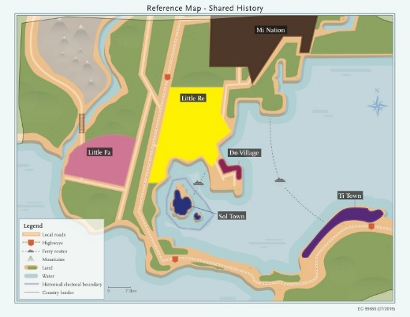
Activity
Use the reference maps to create eight electoral districts on the master map.
Use dry-erase markers only.
One district is already created.

Slide 11
Activity
Guidelines:
Aim for a similar number of people in each district.
Use the reference maps to guide your decisions.
You can create more than eight districts, but you must explain why.
Notes:
[Teacher’s notes: Allow 20 to 30 minutes for the activity. Remind students to consider geographic features, population, language and shared history.]

Slide 12
Consolidation
Share your thinking:
post your group’s map
explain your thinking
Notes:
[Teacher’s notes: We suggest a gallery walk where one student stays with the group’s map and explains how they divided it as other students visit each map. Have this student switch with another in the group halfway through the process.]

Slide 13
Consolidation
Discussion:
What similarities and differences do you see?
What changes would you make to your map?

Slide 14
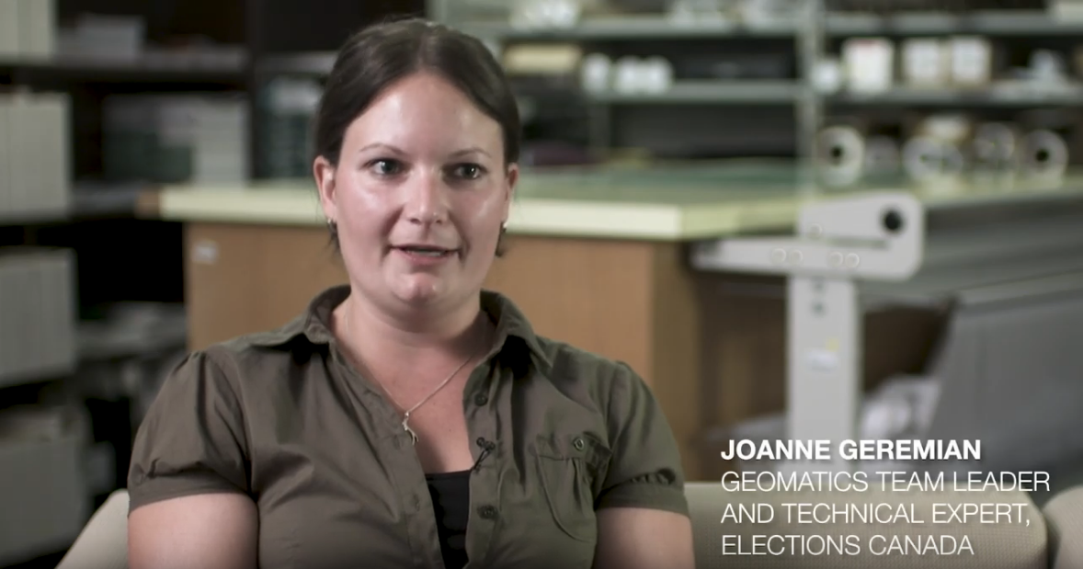
Consolidation
Interview with an Elections Canada geographer

Slide 15
Inquiry Question
What makes an electoral district fair?

Slide 16
Consolidation
Reflection:
How important is each factor in defining electoral districts fairly?
equal populations
respect of communities of interest or identity
respect of historical patterns of previous boundaries
manageable geographic size
Notes:
[Teacher’s note: You can use the provided Exit Card handout, on which these questions are printed.]

