Slide 1
My Portfolio

Slide 2
When I am having fun with books I …
Artifact: Insert Picture, Video, and/or Recording

Slide 3
When I am having fun with numbers I …
Artifact: Insert Picture, Video, and/or Recording

Slide 4
When I am having fun with my friends I …
Artifact: Insert Picture, Video, and/or Recording

Slide 5
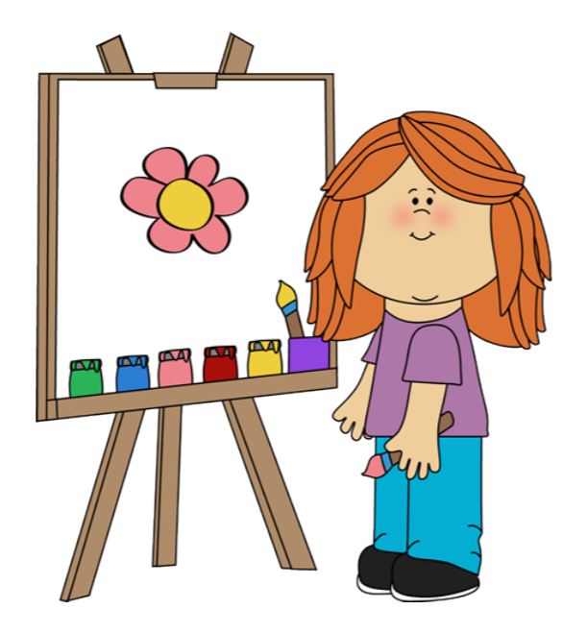
I am proud of …
Artifact: Insert Picture, Video, and/or Recording

Slide 6
I want to get better at …

Slide 7
This is Me!
Cliparts retrieved from Cliparts Zone: https://cliparts.zone. “Cliparts Zone mission is to create and curate the best cliparts online and offer it to users for free so that they can use them in their websites, documents or presentations.”

