Slide 1
Artifacts Tell Our Stories
Grade 8

Slide 2
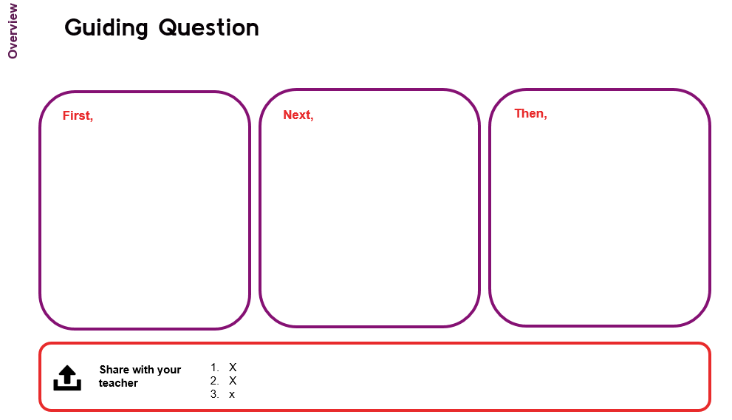
The Design of this Learning Experience
1. Essential Question & Challenge
2. Guiding Questions
3. Title Pages identify which guiding question
4. Learning Provocations introduce the investigation of each guiding question
5. Overview of the investigation of each guiding question
8. Evidence of Learning is documented for each guiding question and the essential question
6. Learning Sequence (First, Next, Then, Finally) Additional blank slides are used if needed.
7. Learning Supports and Critical Reflections

Slide 3
How do artifacts tell our stories and deepen our understandings of ourselves, others, and our relationship to history?
Our Essential Question
Challenge: Gather a collection of personal artifacts that represent you to tell each artifact’s story in an exhibit. Using one of the artifacts, investigate any changes through time to evaluate its historical importance/significance.

Slide 4
What will I learn?
These questions will guide your investigations
What do our artifacts say about us? Why are they important?
How do we read and interpret the stories artifacts tell?
What are the different stories and perspectives an artifact can tell? How do they enrich our shared histories?
How do our personal artifacts reflect and deepen our understanding of our shared histories over time?

Slide 5
What do our artifacts say about us? Why are they important?
Our Guiding Question #1

Slide 6
What do our artifacts say about us? Why are they important?
Learning Provocation
Now, it is your turn!
Can you think of an artifact that matters to you?
What is the artifact?
Why is the artifact important to you?
How does the artifact help tell your story?
Insert
Teacher Artifact 1
Insert
Teacher Artifact 2
Insert
Teacher Artifact 3
Investigate Me!
What do you learn about me by viewing these artifacts? What are you wondering about?

Slide 7
What do our artifacts say about us? Why are they important?
Overview
First, investigate a collection of artifacts.
Next, curate a collection of historical artifacts.
Then, analyze collections of artifacts.
Individually or in a group, analyze each collection of artifacts to uncover the person’s identity.
Suggest additional artifacts that each collection may also include.
Examine the group of artifacts to uncover who the identity is of the person.
Write or record your findings about the person.
Individually, or in groups, choose who your collection will represent.
Include two or more images of artifacts that may have belonged to that person. Add these to a PowerPoint slide.
Your findings about the collection of artifacts (Slide 9)
Your PPT slide of artifacts belonging to a particular person in history (Slide 10)
Your ‘Analyzing Artifacts’ graphic organizer’ (Slide 12)
Your ideas from ‘Your Thoughts Matter’ (Slide 13)
Share with your teacher

Slide 8
First,
First,
Investigate a Collection of Artifacts
1. Look closely at the collection of artifacts (Slide 9) to uncover who they might have belonged to. You may need to do internet searches to dig deeper.
2. Write or record your findings.
What do you know about this person from their artifacts?
What kinds of information did you learn? (e.g. where they lived
What other artifacts could also be included in this collection?
7

Slide 9
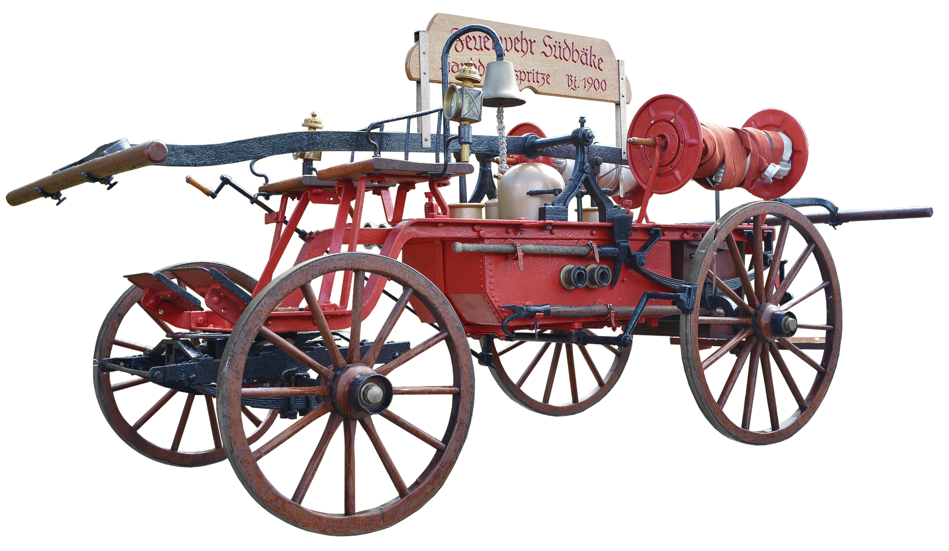
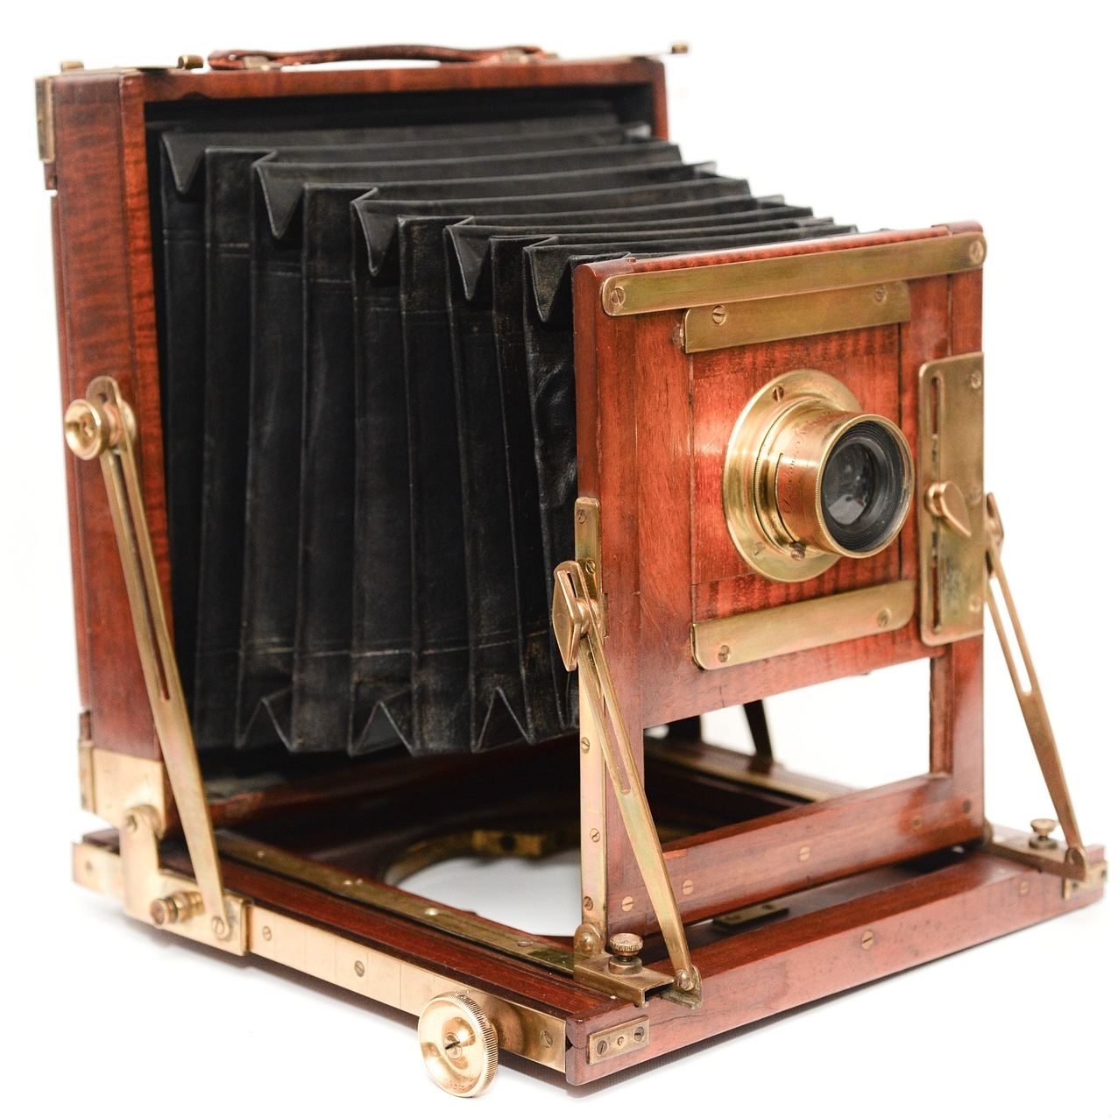
Analyze this collection of artifacts. Who am I?
What do you know about this person from their artifacts?
What kinds of information did you learn?
What other artifacts could also be included in this set?
Tip: Click and enlarge an image to see it more closely

Slide 10
Next,
Next,
Curate a Collection of Artifacts
Who will your collection represent?
Choose: (Use slide 11)
A time in history
A place in the world
A job / role in society
* You may include other details such as age, gender, leisure activities etc.
2. Find at least two or more images of artifacts related to your chosen person. Place the images on one PPT slide. Tip: Do not reveal the identity of your person on the slide. Email the slide to the teacher.
9

Slide 11
Then,
Then,
Analyze collections of Artifacts
Look through the collections of artifacts. For each collection, uncover the person’s identity.
Use the “Analyzing Artifacts Graphic Organizer” (Slide 12) to record observations and suggest other artifacts you might add to the collections.
10

Slide 12
Use the graphic organizer to analyze each collection of artifacts.
Analyzing Artifacts | What do you know about this person?
 | When did they live? | Where did they live? | Job/Role in Society | Other (age, gender etc.) | What other artifacts might you include?
PPT Slide Number
A.
B.
C.
D.
E.

Slide 13
Finally,
What Do You Think?
Agree, disagree, or partially agree? Explain your thinking.
An artifact provides very little information about the person that used it.
An artifact only provides evidence of one person’s identity.

Slide 14
Remember to Share your Learning
Your findings about the collection of artifacts (Slide 9)
Your PPT slide of artifacts belonging to a person in history (Slide 10)
3. Your ‘Analyzing Artifacts Graphic Organizer’ (Slide 12)
4. Your ideas from ‘What Do You Think?’ (Slide 13)

Slide 15
How do we read and interpret the stories artifacts tell?
Our Guiding Question #2

Slide 16
How do we read and interpret the stories artifacts tell?
Make a prediction. What might be the story of this suitcase?
Learning Provocation

Slide 17
How do we read and interpret the stories artifacts tell?
Overview
First, read the artifact and record observations
Next, research and interpret aspects of the artifact
Then, tell the story/stories of the artifact.
Individually or in a group, tell the story of the suitcase in any form.
(e.g. dramatic scene, picture book, spoken word).
View the video and photo of the artifact. What do you notice? Write down all physical characteristics of the artifact (1 per sticky note). Then, sort these into themes/patterns.
Discuss changes through time. How does this suitcase compare with those of today?
Individually, or in groups, use the sort to add information by researching aspects of the suitcase
Interpret the artifact’s information. What are your findings? What story/ stories are emerging about the artifact?
Share these stories.
Your teacher will share what is known about the suitcase.
Key points in your discussion about suitcases through time (Slide 20)
Your sort activity with an explanation of your findings and thinking (Slide 22)
Your telling of the suitcase’s story (Slide 23)
Your ideas from ‘What Do You Think?r’ (Slide 25)
Share with your teacher

Slide 18
First,
Read the Artifact
View the video and photos of the suitcase. https://tinyurl.com/suitcasestory
What do you notice?
Write down all physical characteristics of the artifact (1 per sticky note). Think about: shape, color, material, texture, size, weight, age, condition, movable parts, or anything written on it.
Self-check your Sticky Notes: Could you describe the suitcase as if you were explaining it to someone who can’t see it?
18

Slide 19
Sort and Make Connections
Sort the sticky notes into themes/categories/patterns.
Discuss what story/stories are emerging.
Name of theme/pattern/category
What?
Who?
Name of theme/pattern/category
Where?
Why?
How?
Name of theme/pattern/category
Name of theme/pattern/category
19

Slide 20
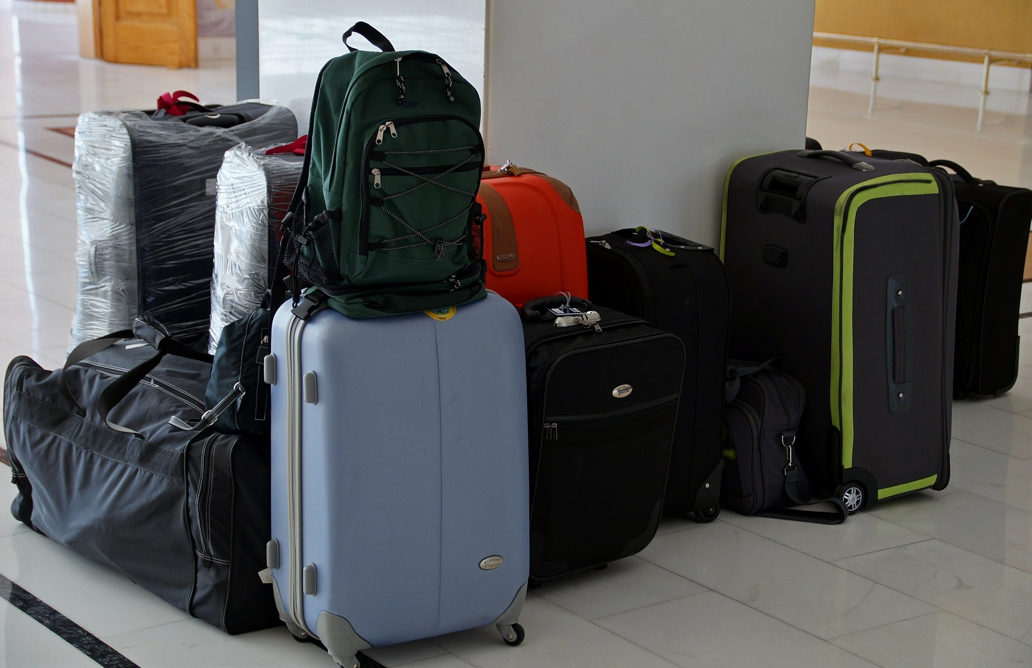
Compare the Artifact
Using your sort, discuss changes to suitcases through time.
How does the artifact compare to those of today?
What might be the reasons for these similarities and differences that help us further understand the artifact?
social/cultural changes
political/historical changes
economical
changes
technological/ environmental changes

Slide 21
Next,
Next,
Research and Interpret the Artifact
Use your sort to add information by researching different aspects of the suitcase. Add this information to your sort.
What keywords could you use?
Who could you ask? What would you ask?

Slide 22
“
Visual objects and artifacts are multimodal and sensory texts. We can smell, feel, and hear them. Moreover, artifacts and visual objects embody lived experiences, values, identities, and cultures.
Kate Pahl and Jennifer Rowell
”
Interpret the Artifact
Interpret all the information you have gathered about the artifact. What does the information tell you about the time, place, and people? The questions within Try to Make Sense may be helpful.
2. Share your sort and your thinking. You may want to use a video (e.g. Flipgrid, mp4 file) to show your sort as you explain or take a photo and add a written explanation.
What are your findings so far?
What story/ stories are emerging about the artifact?

Slide 23
Then,
Then,
Tell the Story of the Artifact
Individually or in a group, tell the story of the suitcase. See Slide 24.
Then, we will share stories of the suitcase. You will soon find out what is known about the story of the suitcase.
23

Slide 24
Questions to help tell the Suitcase’s Story
Think about these questions and discuss with a classmate.
How will your telling of the suitcase’s story showcase its importance/significance? What will happen at the beginning, middle, and end of your story.
What can you use to help tell the story of the suitcase:
information from the sorting activity
simple tools such as storyboards to think of the beginning, middle, and end of the story.
your imagination to fill in any gaps in the suitcase’s story’s. Identify these at the end of your story.
How can you revise and edit your story to improve it for accuracy and impact?
What are some ways you can practice sharing your story?
. . . . . Happy creating!

Slide 25
Finally,
What Do You Think?
Agree, disagree, or partially agree? Explain your thinking.
It is easy to uncover the story or stories of an artifact.
All artifacts change, but some change through time more quickly.

Slide 26
Remember to Share your Learning
Key points in your discussion about suitcases through time (Slide 20)
Your sort activity with an explanation of your findings and thinking (Slide 22)
3. Your telling of the suitcase’s story (Slide 23)
4. Your ideas from ‘What Do You Think?’ (Slide 25)

Slide 27
What are the different stories and perspectives an artifact can tell? How do they enrich our shared histories?
Our Guiding Question #3

Slide 28
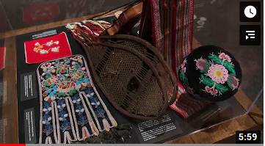
What are the different stories and perspectives an artifact can tell? How do they enrich our shared histories?
Learning Provocation
Learning Provocation
View the video.
When historians, curators, artists, and archeologists work together, what are they hoping to achieve with an exhibit?
How does each role bring a unique perspective to the exhibit?
https://www.youtube.com/watch?v=iQoMgqNx8yI

Slide 29
What are the different stories and perspectives an artifact can tell? How do they enrich our shared histories?
Overview
First, in pairs students choose an artifact that interests you and share.
Next, analyze artifacts for multiple perspectives.
Then, create a mini exhibit of your artifact.
Use the curator’s notes of the suitcase to colour code the different perspectives.
Now, your turn! In pairs further unpack your chosen artifact by researching its different perspectives. Write or record your findings.
Your exhibit will showcase the artifact and its story through many perspectives.
Share what you know about the artifact. Use the 5 W’s and H.
Share your exhibit. Discuss why it is so important to look at artifacts from different perspectives.
Your colour coded information about the multiple perspectives of the suitcase (Slide 31)
Your research about the multiple perspectives of your chosen artifact (Slide 32)
Your draft of your artifact’s story that highlights multiple perspectives (Slide 33)
Your mini exhibit of your artifact (Slide 34)
Presentation of your exhibit and the discussion of all exhibits (Slide 35)
Your ideas from “Your Thoughts Matter” (Slide 36)
Share with your teacher

Slide 30
First,
First,
Choose an Artifact
1. Choose an artifact that interests you. Your artifact should showcase one or more aspects of society (e.g. culture, education, science, trade, power, war, sports). You may want to check out http://www.bbc.co.uk/ahistoryoftheworld/about/british-museum-objects
2. Share what you know about your artifact
Include the 5 W’s and an H.
30

Slide 31
Next,
Next,
Analyze Artifacts for
Multiple Perspectives
You will be looking at curator’s notes for multiple perspectives and then researching your artifact’s story through multiple perspectives.
1. Use the curator’s notes of the suitcase to colour code the different perspectives:
- social/cultural (yellow)
- political/historical (red)
- economical (blue)
- technological/environmental (green)
31

Slide 32
Investigate and Write the Story of Your Artifact
Now, it’s your turn. Further unpack your chosen artifact by researching different perspectives. Write or record your findings.
Investigating Tips
Closely examine your artifact to uncover its story. What do you notice?
Use what you know about the artifact to gather more information about its story through multiple perspectives.
Reach out to family members and others that may provide information
Search online by using research strategies and processes to find information that helps tell the story of each artifact. https://www.literacyideas.com/top-research-strategies-for-students-and-teachers
. . . . . After gathering information, write the story of your artifact and then revise using Slide 33.

Slide 33
Steps to Revise your Artifact’s Story
Check your artifact’s story for accuracy (time, place, people, events)
Does each artifact’s story include multiple perspectives? Highlight them in your draft to check.
What other revision and editing steps will you take?
Make a list of these to help you do them all.
Who could you reach out to for feedback? Share your
work and use the feedback to make changes.
social/cultural (yellow)
political/historical (red)
economical (blue)
technological/environmental (green)

Slide 34
Then,
Then,
Create a Mini Exhibit
How might you create your exhibit? You may want to use materials from home or create it digitally in PPT or another program.
What might be in your exhibit?
The artifact, clearly featured
A plaque with the artifact’s name, date, and story (highlighting multiple perspectives).
Optional- you may want to include other photos and artifacts that bring your artifact’s story to life.
34

Slide 35
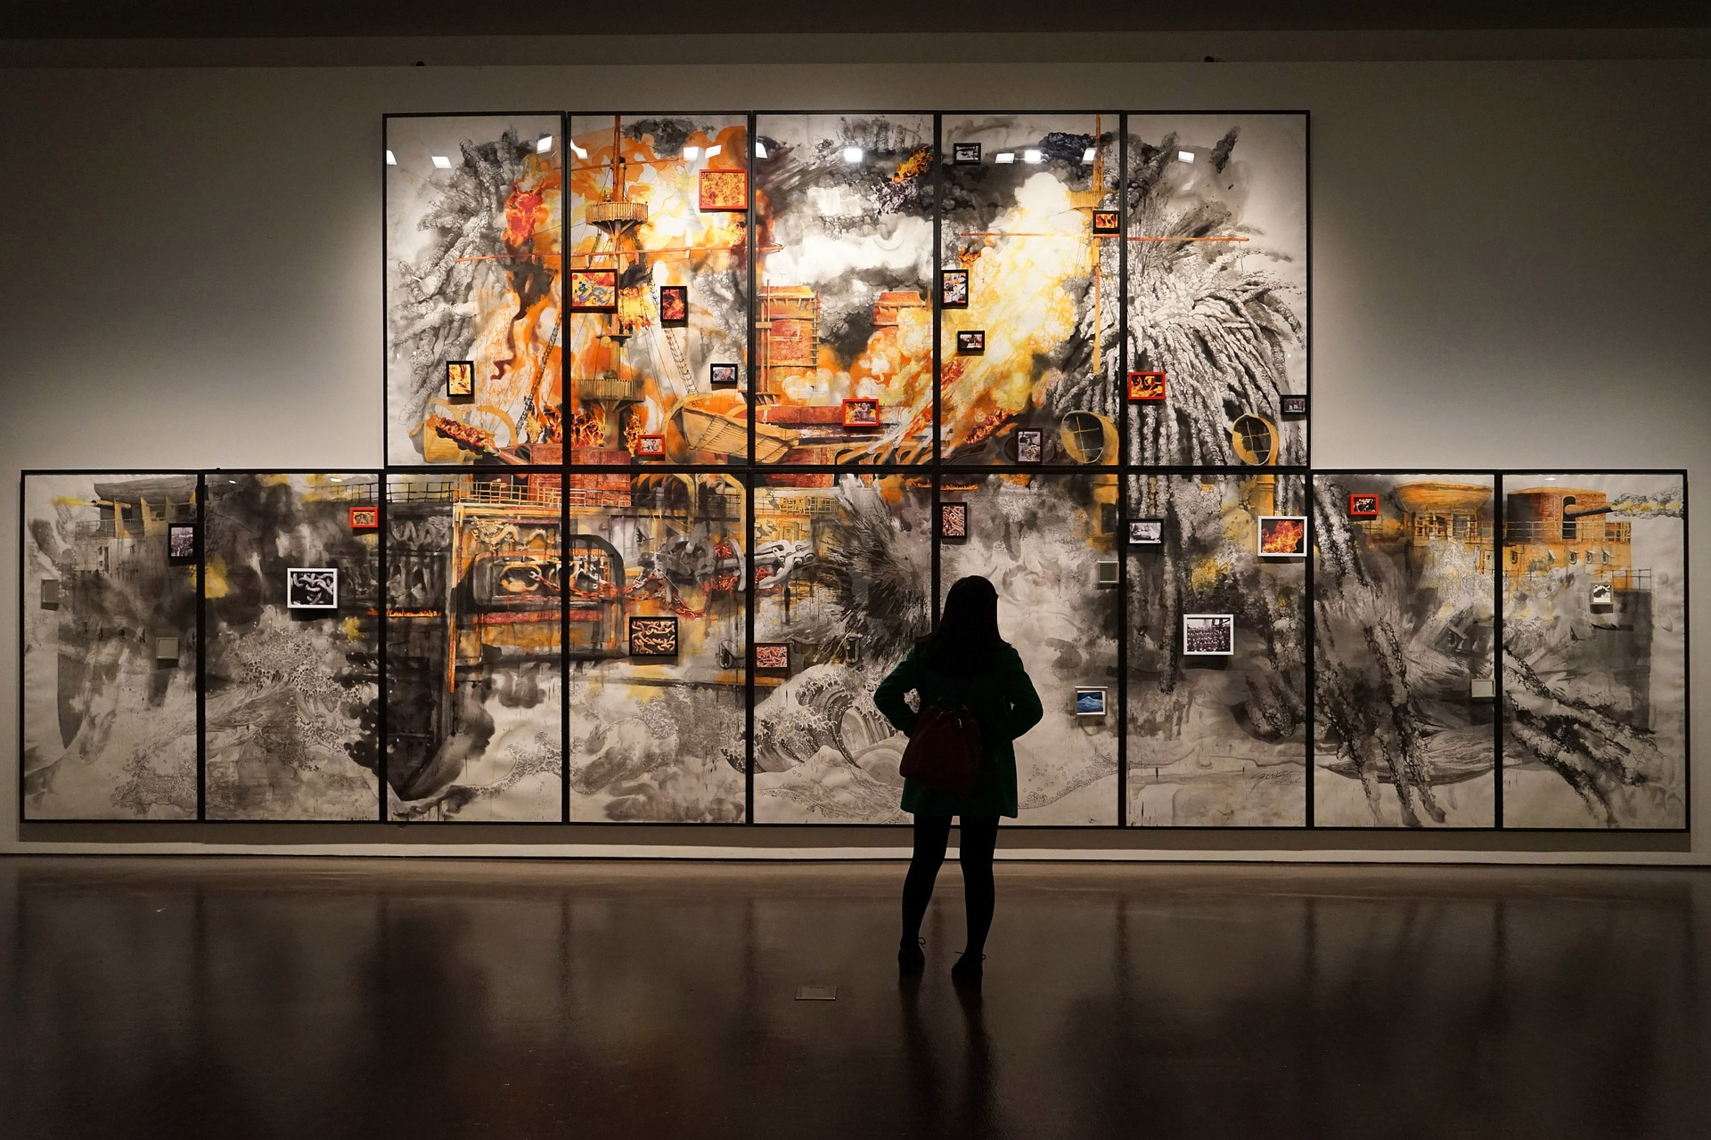
Share your exhibit and Make Connections
Share your exhibit and view other students’ exhibits.
What are your thoughts and questions about each exhibit?
What multiple perspectives do you notice? How do these perspectives enhance the artifact’s story?
2. Discuss: why it is so important to look at artifacts from different perspectives? How does this enrich our shared histories?

Slide 36
Finally,
What Do You Think?
Agree, disagree, or partially agree? Explain your thinking.
It is important to analyze history from multiple perspectives.
Museums no longer play an important role in our present day lives.

Slide 37
Remember to Share your Learning
Your colour coded information about the multiple perspectives of the suitcase (Slide 31)
Your research about the multiple perspectives of your chosen artifact (Slide 32)
Your draft of your artifact’s story that highlights multiple perspectives (Slide 33)
Your mini exhibit of your artifact (Slide 34)
Presentation of your exhibit and the discussion of all exhibits (Slide 35)
Your ideas from “What Do You Think?” (Slide 36)

Slide 38
How do our personal artifacts reflect and deepen our understanding of our shared histories over time?
Our Guiding Question #4

Slide 39
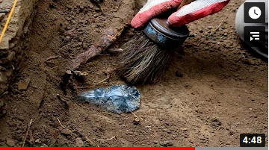
How do our personal artifacts reflect and deepen our understanding of our shared histories over time?
Learning Provocation
Learning Provocation
View the video and the magazine article.
How do the artifacts found in British Columbia impact our past and present histories?
and
https://www.youtube.com/watch?v=Mr3pQcvGOdA
https://www.smithsonianmag.com/smart-news/one-oldest-north-american-settlements-found-180962750/

Slide 40
How do our personal artifacts reflect and deepen our understanding of our shared histories over time?
Overview
First, choose artifacts for your collection
Next, investigate your artifacts
Then, design and share your exhibit to celebrate our learning!
Select 3 artifacts that represent your lived experiences, values, cultures and overall identity. Explain why you chose each artifact.
Use strategies to investigate the story of each artifact’s provenance.
Write or record the artifact’s story through multiple perspectives.
Choose one artifact to research how it has changed through time to evaluate its historical importance/significance.
Practice how you will present your exhibit to others. Then, share.
As you view other exhibits, prepare to discuss:
How artifacts tell our stories and deepen our understanding of ourselves, others, and our relationship to history?
Your collection of artifacts and each artifact’s story (Slide 42)
Your information about one artifact that changes through time with reasons for these changes (Slide 45)
3. Your exhibit and presentation (Slide 46)
4. Your thinking from the big conversation (Slide 50)
Share with your teacher

Slide 41
First,
First,
Choose artifacts for your Collection
Select 3 artifacts that represent your lived experiences, values, culture and overall identity. Each artifacts may represent different characteristics of who you are.
Write an explanation of why you chose each artifact.
This information will be featured in your exhibit.
41

Slide 42
Next,
Next,
Investigate Your Artifacts
1. Investigate your artifact’s story. Use Slide 43 to help you discover each artifact’s provenance. *Provenance: curator’s term for the history of the artifact since it was made or created
2. Write the story of each artifact through multiple perspectives.
3. Revise each story using Slide 44 and then, proceed to the next step on Slide 45.
42

Slide 43
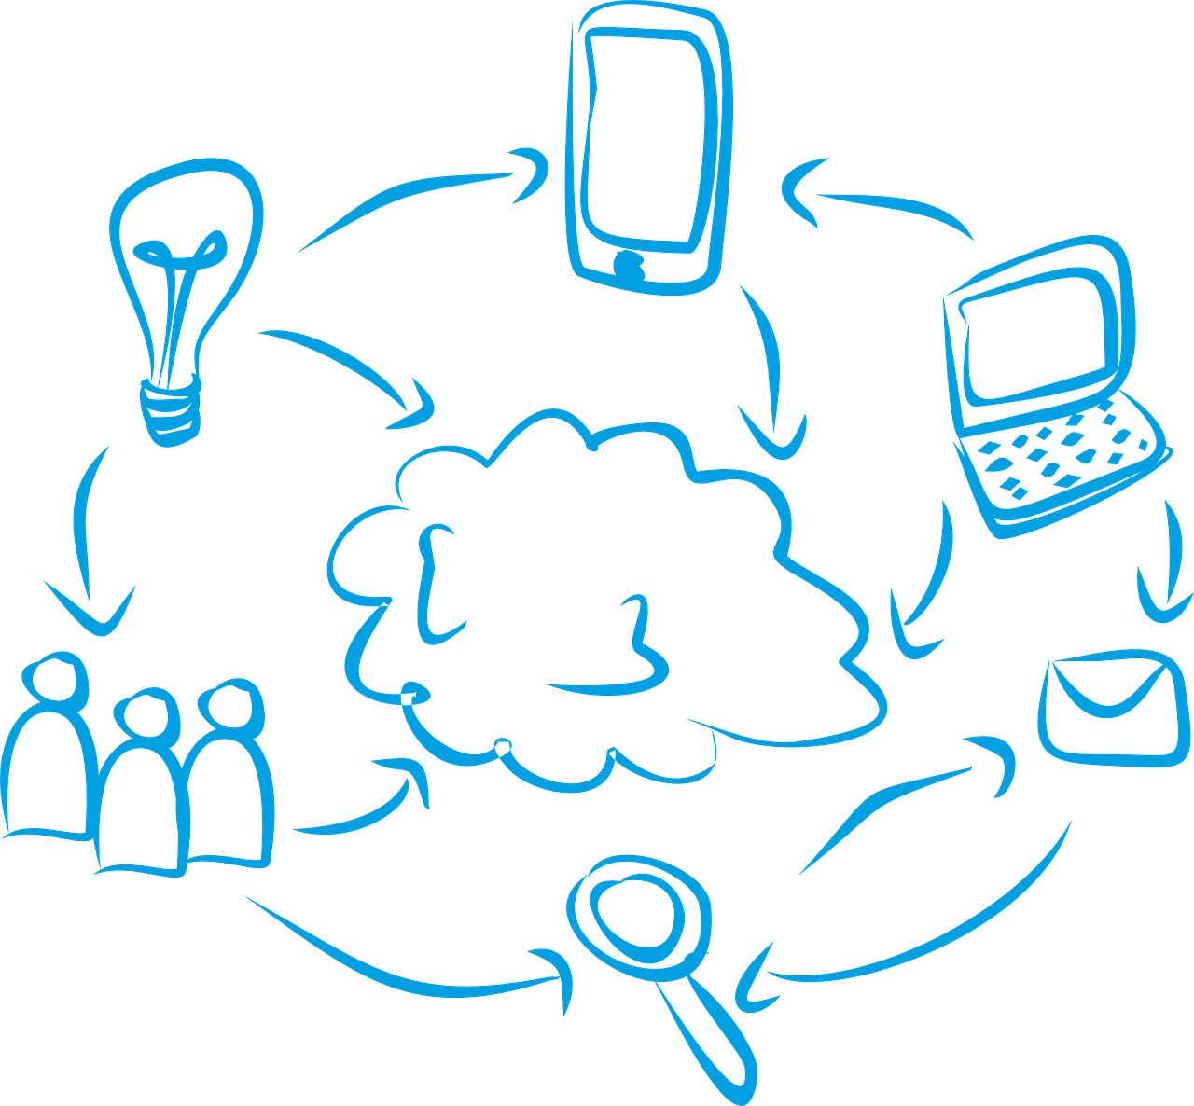
Ways to Investigate your Artifacts
Closely examine each artifact to uncover its story. What do you notice?
Use what you know about each artifact to gather more information about its story.
Reach out to family members and others that may provide information
Search online by using research strategies and processes to find information that helps tell the story of each artifact. https://www.literacyideas.com/top-research-strategies-for-students-and-teachers
. . . . . After gathering information, write the story of each artifact.

Slide 44
Steps to Revise each Artifact’s Story
Check your artifact’s story for accuracy (time, place, people, events)
Does each artifact’s story include multiple perspectives? Highlight them in your draft to check.
What other revision and editing steps will you take?
Make a list of these to help you do them all.
Who could you reach out to for feedback? Share your
work and use the feedback to make changes.
social/cultural (yellow)
political/historical (red)
economical (blue)
technological/environmental (green)

Slide 45
http://www.localhistories.org/clocks.html
Now, investigate one artifact through time
1. Research one of your artifacts through history to explain its historical importance/significance.
How has your artifact changed through history?
How often has it changed and/or stayed the same? Give reasons why these changes may or may not have occurred.
2. Write or record a description of the artifact’s historical importance/ significance through history. Feature your ideas in your exhibit.
An example of one piece of research about clocks through time
http://www.localhistories.org/clocks.html
45

Slide 46
Then,
Then,
Design and Share your Exhibit to Celebrate our Learning
1. Create your exhibit and decide on how you will present it at ‘opening night’ of “Stories of Us.” Use the checklist on Slide 47 to help you prepare.
2. Before ‘opening night,’ prepare yourself as a viewer. You will need to gather information in preparation for the grand discussion. Find out more on Slide 48.
46

Slide 47
Are you ready to share your exhibit?
Your exhibit includes:
a title
three or more artifacts that represent you and your history
each artifact’s name, date, and/or place of origin
each artifact’s significance to you
each artifact’s story told through multiple perspectives
*one artifact’s story about how it has changed through time
a physically-created or virtually-created display. *Consider how you want to present your exhibit to others on the big reveal.
Share with a friend to get feedback.
47

Slide 48
Are you ready to view others’ exhibits?
Think about the questions on Slide 46.
Be prepared to take notes of important points that arise during the sharing of the exhibits, so you can discuss them.
Think about how you might give feedback including positive acknowledgement to others.
48

Slide 49
Opening Night
“Stories of Us”
Celebratory Exhibits

Slide 50
Let the big conversation begin…
Why are artifacts important? How do artifacts impact you? How do artifacts deepen our understanding of ourselves, others, and our relationship to history?
What are some ways you can uncover an artifact’s story/stories? What is the importance of looking at artifacts through multiple perspectives?
Do all artifacts change over time? Why or why not? Why might societies stay the same or change over time and how does this impact us?
50

Slide 51
Remember to Share your Learning
Your collection of artifacts and each artifact’s story (Slide 42)
Your information about one artifact that changes through time with reasons for these changes (Slide 45)
3. Your exhibit and presentation (Slide 46)
4. Your thinking from the big conversation (Slide 50)

Slide 52
Grow your Curiosity
Our Shared Histories Matter
Ask grandparents and others about their artifacts
You never know what you might learn or find our about a person through their artifacts!
The Canadian Museum of History- Search and explore 95 different online exhibits. https://www.historymuseum.ca/exhibitions/online-exhibitions/
Smithsonian National Museum of Natural History- Move at your own pace through the 360-degree, room-by-room tour of every exhibit. https://naturalhistory2.si.edu/vt3/NMNH/
The Louvre, Paris: Take a virtual tour of several famous exhibits, including Egyptian Antiquities. https://www.louvre.fr/en/visites-en-ligne#tabs
Visit virtual museums
View this video of myterious artifacts
12 Most Mysterious Archaeological Artifacts That Really Exist
https://www.youtube.com/watch?v=imbaot4D1UI

Slide 53
Visual objects and artifacts are multimodal and sensory texts. We can smell, feel, and hear them. Moreover, artifacts and visual objects embody lived experiences, values, identities, and cultures.
Kate Pahl and Jennifer Roswell

Slide 54
Credits
Special thanks to all the people who made this learning experience possible.
Presentation template by SlidesCarnival with photographs by Unsplash
Images by Pixabay

