Slide 1
Multiplication & Division
Grade 3

Slide 2
Information
Math Talks
Rich Tasks
Visuals
Asynchronous
Games
INFORMATION
Notes:
Editable - Do NOT delete!!

Slide 3
Guiding Concepts
Anchored in inquiry
Open-ended questions, student centered, student choice
Low floor, high ceiling
Multiple ways to show understanding

Slide 4
Curricular Outcomes:
3.N.1 - Say the number sequence between any two given numbers forward and backward
From 0 to 1 000 by
10s or 100s, using any starting point
5s, using starting points that are multiples of 5
25s, using starting points that are multiples of 25
From 0 to 100 by
3s, using starting points that are multiples of 3
4s, using starting points that are multiples of 4

Slide 5
Curricular Outcomes:
3.N.11 - Demonstrate an understanding of multiplication to 5x5 by
Representing and explaining multiplication using equal grouping and arrays
Creating and solving problems in context that involve multiplication
Modeling multiplication using concrete and visual representations, and recording the process symbolically
Relating multiplication to repeated addition
Relating multiplication to division
3.N.12 - Demonstrate an understanding of division by
Representing and explaining division using equal sharing and equal grouping
Creating and solving problems in context that involve equal sharing and equal grouping
Modeling equal sharing and equal grouping using concrete and visual representations, and recording the process symbolically
Relating division to repeated subtraction
Relating division to multiplication (limited to division related to multiplication to 5x5)

Slide 6
Instructions - Using this resource
This collection of tasks is designed around the concept of multiplication and division, more specifically introducing multiplication and division. The 6 main sections (colored tabs on top of each slide) represent independent methods/types of tasks for teaching with a combination of synchronous and asynchronous parts, some of which are easily adaptable either way depending on your situation and access to technology and connectivity.
These resources represent a collection of research-based, high engaging tasks to introduce multiplication and division in a remote setting. Tasks were collected with the intention that a teacher will adapt them to fit the needs of their situation and the learning needs of their students. Links to resources can be found in the notes section of each slide if a teacher finds they would like to access them.
Using the style of the 3-Part lesson, teachers are encouraged to select a Number Talk, a main task (which would include consolidation), and then assign an appropriate asynchronous task (game, reflection on a visual…).

Slide 7
Materials
Hands-on manipulatives are ideal as significant learning occurs when students can build and visualize different representations of mathematics. Websites containing virtual manipulatives are suggested.
If a specific platform is used for delivering online instruction (i.e. Seesaw, Google Classroom), asynchronous tasks can be uploaded there.
For virtual manipulatives visit https://toytheater.com/category/teacher-tools/virtual-manipulatives/

Slide 8
Mathematical Language / Vocabulary:
sets of divide
groups of division
multiply equal groups
multiplication sharing
product array
quotient times
Notes:
Source: Manitoba Grade 3 Provincial Support Document

Slide 9
Information
Math Talks
Rich Tasks
Visuals
Asynchronous
Games
MATH TALKS

Slide 10
Which One Doesn’t Belong?
3 x 4
6 + 6
3 + 3 + 3 + 3
4 + 4 + 4
Notes:
Find pre-made, ready to use Which One Doesn’t Belong images at: http://wodb.ca/index.html
Or...Make your own (like this one)!

Slide 11
Which One Doesn’t Belong?
12 ÷ 4
12 ÷ 2
12 - 3 - 3 - 3 - 3
12 ÷ 3 = 4
Notes:
Students need as much experience working with the concept of repeated subtraction, fair shares and equal groupings as they do with multiplication concepts. Take every opportunity to connect them, do NOT teach them in isolation of each other.

Slide 12
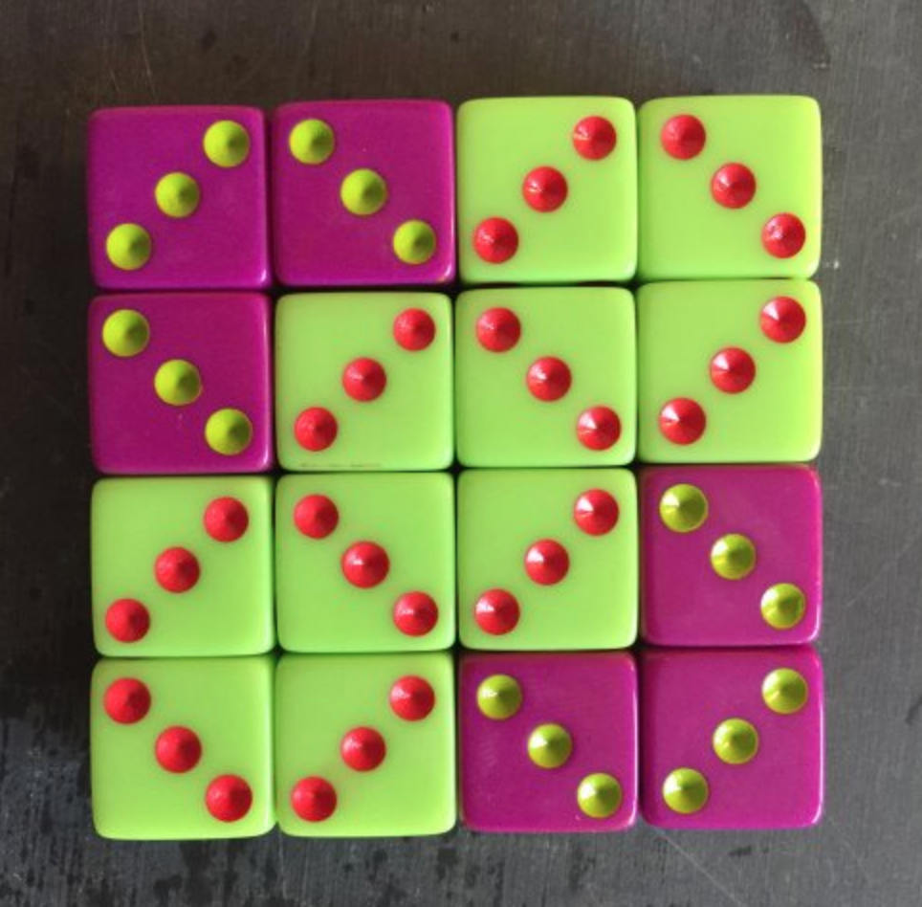
What Do You Notice?
What Do You Wonder?
Notes:
Find pre-made, ready to use Dice (and other) images at Mathforlove.

Slide 13
What Do You Notice?
What Do You Wonder?
Notes:
Source: https://vimeo.com/264526980 and https://mathvisuals.wordpress.com/multiplication-division/
How to Use: Watch and ask: What do you notice? What do you wonder? What is the same? What is different? Does this work with other numbers? How could this make solving other problems easier?

Slide 14
What Do You Notice?
What Do You Wonder?
Notes:
Source: https://vimeo.com/259494503 and https://mathvisuals.wordpress.com/multiplication-division/
How to Use: Watch and ask: What do you notice? What do you wonder? What is the same? What is different? Does this work with other numbers? How could this make solving other problems easier?

Slide 15
What is the Same?
What is Different?
Notes:
Source: https://vimeo.com/319333142 and https://mathvisuals.wordpress.com/multiplication-division/
How to Use: Watch and ask: What do you notice? What do you wonder? What is the same? What is different? Does this work with other numbers? How could this make solving other problems easier?

Slide 16
What is the Same?
What is Different?
Notes:
Source: https://vimeo.com/233144381 and https://mathvisuals.wordpress.com/multiplication-division/
How to Use: Watch and ask: What do you notice? What do you wonder? What is the same? What is different? Does this work with other numbers? How could this make solving other problems easier?

Slide 17
What is the Same?
What is Different?
Notes:
Source: https://vimeo.com/264885843 and https://mathvisuals.wordpress.com/multiplication-division/
How to Use: Watch and ask: What do you notice? What do you wonder? What is the same? What is different? Does this work with other numbers? How could this make solving other problems easier?

Slide 18
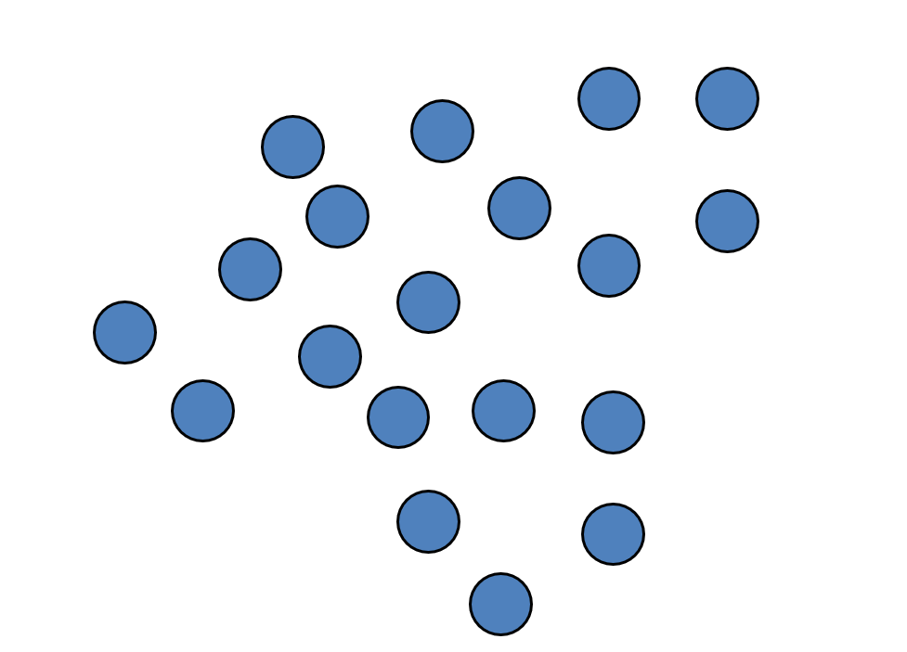
Splat!
Notes:
Find pre-made, ready to use Splats! https://stevewyborney.com/2017/02/splat/
Or...Make your own!

Slide 19
How many dots?
Notes:
Find pre-made, ready to use Splats! https://stevewyborney.com/2017/02/splat/
Or...Make your own!

Slide 20
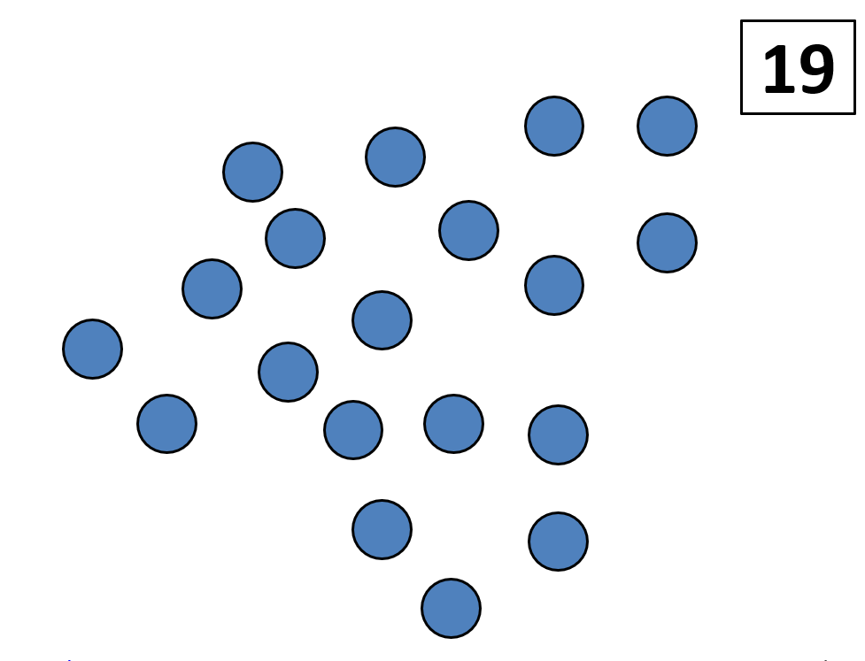

Slide 21
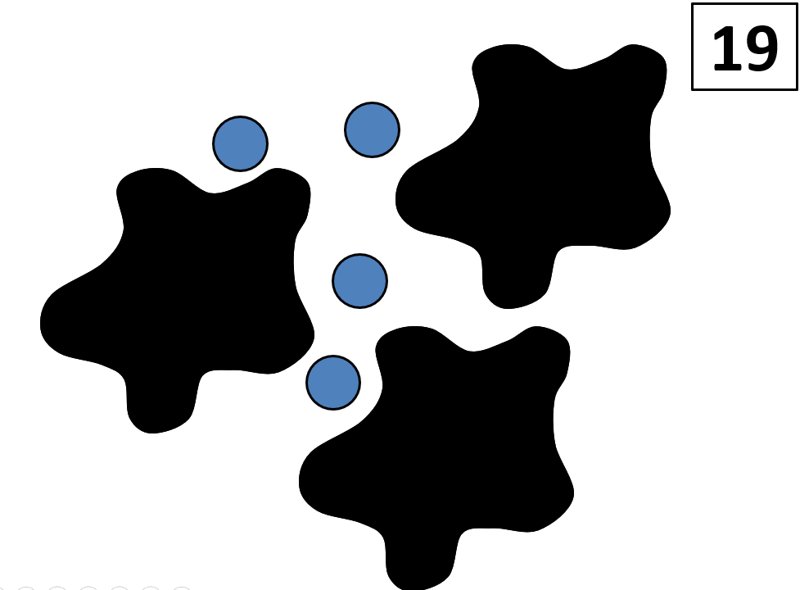
Notes:
19 - 4 = ___
19 - 4 = 15
3 groups of ? = 15
15 ÷ 3 = ?

Slide 22
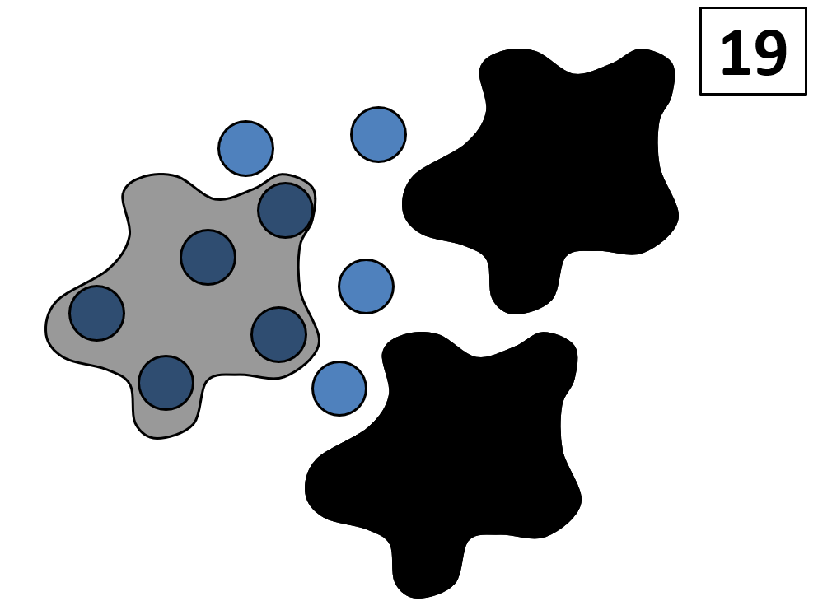
Notes:
5 + 5 + 5 + 4 = 19
or, 3 x 5 + 4 = 19
or, 19 - 4 = 15 and 15 ÷ 5 = 3

Slide 23
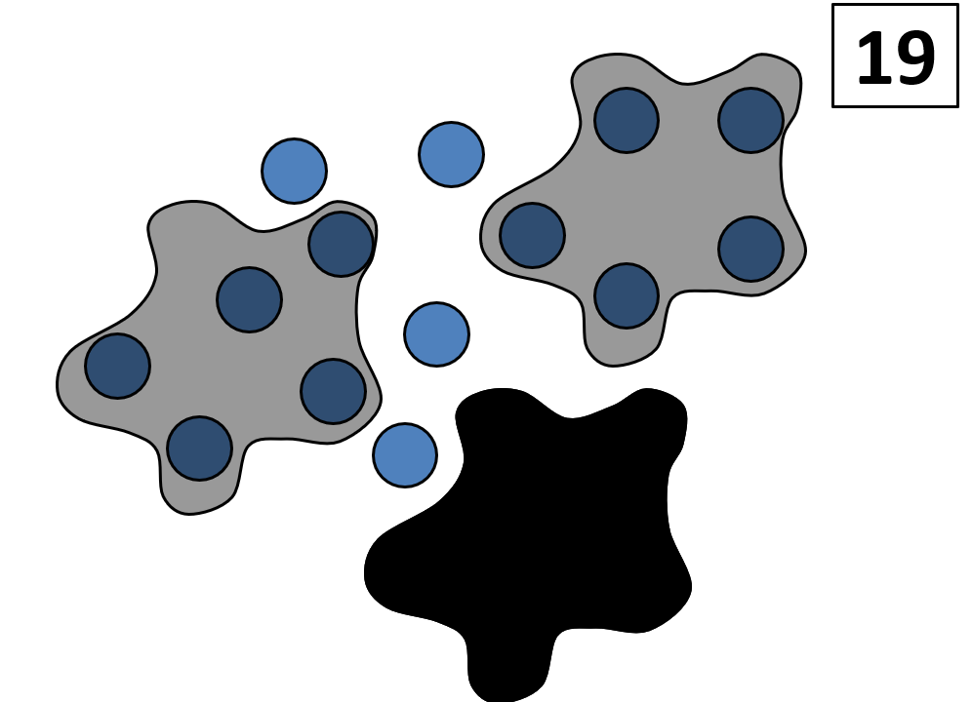

Slide 24
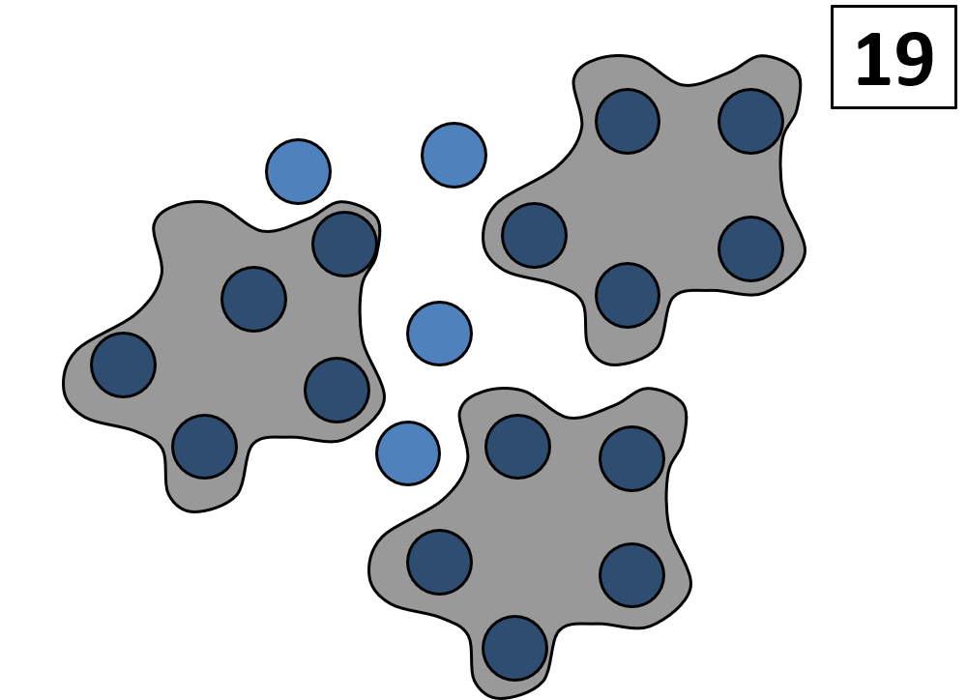
Notes:
End of this SPLAT!

Slide 25
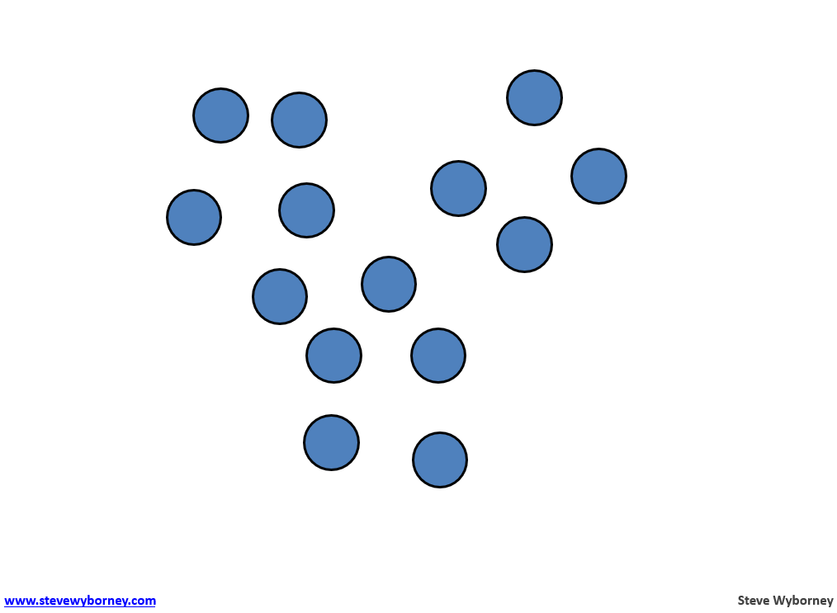
Splat!
Notes:
Find pre-made, ready to use Splats! https://stevewyborney.com/2017/02/splat/
Or...Make your own!

Slide 26
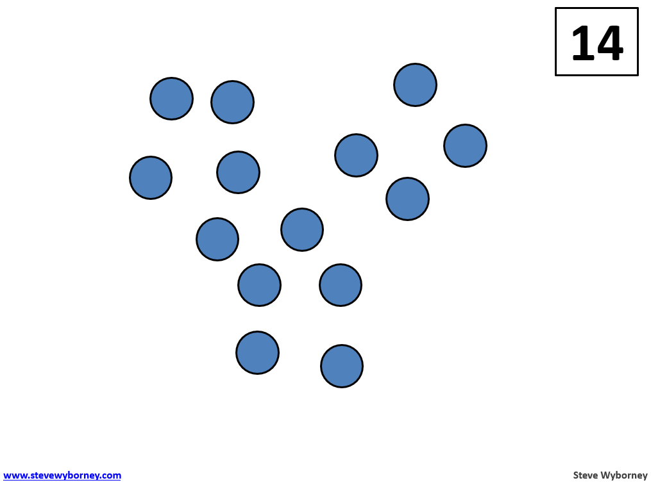

Slide 28
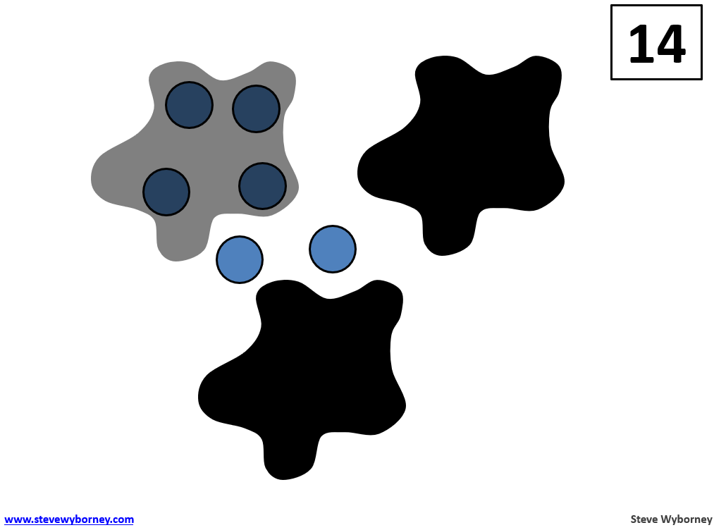

Slide 29
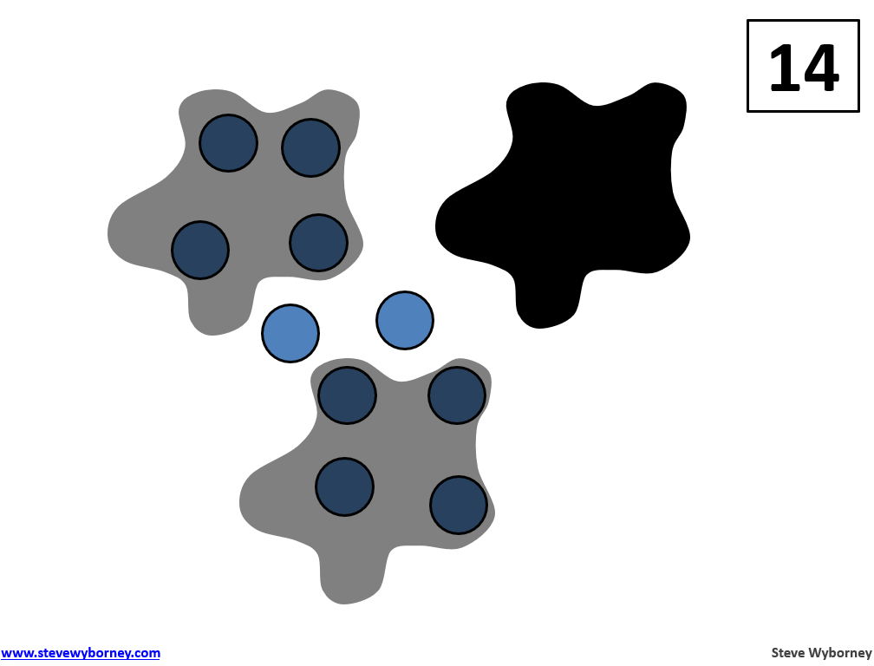

Slide 30
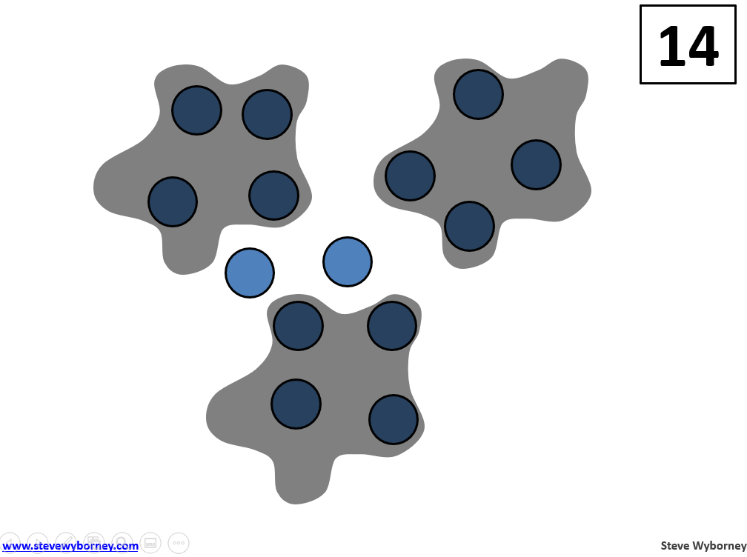
Notes:
End of this Splat!

Slide 31
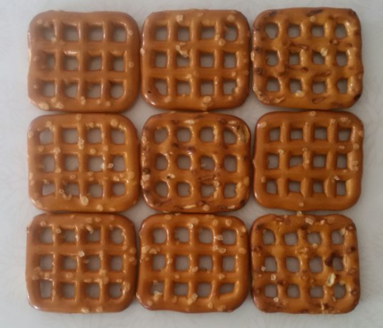
What Do You Notice?
What Do You Wonder?
Notes:
Source: http://ntimages.weebly.com/photos.html
This image is an excellent one to use prior to counting collections.Kids have lots of different ways they may count the objects in your picture. It could be something like the total crackers, or as many as the little holes in each cracker. Look for an image that provides many entry points.

Slide 32
What Do You Notice?
What Do You Wonder?
Notes:
Source: http://ntimages.weebly.com/photos.html
Remember to set a learning intention or learning goal for your lesson. How does this image fit with your grade level goal? This shows the array 5 x 6 or 6 x 5. Can the students also see 30 ÷ 5 or 30 ÷ 6? How do they see this?
Teachers are encouraged to use the drawing tools to write on each image. Teachers may also want to duplicate each slide for students to work on asynchronously PRIOR to the number talk. That gives students the opportunity to prepare their thinking ahead of time. Teacher can then show examples of student work within the number talk and prompt students who did not create that particular example, to ponder what the classmate who create this was think.

Slide 33
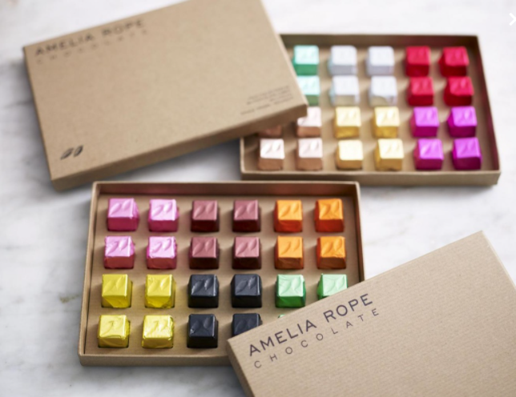
What Do You Notice?
What Do You Wonder?
Notes:
Source: http://ntimages.weebly.com/photos.html Amelia Rope Chocolate (https://www.ameliarope.com/product/dark-cube-pale-cube-bonanza/)

Slide 34
Get Ready to Subitize!
Notes:
Source: http://www.clipartbest.com/clipart-niEXK849T
When presenting these slides for activating the learning, teachers can insert a blank slide between each dice pattern. Teachers can determine how many of these types of slides to use in their number talk. Use as few or as many as needed for a quality time to discuss the visual patterns and arrangements of the dice.
The following slides are adapted from: https://gfletchy.com/2019/03/17/multiplication-subitizing-cards/
Follow the link to find more and other ideas for developing multiplicative thinking for students.

Slide 35
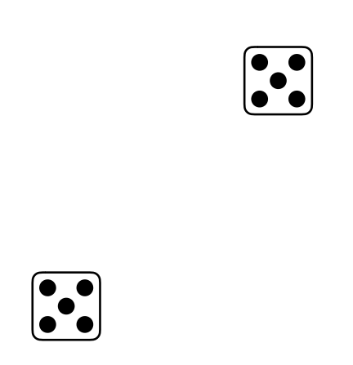
Notes:
Source: https://gfletchy.com/2019/03/17/multiplication-subitizing-cards/
Ask: How many did you see? How did you see it?
What is an equation we could write to match this image?

Slide 36
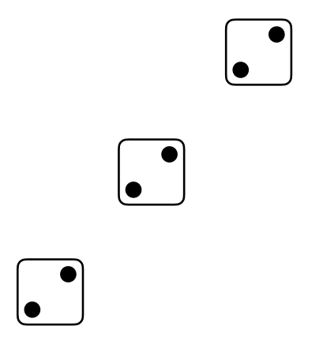
Notes:
Source: https://gfletchy.com/2019/03/17/multiplication-subitizing-cards/
Ask: How many did you see? How did you see it?
What is an equation we could write to match this image?

Slide 37
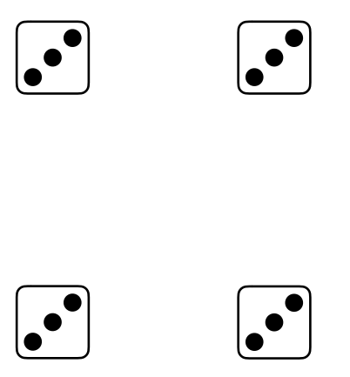
Notes:
Source: https://gfletchy.com/2019/03/17/multiplication-subitizing-cards/
Ask: How many did you see? How did you see it?
What is an equation we could write to match this image?

Slide 38
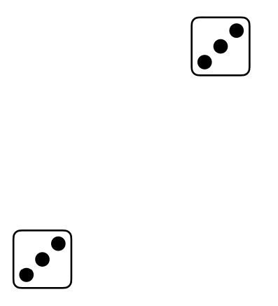
Notes:
Source: https://gfletchy.com/2019/03/17/multiplication-subitizing-cards/
Ask: How many did you see? How did you see it?
What is an equation we could write to match this image?

Slide 39
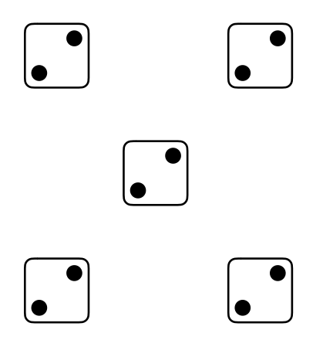
Notes:
Source: https://gfletchy.com/2019/03/17/multiplication-subitizing-cards/
Ask: How many did you see? How did you see it?
What is an equation we could write to match this image?

Slide 40
Information
Math Talks
Rich Tasks
Visuals
Asynchronous
Games
RICH TASKS

Slide 41
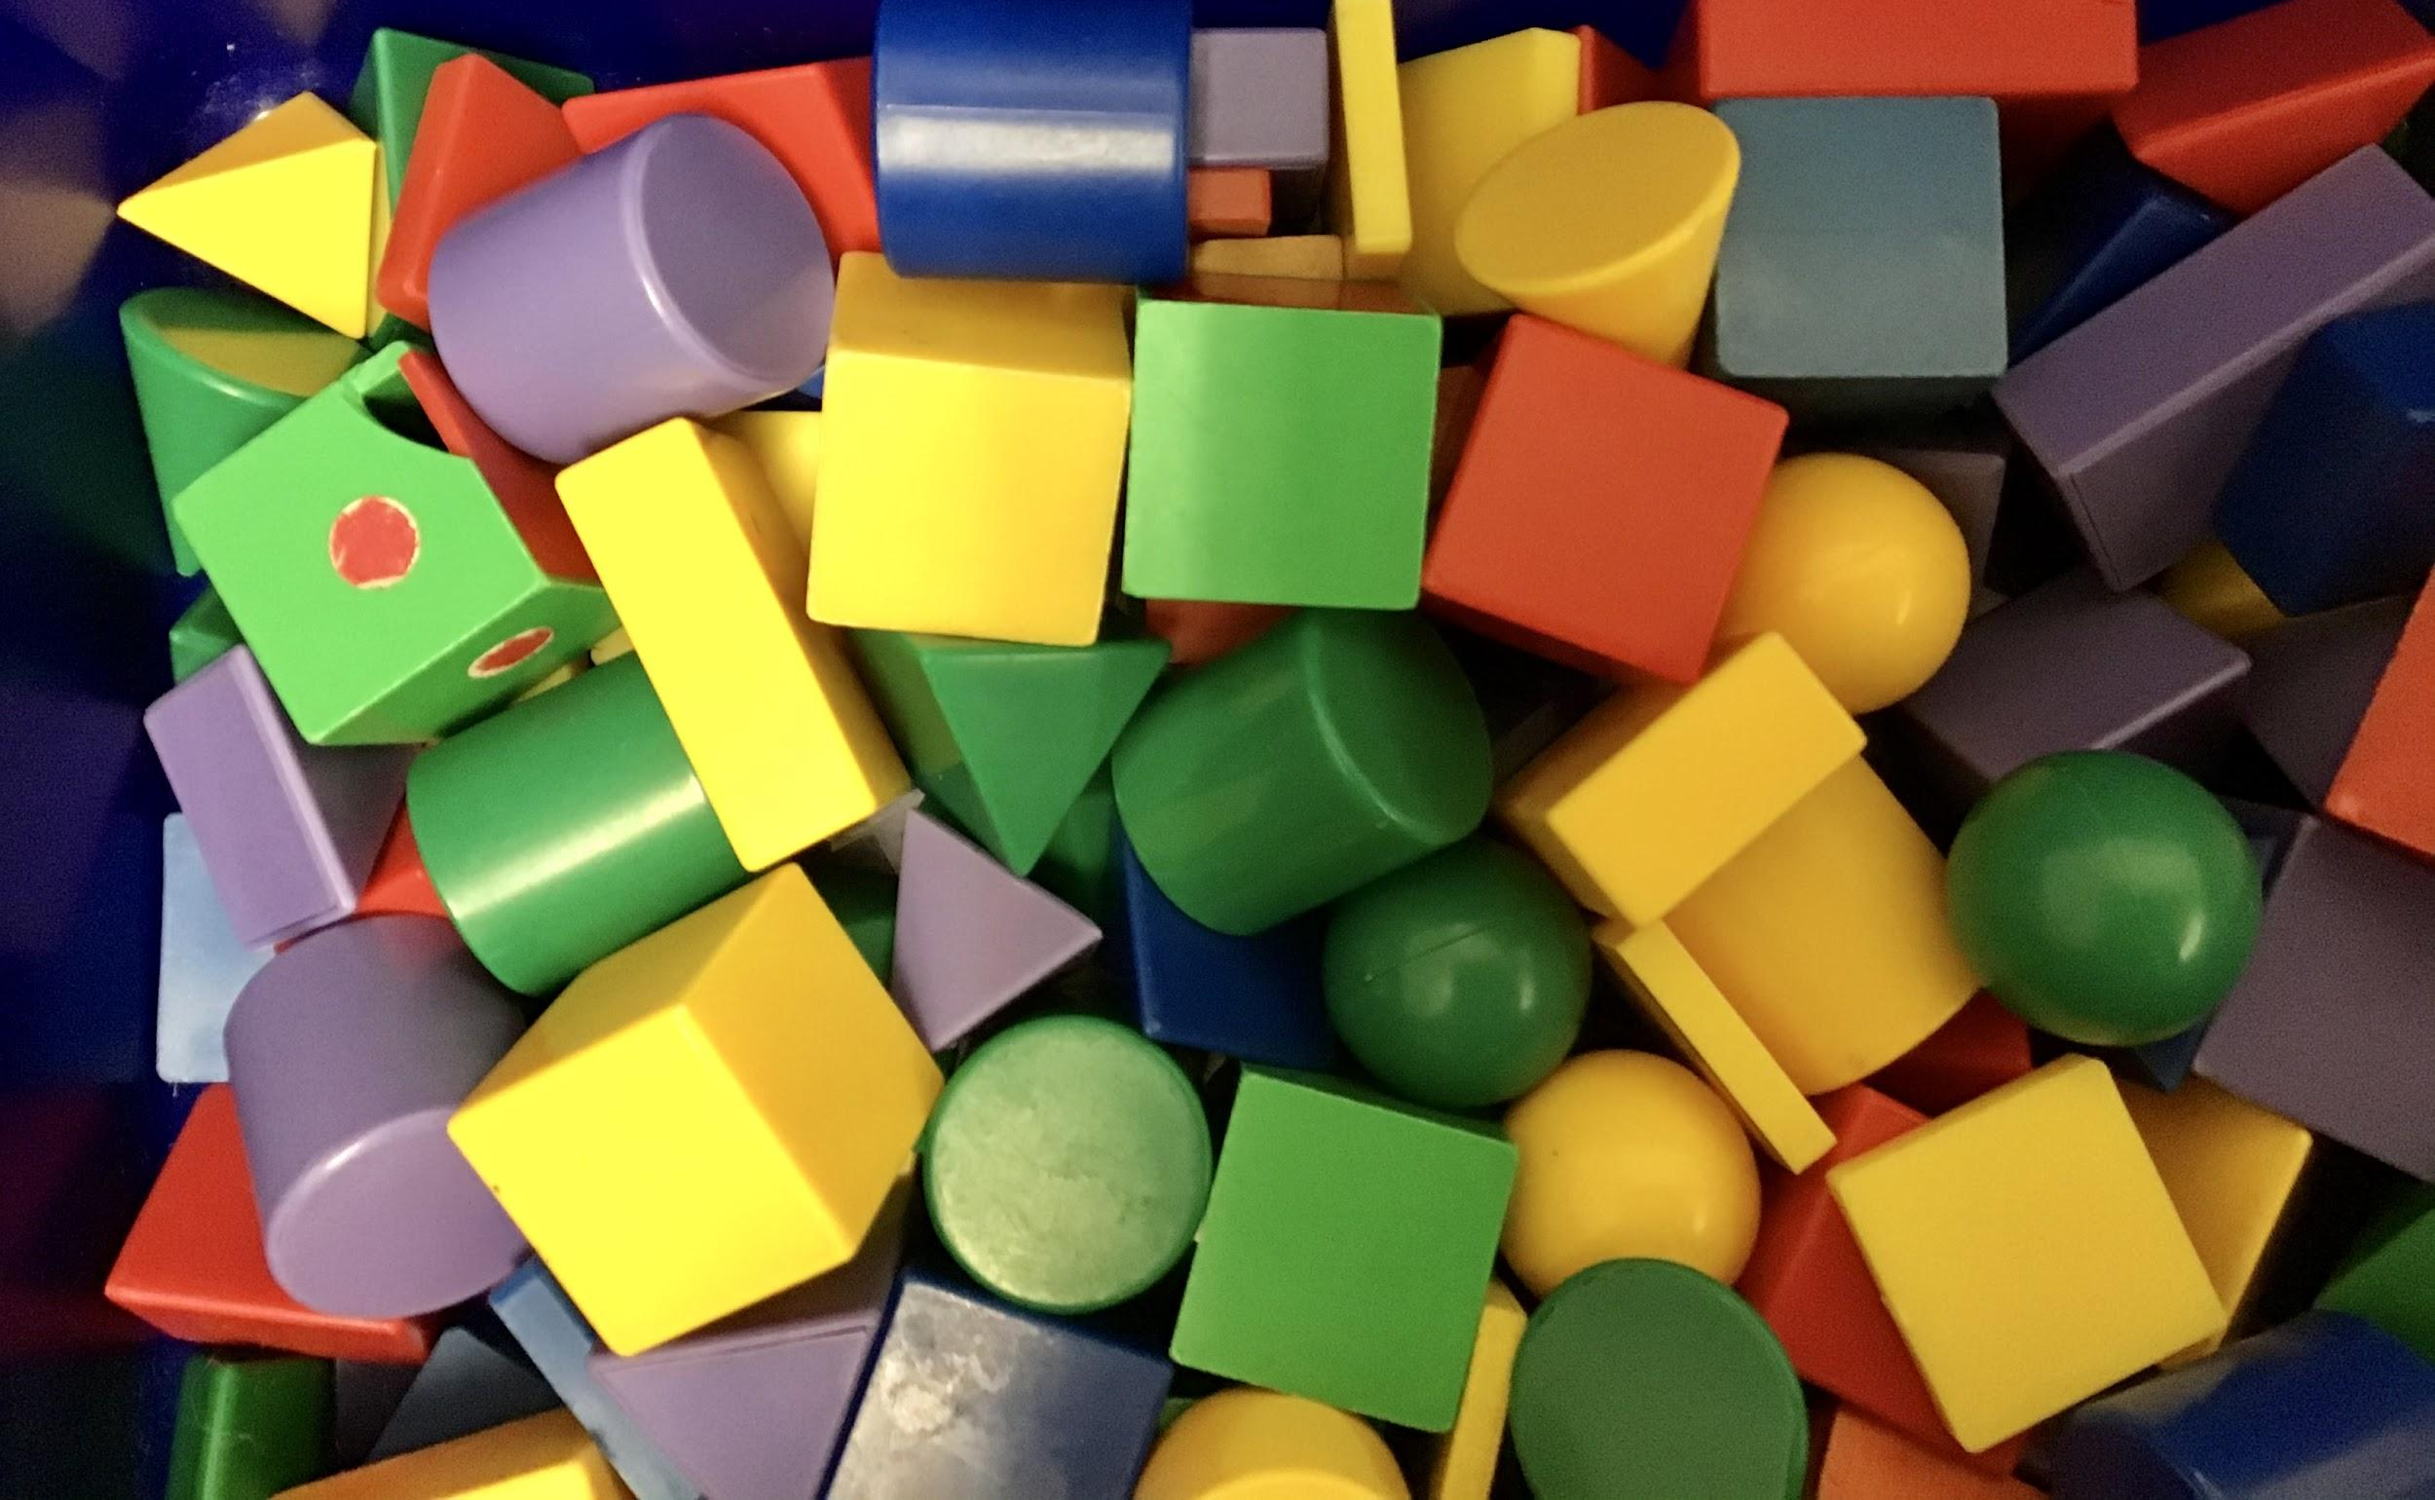
Counting Collections
Notes:
Warming students up to the idea of counting is something that should be built into daily routines. Start with an image.
Counting collections is useful in connecting home and school mathematics! Engaging families, just as you do with students allows parents to see their children generate their own mathematical ideas and pick up and use these same ideas at home. It also enables us to build on counting tasks that families already do and add to their repertoire of how to engage in counting with their children.
Most families want to help their children be successful in math, and they want to know what's happening in the online classroom, Parents can be allies in helping children develop their mathematical ideas.

Slide 42
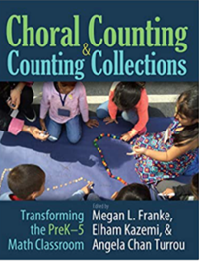
Counting Collections At Home!
Notes:
http://www.youtube.com/watch?v=kfIb4O1kPWI
Counting collections is an excellent routine for students to experience many times over. Students will gain confidence and skill in arranging their groups, choosing what to count by and representing their count on paper. This is a good weekly (or bi-weekly) routine to incorporate all year long to provide students the space to work on developing their sense of quantity, equal groupings and allow you to connect those ideas to written number sentences later in the year.
Video Source: https://www.youtube.com/watch?v=kfIb4O1kPWI&t=62s
Image created.
This is an excellent video that explains how Counting Collections can be done at home. This video is not intended for Students to watch, but teachers can share this with parents.

Slide 43
Critical Features of Counting Collections
Children count a collection of objects
Children choose how to count, including how to space, whether to use tools or not, and how to organize their collection
Teachers may choose types of collections (quantities and kinds of objects)
During or after counting, children choose how to make a recording of their count to show how they counted
Before, during, or after the count teachers may choose to highlight insights, children are developing
Choral Counting and Counting Collections 2018
Notes:
Source: Choral Counting and Counting Collections, 2018

Slide 44
Asking Questions to Reveal Student Thinking
DOUBLE CHECKING YOUR COUNT
How many objects are in your collection? Can you prove it? Can you count it another way?
PLANNING
"How are you going to count your collection? What is your plan? "
GROUPING
"Counting by 1's is taking a while, isn't it? Is there a faster way to count how many?"
RECORDING
"You found out how many in your collection. How can you record that on paper? Try to make it clear so someone can see how you counted."
EXTENDING THEIR THINKING
"How many would you have if you had 1 more?
How many more do you need to get to 100?
What if you already have a collection of 50...now how many do you have?"
STUDENT WORK
"Tell me about your picture/recording. What does it show?"
Notes:
Image Source: Powerpoint Designer
Always be sure to set learning intentions for lessons. It is very important to be intentional in this. How might this number talk or rich task fit the goal for the learning experience? Asking questions to reveal student thinking is imperative to gain access to their conceptual understanding and seeing relationships between mathematical concepts.

Slide 45
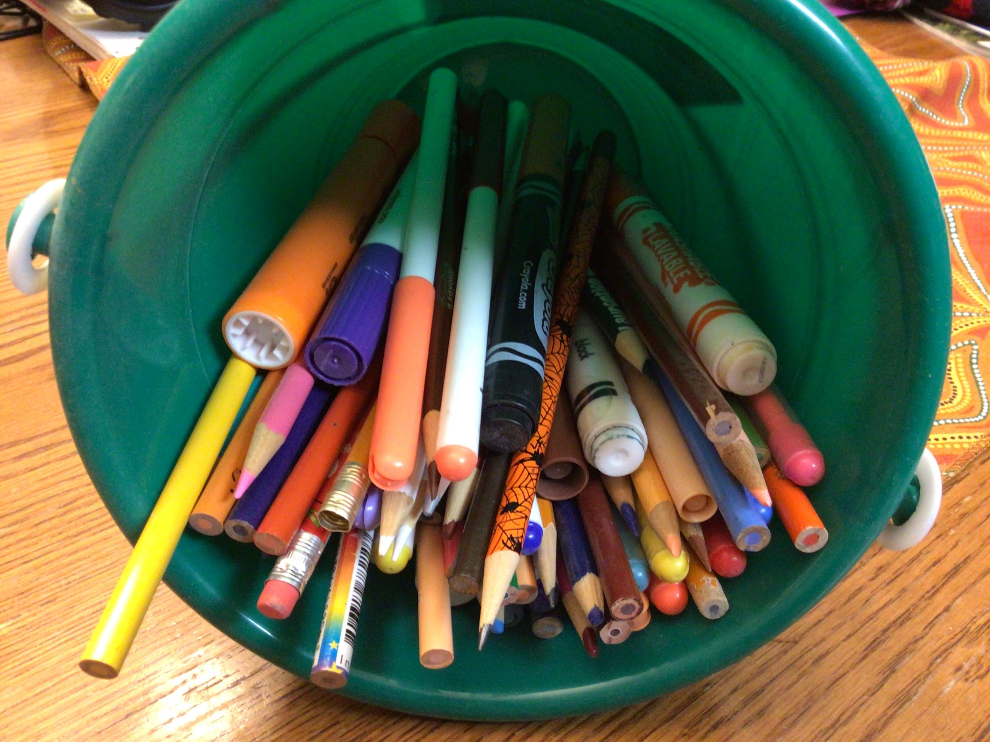
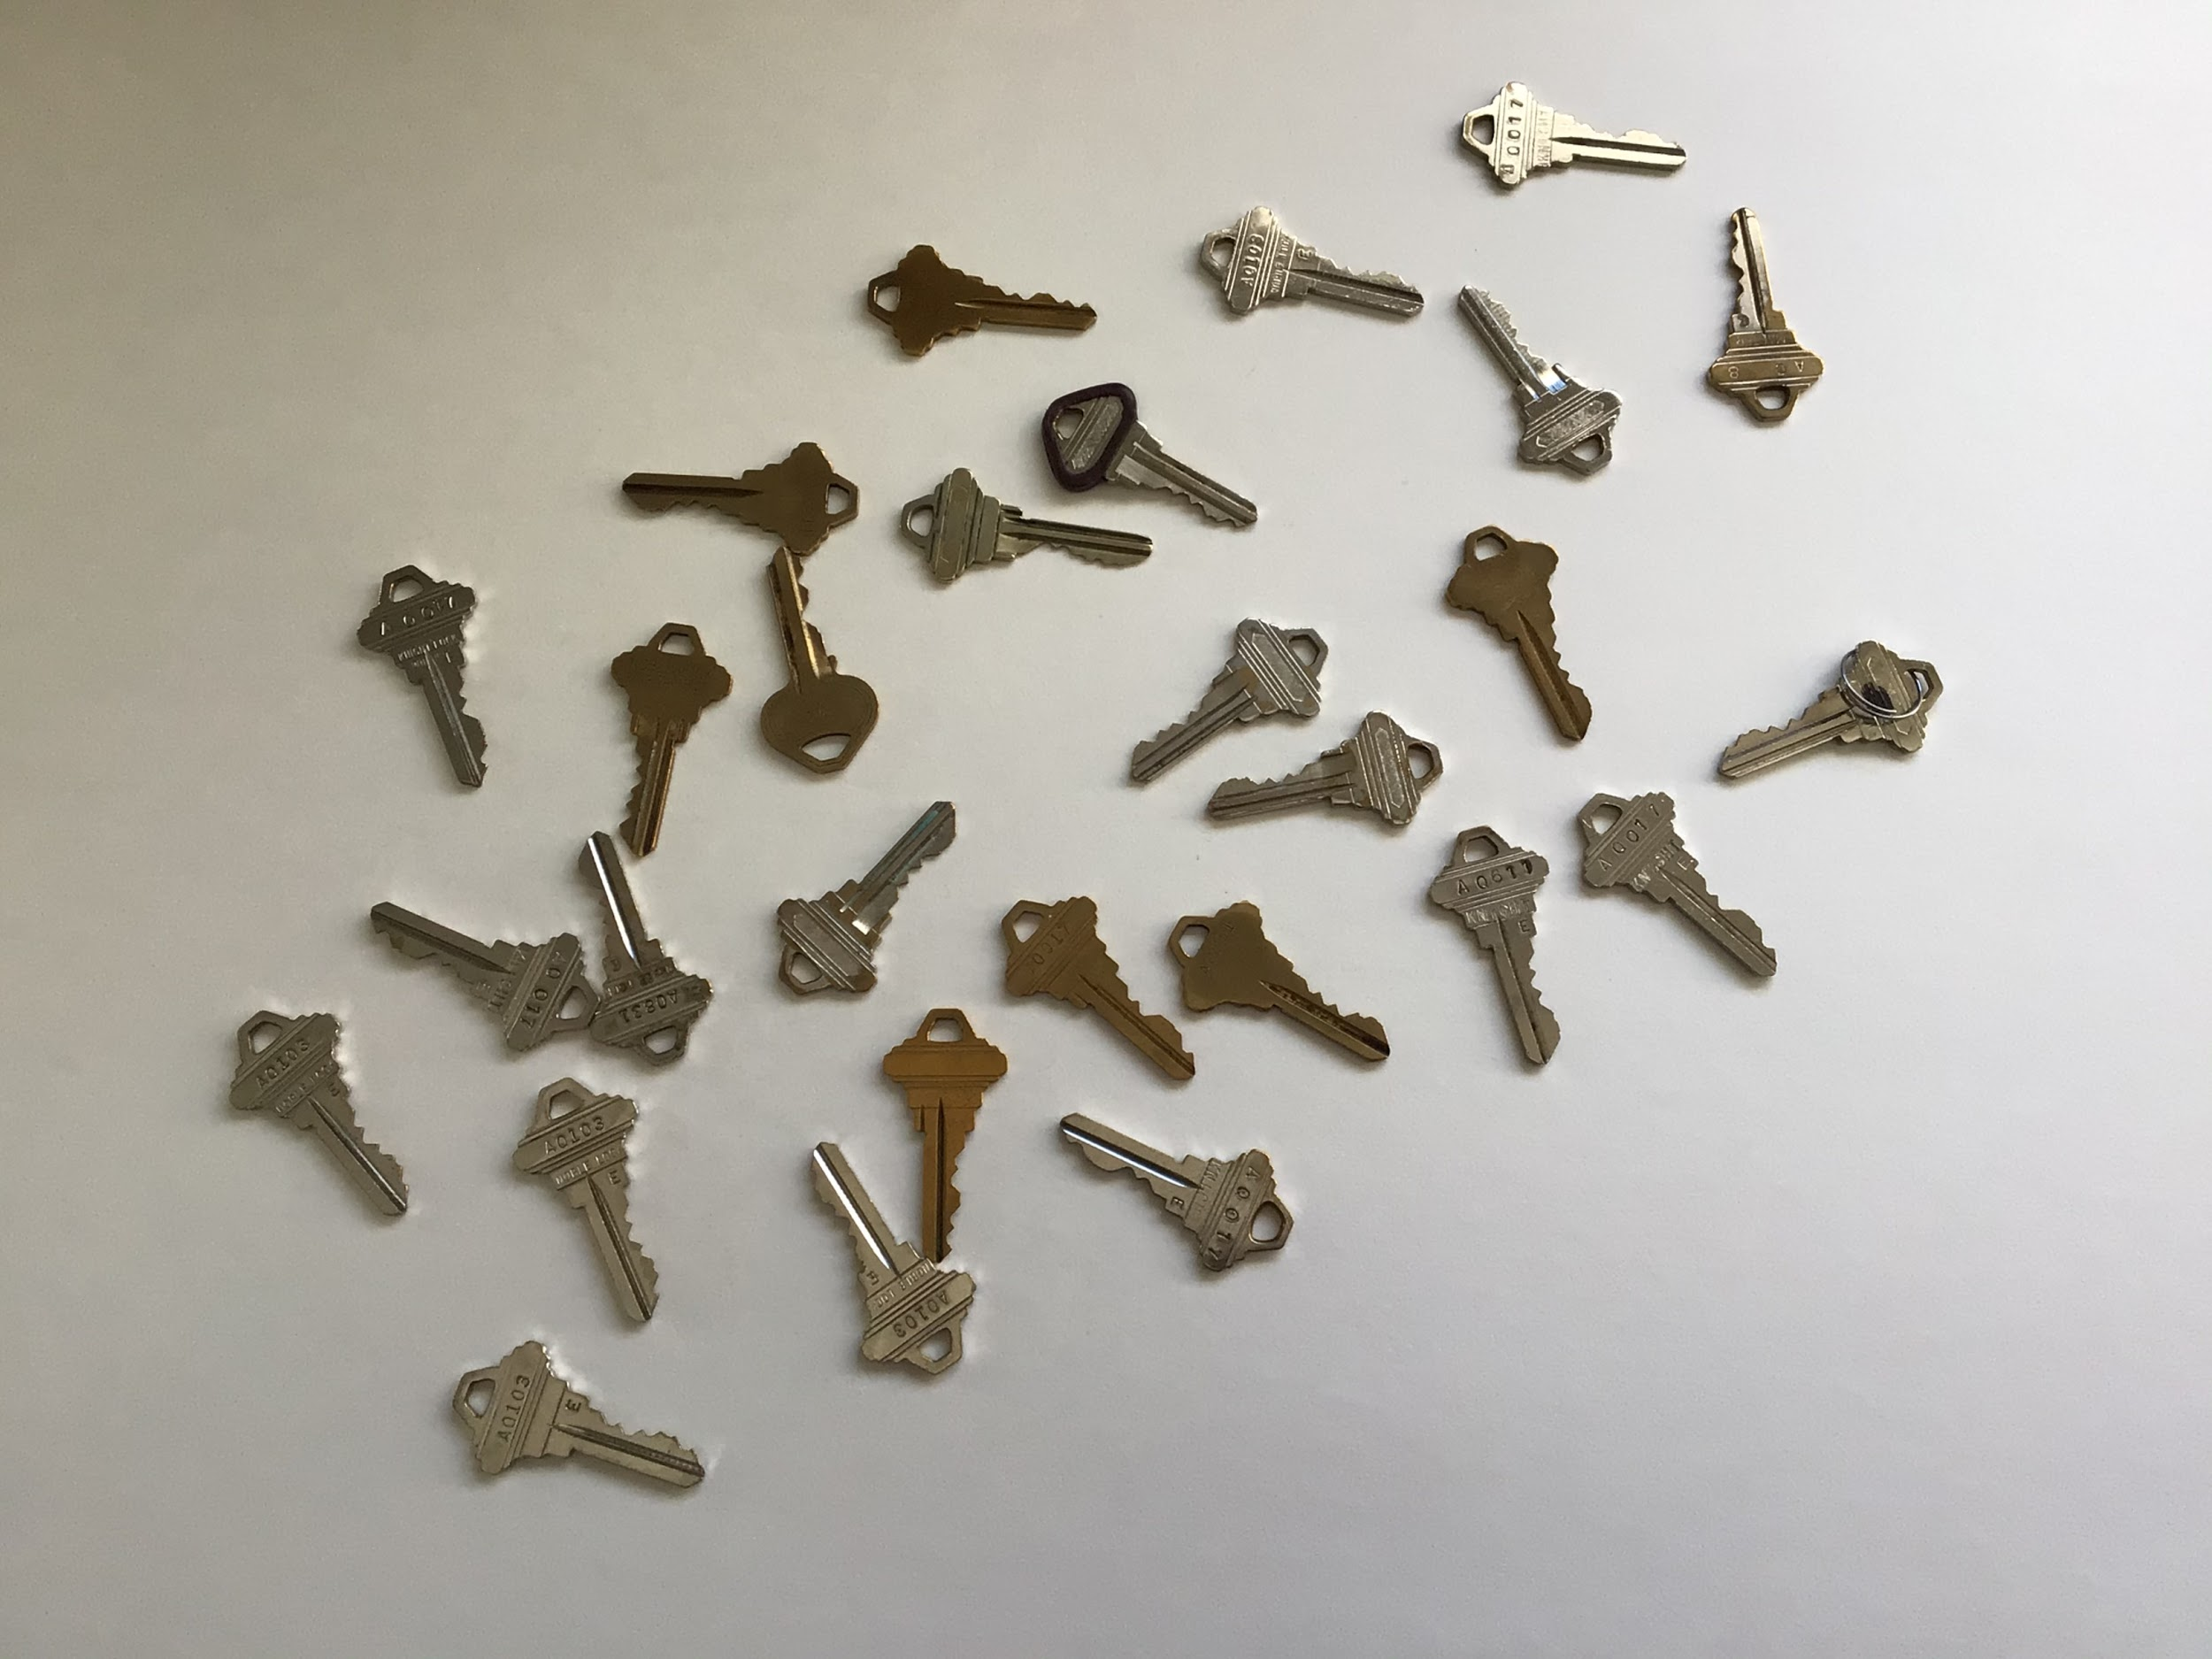
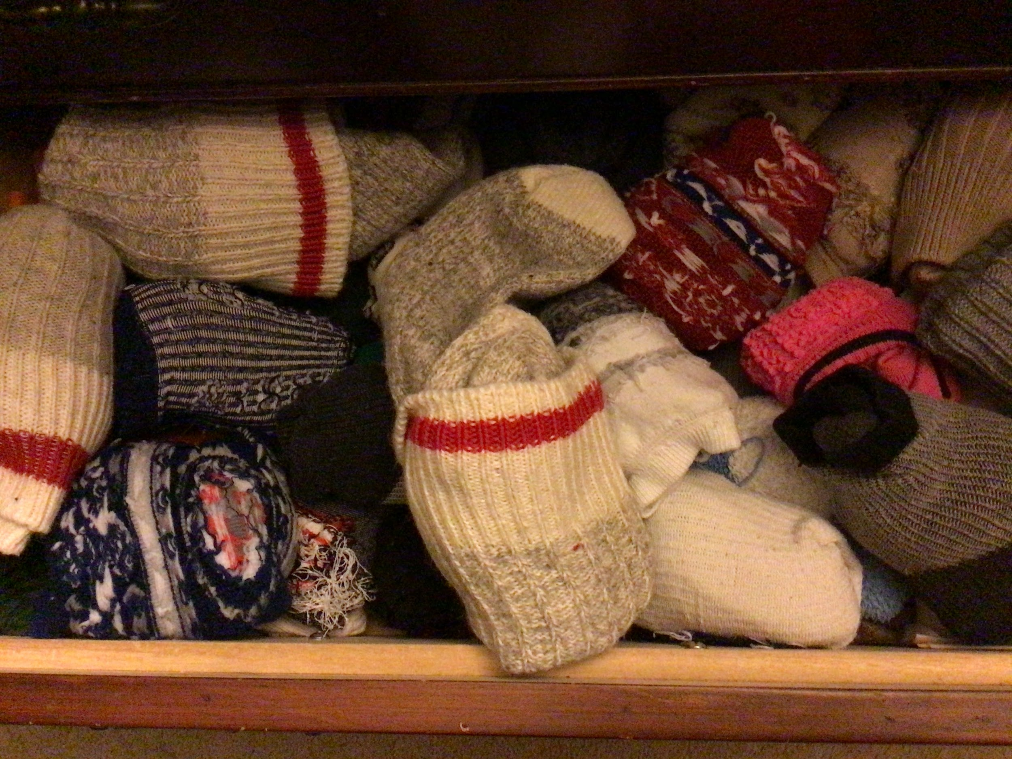
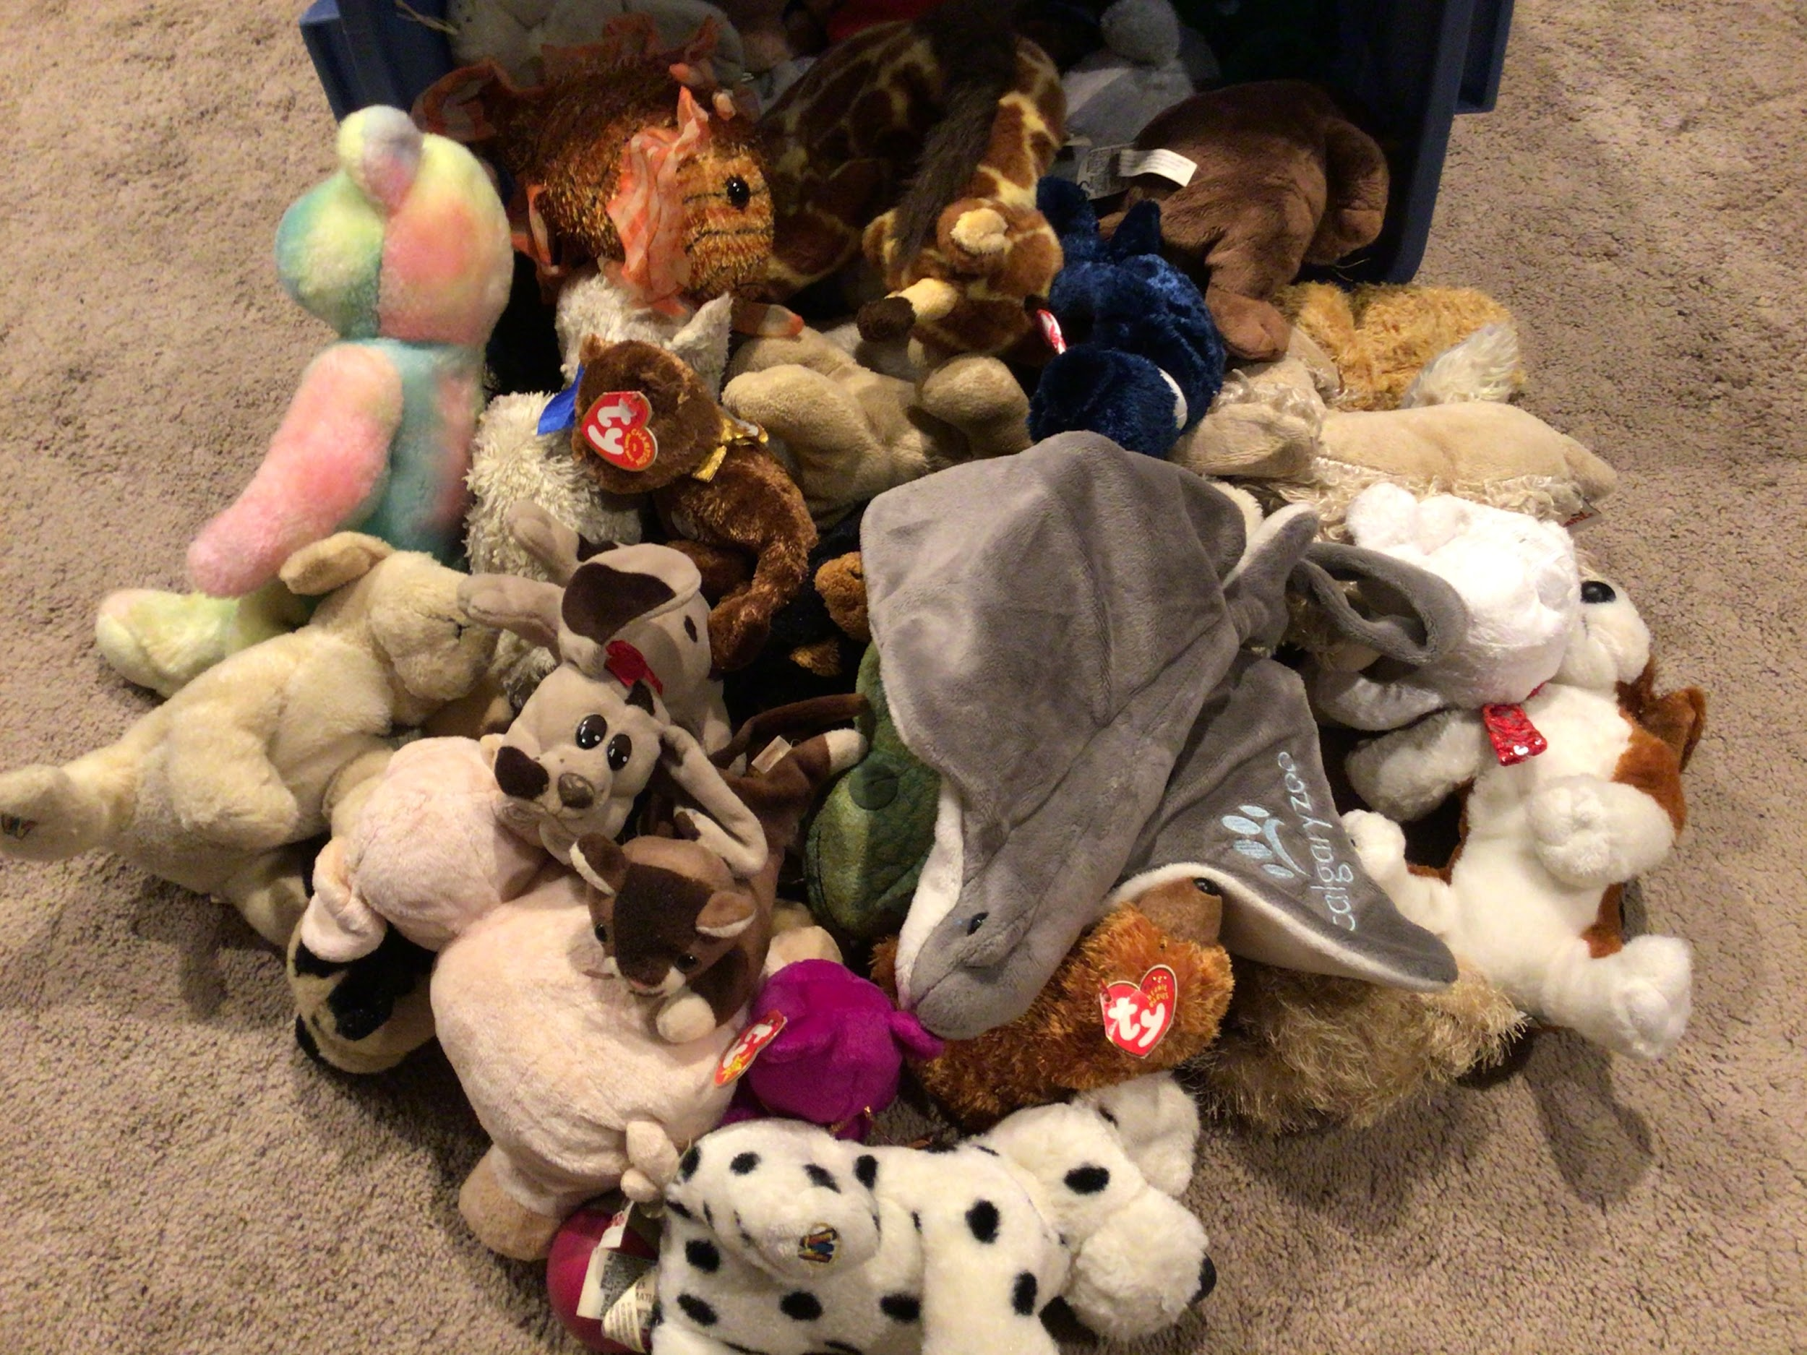
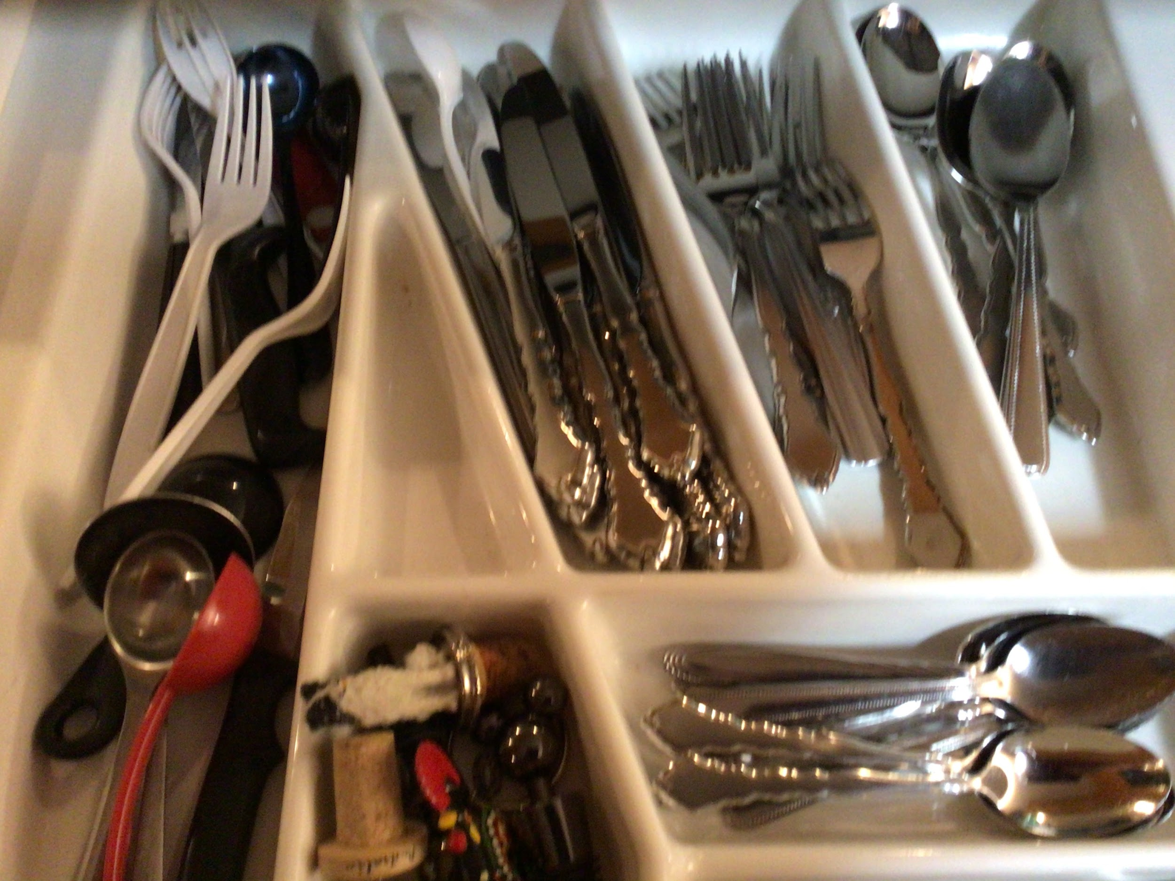
Look Around the House
Notes:
Images created

Slide 46
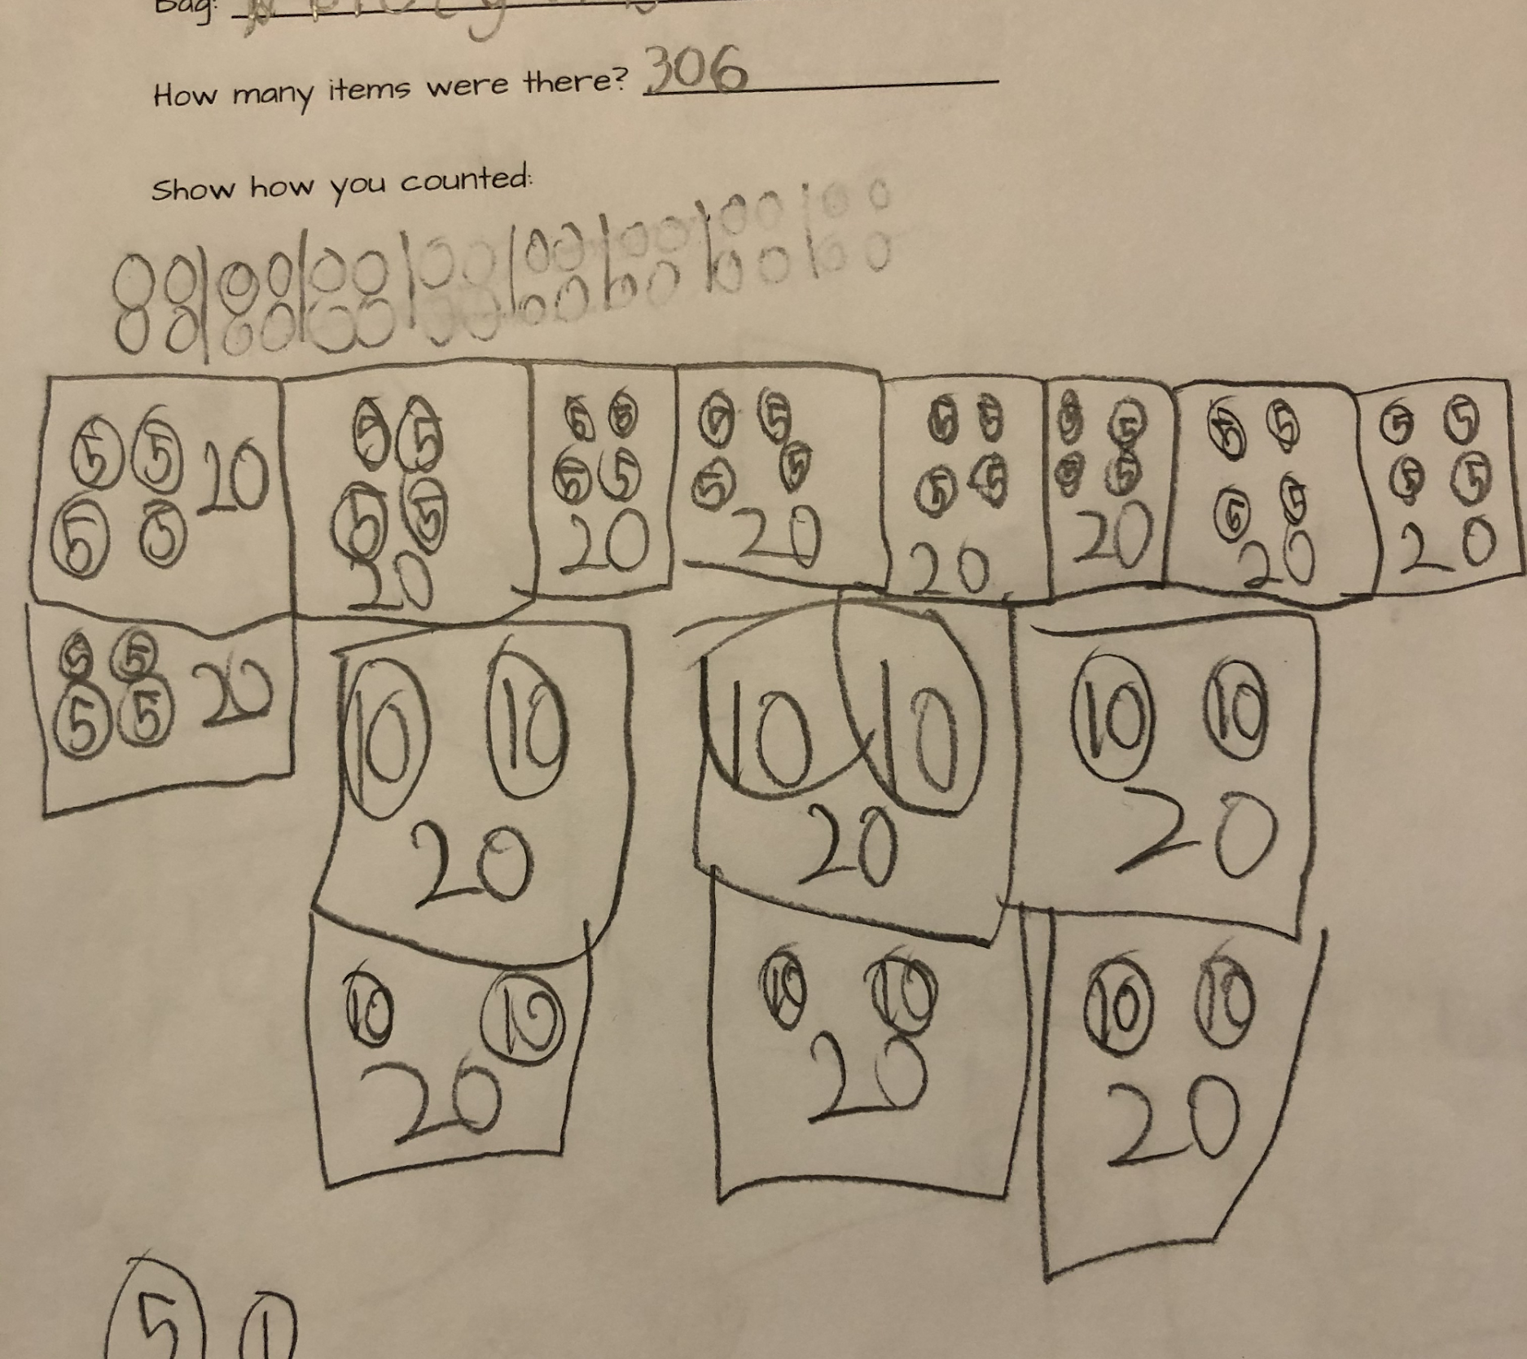
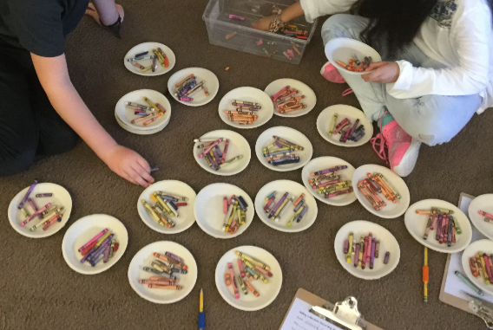
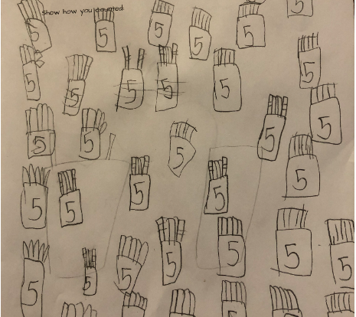
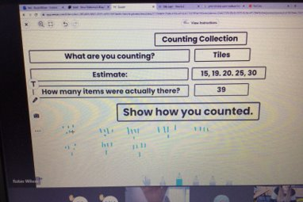
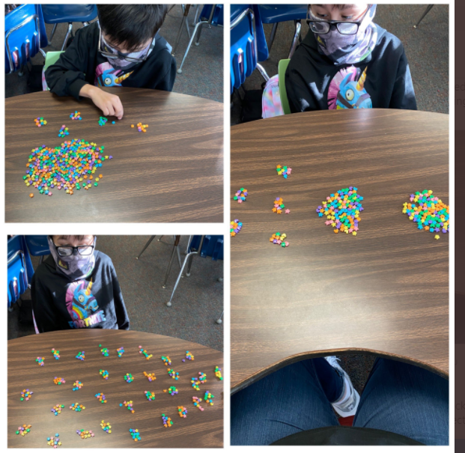
How students might show their thinking
Notes:
Images Created

Slide 47
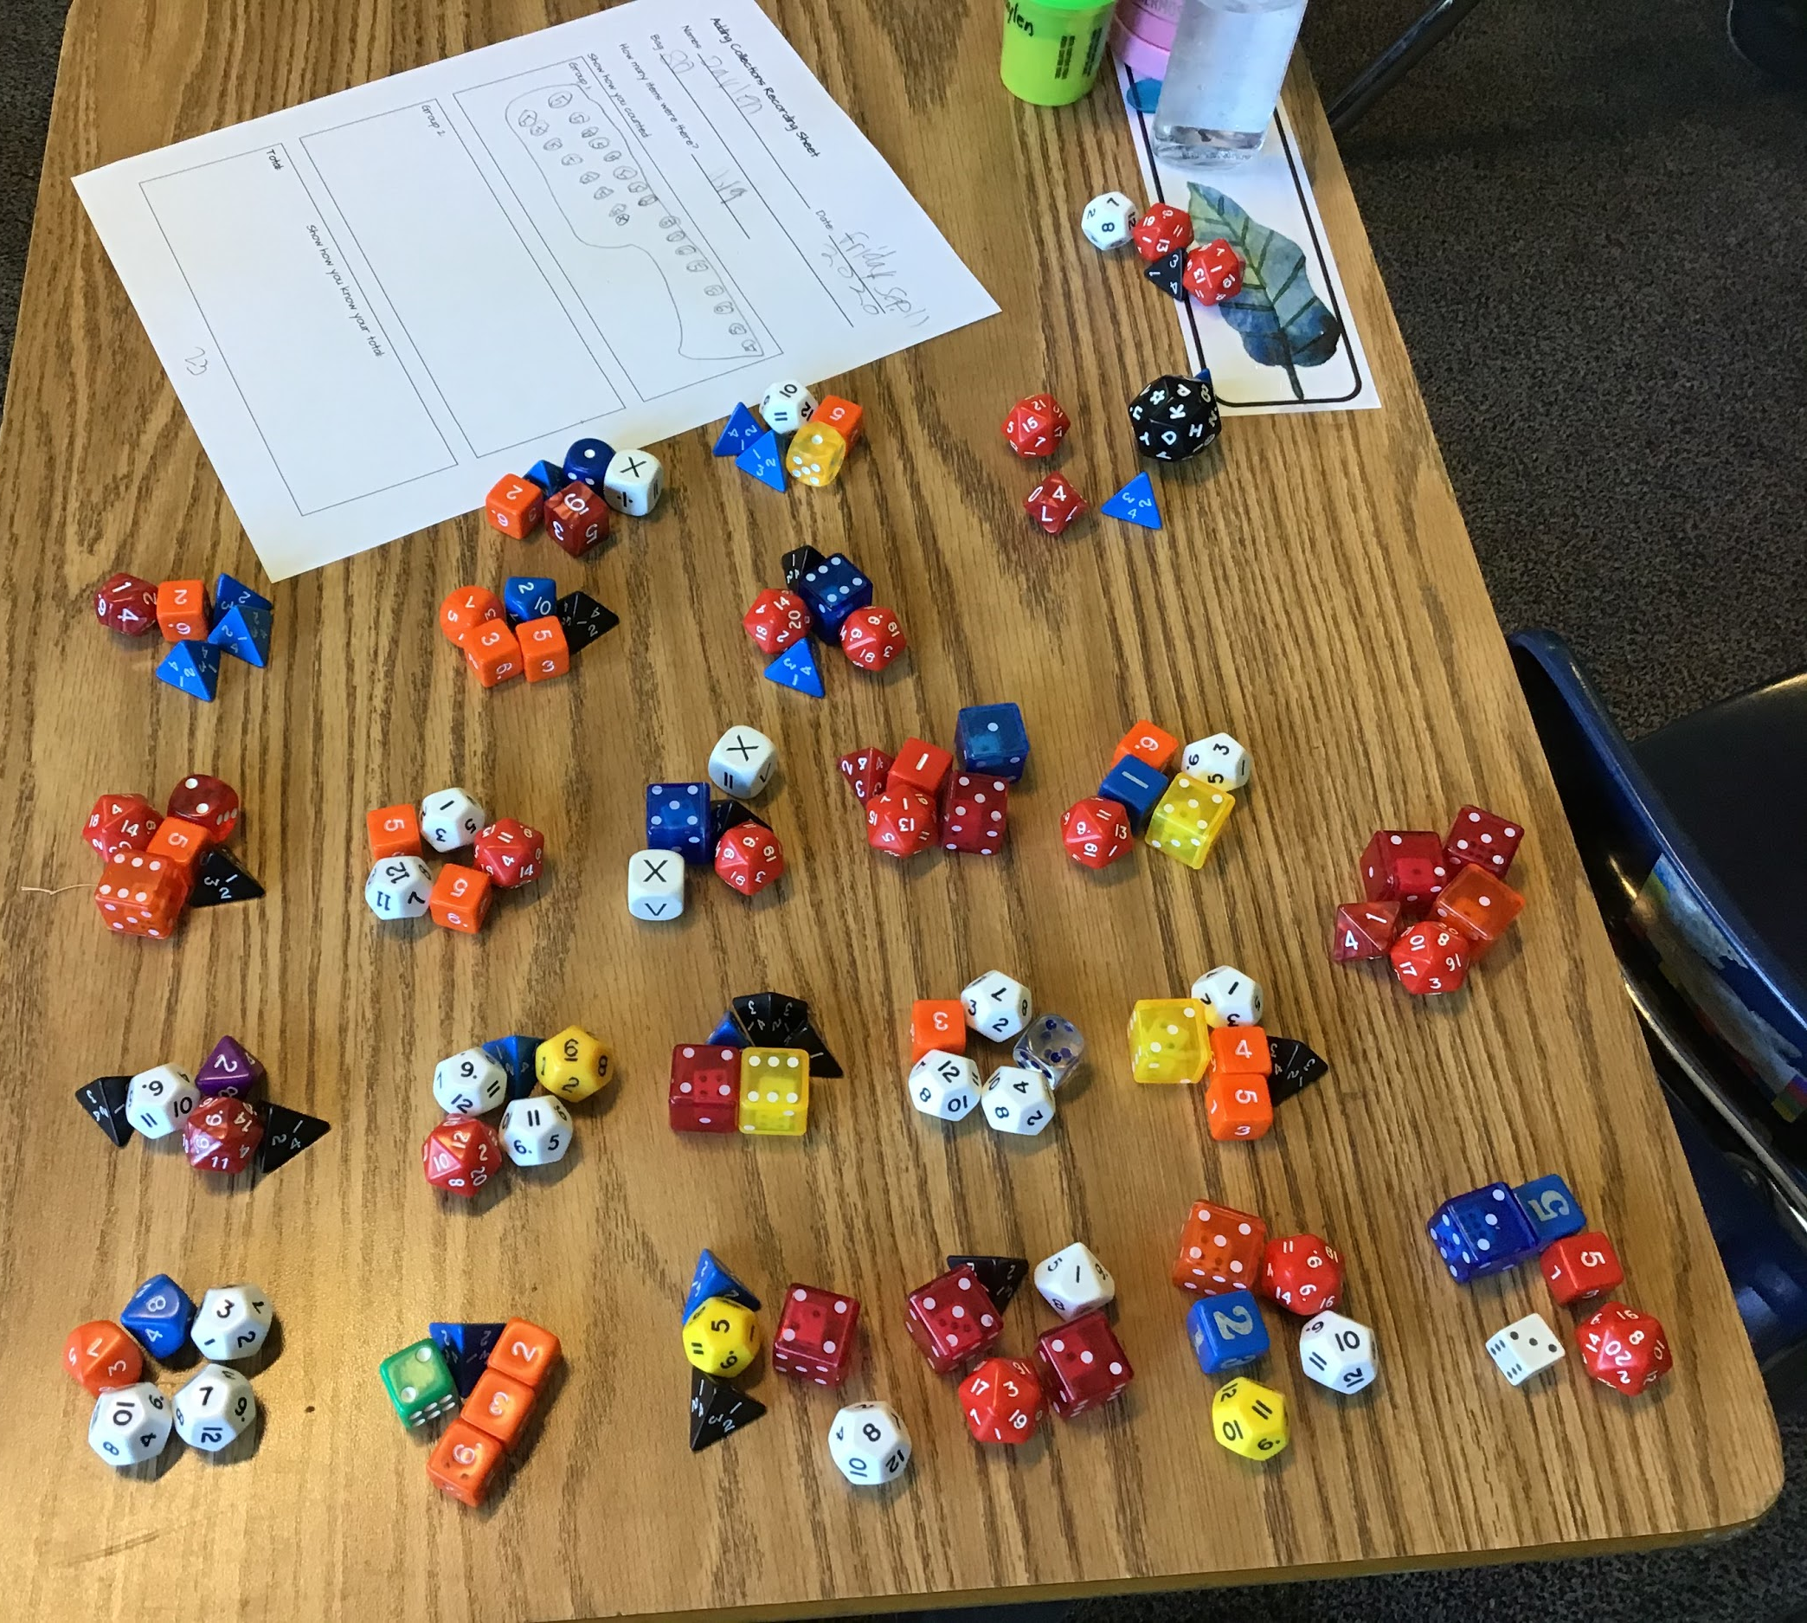
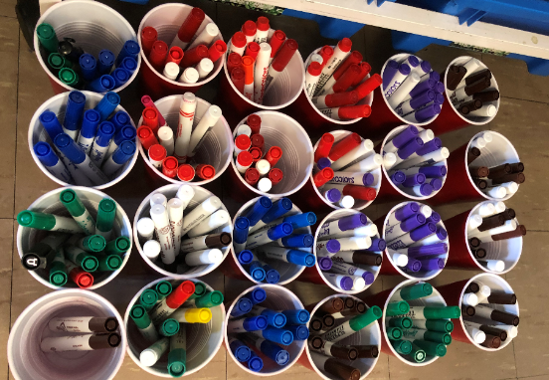
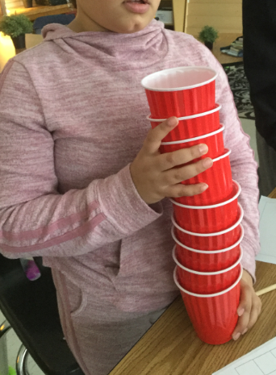
Notes:
Images created

Slide 48
Ben’s Ice Cream Cone
Ben wants an ice cream cone, but he is having trouble deciding which flavor and topping to get!
He can get either cookie dough ice cream or chocolate ice cream, and either cookie crumbles or sprinkles
for a topping.
What are the different choices of ice cream cone
with topping that Ben has?
Notes:
Source: Children are Mathematical Problem Solvers (Sakshaug, Olson and Olson)
Image source: https://pixy.org/800351/

Slide 49
Stickers
Brodie had 3 full sheets of stickers and 4
loose ones.
Sadie had 2 full sheets of stickers and 12
loose ones.
They each have the same number of stickers.
Every full sheet has the same number of stickers.
How many stickers are there in a full sheet?
Notes:
Source: Adapted from Crown copyright, 2000, Mathematical Problems for Able Pupils.pdf retrieved from https://www.egfl.org.uk/sites/default/files/maths%20puzzles%20all.pdf
Image source: https://pixabay.com/illustrations/sticky-notes-post-it-notes-sticky-938602/

Slide 50
3 fish limit
Some friends are camping near the shore and decide to go fishing. Six boats are available at the campsite. Each boat holds two people and the friends are excited because that is exactly how many they need. The rule on this lake is that each person can catch only three fish. How many fish did the friends catch that day if each friend caught the limit?
Notes:
Source: https://www.exemplars.com/education-materials/free-samples/pscc-3-assessment
Image Source: https://pixabay.com/vectors/black-cartoon-fish-sea-stripes-2027750/

Slide 51
How many squares on a 3x3 checkerboard?
**Be careful - are you sure you have found them all?
How about a 2x2 checkerboard?
How about a 4x4 checkerboard?
Do you notice any patterns with your answers?
Notes:
Source: Adapted from a problem by Rita Zazkis
Image created

Slide 52
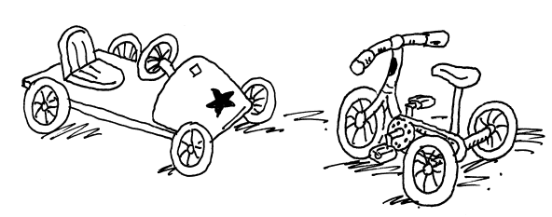
At the Toy Shop
The toy shop stocks tricycles and go-carts. The tricycles have 3 wheels. The go-carts have 5 wheels. Suna counted the wheels. There were 37 wheels altogether. How many tricycles and go-carts might there be?
Notes:
*note, the fifth wheel on the go-cart is the steering wheel.
Source: Adapted from Crown copyright, 2000, Mathematical Problems for Able Pupils.pdf retrieved from https://www.egfl.org.uk/sites/default/files/maths%20puzzles%20all.pdf

Slide 53
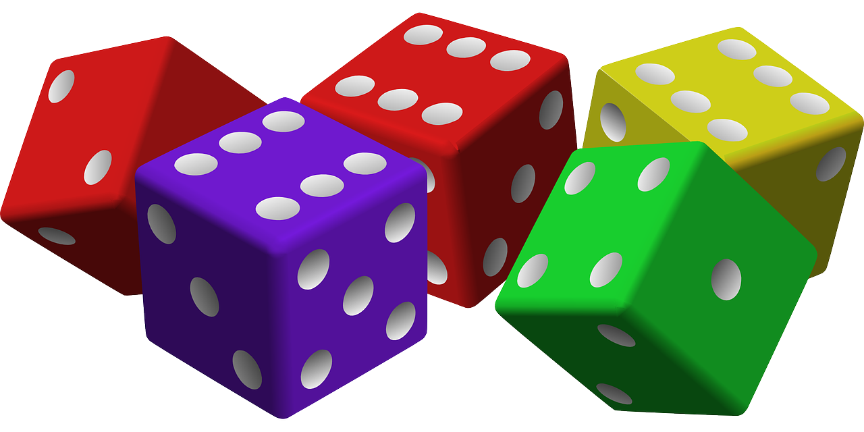
Playing with Dice
Roll 10-20 dice.
Find a grouping strategy to help you figure out the total number of dots without counting one-by-one.
Without changing the number on top, rearrange the dice using a different grouping strategy and find the total again. Does it match the first total?
Find a way to record your strategies and totals as you go.
Repeat with a new roll of the dice.
Notes:
Image source: https://pixabay.com/vectors/dice-game-luck-gambling-cubes-red-161376/

Slide 54
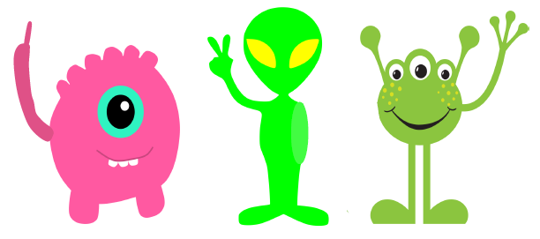
Aliens
I woke up from a dream and only remember parts of it. The aliens were very different - they only had one arm each. When I left, they waved goodbye. Some held up 1 finger. Some held up 2 fingers. Some held up 3 fingers. In all, 24 fingers were held up. How many aliens were there?
Notes:
Source: Burdess (http://www.aliciaburdess.com/)
Image Source:
https://pixabay.com/illustrations/martian-monster-green-1674016/ (Martian)
https://pixy.org/1519602/ (middle alien)
https://webstockreview.net/pict/getfirst (pink)

Slide 55
Information
Math Talks
Rich Tasks
Visuals
Asynchronous
Games
VISUALS

Slide 56
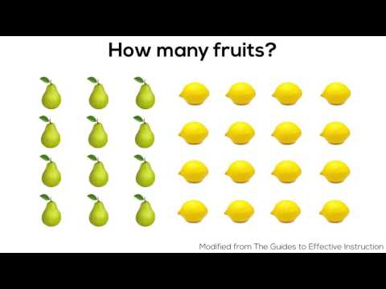
Notes:
Source: http://www.youtube.com/watch?v=RSluR2Qxkzk and https://mathisvisual.com/how-many-fruit/

Slide 57
Notes:
Source: http://www.youtube.com/watch?v=H6c0MNhyAuA and https://mathisvisual.com/halving-doubling/

Slide 58
Notes:
Source: http://www.youtube.com/watch?v=Uw9VGscJFVI and https://mathisvisual.com/division/

Slide 59
Notes:
Source: https://mathvisuals.wordpress.com/multiplication-division/

Slide 60
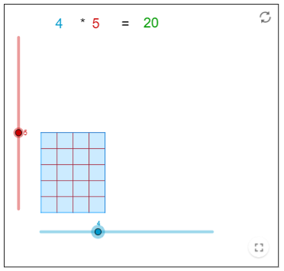
Notes:
Source: https://www.geogebra.org/m/zjbeA2nQ

Slide 61
Create Different Sets
Use the green dots and purple rings to make as many different sets as you can with no dots left over. Once you have created a set, record what you have made, and take a picture. Then go to another slide and make something different.
Use me

Slide 62
Create Different Sets
Use me

Slide 63
Information
Math Talks
Rich Tasks
Visuals
Asynchronous
Games
ASYNCHRONOUS

Slide 64
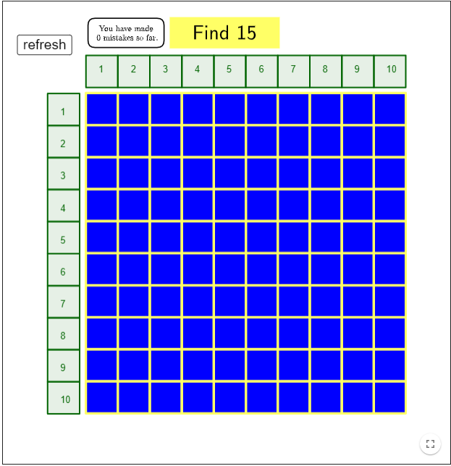
GeoGebra Applets: Multiplication
Notes:
Animation/Game where students need to find the number based on its factors. For example, students could find 15 in two different locations (5 x 3 or 3 x 5). This allows for students to see that these facts are connected.
https://www.geogebra.org/m/rSjV8S8q#material/cxf3dm8a

Slide 65
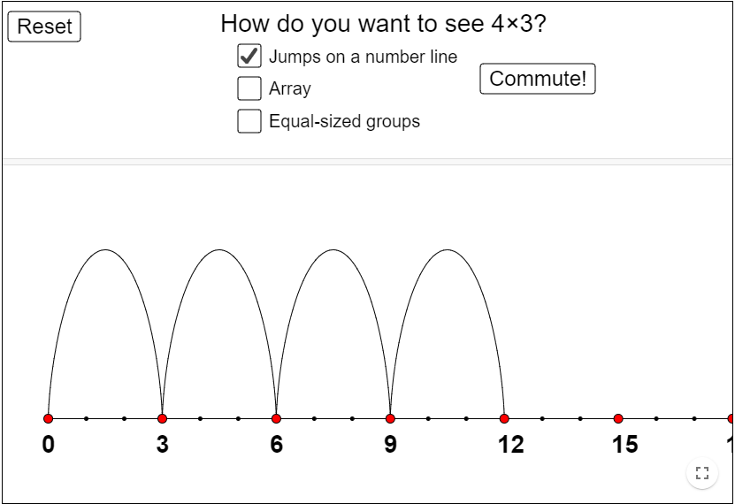
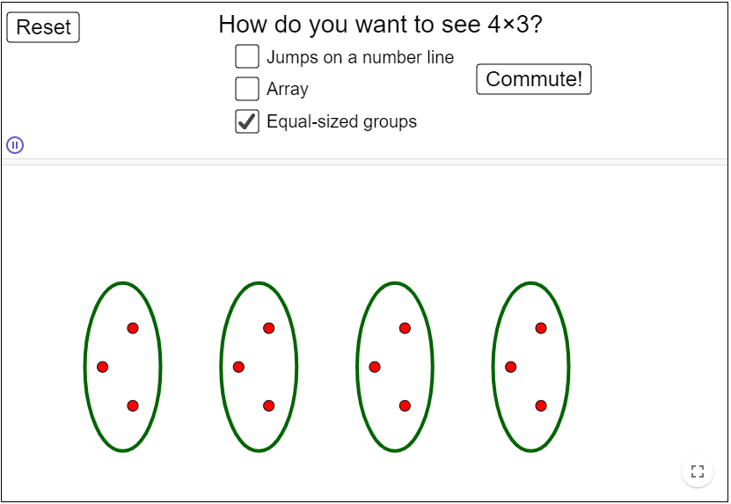
GeoGebra Applets: Multiplication
Notes:
Animation/Visual for students to see the different ways of multiplying. Students can choose the factors to see how groups form a product. Teachers may wish to ask students to work through the different methods and then choose the method they like best to share with the class. Students could then write a story problem to match their expression and method for solving.
https://www.geogebra.org/m/rSjV8S8q#material/HSc7AK5m

Slide 66
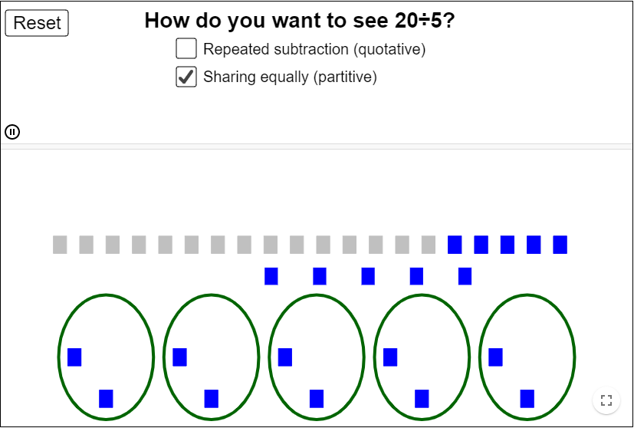
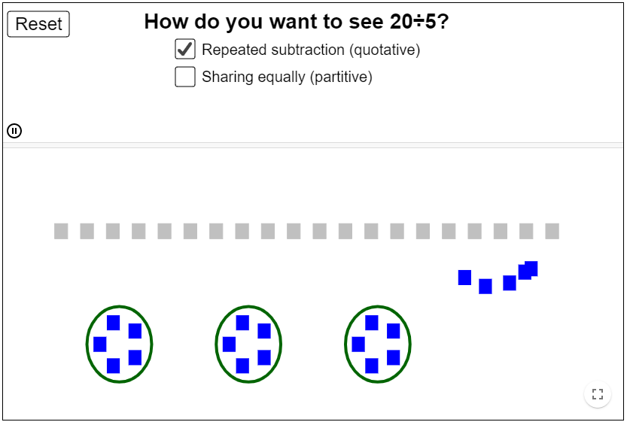
GeoGebra Applets: Division
Notes:
Animation/Visual for students to see the different ways of dividing. Students can choose the dividend and divisor to see how groups are shared. Teachers may wish to ask students to work through the different methods and then choose the method they like best to share with the class. Students could then write a story problem to match their expression and method for solving.
https://www.geogebra.org/m/rSjV8S8q#material/Jvtgbdv8

Slide 67
Multiplication Course
-Steve Wyborney
Notes:
Source: https://stevewyborney.com/2020/08/the-multiplication-course-by-steve-wyborney/
This course could be assigned to students asynchronously to compliment synchronous lessons on multiplication and division. Students can complete the course at their own pace.
This course also explores corresponding division facts.

Slide 68
Information
Math Talks
Rich Tasks
Visuals
Asynchronous
Games
GAMES

Slide 69
On the Double
Players: Two to Four
Materials: 10-sided die or a deck of playing cards with the face cards removed (ace= 1), 15 counters per student, 1 “On the Double” game board for each student.
Directions: Students place all of their counters over different spaces on the game board. (For example, if they think an 8 will occur most often, they may place more counters over the 8). Once the counters have been placed, they cannot be moved to a different location.
Players take turns rolling the die, doubling the number, saying the corresponding multiplication fact aloud (eg. “2 groups of/rows of/sets of/times 4 equals 8”), and removing a counter from that space on the board.
If they do not have a counter on that number, no counter is removed.
The first student to remove all of their counters wins the game.
Notes:
Variation: If using playing cards, use Kings as wildcards.
Concept Development: Doubles to 20 and multiplication of 2
Source: Math Fact Fluency: 60+ Games and Assessment Tools to Support Learning and Retention, Jennifer Bay-Williams and Gina King (2019)

Slide 71
Multiplication Challenge
Material: A deck of playing cards without Jokers, Jacks, Queens, and Kings.
Players: Two player
Rules: Deal cards so that each player has the same number of cards. Keep the cards face down. Both players turn over their top two cards. Whoever has the highest product (by multiplying their two cards together) takes all turned over cards and places the cards face down on the bottom of their deck. If both cards are equal, there is a challenge. In a challenge, each player places a card face down on top of their first card. Then, each player places two cards face up on top of their down card. Whoever has the highest product (by multiplying their second set of two cards together) takes all of the played cards (face up and face down). If the products are equal, the players have another challenge (another face down card, and another two face up cards)
Play continues until one person is out of cards (or only has one card). Whoever has the most cards is the winner.
Notes:
Source: Manitoba Education and Training Resources
Rules adapted from Rules of Card Games: War. http://www.pagat.com/war/war.html
Variation One: For 3 or 4 players. The game can be played with three or four players in exactly the same way except that in the challenge all of the players (not just the ones who tied) take part. Again, if any two products are tied for highest, the players have another challenge (another face down card, another two face-up cards).
A player who runs out of cards (or only has one card) drops out and the other players continue to play. Whoever has all of the cards is the winner.
Variation Two: Players can play so that the lowest product wins.

Slide 72
Four in a Row
Skills/Concepts: Multiplication facts to 25
Materials: Game Board,, 2 paper clips, counters/markers
Players: Two
Directions: Player A places two paper clips at the bottom of the game board, indicating two numbers. Player A multiplies the selected factors and places a marker on that product. (A player can have two paper clips on the same factor.) Player B moves only one of the paper clips to a new factor, multiplies the two factors and places a marker on that product. Players continue alternating turns, moving one paper clip each time, multiplying the factors, and placing markers on the product. The winner is the first player to have four markers in a row horizontally, vertically, or diagonally.
Notes:
Variation: Play until a player has five in row.

Slide 73
Player 1 Tokens:
Player 2 Tokens:

Slide 74
Array Game
Materials: centimetre grid paper, 2 different coloured (0-5 or 1-6) dice, markers (a different colour for each player)
Players: Two
Rules: Decide which colour die will represent the number of rows and which colour will represent the number in each row. Arrays cannot overlap.
Directions: Player 1 rolls the dice and determines the number of rows and the number in each row. Then outlines the matching array on the grid paper. The player writes the corresponding equation inside the array. Player 2 takes their turn. If the array does not fit on the grid paper, the player loses a turn. Play continues until each player has had 5 turns. The player with the most arrays on the board wins. In the event of a tie, total up the number of squares outlined by each player. The player with the larger number wins.
Notes:
Manitoba Education: Grade 3 Support Document for Teachers
Note:
Spinners can also be used
If the dice are the same colour (or one spinner is used) roll them separately. The first die represents the number of rows, and the second die represents the number in each row.

Slide 75
Race to the Moon
Race to the Moon is a fun Math game that develops rapid recall of Math facts.
The aim of the game is to be the first player to complete an unbroken path of counters from the Earth to the Moon.
It is a simple game to play, and only requires different colored counters.
Click on this link: https://www.math-salamanders.com/math-division-games.html
Notes:
Souce: https://www.math-salamanders.com/math-division-games.html
Image Source: https://openclipart.org/download/261337/three-window-rocket.svg

Slide 76
Credits:
T. Scott Dempster - St. James-Assiniboia School Division
Heather Jones - St. James-Assiniboia School Division
Dayna Quinn-LaFleche - St. James-Assiniboia School Division
Reviewers:
Charmaine Mackid – Hanover School Division
Sherry Perih – Manitoba Education Curriculum Development

Slide 77
Assessment Rubric
Basic descriptors to help guide your formative assessments. Full details of the student achievement profiles can be found here: Mental Math & Estimation Knowledge and Understanding Problem Solving | Requires considerable, on-going teacher support | Requires occasional, teacher or peer support | Accurate, clear, uses appropriate strategies & procedures. Requires occasional prompting for clarification. | Accurate, clear, flexible, consistent & efficient. Justifies and explains reasoning clearly and completely using accurate mathematical vocabulary.
Gr. 3 - Multiplication & Division RUBRIC | Limited | Basic | Good | Very Good/ Excellent
Describe and apply Mental Math strategies: Adding the same number (skip counting)
Describe and apply MM strategies: Subtracting the same number (skip counting backwards)
Describe and apply Mental Math strategies: knowing half/ breaking into smaller parts
Represents and explains multiplication using equal grouping and arrays (up to 5x5)
Represents and explains division as equal sharing and/or equal grouping (up to 5x5)
Models multiplication using concrete and visual representations (up to 5x5)
Models division using concrete and visual representations (up to 5x5)
Relates multiplication to repeated addition and vice versa
Relates division to repeated subtraction and vice versa
Relates multiplication to division and vice versa (up to 5x5) using arrays and related number sentences
Solves problems in context that involve multiplication
Solves problems in context that involve equal sharing and/or equal grouping
Suggested Codes for daily record keeping purposes:
I - Knowledge has been demonstrated individually
H - is used when knowledge has been demonstrated individually, but with help from the teacher or a peer
G - is used when knowledge has been demonstrated within a group
X - is used when a question has been attempted but answered incorrectly
N - is used when a question has not been attempted.
Notes:
You can also copy and paste the table above into Microsoft Word or similar program.
Tracking student data throughout these learning experiences will allow the teacher to make an informed assessment about the students’ level of achievement on these outcomes.
Adapted from: Liljedahl, P. (2021). Building thinking classrooms in mathematics, grades K-12: 14 teaching practices for enhancing learning. Thousand Oaks, CA: Corwin Press Inc.

Slide 78
The End.

