Slide 1
We are Water Protectors
Grade 2 Learning Experience
PowerPoint template entitled “Ocean Presentation” courtesy of Microsoft Office

Slide 2
Questions:
Why is water important to humans and all living things?
How do we protect our water?
What does it mean when you make a promise or a pledge?
2

Slide 3
My initial thinking:
Draw an arrow on each dashboard to show your current thinking. Justify your choice.
How do my actions affect how clean the water is?
I think my actions affect how clean the water is _____________ because…
How do my actions affect how much is available to use?
I think my actions how much is available to use _____________ because…
A little bit
A lot
A little bit
A lot
Not at all
Significantly
Not at all
Significantly

Slide 4
Instructions:
You are going to do a number of tasks to help you answer the questions on the previous slide and to complete the final task below.
FINAL TASK:
Write a pledge or a promise about how you will protect and/or conserve water.

Slide 5
Nibi is Water
What are all of the ways that you and members of your household use water?
View the book Nibi is Water and the author talk with Joanne Robertson.
5
Notes:
https://www.youtube.com/watch?v=MgWBmNTXnbs&t=57s
https://www.youtube.com/watch?v=hlX9Mi5_InY

Slide 6
Nibi is Water Sort
On paper, draw or write all the different ways that you use water.
Choose a way to sort your pictures or words.
Use the space on below to insert a picture of your sort and use a text box to describe your sorting rule.

Slide 7
One Well: Same or Different
How do plants and animals (including humans) use water? Are their uses of water the same or different.
View the book One Well. You can view the whole book or just up to the end of page 13 (Stop the video at 9:20)
On the next slide, record all the ways that plants and animals use water that are the same and all they ways that they are different.
7
Notes:
https://www.youtube.com/watch?v=INZl1LAfn0M

Slide 8
One Well: Same or Different
Same: What is the same about how plants and animals use water?
Different: What is different about how plants and animals use water?

Slide 9
Tracking Water Usage
How do you use water?
For 1 full day, mark a tally in the chart any time you use water.
Use your data to create a pictograph of your water usage. Insert a photo of your work on the next slide.
Water Use | Tally
Bathroom
Washing
Brush teeth
Recreation
Drinking
Other
9

Slide 10
Tracking Water Usage: Pictograph
View your pictograph. What do you notice? What do you wonder?

Slide 11
Measuring Water
How long does your tap need to run to fill a one litre (1L) container?
How could you solve this problem? What are the steps you need to do to answer the question?
Record your method and findings on the next slide.
11

Slide 12
How long to fill a litre (L)?
List your step by step plan:
1.
Draw or write to record what happened:
It took the tap ___________ long to fill one litre.

Slide 13
Estimating Water
Use your findings from the previous slide to estimate how much water you use when you wash the dishes, or have a bath, or take a shower.
I think it will take ____________ long to fill the sink/have a bath/take a shower.
I think that means I use ________ litres of water to fill the sink/have a bath/take a shower.
Optional challenge: How could you check your estimate?
13

Slide 14
Imagine…
Imagine how different the world would look if there was less water available to support living things.
Take or find a picture of a natural environment.
Write, draw, or record a video to show how the environment in the picture would change if there was less water available for living things.
Insert your writing, drawing, video in the space on the right.
14

Slide 15
Save Water
How can we save (or reduce) the amount of water we use?
Watch the video Save Water to Help the Earth. Go for a walk around your home with a care giver. Discuss with a care giver all of the ways and places in your home that you already conserve water. Where could you make some changes?
Record your thoughts on the chart on the following slide.
15
Notes:
https://www.youtube.com/watch?v=rl0YiZjTqpw

Slide 16
Conserving Water in Our Home
Ways we already conserve or save water: | Things we could change to conserve or save water:

Slide 17
All the Way to the Ocean
How do humans pollute the oceans and water systems?
Watch the short movie All the Way to the Ocean.
After, draw a picture, write, or record a video to answer the following questions:
What do humans do to pollute the ocean?
What could humans do to help keep the oceans cleaner?
Use the space on the next slide to record your response.
17
Notes:
https://www.youtube.com/watch?v=sZW2ByM623g&feature=youtu.be

Slide 18
All the Way to the Ocean
What do humans do to pollute the ocean?
What could humans do to help keep the oceans cleaner?

Slide 19
Is Plastic Fantastic?
Is plastic a fantastic material? Insert an arrow on the dash board below and complete the sentence.
I think plastic is a ___________ material because …
somewhat good
very good
horrible
fantastic
19

Slide 20
Is Plastic Fantastic?
Read the book called Is Plastic Fantastic? After reading, reconsider your initial thinking. Has your opinion changed?
I think plastic is a ___________ material because …
My thinking has (changed/stayed the same) because…
somewhat good
very good
horrible
fantastic
20
Notes:
https://static1.squarespace.com/static/55b29de4e4b088f33db802c6/t/5aec87b2562fa7b8e1f73a8f/1525450683981/PPC_KidsBooklet-08_spreads.pdf

Slide 21
Out to Sea?
What kind of garbage ends up in the sea?
Visit the Hong Kong Science Museum exhibit called Out to Sea? The Plastic Garbage Project. Watch the videos about the exhibit. As you watch the videos consider:
What kinds of garbage end up in the oceans?
What artwork was created with the garbage?
After, create a piece of artwork using recyclables or garbage found in your home. Share a picture of your artwork in the space to the right. Check with a caregiver before starting.
21
Notes:
https://hk.science.museum/ms/ots2015/eintroduction.html

Slide 22
My new thinking:
Draw an arrow on the dashboard to show your current thinking. Justify your choice. Reflect on your thinking.
How do my actions affect how clean the water is?
I think my actions affect how clean the water is _____________ because…
My thinking has (changed/stayed the same) because….
A little bit
A lot
Not at all
Significantly

Slide 23
My new thinking:
Draw an arrow on the dashboard to show your current thinking. Justify your choice. Reflect on your thinking.
How do my actions affect how much is available to use?
I think my actions how much is available to use _____________ because…
My thinking has (changed/stayed the same) because….
A little bit
A lot
Not at all
Significantly

Slide 24
I Promise…
What does it mean when we make a promise or a pledge? List your ideas in the text box on the right.
View We Are Water Protectors and I Promise.
24
Notes:
https://www.youtube.com/watch?v=jqWTouyaQ-8
https://www.youtube.com/watch?v=K0lKGohjCnM

Slide 25
A promise or a pledge means…
Describe what it means to make a promise or pledge. DO NOT use the words “promise” or “pledge” in your description.

Slide 26
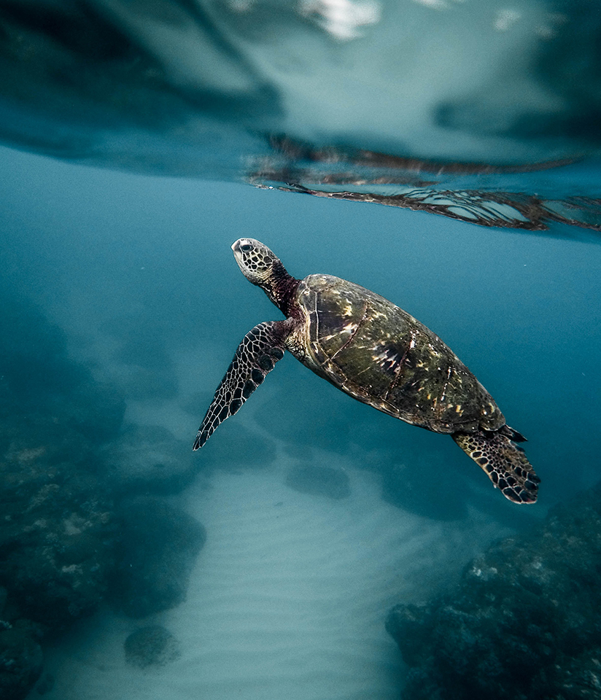
What will you do?
What are you going to do to protect and/or conserve water?
View The Water Walker.
Write a pledge or a promise about how you will protect and/or conserve water.
Record your pledge or promise on the next slide.
Notes:
https://www.youtube.com/watch?v=iyTdZqL1fFA

Slide 27
My Promise/Pledge
Insert Image

