Slide 1
Using MEASUREMENT to
understand and describe
our world
Notes:
Image Source: https://www.flickr.com/photos/155753322@N06/41903827290

Slide 2
Guiding Concepts
Anchored in inquiry
Open ended questions, student centered, student choice
Low floor, high ceiling tasks
Multiple ways to show understanding

Slide 3
Curricular Outcomes
4.SS.3 – Demonstrate an understanding of area of regular and irregular 2-D shapes.
4.SS.4 – Solve problems involving 2-D shapes and 3-D objects
4.PR.3 – Represent and describe patterns and relationships using charts and tables to solve problems.
4.PR.4 - Identify and explain mathematical relationships using charts and diagrams to solve problems.
4.N.5 – Describe and apply mental math strategies such as: skip counting from a known fact, using halving/doubling/, double and add one more group…) to develop an understanding of basic multiplication facts to 9x9. Recall of multiplication and division facts up to 5 x 5.

Slide 4
Instructions
This collection of tasks is designed around the concept of measurement, more specifically perimeter and area. The 6 sections (colored blocks on slide 6 of the PowerPoint) represent independent sets of 3-part learning experiences that could function effectively as 45min-1hour session with a combination of synchronous and asynchronous parts, some of which are easily adaptable either way depending on your situation and access to technology and connectivity.
*FOR SYNCHRONOUS LEARNING, THE SLIDEDECK MUST BE IN EDIT MODE (not present mode)*
Each set provides a different way of engaging with the concept and is divided into 3 main parts:
Get Ready: begins the experience with an activity meant to activate student thinking and promote rich student discourse. This activity can be delivered prior to the lesson as an asynchronous task so students have time to prepare their thinking. It can also be delivered at the beginning of the synchronous session to help the teacher pre-assess prior knowledge and prime thinking for the upcoming learning experience.
Work it out: comprises the main learning experience for the day. This is where new content is presented and individual or small group responses are required. These activities are best completed with students working in pairs or small groups. If your platform allows for breakout rooms, this feature is a good tool that will facilitate student collaboration and discourse.
Look Back: is a final culminating task that provides opportunities to check for student understanding of the concepts, consolidate different solutions and solve problems. It allows for students to reflect on their learning and make connections.
Notes:
More detailed instructions for each learning experience are included in the NOTES section under each slide.

Slide 5
Materials
It is highly recommended that if this is the first-time students are experiencing virtual manipulatives, allow them time to "play". This allows for the opportunity to explore and have fun with the tools BEFORE they will be required to use them purposefully.
Websites for virtual manipulatives are suggested. Hands-on materials are ideal. Significant learning occurs when students can build and visualize different representations of mathematics.
If a specific platform is used for delivering online instruction (i.e. Seesaw, Google Classroom), asynchronous tasks can be uploaded there.
For virtual manipulatives visit https://toytheater.com/category/teacher-tools/virtual-manipulatives/
To enhance their learning experiences students will need:
Pattern blocks https://toytheater.com/pattern-blocks/
Coloured counters https://toytheater.com/color-counters/
Some premade manipulatives have been provided on specific slides
Students will want paper/pencil or dry erase surface & marker available throughout these experiences.

Slide 6
How do we use measurement to understand and describe our world?
Visual Connections
Real World Connections
Mental Math & Estimation
Problem Solving
Pattern Connection
Number Play
Notes:
This is the “launch screen”. Each tile above represents 1-2 “days” worth (approx. 1 hour) of learning experiences.
The slides needed for each section are colour coded and grouped together to help you locate them in the slide deck.
The teacher is free to determine the order these learning experiences will be assigned.
Routinely incorporating conceptual understanding, procedural thinking, and problem solving within instructional design will enable students to master the mathematical skills and concepts of the curriculum. Integration of the mathematical processes are intended to permeate all learning experiences.

Slide 7
Real World Connections
1
Get Ready
2
Work it out!
3
Looking Back
What do you notice? What do you wonder?
Buy More?
Extend your thinking
Better Use
Less is More
Notes:
Activator – number talk to get students thinking and sharing ideas
Work it out - Challenges make up the focus of the day(s) lesson (you may only have one and all students are assigned the same task, you may have a choice of two or three, or you may have all students begin at challenge 1 and move on as greater challenge is needed / Consolidate & Reflect on what you’ve learned during this part of the project.
Looking Back – a place for reflection/self-assessment/further consolidation or extensions

Slide 8
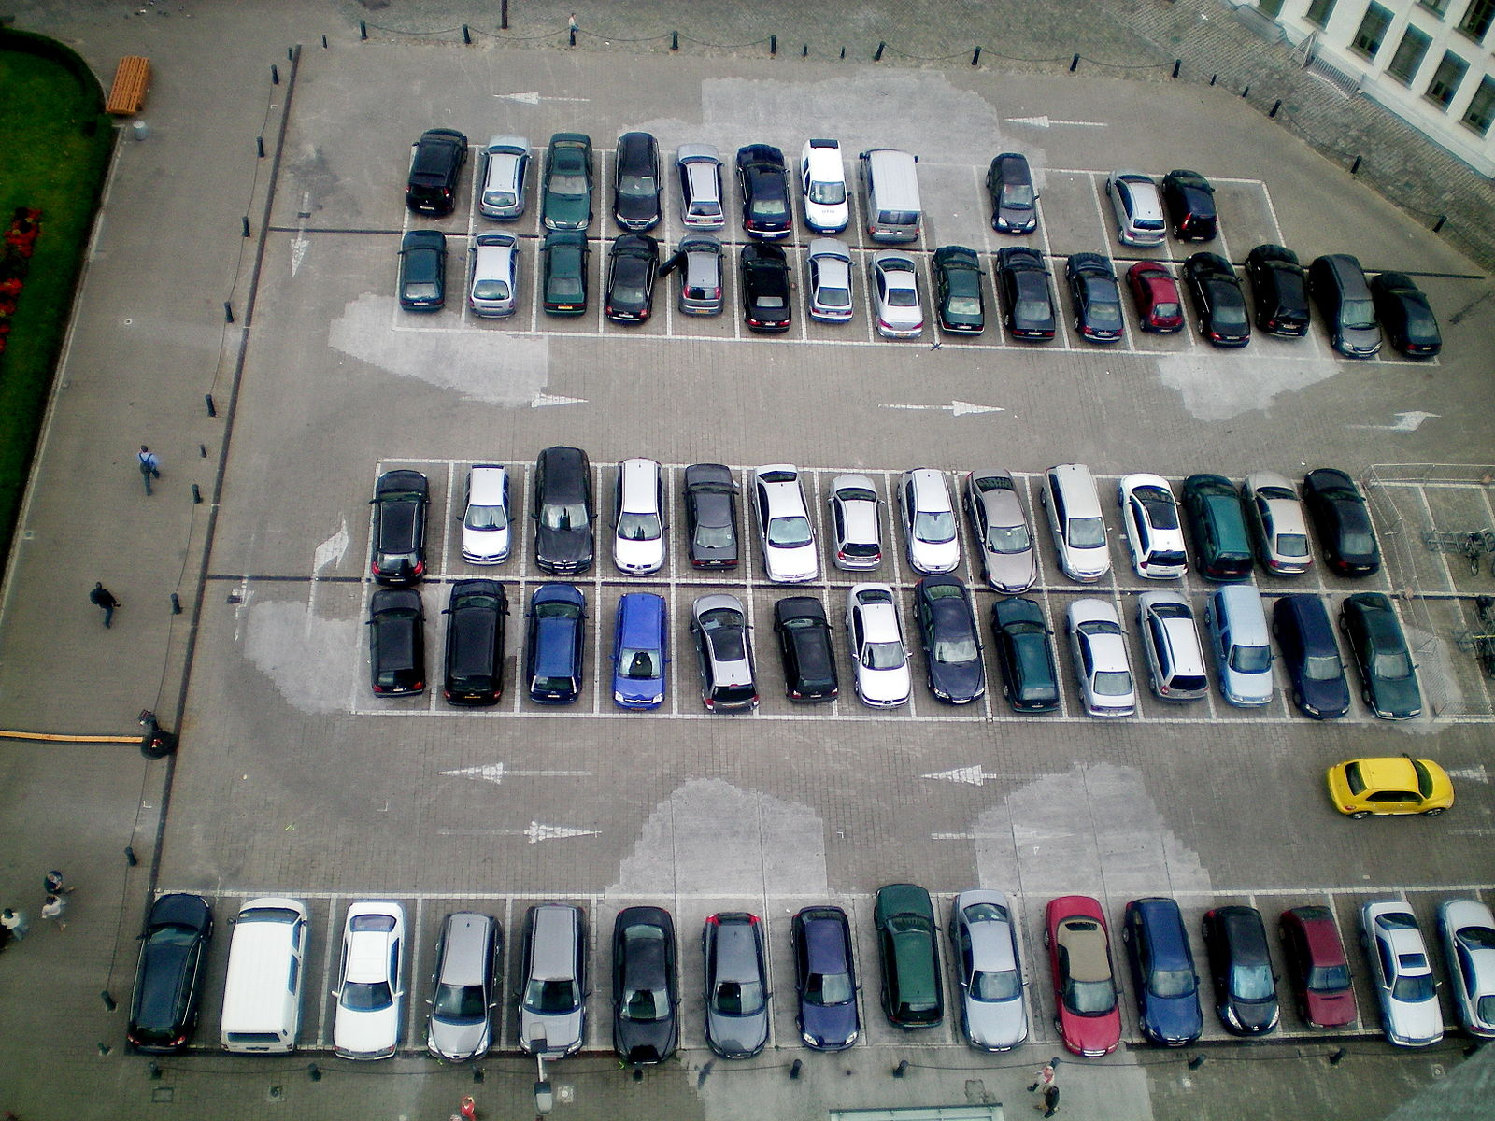
1
Get Ready
What do you NOTICE?
What do you WONDER?
Notes:
Slide for Part I, activating activity…notice and wonder
Image Source: https://commons.wikimedia.org/wiki/File:Car_park_-8.jpg

Slide 9
1
Get Ready
NOTICE WONDER
Notes:
Working Slide:
Teacher can use to collect ideas from a group discussion
Could be assigned to small groups of students working together to complete collaboratively
Can be assigned to individual students – each student to copy and paste the slide (within your PowerPoint) and put their name at the top.

Slide 10
1
Get Ready
End of this section

Slide 11
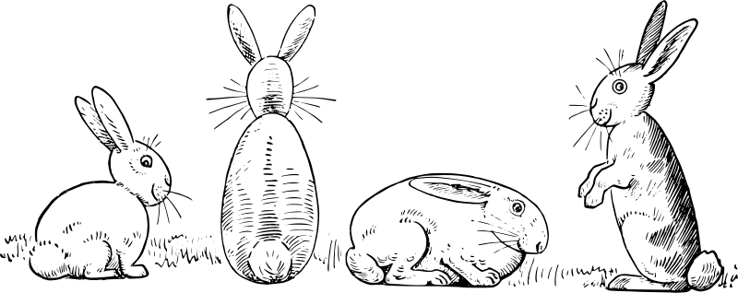
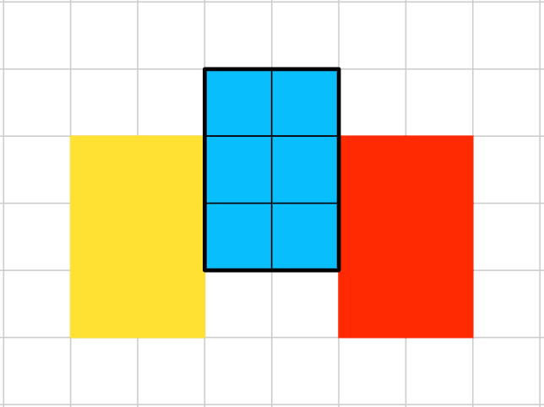
2
Work it out
Alesha bought just enough wire fencing to surround her garden to protect it from being ravaged by the neighbourhood rabbits.
Below is her original plan for the garden. In the yellow area she will plant carrots, peas in the blue area and peppers in the red area.
But now she has decided that she wants more room so she can also plant lettuce.
She needs a way to increase the area she can enclose for planting.
How much fencing did she buy?
What ideas do you have to help her get more area?
2m
Notes:
Real world application problem involving perimeter and area.
This set of slides (11-14):
Teacher can use in a synchronous lesson and step through the slides, one level of difficulty at a time.
Could be assigned to small groups of students working together to complete collaboratively.
Can be assigned to individual students – each student to copy and paste the slide (within your PowerPoint) and put their name at the top.
Image Source: https://openclipart.org/detail/281869/four-rabbits

Slide 12
2
Work it out
Buy More?
2m
IDEA 1: Buy more fencing
Will this idea work?
Use the Area & Perimeter Exploration tool to explore your ideas and work out a new plan for the garden. Show your new plan and tell how much more fencing she will need to buy.
Notes:
Of course this solution will work! Students can choose to add whatever amount of area they feel is reasonable and purchase the fencing to enclose the new garden. This option is wide open and provides a low floor for students to experiment in a low risk way.
LINK: https://toytheater.com/area-perimeter-explorer/

Slide 13
2
Work it out
Better Use
2m
IDEA 2: Use the SAME amount of fencing that she has, but in a different way.
Will this idea work?
Use the Area & Perimeter Exploration tool to explore your ideas and work out a new plan for the garden.
Notes:
This option challenges students to think in more strategic ways. They will need to experiment with different arrangements and determine the various areas that they can enclose using a total perimeter of 22m.
There are multiple arrangements that meet this criteria.
LINK: https://toytheater.com/area-perimeter-explorer/

Slide 14
2
Less is More
Work it out
2m
IDEA 3: Use even LESS fencing than she bought but enclose more area for planting
Will this idea work?
Use the Area & Perimeter Exploration tool to explore your ideas and work out a new plan for the garden.
Notes:
This level will require students to make sense of how square units can be included in the area but not contribute (or contribute in the smallest possible ways) to the perimeter. Blocks that are fully enclosed are ideal and their plan should reflect this.
LINK: https://toytheater.com/area-perimeter-explorer/

Slide 15
2
Work it out
End of this section
Notes:
This is an appropriate time to bring students together for consolidation. Begin at idea 1 and talk through student ideas and discoveries. Move to ideas 2 & 3 and continue to focus on the strategies students needed to use to make each idea work.

Slide 16
3
Looking Back
Design a set of gardens (at least 3) that all have the SAME AREA.
Arrange them in order from the garden needing the least to the garden needing the greatest amount of fencing.
Use the Area & Perimeter Exploration tool to design your gardens. Snap images and paste them here:
What do you notice about the arrangements as the perimeter gets larger?
Notes:
This extension task could be assigned to students as asynchronous work and submitted for teacher feedback.

Slide 17
3
Look Back
End of this section

Slide 18
Mental Math & Estimation
1
Get Ready
2
Work it out!
3
Looking Back
Thinking Flexibly
Using Partial Products
Number String
Connect Ideas
Notes:
Activator – number talk to get students thinking and sharing ideas
Work it out - Challenges make up the focus of the day(s) lesson (you may only have one and all students are assigned the same task, you may have a choice of two or three, or you may have all students begin at challenge 1 and move on as greater challenge is needed / Consolidate & Reflect on what you’ve learned during this part of the project.
Looking Back – a place for reflection/self-assessment/further consolidation or extensions

Slide 19
1
Get Ready
How would you solve this?
5 x 5
Could you solve it a different way?
Notes:
Activating activity…number string.
Students are presented with a set of calculations to do that tie together, the thinking about one can lead to structured thinking for the next.
Students should have recall of facts to 5x5 by end of grade 4, and should be working to use strategies to determine the rest up to 9x9, this warm-up focuses on those mental math strategies that students need to develop.

Slide 20
1
Get Ready
How would you solve this?
5 x 8
Could you solve it a different way?
Notes:
Hopefully the distributive property / partial products will come up in discussion. If we know 5x5, then we could just do 5 groups of 5 and then 3 groups of 5 and add them together (5x5) + (5x3). Students may also know that 10 groups of 8 is 80, so 5 groups would be 40 (10 x 8) – (5 x 8), partial product diagrams that represent these situations are helpful visuals for students to see drawn out.

Slide 21
1
Get Ready
How would you solve this?
7 x 8
Could you solve it a different way?
Notes:
Whatever strategies students provide should be examined and explored by the class. Someone might suggest using the square of 7 or 8 if they are known facts for particular students, then add or subtract a group to get to 7x8.

Slide 22
1
Get Ready
End of this section

Slide 23
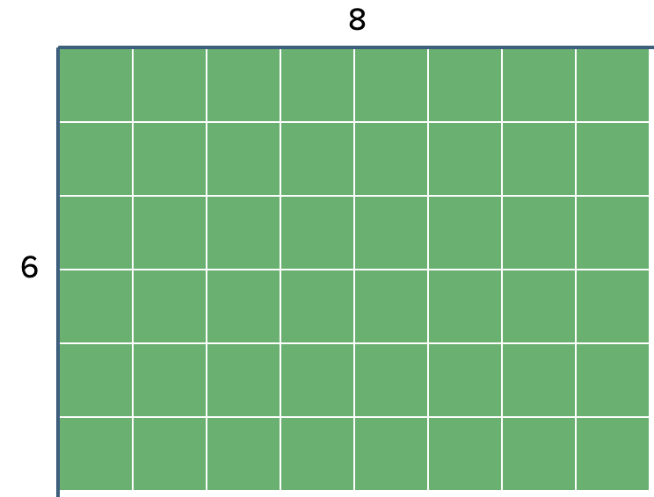
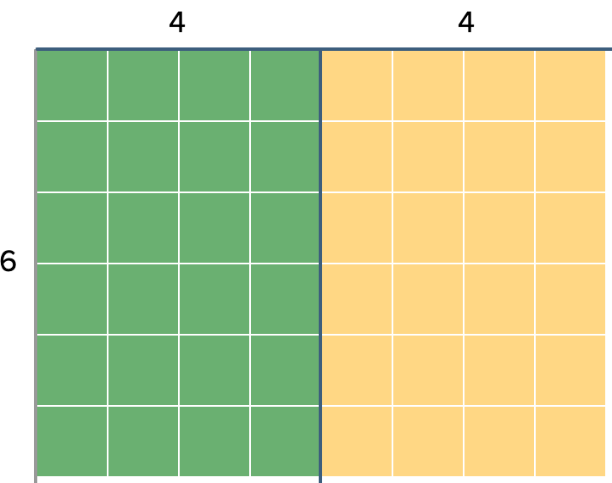
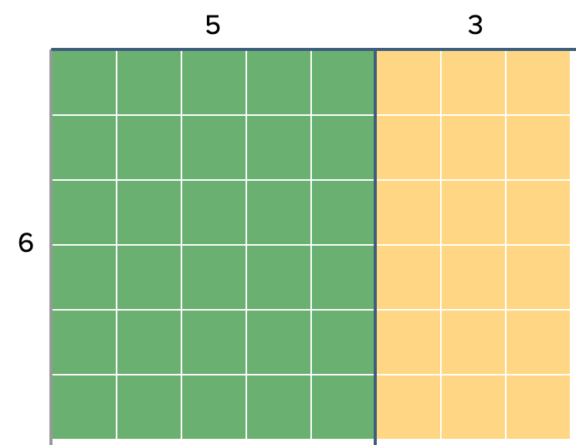
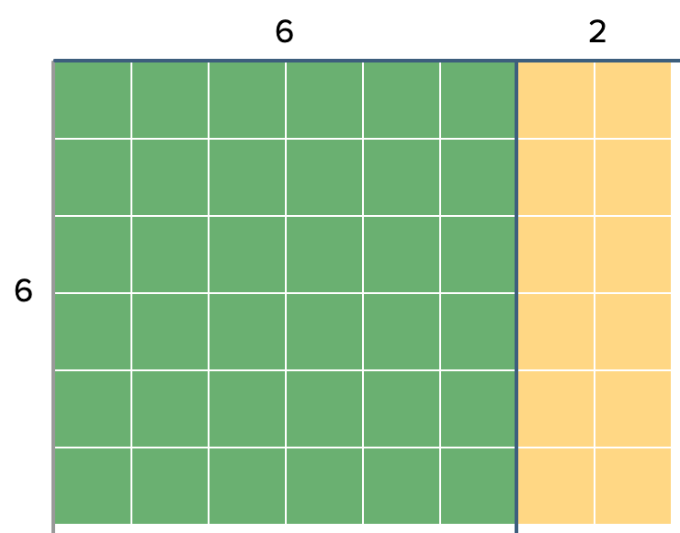
2
Work it out
?
Products can be found by breaking up the factors and working with the smaller parts.
Say we want to know the solution to 6 x 8:
If 6 x 4 is known…
If 6 x 5 is known…
If 6 x 6 is known…
8
8
8
6 x 8 = (6 x 4) + (6 x 4)
6 x 8 = 24 + 24
6 x 8 = ______
6 x 8 = (6 x 5) + (6 x 3)
6 x 8 = 30 + 18
6 x 8 = ______
6 x 8 = (6 x 6) + (6 x 2)
6 x 8 = 36 + 12
6 x 8 = ______
Notes:
This set of slides (23-30) would be best used pushed out to students so they are able to manipulate it themselves as they follow along with you synchronously. You may choose to select this set of slides, make a new PowerPoint including just this day’s work and send that out to students. This will depend on your particular technology arrangements and available platforms.
This slide shows an example of how one might use partial products to determine an unknown fact. Have students spend some time noticing and discussing what they see here. The intention is not to just “tell” students what’s going on, hopefully they will be able to do some critical thinking about what they see and make sense of it.

Slide 24
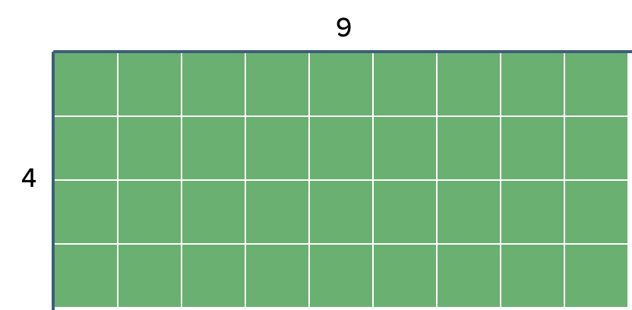
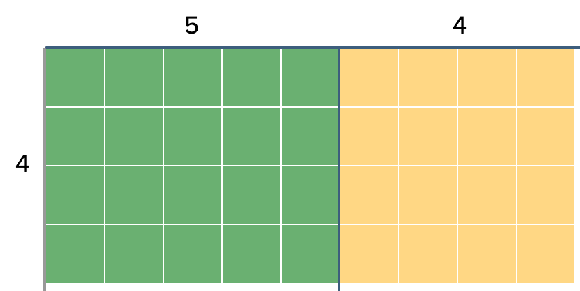
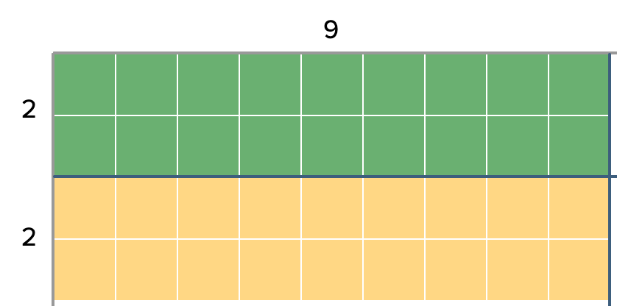
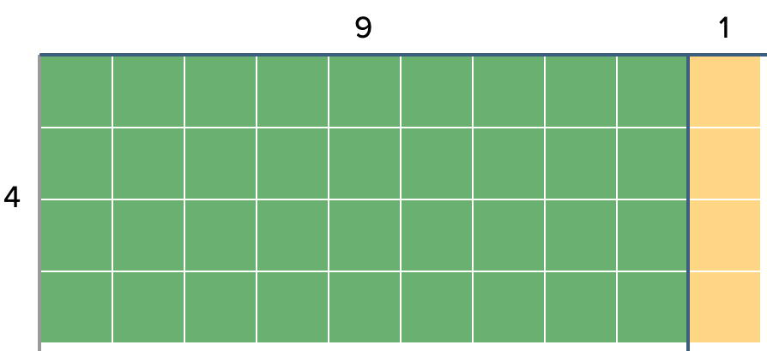
2
Work it out
Say we forgot the solution to 4 x 9:
Examine the visuals below to help you make sense of the strategy used to determine the solution.
If 4 x 5 & 4 x 4 are known…
If 2 x 9 is known…
If 4 x 10 & 4 x 1 are known…
9
9 + 1 = 10
4
4 x 9 = (4 x 5) + (4 x 4)
4 x 9 = ____ + ____
4 x 9 = ____
4 x 9 = (2 x 9) + (2 x 9)
4 x 9 = ____ + ____
4 x 9 = ____
4 x 9 = (4 x 10) - (4 x 1)
4 x 9 = ____ + ____
4 x 9 = ____
Notes:
Now students will examine the visual representations to develop understanding of the strategies and complete the corresponding symbolic equations.

Slide 25
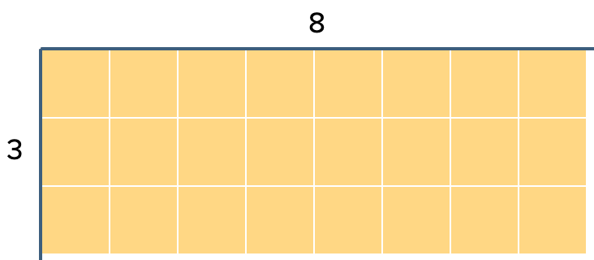
2
Work it out
Say we wanted to figure out the solution to 3 x 8:
Use the partial product tool (found here) to break it up into pieces that are easier for you to work with. Snap an image and paste it below. Describe the strategy you used.
Notes:
Next, students will investigate using the tool to work on a new problem on their own. If possible, have a few students share their strategies with the whole class or send students out to small groups to discuss.
LINK: https://apps.mathlearningcenter.org/partial-product-finder/

Slide 26
2
Work it out
Can you solve it a DIFFERENT WAY?
This will help you prove your first solution is accurate!
Snap a new image and paste it below. Describe the strategy you used this time.
Notes:
This slide has students examine the visual representations to develop understanding of the strategies and complete the corresponding symbolic equations.

Slide 27
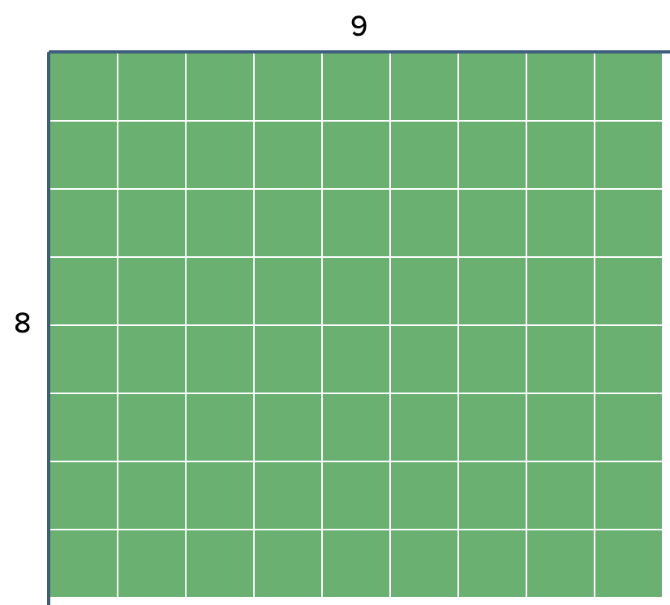
2
Work it out
Say we wanted to determine the solution to 8 x 9:
Use the partial product tool (found here) to break it up into pieces that are easier for you to work with. Snap an image and paste it below. Describe the strategy you used.
Notes:
Now students will investigate using the tool to work on a new problem on their own. If possible, have a few students share their strategies with the whole class or send students out to small groups to discuss.
LINK: https://apps.mathlearningcenter.org/partial-product-finder/

Slide 28
2
Work it out
Can you solve it a DIFFERENT WAY?
Snap a new image and paste it below. Does it match your first solution? Describe the strategy you used this time.
Notes:
This slide has students examine the visual representations to develop understanding of the strategies and complete the corresponding symbolic equations.

Slide 29
2
Work it out
Select a multiplication fact up to 10 x 10 that you would like to investigate.
My fact:
Use the partial products tool to help you find different ways to break it up into easier parts to work with.
Use the following slide to collect your findings.
Snap an image of each one, describe the strategy you used and state state your solution.
___ x ___
Notes:
Now students will investigate a multiplication fact of their choosing on their own. You may choose to have students complete this task in SeeSaw or submit it via your school division’s technology platform.
LINK: https://apps.mathlearningcenter.org/partial-product-finder/

Slide 30
2
Work it out
Use this space to record your work with the fact you selected.
___ x ___
Notes:
Student work would provide insight into student understanding and confidence with these mental math strategies.

Slide 31
2
Work it out
End of this section

Slide 32
3
Looking Back
Consolidation Tasks
What multiplication problem does this whole array represent?
Explain how you can use the array to solve the problem.
Notes:
Adapted from: https://www.edu.gov.mb.ca/k12/cur/math/support_gr4/number.pdf (p 56)
These could be assigned to students as asynchronous work, to be submitted for teacher feedback.

Slide 33
3
Looking Back
How would you choose to split (decompose) this array to determine its value?
Show and explain your thinking and your solution.
Notes:
Adapted from: https://www.edu.gov.mb.ca/k12/cur/math/support_gr4/number.pdf (p 56)

Slide 34
3
Look Back
End of this section

Slide 35
Visual Connections
I
Get Ready
2
Work it out!
3
Looking Back
Keep thinking!
Building Rectangles
Quick Images
Write About It
or,
Record It
Notes:
Number Talk / Focus of the day’s lesson / Consolidate & Reflect

Slide 36
I
Get Ready
In a moment you will see an arrangement of squares.
You will not have enough time to count them 1 by 1.
See if you can figure out how many there are using another strategy.
Notes:
For this part you will want to put the PowerPoint into PRESENT mode so it fully takes over your screen.
You will also want to do a screen share to run this part of the learning experience. This will allow the teacher full control over the length of time an arrangement is viewed and students will not see the thumbnails on the side.

Slide 37
Notes:
Students view this slide for 2-3 seconds only.

Slide 38
How many squares did you see?
How did you see them? (if you can, show more than one way)
Notes:
If synchronous, the teacher would lead this discussion, have students share, record their thinking using a visual (could also connect to number sentences if appropriate to the grade level).

Slide 39
Get ready for another one…

Slide 40
Notes:
These images can be adjusted to have fewer squares if needed for your students.

Slide 41
How many squares did you see?
How did you see them? (if you can, show more than one way)
Notes:
If synchronous, the teacher would lead this discussion, have students share, record their thinking using a visual (could also connect to number sentences if appropriate to the grade level).

Slide 42
Get ready for another one…

Slide 44
How many squares did you see?
How did you see them? (if you can, show more than one way)
Notes:
If synchronous, the teacher would lead this discussion, have students share, record their thinking using a visual (could also connect to number sentences if appropriate to the grade level).

Slide 45
1.
Get Ready
End of this section

Slide 46
2
Work it out (Part 1)
Our thinking focused on the number of squares in the last activity, this represents the AREA that is covered.
Using any of the drawing tools or the coloured tiles on the next slide, create as many rectangles as you can that have an area of 12 square units.
Notes:
These investigations all focus on the differences and connections between perimeter (from grade 3), and area.
Part I – Connect to the quick images, number of tiles represents area of an array.

Slide 47
As many different rectangles as you can find with an area of 12 square units.
What do you notice about the PERIMETER of all these rectangles?
Notes:
Note: Perimeter and length measurements are a focus in grade 3, make connections and review as needed.

Slide 48
2
Work it out (Part II)
PERIMETER is defined as the distance around a two-dimensional shape.
Using any of the drawing tools or the coloured tiles on the next slide, create as many rectangles as you can that have a perimeter of 12 units.

Slide 49
As many different rectangles as you can find with a perimeter of 12 square units.
What do you notice about the AREA of all these rectangles?

Slide 50
2
Work it out (Part III)
Using the tools on the next few slides to help you…
…find a rectangle with a perimeter (measured in units) that is as close as possible to its area (measured in square units).
…find a rectangle where the perimeter is much smaller than its area.
…find a rectangle whose perimeter is much LARGER than its area.

Slide 53
2.
Work it out!
End of this section

Slide 54
3
Looking Back
Thinking back to the quick images from earlier…would it be easier to calculate the AREA or the PERIMETER of these shapes?

Slide 55
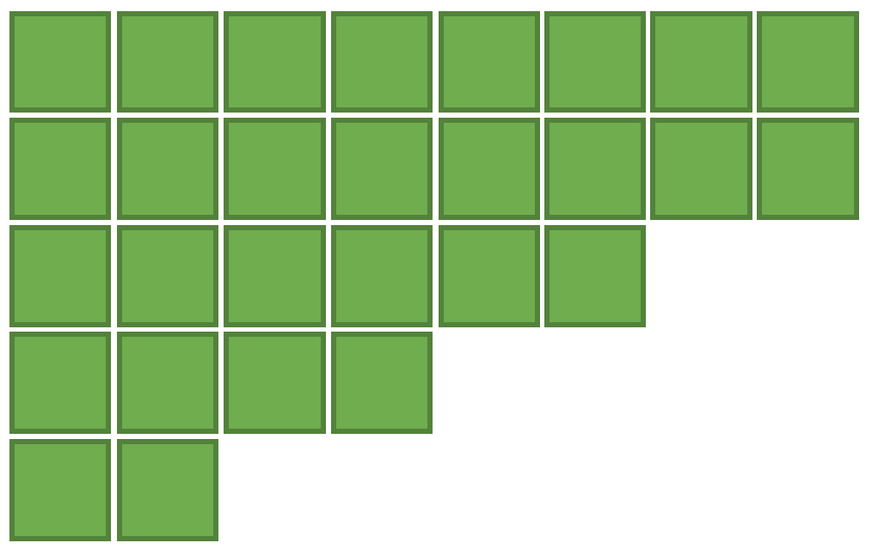
Here is a new shape, think about its perimeter and area.
Which do you think is easier to calculate and why?

Slide 56
Create a shape that would be easy for you to find the area and perimeter of. Then, create a shape where it would be more challenging for you to figure them out and explain why.

Slide 57
3
Looking Back
End of this section.

Slide 58
Problem Solving
1
Get Ready
2
Work it out!
3
Looking Back
Write About It
Which One Doesn’t Belong?
Rope it off!
or
Record It
Notes:
Activator – number talk
Work it out - Challenges make up the focus of the day(s) lesson (you may only have one and all students are assigned the same task, you may have a choice of two or three, or you may have all students begin at challenge 1 and move on as greater challenge is needed / Consolidate & Reflect on what you’ve learned during this part of the project.
Looking Back – a place for reflection/self-assessment

Slide 59
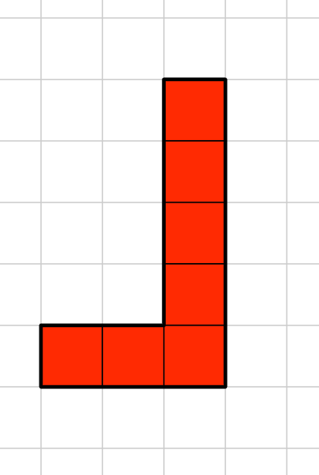
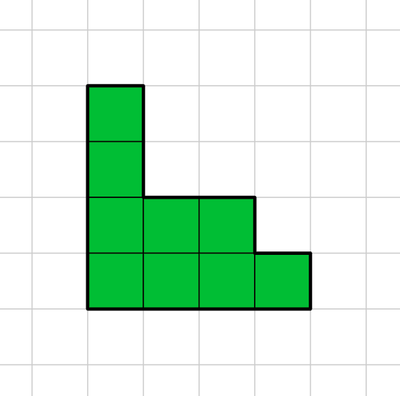
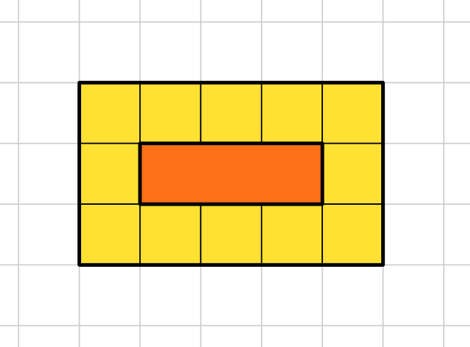
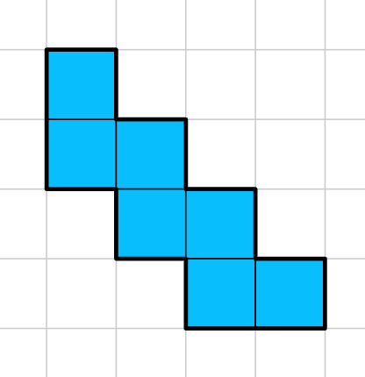
1
Get Ready
Which One Doesn’t Belong?
Notes:
Slide for Part I, the activating activity…number talk, quick images, notice and wonder…

Slide 60
1
Get Ready
This one doesn’t belong because…
This one doesn’t belong because…
Which One Doesn’t Belong?
This one doesn’t belong because…
This one doesn’t belong because…
Notes:
Slide for Part I, the activating activity…number talk, quick images, notice and wonder…

Slide 61
1
Get Ready
End of this section

Slide 62
2
Work it out (a)
Avery and Cruz are designing a game to be played on the school field. To mark off their space in the field, they need to create the largest rectangle possible using the 28m of tug-of-war rope they were given by their Phys Ed teacher.
They untangle it and discover that they have 5 ropes, each marked with one of the following lengths: 3m, 6m, 5m, 8m. The length of the final rope is not marked.
Without bending or cutting any of the ropes, they successfully create a rectangle that uses the full length of all the ropes combined.
Notes:
Slide for Part 2 – Problem Solving
This problem could be presented to students synchronously using the 3 Read Protocol (http://www.sfusdmath.org/3-read-protocol.html)
If the opportunity presents, eliminate the question and let students investigate the information to make sense of the situation and what is “known”. Likely, students will gravitate towards the intended question through their own sense making and wondering.

Slide 63
2
Work it out (a)
Is it possible to create a rectangle out of the ropes without bending or cutting any of the ropes?
Show your thinking:
Notes:
Slide for Part II, the main focus of the work for this part of the activity. Copy and paste as many as you need for your purpose.

Slide 64
2
Work it out (b)
Suppose one of the tug-of-war ropes was marked incorrectly, the 6m length was actually 7m!
Would it still be possible for them to create a rectangle using all the ropes without cutting or bending any of them?
Show and explain your thinking:
Notes:
Slide for Part II, the main focus of the work for this part of the activity. Copy and paste as many as you need for your purpose.

Slide 65
2
Work it out (c)
Give an example of 5 different lengths of rope that COULD be used to make a rectangle (different from the 5 given in the original problem).
Show your thinking:
Notes:
Slide for Part II, the main focus of the work for this part of the activity. Copy and paste as many as you need for your purpose.

Slide 66
2
Work it out (c)
Give an example of 5 different lengths of rope that could be used to make a rectangle but would require some cutting or overlapping of the ropes.
Show your thinking:
Notes:
Slide for Part II, the main focus of the work for this part of the activity. Copy and paste as many as you need for your purpose.

Slide 67
2
Work it out
End of this section

Slide 68
3
Looking Back
Draw 3 rectangles each with a perimeter of 20m.
Notes:
Individual asynchronous task (level 1)
These tasks could be assigned to students as asynchronous work, to be submitted for teacher feedback.

Slide 69
3
Looking Back
What is the greatest perimeter possible of a rectangle with an area of 24m²? Show/explain how you know.
Notes:
Individual asynchronous task (level 2)

Slide 70
3
Look Back
End of this section

Slide 71
Number Play
1
Get Ready
2
Work it out!
3
Looking Back
Area > Perimeter
Open Middle Challenges
Which One Doesn’t Belong?
Investigate your environment
Estimations
Notes:
Activator – number talk
Work it out - Challenges make up the focus of the day(s) lesson (you may only have one and all students are assigned the same task, you may have a choice of two or three, or you may have all students begin at challenge 1 and move on as greater challenge is needed / Consolidate & Reflect on what you’ve learned during this part of the project.
Looking Back – a place for reflection/self-assessment

Slide 72
1
Get in gear!
Which One Doesn’t Belong?
Notes:
Slide for Part I, the activating activity…Which One Doesn’t Belong.
The purpose of this activator is to get students analyzing 2D shapes and 3D objects and discerning similarities and differences. Vocabulary such as faces, edges, corners (vertices) may be used and provides a good opportunity to assess where students are in their thinking

Slide 73
1
Get in gear!
Which One Doesn’t Belong? Can you find at least one reason for each one?
Notes:
Slide for Part I, the activating activity…Which One Doesn’t Belong.
This can be used by the teacher to collect student thinking during a class discussion or by individual students in an asynchronous situation.

Slide 74
1
Get Ready
End of this section

Slide 75
2
Work it out (a)
Using the digits 1 – 9, at most one time each, fill in the boxes so that the value for the area of the rectangle (in square units) is greater that the value for the perimeter (in linear units).
Record all the solutions you find.
What is the greatest difference you can find between the area and perimeter?
What is the smallest difference you can find?
Notes:
Slide for Part II, the main focus of the work for this part of the activity. Copy and paste as many as you need for your purpose.
Extensions (on follow-up slides):
Adjust the complexity of the numbers: make the length a 2digit number, make length and width both 2digit numbers
Source: Adapted from - www.openmiddle.com (Owen Kaplinski)

Slide 76
2
Work it out (b)
Using the digits 1 – 9, at most one time each, fill in the boxes so that the value for the area of the rectangle (in square units) is greater that the value for the perimeter (in linear units).
Record all the solutions you find.
What is the greatest difference you can find between the area and perimeter?
What is the smallest difference you can find?
Notes:
Slide for Part II, the main focus of the work for this part of the activity. Copy and paste as many as you need for your purpose.

Slide 77
2
Work it out (c)
Using the digits 1 – 9, at most one time each, fill in the boxes so that the value for the area of the rectangle (in square units) is greater that the value for the perimeter (in linear units).
Record all the solutions you find.
What is the greatest difference you can find between the area and perimeter?
What is the smallest difference you can find?
Notes:
Slide for Part II, the main focus of the work for this part of the activity. Copy and paste as many as you need for your purpose.

Slide 78
2
Work it out
End of this section

Slide 79
3
Looking Back
Look around your environment and identify 3 different sized rectangles you see (could be the face of any object). Name each object and sketch them in the chart below. Estimate their side lengths and include them in your sketch. Then use mental math to make an estimation for the perimeter and area of each.
Item 1: | Item 2: | Item 3:
Sketch: | Sketch: | Sketch:
Estimated Area: | Estimated Area: | Estimated Area:
Estimated Perimeter: | Estimated Perimeter: | Estimated Perimeter:
Notes:
This consolidating task could be assigned to students as asynchronous work and submitted for teacher feedback.

Slide 80
3
Looking Back
End of this section.

Slide 81
Pattern Connection
1
Get Ready
2
Work it out!
3
Looking Back
Extend Your Thinking…
Create a pattern
Pattern
NOTICE
&
WONDER
Pattern
Pattern
Reflect
Notes:
Activator – number talk
Work it out - Challenges make up the focus of the day(s) lesson (you may only have one and all students are assigned the same task, you may have a choice of two or three, or you may have all students begin at challenge 1 and move on as greater challenge is needed / Consolidate & Reflect on what you’ve learned during this part of the project.
Looking Back – a place for reflection/self-assessment

Slide 82
1
Get Ready
What do you NOTICE?
What do you WONDER?
Notes:
Slide for Part I, the activating activity…number talk, quick images, notice and wonder…

Slide 83
1
Get Ready
NOTICE WONDER
Notes:
Slide for Part I, teacher recording chart.

Slide 84
1
Get Ready
End of this section

Slide 85
2
Work it out (a)
Each triangle has an area of 1 square unit and a perimeter of 3 units.
Term 1
Term 2
Term 3
Term 4
Examine the pattern above and complete the chart below.
Term Number | 1 | 2 | 3 | 4 | 5 | 6 | … | 10
Area
Perimeter
What do you notice about how the area and perimeter are increasing?
Can you predict what the area and perimeter of the 25th term will be?
Notes:
Slide for Part II, the main focus of the work for this part of the activity. Copy and paste as many as you need for your purpose.

Slide 86
2
Work it out (b)
Each blue rhombus has an area of 2 square units and a perimeter of 4 units.
Term 1
Term 2
Term 3
Term 4
Examine the pattern above and complete the chart below.
Term Number | 1 | 2 | 3 | 4 | 5 | 6 | … | 10
Area
Perimeter
What do you notice about how the area and perimeter are increasing?
Can you predict what the area and perimeter of the 25th term will be?
Notes:
Slide for Part II, the main focus of the work for this part of the activity. Copy and paste as many as you need for your purpose.

Slide 87
2
Work it out (c)
Each yellow hexagon has an area of 6 square units and a perimeter of 6 units.
Term 1
Term 2
Term 3
Term 4
Examine the pattern above and complete the chart below.
Term Number | 1 | 2 | 3 | 4 | 5 | 6 | … | 10
Area
Perimeter
What do you notice about how the area and perimeter are increasing?
Can you predict what the area and perimeter of the 25th term will be?
Notes:
Slide for Part II, the main focus of the work for this part of the activity. Copy and paste as many as you need for your purpose.

Slide 88
2
Work it out
End of this section

Slide 89
3
Looking Back
Choose one of the images above and use it to create an increasing pattern.
Examine your pattern and complete the chart below.
Term Number | 1 | 2 | 3 | 4 | 5 | 6 | … | 10
Area
Perimeter
Why did you select that shape to work with?
What can you say about the patterns you see with the perimeter and area?
Notes:
Slide for Part 3. Thinking about what you’ve learned from the lesson on individual shapes repeating, extend your thinking to a new shape or even a composite shape.
This could be an asynchronous activity left with students to “create” and turn in.

Slide 90
3
Look Back
End of this section

Slide 91
Use Measurement to Understand and Describe Our World
Student: | Basic descriptors to help guide your formative assessments.
Full details of the student achievement profiles can be found here: Knowledge & Understanding Mental Math & Estimation Problem Solving | Requires considerable, on-going teacher support. | Requires occasional, teacher or peer support. | Accurate, clear, uses appropriate strategies & procedures. Requires occasional prompting for clarification. | Accurate, clear, flexible, consistent & efficient. Justifies & explains reasoning clearly and completely using accurate math vocabulary.
 | Limited | Basic | Good | Very Good/Excellent
Tracking student data throughout these learning experiences will allow the teacher to make an informed assessment about the students’ level of achievement of these outcomes.
Understand the difference between perimeter & area
Determine and record area and recognize that area is recorded in square units
Construct different rectangles for a given area to demonstrate that many rectangles may have the same area
Represent and describe patterns and relationships using charts and tables
Identify and explain mathematical relationships using charts and diagrams
Describe and apply the mental math strategy of halving/doubling
Describe and apply the mental math strategy of add one more group, count on from a known fact
Describe and apply the mental math strategy of knowing half/ breaking into smaller parts
Solve problems involving area & perimeter
Assessment Rubrics
Suggested Codes for daily record keeping purposes:
I - Knowledge has been demonstrated individually
H - is used when knowledge has been demonstrated individually, but with help from the teacher or a peer
G - is used when knowledge has been demonstrated within a group
X - is used when a question has been attempted but answered incorrectly
N - is used when a question has not been attempted.
Notes:
You can also copy and paste the table above into Microsoft Word or similar program.
Tracking student data throughout these learning experiences will allow the teacher to make an informed assessment about the students’ level of achievement on these outcomes.
Adapted from: Liljedahl, P. (2021). Building thinking classrooms in mathematics, grades K-12: 14 teaching practices for enhancing learning. Thousand Oaks, CA: Corwin Press Inc.

Slide 92
Credits
Heather Jones - St. James-Assiniboia School Division
Reviewers
Scott Dempster - St. James-Assiniboia School Division
Charmaine Mackid - Hanover School Division
Lisa Page - St. James - Assiniboia School Division
Dayna Quinn-LaFleche - St. James-Assiniboia School Division

