Slide 1
Probability
Grades 7/8
Notes:
Source of Image: https://lh5.ggpht.com/_dF1ylEX_abA/SW_BKpInulI/AAAAAAAABzg/HtUA5_jlRV0/ZZ52DA4A3D.jpg?imgmax=800

Slide 2
This is what you will learn:
what probability is
why it’s important
thinking of events on a probability line
using the language of probability
why probability activities are like a science experiment
using fractions, decimals and percent to describe probability
using a table and tree diagram to calculate theoretical probability
comparing experimental and theoretical results
Notes:
Source of Image: 15593-illustration-of-a-dancing-cartoon-blue-man-pv.png (958×958) (freestockphotos.biz)

Slide 3
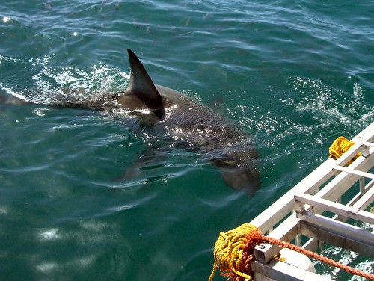
What is probability?
Probability is about how likely something will happen.
We use it all the time in real life.
Sometimes we have to think about the probability of getting injured in a job we are doing.
Notes:
Source of Image: https://c1.staticflickr.com/1/139/384084308_8cd9d5417e.jpg

Slide 4
Why is it important?
Who will likely win the next election?
We use probability all the time in real life.
It is used to make decisions for things like:
forecasting the weather
politics
sports
games of chance
deciding the best location for a business
creating consumer products
military operations
What is the probability of the Winnipeg Jets winning the Stanley Cup?
What are the chances of rain today?
Am I more likely to win if I buy more lottery tickets?
Notes:
Source of Image: https://www.freepik.com/premium-vector/man-is-leaning-against-big-question-mark-symbol-think-question_13267423.htm

Slide 5
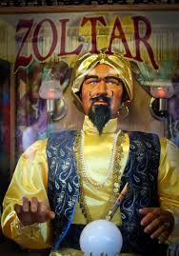
How is Probability Different from Other Math Topics?
In math we are used to dealing with things that are completely certain.
If you add 5 + 5, you’ll always get 10.
If you multiply 2 x 3, you’ll always get 6.
There is no uncertainty at all.
In the real world, things aren’t always so predictable.
Notes:
Source of Image: 15635754159_d3c4d254ba_b.jpg (802×1022) (staticflickr.com)

Slide 6
Probability Can Play a Big Role in the Decisions Made in Real Life
Winnipeg is one of the two test markets in Canada used by McDonalds to try out a product to see how likely customers all over the country will buy it. This clip is from a CBC podcast called Under the Influence with Terry O’Reilly (May 7, 2020).
https://drive.google.com/file/d/1Wq4Lco0KfSULtMWbpyooSqCYfvRyVuc9/view
Questions:
1) What product did McDonald’s first test in Winnipeg? _____ 2) What year was that product created? _____ 3) Based on customers’ feedback, they found it was not likely that people would want these two things that came with the item. What were those 2 things? ____
Notes:
Source of Source of Image: Speaker_Icon_gray.svg.png
Source of Image (McDonald’s Logo): https://upload.wikimedia.org/wikipedia/commons/thumb/5/50/McDonald's_SVG_logo.svg/120px-McDonald's_SVG_logo.svg.png

Slide 7
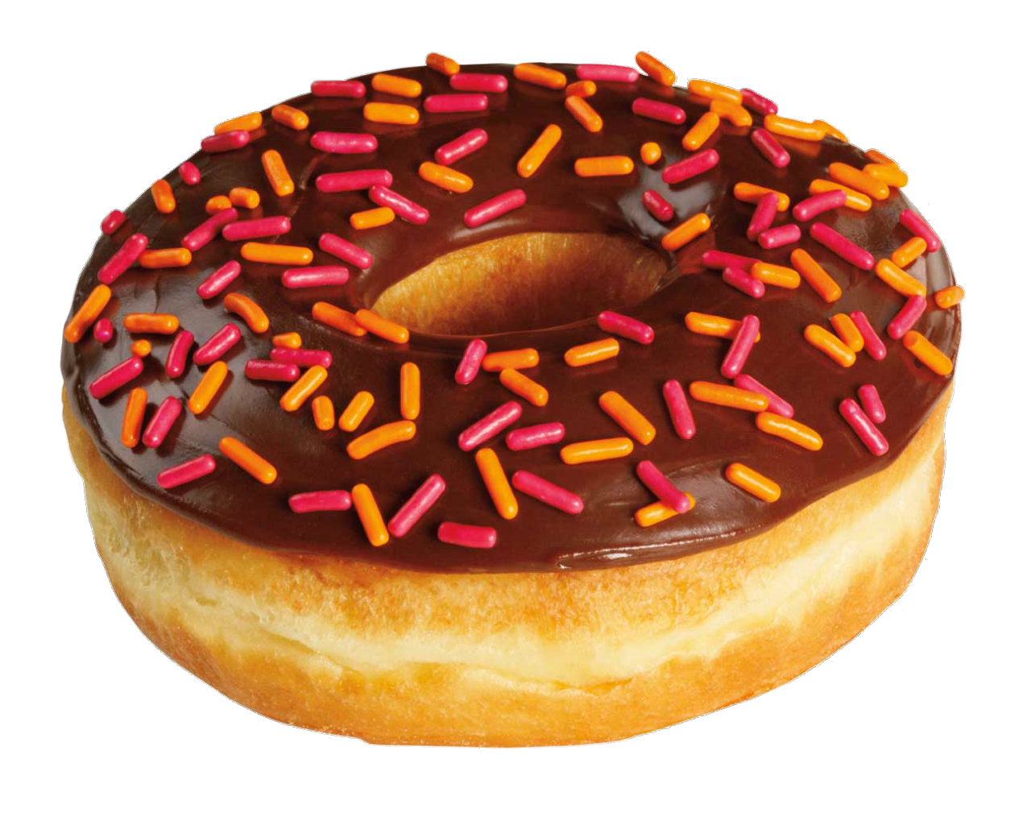
Probability and Games of Chance in Real Life
Tim Horton’s advertises that you have a 1 in 6 chance to win something when you “Roll up the Rim”. This means that for every 6 cups of coffee you buy, you probably should win a prize.
You could win a free drink, a donut, or even a car!
Sometimes you win buying only 1 cup of coffee but sometimes you have to buy a lot!
These two ladies went to test out how many cups you needed to buy before winning a prize.
100 CUPS OF COFFEE! Roll Up The Rim To Win! Lottery Jackpot Challenge
YouTube Video: https://www.youtube.com/watch?v=Y4diZOT4Ugs
Notes:
Source of Image: https://pngimg.com/uploads/donut/donut_PNG96.png
Source of Video: https://www.youtube.com/watch?v=Y4diZOT4Ugs

Slide 8
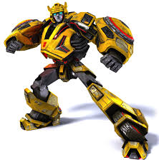
Another Example of Probability:
Toy Companies Testing Products
Toy companies often use kids to test out their games and inventions to see how probable it is for children to want to play with them.
In the movie Big, Josh is a 13-year-old boy who is transformed into a 35-year-old man by a fortune telling machine at a carnival. He still thinks like he’s 13 years old and ends up getting a job at a toy company testing out the design of toys. In this movie clip, he is giving his opinion about the company’s new toy and how likely kids are to like it.
Video Source: https://www.youtube.com/watch?v=3ERuhks3GNk
Notes:
Source of Image: https://tfwiki.net/mediawiki/images2/thumb/6/6a/Bumblebeeanimated.jpg/300px-Bumblebeeanimated.jpg

Slide 9
Using a Probability Line
Most things in real life are neither impossible nor certain to happen. So a probability line can help visualize the likelihood of events happening.
Video Source: Math Antics - Basic Probability - YouTube

Slide 10
How is Doing Probability Activities Like
a Science Experiment?
Well, you really are doing an experiment. You have a problem or situation you’d like to test out because you are not sure how it will turn out.
Here are the steps you go through:
There is a problem or question you’d like to answer.
You predict the outcome.
You perform the experiment.
You compare your results to your prediction.
Notes:
Source of Image: http://www.pngall.com/wp-content/uploads/5/Chemist-PNG-File.png

Slide 11
Some Vocabulary
An outcome is a possible result of an experiment The outcomes for: - rolling a dice are 1, 2, 3, 4, 5, 6. - tossing a coin are heads or tails. - the spinner shown is red, yellow, and green.
A favourable outcome is the outcome that the experimenter is looking for. It is also called an event.
Examples of favourable outcomes or events are: - getting an even number when you roll a die - getting a tail when tossing a coin - landing on a red section when you spin a spinner

Slide 12
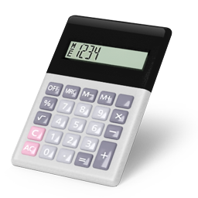
But How Do You Measure Chance?
Probability looks at the chance of something happening.
There are two ways to determine the probability of something happening:
1) Experimentally with trials (experimental probability)
2) Mathematically with calculations (theoretical probability)
Notes:
Source of Image (calculator): http://www.pngall.com/wp-content/uploads/2016/05/Calculator-Transparent.png
Source of Image (flipping coin): https://www.clipartmax.com/download/m2i8N4i8b1K9G6G6_flip-a-coin-flip-a-coin-cartoon/

Slide 13
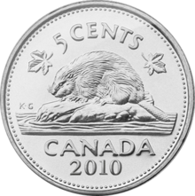
Experimental Probability
Experimental probability is the probability of an event calculated from experimental results.
Problem: What is the probability of getting a “tail” when you toss a coin? You toss a coin 10 times. You get a tail 6 times.
Experimental probability = number of observed favorable outcomes* total number of trials
*A favorable outcome is the outcome the experimenter is looking for.
Your experimental probability is . The way we can write our results is P(tail) = . The outcome you are looking for is inside the brackets. We read it as: “The probability of getting a tail is “.
Notes:
Source of Image: https://upload.wikimedia.org/wikipedia/en/thumb/b/bb/Canadian_Nickel_-_reverse.png/220px-Canadian_Nickel_-_reverse.png

Slide 14
Experimental Probability with Spoons
Let’s do another example.
Problem: What is the probability of dropping a spoon and it landing upside down?
Drop a spoon (metal or plastic) from waist height 20 times.
The way we can write our results is: P(spoon landing upside down) = __ . 20 We read it as: “The probability of a spoon landing upside down is ____ “.
What was your experimental probability? ___________
.
.
Notes:
Source of Image: http://pngimg.com/uploads/spoon/spoon_PNG3050.png

Slide 15
A Big Idea About Experimental Probability
Video Source: https://www.youtube.com/watch?v=KzfWUEJjG18
What is the big idea about experimental probability this person talks about on his video? __________________________________

Slide 16
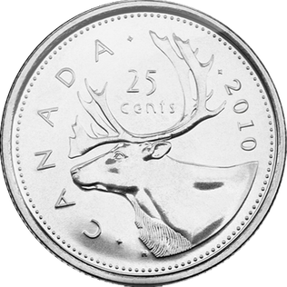
Theoretical Probability
2) Theoretical probability: Another way of finding the probability of a specific outcome, or event, is a logical analysis of the situation.
Problem: What’s the probability of getting a “tail” when you toss a coin?
What are the possible outcomes for a coin to land? 2 (heads or tails) What are the number of ways that event (getting a tail) can occur? 1
Theoretical probability = number of favorable outcomes number of possible outcomes
So, P(tail) is or 0.5 or 50%.
Notes:
Source of Image: https://upload.wikimedia.org/wikipedia/en/3/37/Quarter_Reverse_2010.png

Slide 17
Some More Examples of Theoretical Probability
Video Source: Probability: Determining Chance - YouTube

Slide 18
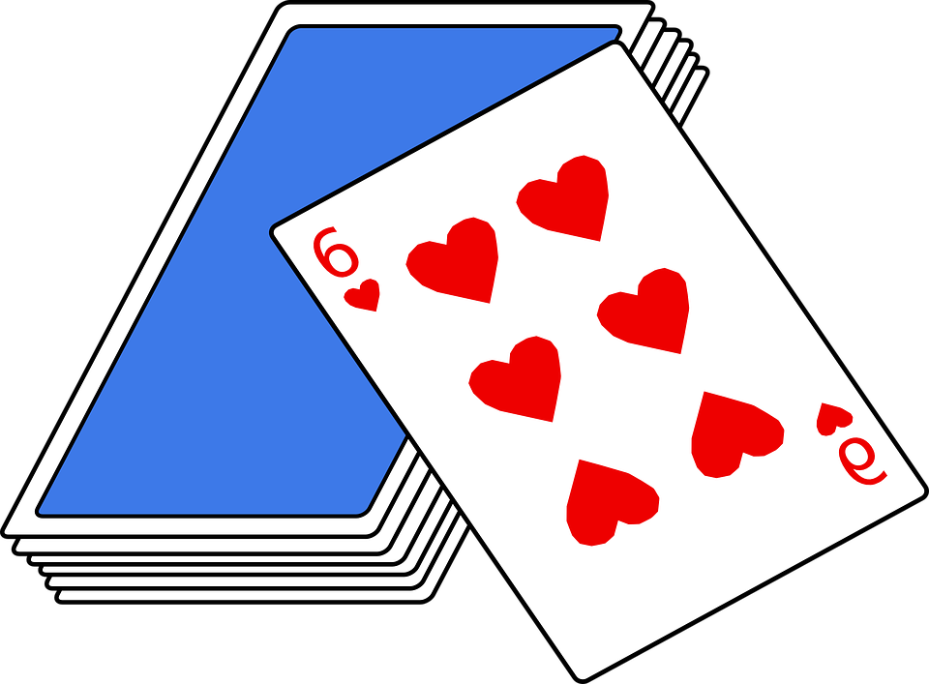
More Vocabulary Words
Independent events are two events in which the outcome of one event does not affect the outcome of the other event. Examples of two independent events are: - rolling a die and spinning a spinner - tossing 2 coins - drawing a card from a deck and rolling a die
The sample space is a list of all the possible outcomes for an experiment that has independent events. An example of the sample space when tossing 2 coins is:
head-tail, tail-head, head-head, tail-tail
Notes:
Source of Image: https://cdn.pixabay.com/photo/2012/04/15/18/12/cards-34749_960_720.png

Slide 19
Two Things to Help Us
There are two tools we can use to help us find theoretical probability:
1) a tree diagram
2) a table
The following slides explain how to use both of them.
Notes:
Source of Image: http://www.pngall.com/wp-content/uploads/5/Investigation-180x180.png

Slide 20
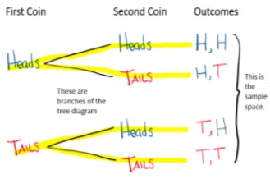
Using a TREE DIAGRAM to Find Theoretical Probability
(with 2 independent events)
We can use a tree diagram to help us find the theoretical probability. When 2 coins are tossed, the outcomes for each coin are heads (H) or tails (T).
A tree diagram lists the possible outcomes for each event in columns and connects them with lines to form branches.
The first column lists all possible outcomes for the first event.
The second column lists all possible outcomes for the second event
The third column lists all possible outcomes.

Slide 21
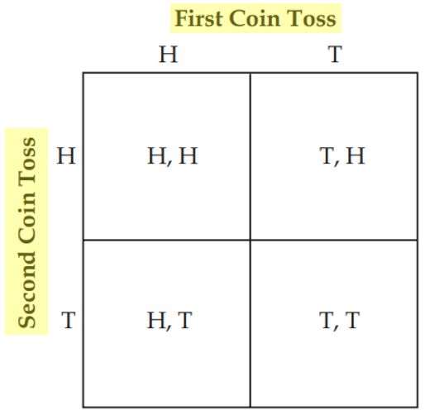
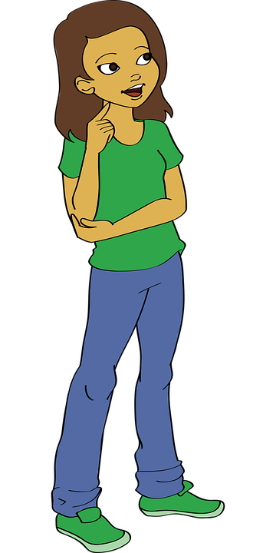
Using a TABLE to Find Theoretical Probability
We can also find all the possible outcomes by using a table.
List the possible outcomes when you toss the first coin across the top of the table.
Then list all the possible outcomes when you toss the second coin down the left side of the table.
Filling in the table shows there are 4 possible outcomes.
H, T and T, H look the same but they can happen differently, so they are two separate outcomes.
Sample Space
Notes:
Source of Image: https://cdn.pixabay.com/photo/2017/01/31/13/10/cartoon-2023899_960_720.png

Slide 22
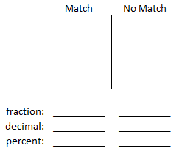
Three Coin Toss
Materials needed: 3 coins
PROBLEM: Toss 3 coins. How likely is it to get all coins to match (all heads or all tails)?
PREDICTION: What percent of the time do you think you will get a match?
EXPERIMENT:
Make a tally chart and label it Match and No Match. Do 10 trials and keep a tally.
Write your the experimental probability for each outcome as a fraction and percent.
COMPARE RESULTS TO THE PREDICTION: 3) How close was your prediction to your results?
Look at the next slide to see what a tree diagram looks like if there are 3 independent events.

Slide 23
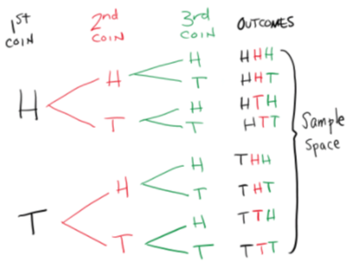
Using a Tree Diagram (with 3 independent events)
Now let’s see what it looks like with tossing 3 coins.

Slide 24
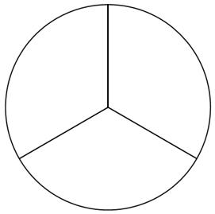
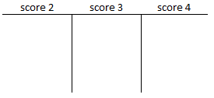
Now You Try it Out: Using a TREE DIAGRAM
Materials needed: a spinner divided into 3 sections, a paper clip
GAME: The spinner is spun twice. Your score is the larger of the two numbers. For example: If you spin a 3 and 2, then your score is 3. If you spin a 2 and 2, then your score is 2.
PREDICTION: What is the most likely score for each turn?
EXPERIMENT: 1) Spin the spinner 10 times. Do a tally of which number came up the most according to the rules. 2) Write your experimental probability for each outcome as a fraction, decimal and percent. P(score of 2) = _____ (fraction) P(score of 3) = _____ (fraction) P(score of 4) = _____ (fraction) _____ (percent) _____ (percent) _____ (percent)
3) Based on your results, what is the most likely score for each turn? ____
Go to the next slide to find the theoretical probability for this game.
2
3
4

Slide 25
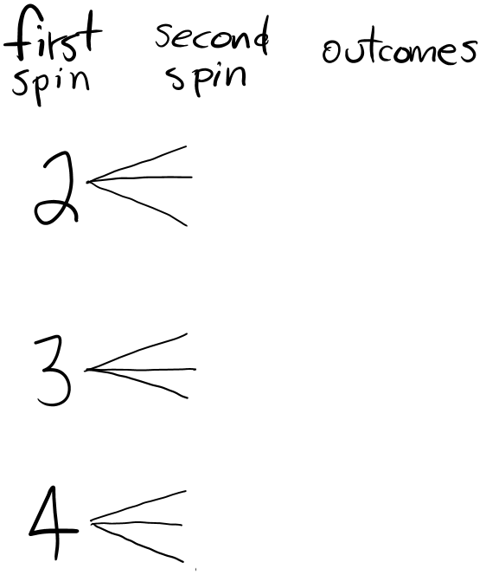
Now You Try it Out: Using a TREE DIAGRAM (continued)
Here are the rules again and the spinner:
GAME: The spinner is spun twice. Your score is the larger of the two numbers.
Now you try finding the theoretical probability using a tree diagram:
2
3
4
Make the tree diagram before going to the next slide to check how you did.
Notes:
Source of Image: http://1.bp.blogspot.com/-G4iZfw2GtdA/Sa6UqfugVAI/AAAAAAAAB_Y/0t61NJBX4Eo/s1600/10273_pencil_mascot_cartoon_character_holding_a_stop_sign.jpg

Slide 26
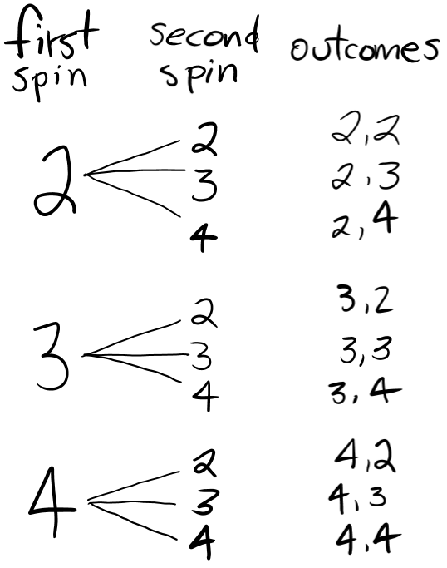
What the Tree Diagram Should Look Like
Here are the rules again and the spinner:
GAME: The spinner is spun twice. Your score is the larger of the two numbers.
Now you try finding the theoretical probability using a tree diagram:
2
3
4

Slide 27
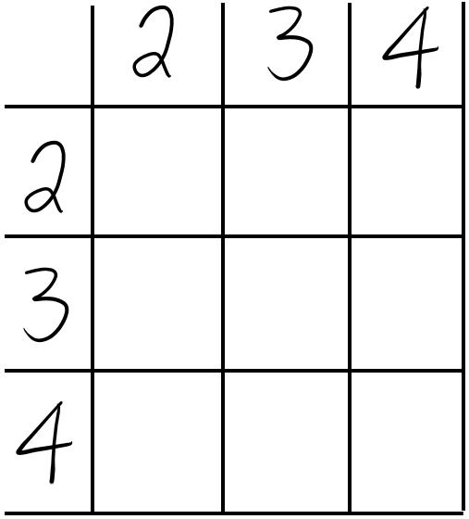
Now You Try it Out: Using a TABLE
What will calculating the theoretical probability look like using a table?
Try it out.
Questions: 1) How many possible outcomes are there? _______ 2) Write the theoretical probability for each event as a fraction: a) P(score is 2) = _____ b) P(score is 3) = _____ c) P(score is 4) = _____
Make the table before going to the next slide to check how you did.
Notes:
Source of Image: http://1.bp.blogspot.com/-G4iZfw2GtdA/Sa6UqfugVAI/AAAAAAAAB_Y/0t61NJBX4Eo/s1600/10273_pencil_mascot_cartoon_character_holding_a_stop_sign.jpg

Slide 28
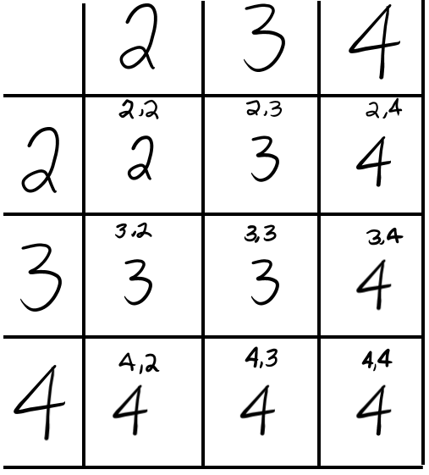
What the Table Should Look Like
What will calculating the theoretical probability look like using a table?
Try it out.
Questions: 1) How many possible outcomes are there? _______ 2) Write the theoretical probability for each event as a fraction: a) P(score is 2) = _____ b) P(score is 3) = _____ c) P(score is 4) = _____

Slide 29
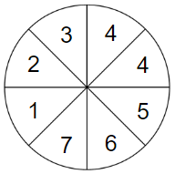
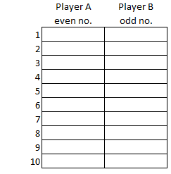
Is This a Fair Game? Spinner Game 1
Materials needed: a spinner divided into 8 sections, a paper clip
PROBLEM: Is this game fair? Spin the spinner. If the pointer lands on an even number, Player A gets a point. If the pointer lands on an odd number Player B gets a point. PREDICTION: I think this is a ________ (fair/unfair) game.
EXPERIMENT: 1) Make a spinner with 8 sections. Put each of these numbers in a section: 1, 2, 3, 4, 4, 5, 6, 7 2) Make a chart and label it: Player A (even no.) and Player B (odd no.). 3) Spin the spinner. Put a check in the box by each trial number as to which player got an even or odd number. 4) Do 10 trials. 5) What is your experimental probability for getting an odd number? P(odd number) = _____(fraction) _____ (percent) 6) What is the theoretical probability of getting an odd number? P(odd number) = _____(fraction) _____ (percent) (*Use a calculator if needed.)
COMPARE RESULTS TO THE PREDICTION: 7) Is this a fair game? How do you know? 8) If you do another 10 trials will your experimental results be the same? Try it.

Slide 30
A Surprising Thing About Theoretical Probability
Video Source: https://www.youtube.com/watch?v=KzfWUEJjG18
What is the surprising thing that happens when you add the theoretical probability of an event happening plus the probability of it not happening? _______________

Slide 31
Probability of Something Happening and Not Happening
Let’s look at the theoretical probability from the last game.
Find:
1) Total possible outcomes: ____
2) a) P(even number) ____ b) P(odd number) ____ c) Total = ____
3) a) P(7) ____ b) P(not getting a 7) ____ c) Total = ____
4) a) P(4) ____ b) P(not getting a 4) ____ c) Total = ____
Notes:
Source of Image: http://4.bp.blogspot.com/-DElrzX-BRgM/TkFoic9h4GI/AAAAAAAAAkI/wScwonetCVk/s1600/mm8_boyatdesk5.png

Slide 32
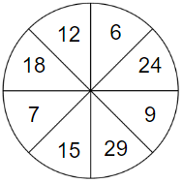
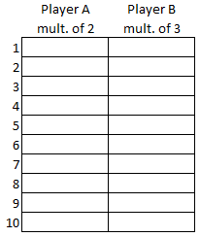
Is This a Fair Game? Spinner Game 2
Materials needed: a spinner divided into 8 sections, a paper clip
PROBLEM: Is this game fair? Spin the spinner. If the pointer lands on a multiple of 2, Player A gets a point. If it lands on a multiple of 3, Player B gets a point. PREDICTION: Is this a fair game? How do you know?
EXPERIMENT: 1) Make a spinner with 8 sections. Put each of these numbers in a section: 6, 7, 9, 12, 15, 18, 24, 29 2) Make a chart and label it: Player A (multiple of 2) and Player B (multiple 3). 3) Spin the spinner. Put a check in the box by each trial number as to which player got a point. 4) Do 10 trials. 5) What is your experimental probability for getting a multiple of 2? multiple of 3? Write it as a fraction and percent. 6) What is the theoretical probability of getting a multiple of 2? multiple of 3? Write it as a fraction and percent. (*Use a calculator if needed.)
COMPARE RESULTS TO THE PREDICTION: 7) Questions: a) Is this a fair game? How do you know? b) Would you have the same experimental results if you played this game again?

Slide 33
More Probability of Something Happening and
Not Happening
Let’s look at the theoretical probability from the last game.
Record:
1) Total possible outcomes: ____
2) a) P(multiple of 2) ____ b) P(not a multiple of 3) ____ c) Total = ____
3) a) P(multiple of 3) ____ b) P(not multiple of 2) ____ c) Total = ____
4) a) P(12) ____ b) P(not getting a 12) ____ c) Total = ____
Notes:
Source of Image: https://www.freepngimg.com/thumb/teacher/35442-1-teacher-picture.png

Slide 34
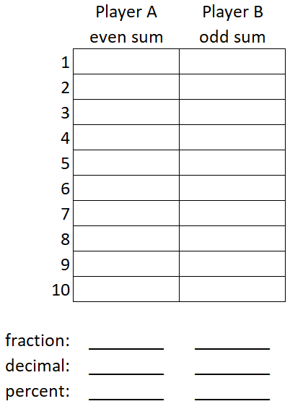
Is This a Fair Game?
Two-Dice Game with Sums
Materials needed: 2 dice or use digital dice (https://toytheater.com/dice/), (or 2 spinners)
PROBLEM: Is this a fair game? Roll 2 dice. Add the the numbers. If the sum is even, Player A gets a point. If the sum is odd, Player B gets a point. PREDICTION: I think this player is more likely to win. ____
EXPERIMENT: 1) Make a chart and label it Player A (even sum) and Player B (odd sum). 2) Roll the dice. Put a check in the box by each trial number as to which player got an even or odd sum. 3) Do 10 trials. 4) Write your experimental probability for each outcome as a fraction, decimal and percent. COMPARE RESULTS TO THE PREDICTION: 5) Questions: a) How do your results compare to your prediction? b) Would you have the same results if you did this experiment again?

Slide 35
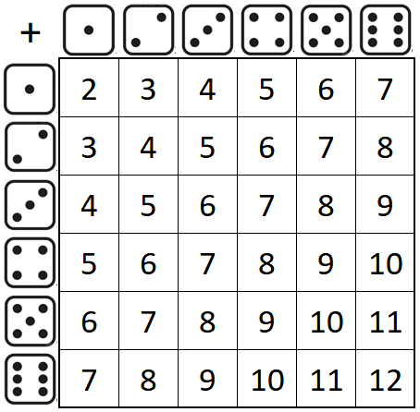
Two-Dice Game with Sums (Theoretical Probability)
Let’s use theoretical probability to analyze the game.
To list all the possible outcomes, it will be easier if we make a table.
Total sums = _______
2. Total number of: - even sums ______ - odd sums ______
3. P(even sum): - fraction ______ - decimal ______ - percent ______
4. P(odd sum): - fraction ______ - decimal ______ - percent ______
5. Is this game fair? _____ Explain your thinking.

Slide 36
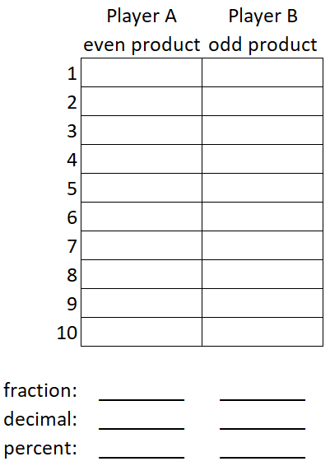
Is This a Fair Game?
Two-Dice Game with Products
Materials needed: 2 dice or use digital dice (https://toytheater.com/dice/), (or 2 spinners)
PROBLEM: Is this a fair game?: Roll 2 dice. Multiply the the numbers. If the product is even, Player A gets a point. If the product is odd, Player B gets a point. PREDICTION: I think this player is more likely to win. ___________
EXPERIMENT: 1) Make a chart and label it Player A (even product) and Player B (odd product). 2) Roll the dice. Put a check in the box by each trial number as to which player got an even or odd product. 3) Do 10 trials. 4) Write your experimental probability for each outcome as a fraction, decimal and percent. COMPARE RESULTS TO THE PREDICTION: 5) Questions: a) How do your results compare to your prediction? b) Would you have the same results if you did this experiment again?

Slide 37
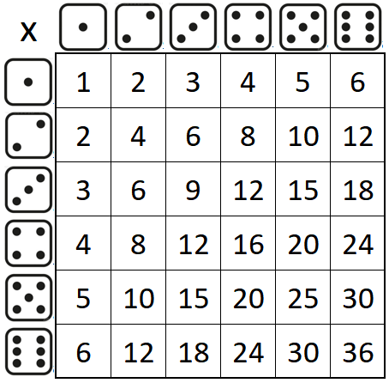
Two-Dice Game with Products (Theoretical Probability)
Let’s use theoretical probability to analyze the game.
To list all the possible outcomes, it will be easier if we make a table.
Total products = _______
2. Total number of: - even products ______ - odd products ______
3. P(even product): - fraction ______ - decimal ______ - percent ______
4. P(odd product): - fraction ______ - decimal ______ - percent ______
5. Is this game fair? _____ Explain your thinking.

Slide 38
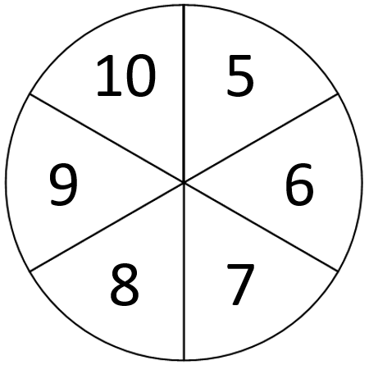
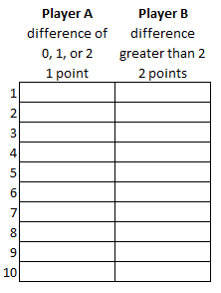
Dicey Differences
Materials needed: 2 spinners (divided into 6 sections with a number from 5-10 in each section), paper clip PROBLEM: Players take turns spinning the spinners and finding the difference between the two numbers. If the difference is 0, 1, or 2, Player A scores 1 point. Otherwise, Player B scores 1 point. Is this a fair game?
PREDICTION: I think this is a __________ (fair/unfair) game.
EXPERIMENT: 1) Make a chart to record who got the point for each trial. 2) Players take turns spinning the spinners and subtracting the smaller number from the larger one. 3) Do this for 10 trials.
COMPARE RESULTS TO THE PREDICTION: 4) I found these differences came up the most often: ____________ 5) How do your experimental results compare with your prediction?

Slide 39
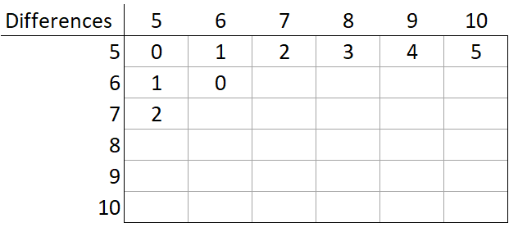
Dicey Differences - Theoretical Probability
Here are the rules again: If the difference is 0, 1, or 2, Player A scores 1 point. Otherwise, Player B scores 1 point.
Complete the table to find the theoretical probability of winning.
QUESTIONS: 1) Which difference is the most likely? ___ 2) Which difference is the least likely? ___
(NOTE TO TEACHERS: Answer on Slide 49.)
Is this a fair game? Use the results from your table to explain your thinking.
Notes:
Source of Image: https://cdn.pixabay.com/photo/2013/07/12/17/48/girl-152498_960_720.png

Slide 40
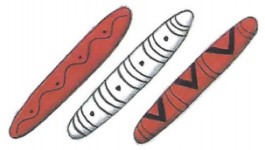
Stick Dice – An Indigenous Game
Pugasaing was a game played by Indigenous communities throughout North America. This version used 3 sticks, each with one red side and one white side. The sticks were made from bone, wood, or horn. They were usually shaken in a basket and tossed onto the ground.
The scoring rules for each turn were: 3 white - 3 points 3 red - 2 points 2 red, 1 white - 1 point 1 red, 2 white - 0 points
ACTIVITY:
1) Play this game using 3 popsicle sticks. Color one side of each stick red with a marker. 2) Do 10 trials and keep track of your points. Make a tree diagram to find out: 1) How many combinations are there altogether? ______ 2) P(scoring 3 points) _______ 3) P(scoring 2 points) _______ 4) P(scoring 1 point) _______ 5) P(scoring 0 points) _______

Slide 41
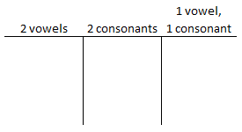
Go TEAM!
Materials needed: a spinner divided into 2 sections, a paper clip, 4 small pieces of paper, small bag
PROBLEM: Spin the spinner and draw card from the bag. How likely is it to draw 2 vowels?
EXPERIMENT: 1) Make a spinner with 2 sections. Put a “G” in one section and an “O” in the other section. 2) Write each letter in the word “TEAM” on a piece of paper. Place them in a bag. 3) Spin the spinner and draw a card from the bag. 4) Keep a tally of whether you got: 2 vowels, 2 consonants or 1 of each. 5) Put the letter back in the bag. 6) Do this 10 times. 6) What is your experimental probability as a percent for getting: a) 2 vowels _____ b) 2 consonants _____ c) a vowel and a consonant _____ 7) Would you have the same experimental results if you did this activity 30 times? 8) Draw a tree diagram to find the theoretical probability of getting 2 vowels. _____

Slide 42
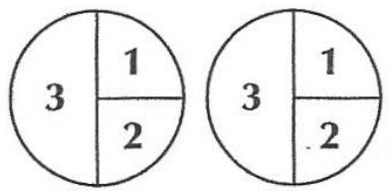
Spinner Sums A
Materials needed: 2 paper clips, paper to make 2 spinners, recording sheet
PROBLEM: Both spinners are the same. When you spin both spinners and add those numbers, are some sums more likely to come up?
PREDICTION: Predict which sum will occur the most often. ____________
EXPERIMENT:
1) Spin both spinners and add the two numbers that come up. Write the addition sentence in the correct column on the recording sheet . 2) Repeat until one column on the recording sheet is filled in.
COMPARE RESULTS TO THE PREDICTION:
3) How do your results compare to your prediction? 4) Why do you think that sum came up the most often?

Slide 43
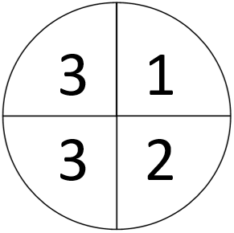
What Happens if All the Spaces on the Spinner
Are Not the Same Size?
When theoretical probability is used to make predictions about future events, the events must be equally likely.
If you do an event such as tossing a paper cup and seeing which way it will land (right-side up, upside down, or on its side), the events are NOT equally likely.
If the events are NOT equally likely, then you use experimental probability to make future predictions.
We need to split the 3 so the segments are the same size. This makes each segment equally likely to happen.
Notes:
Source of Image: http://www.pngall.com/wp-content/uploads/4/Cartoon-Teacher-PNG.png

Slide 44
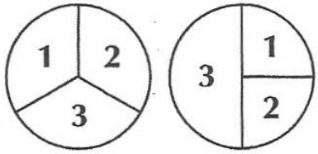
Spinner Sums B
Materials needed: 2 paper clips, paper to make 2 spinners, recording sheet
PROBLEM:
Both spinners have the same numbers but the sections are divided up differently. When you spin both spinners and add both numbers, are some sums more likely to come up?
PREDICTION: Predict which sum will occur the most often. ____________
EXPERIMENT:
Spin both spinners and add the two numbers that come up.
Write the addition sentence in the correct column on the recording sheet.
Repeat until one column on the recording sheet is filled in.
COMPARE RESULTS TO THE PREDICTION:
a) How do your results compare to your prediction? b) Why do you think that sum came up the most often? c) Are the results the same or different as Spinner Sums A?

Slide 45
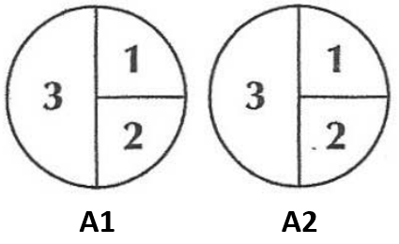
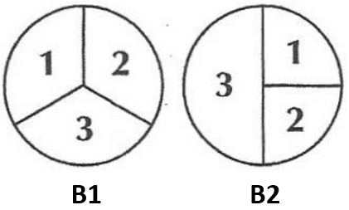
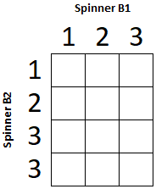
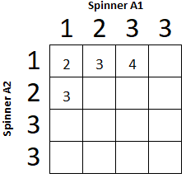
Spinner Sums Summary
Spinner Sums A
Spinner Sums B
1) The most likely sum to come up is ___. 2) The least likely sum to come up is ___. 3) Give an example of a sum that is impossible to come up on any of these spinners. ______
The most likely sum to come up is ___.
The least likely sum to come up is ___.
Give an example of a sum that is impossible to come up on any of these spinners. ______
Make the tables before going to the next slide to check how you did.
Notes:
Source of Image: http://1.bp.blogspot.com/-G4iZfw2GtdA/Sa6UqfugVAI/AAAAAAAAB_Y/0t61NJBX4Eo/s1600/10273_pencil_mascot_cartoon_character_holding_a_stop_sign.jpg

Slide 46
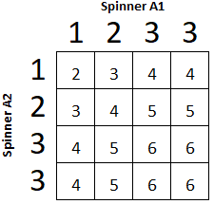
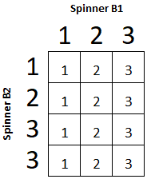
What the Tables Should Look Like
Spinner Sums A
Spinner Sums B
1) The most likely sum to come up is ___. 2) The least likely sum to come up is ___. 3) Give an example of a sum that is impossible to come up on any of these spinners. ______
The most likely sum to come up is ___.
The least likely sum to come up is ___.
Give an example of a sum that is impossible to come up on any of these spinners. ______

Slide 47
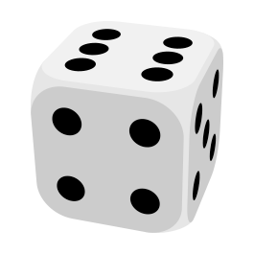
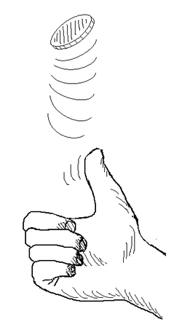
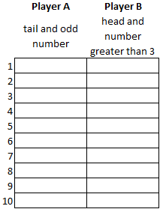
Coin and Die Toss
Materials needed: 1 coin and 1 die or use a digital die (https://toytheater.com/dice/), (or a spinner)
PROBLEM: Is this a fair game?
When you toss a die and a coin: - Player A gets 1 point if a tail and an odd number come up. - Player B gets 1 point if a head and a number greater than 3 come up. - Sometimes neither player will get a point.
Is this a fair game? PREDICTION: I think this player is more likely to win. ____
EXPERIMENT: 1) Make a chart and label it Player A (tail + odd no.) and Player B (head + >3). 2) Flip a coin and a die. Use a tally mark to record the results. 3) Do 10 trials. 4) Write your experimental results as a fraction and percent. 5) Use either a tree diagram or a table to find the theoretical probability of each event. COMPARE RESULTS TO THE PREDICTION: 6) Questions: a) How do your experimental results compare to your theoretical results? b) Do you think this game is fair? If not, how would you make it fair?
Notes:
Source of Image (hand): https://upload.wikimedia.org/wikipedia/commons/thumb/0/0f/Pile_ou_face.png/250px-Pile_ou_face.png
Source of Image (dice): https://pngimg.com/uploads/dice/dice_PNG49.png

Slide 48
Making a Spinner
TASK: Construct a spinner with red, yellow, blue and green sections so the following probabilities are true:
The probability of landing on red is ⅕.
The probability of landing on yellow is 50%.
The probability of landing on blue is 0.1.
The probability of landing on yellow is green is 20%.
Notes:
Source of Video: https://p2.piqsels.com/preview/562/443/681/question-question-mark-help-response.jpg

Slide 49
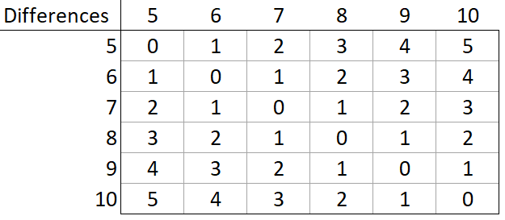
Dicey Differences (slide 38): Completed Table

