Slide 1
Plastic in the Ocean
Grade 8 Science
Cluster 4 Water Systems

Slide 2
Start Your Thinking

Slide 3
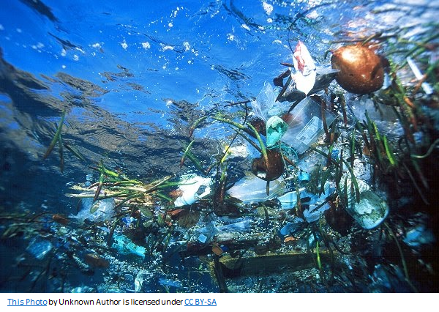
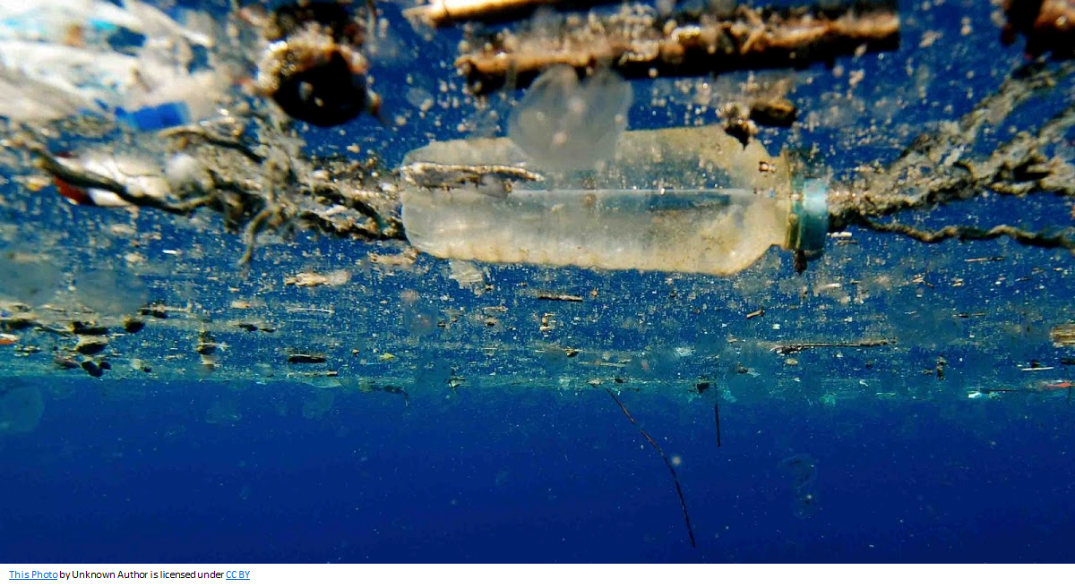
What do you Notice?
What do you Wonder?

Slide 4
Why should I care that the oceans are being polluted when I live in the middle of the continent?

Slide 5
Thoughtbook #1:
How are you going to answer the critical thinking question: Why should I care that the oceans are being polluted when I live in the middle of the continent?
What questions do you have that need to be answered?
What do you need to think about?
What steps do you need to take?
Begin your thinking and jot down some ideas
Initiating

Slide 6
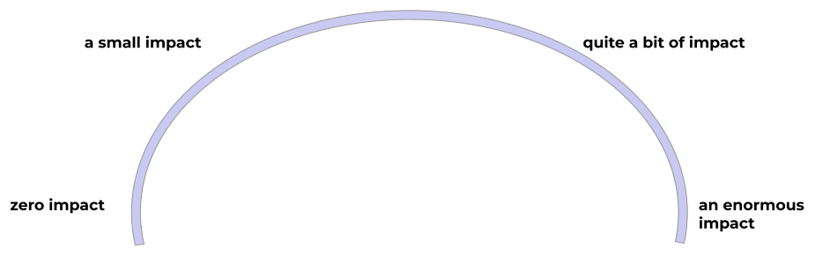
Thoughtbook #1 continued:
I think my actions have _________________________ on the pollution level in the ocean…
because…
Notes:
Teacher Notes:
Each student should have a copy of this slide to put into their thoughtbooks.
Insert Arrow to indicate students thinking.

Slide 7
KWLN: Global water cycle, North American drainage system, & Oceans
What I Think I Know
What I Learned
I know about…
I learned…
What I wonder About?
What new questions I have After Learning?
I wonder about …
I want to learn more about...
Concluding and Applying
Initiating
Reflecting

Slide 8
Enrich Your Thinking

Slide 9
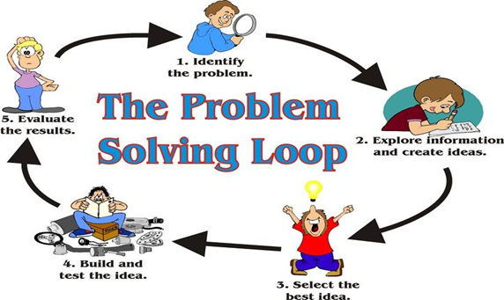
End of Learning Challenge:
Your job at the end of the unit is…
Design a campaign to solve a problem related to proper management of water.
Image: https://pixy.org/4592163/
You will be choosing one from each column:
Audience:
Local
Provincial
National
Global
Type:
Blitz or Media Campaign
Civil Society Campaign
Public Service Announcement
Other: __________________________ (must be pre-approved by the teacher)
Problem:
Water scarcity for human consumption
Water contamination caused by globalization
Water infrastructure and water management systems
Water scarcity for the environment
Other: ______________________ (must be pre-approved by the teacher)

Slide 10
How are the following relevant to fresh water availability in your local geographical area?
Global Water Cycle
North American Drainage System
Large Bodies of Water (Oceans)
Horse Race - Select the horse and push the left and right arrows to place the horse where you think it should go to answer the question above.
Not Relevant
A Little Relevant
Quite Relevant
Very Relevant

Slide 11
How are the following relevant to fresh water availability in the world?
Global Water Cycle
North American Drainage System
Large Bodies of Water (Oceans)
Horse Race - Select the horse and push the left and right arrows to place the horse where you think it should go to answer the question above.
Not Relevant
A Little Relevant
Quite Relevant
Very Relevant

Slide 12
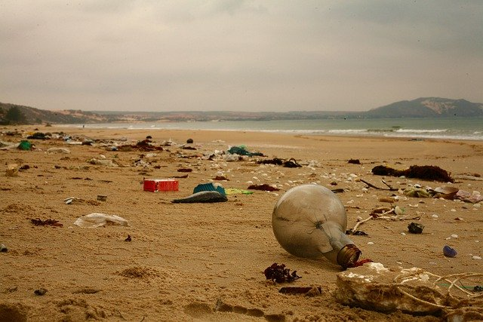
Table of Contents:
01
02
03
04
05
Global & Local Water Cycles
North American Drainage System
https://cdn.pixabay.com/photo/2020/03/09/04/25/beach-4914403_960_720.jpg
Campaign
From Me to the Ocean
The Impact of My Actions

Slide 13
01
Global & Local Water Cycles
Guiding Questions:
What is the water cycle?
How do the water cycles compare globally and locally?
How are these cycles interrelated?

Slide 14
Cloud in a Jar - Experiment #1
Procedure
Pour the 80 ml of hot water into the jar.
Swirl the water around gently to warm up the sides of the jar.
Place the lid for the jar upside down on the top of the jar.
Place as many ice cubes that will fit into the lid.
Leave lid with ice cubes on top of jar for about 30 seconds .
Remove the lid enough so you can quickly spray a quick burst of aerosol hairspray into the jar.
Move the lid back into position and observe.
When you see condensation fill the jar remove the lid and observe.
Materials:
A Jar with a lid
80 ml of hot water (not boiling)
Ice
Aerosol Hair spray
Tips
Only a TINY amount of hairspray is required.
A metal lid works best.
Planning
Implementing Plan

Slide 15
Example of what your experiments should look like:
Ice cubes
Upside down jar lid
Aerosol hair spray
?
Hot water
Image: David Gamble 2020
Image: David Gamble 2020
Record your results on the next page
Planning
Implementing Plan

Slide 16
My Observations
Record your observations: (What is happening? What can you see?)
Observing, Measuring, Recording
Where do you see this happening in the natural environment? What is it called? Describe it.
Analyzing & Interpreting

Slide 17
Word Work Part 1:
Match the Water Cycle Vocabulary with the appropriate definition.
Definitions | Water Cycle Vocabulary
Quantity of water discharged in surface streams, includes not only the waters that travel over the land surface and through channels to reach a stream but also interflow, the water that infiltrates the soil surface and travels by means of gravity toward a stream channel and eventually empties into the channel. | Evaporation
The process by which an element or compound transitions from its liquid state to its gaseous state below the temperature at which it boils; in particular, the process by which liquid water enters the atmosphere as water vapour. | Sublimation
The conversion of a substance from the solid to the gaseous state without its becoming liquid. An example is the vaporization of frozen carbon dioxide (dry ice) at ordinary atmospheric pressure and temperature. | Transpiration
A plant’s loss of water, mainly through the leaves. | Runoff
Researching
Notes:
Teacher Notes:
Definition Sources:
https://www.britannica.com/

Slide 18
Water cycle
Before Question(s) you have about the water cycle before the video. | During What stages of the water cycle are reliant on other stages and what would happen if one of those connections were broken/absent? | After Question(s) you have about the water cycle after the video.
Researching
Notes:
Teacher Notes:
Video Link: https://youtu.be/jFjI6y46QRk

Slide 19
Word Work Part 2:
Rewrite the definition in your own words. Then draw a picture and provide an example to help you remember what each new word means.
Definition My Words | Picture | Example
Evaporation
Transpiration
Sublimation
Runoff

Slide 20
Create a diagram of your Local Water Cycle
Using the diagram in the video, determine what stages of the Global Water Cycle (GWC) are in your community or local geographical area.
What parts of the GWC can you see in the area you live?
Concluding & Applying

Slide 21
Thoughtbook Entry #2
Read the book: A Drop Around the World by Barbara Shaw McKinney
https://www.getepic.com/book/62869270/a-drop-around-the-world
https://www.youtube.com/watch?v=6q_CQiDqtRU
Try your best to answer the following questions:
How do I interact with the local & global water cycles? (Include recreational and basic needs interactions such as drinking water.) | How do my actions or the actions of my community members, impact the Global Water Cycle?
Initiating
Notes:
Teacher Notes:
A Drop Around the World by Barbara Shaw McKinney
Epic link: https://www.getepic.com/book/62869270/a-drop-around-the-world
Youtube video: https://www.youtube.com/watch?v=6q_CQiDqtRU

Slide 22
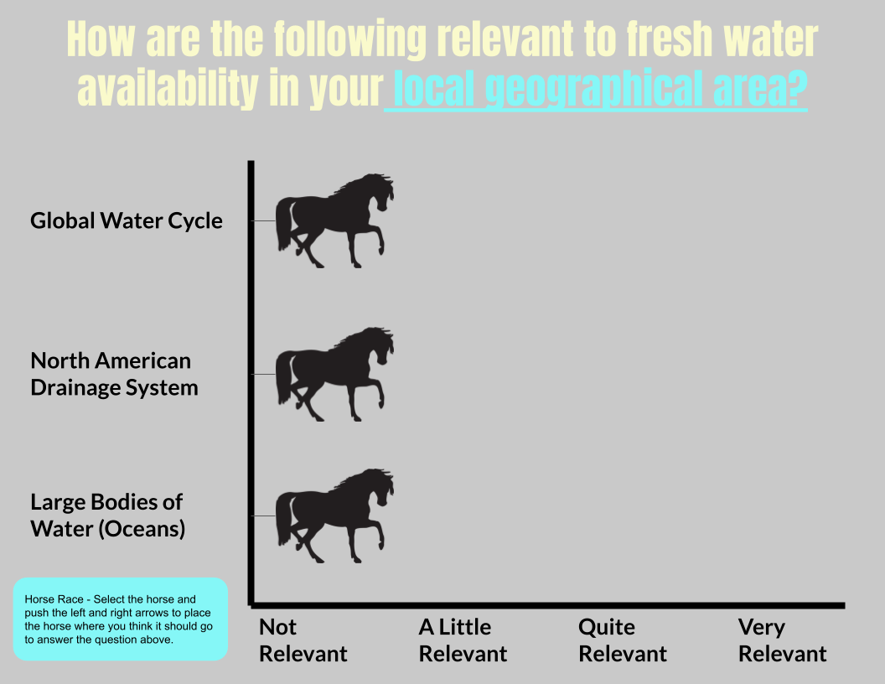
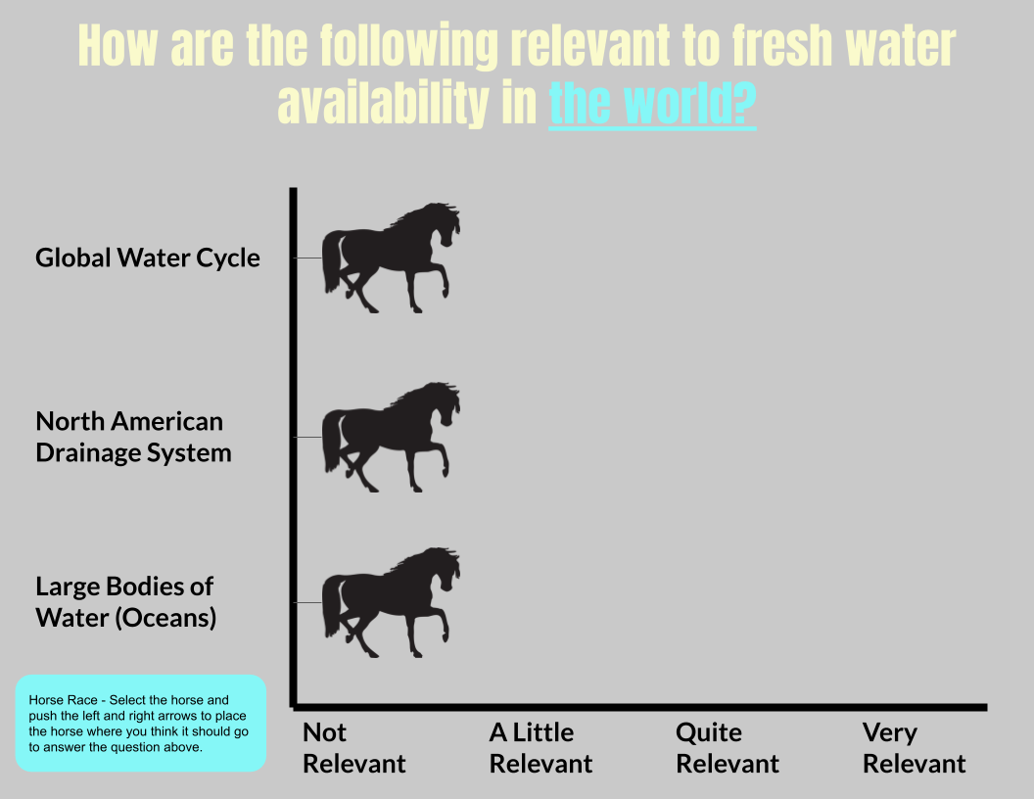
Thoughtbook Entry #2 continued
How is the Global Water Cycle relevant to fresh water availability in your local geographical area?
Not Relevant
A Little Relevant
Quite Relevant
Very Relevant
How is the Global Water Cycle relevant to fresh water availability in the world?
Not Relevant
A Little Relevant
Quite Relevant
Very Relevant
Review these slides
Did your thinking change? My thinking (did / did not) change because…

Slide 23
Reflect on your Learning
Head back to this page/slide:
Fill in the teal and yellow sections.
Reflecting

Slide 24
02
North American Drainage Systems
Guiding Questions:
What is the North American Drainage System?
How do local and global drainage systems compare?
How are drainage systems connected to water cycles?

Slide 25
Watersheds & Drainage Systems
Predictions: What do you think a watershed is? Where do you think you would see it? Why do you think it is important to you? | Answers: What is a watershed? Where do you see it? What is the watershed in your geographical location? Why is it important to you? | Reflection: What other question(s) do you still you have about the watersheds after the videos.
Search videos, articles, books, etc. that could help you answer the questions above:
Link them here:
Researching
Initiating
Notes:
Teacher Notes:
Possible Video Links for students who need support getting started:
https://youtu.be/2pwW2rlGIa8 Stop video at ~2 minutes.
https://www.pbslearningmedia.org/resource/ket09.sci.ess.water.wshed/what-is-a-watershed/
https://youtu.be/QOrVotzBNto

Slide 26
Watersheds & Drainage Systems
The North American drainage system is made up of six smaller watersheds.
These watersheds all drain into larger bodies of water like oceans, seas, or endorheic basins (retains water in a saline lake or salt flat ).
Find an image or diagram to show which of these watersheds we belong to and also find an image or diagram of a smaller local watershed that you belong to.
Image/Diagram of a Watershed
Image/Diagram of your local watershed
Researching

Slide 27
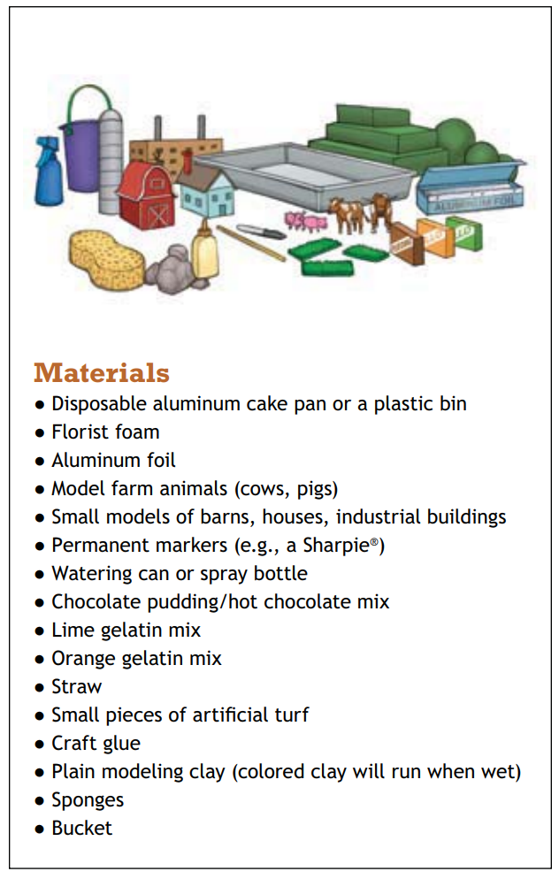
Building a Watershed Model
Follow the link - create your own model.
HOW TO BUILD A MODEL WATERSHED
If you need to substitute materials please feel free to do so.
Make a plan and list your materials below:
Image Source: https://www.iwla.org/docs/default-source/how-to/how_to_build-a-model-watershed.pdf?sfvrsn=8
Planning
Implementing Plan
Notes:
Teacher Notes:
Link to building a model watershed - https://www.iwla.org/docs/default-source/how-to/how_to_build-a-model-watershed.pdf?sfvrsn=8
Instructions for this model are in the link.

Slide 28
Insert picture or draw the watershed model you created.
Planning

Slide 29
My Observations after first rain storm (Step #6)
Record your observations in detail: (What is happening when you make it rain? What can you see? What did you notice about the pollutants? )
Observing, Measuring, Recording
If the large bodies of water are polluted, how would this impact the global water cycle? Why is this important to understand?
Analyzing & Interpreting
Notes:
See https://www.iwla.org/docs/default-source/how-to/how_to_build-a-model-watershed.pdf?sfvrsn=8 for the instruction steps.

Slide 30
My observations after 2nd rainstorm (Step #8)
What did you notice during your rain storm? What does this mean for our environment?
Observing, Measuring, Recording
Make connections to your learning: (What is happening in the experiment that connects with watersheds and the North American Drainage Systems)
Analyzing & Interpreting
Notes:
See https://www.iwla.org/docs/default-source/how-to/how_to_build-a-model-watershed.pdf?sfvrsn=8 for the instruction steps.

Slide 31
Thoughtbook #3:
How do my actions impact the North American Drainage Systems? | How does the North American Drainage System impact local & global water cycles? | How is North American Drainage Systems connected to the ocean pollution and the health of ocean life?
Concluding & Applying

Slide 32
Reflect on your Learning
Head back to this page/slide:
Fill in the teal and yellow sections.
Reflecting

Slide 33
03
From Me to the Ocean
Guiding Question:
How am I connected to the trash in the oceans?

Slide 34
A Trash’s Journey
Read The Story of a Raindrop
Choose a piece of trash:
Plastic Straw
Plastic Bag
Plastic Water Bottle
Choose a literary form:
Poem
Children's story
Timeline on a Map
Poster
Diary or Journal
Memoir
Scrapbook
Other ________________________ (must be approved by the teacher)
Who is telling the story?
How do you know who is telling the story?
How is a raindrop’s journey different/same from a piece of trash’s journey?
Create a literary piece that describes the journey a piece of trash will take from you to the ocean. You will create using the perspective of the piece of trash.
Notes:
Teacher Notes:
https://www.chw.net.au/mvc/k12webapi/media/education_sustainability/education%20resources/school%20program/the-story-of-a-raindrop.pdf

Slide 35
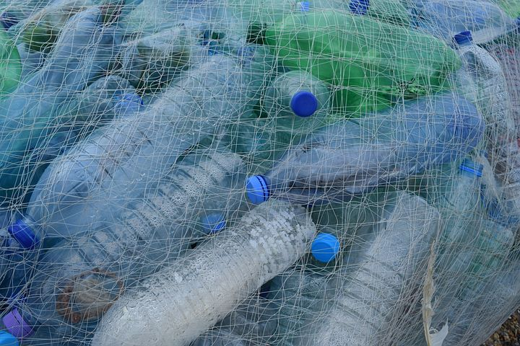
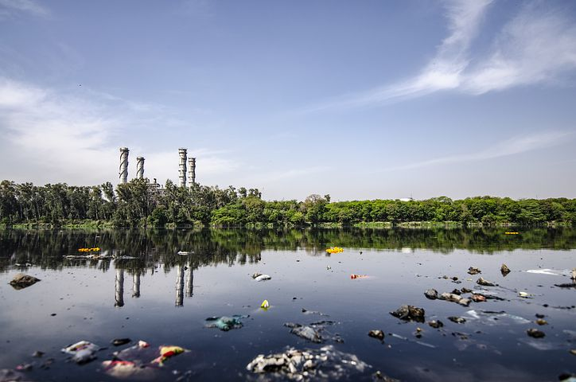
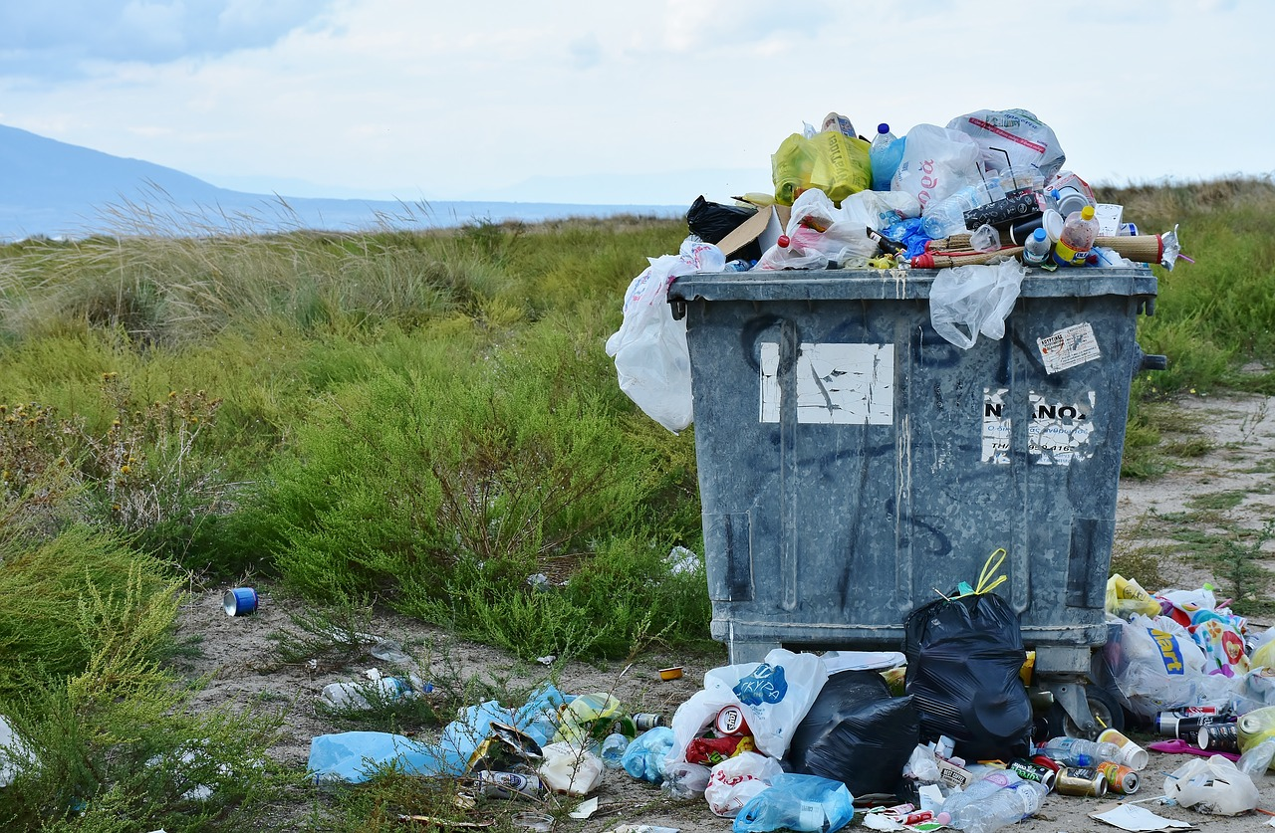
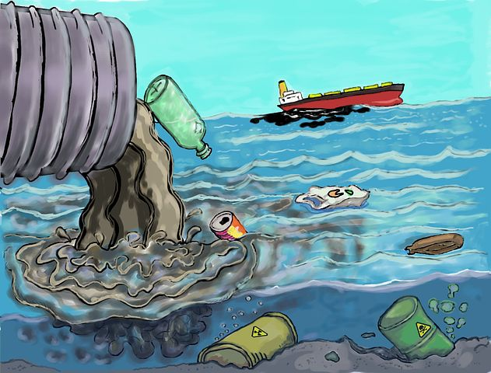
Present your literary pieces with the class
https://cdn.pixabay.com/photo/2014/07/09/23/43/plastic-bottles-388679_960_720.jpg
https://cdn.pixabay.com/photo/2019/06/20/10/08/contamination-4286704_960_720.jpg
https://cdn.pixabay.com/photo/2017/09/08/18/20/garbage-2729608_960_720.jpg
https://cdn.pixabay.com/photo/2016/08/18/19/02/pollution-1603644_960_720.jpg

Slide 36
Thoughtbook #4:
If someone throws a piece of garbage out of their car window, where could it end up? How does this impact fresh water availability in your local geographical area? | If everyone throws one piece of garbage onto the ground each day, where would these garbage pieces end up and how would this impact fresh water availability in your local geographical area? | If all the trash we litter on the ground follows the same path as in your story, how does that impact oceans and ocean life?
Concluding & Applying

Slide 37
Thoughtbook Entry #4 continued
How is the North American Drainage System relevant to fresh water availability in your local geographical area?
How is the North American Drainage System relevant to fresh water availability in your local geographical area?
Not Relevant
Not Relevant
A Little Relevant
A Little Relevant
Quite Relevant
Quite Relevant
Very Relevant
Very Relevant
How is the North American Drainage System relevant to fresh water availability in the world?
How is the North American Drainage System relevant to fresh water availability in the world?
Not Relevant
Not Relevant
A Little Relevant
A Little Relevant
Quite Relevant
Quite Relevant
Very Relevant
Very Relevant
Review these slides
Did your thinking change? My thinking (did / did not) change because…
Review these slides
Did your thinking change? My thinking (did / did not) change because…

Slide 38
Reflect on your Learning
Head back to this page/slide:
Fill in the teal and yellow sections.
Reflecting

Slide 39
04
The Impact of my Actions
Guiding Questions:
How do my actions and decisions contribute to the garbage problem in the oceans?
What changes can I make or support to help find a solution to this issue?

Slide 40
How Much Plastic does my Household Use in a Week?
Plastic Items: | Number we use in a week: one tally every time you or someone in your family uses one of these in the week
Plastic bags (grocery, ziplock, produce bags, saran wrap)
Water Bottles (one time use)
Plastic food and beverage containers (water bottles, tupperware, rubbermaid, ziplock etc)
Plastic straws and stirrers
Toys & Gaming devices (lego, barbies, dolls, action figures, phone cases)
Plastic dishes (forks, knives, cups, plates etc.)
Other - List below:
Choose a graph to represent this data and justify why you chose that graph: (bar or multi-bar graph, line graph, scatterplot, pictograph, circle graph)

Slide 41
Put your graph here:
I chose this graph because…

Slide 42
Scavenger hunt : Visit the Virtual Tour EN — Plastic Garbage Project. Try to find the answer to a question from each column. Challenge: Find all the answers!
O | C | E | A | N
How many plastics are produced every year? | How long does it take a plastic bottle to decompose in the ocean? | How much does it cost to clean up the garbage on Sorfugloya Island, a nature reserve with no human inhabitants, each year? | What health risks is BPA associated with? | What plastic product do Freitag Bags use?
How much plastic ends up in the ocean every year? | Describe one effect of plastics on animals. | How many marine animals do plastics kill every year? | What qualities of plastics make it a popular material? | What technologies are used to separate recyclable products?
What percent of plastic sinks to the ocean floor? | How do nurdles affect marine life? | How long is the life cycle of a plastic bag? | What are the different types of plastic? | What plastics are difficult to recover from the ocean?
Name 5 identifiable plastic objects in the exhibit. | How long can garbage stay in a gyre? | How many plastic bags are used in California each year? | What is the difference between biodegradable and biobased? | How can plastic products be redesigned so they are easier to recycle?
Notes:
Teacher Notes:
Virtual Tour - Plastic Garbage Project: https://www.plasticgarbageproject.org/virtual-tour-en

Slide 43
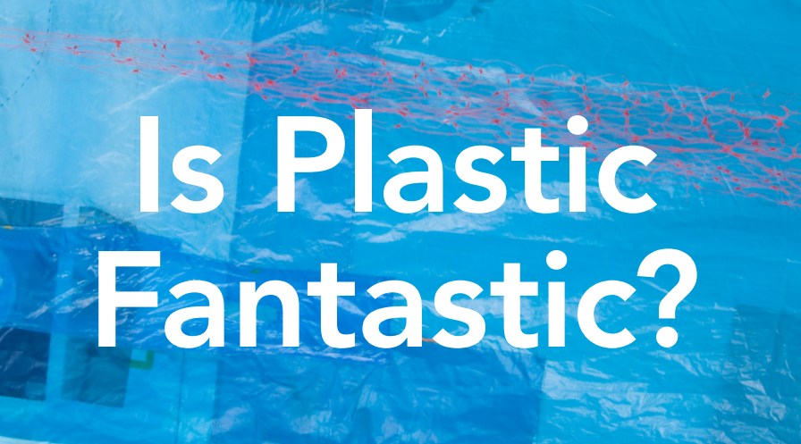
Why should I care about my use of plastics?
Read or view two or more of the following:
Image Source and Story Link: https://static1.squarespace.com/static/55b29de4e4b088f33db802c6/t/5aec87b2562fa7b8e1f73a8f/1525450683981/PPC_KidsBooklet-08_spreads.pdf
Notes:
Teacher Notes:
Is Plastic Fantastic: https://static1.squarespace.com/static/55b29de4e4b088f33db802c6/t/5aec87b2562fa7b8e1f73a8f/1525450683981/PPC_KidsBooklet-08_spreads.pdf
Sources and Impacts of Marine Litter by Jane Lee/Marlisco https://www.youtube.com/watch?v=017bBeXhYz4
The Story of Plastic (Animated Short)

Slide 44
Thoughtbook #5:
Why/how are plastics so problematic in the environment? | Why is it important to keep our oceans clean? | Why should I care that the oceans are being polluted when I live in the middle of the continent? | What actions can I take to reduce the impact of ocean pollution?
Concluding & Applying

Slide 45
Thoughtbook Entry #5 continued
How is the North American Drainage System relevant to fresh water availability in your local geographical area?
How are large bodies of water relevant to fresh water availability in your local geographical area?
Not Relevant
Not Relevant
A Little Relevant
A Little Relevant
Quite Relevant
Quite Relevant
Very Relevant
Very Relevant
How is the North American Drainage System relevant to fresh water availability in the world?
How are large bodies of water System relevant to fresh water availability in the world?
Not Relevant
Not Relevant
A Little Relevant
A Little Relevant
Quite Relevant
Quite Relevant
Very Relevant
Very Relevant
Review these slides
Did your thinking change? My thinking (did / did not) change because…
Review these slides
Did your thinking change? My thinking (did / did not) change because…

Slide 46
Reflect on your Learning
Head back to this page/slide:
Fill in the teal and yellow sections.
Reflecting

Slide 47
Consolidate Your Thinking

Slide 48
05
Campaign
Guiding Questions:
How can we communicate our learning?
How can I influence the decisions and actions of others?

Slide 49
Thoughtbook #6:
Why should I care that the oceans are being polluted when I live in the middle of the continent?
I think my actions have _________________________ on the pollution level in the ocean…
because…
Notes:
Teacher Notes:
Each student should have a copy of this slide to put into their thoughtbooks.
Insert Arrow to indicate students thinking.

Slide 50
Overarching Task:
Your job at the end of the unit is to…
Design a campaign to solve a problem related to proper management of water.
Choose 1 from each column:
Audience:
Local (Community Members)
Provincial (Manitoba Residents)
National (Canadian Residents)
Global (The World)
Type:
Blitz or Social Media Campaign (very short, intensive, and focused marketing campaign for a product or idea)
Civil Society Campaign (intended to mobilize public support and use democratic tools such as lobbying in order to instigate social change.)
Public Service Announcement (is a message in the public interest disseminated without charge, with the objective of raising awareness of, and changing public attitudes and behavior towards, a social issue.)
Other: __________________________ (must be pre-approved by the teacher)
Problem:
Water scarcity for human consumption
Water contamination caused by globalization
Water infrastructure and water management systems
Water scarcity for the environment
Other: ______________________ (must be pre-approved by the teacher)

Slide 51
Guide to Success:
Assessment tool for students and teachers
Task Checklist (What do I need to do?) | Excellence Criteria (What do I need to do to do it well?) | Self Reflection (What did I do well? What could I improve on?) | Teacher Guidance (What is going well? What might need to be changed?)
 |  | Affirm - What did I do really well? Revise - What could I have done better at? What changes could I make? Aspire - Where would I like to go next? What would I like to learn more about? | Affirm - What is going well? Revise - What changes could be considered?
Notes:
Teacher Notes:
Teacher and students should develop a checklist of items that need to be completed & handed in when working on the campaign.
Teacher and students should work together and discuss what makes for an excellent campaign. Develop Excellence criteria together as a class.
Before student hands in their campaigns have them do a self reflection on their project - optional is a peer assessment.
Teachers will use the checklist as well as the excellence criteria to assess students campaigns.

