Slide 1
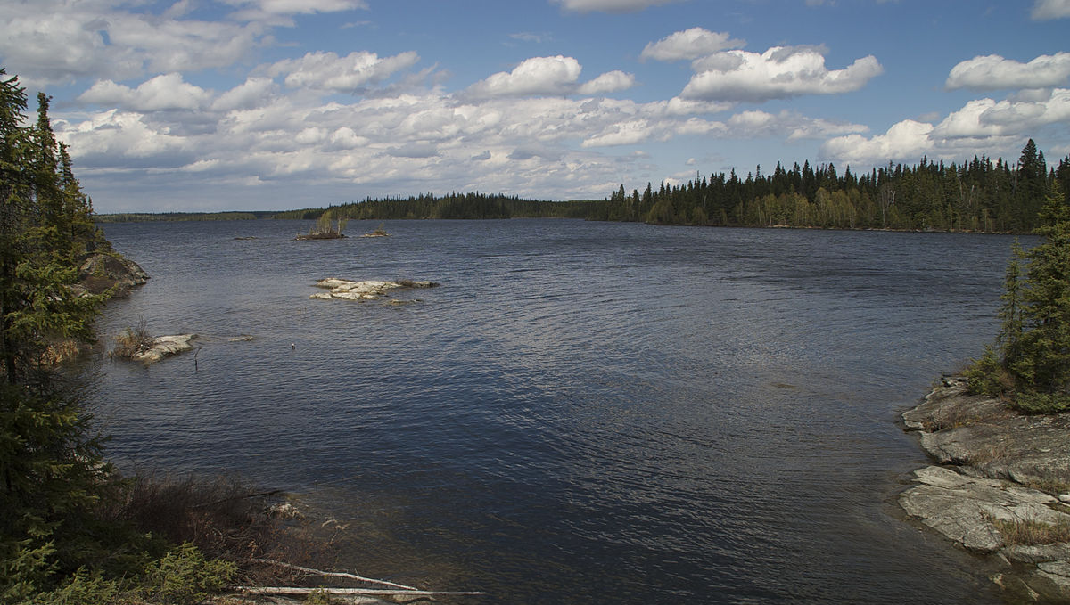
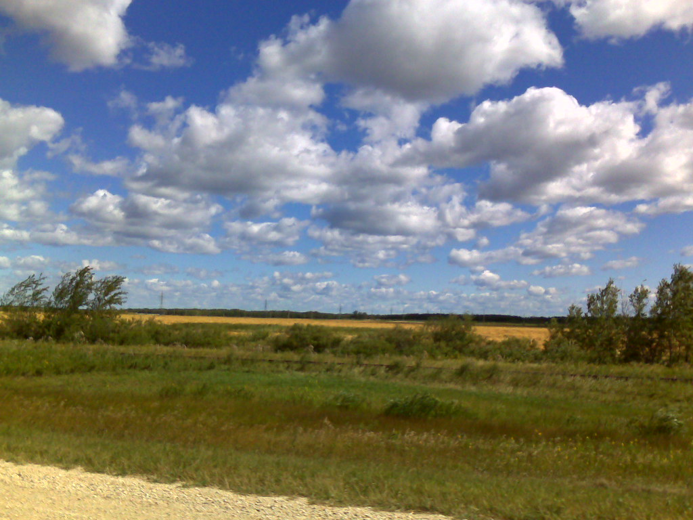
How does the natural world around me help me live? Kindergarten Integrated Social Studies Unit
This Photo by Unknown Author is licensed under CC BY
This Photo by Unknown Author is licensed under CC BY-SA
Notes:
*This learning experience is best used as part of a school year long focus on the natural world around us to help support kindergarten students’ deep understanding and appreciation for the natural world around them.*
Start with asking children what they already know about this topic. Do they know what is meant by natural world? Do the pictures help us understand what the natural world around us is? What does it mean when something helps us? Can they think of an example of something that helps us live, that may be in the natural world or in our homes or schools or communities? Here are some ideas for you as the teacher to help guide conversations throughout the project but I would not tell them these as this unit is about student’s discovery. Plants: Human Use - https://letstalkscience.ca/educational-resources/picture-collections/plants-human-use
(The photo on the top is Alberts Lake, MB; the photo on the bottom left is a Manitoba landscape.)
Sight word suggestions for this unit: nature, help, live, natural, constructed, sort, same, different, play, weave, physical, work, clothing, food, shelter, beauty, beautiful, important, action, Earth, and environment. (Adapted from: Kindergarten Social Studies Cluster 3 - https://www.edu.gov.mb.ca/k12/cur/socstud/foundation_k/cluster3.pdf, p. 128)
You may wish to use the Natural World Around Me Sight Words BLM#8 to help children with their writing tasks throughout this learning experience. They can cut out the words to use or sort.

Slide 2
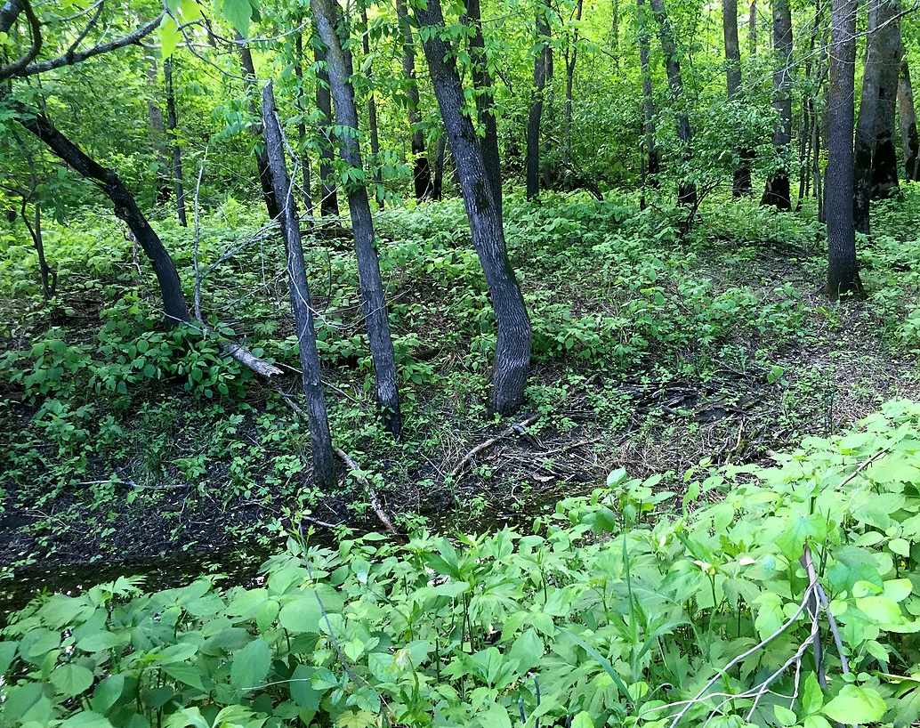
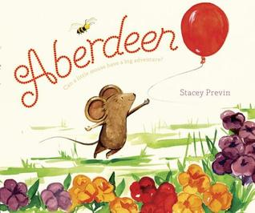
Think about nature as you listen to this story about a curious little mouse.
Aberdeen
by Stacey Previn (5:26 min)
This Photo by Unknown Author is licensed under CC BY-NC-ND
This Photo by Unknown Author is licensed under CC BY-SA
Notes:
Aberdeen by Stacey Previn - https://www.youtube.com/watch?v=YQgdlgEReCw
You may wish to use this book (or another story where nature plays an important part in the story) as an anchor text for the whole learning experience, revisiting it several times, to reinforce what nature is and how important it is to the little mouse. If possible, it is best if you could get the actual book and read it to the child, sharing turning the pages and pointing out pictures, words or letters, as you read the story, modelling how to be a reader engaged in the text. With subsequent readings, you may have the students turn the pages and point out pictures, words or letters that they notice and wonder about.
The following questions may help guide before-during-and after conversations about the book:
Before reading – What do you notice on the cover? What parts of nature do you think are on the cover? Does the cover make you think of something in your own life/family? What do you wonder about the story? What do you think this story will be about?
During reading –What do you notice in the pictures? What do you wonder about what is happening in the story? What questions do you have about what is happening in the story? How is nature part of the story? What do you think or feel about what is happening in the story? Does the story make you think of anything in your own life? What do you think will happen next?
After reading – What did you think about the story? How did the story make you feel? Do you think nature was important/helpful in Aberdeen’s adventure? Were there any items in the story that were important but were not part of nature (the balloon is constructed)?
After reading, it will help students practice comprehension strategies by retelling the story using their words, actions, puppets, and/or drawings following a FIRST, NEXT, THEN, LAST sequence. Students could retell the story to a teacher, caregiver, family member or friend.
Extra information about the book:
Meet the Author & Illustrator of Aberdeen: Stacey Previn - https://elephant-books.com/2018/09/17/stacey-previn/
(The photo is of Brokenhead River Ecological Reserve in Manitoba - https://www.gov.mb.ca/sd/pubs/envir_bio/ec_reserves/Brokenhead_River_Backgrounder.pdf)

Slide 3
Can you retell the story of Aberdeen in order?
First | Next | Then | Last
This Photo by Unknown Author is licensed under CC BY-NC-ND
This Photo by Unknown Author is licensed under CC BY-SA
Notes:
To assess students’ comprehension, have the student retell the story of Aberdeen to you using the outline above. It is also beneficial for them to act it out themselves, with stuffed animals, or with puppets or paper cutouts of characters and setting items. Students may also use Story Book Retell BLM#1 to draw pictures and/or letters and words to retell the story.

Slide 4
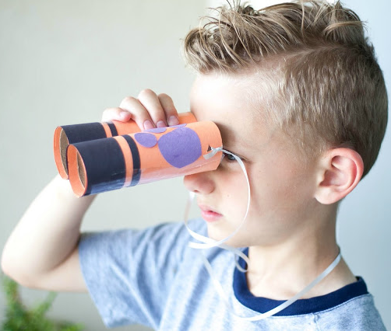
To enjoy many of the activities in this learning experience, you could make some binoculars.
Follow these directions on How To Make Binoculars (1:44 min)
This Photo by Unknown Author is licensed under CC BY-NC-ND
Notes:
How to make binoculars - https://www.youtube.com/watch?v=iM-oM8fPduo
You may wish to use this opportunity to assess children’s fine motor skills if you watch them make the binoculars.

Slide 5
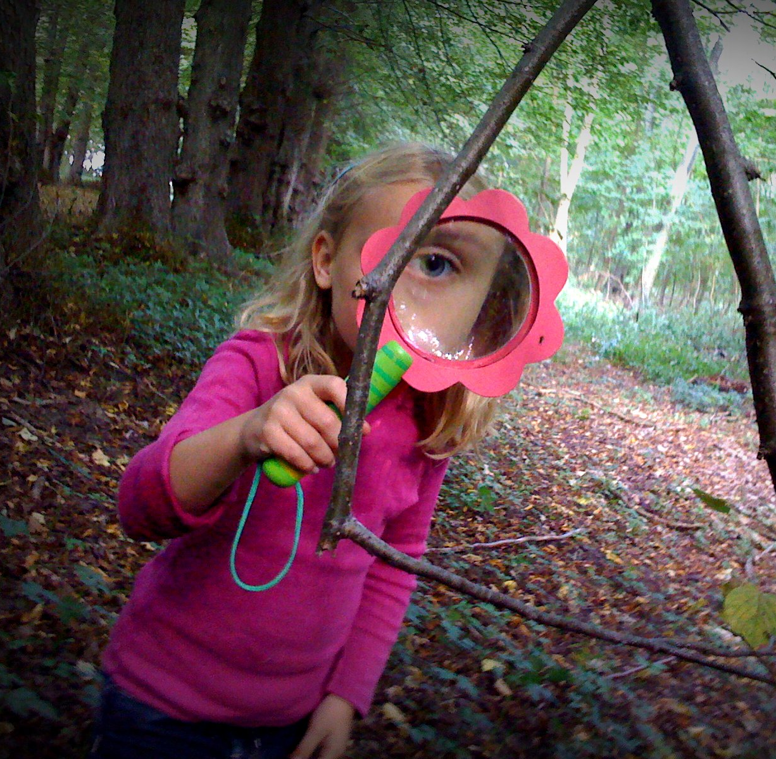
Pretend you are a scientist!
Go outside for a walk.
Look carefully with your binoculars &/or a magnifying glass for 5 things you can collect from outside your home (you can also draw them or take photos of them).
*Note: Be safe and be sure to respect living things. For example, do not tear a leaf or twig off a tree; only take those fallen on the ground.*
This Photo by Unknown Author is licensed under CC BY
Notes:
Children will extend their learning about the natural world as well as practice looking for details and drawing like a scientist with this activity. *Children should have adult supervision when exploring in nature to help keep them safe and to stimulate and guide conversation about what they see and are experiencing.*
-You may wish to use Scientist Journal BLM#2 to support this outside activity. Copy as many pages as students need to record the details (through pictures, letters and some words) of the items that students choose to be part of this learning experience.
-You may also wish to use this sheet to record what they see when they are out on their walk:
What did you see page - https://www.edu.gov.mb.ca/k12/cur/socstud/foundation_k/blms/k-3-2d.pdf

Slide 6
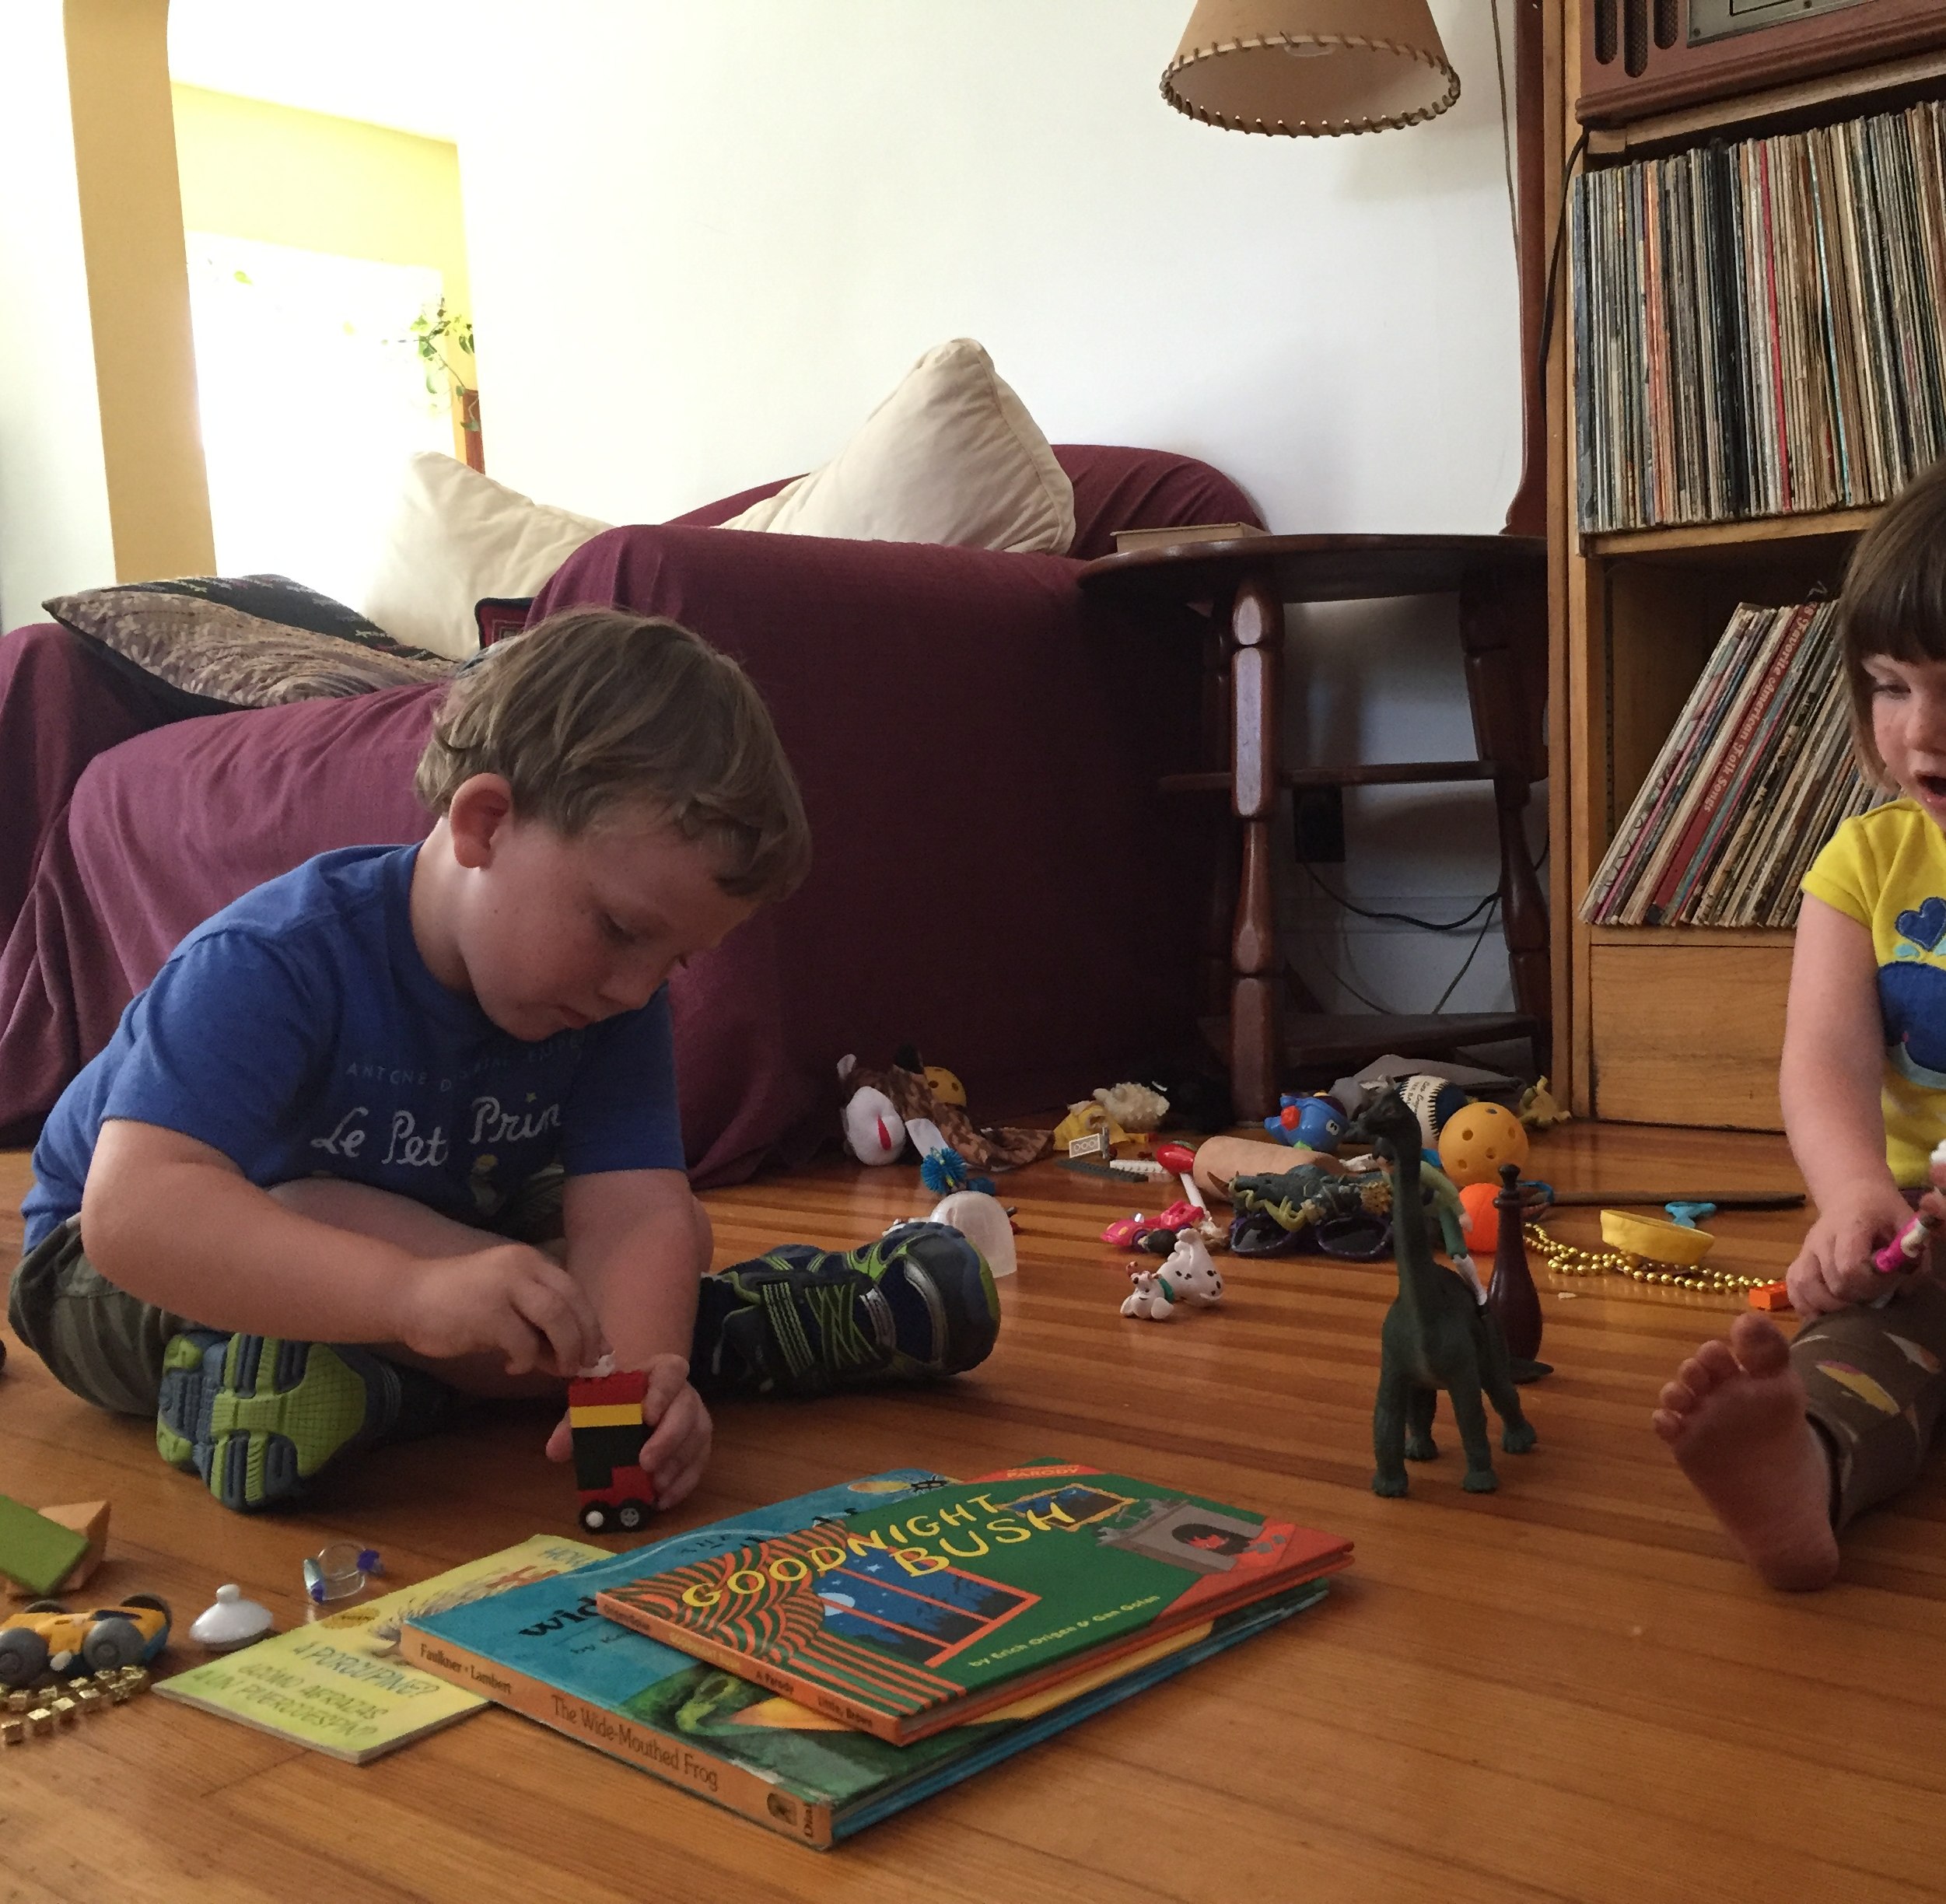
Once you are home, collect 5 more things inside your home (you can also draw them or take photos of them).
When you are ready, sort all the items into 2 groups any way you would like and talk about why you sorted the way you did.
This Photo by Unknown Author is licensed under CC BY
Notes:
Children will extend their learning about the world around them as well as practice looking for details and drawing like a scientist with this activity.
-You may wish to use Scientist Journal BLM#2 to support this inside activity. Copy as many pages as students need to record the details (through pictures, letters and some words) of the items that students choose to be part of this learning experience.
-You may wish to extend this activity by focusing on the Math and sorting the objects by similarities.
K.SS.2 Sort 3-D objects using a single attribute
✓ How are the objects alike?
✓ In which ways can the objects be sorted?
✓ What is the sorting rule?
Count how many items are in each column. (tally marks? numerals) Which had more? Which had less? How do you know?

Slide 7
Now try sorting the items you collected a different way.
Try sorting the items you collected into these 2 groups: natural elements or constructed elements.
Talk about why you think each item is a natural or constructed element.
Natural elements occur naturally in nature/the natural world (trees, flowers, birds); constructed elements are made by humans (toys, tools, buildings).
Now that you know what the difference is between natural and constructed elements, would you like to change any of the items you sorted earlier?
Notes:
Without telling the children what natural or constructed means, ask them to sort into those two categories based on what they think. Changing the sort and having them guess at first which items are natural and which are constructed elements helps students access prior knowledge and build critical thinking skills.
Next, model the difference between natural and constructed elements.
Now have the students make corrections to their sort and discuss the changes to further develop their understanding.
After finalizing understanding of the difference between natural and constructed elements, have the children discuss how the natural elements may help them live?
*You may choose to use the Sorting: Natural or Constructed Elements BLM#3 to support this learning experience.
-Children will continue to extend their learning about the natural world as well as practicing looking for details like a scientist with this activity.
-You may wish to extend this sort by focusing on the MATH and sorting the objects by similarities.
K.SS.2 Sort 3-D objects using a single attribute (in this case, natural or constructed elements)
✓ How are the objects alike?
✓ In which ways can the objects be sorted?
✓ What is the sorting rule?
Count how many items are in each column. (tally marks? numerals) Which had more? Which had less? How do you know?

Slide 8
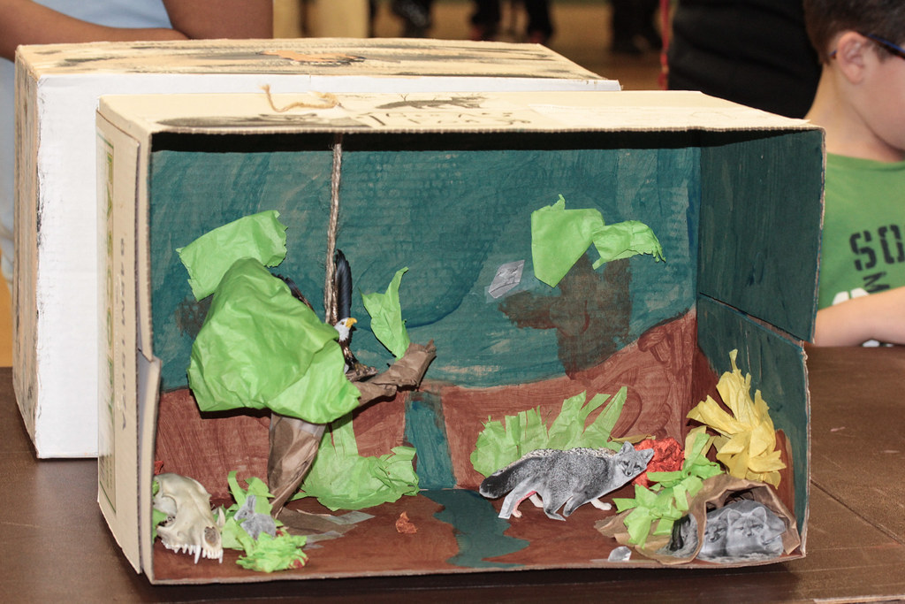
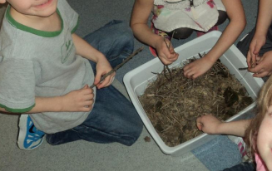
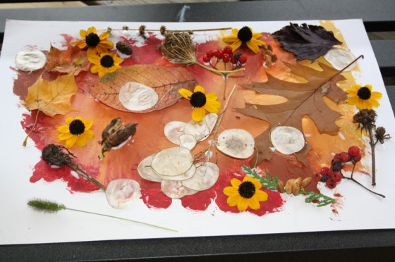
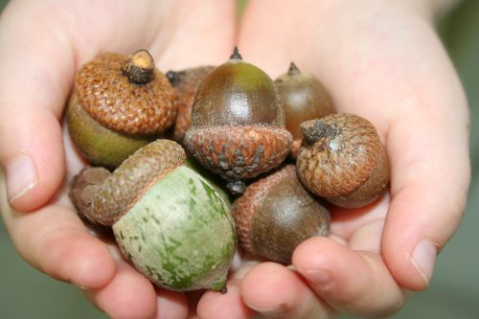
Small World Play
You may now use some of the loose natural parts, you collected and sorted, in your play space and/or to create a barn, house, town or city for some of your other toys!
This Photo by Unknown Author is licensed under CC BY-NC-ND
This Photo by Unknown Author is licensed under CC BY
This Photo by Unknown Author is licensed under CC BY
This Photo by Unknown Author is licensed under CC BY-SA-NC
Notes:
Children may now use/play with those loose natural parts that have been collected on the walk. The loose natural parts can be added to the child’s play space for use with dolls, small plastic animals and figurines, building blocks, playdough, art, crafts, etc.
Children may want to create a representation of the natural and constructed world around them for Small World Play. The child may create the representation using the loose natural parts, blocks, shoeboxes and cartons, or plastic building bricks building anything they want. Some possibilities may include building a great city, a house for their stuffed animals, a robot, or a rocket ship!
Parents/caregivers may video or take a photo of the student’s finished environment to share with the teacher, or students can show their teacher during their contact time, indicating the natural and constructed elements in their model, explaining the beauty and importance of the natural environment, and describing ways in which the natural environment helps them live. (https://www.edu.gov.mb.ca/k12/cur/socstud/foundation_k/cluster3.pdf, p.132.)

Slide 9
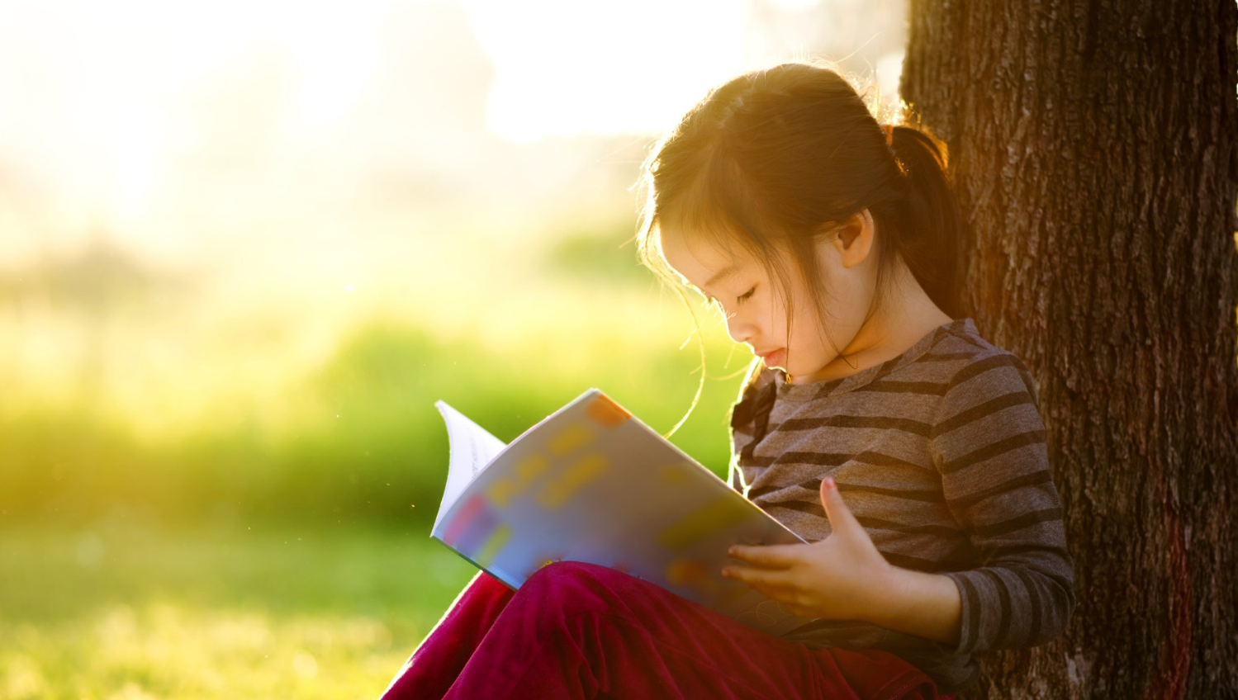
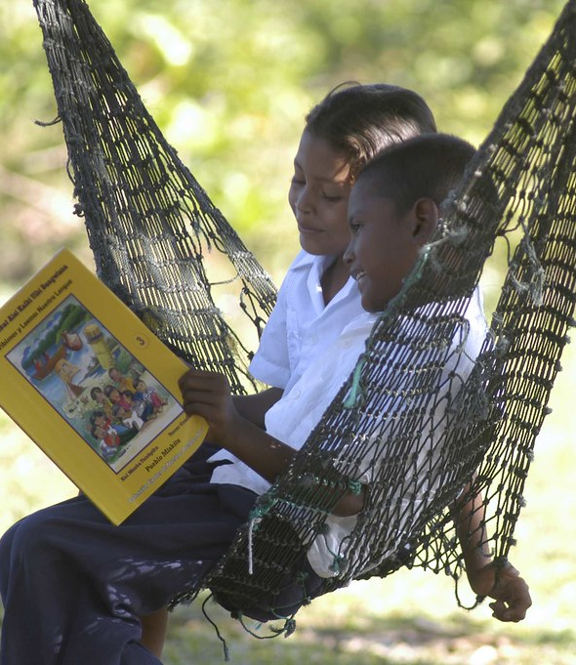
Listen to one or both books: Dad Does Books - Canada ABC (3:38 min) YouTube ABC's of Canada by Kim Bellefontaine (3:44 min) YouTube Which items in the stories are natural elements, and which items are constructed elements? How do the natural elements help us live?
This Photo by Unknown Author is licensed under CC BY-NC-ND
This Photo by Unknown Author is licensed under CC BY-NC-ND
Notes:
Dad Does books – (3:38 min) Canada ABC – https://www.youtube.com/watch?v=jzKSPuMKFMk
ABC’s of Canada by K. Bellefontaine (3:44 min) - https://www.youtube.com/watch?v=Qmjm9N0svBA
Have children talk about which items in the stories are natural and which are constructed or human-made. You may wish to have students practice their knowledge of the alphabet and beginning sounds by having them run to grab something in the home that starts with a specific letter. For example, “Go find something that begins with the letter/sound “B”, and the child runs and brings a ball. You may also ask students how the found item helps them live. This game/task also helps them connect their learning to the world around them. This is another opportunity to assess students’ understanding of natural and constructed elements, as well as their knowledge of letters and letter sounds.
As an extension, you may also have students complete the ABC Practice BLM#4a or you may choose to have students complete the My Favourite Letters BLM#4b.

Slide 10
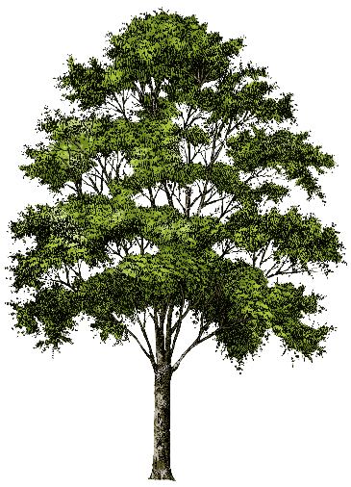
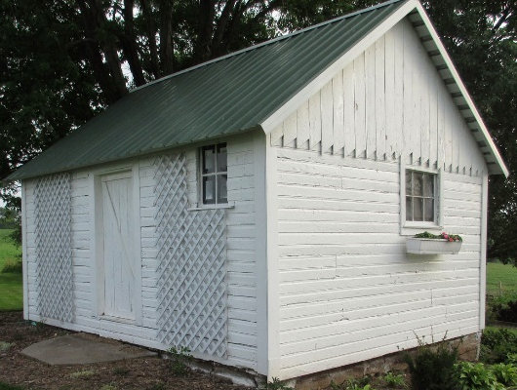
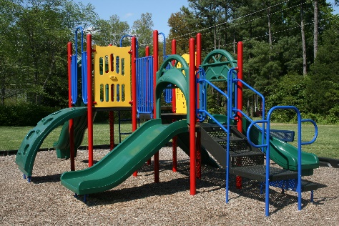
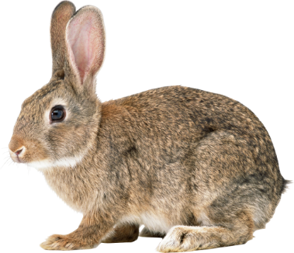
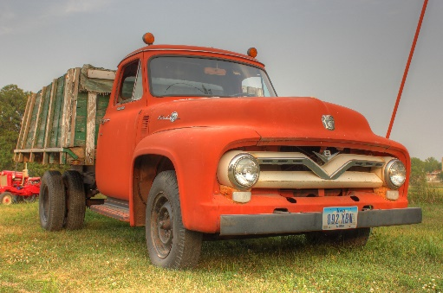
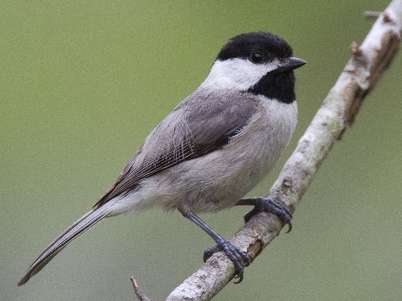
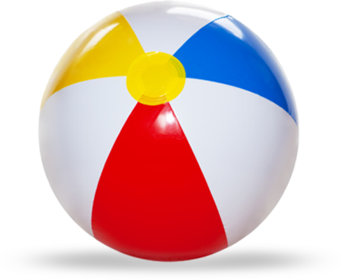
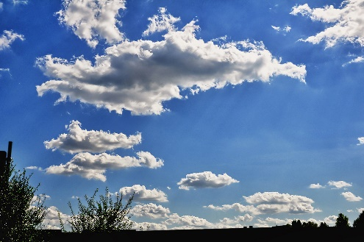
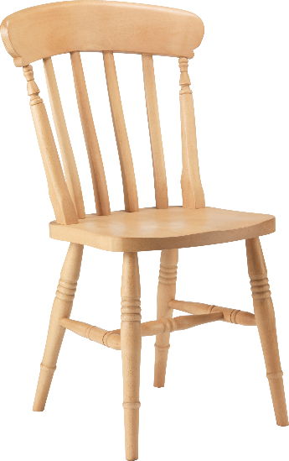
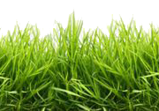
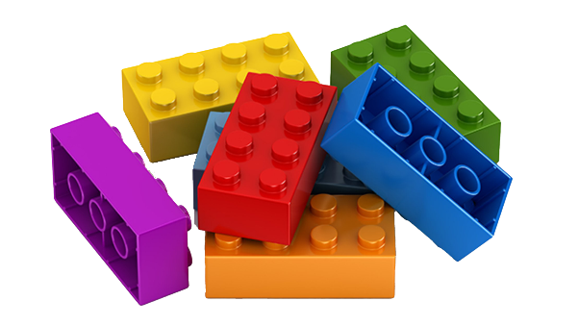
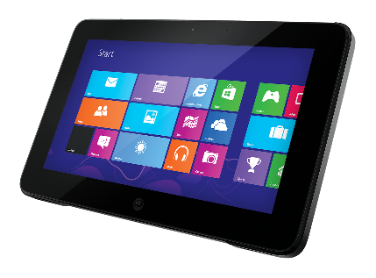
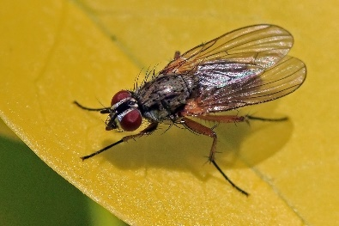
Practice sorting Natural and Constructed Elements:
Natural Elements
Constructed Elements
This Photo by Unknown Author is licensed under CC BY-NC
This Photo by Unknown Author is licensed under CC BY-NC-ND
This Photo by Unknown Author is licensed under CC BY-NC
This Photo by Unknown Author is licenseud nder CC BY
This Photo by Unknown Author is licensed under CC BY-SA-NC
This Photo by Unknown Author is licensed under CC BY-SA-NC
This Photo by Unknown Author is licensed under CC BY-NC
This Photo by Unknown Author is licensed under CC BY-NC
This Photo by Unknown Author is licensed under CC BY-NC
This Photo by Unknown Author is licensed under CC BY-NC
This Photo by Unknown Author is licensed under CC BY-NC
This Photo by Unknown Author is licensed under CC BY-SA
This Photo by Unknown Author is licensed under CC BY-SA
Notes:
Have students predict where the item will go and explain their thinking. This is also a good way to assess their understanding of natural and constructed elements and ability to sort. Have them discuss how the items in the natural elements’ column can help them live.
-You may wish to extend this activity by focusing on the Math and sorting the items by similarity.
K.SS.2 Sort 3-D objects using a single attribute (in this case, natural or constructed elements)
✓ How are the objects alike?
✓ In which ways can the objects be sorted?
✓ What is the sorting rule?
Count how many items are in each column. (tally marks? numerals) Which had more? Which had less? How do you know?

Slide 11
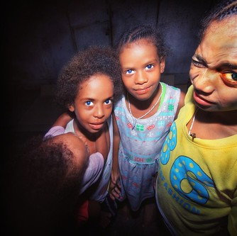
“I spy with my little eye!”
Now challenge your classmates and family to play this fun game outside if possible!
Take turns spying natural and constructed objects.
See if you can stump them!
This Photo by Unknown Author is licensed under CC BY-SA-NC
Notes:
This is a good game for Kindergarteners to practice and have fun with their knowledge of natural and constructed elements. Discuss the difference between natural and constructed elements before beginning to play or use it as a way to assess, reinforce and/or have fun with students’ understanding of natural and constructed elements. (Children should have adult supervision when playing in nature to help keep them safe and to stimulate and guide conversation about what they see and are experiencing.)
The player gives the first letter of the object as a clue. For example, if the player chooses a fence, they say, 'I spy with my little eye something constructed beginning with F’. Alternately, if the player chooses a leaf, they say, ‘I spy with my little eye something natural beginning with L.’ Players take turns to call out guesses until someone gets the right answer. The first person to guess correctly gets the next turn to choose an object.
Variations of the game could include descriptive clues instead of letters:
‘I spy something natural that is tall.’ or ‘I spy something natural that is brown and green.” Answer: tree.
“I spy something constructed that is square.” “I spy something constructed that is clear.” Answer: window).
(https://www.edu.gov.mb.ca/k12/cur/socstud/foundation_k/cluster3.pdf, p. 128)
Once students identify the element as natural or constructed, they can discuss ways in which the natural elements influence/help their daily lives.

Slide 12




Natural Element Math Talk: Which one doesn’t belong?
Notes:
This activity is designed to activate or reinforce perceptual subitizing skills (the ability to see the quantity of familiar arrangements of items quickly without counting) using pictures of natural elements.
K.N.2. Subitize and name familiar arrangements of 1 to 6 dots (or objects).
Look briefly at a given familiar arrangement of 1 to 6 dots (or objects), and identify the number represented without counting.
(https://www.edu.gov.mb.ca/k12/cur/math/framework_k-8/kindergarten.pdf, p. 52)
Ask children to think about the number of each of the items in the grid and choose which one they think does not belong. There is no right or wrong answer for this question.
Ask them to explain their choice based on the number of items.
This math talk is an opportunity for children to build their:
critical thinking and discourse/explanation skills
visualization skills with familiar arrangements of objects for quick assessment of quantity without having to count (perceptual subitizing) just as with dice.
(You may also wish to have follow-up discussions about the natural elements in the grid and how they help us live.)
You may wish to assess and/or extend this activity by having children draw their own Math Talk of natural elements using Which One Doesn’t Belong BLM#5 and/or play games that require a die so children can practice calling out the numbers as they roll.
More Which One Doesn’t Belong activity ideas may be found at - https://wodb.ca/

Slide 13
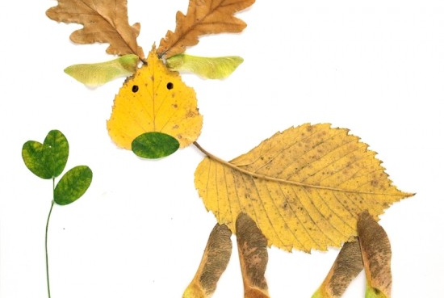
Remember our big question?
How does the natural world around me help me live?
Continue to think about this question for the rest of the learning experience….
This Photo by Unknown Author is licensed under CC BY-SA
Notes:
This may be a mid-point opportunity to assess students’ understanding of the learning so far. Ask children if they think they know more now about the answer to the inquiry question and/or if they have any questions. Their learning about natural and constructed elements should have helped them understand more deeply about what is meant by natural world. Have discussions to reinforce how natural elements come from, and make up, the natural world around us.
The following outcomes may be addressed during the inquiry/learning to follow:
Social Studies KL-013: Give examples of how the natural environment influences daily life. Examples: work, play, clothing . . .
Science K-1-02: Identify ways in which humans and other animals use trees. Examples: humans eat apples and walnuts...
K-3-03: Recognize that paper is most often made from trees.
Physical Education/Health Education K.5.K.A.1: Identify daily habits for leading a physically active and healthy life (e.g., daily exercise, healthy eating, connecting with nature - https://davidsuzuki.org/take-action/act-locally/connecting-youth-with-nature/

Slide 14
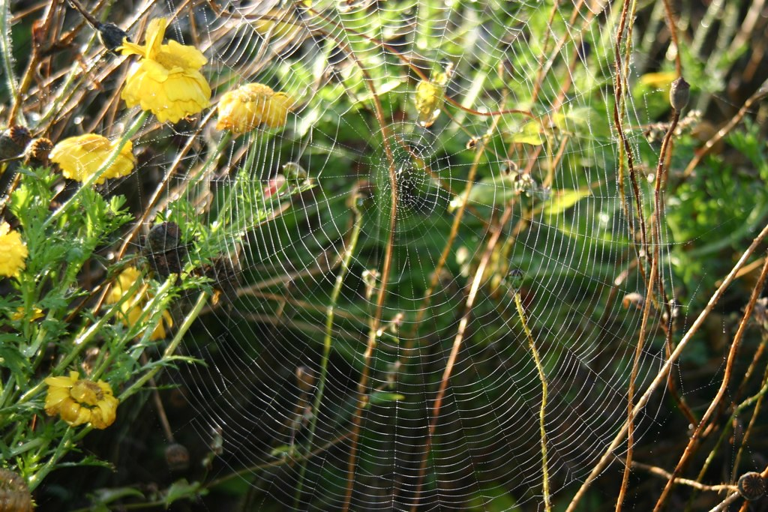
What natural element do you see in the picture?
Yes, a spider web!
"Spider web - photo by FranceHouseHunt.com" by www.FranceHouseHunt.com is licensed under CC BY 2.0
Notes:
For the next learning task on slides 15-18, explain to students that they will use ideas and skills like the skills and knowledge spiders use to build their web.

Slide 15
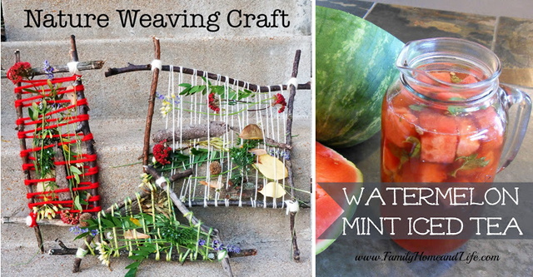
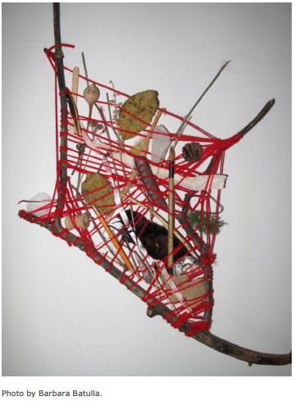
Branch of Life
Using ideas and skills like the ones spiders use to build a web, you and your family or classmates can follow the instructions on the next 3 slides to create a branch of life or nature weaving.
The weaving will hold items that are natural elements or have natural elements in them that help you live.
Source of lesson and far right photo: Education for Sustainable Development: kindergarten.pdf (gov.mb.ca)
This Photo by Unknown Author is licensed under CC BY-NC
Notes:
This activity can be completed as a family or class project, or individually. It is based on a lesson from the document, Education for Sustainable Development: Kindergarten to Grade 4 Poster Activities – Kindergarten PDF of learning experiences, page K13-K16, https://www.edu.gov.mb.ca/k12/esd/poster_activities/kindergarten.pdf (This resource also contains background information and other activity ideas.)
Easy instructions for a similar craft may be found here on page 10 - https://media.curio.ca/filer_public/4f/0c/4f0c4d35-a957-4434-9d10-6abe1f4c268e/gbk_curriculum-spring-v10.pdf

Slide 16
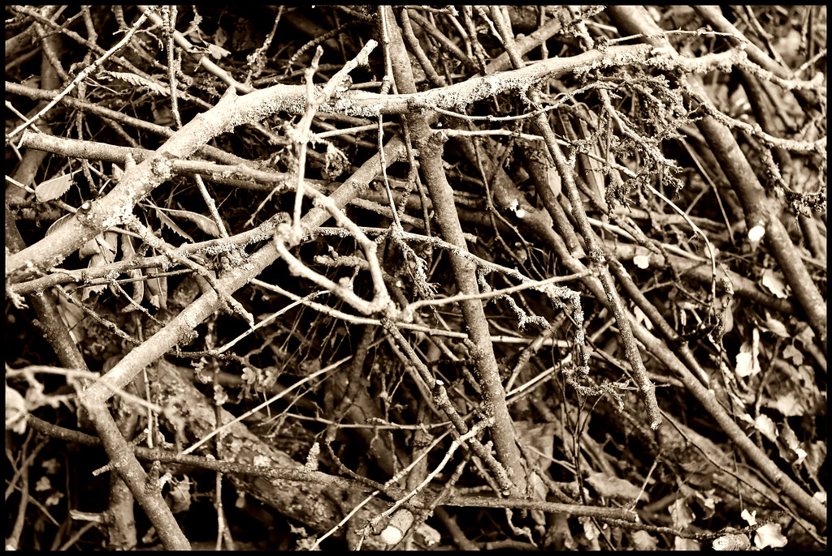

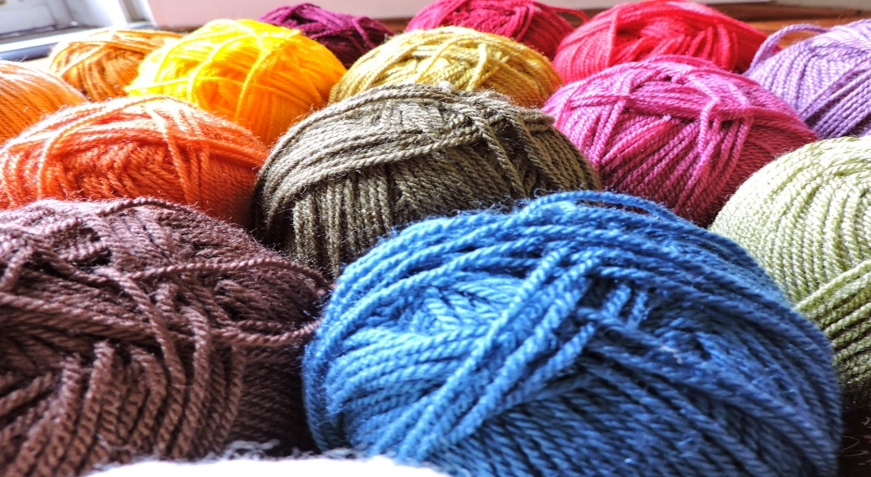
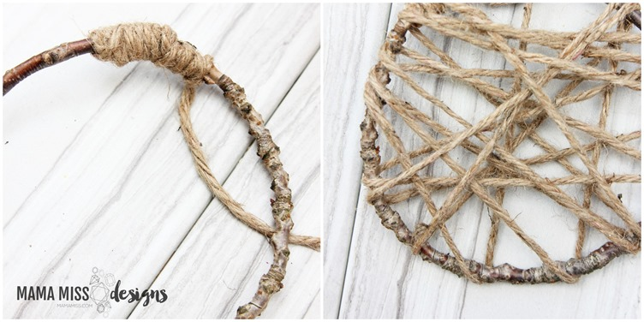
Branch of Life: First Steps
Watch this video: Nature Weaving (3:22 min)
Use your binoculars to search for and gather these items from inside and outside your home:
yarn or twine
dead branches for the frame
Weave in and out, up and down, over and under, back and forth, securing the yarn or twine on your branch frame
This Photo by Unknown Author is licensed under CC BY-SA-NC
This Photo by Unknown Author is licensed under CC BY-SA-NC
Source of lesson and far right photo: Education for Sustainable Development: kindergarten.pdf (gov.mb.ca)
This Photo by Unknown Author is licensed under CC BY-NC-ND
Notes:
Nature Weaving (Curio.ca, 3:22 min) - https://curio.ca/en/video/nature-weaving-24449/
Children should have adult supervision when exploring/gathering in nature to help keep them safe and to stimulate and guide conversation about what they see and are experiencing.

Slide 17
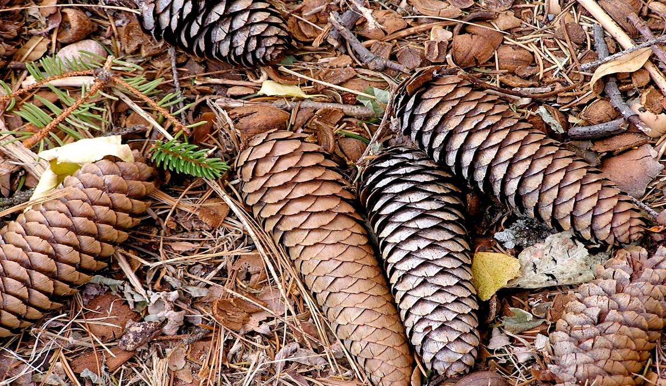
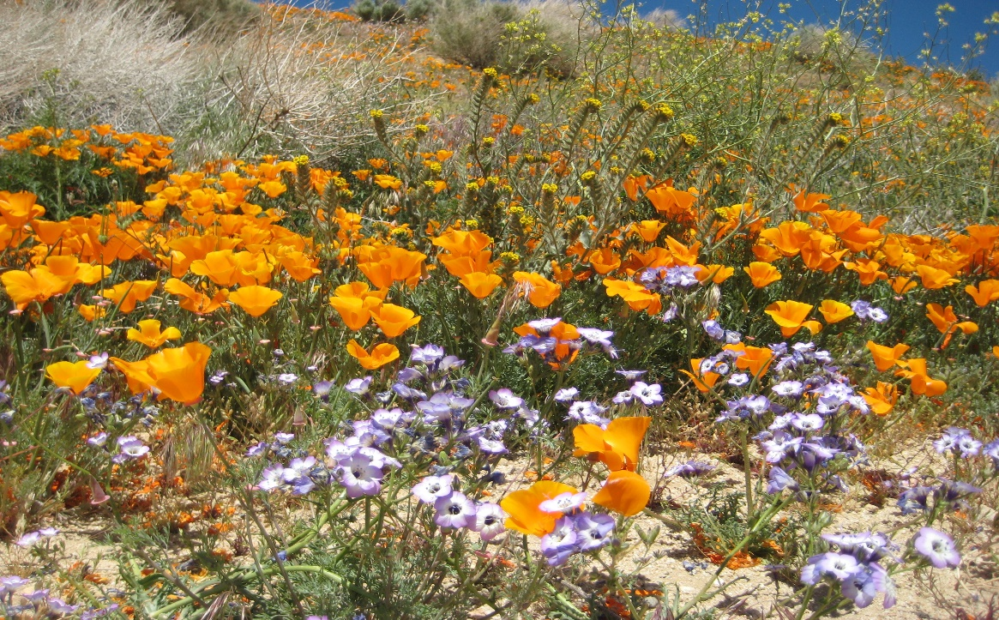
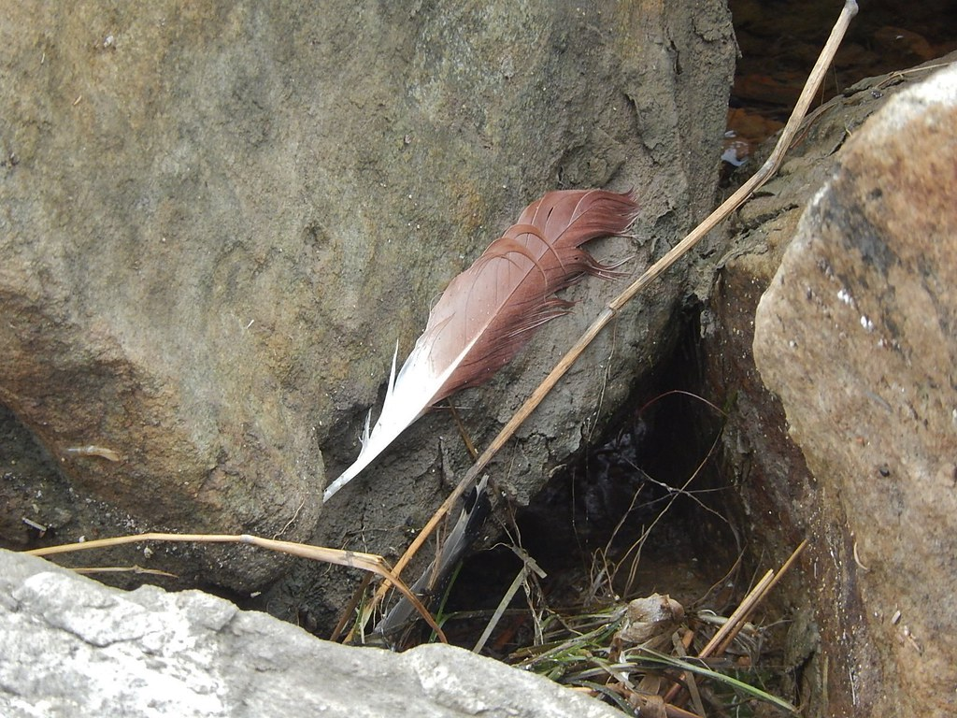
Branch of Life: Next Steps
Use your binoculars to search for and gather natural items or items made from natural elements from inside and outside your home
Only choose items that you think help you live better in some way
When in nature, take only what is abundant and only take a little. Do not pick living things from trees or gardens, pick off the ground.
This Photo by Unknown Author is licensed under CC BY-SA
This Photo by Unknown Author is licensed under CC BY-SA
Source of lesson and far right photo: Education for Sustainable Development: kindergarten.pdf (gov.mb.ca)
This Photo by Unknown Author is licensed under CC BY-SA
Notes:
Suggestions/examples of natural items or items that have natural elements in them are:
leaves, twigs, flowers, feathers, grass, ferns, seed pods, shells, rocks, pinecones
pencil, popsicle stick, clay chunk, piece of cotton or bamboo cloth, leather or paper scrap
Children should have adult supervision when exploring/gathering in nature to help keep them safe and to stimulate and guide conversation about what they see and are experiencing. Caution children about being respectful of nature (try not to disturb plants and animals) and be safe while exploring nature. Talk with students as they are exploring about the details of what they are experiencing and how nature helps them live. Have children collect things that they feel help them live (rocks help make roads or cement for buildings, leaves represent the trees that provide us with shade or compost for gardens, a twig represents wood for a bonfire for roasting hotdogs for food or that builds our home, a flower makes us feel good with its beauty, shells represent food for us or other fish that we could eat, feather represents birds that add joy to our world with song or eat insects that would pester us or our garden, anything that makes sense as long as it is a natural item that they can explain as helping them live.

Slide 18
Branch of Life: Last Steps
Weave the items into your branch frame, over and under the yarn or twine until they are secure, and you like how things look
Once your branch of life is complete, show it to family or class members that did not help you create it
Share and explain the items in your branch of life, where and how you found them, and how they help you live
Source of lesson and far right photo: Education for Sustainable Development: kindergarten.pdf (gov.mb.ca)
This Photo by Unknown Author is licensed under CC BY-NC
Notes:
Some children may need guided through the sharing of their branch of life. Caregivers may video record students explaining their branch of life and send it to the teacher or share a photo of their creation in their online learning platform.

Slide 19
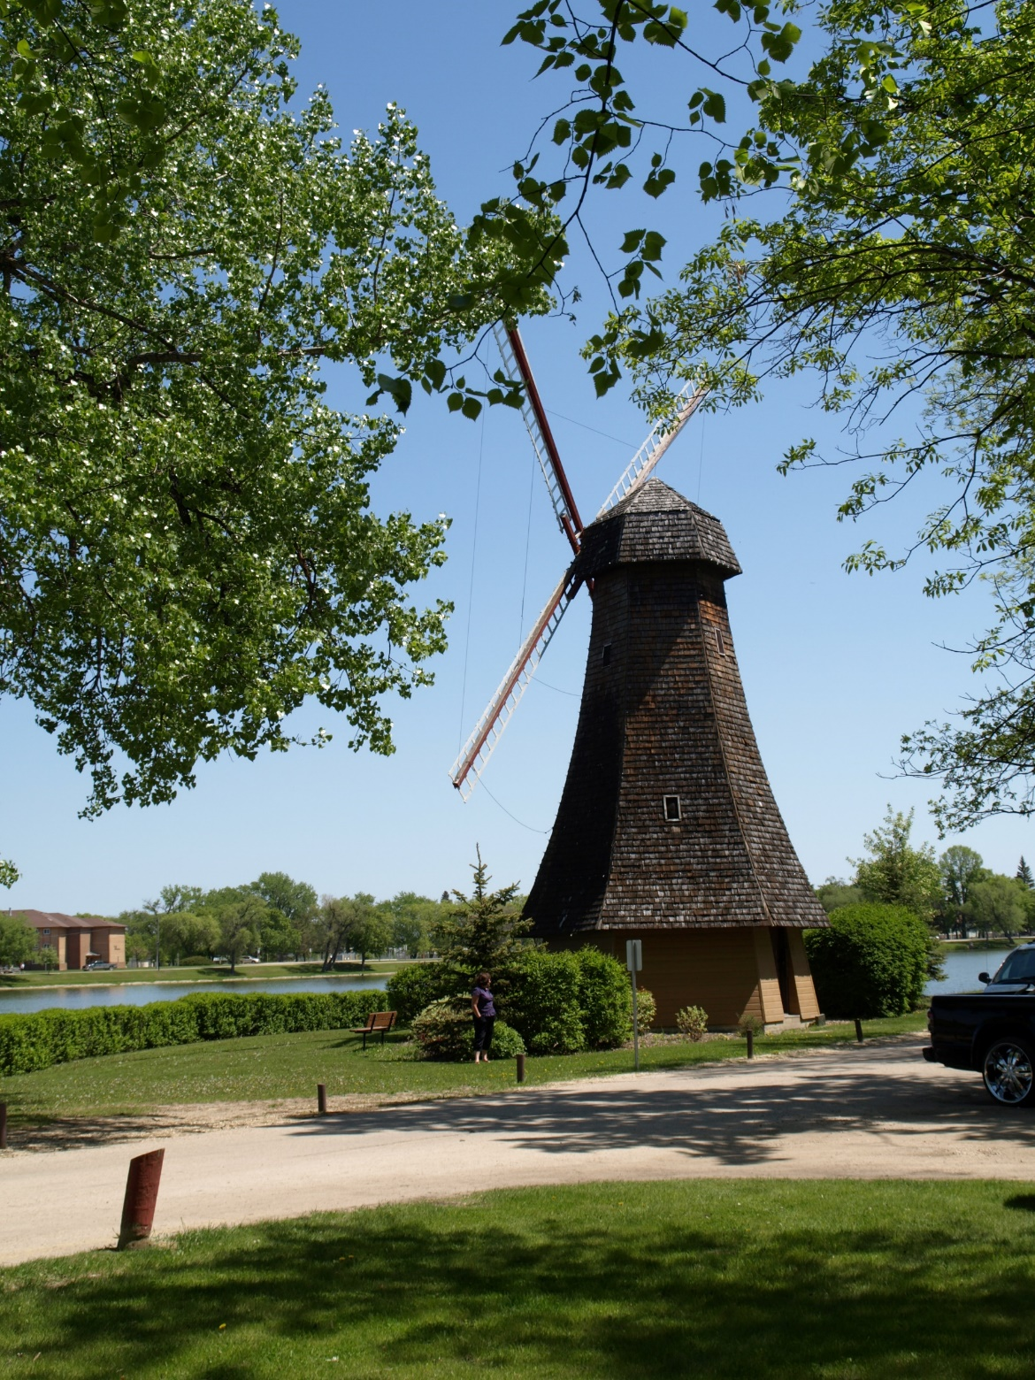
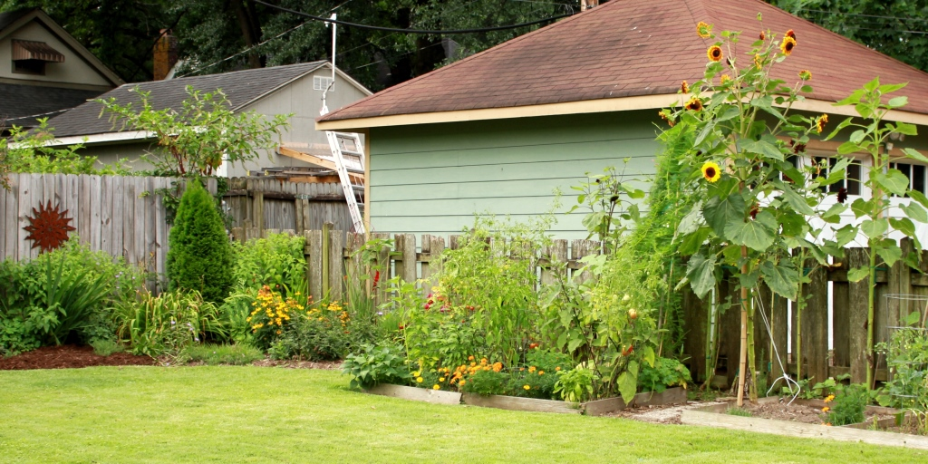
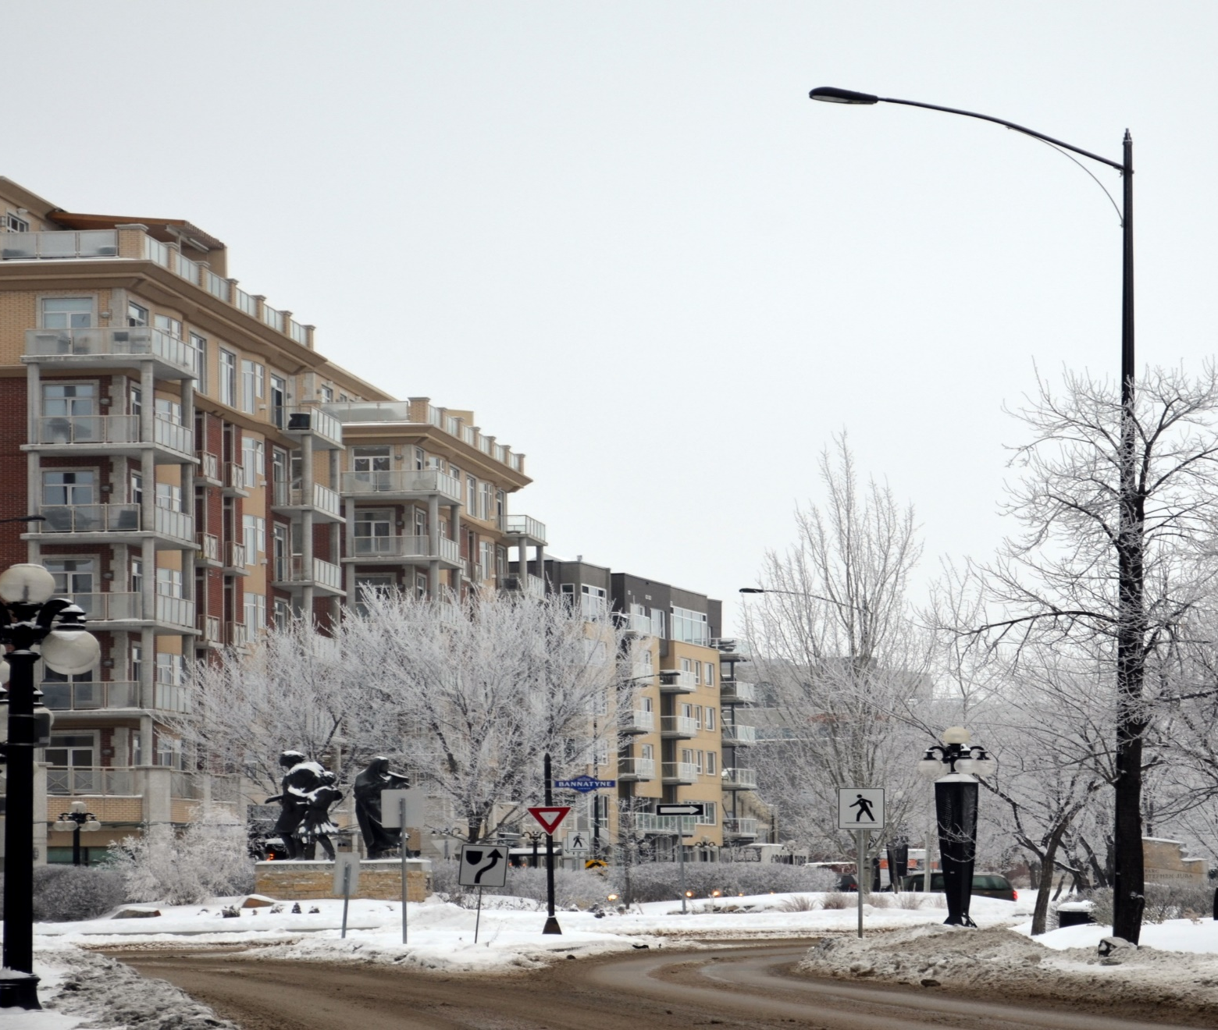
Explore Nature
Listen to this story about children going on a nature hunt. Going On A Nature Hunt (5:41 min)
Now take your binoculars and head outside for a walk. It can be down the sidewalk, in your yard, or in a park. Be sure to be safe and respectful of living things. You may want to take paper to draw and write about what you see, hear, smell, feel, taste, and think.
If you cannot go outside, watch one or both videos and then use your binoculars to look and listen for nature out of your window. Pimachiowin Aki (12:13 min) or Earth Day - Nature Walk (5:08 min)
This Photo by Unknown Author is licensed under CC BY-SA
This Photo by Unknown Author is licensed under CC BY-ND
This Photo by Unknown Author is licensed under CC BY-SA
Notes:
Going On a Nature Hunt (5:41 min) - https://www.youtube.com/watch?v=GGuz954d4sA
Pimachiowin Aki (12:13 min) - https://www.youtube.com/watch?v=-FjcxSqFDLI
Earth Day – Nature Walk (5:08 min) - https://www.youtube.com/watch?v=Yb1Pn6N3zT0
After students’ listen to the story, you may wish to use Story Book Retell BLM#1 to assess children’s comprehension. Children should have adult supervision when exploring in nature to help keep them safe and to stimulate and guide conversation about what they see and are experiencing.
It is very important for children to experience nature for their health, well-being, and development. You may want to give children copies of the Exploring Nature BLM#s 6a-1 – 6a-5 so they can record through drawing and Kindergarten writing (letter and some words) what they see, hear, smell, feel, and taste while exploring nature. Be sure to caution them about being respectful of nature (try not to disturb plants and animals) and safe while exploring nature. Talk with students as they are exploring about the details of what they are experiencing and how nature helps them live. And/or you may wish to use the Exploring Nature Reflection BLM#6b after children finish exploring nature. *If you choose to have children draw and write about their exploration of nature, please note that kindergarten children can show what they know by drawing pictures and writing down the sounds they can hear in the words they want to write. Kindergarten children are not expected to know how to spell a whole word. Children need to know it is their ideas that matter most, and we encourage them to write what they can hear and not worry about knowing all the letters they need to spell a word. Kindergarteners need to be able to draw and write letters or words to show what they want to say; we don't expect children to know the correct spelling for words in kindergarten. Children can record their thoughts with pictures, letters, and words they know, to represent their ideas.*
The following resources talk about the importance and benefits of outdoor play:
Active Outdoor Play Statement from the Council of Chief Medical Officers of Health - Pan-Canadian Public Health Network (phn-rsp.ca) - http://www.phn-rsp.ca/aop-position-jae/index-eng.php#:~:text=The%20Council%20of%20Chief%20Medical%20Officers%20of%20Health,outdoors-with%20its%20risks-is%20essential%20for%20healthy%20child%20development.
The Benefits of Outdoor Play Infographic (outdoorplaycanada.ca) - https://www.outdoorplaycanada.ca/portfolio_page/benefits-of-outdoor-play-infographic/
Outdoor Play Canada | This summer 2021, play is more important than ever - https://www.outdoorplaycanada.ca/2021/04/22/this-summer-play-is-more-important-than-ever/
39 fun ways kids can play outside this spring - Active For Life - https://activeforlife.com/39-ways-to-play-outside-in-spring/
Optional read alouds about nature walks:
Maisy's Nature Walk (from 6:29- 12:31 min) - https://www.youtube.com/watch?v=sFbqM5dRfw4
Nature Spy (3:32 min) - https://www.youtube.com/watch?v=8gt6xpBDGE8
I Took A Walk (4:45 min) - https://www.youtube.com/watch?v=8au_mPa0TKc
Other resources to support activity in nature:
How to get kids into nature - David Suzuki Foundation - https://davidsuzuki.org/queen-of-green/how-to-get-kids-into-nature/
Home – EcoKids - https://ecokids.ca/
Education Resources – EcoKids - https://ecokids.ca/education-resources/
Canadian Parks Council Key Initiatives – https://parks-parcs.ca/canadian-parks-council-key-initiatives/
Nature Playbook.pdf (parks-parcs.ca) - https://parks-parcs.ca/wp-content/uploads/2020/09/nature-playbook.pdf
The Wild Canadian Year Video Series (cbc.ca) - https://www.cbc.ca/wildcanadianyear/

Slide 20
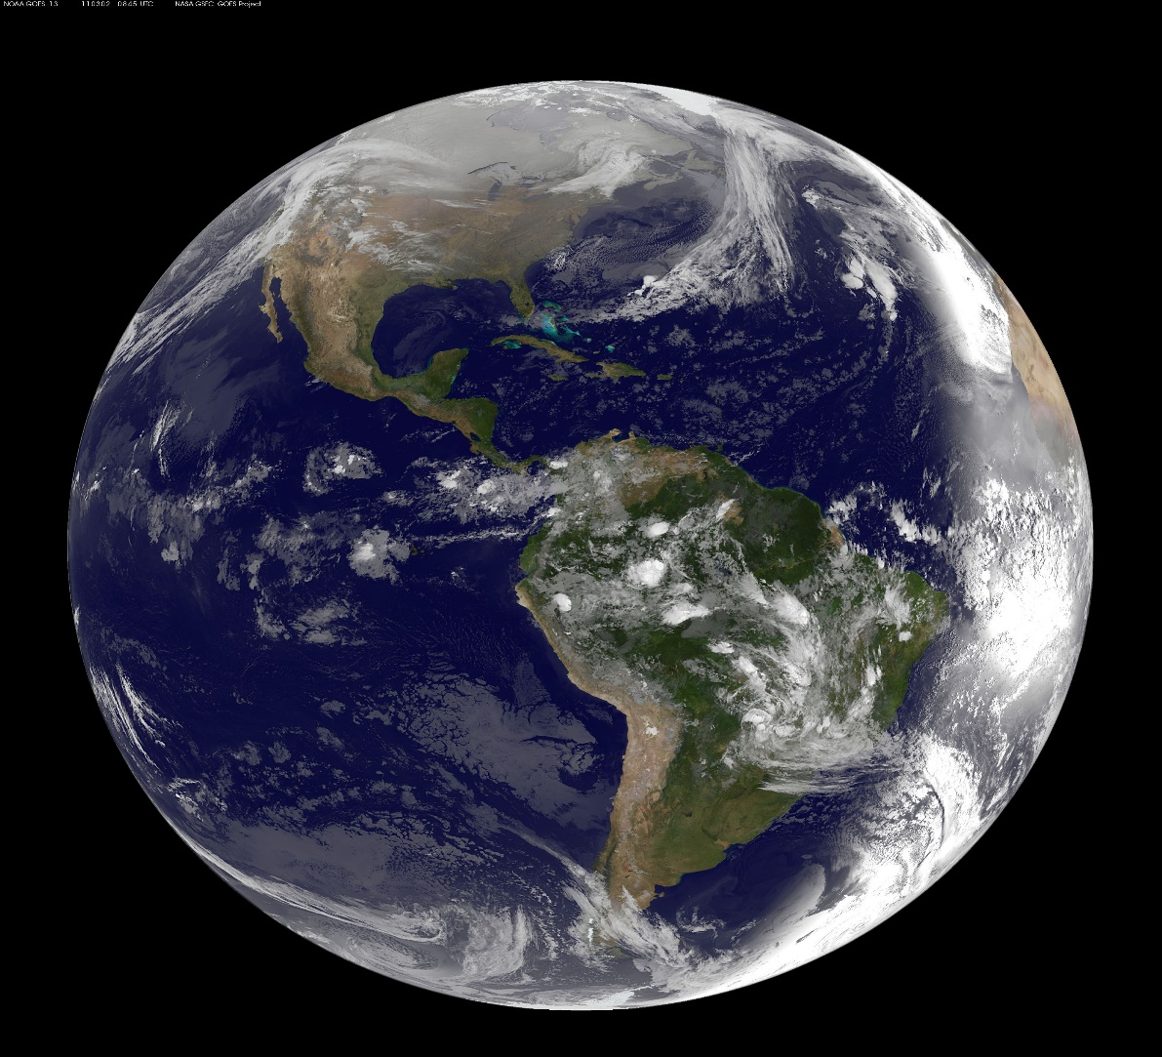
Caring for Mother Earth
Did you know that Indigenous peoples have a special relationship with the land?
Indigenous peoples respect the earth’s gifts that help us live and survive
Indigenous peoples offer gratitude and thanks to Mother Earth for her gifts
Indigenous peoples believe we take only what we need so future generations can thrive
Listen to one or more of the following books to further understand Indigenous peoples’ views of Mother Earth:
Lessons from Mother Earth by Elaine McLeod (8:55 min)
Taking Care of Mother Earth by Leanne Flett Kruger (2:29 min)
I Am Mother Earth (5:01 min)
Indigenous peoples believe that if we take care of the earth, the earth will take care of us
To learn more about Indigenous perspectives watch Learning how to care for Mother Earth with Elder Dave Courchene (3:31 min)
This Photo by Unknown Author is licensed under CC BY-SA
Notes:
Learning how to care for Mother Earth with Elder Dave Courchene (3:31 min) - https://www.youtube.com/watch?v=p7oW9HgIRsI
Lessons from Mother Earth by Elaine McLeod (8:55 min) - https://www.youtube.com/watch?v=PdXjvzY7UQ0
Taking Care of Mother Earth by Leanne Flett Kruger (2:29 min) - https://www.youtube.com/watch?v=l2HB-hmjPNo
I Am Mother Earth (5:01 min) - https://www.youtube.com/watch?v=bvHKL4DzfiU
It is important for us to acknowledge that the Indigenous peoples of the world have perspectives that may help us deepen our appreciation for the natural elements and natural world around us and how it helps us live and survive. The Learning How to Care for Mother Earth Video Notes BLM#6 may help support discussions with the children about Indigenous perspectives.
*This video provides excellent general information about Indigenous peoples in Canada –
The word Indigenous - explained l CBC Kids News (2:26 min) - https://www.youtube.com/watch?v=CISeEFTsgDA
After listening to one or more of the read alouds, you may wish to use the Story Book Retell BLM#1 to assess students’ comprehension of the story.

Slide 21
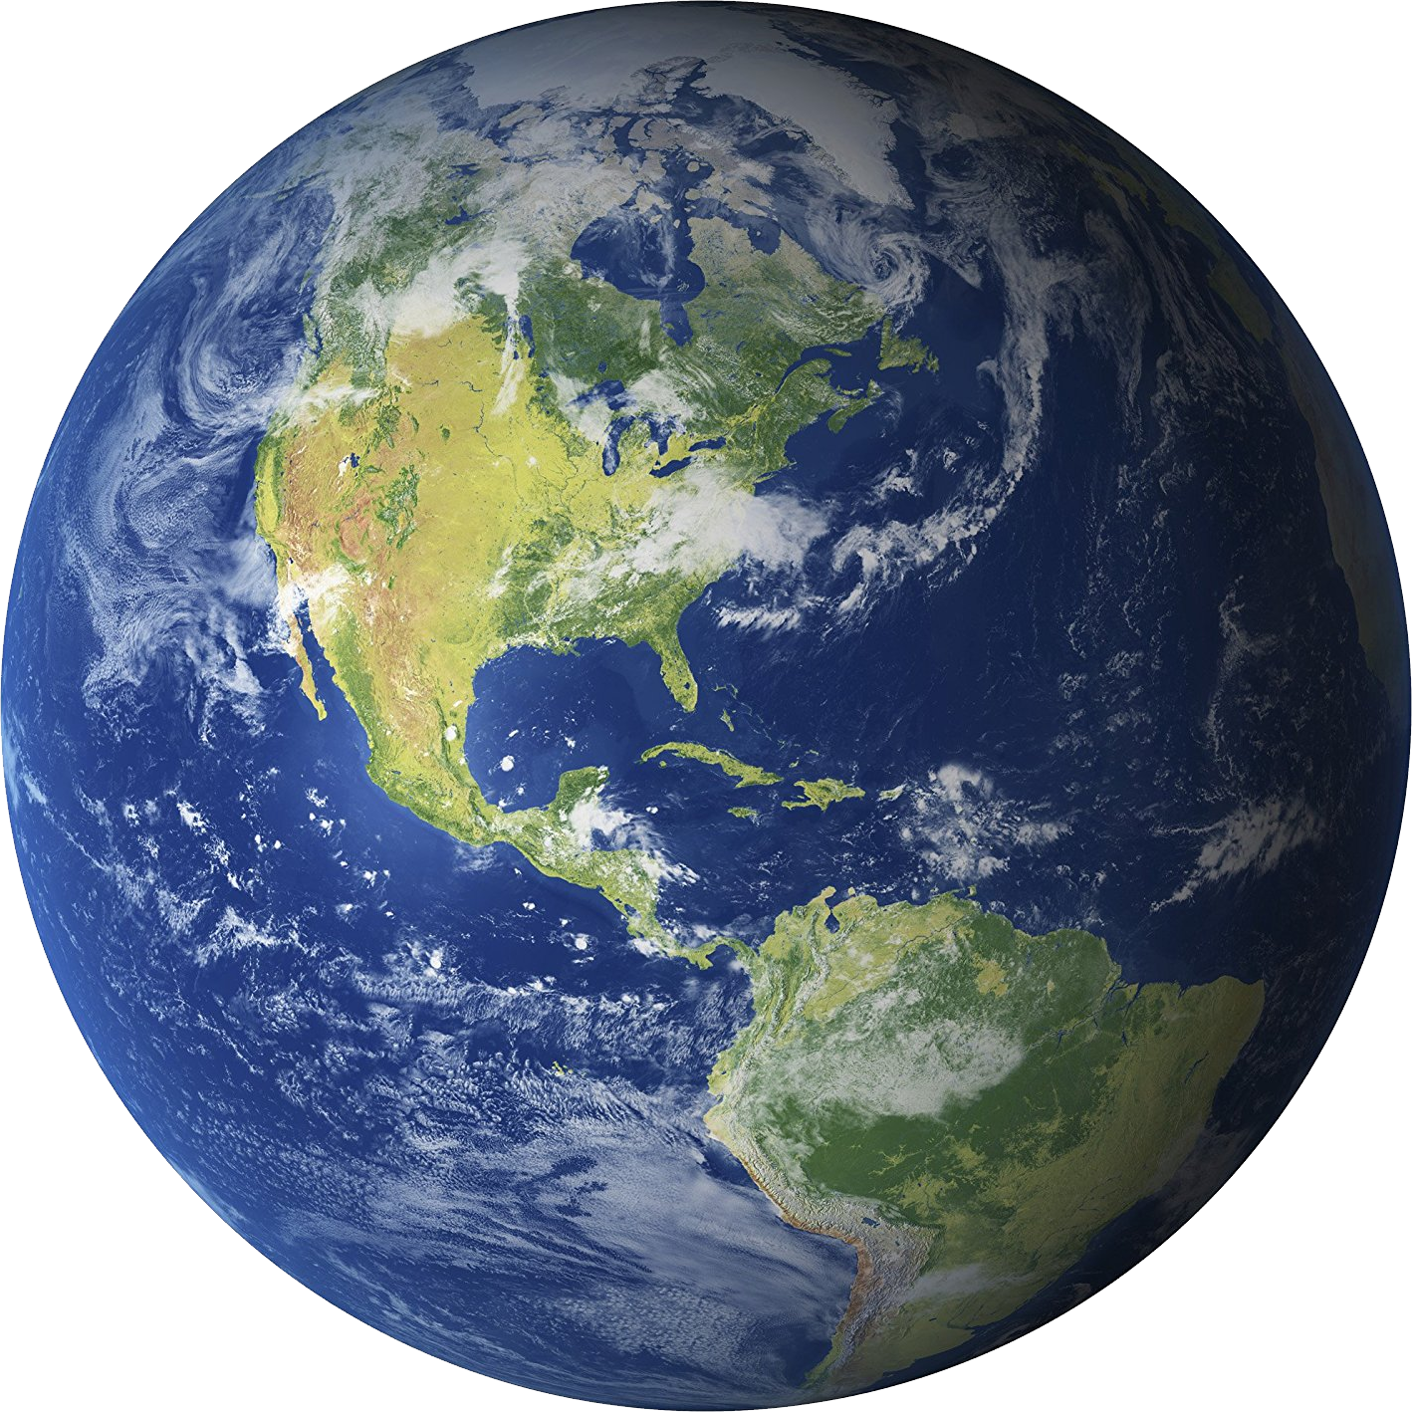
Your turn! How can you take care of our Earth?
This Photo by Unknown Author is licensed under CC BY-NC
Notes:
This may be used as an activator for the next 2 slides’ activity. Have children share their ideas, hopefully making connections to some of their prior learning. This conversation may also be used to assess their learning up to this point.

Slide 22
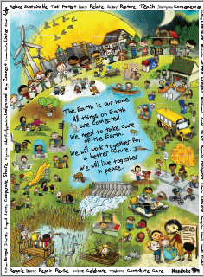
Check out this poster. What do you notice? What do you wonder?
Poster and guiding notes available at Education for Sustainable Development | Manitoba Education (gov.mb.ca)
Notes:
Education for Sustainable Development - https://www.edu.gov.mb.ca/k12/esd/poster.html
Have students examine the poster closely for pictures and/or words that may help them learn about and understand how we can take care of our Earth. Help students share and discuss what they see and think about the pictures/words and caring for our Earth.
“This poster…was created to inspire and encourage teachers and students in Manitoba classrooms to learn about, and to take action related to, sustainable development. It was designed to promote thoughtful discussion and informed decision making, and to encourage students to live a more conscientious lifestyle that contributes to quality of life for all – locally, nationally, and globally. The K–4 poster was designed around the central declaration “The Earth is Our Home.” This declaration was adapted from the Earth Charter, which can be found at <www.earthcharterinaction.org/content>. There is also a “Little Earth Charter” for K–4 students at <www.edu.gov.mb.ca/k12/esd/lec.html> . The images on the K–4 poster were selected to represent activities that relate to sustainable living. The poster has images of all four seasons, urban and rural settings with day and night images. The curvature at the top of the poster represents Earth, and all the students holding hands illustrate working together to achieve a sustainable future. The words that surround the poster were taken from the K–4 Manitoba curriculum learning outcomes that relate to sustainability. ” (Education for Sustainable Development K-4 Poster Activities document- https://www.edu.gov.mb.ca/k12/esd/poster_activities/full_doc.pdf, p. 3).

Slide 23
Take Action!
Create a poster that does one or more of the following:
Shows how to take care of the Earth.
Shows how you are taking care of the Earth
Shows how we should celebrate Earth Day everyday
Source: Education for Sustainable Development | Manitoba Education (gov.mb.ca)
Notes:
Education for Sustainable Development – https://www.edu.gov.mb.ca/k12/esd/poster.html
This is an opportunity for students to discuss the importance of taking action, at home and in school, and to engage in actions to support the environment. Have students discuss the beauty and importance of the natural environment and identify actions they can take to support it (e.g., cleaning up litter, recycling, conserving water…).
If students prefer to do something else to “take action”, honour their ideas as long as they support taking care of the earth.
To extend learning here are some online read alouds about Earth Day:
I CAN SAVE THE EARTH by Alison Inches and Viviana Garofoli (5:13 min) - https://www.youtube.com/watch?v=2Mkwhe6LOBo
EARTH DAY EVERY DAY by Lisa Bullard and Xiao (4:09 min)– https://www.youtube.com/watch?v=qvdhsn-BFDI
THE EARTH BOOK by Todd Parr (2:56 min) -https://www.youtube.com/watch?v=lpEc5nHqO2c
EARTH DAY An Alphabet Book by Gary Kowalski (3:00 min)- https://www.youtube.com/watch?v=w5TwTS2gX1Q

Slide 24
Final Reflection
How does the natural world around you help you live? See if you can talk about at least 3 specific things.
Share one example of how you help take care of our natural world.
This Photo by Unknown Author is licensed under CC BY
Notes:
Guide students to be as specific as possible with their answers and explanations.
This link may also help students see more ideas than they could think of about how the natural world helps them live:
Plants: Human Use - https://letstalkscience.ca/educational-resources/picture-collections/plants-human-use
As a wrap-up extension, you may wish to celebrate the learning and student reflections by including food and drink from the natural world (veggies and fruit) as students share.

