Slide 1
The Extreme Weather Show
Grade 5 Learning Experience

Slide 2
Inquiry Question
How do we communicate ideas about the effects of weather and/or climate?
Guiding Questions:
How are humans and animals affected by weather around the world?
How do we prepare for severe weather?
How do numbers help us describe the effects of weather?
Does where we live affect how we are impacted by weather?

Slide 3
Final Learning Challenge
This learning experience will end with the creation of an Extreme Weather Show! You will contribute to a segment of this show on a weather topic of your choice.
Some ideas might be:
Weather report
Human interest story about weather
Science behind a severe weather event
News report of a weather event
Other ideas??

Slide 4
Which weather conditions impact living things the most?
1
2
Rank the weather conditions and place in order from Greatest Impact (1) to Least Impact (5).
Precipitation
Humidity
UV Index
3
Temperature
Wind
I think ________ affects living things the most because ________________________
_________________________________________________________________________________________________________
4
5

Slide 5
Learning experiences

Slide 6
On the Same Day in March
Watch/view On the Same Day in March by Marilyn Singer.
Choose a location from the book, research the weather for today.
On the following interactive slides, select a textbox at the top and add the information about the weather that is indicated. Then move your box to place the information on the number line in order from least to greatest.
Notes:
https://www.youtube.com/watch?v=HxyOARxq-vs

Slide 7
Type here
Type here
Type here
Type here
Type here
Type here
Type here
Type here
Type here
Type here
Type here
Type here
Type here
Type here
Type here
Type here
Type here
Type here
Type here
Type here
Type here
Type here
Type here
Type here
Least
Instructions: Choose a box at the top. Type the name of your chosen location and today's wind speed. Move your box so it is in the correct order on the number line.
Greatest
Wind Speed

Slide 8
Type here
Type here
Type here
Type here
Type here
Type here
Type here
Type here
Type here
Type here
Type here
Type here
Type here
Type here
Type here
Type here
Type here
Type here
Type here
Type here
Type here
Type here
Type here
Type here
Least
Instructions: Choose a box at the top. Type the name of your chosen location and today's predicted precipitation. Move your box so it is in the correct order on the number line.
Greatest
Predicted Precipitation

Slide 9
Type here
Type here
Type here
Type here
Type here
Type here
Type here
Type here
Type here
Type here
Type here
Type here
Type here
Type here
Type here
Type here
Type here
Type here
Type here
Type here
Type here
Type here
Type here
Type here
Least
Instructions: Choose a box at the top. Type the name of your chosen location and today's predicted probability of precipitation. Move your box so it is in the correct order on the number line.
Greatest
Predicted Probability of Precipitation

Slide 10
Type here
Type here
Type here
Type here
Type here
Type here
Type here
Type here
Type here
Type here
Type here
Type here
Type here
Type here
Type here
Type here
Type here
Type here
Type here
Type here
Type here
Type here
Type here
Type here
Least
Instructions: Choose a box at the top. Type the name of your chosen location and today's current temperature. Move your box so it is in the correct order on the number line.
Greatest
Current Temperature

Slide 11
Type here
Type here
Type here
Type here
Type here
Type here
Type here
Type here
Type here
Type here
Type here
Type here
Type here
Type here
Type here
Type here
Type here
Type here
Type here
Type here
Type here
Type here
Type here
Type here
Least
Instructions: Choose a box at the top. Type the name of your chosen location and today's predicted high temperature. Move your box so it is in the correct order on the number line.
Greatest
Predicted High Temperature

Slide 12
On the Same Day in March
Discussion:
What do the units of these measurements tell us?
How do they help us compare the information?
How does the weather in these various locations impact humans and other living things?

Slide 13
Weather Reports from Around the World
Watch these weather reports:
Winnipeg https://winnipeg.ctvnews.ca/video?binId=1.1814091 (you will have to find a weather clip usually there is one in the first couple of minutes of the show)
England https://news.sky.com/weather
Florida https://wsvn.com/weather/
What do you notice? | What do you wonder?
Notes:
Class discussion: How are weather reports the same/different around the world?

Slide 14
What is a Blizzard?
Watch What is a Blizzard. You may find it helpful to watch to pause and re-watch segments to help you make meaning while viewing.
What are the key features of a blizzard?
Describe what causes a blizzard.
Notes:
https://www.youtube.com/watch?v=WU_Nd-olb6M

Slide 15
What is a ….?
Choose
Choose a severe weather phenomena such as a tornado, thunderstorm, hurricane, extreme wind chill, or flood.
Research
Research the key features of the weather phenomena and what causes it.
Share
Share your findings using a model or a visual representation.

Slide 16
Disasters in Canada by the Numbers
Visit https://www.thecanadianencyclopedia.ca/en/timeline/disasters (use the timeline menu in the top left to narrow the content and dates of the timeline)
Choose a weather-related disaster (e.g. blizzard, tornado, thunderstorm, hurricane, windchill, or flood) to research and answer the questions below:
What numerical data is used to describe the effects of the disaster?
What does the data mean?

Slide 17
Disasters in Canada by the Numbers
Create a representation (such as a graph, model, visual) that communicates the impact of the weather event using data.

Slide 18
Preparing for Emergencies
Brainstorm all the items that you think you should include in an emergency preparedness kit for you and your family to meet your needs for 72 hours. Record your ideas below.

Slide 19
Preparing for Emergencies
Review your ideas from your brainstorm and choose the 5 most important items for your family's emergency preparedness kit.
List the top five items in order of most important (1) to least important (5). Justify your decision.
1.
2.
3.
I think that __________________ is the most important item to include in my family's emergency preparedness kit because...
4.
5.

Slide 20
Preparing for Emergencies
Draw an arrow on the dashboard to show your current thinking. Justify your choice.
How big of a container do I need to store all of the recommended supplies for emergencies?
I think the container can be the size of ____________ because....
Shoe box
Suitcase
Curbside Recycling Bin
Water Bottle

Slide 21
Preparing for Emergencies
Watch the video Preparing a Family Emergency Kit.
Make a list of all the items that your family would need to include in its emergency kit.
Now that you know what you need in an emergency kit, determine the smallest container that can hold all the supplies.
Notes:
https://www.getprepared.gc.ca/cnt/rsrcs/vds/prprng-kt-en.aspx

Slide 22
Preparing for Emergencies
What is the smallest container you could use to hold all your supplies? How do you know?

Slide 23
Preparing for Emergencies
How can you describe the size of your container? What measurements did you use to describe your container? What do those measurements mean?

Slide 24
Preparing for Emergencies
Draw an arrow on the dashboard to show your current thinking. Justify your choice. Reflect on your thinking.
How big of a container do I need to store all of the recommended supplies for emergencies?
I think the container can be the size of ____________ because....
My thinking has (changed/stayed the same) because....
Shoe box
Suitcase
Curbside Recycling Bin
Water Bottle

Slide 25
And Then the Sun Came Out...
After listening to the book And Then the Sun/Rain Came Out... consider how the author, Cresent Dragonwagon, and the illustrator, Diane Greenseid, communicate the effects of the weather on living things. Record your ideas below.

Slide 26
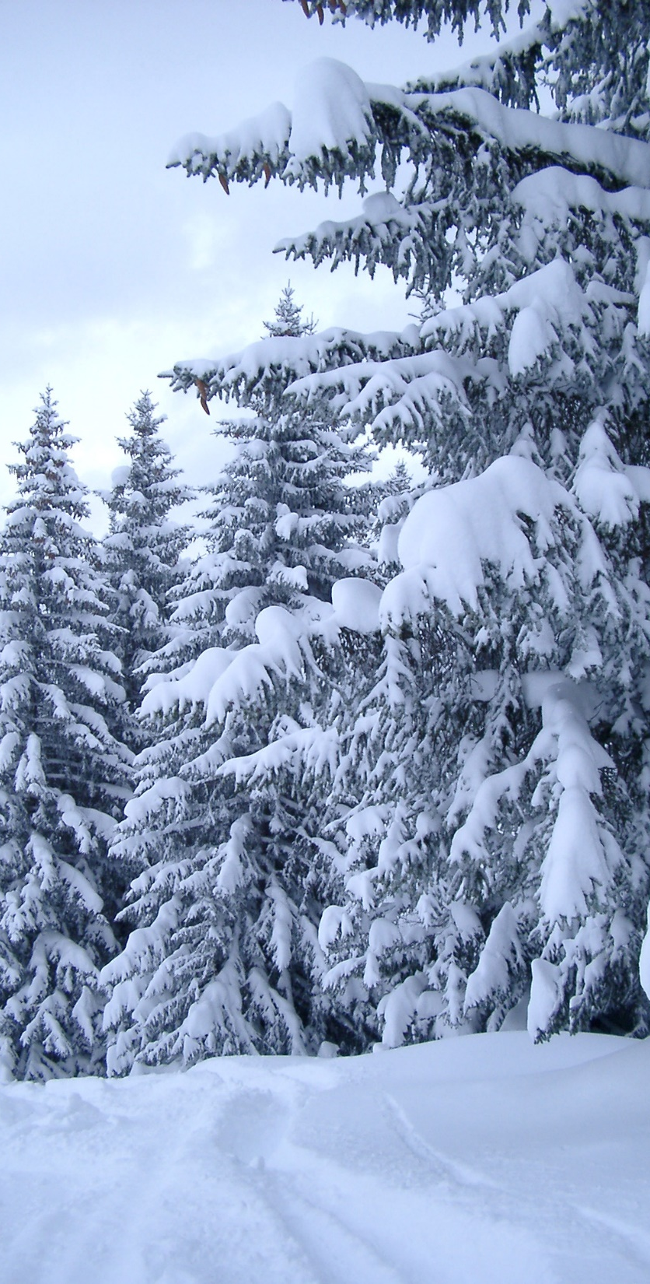
And Then the ...
THINK
How might the story go if it was written about winter? Or a severe weather event? How would the effects of the weather be expressed in the story?
DO
Write a story with two parts that communicates the effects of winter or a severe weather event on living things and the environment.
This Photo by Unknown Author is licensed under CC BY

Slide 27
Guide to Success:
Assessment tool for students and teachers
Task Checklist (What do I need to do?) | Excellence Criteria (What do I need to do to do it well?) | Self-Reflection (What did I do well? What could I improve on?) | Teacher Guidance (What is going well? What might need to be changed?)
 |  | Affirm - What did I do really well? Revise - What could I have done better at? What changes could I make? Aspire - Where would I like to go next? What would I like to learn more about? | Affirm - What is going well? Revise - What changes could be considered?

Slide 28
Final Learning Challenge

Slide 29
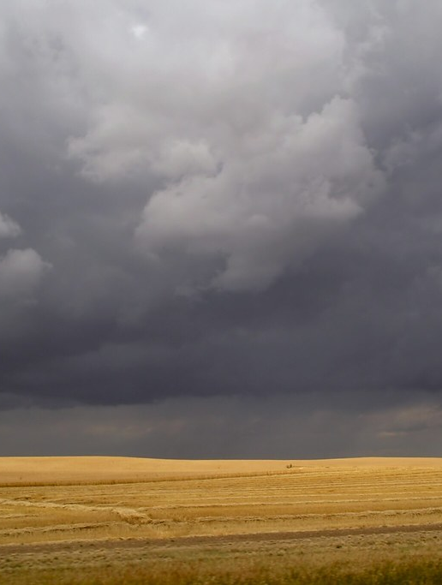
Extreme Weather Show
As a class we are going to create the Extreme Weather Show! You will each contribute to a segment of this show on a weather topic of your choice.
Some ideas might be:
Weather report
Human interest story about weather
Science behind a severe weather event
News report of a weather event
Other ideas??
This Photo by Unknown Author is licensed under CC BY-SA-NC

Slide 30
Guide to Success:
Assessment tool for students and teachers
Task Checklist (What do I need to do?) | Excellence Criteria (What do I need to do to do it well?) | Self-Reflection (What did I do well? What could I improve on?) | Teacher Guidance (What is going well? What might need to be changed?)
 |  | Affirm - What did I do really well? Revise - What could I have done better at? What changes could I make? Aspire - Where would I like to go next? What would I like to learn more about? | Affirm - What is going well? Revise - What changes could be considered?

Slide 31
Reflection of Learning

Slide 32
Inquiry Question
How do we communicate ideas about the effects of weather and/or climate?
Guiding Questions:
How are humans and animals affected by weather around the world?
How do we prepare for severe weather?
How do numbers help us describe the effects of weather?
Does where we live affect how we are impacted by weather?

Slide 33
Which weather conditions impact living things the most?
1
2
Reflect on your learning in this learning experience.
Rank the weather conditions and place in order from Greatest Impact (1) to Least Impact (5).
Precipitation
Humidity
UV Index
3
Temperature
Wind
Now, I think ________ affects living things the most because _____________________
_________________________________________________________________________________________________________
4
5

Slide 34
Learning Reflection
Choose one or two of the inquiry/guiding questions. Write or talk about your learning.
What is something you learned that you didn't know before?
What was your favourite thing that you learned about?
How has your thinking changed?
What would you like to learn more about?
This Photo by Unknown author is licensed under CC BY-NC-ND.

