Slide 1
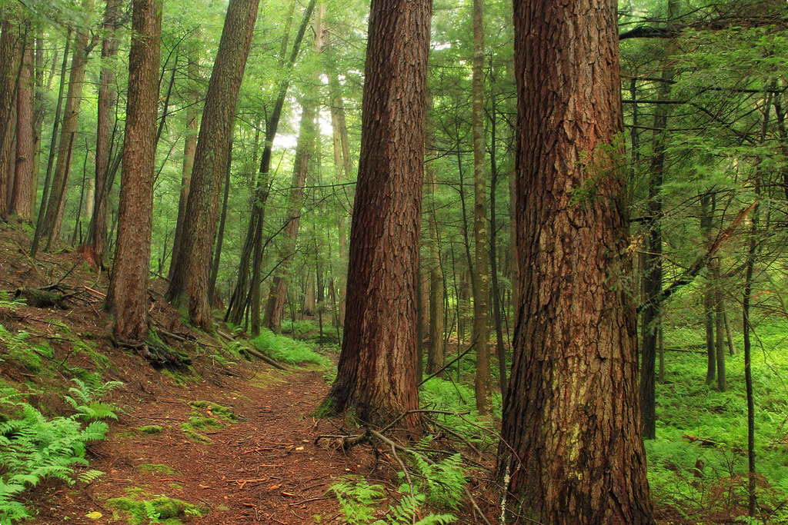
Learning from the Land
BLM #1
"Forrest H. Dutlinger Natural Area (Revisit) (5)" by Nicholas_T is licensed under CC BY 2.0

Slide 2
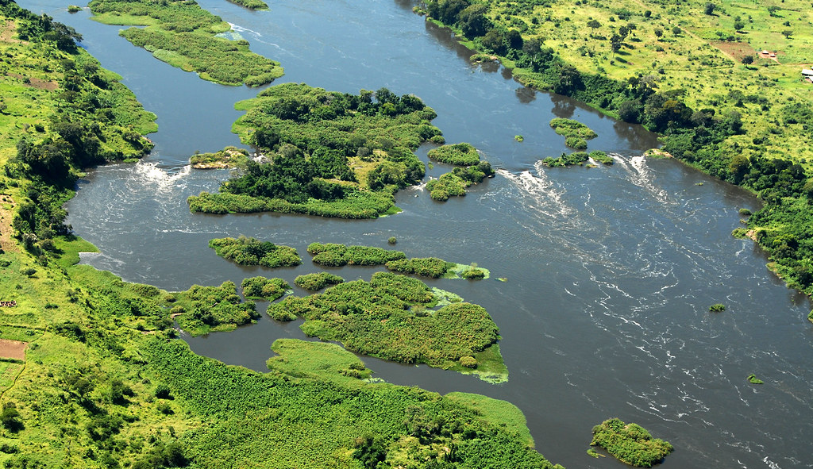
How do we relate to and with the land?
Inquiry Question
What does a relationship with the land look like?
How do we have a healthy relationship with the land?
Why is it important to have a relationship with
the land?
"First Natural Fire 10 flights arrive in Uganda - US Army Africa - 091011" by US Army Africa is licensed under CC BY 2.0
Notes:
Inquiry Question for the entire Learning from the Land learning experience: How do we relate to and with the land?

Slide 3

Friendships
What does it look like when someone is being a good friend?
What does it look like when someone isn't being a good friend?
How does it feel when someone is being a good friend?
How does it feel when someone isn't being a good friend?
BLM #2a
This Photo by Unknown author is licensed under CC BY.
Notes:
This learning experience supports learning of grades K-8 Health outcomes. Refer to the Health Rubric for your grade level(s), to provide students with extra prompts or guiding questions to support learning of the specific K-8 outcomes.

Slide 4

Relationships
What does a healthy relationship look like?
What does an unhealthy relationship look like?
How does it feel to be in a healthy relationship?
How does it feel to be in an unhealthy relationship?
BLM #2b
This Photo by Unknown author is licensed under CC BY-SA.
Notes:
This learning experience supports learning of grades K-8 Health outcomes. Refer to the Health Rubric for your grade level(s), to provide students with extra prompts or guiding questions to support learning of the specific K-8 outcomes.

Slide 5

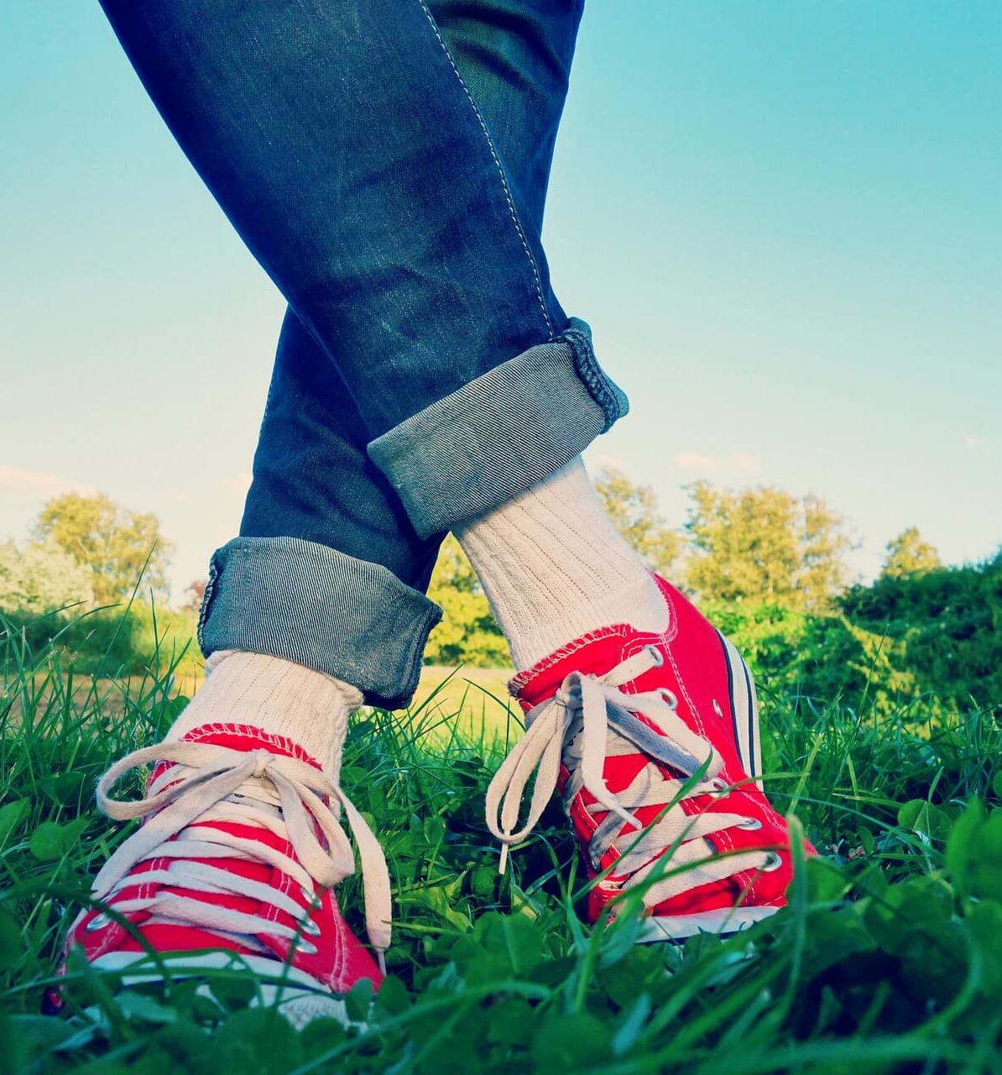
Relationships with the Land
What can the land give you?
What can you give the land?
How does it feel when you give to the land?
How does it feel when the land gives to you?
How does the land take care of us?
How can we take care of the land?
BLM #2c
This Photo by Unknown author is licensed under CC BY.

Slide 6
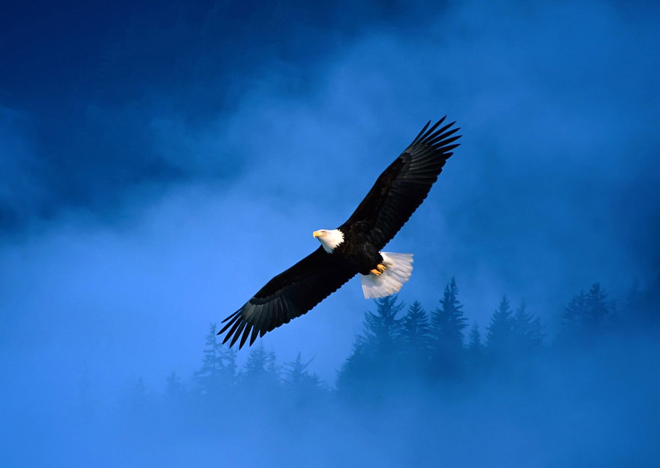
Indigenous Perspectives on Land
Click here to watch the
following video
Elder Dave Courchene: Learning how to care for Mother Earth 3:32 min
Place is alive.
Everything is interconnected.
All of life is living and breathing together.
How is place alive?
How is everything interconnected?
How is all of life living and breathing together?
BLM #3a
This Photo by Unknown author is licensed under CC BY.
Notes:
Elder Dave Courchene: Learning how to care for Mother Earth 3:32 min
https://www.youtube.com/watch?v=p7oW9HgIRsI
These ideas were inspired from the book Natural Curiosity 2nd Edition https://www.naturalcuriosity.ca/book
Place is alive – p. 84
Everything is interconnected – p. 105
All of life is living and breathing together – p. 134

Slide 7
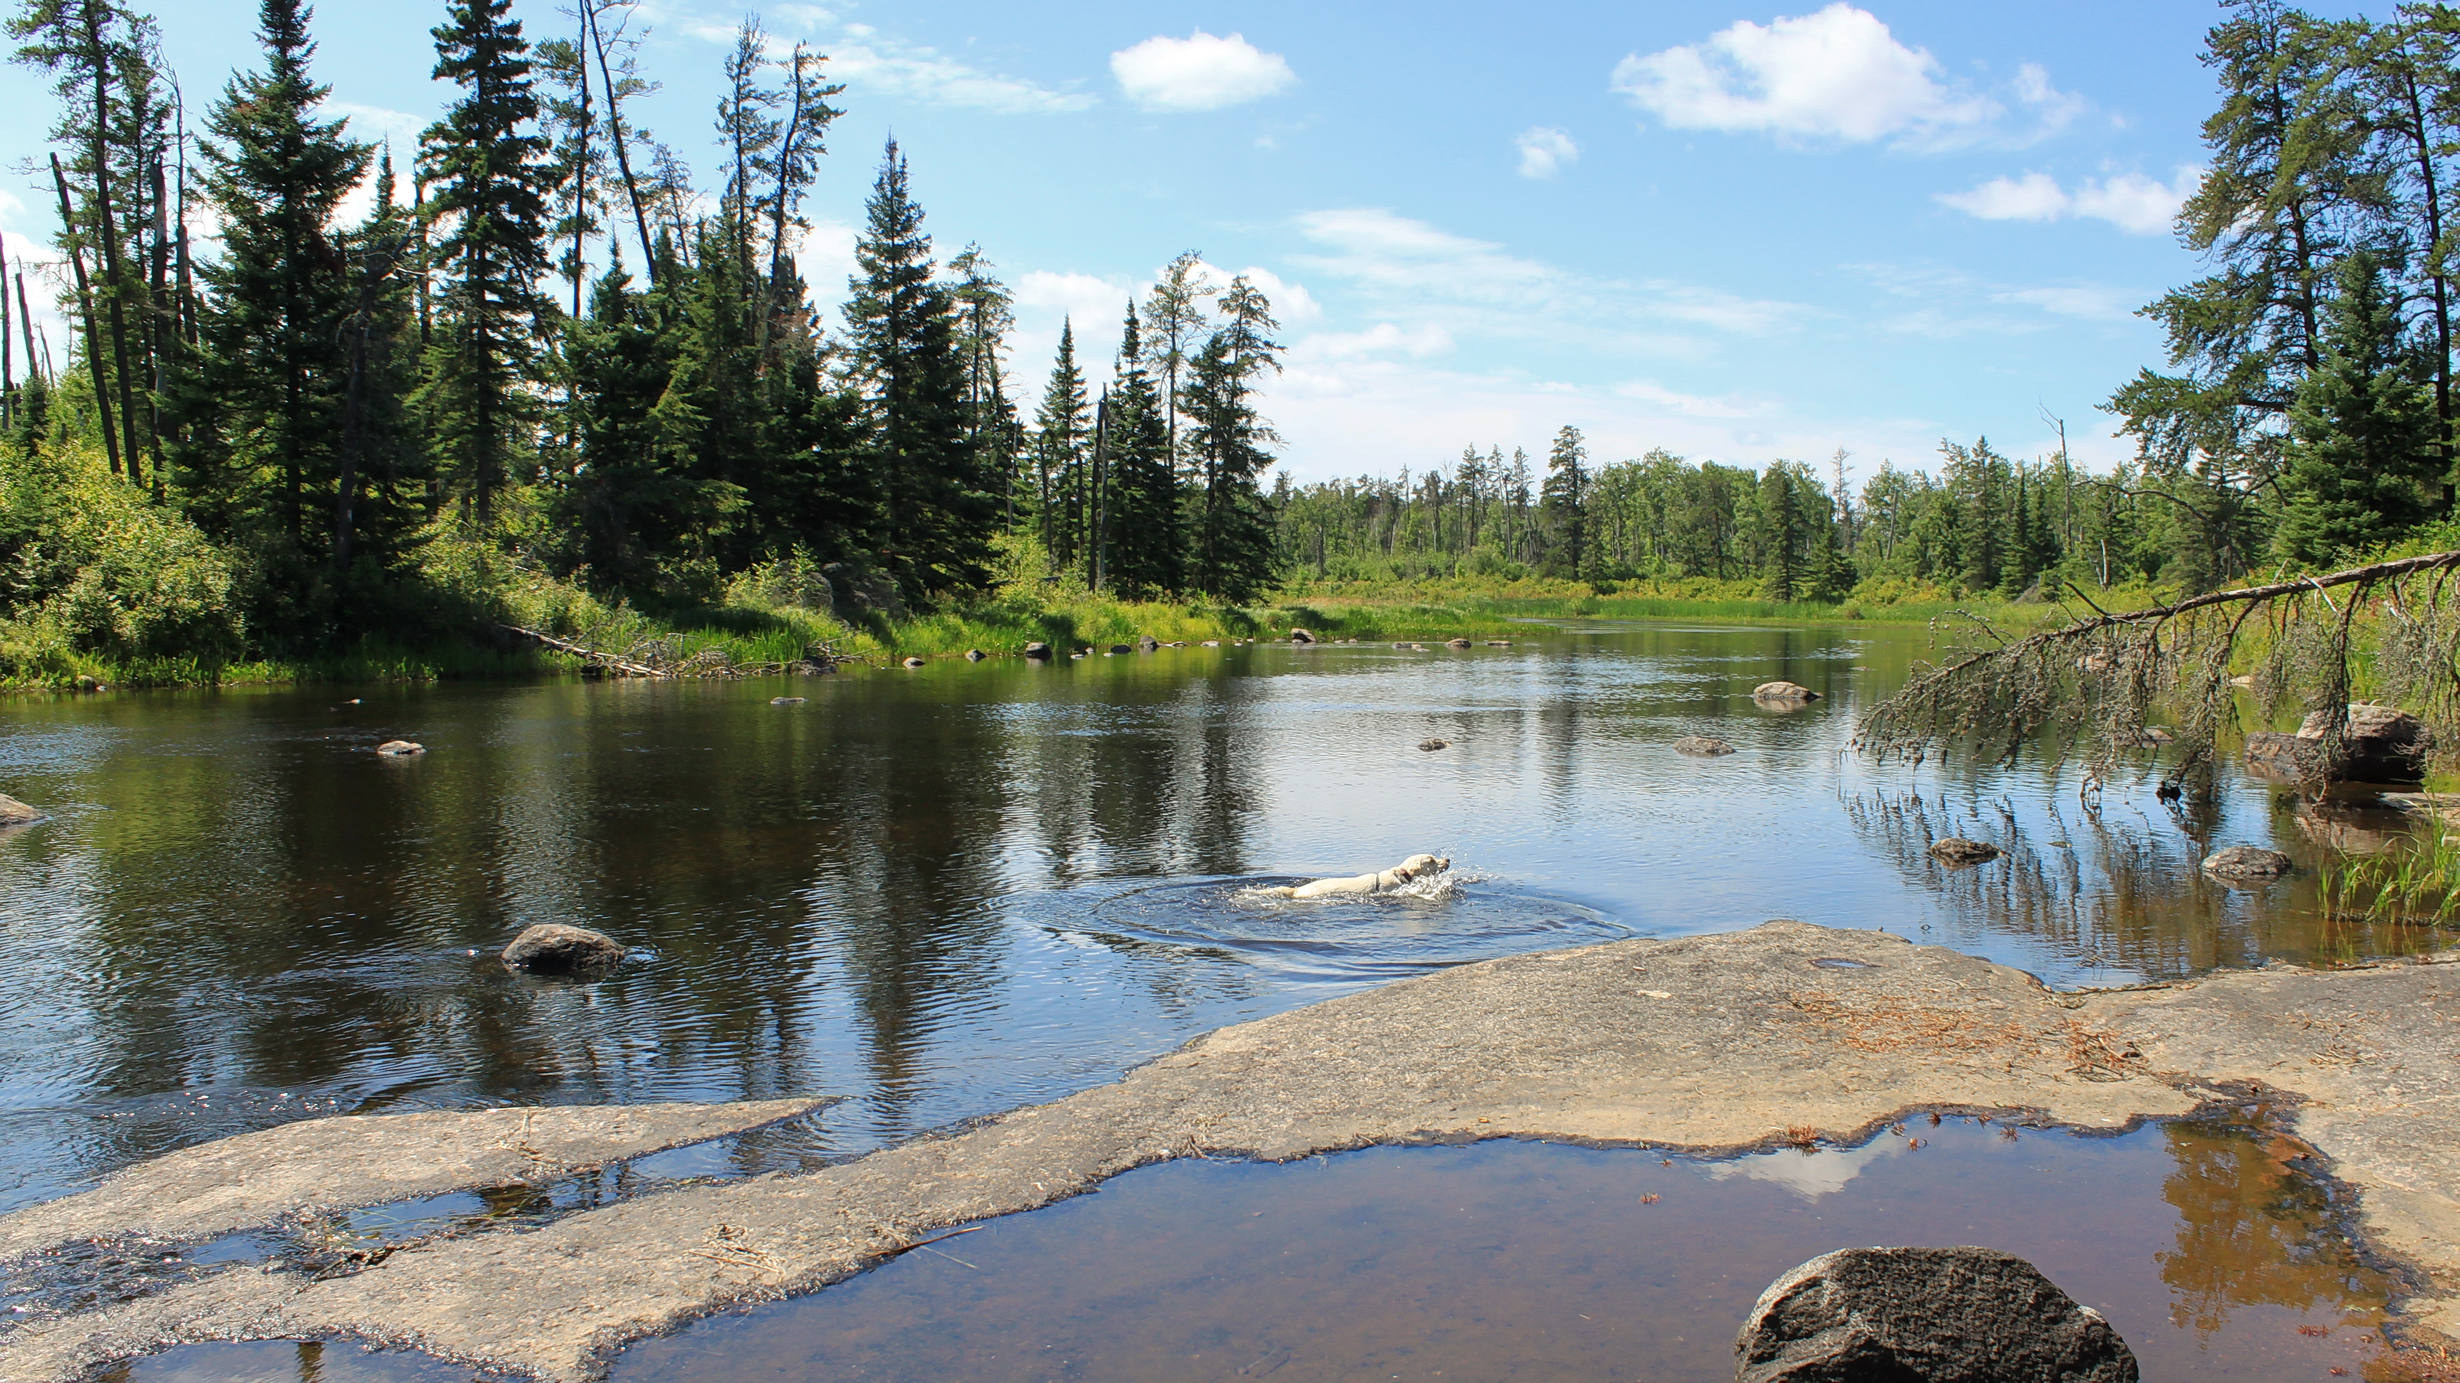
What do we mean when we say land?
Does this change how
you see the land? Explain.
“The Land is our first teacher, and that a relationship with the Earth is necessary to the understanding of ourselves, others, and the world in which we live.”
“The Land encompasses all that is above, below, and around us, including the elements of air, weather, water, earth, and sky, extending to the cosmos.”
BLM #3b
Source: Land Based Education Success Pathway Thompson Community Circle VOICE Pathways to Success (2015) report p. 10, 19
This Photo by Unknown author is licensed under CC BY-SA.
Notes:
Land Based Education Success Pathway Thompson Community Circle VOICE Pathways to Success (2015) report p. 10, 19
https://www.mysterynet.mb.ca/documents/general/Land%20Based%20Educatin%20Success%20Pathway%20-%20Thompson%20Community%20Circle.pdf

Slide 8
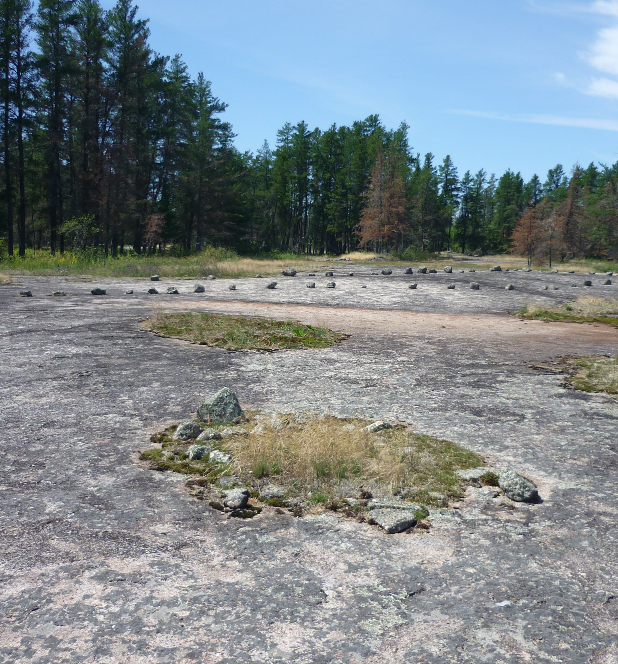
Giving Thanks
“When Aboriginal peoples obtained the necessities for life from the Land, they would offer thanks for the gift received from the Land so that they could live.” Integrating Aboriginal Perspectives into Curricula, (2003) Manitoba Education p. 8
Indigenous Worldview values the importance of giving thanks. When you visit a sacred site, harvest food or medicine, or take from the land, it is very important to give thanks. Many Indigenous peoples give a tobacco offering, as it is considered a sacred medicine.
You can give thanks by acknowledging the land and thanking the land for its gifts.
BLM #3b
This Photo by Unknown author is licensed under CC BY-SA.
Notes:
Integrating Aboriginal Perspectives into Curricula, (2003) Manitoba Education p. 8, or PDF page 14
https://www.edu.gov.mb.ca/k12/docs/policy/abpersp/ab_persp.pdf
Pre-Contact It’s Our Time Tool Kit: Assembly of First Nations Sacred Medicines p. 18, or PDF page 4
https://education.afn.ca/afntoolkit/wp-content/uploads/2018/05/Plaintalk-2-Pre-Contact.pdf
Multi-Touch Book on iTunes
https://books.apple.com/ca/book/pre-contact/id1373932866

Slide 9
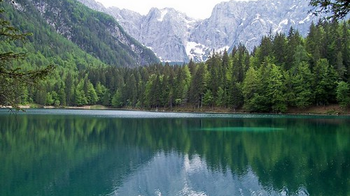
Why do we name places?
"Indigenous place names reinforce an intimate relationship with the land." Stories from the Land: Indigenous Place Names in Canada
Most Indigenous place names describe a place.
For example, places that begin with mni are about water, because in the Dakota language, the word for water is mni.
Click on "Stories from the Land" to learn more.
Did you know, toponymy is the study of place names?
BLM #4a&4b
"nature" by .Elisa. is licensed under CC BY 2.0
Notes:
Stories from the land - https://maps.canada.ca/journal/content-en.html?lang=en&appid=0e585399e9474ccf932104a239d90652&appidalt=11756f2e3c454acdb214f950cf1e2f7d ​

Slide 10
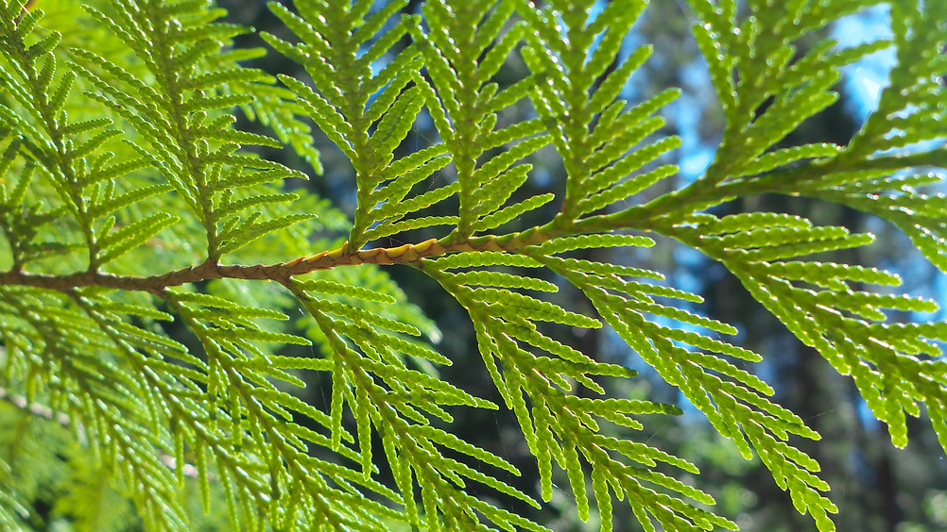
Indigenous Languages
Research and translate Indigenous words that describe a place.
Indigenous place names often describe a place. For example, Sagkeeng means the mouth of the river in the Ojibwe language. There are 63 First Nations Communities in Manitoba. Many of them describe the place. ​
Click to learn more: MFNERC Map
Indigenous Groups in Manitoba:
Anishinaabe (Ojibwe)
Nehetho (Cree)
Oyate (Dakota)
Anishininwak (Oji-Cree)
Denesuline (Dene)
Metis
Inuit
Land
Lake
Water
River
Forest
https://ojibwe.lib.umn.edu/
https://fmp.cla.umn.edu/dakota/
https://www.creedictionary.com/
https://dictionary.michif.atlas-ling.ca/
BLM #4a
This Photo by Unknown author is licensed under CC BY-NC.
Notes:
When you click this link, MFNERC – https://mfnerc.org/community-map/, there are short videos explaining the translation for the First Nation community names. Hover your mouse over each community to play a short video which includes the background to the name and how to pronounce it. ​
Sources to research Indigenous words that describe place:​
https://ojibwe.lib.umn.edu/ ​
https://fmp.cla.umn.edu/dakota/ ​
https://www.creedictionary.com/ ​
https://dictionary.michif.atlas-ling.ca/

Slide 11
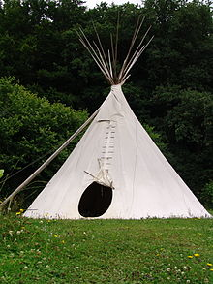
Who calls this land home?
BLM #5
Visit the following websites to learn about:
  Traditional Territories Native-Land.ca
  Treaties www.trcm.ca
Whose Traditional Territories are where you live?
Which Treaties were negotiated where you live?
How does it feel learning about Indigenous peoples and their Traditional Territories?
What is an example of a land acknowledgement?
Why is it important to give land acknowledgements?
This Photo by Unknown author is licensed under CC BY-SA.
Notes:
Traditional Territories - https://native-land.ca/
Treaty Relations Commission of Manitoba - http://www.trcm.ca ​
NativeLand.ca - Teacher Guide - https://native-land.ca/wp/wp-content/uploads/2019/03/teacher_guide_2019_final.pdf
Click Territory Acknowledgement under the Resources tab to find an explanation of what territory/land acknowledgements are and the importance of those acknowledgements.
NativeLand.ca - Land Acknowledgements​ - https://native-land.ca/resources/territory-acknowledgement/
An example of a territory/land acknowledgement is the Winnipeg Jets True North Land Acknowledgement https://www.nhl.com/jets/community/wasac
“Bell MTS Place is located on Treaty One lands, the original territories of the Anishinaabe, Cree, Oji-Cree, Dakota, Lakota, Dene peoples, and the homeland of the Métis Nation.”

Slide 12
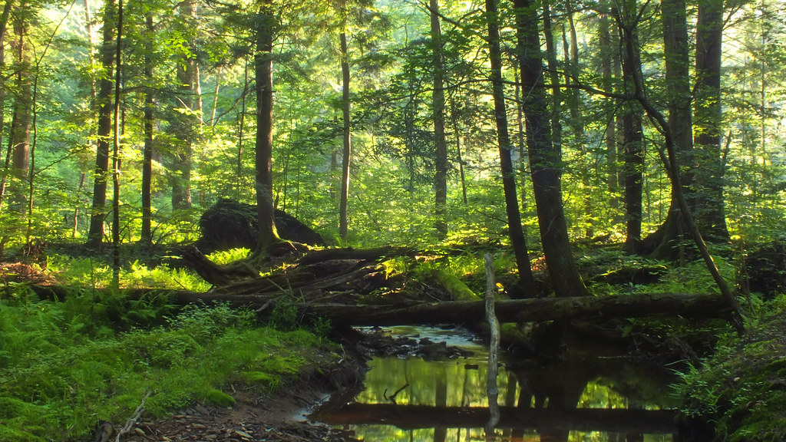
What is your relationship to land?
Think about a place that is
very special to you.
What makes that place special?
Think about where you live.
Think about where your family has
lived over time.
How is your identity (who you are) connected to where you live?
What is your family's connection to
the land?
How does your family interact with
the land?
BLM #6
"Tionesta Research Natural Area (Revisited) (2)" by Nicholas_T is licensed under CC BY 2.0

Slide 13
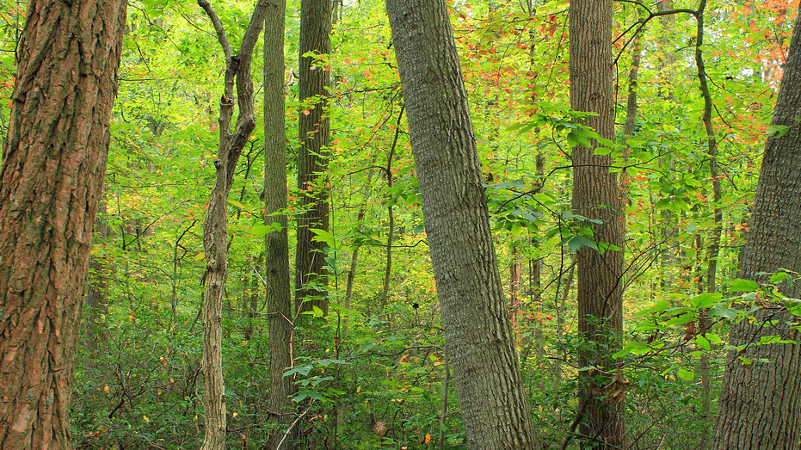
Spend time with the Land
The best way to deepen your relationship with the land is to spend time with the land.
Spending time with land can take place anywhere outside: in a town or city, in the country, in the bush, or in a forest. Nature is everywhere!
The next slide is a Choice Board with ideas of what you can do to spend time with the land. You can pick and choose from 25 land-based activities.
Always check with an adult before going outside. Dress appropriately, respect nature, and be safe!
"Welsh Mountain Nature Preserve (Revisited) (1)" by Nicholas_T is licensed under CC BY 2.0
Notes:
The safety exercised when completing the Choice Board activities supports learning of grades K-8 Health outcomes. Refer to the Health Rubric for your grade level(s) in the appendix, to provide students with extra prompts or guiding questions to facilitate learning of the specific K-8 safety-related outcomes.

Slide 14
Land-based Activities Choice Board
BLM
#7a
#7b
*Always check with an adult before going outside. Make sure an adult goes with you on the nature walks.*​
1. Look at Grass
2. Use your Senses
3. Breathe
4. Make a Tree Friend
5. Look at Trees
6. Types of Trees
7. Sketch a Tree
8. Explore your Backyard
9. Take Pictures
10. Natural and Constructed
11. Explore Nature
12. Explore with a Purpose
13. Collect Pieces of Nature
14. Gather Seeds
15. Find a Keepsake
16. Explore
the Sky
17. What’s the Weather?
18. Cloud Gazing
19. Light and Shadows
20. Act it Out
21. Nature Game
22. Nature Art
23. Nature Shapes
24. Nature Patterns
25. Free Time
Notes:
The safety exercised when completing the Choice Board activities supports learning of grades K-8 Health outcomes. Refer to the Health Rubric for your grade level(s) in the appendix, to provide students with extra prompts or guiding questions to facilitate learning of the specific K-8 safety-related outcomes.
Land-based Activity – SAFETY INSTRUCTIONS
Remind students to always check with an adult before going outside and that adult supervision is required for nature walks/activities to enhance the learning experience and ensure the safety of students.
Remind students to dress appropriately for the weather and to wear proper footwear for long walks. Cold weather – parka, ski pants, toque, mitts, scarf, boots, etc. Warm weather - hat, sunscreen, bug spray, etc. Wet weather – rain jacket, rubber boots, umbrella, etc.
Remind students to be safe while participating in the land-based activities. Avoid areas that have poison ivy, ticks, pesticides, etc. Don’t throw rocks or pick up branches that are too big, don’t climb trees too high or higher than they are comfortable, be careful around water, etc.
Ask students to respect nature. Students can use their senses to look up closely and touch nature, but don’t hurt nature. Remind students if they are doing an activity where they are allowed to gather and collect pieces of nature, to only pick up the items that are already on the ground. Don’t break or pull leaves or branches off of trees.
Land-based Activity Reflections
Have students complete as many land-based activities as you want. Students do not have to do all 25, they can pick and choose, or you can ask them to do certain ones depending on curricular goals and student strengths.
Black Line Masters #7a and #7b have been designed to support student reflection after the activities. Students do not have to do a BLM after every activity, they can pick and choose or you can assign which activities you would like them to complete a reflection on.
Black Line Master #7a is better suited for early and beginner learners
Black Line Master #7b is a more in-depth reflection

Slide 15
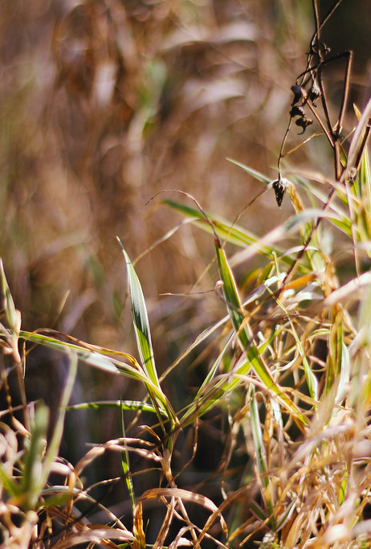
Activity #1 - Look at Grass
Choice Board
Sit on a piece of grass. Think about how everything in nature is living and breathing together.
Now lay on your stomach and look at the grass up close. What do you see? Use your hands to gently spread the grass apart. Amongst the grass do you see soil? decaying plant matter? insects? leaves? twigs? rocks? Compare how the grass looks up close to far away.
Questions:
Which animals, birds, or insects rely on this grass as their home?
What do you think will happen to the decaying plant matter?
"Nature." by Vivian Farinazzo is licensed under CC BY 2.0

Slide 16
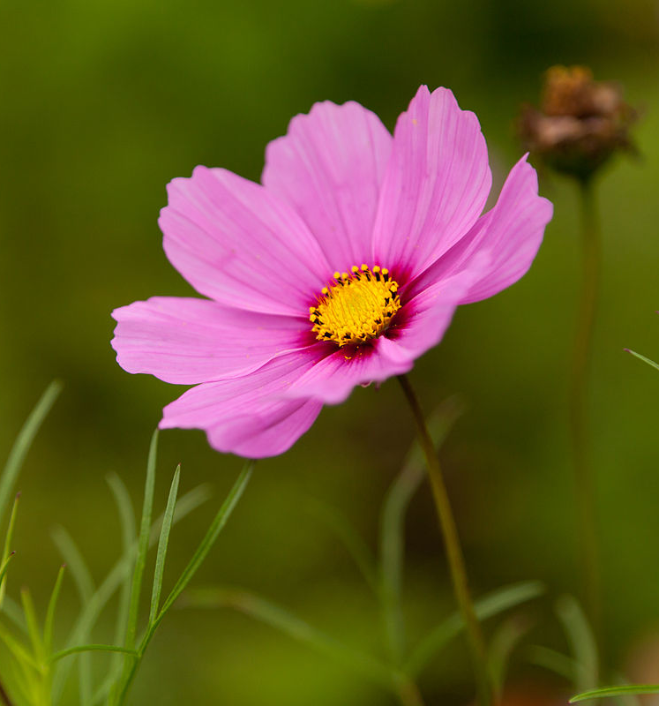
Activity #2 –
Use your Senses
Choice Board
Explore nature using your senses. You can use one sense at a time or use all senses at the same time.
See – What does nature look like? From far away? Up close?
Feel – What does nature feel like? What do different things feel like?
Smell – What does nature smell like? What do different things smell like?
Hear – What does nature sound like? What do different things sound like?
Taste – What does nature taste like? Try foods that come from nature.
Close your eyes to heighten your sense of touch, smell, hearing or taste.
This Photo by Unknown author is licensed under CC BY-SA.
Notes:
Ensure safety and caution students as they use their senses while exploring nature.

Slide 17
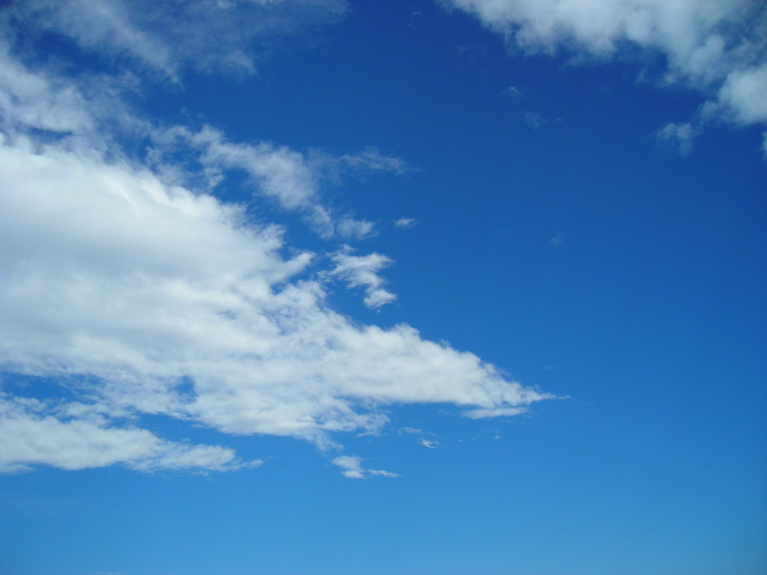
Activity #3 – Breathe
Choice Board
What does it feel like to breathe fresh air?
Can you tell the difference between air indoors and outdoors?
Focus on you breathing by taking nice, calm breaths.
Now go outside and find a nice quiet spot to sit on, such as a piece of grass or beneath a tree.
Close your eyes and focus on your breathing for about 1 minute. What do you notice? How does it make you feel?
It may help to set a timer. With practice you may also try to focus on your breathing for longer than 1 minute.
"Blue sky 1" by Fabio Marini is licensed under CC BY 2.0
Notes:
Besides social studies, science, ELA and health outcomes, this activity also supports learning of a grade 3 Math passage of time outcome. Refer to the Math Rubric in the appendix, to provide students with extra prompts or guiding questions to facilitate learning of the specific grade 3 math outcome.

Slide 18
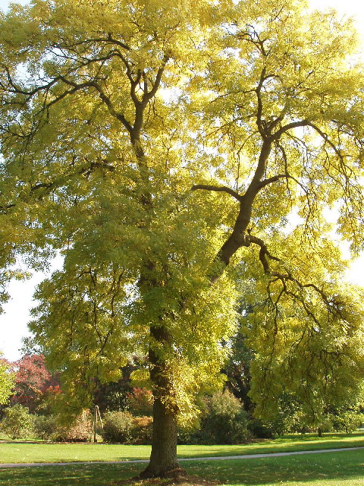
Activity #4 –
Make a Tree Friend
Choice Board
Go outside and pick a tree. Then spend time with your tree like you were visiting a friend or family.
Ideas for how you can spend your time:
  Talk to your tree
  Look at your tree
  Feel the bark
  Walk around your tree
  Hug your tree
  Simply just be with your tree
Questions for afterwards:
What did you learn from your tree?
How did spending time with your tree make you feel?
This Photo by Unknown author is licensed under CC BY-SA.
Notes:
Besides social studies, science, ELA and health outcomes, this activity also supports learning of a grade 3 Math passage of time outcome. Refer to the Math Rubric in the appendix, to provide students with extra prompts or guiding questions to facilitate learning of the specific grade 3 math outcome.

Slide 19
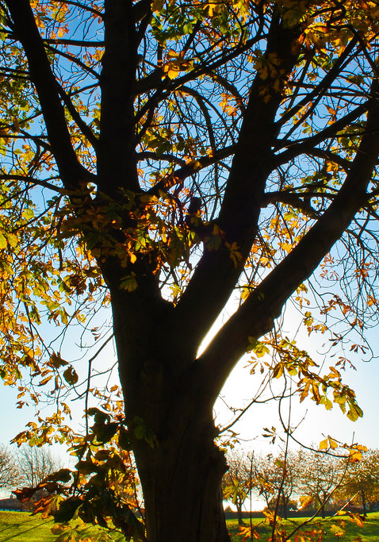
Activity # 5 – Look at Trees
Choice Board
Have you ever noticed how unique each tree is? Explore trees in your school yard, back yard, local park, or area. When you approach each tree, look up to the top, look down at the base, look at the bark and feel it with your hands.
Some questions to think about when you look at each tree:
Is the tree big and tall, teeny tiny, old or young, have holes, a ring or is hollow?
Is the tree bark rough, smooth, warm, cold, sticky with sap or bare due to termites or other bugs or animals?
Is the tree trunk wide, narrow, or split into two or more with lots of sprouts and branches?
Are the tree branches big, small, cut, or have few or many sprouts and leaves?
Are the tree leaves different shapes, sizes, colours, thicknesses, rough or smooth?
Does the tree have moss or fungus? If so, what colour or texture is it?
Does the tree have pinecones and pine needles? Is so, what size, colour and structure are they?
Do the tree roots grow near the surface or deep into the ground?
"Nature" by ChrisA1995 is licensed under CC BY 2.0
Notes:
This activity supports many Math Shape and Space specific outcomes. Refer to the Math Rubric in the appendix, to provide students with extra/more prompts and/or guiding questions to support learning of their grade-specific outcomes.

Slide 20
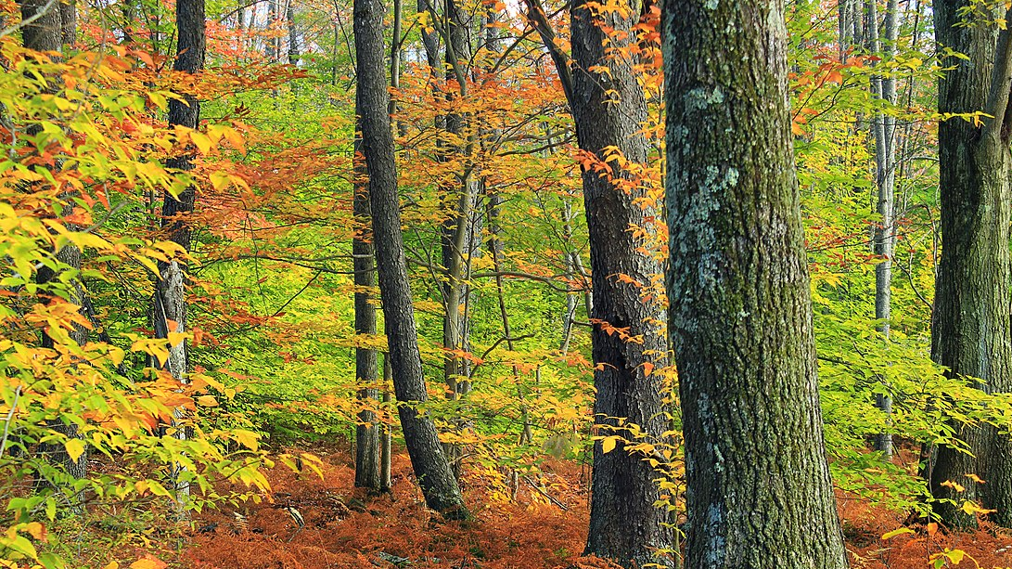
Activity #6 – Types of Trees
Choice Board
Go for a walk outside and note the different types of trees.
Try and guess what types of trees they might be.
Go inside and look at the Field Guide for Trees of Manitoba website.
Go back outside and see if you can identify the different types of trees.
This Photo by Unknown author is licensed under CC BY-SA.
Notes:
Field Guide for Trees of Manitoba - https://www.gov.mb.ca/sd/pubs/forest_lands/field_guide.pdf

Slide 21
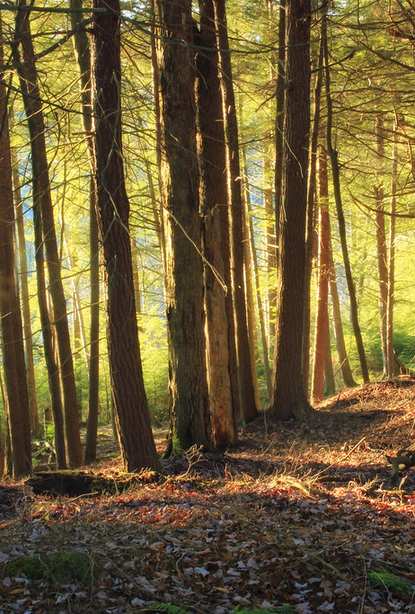
Activity #7 – Sketch a Tree
Choice Board
Pick a tree.
Do you know what kind of tree it is? How could you find out?
How tall do you think your tree is?
How wide is the trunk?
How old do you think your tree is?
What would you name this tree?
Draw a sketch of your tree.
"Fern Rock Nature Trail (6)" by Nicholas_T is licensed under CC BY 2.0
Notes:
This activity supports K-3 Math Shape and Space specific outcomes. Refer to the Math Rubric in the appendix, to provide students with extra/more prompts and/or guiding questions to support learning of their grade-specific outcomes.

Slide 22
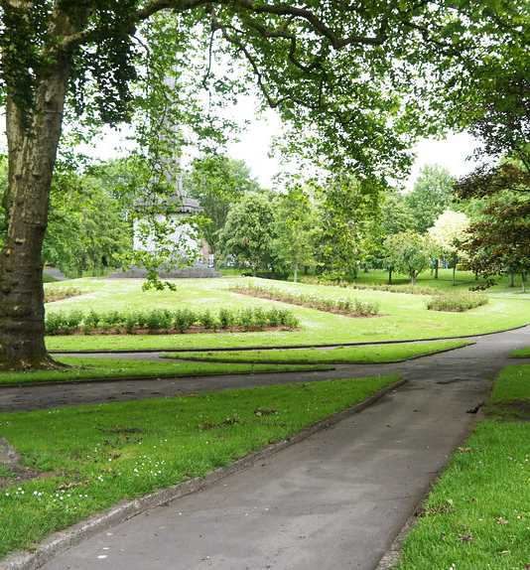
Activity #8 –
Explore your Backyard
Choice Board
Choose a place to explore. It can be your school yard, a back yard, or a nearby park.
Walk around and observe. How much grass is there? How many trees are there? Where are the trees? Is the ground flat or are there hills? Are there any other plants? rocks? water?
Which way is North, South, East, and West?
What are your favourite parts? What are your least favourite parts?
Create a display, map, or poster of the area.
This Photo by Unknown author is licensed under CC BY-SA.
Notes:
Besides social studies, science, ELA and health outcomes, this activity may also be used to cover grades 1-8 Social Studies mapping skills, and grades K-2 math counting and estimating outcomes. Refer to the specific outcomes listed in the rubrics in the appendix, to provide students with extra/more prompts or guiding questions to support their learning of those specific outcomes.

Slide 23
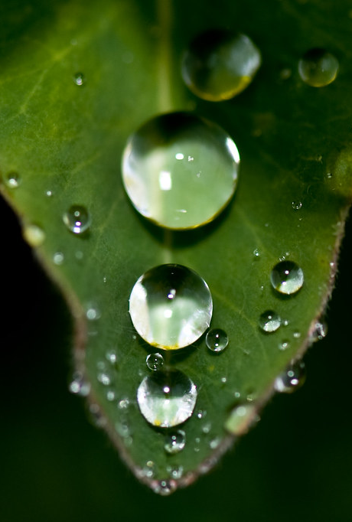
Activity #9 – Take Pictures
Choice Board
Go for a nature walk. Ask an adult to go with you to help you take pictures.
Walk slow and try to look at everything.
When you see something that stands out to you, take a picture.
When you get back from your walk, look at the pictures you took.
Choose your favourite picture and write about why it is your favourite.
Share your pictures at show-and-tell.
"Nature Wallpaper" by tiltti is licensed under CC BY 2.0

Slide 24
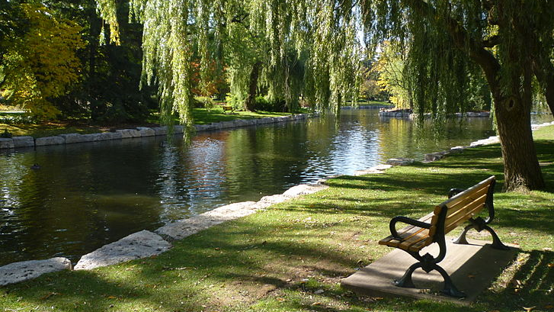
Activity #10 –
Natural and Constructed
Choice Board
Nature is everywhere, even in places where you don't expect.
Many towns and cities have parks, and they plant trees and flowers along sidewalks.
Even constructed objects such as a park bench or a lamp post comes from nature. The wood from the park bench comes from trees and the metal from the lamp post comes from rocks.
Go for a walk and write down all the things you see that are natural and all the things you see that are constructed.
This Photo by Unknown author is licensed under CC BY-SA.
Notes:
Natural elements occur naturally in nature/the natural world (trees, flowers, birds); constructed elements are made by humans (toys, tools, buildings).

Slide 25
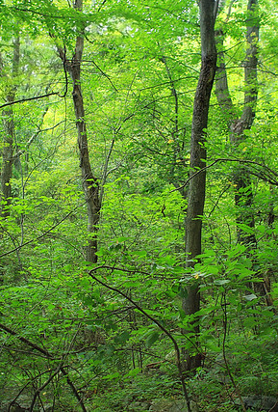
Activity #11 – Explore Nature
Choice Board
Adult Supervision required.
Explore a wooded area.
Walking through a bush can be tricky. You need to go slow, watch your step, and look out for branches.
What do you see? How does it smell?
Stop and listen. What do you hear?
How does it feel to be outside amongst nature?
This Photo by Unknown author is licensed under CC BY.
Notes:
Adult supervision is required to enhance the learning experience through conversation, and to explore nature safely, watching for things that may be harmful (poison ivy, ticks, wasps, etc).
Information and purchasable resource about Winnipeg Walks: http://prairiepathfinders.mb.ca/

Slide 26
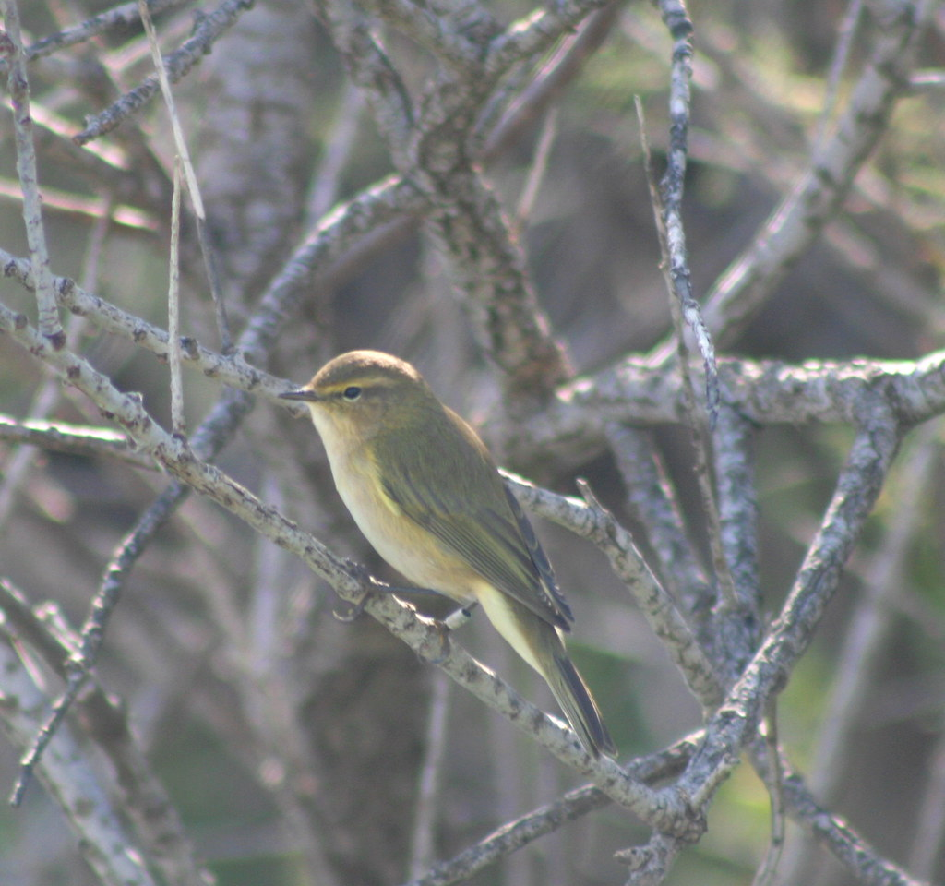
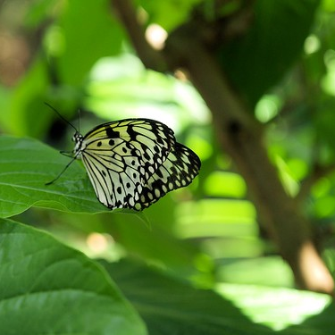
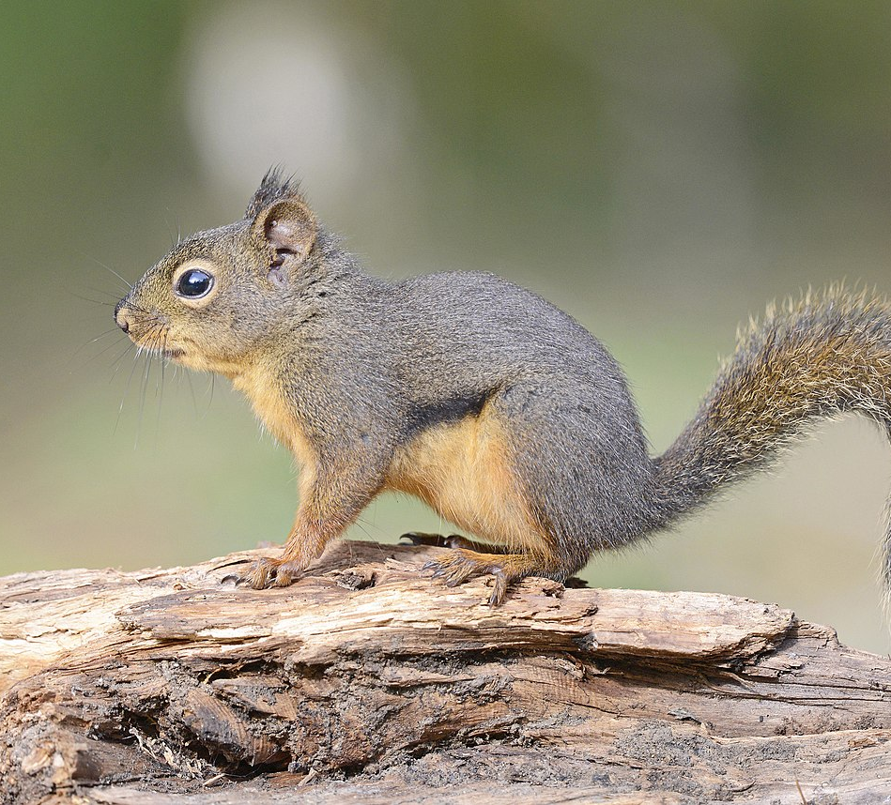
Activity #12 –
Explore with a Purpose
Choose one of the following to discover and explore using your senses. After exploring, come back and share what you discovered.
Look for evidence of animals. Maybe there are tracks in mud or snow, animal poop, or a bird nest? Or a burrow in a tree where a squirrel might live?
Look for animals (squirrels, rabbits, birds, etc.). What do they look and sound like?
Look for insects (ants, ladybugs, flies, etc.). What do they look like and sound like?
Look for plants. See how many different types of plants you can find (grass, flowers, trees, shrubs, berries, leaves, branches, bark, seeds, pinecones, pine needles, etc.).
Look for water. Are there different types of water (puddle, rain drops, dew, snow, ice, moisture in the grass, etc.)?
Look for ground features. What is in the ground (dirt, sand, clay, rocks, etc.)? Is it bumpy, smooth or hilly?
Choice Board
"In search of the Maltese Falcon # 2 - Yellow Wagtail, Ghadira Nature Reserve, Malta" by foxypar4 is licensed under CC BY 2.0
This Photo by Unknown author is licensed under CC BY-NC-ND.
This Photo by Unknown author is licensed under CC BY-SA.
Notes:
Either go for one big walk or several short walks with an adult and record what you see on each walk.
FortWhyte Alive – Backyard Birding Guide: https://www.fortwhyte.org/backyard-birding-guide/

Slide 27
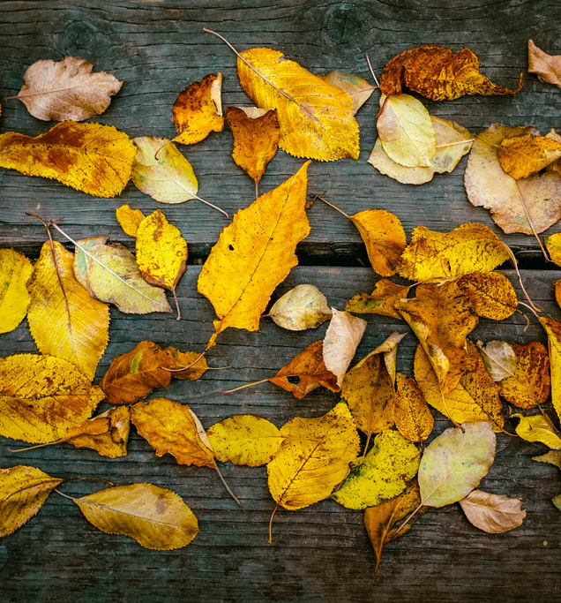
Activity #13 –
Collect Pieces of Nature
Choice Board
Go outside and collect pieces of nature.
This needs to be done carefully. Please don't break or pull anything.
You may wish to bring a bag to carry your nature items.
Pieces of nature that you can collect:
  A small rock
  A small branch or twig
  A leaf or berries that are already on the ground
Bring your pieces of nature inside.
  Look at your nature items up close
  Pick a few of your nature items and try to draw them (sketch)
  Make a nature display, showcasing your nature collection
"Fall Leaves Fall" by avrene is licensed under CC BY 2.0
Notes:
Caution students about not eating berries unless an adult has confirmed they are safe to eat.

Slide 28
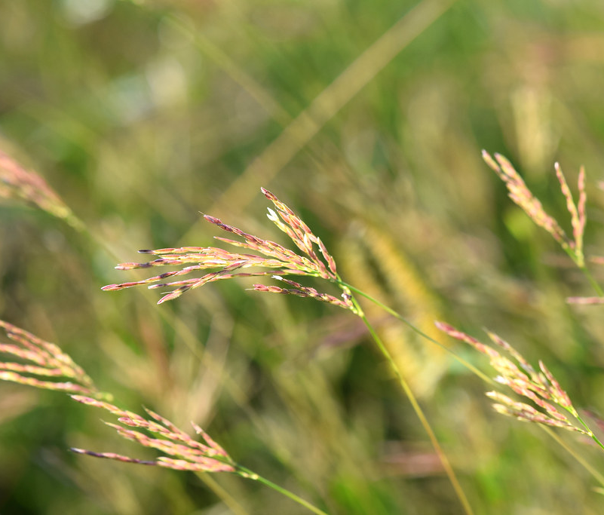
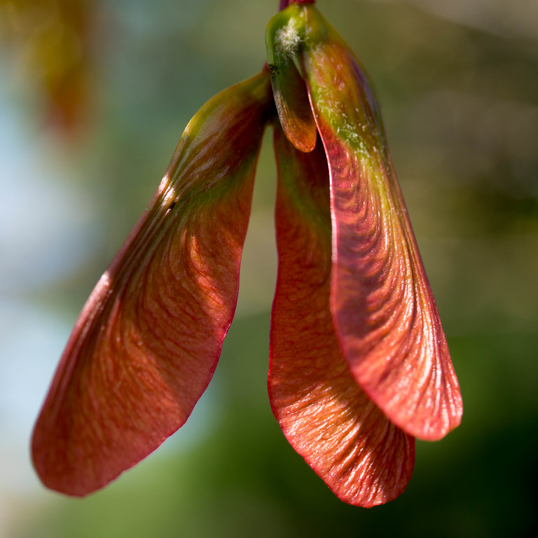
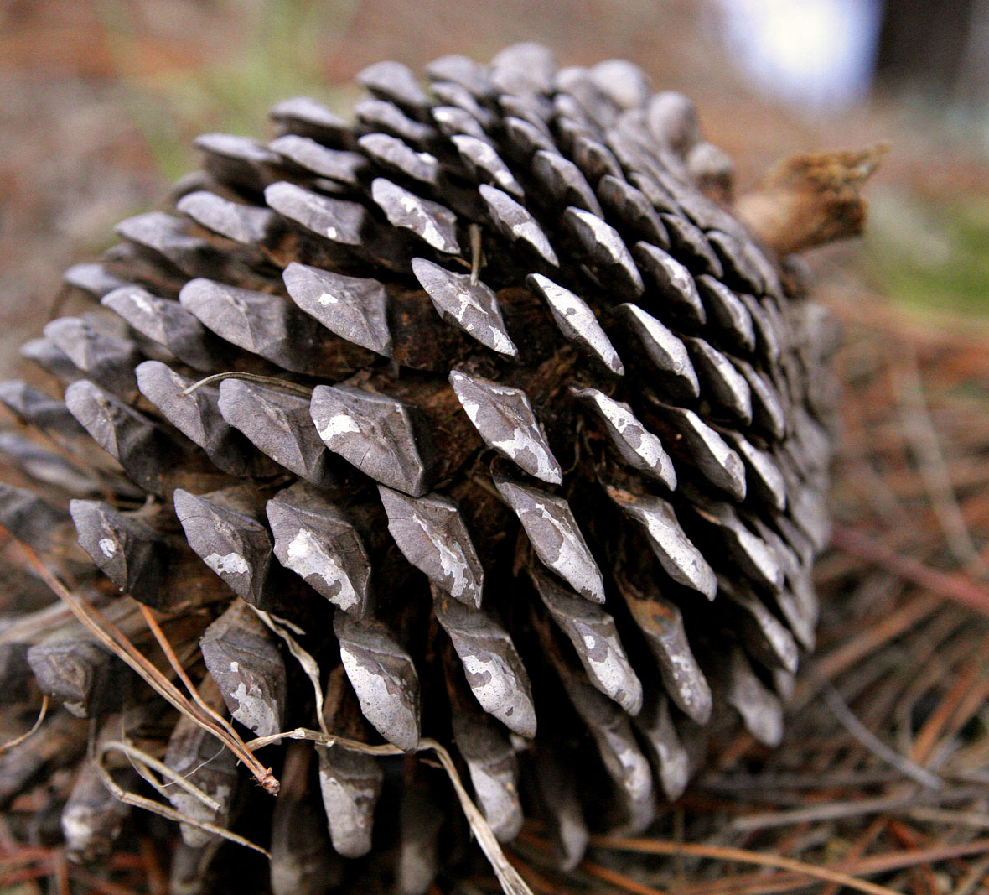
Activity #14 – Gather Seeds
Choice Board
Seeds are everywhere!
There are seeds in fruit, like apples, oranges, etc.
Seeds can also be found in nature, like pinecones, acorns, and dandelion puffs.
Collect seeds for one week and make a seed display.
This Photo by Unknown author is licensed under CC BY-SA.
This Photo by Unknown author is licensed under CC BY-SA-NC.
This Photo by Unknown author is licensed under CC BY-NC.
Notes:
For additional information and activities regarding seeds and Indigenous perspectives, see the grade 5 Three Sisters social studies learning resource on the Manitoba Repository.
https://www.mbremotelearning.ca/k-8-learning-resources?grade=Grade%205

Slide 29
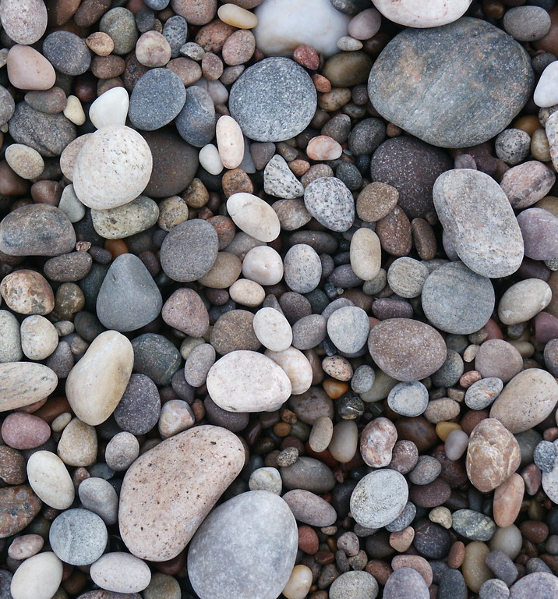
Activity #15 –
Find a Keepsake
Choice Board
Go outside for a nature walk.
On your walk, try and find one small piece of nature that connects with you, such as a rock, branch, or leaf.
Remember, it has to already be on the ground. Please don't break or pull anything.
Pick up your piece of nature and hold it in your hands. How does it feel? How does it look?
Bring your piece of nature inside. Your nature item can be used to help you if you're ever stressed or feeling down.
"Pebbles on Findhorn Beach" by Assaulted Peanut is licensed under CC BY-SA 2.0

Slide 30
Activity #16 – Explore the Sky
Choice Board
Choose a time of day (morning, afternoon, evening, or night).
Look at the sky
  What do you see?
  What do you hear?
  What do you smell?
  What do you feel?
  What do you wonder?
Draw a picture of the sky you saw, including as much detail as possible. Explain your picture to a partner or family member.
"Blue sky 1" by Fabio Marini is licensed under CC BY 2.0

Slide 31

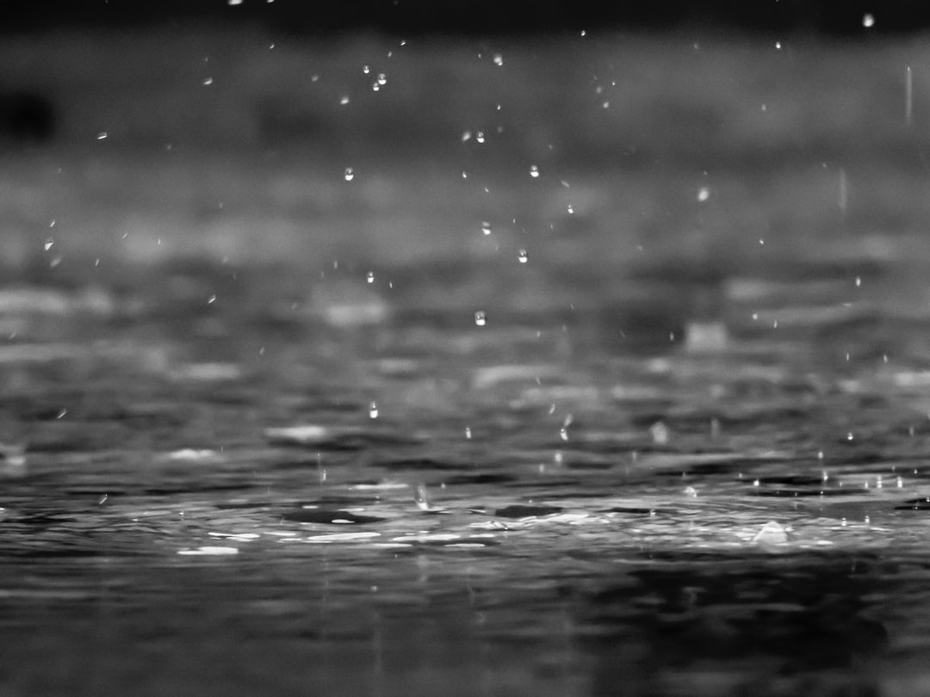
Activity #17 –
What's the Weather?
Choice Board
What is the weather like today? Sunny, cloudy, cool, hot, windy, rainy, or snowy? What is the temperature? How does it change?
What do you think the weather will be like tomorrow?
What’s the difference between day and night?
How can you tell?
Why is the sun important? Why is rain important?
How does the weather affect animals, insects and living things?
What season is it now?
What is your favourite and least favourite season? Summer, winter, fall or spring? Does weather have to do with your choice?
How does water change with the seasons? Freeze, melt, high, low, etc.
This Photo by Unknown author is licensed under CC BY-SA.
This Photo by Unknown author is licensed under CC BY.
Notes:
Many students may not yet understand that the sun rises in the east and sets in the west. This may be a good time to remind them of that fact.

Slide 32
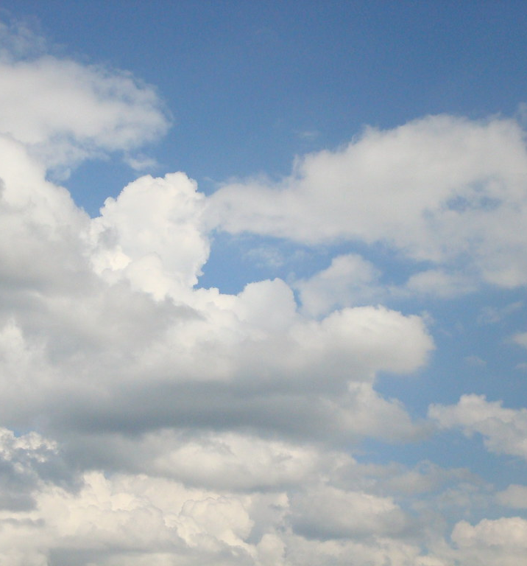
Activity #18 –
Cloud Gazing
Choice Board
Lay on the ground and look up the sky.
Watch the clouds.
  Do you see shapes in the clouds? Shapes of animals or insects?
  Do the clouds cover the entire sky, or only part of it?
  Are the clouds high or low in the sky?
  Are the clouds white and/or gray, thin or thick, flat or rounded, puffy, feathery, or look like ripples of grain?
Make a poster, using cotton balls, of the different types of clouds you see.
More on clouds: Description of the Different Types of Clouds (sciencing.com)
The 10 Basic Types of Clouds and How to Recognize Them (thoughtco.com)
"Cloud Texture 02" by SixRevisions is licensed under CC BY 2.0
Notes:
Research more on clouds at:​
https://sciencing.com/description-different-types-clouds-8376825.html ​
https://www.thoughtco.com/types-of-clouds-recognize-in-the-sky-4025569

Slide 33
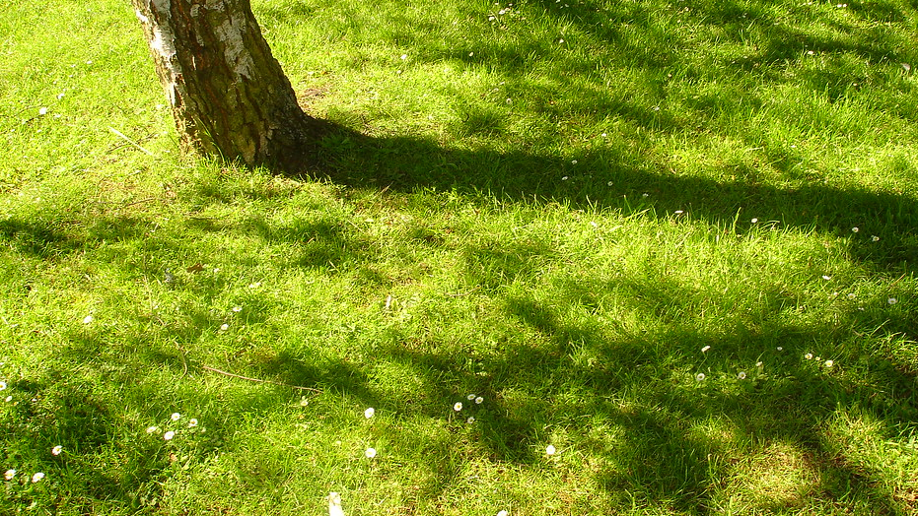
Activity #19 –
Light and Shadows
Choice Board
This activity can only be done if it is sunny outside.
Hold out your hand and see what the shadow looks like when your hand is close to the ground compared to when you are standing with your hand high up in the air. How does the shadow change?
Next, try and make different shapes out of your shadow. You can use your whole body or just your hands.
Have someone guess what kind of shape you are trying to make or take a picture of your shadow and have people guess.
What was your favourite shadow shape and why?
This Photo by Unknown author is licensed under CC BY-SA-NC.

Slide 34
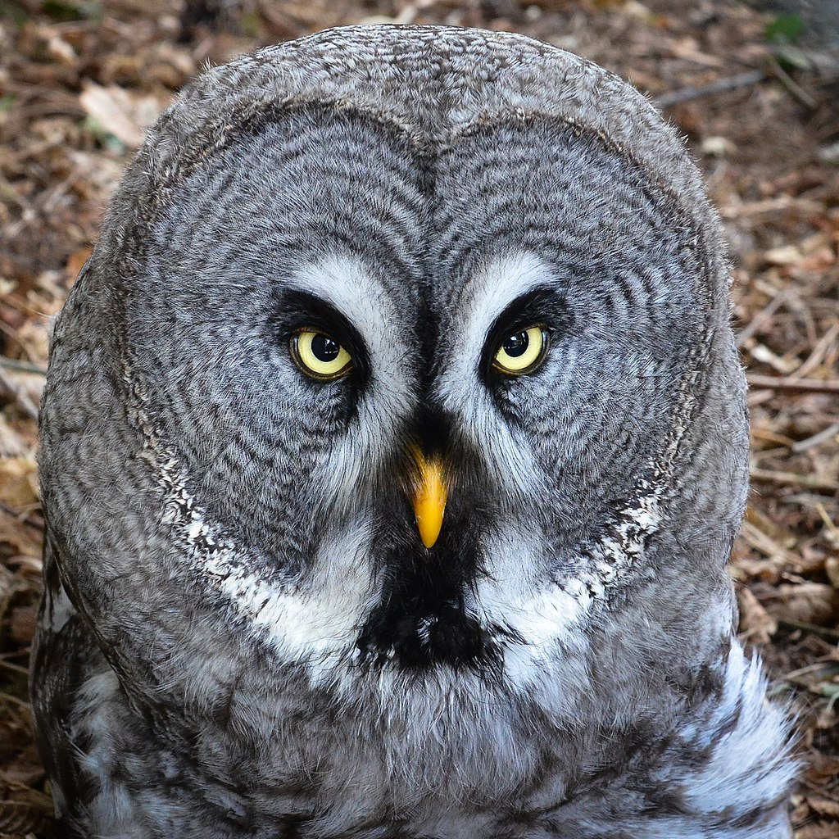
Activity #20 –
Act it Out!
Choice Board
Pretend to be an animal, just for fun! This way, you can imagine what it would be like to be that animal.
You could also have someone try and guess which animal you are.
Or you could have someone take a picture of you acting out your animal and then have people guess.
You could also draw the animal and have people guess which animal it is.
This Photo by Unknown author is licensed under CC BY-SA.

Slide 35
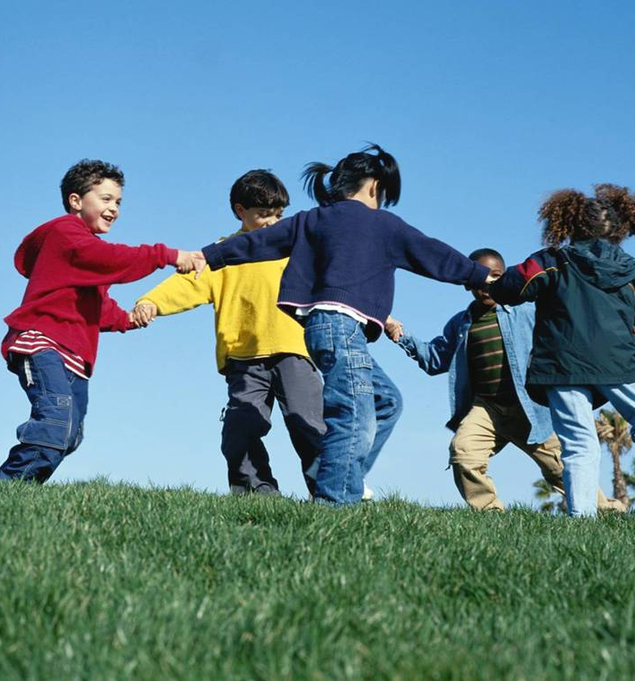
Activity #21 – Nature Game
Choice Board
Create a nature game!
You should be able to play the game outside.
Most games have the following:
  A name for your game
  Rules and a way to gain points
  Directions on how to play your game
  Names and wording in the game matches the theme (in this case, nature)
This Photo by Unknown author is licensed under CC BY-NC-ND.
Notes:
K-2 students may be able to practice counting during the playing of the game. Refer to the math rubric in the appendix, to provide students with extra/more prompts and/or guiding questions to support the learning of the specific outcomes for their grade level.

Slide 36
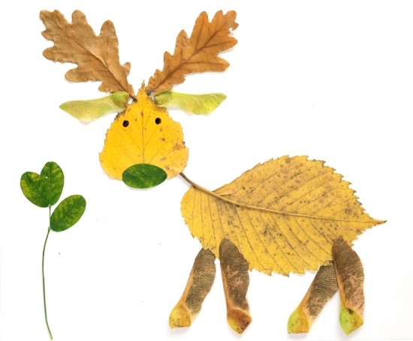
Activity #22 – Nature Art
Choice Board
Go outside and gather pieces of nature that are already on the ground. Such as sticks, stones, leaves, dirt, etc.
Pick an area and create a piece of art with the materials you gathered.
Take a picture.
You could also look at pictures of nature art online for ideas before you go outside.
This Photo by Unknown author is licensed under CC BY-SA.

Slide 37
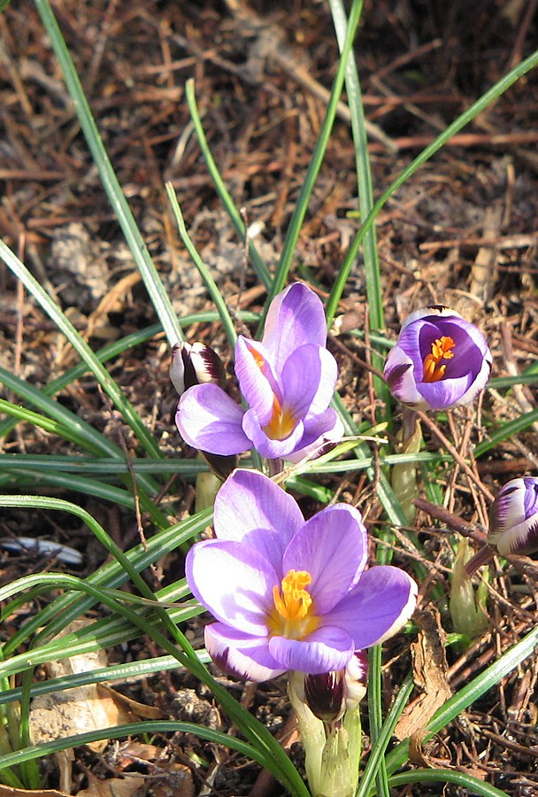
Activity #23 – Nature Shapes
Choice Board
Make a list of 2-D shapes and/or 3-D objects that you think you may find in nature.
Go for a walk outside and see how many different shapes and objects you can find in nature.
Keep a record of the number of each shape and object that you find and graph your results.
Compare the size of the shapes & objects that you find. Which are bigger, longer, wider, shorter?
Are any of the 2-D shapes symmetrical?
Measure and compare length, width, height, perimeter, area, angles, or circumference of the shapes and /or objects.
This Photo by Unknown author is licensed under CC BY-SA.
Notes:
This activity can support learning of many K-8 math Shape & Space and Statistics & Probability outcomes. Refer to the outcomes listed in the Math rubric in the appendix, to provide students with extra/more prompts or guiding questions to support learning of the specific K-8 outcomes. Students may like to know that understanding of 2-D shapes and 3-D objects is important for many jobs such as construction, carpentry, architecture and engineering.
The following shape and shape attribute descriptions by grade may help you plan and differentiate this activity:
Kindergarten- big, little, round, like a box, like a can
Grade 1 – round, flat, pointy, like a box, like a can
Grade 2 – cubes, spheres, cones, cylinders, prisms, pyramids, triangles, squares, rectangles, circles
Grade 3 – triangles, quadrilaterals, pentagons, hexagons, octagons, faces, edges vertices
Grade 4 – rectangular and triangular prisms
Grade 5 – rectangles, squares, trapezoids, parallelograms, rhombuses; edges, faces and sides that are parallel, intersecting, perpendicular, vertical, horizontal
Grade 6 – triangles (scalene, isosceles, equilateral, right, obtuse, acute); triangles, quadrilaterals, pentagons, hexagons, octagons
Grade 7 – circles, triangles, parallelograms
Grade 8 - 3-D objects (cubes, spheres, cones, cylinders, prisms, pyramids, right rectangular prisms, right triangular prisms, right cylinders)
(See the Math Assessment Rubric for specific learning outcomes for each grade.)
6 Easy Math Lessons Found in Nature | Mommy University (mommyuniversitynj.com)
https://mommyuniversitynj.com/2015/05/08/6-easy-math-lessons-found-in-nature/
Beautiful Geometry Captured in Nature 🦋 - YouTube
https://www.youtube.com/watch?v=l9X4ytjFlh4

Slide 38
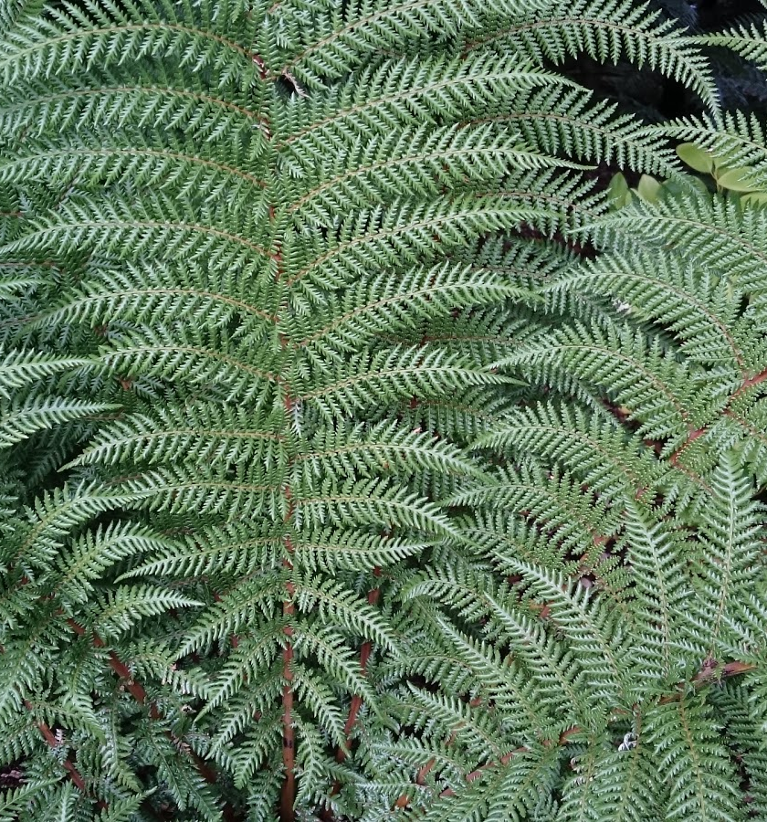
Activity #24 – Nature Patterns
Choice Board
Patterns are everywhere in nature!
How many different patterns can you find?
Some examples may include:
  branching of trees, ferns or river deltas
  spirals in pinecones, flower petals or seeds in a sunflower
  cracking patterns in dry old logs, tree bark, dried mud, or ice in puddles
  shape patterns on animals, birds, fish, insects, or reptiles
Sketch some of the patterns and have a family member or friend guess where the pattern was from.
Create a pattern using items from nature.
This Photo by Unknown author is licensed under CC BY.
Notes:
This activity can support learning of many K-3, 5, 7 & 8 Math Patterns and Relations outcomes. Refer to the outcomes listed in the Math rubric in the appendix, to provide students with extra/more prompts or guiding questions to support learning of the grade-specific outcomes. Students may like to know that understanding of repeating patterns in nature have helped support many architectural and engineering designs.
Nature patterns, fractals, golden ratio and Fibonacci resources:
Nature has patterns everywhere
https://www.youtube.com/watch?v=PjOeyjjPEB4
Fractal Scavenger Hunt – Fractal Foundation
https://fractalfoundation.org/resources/fractivities/scavenger-hunt/
FractalPacks-EducatorsGuide.pdf (fractalfoundation.org)
https://fractalfoundation.org/fractivities/FractalPacks-EducatorsGuide.pdf
Introduction to Fractals (safekid.org)
http://www.safekid.org/images/emag/issue27/introduction-to-fractals-the-geometry-of-nature.pdf
Fractals for Fun: Teaching Kids Patterns in Nature (ku.edu)
https://educationonline.ku.edu/articles/teaching-kids-patterns-in-nature
Doodling in Math: Spirals, Fibonacci, and Being a Plant [1 of 3] – YouTube
https://www.youtube.com/watch?v=ahXIMUkSXX0
Golden Ratio = Mind Blown! - YouTube
https://www.youtube.com/watch?v=c8ccsE_IumM

Slide 39
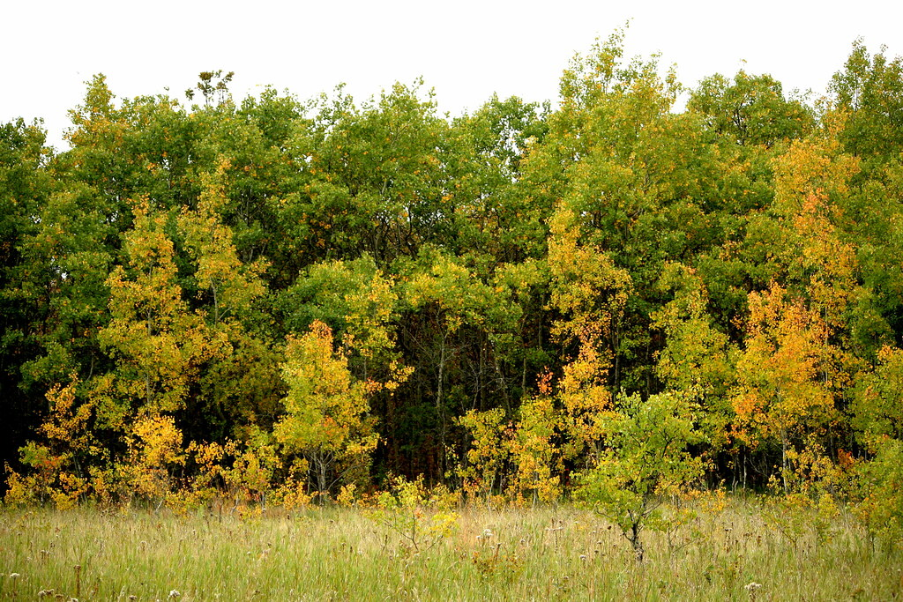
Activity #25 – Free Time
Choice Board
Go outside and spend about 5 minutes just being outside with nature.
Unstructured play is important.
Challenge yourself to spend more and more time each day being outside with nature.
Sign-up for the David Suzuki Nature Challenge!
https://davidsuzuki.org/take-action/act-locally/one-nature-challenge/
This Photo by Unknown author is licensed under CC BY-SA-NC.
Notes:
You may want to have students take pics of themselves spending free time outside and post them as a progression over a month.
David Suzuki Nature Challenge - https://davidsuzuki.org/take-action/act-locally/one-nature-challenge/

Slide 40

Take Action
What can you do with what you have learned?
Do something (help care for Mother Earth)
Continue to learn (about nature)
Create something (make a poster, video, song, art piece)
Raise awareness (educate other people)
Celebrate your relationship with the Land
BLM #8
This Photo by Unknown author is licensed under CC BY-NC.

Slide 41
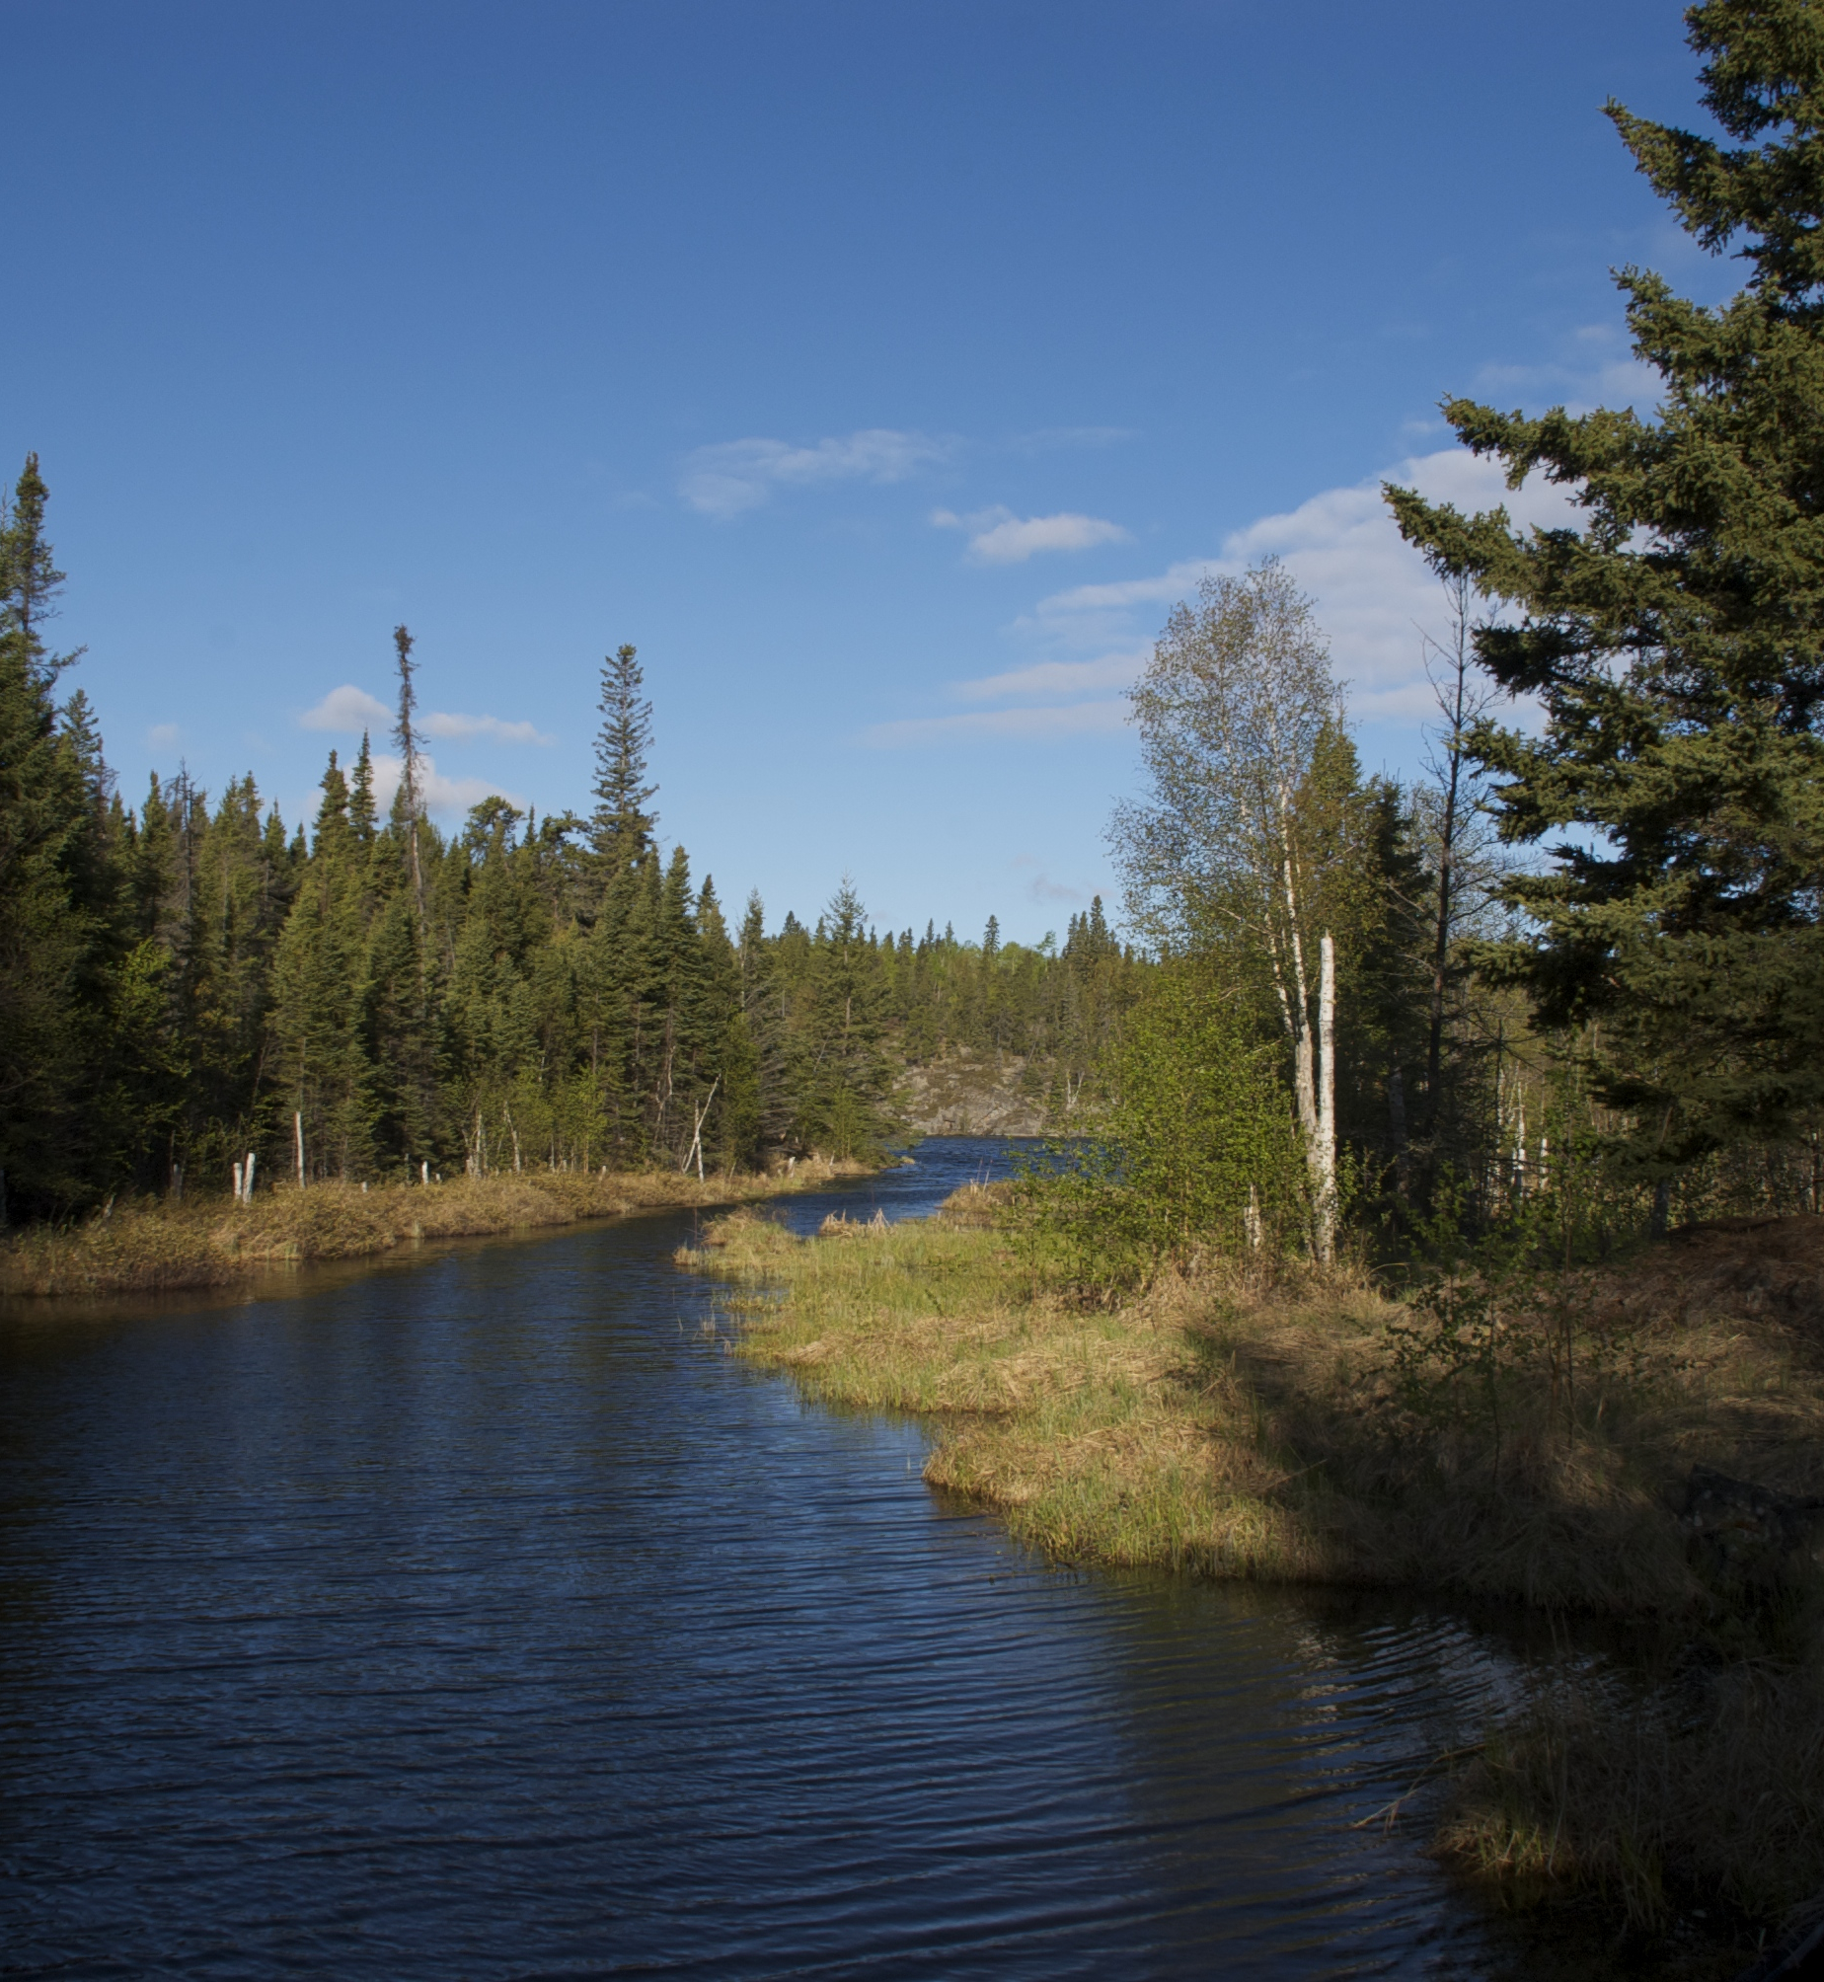
Reflect on our inquiry question:
How do we relate to and with the land?
How has your thinking changed?
Which senses do you use most naturally in your relationship with the land?
Which senses would you like to develop to better interact with the land?
What is something you learned that you didn’t know before?
What was your favourite thing that you learned about?
What would you like to learn more about?
BLM #9
This Photo by Unknown author is licensed under CC BY-SA.

