Slide 1
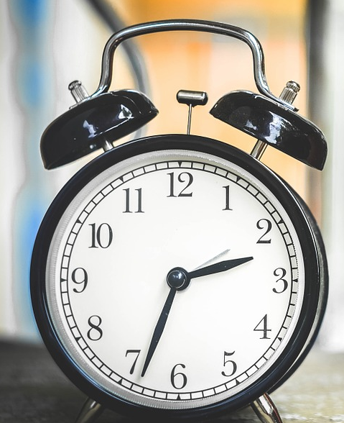
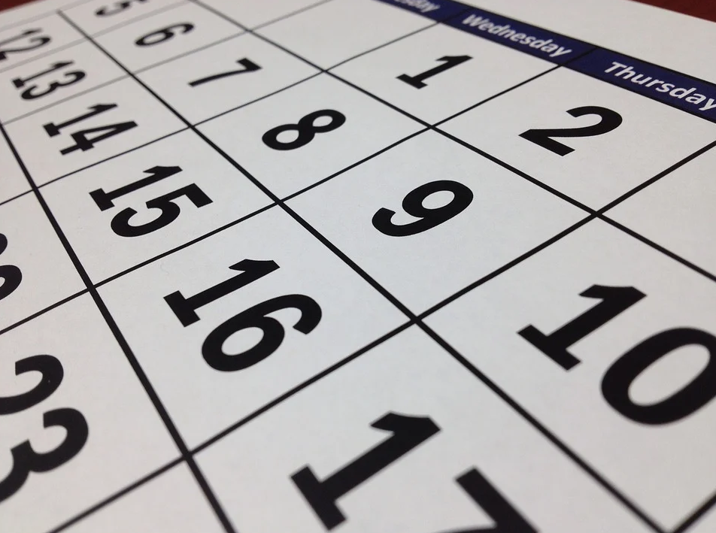
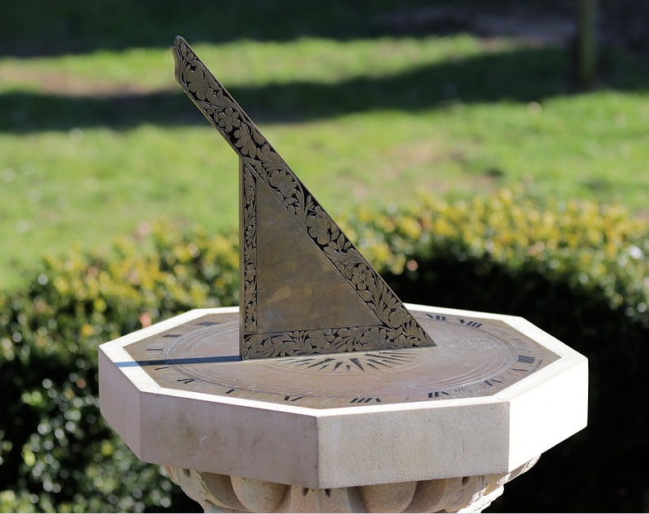
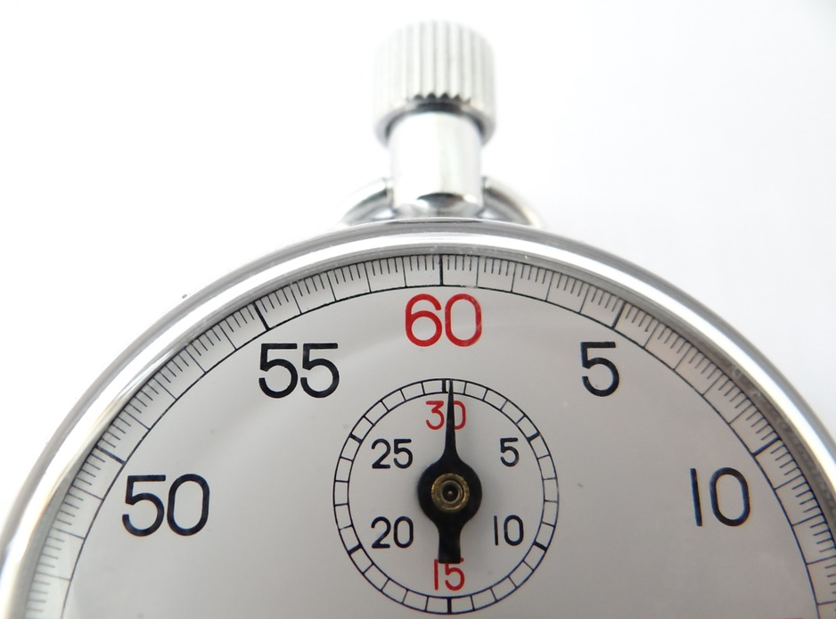
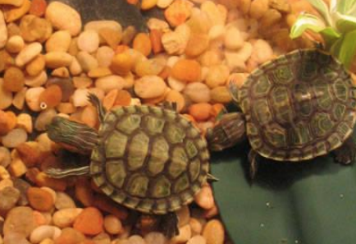
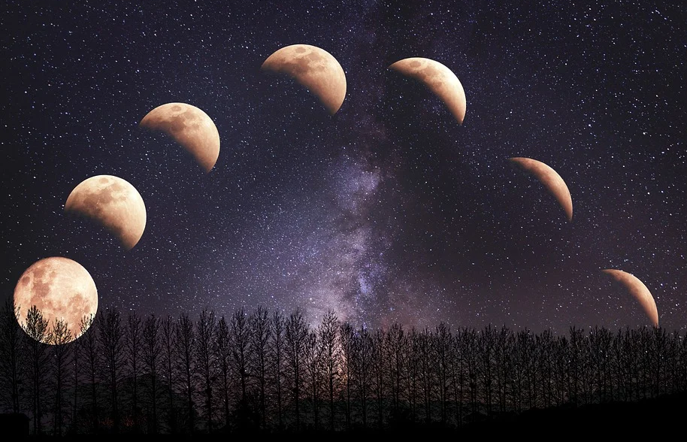
Times of your life
Grade 3 Math: Shapes and Space & Patterns
Notes:
https://pixabay.com/photos/sundial-sun-dial-manor-house-4017657/
https://pixabay.com/photos/hourglass-clock-sand-time-knapp-1875812/
https://pixabay.com/photos/clock-time-alarm-clock-hours-650753/
http://onlc.ca/wp-content/uploads/2014/06/13-Moon-curriculum2.pdf
https://pixabay.com/photos/stop-watch-watch-white-quick-dial-396862/
https://pixabay.com/photos/calendar-date-time-month-week-660670/

Slide 2
How many ways can we measure time?
Answer the question by inserting an arrow
Before Learning:
I think there are ______________________ ways to measure time because…

Slide 3
Enduring Understandings
The measurement of time involves the use of patterns.
Standard units are used to describe, measure, compare and communicate about the passage of time.
We can make sense of problems involving time.
Time measurements can be approximated using known referents.

Slide 4
Essential Questions
What activities take a minute, an hour, a day, a week, a month, or a year to complete?
How are seconds, minutes, and hours related? How are days and months related?
In what ways can time be measured?
How do we use patterns in time to predict future events?

Slide 5
The Modern Calendar
On the next slide, use the template to create a calendar for your favourite month. Include the name of the month, year, days of the week, and the dates. Mark important dates such as celebrations, birthdays, holidays, appointments, etc. Use the empty space to include a picture that would represent your chosen month.
Listen to the story Calendar by Myra Cohn Livingston.
What is your favourite month and why?
Notes:
https://www.youtube.com/watch?v=GACaylLi-dI

Slide 6
__________________

Slide 7
Solving Problems with a Calendar
Use your calendar to solve the following problems. Show your thinking.
Emily is 2 years old. How many months is that?
Mr. Johnson hired you to walk his dog during your favourite month. If you walk the dog twice a day, how many times will you walk the dog during the month?
If it is the 5th day of your favourite month, how many Tuesdays and Thursdays until the 5th of the next month?

Slide 8
Calendar History
How was our current calendar invented? Watch the video A Kid Explains the Calendar. Then complete the following chart with one or two sentences for each part.
In the Text What’s this text about? Who’s telling the story? What does the author want me to know/think?
In your Head What did I notice? What surprised me? What challenged, changed, or confirmed my thinking?
In your Heart How did this make me feel? What did I learn about me, others, the world?
Notes:
https://www.youtube-nocookie.com/embed/-Hg8dsxHzMA?autoplay=1&iv_load_policy=3&loop=1&modestbranding=1&playlist=-Hg8dsxHzMA

Slide 9
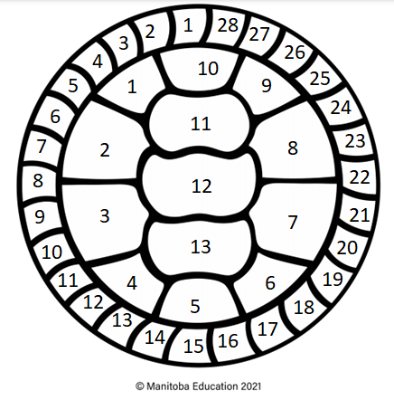
Indigenous Calendar Patterns
View 13 Moons on a Turtles Back by George Couchie.
It takes the moon approximately 28 days to go around earth. This means it goes around the earth about 13 times in one year, giving us 13 lunar months.
Examine the diagram to find the pattern of 13 lunar months and 28 days in a lunar month.
Notes:
https://vimeo.com/409797977

Slide 10
Calendar Patterns
On the turtle’s back outline, label each section with the name of the moon.
Figure out what moon we are in currently and use your turtle calendar to keep track of time.
Notes:
See teacher’s notes for resources for this task.

Slide 11
Comparing Calendars
Consider how our current calendar compares with the Turtle Calendar. Record you thinking below.
How are the Turtle Calendar and calendar we use the same?
How are the Turtle Calendar and the calendar we use different?

Slide 12
Time Patterns in Nature
Before the invention of clocks, people used patterns they observed to help them determine if it was morning, afternoon, evening, or night.
What clues would you see outside that would tell you what time of day it is?
Draw or write about your thinking below.

Slide 13
Time Patterns in The Water Princess
In this story, Susan Verde tell us the story of the long walk that Princess Gie Gie must take every day to get water.
While you view the book, use clues in the pictures and words to predict how long it takes her on her journey to get water.
Share your thinking below.
Notes:
https://www.youtube-nocookie.com/embed/tIWAjQhClK0?autoplay=1&iv_load_policy=3&loop=1&modestbranding=1&playlist=tIWAjQhClK0

Slide 14
Time Patterns in My Life Part 1
Choose four activities that you do every day such as getting out of bed or eating lunch. Record this in the chart under ‘Activity’.
What time of day do you do these activities: morning, afternoon, evening, night? Record this under ‘Time of Day.’
What clues would you see in the sky or the ground to know what time of the day these activities take place in? Record these clues under ‘Clues”
Activity | Time of Day | Clues

Slide 15
Time Patterns in My Life Part 2
Divide a paper up into 4 sections.
Using the information in your chart, draw a picture for each activity using one of the sections for each on your paper. Be sure to include clues so that people viewing your pictures will know what time of day your activity takes place.
Cut apart your 4 pictures and put your pictures in the order that they would occur. Share a photo of your work below.
Save these pictures for your final project!

Slide 16
Measuring time
Would you rather…
Have recess for 10 minutes or for 500 seconds?
Explain your thinking below:
Would you rather…
Vacation for 2 weeks or 15 days?
Explain your thinking below:
Notes:
This is to show what kind of understanding the student has with units of time and how they are related to each other.

Slide 17
Measuring time
Think about some of the things that happen from day to day in your life. Estimate how much time they take. Drag each item or draw a line to the timeline.
Brushing your teeth
Sneezing
Saying “Good night!”
Playing a board game
Watching a movie
Putting on your shoes
Eating a single scoop ice cream cone
Making your bed
Planting a garden
Cutting all the grass at a school
Doing a jumping jack
1 minute
5 minutes
30 minutes
1 hour
More than 1 hour
1 second

Slide 18
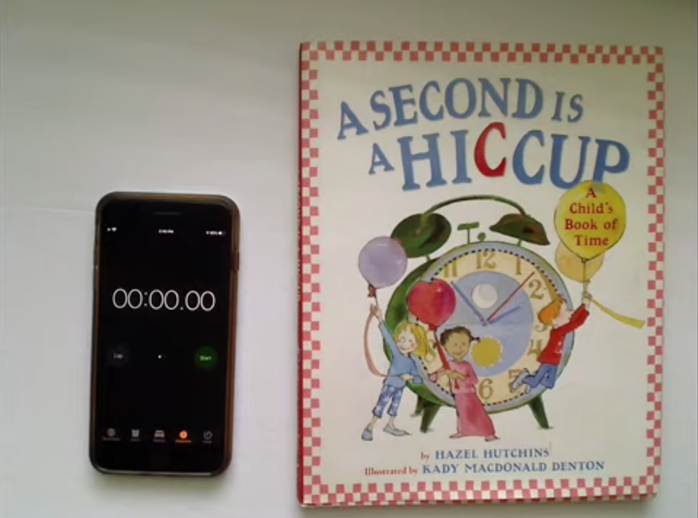
Measuring time
In the book, A Second is a Hiccup: A Child’s Book of Time By Hazel Hutchins, we are invited to think about how long different lengths of time are. How long is a minute? A week? A year? Listen closely! Think about how these different times are related to each other.
Notes:
https://www.youtube.com/watch?v=gRTI_omv0HQ

Slide 19
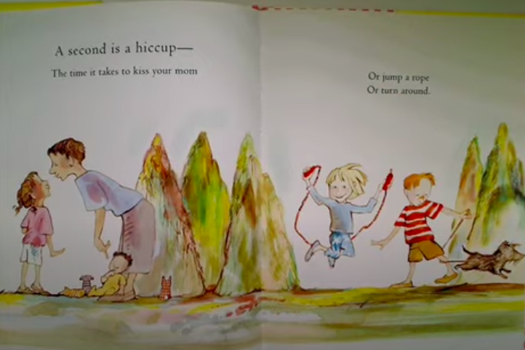
Measuring time
In the book, A Second is a Hiccup, the author starts with helping the reader feel what a second is like and ends the book helping the reader feel what a year is like. As we grow up, we develop a better sense of time. We can better “feel” what a minute, hour, etc. is because of our experiences and awareness of how long an event lasts.
Complete the tasks on the next 4 slides. After each set of tasks, describe what you noticed.
Notes:
Picture from:
https://www.youtube.com/watch?v=gRTI_omv0HQ

Slide 20
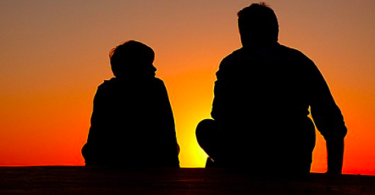
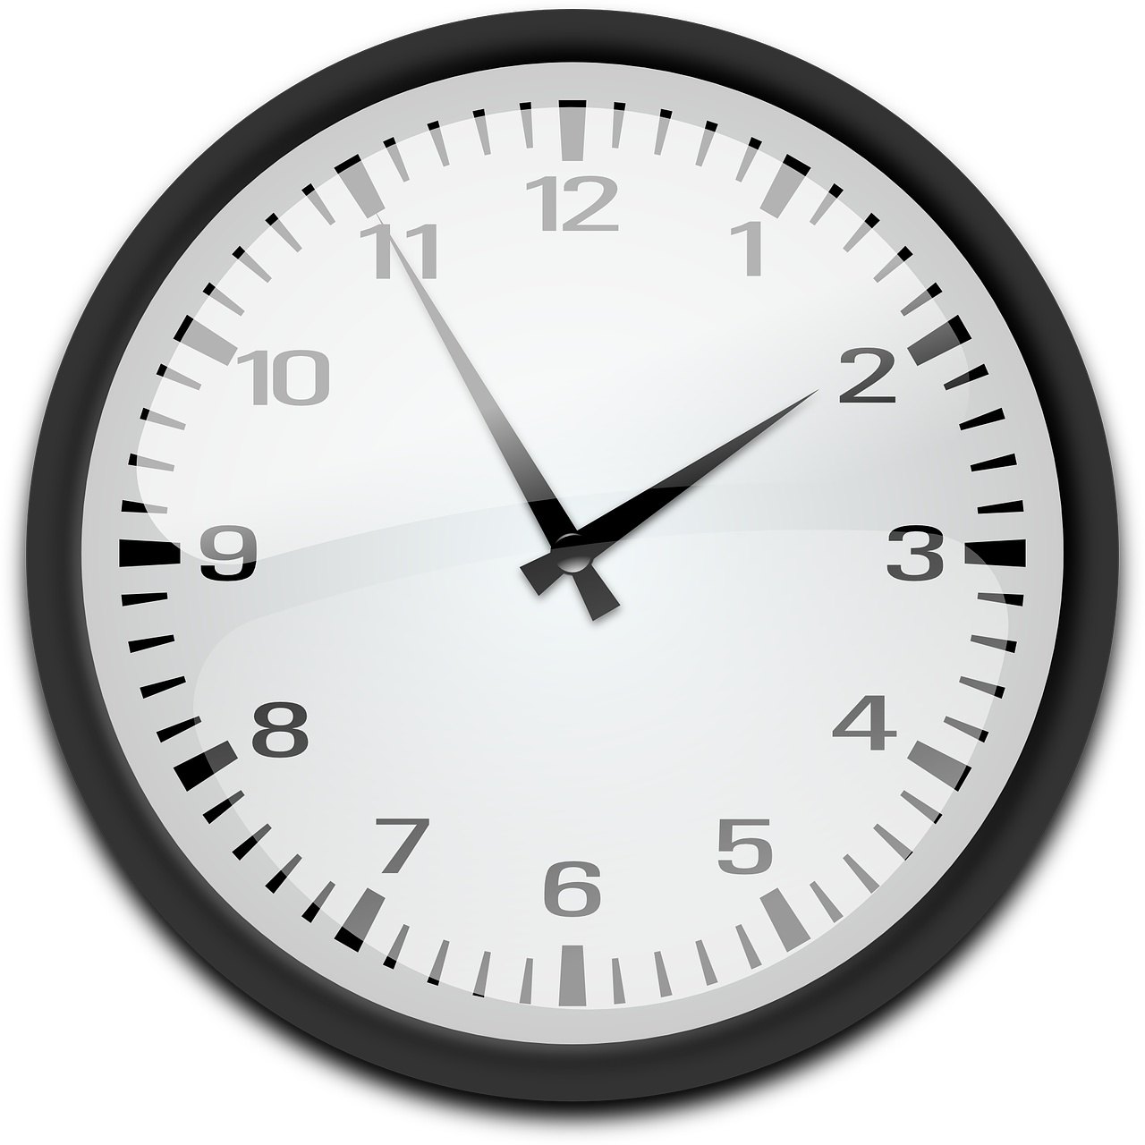
Measuring time
Look at the second hand on an analog clock, watch the second-hand tick while the big hand moves one minute. OR Using a cell phone, start its stopwatch and watch it for one minute.
What did you notice?
Find someone in your house to talk to. Watch the second hand of an analog clock and talk for one minute. OR Using a cell phone, start its stopwatch and talk for one minute.
Notes:
https://pixabay.com/photos/silhouettes-father-and-son-sunset-1082129/
https://pixabay.com/illustrations/search/analog%20clock/

Slide 21
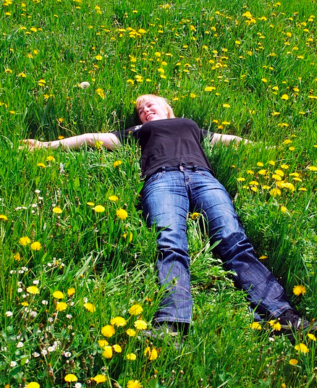
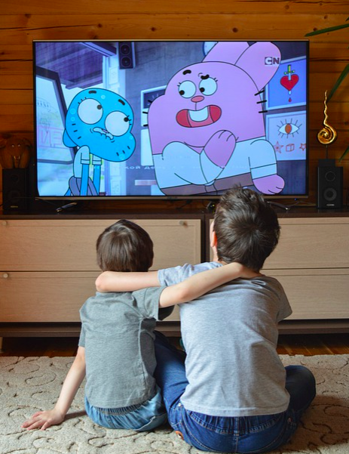
Measuring time
What did you notice?
Find a quiet place in your home or yard. Take something with you to measure the time. Sit or lie with your eyes closed for 10 minutes.
Using your tv or a computer or tablet, watch a video for 10 minutes.
Notes:
https://pixabay.com/illustrations/search/talking/
https://pixabay.com/photos/a-woman-laying-happy-smiling-3021056/

Slide 22
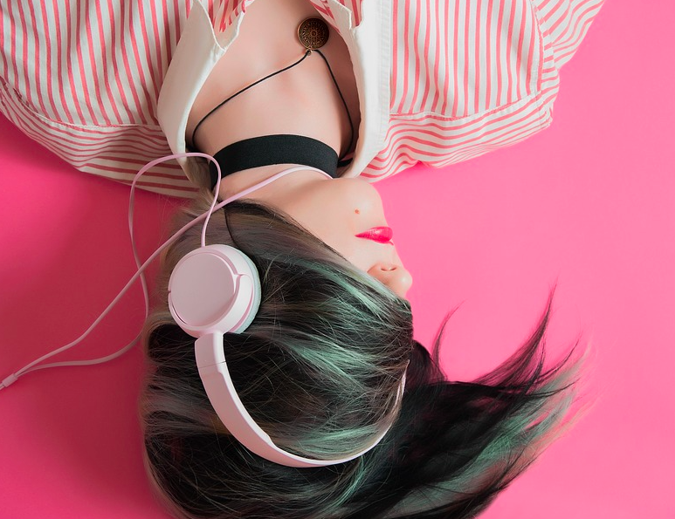
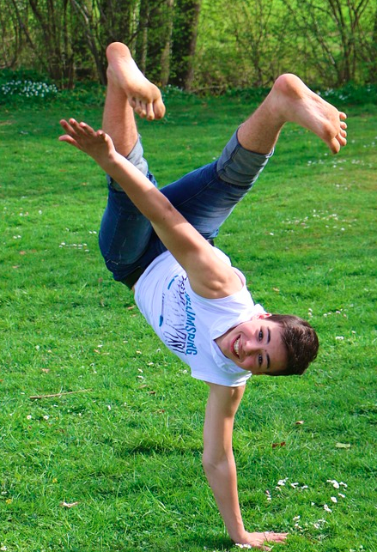
Measuring time
What did you notice?
Turn on some music and dance around for 10 seconds.
Turn on some music and dance around for 2 minutes.
Notes:
https://pixabay.com/photos/meadow-boy-dance-acrobatics-724448/
https://pixabay.com/photos/girl-music-fashion-listen-1990347/

Slide 23
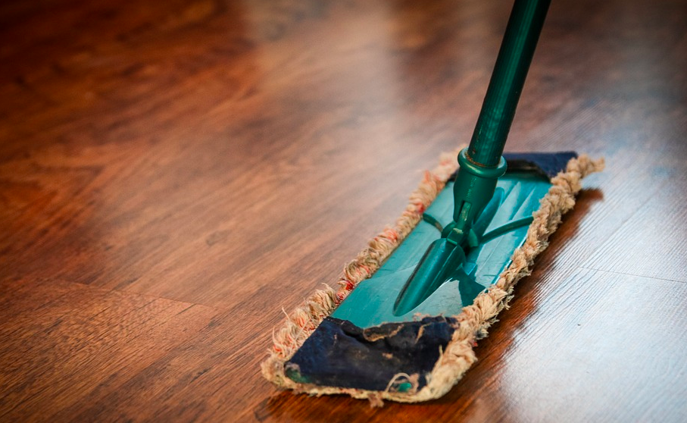
Measuring time
What did you notice?
Choose something you like to do and do it for 30 minutes.
Choose something you don’t really like doing and do it for 10 minutes.
Notes:
https://pixabay.com/photos/girls-dog-playing-pet-leash-puppy-5801275/
https://pixabay.com/photos/cleaning-washing-cleanup-the-ilo-268126/

Slide 24
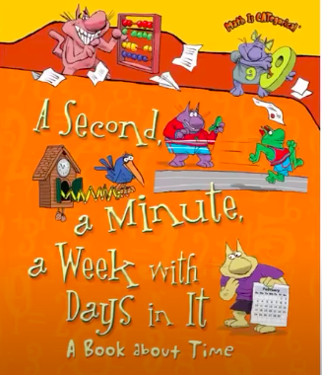
Measuring time
In the book, A Second, a Minute, a Week with Days in It, we hear about what time is and how it is measured. Listen closely! Think about how these different times are related to each other.
Notes:
https://www.youtube.com/watch?v=gRTI_omv0HQ

Slide 25
Measuring time
The poem below shows how different units of time are related to each other. What numbers and words would complete the poem? What patterns do you notice? Listen to our last story again for help if needed.
What patterns do you notice?
60 seconds make up 1 .
minutes make up 1 .
hours make up 1 .
days make up 1 .
weeks make up 1 .
months make up 1 .

Slide 26
Measuring time - A day in the life of...me!
What does a day look like for you? Keep a record of your activities over one day (24 hours). Record the start time and approximately how long each activity took. You can use the next slides to record.
For example:
Activity | Start Time | Duration (Length of Activity)
Feed the dog | 9:05 | 4 minutes
Eat breakfast | 9:20 | 12 minutes
Play Minecraft | 9:45 | 60 minutes
Notes:
https://pixabay.com/vectors/notebook-daily-diary-notes-remarks-2282300/

Slide 27
Measuring time - A day in the life of...me!
Activity | Start Time | Duration (Length of Activity)

Slide 28
Measuring time - A day in the life of...me!
Activity | Start Time | Duration (Length of Activity)

Slide 29
Measuring time - A day in the life of...me!
Activity | Start Time | Duration (Length of Activity)

Slide 30
A day in the life of….Me! Timeline
Final Project
Your task: Create a timeline that includes details of your daily life and routines.
A timeline is a list of events in the order that they happened. Here is an example of a timeline using just events.
Notes:
https://www.thoughtco.com/timeline-activity-for-kids-4145478

Slide 31
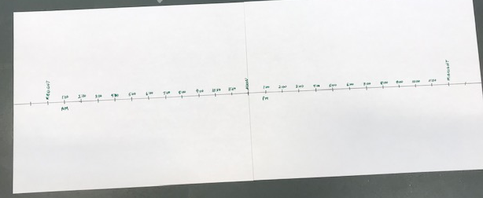
A day in the life of….Me! Timeline
Final Project
Your task: Create a timeline that includes details of your daily life and routines.
To create your timeline, take 2 pieces of paper and tape them together. Across the center of the large page that’s created, draw a line from edge to edge. Draw small lines for each hour of time, beginning with midnight of one day and ending with midnight the next day. This will be enough lines to represent 24 hours.

Slide 32
A day in the life of….Me! Timeline
Final Project
Your task: Create a timeline that includes details of your daily life and routines.
Must Dos:
Begin your timeline with midnight one day and end it with midnight the next day, a complete 24 hours.
Place the 4 pictures you created for slide 15 on the timeline.
Use the information recorded in your table (slide 27) to fill in the timeline.
Include at least 9 items.
Can Dos:
Include more than 9 items.
Record the end time for each task.
Use an analog clock to keep track of the time.
Add more pictures to your timeline where you feel you can.

Slide 33
A day in the life of….Me! Timeline
Final Project follow-up
Choose 3 activities from your timeline that you do every day. Over your favourite month, how much time do you spend on this activity?
If possible, show the thinking you did to you figure this out. Use the next slides to do this.
Example:
If I spend 2 minutes brushing my teeth twice a day, how much time during my favourite month do I spend brushing my teeth?

Slide 34
A day in the life of….Me! Timeline
Final Project follow-up
Activity:
My Thinking:

Slide 35
A day in the life of….Me! Timeline
Final Project follow-up
Activity:
My Thinking:

Slide 36
A day in the life of….Me! Timeline
Final Project follow-up
Activity:
My Thinking:

Slide 37
How many ways can we measure time?
Reflect on your learning in this experience. Look back to slide 2 to view your initial response to this question. Then complete the prompts below based on your current thinking.
Answer the question by inserting an arrow
After Learning:
I think there are ______________________ ways to measure time because…
I agree/disagree with my initial thinking because…

Slide 38
Take a look at the pictures from our first discussions about time. What do you know now? What do you understand now? What are you still wondering about? Record your thoughts in the box below.
Notes:
https://pixabay.com/photos/sundial-sun-dial-manor-house-4017657/
https://pixabay.com/photos/hourglass-clock-sand-time-knapp-1875812/
https://pixabay.com/photos/clock-time-alarm-clock-hours-650753/
http://onlc.ca/wp-content/uploads/2014/06/13-Moon-curriculum2.pdf
https://pixabay.com/photos/stop-watch-watch-white-quick-dial-396862/
https://pixabay.com/photos/calendar-date-time-month-week-660670/

Slide 39
Free templates for all your presentation needs
For PowerPoint and Google Slides
100% free for personal or commercial use
Ready to use, professional and customizable
Blow your audience away with attractive visuals

