Slide 1
All About Treaties
Grade 4 Social Studies Lesson

Slide 2
Inquiry Question
How does the Treaty Relationship apply to you?
Think about it throughout the learning experience

Slide 3
Step 1: Think About It What do you already know? What do you wonder?
1. What is a Treaty?
Step 2: Learn About Treaties
Select from the learning experiences below. You do not have to go in order, and you can pick and choose which ones you would like to do.
2. Act it out!
3. Learn about the Treaties
4. Map Exercise
5. Research about the Treaties
6. Treaty ABCs
7. Kinikinik A Treaty Play
8. Treaty Medal
9. Vignettes
Step 3: Final Project
Pretend you are the communications coordinator for the Treaty Relations Commission of Manitoba.
10. Raise Awareness
Step 4: Looking Back
Reflect on how the Treaty Relationship applies to you.
11. Reflection

Slide 4
1. What is a Treaty?
BLM #1
Choice Board
K
What I know
W
What I wonder
L
What I learned

Slide 5
Treaties are about…
Choice Board
Friendship
A Treaty is an agreement between two or more nations.
Sharing
Keeping Promises

Slide 6
2. Act it out!
Choice Board
As a class, choose a movement for each topic.
Topic | Example of Movement
Sun Shines | While standing, make a circle with your arms.
Grass Grows | Crouch down, slowly rise to a standing position while wiggling your fingers.
Waters Flow | Place both hands together and sway back and forth as you move from standing to crouching.
Treaty People | Go from crouching to standing while extending both arms outward.

Slide 7
All Together Now! (Act and Speak)
Choice Board
Teacher says:
Students say:
“As long as the…”
“sun shines”
“As long as the…”
“grass grows”
“As long as the…”
“waters flow”
“We are all…”
“Treaty people!”
Notes:
Feel free to do this over and over again until you get really good at it! One more time from the top. You could also have students take turns reading the teacher’s line.

Slide 8
3. Learn About the Treaties
Choice Board
Treaty Tales is a trilogy of children's books written by Betty Lynxleg and illustrated by Don Monkman, Amber Green and Scott B. Henderson.
The Handshake and the Pipe
The Friendship
We Are All Treaty People
Click to watch
Watch a Treaty Tales Trailer Treaty Tales Trailer (MFNERC)
Read one of the books online Treaty Tales Free Online Reading Resource (MFNERC)
Click to read

Slide 9
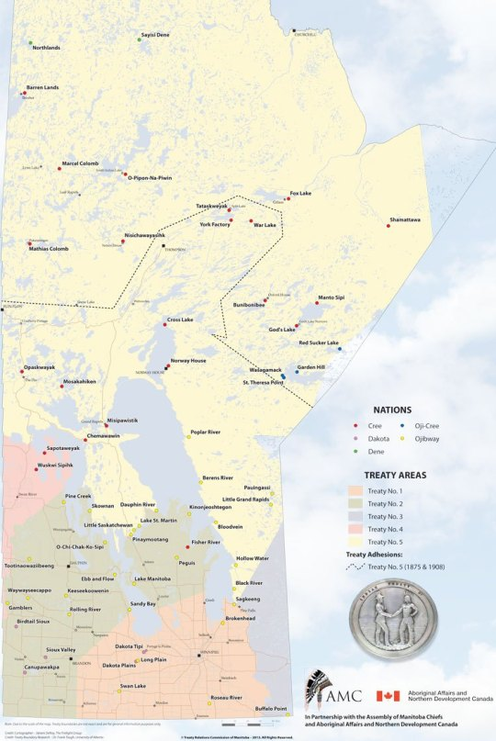
4. Map Exercise Take a look at the map. What do you notice? What do you wonder?
Choice Board
http://www.trcm.ca/treaties/treaties-in-manitoba/view-pdf-interactive-map-of-numbered-treaties-trcm-july-20-entry/

Slide 10
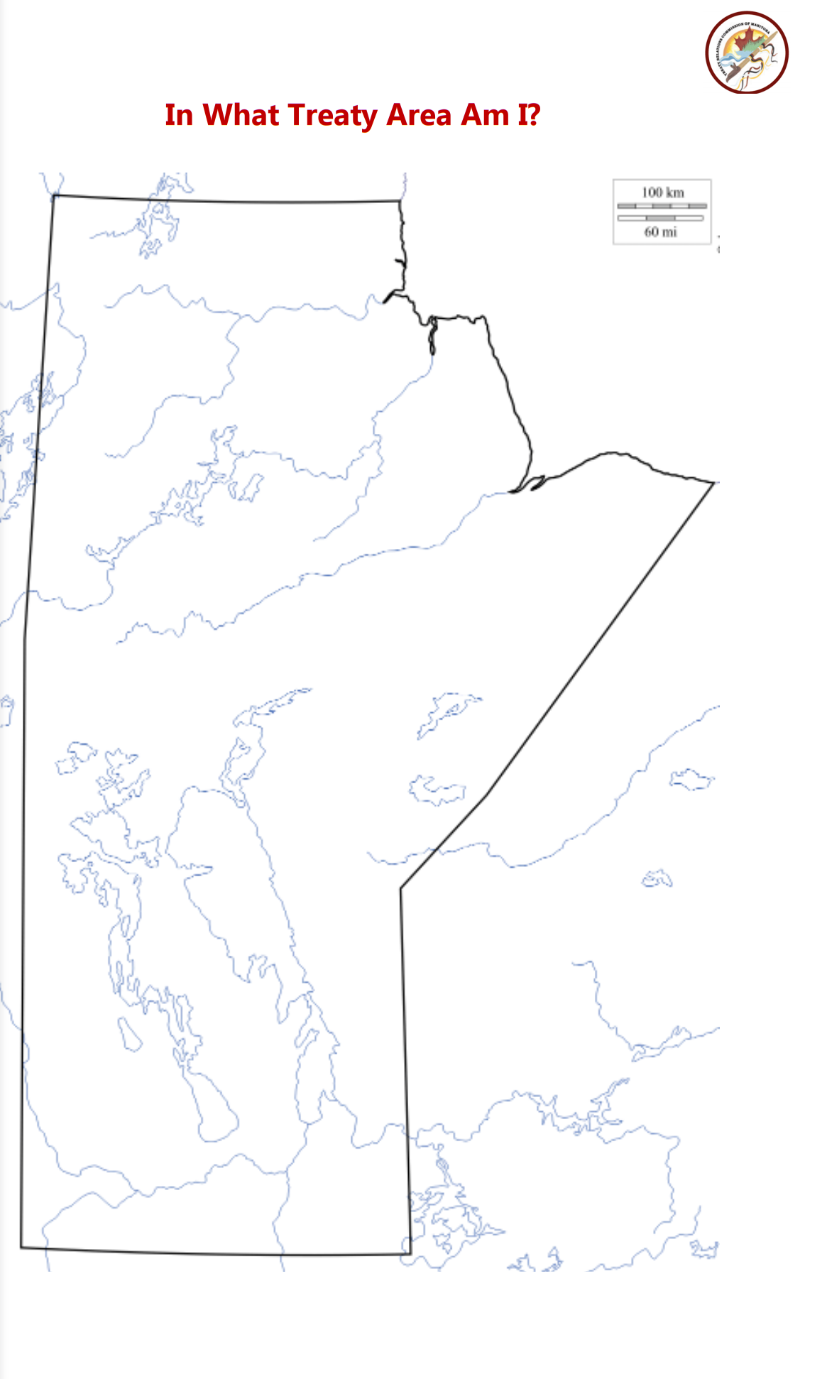
In What Treaty Area Am I?
Choice Board
Draw and colour the treaty area on a map of Manitoba.
Use the template from the Treaty Relations Commission of Manitoba.
This activity was created by the Treaty Relations Commission of Manitoba found here:
http://www.trcm.ca/wp-content/uploads/In-What-Treaty-Area-Am-I.pdf
BLM

Slide 11
5. Research about the Treaties
BLM #2
Choice Board
Choose one of the 5 Treaty areas to research and answer the following questions:
Who is part of this treaty?
When and where was this treaty negotiated?
What was negotiated in this treaty?
Information on the Numbered Treaties can be found here: http://www.trcm.ca/treaties/numbered-treaties/

Slide 12
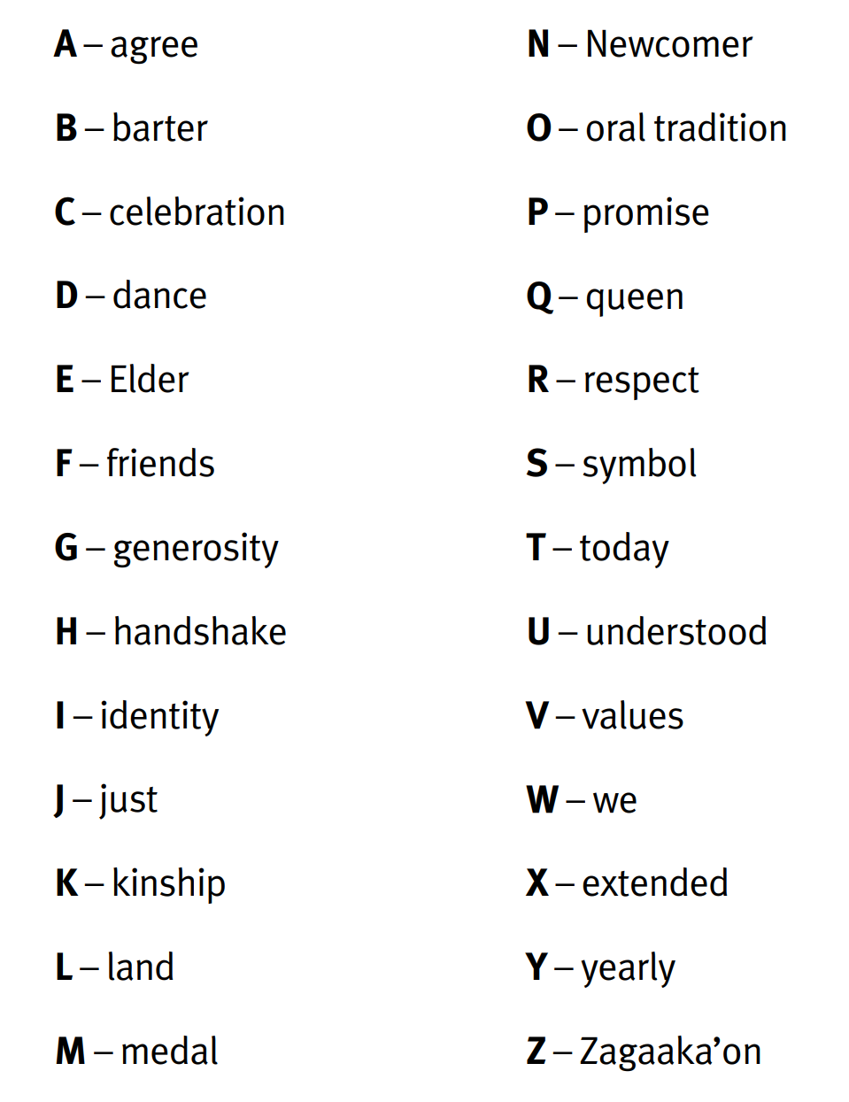
6. Treaty ABC’s: Treaty Vocabulary
Choice Board
Step 1: Choose a letter from the alphabet.
Step 2: Find the word associated with your letter and learn about it.
Step 3: Draw a picture to represent your new word. Use the template found in the link below.
Step 4: Share your word and picture with the class!
This activity was created by the Treaty Relations Commission of Manitoba and can be found here:
http://www.trcm.ca/wp-content/uploads/26891-TR-Treaty-ABCs-book-web.pdf
BLM

Slide 13
7. Kinikinik: A Treaty Play
Choice Board
Read the script as a class. There are 3 roles (turtle, beaver, and wolf); and 20 pages. Assign parts for students to read. For example, one student can be the turtle from pages 1-5, etc. Encourage students to practice reading their lines before the class reading.
Watch the puppet version of the play.
Reflect and discuss as a class the study questions at the end of the script.
This play was commissioned by the Treaty Relations Commission of Manitoba and was created by Governor General Award winning playwright Ian Ross. http://www.trcm.ca/multimedia/theatre/
BLM

Slide 14
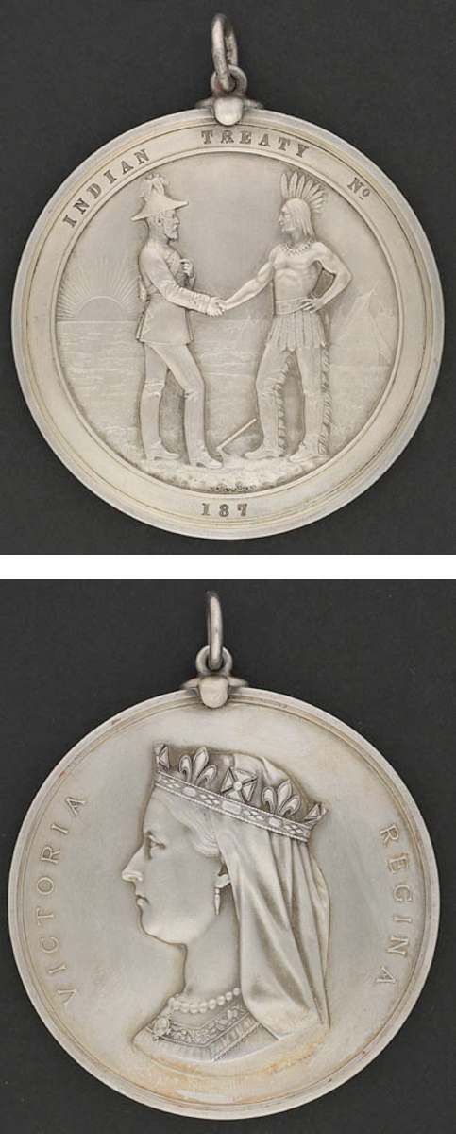
8. Treaty Medal
BLM #3
Choice Board
Step 1: Take a look at the Treaty Medal.
Learn more about the Treaty Medals! http://www.trcm.ca/about-us/trcm-medal/
What do you notice?
What do wonder?
Step 2: Complete the Treaty Medal colouring page and/or design your own Treaty Medal.
BLM
This activity was created by the Treaty Relations Commission of Manitoba and can be found here:
http://www.trcm.ca/wp-content/uploads/Treaty-Medal-Colouring-Page-.pdf

Slide 15
9. Vignettes
BLM #4
Choice Board
Click to watch!
Watch the vignettes more than once. You can watch, pause, and discuss.
1. Share the Land
2. Treaties in the Modern Context
Before | Looking at the title, what do you think it will be about?
During | First Viewing | What do you see?
 | Second Viewing | What do you hear?
 | Third Viewing | What do you feel?
 | Fourth Viewing | What do you think?
After | What do you think is the main message? Do you have more questions now?
The vignettes are from the Treaty Relations Commission of Manitoba
Photo Credit: http://www.trcm.ca/

Slide 16
10. Final Project
BLM #5
Choice Board
Communications Coordinator
Check List:
Identify the message you would like to portray.
Think about your target audience.
Choose a format. You can make a poster, video, brochure, radio script, billboard, speech, a series of tweets, etc.
Your job is to create a campaign to educate the public on the Treaties.
Check out the Treaty Relations Commission of Manitoba website for ideas. www.trcm.ca

Slide 17
11. Reflection
BLM #6
Choice Board
Think back to the inquiry question…
How does the Treaty Relationship apply to you?
Answer the following questions:
What learning has taken place?
How have your thoughts changed?
How would you answer the inquiry question?

