Slide 1


Civic Action: Then and Now

Slide 2

Inquiry Question
How can you take action
to make a difference?

Slide 3
Minds On
Write quietly for two minutes
What is one thing you would like to change in your school, community or society?
What could you do to change it?

Slide 4
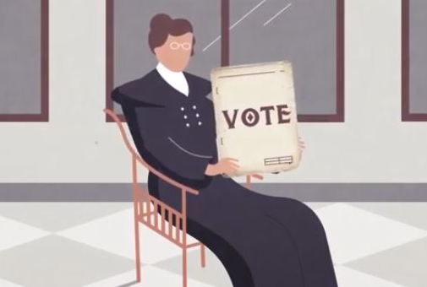
Activity
Watch the video Women and the Vote
What kind of civic actions do you see citizens taking in the video?

Slide 5
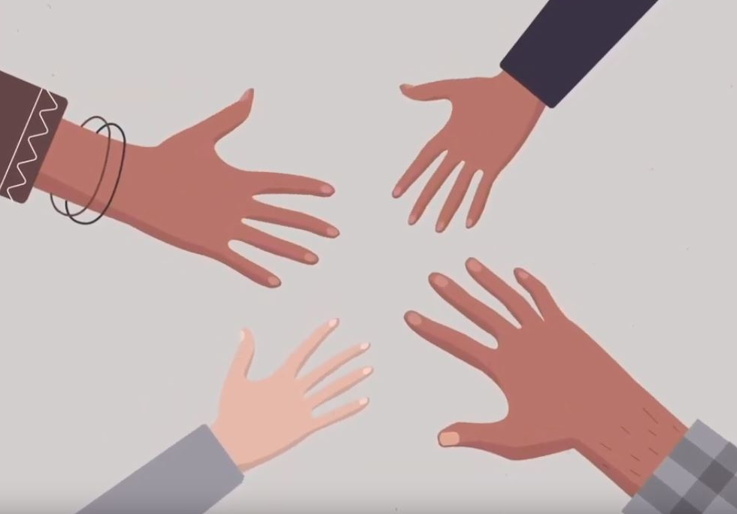
Activity
Watch the video Aboriginal and Treaty Rights in Canada’s Constitution
What kind of civic actions do you see citizens taking in the video?

Slide 6
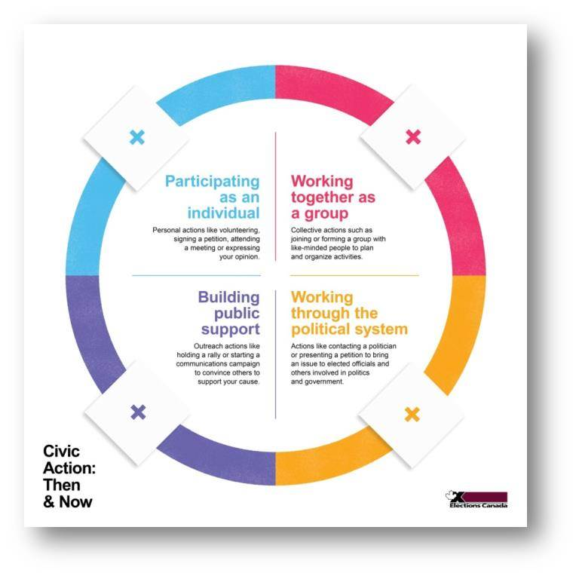

Activity
Getting Ready
Your group will need:
Activity board
Activity cards

Slide 7
Activity
The activity board shows four ways to take
civic action.

Slide 8
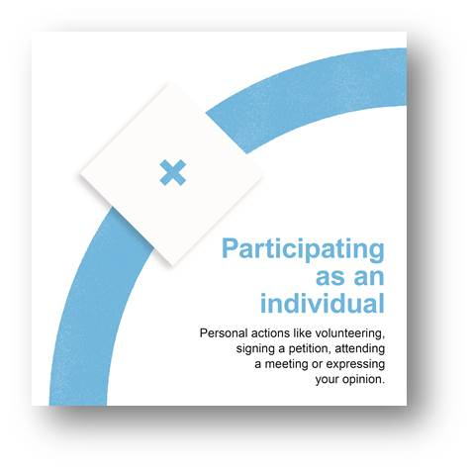
Activity
Participating as an individual:
personal actions like volunteering,
signing a petition, attending a
meeting or expressing your opinion.
What actions did we see in the video
that might be "participating as an
individual"?
E.g. A person who signs a petition is participating as an individual.

Slide 9
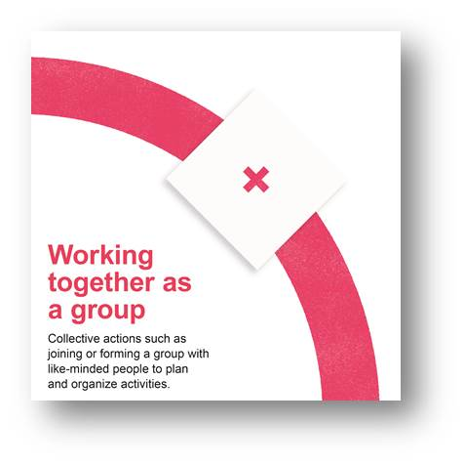
Activity
Working together as a group:
collective actions such as joining or
forming a group with like-minded
people to plan and organize activities.
What actions did we see in the video
that might be “working together as a
group"?
E.g. When many people decide to create and circulate a petition, that
is working together as a group.

Slide 10

Activity
Building public support:
outreach actions like holding a
rally or starting a communications
campaign to convince others to
support your cause.
What actions did we see in the video that might be "building public support"?
E.g. When a petition draws widespread attention to an issue, that is building public support.

Slide 11
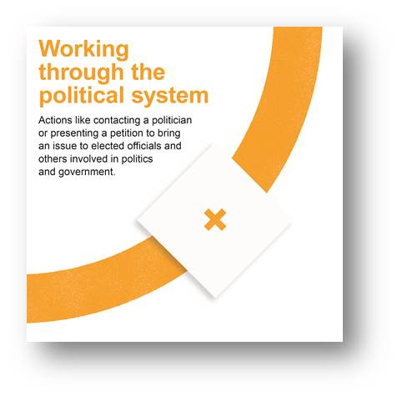
Activity
Working through the
political system:
actions like contacting a politician
or presenting a petition to bring an
issue to elected officials and others
involved in politics and government.
What actions did we see in the video that might be "working through the political system"?
E.g. When a petition is presented to an elected official, that is working through the political system.

Slide 12
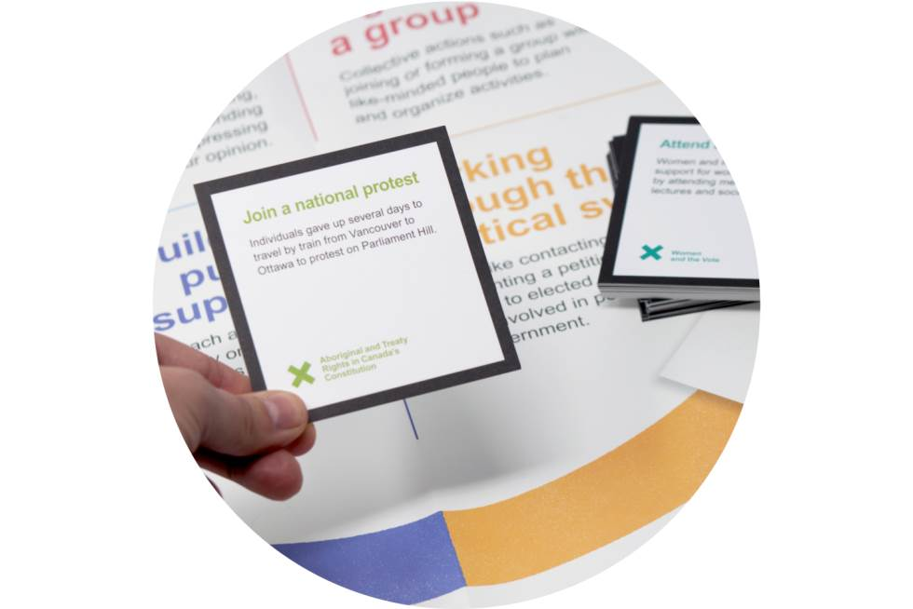
Activity
Read aloud your case study cards.
Place each card on the section
of the activity board that you
think fits best.
Many answers are possible,
but your group must agree.

Slide 13
Consolidation
Discuss in your small group.
Be prepared to share with the class:
What could happen if you removed one of
the sections?

Slide 14
Consolidation
Individual reflection:
Consider the action you wrote down at the start of this activity. What kind of civic action is it? How has your thinking changed since the beginning?

Slide 15
Consolidation
Planning your civic action
Think about the thing you would like to change.
(Hint: You wrote this down at the start of the lesson)
What would it look like if you changed it for
the better?
What results would you like to see?
What else could you do to take action on what you would like to change?

Slide 16
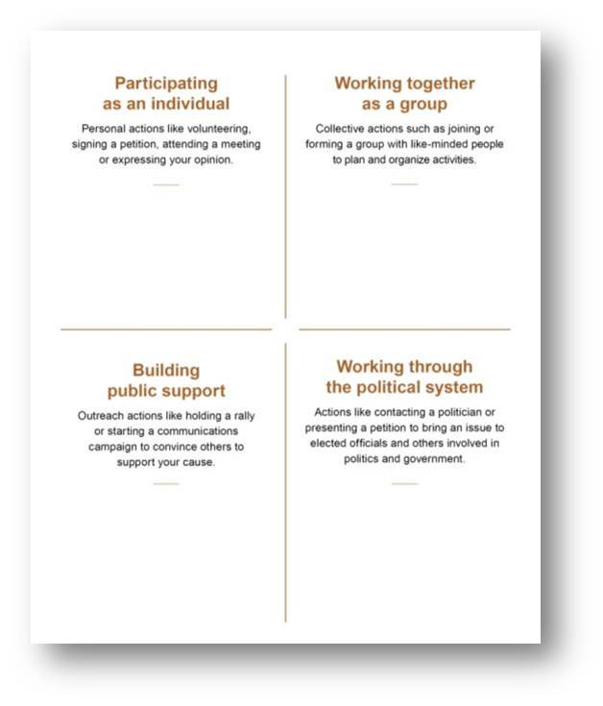
Consolidation
Planning your
civic action
Create a civic action plan
using the activity board as
a template.

