Slide 1
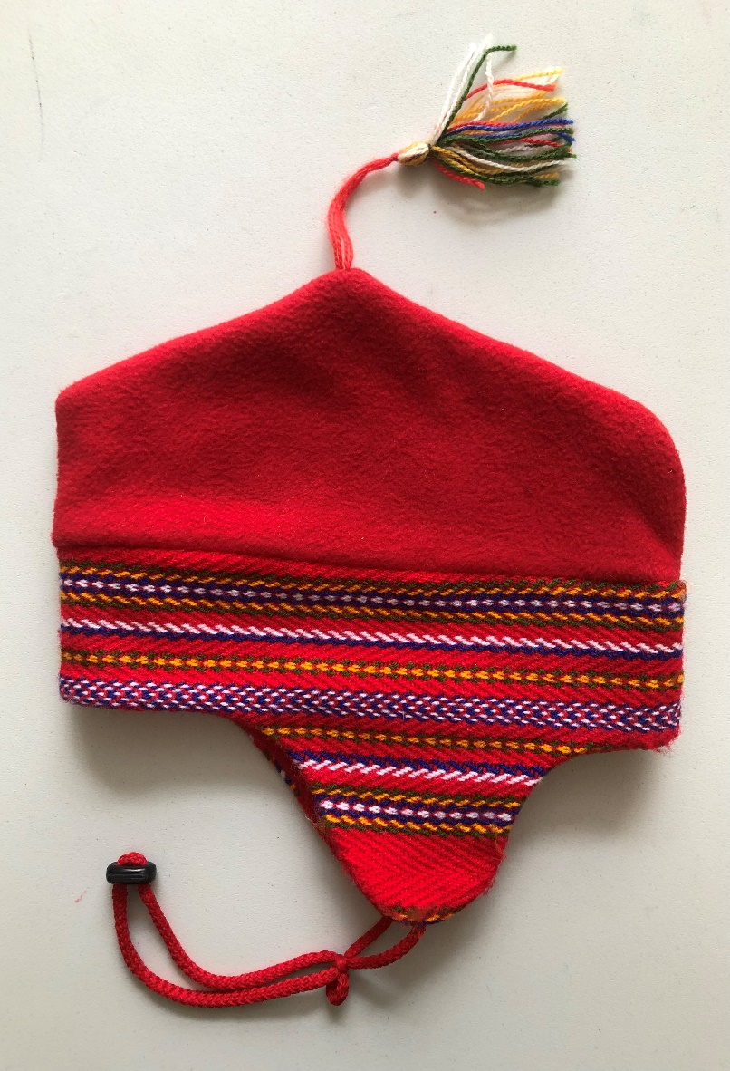
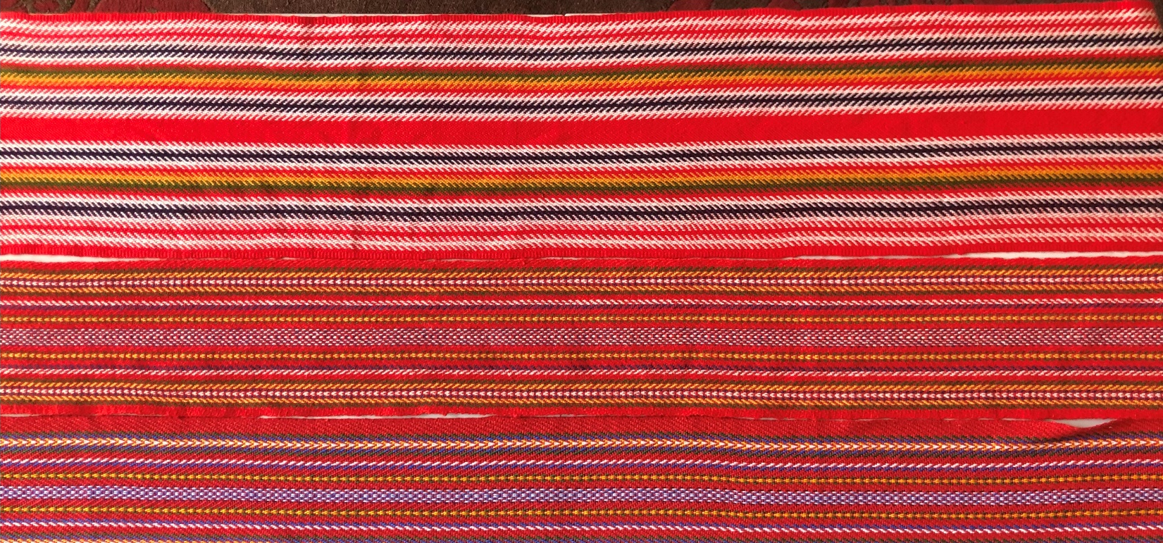
LOUIS RIEL DAY AND THE MÉTIS INQUIRY PROJECT
Grade 1

Slide 2
"Metis sashes" by Chris Corrigan is licensed under CC BY-NC-SA 2.0

Slide 7
Métis Sash Pattern Grid
ABABABAB
AABAABAAB
ACCCACCCA
ABBABBA

Slide 8
Métis Sash Pattern Grid
ABABABAB
AABAABAAB
ACCCACCCA
ABBABBA

Slide 9
Métis Sash Pattern Grid
ABABABAB
AABAABAAB
ACCCACCCA
ABBABBA

Slide 10
Métis Sash Pattern Grid
ABABABAB
AABAABAAB
ACCCACCCA
ABBABBA

Slide 11
"Canada Flag" by Alirod Ameri is licensed under CC BY 2.0

Slide 12
Flag of the Metis by Xasartha is licensed under CC BY-SA 3.0

Slide 13
Louis Riel’s house is in Saint Boniface Manitoba
All content from Kiddle encyclopedia articles (including the article images and facts) can be freely used under Attribution-ShareAlike license, unless stated otherwise. Cite this article:
Louis Riel Facts for Kids. Kiddle Encyclopedia.
https://kids.kiddle.co/Louis_Riel

Slide 14
Louis Riel when he was 14 years old
All content from Kiddle encyclopedia articles (including the article images and facts) can be freely used under Attribution-ShareAlike license, unless stated otherwise. Cite this article:
Louis Riel Facts for Kids. Kiddle Encyclopedia.
https://kids.kiddle.co/Louis_Riel

Slide 15
Who was Louis Riel? "Louis Riel” by BiblioArchives / LibraryArchives is licensed under CC BY 2.0

Slide 16
Louis Riel Day

