Slide 1
Patterns
An exploration of visual patterns - the gateway to rich algebraic thinking

Slide 2
Patterning and Algebraic Thinking Grade 7
Demonstrate an understanding of oral and written patterns and their corresponding relations. PR.1
Construct and graph a table of values from a relation, and analyze the graph to draw conclusions and solve problems. PR.2
Variables and Equations Algebraic Representations with Expressions and Equations Demonstrate an understanding of preservation of equality by modelling it and applying it to solve equations. PR.3
Explain the difference between an expression and an equation. PR.4
Evaluate an expression given the value of the variable(s). PR.5
Model and solve problems that can be represented by linear equations in the form: • x + a = b where a and b are integers and • ax + b = c • ax = b • x a = b, a ≠ 0 where a, b, and c are whole numbers. PR.6 PR.7
This sequence of lessons uses Math outcomes as its lens. Feel free to make cross-curricular connections as you see fit.

Slide 3
There is a serious problem with the way algebra is often introduced in textbooks. A central idea in algebra is that of a variable, which could be x,y, or any other symbol. But students are not introduced to variables that can actually vary. Instead they are asked to solve for x, they do repeated exercises solving for x, and they – not surprisingly – get the idea that x is a number that does not vary. This is not a good representation of a variable. Students are usually introduced to algebra by solving for x in artificial situations where only one number can represent x. But the most critical aspect of a variable is that it is something that varies.
Mindset Mathematics: Visualizing and Investigating Big Ideas,Grade 7 Jo Boaler, Jen Munson, Cathy Williams ISBN: 978-1-119-35801-5 July 2019 Jossey-Bass 304 Pages
In this sequence of lessons students will begin their exploration of algebra by experiencing variables as symbols whose values vary. The lessons contained within this exploration are meant to facilitate both synchronous and asynchronous exploration.
Note: the slides with the blue frame contain teacher content and possibly student activities. The slide with the orange frame are meant for students

Slide 4
Big Question: What are Visual Patterns and How are They Useful?
What do patterns have to do with math?
How can we describe patterns?
How do we make a T table from a pattern? Why is this useful?
How do we make a picture from our T table?
How do we identify a linear relationship?
How do we make a rule from a pattern?
How does a rule become an equation and what is it good for?
What is preservation of equality?
How can we use our data to look ahead?
What does it look like when we put it all together?

Slide 5
Whenever possible it is suggested that topics are explored through the lens of this teaching and learning cycle.
Activating thinking and guiding focus onto the new learnings.
Seek opportunities to consolidate the underpinnings and provide opportunity for collaborative practice wherever possible.
Use formative assessment throughout to reveal gaps and misconceptions. Remediate by engaging with students as and when needed
Activating/revealing Thinking
Demonstration of learning
Exploration of new learning
Gaps/misconceptions addressed
Collaborative/ personal practice
Consolidate learning

Slide 6
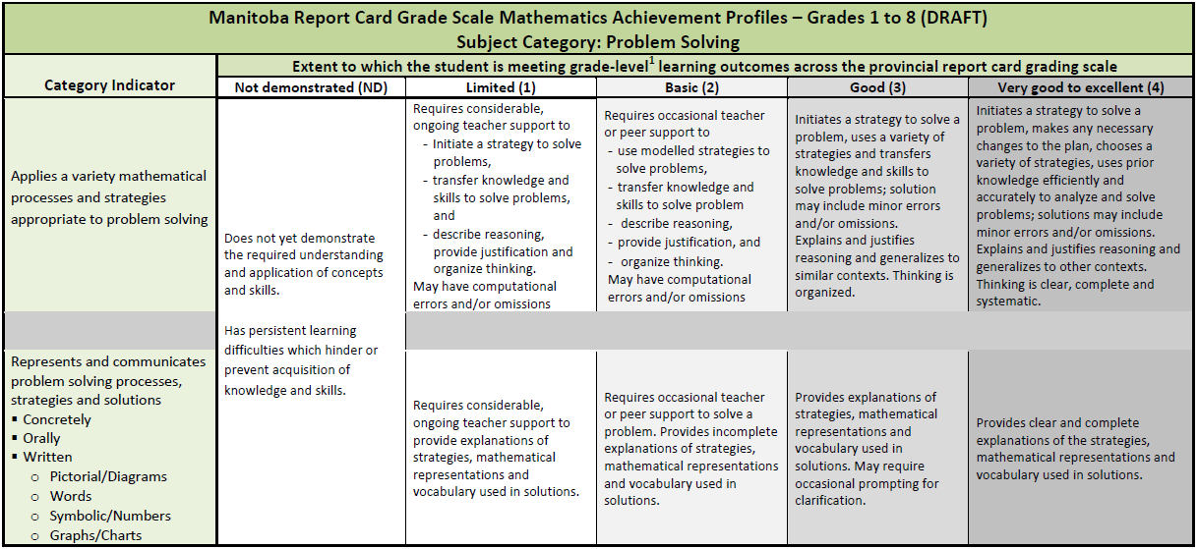
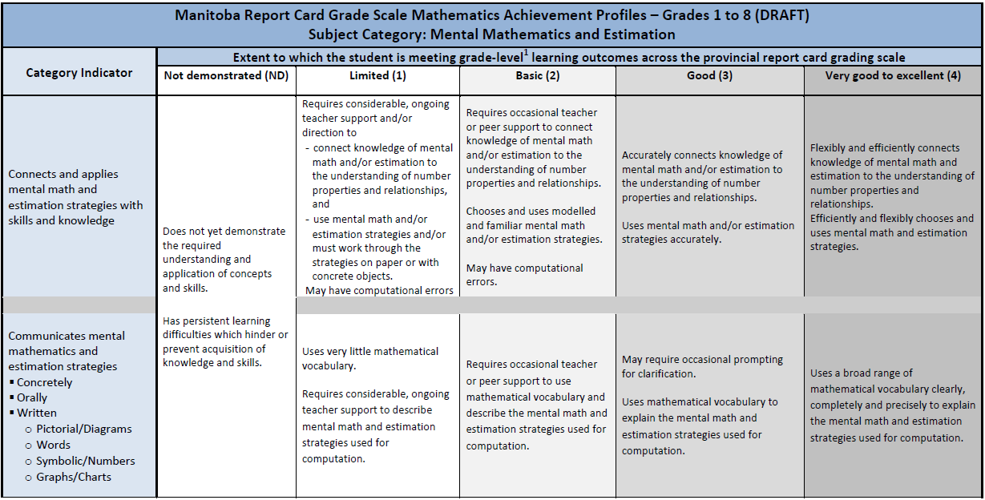
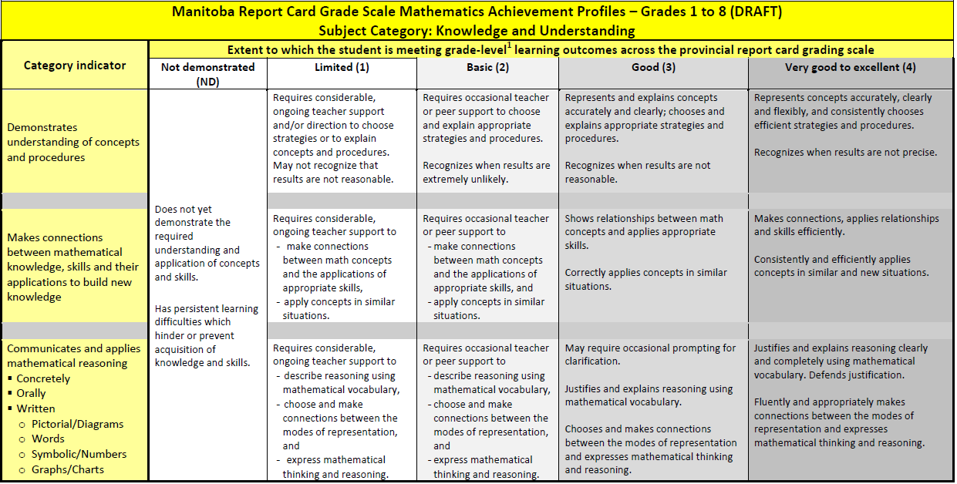
Assessment
LANGUAGE ARTS |  |  |  |  | MATHEMATICS |  |  | SCIENCE |  |  | SOCIAL STUDIES
COMP. Listening & Viewing | COMP. Reading | COMM. Speaking & Represent. | COMM. Writing | Critical Thinking | Knowledge and Understanding | Mental Math & Estimation | Problem Solving | Knowledge and Understanding | Scientific Inquiry Process | Design Process & Problem Solving | Knowledge and Understanding | Research and Communication | Critical Thinking and Citizenship
 |  |  |  |  | x | x | x
https://www.edu.gov.mb.ca/k12/assess/report_cards/grading/profiles.html

Slide 7
Rubrics for Outcomes
 | Nd Student has not yet demonstrated an understanding of this concept | 1 Requires considerable, on-going teacher support. | 2 Requires occasional, teacher or peer support | 3 Accurate, clear, uses appropriate strategies & procedures. Requires occasional prompting for clarification. | 4 Accurate, clear, flexible, consistent & efficient. Justifies and explains reasoning clearly and completely using accurate mathematical vocabulary.
Demonstrate an understanding of oral and written patterns and their corresponding relations. PR.1
Construct and graph a table of values from a relation, and analyze the graph to draw conclusions and solve problems. PR.2
Variables and Equations Algebraic Representations with Expressions and Equations Demonstrate an understanding of preservation of equality by modelling it and applying it to solve equations. PR.3
Explain the difference between an expression and an equation. PR.4
Evaluate an expression given the value of the variable(s). PR.5
Model and solve problems that can be represented by linear equations in the form: • x + a = b where a and b are integers and • ax + b = c • ax = b • x a = b, a ≠ 0 where a, b, and c are whole numbers. PR.6 PR.7

Slide 8
Question: What Do Patterns Have To Do With Math?
Teacher’s instructions: Show https://vimeo.com/128532018 discuss patterns students have noticed. Complete task https://www.youcubed.org/tasks/squares-upon-squares/ https://bhi61nm2cr3mkdgk1dtaov18-wpengine.netdna-ssl.com/wp-content/uploads/2017/03/Shapes-Task-Handout.pdf Step-by-step instructions for students: How do you see the pattern growing? How many squares are in figure 10? Explain how you know. How many squares are in figure 55? Explain how you know. How can you figure out how many total squares are in any figure?

Slide 9
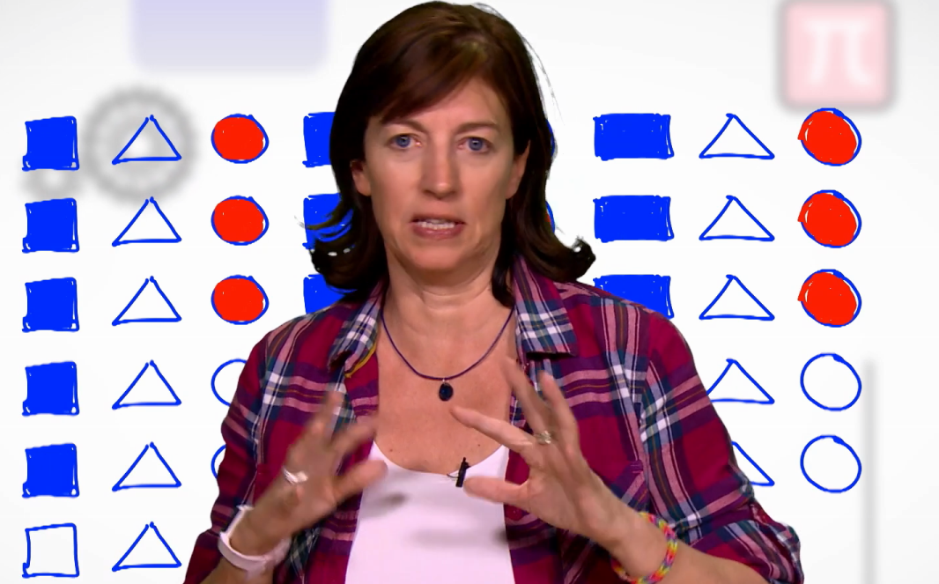
Question: What Do Patterns Have To Do With Math?
Teacher’s instructions (if needed): Show https://vimeo.com/128532018 discuss patterns students have noticed. Complete task https://www.youcubed.org/tasks/squares-upon-squares/ https://bhi61nm2cr3mkdgk1dtaov18-wpengine.netdna-ssl.com/wp-content/uploads/2017/03/Shapes-Task-Handout.pdf Step-by-step instructions for students: How do you see the pattern growing? How many squares are in figure 10? Explain how you know. How many squares are in figure 55? Explain how you know. How can you figure out how many total squares are in any figure?

Slide 10
Question: How Can We Describe Patterns?
Teacher’s instructions: Complete task https://www.youcubed.org/tasks/squares-to-stairs/ Step-by-step instructions for students: https://www.youcubed.org/tasks/squares-to-stairs/ How do you see the pattern growing? How many squares are in figure 10? Explain how you know. How many squares are in figure 55? Explain how you know. Can you use 190 squares to make a stair-like structure? Mathematically justify your answer. How can you figure out how many total squares are in any figure? If you have 1,478 squares, can you make a stair-like structure using all of the squares?
?
Notes:
How many shapes or terms do you need in order to be sure you know the pattern?

Slide 11
Question: How Can We Describe Patterns?
Teacher’s instructions: Preselect patterns from http://www.visualpatterns.org/ to display to your class. Samples provided in upcoming slides Ask for responses as to how they see the pattern change. Ask “Can you find a way to describe the changes you see so that others can follow your rule and get the same results?” How can you test this? Step-by-step instructions for students: How do you see the pattern change. Can you find a way to describe the changes you see so that others can follow your rule and get the same results? How can you test this?

Slide 12
How do you see the pattern change.
Can you find a way to describe the changes you see so that others can follow your rule and get the same results?
How can you test this?
http://www.visualpatterns.org/

Slide 13
?
?
How do you see the pattern changing?
What might the first and fourth shape look like?
How do you see the pattern change.
Can you find a way to describe the changes you see so that others can follow your rule and get the same results?
How can you test this?
Notes:
Use this slide or the Slide deck grade 7 cross pattern or the many other slide decks in the appendix
If you wish students to create their own pattern and submit pictures www.mathsbot.com has many virtual manipulatives available free of charge.

Slide 14
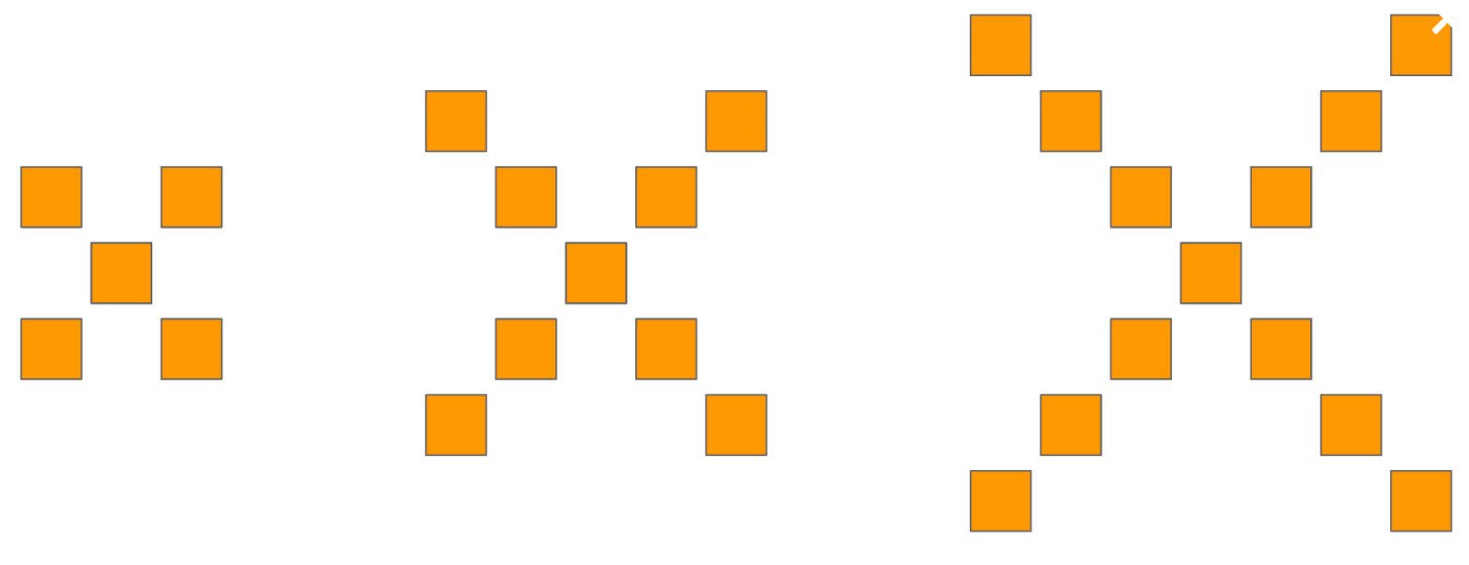
Question: How do we make a T chart from a pattern? Why is this useful?
Teacher’s instructions: Using the site visualpatterns.org have students examine the change in a pattern of your choice. Have the students record the change in the object as the picture changes. After several entries ask students to predict the next row. Step-by-step instructions for students: Examine the pattern you’re given. Examine the pattern of change and predict what the next shape would look like. Fill in a T table showing the change in pattern with each successive term. Is it easier for you to predict the next shape using the pattern or the T table?
Notes:
Student slide

Slide 15
Number of squares
shape
12345
5 9 13? ?
http://www.visualpatterns.org/

Slide 16
number of squares
term
2345
13 19? ?
?
What might the first term look like?
How do you see the pattern change.
Can you find a way to describe the changes you see so that others can follow your rule and get the same results?
How can you test this?
Notes:
Introduce the idea that the first shape is referred to as term 1, The 2nd shape is term 2 etc…..

Slide 17
Question: How do we make a picture from our T chart?
Teacher’s instructions: Use graph paper Virtual or otherwise to have students graph data from T charts they’ve developed from patterns. This may not be the time to have an in-depth discussion about dependent and independent variables so they will likely need help deciding which axis showed represent the terms and which to represent the number of tiles. By being selective about the patterns you explore you can ensure that the patterns are linear. Step-by-step instructions for students: Create a table of values for the pattern you are given. Use graph paper to record the data on your graph.
Notes:
(limited to discrete elements). Quadrant 1 on the cartesian plane
You may wish to try this 3 act task now (located in slide 51)https://tapintoteenminds.com/3act-math/placing-toothpicks/
This introduces the concept of independent and dependent variables

Slide 18
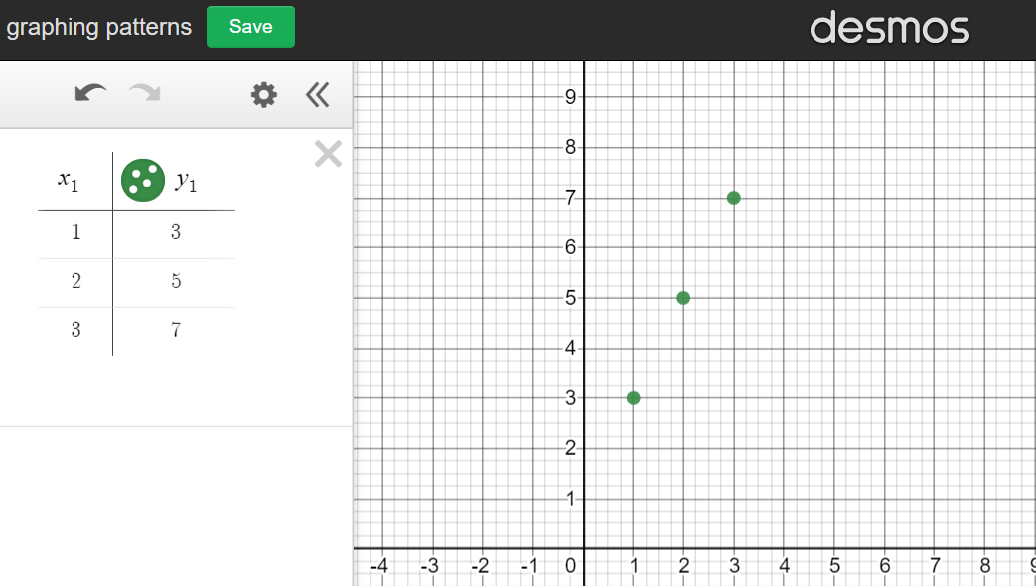
Question: How do we make a picture from our T chart?
Teacher’s instructions: ask students to use Desmos graphing calculator to make a T table for this pattern https://www.desmos.com/calculator
Notes:
(limited to discrete elements). Quadrant 1 on the cartesian plane

Slide 19
Question: How can we make a picture from our T chart?
Number of tiles
term
12345
3 5 7
? ?
Notes:
Match the graph to t chart

Slide 20
Match the graph to T table
Number of tiles
Number of tiles
Number of tiles
term
term
term
1234
2 4 6
8
1234
75 3 1
1234
3 4 5
6
Notes:
Teachers if you choose to use Desmos, perhaps delete the graphs on this page and have students generate the graphs using the T table data.

Slide 21
Question: How do We Identifying a Linear Relationship?
Teacher’s instructions: Discuss the change students see in the patterns that you’ve explored so far in this sequence of lessons. Recalling these patterns may be helpful. Identify the patterns which change at a consistent rate. These are linear relationships. The rest of this topic will focus on linear relationships. Non linear relationships are explored in subsequent grades. Show how T table data can be plotted on a graph. A straight line on a graph indicates a linear relationship. In this case a rule can be found and an equation can be developed. What clues in the table of values suggests that a relationship is linear? Step-by-step instructions for students: Study the t tables and graph that follow. For each ask: Is the relationship between the term and the number of titles linear? How do you know? What clues in the table of values suggests that a relationship is linear? What clues in the graph suggests that a relationship is linear?

Slide 22
Study the T chart and the graph:
Is the relationship between the term and the number of tiles linear?
How do you know?
Number of tiles
term
12345
3 5 7
? ?
Notes:
Include a pattern

Slide 23
Study the T chart and the graph:
Is the relationship between the term and the number of tiles linear?
How do you know?
Number of tiles
term
12345 6
18 15 12
9 6 ?
Notes:
This may be the first decreasing pattern the students have explored. See visualpatterns.org for more decreasing patterns or simple reverse previously used increasing patterns.

Slide 24
Study the T chart and the graph:
Is the relationship between the term and the number of tiles linear?
How do you know?
Number of tiles
term
12345
3 6 15
36 ?

Slide 25
Use a coins, buttons, bits of paper or other items you have available to make a linear pattern whose 1st term is 3 and each term after increases by 2.
Number of tiles
term
12345
3 ? ?
? ?
How do you know the relationship between the term and the number of tiles linear?
Notes:
Encourage students to share there patterns via the method most suited in your current context.
How many shapes or terms do you need in order to be sure you know the pattern?

Slide 26
Question: How do we make a rule from a pattern?
Teacher’s instructions: a rule can be made by examining the change in a table of values Step-by-step instructions for students: Make a T chart of a pattern. Make note of the change with each term. To find the starting number take the first total and subtract the change For this example the rule is start at 1 and add 3 with each term
Number of tiles
term
12345
4 7 10
13 ?
+3
+3
+3
The change is +3
The starting number is 4 – 3 = 1
This Photo by Unknown Author is licensed under CC BY-SA-NC
Notes:
Note a rule can be written as an EXPRESSION. Eg. Start a pattern at 2 and add 3 each time could be 3x+2.
This differs from an equation because it represents the pattern, not specific values within the pattern. These can be easily distinguished as equations must contain = signs.

Slide 27
Question: How do we make a rule from a pattern?
Teacher’s instructions: Rules can be made by examining the pattern Step-by-step instructions for students: Examine the pattern. Try to identify what part of the pattern repeats in each term. Circle the part that repeats. The left over is the starting number. In this example it’s 1 The rule here is start at 1 and add 3 for each term
This Photo by Unknown Author is licensed under CC BY-SA-NC

Slide 28
Use a strategy of your choice to make a rule for these patterns
http://www.visualpatterns.org/181-200.html
Does your rule give you a clue as to which of these patterns are linear?
For the linear patterns write your rule as an expression
Notes:
Encourage students to share there patterns via the method most suited in your current context. You may wish to create a new slide for each pattern.
How many shapes or terms do you need in order to be sure you know the pattern?

Slide 29
Create a linear pattern using object readily available to you.
How do you know this is a pattern?
Be sure to record your rule
Write your rule as an expression.
Submit a photo or file along with the expression of your pattern to your teacher.
Pattern may be shared with your fellow scholars
Notes:
Encourage students to share their patterns via the method most suited in your current context.
How many shapes or terms do you need in order to be sure you know the pattern?

Slide 30
Question: How does a rule become an Equation and what is it good for?
Teacher’s instructions: Rules can become expressions and expressions can become equations when we want to find out an unknown value using what we already know about the pattern Step-by-step instructions for students: Examine the pattern. Try to identify what part of the pattern repeats in each term. Circle the part that repeats. This is the Coefficient. (the number in front of the variable in this example it’s 3) The left over is the constant. In this example it’s 1. The equation for this pattern is y= 3x+1
Number of tiles
term
12345
4 7 10
13 ?
+3
+3
This Photo by Unknown Author is licensed under CC BY-SA-NC
Notes:
Note: Rules can also be made by examining the pattern

Slide 31
Question: How does a rule become an Equation and what is it good for?
Teacher’s instruction: Rules can become equations when we use what we know to find out new data. For example ‘a pattern starts at 5 and adds 2 for each term.” can become total number = 2(term) + 3, or y = 2x +3, where x = the term and Y = the total number required to make the shape. Step-by-step instructions for students: Make a T table of a pattern. Make note of the change with each term. This is the coefficient (the number in front of the variable). The difference between the change and the 1st total is the constant In this example the change is +2 and the difference between the 1st term number and the change is 5-2=3 The equation for this pattern is y= 3x+2
term
number
1
2
3
4
5
7
9
11
Notes:
Note: Rules can also be made by examining the T table

Slide 32
Use a strategy of your choice to make an equation for each pattern
http://www.visualpatterns.org/181-200.html
Notes:
Encourage students to share their patterns via the method most suited in your current context.
How many shapes or terms do you need in order to be sure you know the pattern?

Slide 33
Use a strategy of your choice to make an equation for each pattern
Notes:
Encourage students to share there patterns via the method most suited in your current context.
How many shapes or terms do you need in order to be sure you know the pattern?

Slide 34
Create a linear pattern using object readily available to you.
How do you know this is a pattern?
Be sure to record your rule
Create an equation for your pattern
Submit a photo or file of your pattern to your teacher.
Pattern may be shared with your fellow scholars
Notes:
Encourage students to share their patterns via the method most suited in your current context.
How many shapes or terms do you need in order to be sure you know the pattern?

Slide 35
Question: What is preservation of equality?
Teacher’s instructions:
- 6
- 6
Preservation of equality is the idea that any operation applied to one side of the equation must also be applied to the other side of the equation to ensure the sides remain equal.
Any operation is permitted however not all will help solve for an unknown.
5 + 4
=
2 + 7
x 5
x 5
5 + 3
=
2 x 4
Step-by-step instructions for students:
What needs to be done to the other side in order for the equations on the next page to remain equal.
÷ 4
÷ 4
9 + 3
=
2 x 6

Slide 36
Question: What is preservation of equality?
- 4
- ?
- 5
?
5x+ 4
=
14
5 + 4x
=
37
+ 3
+ ?
?
?
2x - 3
=
2 x 4
5x + 3
=
58
x 3
?
$$\frac{2x}{3}$$
x ?
?
=
6
9x + 3
=
21
Notes:
Whatever we do to one side we do to the other is the idea behind the preservation of equality.
When combined with the zero principal these two concepts make powerful problem solving strategies.
Zero principle refers to when the preservation of equality is applied to an equation resulting in opposite values.
Note in the 1st example above. -4 is added to both sides.

Slide 37
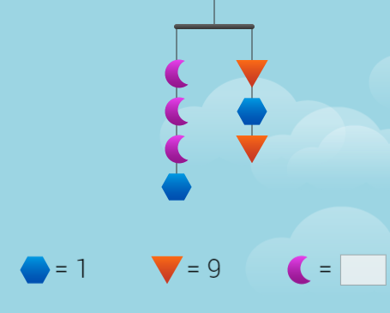
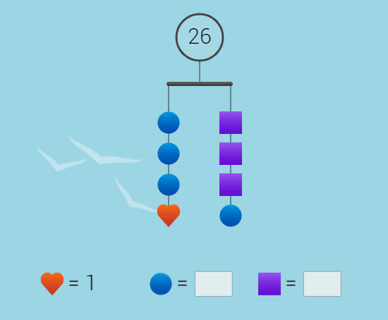
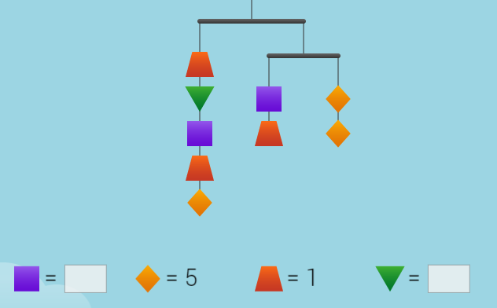
Solve for the value of all shapes
Visit https://solveme.edc.org/mobiles/ to solve more mobile puzzles and even create your own.
Be sure to share your creation with your class

Slide 38
Question: What is the zero principle?
+4 and -4 are opposite integers because they are both the same distance away from 0 yet on opposite sides. The “net” worth of opposite integers is 0.
There are a total of 10 disks below. 6 negative disks and 4 positive disks. If the red represents negative numbers and the yellow represents positive values then we have an example of the Zero Principle. The net worth of these disks is - 2
Notes:
Zero principle refers to when the preservation of equality is applied to an equation resulting in opposite values.

Slide 39
Question: What is the zero principle?
+1 and -1 are opposite integers because they are both the same distance away from 0 yet on opposite sides. The “net” worth of opposite integers is 0.
If the red represents negative numbers and the yellow represents positive values then we have an example of the Zero Principle. The net worth of these disks is - 3
Notes:
Zero principle refers to when the preservation of equality is applied to an equation resulting in opposite values.
We can use zero principles to simplify equations

Slide 40
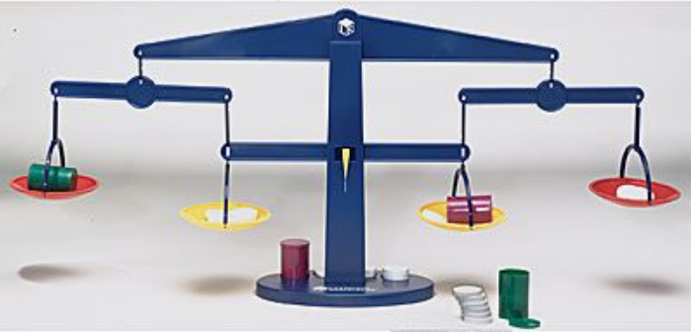
Question: What is the zero principle?
Demonstrating the zero principle using a 4 pan balance
Notes:
Zero principle refers to when opposite values have a net sum of zero.
Note about using math tools. Ensure transfer from concrete to symbolic by asking “What does that look like on paper?”

Slide 41
2
What is hidden if the total is +2
www.stevewyborney.com
Adapted from Steve Wyborney
Notes:
How is it that this total can be +2?

Slide 42
0
What is hidden if the total is…………..
www.stevewyborney.com
Adapted from Steve Wyborney

Slide 43
3
What is hidden if the total is…………..
www.stevewyborney.com
Adapted from Steve Wyborney

Slide 44
4
What is hidden if the total is…………..
www.stevewyborney.com
Adapted from Steve Wyborney

Slide 45
-2
What is hidden if the total is…………..
www.stevewyborney.com
Adapted from Steve Wyborney

Slide 46
Creating Zero
Using the digits 1-9 at most one time each, fill in the boxes to make the equality true:
( ____ + ____ - ____ + ____ ) – ( ____ + ____ - ____ + ____ ) = 0
https://www.openmiddle.com/creating-zero/

Slide 47
Question: Using our Data look ahead
Teacher’s instructions: If you know the rule is start at 2 and add 3 for each term, then the equation is y = 3x + 2 You can use this to predict future events. For example if you want to find out how many tiles in the 25 term you can use your new strategies to find out. Put the 25 in place of the variable. y = 3 (25) + 2 Now you can solve for the 25th term. y = 75 + 2 y = 77 The 25th term will use 77 tiles.
Notes:
Using equations to find explicit data

Slide 48
Question: Using our Data look ahead
Teacher’s instructions:
You can also see if any term will use exactly a specific number of tiles.
Will any term use exactly 48 tiles?
Start with your equation y = 3x + 2. substitute 48 in place of the variable for number of tiles ( y )
48 = 3x +2 use the zero principle to simplify the equation. -2 -2
46 = 3x
46 ÷ 3 = 3x÷3
15.3333 = x
now you know what 3x is. To find what 1x is divide both sides by 3.
x is the number of terms. Since you can’t have a fraction of a term you know no full term in this pattern will contain exactly 48 tiles.
Notes:
Using equations to find explicit data

Slide 49
Question: Using Our Data to Look Ahead
Demonstrating the zero principle and how it is used to solve equations
Notes:
Zero principle refers to when the preservation of equality is applied to an equation resulting in opposite values.
We can use zero principles to simplify equations
Note about using math tools. Ensure transfer from concrete to symbolic by asking “What does that look like on paper?”

Slide 50
Examine the pattern.
Create a T table
Generate a rule
Use the rule to generate an equation.
Use the equation to find out how many tiles in the 40th term.

Slide 51
How many tiles in the 80th term?

Slide 52
Create a linear pattern using object readily available to you.
How do you know this is a pattern?
Be sure to record your rule.
Create an expression for your pattern
Submit a photo or file of your pattern to your teacher.
Use the strategies we’ve explored to find the number of tiles in 100th term

Slide 53
Question: What does it look like when we put it all together?
Teacher’s instructions: The following slides illustrate examples of how you can present questions that allow students to put together everything they have learned in this exploration.
Notes:
T table = graph = equation

Slide 54
?
?
This shape is a part of a pattern. ?
What might the previous shape and the next shape look like?
What would a graph of this pattern look like?
How many squares would be in the 50th term in your pattern?
Be sure to make your thinking visible.
How will you share your thinking?

Slide 55
?
The 5th term in a shrinking pattern uses at least 7 tiles.
What might the previous shape and the next shape look like?
What would a graph of this pattern look like?
Will your pattern go on forever? How do you know?
Be sure to make your thinking visible.
How will you share your thinking?

Slide 56
?
A term in a linear pattern contains 6 tiles another contains 15 tiles. These terms are not beside each other.
What is the smallest number of terms between these t tow shapes? How do you know?
What might this look like?
What would a graph of this pattern look like?
Would any term contain exactly 48 tiles?
Be sure to make your thinking visible.
How will you share your thinking?

Slide 57
Is this Letter H pattern increase linear? How do you know?
Do the patterns of all letters increase linearly?
Are there any letters whose patterns cannot be designed to increase linearly?
Which letters result in patterns that increase most rapidly?
Choose several letters to explore and then represent their patterns using rules, equations, T tables and graphs
Mindset Mathematics: Visualizing and Investigating Big Ideas, Grade 7
Jo Boaler, Jen Munson, Cathy Williams
ISBN: 978-1-119-35801-5 July 2019 Jossey-Bass 304 Pages
Term 1
Term 2
Term 3
Notes:
Mindset Mathematics: Visualizing and Investigating Big Ideas, Grade 7
Jo Boaler, Jen Munson, Cathy Williams
ISBN: 978-1-119-35801-5 July 2019 Jossey-Bass 304 Pages

Slide 58
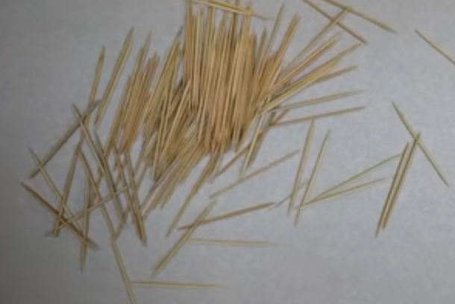
Patterning, Proportional/Direct Variation Linear Relations
3 act task
Try this
https://tapintoteenminds.com/3act-math/placing-toothpicks/

Slide 59
Try This
Desmos Rocks
https://teacher.desmos.com/activitybuilder/custom/5750c5d83c8122b616e6f4ae

Slide 60
Try This
Desmos Rocks
https://teacher.desmos.com/activitybuilder/custom/58798fc7e338613f05a42feb?collections=5e72d28669f1f80f4025bcc1

Slide 61
Credit: Jerrold Wiebe - Pembina Trails
Reviewers: Scott Dempster – St James Assinibione school Division
Charmaine Mackid – Hanover School division

