Slide 1
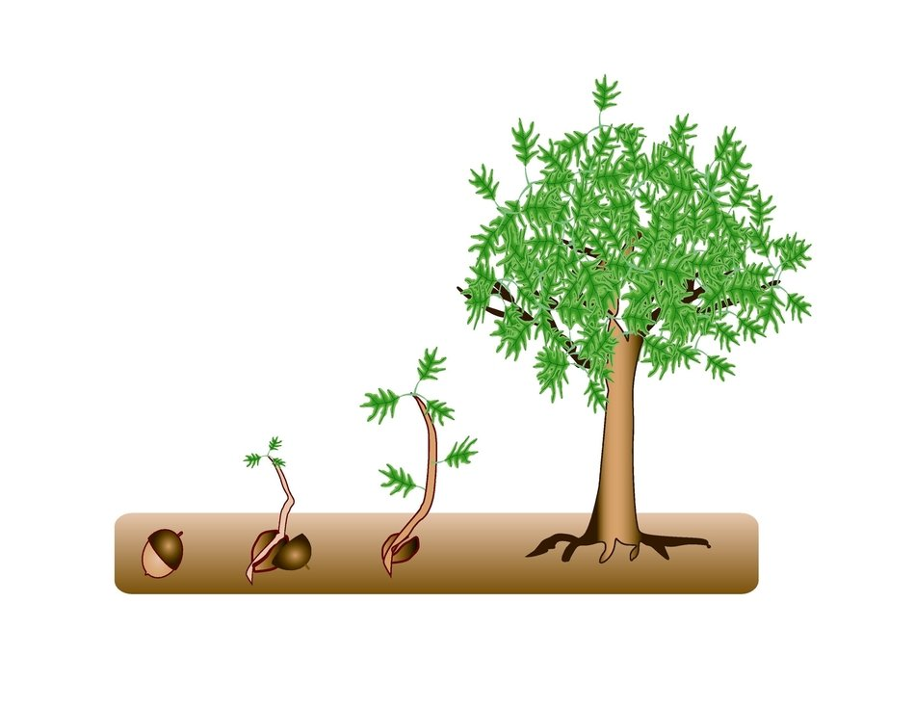
How do you GROW a positive mindset?
Notes:
Image source: https://pixy.org/src/447/4473268.jpeg

Slide 2
Guiding Concepts
Anchored in inquiry
Open ended questions, student centered, student choice
Low floor, high ceiling tasks
Multiple ways to show understanding

Slide 3
Curricular Outcomes
These are non-curricular specific tasks (they cover a range of topics and grade levels and can be adjusted as needed by the classroom teacher). They are intended to engage students in mathematical thinking for the purpose of gaining insight into their own mathematical mindset.
Most learning experiences in this power point package are intended for grades four and up, however they can be adapted for your grade level or goals.
Notes:
Specific to grade level outcomes, could include multiple disciplines (Math, ELA…)

Slide 4
Enduring Understandings:
Fostering the development of a positive mathematical mindset is essential to student’s mathematical identity in which they believe all learners can excel in mathematics at a high level.
Essential Questions:
What do you do when things get challenging?
What happens when things don’t go your way?
What is going on in your brain when you draw out an idea?
Why does it help to work together?
Why do we ask questions?
When does the benefit outweigh the risk?

Slide 5
Materials
If this is the first-time students are experiencing virtual manipulatives, it is highly recommended that students are allow time to "play". This provides students the opportunity to explore and have fun with the tools BEFORE they will be required to use them purposefully.
Websites for virtual manipulatives are suggested. Hands-on materials are ideal. Significant learning occurs when students can build and visualize different representations of mathematics.
If School Divisions have another platform for delivering online instruction (i.e., See Saw, Google Classrooms), asynchronous tasks can be uploaded there.
For virtual manipulatives visit https://toytheater.com/category/teacher-tools/virtual-manipulatives/
To enhance their learning experiences students will need:
Base ten blocks https://www.coolmath4kids.com/manipulatives/base-ten-blocks
Coloured counters https://toytheater.com/color-counters
Some premade manipulatives have been provided on specific slides
Notes:
This would be general information to the teacher about the

Slide 6
Instructions
This collection of tasks is designed around the concept of Growth Mindset. Each section represents independent sets of 3-part learning experiences that could function effectively as 1–2-hour sessions with a combination of synchronous and asynchronous parts, some of which are easily adaptable either way depending on your situation and access to technology and connectivity.
FOR SYNCHRONOUS LEARNING, THE SLIDEDECK SHOULD BE IN EDIT MODE.
Each section has been divided into 3 main parts. Each part provides various ways of engaging with the concept:
What is it? And do I have it?: Students begin by assessing their current state and exploring each of the characteristics of mindset.
Challenges: This section provides students with choice of task and is designed to challenge their identity related to the characteristic being explored. Teachers/Students can choose to complete 1 or more of these challenges while they explore the mindset characteristic. These activities can be completed either individually or with students working in pairs or small groups. If your platform allows for breakout rooms, this feature is a good tool that will facilitate student collaboration and discourse.
Reflect: Students will have the opportunity to reflect on the growth of the mindset characteristic relating to their previous identification at the beginning of the learning experience. Students are asked to reflect as well as plan for improvement to reinforce fostering a growth mindset.
Notes:
This would be general information to the teacher about the

Slide 7
GROWTH MINDSET
Flexibility
Collaboration
Visualization
Perseverance
Risk Taking
Curiosity
Fostering Curiosity
Notes:
Image source: https://openclipart.org/detail/308903/umbrella

Slide 8
PERSEVERANCE
What do you do when things get challenging?

Slide 9
1.
What is it?
And do I have it?
2.
Select at least 1 of the challenges to work on:
3.
Reflect on your experience.
Gather information
So many Sevens!
Write About It
Mondrian Art
or,
Collect your thoughts
Record It
Self Assess
Pattern Challenge
Notes:
Understand what it is / put yours to the test / reflect on the experience
Image Source:
https://openclipart.org/detail/172707/edit-icon-icono-editar (pencil and paper)
https://openclipart.org/detail/212116/screencast (record)
https://openclipart.org/detail/70135/manga-eyes (eyes)
https://openclipart.org/detail/122155/pencil (pencil)
https://www.uihere.com/free-cliparts/brain-clip-art-head-2099525 (brain)

Slide 10
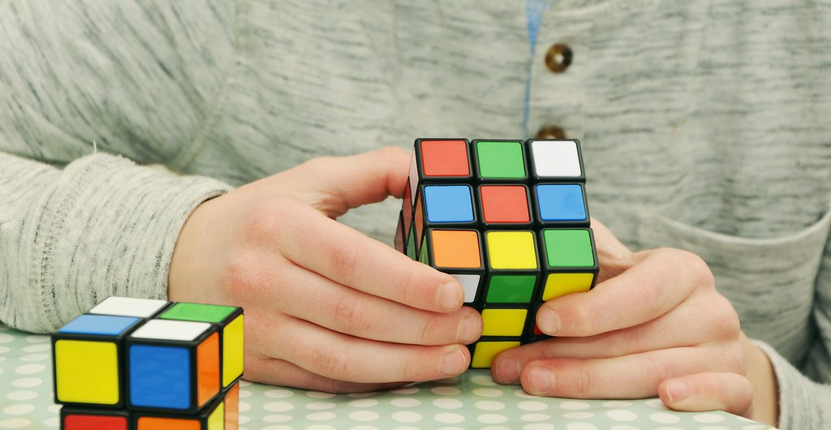
VIDEO to watch
We all have obstacles to overcome!
The link below will let you explore stories of perseverance of some people you may have seen or heard about before..
Choose a story here!
Notes:
Video: https://youtu.be/2MGMvEnoD6U
Source: ClassDojo Task- The Dip (https://ideas.classdojo.com/i/discovering-the-dip)
Image Source: https://pxhere.com/en/photo/1374906
https://openclipart.org/detail/70135/manga-eyes (eyes)

Slide 11
PERSEVERANCE ^{(collect your thoughts)}
What does it LOOK like?
What does it SOUND like?
What does it FEEL like?
Notes:
Image Source
https://www.uihere.com/free-cliparts/brain-clip-art-head-2099525 (Brain)

Slide 12
Based on what you’ve learned about perseverance, describe…
A personal challenge you are facing:
What are you doing or what do you think you could do to help keep you on track to reaching your goals?
Drag the black arrow below to show the level of perseverance you believe you usually have during challenging tasks:
Low level of perseverance
High level of perseverance
Notes:
Image Source: https://openclipart.org/detail/122155/pencil (pencil)

Slide 13
So Many Sevens
If you were to write the numbers from 1 to 1 000, how many times would you need to write the digit 7?
Show how you know.
Notes:
Adaptation– numbers from 1 to 100
Extension– numbers from 1 to 10 000

Slide 14
Modrian Art Challenge:
The Rules:
Completely cover the square grid with rectangles.
All rectangles must have different dimensions (ex. 4x5 and a 5x4 rectangle cannot exist on the same grid).
Rectangles with the same area can exist together on the grid (ex. 2x6 and 3x4 are fine).
Your score:
Subtract the area of your smallest rectangle from the area of your largest rectangle. Smallest score possible!
Mondrian Art Challenge
Example:
score for this 5x5 grid…
10 – 2 = 8
3
My Score:
6
10
To change colours on the grid, highlight the squares you want to cover and use the “shape fill” button to make different colours.
2
4
Notes:
Source: Adapted from https://mathpickle.com/wp-content/uploads/2015/08/Mondrian-Art-Puzzles.pdf

Slide 15
Mondrian Art Challenge
(more space)
8 x 8 Grids to play on:
My Score:
My Score:

Slide 16
Mondrian Art Challenge (extension)
Does your thinking change if it’s a 9 x 9 grid?
My Score:
My Score:

Slide 17
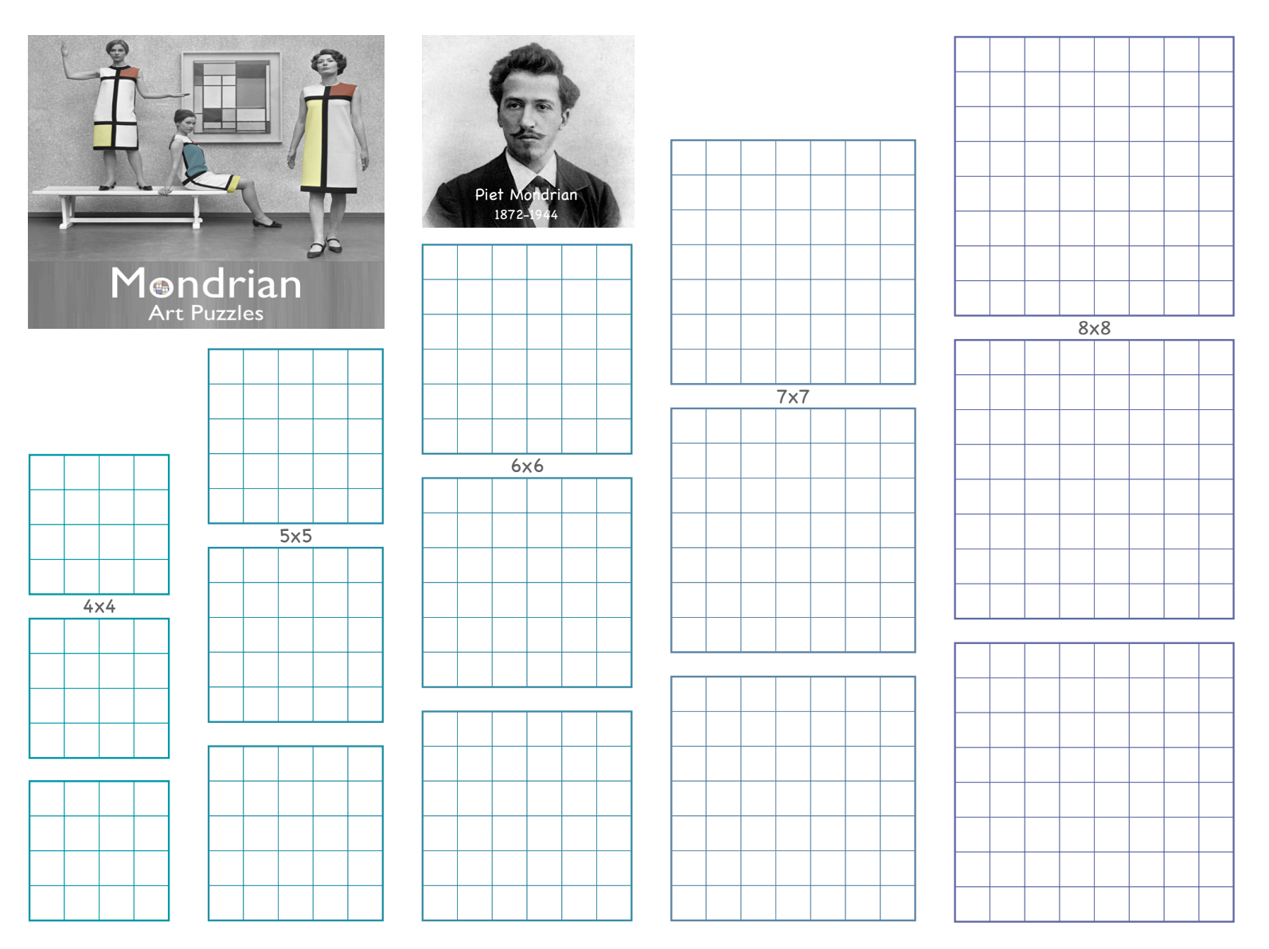
Mondrian used to work in ink, so could not erase his work!
With 3 attempts, what is the smallest score possible for each grid size?
What do you think the smallest score would be for a 100x100 grid? Is it possible to know?
Notes:
Image screen shot from Math Pickle (https://mathpickle.com/mondrian-art-puzzles-solutions/).

Slide 18
How do you see this pattern growing?
What would the next few terms of the pattern look like?
What would the 10th term look like?
Can you find a way to figure out what the 25th term would be without needing to build or draw all the terms before it?
Sketch and describe what the 43rd term would look like.
Can you figure out how many cubes you would need to build it?
Pattern Challenge
Notes:
K-3 pattern
Source: http://www.visualpatterns.org/1-20.html
Questions could be split onto multiple slides and led as a synchronous activity.

Slide 19
Now that you have spent time working on some challenging tasks, consider again how you would assess your ability to persevere. Without looking back at your first slider, place the arrow on the line below.
Low level of perseverance
High level of perseverance
Once you are confident about where you have placed your arrow on the line above, go back and compare to where you placed it before.
Did your level of perseverance grow?
What actions can you take to develop greater perseverance?
Reflect
19
Notes:
Image Source:
https://openclipart.org/detail/172707/edit-icon-icono-editar
https://openclipart.org/detail/212116/screencast

Slide 20
FLEXIBILITY
What happens when things don’t go your way?

Slide 21
1.
What is it?
And do I have it?
2.
Select at least 1 of the challenges to work on:
3.
Reflect on your experience.
Gather information
How close can you get?
Write About It
Quarter the Cross
or,
Collect your thoughts
Record It
Self Assess
Solve This
Notes:
Understand what it is / put yours to the test / reflect on the experience
Image Source:
https://openclipart.org/detail/172707/edit-icon-icono-editar (pencil and paper)
https://openclipart.org/detail/212116/screencast (record)
https://openclipart.org/detail/70135/manga-eyes (eyes)
https://openclipart.org/detail/122155/pencil (pencil)
https://www.uihere.com/free-cliparts/brain-clip-art-head-2099525 (brain)

Slide 22
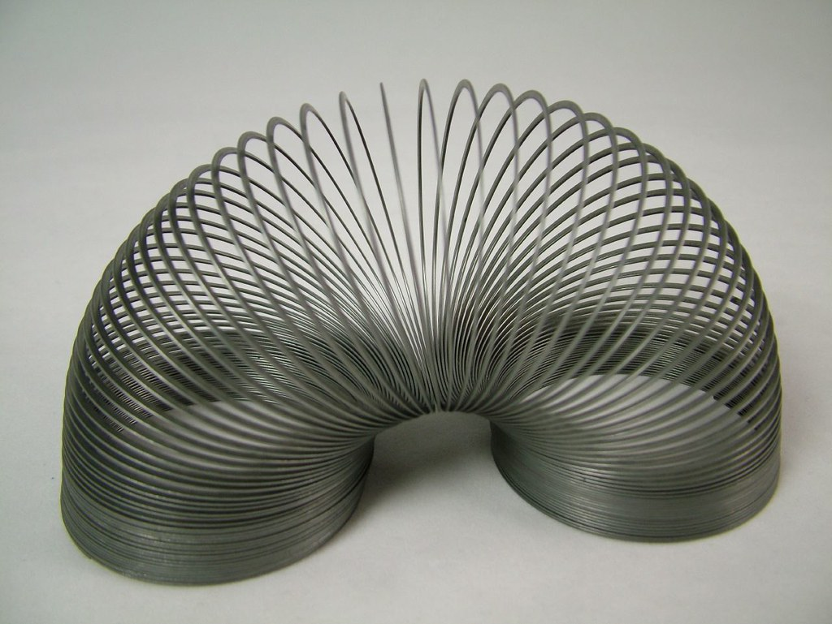
Watch the video “Soar”
Now think about a slinky.
How does a slinky show flexibility?
How did the kid in “Soar” show flexibility?
Notes:
Video Source: https://www.youtube.com/watch?v=UUlaseGrkLc
Image Source: "Slinky" by unloveablesteve is licensed with CC BY-NC-SA 2.0. To view a copy of this license, visit https://creativecommons.org/licenses/by-nc-sa/2.0/
https://openclipart.org/detail/70135/manga-eyes (eyes)

Slide 23
FLEXIBILITY ^{(collect your thoughts)}
What does it LOOK like?
What does it SOUND like?
What does it FEEL like?
Notes:
Image Source: https://www.uihere.com/free-cliparts/brain-clip-art-head-2099525

Slide 24
Based on what you’ve learned about flexibility, describe…
A time where you had to change your plan(s):
When you find something challenging, how can you approach the solution?
Drag the black arrow below to show level of flexibility you believe you usually have during challenging tasks:
Not at all flexible
Super Duper Flexible
Notes:
Image Source: https://openclipart.org/detail/122155/pencil (pencil)

Slide 25
Use all the digits below only once each and any operations to make a number as close to 4618 as possible.
Digits can be combined to form a larger number (5, 7 and 3 may be written as 573).
How close can you get?
Notes:
Source: Adapted from NCTM

Slide 26
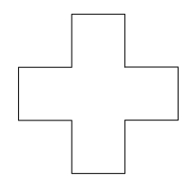
Colour in one quarter of the cross. Make sure it is exactly one quarter!
Can you do it another way?
Quarter the Cross

Slide 27
Choose one. How would you solve it?
Solve This
4 x 53
14 x 53
Can you do it another way?
Notes:
Present different questions to meet the needs of your students.

Slide 28
Now that you have spent time working on some challenging tasks, consider again how you would assess your ability to be flexible. Without looking back at your first slider, place the arrow on the line below.
Not at all flexible
Super duper flexible
Once you are confident about where you have placed your arrow on the line above, go back and compare to where you placed it before.
Did your level of flexibility grow?
What actions can you take to develop greater flexibility?
Reflect
28
Notes:
Image Source:
https://openclipart.org/detail/172707/edit-icon-icono-editar
https://openclipart.org/detail/212116/screencast

Slide 29
Visualization
What is going on in your brain when you draw out an idea?

Slide 30
1.
What is it?
And do I have it?
2.
Select at least 1 of the challenges to work on:
3.
Reflect on your experience.
Gather information
Time to subitize
Write About It
How do you see it growing?
or,
Collect your thoughts
Record It
Self Assess
Visualizing the symbolic
Notes:
Understand what it is / put yours to the test / reflect on the experience
Image Source:
https://openclipart.org/detail/172707/edit-icon-icono-editar (pencil and paper)
https://openclipart.org/detail/212116/screencast (record)
https://openclipart.org/detail/70135/manga-eyes (eyes)
https://openclipart.org/detail/122155/pencil (pencil)
https://www.uihere.com/free-cliparts/brain-clip-art-head-2099525 (brain)

Slide 31
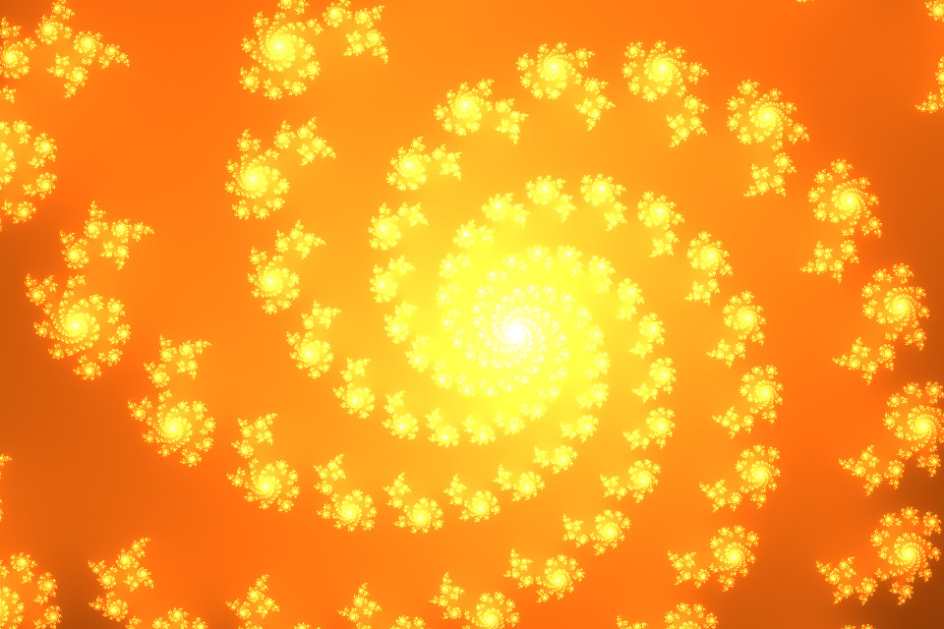
Watch the video on “Brain Crossing” by Dr. Jo Boaler.
When have you visualized a problem in math?
Why do you think your brain decided it was best to visualize the problem?
Do you think we can visualize anything in math?
Brain Crossing
Notes:
Video: https://youtu.be/FWKzfXvxnkM
Image Source: "iPhone Background - Swirl" by Patrick Hoesly is licensed with CC BY 2.0. To view a copy of this license, visit https://creativecommons.org/licenses/by/2.0/
https://openclipart.org/detail/70135/manga-eyes (eyes)

Slide 32
VISUALIZATION ^{(collect your thoughts)}
What does it LOOK like?
What does it SOUND like?
What does it FEEL like?
Notes:
Image Source: https://www.uihere.com/free-cliparts/brain-clip-art-head-2099525

Slide 33
Based on what you’ve learned about visualization…
Describe or show how you could make the following more visual:
5 x 3 = 15
The perimeter of the octagon is 32 cm
Drag the black arrow below to show how comfortable you are imagining or drawing out a math idea as a picture:
Never Imagine or Draw Ideas Out
Always thinking in sketches and pictures
Notes:
Image Source: https://openclipart.org/detail/122155/pencil (pencil)

Slide 34
Time to Subitize
There are many different ways people see and record images in their mind.
In a moment, you will see an arrangement of dots on an otherwise blank screen.
You will only see them for about 3 seconds.
Afterwards I’m interested in your answers to two questions:
How many dots did you see?
How did you see them?
Let’s see how your brain records the information!
Notes:
This activity will be best delivered by sharing your screen in PRESENT mode. You do not want students to see the thumbnail slides on the left! This will also allow you to control the length of time the arrangement of dots is visible to students.
Source: www.youcubed.org

Slide 36
How many dots did you see?
How did you see them?
Notes:
Use this slide to record the thinking of the first 2-3 students who share. The next slide can be used to save you the time of redrawing the arrangement over and over again.

Slide 38
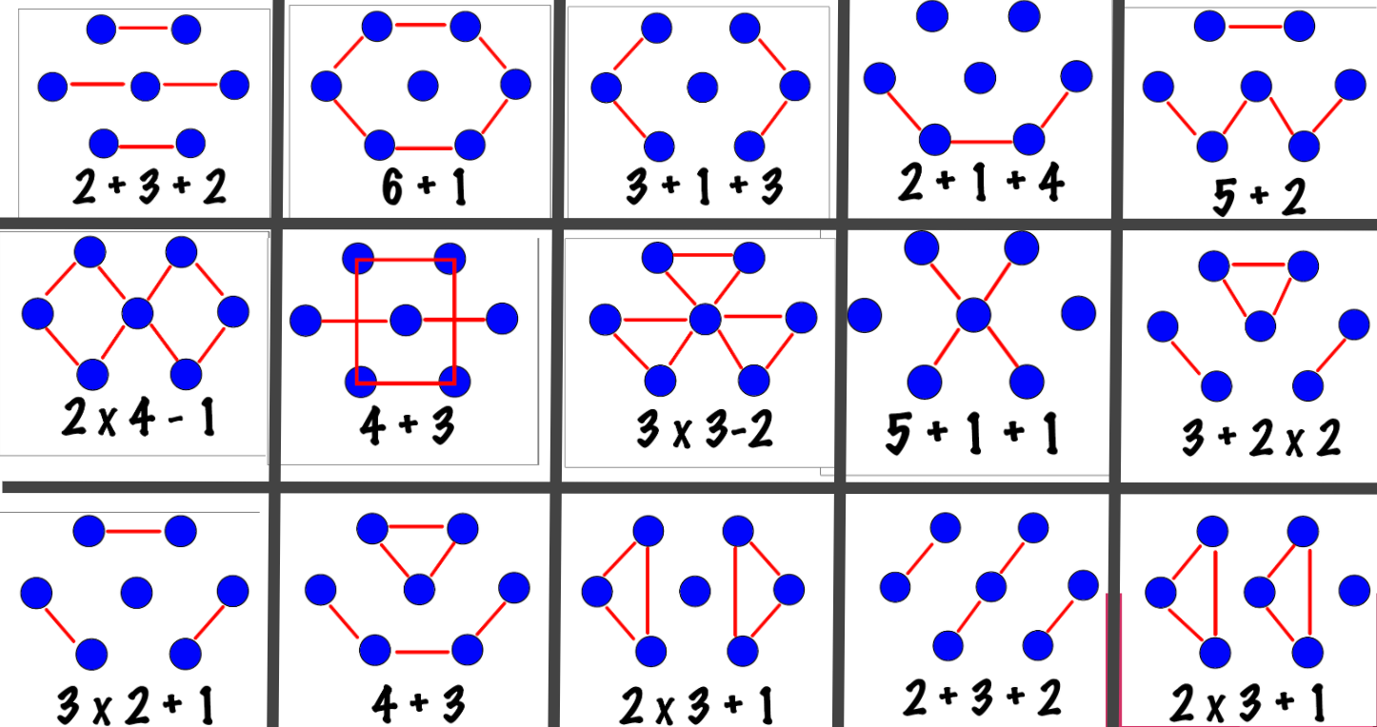
Sample student responses and how you might record them:
“I saw like a tie fighter from Star Wars, three on each side and one in the. middle.”
“I saw a W and then a pair across the top.”
“I saw 3 horizontal lines, two on top, then a line of 3 and then another line of 2.”
“I saw two diamonds! They overlapped in the middle.”
Notes:
Example of some possible student thinking. The RED lines show HOW students grouped the dots together, the number sentence reflects how mathematically they could use their way of thinking to arrive at the total number of dots.

Slide 39
Have a good look at the first three terms of the pattern below.
Describe in words how you see it growing.
How do you see it growing?
Use the fill tool above to color in the squares to illustrate how you see it growing.
Notes:
Source: www.youcubed.org

Slide 40
Student Name:
Notes:
This slide is for teacher use to collect a variety of student thinking. If possible you could copy and paste student work instead of filling in all the boxes.

Slide 41
How do you see it growing?
Two possible examples (there are more)!
Notes:
For teacher reference only!
Source: www.youcubed.org

Slide 42
How do you see it growing?
How many squares would there be in the 10th term of the pattern?
Show how you figured it out:
Notes:
This follow-up task can be adjusted for grade level. Younger students could be asked to draw the next term, the next few terms, older students could be asked about the 10th, 50th, 100th or n^{th} term.
Source: www.youcubed.org

Slide 43
Visualizing the symbolic
Select one of the following questions to solve using pictures or diagrams:
286 + 365
12 x 16
Represent the number 17 in at least 3 different ways without using symbolic numbers.
What does each representation show you about the number?
Place the following numbers on a number line: zero, one million, one billion
Tell how you decided where they belong.
Notes:
You may have to adjust these problems to better suit your grade level. Select straightforward symbolic tasks that

Slide 44
Student Work Page
Copy the question from the previous page that you have selected to solve.
Use the space below to solve and show your thinking.
Visualizing the symbolic
Notes:
You may have to adjust these problems to better suit your grade level. Select straightforward symbolic tasks that

Slide 45
Now that you have spent time working on some challenging tasks, consider again how you would assess your level of using visualization. Without looking back at your first slider, place the arrow on the line below.
Never Imagine or Draw Ideas Out
Always thinking in sketches and pictures
Once you are confident about where you have placed your arrow on the line above, go back and compare to where you placed it before.
Did your visualization skills grow?
What actions can you take to develop greater visualization skills?
Reflect
45
Notes:
Image Source:
https://openclipart.org/detail/172707/edit-icon-icono-editar (pencil)
https://openclipart.org/detail/212116/screencast (record)

Slide 46
COLLABORATION
Why does it help to work together?

Slide 47
1.
What is it?
And do I have it?
2.
Select at least 1 of the challenges to work on:
3.
Reflect on your experience.
Gather information
Magic Circles
Write About It
The Game of Nim
or,
Collect your thoughts
Record It
Self Assess
The Four Fours
Notes:
Understand what it is / put yours to the test / reflect on the experience
Image Source:
https://openclipart.org/detail/172707/edit-icon-icono-editar (pencil and paper)
https://openclipart.org/detail/212116/screencast (record)
https://openclipart.org/detail/70135/manga-eyes (eyes)
https://openclipart.org/detail/122155/pencil (pencil)
https://www.uihere.com/free-cliparts/brain-clip-art-head-2099525 (brain)

Slide 48
Listen to the story Boxitects by Kim Smith.
In this story, the girls overcome their differences to work together.
Tell about a time when you had to overcome your differences with someone and work together .
How did the meercats show collaboration?
Notes:
There are read aloud versions on YouTube of “Boxitects”. Other Picture books like “Mixed: A Colorful Story” by Arree Chung and “Fruit Bowl” by Mark Hoffman are other titles that require collaboration
Video Source: https://youtu.be/6fbE52YDEjU
Image Source: https://openclipart.org/detail/70135/manga-eyes (eyes)
https://books.google.ca/books/about/Boxitects.html?id=M45_DwAAQBAJ&printsec=frontcover&source=kp_read_button&redir_esc=y#v=onepage&q&f=false

Slide 49
COLLABORATION ^{(collect your thoughts)}
What does it LOOK like?
What does it SOUND like?
What does it FEEL like?
Notes:
Image Source: https://www.uihere.com/free-cliparts/brain-clip-art-head-2099525

Slide 50
Things I like when working in a group on math….
Things I do not like when working in a group on math….

Slide 51
Based on what you’ve learned about collaboration, describe…
When do you like to collaborate with others?
Mathematicians often discuss their ideas and work together to solve challenging problems. What helps you work well in a group?
Drag the black arrow below to show level of collaboration you believe you usually have while solving challenging problems:
I prefer to work alone.
Let’s work together!
Notes:
Image Source: https://openclipart.org/detail/122155/pencil (pencil)

Slide 52
Magic Circles
Start with 8 chips or pieces of paper each one with one number 1-8.
Place the numbers one at a time, in consecutive order, in two piles,
so that no two chips in one pile have the sum of one chip in that same pile.
2 3
4
1 5
Chip #6 can't go in the red circle since 2 + 4 = 6
Chip #6 can't go in the green circle since 1 + 5 = 6
Notes:
Source:
Adapted from "Bubbling Cauldrons", https://mathpickle.com/project/4130/
In the Early Years, students benefit from lots of addition practice .
In Middle Years students start to look for patterns and using algebra to determine, "what is the highest number which can be placed if the rule Is the sum of 2 digits, 3 digits, 4 digits etc.?" "How high can you go with 3 circles, 3 circles, n circles"?

Slide 53
Magic Circles
Start with 8 chips or pieces of paper each one with one number 1-8.
Place the numbers one at a time, in consecutive order, in two piles,
so that no two chips in one pile have the sum of one chip in that same pile.
Notes:
Student Workspace

Slide 54
Extension:
Using the numbers 2-12, can you fit them in the two circles? The same rules apply.
Magic Circles
3
4
5 2
1
2
3
4
5
6
7
8
9
10
11
12

Slide 55
Extension:
Using the numbers 2-12, can you fit them in the two circles? The same rules apply.
Magic Circles
1
2
3
4
5
6
7
8
9
10
11
12
Notes:
Student work Space

Slide 56
Extension:
Add a third magic circle. How high can you get? The same rules apply.
Magic Circles
1
2
3
4
5
6
7
8
9
10
11
12

Slide 57
Extension:
Using two circles, how high can you get if you can use the sum of any three chips?
Magic Circles
1
2
3
4
5
6
7
8
9
10
11
12

Slide 58
The Game of Nim
Nim is a two-player game.
Start with a pile of counters.
On your turn, remove one or two counters from the pile. You must take at least one token on your turn, but you may not take more than two. Whoever takes the last token is the winner.
How can you win 1-2 Nim?
What would a perfect strategy look like?
Notes:
Essential Understandings: Counting, Operations with Whole Numbers, and Patterning Algebraic Thinking
Grades: K-8
Keywords: Addition, Counting, Divisibility, Logic, Patterns, Subtraction
Variations:
Change the size of the pile. This is a two person game. 1-2-3 Nim: players may take one, two, or three counters per turn. 3. Poison: Whoever fills up the 10-Frame loses.
Good questions for the teacher to ask students:
What move should I (the teacher) make?
How did you/they/I win that game?
What do you think your/my opponent will do if you/I take two counters?
Would you like to take back your move?
What have you noticed about this game
For students who have figured out the game, some challenge questions:
How would you win 1-2 Nim if you start with a pile of 20? 30? 100? 217?
These challenges can also apply to 1-2-3 Nim and Poison variations.
Source: https://mathforlove.com/lesson/1-2-nim/

Slide 59
The Four Fours
Can you find every number between 1 and 20 using only four 4’s and any operation?
4
4
4
4
Notes:
Teacher Notes
Duplicate the next slide for the number of groups you will have to complete this activity.
Place students into breakout rooms of 4-5 students each.
Students can then use an interactive whiteboard, or their group slide to share their thinking with one another.

Slide 60
Using EXACTLY four 4s and any operation ( + - x ÷ ), create an expression for each of the numbers from 1 to 20.
The Four Fours
1 =
2 =
3 =
4 =
5 =
6 =
7 =
8 =
9=
10 =
11 =
12 =
13 =
14 =
15 =
16 =
17 =
18 =
19 =
20 =
Notes:
Teacher Notes
Duplicate this slide for groups/students
Students can then use an interactive whiteboard, or their group slide to share their thinking with one another.
Students need to become comfortable with speaking with one another using their mics in math. Setting the norm that students need to talk with one another when in groups will help students become used to speaking with one another.

Slide 61
Now that you have spent time working on some challenging tasks, consider again how you would assess your ability to collaborate. Without looking back at your first slider, place the arrow on the line below.
I prefer to work alone.
Let’s work together!
Once you are confident about where you have placed your arrow on the line above, go back and compare to where you placed it before.
Did your level of collaboration grow?
What actions can you take to develop greater collaboration skills?
Reflect
61
Notes:
Image Source:
https://openclipart.org/detail/172707/edit-icon-icono-editar
https://openclipart.org/detail/212116/screencast

Slide 62
FOSTERING CURIOSITY
Why do we ask questions?

Slide 63
1.
What is it?
And do I have it?
2.
Select at least 1 of the challenges to work on:
3.
Reflect on your experience.
Gather information
SPLAT!
Write About It
Reese’s Peanut Butter Cups
or,
Collect your thoughts
Record It
Self Assess
Jumping Frogs
Notes:
Understand what it is / put yours to the test / reflect on the experience
Image Source:
https://openclipart.org/detail/172707/edit-icon-icono-editar (pencil and paper)
https://openclipart.org/detail/212116/screencast (record)
https://openclipart.org/detail/70135/manga-eyes (eyes)
https://openclipart.org/detail/122155/pencil (pencil)
https://www.uihere.com/free-cliparts/brain-clip-art-head-2099525 (brain)

Slide 64
VIDEO to watch
Watch the video “Coin Operated”.
What was the boy curious about?
What are you curious about?
Listen to the story “Counting on Frank” by Rod Clement.
How does the boy satisfy his curiosity?
Notes:
Source:
You can find Counting on Frank in TumbleMath 2020. If you need the username and password, please ask your school librarian. You can find a read aloud of Counting on Frank on YouTube, https://www.youtube.com/watch?v=RxnNmCdkp-o
https://openclipart.org/detail/70135/manga-eyes (eyes)

Slide 65
CURIOSITY ^{(collect your thoughts)}
What does it LOOK like?
What does it SOUND like?
What does it FEEL like?
Notes:
https://www.uihere.com/free-cliparts/brain-clip-art-head-2099525

Slide 66
Based on what you’ve learned about fostering curiosity, describe…
A time you were very interested while investigating something:
When you find something interesting, how do you approach the solution?
Drag the black arrow below to show level of curiosity you believe you usually have during challenging tasks:
Not at all curious
Extremely curious
Notes:
Image Source: https://openclipart.org/detail/122155/pencil (pencil)

Slide 67
?
11
Splat!
We don’t know the total number of blue shapes. We do know that because both of the splats are the same color they must have the same number under each of them.
SPLAT!
What could the total be?
What are some possibilities?
How are the possibilities connected?
How is the list of possible totals like the picture?
Let’s look under one splat to see how many shapes are there.
What is the total?
www.stevewyborney.com
Steve Wyborney
Notes:
You will need to put this into present mode to properly run the animations.
Source: www.stevewyborney.com

Slide 68
?
18
SPLAT!
www.stevewyborney.com
Steve Wyborney
Notes:
You will need to put this into present mode to properly run the animations.
Source: www.stevewyborney.com

Slide 69
?
17
SPLAT!
www.stevewyborney.com
Steve Wyborney
Notes:
You will need to put this into present mode to properly run the animations.
Source: www.stevewyborney.com

Slide 70
Reese’s Peanut Butter Cups
Reese’s Peanut Butter Cups
Act 1
What Do You Notice? What Do You Wonder?
Notes:
Click on Link to Watch Act 1 of Reese’s Peanut Butter Cups OR put in present mode to play in the slideshow.
(Watch twice, the first time just to watch it. The second time to make observations with the eyes of a mathematician).
Once the question: “How many Reese’s Cups does he eat?” comes up, have the students make an estimate on their recording slide.
Source: https://tapintoteenminds.com/3act-math/reeses/
Video Source: https://www.youtube.com/watch?v=8h6679U8NQk&feature=emb_logo

Slide 71
Reese’s Peanut Butter Cups
What do you NOTICE?
What do you Wonder?
Estimate
Other information you would like to know.
Notes:
Every student has their own copy of this slide.
MUTE ALL STUDENTS - This way no one can call out their thoughts. Some students need more time to process their thinking, and this allows for every student to have a “voice”.
Have them record their notice and wonderings on this individual sheet.
Facilitate a “group discussion” from what you can view from each students as to the notice and wonderings and record this on the class notice and wonderings page

Slide 72
Reese’s Peanut Butter Cups
Class Notice and Wonderings
What do you NOTICE?
What do you Wonder?
Notes:
Facilitate a “group discussion” from what you can view from each students as to the notice and wonderings and record this on the class notice and wonderings slide.
Once the question: “How many Reese’s Cups does he eat?” comes up, have the students make an estimate on their recording slide.

Slide 73
Reese’s Peanut Butter Cups
Reese’s Peanut Butter Cups
Act 2
How many Reese’s Cups will he eat? Update your estimate
Notes:
Click on Act 2 to Link to watch video for total number of Reese’s Peanut Butter Cups OR put in present mode to play in the slideshow.
Students can record this information on their individual slide under “other information you would like to know”
Source: https://tapintoteenminds.com/3act-math/reeses/
Video Source: https://www.youtube.com/watch?v=mqy21IaCKwg&feature=emb_logo

Slide 74
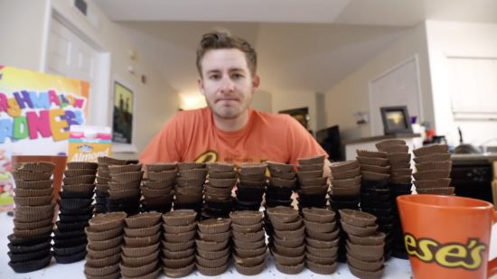
Reese’s Peanut Butter Cups
Update your Estimate.
How many Reeses Cups are there?
Notes:
You can have students make TWO estimates here - a low estimate and a high estimate.
This allows for those students who are not willing to risk making a mistake a safe place.
Source: https://tapintoteenminds.com/3act-math/reeses/

Slide 75
Reese’s Peanut Butter Cups Student Thinking
Reese’s Peanut Butter Cups
Notes:
Students can go to a break out room, to collaborate on how they would solve how many Reese’s Cups does he eat.
Use the new information that you have now to calculate the actual amount of Reese’s Cups does he eat.
Screenshot the thinking and have conversations of what is the same? What is different? What is the most efficient way to solve this? How can we use this information?

Slide 76
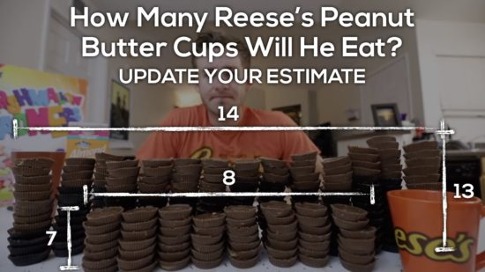
Reese’s Peanut Butter Cup Teacher Page
Reese’s Peanut Butter Cups
Monitor, Sequence and Share student thinking of how they solved how many Reese’s Cups he would eat.
Notes:
Students can go to a break out room, to collaborate on how they would solve how many Reese’s Cups does he eat.
Source: https://tapintoteenminds.com/3act-math/reeses/

Slide 77
Reese’s Peanut Butter Cups
Reese’s Peanut Butter Cups
Act 3
Find out how this ends!!
Notes:
Click on Act 3 to Link to watch the complete video from start to finish OR put in present mode to play in the slideshow.
Source: https://tapintoteenminds.com/3act-math/reeses/
Video Source: https://www.youtube.com/watch?v=WZ5f_cw9lUY&feature=emb_logo

Slide 78
Reese’s Peanut Butter Cups
Reese’s Peanut Butter Cups
Act 3
Find out how this ends!!
Notes:
Alternate Ending
Click on Act 3 to Link to watch the complete video from start to finish.
Source: https://tapintoteenminds.com/3act-math/reeses/
Video Source: https://www.youtube.com/watch?v=b5pWL-PFDSA&feature=emb_logo

Slide 79
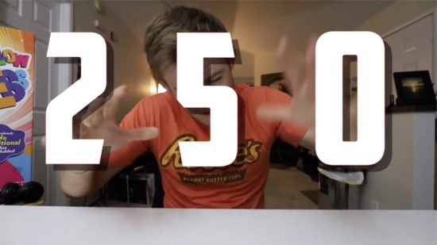
Reese’s Peanut Butter Cups

Slide 80
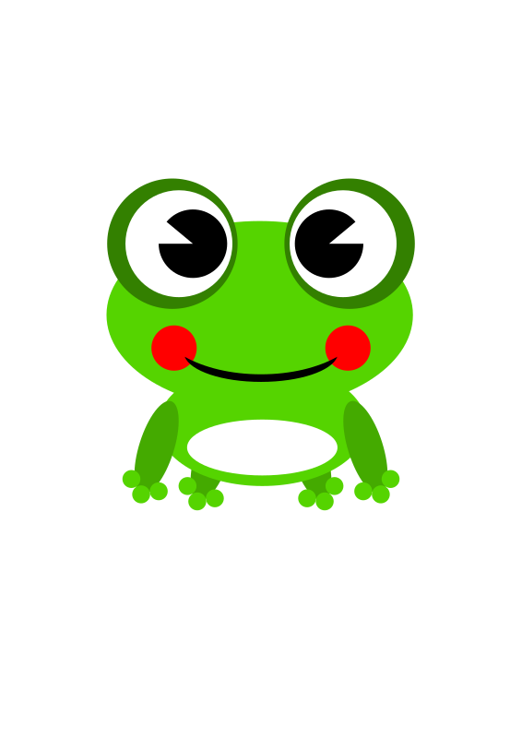
Jumping Frogs
Notes:
Source: https://mathpickle.com/project/jumping-frogs/
Play video up to 1:35 mark to introduce problem.
Image Source: https://openclipart.org/detail/100621/frogby-ramy

Slide 81
Jumping Frogs
Try it!
Notes:
Is this possible for 6 frogs? Try it out.
Source: https://mathpickle.com/project/jumping-frogs/
Image Source: https://openclipart.org/detail/100621/frogby-ramy

Slide 82
Jumping Frogs
Jumping Frogs Student Thinking
Notes:
Students can show their thinking.
Image Source: https://openclipart.org/detail/100621/frogby-ramy

Slide 83
Now that you have spent time working on some challenging tasks, consider again how you would assess your level of curiosity. Without looking back at your first slider, place the arrow on the line below.
Not at all curious
Extremely curious
Once you are confident about where you have placed your arrow on the line above, go back and compare to where you placed it before.
Did your level of curiosity grow?
What actions can you take to develop greater curiosity?
Reflect
83
Notes:
Image Source:
https://openclipart.org/detail/172707/edit-icon-icono-editar
https://openclipart.org/detail/212116/screencast

Slide 84
TAKING RISKS
What scares you? What do you do?

Slide 85
1.
What is it?
And do I have it?
2.
Select at least 1 of the challenges to work on:
3.
Reflect on your experience.
Gather information
Which One Doesn’t Belong?
Write About It
Conjecture
or,
Collect your thoughts
Record It
Self Assess
Closest to 75
Notes:
Understand what it is / put yours to the test / reflect on the experience
Image Source:
https://openclipart.org/detail/172707/edit-icon-icono-editar (pencil and paper)
https://openclipart.org/detail/212116/screencast (record)
https://openclipart.org/detail/70135/manga-eyes (eyes)
https://openclipart.org/detail/122155/pencil (pencil)
https://www.uihere.com/free-cliparts/brain-clip-art-head-2099525 (brain)

Slide 86
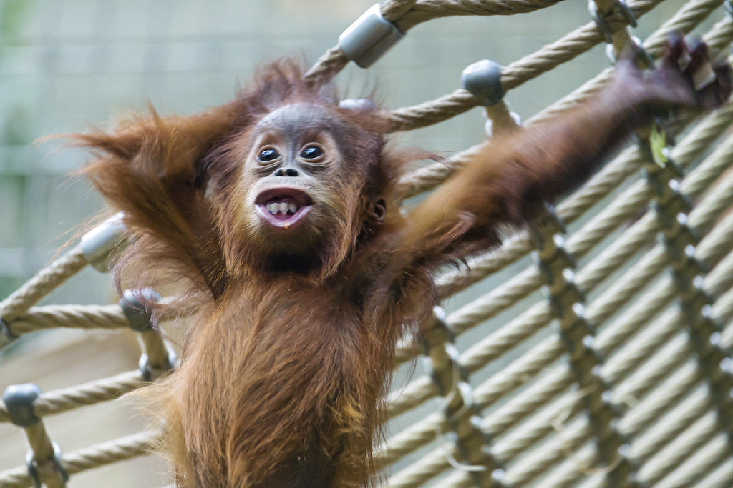
Watch the video “Ormie the Pig”.
What risks did you notice Ormie taking in order to solve his problem?
What else did you notice about Ormie’s Mindset throughout his struggle?
Funny Face
With your teacher when in your online class, turn on your camera to make a funny face (small risks are still risks)
Notes:
Video Source: https://www.youtube.com/watch?v=xd63g3d8qOs&feature=emb_logo
Image Source: "The baby orangutan with a funny face!" by Tambako the Jaguar is licensed under CC BY-ND 2.0
https://openclipart.org/detail/70135/manga-eyes (eyes)

Slide 87
TAKING RISKS ^{(collect your thoughts)}
What does it LOOK like?
What does it SOUND like?
What does it FEEL like?
Notes:
Image Source: https://www.uihere.com/free-cliparts/brain-clip-art-head-2099525

Slide 88
Based on what you’ve learned about taking risks, describe…
A time you were very worried about “looking stupid”:
When you find you are worried about “looking stupid”, how do you approach the solution?
Drag the black arrow below to show level of risk taking you believe you usually have during challenging tasks:
Never Take Risks
High Risk Taker
Notes:
Image Source: https://openclipart.org/detail/122155/pencil (pencil)

Slide 89
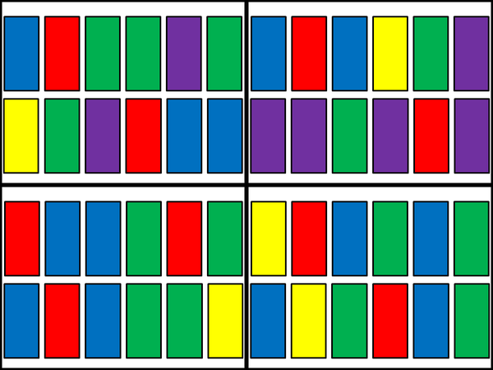
Which One Doesn’t Belong?
Which One Doesn’t Belong?
Take a risk and share with the class
Notes:
Source: http://wodb.ca/shapes.html (shape 24)

Slide 90
Which One Doesn’t Belong?
Which One Doesn’t Belong?
This one doesn’t belong because…
This one doesn’t belong because…
This one doesn’t belong because…
This one doesn’t belong because…
Take a risk and share with the class
Notes:
Teacher Notes
Student page (duplicate for the number of students you have if working synchronously with students)
This is a slide where the teacher can scribe/record student notice and wonderings. (If students have viewed this ahead of time, they may have some responses ready. The teacher can then collect the responses ahead of time.
Source: http://wodb.ca/shapes.html (shape 24)

Slide 91
How many will there be in the 7th picture?
Conjecture
When we make a conjecture, we take a risk.
Notes:
An extension could be to find the rule or multiple rules to explain this picture.

Slide 92
Show how you know your conjecture is right or wrong.
Conjecture
It’s not about right and wrong, but that we tried and learned.

Slide 93
Using the digits 2-9 create two numbers that have sum closest to 75. Use each digit only once.
Closest to 75
2
2
2
2
2
2
2
2
2
2
3
3
3
3
3
3
3
3
3
3
4
4
4
4
4
4
4
4
4
4
.
+
.
5
5
5
5
5
5
5
5
5
5
6
6
6
6
6
6
6
6
6
6
7
7
7
7
7
7
7
7
7
7
8
8
8
8
8
8
8
8
8
8
9
9
9
9
9
9
9
9
9
9
Use Me!
Notes:
Adapted from: https://www.openmiddle.com/
Student page (copy and paste as needed if working synchronously with students)
Teacher Notes
First Question: The sum closest to 75
Second Question (Next Slide): The largest possible sum
Third Question (Third Slide): The smallest possible sum
Encourage use of estimation to make decisions about which digits would be best in each place value position...for example, encourage students to write down possibilities and talk them through...which would be smaller, 23.4 + 5.6 or 25.4 4.6? Then have them calculate the actual sums and verify their predictions.
Students may also wish to use the mental math strategies to solve expressions they create.

Slide 94
Now that you have spent time working on some challenging tasks, consider again how you would assess your willingness to take risks. Without looking back at your first slider, place the arrow on the line below.
Never Take Risks
High Risk Taker
Once you are confident about where you have placed your arrow on the line above, go back and compare to where you placed it before.
Did your comfort level for taking risks grow?
What actions can you take to develop greater comfort taking a risk?
Reflect
94
Notes:
Image Source:
https://openclipart.org/detail/172707/edit-icon-icono-editar
https://openclipart.org/detail/212116/screencast

Slide 95
Credits
Lisa Page St. James-Assiniboia School Division
Dayna Quinn-LaFleche St. James-Assiniboia School Division
T. Scott Dempster St. James-Assiniboia School Division
Heather Jones St. James-Assiniboia School Division
Reviewers
Charmaine Mackid Hanover School Division

Slide 96
Free templates for all your presentation needs
For PowerPoint and Google Slides
100% free for personal or commercial use
Ready to use, professional and customizable
Blow your audience away with attractive visuals

