Slide 1
Three Sisters
Grade 5 Social Studies Project
Notes:
You may want to ask students what they think this unit will be about.

Slide 2
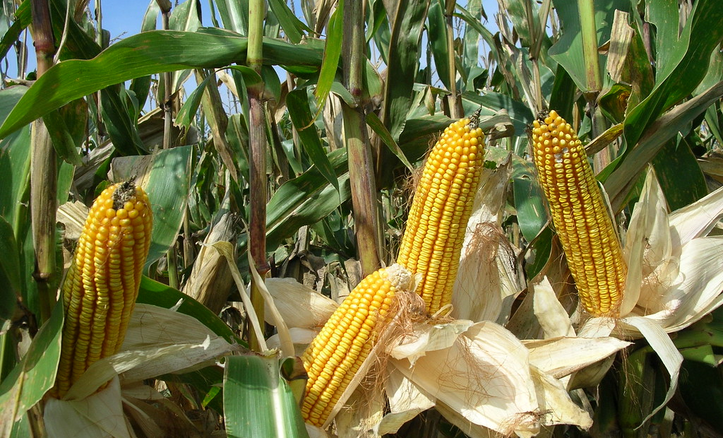
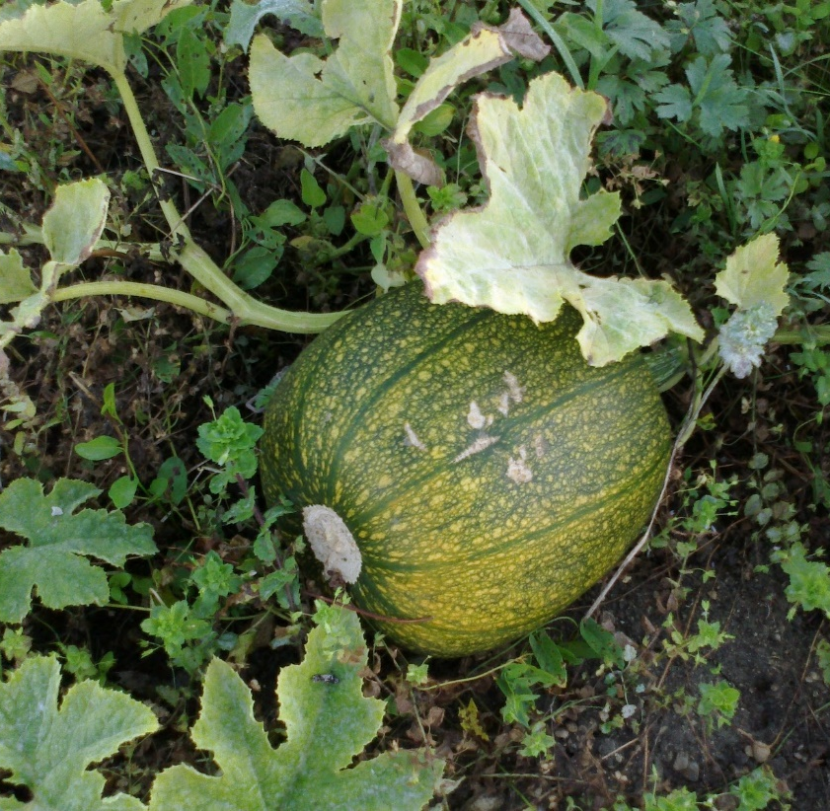
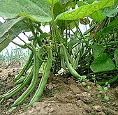
Look at the pictures.
This Photo by Unknown Author is licensed under CC BY-SA-NC
This Photo by Unknown Author is licensed under CC BY-SA
What do you notice?
What do you wonder?
This Photo by Unknown Author is licensed under CC BY-SA
Notes:
The top left picture is corn, top right is squash, and the bottom right is beans. All three of these foods originated in the Americas and can be grown in what is called companion planting. The students will discover more about this as they work through the unit.

Slide 3
Inquiry Question
How has Indigenous Agriculture impacted life in Canada?
Think about it throughout the learning experience

Slide 4
Step 1: Think About It What do you already know? What do you wonder?
1. KWL
Step 2: Learn About
Select from the learning experiences below. You do not have to go in order, and you can pick and choose which ones you would like to do.
2. Traditional Story about the Three Sisters
3. Food Origins Sort & Predict
4. Three Sisters Video
5. Manitoba’s First Farmers
6. Indigenous Perspectives on Food Plants
7. A Day in the Life of...
8. Seeds & Gardening
9. Recipes & Restaurants
Step 3: Final Project
Choose a way to show what you have learned throughout the unit.
10. Raise Awareness
Step 4: Looking Back
Reflect on what you have learned.
11. Reflection
Notes:
Links are embedded from this choice board to the slide with the details of each learning experience so just click the learning experience in presentation mode and you will be directed to the details of that experience. BLMs are available for each learning experience.

Slide 5
1. Three Sisters KWL
Choice Board
K
What do you already know?
W
What do you wonder?
L
What have you learned?
BLM 1
Notes:
There is a KWL BLM to support this activity. The final section, “What have you/I learned?”, is to be completed as part of the final Reflection activity.

Slide 6
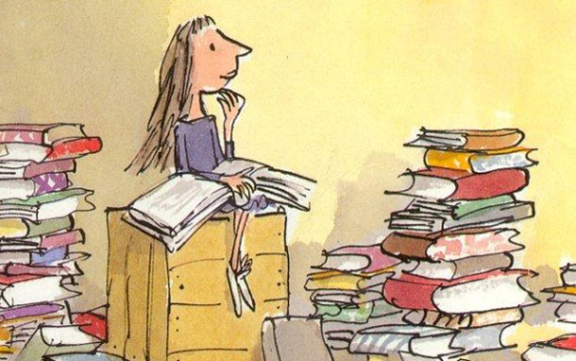
2. Traditional Story
Choice Board
Listen as the Three Sisters story is read aloud. BeanKeepers-ThreeSisters.pdf(evergreen.ca)
As the story is read, draw or paint a picture of what is happening in the story.
The teacher will read it at least twice so that you have time to refine your drawing or painting.
BLM 2
This Photo by Unknown Author is licensed under CC BY-SA-NC
This Photo by Unknown Author is licensed under CC BY
Notes:
There is a Picture Retell BLM to support this activity or students can use blank paper.

Slide 7
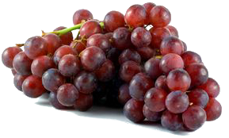
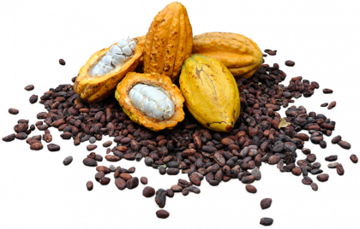
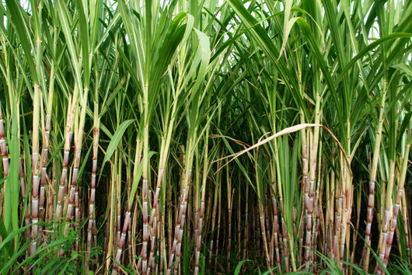
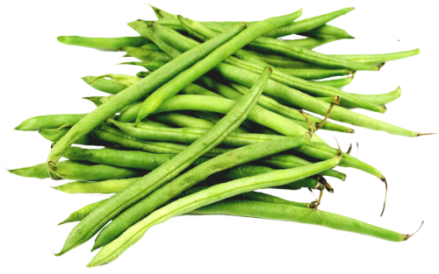
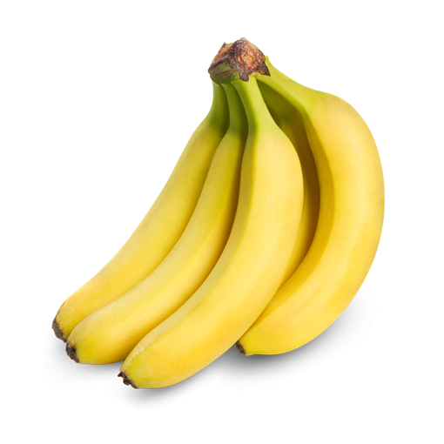
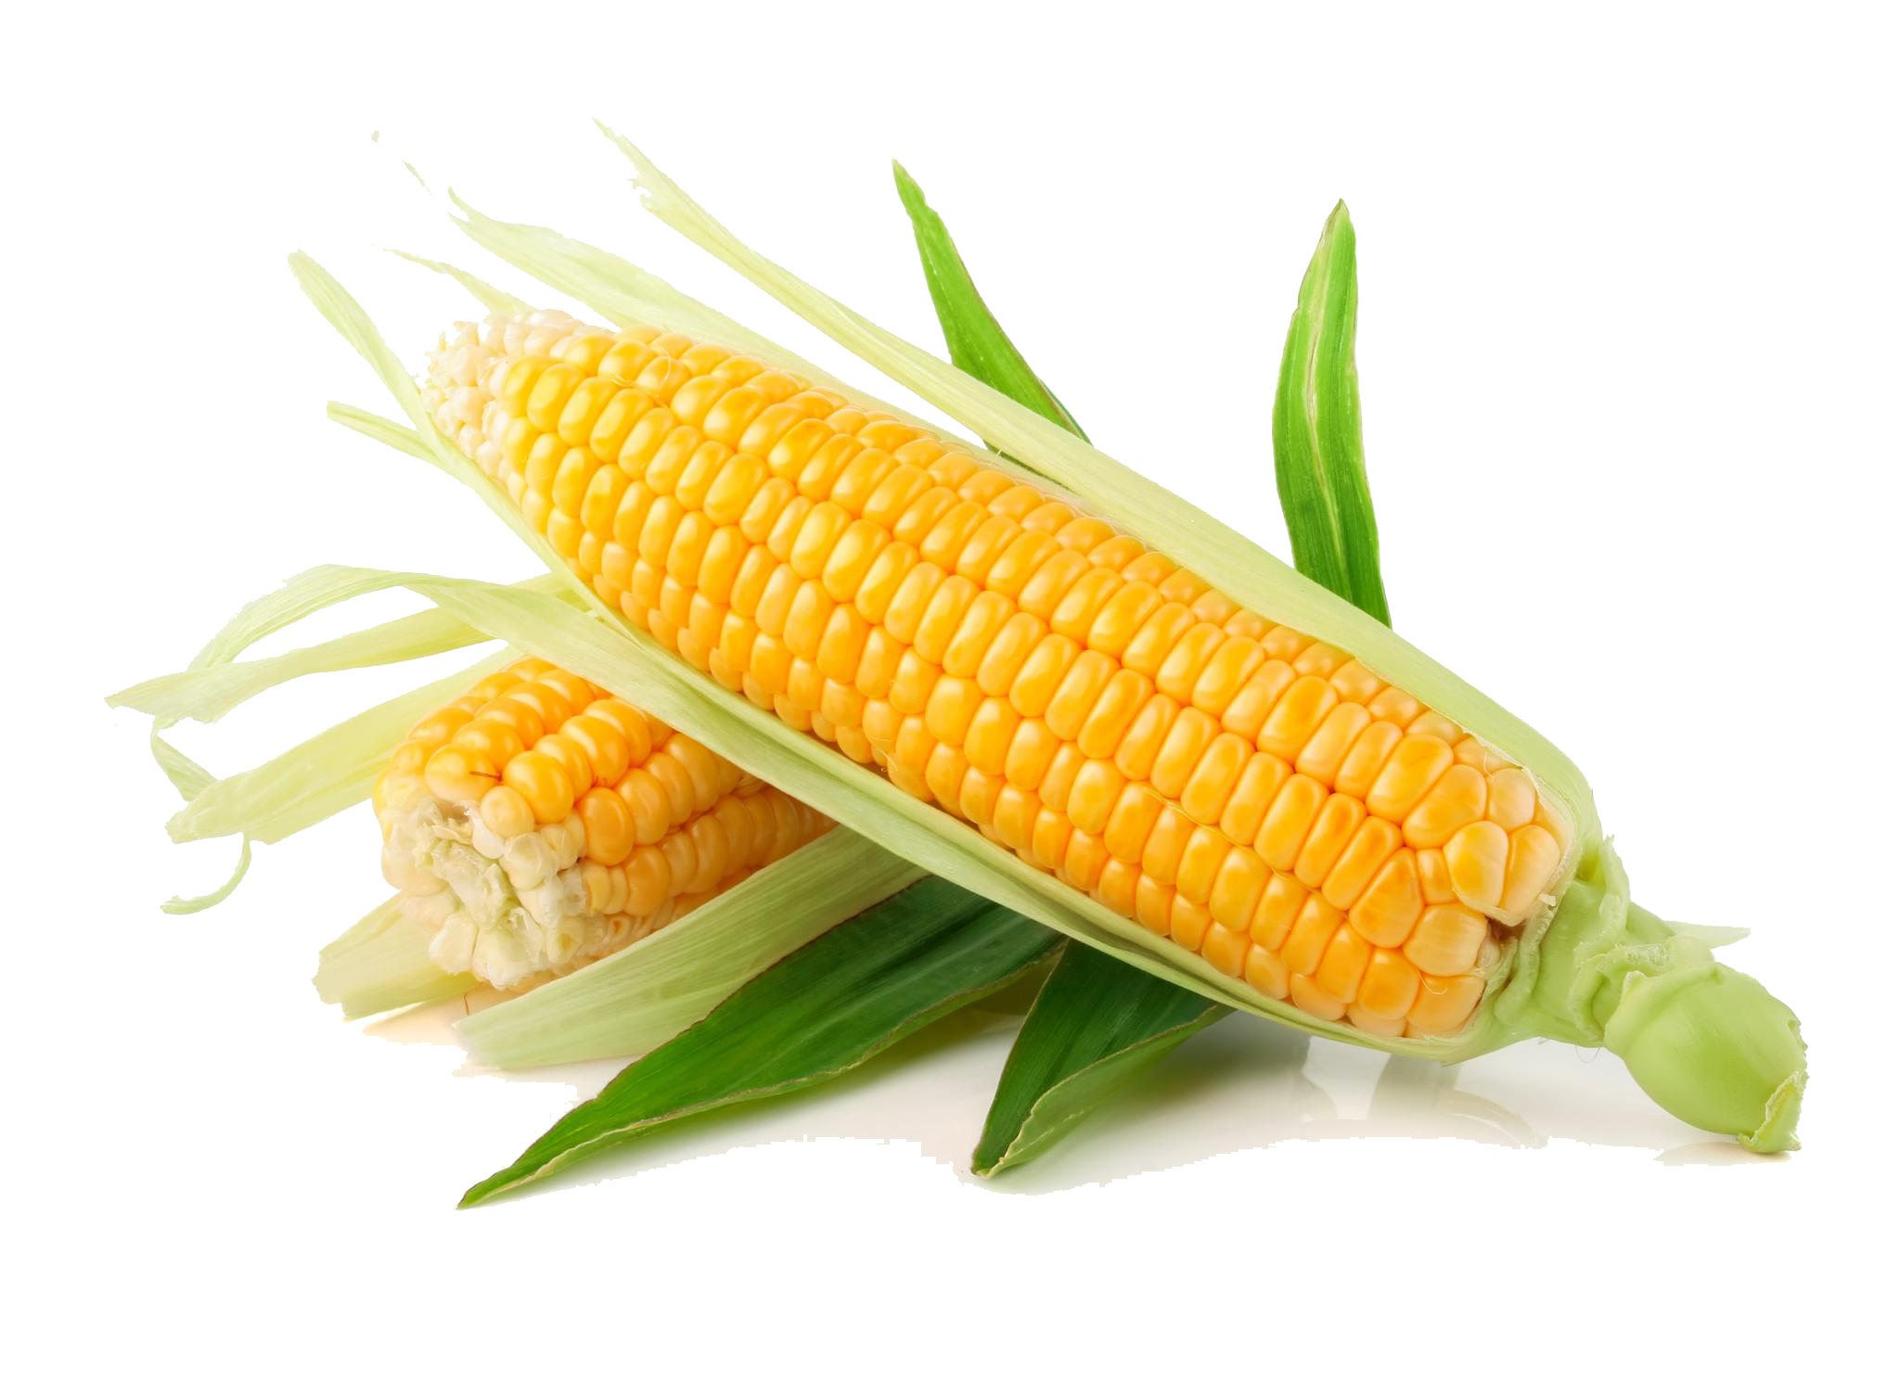
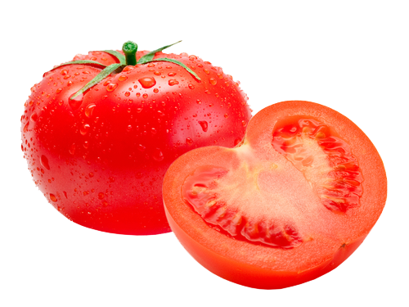
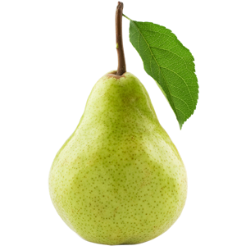
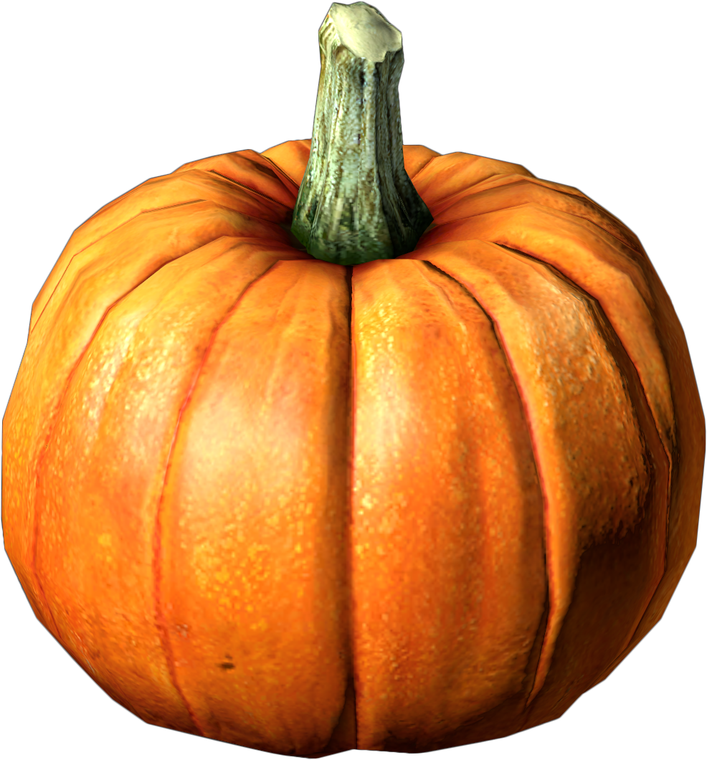
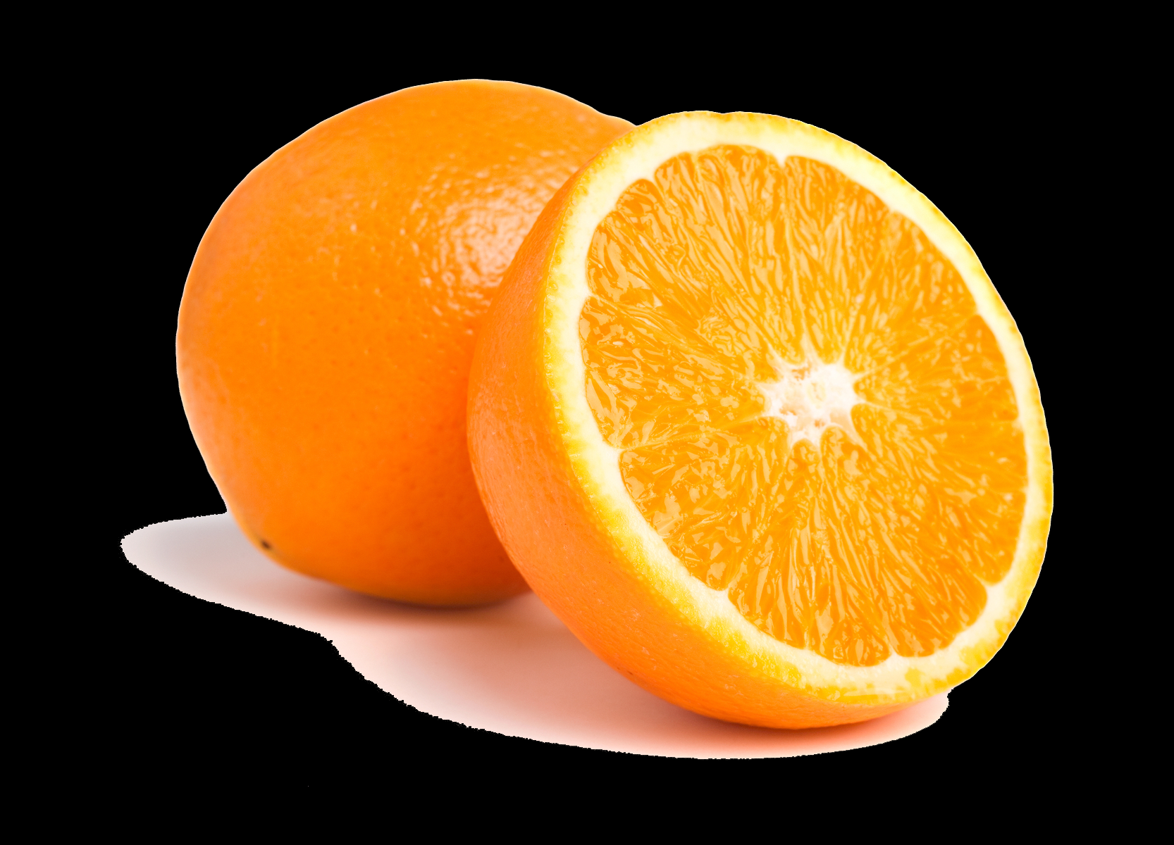
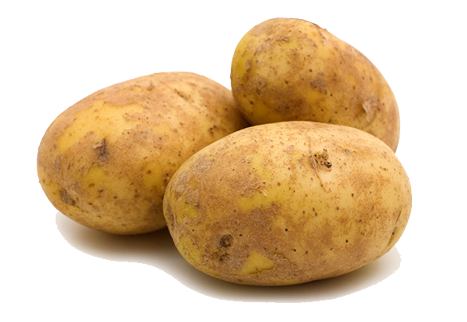
3. Food Origins Sort & Predict
Choice Board
BLM 3
This Photo by Unknown author is licensed under CC BY-NC.
This Photo by Unknown author is licensed under CC BY-NC.
This Photo by Unknown author is licensed under CC BY-SA.
This Photo by Unknown author is licensed under CC BY-NC.
This Photo by Unknown author is licensed under CC BY-NC.
This Photo by Unknown author is licensed under CC BY-NC.
This Photo by Unknown author is licensed under CC BY-NC.
This Photo by Unknown author is licensed under CC BY-NC.
This Photo by Unknown author is licensed under CC BY-NC.
This Photo by Unknown author is licensed under CC BY-SA-NC.
This Photo by Unknown author is licensed under CC BY-NC.
This Photo by Unknown author is licensed under CC BY-NC.
Notes:
Students can sort, predict, and drag items to the arrow showing origination in North/South America then shared with Europe/Asia/Africa; and which items originated in Europe/Asia/Africa and were shared with the North/South America.
(Corn, potatoes, pumpkin, cacao beans (chocolate), tomatoes, and beans originated in the North/South America; grapes, oranges, pears, bananas, coffee beans, and sugar cane (sugar) originated in Europe/Asia/Africa.
There is a Food Origins Sort and Predict BLM to further support this activity that has more food items to sort.
Note: There are more than 370 million Indigenous peoples in the world on every continent, that make up more than 5,000 different groups. To learn about Indigenous peoples of the world, check out the United Nations Food and Agriculture Organization link here: http://www.fao.org/indigenous-peoples/en/ and the Indigenous Peoples can feed the world YouTube video https://www.youtube.com/watch?v=1VWT2LWRJVs

Slide 8
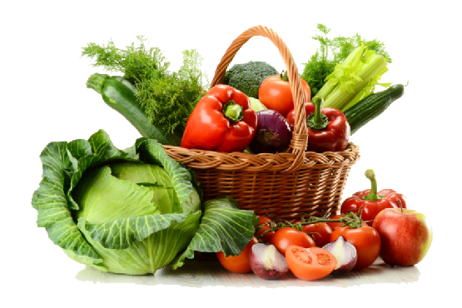
4. Three Sisters Video
Choice Board
Watch the following video segments in The Three Sisters – YouTube (20 min) from New World Ideas:
Intro
History of Indigenous farming
The Three Sisters and Companion Planting
The Gift of Innovative Foods
Food Sovereignty and Gardens
Restaurants
Closing
Complete BLM 4, in sections, as you watch the video.
BLM 4
This Photo by Unknown Author is licensed under CC BY-NC
Notes:
It may be easier for students to do this activity one segment at a time as there is a lot of information. Students may complete this activity individually, as a whole class, in small groups or partners. Students may also want/need to view some of the clips more than once. See New World Ideas PDF for more class activities https://www.newworldideas.org/. The video refers to Neechi Commons, but unfortunately it is now closed which may also be important to discuss with students regarding why and the impact on the community. Video from CBC on the closing of Neechi Commons: https://www.cbc.ca/player/play/1267305539535

Slide 9
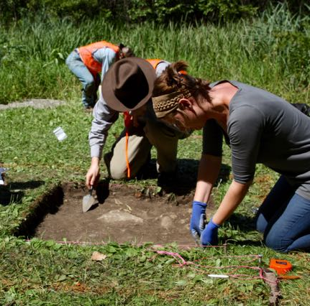
5. Manitoba's First Farmers
Choice Board
Watch the Lockport Dig section, from 6:25-10:15 minutes, of The Three Sisters – YouTube video.
As you watch, think about:
Where corn comes from.
The lives and habits of the early First Nation peoples.
What the archeologists are doing?
The artifacts that were found.
Imagine what it must be like to be an archeologist. Complete BLM 5.
You may want to explore the links below to learn more about the Lockport dig and archeology:
​CBC News Article: Anthropology students digging at Lockport site for connections to Aboriginal agriculture | CBC News
Wild Archeology – Diggin Away -Virtual Reality YouTube Video 207 Diggin Away – YouTube (5 min)
BLM 5
This Photo by Unknown Author is licensed under CC BY-NC-ND
Notes:
You may wish to have students watch a few minutes and then discuss or watch the video more than once. Or you may also wish to As an extension, you may wish to prepare a tub or container of dirt with items hidden in it for the students to practice being archeologists.
Further links to information about Manitoba’s First Farmers and archeology: - Manitoba Museum Virtual Field Trip – First Farmers | The Manitoba Museum - Manitoba Historical Society - Manitoba History: Manitoba’s First Farmers (mhs.mb.ca) - Manitoba Archaeological Society - Manitoba Archaeological Society - APTN Show Wild Archeology - https://wildarchaeology.com/

Slide 10
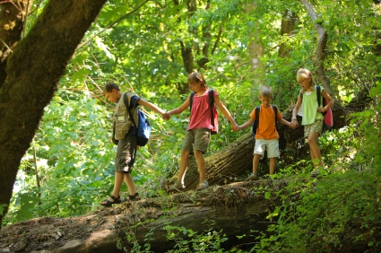
6. Indigenous Perspectives of Food Plants
Choice Board
Watch The Great Laws of Nature: Indigenous Organic Agriculture Documentary – YouTube (22 min)
Think about these First Nation perspectives of Food:
“Nature is the greatest teacher if you take time and listen …”
Everything has life and everything has spirit. Everything has a purpose in its natural state.
Be good to your plants and they will give you a return, they will give you their love.
BLM 6
Spend 5 minutes in nature with plants using your senses of sight, touch, hearing, and smell.
This Photo by Unknown Author is licensed under CC BY-ND
Notes:
-As students watch the video, you may wish to pause to discuss the Indigenous perspectives as they come up.
-There is an Indigenous Perspectives of Food Plants BLM to support this learning experience.
-The spending 5 minutes in nature activity will hopefully heighten students’ appreciation for nature.
For land-based learning ideas check out this book/website: https://www.naturalcuriosity.ca/
-Note: The Indigenous perspectives in this video are from the people in the video. Although Indigenous perspectives are similar across Canada, North America, the world, there is also diversity of perspectives. Indigenous Worldviews – Indigenous peoples "are as diverse in their personal beliefs and ideologies as any other cultural or ethnic group." See pages 7-12 of the Integrating Aboriginal Perspectives into Curricula Manitoba Ed. document: https://www.edu.gov.mb.ca/k12/docs/policy/abpersp/ab_persp.pdf ​
Muskoday First Nation Organic Growers Co-op News Article from the Western Producer July 16, 2009:
https://www.producer.com/production/muskoday-reignite-relationship-with-food-organic-matters/
Muskoday First Nation is located in Saskatchewan. We are not sure if the Organic Growers Co-op is still operating, but we decided to include the video anyway because of how well it portrays Indigenous perspectives of food plants. There are plenty of examples of Indigenous Food Sovereignty initiatives in Manitoba and Canada. See below to learn more.
Further resources:
Peguis First Nation Agriculture Project:
https://weseedchange.org/indigenous-food-sovereignty-in-action-a-qa-with-carl-mccorrister-of-peguis-first-nation/
http://www.nmfccc.ca/blog/peguis-first-nation-peguis-agriculture-project
Links from The Northern Manitoba Food, Culture, and Community Collaborative:
http://www.nmfccc.ca/links-and-articles.html
Indigenous Food Sovereignty
Indigenous Food Initiatives in Canada Map Data collected and mapped by Jennifer Sumner, M. Derya Tarhan, and J. J. McMurtry
https://www.google.com/maps/d/u/0/viewer?mid=1oJUIKoPXI-_vVxB6kjEt-yWwV5x6Qmpu&ll=69.17904837810917%2C-99.496619759454&z=3
Seven Ways to Stand Beside Indigenous Food Sovereignty This poster was created by many hands, but with gratitude by Tabitha Robin. “This is a starting point. We hope to continue to change and add over the years.”
http://www.nmfccc.ca/uploads/4/4/1/7/44170639/7waystostandposterfinal.pdf
'Indigenous Food is Health Care': symposium imagines future of hospital meals By: Rhiannon Johnson, CBC News
https://www.cbc.ca/news/indigenous/traditional-food-health-care-1.5139304
Boreal Gardening Project website A website curated by community partner, Grow North, in Leaf Rapids http://www.borealgardening.com/
CBC Unreserved Podcast – Using food to strengthen Indigenous culture and resist colonization
https://www.cbc.ca/radio/unreserved/using-food-to-strengthen-indigenous-culture-and-resist-colonization-1.5126272

Slide 11
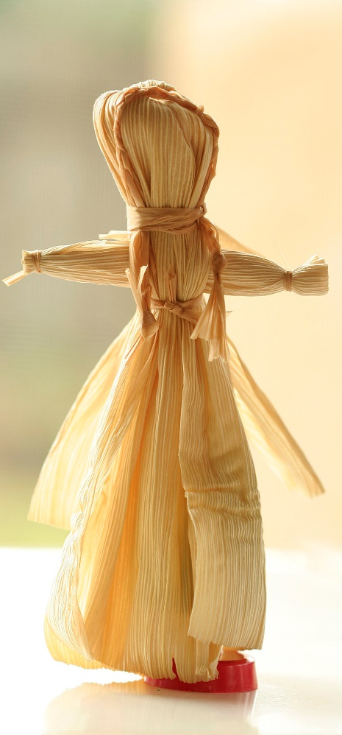
7. A Day in the Life
Choice Board
Imagine and learn what it would be like to live long ago as you watch The Wampanoag Way – YouTube (7 min)
Compare your life with the way the Wampanoag lived long ago (see BLM 7).
Optional - Learn about harvesting Wild Rice and Berries by watching these two Virtual Reality Videos:
Wild Rice - VR: Wild Rice – YouTube (5 min)
Berries - VR: Food Is Medicine – YouTube (3 min)
BLM 7
This Photo by Unknown Author is licensed under CC BY-SA
Notes:
There is The Wampanoag Way BLM to support this activity.
Although, the Wampanoag are Indigenous to the northeastern United States, they would've lived a lifestyle similar to the Haudenosaunee (Iroquois) and the Wendat (Huron) nations in present day Canada.

Slide 12
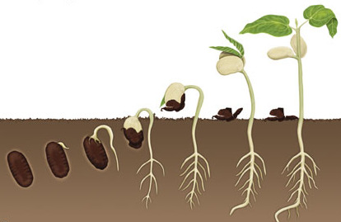
8. Seeds and Gardening
Choice Board
Watch the following video Indigenous Seed Keepers Network – YouTube (3 min) and answer the questions on BLM #8a.
Do the Seed Collection Activity
Select from some of the optional seed and gardening activities below. Use BLM#8b as a guide to help you choose.
Design a garden plan
Make a garden diorama
Watch some YouTube videos and/or play an online gardening game
Grow a single plant in a pot
Help grow a school or community garden
BLM 8
This Photo by Unknown Author is licensed under CC BY
Notes:
Further resources about seeds and gardening:
https://www.pnc.com/en/about-pnc/corporate-responsibility/grow-up-great/lesson-center/farm-to-preschool/seeds-in-our-food.html
https://www.scholastic.com/teachers/lesson-plans/teaching-content/comparing-seeds-nature-activity/
Springtime Seed Hunting and Collecting: https://onetimethrough.com/springtime-seed-hunting/
www.littlegreenthumbs.org
https://www.towergarden.ca/school-gardens
Grants for Gardening:
https://www.mbcommunitiesinbloom.ca/community-resources/grants-contests/
https://can-plant.ca/Community-Planting-Grants.htm
https://www.edu.gov.mb.ca/k12/esd/grant/index.html
https://www.gov.mb.ca/grants/grant-subject.html

Slide 13
Optional: Garden Number Talk
Watch the following music video: Area Model Multiplication Song using Bean Gardens – YouTube (3 min)
Look at the following garden plan.
What strategies could you use to find out how many plants are in this garden?
Write the multiplication expression that represents this garden plan.
5x10=50
50
25
20
+10
105
5x5=25
2x10=20
2x5=10
BLM 8
(5x10)+(2x10)+(5x5)+(2x5)=105 OR 7x15=105
Notes:
You may want to encourage students to use similar grouping strategies as modelled in the area model song. You may want to show them (5x10)+(2x10)+(5x5)+(2x5) OR just let them come up with several groupings that they see and then choose the most efficient from their suggestions. See BLM 8c & 8d for more Garden Math involving multiplication using the area model.

Slide 14
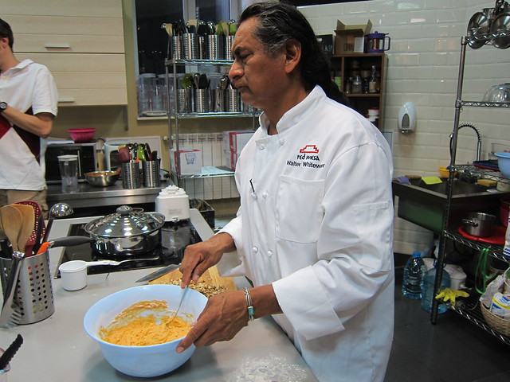
9. Recipes and Restaurants
Choice Board
Watch videos of famous Indigenous Chefs Moosemeat & Marmalade.com) and seek out examples of Indigenous Restaurants Feast: Community Cooking and Indigenous Foodways- YouTube (3 min)
Pretend you are now the new owner of an Indigenous-themed restaurant:
Think of a name for your restaurant
Create a menu.​ The menu should include at least three areas to choose from. For example, appetizer/soup/salad, entree, and dessert/drinks. Try and use foods that originate from the North & South America.​
BLM 9
Make an Indigenous Recipe Card. Pick at least one dish from your restaurant menu and create a recipe card for that dish.
This Photo by Unknown Author is licensed under CC BY-ND
Notes:
There is an Indigenous Cuisine BLM for this activity. Students may do this individually, with another student, or in a small group, depending on your class context. If possible, students could make and share one dish with their family or classroom community.
Cooking shows on APTN:
- Chuck and the First Peoples' Kitchen https://www.aptn.ca/chuckandthefirstpeopleskitchen/
- Moosemeat and Marmalade https://www.aptn.ca/moosemeatandmarmalade/
- Feast https://www.aptn.ca/feast/
The Feast Café and Bistro – Winnipeg
http://www.feastcafebistro.com/
A Day at Feast (the restaurant)
https://www.youtube.com/watch?v=XbdyrCvNL20&t=74s
Our Visit to the Bison Farm
https://www.youtube.com/watch?v=r6cSSdmFOaU
Indigenous Cuisine Across Canada
https://indigenouscuisine.ca/
CBC Unreserved Podcast - Bannock, wild meat and indigenous food sovereignty https://www.cbc.ca/radio/unreserved/bannock-wild-meat-and-indigenous-food-sovereignty-1.3424436
1:20-6:55 – Feast Restaurant
7:46-13:56 – Bannock and Neechi Commons
13:56-24:02 – The Bannock Lady (help people in Winnipeg)
24:03-26:12 – Lheidli T'enneh First Nation (help Indigenous families in BC)
26:13-33:28 – Masters in Indigenous Food Sovereignty at the U of M
33:29-40:24 – Indigenous chef, learned from her grandmother on the land (QC)
Three Sisters Soup and other Indigenous food https://www.cbc.ca/kidscbc2/the-feed/three-sisters-soup-and-other-indigenous-food
Three Sisters: Optimizing its value and food potential https://www.agr.gc.ca/eng/news-from-agriculture-and-agri-food-canada/scientific-achievements-in-agriculture/the-three-sisters-optimizing-the-value-and-food-potential-of-an-ancestral-indigenous-crop-system/?id=1542138031075

Slide 15
10. Final Project
Choice Board
Brainstorm
Choose
Create and Explain
Share
TO RAISE AWARENESS ABOUT INDIGENOUS AGRICULTURE IN THE PAST, PRESENT, AND FUTURE.
BLM 10
Notes:
The Raising Awareness Final Project BLM is available to support this activity. Students could do this individually, in pairs, or a small group, depending on your class context.
You may wish to create detailed criteria and guidelines with the students to include them in deciding the quality and rigor of the projects.

Slide 16
11. Reflection
Choice Board
Think back to the inquiry question…
How has Indigenous Agriculture impacted life in Canada?
Answer the following questions:
What learning has taken place?
How have your thoughts changed?
How would you answer the inquiry question?
BLM 11
Notes:
This section is set up to facilitate debrief conversation with the students. Complete the final section, “What have I learned?”, on the KWL BLM from the first activity.

