Slide 1
What Objects “Like” And “Don’t Like” Each Other?
Grade 3 Lesson on Magnets & Static Electricity

Slide 2
Lesson Objectives
In this lesson you will learn:
Science
Vocabulary related to forces.
Recognize that force is a push or pull and that attraction and repulsion are types of pushes and pulls.
Predict and test to identify materials that are attracted by magnets and those that can be magnetized.
Investigate to determine the location of poles on a magnet.
Demonstrate that opposite poles attract and like poles repel.
Describe and demonstrate ways to use everyday materials to produce electrostatic charges.
Investigate to determine how electrostatically charged materials interact with each other and with uncharged materials.
Math:
Relate the passage of time to common activities using standard units.
Demonstrate an understanding of measuring length by:
selecting and justifying referents for the units,
measuring and recording length.

Slide 3
Teacher provided Materials
(if possible)
Lesson 2:
Toy cars (2 per student)
Bar magnets (2 per student)
Masking tape
Lesson 3: (optional)
Magnets (different shapes and sizes)
Lesson 4:
Balloons (3 per student)
Stopwatch (optional)

Slide 4
Student Project Board
Complete each section in order.
All About Magnets!
What do Magnets Like?
The Strength of Magnets!
Static Electricity
Final Project
1
2
3
4
5

Slide 5
All About Magnets
1

Slide 7
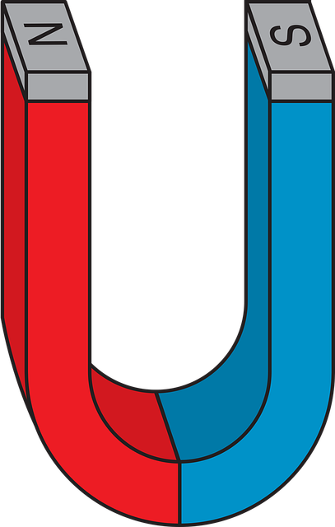
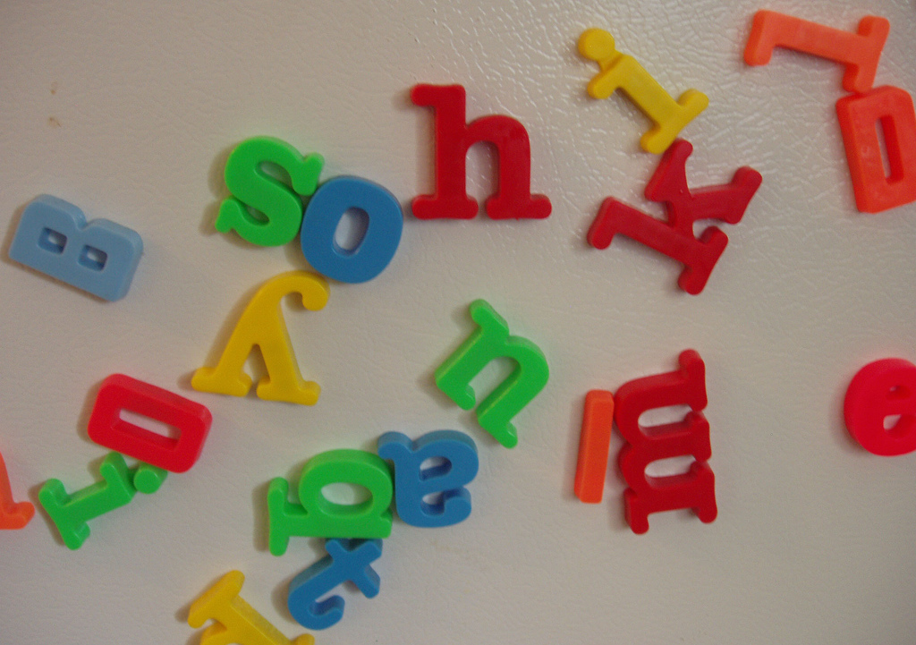
What is a Magnet?
A magnet is a rock or piece of metal that can pull or attract objects towards itself. Magnets can also push or repel certain objects away from itself.
N
S
File:Magnetic letters scattered on a refrigerator door.jpg

Slide 8
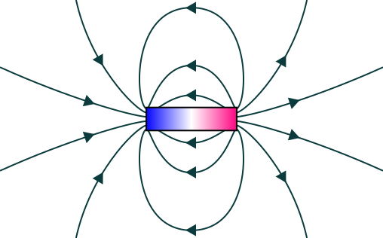
What is Magnetism?
Magnetism is an force that you cannot see. It happens because the electrons in the magnet all spin in the same direction. This arrangement causes a North and South pole on a magnet. These poles attract and cause a magnetic field around the magnet.
N
S
Adapted from File:Magnetic field.svg

Slide 9
Magnetic Poles:
Magnets have 2 poles, North and South. These poles are either end of a magnet. This is where the magnetic field is the strongest. Two poles that are the same will push each other away (repel). Poles that are the opposite will attract. If you break a magnet in two then each of those will develop their own poles. Where else do you have north and south poles?? _______________
Photo credits: www.Pixabay.com

Slide 10
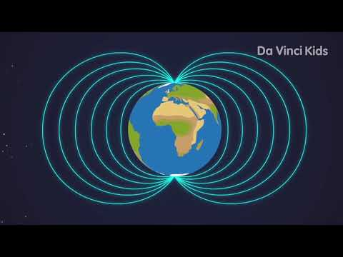
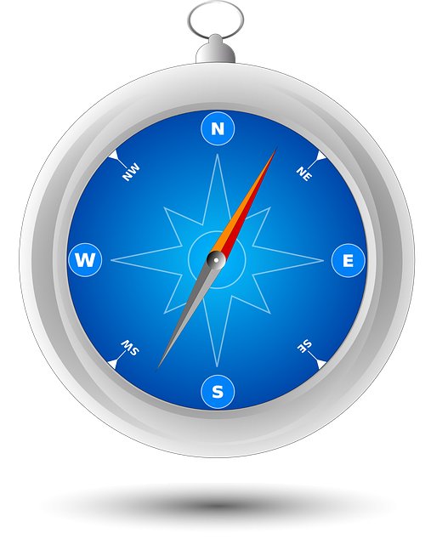
Our Planet
The Earth's Magnetic Fields Down To Earth Da Vinci Kids TV YouTube
Did you know Earth is a giant magnet?
Just like a bar magnet, Earth has North and South poles.
Earth also has a magnetic field that protects us from particles in the universe.
Photo Credit: Compass Navigation

Slide 11
ATTRACT
Write your own definition below for this vocabulary word
My Definition:
?
?
?
Photo credits: www.Pixabay.com

Slide 12
REPEL
Write your own definition below for this vocabulary word
My Definition:
?
?
?
Photo credits: www.Pixabay.com

Slide 13
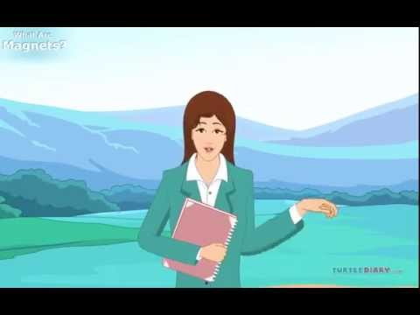
WATCH THIS VIDEO
Video Link: The Science of Magnets Video for Kids

Slide 14
What do magnets like?
2

Slide 15
2
All Magnets “Like” All Other Objects!
Start Your Thinking!
TRUE
FALSE
I think this because…

Slide 16
My PREDICTIONS:
If a magnet “likes” an object it will stick to it (attract). If it does not like an object it will not stick or it will push it away (repel).
What do you think will happen with these objects?
When we make a prediction we are using what we already know to be true and paying attention to details to make a reasonable guess. This is called
Sound Reasoning!
Objects
Nickel (5￠)
Lego piece or block
Jar or glass cup
Fork or spoon
Tinfoil or pop can
Penny (1￠)
Stick or pencil
T-shirt
Paper clip
Screw or Nail
Prediction:
Attract
Attract
Attract
Attract
Attract
Attract
Attract
Attract
Attract
Attract
Repel
Repel
Repel
Repel
Repel
Repel
Repel
Repel
Repel
Repel

Slide 17
Time to EXPERIMENT:
Ask a caregiver to help you collect the items on the list. Collect as many as you can. You can also add a few of your own. Add them to the bottom of the list.
Use a magnet (provided by your teacher, or found on your fridge) and try to attract the objects on the list.
Check off if the magnet was attracted to the object or not.
Objects
Nickel (5￠)
Lego piece or block
Jar or glass cup
Fork or spoon
Tinfoil or pop can
Penny (1￠)
Stick or pencil
T-shirt
Paper clip
Screw or Nail
Results
Attract
Attract
Attract
Attract
Attract
Attract
Attract
Attract
Attract
Attract
Repel
Repel
Repel
Repel
Repel
Repel
Repel
Repel
Repel
Repel

Slide 18
Describe your results:
Make a T-chart and list all the items you tested under the appropriate headings and then try to answer the questions. Use Sound Reasoning!
Items attracted to Magnets
Items Repelled By Magnets
I noticed that all the items attracted to magnets are…
I noticed that all items repelled by magnets are…
I think that means that… because...

Slide 19
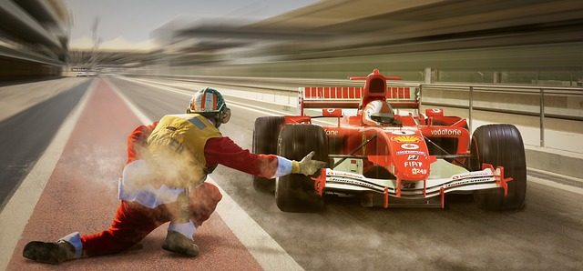
ON YOUR MARK, GET SET, GO!
Materials needed:
2 Magnets per racer
1 toy car per racer
Tape
Directions:
Tape 1 magnet to the top of your toy car
Tape a starting line and a finishing line.
On “GO” use your magnet to repel the car forward. (remember 2 like poles repel).
Rules:
You cannot touch your toy car at all
First car over the finish line wins!
Photo Credit : Free Image on Pixabay - Racing, Formula 1, Pit Lane

Slide 20
2
All Magnets “Like” All Other Objects!
Connect Your Thinking!
TRUE
FALSE
I (agree/disagree) with my initial decision. I think this because…

Slide 21
The Strength of Magnets
3

Slide 22
3
Some magnets are stronger than others and can attract objects with more force than other magnets.
Start Your Thinking!
TRUE
FALSE
I think this because…

Slide 23
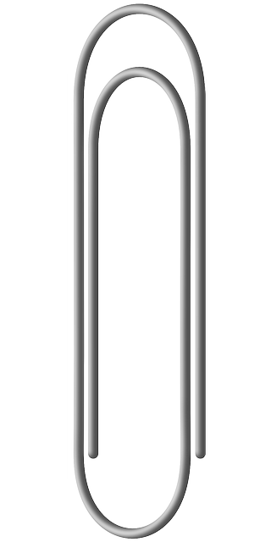
Let’s TEST it Out!
Directions:
Put a line of masking tape along the table or floor.
Use a ruler and mark m, cm or mm along the tape line. (decide which unit of measure is best for this project)
Place the paper clip at 0 (cm or mm)
Use a magnet and try to attract the paper clip to the magnet.
Record where on the tape the magnet was able to pull the the paper clip from.
Repeat with a new magnet.
Record your findings and connect your thinking.
Materials Needed:
Masking Tape
Marker
Ruler
Magnets
1 from teacher
2 from around the house
Paper clip.
Photo credits: www.Pixabay.com

Slide 24
Observation and Recording Chart
Magnet Used (Draw & describe the magnet you used) | Distance of attraction (how many m, cm or mm did you pull the paper clip)
Magnet #1:
Magnet #2:
Magnet #3:
I chose to use (m, cm or mm) because…
I noticed magnet # ____ stayed had the longest distance of attraction.
I think this was because…
Notes:
Give more space for responses

Slide 25
3
Some magnets are stronger than others and can attract objects with more force than other magnets.
Connect Your Thinking!
TRUE
FALSE
I (agree/disagree) with my initial decision. I think this because…

Slide 26
All About Static Electricity
4

Slide 27
4
Static charges get stronger over time.
Start Your Thinking!
TRUE
FALSE
I think this because…

Slide 28
What is Static Electricity?
Ever touch someone and feel a “zap”. That is static electricity at work. Static electricity is when there is a buildup of electric charge on the surface of an object. It is called static because it does not move.
Photo Credit: Zap Comic Book

Slide 29
How Does Static Electricity Form?
Surfaces can have charges. Some positive and some negative. When a positive and a negative surface touch each other or rub together the surface becomes electrically charged. Items with opposite charges will attract each other. Items with the same charge will repel.

Slide 30
Let’s Learn More:
Static Electricity For Kids
Science: Static Electricity
Electricity Children's Book Collection
Reading Material
The Science of Static Electricity
Electric Charge
Bill Nye the Science Guy - Static Electricity
Viewing Material

Slide 32
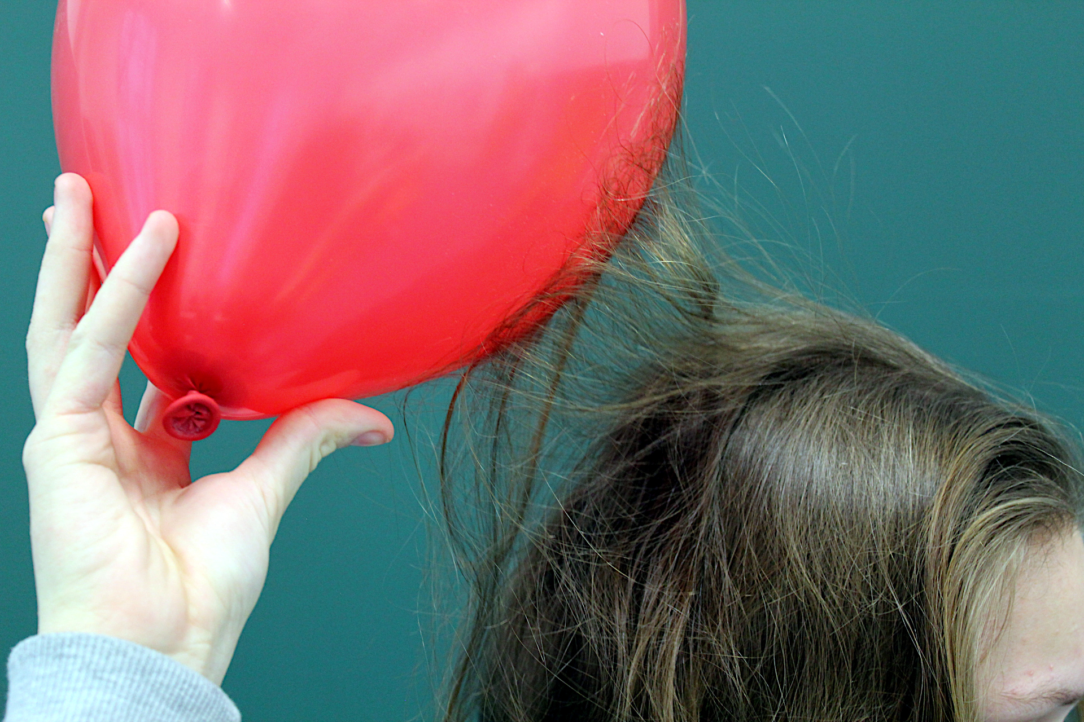
Charging a Balloon
Have you ever rubbed a balloon on your hair and made your hair stick straight up.
This is an example of charging your hair. You also charge the balloon at the same time.
Do you think charges can be stronger or weaker depending on how long you charge it for?
Photo Credit: https://upload.wikimedia.org/wikipedia/commons/b/b9/Attractive-electric-force-between-hair-and-balloon.jpg
Answer Here:

Slide 33
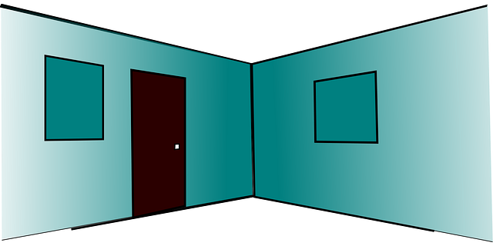
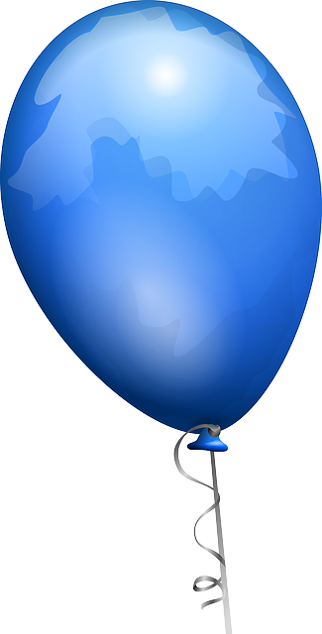
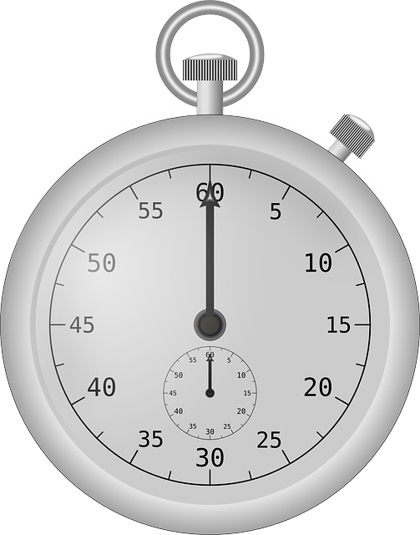
Let’s Test it Out!
Materials Needed:
3 Balloons
Sharpie Marker
Stopwatch or Clock
Dry/Clean Wall Surface
Dry/Clean Hair
Directions:
Ask an adult to help you blow up 3 balloons, tie them and mark them with #1, #2, #3.
Set your stop watch to 0. (If you do not have a clock with a second hand or a stopwatch you can count 1 mississippi, 2 mississippi, 3 mississippi… etc.)
Take balloon #1 and rub it against clean dry hair 1 time!
Place it against the wall and time how long it sticks without falling to the ground. Record the time. (see chart on next slide)
Put balloon #1 away from the other balloons.
Take Balloon #2 and rub it on clean dry hair 2 times.
Place on wall, time and record.
Take Balloon #3 and rub it on clean dry hair 3 times.
Wall, time, record.
Answer the connection questions.
Photo credit: www.pizxabay.com

Slide 34
Observation and Recording Chart:
Balloon | Length of Charge (# of hair rubs) | Strength of Charge. (Time on the wall) I used _____________ to record the time.
Balloon #1
Balloon #2
Balloon #3
I noticed balloon # ____ stayed on the wall the longest.
I think this was because…
If I charged a balloon ____ times i think it would stay on the wall for _____ seconds.

Slide 35
4
Static charges get stronger over time.
Connect Your Thinking!
TRUE
FALSE
I (agree/disagree) with my initial decision. I think this because…

Slide 36
Return to KWL Slide and complete the “I Learned” portion!

Slide 37
Final Project
5

Slide 38
Final Project:
Static electricity for children
Always ask and adult before doing experiments!
Take a look at the different experiments by following the links in the circles →
Choose 1 experiment to try:
Create a question that you will answer by completing the experiment. (This can be a true or false or any other question)
Write your prediction (hypothesis) on how you think the experiment will turn out. (Answer your own question)
Write out a plan to conduct your experiment
Write out the steps
Conduct your experiment
Record your results
Analyze your results - What did you notice, what do you think that means.
Connect your results to your question and explain if your prediction was right or wrong and why.
Make a Compass
Spinning Match
You may also design your own but you must ask the teacher first!

Slide 39
5
My Question:
Start Your Thinking!
Hypothesis (Prediction):
I think...
because…

Slide 40
5
Experiment Title: ________________
Enrich Your Thinking!
My Plan:
Step 1:
Step 2:
Step 3:
Step 4:

Slide 41
5
Observation and Recording Chart
Enrich Your Thinking!

Slide 42
5
Analyzing My Results:
Connect Your Thinking!
I noticed:
I think this happened because:

Slide 43
5
My Conclusion:
Enrich Your Thinking!
My hypothesis was (correct/incorrect).
I (agree/disagree) with my hypothesis because…

Slide 44
GLOSSARY:
Magnet | a piece of some material (as the mineral iron oxide) that is able to attract iron
Attract | to pull to or toward oneself or itself <a magnet attracts iron >
Repel | to force away or apart or tend to do so by mutual action at a distance <two like electrical charges repel each other >
Magnetism | the property of attracting certain metals or producing a magnetic field as shown by a magnet, a magnetized material, or a conductor carrying an electric current
Electrons | an elementary particle that has a negative charge of electricity and travels around the nucleus of an atom
Magnetic Field | the portion of space near a magnetic body or a body carrying an electric current within which magnetic forces due to the body or current can be detected
Static Electricity | electricity that consists of isolated stationary charges
Charge | to give an electric charge to
Source: Kids Dictionary

Slide 45
Grade 3 SCIENCE Assessment:
→ Indicate in each box emerging, expanding or extending and describe student evidence of learning.
→ View Achievement Profiles: Manitoba Report Card Grade Scale—Science Achievement Profiles. Subject Category: Knowledge and Understanding
Science Outcomes | In the boxes below indicate the students responses and evidence of learning through their work in the different project areas.
 | Exceeding Expectations: | Meeting Expectations: | Approaching Expectations: | Starting towards Expectations:
(3-3-01) Vocabulary related to force
(3-3-02) Recognize that force is a push or pull and that attraction and repulsion are types of pushes and pulls.
(3-3-04) Predict and test to identify materials that are attracted by magnets and those that can be magnetized.
(3-3-06) Investigate to determine the location of poles on a magnet…
(3-3-07) Demonstrate that opposite poles attract and like poles repel.
(3-3-11) Describe and demonstrate ways to use everyday materials to produce electrostatic charges.
(3-3-12) Investigate to determine how electrostatically charged materials interact with each other and with uncharged materials.

Slide 46
Grade 3 SCIENCE Assessment:
→ Indicate in each box emerging, expanding or extending and describe student evidence of learning.
→ View Achievement Profiles: Manitoba Report Card Grade Scale—Science Achievement Profiles (Grades 1 to 8) Subject Category: Design Process and Problem Solving
→ View Achievement Profiles: Manitoba Report Card Grade Scale—Science Achievement Profiles (Grades 1 to 8) Subject Category: Scientific Inquiry
Science Outcomes | In the boxes below indicate the students responses and evidence of learning through their work in the different project areas.
 | Exceeding Expectations: | Meeting Expectations: | Approaching Expectations: | Starting towards Expectations:
(3-0-1a) Ask questions that lead to investigations of objects
(3-0-3c) Create, with the class, a plan to answer a given question.
(3-0-4a) Carry out a plan, and describe the steps followed.
(3-0-5a) Make observations that are relevant to a specific question.
(3-0-7a) Draw a simple conclusion based on their observations.

Slide 47
Grade 3 Math Assessment:
→ Indicate in each box emerging, expanding or extending and describe student evidence of learning.
→ View Achievement Profiles: Manitoba Report Card Grading Profiles in Mathematics—Knowledge and Understanding
Math Outcomes | In the boxes below indicate the students responses and evidence of learning through their work in the different project areas.
 | Exceeding Expectations: | Meeting Expectations: | Approaching Expectations: | Starting towards Expectations:
(3.SS.1) Relate the passage of time to common activities using nonstandard and standard units (recording of time in Lesson 4)
(3.SS.3) Demonstrate an understanding of measuring length by: selecting and justifying referents for the units, measuring and recording length… (Lesson 3)

