Slide 1
Inquiry into Improving Wellness Grade 7

Slide 2
Why is Wellness Important?
Playlist
Why is Wellness So Important? By Ryan Corte
https://introwellness.com/health/what-is-wellness/
Indigenous Youth Wellness Website http://www.indigenousyouthwellness.ca/
Benefits of Exercise for Health and Wellbeing By Rhodes Wellness College
https://www.rhodescollege.ca/infographic-why-is-wellness-so-important/
Explore the playlist. What words, phrases, and sentences stand out to you about wellness?

Slide 3
What can you do to improve your wellness and promote healthy habits?
Challenge: Propose actions to improve your personal care and wellness.

Slide 4
What will I learn?
These questions will guide your investigations
How do my habits affect my wellness?
What do my routines say about me?
How will I improve my personal care and wellness?

Slide 6
How do my habits affect my wellness?
Learning Provocation
As you view this video,
write down or record
what you are wondering about
new or interesting habits and ideas
https://youtu.be/vN1aRN5bQQ0

Slide 7
How do my habits affect my wellness?
Overview
First, explore habits
Next, connect it to your life
Then, connect it to your world
Add to your journal entry. Analyze the infographic to suggest ways to improve physical and mental health.
https://www150.statcan.gc.ca/n1/pub/11-627-m/11-627-m2020039-eng.htm
Read the article. Choose to write or record a journal entry and conduct/record an interview.
Add to your journal entry by using the reflective questions.
https://www.nytimes.com/2020/02/26/learning/do-you-have-more-good-habits-than-bad.html?searchResultPosition=7
Share with your teacher
1. Your wonderings and things in the learning provocation activity (Slide 6)
2. Your journey entry (writing and/or recording)

Slide 8
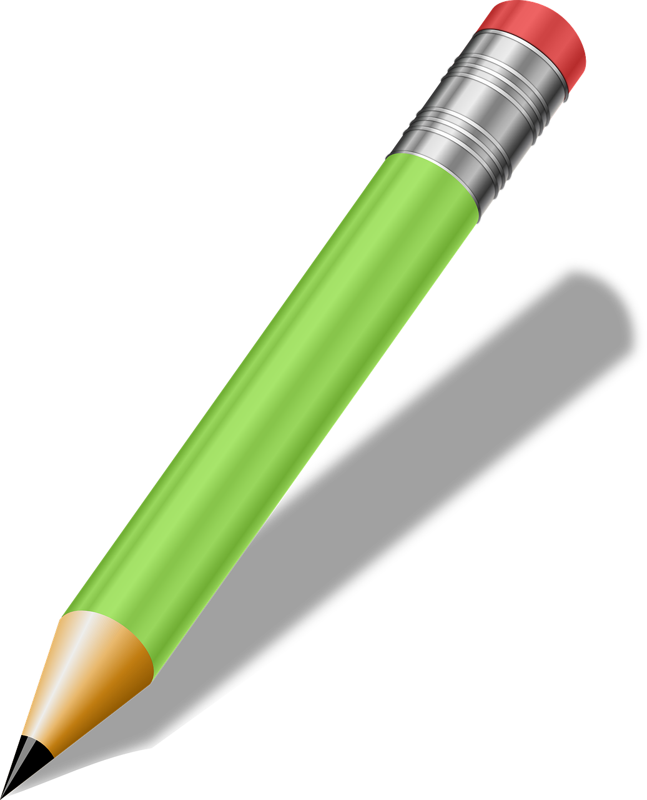
First,
Explore Habits
Read this New York Times article on habits, "Do you Have More Good Habits than Bad?" by Jeremy Engle https://www.nytimes.com/2020/02/26/learning/do-you-have-more-good-habits-than-bad.html
Write or record a response to one of the writing prompts found by scrolling to the bottom of Jeremy Engle's article.
Or
Speak and listen while conducting an interview with a family member or friend about their different habits. You could conduct the interview in-person, by phone, or online. Share what you've learned about their habits.

Slide 9
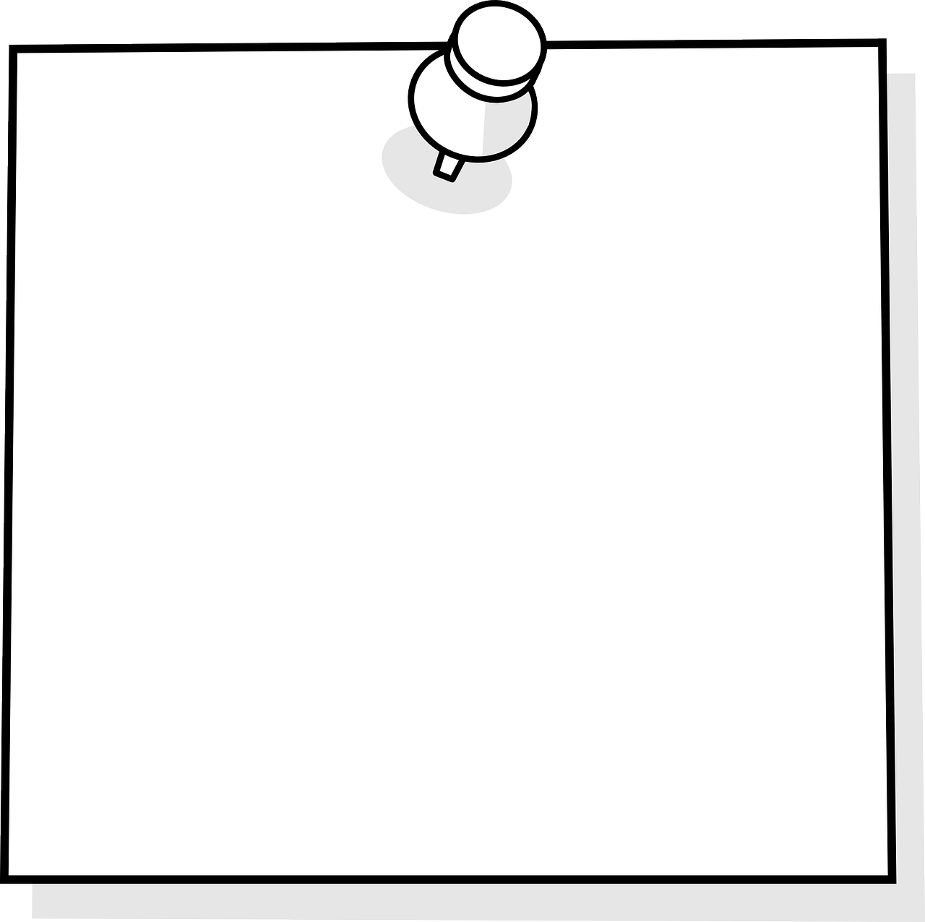
Next,
Connect It to Your Life
Add to your journal entry using the "Thinking about Habits" questions.
Choose to write or
record
Thinking About Habits
What are habits?
What are some of your habits?
Are they good habits or bad habits? Why?

Slide 10
Then,
Connect to the World
Add to your journal entry (either write or record)
How are Canadians staying well during the pandemic? What ideas would you add to this infographic to improve physical and mental health during stressful times?
https://www150.statcan.gc.ca/n1/pub/11-627-m/11-627-m2020039-eng.htm

Slide 11
Share
Share with your teacher on your
learning platform.
1. Your wonderings and things in the learning provocation activities (Slide 6)
2. Your journal entry (writing and/or recording).

Slide 12
What do my routines say about me?
Learning Provocation
Now it is your turn!
Create your emoji routine to show the routine of your "average" day.
Break the code!
What do you know about this person's routine by looking at their emoji routine?
by @msmclauchlan is licensed under CC BY-SA

Slide 13
What do my routines say about me?
Overview
https://www.nytimes.com/2018/10/23/learning/do-you-wish-you-had-a-different-morning-routine.html
First, explore routines
Next, make comparisons
Then, consider possibilities
Read the article. Choose to write or record a journal entry and conduct/record an interview.
Read the article and show your ideas in a comparison chart.
Choose texts from the playlist to help you add to your comparison chart.
Similarities | Differences | New habits I may want to fit into my routine
https://careers.workopolis.com/advice/morning-routines-from-around-the-world/
Share with your teacher
1. Your emoji routine
2. Your journal entry (writing and/or recording)
3. Your comparison chart

Slide 14
First,
Explore Routines
Read this New York Times article on habits: “Do You Wish You Had a Better Morning routine?” by Jeremy Engle https://www.nytimes.com/2018/10/23/learning/do-you-wish-you-had-a-different-morning-routine.html
Write or record a response to one of the writing prompts found by scrolling to the bottom of Jeremy Engle's article.
Or
Speak and listen while conducting an interview with a family member or friend about their different routines. You could conduct the interview in-person, by phone, or online. Share what you've learned about their routines.

Slide 15
Next,
Make Comparisons
1. Read the article https://careers.workopolis.com/advice/morning-routines-from-around-the-world/
2. Place your ideas in a comparison chart. How are your morning routines similar and different to others? Would you consider any of these in your morning routine?
Similarities | Differences | New habits I may want to fit into my routine

Slide 16
Then,
Consider Possibilities
Choose texts from the playlist to help you add to your comparison chart. You can add your own texts to the playlist, too.
Our Playlists
5 Habits That Will Change Your Life https://www.youtube.com/watch?v=BXc9gjolgeM
The Couch Potato by Jory John and Pete Oswald
https://www.youtube.com/watch?v=HSDnt30uJME&t=216s
10 Healthy Habits For Teenagers https://www.youtube.com/watch?v=EX1nLEgT9I8
8 ways to foster hope in your daily life https://kidshelpphone.ca/get-info/8-ways-foster-hope-your-daily-life/

Slide 17
Share,
Share with your teacher on your
learning platform.
1. Your emoji routine. ​
2. Your journal entry (writing and/or recording).​
3. Your comparison chart​

Slide 18
How will I improve my wellness?
Learning Provocation
Video battle! You decide who wins. Try them out!
Which video inspires you the most? Or can you find another fitness video that inspires you?
Let's Get Moving!
https://www.youtube.com/watch?v=t1KU0gaoy4k
https://www.youtube.com/watch?v=ySCXZgML7cU
My wellness is a tray of delicious food. In

Slide 19
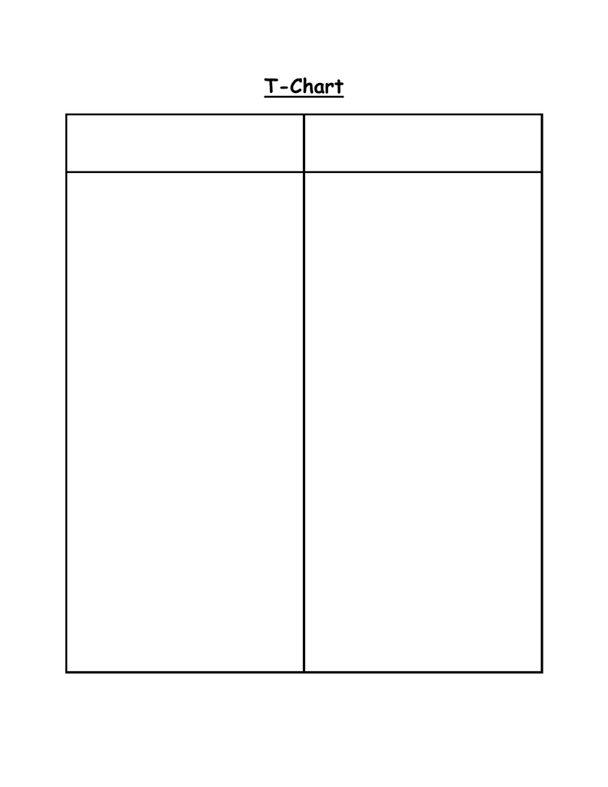
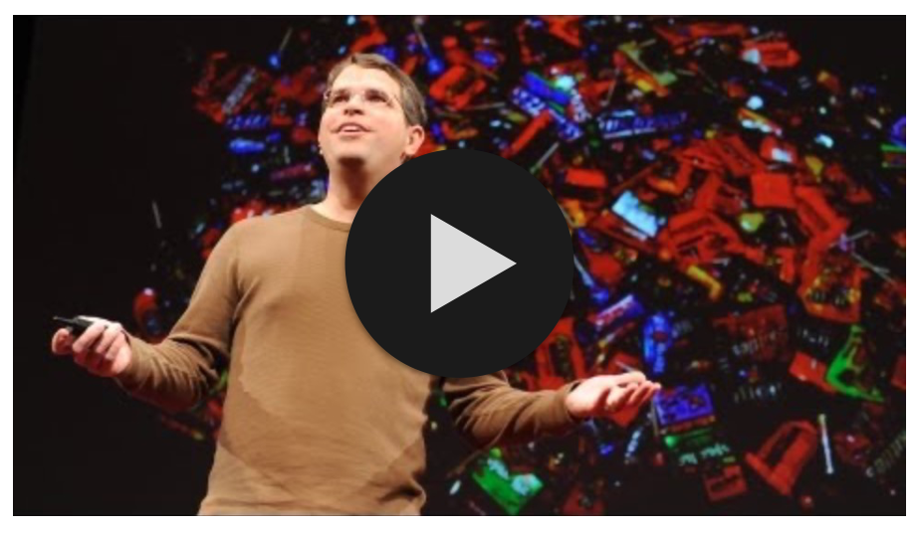
How will I improve my personal wellness?
Overview
First, get inspired
Next, create an action plan
Then, design a motivational text
View the video. Choose to write or record ways the author's life has improved by changing his habits.
Create an action plan to improve your habits. Decide on how to track progress and overcome challenges.
Thinking about your plan, create a motivational text with positive affirmations. This can help you
reach your goals!
Choose one text type:
A video message
A wellness Box
Start a blog with your first entry
Improve my Habits
Share with your teacher
1. Your thoughts about the author's life changes
2. Your action plan
3. Your first draft and final draft of the motivational text
Want to learn more?
Read this New York Times article on time management. Scroll to the bottom of the article and respond to any of the prompts listed at the end.

Slide 20
First,
Get Inspired​
1. View the video.
2. Write down or record ways the author's life has improved
by changing his habits.
https://youtu.be/UNP03fDSj1U

Slide 21
Next,
Create an Action Plan​
Improve your life by creating this 3-part action plan to change your habits. Then, put your plan into action!
Part 1. Reflect on the things in your life that you want to improve. Use the T-Chart to brainstorm the habits you want to 'Do More Of' or 'Do Less Of'. These will be your goals.
Part 2. Explain how you will track your progress. What system will you use. Add a "tracker tool" as needed.
Part 3. Describe two or more challenges you may encounter. How might you overcome these challenges.
Improve my Habits
Do More Of
Do Less Of

Slide 22
Design a Motivational Text
Then,
1. Think about the habits you want to improve. Put positive thinking to action. Create 3 to 5 positive affirmations, motivational statements, to help you reach your goal. Need help? Here are a few examples.
2. Use these positive affirmations to create a motivational text, a text to inspire you to reach your goals.
Choose one of the following:
A video message (Slide 23)
A Wellness Box (Slide 24)
Start a blog with your first entry (Slide 25)
Who is your audience? Yourself! The purpose is to inspire yourself throughout your improvement journey.

Slide 23
Create a Video Message
Things to Consider
Begin planning. Who is your audience and what is the purpose of your video?
What message do you want to send to your audience? What do you want them to think about your idea, topic, or information?
Begin creating. What will your storyboard say and which background and visual elements or props will you include?
Begin recording. What recording device will you use (phone, I-Pad, computer program, etc.)?
Will you require any help using the technology? Who can you ask for help?
Where will you film? Do you have a location that is quiet and has good lighting?
Who can you test your video out on? A family member, friend, or classmate? (Slide 26)
Revise and edit your video.

Slide 24
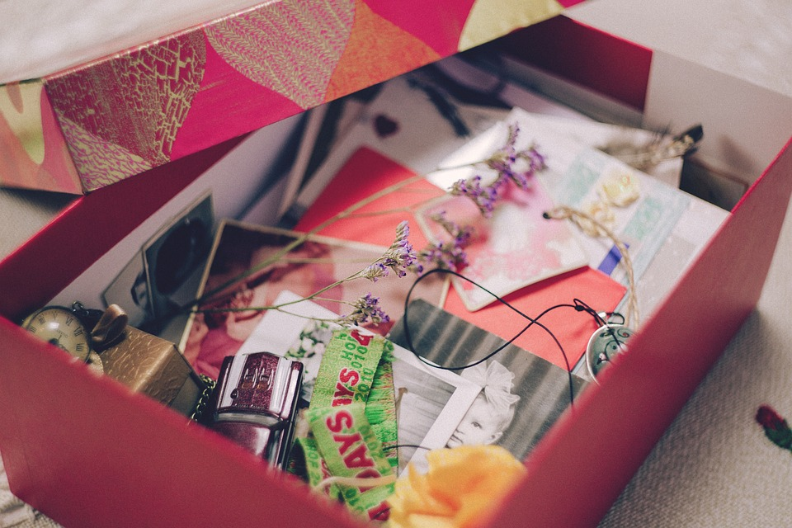
Create a Wellness Box
What is a wellness box?
A wellness box is a cross between a memory box and a shadow box. Its purpose is to provide you with encouragement and inspiration when you hold, look, or smell the items in the box. The items you choose should relate to your positive affirmations and the habits you want to improve.
Things to Consider
Begin planning. What will you use to hold your items. Shoe box, plastic tub, basket, etc.?
Which 5-7 items will you chose to put into your wellness box? Why or how do they motivated and inspired you to reach your goals?
Who can you practice sharing your wellness box with? Family, friends, classmates? How will you remember everything you want to say about each item?
How will you share your wellness box with your teacher? Will it be a virtual meeting with your teacher where you show your items and explain why you chose each of them or will you take a picture of your memory box items and write an explanation for why you chose each one?

Slide 25
Create a Blog
What is a blog?
Check out
https://www.youtube.com/watchv=oDxg5ODEXEQ&list=PLq4p3q2fmMYXKSXEmIWBZJb6InDYudtTd%E2%80%8B
Things to Consider
1. What is the name of your blog? Who is your audience?
2. Begin planning. What message do you want to send to your audience for the first blog? How will you organize your blog entry to include your positive affirmations? Remember to
write a compelling title and headlines
add subheadings and shorter paragraphs to break up the page.
gather visual elements you will include in your blog to support your message
3. Begin writing. Write a draft of your first blog with a subject line, introduction, and body.
4. Revise and edit your blog (Slide 26). Then, post your blog on your chosen blog website.

Slide 26
Don't Stop Now!
Part of good communication is being open to suggestions from others to help send message.
Share your motivational text with someone (a friend, family member etc.). Get their feedback. How can you make your text better?
Use their feedback to make changes to your motivational text.

Slide 27
Share,
Share with your teacher on your
learning platform.
1. Your thoughts about the author's life changes ​
2. Your action plan​
3. Your first draft and final draft of the motivational text

Slide 28
A special surprise for you.

Slide 29
Image Attributions
No attribution is required for all images https://pixabay.com/

