Slide 1
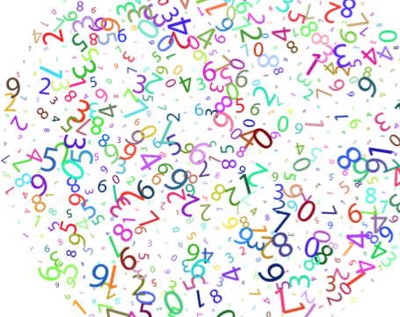
Getting Stronger with Number
Notes:
Photo Source: https://openclipart.org/detail/254730/prismatic-random-numbers-cloud

Slide 2
Guiding Concepts
Anchored in inquiry
Open-ended questions, student centered, student choice
Low floor, high ceiling tasks
Multiple ways to show understanding

Slide 3
Curricular Outcomes
6.N.4 – Relate improper fractions to mixed numbers
6.N.8 – Demonstrate an understanding of multiplication of decimals
6.N.9 – Explain and apply the order of operations, excluding exponents
Notes:
Specific to grade level outcomes, could include multiple disciplines (Math, ELA…)

Slide 4
Instructions
This collection of tasks is designed around the concept of number, more specifically understanding fractions, using decimal operations and order of operations. The 6 main sections (colored blocks on Slide 6 of PowerPoint) represent independent sets of 3-part learning experiences that could function effectively as 45min-1hour session with a combination of synchronous and asynchronous parts, some of which are easily adaptable either way depending on your situation and access to technology and connectivity.
FOR SYNCHRONOUS LEARNING, THE SLIDEDECK SHOULD BE IN EDIT MODE.
Each independent set provides a different way of engaging with the concept and is divided into 3 main parts:
Get Ready: begins the experience with an activity meant to activate student thinking and promote rich student discourse. This activity can be delivered prior to the lesson as an asynchronous task so students can prepare their thinking. Alternatively, the task can be used at the beginning of a synchronous session to help the teacher assess prior knowledge and prime thinking for the upcoming learning experience.
Work it out: comprises the main learning experience for the day. This is where new content is presented and individual or small group responses are solicited. These activities are best completed by having students work collaboratively. If the platform you use allows for breakout rooms, this feature is a good tool to help facilitate student collaboration and discourse.
Look Back: is a final culminating task that provides opportunities to check for student understanding, consolidate given solutions and solve problems. It allows for students to reflect on their learning and make connections.
Notes:
More detailed instructions for each learning experience are included in the NOTES section under each slide.

Slide 5
Materials
If this is the first time students are experiencing virtual manipulatives, it is highly recommended to allow them time to "play". This gives the opportunity to explore and have fun with the tools BEFORE student are required to use them purposefully.
Hands-on manipulatives are ideal as significant learning occurs when students can build and visualize different representations of mathematics. Websites containing virtual manipulatives are suggested.
If a specific platform is used for delivering online instruction (i.e. Seesaw, Google Classroom), asynchronous tasks can be uploaded there.
For virtual manipulatives visit https://toytheater.com/category/teacher-tools/virtual-manipulatives/

Slide 6
Getting Stronger with Numbers
Visual Connections
Real World Connections
Mental Math & Estimation
Problem Solving
Interdisciplinary Connections
Number Play
Notes:
This is the “launch screen”. Each tile above represents 1-2 “days” worth (approx. 1 hour) of learning experiences.
The slides needed for each section are colour coded and grouped together to help you locate them in the slide deck.
The teacher is free to determine the order these learning experiences will be assigned.
Routinely incorporating conceptual understanding, procedural thinking, and problem solving within instructional design will enable students to master the mathematical skills and concepts of the curriculum. Integration of the mathematical processes are intended to permeate all learning experiences.

Slide 7
Number Play
Teacher notes are available on each slide to assist with implementation of the lesson.
Lesson Instructions
This set of slides is designed to be a guided lesson.
Get Ready: A specific type of number talk routine called Which One Doesn’t Belong
Work it out: Variety of Open Middle tasks
Look back: Student reflection on their thinking and learning for that set
The tasks were designed as low floor/high ceiling to allow multiple entry points for students. They are intended to encourage discourse between students to share their learning, misunderstandings and discoveries. These encourage and allow teachers/students to explore vocabulary and highlight the important benchmark fractions with which students are familiar.
The learning experience can be completed asynchronously but is best implemented synchronously with a teacher. Teachers can edit/delete slides before uploading for students to work on to best suit the needs of the students engaging in the material. This learning experience may need to be taught over two days to ensure the students can develop a deep level conceptual understanding.
Student slides should be duplicated if working synchronously to allow them to work on tasks individually while they discuss their findings with peers. This allows students to have think time in their own workspace.
Alternatively, slides can be used to work through in groups if your platform allows.

Slide 8
Number Play
1
Get Ready
2
Work it out
3
Looking Back
Descending
Which One Doesn’t Belong?
Write About It
or,
Ascending
Record It
0, 1/2, 1
Notes:
Activator – number talk
Work it out - Challenges make up the focus of the day(s) lesson (you may only have one and all students are assigned the same task, you may have a choice of two or three, or you may have all students begin at challenge 1 and move on as greater challenge is needed / Consolidate & Reflect on what you’ve learned during this part of the project.
Looking Back – a place for reflection/self-assessment
Photo Sources: https://openclipart.org/detail/172707/edit-icon-icono-editar, https://openclipart.org/detail/212116/screencast

Slide 9
LI
Learning Intention
Discovering and using benchmark fractions to compare, represent, and estimate fractions
Notes:
Learning Intention for the day

Slide 10
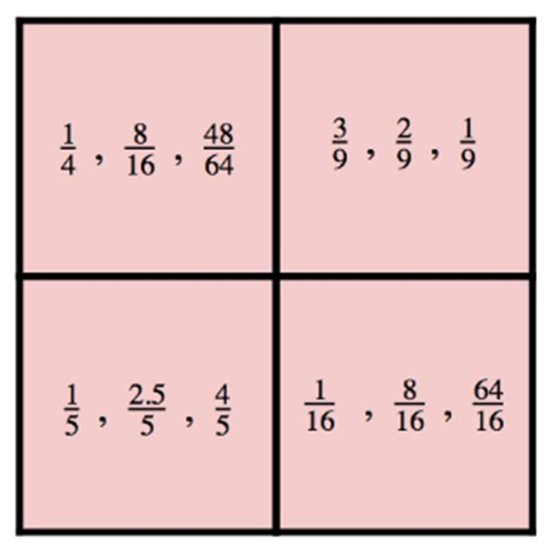
1
Get Ready
Which One Doesn’t Belong?
Notes:
Teacher Notes
This slide is intended to be on screen when students are signing into your class to prime their thinking for the day.
Source: wodb.ca

Slide 11
1
Print me to limit screen time
Which One Doesn’t Belong?
Get Ready
This one doesn’t belong because…
This one doesn’t belong because…
This one doesn’t belong because…
This one doesn’t belong because…
Notes:
Teacher Notes
Student page (duplicate for the number of students you have if working synchronously with students)
This is a slide where the teacher can scribe/record student notice and wonderings. (If students have viewed this ahead of time, they may have some responses ready. The teacher can then collect the responses ahead of time.
Source: wodb.ca

Slide 12
1
Get Ready
End of section

Slide 13
2
Print me to limit screen time
Work it out
Create three fractions in descending order using the digits 1-9.
Use each digit only once.
1
1
1
1
1
1
1
1
1
1
2
2
2
2
2
2
2
2
2
2
3
3
3
3
3
3
3
3
3
3
4
4
4
4
4
4
4
4
4
4
5
5
5
5
5
5
5
5
5
5
6
6
6
6
6
6
6
6
6
6
7
7
7
7
7
7
7
7
7
7
8
8
8
8
8
8
8
8
8
8
9
9
9
9
9
9
9
9
9
9
Use Me!
Notes:
Teacher Notes
One possible answer:
5/4, 2/3, 1/8
Source: Adapted from - www.openmiddle.com

Slide 14
2
Print me to limit screen time
Work it out
Create three new fractions that are in ascending order using the digits 1-9. Use each digit only once.
1
1
1
1
1
1
1
1
1
1
2
2
2
2
2
2
2
2
2
2
3
3
3
3
3
3
3
3
3
3
4
4
4
4
4
4
4
4
4
4
5
5
5
5
5
5
5
5
5
5
6
6
6
6
6
6
6
6
6
6
7
7
7
7
7
7
7
7
7
7
8
8
8
8
8
8
8
8
8
8
9
9
9
9
9
9
9
9
9
9
Use Me!
Notes:
Teacher Notes
1/7, 3/6, 8/9
Extension: What is the total difference? Answer: 16/63
Source: Adapted from - www.openmiddle.com

Slide 15
2
Print me to limit screen time
Work it out
Create three fractions that are as close to zero, one half and one whole as possible using the digits 1-9. Use each digit only once.
1
1
1
1
1
1
1
1
1
1
2
2
2
2
2
2
2
2
2
2
3
3
3
3
3
3
3
3
3
3
4
4
4
4
4
4
4
4
4
4
5
5
5
5
5
5
5
5
5
5
0
½
1
6
6
6
6
6
6
6
6
6
6
7
7
7
7
7
7
7
7
7
7
8
8
8
8
8
8
8
8
8
8
9
9
9
9
9
9
9
9
9
9
Use Me!
Notes:
Teacher Notes
One possible answer:
1/7, 3/6, 8/9
Extension: What is the total difference? Answer: 16/63
Source: Adapted from - www.openmiddle.com

Slide 16
2
Print me to limit screen time
Bonus
Create three fractions that are as close to three numbers of your choosing using the digits 1-9. Use each digit only once.
1
1
1
1
1
1
1
1
1
1
2
2
2
2
2
2
2
2
2
2
3
3
3
3
3
3
3
3
3
3
4
4
4
4
4
4
4
4
4
4
5
5
5
5
5
5
5
5
5
5
6
6
6
6
6
6
6
6
6
6
7
7
7
7
7
7
7
7
7
7
8
8
8
8
8
8
8
8
8
8
9
9
9
9
9
9
9
9
9
9
Use Me!
Notes:
Teacher Notes
Source: Adapted from - www.openmiddle.com

Slide 17
2
Work it out
End of section

Slide 18
3
Print me to limit screen time
Looking Back
Write/Record 3 things you learned today:
What did you discover? What did you notice about your thinking?
What did you learn? How did this learning experience feel for you?
1.
2.
3.
Notes:
Student slide (copy and paste as needed if working synchronously with students)
Teacher Notes
This slide may be completed synchronously or asynchronously, depending on teacher intentions for the lesson.
Photo Sources: https://openclipart.org/detail/172707/edit-icon-icono-editar, https://openclipart.org/detail/212116/screencast

Slide 19
3
Look Back
End of section

Slide 20
Work it out
Teacher notes are available on each slide to assist with implementation of the lesson.
Lesson Instructions
This set of slides is designed to be a guided lesson.
Get Ready: A math routine called What do you notice, What do you wonder
Work it out: Low floor/high ceiling problem solving task
Look back: Open-ended application and extension of the problem solving task
The Get Ready task is intended to spark curiosity in students. Teachers can lead the conversation toward fractions if they wish or listen to student discourse to hear the rich thinking a class has.
The brownie recipe task is designed as low floor/high ceiling to allow multiple entry points for students The goal is to encourage discourse between students to share their learning, misunderstandings and discoveries.
Student slides should be duplicated if working synchronously to allow them to work on tasks individually while they discuss their findings with peers. This allows students to have think time in their own workspace.
Alternatively, slides can be used to work through in groups if your platform allows.
The learning experience can be completed asynchronously but is best implemented synchronously with a teacher. Teachers can edit/delete slides before uploading for students to work on to best suit the needs of the students engaging in the material. This learning experience may need to be taught over two days to ensure the students can develop a deep level conceptual understanding.

Slide 21
Real World Connections
1
Get Ready
2
Work it out
3
Looking Back
Write About It
What do you notice?
What do you wonder?
Brownies!
or,
Record It
Notes:
Activator – number talk
Work it out - Challenges make up the focus of the day(s) lesson (you may only have one and all students are assigned the same task, you may have a choice of two or three, or you may have all students begin at challenge 1 and move on as greater challenge is needed / Consolidate & Reflect on what you’ve learned during this part of the project.
Looking Back – a place for reflection/self-assessment
Photo Sources: https://openclipart.org/detail/172707/edit-icon-icono-editar, https://openclipart.org/detail/212116/screencast

Slide 22
LI
Learning Intention
Connecting understanding of fractions in a Real-Word setting
Notes:
Learning Intention for the day

Slide 23
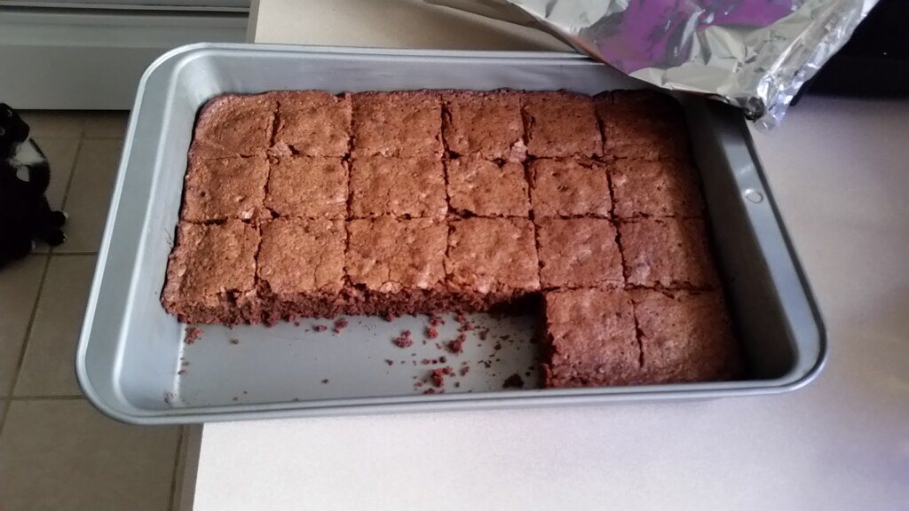
1
Get Ready
What do you notice?
What do you wonder?
Notes:
Teacher Notes
This slide is intended to be on screen when students are signing into your class to prime their thinking for the day.
Ask students what do they notice, what do they wonder? Students can use the next slide to record their thoughts.
Photo Source: https://search.creativecommons.org/photos/7a781de3-907b-41c3-b397-39f25c2c6894

Slide 24
1
Print me to limit screen time
Get Ready
What do you notice?
What do you wonder?
Notes:
Teacher Notes
Student slide (copy and paste as needed if working synchronously with students)
This is a slide where the teacher can scribe/record student notice and wonderings. (If students have viewed this ahead of time, they may have some responses ready. The teacher can then collect the responses ahead of time.
Photo Source: https://www.makebetterfood.com/recipes/fudge-brownies/

Slide 25
1
Get Ready
End of section

Slide 26
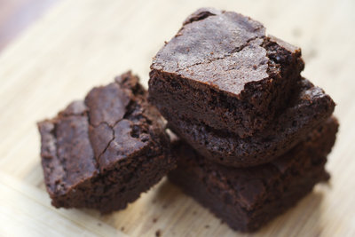
2
Print me to limit screen time
Work it out
A Brownie Recipe
A brownie recipe calls for the following ingredients:
1 ½ cups all-purpose flour
1 ¼ cups of cocoa powder
1 teaspoon coarse sea salt
1 teaspoon baking powder
4 large eggs
1 tablespoon vanilla
1 cup of butter
2 ¼ cups of sugar
2 cups semi-sweet chocolate chips
Which amounts are fractions? Which amounts are whole numbers?
Which number looks different from the others?
If you need to use 2 ¼ cups sugar, and you have the following measuring cups available: ¼ cup, ⅓ cup, ½ cup, and 1 cup, what are all the ways you can measure 2 ¼ cups?
What combination of measuring cups would be the most efficient to use?
Look yummy? Try out the full recipe here: https://www.makebetterfood.com/recipes/fudge-brownies/
Notes:
Teacher Notes
Using a three read approach would assist in implementing this task synchronously with students.
Detailed information about the 3-read approach: http://www.sfusdmath.org/3-read-protocol.html
Adapted from: https://www.makebetterfood.com/recipes/fudge-brownies/
Photo Source: https://www.makebetterfood.com/recipes/fudge-brownies/

Slide 27
2
A Brownie Recipe
Work it out
1 ½ cups all-purpose flour
1 ¼ cups of cocoa powder
1 teaspoon coarse sea salt
1 teaspoon baking powder
4 large eggs
1 tablespoon vanilla
1 cup of butter
2 ¼ cups of sugar
2 cups semi-sweet chocolate chips
Which amounts are fractions?
Which amounts are whole numbers?
Which number looks different from the others?
If you need to use 2 ¼ cups sugar, and you have the following measuring cups available: ¼ cup, ⅓ cup, ½ cup, and 1 cup, what are all the ways you can measure 2 ¼ cups?
What combination of measuring cups would be the most efficient to use?
Notes:
Adapted from: https://www.makebetterfood.com/recipes/fudge-brownies/

Slide 28
2
Work it out
End of section

Slide 29
3
Looking Back
Using the brownie recipe, or a recipe of your choosing try baking with an adult at home!
Try to choose a recipe that involves Fractions.
Try doubling the recipe for an extra challenge.
Record or write your observations.
Notes:
Student page (copy and paste as needed if working synchronously with students)
Photo Sources: https://openclipart.org/detail/172707/edit-icon-icono-editar, https://openclipart.org/detail/212116/screencast, https://openclipart.org/detail/63541/measuring-cup

Slide 30
3
Look Back
End of section

Slide 31
Lesson Instructions
Teacher notes are available on each slide to assist with implementation of the lesson.
This set of slides is designed to be a guided lesson.
Get Ready: A math routine called Number Talk
Work it out: Variety of Open Middle tasks
Look back: Open-ended application and extension
The Get Ready encourages and allows teachers/students to explore vocabulary and highlight important strategies for multiplying decimal numbers with whole number multipliers.
The Work it out was designed as low floor/high ceiling to allow multiple entry points for students. The goal is to encourage discourse between students to share their learning, misunderstandings and discoveries.
Student slides should be duplicated if working synchronously to allow them to work on tasks individually while they discuss their findings with peers. This allows students to have think time in their own workspace.
Alternatively, slides can be used to work through in groups if your platform allows.
The learning experience can be completed asynchronously but is best implemented synchronously with a teacher. Teachers can edit/delete slides before uploading for students to work on to best suit the needs of the students engaging in the material. This learning experience may need to be taught over two days to ensure the students can develop a deep level conceptual understanding.

Slide 32
Mental Math & Estimation
1
Get Ready
2
Work it out
3
Looking Back
Smallest Product
Write About It
Solve This Expression
or,
Largest Product
Record It
Closest to 100
Notes:
Activator – number talk, choral count…
Work it out - Challenges make up the focus of the day(s) lesson (you may only have one and all students are assigned the same task, you may have a choice of two or three, or you may have all students begin at challenge 1 and move on as greater challenge is needed / Consolidate & Reflect on what you’ve learned during this part of the project.
Looking Back – a place for reflection/self-assessment
Photo Sources: https://openclipart.org/detail/172707/edit-icon-icono-editar, https://openclipart.org/detail/212116/screencast

Slide 33
LI
Learning Intention
Multiplying decimal numbers by whole numbers
Notes:
Learning Intention for the day

Slide 34
1
Print me to limit screen time
Get Ready
How would you solve this?
12 x 8
Can you solve it another way?
Notes:
Teacher Notes
This slide is intended to be on screen when students are signing into your class to prime their thinking for the day.
Multiplying Decimals
NOTE: You will be looking to highlight the Double and Halving strategy. Students may also use the distributive property (area model) or the working with a known fact to solve this problem.
Source: Adapted from: Humphreys, C., & Parker, R. (2015). Making Number Talks Matter: Developing Mathematical Practices and Deepening Understanding, Grades 3-10 (Illustrated ed.). Stenhouse Publishers.

Slide 35
1
Print me to limit screen time
Get Ready
How would you solve this?
12 x 0.8
Can you solve it another way?
Notes:
Teacher Notes
Multiplying Decimals
You will be looking to see whether students see the relationship from the previous slide and this slide, allowing them to use the same strategies discussed, adjusting now for the decimal.
Having students say the numbers properly (eight tenths) will help them see the reasoning behind their answers.
ex: 12 x 0.8 = 96 tenths or 9.6.
Source: Adapted from: Humphreys, C., & Parker, R. (2015). Making Number Talks Matter: Developing Mathematical Practices and Deepening Understanding, Grades 3-10 (Illustrated ed.). Stenhouse Publishers.
You may wish to skip the next slide depending on timing and your goals for the lesson. ​

Slide 36
1
Print me to limit screen time
Get Ready
Pick ONE of these:
3.1 x 16
17 x 0.4
1.5 x 12
Can you solve it another way?
How would you solve it?
Notes:
Student slide (copy and paste as needed if working synchronously with students)
Source: Adapted from: Humphreys, C., & Parker, R. (2015). Making Number Talks Matter: Developing Mathematical Practices and Deepening Understanding, Grades 3-10 (Illustrated ed.). Stenhouse Publishers.

Slide 37
1
Get Ready
End of section

Slide 38
2
Print me to limit screen time
Work it out
Using the digits 2-9 create two numbers that have the smallest possible product. Use each digit only once.
2
2
2
2
2
2
2
2
2
2
3
3
3
3
3
3
3
3
3
3
. x
4
4
4
4
4
4
4
4
4
4
5
5
5
5
5
5
5
5
5
5
6
6
6
6
6
6
6
6
6
6
7
7
7
7
7
7
7
7
7
7
8
8
8
8
8
8
8
8
8
8
9
9
9
9
9
9
9
9
9
9
Use Me!
Notes:
Adapted from: https://www.openmiddle.com/
Student page (copy and paste as needed if working synchronously with students)
Teacher Notes
First Question: The smallest possible product (34.5 x 2 = 69)
Second Question (Next Slide): The largest possible product (87,6 x 9 = 788.4)
Third Question (Third Slide): The product closest to 100 (49.5 x 2 = 99 & 19.8 x 5 = 99, but. . ..49.8 x 2 = 99.6 and 25.1)
Encourage use of estimation to make decisions about which digits would be best in each place value position...for example, encourage students to write down possibilities and talk them through...which would be smaller, 23.4 x 5 or 23.5 x 4? 24x5 is definitely >100 while 24x4 is<100...What about 34.5x2? Then have them calculate the actual products and verify their predictions.
Students may also wish to use the strategies they were working with during the number talk to solve expressions they create.

Slide 39
2
Print me to limit screen time
Work it out
Using the digits 2-9 create two numbers that have the largest possible product. Use each digit only once.
2
2
2
2
2
2
2
2
2
2
3
3
3
3
3
3
3
3
3
3
. x
4
4
4
4
4
4
4
4
4
4
5
5
5
5
5
5
5
5
5
5
6
6
6
6
6
6
6
6
6
6
7
7
7
7
7
7
7
7
7
7
8
8
8
8
8
8
8
8
8
8
9
9
9
9
9
9
9
9
9
9
Use Me!
Notes:
Adapted from: https://www.openmiddle.com/
Student page (copy and paste as needed if working synchronously with students)
Teacher Notes
Second Question: The largest possible product (87,6 x 9 = 788.4)
Third Question (Next Slide): The product closest to 100 (49.5 x 2 = 99 & 19.8 x 5 = 99, but. . ..49.8 x 2 = 99.6 and 25.1)
Encourage use of estimation to make decisions about which digits would be best in each place value position...for example, encourage students to write down possibilities and talk them through...which would be smaller, 23.4 x 5 or 23.5 x 4? 24x5 is definitely >100 while 24x4 is<100...What about 34.5x2? Then have them calculate the actual products and verify their predictions.
Students may also wish to use the strategies they were working with during the number talk to solve expressions they create.

Slide 40
2
Print me to limit screen time
Work it out
Using the digits 2-9 create two numbers that have a product as close as possible to 100. Use each digit only once.
2
2
2
2
2
2
2
2
2
2
3
3
3
3
3
3
3
3
3
3
. x
4
4
4
4
4
4
4
4
4
4
5
5
5
5
5
5
5
5
5
5
6
6
6
6
6
6
6
6
6
6
7
7
7
7
7
7
7
7
7
7
8
8
8
8
8
8
8
8
8
8
9
9
9
9
9
9
9
9
9
9
Use Me!
Notes:
Adapted from: https://www.openmiddle.com/
Student page (copy and paste as needed if working synchronously with students)
Teacher Notes
Third Question (Next Slide): The product closest to 100 (49.5 x 2 = 99 & 19.8 x 5 = 99, but. . ..49.8 x 2 = 99.6 and 25.1)
Extension: What if you COULD use the 1? How would that change your solutions?
Encourage use of estimation to make decisions about which digits would be best in each place value position...for example, encourage students to write down possibilities and talk them through...which would be smaller, 23.4 x 5 or 23.5 x 4? 24x5 is definitely >100 while 24x4 is<100...What about 34.5x2? Then have them calculate the actual products and verify their predictions.
Students may also wish to use the strategies they were working with during the number talk to solve expressions they create.

Slide 41
2
Work it out
End of section

Slide 42
3
Looking Back
Find an example of multiplying decimals by whole numbers around your house.
Take a picture of your example as well as your calculations.
Notes:
Student page (copy and paste as needed if working synchronously with students)
Photo Sources: https://openclipart.org/detail/172707/edit-icon-icono-editar, https://openclipart.org/detail/212116/screencast,
https://openclipart.org/detail/20364/cartoon-camera

Slide 43
3
Look Back
End of section

Slide 44
Visual Connections
Teacher notes are available on each slide to assist with implementation of the lesson.
Lesson Instructions
This set of slides is designed to be a guided lesson.
Get Ready: A routine called Image Talk
Work it out: Variety of Open Middle tasks
Look back: Self-reflection prompt
The first part of this learning experience is designed as a student paced experience starting with a whole class talk that should encourage and allow you to explore fractions using visuals. Next, students have the choice of working through a task (in small groups if possible) or watching a video before moving on to the next task. Having a discussion between tasks will allow the teacher to ensure students were able to understand what they are learning.
Student slides should be duplicated if working synchronously to allow them to work on tasks individually while they discuss their findings with peers. This allows students to have think time in their own workspace.
Alternatively, slides can be used to work through in groups if your platform allows.
The learning experience can be completed asynchronously but is best implemented synchronously with a teacher. Teachers can edit/delete slides before uploading for students to work on to best suit the needs of the students engaging in the material. This learning experience may need to be taught over two days to ensure the students can develop a deep level conceptual understanding.

Slide 45
Visual Connections
1
Get Ready
2
Work it out
3
Looking Back
Fraction Grids
Write About It
or,
Tiled Area
Mixed Number to an Improper Fraction
Record It
Notes:
Activator – number talk
Work it out - Challenges make up the focus of the day(s) lesson (you may only have one and all students are assigned the same task, you may have a choice of two or three, or you may have all students begin at challenge 1 and move on as greater challenge is needed / Consolidate & Reflect on what you’ve learned during this part of the project.
Looking Back – a place for reflection/self-assessment
Photo Sources: https://openclipart.org/detail/172707/edit-icon-icono-editar, https://openclipart.org/detail/212116/screencast

Slide 46
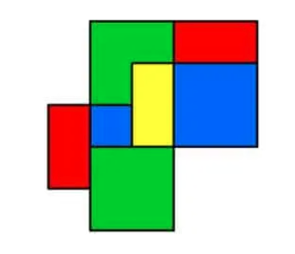
1
Tiled Area
Get Ready
If the little blue square is worth 1, what is the value of the other coloured areas?
What if the large blue square is 1, what is the value of the other coloured areas?
Notes:
Teacher Notes
This slide is intended to be on screen when students are signing into your class to prime their thinking for the day.
Source: https://stevewyborney.com/2017/01/tiled-area-questions/

Slide 47
1
Print me to limit screen time
Tiled Area
Get Ready
If the little blue square is worth 1, what is the value of the other coloured areas?
What if the large blue square is 1, what is the value of the other coloured areas?
Notes:
Student page (copy and paste as needed if working synchronously with students)
Teacher Notes
This is a slide where the teacher can scribe/record student notice and wonderings. (If students have viewed this ahead of time, they may have some responses ready. The teacher can then collect the responses ahead of time.
Source: https://stevewyborney.com/2017/01/tiled-area-questions/

Slide 48
1
Get Ready
End of section

Slide 49
LI
Learning Intention
Use visual models to represent the relationship between improper fractions and mixed numbers.
Notes:
Learning Intention for the day

Slide 50
2
Print me to limit screen time
Work it out (a)
0
You can show how an improper fraction is equal to a mixed number using the rectangles below.
For example, use 2 rectangles divided into fourths to show 6/4 = 1 2/4.
0
0
0
0
0
0
0
0
0
1
1
1
1
1
1
1
1
1
1
2
2
2
2
2
2
2
2
2
2
3
3
3
3
3
3
3
3
3
3
=
4
4
4
4
4
4
4
4
4
4
5
5
5
5
5
5
5
5
5
5
6
6
6
6
6
6
6
6
6
6
=
7
7
7
7
7
7
7
7
7
7
8
8
8
8
8
8
8
8
8
8
9
9
9
9
9
9
9
9
9
9
Use Me!
Notes:
Teacher Notes
This slide is intended to be screenshared with students during a synchronous lesson but can be adapted to fit your needs.
6/4 sections in total are covered, or 1 whole rectangle and 2/4 sections in the second rectangle.
6/4 = 1 2/4
Simplified: 1 2/4 = 1 1/2
You could colour 6 columns and then rearrange to show that 1 whole rectangle and 2/4 of another rectangle is covered.
Copy and paste as many as you need for your purpose.

Slide 51
2
Work it out (b)
Watch the video to learn more about the relationship between mixed numbers and improper fractions.
https://www.youtube.com/watch?v=qk2oP6FZ6HA&feature=emb_logo
Notes:
Teacher Notes
Students can watch the video individually/asynchronously to learn more about the relationship between mixed numbers and improper fractions. This can also be watched as a whole class.
Afterwards, have a class discussion about the video and what was learned. This is key for students to solidify their understanding of the relationship.
Source: https://www.youtube.com/watch?v=qk2oP6FZ6HA&feature=emb_logo

Slide 52
2
Print me to limit screen time
Use Me!
Work it out
Use the number tiles to create an improper fraction.
Then, use rectangles to show represent your fraction visually. Finally, state its mixed number equivalent.
What is important when you choose the rectangle?
0
0
0
0
0
0
0
0
0
0
1
1
1
1
1
1
1
1
1
1
2
2
2
2
2
2
2
2
2
2
3
3
3
3
3
3
3
3
3
3
4
=
4
4
4
4
4
4
4
4
4
5
5
5
5
5
5
5
5
5
5
6
6
6
6
6
6
6
6
6
6
7
7
7
7
7
7
7
7
7
7
=
8
8
8
8
8
8
8
8
8
8
9
9
9
9
9
9
9
9
9
9
Use Me!
Notes:
Student page (copy and paste as needed if working synchronously with students)
Teacher Notes
This slide may be completed synchronously or asynchronously, depending on teacher intentions for the lesson.
You may wish to create multiple copies for your students to encourage further exploration into mixed numbers and improper fractions

Slide 53
2
Work it out
End of section

Slide 54
3
Print me to limit screen time
Looking Back
Write/Record 3 things about fractions that you were reminded of or learned today.
1.
2.
3.
Notes:
Student slide (copy and paste as needed if working synchronously with students)
Teacher Notes
This slide may be completed synchronously or asynchronously, depending on teacher intentions for the lesson.
Photo Sources: https://openclipart.org/detail/172707/edit-icon-icono-editar, https://openclipart.org/detail/212116/screencast

Slide 55
3
Look Back
End of section

Slide 56
Lesson Instructions
Teacher notes are available on each slide to assist with implementation of the lesson.
This set of slides is designed to be a guided lesson.
Get Ready: A specific type of number talk routine called Which One Doesn’t Belong
Work it out: Variety of related problem-solving tasks
Look back: Self-reflection prompts
The Get Ready encourages and allows teachers/students to explore vocabulary and review order of operations which students are familiar.
The problem-solving tasks were designed as low floor/high ceiling to allow multiple entry points for students. They are intended to encourage discourse between students to share their learning, misunderstandings and discoveries. There are 3 levels of problems using the order of operations to allow students to begin with one challenge and work their way up to the final challenge (grade 8 level).
Student slides should be duplicated if working synchronously to allow them to work on tasks individually while they discuss their findings with peers. This allows students to have think time in their own workspace.
Alternatively, slides can be used to work through in groups if your platform allows.
The learning experience can be completed asynchronously but is best implemented synchronously with a teacher. Teachers can edit/delete slides before uploading for students to work on to best suit the needs of the students engaging in the material. This learning experience may need to be taught over two days to ensure the students can develop a deep level conceptual understanding.

Slide 57
Problem Solving
1
Get Ready
2
Work it out
3
Looking Back
Which One Doesn’t Belong?
The Four 4s
Write About It
1, 2, 3, 4
or,
Record It
1, 2, 3, 4, 5
Notes:
Activator – number talk, choral count…
Work it out - Challenges make up the focus of the day(s) lesson (you may only have one and all students are assigned the same task, you may have a choice of two or three, or you may have all students begin at challenge 1 and move on as greater challenge is needed / Consolidate & Reflect on what you’ve learned during this part of the project.
Looking Back – a place for reflection/self-assessment
Photo Sources: https://openclipart.org/detail/172707/edit-icon-icono-editar, https://openclipart.org/detail/212116/screencast

Slide 58
LI
Learning Intention
Growing in flexible use of all four operations while developing a deep understanding of the order of operations.
Notes:
Learning Intention for the day

Slide 59
1
Get Ready
Which One Doesn’t Belong?
(16 + 4) = 1
20
8 ÷ 4 - 1
8 ÷ 2
4
8 x 4 - 1
Notes:
Teacher Notes
This slide is intended to be on screen when students are signing into your class to prime their thinking for the day.
Source: wodb.ca

Slide 60
1
Print me to limit screen time
Which One Doesn’t Belong?
Get Ready
This one doesn’t belong because…
This one doesn’t belong because…
(16 + 4) = 1
20
8 ÷ 4 - 1
This one doesn’t belong because…
8 ÷ 2
4
This one doesn’t belong because…
8 x 4 - 1
Notes:
Teacher Notes
Student page (duplicate for the number of students you have if working synchronously with students)
This is a slide where the teacher can scribe/record student notice and wonderings. (If students have viewed this ahead of time, they may have some responses ready. The teacher can then collect the responses ahead of time.

Slide 61
1
Get Ready
End of this section

Slide 62
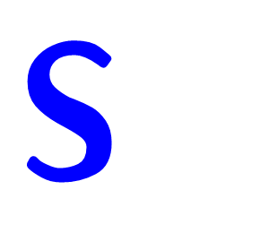
2
Work it out (a)
Four
Using EXACTLY four 4s and any operation ( + - x ÷ ), create an expression for each of the numbers from 1 to 20.
Notes:
Source: https://www.youcubed.org/tasks/the-four-4s/

Slide 63
2
Print me to limit screen time
Work it out (a)
Using EXACTLY four 4s and any operation ( + - x ÷ ), create an expression for each of the numbers from 1 to 20.
Four
1 =
2 =
3 =
4 =
5 =
6 =
7 =
8 =
9 =
10 =
11 =
12 =
13 =
14 =
15 =
16 =
17 =
18 =
19 =
20 =
Notes:
Student page (duplicate for the number of students you have if working synchronously with students)
Source: https://www.youcubed.org/tasks/the-four-4s/

Slide 64
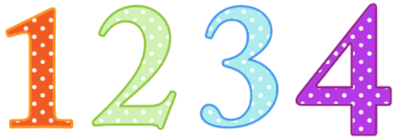
2
Work it out (b)
Using the digits 1, 2, 3 and 4 exactly once each, and any operation ( + - x ÷ ), create an expression for each of the numbers from 1 to 20.
Notes:
Adapted from: https://nrich.maths.org/1881
Photo Source: https://openclipart.org/detail/221916/colorful-numbers

Slide 65
2
Print me to limit screen time
Work it out (b)
Using the digits 1, 2, 3 and 4 exactly once each, and any operation ( + - x ÷ ), create an expression for each of the numbers from 1 to 20.
1 =
2 =
3 =
4 =
5 =
6 =
7 =
8 =
9 =
10 =
11 =
12 =
13 =
14 =
15 =
16 =
17 =
18 =
19 =
20 =
Notes:
Student page (duplicate for the number of students you have if working synchronously with students)
Adapted from: https://nrich.maths.org/1881
Photo Source: https://openclipart.org/detail/221916/colorful-numbers

Slide 66
2
Work it out (c)
+/-
+/-
+/-
+/-
+/-
Using any combination of the digits 1, 2, 3, 4 and 5 in either their positive or negative form, and any operation ( + - x ÷ ), create an expression for each of the numbers from -10 to +10. Try to incorporate MORE THAN ONE operation in each expression.
Notes:
Adapted from: https://nrich.maths.org/1881
Photo Source: https://openclipart.org/detail/221916/colorful-numbers

Slide 67
2
Print me to limit screen time
Work it out (c)
Using any combination of the digits 1, 2, 3, 4 and 5 in either their positive or negative form, and any operation ( + - x ÷ ), create an expression for each of the numbers from -10 to +10. Try to incorporate MORE THAN ONE operation in each expression.
0 =
+1 =
+2 =
+3 =
+4 =
+5 =
+6 =
+7 =
+8 =
+9 =
+10 =
-1 =
-2 =
-3 =
-4 =
-5 =
-6 =
-7 =
-8 =
-9 =
-10 =
Notes:
Student page (duplicate for the number of students you have if working synchronously with students)
Adapted from: https://nrich.maths.org/1881

Slide 68
2
Work it out
End of section

Slide 69
3
Print me to limit screen time
Looking Back
Today I learned...
I’m wondering about...
I’m ready to try...
Notes:
Student page (duplicate for the number of students you have if working synchronously with students)
3-2-1
Students to write/record 3 things they learned today, 2 things they are still wondering about, and 1 thing they are ready to try out based on their new found knowledge/confidence.
Adapted from: https://www.theresawills.com/templates
Photo Sources: https://openclipart.org/detail/172707/edit-icon-icono-editar, https://openclipart.org/detail/212116/screencast

Slide 70
3
Look Back
End of section

Slide 71
Lesson Instructions
Teacher notes are available on each slide to assist with implementation of the lesson.
This set of slides is designed to be a guided lesson.
Get Ready:
Get Ready: A math routine called Number Talk
Work it out: Tic-Tac-Toe
Look back: Explain Your thinking or Create a story
The Get Ready encourages and allows teachers/students to explore vocabulary and highlight important strategies for multiplying decimal numbers with whole number multipliers.
The tic-tac-toe learning experience is designed to have a low floor/high ceiling to allow multiple entry points for students. This visible thinking routine is usually found in an ELA classroom to promote critical thinking and teachers may wish to use evidence of student learning in this lesson to assess ELA as well.
Student slides should be duplicated if working synchronously to allow them to work on tasks individually while they discuss their findings with peers. This allows students to have think time in their own workspace.
Alternatively, slides can be used to work through in groups if your platform allows.
The learning experience can be completed asynchronously but is best implemented synchronously with a teacher. Teachers can edit/delete slides before uploading for students to work on to best suit the needs of the students engaging in the material. This learning experience may need to be taught over two days to ensure the students can develop a deep level conceptual understanding.

Slide 72
Interdisciplinary (ELA) Connections
1
Get Ready
2
Work it out
3
Looking Back
Write About It
Solve This Expression
Tic-Tac-Toe
or,
Record It
or…
Story Time
Notes:
Activator – number talk
Work it out - Challenges make up the focus of the day(s) lesson (you may only have one and all students are assigned the same task, you may have a choice of two or three, or you may have all students begin at challenge 1 and move on as greater challenge is needed / Consolidate & Reflect on what you’ve learned during this part of the project.
Looking Back – a place for reflection/self-assessment
Photo Sources: https://openclipart.org/detail/172707/edit-icon-icono-editar, https://openclipart.org/detail/169379/open-book

Slide 73
LI
Learning Intention
Making connections and understanding the differences between different types of fractions.
Notes:
Learning Intention for the day

Slide 74
1
Print me to limit screen time
Get Ready
How would you solve this?
18 x 23
Can you solve it in another way?
Notes:
Teacher Notes
This slide is intended to be on screen when students are signing into your class to prime their thinking for the day.
Multiplying Decimals
NOTE: You will be looking to highlight the Round and Adjust strategy. Students may also use the distributive property (area model) or double and halving to solve this problem.
Students understanding of rounding to the nearest whole number will be critical for them to be successful in solving these types of expressions.
Source: Adapted from: Humphreys, C., & Parker, R. (2015). Making Number Talks Matter: Developing Mathematical Practices and Deepening Understanding, Grades 3-10 (Illustrated ed.). Stenhouse Publishers.

Slide 75
1
Print me to limit screen time
Get Ready
How would you solve this?
1.8 x 23
Can you solve it in another way?
Notes:
Teacher Notes
Multiplying Decimals
NOTE: You will be looking to see whether students see the relationship from the previous slide and this slide, allowing them to use the same strategies discussed, adjusting now for the decimal.
Students understanding of rounding to the nearest whole number will be critical for them to be successful in solving these types of expressions.
Source: Adapted from: Humphreys, C., & Parker, R. (2015). Making Number Talks Matter: Developing Mathematical Practices and Deepening Understanding, Grades 3-10 (Illustrated ed.). Stenhouse Publishers.
You may wish to skip the next slide depending on timing and your goals for the lesson. ​

Slide 76
1
Print me to limit screen time
Get Ready
Pick ONE of these:
3 x 5.8
72 x 0.8
4.1 x 12
How would you solve this?
Can you solve it in another way?
Notes:
Student slide (copy and paste as needed if working synchronously with students)
Source: Adapted from: Humphreys, C., & Parker, R. (2015). Making Number Talks Matter: Developing Mathematical Practices and Deepening Understanding, Grades 3-10 (Illustrated ed.). Stenhouse Publishers.

Slide 77
1
Get Ready
End of section

Slide 78
2
Work it out
To win a game of Tic-Tac-Toe, you need to get a line of 3 “X”s or “O”s.
Today we will be creating our own Tic-Tac-Toe boards on Fractions, where you will place 9 words on the board.
Your goal is to have at least one line with 3 words that are connect to one another. Can you get all lines connected?
Notes:
Teacher Notes
Instructions leading up to the activity. This activity can be difficult for students if not explained in detail. Giving an example on the next slide helps students understand what is expected of them. It is important to note that it would be best to provide an example not using the words provided to maximize student thinking and creativity for the activity.

Slide 79
2
Print me to limit screen time
3/9
Work it out
Create a Tic-Tac-Toe board connecting fraction terms horizontally and/or vertically.
1
Proper Fraction
Improper Fraction
Mixed Number
1/4
0.25
a/b
100
8/3
2 2/3
decimal
fraction
Part of a Whole
2/8
Benchmark Fraction
Whole
Notes:
Teacher Notes
Students will create a Tic-Tac-Toe board connecting fraction terms horizontally and/or vertically.
Example: “Addition”, “+”, and “3.5 + 7.4 = 10.9” all have addition in common.
They will need to explain why one of the lines (3 terms) all connect with one another.
Next, explain what each term means.
Extension: How many lines of terms can you connect all at once?
Can you connect all lines (horizontal, vertical, diagonal)? Why or why not? ​

Slide 80
2
Print me to limit screen time
Work it out
Whole
Proper Fraction
2/8
Benchmark Fraction
Improper Fraction
3/9
Part of a Whole
Mixed Number
1
fraction
0.25
1/4
100
a/b
2 2/3
8/3
decimal
Notes:
Teacher Notes
This page can be printed for students ahead of the lesson if needed. Students would need to cut out the terms to place on their Tic-Tac-Toe board.

Slide 81
2
Work it out
End of section

Slide 82
3
Looking Back (a)
Explain why one of the lines (3 terms) all connect with one another.
Next, explain what each term means.
Can you connect all lines (horizontal, vertical, diagonal)? Why or why not? ​
Notes:
Students creating the story would not have to complete this task
Photo Sources: https://openclipart.org/detail/172707/edit-icon-icono-editar, https://openclipart.org/detail/212116/screencast

Slide 83
3
Looking Back (b)
Proper Fraction
Improper Fraction
Create a story about fractions to show your understanding of them.
On the side are some words you should try to use in your story. You can also use words from your Tic-Tac-Toe.
You can write your story, record your voice, or create a video.
Mixed Number
Part of a Whole
Whole
Fraction
Benchmark Fraction
Notes:
Photo Sources: https://openclipart.org/detail/172707/edit-icon-icono-editar, https://openclipart.org/detail/212116/screencast,
https://openclipart.org/detail/169379/open-book

Slide 84
3
Look Back
End of section

Slide 85
Basic descriptors to help guide your formative assessments. Full details of the student achievement profiles can be found here: Mental Math & Estimation Knowledge and Understanding Problem Solving | Requires considerable, on-going teacher support. | Requires occasional, teacher or peer support. | Accurate, clear, uses appropriate strategies & procedures. Requires occasional prompting for clarification. | Accurate, clear, flexible, consistent & efficient. Justifies and explains reasoning clearly and completely using accurate mathematical vocabulary.
Fractions/Decimal Operations | Limited | Basic | Good | Very Good/ Excellent
Describe and apply Mental Math strategies: Halving/Doubling,
Describe and apply Mental Math strategies: Round and Adjust
Describe and apply Mental Math strategies: Distributive Property (Area Model)
Identify Mixed Numbers and Improper Fractions
Relate Improper Fractions to Mixed Numbers
Convert Improper Fractions to Mixed Numbers and vice versa
Explain and Apply the order of operations
Multiplication of Decimals
Solves problems involving improper fractions and mixed numbers
Assessment Rubrics
Suggested Codes for daily record keeping purposes:
I - Knowledge has been demonstrated individually
H - is used when knowledge has been demonstrated individually, but with help from the teacher or a peer
G - is used when knowledge has been demonstrated within a group
X - is used when a question has been attempted but answered incorrectly
N - is used when a question has not been attempted.
Notes:
You can also copy and paste the table above into Microsoft Word or similar program.
Tracking student data throughout these learning experiences will allow the teacher to make an informed assessment about the students’ level of achievement on these outcomes.
Adapted from: Liljedahl, P. (2021). Building thinking classrooms in mathematics, grades K-12: 14 teaching practices for enhancing learning. Thousand Oaks, CA: Corwin Press Inc.

Slide 86
Credits
T. Scott Dempster - St. James-Assiniboia School Division
Reviewers
Heather Jones - St. James-Assiniboia School Division
Charmaine MacKid - Hanover School Division
Lisa Page - St. James-Assiniboia School Division
Dayna Quinn-LaFleche - St. James-Assiniboia School Division

