Slide 1
Patterns of Time
Grade 1
Daily and Seasonal Changes

Slide 2
Introduction

Slide 3
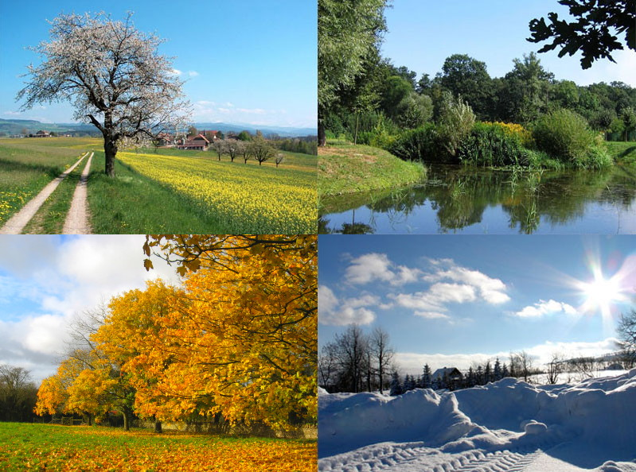
Introduction
Look at the pictures of the seasons on the left.
Some things that change include:
Temperature Wind Rain
Snow Amount of Sunlight
Draw or write to describe what you do to be comfortable and safe when it is cold outside:
Draw or write to describe what you do to be comfortable and safe when it is hot outside:
This Photo by Unknown Author is licensed under CC BY-SA

Slide 4
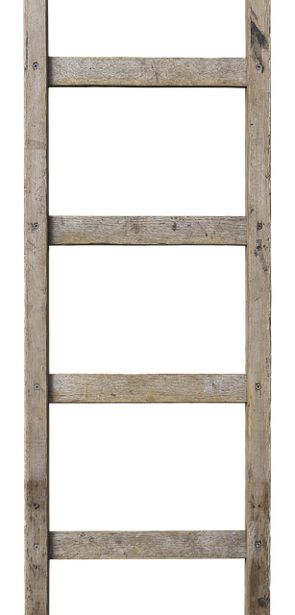
What season affects me and animals the most?
Rank the seasons and place in order from Greatest Impact (1) to Least Impact (4).
1
Fall
Summer
Spring
Winter
2
I think ______ affects me and animals the most because ______________________________________________________________________________________________________________
3
4

Slide 5
Introduction
In this learning experience we will look at patterns that exist over time such as day and night, weeks, and seasons.
At the end you will design a device or a structure to support an animal with seasonal changes.

Slide 6
Learning Activities

Slide 7
The Medicine Wheel and Seasons
Read the story Seasons by Caylie Gnyra.
Below, make your own Medicine Wheel. Draw pictures that show what things you see and do outside in each season.
Winter
Spring
Fall
Summer
Notes:
Story is in the Teacher Instructions pdf or can be access here: https://indigenousstorybooks.ca/pdf/en/en-0004_seasons.pdf

Slide 8
For each season, write sentences about your pictures.
Spring
___________________________________________________________________________________________________________________________
Summer
___________________________________________________________________________________________________________________________
Fall
___________________________________________________________________________________________________________________________
Winter
___________________________________________________________________________________________________________________________

Slide 9

Tree Art
Supplies:
Brown or black paint
Paint brush
Large paper
Glue
Various supplies from around home such as dried split peas, leaves, popcorn kernels, flowers, seeds, cotton balls, sand to represent the leaves and ground cover during the different seasons.
Directions:
Fold paper in half and then half again to make 4 squares.
Paint a tree in each square similar to the image.
Use what ever supplies you have available to decorate your trees to represent each season. Use the glue to attach your decorations.
Label the seasons.
Share a photo of your art work with your teacher.

Slide 10

Scavenger Hunt
Search around your home to find 3-5 items that are related to each season.
Talk to a family member about why you chose those items.
Draw a picture of one item for each season. Explain how it represents the season.
This Photo by Unknown Author is licensed under CC BY-SA-NC
____________________________________________________________________________________
Spring
____________________________________________________________________________________
Summer
____________________________________________________________________________________
Fall
Winter
____________________________________________________________________________________

Slide 11

Four Seasons - Vivaldi
Vivaldi wrote a whole concerto to reflect the changes in the seasons.
Listen to a clip of music from each season.
How does the music change in each part to represent each season? Discuss with a family member.
Create a dance to represent each season. If possible, record your dance and share with your teacher.
This Photo by Unknown Author is licensed under CC BY
Notes:
https://www.youtube.com/watch?v=GRxofEmo3HA

Slide 12

Examining Calendars
For this activity and the next two slides you will need a calendar (can be an old one) that has pictures of scenery. We will be cutting it up so check with a caregiver first!
Look through the calendar.
Look at how the pages are organized.
Look at the charts.
What patterns do you notice?
_________________________________________________________________________________________________________________________________________________________________________________________________________________________________________________
_________________________
________________________
________________________
This Photo by Unknown Author is licensed under CC BY-SA

Slide 13
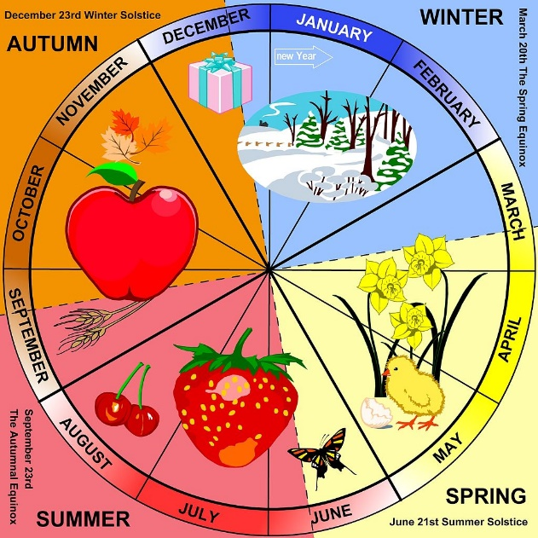
Now cut out the pictures from your calendar.
Mix them up.
Sort the pictures into the four seasons.
Share your sort with a family member. If possible, take a photo and insert below.
This Photo by Unknown Author is licensed under CC BY-SA

Slide 14

Mix up the calendar images again.
Arrange the pictures in a sequence or cycle in the order they would occur.
Share your sequence or cycle with a family member. If possible, take a photo.
This Photo by Unknown Author is licensed under CC BY-SA

Slide 15
Thirteen Moons on Turtle’s Back
Listen to Thirteen Moons on Turtle’s Back by Joseph Bruchac and Jonathan London.
What do you notice about the pictures? How do the images change? Why?
Draw or write to share your thinking.
Notes:
https://www.youtube.com/watch?v=MpT7MfXogTQ

Slide 16

Turtle Calendar
View 13 Moons on a Turtle's Back by George Couchie.
It takes the moon approximately 28 days to go around earth. This means it goes around the earth about 13 times in one year, giving us 13 lunar months.
Examine the diagram below to find the pattern of 13 lunar months and 28 days in a lunar month.
2
1
28
27
3
26
4
10
25
5
1
9
6
11
24
7
2
8
23
8
12
22
9
3
7
21
10
13
20
11
4
6
19
12
5
18
13
17
14
15
16
Notes:
https://vimeo.com/409797977

Slide 17

On the turtle’s back outline below, label each section with the name of the moon and draw a picture to represent the significance of each moon.
Optional: Figure out what moon we are in currently and use your turtle calendar to keep track of time.
Notes:
See teacher’s notes for resources for this task.

Slide 18
Patterns of Time
What events or activities happen on a daily basis? (e.g. wake up, brush teeth, read a bedtime story, etc.)
What events or activities happen every week? (e.g. music lessons, going to school, etc.)
What events or activities happen every year?

Slide 19
In the space below, create a visual sequence or cycle to represent the patterns that occur every year, every week, OR every day.
Example:
Breakfast
Lunch
Supper

Slide 20
Pondering time problem
Which is more?
The number of seasons in 4 years
OR
The number of days in 2 weeks

Slide 21
What season is the Longest?
Winter
Spring
Summer
Fall
Shortest
Longest
Arrange the seasons from shortest to longest.
I think _______________ is the longest season because _______________________________________________________________________________________________________________________________________

Slide 22
Watch the video Earth’s Rotation & Revolution.
Have a family member help you read Season facts for kids.
Reflect on your thinking about which season is the longest.
Winter
Spring
Summer
Fall
Shortest
Longest
Arrange the seasons from shortest to longest.
Now, I think _______________ is the longest season because _______________________________________
__________________________________________________________________________________________
Notes:
https://www.youtube.com/watch?v=6SzjlsuyTdk
https://kids.kiddle.co/Season

Slide 23
What season affects me and animals the most?
Listen to the story Animals in Winter.
Reflect on your thinking about which season affects you and animals the most.
Rank the seasons and place in order from Greatest Impact (1) to Least Impact (4).
1
Fall
Summer
Spring
Winter
2
Look back slide 4.
Now I think ______ affects me and animals the most because ________________________
________________________________________________________________________________________________
3
4
Notes:
https://www.youtube.com/watch?v=tMgZ9PSe2Uc

Slide 24
Challenge

Slide 25


Challenge
People use technology in order to be more comfortable and safe throughout the seasons.
Animals cannot change their surroundings the same way humans can. We need to help them to survive.
How do humans help wild animals in the winter? In summer?
How do we help our pets stay warm in the winter? Safe in the summer?
Design a device or a structure that will help a Manitoba animal adjust to seasonal changes.

Slide 26

Task
What is your task?
(Describe the seasonal change and the animal you are going to support.)

Slide 27

Imagine
What ideas could you use for your design?
(Brainstorm all the possible solutions for your task.)

Slide 28

Plan
Plan your design.
(Draw & label your design, list your materials and instructions for making your design.)

Slide 29

Create
What materials did you use?
(List the materials you ended up using and insert a picture of your device or structure.)

Slide 30

Improve
What improvements could you make to your design?

Slide 31

Share
Ask a family member for constructive feedback.
Record what they say.

Slide 32
WAY TO GO!
CREDITS: This presentation template was created by Microsoft.

