Slide 1
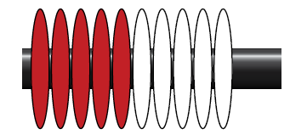
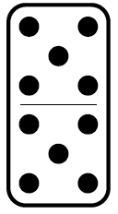
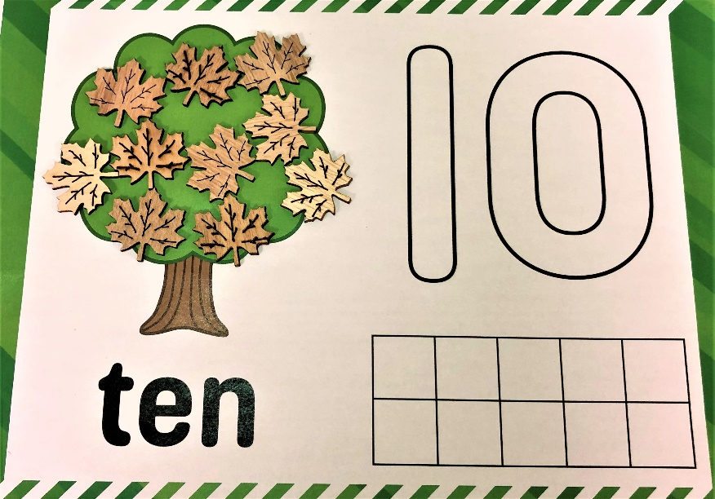
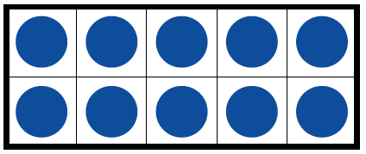
Exploring the Number Ten

Slide 2
Teacher Instructions
This collection of learning experiences is designed around the concept of number and the development of number ideas for numbers up to 10, specifically the number five. Students come to schools with many ideas about number but it takes many learning experiences and time to develop a full understanding of a sense of number. The learning experiences represented in the PowerPoint consist of daily sessions that can take place over two weeks. The 30 to 45 minutes sessions are a combination of synchronous and asynchronous parts that can be adapted depending on your situation and access to technology and connectivity.
*FOR SYNCHRONOUS LEARNING, THE SLIDEDECK MUST BE IN EDIT MODE (not present mode)*
Slides with green borders are teacher instructions, slides with red borders are student presentation slides. Slides with both green and red borders are slides that usually show an example. The decision to show or not to show the slide is the decision of the teacher.
Turn the PowerPoint to present mode to show the story books.
For each day, the lesson is presented in three parts:
Opening Routine - Number talk to get students thinking and sharing ideas
Work it out – These are learning experiences for each lesson. Lessons can be done with the whole class, small groups or individuals.
Debrief and Consolidation - Learning experiences that involve reflections, assessments, further consolidation or extensions.
Notes:
1. Opening Routine – number talk to get students thinking and sharing ideas
2. Work it out - These are learning experiences for each lesson. Lessons can be done with the whole class, small groups or individuals Depending on the set up available, you can put students into breakout rooms to work on the lessons together.
3. Debrief and Consolidation– Learning experiences that involve reflections, assessments, further consolidation or extensions.

Slide 3
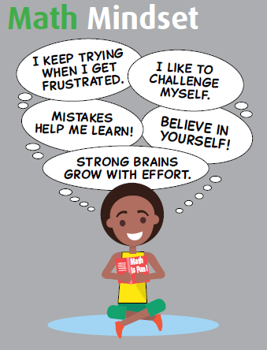
Teacher Instructions
The Importance of Building Community, Communication and Growth Mindset
Students and educators work together to nurture relationships and co-create school, classroom, and online environments to support mathematics learning. When building a community of online learners, wellness is nurtured by creating a sense of safety and belonging for each learner; providing opportunities for all students to build self-confidence and self-efficacy; empowering individuals as self-reflective learners; and valuing each student’s voice on the path to becoming an independent, lifelong learner.
Communicating and messaging effectively, facilitating discussions, assessing learning, using the best tools for each context and knowing your students and their families are some key factors to building an effective remote learning environment. Building on routines but remembering to be flexible will help in planning, learning and teaching of mathematics.
Students with a growth mindset believe they can develop their abilities through effort, persistence and hard work. Teachers who actively model a growth mindset create an environment where students openly look for and engage in finding a variety of strategies for solving problems. Students who are engaged in the productive struggle of doing and discussing mathematics explore alternatives, and develop as confident mathematical risk takers. As teachers plan for remote learning, something to remember is that it will be different for all and being flexible will aid in the learning.

Slide 4
Teacher Background Information
Having good number sense involves an understanding of the many relationships that exist among numbers. It is important to emphasize number relationships in order to use numbers in meaningful ways. When students learn to represent numbers in various ways and investigate how numbers interconnected, they build their knowledge of how numbers relate to each other. In the math resource, Teaching Student Centered Mathematics PreK-2 (2018) , the author John Van de Walle’s book outlines four important number relationships that help students develop number sense and working with operations.
One and Two More/Less – Knowing which numbers are one and two less or more than any given number. The one/two more or less than relationship involves more than just the ability to count. Students must also associate quantity with the count. For example, being able to communicate to say 6 is one more than 5 and 2 less than 8.
Anchors and Benchmarks of Five and Ten – Ten is an important number in our numeration system. The ability to relate numbers to both 5 and 10 is useful for comparing and relating numbers. A benchmark number serves as a reference to which something else (e.g., another number) may be compared (e.g., In the question, “Is the number 4 closer to the number 1 or to the number 5?“ the numbers 1 and 5 are benchmarks.).
Part-Part-Whole Relationships – Part-part-whole is being able to recognize numbers can be broken apart and then put together. Understanding numbers can be represented in many ways supports students understanding of part-part-whole relationships. Addition and subtraction are built on composition (putting numbers together) and decomposition (breaking up numbers).
Spatial Relationships (Subitizing) – Subitizing is being able to recognize sets of objects in patterned arrangements and tell how many without counting. There are two types of subitizing.
Perceptual subitizing is the ability to recognize the quantity of a set without counting. It is the basis for counting and cardinality.
Conceptual subitizing is seeing number patterns within a set (part—whole) and then determining the quantity by putting the number patterns together.
These four relationships will be used to understand the importance of the number ten. Highlighting these number relationships is crucial to supporting students’ development of number sense. The following lessons focus on developing and strengthening these number relationships.

Slide 5
Curricular Outcomes
1.N.1. Say the number sequence by 1s forward and backward between any two given numbers (0 to 100); 2s to 30, forward starting at 0; 5s and 10s to 100, forward starting at 0.
1.N.2. Subitize and name familiar arrangements of 1 to 10 dots (for objects).
1.N.3. Demonstrate an understanding of counting by using the counting-on strategy and using parts of equal groups to count sets
1.N.4. Represent and describe numbers to 20, concretely, pictorially, and symbolically.
1.N.6. Estimates quantities to 20 by using referents.
1.N.8. Identify the number, up to 20, that is one more, tow more, one less, and two less and than a given number.
1.N.10. Describe and use mental mathematics strategies, including counting on, counting back; using one more, one less; making 10; starting from known doubles; using addition to subtract to determine the basic addition and related subtraction facts to 18.

Slide 6
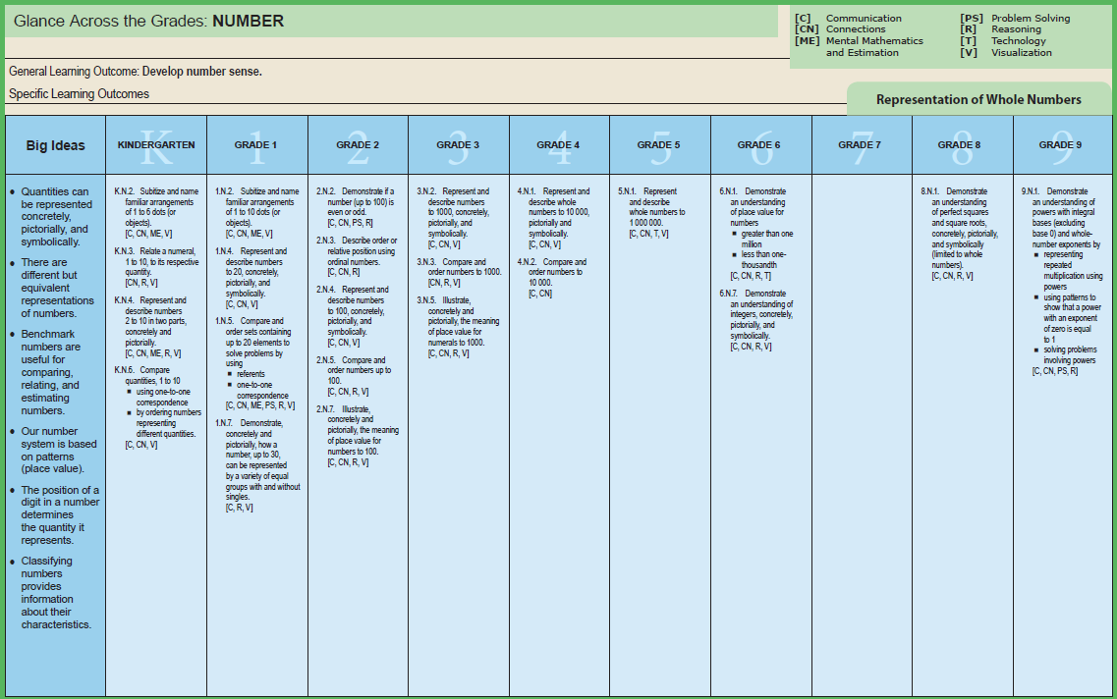
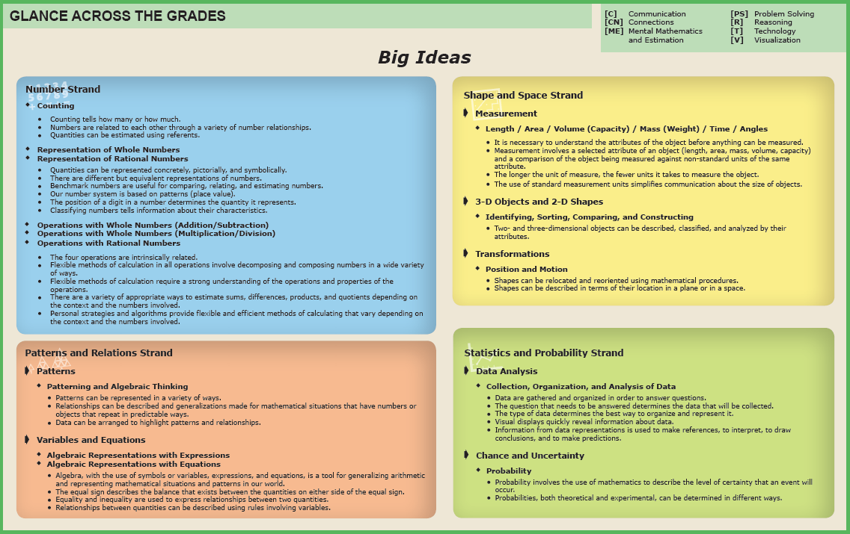
Big Ideas
The Glance Across the Grades document is a learning progression based on the Manitoba math curriculum. Teachers can gain information about their students’ progress in math using the document, which in turn, can support differentiating instruction and support learning.
Viewing learning outcomes as connections of big ideas allows students to think about the big picture of mathematics and its applications. Big ideas make connections between specific learning outcomes and mathematical concepts and provide purpose, focus, and meaning for teaching and learning the curriculum. Glance Across the Grades provides descriptions of big ideas within strands that can lead to making mathematics instruction more purposeful. Framing big ideas within mathematical content and learning experiences allows students to make essential connections between mathematical concepts and procedures.
Glance Across the Grades

Slide 7
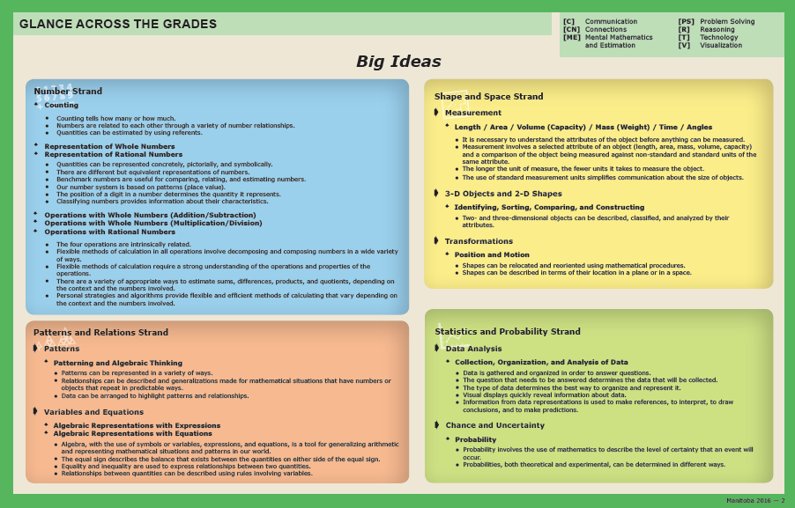
Big Ideas Within the Learning Experiences
Counting tells how many and how much.
Numbers are related to each other through a variety of number relationships.
Quantities can be represented concretely, pictorially, and symbolically.
There are different but equivalent representations of numbers.
The four operations are intrinsically related.
Flexible methods of calculation in all operations involve decomposing and composing numbers in a wide variety of ways.

Slide 8
Background Information
As students develop, explore and represent numbers in multiple ways, they develop flexible thinking about numbers. Focusing on number relationships with students will help them learn how numbers are interconnected and how numbers can be used in meaningful ways. As students work with numbers 1 to 10, they build on three number relationships that help the make meaning of numbers and operations.
One and two more, one and two less
Benchmarks of 5 and 10
Part-part-whole relationships
Students need many experiences using and constructing the number ten because it is a pivotal number in our base-ten system. Students who are able to compose and decompose the number ten and numbers into ten, will be able to have more flexibility in mental mathematics and estimation.

Slide 9
Materials
The PowerPoint, project instructions and rubric.
It is highly recommended that if this is the first-time students are experiencing virtual learning, allow them time to "play". This allows for the opportunity to explore and have fun with the tools BEFORE they will be required to use them purposefully.
Students will be virtually using tool on the PowerPoint. Hands-on materials are ideal. Significant learning occurs when students can build and visualize different representations of mathematics.
If School Divisions have another platform for delivering online instruction (ie See Saw, Google Classrooms), asynchronous tasks can be uploaded there.
Collection of counting items.
Deck of playing cards
Caterpillar Make 10 Games

Slide 10
Day 1
1
Opening Routine
2
Work it out!
3
Debrief and Consolidation
Sharing and Recording Thinking About Counting
Counting Collections
Action Cards
Notes:
Opening Routine – number talk to get students thinking and sharing ideas
Work it out - Challenges make up the focus of the day(s) lesson. Lessons can be done with the whole class, small groups or individuals. Depending on the set up available, you can put students into breakout rooms to work on the lessons together.
Debrief and Consolidation– a place for reflection/self-assessment/further consolidation or extensions

Slide 11
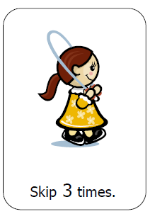
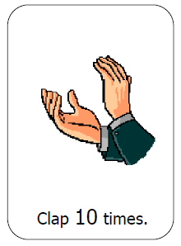
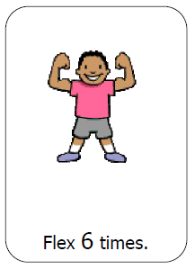
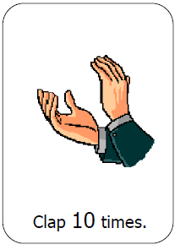
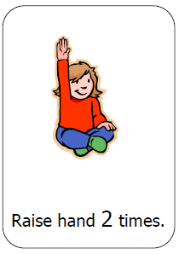
1
Action Cards
Opening Routine
Move the Cards to see the Action Cards.
Get ready to count and move!
Remember to count out loud and the correct number of times.
Notes:
Show the action cards one at time. The students perform the activity on the card that number of times. Have students count aloud as the actions are performed. This activating strategy can review counting principles such as:
Stable Order
One-to-one correspondence
Cardinality
For more information regarding the counting principles see the Grade 1 Math Support document (https://www.edu.gov.mb.ca/k12/cur/math/support_gr1/index.html). Also check out Kyle Pearce’s document, Principles of Counting and Quantity (https://tapintoteenminds.com/counting-principles/).
Action cards can be found in the Kindergarten Support Document BLMs (https://www.edu.gov.mb.ca/k12/cur/math/k_support/blms/index.html)

Slide 12
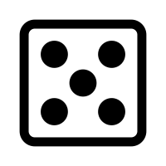
1
Opening Routine
Which pictures make it easy to see five without counting? Why?
Notes:
Discuss the questions.
The range of answers may vary. Some students will say the five frame because the frame is full. A student may say the dice because they play games and use it all the time. The reflections from students will help you understand their thinking. An additional question to ask students is, “Does how each picture is shown, help you see it the number more quickly and easier?” OR “Which picture did you just know there was 5?”
We want to have students not relying on counting from one. The tools we use helps us relate number to objects, conservation of number, representation of number and with part-part-whole understanding.
Question adapted from Open Questions for Rich Math Lessons by Marian Small. Rubicon Publishing, 2016.

Slide 13
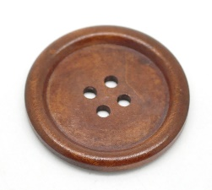
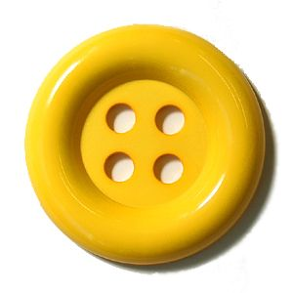
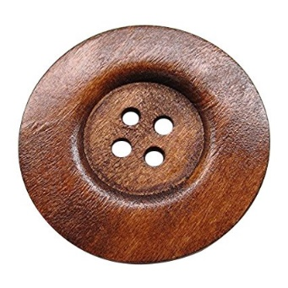
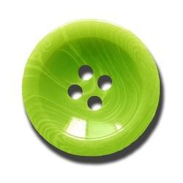
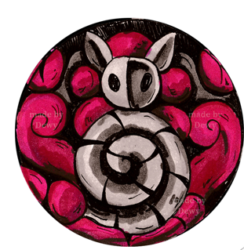
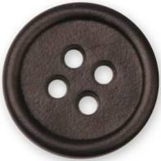
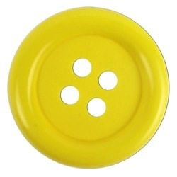
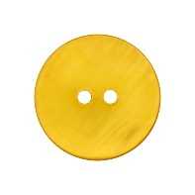
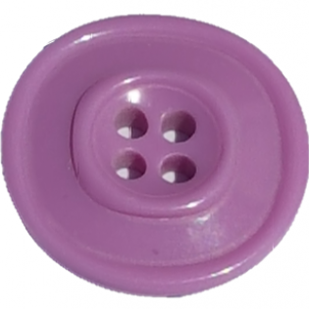
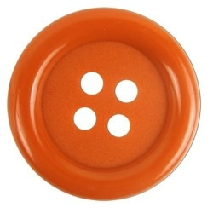
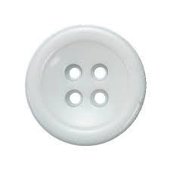
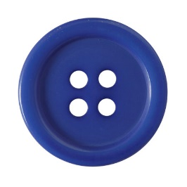
2
Work it out
Today we will be learning to count collections in different ways.
Notes:
https://thenounproject.com/term/clothes-button/730376/
https://hobbii.com/plastikknap-18-mm-sort?store_id=10&gclid=Cj0KCQiAw_H-BRD-ARIsALQE_2PVYjhVCx77Ae3X8jjsCD93w1t_067rbBmylQ7Cq2qCHdGXHK4m5pcaAvvOEALw_wcB
https://www.onlinewebfonts.com/icon/62337
https://pixabay.com/vectors/search/record%20button/
https://pixy.org/2782713/
https://www.dewyvenerius.com/en/product/shaman-stone-button-hollow-knight/
https://www.dewyvenerius.com/en/product/gathering-swarm-button-hollow-knight/
https://www.indiamart.com/proddetail/shirt-button-11877492897.html
https://www.123rf.com/photo_29287257_blue-shirt-button.html
https://shop.buttons.com/770012836100141-p/770012836100141.htm
https://shop.buttons.com/770012836100361-p/770012836100361.htm
https://dolejsi.si/en/products/buttons_and_accessories_made_of_plastic/women/shirt_buttons/1379/button_g_5128/
https://shop.buttons.com/770012836100331-p/770012836100331.htm
https://www.pinterest.ca/pin/482307441315092730/
https://www.myfabrics.co.uk/24-453037-040_mother-of-pearl-button-roots-sunshine-yellow.html
https://buttontopia.com.au/reddish-brown-plain-wood-large-button-4-holes-40mm-1-5-8/
https://www.aliexpress.com/item/32849332625.html
https://www.indiamart.com/proddetail/garment-plain-button-12193290548.html
https://www.indiamart.com/proddetail/plastic-button-10119889348.html
https://www.pixelscrapper.com/melo-vrijhof/designs/hello-hot-pink-button-asset-embellishment-4-hole-sewing
https://webiconspng.com/icon/53760
https://webiconspng.com/icon/53736

Slide 14
2
Work it out
My grandma gave me some buttons to add to my collection. I would like to find out how many buttons there are.
Think about a way we can count this collection of buttons?
Notes:
Have students share their different ways of counting.
https://thenounproject.com/term/clothes-button/730376/
https://hobbii.com/plastikknap-18-mm-sort?store_id=10&gclid=Cj0KCQiAw_H-BRD-ARIsALQE_2PVYjhVCx77Ae3X8jjsCD93w1t_067rbBmylQ7Cq2qCHdGXHK4m5pcaAvvOEALw_wcB
https://www.onlinewebfonts.com/icon/62337
https://pixabay.com/vectors/search/record%20button/
https://pixy.org/2782713/
https://www.dewyvenerius.com/en/product/shaman-stone-button-hollow-knight/
https://www.dewyvenerius.com/en/product/gathering-swarm-button-hollow-knight/
https://www.indiamart.com/proddetail/shirt-button-11877492897.html
https://www.123rf.com/photo_29287257_blue-shirt-button.html
https://shop.buttons.com/770012836100141-p/770012836100141.htm
https://shop.buttons.com/770012836100361-p/770012836100361.htm
https://dolejsi.si/en/products/buttons_and_accessories_made_of_plastic/women/shirt_buttons/1379/button_g_5128/
https://shop.buttons.com/770012836100331-p/770012836100331.htm
https://www.pinterest.ca/pin/482307441315092730/
https://www.myfabrics.co.uk/24-453037-040_mother-of-pearl-button-roots-sunshine-yellow.html
https://buttontopia.com.au/reddish-brown-plain-wood-large-button-4-holes-40mm-1-5-8/
https://www.aliexpress.com/item/32849332625.html
https://www.indiamart.com/proddetail/garment-plain-button-12193290548.html
https://www.indiamart.com/proddetail/plastic-button-10119889348.html
https://www.pixelscrapper.com/melo-vrijhof/designs/hello-hot-pink-button-asset-embellishment-4-hole-sewing
https://webiconspng.com/icon/53760
https://webiconspng.com/icon/53736

Slide 15
2
Work it out
Move the buttons.
How could we count the buttons?
What strategy could we use?
How can we record the way we counted?
Can we count the buttons another way?
Notes:
Send students the slide so they can count the buttons. Students can work in breakout rooms and work as partners if this is available.
https://thenounproject.com/term/clothes-button/730376/
https://hobbii.com/plastikknap-18-mm-sort?store_id=10&gclid=Cj0KCQiAw_H-BRD-ARIsALQE_2PVYjhVCx77Ae3X8jjsCD93w1t_067rbBmylQ7Cq2qCHdGXHK4m5pcaAvvOEALw_wcB
https://www.onlinewebfonts.com/icon/62337
https://pixabay.com/vectors/search/record%20button/
https://pixy.org/2782713/
https://www.dewyvenerius.com/en/product/shaman-stone-button-hollow-knight/
https://www.dewyvenerius.com/en/product/gathering-swarm-button-hollow-knight/
https://www.indiamart.com/proddetail/shirt-button-11877492897.html
https://www.123rf.com/photo_29287257_blue-shirt-button.html
https://shop.buttons.com/770012836100141-p/770012836100141.htm
https://shop.buttons.com/770012836100361-p/770012836100361.htm
https://dolejsi.si/en/products/buttons_and_accessories_made_of_plastic/women/shirt_buttons/1379/button_g_5128/
https://shop.buttons.com/770012836100331-p/770012836100331.htm
https://www.pinterest.ca/pin/482307441315092730/
https://www.myfabrics.co.uk/24-453037-040_mother-of-pearl-button-roots-sunshine-yellow.html
https://buttontopia.com.au/reddish-brown-plain-wood-large-button-4-holes-40mm-1-5-8/
https://www.aliexpress.com/item/32849332625.html
https://www.indiamart.com/proddetail/garment-plain-button-12193290548.html
https://www.indiamart.com/proddetail/plastic-button-10119889348.html
https://www.pixelscrapper.com/melo-vrijhof/designs/hello-hot-pink-button-asset-embellishment-4-hole-sewing
https://webiconspng.com/icon/53760
https://webiconspng.com/icon/53736

Slide 16
2
Work it out
Move the buttons.
Let’s record how we counted.
Notes:
Within the editing mode of PowerPoint, you can move the buttons around in the different ways students suggest. Four slides have been created to show the different ways students counted the collections. Duplicate the slide if more slides are needed.
ttps://thenounproject.com/term/clothes-button/730376/
https://hobbii.com/plastikknap-18-mm-sort?store_id=10&gclid=Cj0KCQiAw_H-BRD-ARIsALQE_2PVYjhVCx77Ae3X8jjsCD93w1t_067rbBmylQ7Cq2qCHdGXHK4m5pcaAvvOEALw_wcB
https://www.onlinewebfonts.com/icon/62337
https://pixabay.com/vectors/search/record%20button/
https://pixy.org/2782713/
https://www.dewyvenerius.com/en/product/shaman-stone-button-hollow-knight/
https://www.dewyvenerius.com/en/product/gathering-swarm-button-hollow-knight/
https://www.indiamart.com/proddetail/shirt-button-11877492897.html
https://www.123rf.com/photo_29287257_blue-shirt-button.html
https://shop.buttons.com/770012836100141-p/770012836100141.htm
https://shop.buttons.com/770012836100361-p/770012836100361.htm
https://dolejsi.si/en/products/buttons_and_accessories_made_of_plastic/women/shirt_buttons/1379/button_g_5128/
https://shop.buttons.com/770012836100331-p/770012836100331.htm
https://www.pinterest.ca/pin/482307441315092730/
https://www.myfabrics.co.uk/24-453037-040_mother-of-pearl-button-roots-sunshine-yellow.html
https://buttontopia.com.au/reddish-brown-plain-wood-large-button-4-holes-40mm-1-5-8/
https://www.aliexpress.com/item/32849332625.html
https://www.indiamart.com/proddetail/garment-plain-button-12193290548.html
https://www.indiamart.com/proddetail/plastic-button-10119889348.html
https://www.pixelscrapper.com/melo-vrijhof/designs/hello-hot-pink-button-asset-embellishment-4-hole-sewing
https://webiconspng.com/icon/53760
https://webiconspng.com/icon/53736

Slide 17
2
Work it out
10
15
EXAMPLE
5
Let’s record how we counted.
5
5
20
5
21
23
24
22
1
1
1
1
5
Notes:
This is one example students may share. We want students to move toward increasingly sophisticated and efficient strategies, like counting by tens but this may take time. If students have access to ten frames, or five frames, that will help with their grouping.
With continued experience and guiding questions, students should learn to group items. needed.
ttps://thenounproject.com/term/clothes-button/730376/
https://hobbii.com/plastikknap-18-mm-sort?store_id=10&gclid=Cj0KCQiAw_H-BRD-ARIsALQE_2PVYjhVCx77Ae3X8jjsCD93w1t_067rbBmylQ7Cq2qCHdGXHK4m5pcaAvvOEALw_wcB
https://www.onlinewebfonts.com/icon/62337
https://pixabay.com/vectors/search/record%20button/
https://pixy.org/2782713/
https://www.dewyvenerius.com/en/product/shaman-stone-button-hollow-knight/
https://www.dewyvenerius.com/en/product/gathering-swarm-button-hollow-knight/
https://www.indiamart.com/proddetail/shirt-button-11877492897.html
https://www.123rf.com/photo_29287257_blue-shirt-button.html
https://shop.buttons.com/770012836100141-p/770012836100141.htm
https://shop.buttons.com/770012836100361-p/770012836100361.htm
https://dolejsi.si/en/products/buttons_and_accessories_made_of_plastic/women/shirt_buttons/1379/button_g_5128/
https://shop.buttons.com/770012836100331-p/770012836100331.htm
https://www.pinterest.ca/pin/482307441315092730/
https://www.myfabrics.co.uk/24-453037-040_mother-of-pearl-button-roots-sunshine-yellow.html
https://buttontopia.com.au/reddish-brown-plain-wood-large-button-4-holes-40mm-1-5-8/
https://www.aliexpress.com/item/32849332625.html
https://www.indiamart.com/proddetail/garment-plain-button-12193290548.html
https://www.indiamart.com/proddetail/plastic-button-10119889348.html
https://www.pixelscrapper.com/melo-vrijhof/designs/hello-hot-pink-button-asset-embellishment-4-hole-sewing
https://webiconspng.com/icon/53760
https://webiconspng.com/icon/53736

Slide 18
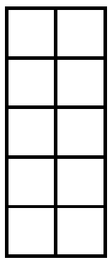
2
Work it out
Notes:
You may suggest tools to help students keep track of their count. Empty five frames and ten frames can be used from the Math Tool Kits: Tools to Support Thinking and Learning in the Early Years' Mathematics Classroom (https://www.edu.gov.mb.ca/k12/cur/math/math_toolkit/). The five and ten frame from this slide could be cut and pasted onto other slides.

Slide 19
3
Debrief and Consolidation
What did you discover?
What was a common way of counting the collections?
What strategy helped us count quickly and easily?
Why do we count?
Notes:
Observations:
What mathematical thinking did students show?
How did the group organize the collection? Let them show you their thinking. Was it efficient for the count?
Discuss the questions and let students share their thinking. You can listen to reflections or have students write about and send you their reflections. Choose two questions for students to share in breakout rooms if this is available.

Slide 20
Day 2
1
Opening Routine
2
Work it out!
3
Debrief and Consolidation
Sharing and Recording Thinking About Counting
Counting Collections
In Our Home
Change the Count
Ink Splat

Slide 21
1
Opening Routine
Look at the number shown and count on from there.
Mr. Happy’s finger will show you whether you count forwards or backwards.
Forwards
Backwards
Notes:
One of the counting principles is stable order. Stable order are the words used in counting and must be the same sequence of words used from
one count to the next. Helping students acquire the flexibility to count on and count backwards will take time but will help build an understanding of counting and quantity.
If you observed students miscounting try intentionally miscounting and asking the student to tell what number you missed.
Change the Count – Start counting together from a given starting point. After a short time clap your hands and move on to the next count. For example: The number 8 is shown in the slide, students will starting counting the next number until you clap or give a signal. Switch slides and start at another number. The emoji tells students to count forwards or backwards. Explain the directions for the students.
Different numbers have been placed on the slide to help with the count. Students can use number charts found in the Math Tool Kits: Tools to Support Thinking and Learning in the Early Years' Mathematics Classroom (https://www.edu.gov.mb.ca/k12/cur/math/math_toolkit/).
In counting on, the students count forwards beginning at any number. Counting back is challenging for many young students, and students need many opportunities to gain skill and confidence in counting backwards from different numbers.

Slide 22
1
Opening Routine

Slide 23
1
Opening Routine

Slide 24
1
Opening Routine

Slide 25
1
Opening Routine

Slide 26
1
Opening Routine

Slide 27
1
Opening Routine

Slide 28
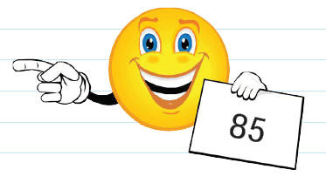
1
Opening Routine

Slide 29
1
Opening Routine

Slide 30
1
Opening Routine

Slide 31
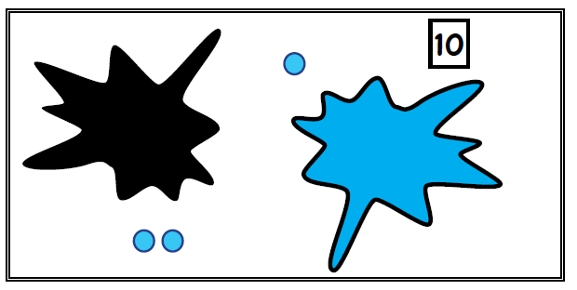
1
Opening Routine
Notes:
Splat is a thinking game. Some ink has spilled onto the picture. Look at the ink splats below and reason out how many dots are hidden beneath each one.
The number on top represents the number of dots in the entire picture.
Ask the following questions:
How many dots do you see?
When splats are different colours, they are covering different amounts of dots.
How many dots have been covered by the ink splats?
Explain how you know? Is there more than one way?
This particular splat was taken from the Grade 1 Numeracy Learning At Home Newsletter, Issue 2. For more examples, please link to Steve Wyborney’s site that gives other examples (Splat! - Steve Wyborney's Blog: I'm on a Learning Mission.)

Slide 32
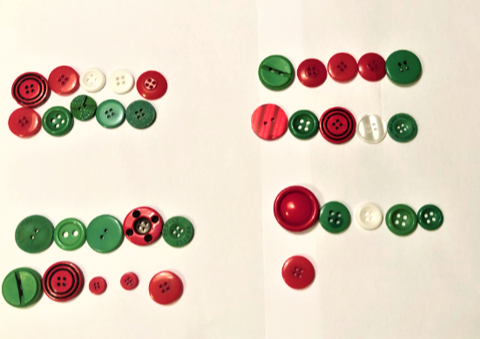
2
Work it out
What do you notice about this counting collection?
Notes:
Show the visual and have students share their thinking.
Remain open to various types of groupings and have students explain efficient counting strategies. The following introduction nudges students into groupings by ten. Allow students to share responses. Some guiding questions to ask:
What strategy to you think this person used to count?
What are other ways to count the collection?
For the next activity students will be working asynchronously to find counting collections around their home.
Counting collections is an instructional routine that helps students understand the big idea of counting, “Counting tells how many or how much.” At first, counting collections can be done informally as way to observe and collect evidence of students counting abilities. As students become familiar and more confident with counting collections, short classroom lessons can be introduced to go over strategies and to guide students’ in their thinking and understanding about counting.
“We find out who can make one-to-one correspondence and count consistently, who can “count on,” who remembers what comes after 59, and who can then count his groups by tens.” Counting Collections by Julie Ken Schwerdtfeger and Angela Chan, Teaching Children Mathematic, NCTM, March 2007.

Slide 33
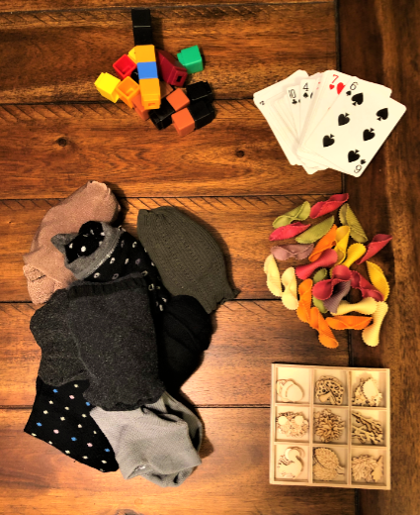
2
Work it out
Find a counting collection in your home!
Ask an adult to help you find a collection of items to count. Some items to count are toys, books, blocks, socks in a drawer, a cup of macaroni, rock collections, cards, craft material, buttons or paperclips.
Notes:
Copy or send the next slides for students.

Slide 34
2
Work it out
Find a counting collection in your home!
Find two or more collections of items to count.
Count your collection.
Record how you counted on a piece of paper.
Use ten frames, number charts, cups muffin cups or egg cartons to help you organize your count.
On another piece of paper, record another way to count those items.

Slide 35
3
Debrief and Consolidation
How did you count?
How many do you have in all?
What strategy did you use to count?
How did you record your counting?
How is the picture telling how you counted?
Why do we count?
Notes:
Observations:
Set up interviews with students:
What mathematical thinking did students show?
How did the group organize the collection? Let them show you their thinking. Was it efficient for the count?
Discuss the questions and let students share their thinking the next time you meet with them. You can listen to reflections or have students write about and send you their reflections. Choose two questions for students to share in breakout rooms if that is available.

Slide 36
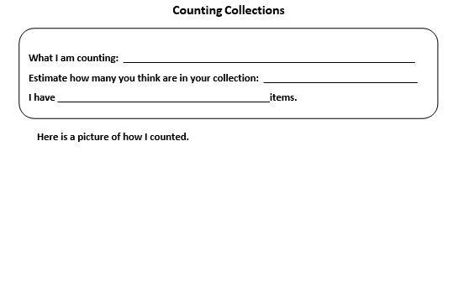
3
Debrief and Consolidation
Notes:
Observations:
This template may be uploaded to SeeSaw or a similar platform for students to use.
Image source: http://www.meaningfulmathmoments.com/counting-collections.html
What mathematical thinking did students show?
How did the group organize the collection? Let them show you their thinking. Was it efficient for the count?
Discuss the questions and let students share their thinking. You can listen to reflections or have students write about and send you their reflections. Choose two questions for students to share in breakout rooms if that is available.

Slide 37
Day 3
1
Opening Routine
2
Work it out!
3
Debrief and Consolidation
Ten Frames: How many more to 10?
Show 10 in Different Ways
Ways to Show 10

Slide 38
1
Opening Routine
How many do you see?
How do you know?
How many more to 10?
Notes:
This routine directly links to goal of the lesson project. This activity can be adapted easily depending on the needs of students. The various arrangements of counters on the ten frames will prompt different mental images of numbers, all in connection with the numbers' relationship to ten. The arrangement of the dots are in a five-wise pattern. Using the five-wise pattern helps students use the number 5 as an anchor. The top row is filled, so you know there are five, count on from 5 instead of starting from one.
Go over the three questions you will ask students. If you are using an online platform such as Teams or Zoom, have students place their answers to one of the questions in the chat box or call upon students to answer one of the questions. Use the first ten frame as an example. Flash each frame for about 3 seconds and move onto the next slide with the questions. There is an empty slide after each ten frame so you can quickly flash and it and have an opportunity to have a discussion if necessary.
How many do you see?
How do you know?
How many more to 10?

Slide 39
1
Opening Routine

Slide 41
1
Opening Routine

Slide 43
1
Opening Routine

Slide 45
1
Opening Routine

Slide 47
1
Opening Routine

Slide 49
1
Opening Routine

Slide 51
1
Opening Routine

Slide 53
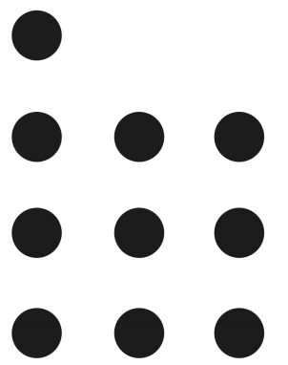
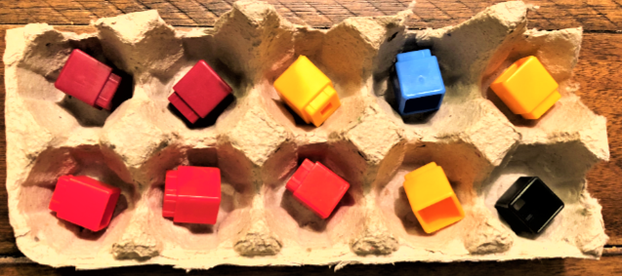
2
Work it out
What do you notice in these pictures?
10 = 5 + 5
10 = 6 + 4
10 = 7 + 3
10 = 4 + 4 + 2
10 = 2 + 2 + 2 +2 + 2
Notes:
To develop a good sense of number, students have to develop an intuition about numbers and their relationships. Their ability to think flexibly about numbers develops gradually as a result of exploring numbers and visualizing them in a variety of contexts.
When students are representing numbers in a variety of ways, they demonstrate their understanding of the use of a number (e.g., my house number is 34), how a number compares to another number (e.g., 34 is 1 less than 35), how a number can be broken into parts (e.g., 34 is 32 + 2), and place value (e.g., 34 is 30 + 4 or 20 + 14 or 10 + 24).
The ability to represent numbers in a variety of ways will benefit students when doing operations and mental mathematics problems. Present number sentences horizontally as well as vertically to encourage students to use different representations of numbers and part-part-whole thinking.
Ask students, “What do you notice about 10 in each of these pictures?” It’s important to have students make different representations of numbers but it is important to have students to see what they see in each representation. This question helps students see different relationships in numbers and elicits the big ideas such as:
showing the number is made up of parts
showing the number is greater or less than another number
showing the number is made up of equal parts
making the number easy to identify quickly
showing the number is close to a familiar benchmark number
showing how the number relates to another number

Slide 54
3
Debrief and Consolidation
Show 10 in the following ways:
show how 10 is made up of parts
show how 10 is greater than another number
show how 10 is less than another number
show how 10 is made up of equal parts
show a 10 that is easy to identify
show how 10 relates to another number
Show your different ways on paper. Send a picture to you teacher.
Notes:
Have students show the six different ways to show 10.
Students can work synchronously in breakout groups or asynchronously at home. Send these instructions home or post them to your platform.

Slide 55
Day 4
1
Opening Routine
2
Work it out!
3
Debrief and Consolidation
Action Cards:
Show Number Relationships
Guess the Number on the Number Path
Using the Number Path

Slide 56
1
Opening Routine
Action Cards
Move the Cards to see the Action Cards.
Listen to instructions!
Notes:
Instead of just performing the activity on the card that number of times, adapt the number by telling students to take the action and the number and do the following:
The number one/two less of the number shown
The number one/two more of the number shown
Make connections to mental math strategies:
Double the number shown
Double plus one the number shown
Double minus the number shown
Action cards can be found in the Kindergarten Support Document BLMs (https://www.edu.gov.mb.ca/k12/cur/math/k_support/blms/index.html)

Slide 57
2
Work it out
What do you notice about this number path?
Notes:
The number path is a good tool to use before students use the number line. The number path is a counting model. Each rectangle space can be counted. The units on a number path are easier to recognize. The number path accentuates the units (the spaces). Students can also build a number path with linking cubes. The cubes show that each block is “one unit”, and that same unit is repeated over and over (iterated) to form the number path. This is a big idea for measurement.
Students will give various answers. There are four text boxes available to write in. You can have students share their responses orally or in the chat box and you can write them in the boxes. If students do not notice how the numbers are shaded in groups of five, ask them about it. The shading helps students recognize benchmark numbers.
How the number pathway is structured (shaded) brings out the importance of the benchmark numbers such as 5, 10 and 20.

Slide 58
2
Work it out
Show 5!
Use Me:
Move and stretch
Notes:
Have students show different numbers. Remember if they are showing you five, the first five rectangles need to be shaded or circled.

Slide 59
2
Work it out
Show 5!
Notes:
Illustration of how to show 5.
*Remember if they are showing you five, the first five rectangles need to be circled. If you show 7, the first seven rectangles must be circled. This supports the counting principle of cardinality. Emphasize how the structure of this number path helps them recognize numbers quickly. The structure can support students to get past counting one-to-one. The shading on the number paths in groups of 5 makes it easier to relate numbers to the benchmarks of 5 and 10.

Slide 60
2
Work it out
Show 7!
Use Me:
Move and stretch
Notes:
Have students describe how they would show 12 and then show it on the number path. Ask students if they agree. Discuss.

Slide 61
2
Work it out
Show 12!
Use Me:
Move and stretch
Notes:
Have students describe how they would show 12 and then show it on the number path. Ask students if they agree. Discuss.

Slide 62
2
Let’s learn about starting at a number and counting on from a number.
Work it out
https://youtu.be/wf32qr0eXWg
1st Grade Number Path - Count from a number - YouTube
Notes:
The following video from Motion-Tutor describes how to add on more jumps. The video link can be shown or sent to students. You can show the video or discuss the concept with students.
https://youtu.be/wf32qr0eXWg

Slide 63
2
Work it out
Use Me to show the jumps.
Show 5 and 3 more!
What number do you think we will land on?
Explain your thinking?
The number we land on is _____.
Use Me:
Move and stretch
Notes:
Have students describe how they would show the numbers and then show it on the number path. Ask students if they agree. Discuss.
The number path is a good tool to teach operations with. It is a good scaffold before using number lines. If students understand the addition symbol, you can have students record equations.
Reminder: If you introduce the “=“ symbol to students write the equations different ways so students do not learn that the sign means “give the answer”. Record equations in different ways: 8 = 5 + 3, 5 + 3 = 8, 8 = 8
Discuss the students thinking about predicting what number it will land on.

Slide 64
3
Debrief and Consolidation
Your turn to show me your thinking!
Show 5 and 3 more!
What number do you think we will land on ___?
Explain your thinking?
Use Me to show the jumps.
Use Me:
Move and stretch
Notes:
Have students describe how they would show the numbers and then show it on the number path. Ask students if they agree. Discuss.
This template may be uploaded to SeeSaw or a similar platform for students to use.
These questions could also be used with individually students for assessment.

Slide 65
3
Debrief and Consolidation
Your turn to show me your thinking!
Show 5 and 3 more!
What number do you think we will land on ___?
Explain your thinking?
Use Me to show the jumps.
Use Me:
Move and stretch
Notes:
Have students describe how they would show the numbers and then show it on the number path. Ask students if they agree. Discuss.
Assessment:
This template may be uploaded to SeeSaw or a similar platform for students to use.
These questions could also be used with individually students for assessment.

Slide 66
3
Debrief and Consolidation
Your turn to show me your thinking!
Show 5 and 3 more!
What number do you think we will land on ___?
Explain your thinking?
Use Me to show the jumps.
Use Me:
Move and stretch
Notes:
Have students describe how they would show the numbers and then show it on the number path. Ask students if they agree. Discuss.
Assessment:
This template may be uploaded to SeeSaw or a similar platform for students to use.
These questions could also be used with individually students for assessment.

Slide 67
Day 5
1
Opening Routine
2
Work it out!
3
Looking Back
1. Counting Strategies
2. Using the Number Path: What number might the ? represent?
Benchmark Numbers
Placing Numbers on the Number Path

Slide 68
1
Opening Routine
What strategy can you use to count the stars?
Notes:
We want to nudge students to be strategic about counting. We do not want students overly reliant on immature counting-based strategies (one-to-one counting). Ask students to find how many in the picture by asking them to find how many stars but do not count them one at a time.
Have students share strategies.

Slide 69
1
Opening Routine
What number might the ? represent?
Prove it!
5
?
Notes:
The opening routine is using the number path and having students reason out what the missing number is. Focus on the explanation of students. Listen to hear if students are using the structure of the number path. Students may not know the term “benchmark” yet. In this lesson students will learn the term.
Some of the language you can model:
It must be more than 5
I used groups of 5 and counted on

Slide 70
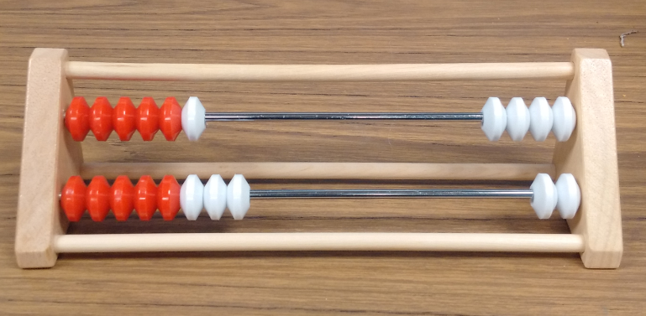
2
Work it out
How are these tools the same?
How are these tools different?
Notes:
Discuss the question with students. This slide could be sent earlier to allow students time to think. Each tool emphasizes benchmarks of 5 and 10. Have students use the word benchmark. If you have a Rekenrek available, it would be good to show the students how it is arranged. You can also show a digital Rekenrek from The Math Learning Center, https://apps.mathlearningcenter.org/number-rack/.
Benchmarks of numbers are useful for comparing and relating numbers. We want to students to understand:
Numbers are related to each other through a variety of number relationships
Benchmark numbers of 5 and 10 are useful for comparing and relating numbers.
They can gain a sense of the size of number by comparing them to the benchmark numbers of 5 and 10.
We can do this by drawing upon students’ understanding of the number order and sequence and develop a visual picture that numbers have value. Using the number path and the Rekenrek can support this thinking.

Slide 71
2
Work it out
Why are numbers like 5 and 10 important?
What are benchmark numbers?
How can you describe where 7 is on the path.
Notes:
Discuss the questions with the students.
Follow-up questions:
How can we use the groupings to help us choose numbers?
How can we explain where 12 is on the number path?
How can we explain where 7 is on the number path?
Model the following language:
Benchmark number (5, 10, 15, 20) – “You know where 7 is because in between the benchmark numbers of 5 and 10.”
One more/two more - “You used the benchmark number of 5 to find by counting two more from 5.”
One less/two less – “You know that 7 is less than the benchmark number of 10.”
“You did not have to count from 1 because you used the benchmark number of 5 and counted on.”
Teacher background information:
Using benchmark numbers five and ten:
Helps students’ understanding of how a number relates to other numbers to support thinking about various number relationships
Helps students move away from the of reliance of counting
Helps students see how any number is within 2 of any of the benchmark numbers
Using the benchmarks helps chunk numbers in order to add and subtract more efficiently
Using specific manipulatives helps bring out those relationships
Five frames
Ten frames
Rekenrek/Arithmetic Rack/Number Rack

Slide 72
3
Debrief and Consolidation
6
7
11
14
9
17
15
18
12
Place The Number
19
16
1
2
8
Move the numbers to show on the path.
5
4
3
20
13
10
I chose the number ______
My strategy for placing it that spot was ______________________________________
Notes:
Place The Number: Students will choose a number and place the number on the path and explain their reason. Most students will think the number path starts at one. Some students will choose a different way. We want students to justify their answers. We want to hear and see the students using the language of more/less, counted on, starting from a known number, and benchmark number.
This template may be uploaded to SeeSaw or a similar platform for students to use.
These questions could also be used with individually students for assessment.
They have to explain their strategy of placing that number on the number path. Copy the next four slides so that they explain their strategy to send to you. They could also video record their explanation and send it to you. You can also use this in small groups or with individuals. You can also put pair up students in breakout rooms to explain their thinking to another student.

Slide 73
3
Debrief and Consolidation
6
7
11
14
9
17
15
18
12
Place The Number
19
16
1
2
8
Move the numbers to show on the path.
5
4
3
20
13
10
I chose the number ______
My strategy for placing it that spot was ______________________________________

Slide 74
3
Debrief and Consolidation
6
7
11
14
9
17
15
18
12
Place The Number
19
16
1
2
8
Move the numbers to show on the path.
5
4
3
20
13
10
I chose the number ______
My strategy for placing it that spot was ______________________________________

Slide 75
3
Debrief and Consolidation
6
7
11
14
9
17
15
18
12
Place The Number
19
16
1
2
8
Move the numbers to show on the path.
5
4
3
20
13
10
I chose the number ______
My strategy for placing it that spot was ______________________________________

Slide 76
Exploring the Number Ten End of Week 1

Slide 77
Day 1
1
2
Work it out!
3
Debrief and Consolidation
Opening Routine
Ten Frame Flash
What do you notice?
What do you wonder?
Use Different Representations of Numbers to Make a Number Path
Making a Number Path

Slide 78
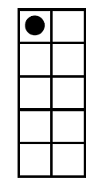
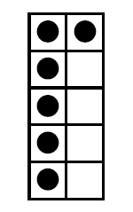
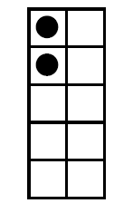
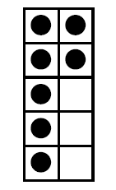
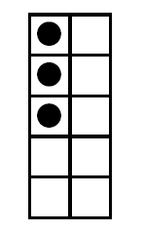
1
Opening Routine
Ten Frame Flash
Say the number that is 2 more
Move the Cards to see the Action Cards.
Ten Frames Cards
(Underneath)
Notes:
The following slides are a quick routine by showing a ten frame and having students say the number that is 2 more.

Slide 79
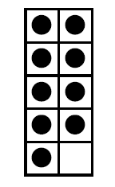
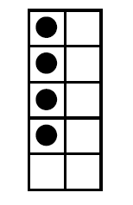
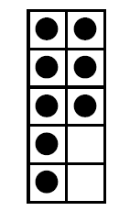
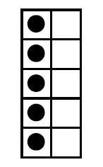
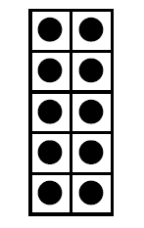
1
Opening Routine
Move the Cards to see the Action Cards.
Ten Frame Flash
Say the number that is 2 less
Ten Frames Cards
(Underneath)
Notes:
The following slides are a quick routine by showing a ten frame and having students say the number that is 2 less.

Slide 80
1
Opening Routine
Put your thinking caps on!
A number on a number path is a bit closer to 20 than 10. What might that number be?
Explain your thinking using words and pictures.
Notes:
You can use this question as an opening prompt or as an assessment question. This assessment question would be a good question to have students answer in a digital journal or write and send it via email. Look for how the student reasons or justifies their answer and communicates mathematically. This question could be send earlier so that students are ready to share and show their thinking.

Slide 81
2
Work it out
Guess My Number!
Less than 16
How do you know?
Notes:
Discuss possible answers.

Slide 82
2
Work it out
Guess My Number!
Greater than 12
How do you know?
Notes:
Discuss possible answers.

Slide 83
2
Work It Out!
Put your thinking caps on!
Use words like, benchmark, counting-on, more than, less than, and skipped count.
What number might the represent?
How do you know?
?
?
20
Notes:
This question can be used as an assessment question to assess if students are using benchmark numbers. This question could be sent out earlier and students could respond to you via email or you could set up an individual interview with students.
Question adapted from Open Questions for Rich Math Lessons by Marian Small. Rubicon Publishing, 2016.
The question mark and the number on the number path can be moved/changed to make other numbers.
Remind students to communicate mathematically using math words .

Slide 84
2
Work it out
Let’s make a number path from 1 to 10 with ten frames!
How can we start? Is there another way?
Notes:
Make a number path out of ten frames with the students from 1 to 10. This activity allows students to use the learning within the last week and connect it to prior learning. This learning experience involves students explaining how you could make a number path with the ten frames. Ask them how to start it. Listen if students will place them in order or if they will tell you to place the benchmark numbers first. You may have to nudge them their thinking. Model the following language in order for students to hear and use it in context.
Can we start our number path with benchmark numbers?
Can we place numbers that are less than 5?
Can we place numbers that are more than 5?
What comes after …?
What comes before…?

Slide 85
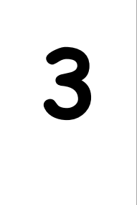
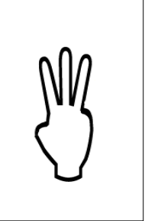
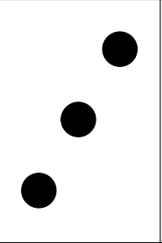
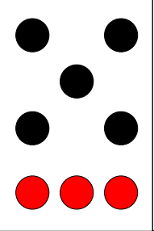
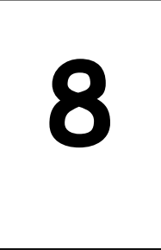
2
Move the cards to make the path.
Debrief and Consolidation
Directions: Make 2 Number Paths
They could be of the same representation or a mix of different representations. (For example, the path could be all ten frames or mix of ten frames, dot cards, finger patterns and numerals.
Use math words such as benchmark, count-on, more than, and less than as you build your number path.
Take a picture of your number path or make a video of you making and explaining how you made your number path to your teacher.
Move the cards to make the path.
Notes:
Students will build a number path (1 to 10) using a different representations of numbers Students make two number paths 1-10. The number paths can have the same representations or different ones. Remind them to use math words like, benchmark, counting-on, more than, less than, and skipped count as they make the number path.
Have students share videos or pictures showing their thinking or set up individual meetings to observe students. Explain to students that you want them to use what they learned about benchmark numbers to create the number paths.

Slide 86
Make Two Number Paths
Move the cards to make the path.
Move the cards to make the path.
Directions: Make 2 Number Paths
They could be of the same representation or a mix of different representations. (For example, the path could be all ten frames or mix of ten frames, dot cards, finger patterns and numerals.
Use math words such as benchmark, count-on, more than, and less than as you build your number path.
Take a picture of your number path or make a video of you making and explaining how you made your number path to your teacher.
Notes:
Student instructions: Choose any two different representations of the numbers and build a number path. Please share it with your teacher. Use words like, benchmark, counting-on, more than, less than, and skipped count.

Slide 87
Day 2
1
Opening Routine
2
Work it out!
3
Debrief and Consolidation
What do you notice?
What do you wonder? Same and Different
Story:
Ten Flashing Fireflies
Model the Story:
Show Ten

Slide 88
2
Opening Routine
What do you notice?
What do you wonder?
Notes:
Students will present various answers. Welcome all answers. This routine builds a community. This is a routine to help students communicate mathematically.

Slide 89
2
Opening Routine
How are the two pictures mathematically the same?
How are the two pictures mathematically different?
Notes:
These secondary questions are to help focus the thinking on the mathematics of the images in case students did not notice it with the “Notice and Wonder” slide. The way the red and white beads are arranged shows how arranging collections in groups helps us to count efficiently.

Slide 90
2
Listen to the story,
“Ten Flashing Fireflies"
by Philemon Sturges
Work it out
Ten Flashing Fireflies by Philemon, North-South Books, 1995 ISBN: 1558584218, 9781558584211
Notes:
Click the link to the story “Ten Flashing Fireflies " on YouTube. Have students listen..

Slide 91
2
Listen to the story,
“Ten Flashing Fireflies"
by Philemon Sturges
Work it out
While you listen to the story, use pictures or counters to represent the actions you hear.
Ten Flashing Fireflies by Philemon, North-South Books, 1995 ISBN: 1558584218
Notes:
Click the link to the story “Ten Flashing Fireflies " on YouTube. In the reading the second time, students will be modelling the story using counters.
Have students get counters from their math tool kit or something around the house such as coins, buttons or little pieces of paper. Have students ask an adult for any empty jar. The students will model the actions as they hear the story. You can stop the story and ask students what their representation looks like.

Slide 92
3
Solve the Problem:
Show all the different ways you can put 10 fireflies in two groups.
Debrief and Consolidation
5 in the jar and 5 out of the jar
in the jar and out of the jar
in the jar and out of the jar
in the jar and out of the jar
in the jar and out of the jar
in the jar and out of the jar
in the jar and out of the jar
in the jar and out of the jar
in the jar and out of the jar
in the jar and out of the jar
in the jar and out of the jar
In the jar
Out of the jar
Type your different ways into the box.
Notes:
Students will arrange the different ways the fireflies can be arranged into two different ways. Explain to students that they will show all the possible ways they can arrange the fireflies into two groups.
Have students share videos showing their thinking or set up individual meetings to observe and listen what they do. Explain to students that you want them to use what they learned about benchmark numbers to create the number paths.
The next template may be uploaded to SeeSaw or a similar platform for students to use.
These questions could also be used with individually students for assessment.

Slide 93
Solve the Problem:
Show, then record all the different ways you can put 10 fireflies in two groups.
Debrief and Consolidation
3
in the jar and out of the jar
in the jar and out of the jar
in the jar and out of the jar
in the jar and out of the jar
in the jar and out of the jar
in the jar and out of the jar
in the jar and out of the jar
in the jar and out of the jar
in the jar and out of the jar
in the jar and out of the jar
in the jar and out of the jar
Out of the jar
In the jar
Move the fireflies
Notes:
Student instructions: Move the fireflies into two groups, in the jar and out of the jar. Record your way in the box. Write all the ways you can.

Slide 94
Day 3
1
Opening Routine
2
Work it out!
3
Debrief and Consolidation
What do You Notice, What do You Wonder
Compatible Number Pairs for 10
Make 10 Game

Slide 95
1
Opening Routine
What do you notice?
What do you wonder?
Notes:
Present this image on the screen. Ask What do you notice? Gather student responses. Then ask "What do you wonder?"
**Note** To allow all students think time, teachers can push this slide out to students prior to the synchronous lesson. That allows for all students to collect their ideas ahead of time and have something to share.

Slide 96
1
Opening Routine
What number is the upside down card so that the sum of all the cards is less than 10?
Notes:
Present this image on the screen. Ask What do you notice? Gather student responses. Then ask "What do you wonder?"
**Note** To allow all students think time, teachers can push this slide out to students prior to the synchronous lesson. That allows for all students to collect their ideas ahead of time and have something to share.

Slide 97
Part-Part-Whole
2
Work it out
How many blocks? The Whole
What could the equation look like?
Part
Part
Notes:
Students will participate in partitioning the number 10. Have students use a part-part-whole board and 10 blocks to partition them into two parts. Part-whole relationships refer to the idea that numbers can be broken down into parts, and that these parts can be compared to the whole. According to John Van de Walle, to conceptualize a number as being made up of two or more parts is the most important relationship that can be developed about numbers. A pair of numbers that is easy to work with mentally (also known as friendly or nice numbers) are said to be compatible.
Go over the meaning of whole and parts: The whole of 10 and break it into two parts, 6 and 4. Model other numbers and language.
Part-whole relationships refer to the idea that numbers can be broken down into parts, and that these parts can be compared to the whole. According to John Van de Walle, to conceptualize a number as being made up of two or more parts is the most important relationship that can be developed about numbers. A pair of numbers that is easy to work with mentally (also known as friendly or nice
numbers) are said to be compatible.
Go over the meaning of whole and parts: The whole of 10 and break it into two parts, 6 and 4.
Model other numbers and language.
** If some students are not ready for 10, use a smaller number with them.

Slide 98
Part-Part-Whole
2
Work it out
How many blocks? The Whole
Part
Part
_____ and _____ make 10
10 = _____ + _____
Notes:
Continue to discuss with students. These slides can be duplicated and sent to students to complete.

Slide 99
Part-Part-Whole
2
Work it out
How many blocks? The Whole
Part
Part
_____ and _____ make 10
10 = _____ + _____
Notes:
Continue to discuss with students. These slides can be duplicated and sent to students to complete.

Slide 100
Part-Part-Whole
2
Work it out
How many blocks? The Whole
Part
Part
_____ and _____ make 10
10 = _____ + _____
Notes:
Continue to discuss with students. These slides can be duplicated and sent to students to complete.

Slide 101
Part-Part-Whole
2
Work it out
How many blocks? The Whole
Part
Part
_____ and _____ make 10
10 = _____ + _____
Notes:
Continue to discuss with students. These slides can be duplicated and sent to students to complete.

Slide 102
Part-Part-Whole
2
Work it out
How many blocks? The Whole
Part
Part
_____ and _____ make 10
10 = _____ + _____
Notes:
Continue to discuss with students. These slides can be duplicated and sent to students to complete.

Slide 103
3
Debrief and Consolidation
Move the chips
Move the chips
Notes:
The following game allows for the practice of making ten. Explain the game to students. A copy of the game is found in the Teacher’s Instruction document. A copy of a game also comes in a version with dot patterns and if found in the Teacher’s Instruction document.
Instructions: Two players take turns covering pairs of digits that add to 10 along the caterpillar with different colours of counters.
Add an element of strategy to the game. The winner is the one with the longest string of numbers covered in their colour.

Slide 104
Move the chips
Move the chips
Notes:
Find a family member or play yourself.
Instructions: Two players take turns covering pairs of digits that add to 10 along the caterpillar with different colours of counters.
Add an element of strategy to the game. The winner is the one with the longest string of numbers covered in their colour. Will this change how you find the ways to make 10?

Slide 105
Day 4
1
Opening Routine
2
Work it out!
3
Debrief and Consolidation
Ways to Make 10
Mice Mischief
A

Slide 106
1
Opening Routine
What do notice? What do you wonder?
Notes:
Students will present various answers. Welcome all answers. The routine builds a community. This is a routine to help students communicate mathematically.

Slide 107
2
Work it out
What are the ways we can make 10 with the ten frames?
Move the ten frames to make 10.
Notes:
In grade one, students are determining compatible number pairs for pairs for 5, 10 and 20. Helping to build fluency with these numbers will support students with the automaticity of math facts and working with larger numbers in the future.
Ask students to find the compatible numbers for 10. Ask them how them determined they went together.

Slide 108
3
Debrief and Consolidation
4 and 6 equals 10.
Make Ten?
6
2
10
Say the equation!
7
1
6
6
3
5
9
8
3
8
6
2
2
2
1
4
1
3
10
1
10
Number cards to move to make a 3 by 3 array
7
9
4
5
3
5
4
4
5
7
3
10
7
5
8
8
Notes:
Students can play this game with a family member or by themselves..
The player looks for all the pairs of numbers that equal 10. The player keeps those cards and then replaces the missing cards from the pile of cards to fill up the the 3 by 3 array.
The next player continues in the same way.
The game continues until all the cards have been dealt and no more pairs of 10’s can be found.
The winner is the player with the most pairs of equal to ten.
This game works well with a deck of playing cards.

Slide 109
Day 5
1
Opening Routine
2
Work it out!
3
Debrief and Consolidation
Another way to say?
What do notice? What do you wonder?
Connecting to Addition and Subtraction
Fact Families

Slide 110
1
Opening Routine
What is another way to say it?
5 + 5
Notes:
This routine is a way to think about a number instead of thinking about the answer.

Slide 111
2
Work it out
What do you notice about the math facts?
5 = 2 + 3
5 = 3 + 2
5 = 5 - 2
5 = 5 - 3
Notes:
To help students become efficient with computational fluency, students need to develop mental math skills and recall math facts automatically. Learning math facts is a developmental process where the focus of instruction is on thinking and building number relationships.
To ensure understanding of the processes of addition and subtraction, students need many experiences at each stage combining and breaking
up sets. Use:
objects (e.g., counters)
pictures and words
numbers and words
numbers and symbols
Model the language for the operations and the symbols (+, — , =) used.
Introducing the operations of addition and subtraction together can support students’ understanding of how they relate to one another. Ask students if they can make other fact families using the number five. Ask them what they notice about them.

Slide 112
3
1
Debrief and Consolidation
1
1
Make the fact families for 10!
1
2
2
Parts
2
2
Whole
3
3
3
3
6
4
4
4
6
Move the number cards to make equations.
5
5
5
5
5
Move the blocks to make parts.
6
10
6
6
7
7
7
7
4
10
4
8
8
8
8
9
9
9
9
10
10
Notes:
This template may be uploaded to SeeSaw or a similar platform for students to use.
These questions could also be used with individually students for assessment.
Use this template to demonstrate what to do for students
Student instructions: Move the blocks into the parts Make the matching math fact family. Create all the fact families for 10.

Slide 113
3
1
Debrief and Consolidation
1
Make the fact families for 10!
1
2
2
2
Parts
Whole
3
3
3
4
4
4
5
Move the number cards to make equations.
5
Move the blocks to make parts.
5
Move the number cards to make equations.
6
6
6
7
7
7
8
8
8
9
9
9
10
10
10
Notes:
Student instructions: Move the blocks into the parts Make the matching math fact family. Create all the fact families for 10. Record your equations on paper.

Slide 114
3
Debrief and Consolidation
Lee has 10 skipping ropes in two baskets. How many skipping ropes could be in the two baskets? Show all the possible answers.
To solve the problem use:
Pictures
Counting
Counters
Number Path
Other:
Notes:
Use the following problem to assess students.

