Slide 1
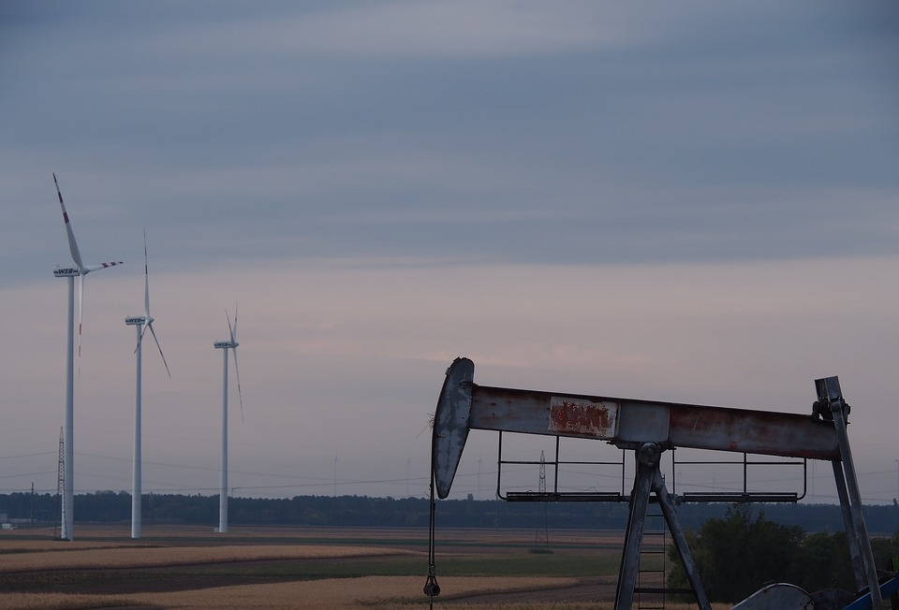
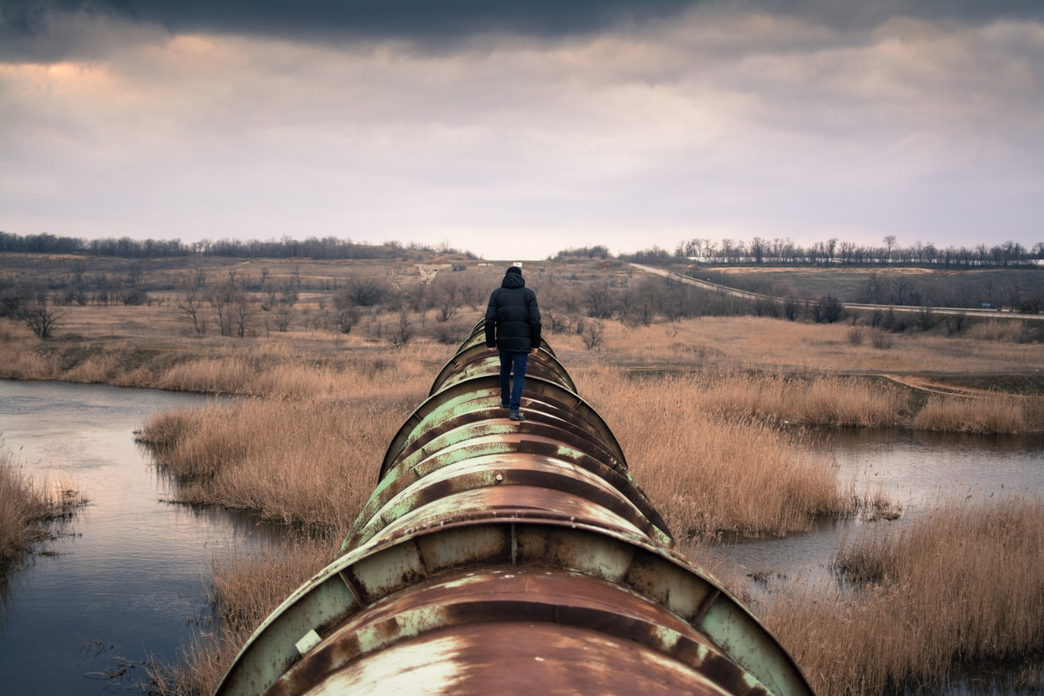

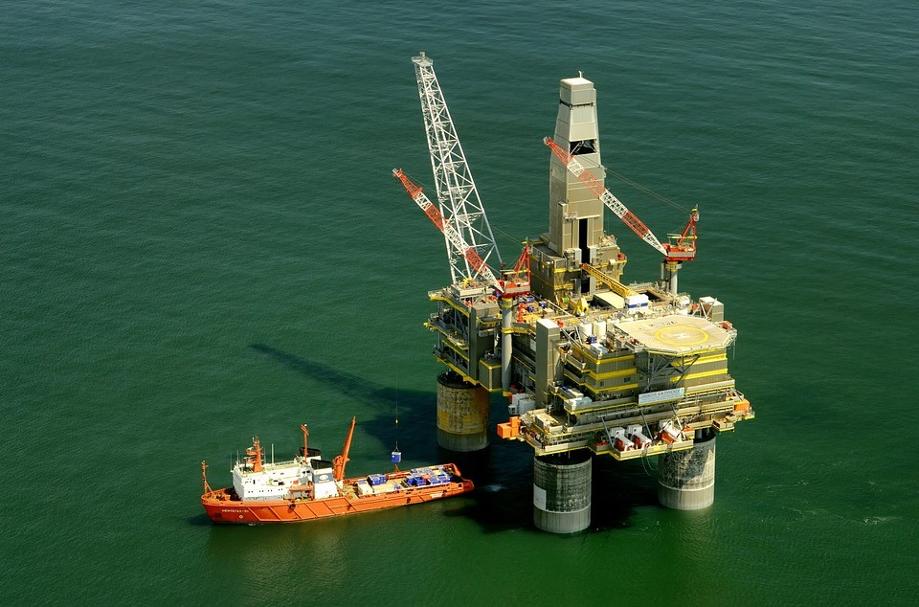
Pictures
https://cdn.pixabay.com/photo/2017/09/06/15/54/pinwheel-2722021_960_720.jpg
https://pixabay.com/photos/person-walking-pipeline-tube-steel-731319/
What do you see?
Who do you think took the pictures?
Why do you think they took the picture?
What do you wonder?
https://cdn.pixabay.com/photo/2013/05/21/14/32/russia-112445_960_720.jpg
Notes:
Day 1

Slide 2
To Dig or Not to Dig?
Grade 7 Learning Experience
Notes:
Day 1

Slide 3

Essential Question
How do personal experiences and local context knowledge impact our ideas, opinions, and decision making about sustainable development of geological resources?
Student Challenge
Create an actionable plan that support sustainable development of geological resources that is supported by research, and reflects your understandings and opinions about sustainable development.
Pages with this symbol indicate learning experiences we will do together during our online time.
Pages with this symbol indicate learning experiences you will do independently.
Notes:
Day 1

Slide 4
Guiding Question
How do the beliefs, values, and ideas expressed in texts, influence my understanding of sustainability of geological resources?
1
How do our understandings of sustainable development impact our ideas and opinions about the development of geological resources?
2
In this learning experience we will explore two questions:
Notes:
Day 1

Slide 5
We are Water Protectors
Watch the read aloud and book talk with Carole Lindstrom, author of We are Water Protectors. Then complete the THH chart below.
In the Text What’s this text about? Who’s telling the story? What does the author want me to know/think?
In your Head What did I notice? What surprised me? What challenged, changed, or confirmed my thinking?
In your Heart How did this make me feel? What did I learn about me? How will this influence my decision making and actions?
Notes:
Day 1
https://www.youtube.com/watch?v=2YHaRmj9wLU
Independently watch video – perhaps in the morning before a synchronous discussion in the afternoon. Use questions in template to guide discussion, draw attention to details in images in text and author's purpose and perspective for writing. During synchronous session the teacher can model completing the template based on the discussion

Slide 6
CAPP – Oil Extraction
View this website by the Canadian Association of Petroleum Producers. Then complete the THH chart below.
In the Text What’s this text about? Who’s telling the story? What does the author want me to know/think?
In your Head What did I notice? What surprised me? What challenged, changed, or confirmed my thinking?
In your Heart How did this make me feel? What did I learn about me? How will this influence my decision making and actions?
Notes:
Day 2
https://www.capp.ca/oil/extraction/
Students will do this asynchronously

Slide 7
What are the Tar Sands and Why Should we Oppose Them?
View this article by Marina Qutab from the One Green Planet organization. Then complete the THH chart below.
In the Text What’s this text about? Who’s telling the story? What does the author want me to know/think?
In your Head What did I notice? What surprised me? What challenged, changed, or confirmed my thinking?
In your Heart How did this make me feel? What did I learn about me? How will this influence my decision making and actions?
Notes:
Day 3
https://www.onegreenplanet.org/environment/what-are-tar-sands/
Students will do this asynchronously

Slide 8
How important are each of these to sustainable development?
Use the shape tool to make a mark on each line below to indicate what you think is the level of importance of each of these to sustainability.
Environment
Economics
Social Responsibility
Not Important
Important
Not Important
Important
Not Important
Important
Notes:
Day 3
Complete asynchronously

Slide 9
What is sustainable development?
Watch the video,
What is sustainable development?
Then in the space to the right, use 2-3 sentences to explain or describe what we need to keep in mind about sustainable development.
Notes:
Day 3
https://www.youtube.com/watch?v=7V8oFI4GYMY
Complete asynchronously
There are a variety of ways that you can have students record their response for this. Make copies of this slide for each student, use another platform such as Flipgrid, create an assignment in Teams notebook, or have students record in a journal and have ready for their synchronous lesson the next day.

Slide 10
Breakout Room Discussion – Part 1
How do the ideas and opinions expressed in the previously viewed texts address or reflect the three pillars of sustainability (environment, economics, and social responsibility)? Write evidence from the texts in the appropriate box in the chart.
 | Environment | Economics | Social Responsibility
Carole Lindstrom (We are Water Protectors)
CAPP (Oil Extraction)
One Green Planet (What are the Tar Sands)
Notes:
Day 4
Synchronous - Breakout rooms (2 parts) - make duplicates of this slide so there is one for each group
In the whole group have students 'gallery walk' the slides and compare and contrast the evidence in the charts.

Slide 11
Breakout Room Discussion – Part 2
Discuss and record the similarities and differences between the three perspectives presented in the texts you read and heard.
What similarities do you notice? | What differences do you notice?
What do you wonder?
Notes:
Day 4
Part 2 – return to breakout rooms, explore the similarities and differences between the three perspectives presented in these texts
Duplicate this slide so there is one for each group
In the whole group have groups share a notice and/or wonder

Slide 12
Burning Questions
Type a question here.
Type a question here.
Type a question here.
Type a question here.
Type a question here.
Type a question here.
Type a question here.
Type a question here.
Type a question here.
Type a question here.
Type a question here.
Type a question here.
Type a question here.
Type a question here.
Type a question here.
Type a question here.
Type a question here.
Type a question here.
Type a question here.
Type a question here.
Type a question here.
Notes:
Day 4/5
Review and put their burning question in a text box,
Next day: teacher and class would categorize questions, student would then pick a question they want to investigate.

Slide 13
Burning Question Inquiry Process
Today – Begin investigating your burning or inquiry question
In a couple of days – You will share your initial findings and discuss connections to the essential and guiding questions
Continue with your inquiry and start planning how you will communicate your learning
Opportunity to summarize your learning and get feedback on your communication plan
Revise!
Share your learning and reflection

Slide 14
Reflection and Connection
  How does your inquiry topic connect to the essential question or guiding questions?
  How does your inquiry help deepen your thinking and inform your understandings of sustainable development of geological resources?
Essential Question:
How do personal experiences and local context knowledge impact our ideas, opinions, and decision making about sustainable development of geological resources?
Guiding Questions:
How do the beliefs, values, and ideas represented in texts, impact my understanding of environmental sustainability of geological resources?
How do our understandings of sustainable development impact our ideas and opinions about the development of geological resources?
Notes:
Day 5/6

Slide 15
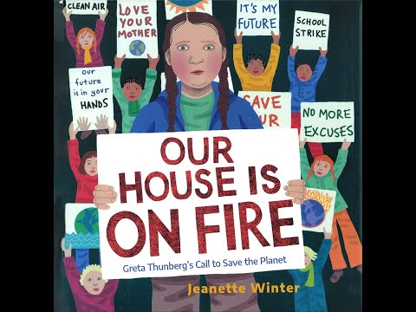
Our House is on Fire
Do you know who Greta Thunberg is? If not please listen to this story: Our House is on Fire
Notes:
Day 8
https://www.youtube.com/watch?v=ErFCIOqUj7Q

Slide 16
Our House is on Fire
While reading 'Code the Text' using the following:
Read the following articles as provided by your teacher:
Greta Thunberg admonishes leaders as U.N. climate summit fails to deliver action
The anti-Greta: A conservative think tank takes on the global phenomenon
Text Coding Symbols
Symbol | When to Use It
√ | Confirms what I think or know
! | Is new, interesting or surprising
? | Raises a question I would like to discuss with others
?? | Confusing…something I do not understand
* | Seems important…answers a question
>< | I have a connection
Notes:
Day 8/9
https://www.latimes.com/environment/story/2019-09-23/greta-thunberg-un-climate-summit-global-warming
https://www.washingtonpost.com/climate-environment/2020/02/23/meet-anti-greta-young-youtuber-campaigning-against-climate-alarmism/

Slide 17
Our House is on Fire Discussion
What are the beliefs and/or perspective of Greta and Naomi?
Which pillars of sustainability are Greta and Naomi considering?
In what way are they considering them?
What might be the beliefs and/or perspective of the authors of these articles?
Notes:
Day 9

Slide 18
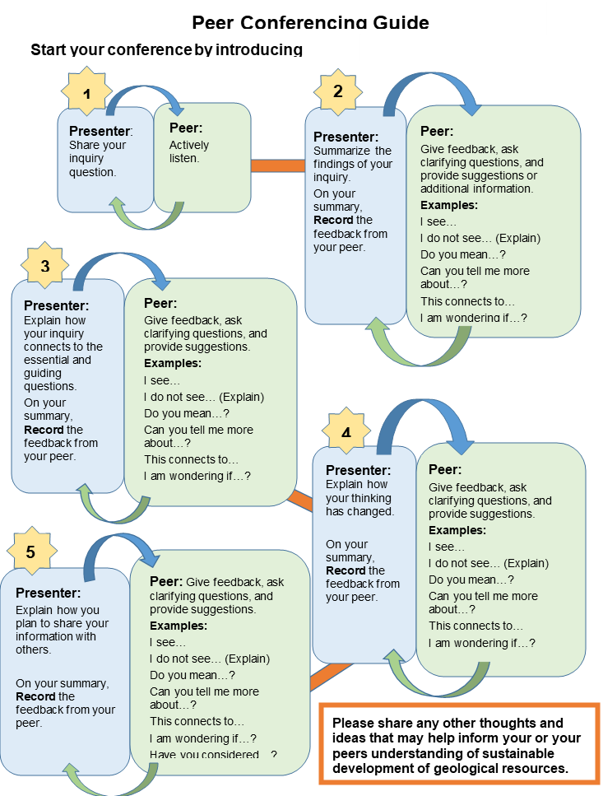
Notes:
Day 12

Slide 19
Reflection and Connection
  What are some things you learned from your peers that have influenced your understandings and opinions?
How might this influence your decisions and actions regarding sustainable development of geological resources?
Notes:
Day 14

Slide 20
Ideas for Actionable Plans
Notes:
Day 15

Slide 21
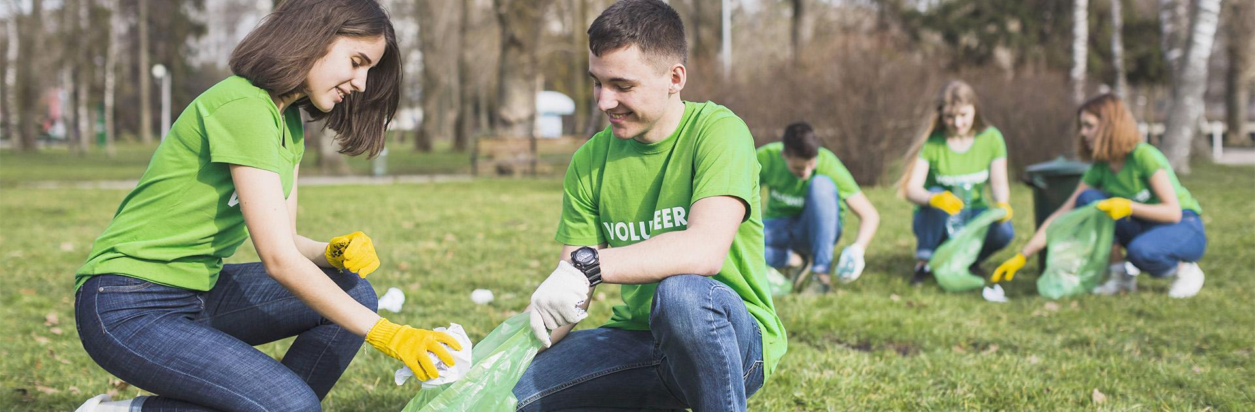
Challenge
Criteria
Your actionable plan should include:
Create an actionable plan that supports sustainable development of geological resources that is supported by research and reflects your understandings and opinions about sustainable development.
Notes:
Day 15

Slide 22
How important are each of these to sustainable development?
Use the shape tool to make a mark on each line below to indicate the level of importance to sustainability.
Environment
Economics
Social Responsibility
How has your thinking changed or deepened since your initial opinion? What has influenced you?
Not Important
Important
Not Important
Important
Not Important
Important
Notes:
Day 15

Slide 23
The End!
Please keep this slide for attribution

