Slide 1
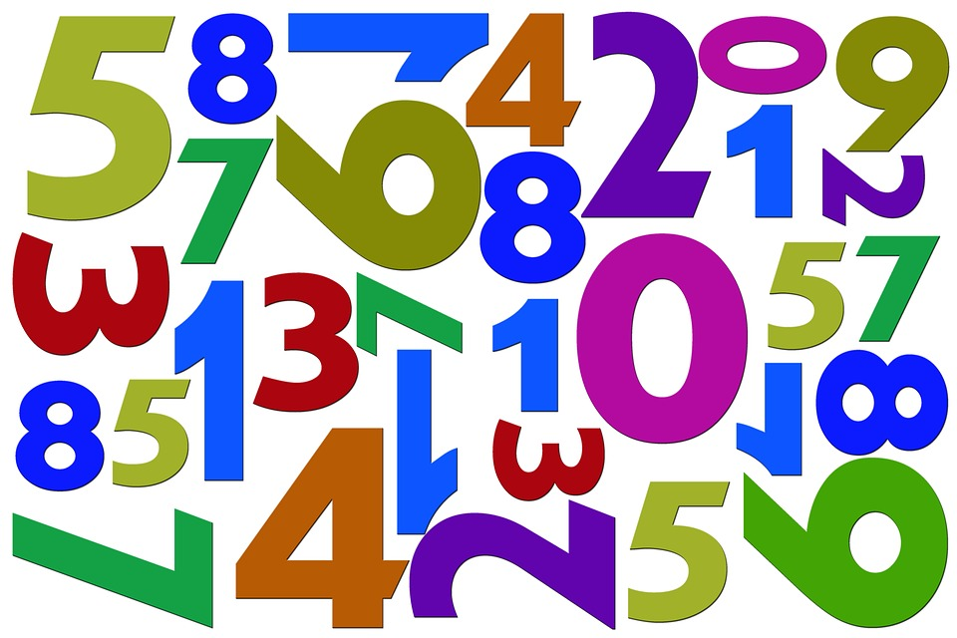
Investigating Numbers to 1000
Notes:
Photo Source: https://openclipart.org/detail/254730/prismatic-random-numbers-cloud

Slide 2
Guiding Concepts
Anchored in inquiry
Open ended questions, student centered, student choice
Low floor, high ceiling
Multiple ways to show understanding

Slide 3
Big Ideas
Counting tells how many or how much.
Benchmark numbers can be useful for comparing, relating, ad estimating numbers.
Numbers are related to each other through a variety of number relationships.
Quantities can be estimated by using referents.
Curricular Outcomes
3.N.1 Say the number sequence between any two given numbers forward and backward
from 0 to 1000 by:
10s or 100s, using any starting point
5s, using starting points that are multiples of 5
25s, using starting points that are multiples of 25
from 0 to 100 by:
3s, using starting points that are multiples of 3
4s, using starting points that are multiples of 4
3.N.3 Compare and order numbers to 1000.
3.N.4 Estimate quantities less than 1000 using referents.
Notes:
Specific to grade level outcomes, could include multiple disciplines (Math, ELA…)

Slide 4
Enduring Understandings:
Counting is a strategy for finding the answer to how many.
Place value patterns are repeated in large numbers and these patterns can be used to compare and order numbers.
The position of a digit in a number determines the quantity it represents.
Estimation is a way to get an approximate answer.
Essential Questions:
Is there a quicker way to find the answer than counting by ones from one?
How are place value patterns repeated in numbers?
How does the position of a digit in a number affect its value?
What are strategies to make reasonable estimates?
Does the use of referents help us make a more reasonable estimate?

Slide 5
Materials
It is highly recommended that if this is the first-time students are experiencing virtual manipulatives, allow them time to "play". This allows for the opportunity to explore and have fun with the tools BEFORE they will be required to use them purposefully.
Websites for virtual manipulatives are suggested. Hands-on materials are ideal. Significant learning occurs when students can build and visualize different representations of mathematics.
If School Divisions have another platform for delivering online instruction (ie See Saw, Google Classrooms), asynchronous tasks can be uploaded there.
For virtual manipulatives visit https://toytheater.com/category/teacher-tools/virtual-manipulatives/
To enhance their learning experiences students will need:
Base ten blocks https://www.coolmath4kids.com/manipulatives/base-ten-blocks
Coloured counters https://toytheater.com/color-counters/
Some premade manipulatives have been provided on specific slides

Slide 6
Instructions
This collection of tasks is designed around the concept of number, more specifically counting, number patterns and estimation of quantities. Each day represents independent sets of 3-part learning experiences that could function effectively as 45min-1hour session with a combination of synchronous and asynchronous parts, some of which are easily adaptable either way depending on your situation and access to technology and connectivity.
FOR SYNCHRONOUS LEARNING, THE SLIDEDECK SHOULD BE IN EDIT MODE.
Each day has been divided into 3 main parts. Each part provides various ways of engaging with the concept and is correlated with the coloured blocks found on slide 7:
Get Ready: begins the experience with an activity meant to activate student thinking and promote rich student discourse. This activity can be delivered prior to the lesson as an asynchronous task so students have time to prepare their thinking. It can also be delivered at the beginning of the synchronous session to help the teacher pre-assess prior knowledge and prime thinking for the upcoming learning experience.
Work it out: comprises the main learning experience for the day. This is where new content is presented and individual or small group responses are required. These activities are best completed with students working in pairs or small groups. If your platform allows for breakout rooms, this feature is a good tool that will facilitate student collaboration and discourse.
Look Back: is a final culminating task that provides opportunities to check for student understanding of the concepts, consolidate different solutions and solve problems. It allows for students to reflect on their learning and make connections.

Slide 7
Investigating Numbers to 1000
Visual Connections
Mental Math & Estimation
Problem Solving
Interdisciplinary Connections
Number Play
Notes:
This is the “launch screen”. Each tile above represents different learning experiences.
The outer border of each slide is colour-coded and corresponds to the tiles above.

Slide 8
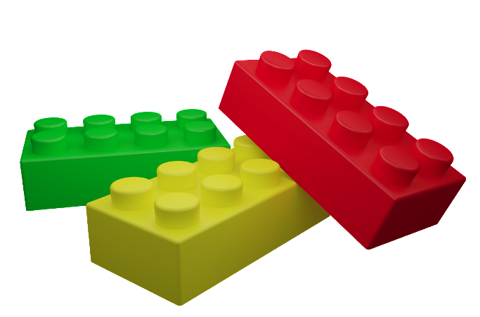
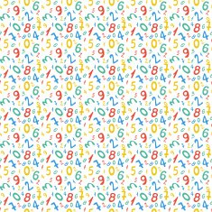
DAY 1
1
Get Ready
2
Work it out!
3
Looking Back
Build It
Choral Count
or,
Draw It
Number Lines in Disguise
Write About It
or…
Record It
Notes:
Images sourced from openclipart.org
Image source: https://pixy.org/src/447/4473268.jpeg
https://pixabay.com/illustrations/constructor-detail-part-brick-game-761618/
https://www.pikist.com/free-photo-swbtb
https://openclipart.org/detail/172707/edit-icon-icono-editar
https://openclipart.org/detail/212116/screencast
https://pixy.org/2420669/

Slide 9
1
Get Ready!
Let's begin by counting forwards by 2's starting at 83.
83 | 85
Notes:
Slide for Part I, the activating activity…number talk.
Students will skip count together from 83 to 131
The teacher will record the numbers horizontally, making a 5 x 5 grid.
The teacher will then facilitate a discussion around different counting patterns found in the grid.

Slide 10
1
Get Ready!
Let's begin by counting forwards by 2's starting at 83.
83 | 85 | 87 | 89 | 91
93 | 95 | 97 | 99 | 101
103 | 105 | 107 | 109 | 111
113 | 115 | 117 | 119 | 121
123 | 125 | 127 | 129 | 131
Notes:
Slide for Part I, the activating activity…number talk.
Students will skip count together from 83 to 131
The teacher will record the numbers horizontally, making a 5 x 5 grid.
The teacher will then facilitate a discussion around different counting patterns found in the grid.
Alternately, the students could record the numbers themselves.
Possible patterns:
Columns increase/decrease by 10.
Diagonal (left to right, top to bottom) increase by 12
Diagonal (right to left, top to bottom) increase by 8
The ones digits is always odd
There are 5 numbers in every decade (except the 80's– only 4)
The sum of the digits in each column (top to bottom) increases by 1 (In order to make this happen for some of the numbers the digital root of a number will have to used. The digital root of a number is the single digit that you get by adding all of the digits of the original number together. If the result of that is multiple digits, you add those digits together, repeating the process until you get a single digit. That digit is the digital root of the original number. For example in the second column, take the number 193 and all the digits, 1 + 9 + 3 = 13, 1 + 3 = 4. The digital root of 193 would be 4.)

Slide 11
1
Get Ready!
End of this section​

Slide 12
2
Work it out
Number Lines in Disguise
What do you notice? What do you wonder?
9
Notes:
Slide for Part II, the main focus of the work for this part of the activity.
Starting at 9, what MIGHT the number line increase by? Do some practicing skip counting by various increments (suggested by students). You might ask, if the number line is increasing by 2s, what number would the number line start at? If the number line kept going, would you ever say the number 18? How do you know? If it’s increasing by 5, would we ever hit the number 44? How do you know?
This lesson is adapted from https://nrich.maths.org/13452
Students should be encouraged to look for skip counting patterns in order to determine what numbers may be placed above the other lines

Slide 13
2
Work it out
Number Lines in Disguise
What do you notice NOW?
9
27
Notes:
Now, what do you notice? Is there more than one possible set of numbers? Why or why not?
This lesson is adapted from https://nrich.maths.org/13452
Students should be encouraged to look for skip counting patterns in order to determine what numbers may be placed above the other lines

Slide 14
2
Work it out
Number Lines in Disguise
9
27
What is the counting pattern?
What numbers are missing?
Notes:
Slide for Part II, the main focus of the work for this part of the activity.
This lesson is adapted from https://nrich.maths.org/13452
Students should be encouraged to look for skip counting patterns in order to determine what numbers may be placed above the other lines

Slide 15
2
Work it out
Number Lines in Disguise
What do you notice? What do you wonder?
114
Notes:
Starting at 114, what MIGHT the number line decrease by? Do some practicing skip counting by various increments (suggested by students). You might ask, if the number line is decreasing by 2s, what number would the number line start at? If the number line kept going, would you ever say the number 98? How do you know? If it’s decreasing by 5, would we ever hit the number 84? How do you know?

Slide 16
2
Work it out
Number Lines in Disguise
74
114
What is the counting pattern? ​
What numbers are missing? ​
Notes:
Students should be encouraged to look for any patterns (both numbers have a 4 in the ones place...). Does this help the to decide what the counting pattern might be?

Slide 17
2
Work it out
Number Lines in Disguise
What do you notice now? What do you wonder now?
74
114
Notes:
Students should be encouraged to look for any patterns (both numbers have a 4 in the ones place...) in the numbers. Does this help the to decide what the counting pattern might be?
How does moving the benchmark numbers, change the counting pattern?

Slide 18
2
Work it out
End of this section

Slide 19
3
Looking Back
35
75
Look at these two number lines. Which number line makes it easier to determine the skip counting pattern? Why?
35
75
Notes:
This could be an asynchronous activity. If See Saw or Google Classroom are digital platforms, copy the link to the blank number line sheet for the students.

Slide 20
3
Looking Back
End of this day.
Notes:
This could be an asynchronous activity. If your school uses See Saw, you can copy this slide into that platform.

Slide 21
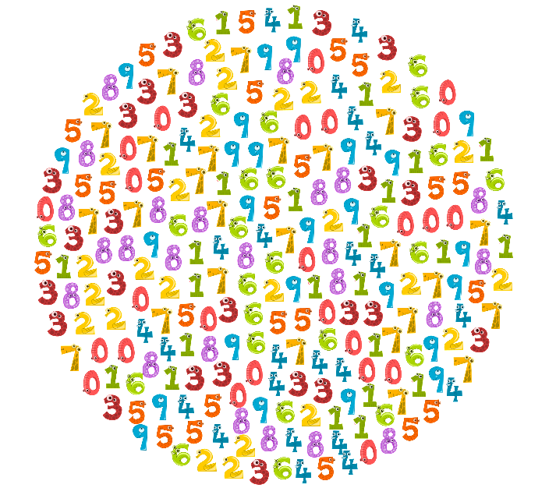
Day 2
1
Get Ready
2
Work it out!
3
Looking Back
Choral
Count in a Circle​
Write It,
and
Record It
Benchmarks on a Number Line
Great Estimations
Notes:
Images sourced from: https://pixabay.com/vectors/numbers-numerals-counting-math-3691893/
Images source:
https://openclipart.org/detail/172707/edit-icon-icono-editar (pencil)
https://openclipart.org/detail/212116/screencast (record)

Slide 22
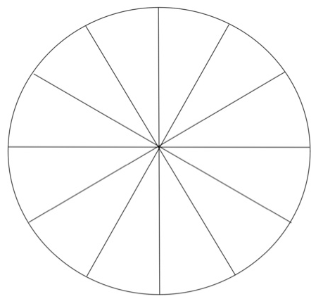
1
Get Ready!
We are going to count by 10s.
We will start at 0 and stop at 110.
0
Insert Name
Insert Name
Insert Name
Insert Name
Insert Name
Insert Name
Insert Name
Insert Name
Who do you think will say 110?​
Insert Name
Insert Name
Insert Name
Insert Name
Notes:
Source: Grade 3 Mathematics: Support Document for Teachers. Manitoba Education
Instructions to note:
We are going to start at zero and count by 10s to 110. Who do you think will say 110?
Create a wheel that has student names. Decide where zero will be. Have students predict which student will say 110.
**Note** To allow all students think time, teachers can push this slide out to students prior to the synchronous lesson. That allows for all students to collect their ideas ahead of time and have something to share.

Slide 23
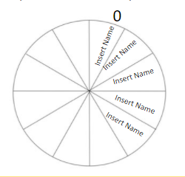
1
Get Ready!
Count by 10s.
Start at 0 and stop at 110.
I think that __________ will say 110 because...
Notes:
Source: Grade 3 Mathematics: Support Document for Teachers. Manitoba Education
Instructions to note:
We are going to start at zero and count by 10s to 110. Who do you think will say 110?
Create a wheel that has student names. Decide where zero will be. Have students predict which student will say 110.
**Note** To allow all students think time, teachers can push this slide out to students prior to the synchronous lesson. That allows for all students to collect their ideas ahead of time and have something to share.

Slide 24
1
Get Ready!
Count by 5s.
Start at 0 and stop at 110. Who do you think will say 110?
Insert Name
Insert Name
Insert Name
Insert Name
0
Insert Name
Insert Name
Insert Name
Insert Name
Who do you think will say 110?​
Insert Name
Insert Name
Insert Name
Insert Name
Notes:
Source: Grade 3 Mathematics: Support Document for Teachers. Manitoba Education
Instructions to note:
We are going to start at zero and count by 5s to 110. Who do you think will say 110?
Create a wheel that has student names. Decide where zero will be. Have students predict which student will say 110.
**Note** To allow all students think time, teachers can push this slide out to students prior to the synchronous lesson. That allows for all students to collect their ideas ahead of time and have something to share.

Slide 25
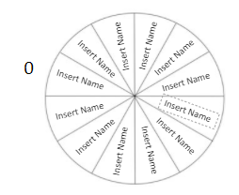
1
Get Ready!
Count by 5s.
Start at 0 and stop at 110.
I think that __________ will say 110 because...
Notes:
Source: Grade 3 Mathematics: Support Document for Teachers. Manitoba Education
Instructions to note:
We are going to start at zero and count by 5s to 110. Who do you think will say 110?
Create a wheel that has student names. Decide where zero will be. Have students predict which student will say 110.
**Note** To allow all students think time, teachers can push this slide out to students prior to the synchronous lesson. That allows for all students to collect their ideas ahead of time and have something to share.

Slide 26
2
Work it out
Put a red dot at the midpoint of this number line.
Use me!
0
100
What number could it be? What makes you say that?
Notes:
Source: https://www.scholastic.com/parents/school-success/learning-toolkit-blog/number-lines.html
Duplicate this slide for each student.
Can they find the middle?
What number might it be?
Can they provide a reasonable answer.
Students need to understand that the mid point between 0 and 100 is 50. 50 is an important benchmark referent when estimating values between 0 – 100.

Slide 27
2
Work it out
Put a red dot at the midpoint of this number line.
Use me!
0
1000
What number could it be? What makes you say that?
Notes:
Source: https://www.scholastic.com/parents/school-success/learning-toolkit-blog/number-lines.html
Duplicate this slide for each student.
Can they use the information from the first slide to find the middle?
What number might it be?
Can they provide a reasonable answer.
Students need to understand that the mid point between 0 and 1000 is 500. 500 is an important benchmark referent when estimating values between 0 – 1000.

Slide 28
2
Work it out
Put a red dot at the midpoint of this number line.
Use me!
0
500
What number could it be? What makes you say that?
Notes:
Source: https://www.scholastic.com/parents/school-success/learning-toolkit-blog/number-lines.html
Students have now experienced finding the midpoint for 100 and 1000. Can they now find the mindpoint between 0 – 500. This might be a bit more of a challenge for some. But they may be able to make connections that half of 500 is 250.
Duplicate this slide for each student.
Can they find the middle?
What number might it be?
Can they provide a reasonable answer.
Students need to understand that the mid point between 0 and 500 is 250. 250 is an important benchmark referent when estimating values between 0 – 500.

Slide 29
2
Work it out
Where is the yellow dot?
0
100
What number could it be? What makes you say that?
Notes:
Source: https://www.scholastic.com/parents/school-success/learning-toolkit-blog/number-lines.html
Do students notice the yellow dot is about be half way between 0 and the red. At this point, this is DISCUSSION only.
Can students make a connection that the red dot is 50 and the yellow dot is approx. At 25. Another important benchmark for estimating within 100.

Slide 30
2
Work it out
Where is the green dot?
0
100
What number could it be? What makes you say that?
Notes:
Source: https://www.scholastic.com/parents/school-success/learning-toolkit-blog/number-lines.html
Continue with the discussion.
Do students now notice that the greeen dot is mid way between the red 50 dot and 100. Have the students noticed that each intersecting line are at intervals of 10? How can they determine the value of the green dot?

Slide 31
2
Work it out
What numbers could be at the dots?
0
100
What number could it be? What makes you say that?
Notes:
Source: https://www.scholastic.com/parents/school-success/learning-toolkit-blog/number-lines.html
Duplicate this slide for each student. This will show their understanding of the task thusfar. Can they determine the correct values? Can they justify or reason why they are the number that they are.

Slide 32
2
Work it out
What numbers could be at the dots?
0
1000
What number could it be? What makes you say that?
Notes:
Source: https://www.scholastic.com/parents/school-success/learning-toolkit-blog/number-lines.html
Duplicate this slide for each student. Follow the same directions from the previous slide.

Slide 33
2
Work it out
What is the same about these number lines? What is different?
0
100
1000
0
Notes:
Source: https://www.scholastic.com/parents/school-success/learning-toolkit-blog/number-lines.html
Can students compare and connect the simlarities and differences between the two visual representations? Can they make a connection that the dots are all at BENCHMARK representations.

Slide 34
2
Work it out
End of this section

Slide 35
3
Looking Back
Count Forward by 2s:
42, ____, ____, ____, ____, ____, ____, ____, _____, ____,____
13, ____, ____, ____, ____, ____, ____, ____, ____, ____, ____
Count Backwards by 2s:
78, ___, ____, ____, _____, ____, ____, ____, ____, ____, ____
Notes:
This could be an asynchronous activity. If See Saw or Google Classroom are digital platforms, copy this slide into that platform.
These could be assigned to students as asynchronous work, to be submitted for teacher feedback.
What to watch for:
Can the student
count by 2s
forward on the multiple
forward off the multiple
backward on the multiple

Slide 36
3
Looking Back
Count Forwards by 10s:
30, ____, ____, ____, ____, ____, ____, ____
7, ____, ____, ____, _____, ____
Count backwards by 10s:
100, ____, _____, _____, _____, _____, ____, ____, ____
Notes:
This could be an asynchronous activity. If See Saw or Google Classroom are digital platforms, copy this slide into that platform.
These could be assigned to students as asynchronous work, to be submitted for teacher feedback.
What to watch for:
Can the student
count by 10s
forward on the multiple
forward off the multiple
backward on the multiple
count by 5s
forward on the multiple
backward on the multiple
count by 3s
forward on the multiple
count by 4s
forward on the multiple

Slide 37
3
Looking Back
Count Forward by 5s:
15, ____, _____, ______, _____, _____, _____, _____, _____, ____
Count Backwards by 5s:
85, ____, ____, ____, ____, ____, ____, ____, ____, ____, ____
Notes:
This could be an asynchronous activity. If See Saw or Google Classroom are digital platforms, copy this slide into that platform.
These could be assigned to students as asynchronous work, to be submitted for teacher feedback.
What to watch for:
Can the student
count by 5s
forward on the multiple
backward on the multiple

Slide 38
3
Looking Back
Count forwards by 3s:
3, ____, ____, ____, ____, ____, ____, ____
Count forwards by 4s:
4, ____, ____, ____, ____, _____, ____, _____
Notes:
This could be an asynchronous activity. If See Saw or Google Classroom are digital platforms, copy this slide into that platform.
These could be assigned to students as asynchronous work, to be submitted for teacher feedback.
What to watch for:
Can the student:
count by 3s
forward on the multiple
count by 4s
forward on the multiple

Slide 39
2
Work it out
Great Estimations
by Bruce Goldstone
Why are referents important to use in estimation?
Notes:
Source: https://youtu.be/IbFrQy7T6Gs
This might be an asynchronous activity for your students to view. This is a fantastic video for explaining estimation.

Slide 40
3
Looking Back
End of this day.

Slide 41
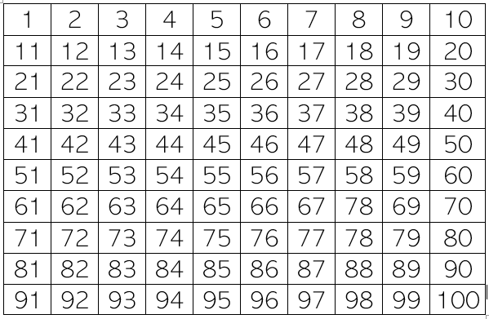
Day 3
1
Get Ready
2
Work it out!
3
Looking Back
Hundred Chart Patterns
Counting Collections
Estimation Task

Slide 42
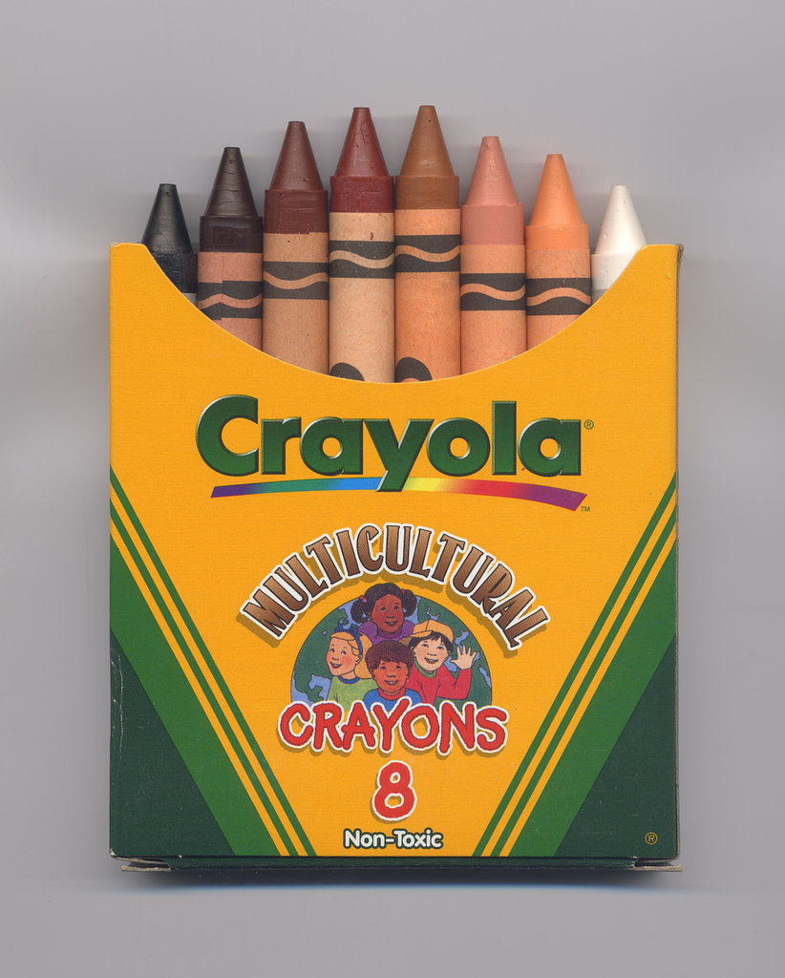
1
How could we count to find the total number of crayons?
Get ready!
8
8
8
8
8
8
8
8
8
8
8
8
8
8
8
8
8
8
Notes:
Students should be encouraged to find the total using mental math and estimation. What kind of counting and estimation strategies are students using?
Ask students to estimate first before any doing any calculations. You can provide a prompt such as "Do you think there are more or less than 100, 200 etc?
Students could be asked to consider another possible way to count.
Image source: https://search.creativecommons.org/photos/96f2da03-99b1-48af-83d8-a84088a5a186

Slide 43
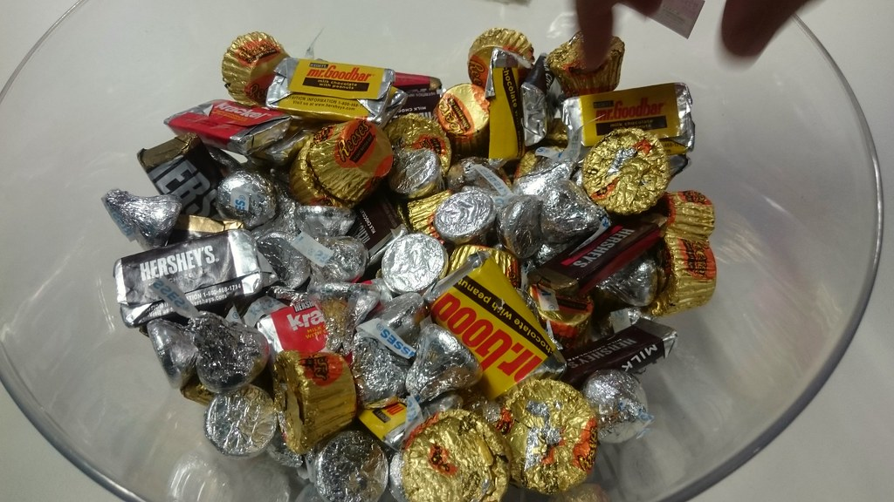
1
How could we count to find the total number of treats?
Get ready!
75
55
90
Notes:
Students should be encouraged to find the total using mental math and estimation. What kind of counting and estimation strategies are students using?
Ask students to estimate first before any doing any calculations. You can provide a prompt such as "Do you think there are more or less than 100, 200 etc?
Image source: https://search.creativecommons.org/photos/9b83ed65-e3c4-49c1-95f8-b443d6a1ff47

Slide 44
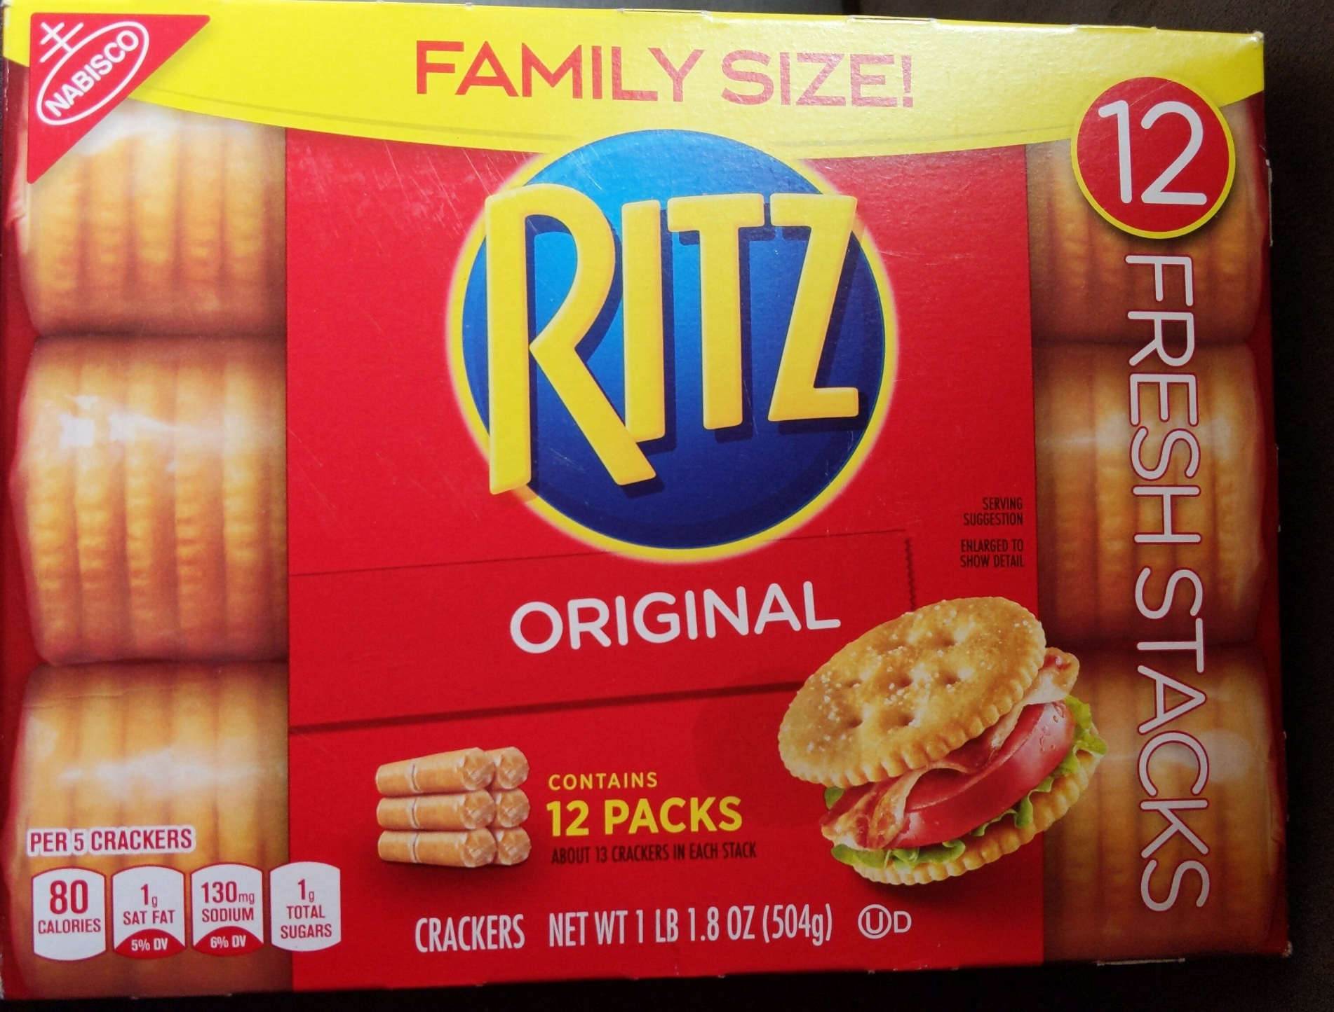
1
How could we count to find the total number of crackers?
Get ready!
12 packs, 20 crackers per pack
Notes:
Students should be encouraged to find the total using mental math and estimation. What kind of counting and estimation strategies are students using?
Ask students to estimate first before any doing any calculations. You can provide a prompt such as "Do you think there are more or less than 100, 200 etc?
Image source: https://www.google.com/search?q=box%20of%20crackers&tbm=isch&tbs=il%3Acl#imgrc=kh9hL6cQniLLAM

Slide 45
1
Get ready!
End of this section​

Slide 46
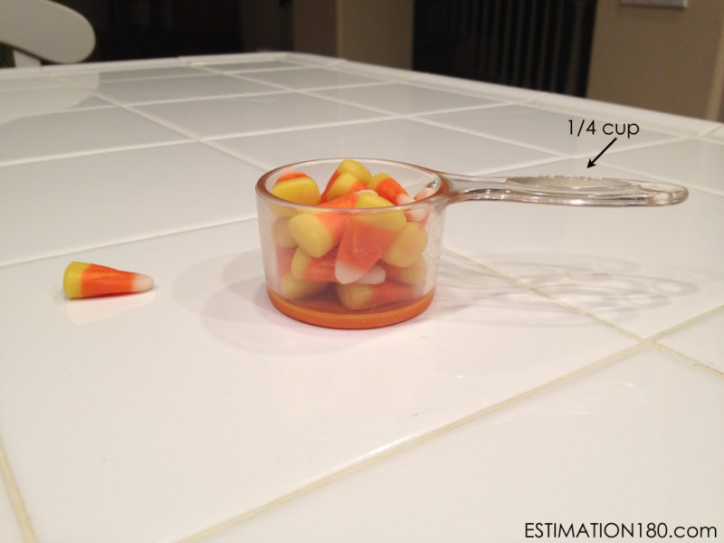
2
Estimation Task
Work it out
About how many pieces of candy corn are in the cup?
Notes:
Image Source: https://estimation180.com/day-25/

Slide 47
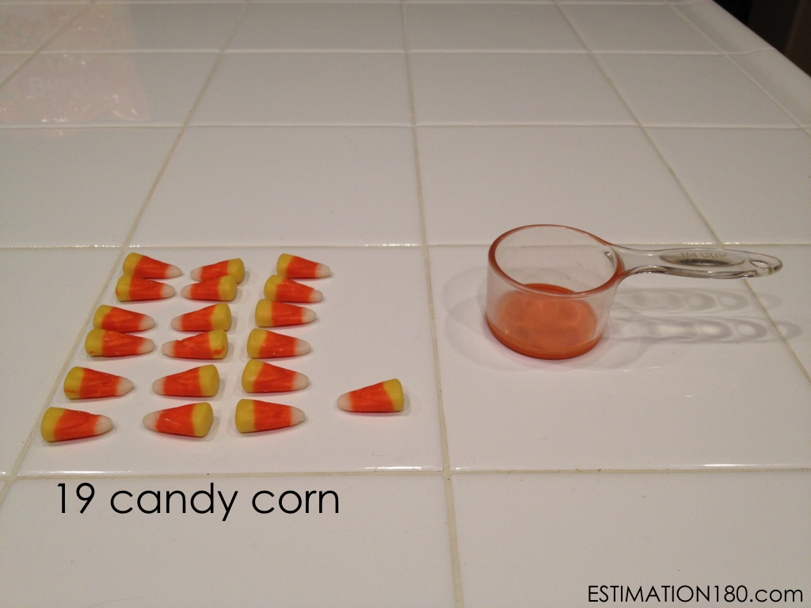
2
Estimation Task
Work it out
Was your estimate reasonable?
Notes:
Image Source: https://estimation180.com/day-25/#single/0

Slide 48
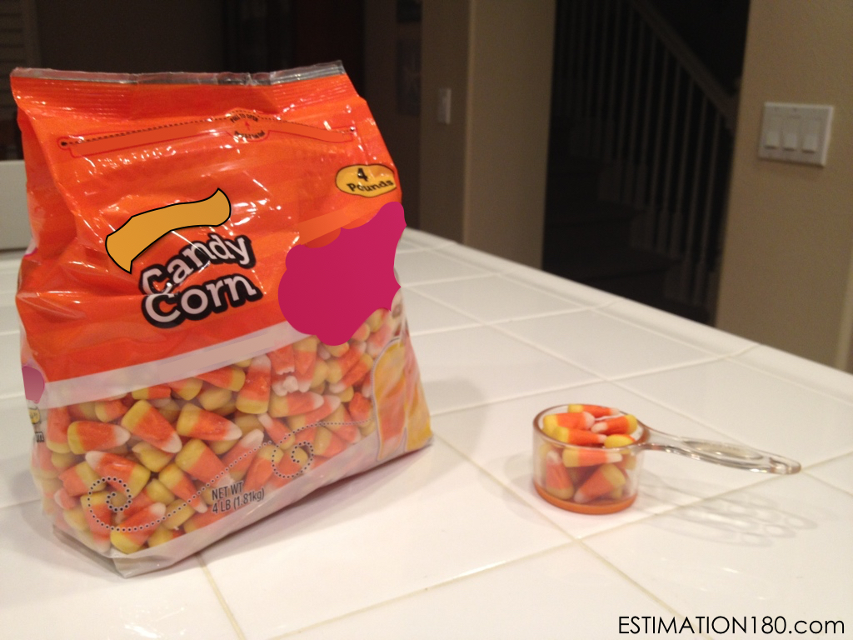
2
Estimation Task
Work it out
Knowing that there are 19 candies in the small cup, about how many pieces of candy corn are in the bag?
Notes:
Image Source: https://estimation180.com/day-26/#single/0

Slide 49
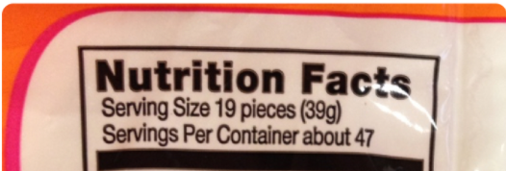
2
Estimation Task
Work it out
Use this information to determine the approximate number of candies in the bag.
Notes:
Image Source: https://estimation180.com/day-26/

Slide 50
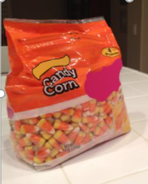
2
Estimation Task
Work it out
How did you find the total number of candies?
$$\sim$$
893 pieces of candy
$$\sim$$
(Approximately Equal)
Notes:
Image Source: https://estimation180.com/day-26/

Slide 51
2
Get ready!
End of this section​

Slide 52
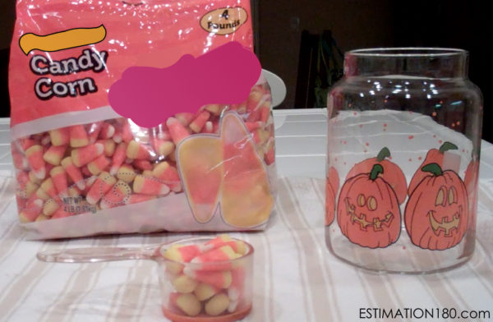
3
Looking Back
Using what you’ve learned, give a reasonable estimate of the number of candies that will fill the jar.
893
19
Notes:
Image source: https://estimation180.com/day-27/#single/0
Encourage the students to use one or both of the numbers known (19/ 893) to make their estimate. Students sometimes do not use available information to solve a new problem.
This page can be posted on See Saw if needed.

Slide 53
3
Looking Back
End of this day​

Slide 54
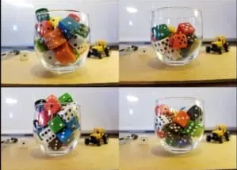
Day 4
1
Get Ready
2
Work it out!
3
Looking Back
Estimation Clip Board
Estimate and Write It
Ice Cream Scoop
or,
Record It
Notes:
Images sourced from : https://stevewyborney.com/2018/04/the-estimation-clipboard/
Images sourced:
https://openclipart.org/detail/172707/edit-icon-icono-editar
https://openclipart.org/detail/212116/screencast

Slide 55
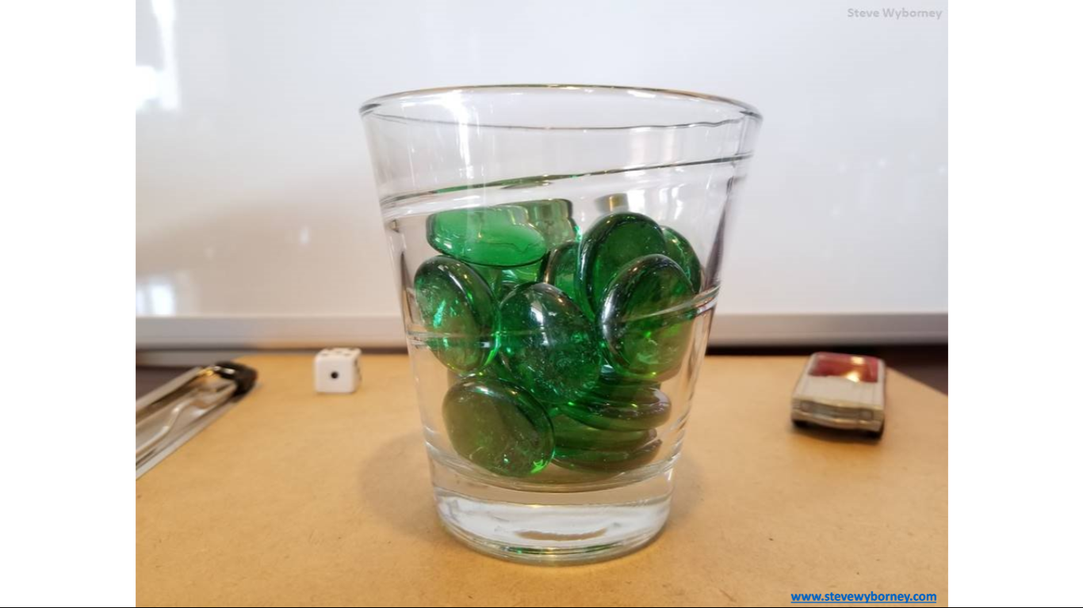
1
Get Ready!
Estimation Clip Board
Notes:
Source: https://stevewyborney.com/2018/04/the-estimation-clipboard/
Instructions to note:
TO USE THE FOLLOWING SLIDES YOU MUST BE IN SLIDE SHOW / PRESENT MODE.
Students will need to have access to slide 56 to record their thinking throughout this task.

Slide 56
1
Get Ready!
Student Recording Page
My Estimate:
My Estimate:
My Estimate:
My Estimate:
Notes:
Slide for Part I, the activating activity…
Source: https://stevewyborney.com/2018/04/the-estimation-clipboard/
Student working page. Copy a slide for each student. Have them record their estimates in the box as they are presented. Discuss, how close they were and if they need to adjust their estimate for the next image.
What to watch for. Can the student :
select and use an appropriate referent (10, 25, 100)
make a reasonable estimate
explain his or her thinking

Slide 57
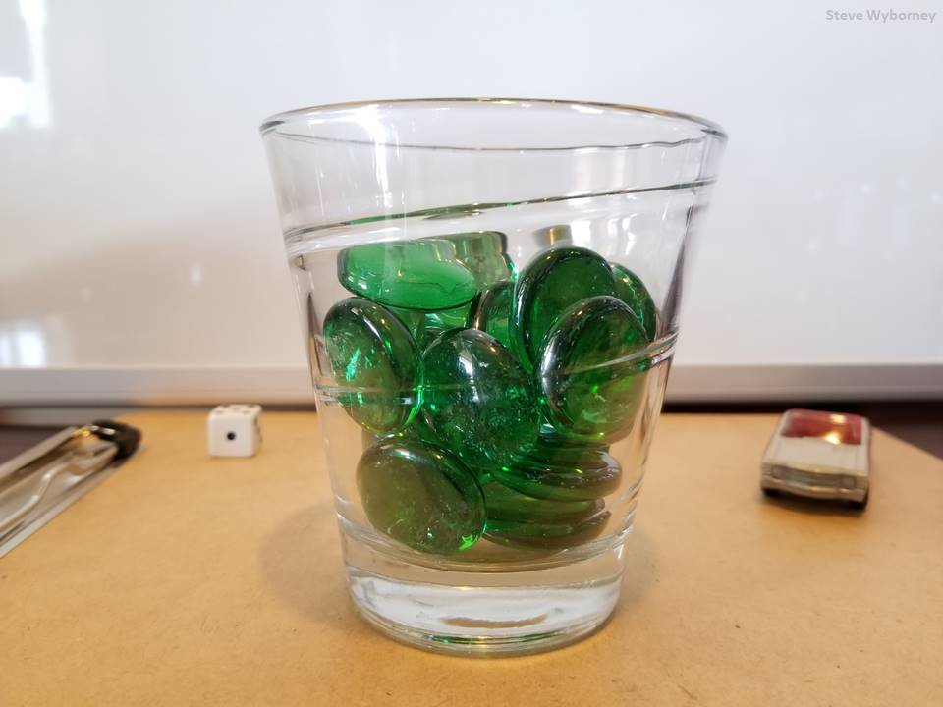
How many glass gems are in the glass?
25 glass gems
The Reveal
www.stevewyborney.com
Notes:
TO USE THE FOLLOWING SLIDES YOU MUST BE IN SLIDE SHOW/ PRESENT MODE. PRESENT FROM CURRENT SLIDE.
Source: https://stevewyborney.com/2018/04/the-estimation-clipboard/

Slide 58
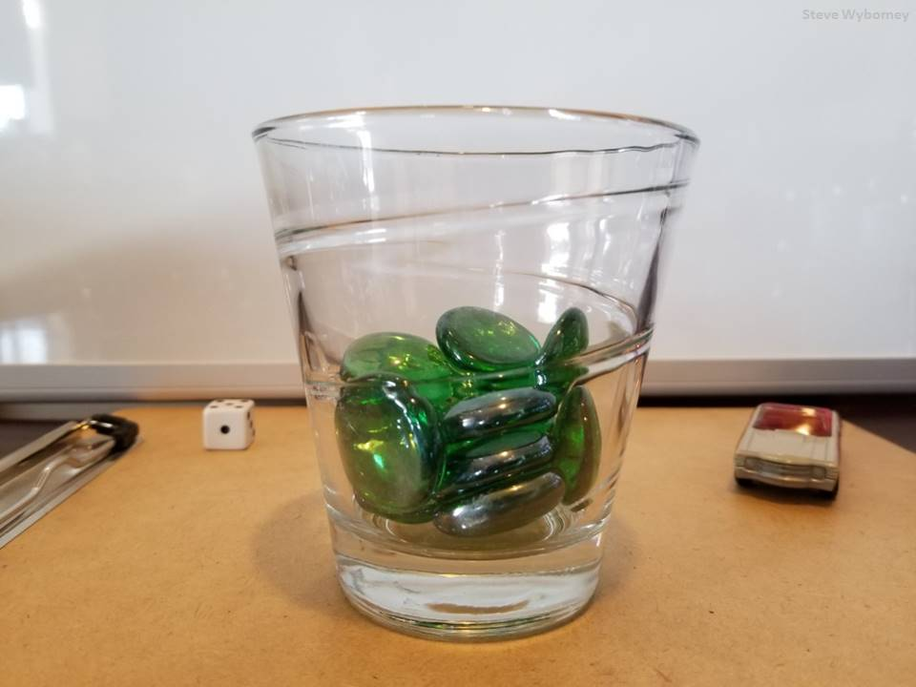
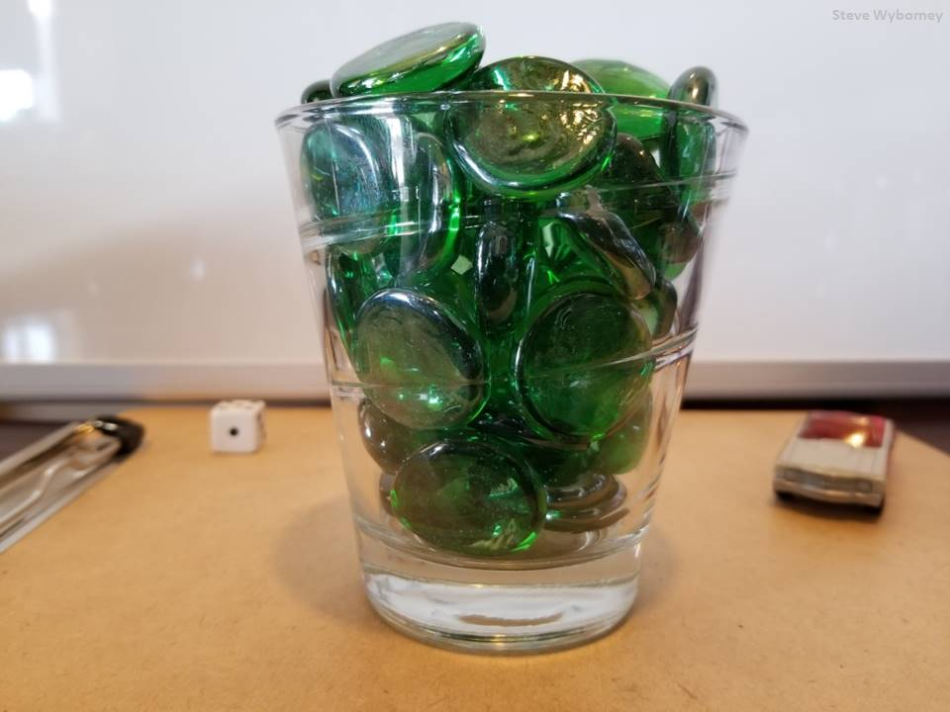
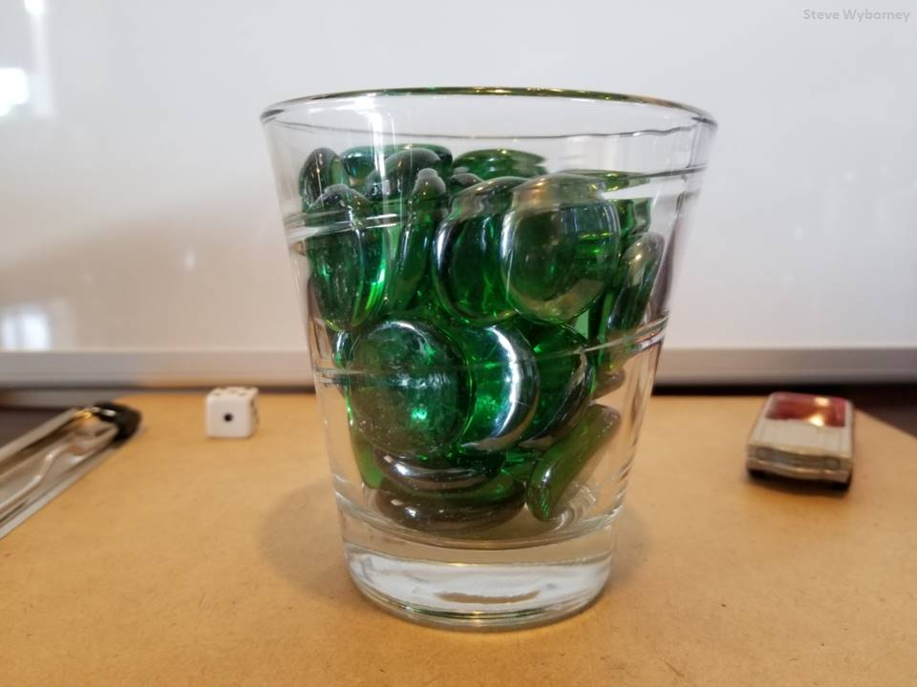
25 glass gems
14 glass gems
The Reveal
51 glass gems
The Reveal
37 glass gems
The Reveal
www.stevewyborney.com
Notes:
TO USE THE FOLLOWING SLIDES YOU MUST BE IN SLIDE SHOW/PRESENT MODE. PRESENT FROM CURRENT SLIDE.
Source: https://stevewyborney.com/2018/04/the-estimation-clipboard/

Slide 59
1
Get Ready!
End of this section​

Slide 60
2
Ice Cream Scoop
Work it out
In shops with lots of ice-cream flavors there are many different flavor combinations, even with only a 2-scoop cone.
With 1 ice-cream flavor there is 1 kind of 2-scoop cone, but with 2 flavors there are 3 possible combinations (e.g., vanilla/vanilla, chocolate/chocolate, and vanilla/chocolate).​
​
How many kinds of 2-scoop cones are there with 3 flavors?​
Notes:
If you have used the first series of lessons found in the Manitoba Remote Learning Support Centre Repository, this is a spiral back to reinforce the concepts for 3.PR.1 Increasing Patterns. It is important to review previous concepts and investigate them in a problem solving context.
Source: https://www.youcubed.org/task/ice-cream-scoop/
If students are having difficulty getting started, suggest using manipulatives or a drawing to record possible combinations.
How could you keep track of your flavour combinations? Encourage students to come up with a labelling system.
Adapting or differentiating the task:
Change the amount of scoops. What if you had 3 scoops per cone instead of 2?
Depending on your selected goal, you may only wish to have students focus on organizing possible combinations and working on communication strategies instead of focusing on getting the total number of combinations.
Image Source:
https://pixabay.com/vectors/ice-cream-cone-scoop-dessert-32097/ (one cone)
https://pixabay.com/illustrations/ice-cream-dessert-chocolate-taste-2453389/(three cones)

Slide 61
2
Ice Cream Scoop
Work it out
In shops with lots of ice-cream flavors there are many different flavor combinations, even with only a 2-scoop cone.
With 1 ice-cream flavor there is 1 kind of 2-scoop cone, but with 2 flavors there are 3 possible combinations (e.g., vanilla/vanilla, chocolate/chocolate, and vanilla/chocolate).​
​How many kinds of 2-scoop cones are there with 3 flavors?​
Use this space to show your thinking. Use this link to find a working tool.
Notes:
Source: https://www.youcubed.org/task/ice-cream-scoop/
If students are having difficulty getting started, suggest using manipulatives or a drawing possible combinations.
What to look for:
How do students organize their thinking (do they use visual representations? Can they explain how their representations connect to the problem?
Do students make a t-chart or table to organize their thinking?
Image Source:
https://pixabay.com/vectors/ice-cream-cone-scoop-dessert-32097/ (one cone)
https://pixabay.com/illustrations/ice-cream-dessert-chocolate-taste-2453389/(three cones)

Slide 62
2
Ice Cream Scoop
Work it out
EXTENSION Challenge
How many kinds of 2-scoop cones are there with 6 flavors?​
Notes:
Source: https://www.youcubed.org/task/ice-cream-scoop/
EXTENSION QUESTION:
For students who are able to find 55 combinations for the 10 flavours, you could ask: How many combinations would there be for any number of flavours? How do you know you have all of the combinations for x flavours?
Image Source:
https://pixabay.com/vectors/ice-cream-cone-scoop-dessert-32097/ (one cone)
https://pixabay.com/illustrations/ice-cream-dessert-chocolate-taste-2453389/(three cones)

Slide 63
2
Work it out
End of this section

Slide 64
3
Print me to limit screen time
Looking Back
Estimate the number of objects in each box.
Explain how you decided on your estimate.
My Estimate:
My Estimate:
My Estimate:
Notes:
This could be an asynchronous activity. If See Saw or Google Classroom are digital platforms, copy this slide into that platform.
Source: Grade Three Support Document for Teachers, Manitoba Education
What to watch for. Can the student :
select and use an appropriate referent (10, 25, 100)
make a reasonable estimate
explain his or her thinking

Slide 65
3
Looking Back
End of this day.

Slide 66
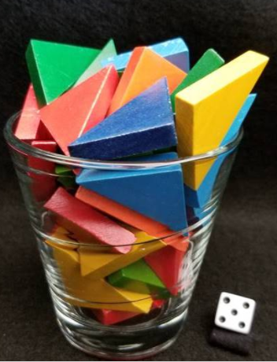
Day 5
1
Get Ready
2
Work it out!
3
Looking Back
Esti-Mystery
Write About It
Placing Numbers
Record It
Notes:
Images sourced from openclipart.org and https://openclipart.org/detail/172707/edit-icon-icono-editar
https://openclipart.org/detail/212116/screencast
https://stevewyborney.com/2019/09/51-esti-mysteries/

Slide 67
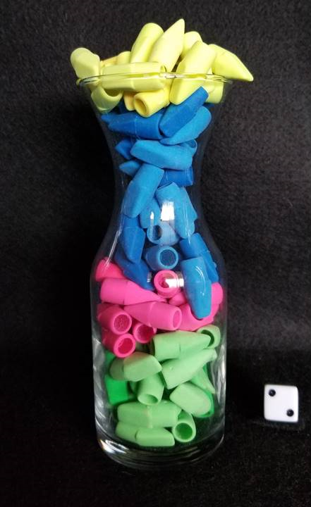
1
Get Ready!
Estimate the number of erasers in the vase.
Notes:
Source: https://stevewyborney.com/2019/09/51-esti-mysteries/ #309
On the following slides, students will be given a set of clues to help guide/change their estimates. Students are encourage to make a list of the possible answers after each clue is given and then eliminate non-possibilities after each new clue is revealed

Slide 68
1
Get Ready!
Clue #1 – The number is less than 200.
Notes:
Source: https://stevewyborney.com/2019/09/51-esti-mysteries/ #309

Slide 69
1
Get Ready!
Clue #1 – The number is less than 200.
Clue #2 – The digits 7,8,9,0 are not in the answer.
Notes:
Source: https://stevewyborney.com/2019/09/51-esti-mysteries/ #309

Slide 70
1
Get Ready!
Clue #1 – The number is less than 200.
Clue #2 – The digits 7,8,9,0 are not in the answer.
Clue #3 – Count by 7 from 7 – 35. The answer is 100 more than one of these numbers.
Notes:
Source: https://stevewyborney.com/2019/09/51-esti-mysteries/ #309

Slide 71
1
Get Ready!
Clue #1 – The number is less than 200.
Clue #2 – The digits 7,8,9,0 are not in the answer.
Clue #3 – Count by 7 from 7 – 35. The answer is 100 more than one of these numbers.
Clue #4 – The answer does not include the digit shown on the die.
Notes:
Source: https://stevewyborney.com/2019/09/51-esti-mysteries/ #309

Slide 72
1
Get Ready!
Clue #1 – The number is less than 200.
Clue #2 – The digits 7,8,9,0 are not in the answer.
Clue #3 – Count by 7 from 7 – 35. The answer is 100 more than one of these numbers.
Clue #4 – The answer does not include the digit shown on the die.
Clue #5– The answer is an even number.
Notes:
Source: https://stevewyborney.com/2019/09/51-esti-mysteries/ #309

Slide 73
1
Get Ready!
What is your final answer?
Click on the next slide for the reveal.
Notes:
Source: https://stevewyborney.com/2019/09/51-esti-mysteries/ #309

Slide 74
1
Get Ready!
114 erasers
Notes:
Source: https://stevewyborney.com/2019/09/51-esti-mysteries/ #309

Slide 75
1
Get Ready!
End of this section​

Slide 76
2
Work it out
Placing Numbers
What numbers could the coloured dots represent on the number line? Justify each answer.
100
500
Notes:
Adapted from: Marian Small, Open Questions for Rich Math Lessons
Ask the students: Which dot did they begin with (many students will proceed from left to right, but it may be more helpful for some to choose a different dot)

Slide 77
2
Work it out
Placing Numbers
_______
_______
_______
_______
_______
100
500
Notes:
Adapted from: Marian Small, Open Questions for Rich Math Lessons
Ask the students: Which dot did they begin with (many students will proceed from left to right, but it may be more helpful for some to choose a different dot)

Slide 78
2
Work it out
End of this section

Slide 79
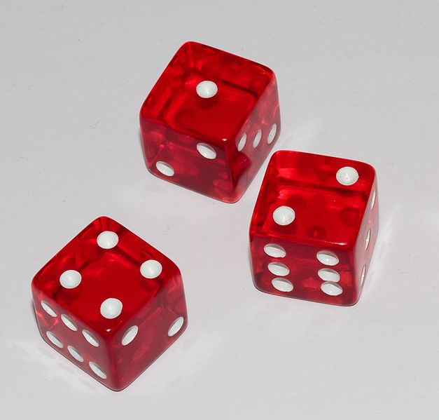
3
Looking Back
Roll and Order
A game for 2 or more players
Materials: 3 dice, paper/pencil
Directions:
Each player should draw ten lines on the paper in a row (or use the gameboard on the next slide)
On your turn, roll the three dice and create a three-digit number. Place your number on one of the lines on your paper. On each subsequent turn, you must arrange the dice to create a number that will be able to be placed on your paper, so all your numbers will be in increasing order from left to right when you are finished.
The first player to complete all ten numbers, wins!
Notes:
Adapted from MB Education Grade 3 Math support document, p. 24 (Roll and Order)
Image source: https://commons.wikimedia.org/wiki/File:Three_six-sided_dice.jpg

Slide 80
3
Looking Back
Roll and Order
Example of game...
Roll 1) 4, 1, 2 – create 412
Roll 2) 3, 3, 6 – create 363
Roll 3) 6, 1 ,2 – create 126
126
363
126
363
412
Notes:
Adapted from MB Education Grade 3 Math support document, p. 24 (Roll and Order)
Image source: https://commons.wikimedia.org/wiki/File:Three_six-sided_dice.jpg

Slide 81
3
Looking Back
Roll and Order
Roll 1) _______ Roll 6) _______
Roll 2) _______ Roll 7) _______
Roll 3) _______ Roll 8) _______
Roll 4) _______ Roll 9) _______
Roll 5) _______ Roll 10) _______
126
363
Notes:
Adapted from MB Education Grade 3 Math support document, p. 24 (Roll and Order)
Image source: https://commons.wikimedia.org/wiki/File:Three_six-sided_dice.jpg

Slide 82
3
Looking Back
End of this day.

Slide 83
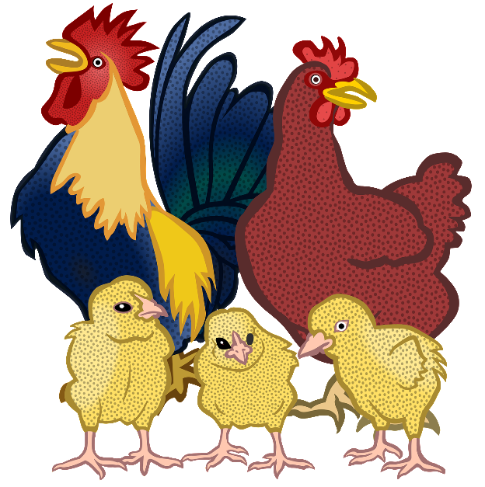
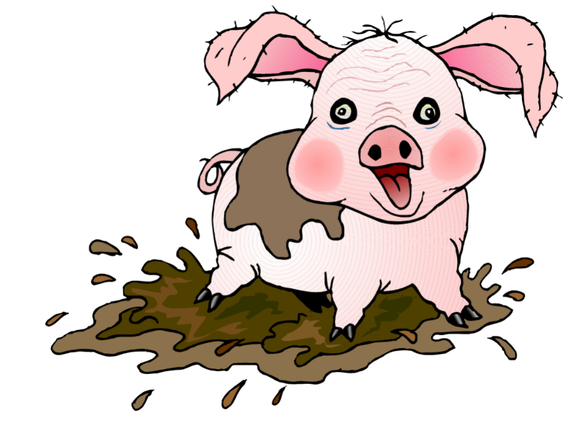
Day 6
1
Get Ready
2
Work it out!
3
Looking Back
Choral
Count in a Circle​
Write It,
and
Record It
Chicken and Pigs, Heads and Feet
Notes:
Images sourced from: https://pixabay.com/vectors/numbers-numerals-counting-math-3691893/
https://pixy.org/1290424/ (pig)
https://pixabay.com/vectors/animal-chick-chicken-cock-farm-2024095/ (chickens)
Images source:
https://openclipart.org/detail/172707/edit-icon-icono-editar (pencil)
https://openclipart.org/detail/212116/screencast (record)

Slide 84
1
Get Ready!
Count by 10s.
Start at 515 and stop at 345. Who do you think will say 345?
Insert Name
Insert Name
Insert Name
Insert Name
Insert Name
Insert Name
Insert Name
Insert Name
515
Insert Name
Insert Name
Insert Name
Insert Name
Notes:
Slide for Part I, the activating activity…
Source: Grade 3 Mathematics: Support Document for Teachers. Manitoba Education
Instructions to note:
We are going to start at 515 and count back by 10s to 345. Who do you think will say 345?
Create a wheel that has student names. Decide where 515 will be. Have students predict which student will say 345.
**Note** To allow all students think time, teachers can push this slide out to students prior to the synchronous lesson. That allows for all students to collect their ideas ahead of time and have something to share.

Slide 85
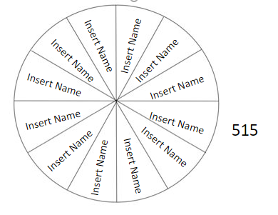
1
Get Ready!
Count by 10s.
Start at 515 and stop at 345.
I think that __________ will
say 345 because...
Notes:
Slide for Part I, the activating activity…
Source: Grade 3 Mathematics: Support Document for Teachers. Manitoba Education
Instructions to note:
We are going to start at 515 and count back by 10s to 345. Who do you think will say 345?
Create a wheel that has student names. Decide where 515 will be. Have students predict which student will say 345.
**Note** To allow all students think time, teachers can push this slide out to students prior to the synchronous lesson. That allows for all students to collect their ideas ahead of time and have something to share.

Slide 86
1
Get Ready!
Count by 5s.
Start at 515 and stop at 345. Who do you think will say 345?
Insert Name
Insert Name
Insert Name
Insert Name
Insert Name
Insert Name
Insert Name
Insert Name
515
Insert Name
Insert Name
Insert Name
Insert Name
Notes:
Slide for Part I, the activating activity…
Source: Grade 3 Mathematics: Support Document for Teachers. Manitoba Education
Instructions to note:
We are going to start at 515 and count back by 5s to 345. Who do you think will say 345?
Create a wheel that has student names. Decide where 515 will be. Have students predict which student will say 345.
**Note** To allow all students think time, teachers can push this slide out to students prior to the synchronous lesson. That allows for all students to collect their ideas ahead of time and have something to share.

Slide 87
1
Get Ready!
Count by 5s.
Start at 515 and stop at 345. Who do you think will say 345?
I think that __________ will say 345 because...
Notes:
Slide for Part I, the activating activity…
Source: Grade 3 Mathematics: Support Document for Teachers. Manitoba Education
Instructions to note:
We are going to start at 515 and count back by 5s to 345. Who do you think will say 345?
Create a wheel that has student names. Decide where 515 will be. Have students predict which student will say 345.
**Note** To allow all students think time, teachers can push this slide out to students prior to the synchronous lesson. That allows for all students to collect their ideas ahead of time and have something to share.

Slide 88
1
Get Ready!
End of this section​

Slide 89
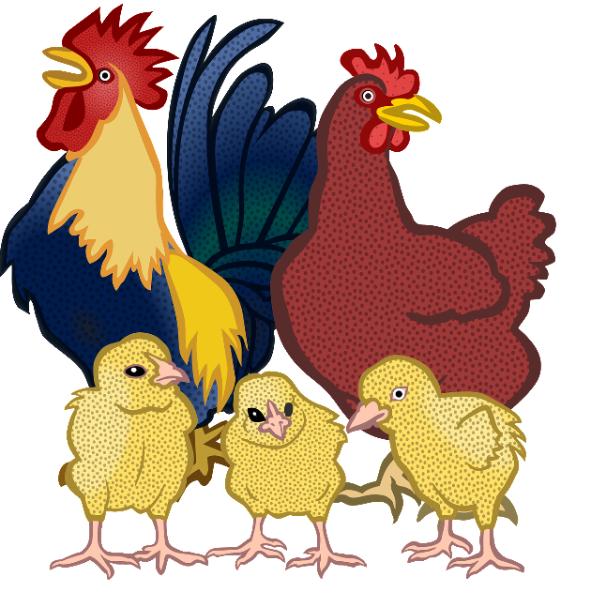
2
Work it out
Chicken and Pigs, Heads and Feet
Nicholas has chickens and pigs on his farm. Each chicken has two legs, and each pig has four legs. Each animal has one head. He looked out one day and counted 48 animal heads and 134 legs. How many of each animal live on the farm?
Notes:
Image source: https://pixabay.com/vectors/animal-chick-chicken-cock-farm-2024095/ (chickens)
https://pixy.org/1290424/ (pig)
Adapted from: https://www.cemc.uwaterloo.ca/resources/potw-strands/2019-20/English/POTWA-19-Combined3-4.pdf

Slide 90
2
Print me to limit screen time
Work it out
Chicken and Pigs, Heads and Feet
Nicholas has chickens and pigs on his farm. Each chicken has two legs, and each pig has four legs. Each animal has one head. He looked out one day and counted 48 animal heads and 134 legs. How many of each animal live on the farm?
Show your thinking here:
Notes:
Image source: https://pixabay.com/vectors/animal-chick-chicken-cock-farm-2024095/ (chickens)
https://pixy.org/1290424/ (pig)
Adapted from: https://www.cemc.uwaterloo.ca/resources/potw-strands/2019-20/English/POTWA-19-Combined3-4.pdf

Slide 91
2
Work it out
End of this section​

Slide 92
3
Looking Back
What numbers might be at the marked points?
Justify your answers.
A
B
C
D
E
0
100
400
Notes:
Adapted from: Marian Small, Open Questions for Rich Math Lessons

Slide 93
3
What numbers might be at the marked points?
Justify your answers.
Looking Back
A
B
C
D
E
0
100
400
I think these are the values for:
A. ______ B. _____ C. _____ D. _____ E. _____
Because...
Notes:
Adapted from: Marian Small, Open Questions for Rich Math Lessons
What to look for. Can Students:
identify and compare numbers to 1000 correctly
order numbers to 100
use a referent to make a reasonable estimate

Slide 94
3
Looking Back
End of this section & end of this day.

Slide 95
Day 7
1
Get Ready
2
Work it out!
3
Looking Back
Choral Count
Write About It
Counting Numbers
Record It
Notes:
Activator – number talk, choral count…
Work it out - Challenges make up the focus of the day(s) lesson (you may only have one and all students are assigned the same task, you may have a choice of two or three, or you may have all students begin at challenge 1 and move on as greater challenge is needed / Consolidate & Reflect on what you’ve learned during this part of the project.
Looking Back – a place for reflection/self-assessment
Images sourced from openclipart.org
Source: https://openclipart.org/detail/172707/edit-icon-icono-editar
https://openclipart.org/detail/212116/screencast
https://pixy.org/2420669/

Slide 96
1
Get Ready!
Let's begin by counting backwards by 2's starting at 225.
225 | 223
215
 |  |  | 189
Notes:
Slide for Part I, the activating activity…number talk.
Students will skip count together from 225 to177
The teacher will record the numbers horizontally, making a 5 x 5 grid.
The teacher will then facilitate a discussion around different counting patterns found in the grid.

Slide 97
1
Get Ready!
Let's begin by counting backwards by 2's starting at 225.
225 | 223 | 221 | 219 | 217
215 | 213 | 211 | 209 | 207
205 | 203 | 201 | 199 | 197
195 | 193 | 191 | 189 | 187
185 | 183 | 181 | 179 | 177
Notes:
Slide for Part I, the activating activity…number talk.
Students will skip count together from 225 to177
The teacher will record the numbers horizontally, making a 5 x 5 grid.
The teacher will then facilitate a discussion around different counting patterns found in the grid.
Alternately, the students could record the numbers themselves.
Possible patterns:
Columns decrease by 10 top to bottom.
Diagonal (left to right, top to bottom) decrease by 12
Diagonal (right to left, top to bottom) decrease by 8
The ones digits is always odd and does not change
There are 5 numbers in every decade (except the 220's – only 3)
The sum of the digits in each column (top to bottom) decreases by 1 - (In order to see this pattern for all numbers, students would have to find the digital root of some numbers. The digital root of a number is the single digit that you get by adding all of the digits of the original number together. If the result of that is multiple digits, you add those digits together, repeating the process until you get a single digit. That digit is the digital root of the original number. For example for the number 193, find the sum of the digits, 1 + 9 + 3 = 13, then add the sum of the digits for 13, 1 + 3 = 4. The digital root of 193 would be 4.)

Slide 98
1
Get Ready!
End of this section​

Slide 99
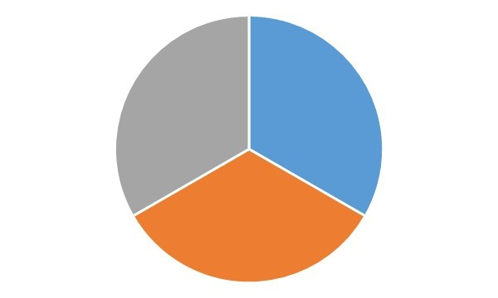
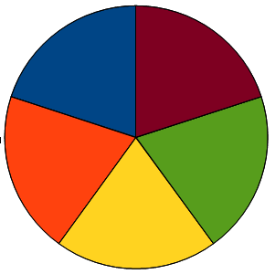
2
Work it out
Counting Numbers
Look at the spinners below. Choose 1 number from each spinner and write out the counting pattern.
2
5
10th
12th
25
10
100
10
25
20th
16th
100
Start at
Count by
End at ___ term
Notes:
Adapted from: Marian Small, Open Questions for Rich Math Lessons
See next page for an example.
(In outcome, 3.N.1, students count by 25s, using starting points that are multiples of 25. If students choose 10 to start with and use 25s to count by, they can try to do it and explore the pattern.)

Slide 100
2
Work it out
Counting Numbers
For example, I chose 10 from the first spinner, 10 from the second spinner, and 12th from the third spinner. This is my counting pattern:
2
5
10 | 20 | 30 | 40 | 50 | 60 | 70 | 80 | 90 | 100
100
10
25
110 | 120
Notes:
Adapted from: Marian Small, Open Questions for Rich Math Lessons
(In outcome, 3.N.1, students count by 25s, using starting points that are multiples of 25. If students choose 10 to start with and use 25s to count by, they can try to do it and explore the pattern.)

Slide 101
2
Work it out
Counting Numbers
2
5
100
10
25
Notes:
Adapted from: Marian Small, Open Questions for Rich Math Lessons

Slide 102
2
Work it out
Counting Numbers
Challenge: Start at 1000 and choose a number from the second and third spinner. Count backwards from 1000.
2
5
100
10
25
Notes:
Adapted from: Marian Small, Open Questions for Rich Math Lessons

Slide 103
3
Looking Back
Thinking About Counting Patterns
Choose two of the counting patterns you created in the last activity. Answer the following questions:
1) Which pattern was easier to create?
2) What did you notice about the numbers you wrote? Do you see any other patterns?
3) If you tried the challenge, was it easier to count forwards or backwards? Why?
Notes:
This slide may be recreated onto SeeSaw or other platform for asynchronous work.

Slide 104
3
Looking Back
End of this section.
Notes:
This could be an asynchronous activity. If your school uses See Saw, you can copy this slide into that platform.

Slide 105
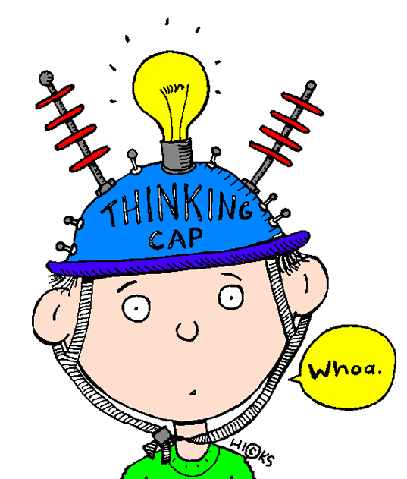
Day 8
1
Get Ready
2
Work it out!
3
Looking Back
Estimation Clip Board
Largest or Smallest
Think About It
then,
Write About It
or,
Record It
Notes:
Image Source:
https://stevewyborney.com/2018/04/the-estimation-clipboard/
Dice image created.
https://pixy.org/906437/
https://openclipart.org/detail/172707/edit-icon-icono-editar
https://openclipart.org/detail/212116/screencast

Slide 106
1
Get Ready!
Estimation Clip Board
Notes:
Source: https://stevewyborney.com/2018/04/the-estimation-clipboard/
Instructions to note:
TO USE THE FOLLOWING SLIDES YOU MUST BE IN SLIDE SHOW / PRESENT MODE.

Slide 107
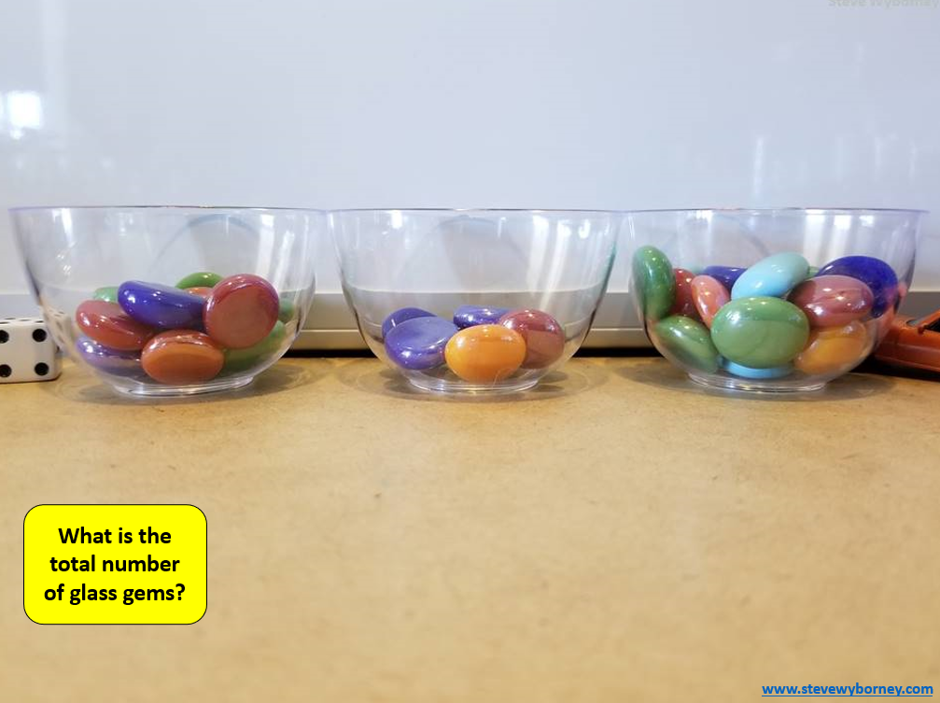
1
Get Ready!
Student Recording Page
How many are in each bowl?
What is the total?
My Estimate:
My Estimates:
___________
___________
___________
Notes:
Slide for Part I, the activating activity…
Source: https://stevewyborney.com/2018/04/the-estimation-clipboard/
Student working page. Copy a slide for each student. Have them record their estimates in the box as they are presented. Discuss, how close they were to the total. How do they use the information from the total to decompose into the smaller amounts.
What to watch for. Can the student :
select and use an appropriate referent (10, 25, 100)
make a reasonable estimate
explain his or her thinking

Slide 108
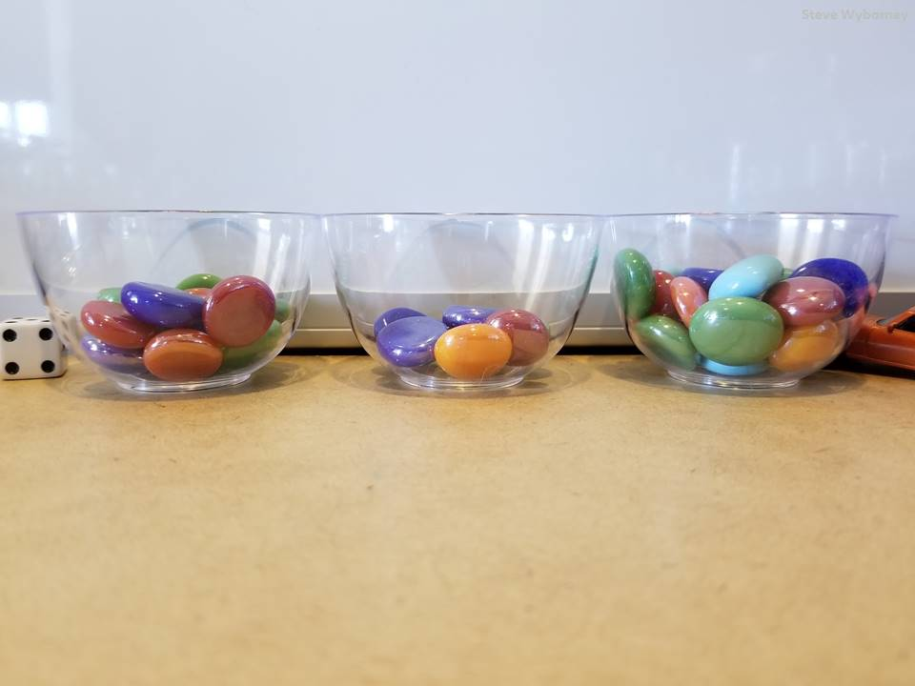
The Total
The total is 43 glass gems.
?
?
?
14 glass gems
8 glass gems
21 glass gems
What is the total number of glass gems?
How many are in each bowl?
www.stevewyborney.com
Notes:
TO USE THE FOLLOWING SLIDES YOU MUST BE IN SLIDE SHOW. PRESENT FROM CURRENT SLIDE.* Don’t worry, when you go into Slide Show it won't look like a mess.
Source: https://stevewyborney.com/2018/04/the-estimation-clipboard/

Slide 109
1
Get Ready!
End of this section​

Slide 110
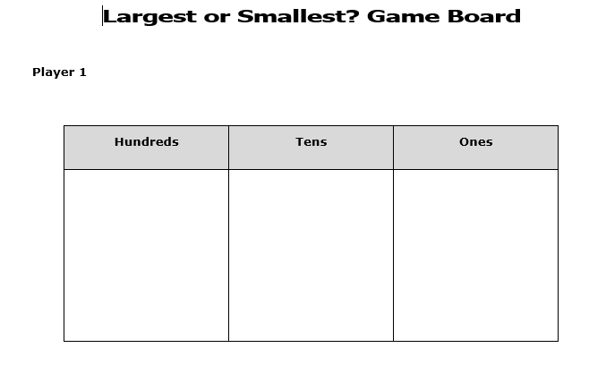
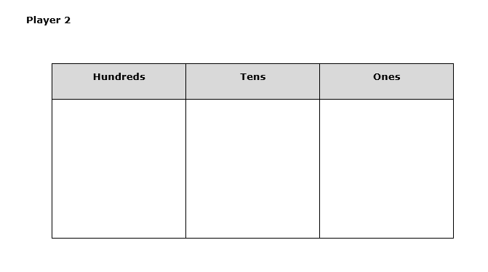
1
Print me to limit screen time
Working On It!
Largest or Smallest
This is a 2 – player game.
Objective: to make the largest/smallest number ​
Materials: one die (0 to 9), game board for each player​
​
Notes:
Source: Grade Three Support Document for Teachers, Manitoba Education.
You can download the BLM 3.N.3.4 from this document for paper copies of the game board.

Slide 111
1
Print me to limit screen time
Working On It!
Largest or Smallest
Directions: ​
1. Decide whether players are making the largest or smallest number. ​
2. Player 1 rolls the die and calls out the number. ​
3. Both players choose to place the number (digit) in the hundreds, tens, or ones place on their game boards. ​
4. The die is rolled two more times with players filling in their game boards each time until the number is complete.
5. Players compare their numbers. The player with the largest/smallest number scores 1 point. In the event of a tie both players score a point. ​
6. Player 2 then rolls the die.
Play continues until one player scores 10 points.​
Notes:
Source: Grade Three Support Document for Teachers, Manitoba Education.

Slide 112
1
Print me to limit screen time
Working On It!
Largest or Smallest
We are making the ________________________ number.
Player One |  |  | Roll the die | Player Two
hundreds | tens | ones |  | hundreds | tens | ones
Notes:
Source: Grade Three Support Document for Teachers, Manitoba Education.
When students click link to: https://toytheater.com/dice/ for the dice. They will need to select the 10 sided die (the fourth die down from the top). This link also take students out of the main page, so teachers will need to instruct students on how to navigate through this.
Ask:
How do you decide where to place each number?
Does your strategy help you score points?

Slide 113
2
Working On It!
End of this section​

Slide 114
3
Print me to limit screen time
Looking Back
Reflection: Largest or Smallest
How do you decide where to place each number?
Does your strategy help you score points?
Notes:
You might want to upload this slide into other platforms such as See Saw.

Slide 115
3
Looking Back
End of this section​ & end of this day.
Notes:
Slide for Part I, the activating activity…number talk, quick images, notice and wonder…

Slide 116
Day 9
1
Get Ready
2
Work it out!
3
Looking Back
Think About It
then,
Counting Patterns
Money Maze
Write About It
or,
Record It
Notes:
Images sourced from openclipart.org
Image Source: https://pixy.org/906437/
https://openclipart.org/detail/172707/edit-icon-icono-editar
https://openclipart.org/detail/212116/screencast

Slide 117
1
Get Ready!
201 | 206 | 211 | 216
226 |  | 236 | 241 | 246
 |  | 261 | 266
276 |  | 286 | 291 | 296
 |  | 311 |  | 321
Look at the chart to the right. Determine the counting pattern as you move from left to right. Fill in the missing numbers.
Look at all the numbers, rows and columns.
What is the counting pattern?
What other patterns do you see?
Notes:
Teacher Notes
This slide may present the opportunity to discuss the terms “row” and “column” with your students.

Slide 118
1
Get Ready!
End of this section​

Slide 119
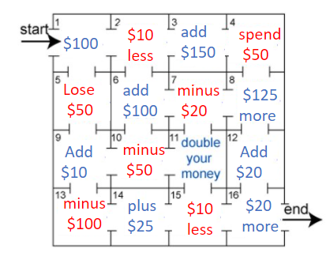
2
Print me to limit screen time
Work it out
Go through the maze, collecting and losing your money as you go. You may not go through any cell more than once and can only go into a cell through a "doorway".
Notes:
Adapted from: https://nrich.maths.org/2648

Slide 120
2
Print me to limit screen time
Work it out
Eg.
Start ($100), (-$50),
(+$10), (- $50),
(double), (-$10),
(+20), (end)
100 – 50 + 10 – 50 + 10 (double) - 10 + 20 = 30
Notes:
Adapted from: https://nrich.maths.org/2648

Slide 121
2
Print me to limit screen time
Work it out
Going through the maze, what is the largest sum you can make?
What is the smallest sum you can make?
Notes:
Adapted from: https://nrich.maths.org/2648

Slide 122
2
Work It Out!
End of this section​

Slide 123
3
Looking Back
Here is one example of an equation created from the money maze.
100 – 10 + 150 – 50 + 125 – 20 + 180 – 10 + 20 = ?
Instead of adding from left to right, how else can you work out this equation?
Notes:
Do students notice that they can group amounts for ease of adding and subtracting. For example, 150 – 50 = 100, then 100 + 100 = 200. -20 + 20 = 0....
Students should be encouraged to look for ways to move numbers around to facilitate mental calculations.
You can start with an easier example (2 + 5 + 6 + 3 + 1 + 5 + 8 can be re-written as 2 + 8 + 6 + 3 + 1 + 5 + 5 = 10 + 10 + 10 = 30)

Slide 124
Day 10
1
Get Ready
2
Work it out!
3
Looking Back
100 Chart Mystery
Think About It
then...
Number Architect
Write About It
or,
Record It
Notes:
Image Source:
https://pixy.org/4187291/
https://pixy.org/906437/
https://openclipart.org/detail/172707/edit-icon-icono-editar
https://openclipart.org/detail/212116/screencast

Slide 125
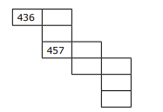
1
Print me to limit screen time
Get Ready!
100 Chart Mystery
What numbers are missing?
How do you know?
Notes:
Source: Grade Three Support Document for Teachers, Manitoba Education
Students fill in the missing pieces on the 100 chart.

Slide 126
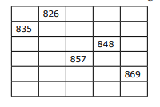
1
Get Ready!
100 Chart Mystery
This was taken from a larger chart.
What numbers are missing?
How do you know?
Notes:
Source: Grade Three Support Document for Teachers, Manitoba Education

Slide 127
1
Get Ready!
End of this section​

Slide 128
2
Work it out
Number Architect
Use 7 base ten blocks, construct a number you think no one else in the class would build. Use this link to access base ten blocks. Write the number you created.
Notes:
https://www.coolmath4kids.com/manipulatives/base-ten-blocks
Image source:
What is the largest possible number? What is the smallest possible number?
What to look for. Can students:
Select 7 base ten blocks and correctly write the number.

Slide 129
2
Work it out
Number Architect
Use Me!
Where would you place the number you created on the number line?
Use the dot to represent your number and record the value below.
0
700
Explain why you chose the placement you did.
Notes:
Discuss where the middle referent would be with your students. Ask: What referents would help you when placing the number you created?
What to look for. Can students:
place the number accurately on the number line
refer to the halfway point
Justify the reasoning behind placing their number where they did.

Slide 130
2
Work it out
Number Architect
These are the numbers that were created today:
Notes:
Use this slide to post the numbers that were created from the students.

Slide 131
2
Work it out
Number Architect
Use Me!
Choose 5 numbers that were created by your peers. Plot them on the number line.
0
700
Notes:
Discuss where the middle referent would be with your students. Ask: What referents would help you when placing the number you created?
What to look for. Can students:
Order the values correctly

Slide 132
2
Work It Out!
End of this section​

Slide 133
3
Looking Back
In thinking about this learning experience on Investigating Numbers to 1000: Tell what you know about Estimating.
Think about:
Why benchmark numbers are important when estimating
Where we use estimating in our world
How using referents can help when estimating
Notes:
This would be an opportunity to compare student solutions to look at similarities, differences, and make connections between them

Slide 134
Why benchmark numbers are important when estimating
Where we use estimating in our world
How using referents can help when estimating
Notes:
Duplicate for each student to reflect upon their learning experience.

Slide 135
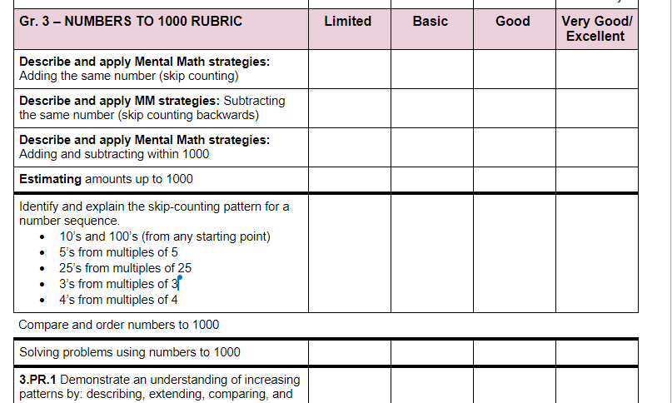
Assessment Rubrics
Suggested Codes for daily record keeping purposes:
I - Knowledge has been demonstrated individually
H - is used when knowledge has been demonstrated individually, but with help from the teacher or a peer
G - is used when knowledge has been demonstrated within a group
X - is used when a question has been attempted but answered incorrectly
N - is used when a question has not been attempted.
See attached rubric for detailed information

Slide 136
Credits
Lisa Page St. James-Assiniboia School Division
Dayna Quinn-LaFleche St. James-Assiniboia School Division
Reviewers
T. Scott Dempster St. James-Assiniboia School Division
Heather Jones St. James-Assiniboia School Division
Charmaine Mackid Hanover School Division

