Slide 1
Levers

Slide 2
QUESTION & CHALLENGE:
CHALLENGE
How likely is it that a simple lever can move a small object over a meter away?
Create a lever to move an small object 1 meter!
Place an arrow to indicate your initial thinking.

Slide 3
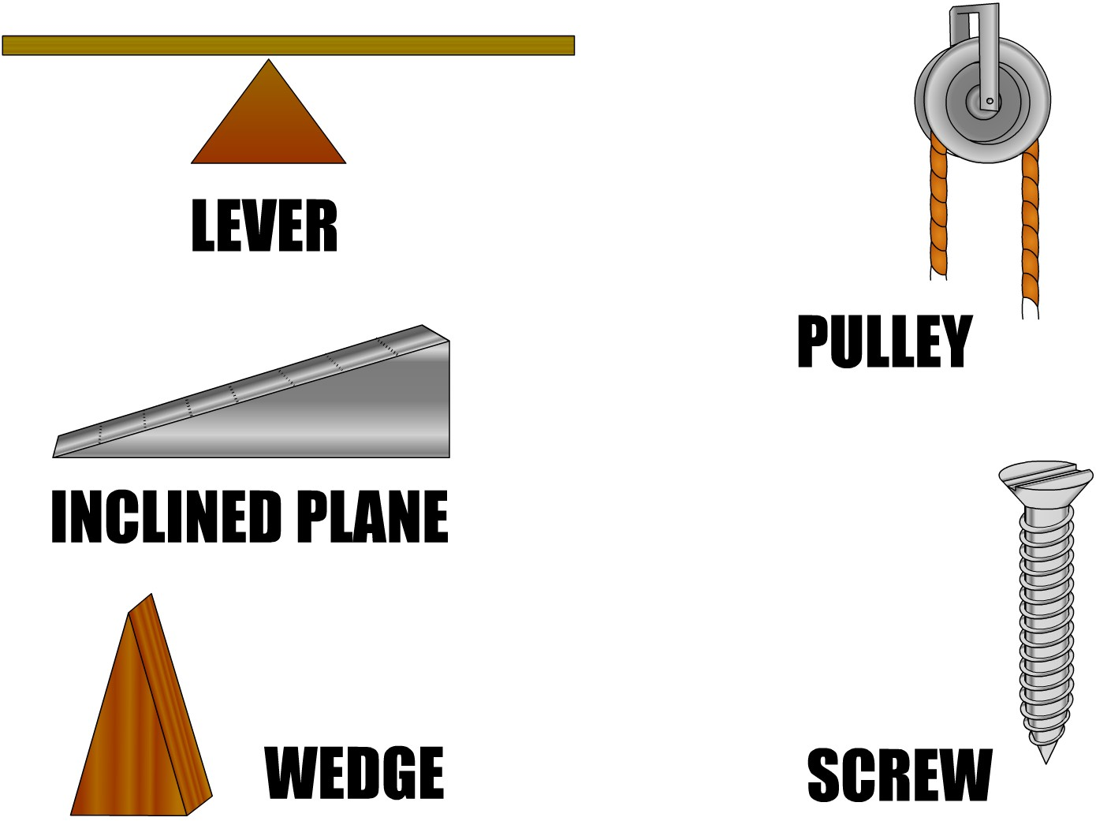
Introduction
In a world of ever-changing and advancing technology, we need to understand how some of our most advanced technology is based on ancient technology that has been around for thousands of years. Almost all non-digital technology is based on one or more of the below simple machines. They make our lives easier and make some of our most current technology possible. By working through this, you will better understand how levers work and how they make our lives easier.
Glossary of new vocabulary
Image :https://pixy.org/606790/

Slide 4
Objectives:
Upon completion of this activity, you will be able to:
Identify the parts of a lever in writing and on diagrams.
Identify and define the different classes of levers.
Be able to give examples of each class of lever.
Provide real world examples of levers and classify them.
Construct a lever that will move an object over a meter away.
Present and explain the design of your lever and how it operates.
Label and sketch the model of your lever.
Glossary of new vocabulary

Slide 5
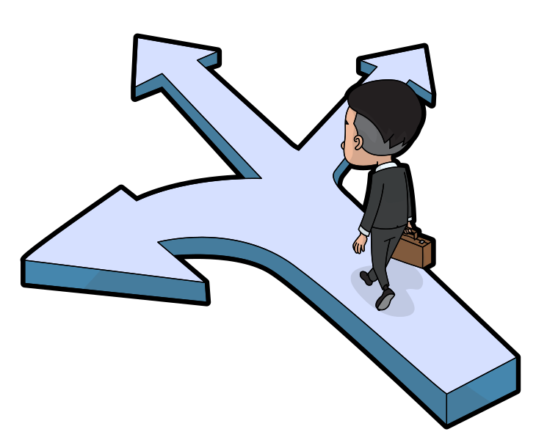
Now that you have read the objectives of this learning experience choose which pathway best describes your understanding.
Pathway 1
“This is kid's stuff; I could do this with my eyes closed! I am going straight to the activities!”
Pathway 2
“I don’t have a clue what you are talking about.” I better start at the beginning.”
Student Learning Pathway
Pathway 3
“I know what a lever is but don’t know everything listed in the objectives. I need a bit more information on the classes of levers. “
Glossary of new vocabulary
Images: https://commons.wikimedia.org/wiki/File:Cartoon_Man_Arriving_At_A_Career_Crossroad.svg

Slide 6
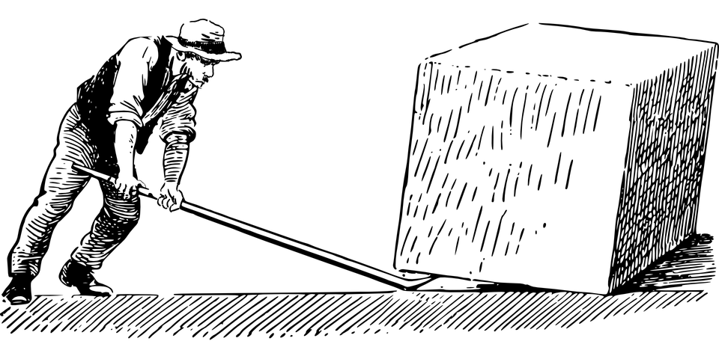
Information
So what is a lever you may ask, well a lever is a simple machine that allows us to do work with less force. It will not save you any work. It involves moving a load around a pivot called a fulcrum using a force. Levers are divided up into three classes; the placement of force and load around the fulcrum determines their class.
Force
Fulcrum
Load
Lever
Glossary of new vocabulary
Image:https://pixabay.com/vectors/archimedes-lever-quarryman-worker-148273/

Slide 7
There are 3 Classes of of Levers:
First Class
It uses a fulcrum in between of the lever, and the applied force and load are at opposite ends.
Examples: seesaw (teeter totter), prybar, scissors, trebuchet
Second Class
The fulcrum is at one end, and the applied force at the opposite end The load that is to be moved is between them.
Examples: Hammer, nutcracker, wheelbarrow.
Third Class
The fulcrum is at one end of the lever, but this time the load is at the opposite end, and you apply a force in between. Regardless of where you apply the force, the force you apply must always be greater than the force of a load.This lever moves the load in the same direction as the force you apply.
Examples: Fishing rod,
tweezers, tongs, and your arm
Glossary of new vocabulary

Slide 8
Draw an arrow and match the lever to its appropriate class!
Force
Fulcrum
Load
First Class Lever
Force
Second Class Lever
Fulcrum
Load
Third Class Lever
Force
Fulcrum
Load

Slide 9
First Class Levers
Force
Fulcrum
Load
How does this lever work?
The first-class lever is the one you may be most familiar with. It uses a fulcrum in between, and the applied force and load are at opposite ends. A teeter-totter is an excellent example of a first-class lever, as the weight of one rider (the force) pushes down the other rider (the load) is pushed up. This process moves back and forth between the passengers and is made possible by the pivot point or fulcrum.
What is the purpose of this lever?
All first class levers reverse the direction of movement. These levers give you a mechanical advantage because they allow you to lift heavier loads with less effort.
Glossary of new vocabulary

Slide 10
Second Class Levers
Force
Fulcrum
Load
How does this lever work?
The second class lever causes the load to move in the same direction as the force you apply. A wheelbarrow uses a second class lever to make the load feel lighter while carrying and transporting material.
What is the purpose of this lever?
This lever allows us to move loads in the same direction as the force.
Glossary of new vocabulary

Slide 11
Third Class Levers
Force
Fulcrum
Load
How does this lever work?
This lever moves the load in the same direction as the force you apply, which is convenient. So is the application of force between the load and the fulcrum. A fishing rod is an example of a third class lever, the fulcrum is your hand holding the rod, you apply force when you cast, and the fish hook and line are the load.
What is the purpose of this lever?
These levers are important making precise movements. In some cases have the force closer to the load makes it easier to move.
Glossary of new vocabulary

Slide 12
Lever Scavenger Hunt
Trebuchet
Vs.
Catapult
Vocabulary & Diagram Practice
Learn more here before you complete the final challenge!
THE CHALLENGE STARTS HERE

Slide 13
Lever Scavenger Hunt
Where can we find levers in our everyday lives?
Back to student choices

Slide 14
Create a table like the one below to complete this task:
1) Look around your home or community - Locate items that are or incorporate levers. List the item in the first column. (Try finding 10-15 levers)
2) Sketch a small diagram of each item and identify and label the forces, load and fulcrum
3) Identify the class of each lever in column 3.
Levers in the world: | Diagram: (indicated, force, load and fulcrum) | Class of Lever: (First, Second or Third)

Slide 15
Vocabulary Practice
Study science terms and diagrams to become more familiar with new vocabulary
Back to student choices

Slide 16
Levers
Crossword
Puzzle
1
2
Use the clues on the next slide to determine the vocabulary words used in this crossword puzzle.
3
4
5
6
7
8

Slide 17
Clues
Lever Crossword
Puzzle Clues
 | Across |  | Down
1 | The three things that are part of every lever are: The Fulcrum, Force, and . | 1 | A is a simple machine that allows us to work with less force.
3 | A teeter-totter is an example of which class lever? | 2 | I am an example of a third class lever, I grab things, and I am used for writing.
6 | The is the pivot point that gives a lever its mechanical advantage. | 4 | A pancake flipper is an example of what class of lever?
7 | What class of lever has its fulcrum on the end, its force in the middle, and its load on the opposite end? | 5 | A lever is an example of a Machine.
8 | Levers are separated into . | 6 | is required to lift the load.

Slide 18
Draw and Label Each type of Lever:
First Class Lever
Second Class Lever
Third Class Lever

Slide 19
Trebuchet vs. Catapult
Which lever, the trebuchet or the catapult, is most effective?
Back to student choices
Notes:
What lever is most effective the trebuchet or the catapult?

Slide 20
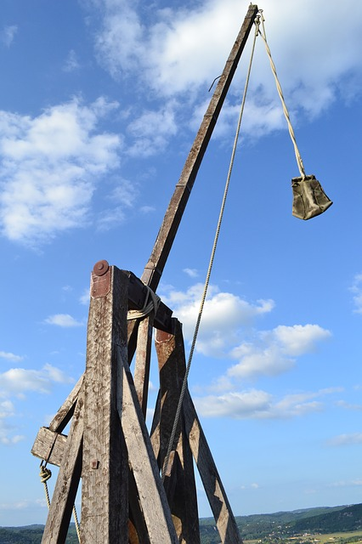
History of the Trebuchet:
Perhaps the most famous use of a lever in military history is arguably the trebuchet. The trebuchet first appeared in China over 2000 years ago, it slowly moved its way west and became an essential part of an army for defence and offence. Its ability to throw objects more accurately and to greater distances made it an ideal siege engine well into the 1300s.
Find videos that demonstrate how a trebuchet works!
Can you find the:
Force
Load
Fulcrum
What Class of lever is the Trebuchet?
Glossary of new vocabulary
image : https://pixabay.com/photos/trebuchet-catapult-medieval-weapon-890637/

Slide 21
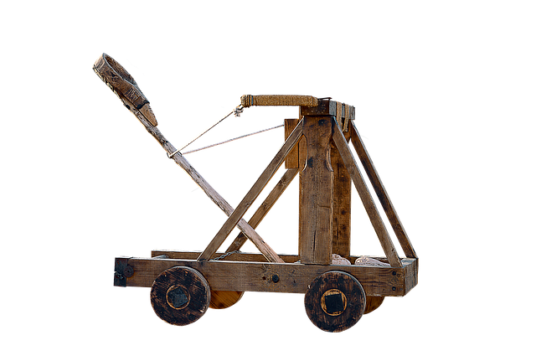
History of the Catapult
The catapult was invented around 400 BC in Greece. The first catapults looked like giant crossbows and where called Gastraphete. Catapults possessed incredible destructive power toppling walls and buildings with a single projectile. Catapults were used in siege warfare across Europe until the invention of the gunpowder cannon in the 14th century.
Can you find the:
Force
Load
Fulcrum
Find videos that demonstrate how a catapult works!
What Class of lever is the Catapult?
Glossary of new vocabulary
Image:https://pixabay.com/photos/png-catapult-weapon-medieval-2687075/

Slide 22
Criteria for most effective lever:
Least amount of force | When comparing 2 levers, the most effective lever moves the same amount of weight similar distances, with the least amount of force.
Greatest weight moved | When comparing 2 levers, the most effective lever moves the most amount of weight the same distance with similar force.
Longest distance moved | When comparing 2 levers, the most effective lever moves the same amount of weight the longest distance with the same amount of force.

Slide 23
Which lever, the trebuchet or the catapult, is the most effective?
Least amount of force | When comparing 2 levers, the most effective lever moves the same amount of weight similar distances, with the least amount of force.
Greatest weight moved | When comparing 2 levers, the most effective lever moves the most amount of weight the same distance with similar force.
Longest distance moved | When comparing 2 levers, the most effective lever moves the same amount of weight the longest distance with the same amount of force.
Use the information from the slides, your own research and the criteria to decide and justify which lever would be most effective.
“I think the most effective lever is the ____________ because… “

Slide 24
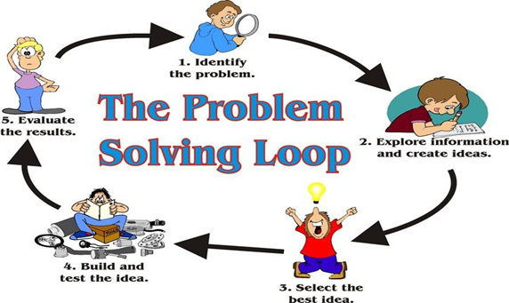
The CHALLENGE!
Back to student choices
Image created by https://pixy.org/4592163/

Slide 25
Building a Lever:
Use materials you can find at home to construct a lever that can move an object over 1 meter. Here are some suggested materials to use:
Household items you could use: | (Teachers) Items to include in a kit
Spoon or fork Rubber bands or ponytails Popsicle sticks Tape Glue Cardboard String Recyclables Dowl/pencil/pen Cloth/piece of rubber Playdough Natural materials Sticks Leaves Rocks Be creative | Weight Item to move (marble, bouncy ball etc)

Slide 26
Checklist to be included:
A sketch or photo with parts labeled, labels must clear and concise.
Include all measurements of parts used in construction.
Length of lever
Fulcrum placement and measurement
Load placement and weight
List of materials used.
Photo or video of stages of the construction process to submit to teacher.
Final explanation of design: Student’s choice. this can be a video, an essay, or a photo story!

Slide 27
Reassess your initial Thinking
CHALLENGE
How likely is it that a simple lever can move a small object over a meter away?
Place an arrow to indicate your new thinking.
Did you change your initial thinking? Why or why not?

Slide 28
Outcomes Addressed | Achievement Grade Profiles https://www.edu.gov.mb.ca/k12/assess/report_cards/grading/profiles.html
 | Limited | Basic | Good | Very Good to Excellent:
Science - Design Process and Problem Solving | Requires considerable, ongoing teacher support to ▪ apply strategies to solve practical problems and to explain reasoning ▪ use scientific vocabulary ▪ use criteria or constraints to define a problem and evaluate the chosen solution ▪ recognize when changes need to be made to a plan ▪ work collaboratively with peers | Requires occasional teacher or peer support to ▪ apply strategies to solve practical problems and to explain reasoning ▪ use scientific vocabulary ▪ use criteria or constraints to define a problem and evaluate the chosen solution ▪ recognize when changes need to be made to a plan ▪ work collaboratively with peers | Applies appropriate strategies to solve practical problems; requires occasional prompting to recognize when changes need to be made to a plan. Explains and justifies reasoning using appropriate science vocabulary, and generalizes to similar contexts; requires occasional prompting for clarification. Collaborates effectively with peers. | Demonstrates flexibility, resilience, and creativity when solving practical problems; critically analyzes results and makes any necessary changes to a plan. Explains and justifies reasoning clearly using appropriate science vocabulary and generalizes to other contexts. Collaborates effectively with peers, often taking a key role in group work.
5-3-01 Use appropriate vocabulary related to their investigations of forces and simple machines.
5-3-02 Describe, using diagrams, the forces acting on an object and the effects of increasing or decreasing them
5-3-03 Investigate a variety of levers used to accomplish particular tasks in order to compare them qualitatively with respect to
Math - Knowledge and understanding | Requires considerable, ongoing teacher support to make connections between math concepts and the applications of appropriate skills apply concepts in similar situations | Requires occasional teacher or peer support to make connections between math concepts and the applications of appropriate skills apply concepts in similar situations | Shows relationships between math concepts and applies appropriate skills. Correctly applies concepts in similar situations. | Makes connections, applies relationships and skills efficiently. Consistently and efficiently applies concepts in similar and new situations.
5.SS.2 - Demonstrate and understanding of measuring length by * Selecting and justifying referents for the unit mm * Modelling and describing the relationship between mm, cm and m
5.SP.3 - Describe the likelihood of a single outcome occurring using words such as: Impossible, Possible and Certain

Slide 29
GLOSSARY
counterweight-a weight used as a counterbalance.
force-the effort applied
fulcrum- the support or point of rest, on which a lever turns in moving a body.
lever-rigid bar that pivots about one point and that is used to move an object at a second point by a force applied at a third.
load-anything put in or on something for conveyance or transportation
mechanical advantage- is the factor by which a mechanism multiplies the force or torque put into it.
siege engine-is a device that is designed to break or circumvent city walls and other fortifications in siege warfare.
sling- is a projectile weapon typically used to throw a blunt projectile such as a stone.
tension- is the magnitude of the pulling force exerted by a string, cable, chain, or similar object on another object.
torsion-is the twisting of an object due to an applied torque.
trebuchet-is a siege engine that was employed in the middle ages either to smash masonry walls or to throw projectiles over them.

